Slide 1
OUR MISSION:
Crazy Love!
This lesson uses “Feast of Flesh” font, free at: https://www.dafont.com/feast-of-flesh-bb.font
And “impossible-0”, free at: https://www.dafont.com/impossible.font
Notes:
Background = https://static.pexels.com/photos/110854/pexels-photo-110854.jpeg
Copyright © 2006−2021. All rights reserved. Bible Point is a registered trademark of Dennis Henderson. All other trademarks acknowledged.
Bible Point contains graphics from Bible Point artists. These illustrations belong to Bible Point and the respective artists. You may use the designs and illustrations for graphical illustration of lessons free and without special permission, provided they are not used in any way that maligns the Christian faith. Furthermore, republication or production of any illustration by any other graphic service whether it be in book, in a machine-readable form, or in any other design resource is strictly prohibited. Furthermore, they cannot be duplicated or resold as any other form of publishing, clip art, or graphic resource.
So What does it mean? (A simple translations of the legal jargon)
So, if you don’t own the presentation(s), graphic(s), and text(s) how can you legally use them? The purchase of the license allows you to use all the images in the product. However, the actual ownership and copyright of the presentation(s), graphic(s), and text(s) remain the property of Bible Point and its licensors. If you had plans on using this product in your “for sale” work—think again!
License Agreement
Article 1: License Grant
All the graphics and text in Bible Point presentations (excluding quotes from the Bible and stated sources) are the intellectual and real property of Bible Point and its licensors, and is protected by law, including United States copyright laws and international treaties. Bible Point grants to you a license:
1. To use the presentation in a single church, single school, or single office of a Christian organization.
2. To make a single archival back-up copy of the program.
3. To modify the presentation(s) and merge with other presentations in a single church, school, or Christian organization.
4. To transfer to another party if that party agrees to accept the terms and conditions of this agreement, and you do not retain any copies of the presentation, whether printed, machine readable, modified, or merged form.
Article 2: Terms
This license is effective until terminated. You may terminate the license at any time by destroying the presentation(s), graphic(s), or text(s) together with all copies, modifications and merged portions in any form. Bible Point may terminate your license if you fail to comply with this Agreement. You agree, upon such termination, for any reason, to destroy the presentation(s), graphics, and text(s) with all copies, modifications, and merged portions in any form.
Article 3: Disclaimers
1. Bible Point presentations, graphics, and texts are licensed to you As Is. You, the consumer, bear the entire risk relating to the quality and performance of the presentation(s), graphic(s), or text(s). In no event will Bible Point be liable for damages resulting from any defect.
2. Thirty-day limited warrantee on disks. Bible Point warrants the disks to be free of defects in material and workmanship under normal use for 30 days after purchase. During the 30-day period you may return a defective presentation, graphic, or text with proof of purchase and it will be replaced without charge, unless the presentation is damaged by misuse.
Article 4: General
1. You may not sub-license, assign, or transfer the license of the presentation(s), graphic(s), or text(s) except as provided by this Agreement.
2. This Agreement will be governed by the laws of the State of Michigan.
So What does it mean? (A simple translations of the legal jargon)
May I let someone borrow or copy my licensed Bible Point presentation (even after I modified it)? As long as it is within your local church, or single school, or the immediate office of a Christian organization you may. Otherwise, please refer the person interested in borrowing to: http://www.biblepoint.com or E-mail: dennis@DrDH.net with any related questions.

Slide 2
OUR MISSION:
Crazy Love!
This lesson uses “Feast of Flesh” font, free at: https://www.dafont.com/feast-of-flesh-bb.font
And “impossible-0”, free at: https://www.dafont.com/impossible.font
Notes:
Background = https://static.pexels.com/photos/110854/pexels-photo-110854.jpeg
Copyright © 2006−2021. All rights reserved. Bible Point is a registered trademark of Dennis Henderson. All other trademarks acknowledged.
Bible Point contains graphics from Bible Point artists. These illustrations belong to Bible Point and the respective artists. You may use the designs and illustrations for graphical illustration of lessons free and without special permission, provided they are not used in any way that maligns the Christian faith. Furthermore, republication or production of any illustration by any other graphic service whether it be in book, in a machine-readable form, or in any other design resource is strictly prohibited. Furthermore, they cannot be duplicated or resold as any other form of publishing, clip art, or graphic resource.
So What does it mean? (A simple translations of the legal jargon)
So, if you don’t own the presentation(s), graphic(s), and text(s) how can you legally use them? The purchase of the license allows you to use all the images in the product. However, the actual ownership and copyright of the presentation(s), graphic(s), and text(s) remain the property of Bible Point and its licensors. If you had plans on using this product in your “for sale” work—think again!
License Agreement
Article 1: License Grant
All the graphics and text in Bible Point presentations (excluding quotes from the Bible and stated sources) are the intellectual and real property of Bible Point and its licensors, and is protected by law, including United States copyright laws and international treaties. Bible Point grants to you a license:
1. To use the presentation in a single church, single school, or single office of a Christian organization.
2. To make a single archival back-up copy of the program.
3. To modify the presentation(s) and merge with other presentations in a single church, school, or Christian organization.
4. To transfer to another party if that party agrees to accept the terms and conditions of this agreement, and you do not retain any copies of the presentation, whether printed, machine readable, modified, or merged form.
Article 2: Terms
This license is effective until terminated. You may terminate the license at any time by destroying the presentation(s), graphic(s), or text(s) together with all copies, modifications and merged portions in any form. Bible Point may terminate your license if you fail to comply with this Agreement. You agree, upon such termination, for any reason, to destroy the presentation(s), graphics, and text(s) with all copies, modifications, and merged portions in any form.
Article 3: Disclaimers
1. Bible Point presentations, graphics, and texts are licensed to you As Is. You, the consumer, bear the entire risk relating to the quality and performance of the presentation(s), graphic(s), or text(s). In no event will Bible Point be liable for damages resulting from any defect.
2. Thirty-day limited warrantee on disks. Bible Point warrants the disks to be free of defects in material and workmanship under normal use for 30 days after purchase. During the 30-day period you may return a defective presentation, graphic, or text with proof of purchase and it will be replaced without charge, unless the presentation is damaged by misuse.
Article 4: General
1. You may not sub-license, assign, or transfer the license of the presentation(s), graphic(s), or text(s) except as provided by this Agreement.
2. This Agreement will be governed by the laws of the State of Michigan.
So What does it mean? (A simple translations of the legal jargon)
May I let someone borrow or copy my licensed Bible Point presentation (even after I modified it)? As long as it is within your local church, or single school, or the immediate office of a Christian organization you may. Otherwise, please refer the person interested in borrowing to: http://www.biblepoint.com or E-mail: dennis@DrDH.net with any related questions.

Slide 3
OUR MISSION:
Crazy Love!
Notes:
Background = https://static.pexels.com/photos/110854/pexels-photo-110854.jpeg
Now I’m not talking about being “crazy in love,” I’m talking about “crazy love.” There is a difference.
“Crazy in love” = an extreme feeling. He or she is like totally in love and does really stupid things that reflect it. Like acting ga-ga in public.
“Crazy love” = an extreme act of supreme sacrifice putting others before yourself. Like what Jesus did for us in coming into the world to save us! That was CRAZY LOVE!
You see when we act like that we have CRAZY LOVE too!
Crazy Love is what our passage today is about.
OR introduce with ...
He Gave His Son
Illustration Information
Title He Gave His Son Author Unknown
Referencesent to me on the internet by Laura MerrillSubmitted ByEllen KlinkeSubmitted OnMarch 20, 2006Last ModifiedDecember 9, 2006
After a few of the usual Sunday evening hymns, the church's pastor slowly stood up, walked over to the pulpit and, before he gave his sermon for the evening, briefly introduced a guest minister who was in the service that evening. In the introduction, the pastor told the congregation that the guest minister was one of his dearest childhood friends and that he wanted him to have a few moments to greet the church and share whatever he felt would be appropriate for the service.
With that, an elderly man stepped up to the pulpit and began to speak. "A father, his son, and a friend of his son were sailing off the Pacific coast," he began, "when a fast-approaching storm blocked any attempt to get back to the shore. The waves were so high, that even though the father was an experienced sailor, he could not keep the boat upright and the three were swept into the ocean as the boat capsized."
The old man hesitated for a moment, making eye contact with two teenagers who were, for the first time since the service began, looking somewhat interested in his story.
The aged minister continued with his story. "Grabbing a rescue line, the father had to make the most excruciating decision of his life: to which boy would he throw the other end of the life line? He only had seconds to make the decision. The father knew that his son was a Christian and he, also, knew that his son's friend was not. The agony of his decision could not be matched by the torrent of waves.
As the father yelled out, "I love you, son!" he threw out the lifeline to his son's friend. By the time the father had pulled the friend back to the capsized boat, his son had disappeared beneath the raging swells into the black of night. His body was never recovered.
By this time, the two teenagers were sitting up straight in the pew, anxiously waiting for the next words to come out of the old minister's mouth.
"The father," he continued, "knew his son would step into eternity with Jesus and he could not bear the thought of his son's friend stepping into an eternity without Jesus. Therefore, he sacrificed his son to save the son's friend.
"How great is the love of God that he should do the same for us. Our heavenly father sacrificed his only-begotten son that we could be saved. I urge you to accept his offer to rescue you and take a hold of the life line he is throwing out to you in this service." With that, the old man turned and sat back down in his chair as silence filled the room.
The pastor again walked slowly to the pulpit and delivered a brief sermon with an invitation at the end. However, no one responded to the appeal.
Within minutes after the service ended, the two teenagers were at the old man's side. "That was a nice story," politely stated one of them, "but I don't think it was very realistic for a father to give up his only son's life in hopes that the other boy would become a Christian.“
"Well, you've got a point there," the old man replied glancing down at his worn Bible. A big smile broadened his narrow face. He once again looked up at the boys and said, "It sure isn't very realistic, is it? But I’m standing here today to tell you that story gives me a glimpse of what it must have been like for God to give up his son for me. You see, I was that father and your pastor is my son's friend.“
That’s a crazy love!!!

Slide 4

CRAZY LOVE
¹³ If we are out of our mind, it is for the sake of God; if we are in our right mind,
it is for you.
¹⁴ For Christ's love
compels us,
Notes:
https://pixabay.com/en/brain-energy-thought-mental-1845940/

Slide 5
CRAZY LOVE
¹³ If we are out of our mind, it is for the sake of God; if we are in our right mind,
it is for you.
¹⁴ For Christ's love
compels us,
Notes:
https://pixabay.com/en/brain-energy-thought-mental-1845940/

Slide 6



CRAZY LOVE
¹³ If we are out of our mind, it is for the sake of God; if we are in our right mind,
it is for you.
¹⁴ For Christ's love
compels us,
Notes:
Thornes on Bible = https://pixabay.com/en/love-died-cross-thorns-crown-699480/

Slide 7
CRAZY LOVE
¹³ If we are out of our mind, it is for the sake of God; if we are in our right mind,
it is for you.
¹⁴ For Christ's love
compels us,
For the love of Christ
Notes:
Thornes on Bible = https://pixabay.com/en/love-died-cross-thorns-crown-699480/

Slide 8

CRAZY LOVE
¹³ If we are out of our mind, it is for the sake of God; if we are in our right mind,
it is for you.
¹⁴ For Christ's love
compels us,
For the love of Christ
Notes:
Thornes on Bible = https://pixabay.com/en/love-died-cross-thorns-crown-699480/

Slide 9
CRAZY LOVE
¹³ If we are out of our mind, it is for the sake of God; if we are in our right mind,
it is for you.
¹⁴ For Christ's love
compels us,
For the love of Christ
Notes:
Thornes on Bible = https://pixabay.com/en/love-died-cross-thorns-crown-699480/

Slide 10
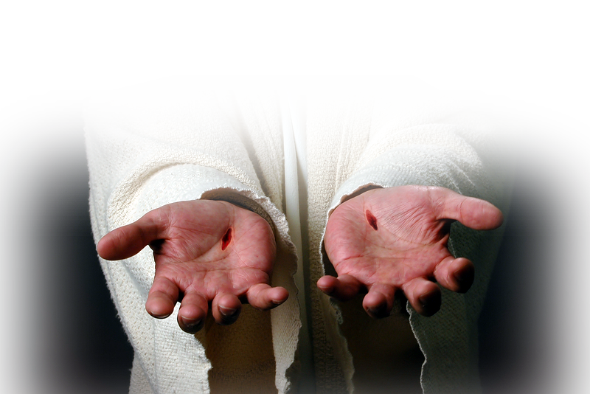
1. Compels Us 14-15
¹³ If we are out of our mind, it is for the sake of God; if we are in our right mind,
it is for you.
¹⁴ For Christ's love
compels us,
press, compress, squeeze
Notes:
Heart cross = https://pixabay.com/en/heart-cross-christianity-faith-1166557/
This crazy love, radical love, extreme love, out of your mind love is what compels us. His love presses us onward, forward. It is the coaxing of love.
Hughes 2 Cor p.192 “that shuts him in, confines him as between two walls”

Slide 11
1. Compels Us 14-15
¹³ If we are out of our mind, it is for the sake of God; if we are in our right mind,
it is for you.
¹⁴ For Christ's love
compels us,
press, compress, squeeze
WHY?
Notes:
Heart cross = https://pixabay.com/en/heart-cross-christianity-faith-1166557/
This crazy love, radical love, extreme love, out of your mind love is what compels us. His love presses us onward, forward. It is the coaxing of love.
Hughes 2 Cor p.192 “that shuts him in, confines him as between two walls”

Slide 12
1. Compels Us 14-15
¹⁴ For Christ's love compels us,
because we are convinced that one died for all, and therefore all died.

Slide 13
1. Compels Us 14-15
¹⁴ For Christ's love compels us,
because we are convinced that one died for all, and therefore all died.
Notes:
We have been won over, We are persuaded beyond a shadow of doubt by such love.
“Convinced” = Judged, concluded. It like we say, Here’s the “bottom line” Here is the total, sum of the matter ...

Slide 14
1. Compels Us 14-15
¹⁴ For Christ's love compels us,
because we are convinced that one died for all, and therefore all died.
BOTTOM LINE = LOVE OF CHRIST
Notes:
We have been won over, We are persuaded beyond a shadow of doubt by such love.
“Convinced” = Judged, concluded. It like we say, Here’s the “bottom line” Here is the total, sum of the matter ...

Slide 15
1. Compels Us 14-15
Died
Buried
Rose Again
For you and me
¹⁴ For Christ's love compels us,
because we are convinced that one died for all, and therefore all died.
BOTTOM LINE = LOVE OF CHRIST
Notes:
We have been won over, We are persuaded beyond a shadow of doubt by such love.
“Convinced” = Judged, concluded. It like we say, Here’s the “bottom line” Here is the total, sum of the matter ...

Slide 16
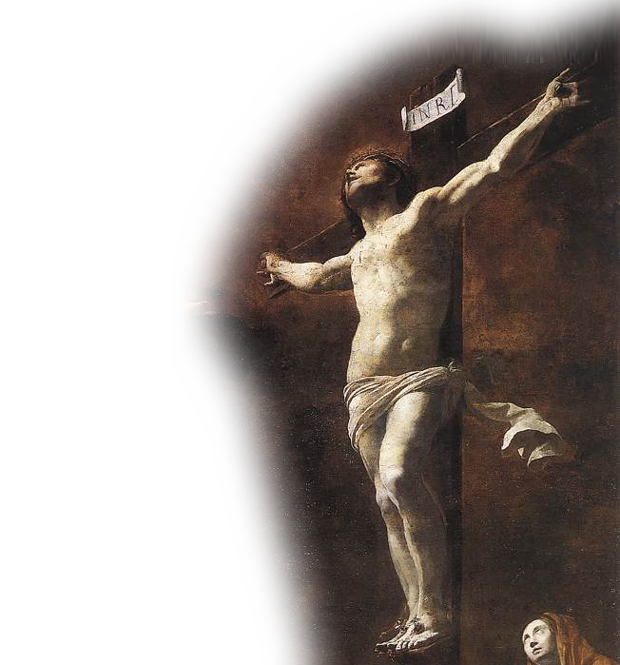
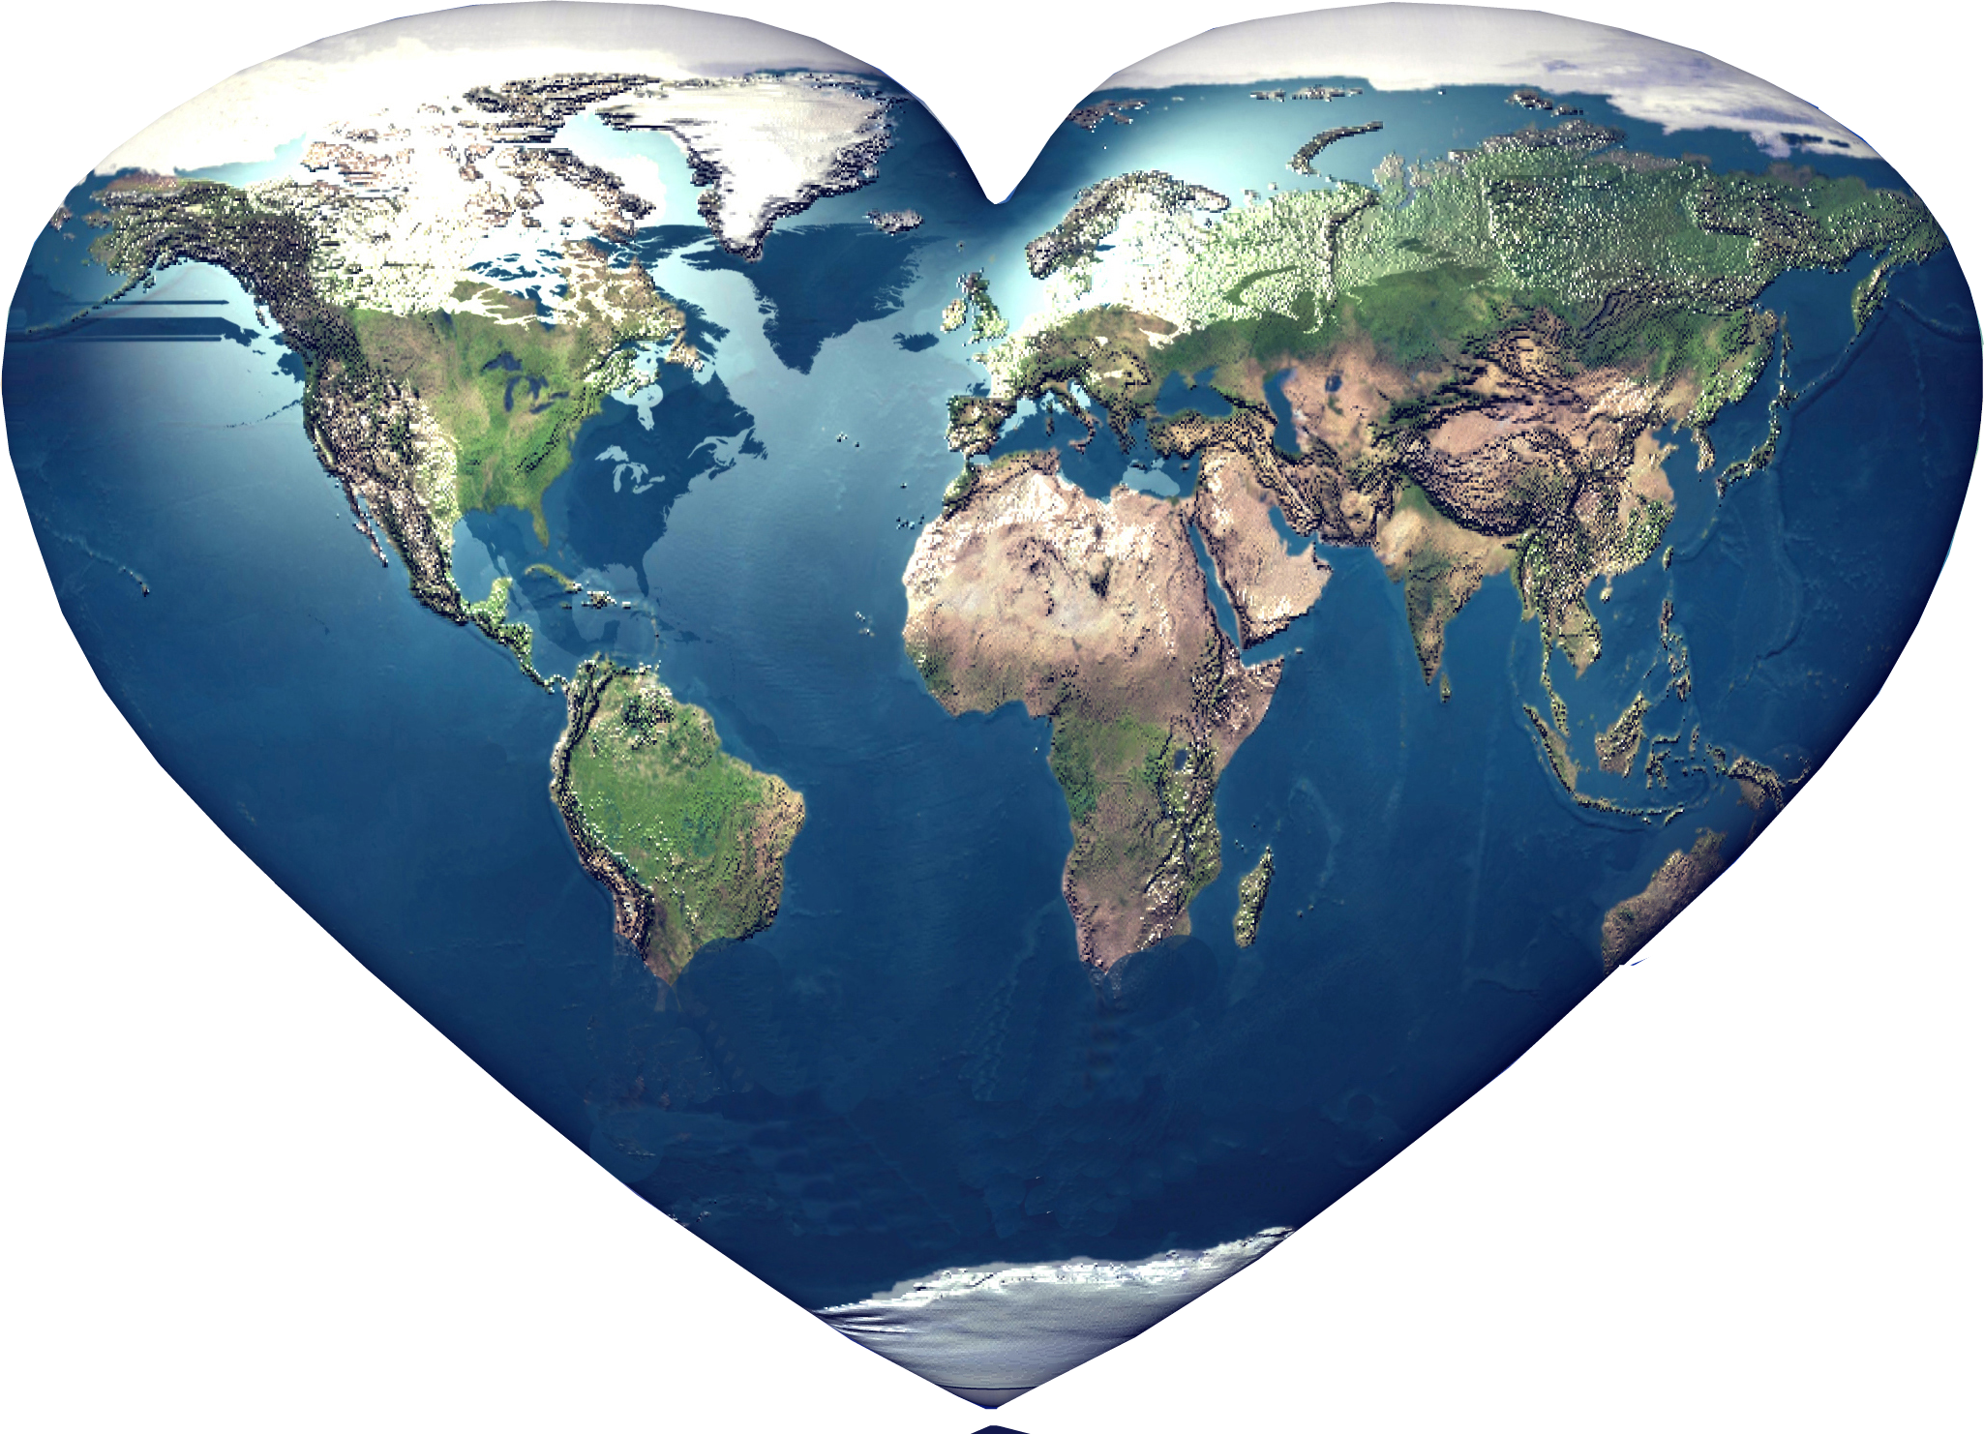
1. Compels Us 14-15
¹⁴ For Christ's love compels us,
because we are convinced that one died for all, and therefore all died.
Notes:
Christ on cross = https://upload.wikimedia.org/wikipedia/commons/6/66/SVouet.jpg
That the death of Christ is all sufficient.

Slide 17
1. Compels Us 14-15
¹⁴ For Christ's love compels us,
because we are convinced that one died for all, and therefore all died.
Notes:
It was subtitutionary, and as such, all who believe in him died in Him when he died on the cross.

Slide 18
1. Compels Us 14-15
¹⁴ For Christ's love compels us,
because we are convinced that one died for all, and therefore all died. ¹⁵ And he died for all, that those who live should no longer live for themselves but for him who died for them and was raised again.

Slide 19
1. Compels Us 14-15
¹⁴ For Christ's love compels us,
because we are convinced that one died for all, and therefore all died. ¹⁵ And he died for all, that those who live should no longer live for themselves but for him who died for them and was raised again.
WHY?

Slide 20
1. Compels Us 14-15
¹⁴ For Christ's love compels us,
because we are convinced that one died for all, and therefore all died. ¹⁵ And he died for all, that those who live should no longer live for themselves but for him who died for them and was raised again.
Notes:
He also raised from the dead. As such we raised with Him.
Gal 2:20

Slide 21
1. Compels Us 14-15
¹⁴ For Christ's love compels us,
because we are convinced that one died for all, and therefore all died. ¹⁵ And he died for all, that those who live should no longer live for themselves but for him who died for them and was raised again.

Slide 22
1. Compels Us 14-15
¹⁴ For Christ's love compels us,
because we are convinced that one died for all, and therefore all died. ¹⁵ And he died for all, that those who live should no longer live for themselves but for him who died for them and was raised again.
[live]

Slide 23
1. Compels Us 14-15
This is OUR CRAZY LOVE MOTIVATION!
¹⁴ For Christ's love compels us,
because we are convinced that one died for all, and therefore all died. ¹⁵ And he died for all, that those who live should no longer live for themselves but for him who died for them and was raised again.
²¹ God made him who had no sin to be sin for us, so that in him we might become the righteousness of God.
[live]
Notes:
His love, demonstrated in His death, mandates (compels) us to live for Him!

Slide 24
2. Changes Us 16-17
Notes:
Caterpillar to Butterfly
We used to be “caterillar” people

Slide 25

2. Changes Us 16-17
¹⁶ So from now on we regard no one from a worldly point of view. Though we once regarded Christ in this way, we do so no longer.
¹⁷ Therefore, if anyone is in Christ, he is a new creation; the old has gone, the new has come!
Notes:
Caterpillar to Butterfly
We used to be “caterillar” people

Slide 26

2. Changes Us 16-17
¹⁶ So from now on we regard no one from a worldly point of view. Though we once regarded Christ in this way, we do so no longer.
¹⁷ Therefore, if anyone is in Christ, he is a new creation; the old has gone, the new has come!
Notes:
Caterpillar to Butterfly
Then we converted to Christ.

Slide 27

2. Changes Us 16-17
¹⁶ So from now on we regard no one from a worldly point of view. Though we once regarded Christ in this way, we do so no longer.
¹⁷ Therefore, if anyone is in Christ, he is a new creation; the old has gone, the new has come!
Notes:
Caterpillar to Butterfly
Then we became “Butterfly Believers”

Slide 28
2. Changes Us 16-17
¹⁶ So from now on we regard no one from a worldly point of view. Though we once regarded Christ in this way, we do so no longer.
¹⁷ Therefore, if anyone is in Christ, he is a new creation; the old has gone, the new has come!
Notes:
Caterpillar to Butterfly
Because we are “butterfly” Christians we don’t view the world like a caterpillar

Slide 29
2. Changes Us 16-17
¹⁶ So from now on we regard no one from a worldly point of view. Though we once regarded Christ in this way, we do so no longer.
¹⁷ Therefore, if anyone is in Christ, he is a new creation; the old has gone, the new has come!
Notes:
Caterpillar to Butterfly
We used to think like the caterpillar world--

Slide 30
2. Changes Us 16-17
¹⁶ So from now on we regard no one from a worldly point of view. Though we once regarded Christ in this way, we do so no longer.
¹⁷ Therefore, if anyone is in Christ, he is a new creation; the old has gone, the new has come!
Notes:
Caterpillar to Butterfly
But we don’t any more!

Slide 31
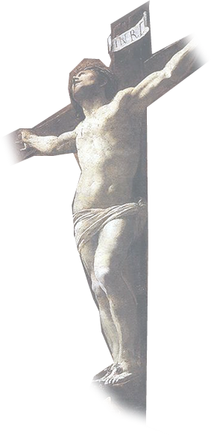
2. Changes Us 16-17
¹⁶ So from now on we regard no one from a worldly point of view. Though we once regarded Christ in this way, we do so no longer.
¹⁷ Therefore, if anyone is in Christ, he is a new creation; the old has gone, the new has come!
Notes:
Caterpillar to Butterfly
You see, when we accepted Jesus as Savior, we cocooned in him -- we became believers “in Him” and God united us to Him. So we are “in Him.”

Slide 32
2. Changes Us 16-17
¹⁶ So from now on we regard no one from a worldly point of view. Though we once regarded Christ in this way, we do so no longer.
¹⁷ Therefore, if anyone is in Christ, he is a new creation; the old has gone, the new has come!
Notes:
Caterpillar to Butterfly
As a result the old caterpillar me is gone ...

Slide 33
2. Changes Us 16-17
¹⁶ So from now on we regard no one from a worldly point of view. Though we once regarded Christ in this way, we do so no longer.
¹⁷ Therefore, if anyone is in Christ, he is a new creation; the old has gone, the new has come!
Notes:
Caterpillar to Butterfly
The new Butterfly me has come. I’m different now!
And everyone can see it. It people can’t see the drastic change from the old caterpillar you to a new butterfly you—then you may be fooling yourself and may need to go into a conversion cocoon with Jesus today. He will radically change you life . He did mine.
You see, CRAZY LOVE CHANGES US.

Slide 34
2. Changes Us 16-17
¹⁶ So from now on we regard no one from a worldly point of view. Though we once regarded Christ in this way, we do so no longer.
¹⁷ Therefore, if anyone is in Christ, he is a new creation; the old has gone, the new has come!
This is OUR CRAZY LOVE Metamorphis!
Notes:
Caterpillar to Butterfly
The new Butterfly me has come. I’m different now!
And everyone can see it. It people can’t see the drastic change from the old caterpillar you to a new butterfly you—then you may be fooling yourself and may need to go into a conversion cocoon with Jesus today. He will radically change you life . He did mine.
You see, CRAZY LOVE CHANGES US.

Slide 35
3. Reconciles Us 18-19
Notes:
Explosion =https://pixabay.com/en/fireball-explosion-devastation-422748/

Slide 36



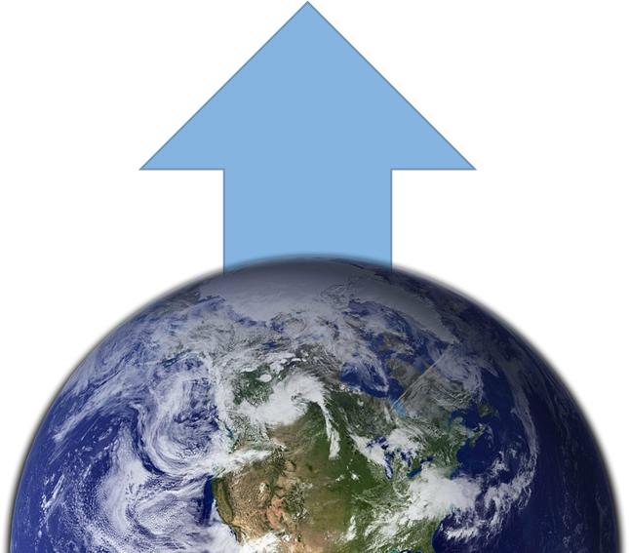
3. Reconciles Us 18-19
¹⁸ All this is from God, who reconciled us to himself through Christ and gave us the ministry of reconciliation: ¹⁹ that God was reconciling the world to himself in Christ, not counting men's sins against them. And he has committed to us the message of reconciliation.
Notes:
Explosion =https://pixabay.com/en/fireball-explosion-devastation-422748/

Slide 37
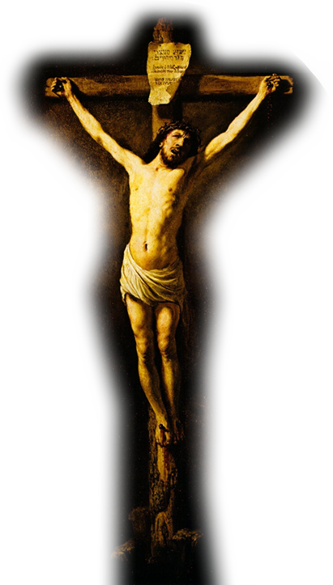
3. Reconciles Us 18-19
¹⁸ All this is from God, who reconciled us to himself through Christ and gave us the ministry of reconciliation: ¹⁹ that God was reconciling the world to himself in Christ, not counting men's sins against them. And he has committed to us the message of reconciliation.
Notes:
Explosion =https://pixabay.com/en/fireball-explosion-devastation-422748/
Earth = https://pixabay.com/en/earth-planet-front-side-back-11593/
Jesus on the cross = https://upload.wikimedia.org/wikipedia/commons/b/be/Crucifixion_by_Rembrandt_%281631%2C_S.Vincent_du_Mas-d%27Agenais%29.jpg

Slide 38
3. Reconciles Us 18-19
¹⁸ All this is from God, who reconciled us to himself through Christ and gave us the ministry of reconciliation: ¹⁹ that God was reconciling the world to himself in Christ, not counting men's sins against them. And he has committed to us the message of reconciliation.
Notes:
Explosion =https://pixabay.com/en/fireball-explosion-devastation-422748/
Earth = https://pixabay.com/en/earth-planet-front-side-back-11593/

Slide 39

3. Reconciles Us 18-19
¹⁸ All this is from God, who reconciled us to himself through Christ and gave us the ministry of reconciliation: ¹⁹ that God was reconciling the world to himself in Christ, not counting men's sins against them. And he has committed to us the message of reconciliation.
Notes:
Explosion =https://pixabay.com/en/fireball-explosion-devastation-422748/
Earth = https://pixabay.com/en/earth-planet-front-side-back-11593/
Finger pointing = https://static.pexels.com/photos/289844/pexels-photo-289844.png

Slide 40
3. Reconciles Us 18-19
¹⁸ All this is from God, who reconciled us to himself through Christ and gave us the ministry of reconciliation: ¹⁹ that God was reconciling the world to himself in Christ, not counting men's sins against them. And he has committed to us the message of reconciliation.
Notes:
Explosion =https://pixabay.com/en/fireball-explosion-devastation-422748/
Earth = https://pixabay.com/en/earth-planet-front-side-back-11593/

Slide 41
3. Reconciles Us 18-19
¹⁸ All this is from God, who reconciled us to himself through Christ and gave us the ministry of reconciliation: ¹⁹ that God was reconciling the world to himself in Christ, not counting men's sins against them. And he has committed to us the message of reconciliation.
This is OUR CRAZY LOVE Message!
Notes:
Explosion =https://pixabay.com/en/fireball-explosion-devastation-422748/
Earth = https://pixabay.com/en/earth-planet-front-side-back-11593/

Slide 42
4. Implores Us 20

Slide 43
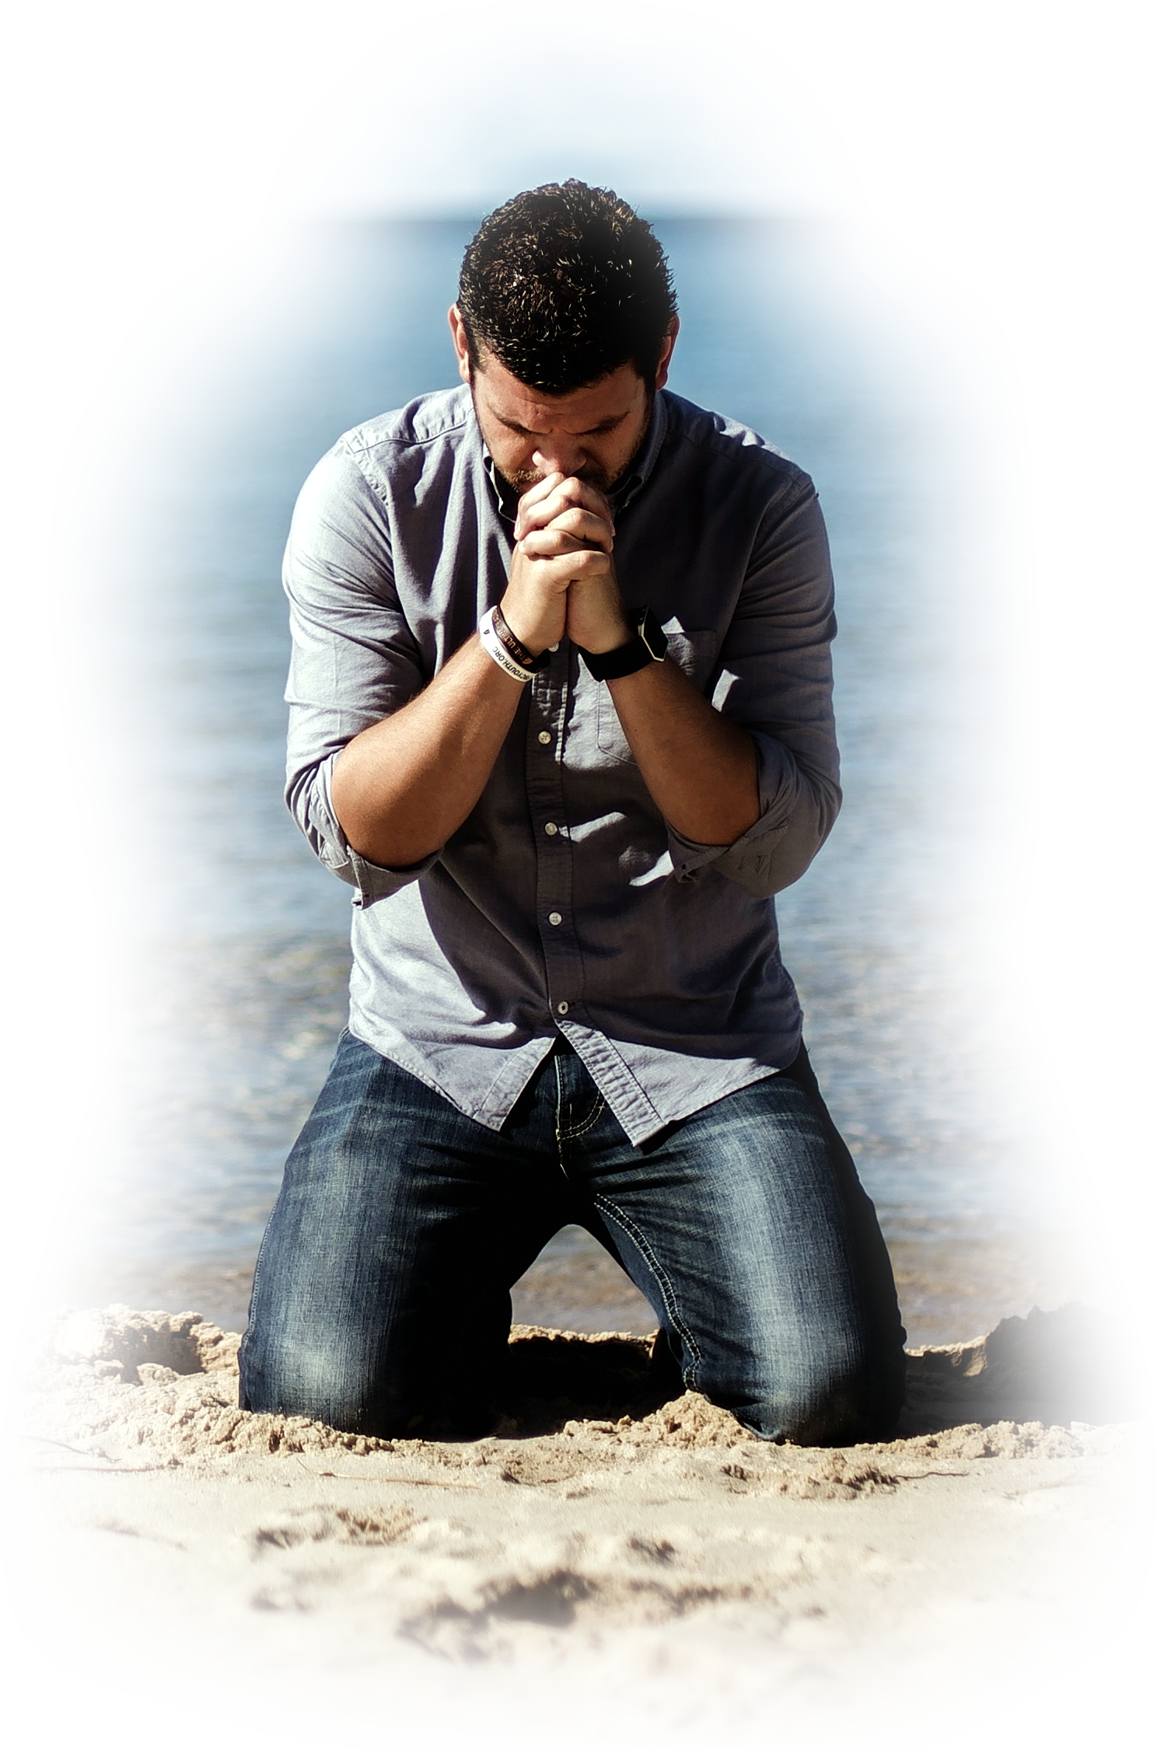
4. Implores Us 20
²⁰ We are therefore Christ's ambassadors, as though God were making his appeal through us. We implore you on Christ's behalf: Be reconciled to God.

Slide 44

4. Implores Us 20
²⁰ We are therefore Christ's ambassadors, as though God were making his appeal through us. We implore you on Christ's behalf: Be reconciled to God.
Notes:
Praying man =https://pixabay.com/en/beach-idyllic-man-ocean-peaceful-1867017/
Embassy Seal =http://www.dondero.com/html%20sheets/embassy_usa.html
Bethany Church is the Embassy of the Most High God. We are Christ’s Ambassadors—we represent him to this world.

Slide 45
4. Implores Us 20
²⁰ We are therefore Christ's ambassadors, as though God were making his appeal through us. We implore you on Christ's behalf: Be reconciled to God.
Notes:
Praying man =https://pixabay.com/en/beach-idyllic-man-ocean-peaceful-1867017/
We take His message to this world.

Slide 46
4. Implores Us 20
²⁰ We are therefore Christ's ambassadors, as though God were making his appeal through us. We implore you on Christ's behalf: Be reconciled to God.
This is OUR CRAZY LOVE MISSION!
Notes:
Praying man =https://pixabay.com/en/beach-idyllic-man-ocean-peaceful-1867017/

Slide 47
5. Justifies Us 21

Slide 48
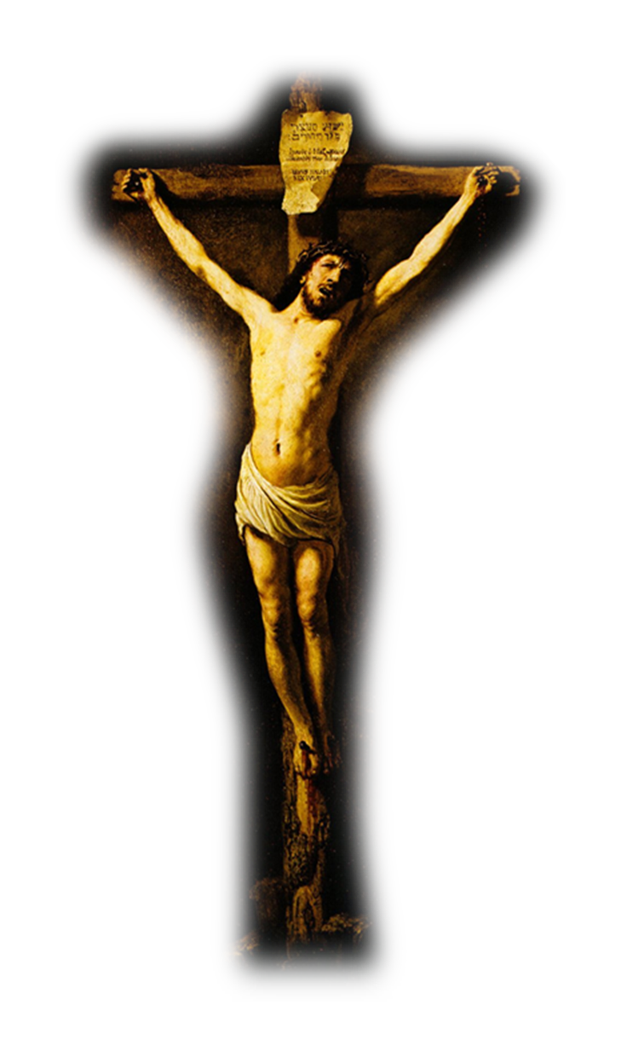
5. Justifies Us 21
²¹ God made him who had no sin to be sin for us, so that in him we might become the righteousness of God.

Slide 49


5. Justifies Us 21
²¹ God made him who had no sin to be sin for us, so that in him we might become the righteousness of God.
SIN
Notes:
BLACK SPOT = https://pixabay.com/en/hole-black-spot-dirt-dirty-1991881/

Slide 50
5. Justifies Us 21
²¹ God made him who had no sin to be sin for us, so that in him we might become the righteousness of God.
SIN

Slide 51
5. Justifies Us 21
²¹ God made him who had no sin to be sin for us, so that in him we might become the righteousness of God.
SIN

Slide 52
5. Justifies Us 21
²¹ God made him who had no sin to be sin for us, so that in him we might become the righteousness of God.
SIN

Slide 53


5. Justifies Us 21
²¹ God made him who had no sin to be sin for us, so that in him we might become the righteousness of God.

Slide 54
5. Justifies Us 21
²¹ God made him who had no sin to be sin for us, so that in him we might become the righteousness of God.
RIGHTEOUSNESS

Slide 55
5. Justifies Us 21
²¹ God made him who had no sin to be sin for us, so that in him we might become the righteousness of God.
RIGHTEOUSNESS

Slide 56

5. Justifies Us 21
²¹ God made him who had no sin to be sin for us, so that in him we might become the righteousness of God.
RIGHTEOUSNESS

Slide 57

5. Justifies Us 21
²¹ God made him who had no sin to be sin for us, so that in him we might become the righteousness of God.
This is OUR CRAZY LOVE Makeover!
RIGHTEOUSNESS

Slide 58
Let’s Sum up

Slide 59
Let’s Sum up
Therefore
go and make disciples
of all nations
(Mat 28:19)

Slide 60
Let’s Sum up
You will be my witnesses in Jerusalem, and in all Judea and Samaria,
and to the ends of the earth
(Act 1:8)
Notes:
Jerusalem is like Waterford – a city
Jueda and Samaria are like stares – Michigan and Ohio
Ends of the earth is like HUNGARY ....

Slide 61
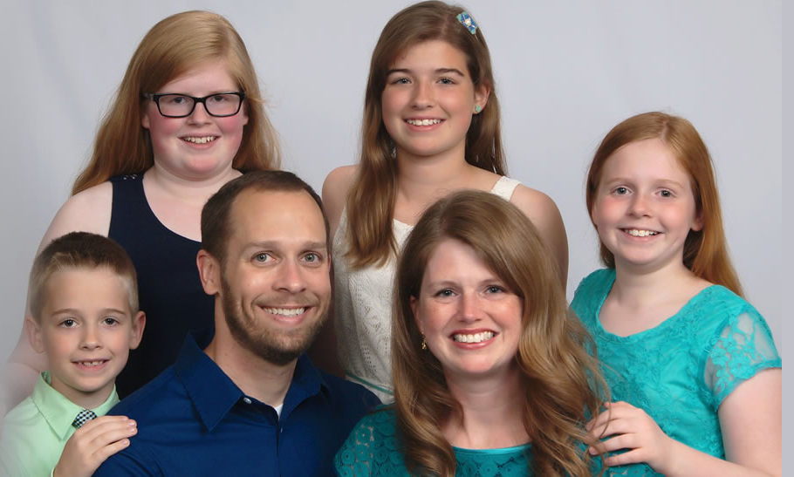
Let’s Sum up
The Goods

Slide 62
OUR MISSION:
Crazy Love!
Notes:
Background = https://static.pexels.com/photos/110854/pexels-photo-110854.jpeg

Slide 63
Let’s Pray!

