Slide 1

Notes:
Copyright © 2006−2021. All rights reserved. Bible Point is a registered trademark of Dennis Henderson. All other trademarks acknowledged.
Bible Point contains graphics from Bible Point artists. These illustrations belong to Bible Point and the respective artists. You may use the designs and illustrations for graphical illustration of lessons free and without special permission, provided they are not used in any way that maligns the Christian faith. Furthermore, republication or production of any illustration by any other graphic service whether it be in book, in a machine-readable form, or in any other design resource is strictly prohibited. Furthermore, they cannot be duplicated or resold as any other form of publishing, clip art, or graphic resource.
So What does it mean? (A simple translations of the legal jargon)
So, if you don’t own the presentation(s), graphic(s), and text(s) how can you legally use them? The purchase of the license allows you to use all the images in the product. However, the actual ownership and copyright of the presentation(s), graphic(s), and text(s) remain the property of Bible Point and its licensors. If you had plans on using this product in your “for sale” work—think again!
License Agreement
Article 1: License Grant
All the graphics and text in Bible Point presentations (excluding quotes from the Bible and stated sources) are the intellectual and real property of Bible Point and its licensors, and is protected by law, including United States copyright laws and international treaties. Bible Point grants to you a license:
1. To use the presentation in a single church, single school, or single office of a Christian organization.
2. To make a single archival back-up copy of the program.
3. To modify the presentation(s) and merge with other presentations in a single church, school, or Christian organization.
4. To transfer to another party if that party agrees to accept the terms and conditions of this agreement, and you do not retain any copies of the presentation, whether printed, machine readable, modified, or merged form.
Article 2: Terms
This license is effective until terminated. You may terminate the license at any time by destroying the presentation(s), graphic(s), or text(s) together with all copies, modifications and merged portions in any form. Bible Point may terminate your license if you fail to comply with this Agreement. You agree, upon such termination, for any reason, to destroy the presentation(s), graphics, and text(s) with all copies, modifications, and merged portions in any form.
Article 3: Disclaimers
1. Bible Point presentations, graphics, and texts are licensed to you As Is. You, the consumer, bear the entire risk relating to the quality and performance of the presentation(s), graphic(s), or text(s). In no event will Bible Point be liable for damages resulting from any defect.
2. Thirty-day limited warrantee on disks. Bible Point warrants the disks to be free of defects in material and workmanship under normal use for 30 days after purchase. During the 30-day period you may return a defective presentation, graphic, or text with proof of purchase and it will be replaced without charge, unless the presentation is damaged by misuse.
Article 4: General
1. You may not sub-license, assign, or transfer the license of the presentation(s), graphic(s), or text(s) except as provided by this Agreement.
2. This Agreement will be governed by the laws of the State of Michigan.
So What does it mean? (A simple translations of the legal jargon)
May I let someone borrow or copy my licensed Bible Point presentation (even after I modified it)? As long as it is within your local church, or single school, or the immediate office of a Christian organization you may. Otherwise, please refer the person interested in borrowing to: http://www.biblepoint.com or E-mail: dennis@DrDH.net with any related questions.
).

Slide 3
Change can be a good thing…

Slide 4
Change can be a good thing…
Especially when
we begin to do
GOD’S WILL.

Slide 5
How do we do GOD’S WILL?

Slide 6
Psalm 37:
27 Turn from evil and do good;

Slide 7

Psalm 37:
27 Turn from evil and do good;

Slide 8
Psalm 37:
27 Turn from evil and do good;
EVIL
GOOD

Slide 9
Psalm 37:
27 Turn from evil and do good;
EVIL
GOOD

Slide 10
Psalm 37:
27 Turn from evil and do good;
Repentance
EVIL
GOOD

Slide 11
Psalm 37:
27 Turn from evil and do good;
Repentance
CHANGE
EVIL
GOOD

Slide 12
27 Turn from evil and do good;
then you will dwell in
the land forever.
Repentance
CHANGE

Slide 13
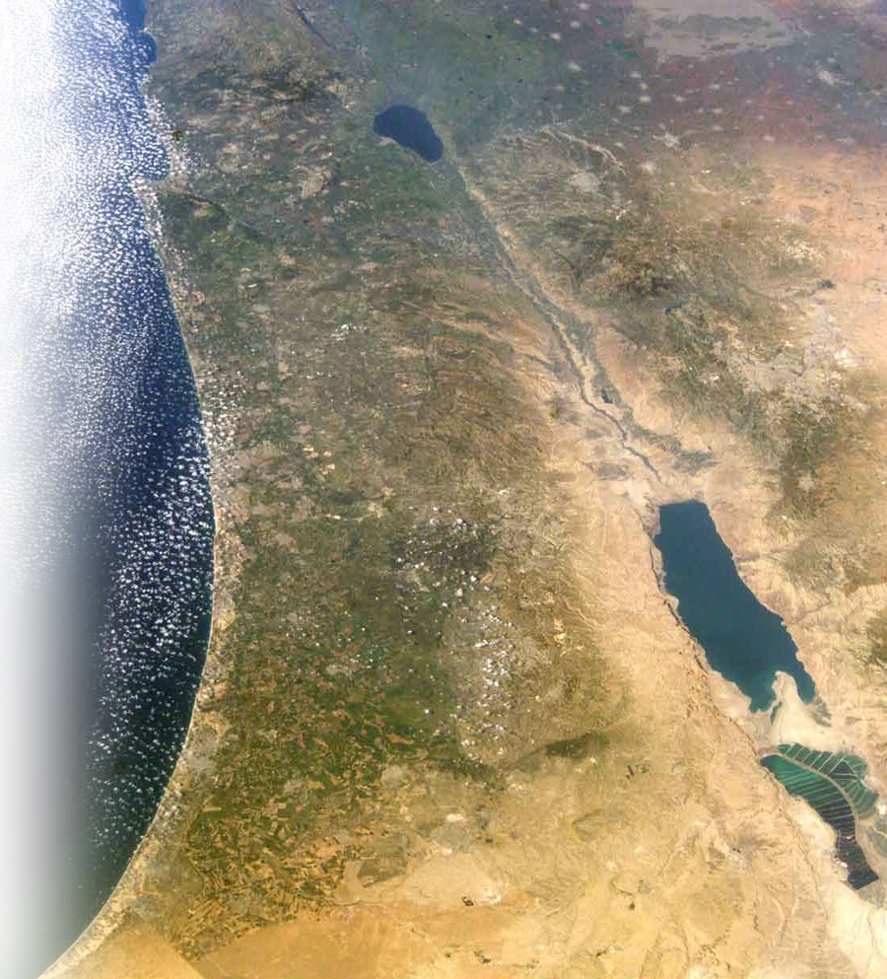
27 Turn from evil and do good;
then you will dwell in
the land forever.
Repentance
CHANGE

Slide 14
27 Turn from evil and do good;
then you will dwell in
the land forever.
Repentance
CHANGE
Why is change the key?

Slide 15
For FIVE Good Reasons…

Slide 16

For FIVE Good Reasons…
1
For LOVE sake
28 For the LORD loves the just and

Slide 17

For FIVE Good Reasons…
1
For LOVE sake
For HIS PRESENCE sake
2
28 For the LORD loves the just and
will not forsake his faithful ones.

Slide 18
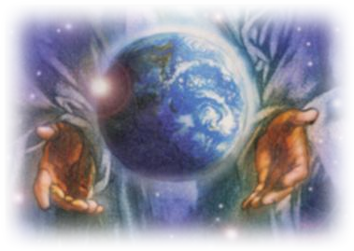
For FIVE Good Reasons…
1
For LOVE sake
For HIS PRESENCE sake
For PROTECTION sake
2
3
28 For the LORD loves the just and
will not forsake his faithful ones. They will be protected forever,

Slide 19

For FIVE Good Reasons…
1
For LOVE sake
For HIS PRESENCE sake
For PROTECTION sake
For JUDGMENT sake
2
3
4
28 For the LORD loves the just and
will not forsake his faithful ones. They will be protected forever, but the offspring of the wicked will be cut off;

Slide 20
For FIVE Good Reasons…
1
For LOVE sake
For HIS PRESENCE sake
For PROTECTION sake
For JUDGMENT sake
For the FUTURE sake
2
3
4
5
28 For the LORD loves the just and
will not forsake his faithful ones. They will be protected forever, but the offspring of the wicked will be cut off; 29 the righteous will inherit the land and dwell in it forever.

Slide 21
What does living in God’s Will look like ?

Slide 22
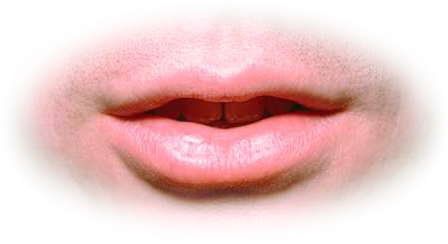
What does living in God’s Will look like ?
30 The mouth of the righteous man utters wisdom,

Slide 23
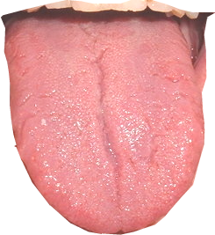
What does living in God’s Will look like ?
30 The mouth of the righteous man utters wisdom,
and his tongue speaks what is just.

Slide 24

What does living in God’s Will look like ?
30 The mouth of the righteous man utters wisdom,
and his tongue speaks what is just.
31 The law of his God is in his heart;

Slide 25
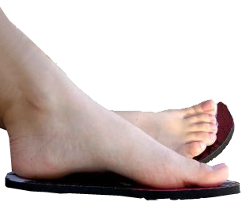
What does living in God’s Will look like ?
30 The mouth of the righteous man utters wisdom,
and his tongue speaks what is just.
31 The law of his God is in his heart;
his feet do not slip.

Slide 26
What does living in God’s Will look like ?
30 The mouth of the righteous man utters wisdom,
and his tongue speaks what is just.
31 The law of his God is in his heart;
his feet do not slip.

Slide 27
What does living in God’s Will look like ?
30 The mouth of the righteous man utters wisdom,
and his tongue speaks what is just.
31 The law of his God is in his heart;
his feet do not slip.

Slide 28
What does living in God’s Will look like ?
30 The mouth of the righteous man utters wisdom,
and his tongue speaks what is just.
31 The law of his God is in his heart;
his feet do not slip.

Slide 29
What does living in God’s Will look like ?
30 The mouth of the righteous man utters wisdom,
and his tongue speaks what is just.
31 The law of his God is in his heart;
his feet do not slip.

Slide 30
What does living in God’s Will look like ?
30 The mouth of the righteous man utters wisdom,
and his tongue speaks what is just.
31 The law of his God is in his heart;
his feet do not slip.
Do it all
for the glory
of God
1 Cor 10:31

Slide 31
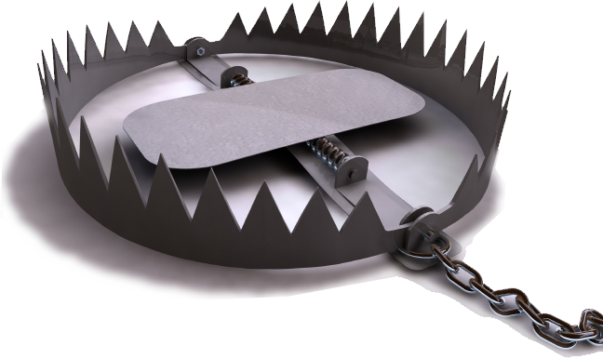
Still all does not go well …
32 The wicked lie in wait for the righteous, seeking their very lives;

Slide 32
Still all does not go well …
32 The wicked lie in wait for the righteous, seeking their very lives;
33 but the LORD will
not leave them in their power or let them be condemned when brought to trial.

Slide 33
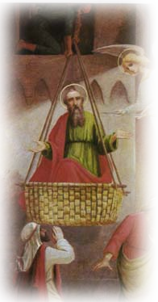
Still all does not go well …
Acts 9:22 Yet Saul grew more and more powerful and baffled the Jews living in Damascus by proving that Jesus is the Christ. 23 After many days had gone by, the Jews conspired to kill him, 24 but Saul learned of their plan. Day and night they kept close watch on the city gates in order to kill him. 25 But his followers took him by night and lowered him in a basket through an opening in the wall.
32 The wicked lie in wait for the righteous, seeking their very lives;

Slide 34
Still all does not go well …
Acts 9:22 Yet Saul grew more and more powerful and baffled the Jews living in Damascus by proving that Jesus is the Christ. 23 After many days had gone by, the Jews conspired to kill him, 24 but Saul learned of their plan. Day and night they kept close watch on the city gates in order to kill him. 25 But his followers took him by night and lowered him in a basket through an opening in the wall.
32 The wicked lie in wait for the righteous, seeking their very lives;

Slide 35
Still all does not go well …
Acts 9:22 Yet Saul grew more and more powerful and baffled the Jews living in Damascus by proving that Jesus is the Christ. 23 After many days had gone by, the Jews conspired to kill him, 24 but Saul learned of their plan. Day and night they kept close watch on the city gates in order to kill him. 25 But his followers took him by night and lowered him in a basket through an opening in the wall.
32 The wicked lie in wait for the righteous, seeking their very lives;

Slide 36
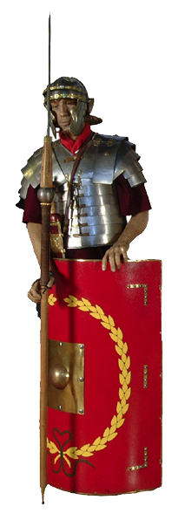
Still all does not go well …
Acts 21:30 Seizing Paul, they dragged him from the temple, and immediately the gates were shut. 31 While they were trying to kill him, news reached the commander of the Roman troops that the whole city of Jerusalem was in an uproar. 32 He at once took some officers and soldiers and ran down to the crowd. When the rioters saw the commander and his soldiers, they stopped beating Paul.
32 The wicked lie in wait for the righteous, seeking their very lives;

Slide 37
Still all does not go well …
Acts 21:30 Seizing Paul, they dragged him from the temple, and immediately the gates were shut. 31 While they were trying to kill him, news reached the commander of the Roman troops that the whole city of Jerusalem was in an uproar. 32 He at once took some officers and soldiers and ran down to the crowd. When the rioters saw the commander and his soldiers, they stopped beating Paul.
32 The wicked lie in wait for the righteous, seeking their very lives;

Slide 38
Still all does not go well …
Acts 21:30 Seizing Paul, they dragged him from the temple, and immediately the gates were shut. 31 While they were trying to kill him, news reached the commander of the Roman troops that the whole city of Jerusalem was in an uproar. 32 He at once took some officers and soldiers and ran down to the crowd. When the rioters saw the commander and his soldiers, they stopped beating Paul.
32 The wicked lie in wait for the righteous, seeking their very lives;

Slide 39
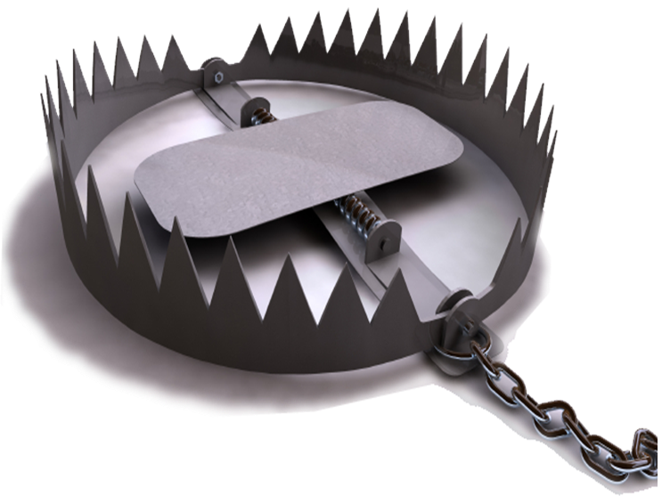
Still all does not go well …
32 The wicked lie in wait for the righteous, seeking their very lives;
33 but the LORD will
not leave them in their power or let them be condemned when brought to trial.

Slide 40
What it takes to do God’s will …

Slide 41
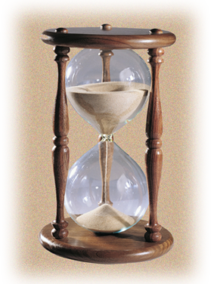
What it takes to do God’s will …
1
Patience
34 Wait for the LORD and

Slide 42

What it takes to do God’s will …
1
Patience
Persistence
2
34 Wait for the LORD and
keep his way.

Slide 43
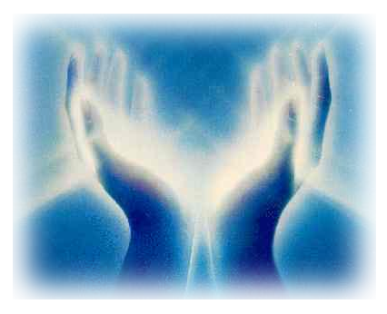
What it takes to do God’s will …
1
Patience
Persistence
Humility
2
3
34 Wait for the LORD and
keep his way.
He will exalt you

Slide 44
What it takes to do God’s will …
1
Patience
Persistence
Humility
Focus
2
3
4
34 Wait for the LORD and
keep his way.
He will exalt you
to inherit the land;
when the wicked are cut
off, you will see it.

Slide 45
What it takes to do God’s will …
1
Patience
Persistence
Humility
Focus
2
3
4
34 Wait for the LORD and
keep his way.
He will exalt you
to inherit the land;
when the wicked are cut
off, you will see it.

Slide 46
Now consider what I’ve seen…

Slide 47

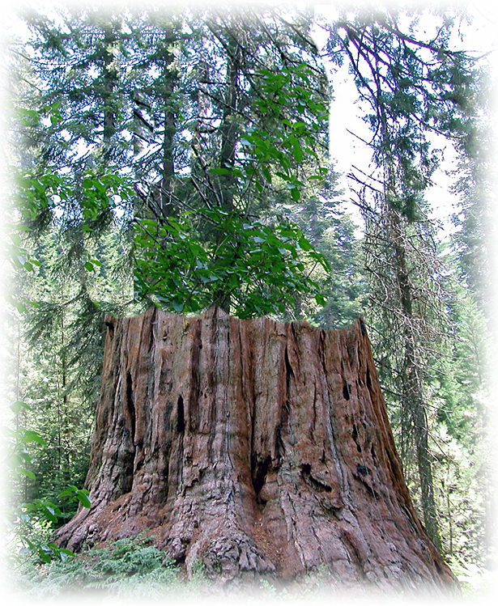
I’ve seen the wicked …
35 I have seen a wicked and ruthless man flourishing like a green tree in its native soil, 36 but he soon passed away and was no more; though I looked for him, he could not be found.

Slide 48
I’ve seen the wicked …
35 I have seen a wicked and ruthless man flourishing like a green tree in its native soil, 36 but he soon passed away and was no more; though I looked for him, he could not be found.

Slide 49
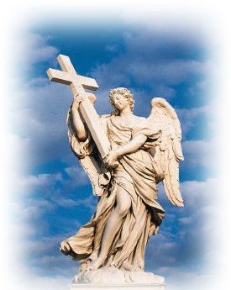
I’ve seen the blameless…
37 Consider the blameless,
observe the upright;
there is a future for the man of peace.

Slide 50
I’ve seen the wicked…
38 But all sinners will be destroyed; the future of the wicked will be cut off.

Slide 51

I’ve seen Salvation …
39 The salvation of the righteous comes from the LORD; he is their stronghold in time of trouble.
40 The LORD helps them and delivers them; he delivers them from the wicked and saves them, because they take refuge in him.

Slide 52
I’ve seen Salvation …
39 The salvation of the righteous comes from the LORD; he is their stronghold in time of trouble.
40 The LORD helps them and delivers them; he delivers them from the wicked and saves them, because they take refuge in him.

Slide 53
I’ve seen Salvation …
39 The salvation of the righteous comes from the LORD; he is their stronghold in time of trouble.
40 The LORD helps them and delivers them; he delivers them from the wicked and saves them, because they take refuge in him.

Slide 54

I’ve seen Salvation …
39 The salvation of the righteous comes from the LORD; he is their stronghold in time of trouble.
40 The LORD helps them and delivers them; he delivers them from the wicked and saves them, because they take refuge in him.

Slide 55

I’ve seen Salvation …
39 The salvation of the righteous comes from the LORD; he is their stronghold in time of trouble.
40 The LORD helps them and delivers them; he delivers them from the wicked and saves them, because they take refuge in him.

Slide 56
Change can be a good thing…

Slide 57
Change can be a good thing…
Especially when
we begin to do
God’s will.

Slide 58
Change can be a good thing…
27 Turn from evil and do good;
Repentance
EVIL
GOOD

Slide 59
1 Thes 1:9 They tell how you turned to God
from idols to serve the living and true God,
Repentance
Good Change
IDOLS
GOD

Slide 60
How do you live with change?

Slide 61
How do you live with change?
If it is a bad change—
you turn from it.

Slide 62
How do you live with change?
If it is a bad change—
you turn from it.
If it is good change—
you turn to it!

Slide 63
How do you live with change?
If it is a bad change—
you turn from it.
If it is good change—
you turn to it!
What if you don’t know the difference?

Slide 64
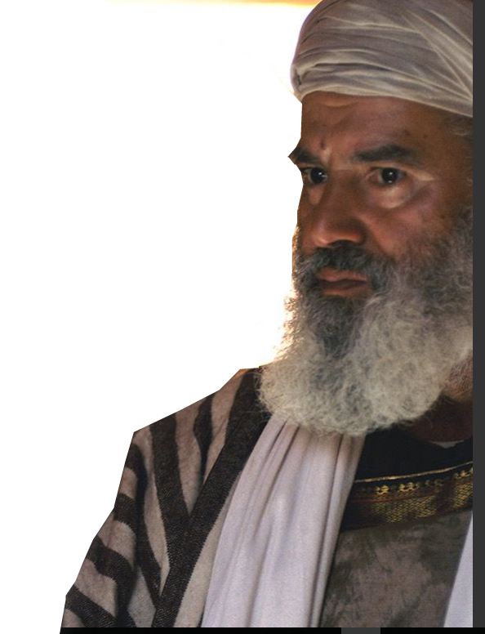
Wise Counsel from Gamaliel:
Act 5 ³⁸ Therefore, in the present case I advise you: Leave these men alone! Let them go! For if their purpose or activity is of human origin, it will fail. ³⁹ But
if it is from God, you will not be able to stop these men; you
will only find yourselves
fighting against God."
Notes:
Gamaliel = FREE = http://www.freebibleimages.org/photos/lumo-jesus-paralysed-man/

Slide 65
Wise Counsel from Gamaliel:
Act 5 ³⁸ Therefore, in the present case I advise you: Leave these men alone! Let them go! For if their purpose or activity is of human origin, it will fail. ³⁹ But
if it is from God, you will not be able to stop these men; you
will only find yourselves
fighting against God."

Slide 66
Wise Counsel from Gamaliel:
Act 5 ³⁸ Therefore, in the present case I advise you: Leave these men alone! Let them go! For if their purpose or activity is of human origin, it will fail. ³⁹ But
if it is from God, you will not be able to stop these men; you
will only find yourselves
fighting against God."

Slide 67
Let’s Pray

