Slide 1
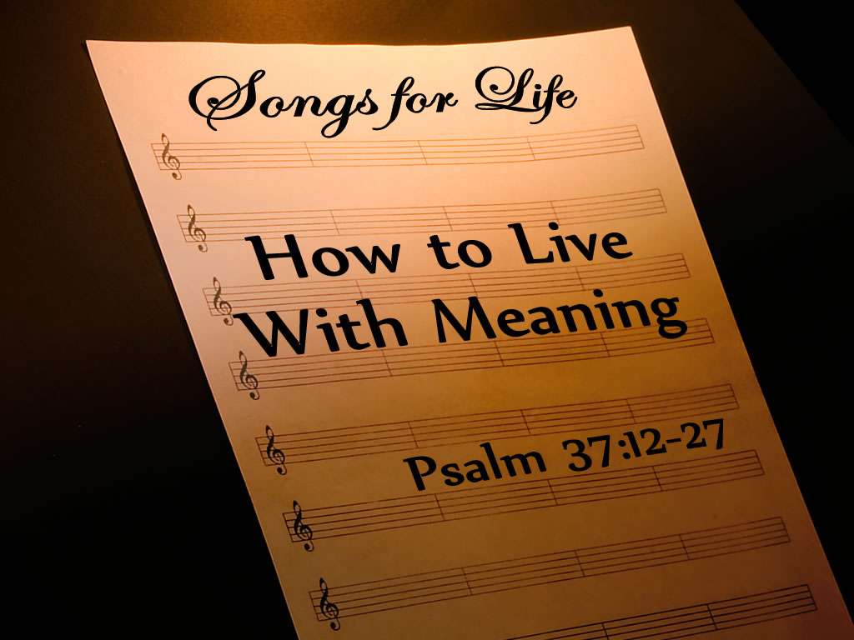
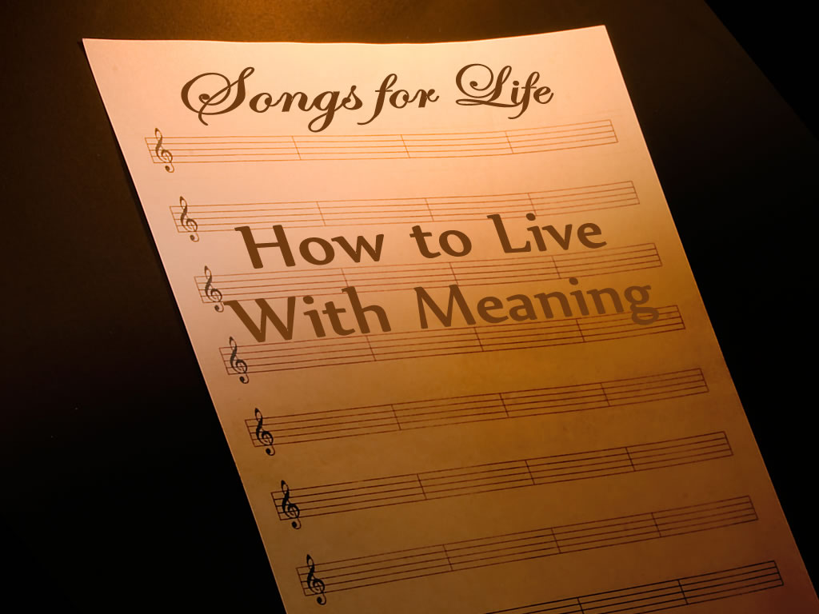
;
Notes:
Copyright © 2006−2021. All rights reserved. Bible Point is a registered trademark of Dennis Henderson. All other trademarks acknowledged.
Bible Point contains graphics from Bible Point artists. These illustrations belong to Bible Point and the respective artists. You may use the designs and illustrations for graphical illustration of lessons free and without special permission, provided they are not used in any way that maligns the Christian faith. Furthermore, republication or production of any illustration by any other graphic service whether it be in book, in a machine-readable form, or in any other design resource is strictly prohibited. Furthermore, they cannot be duplicated or resold as any other form of publishing, clip art, or graphic resource.
So What does it mean? (A simple translations of the legal jargon)
So, if you don’t own the presentation(s), graphic(s), and text(s) how can you legally use them? The purchase of the license allows you to use all the images in the product. However, the actual ownership and copyright of the presentation(s), graphic(s), and text(s) remain the property of Bible Point and its licensors. If you had plans on using this product in your “for sale” work—think again!
License Agreement
Article 1: License Grant
All the graphics and text in Bible Point presentations (excluding quotes from the Bible and stated sources) are the intellectual and real property of Bible Point and its licensors, and is protected by law, including United States copyright laws and international treaties. Bible Point grants to you a license:
1. To use the presentation in a single church, single school, or single office of a Christian organization.
2. To make a single archival back-up copy of the program.
3. To modify the presentation(s) and merge with other presentations in a single church, school, or Christian organization.
4. To transfer to another party if that party agrees to accept the terms and conditions of this agreement, and you do not retain any copies of the presentation, whether printed, machine readable, modified, or merged form.
Article 2: Terms
This license is effective until terminated. You may terminate the license at any time by destroying the presentation(s), graphic(s), or text(s) together with all copies, modifications and merged portions in any form. Bible Point may terminate your license if you fail to comply with this Agreement. You agree, upon such termination, for any reason, to destroy the presentation(s), graphics, and text(s) with all copies, modifications, and merged portions in any form.
Article 3: Disclaimers
1. Bible Point presentations, graphics, and texts are licensed to you As Is. You, the consumer, bear the entire risk relating to the quality and performance of the presentation(s), graphic(s), or text(s). In no event will Bible Point be liable for damages resulting from any defect.
2. Thirty-day limited warrantee on disks. Bible Point warrants the disks to be free of defects in material and workmanship under normal use for 30 days after purchase. During the 30-day period you may return a defective presentation, graphic, or text with proof of purchase and it will be replaced without charge, unless the presentation is damaged by misuse.
Article 4: General
1. You may not sub-license, assign, or transfer the license of the presentation(s), graphic(s), or text(s) except as provided by this Agreement.
2. This Agreement will be governed by the laws of the State of Michigan.
So What does it mean? (A simple translations of the legal jargon)
May I let someone borrow or copy my licensed Bible Point presentation (even after I modified it)? As long as it is within your local church, or single school, or the immediate office of a Christian organization you may. Otherwise, please refer the person interested in borrowing to: http://www.biblepoint.com or E-mail: dennis@DrDH.net with any related questions.
).

Slide 2
;
Notes:
He has made everything beautiful in its time. He has also set eternity in the hearts of men; yet they cannot fathom what God has done from beginning to end. (Ecc 3:11 NIV)
Eccle 1:2
² "Meaningless! Meaningless!" says the Teacher. "Utterly meaningless! Everything is meaningless."
³ What does man gain from all his labor at which he toils under the sun?
(Ecc 1:2-3 NIV)
Ten meaningless things viewed from “under the sun.” Without God,
human wisdom is meaningless (2:14–16);
labor (2:18–23);
things (2:26);
life itself (3:18–22);
competition (4:4);
selfish overwork (4:7–8);
power and authority (4:16);
greed (5:10);
wealth and accolades (6:1–2); and
perfunctory religion (8:10–14).
“Now all has been heard;
here is the conclusion of the matter:
Fear God and keep his commandments,
for this is the duty of all mankind” (Ecclesiastes 12:13).

Slide 3
So how do we live with …
MEANING?

Slide 4
NOT like our meaningless
CULTURE!
Notes:
Yes we are in the world .... But we are not of the world.
We live in the American culture ... But we are foremost citizens of heaven.
It’s not so much that we are against it ... It’s more we are for a Christian Culture.
The world’s culture always leaves you meaningless, cut-throat, dog-eat-dog, survival of the fittest, and trampling on the little guy.

Slide 5

First: They Plot Against Us
12 The wicked plot against the righteous and gnash their teeth at them;
Notes:
Like the reporter who has a “gotcha question.” They tried to trap Jesus and they will try to trap you. Don’t do the same.

Slide 6
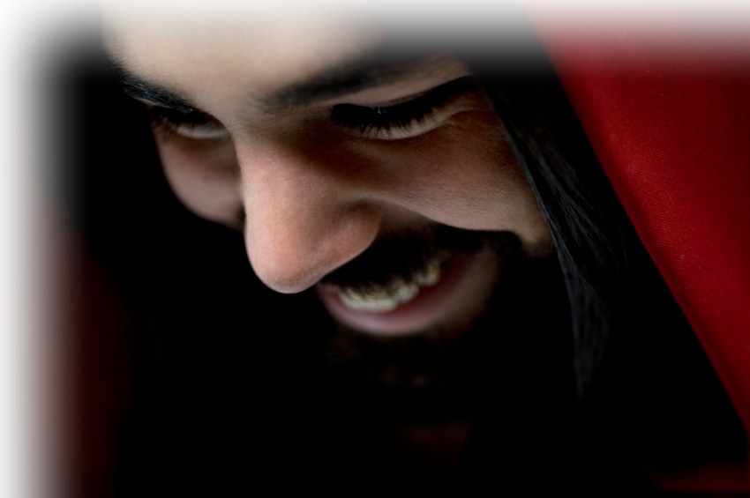
First: They Plot Against Us
12 The wicked plot against the righteous and gnash their teeth at them; 13 but the Lord laughs at the wicked, for he knows their day is coming.

Slide 7
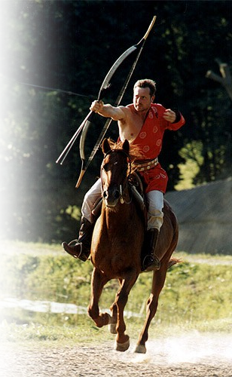
Second: They Want to Slay Us
14 The wicked draw the sword and bend the bow to bring down the poor and needy, to slay those whose ways are upright.
Notes:
Roman Archer = https://en.wikipedia.org/wiki/File:Lajos-kassai-hba.jpg

Slide 8
Second: They Want to Slay Us
14 The wicked draw the sword and bend the bow to bring down the poor and needy, to slay those whose ways are upright.
Notes:
Jesus said "If the world hates you, keep in mind that it hated me first. (Joh 15:18 NIV)
As it is, you do not belong to the world, but I have chosen you out of the world. That is why the world hates you. (Joh 15:19 NIV)

Slide 9
Second: They Want to Slay Us
14 The wicked draw the sword and bend the bow to bring down the poor and needy, to slay those whose ways are upright. 15 But their swords will pierce their own hearts, and their bows will be broken.

Slide 10
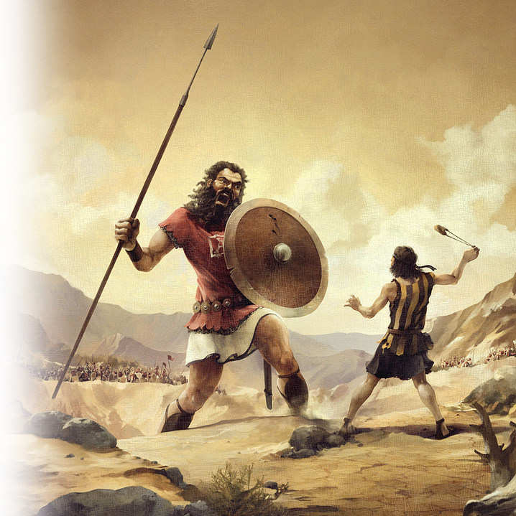
Second: They Want to Slay Us
14 The wicked draw the sword and bend the bow to bring down the poor and needy, to slay those whose ways are upright. 15 But their swords will pierce their own hearts, and their
bows will be broken.
Notes:
David and Goliath = https://www.flickr.com/photos/x1brett/2979430694

Slide 11
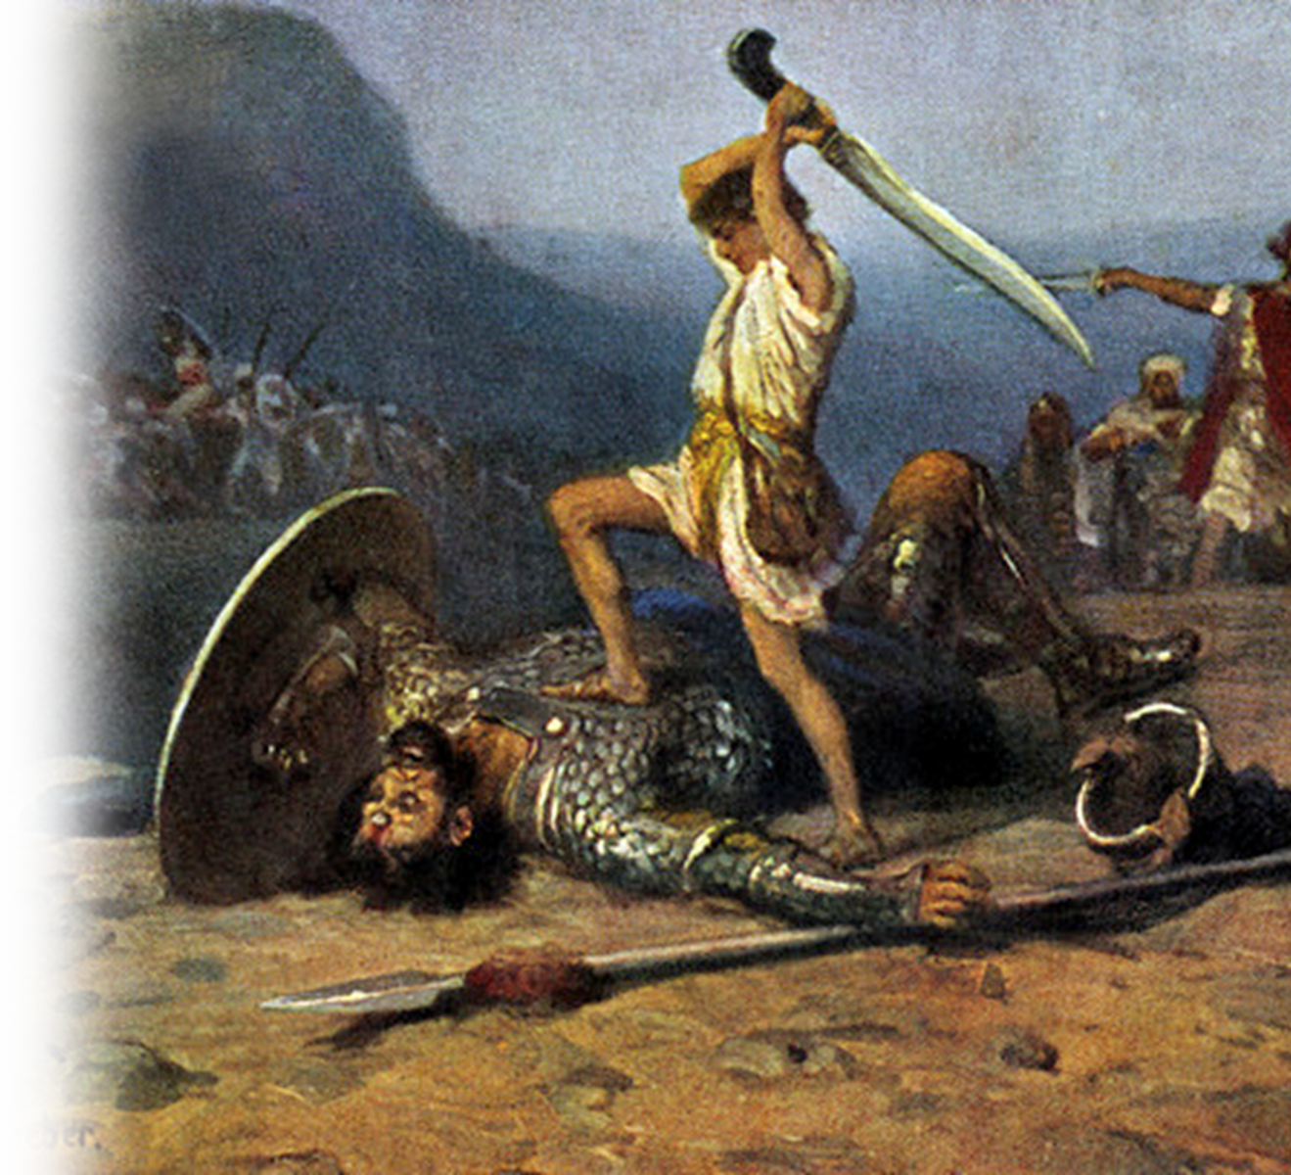
Second: They Want to Slay Us
14 The wicked draw the sword and bend the bow to bring down the poor and needy, to slay those whose ways are upright. 15 But their swords will pierce their own hearts, and their
bows will be broken.
Notes:
https://commons.wikimedia.org/wiki/File:Anton_Robert_Leinweber_%E2%80%93_David_und_Goliath.jpg

Slide 12
And So How Must We Live to Find MEANING?
Notes:
We must live counter cultural ... Not anti-cultural. We must go against the flow, when the flow is going against God.
Interestingly ... The churches that have gone PC correct, more liberal in their theology ... Decline and die! Those who stay true to the Book ... Grow.

Slide 13
And So How Must We Live to Find MEANING?
Answer: Counter Culture
Notes:
We must live counter cultural ... Not anti-cultural. We must go against the flow, when the flow is going against God.
Interestingly ... The churches that have gone PC correct, more liberal in their theology ... Decline and die! Those who stay true to the Book ... Grow.

Slide 14
1. Live Content with God’s Little
16 Better the little that the righteous have than the wealth of many wicked;

Slide 15
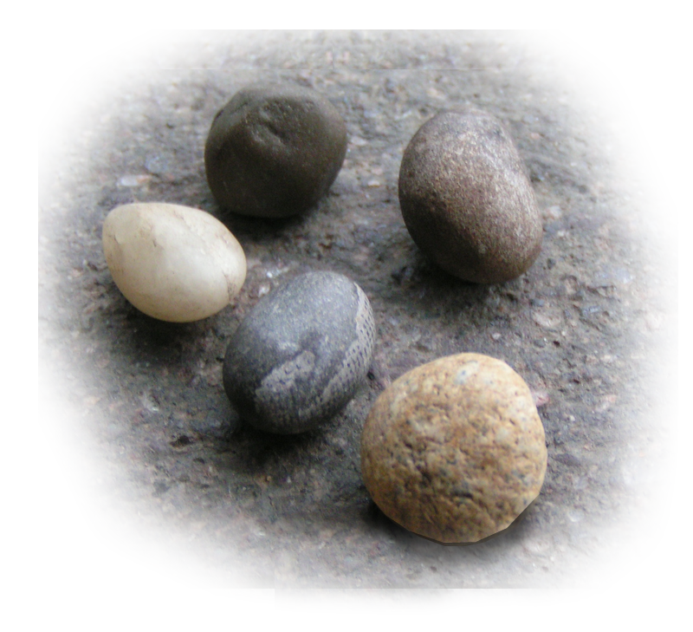
1. Live Content with God’s Little
16 Better the little that the righteous have than the wealth of many wicked;
Notes:
Five stones = FREE = https://commons.wikimedia.org/wiki/File:Five_little_stones.png
Why five stones when he only needed one? Some suggest because Goliath had four other brothers who were giants too.
Then he took his staff in his hand, chose five smooth stones from the stream, put them in the pouch of his shepherd's bag and, with his sling in his hand, approached the Philistine. (1Sa 17:40 NIV)

Slide 16
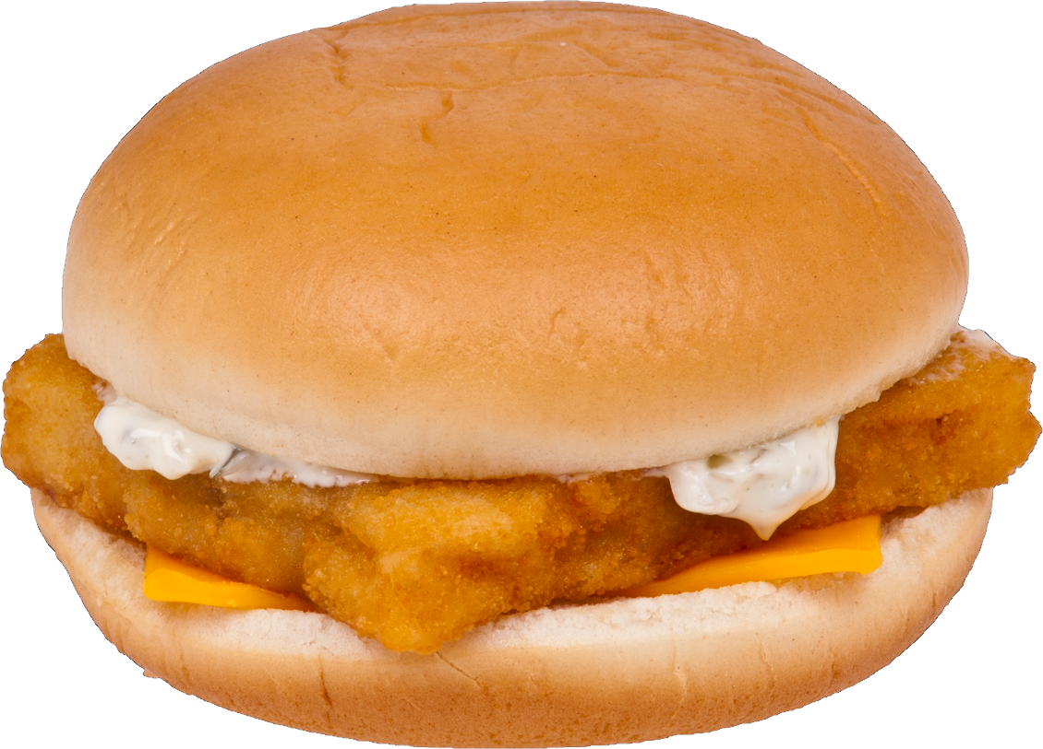
1. Live Content with God’s Little
16 Better the little that the righteous have than the wealth of many wicked;
Notes:
Fish sandwich = free =https://en.wikipedia.org/wiki/File:Filet-O-Fish_transparent.png
“Here is a boy with five small barley loaves and two small fish, but how far will they go among so many?" (Joh 6:9 NIV)

Slide 17
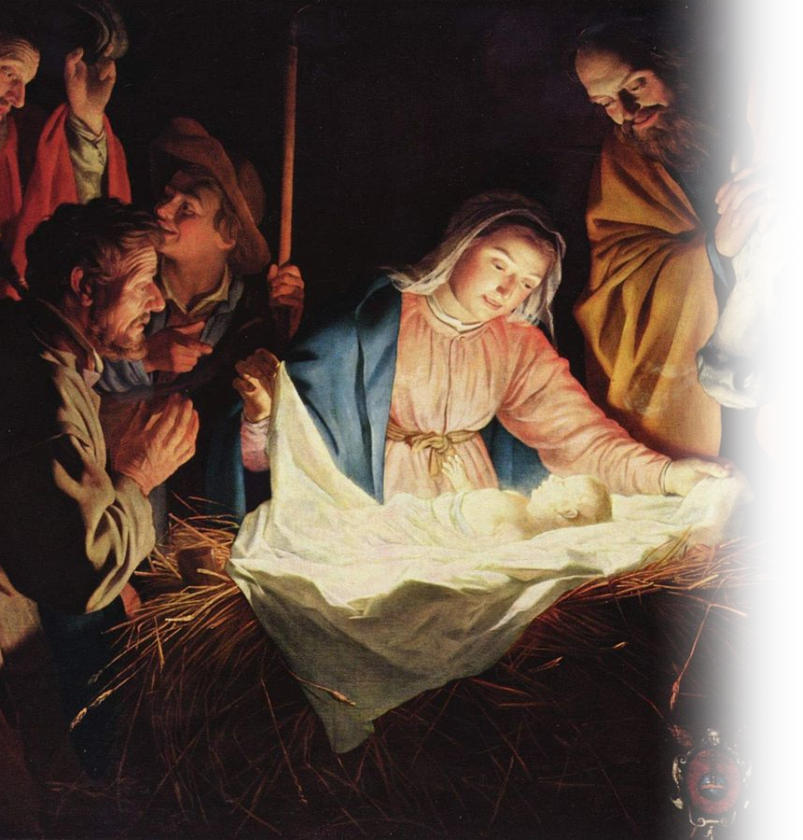
1. Live Content with God’s Little
16 Better the little that the righteous have than the wealth of many wicked;
Notes:
Baby Jesus = FREE = https://en.wikipedia.org/wiki/File:Gerard_van_Honthorst_001.jpg
and she gave birth to her firstborn, a son. She wrapped him in cloths and placed him in a manger, because there was no room for them in the inn. (Luk 2:7 NIV)

Slide 18
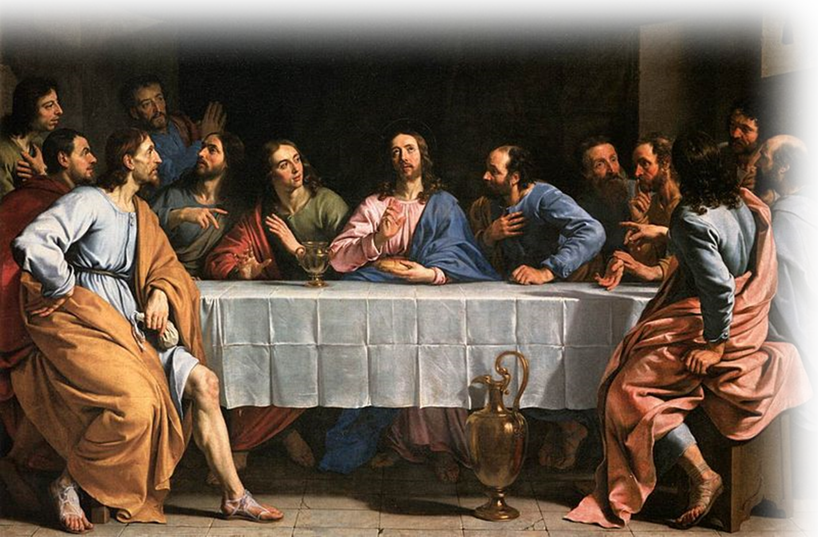
1. Live Content with God’s Little
16 Better the little that the righteous have than the wealth of many wicked;
Notes:
Baby Jesus = FREE = https://en.wikipedia.org/wiki/File:Gerard_van_Honthorst_001.jpg

Slide 19
1. Live Content with God’s Little
I have learned to be content whatever the circumstances. Phil 4:11
16 Better the little that the righteous have than the wealth of many wicked;
Notes:
Baby Jesus = FREE = https://en.wikipedia.org/wiki/File:Gerard_van_Honthorst_001.jpg

Slide 20
1. Live Content with God’s Little
But godliness with contentment is
great gain. 1 Tim 6:6
16 Better the little that the righteous have than the wealth of many wicked;
Notes:
Baby Jesus = FREE = https://en.wikipedia.org/wiki/File:Gerard_van_Honthorst_001.jpg

Slide 21
1. Live Content with God’s Little
But godliness with contentment is
great gain. 1 Tim 6:6
16 Better the little that the righteous have than the wealth of many wicked;
“Little is much when God is in it!”
Notes:
Baby Jesus = FREE = https://en.wikipedia.org/wiki/File:Gerard_van_Honthorst_001.jpg

Slide 22
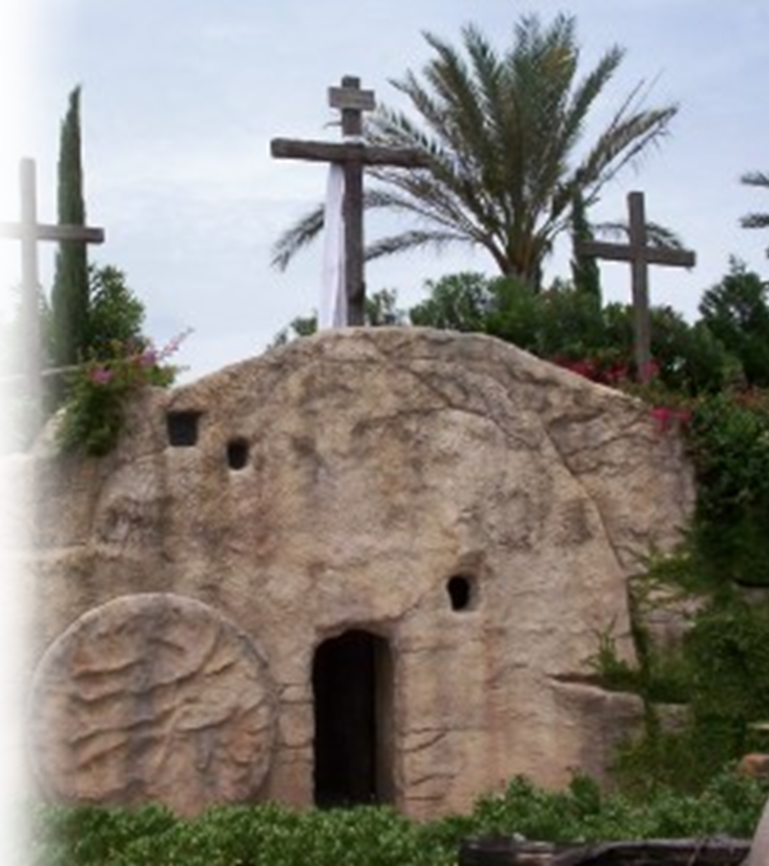
2. Live Backed-Up by God’s Power
17 for the power of the wicked will be broken, but the LORD upholds the righteous.

Slide 23
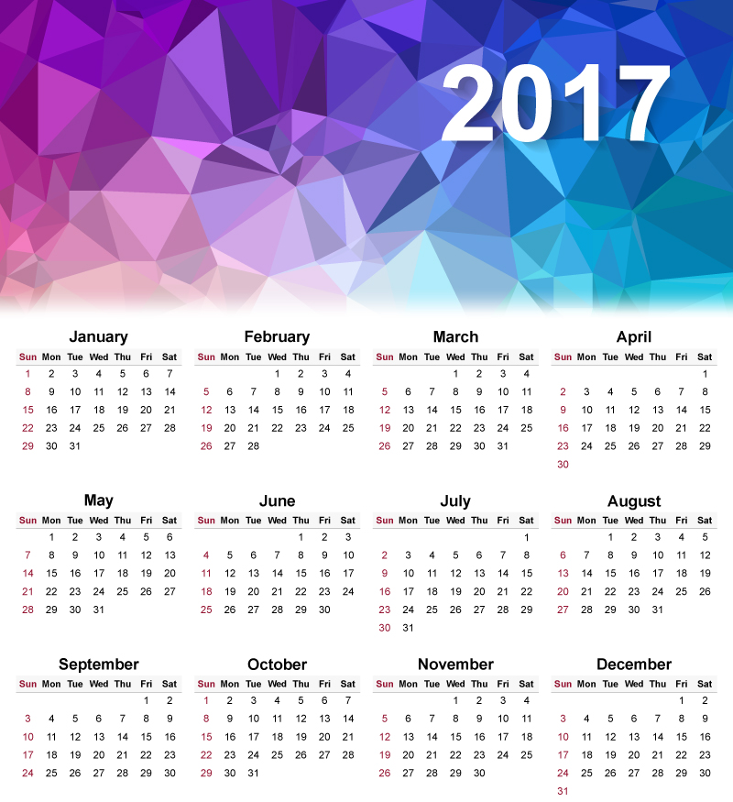
3. Live Reassured by God’s Knowledge
18 The days of the blameless are known to the LORD, and their inheritance will endure forever.
Notes:
Psalm 147:5 Great is our Lord and mighty in power; his understanding has no limit. (Psa 147:5 NIV)

Slide 24
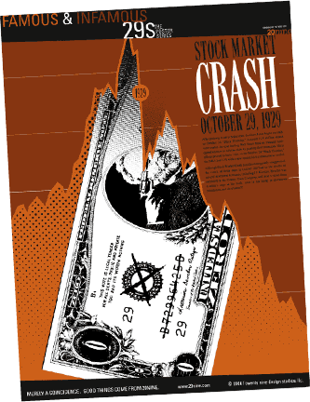
4. Live Anticipating God’s Plenty
19 In times of disaster they will not wither; in days of famine they will enjoy plenty.

Slide 25
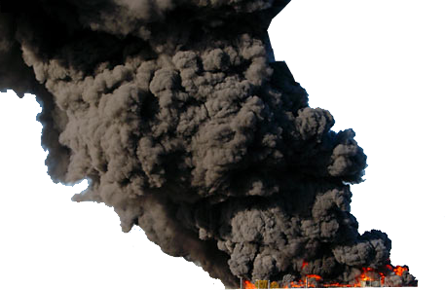
4. Live Anticipating God’s Plenty
19 In times of disaster they will not wither; in days of famine they will enjoy plenty. 20 But the wicked will perish: The LORD's enemies will be like the beauty of the fields, they will vanish-- vanish like smoke.

Slide 26
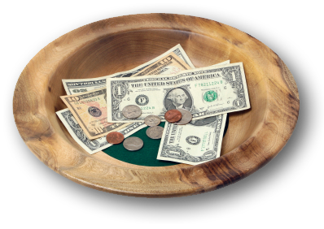
5. Live Sharing God’s Bounty
21 The wicked borrow and do not repay, but the righteous give generously;
Notes:
Sticker on the inside cover of the book I borrowed said, “The wicked borrow and do not repay” (Psalm 37:21)
The righteous TITHE! They give generously to needs. They are compassionate on those in need.

Slide 27


Slide 28
[The “You Are Here.mp4”
video replaces this slide]

Slide 29
5. Live Sharing God’s Bounty
21 The wicked borrow and do not repay, but the righteous give generously;

Slide 30
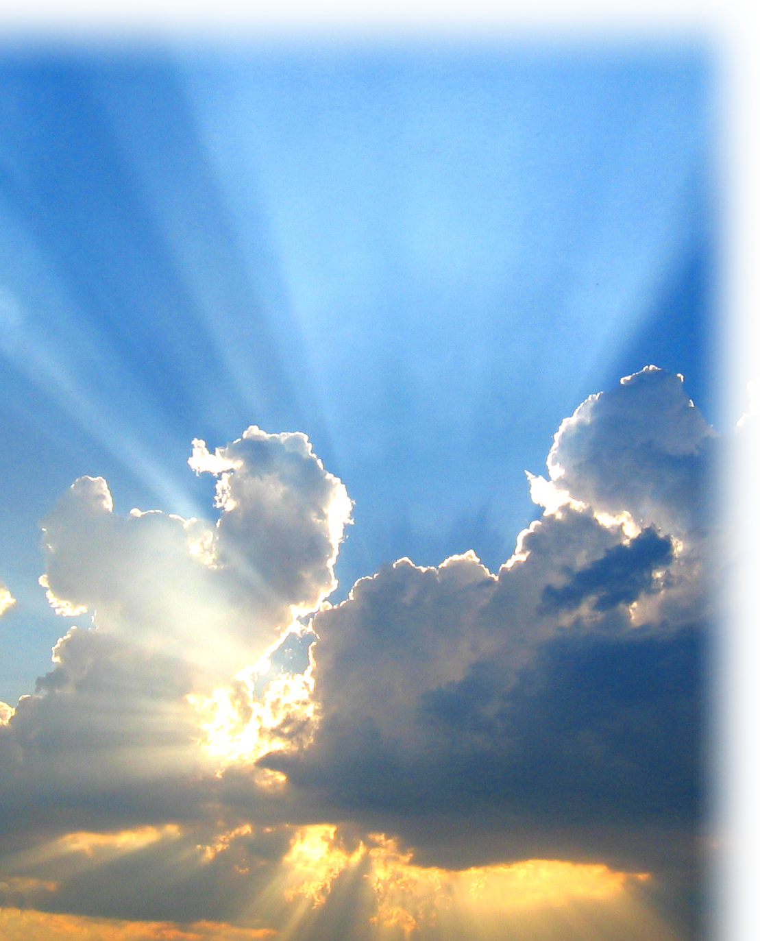
6. Live Expecting God’s Blessing
22 those the LORD blesses will inherit the land, but those he curses will be cut off.

Slide 31
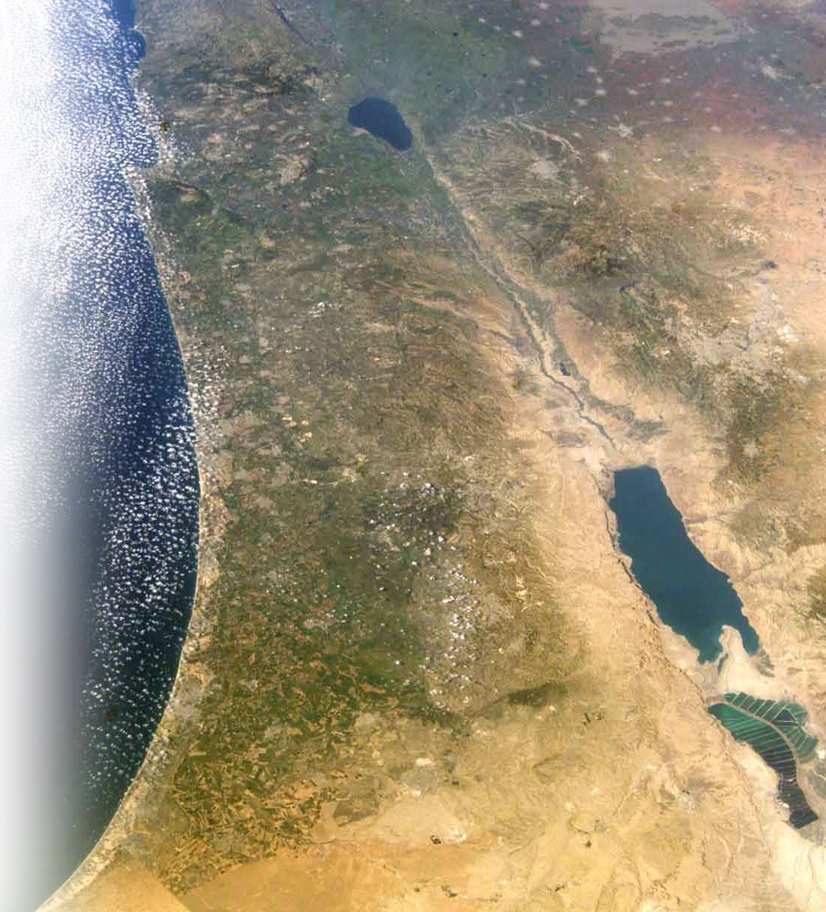
6. Live Expecting God’s Blessing
22 those the LORD blesses will inherit the land, but those he curses will be cut off.

Slide 32

7. Live Following God’s Path
23 If the LORD delights in a man's way, he makes his steps firm;

Slide 33
7. Live Following God’s Path
23 If the LORD delights in a man's way, he makes his steps firm;
“The steps of a man are established by the LORD, And He delights in his way.”
(NASB)

Slide 34

8. Live Holding God’s Hand
24 though he stumble, he will not fall, for the LORD upholds him with his hand.

Slide 35

8. Live Holding God’s Hand
24 though he stumble, he will not fall, for the LORD upholds him with his hand.
Notes:
HOLDING HAND = FREE = https://pixabay.com/en/hands-toddler-hand-child-s-hand-1797401/

Slide 36
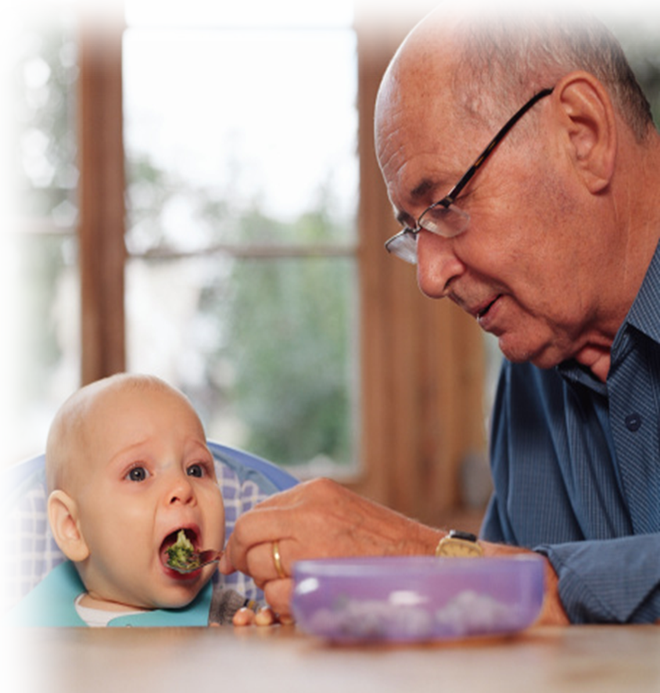
9. Live Accepting God’s Security
25 I was young and now I am old, yet I have never seen the righteous forsaken or their children begging bread.
Notes:
This is not Uncle Sam’s Social Security – This is the Heavenly Father’s Divine Security.

Slide 37
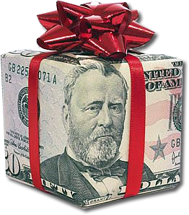
10. Live Giving Away God’s Blessings
26 They are always generous and lend freely; their children will be blessed.

Slide 38
Conclusion: “Living with Meaning” means “Living in God’s Will.”

Slide 39
Conclusion: “Living with Meaning” means “Living in God’s Will.”
HOW?

Slide 40
Conclusion: “Living with Meaning” means “Living in God’s Will.”
HOW?
27 Turn from evil and do good; then you will dwell in the land forever.
E
V
I
L

Slide 41
Conclusion: “Living with Meaning” means “Living in God’s Will.”
HOW?
27 Turn from evil and do good; then you will dwell in the land forever.
G
O
O
D
E
V
I
L
Notes:
A Baptist and a Priest joined forces to warn the people of their town of impending doom.
They both stood outside their respective churches, which were across the street from each other on the main road leading out of town.
They both had a huge placard sign that said, “Repent, the end is near!”
As cars went by the passengers would wag their heads at them and mock them. The cars would speed up, then slam on their brakes, there would be a moment of silence then a kaploooshka. Sound.
After a few such events the Baptist said to the priest, You think we should change the sign from “Repent, the end is near” to “Turn Around, Bridge out ahead!”
That’s kinda funny—but the reality is, people are going down a road that leads to destruction of lives—physically, spiritually, emotionally, socially, and eternally.
We who know the Lord should be warning them “Turn around, disateris ahead!”

Slide 42
Conclusion: “Living with Meaning” means “Living in God’s Will.”
HOW?
27 Turn from evil and do good; then you will dwell in the land forever.
G
O
O
D
E
V
I
L
S
T
O
P

Slide 43
Conclusion: “Living with Meaning” means “Living in God’s Will.”
HOW?
27 Turn from evil and do good; then you will dwell in the land forever.
G
O
O
D
E
V
I
L
S
T
O
P
R
T
S
T
A

Slide 44
Conclusion: “Living with Meaning” means “Living in God’s Will.”
HOW?
27 Turn from evil and do good; then you will dwell in the land forever.
Notes:
“in the land” is synonymous with “in God’s will.”

Slide 45
Let’s Pray.

