Slide 1
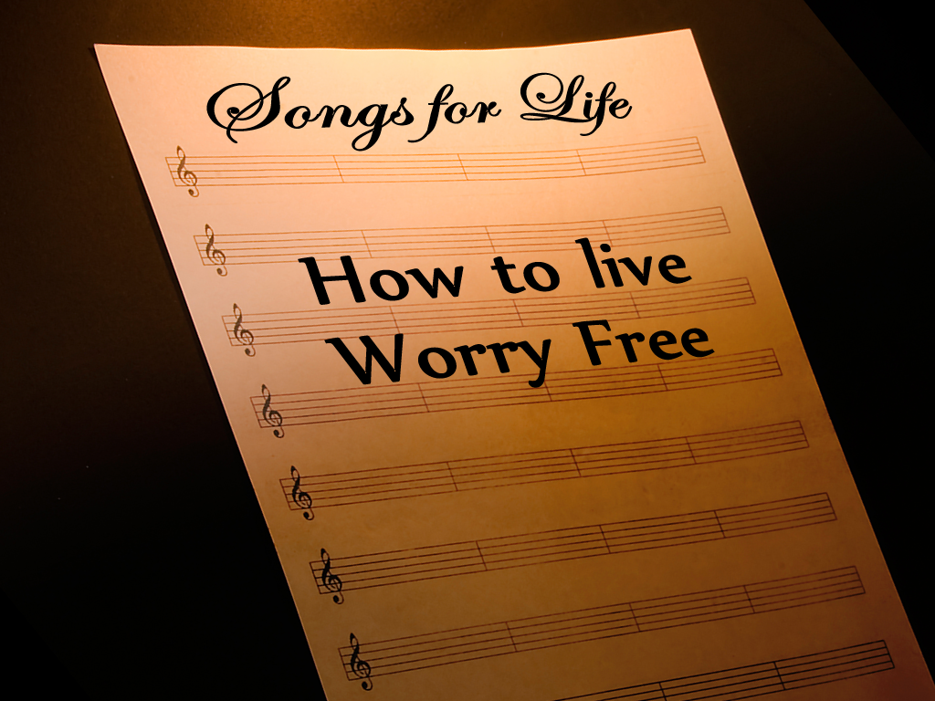
Notes:
Copyright © 2006−2021. All rights reserved. Bible Point is a registered trademark of Dennis Henderson. All other trademarks acknowledged.
Bible Point contains graphics from Bible Point artists. These illustrations belong to Bible Point and the respective artists. You may use the designs and illustrations for graphical illustration of lessons free and without special permission, provided they are not used in any way that maligns the Christian faith. Furthermore, republication or production of any illustration by any other graphic service whether it be in book, in a machine-readable form, or in any other design resource is strictly prohibited. Furthermore, they cannot be duplicated or resold as any other form of publishing, clip art, or graphic resource.
So What does it mean? (A simple translations of the legal jargon)
So, if you don’t own the presentation(s), graphic(s), and text(s) how can you legally use them? The purchase of the license allows you to use all the images in the product. However, the actual ownership and copyright of the presentation(s), graphic(s), and text(s) remain the property of Bible Point and its licensors. If you had plans on using this product in your “for sale” work—think again!
License Agreement
Article 1: License Grant
All the graphics and text in Bible Point presentations (excluding quotes from the Bible and stated sources) are the intellectual and real property of Bible Point and its licensors, and is protected by law, including United States copyright laws and international treaties. Bible Point grants to you a license:
1. To use the presentation in a single church, single school, or single office of a Christian organization.
2. To make a single archival back-up copy of the program.
3. To modify the presentation(s) and merge with other presentations in a single church, school, or Christian organization.
4. To transfer to another party if that party agrees to accept the terms and conditions of this agreement, and you do not retain any copies of the presentation, whether printed, machine readable, modified, or merged form.
Article 2: Terms
This license is effective until terminated. You may terminate the license at any time by destroying the presentation(s), graphic(s), or text(s) together with all copies, modifications and merged portions in any form. Bible Point may terminate your license if you fail to comply with this Agreement. You agree, upon such termination, for any reason, to destroy the presentation(s), graphics, and text(s) with all copies, modifications, and merged portions in any form.
Article 3: Disclaimers
1. Bible Point presentations, graphics, and texts are licensed to you As Is. You, the consumer, bear the entire risk relating to the quality and performance of the presentation(s), graphic(s), or text(s). In no event will Bible Point be liable for damages resulting from any defect.
2. Thirty-day limited warrantee on disks. Bible Point warrants the disks to be free of defects in material and workmanship under normal use for 30 days after purchase. During the 30-day period you may return a defective presentation, graphic, or text with proof of purchase and it will be replaced without charge, unless the presentation is damaged by misuse.
Article 4: General
1. You may not sub-license, assign, or transfer the license of the presentation(s), graphic(s), or text(s) except as provided by this Agreement.
2. This Agreement will be governed by the laws of the State of Michigan.
So What does it mean? (A simple translations of the legal jargon)
May I let someone borrow or copy my licensed Bible Point presentation (even after I modified it)? As long as it is within your local church, or single school, or the immediate office of a Christian organization you may. Otherwise, please refer the person interested in borrowing to: http://www.biblepoint.com or E-mail: dennis@DrDH.net with any related questions.
Worry Illustrations
A very nervous airline passenger began pacing the terminal when bad weather delayed his flight. During his walk, he came across a life insurance machine. It offered $100,000 in the event of an untimely death aboard his flight. The policy was just three dollars.
He looked out the window at the threatening clouds and thought of his family at home. For that price it was foolish not to buy, so he took out the coverage. He then looked for a place to eat. Airports now carry a good variety of eateries so he settled on his favorite, Chinese.
It was a relaxing meal until he opened his fortune cookie. It read, “Your recent investment will pay big dividends.”
==============
James Cash Penney (who started J. C. Penney stores) made some unwise commitments and became very depressed. He worried so much that he developed shingles. He went to see his doctor who admitted him to the hospital, but his condition became worse. One night he was prescribed a sedative that quickly wore off, and he awoke believing that he would die that night. He wrote letters to his family and fell asleep.
He woke up the next morning and was surprised that he was still alive. He heard people singing “God Will Take Care of You” in the chapel and went in. He listened to the singing and message with a heavy heart, but then something happened. He later said, “I realized then that I alone was responsible for my troubles. I knew that God with His love was there to help me.”
He said that from that day forward his life was free of worry, and it was all because he realized that God would take care of him.
Source: How to Stop Worrying and Start Living, Dale Carnegie

Slide 2
Notes:
Worry Illustrations
A very nervous airline passenger began pacing the terminal when bad weather delayed his flight. During his walk, he came across a life insurance machine. It offered $100,000 in the event of an untimely death aboard his flight. The policy was just three dollars.
He looked out the window at the threatening clouds and thought of his family at home. For that price it was foolish not to buy, so he took out the coverage. He then looked for a place to eat. Airports now carry a good variety of eateries so he settled on his favorite, Chinese.
It was a relaxing meal until he opened his fortune cookie. It read, “Your recent investment will pay big dividends.”
==============
James Cash Penney (who started J. C. Penney stores) made some unwise commitments and became very depressed. He worried so much that he developed shingles. He went to see his doctor who admitted him to the hospital, but his condition became worse. One night he was prescribed a sedative that quickly wore off, and he awoke believing that he would die that night. He wrote letters to his family and fell asleep.
He woke up the next morning and was surprised that he was still alive. He heard people singing “God Will Take Care of You” in the chapel and went in. He listened to the singing and message with a heavy heart, but then something happened. He later said, “I realized then that I alone was responsible for my troubles. I knew that God with His love was there to help me.”
He said that from that day forward his life was free of worry, and it was all because he realized that God would take care of him.
Source: How to Stop Worrying and Start Living, Dale Carnegie
Copyright © 2006−2021. All rights reserved. Bible Point is a registered trademark of Dennis Henderson. All other trademarks acknowledged.
Bible Point contains graphics from Bible Point artists. These illustrations belong to Bible Point and the respective artists. You may use the designs and illustrations for graphical illustration of lessons free and without special permission, provided they are not used in any way that maligns the Christian faith. Furthermore, republication or production of any illustration by any other graphic service whether it be in book, in a machine-readable form, or in any other design resource is strictly prohibited. Furthermore, they cannot be duplicated or resold as any other form of publishing, clip art, or graphic resource.
So What does it mean? (A simple translations of the legal jargon)
So, if you don’t own the presentation(s), graphic(s), and text(s) how can you legally use them? The purchase of the license allows you to use all the images in the product. However, the actual ownership and copyright of the presentation(s), graphic(s), and text(s) remain the property of Bible Point and its licensors. If you had plans on using this product in your “for sale” work—think again!
License Agreement
Article 1: License Grant
All the graphics and text in Bible Point presentations (excluding quotes from the Bible and stated sources) are the intellectual and real property of Bible Point and its licensors, and is protected by law, including United States copyright laws and international treaties. Bible Point grants to you a license:
1. To use the presentation in a single church, single school, or single office of a Christian organization.
2. To make a single archival back-up copy of the program.
3. To modify the presentation(s) and merge with other presentations in a single church, school, or Christian organization.
4. To transfer to another party if that party agrees to accept the terms and conditions of this agreement, and you do not retain any copies of the presentation, whether printed, machine readable, modified, or merged form.
Article 2: Terms
This license is effective until terminated. You may terminate the license at any time by destroying the presentation(s), graphic(s), or text(s) together with all copies, modifications and merged portions in any form. Bible Point may terminate your license if you fail to comply with this Agreement. You agree, upon such termination, for any reason, to destroy the presentation(s), graphics, and text(s) with all copies, modifications, and merged portions in any form.
Article 3: Disclaimers
1. Bible Point presentations, graphics, and texts are licensed to you As Is. You, the consumer, bear the entire risk relating to the quality and performance of the presentation(s), graphic(s), or text(s). In no event will Bible Point be liable for damages resulting from any defect.
2. Thirty-day limited warrantee on disks. Bible Point warrants the disks to be free of defects in material and workmanship under normal use for 30 days after purchase. During the 30-day period you may return a defective presentation, graphic, or text with proof of purchase and it will be replaced without charge, unless the presentation is damaged by misuse.
Article 4: General
1. You may not sub-license, assign, or transfer the license of the presentation(s), graphic(s), or text(s) except as provided by this Agreement.
2. This Agreement will be governed by the laws of the State of Michigan.
So What does it mean? (A simple translations of the legal jargon)
May I let someone borrow or copy my licensed Bible Point presentation (even after I modified it)? As long as it is within your local church, or single school, or the immediate office of a Christian organization you may. Otherwise, please refer the person interested in borrowing to: http://www.biblepoint.com or E-mail: dennis@DrDH.net with any related questions.

Slide 3

When You’re
PRONE TO WORRY

Slide 4
10 ACTIONS TO TAKE
When You’re
PRONE TO WORRY

Slide 5
10 ACTIONS TO TAKE
When You’re
PRONE TO WORRY
Psalm 37 Of David.
¹ Do not fret because of
evil men or

Slide 6
10 ACTIONS TO TAKE
When You’re
PRONE TO WORRY
Psalm 37 Of David.
¹ Do not fret because of
evil men or
[Don’t] be envious of those who do wrong; ² for like
the grass they will soon wither, like green plants
they will soon die away.

Slide 7
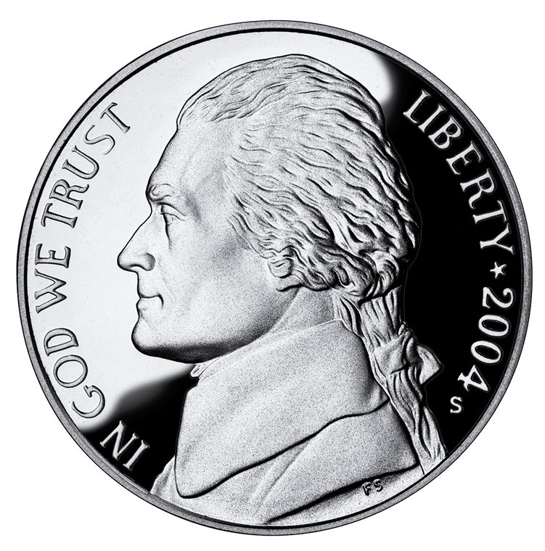
1
³ Trust in the LORD
Commit
it to
God!

Slide 8
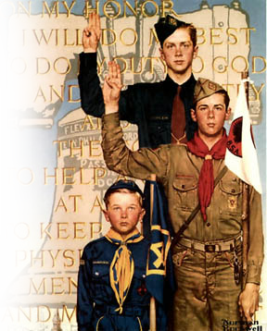
1
³ Trust in the LORD and
do good;
2
Do the Right Thing

Slide 9
1
³ Trust in the LORD and
do good;
2
Do the Right Thing
Like Jesus Who…
Acts 10:38

Slide 10
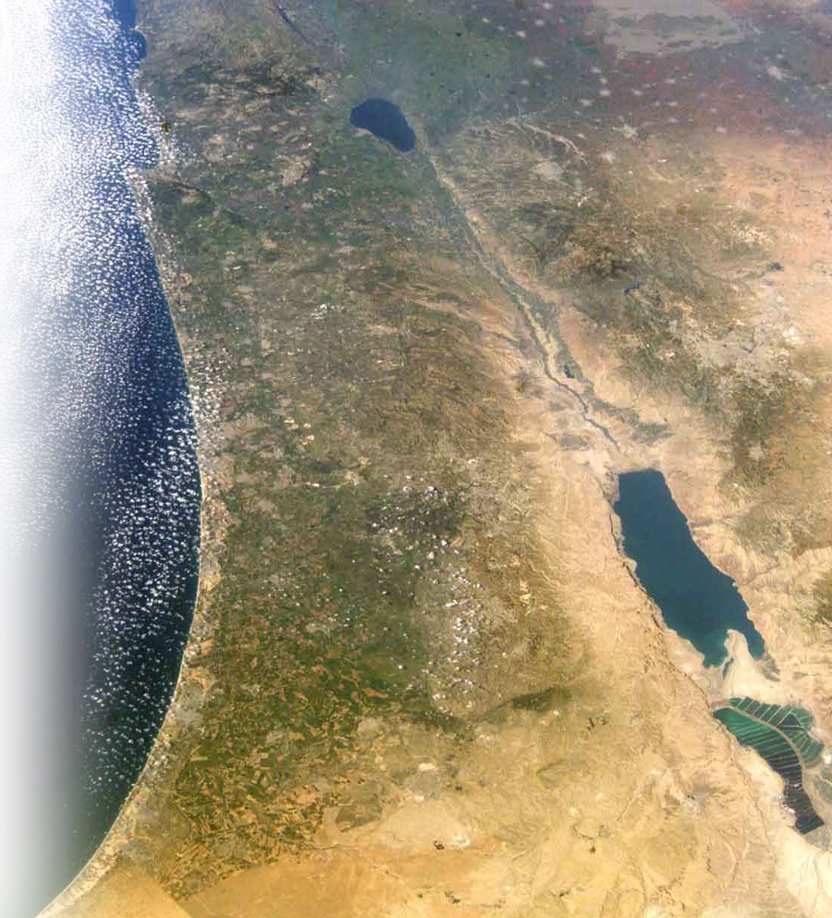
1
³ Trust in the LORD and
do good;
dwell in the land
2
3
Live in
God’s
Revealed
Will!

Slide 11
1
³ Trust in the LORD and
do good;
dwell in the land
2
3
Live in
God’s
Revealed
Will!
CANAAN

Slide 12
1
³ Trust in the LORD and
do good;
dwell in the land
2
3
Live in
God’s
Revealed
Will!
CANAAN

Slide 13
1
³ Trust in the LORD and
do good;
dwell in the land
2
3
Live in
God’s
Revealed
Will!
CANAAN

Slide 14
1
³ Trust in the LORD and
do good;
dwell in the land
2
3
Live in
God’s
Revealed
Will!
CANAAN

Slide 15
1
³ Trust in the LORD and
do good;
dwell in the land
2
3
Live in
God’s
Revealed
Will!
CANAAN

Slide 16

1
³ Trust in the LORD and
do good;
dwell in the land and
enjoy safe pasture.
2
3
4
Find a
Safe
Place!

Slide 17

1
³ Trust in the LORD and
do good;
dwell in the land and
enjoy safe pasture.
⁴ Delight yourself in the
LORD and he will give you the desires of your heart.
2
3
4
5
Make Yourself
Happy!
Notes:
Most people do not consider the following a hymn or a praise song...but it is theologically accurate:
Don't Worry Be Happy
Bobby McFerrin
Here's a little song I wrote
You might want to sing it note for note
Don't worry, be happy
In every life we have some trouble
But when you worry you make it double
Don't worry, be happy
Don't worry, be happy now
don't worry
(Ooh, ooh ooh ooh oo-ooh ooh oo-ooh) be happy
(Ooh, ooh ooh ooh oo-ooh ooh oo-ooh) don't worry, be happy
(Ooh, ooh ooh ooh oo-ooh ooh oo-ooh) don't worry
(Ooh, ooh ooh ooh oo-ooh ooh oo-ooh) be happy
(Ooh, ooh ooh ooh oo-ooh ooh oo-ooh) don't worry, be happy
Ain't got no place to lay your head
Somebody came and took your bed
Don't worry, be happy
The landlord say your rent is late
He may have to litigate
Don't worry, be happy
Oh, ooh ooh ooh oo-ooh ooh oo-ooh don't worry, be happy

Slide 18
1
³ Trust in the LORD and
do good;
dwell in the land and
enjoy safe pasture.
⁴ Delight yourself in the
LORD and he will give you the desires of your heart.
2
3
4
5
Don’t Worry ... Be Happy!
Make Yourself
Happy!
Notes:
Most people do not consider the following a hymn or a praise song...but it is theologically accurate:
Don't Worry Be Happy
Bobby McFerrin
Here's a little song I wrote
You might want to sing it note for note
Don't worry, be happy
In every life we have some trouble
But when you worry you make it double
Don't worry, be happy
Don't worry, be happy now
don't worry
(Ooh, ooh ooh ooh oo-ooh ooh oo-ooh) be happy
(Ooh, ooh ooh ooh oo-ooh ooh oo-ooh) don't worry, be happy
(Ooh, ooh ooh ooh oo-ooh ooh oo-ooh) don't worry
(Ooh, ooh ooh ooh oo-ooh ooh oo-ooh) be happy
(Ooh, ooh ooh ooh oo-ooh ooh oo-ooh) don't worry, be happy
Ain't got no place to lay your head
Somebody came and took your bed
Don't worry, be happy
The landlord say your rent is late
He may have to litigate
Don't worry, be happy
Oh, ooh ooh ooh oo-ooh ooh oo-ooh don't worry, be happy

Slide 19
Here's a little song I wrote
You might want to sing it note for note ... Don't worry, be happy
In every life we have some trouble
But when you worry you make it double ... Don't worry, be happy
Don't worry, be happy now
don't worry
Notes:
Most people do not consider the following a hymn or a praise song...but it is theologically accurate:
Don't Worry Be Happy
Bobby McFerrin
Here's a little song I wrote
You might want to sing it note for note
Don't worry, be happy
In every life we have some trouble
But when you worry you make it double
Don't worry, be happy
Don't worry, be happy now
don't worry
(Ooh, ooh ooh ooh oo-ooh ooh oo-ooh) be happy
(Ooh, ooh ooh ooh oo-ooh ooh oo-ooh) don't worry, be happy
(Ooh, ooh ooh ooh oo-ooh ooh oo-ooh) don't worry
(Ooh, ooh ooh ooh oo-ooh ooh oo-ooh) be happy
(Ooh, ooh ooh ooh oo-ooh ooh oo-ooh) don't worry, be happy
Ain't got no place to lay your head
Somebody came and took your bed
Don't worry, be happy
The landlord say your rent is late
He may have to litigate
Don't worry, be happy
Oh, ooh ooh ooh oo-ooh ooh oo-ooh don't worry, be happy

Slide 20
(Ooh, ooh ooh ooh oo-ooh ooh oo-ooh) be happy
(Ooh, ooh ooh ooh oo-ooh ooh oo-ooh) don't worry, be happy
(Ooh, ooh ooh ooh oo-ooh ooh oo-ooh) don't worry
(Ooh, ooh ooh ooh oo-ooh ooh oo-ooh) be happy
(Ooh, ooh ooh ooh oo-ooh ooh oo-ooh) don't worry, be happy
Notes:
Most people do not consider the following a hymn or a praise song...but it is theologically accurate:
Don't Worry Be Happy
Bobby McFerrin
Here's a little song I wrote
You might want to sing it note for note
Don't worry, be happy
In every life we have some trouble
But when you worry you make it double
Don't worry, be happy
Don't worry, be happy now
don't worry
(Ooh, ooh ooh ooh oo-ooh ooh oo-ooh) be happy
(Ooh, ooh ooh ooh oo-ooh ooh oo-ooh) don't worry, be happy
(Ooh, ooh ooh ooh oo-ooh ooh oo-ooh) don't worry
(Ooh, ooh ooh ooh oo-ooh ooh oo-ooh) be happy
(Ooh, ooh ooh ooh oo-ooh ooh oo-ooh) don't worry, be happy
Ain't got no place to lay your head
Somebody came and took your bed
Don't worry, be happy
The landlord say your rent is late
He may have to litigate
Don't worry, be happy
Oh, ooh ooh ooh oo-ooh ooh oo-ooh don't worry, be happy

Slide 21
Ain't got no place to lay your head
Somebody came and took your bed
Don't worry, be happy
The landlord say your rent is late
He may have to litigate
Don't worry, be happy
Oh, ooh ooh ooh oo-ooh ooh oo-ooh don't worry, be happy
Notes:
Most people do not consider the following a hymn or a praise song...but it is theologically accurate:
Don't Worry Be Happy
Bobby McFerrin
Here's a little song I wrote
You might want to sing it note for note
Don't worry, be happy
In every life we have some trouble
But when you worry you make it double
Don't worry, be happy
Don't worry, be happy now
don't worry
(Ooh, ooh ooh ooh oo-ooh ooh oo-ooh) be happy
(Ooh, ooh ooh ooh oo-ooh ooh oo-ooh) don't worry, be happy
(Ooh, ooh ooh ooh oo-ooh ooh oo-ooh) don't worry
(Ooh, ooh ooh ooh oo-ooh ooh oo-ooh) be happy
(Ooh, ooh ooh ooh oo-ooh ooh oo-ooh) don't worry, be happy
Ain't got no place to lay your head
Somebody came and took your bed
Don't worry, be happy
The landlord say your rent is late
He may have to litigate
Don't worry, be happy
Oh, ooh ooh ooh oo-ooh ooh oo-ooh don't worry, be happy

Slide 22
1
³ Trust in the LORD and
do good;
dwell in the land and
enjoy safe pasture.
⁴ Delight yourself in the
LORD and he will give you the desires of your heart.
2
3
4
5
1
Make Yourself
Happy!
Notes:
Most people do not consider the following a hymn or a praise song...but it is theologically accurate:
Don't Worry Be Happy
Bobby McFerrin
Here's a little song I wrote
You might want to sing it note for note
Don't worry, be happy
In every life we have some trouble
But when you worry you make it double
Don't worry, be happy
Don't worry, be happy now
don't worry
(Ooh, ooh ooh ooh oo-ooh ooh oo-ooh) be happy
(Ooh, ooh ooh ooh oo-ooh ooh oo-ooh) don't worry, be happy
(Ooh, ooh ooh ooh oo-ooh ooh oo-ooh) don't worry
(Ooh, ooh ooh ooh oo-ooh ooh oo-ooh) be happy
(Ooh, ooh ooh ooh oo-ooh ooh oo-ooh) don't worry, be happy
Ain't got no place to lay your head
Somebody came and took your bed
Don't worry, be happy
The landlord say your rent is late
He may have to litigate
Don't worry, be happy
Oh, ooh ooh ooh oo-ooh ooh oo-ooh don't worry, be happy

Slide 23

1
³ Trust in the LORD and
do good;
dwell in the land and
enjoy safe pasture.
⁴ Delight yourself in the LORD and he will give you the desires of your heart.
⁵ Commit your way to the LORD;
2
3
4
5
6
Roll your burden
on Him

Slide 24
1
³ Trust in the LORD and
do good;
dwell in the land and
enjoy safe pasture.
⁴ Delight yourself in the
LORD and he will give you
the desires of your heart.
⁵ Commit your way to the LORD;
trust in him and he will do this: ⁶ He will make your righteousness shine like the dawn, the justice of your cause like the noonday sun.
2
3
4
5
1
6
1

Slide 25
1
³ Trust in the LORD and
do good;
dwell in the land and
enjoy safe pasture.
⁴ Delight yourself in the
LORD and he will give you
the desires of your heart.
⁵ Commit your way to the LORD;
trust in him and he will do this: ⁶ He will make your righteousness shine like the dawn, the justice of your cause like the noonday sun.
2
3
4
5
1
6
2
1

Slide 26
1
³ Trust in the LORD and
do good;
dwell in the land and
enjoy safe pasture.
⁴ Delight yourself in the
LORD and he will give you
the desires of your heart.
⁵ Commit your way to the LORD;
trust in him and he will do this: ⁶ He will make your righteousness shine like the dawn, the justice of your cause like the noonday sun.
2
3
4
5
1
6
2
1

Slide 27

7
⁷ Be still before the LORD
Take a
“time-out”
for God!

Slide 28
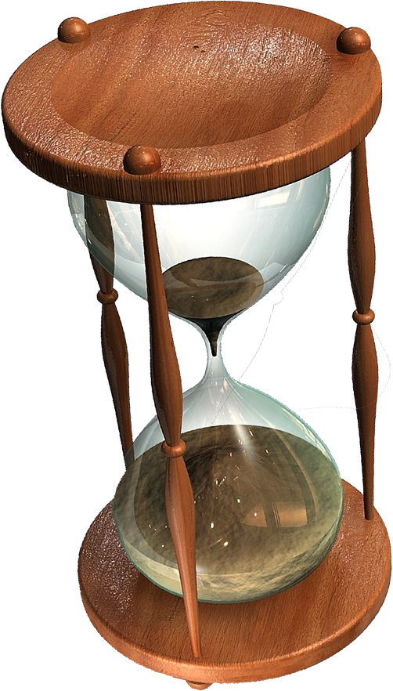
7
⁷ Be still before the LORD and
wait patiently for him;
8
Endure under
extended
pressure!
Wait longingly!

Slide 29
7
⁷ Be still before the LORD and
wait patiently for him;
do not fret when men succeed in their ways,
when they carry out
their wicked schemes.
8

Slide 30

7
⁷ Be still before the LORD and
wait patiently for him;
do not fret when men succeed in their ways,
when they carry out
their wicked schemes.
⁸ Refrain from anger
8
9
Let go of
anger

Slide 31
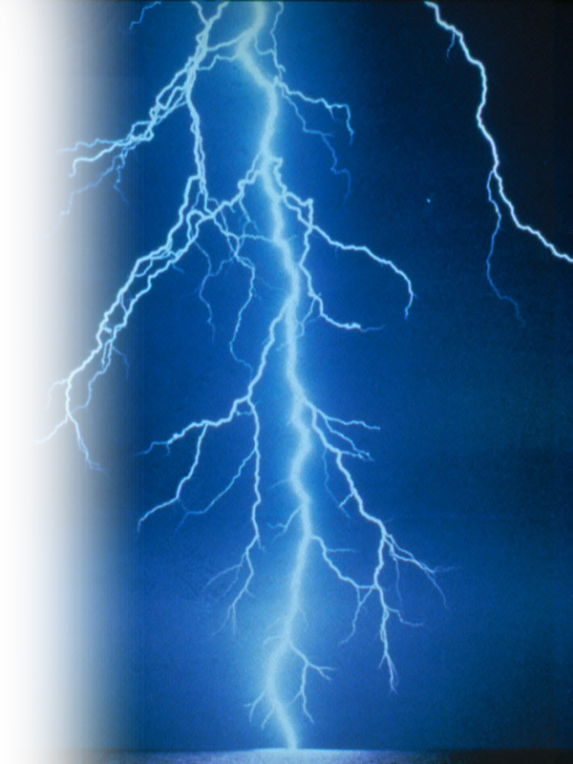
7
⁷ Be still before the LORD and
wait patiently for him;
do not fret when men succeed in their ways,
when they carry out
their wicked schemes.
⁸ Refrain from anger and
turn from wrath;
8
9
10
Let go of
“getting even”

Slide 32
7
⁷ Be still before the LORD and
wait patiently for him;
do not fret when men succeed in their ways,
when they carry out
their wicked schemes.
⁸ Refrain from anger and
turn from wrath;
do not fret-- it leads only
to evil
8
9
10

Slide 33
⁹ For evil men
will be cut off, but those who hope in the LORD
will inherit the land.
3

Slide 34
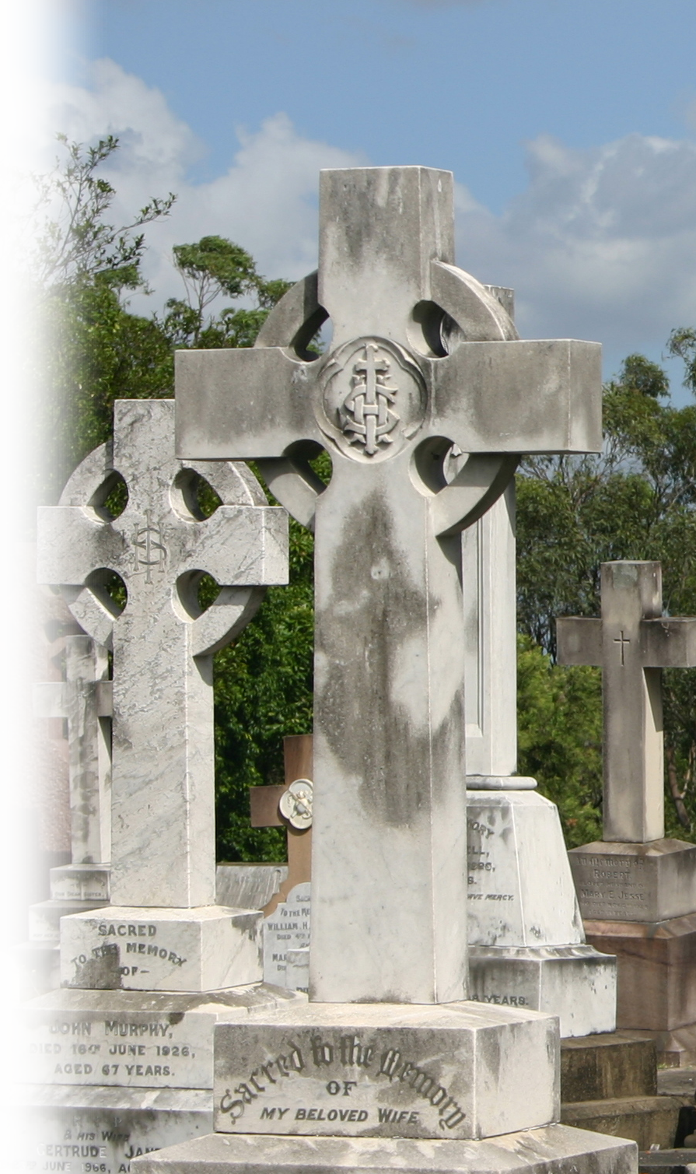
¹⁰ A little while, and the wicked will be no more; though you look for
them, they will not be
found.

Slide 35
¹⁰ A little while, and the wicked will be no more; though you look for
them, they will not be
found.
¹¹ But the meek will
inherit the land and
enjoy great peace.
4

Slide 36
Three times the following is mentioned:

Slide 37
Three times the following is mentioned:
Don’t Fret (Worry)
  Verse 1
  Verse 7
  Verse 8

Slide 38
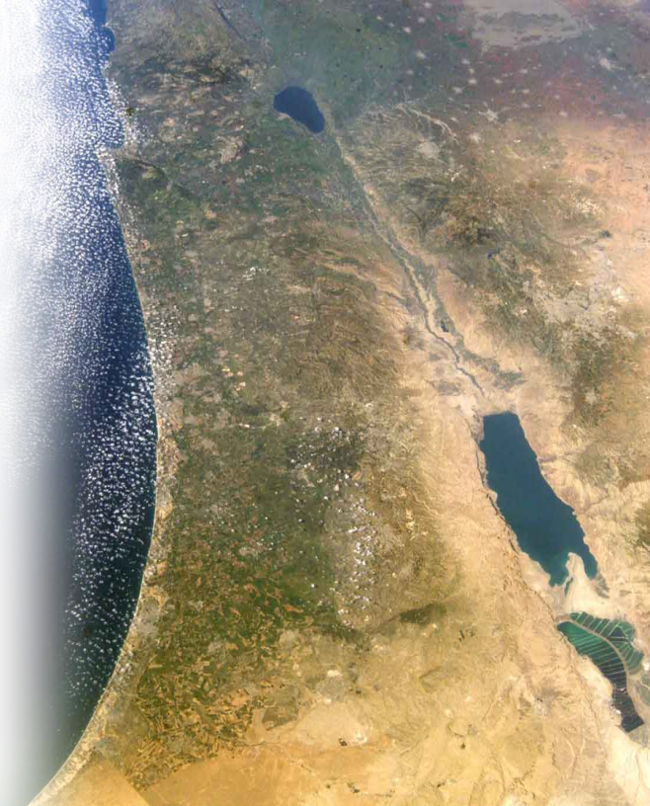
Three times the following is mentioned:
Don’t Fret (Worry)
  Verse 1
  Verse 7
  Verse 8
The land (will of God)
  Verse 5
  Verse 9
  Verse 11

Slide 39
When we do, God will:

Slide 40
When we do, God will:
Move into action,

Slide 41
When we do, God will:
Move into action,
give us the desire of our hearts,

Slide 42
When we do, God will:
Move into action,
give us the desire of our hearts,
and give us peace.

Slide 43
Let’s Pray

