Slide 1



Watch at: https://youtu.be/3wBDgOlXGVA
Notes:
Super MOM = FREE = from BiblePoint art.
Copyright © 2006−2021. All rights reserved. Bible Point is a registered trademark of Dennis Henderson. All other trademarks acknowledged.
Bible Point contains graphics from Bible Point artists. These illustrations belong to Bible Point and the respective artists. You may use the designs and illustrations for graphical illustration of lessons free and without special permission, provided they are not used in any way that maligns the Christian faith. Furthermore, republication or production of any illustration by any other graphic service whether it be in book, in a machine-readable form, or in any other design resource is strictly prohibited. Furthermore, they cannot be duplicated or resold as any other form of publishing, clip art, or graphic resource.
So What does it mean? (A simple translations of the legal jargon)
So, if you don’t own the presentation(s), graphic(s), and text(s) how can you legally use them? The purchase of the license allows you to use all the images in the product. However, the actual ownership and copyright of the presentation(s), graphic(s), and text(s) remain the property of Bible Point and its licensors. If you had plans on using this product in your “for sale” work—think again!
License Agreement
Article 1: License Grant
All the graphics and text in Bible Point presentations (excluding quotes from the Bible and stated sources) are the intellectual and real property of Bible Point and its licensors, and is protected by law, including United States copyright laws and international treaties. Bible Point grants to you a license:
1. To use the presentation in a single church, single school, or single office of a Christian organization.
2. To make a single archival back-up copy of the program.
3. To modify the presentation(s) and merge with other presentations in a single church, school, or Christian organization.
4. To transfer to another party if that party agrees to accept the terms and conditions of this agreement, and you do not retain any copies of the presentation, whether printed, machine readable, modified, or merged form.
Article 2: Terms
This license is effective until terminated. You may terminate the license at any time by destroying the presentation(s), graphic(s), or text(s) together with all copies, modifications and merged portions in any form. Bible Point may terminate your license if you fail to comply with this Agreement. You agree, upon such termination, for any reason, to destroy the presentation(s), graphics, and text(s) with all copies, modifications, and merged portions in any form.
Article 3: Disclaimers
1. Bible Point presentations, graphics, and texts are licensed to you As Is. You, the consumer, bear the entire risk relating to the quality and performance of the presentation(s), graphic(s), or text(s). In no event will Bible Point be liable for damages resulting from any defect.
2. Thirty-day limited warrantee on disks. Bible Point warrants the disks to be free of defects in material and workmanship under normal use for 30 days after purchase. During the 30-day period you may return a defective presentation, graphic, or text with proof of purchase and it will be replaced without charge, unless the presentation is damaged by misuse.
Article 4: General
1. You may not sub-license, assign, or transfer the license of the presentation(s), graphic(s), or text(s) except as provided by this Agreement.
2. This Agreement will be governed by the laws of the State of Michigan.
So What does it mean? (A simple translations of the legal jargon)
May I let someone borrow or copy my licensed Bible Point presentation (even after I modified it)? As long as it is within your local church, or single school, or the immediate office of a Christian organization you may. Otherwise, please refer the person interested in borrowing to: http://www.biblepoint.com or E-mail: dennis@DrDH.net with any related questions.

Slide 2
Notes:
Super MOM = FREE = from BiblePoint art.
Copyright © 2006−2021. All rights reserved. Bible Point is a registered trademark of Dennis Henderson. All other trademarks acknowledged.
Bible Point contains graphics from Bible Point artists. These illustrations belong to Bible Point and the respective artists. You may use the designs and illustrations for graphical illustration of lessons free and without special permission, provided they are not used in any way that maligns the Christian faith. Furthermore, republication or production of any illustration by any other graphic service whether it be in book, in a machine-readable form, or in any other design resource is strictly prohibited. Furthermore, they cannot be duplicated or resold as any other form of publishing, clip art, or graphic resource.
So What does it mean? (A simple translations of the legal jargon)
So, if you don’t own the presentation(s), graphic(s), and text(s) how can you legally use them? The purchase of the license allows you to use all the images in the product. However, the actual ownership and copyright of the presentation(s), graphic(s), and text(s) remain the property of Bible Point and its licensors. If you had plans on using this product in your “for sale” work—think again!
License Agreement
Article 1: License Grant
All the graphics and text in Bible Point presentations (excluding quotes from the Bible and stated sources) are the intellectual and real property of Bible Point and its licensors, and is protected by law, including United States copyright laws and international treaties. Bible Point grants to you a license:
1. To use the presentation in a single church, single school, or single office of a Christian organization.
2. To make a single archival back-up copy of the program.
3. To modify the presentation(s) and merge with other presentations in a single church, school, or Christian organization.
4. To transfer to another party if that party agrees to accept the terms and conditions of this agreement, and you do not retain any copies of the presentation, whether printed, machine readable, modified, or merged form.
Article 2: Terms
This license is effective until terminated. You may terminate the license at any time by destroying the presentation(s), graphic(s), or text(s) together with all copies, modifications and merged portions in any form. Bible Point may terminate your license if you fail to comply with this Agreement. You agree, upon such termination, for any reason, to destroy the presentation(s), graphics, and text(s) with all copies, modifications, and merged portions in any form.
Article 3: Disclaimers
1. Bible Point presentations, graphics, and texts are licensed to you As Is. You, the consumer, bear the entire risk relating to the quality and performance of the presentation(s), graphic(s), or text(s). In no event will Bible Point be liable for damages resulting from any defect.
2. Thirty-day limited warrantee on disks. Bible Point warrants the disks to be free of defects in material and workmanship under normal use for 30 days after purchase. During the 30-day period you may return a defective presentation, graphic, or text with proof of purchase and it will be replaced without charge, unless the presentation is damaged by misuse.
Article 4: General
1. You may not sub-license, assign, or transfer the license of the presentation(s), graphic(s), or text(s) except as provided by this Agreement.
2. This Agreement will be governed by the laws of the State of Michigan.
So What does it mean? (A simple translations of the legal jargon)
May I let someone borrow or copy my licensed Bible Point presentation (even after I modified it)? As long as it is within your local church, or single school, or the immediate office of a Christian organization you may. Otherwise, please refer the person interested in borrowing to: http://www.biblepoint.com or E-mail: dennis@DrDH.net with any related questions.

Slide 3
Proverbs 31: 10, 28-31
¹⁰ A wife of noble character who can find? She is worth far more than rubies....
²⁸ Her children arise and call her blessed; her husband also, and he praises her: ²⁹ "Many women do noble things, but you surpass them all." ³⁰ Charm is deceptive, and beauty is fleeting; but a woman who fears the LORD is to be praised. ³¹ Give her the reward she has earned, and let her works bring her praise at the city gate.

Slide 4
Proverbs 31: 10, 28-31
¹⁰ A wife of noble character who can find? She is worth far more than rubies....
²⁸ Her children arise and call her blessed; her husband also, and he praises her: ²⁹ "Many women do noble things, but you surpass them all." ³⁰ Charm is deceptive, and beauty is fleeting; but a woman who fears the LORD is to be praised. ³¹ Give her the reward she has earned, and let her works bring her praise at the city gate.

Slide 5
Proverbs 31: 10, 28-31
¹⁰ A wife of noble character who can find? She is worth far more than rubies....
²⁸ Her children arise and call her blessed; her husband also, and he praises her: ²⁹ "Many women do noble things, but you surpass them all." ³⁰ Charm is deceptive, and beauty is fleeting; but a woman who fears the LORD is to be praised. ³¹ Give her the reward she has earned, and let her works bring her praise at the city gate.

Slide 6
Proverbs 31: 10, 28-31
¹⁰ A wife of noble character who can find? She is worth far more than rubies....
²⁸ Her children arise and call her blessed; her husband also, and he praises her: ²⁹ "Many women do noble things, but you surpass them all." ³⁰ Charm is deceptive, and beauty is fleeting; but a woman who fears the LORD is to be praised. ³¹ Give her the reward she has earned, and let her works bring her praise at the city gate.

Slide 7
Proverbs 31: 10, 28-31
¹⁰ A wife of noble character who can find? She is worth far more than rubies....
²⁸ Her children arise and call her blessed; her husband also, and he praises her: ²⁹ "Many women do noble things, but you surpass them all." ³⁰ Charm is deceptive, and beauty is fleeting; but a woman who fears the LORD is to be praised. ³¹ Give her the reward she has earned, and let her works bring her praise at the city gate.

Slide 8

Hallelu-jah
Praise – Jah (Jehovah)
Notes:
The term “Praise” occurs three times. The third term is “praise her” is halleluha. (Prov 31:31)
Hallel = to shine, to boast (brag), to glory, to praise
When we brag about God it is PRAISE.
When we brag about ourselves it is BOASTING.
But when we brag about others/Mom she “shines!”

Slide 9

Hallelu-jah
Praise – Jah (Jehovah)
Hallelu-ha
Praise her
Notes:
The term “Praise” occurs three times. The third term is “praise her” is halleluha. (Prov 31:31)
Hallel = to shine, to boast (brag), to glory, to praise
When we brag about God it is PRAISE.
When we brag about ourselves it is BOASTING.
But when we brag about others/Mom she “shines!”

Slide 10
That’s My First Point:
1. Praise Her!

Slide 11
My second point:
2. Praise Her FOR ...

Slide 12
My second point:
2. Praise Her FOR ...
BEING and DOING GOOD

Slide 13
My second point:
2. Praise Her FOR ...
BEING and DOING GOOD
¹⁰ A wife of noble character (NIV)
²⁹ "Many women do noble things, but you surpass them all.“ (NIV)

Slide 14

My second point:
strong
2. Praise Her FOR ...
BEING and DOING GOOD
¹⁰ A wife of noble character (NIV)
²⁹ "Many women do noble things, but you surpass them all.“ (NIV)

Slide 15
My second point:
strong
2. Praise Her FOR ...
BEING and DOING GOOD
strong
¹⁰ A wife of noble character (NIV)
²⁹ "Many women do noble things, but you surpass them all.“ (NIV)
Notes:
Hebrew “hil” = strength, strong, power, virtue --

Slide 16
Praise Her for What?

Slide 17
Praise Her for What?
I’m glad you asked ...

Slide 18

Praise her for being a good:
1. Wife 10-12
¹⁰ A capable wife who can find? She is far more precious than jewels. ¹¹ The heart of her husband trusts in her, and he will have no lack of gain. ¹² She does him good, and not harm, all the days of her life.
Notes:
Hand with wedding ring = FREE =from https://pixabay.com/en/hands-ring-promise-engagement-love-587779/

Slide 19

Praise her for being a good:
Wife 10-12
Shopper 13-14
¹³ She seeks wool and flax, and works with willing hands. ¹⁴ She is like the ships of the merchant, she brings her food from far away.
Notes:
Sale Bag = FREE = BiblePoint

Slide 20

Praise her for being a good:
Wife 10-12
Shopper 13-14
Self-Starter 15
¹⁵ She rises while it is still night and provides food for her household and tasks for her servant-girls.
Notes:
Clock = FREE = from http://www.sxc.hu/photo/72453

Slide 21
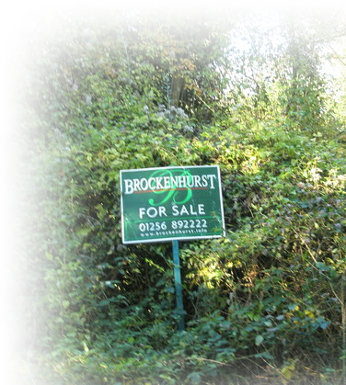
Praise her for being a good:
Wife 10-12
Shopper 13-14
Self-Starter 15
Buyer 16
¹⁶ She considers a field and buys it; with the fruit of her hands she plants a vineyard.
Notes:
For Sale Sign = FREE = from http://commons.wikimedia.org/wiki/File:Displaced_sign_-_geograph.org.uk_-_604210.jpg

Slide 22

Praise her for being a good:
Wife 10-12
Shopper 13-14
Self-Starter 15
Buyer 16
Worker 17
¹⁷ She girds herself with strength, and makes her arms strong.
Notes:
We Can Do It – FREE –from http://commons.wikimedia.org/wiki/File:We_Can_Do_It!.jpg

Slide 23

Praise her for being a good:
6. Merchant 18
¹⁸ She perceives that her merchandise is profitable. Her lamp does not go out at night.
Notes:
Sold = FREE = https://www.flickr.com/photos/106574022@N04/10797449516

Slide 24
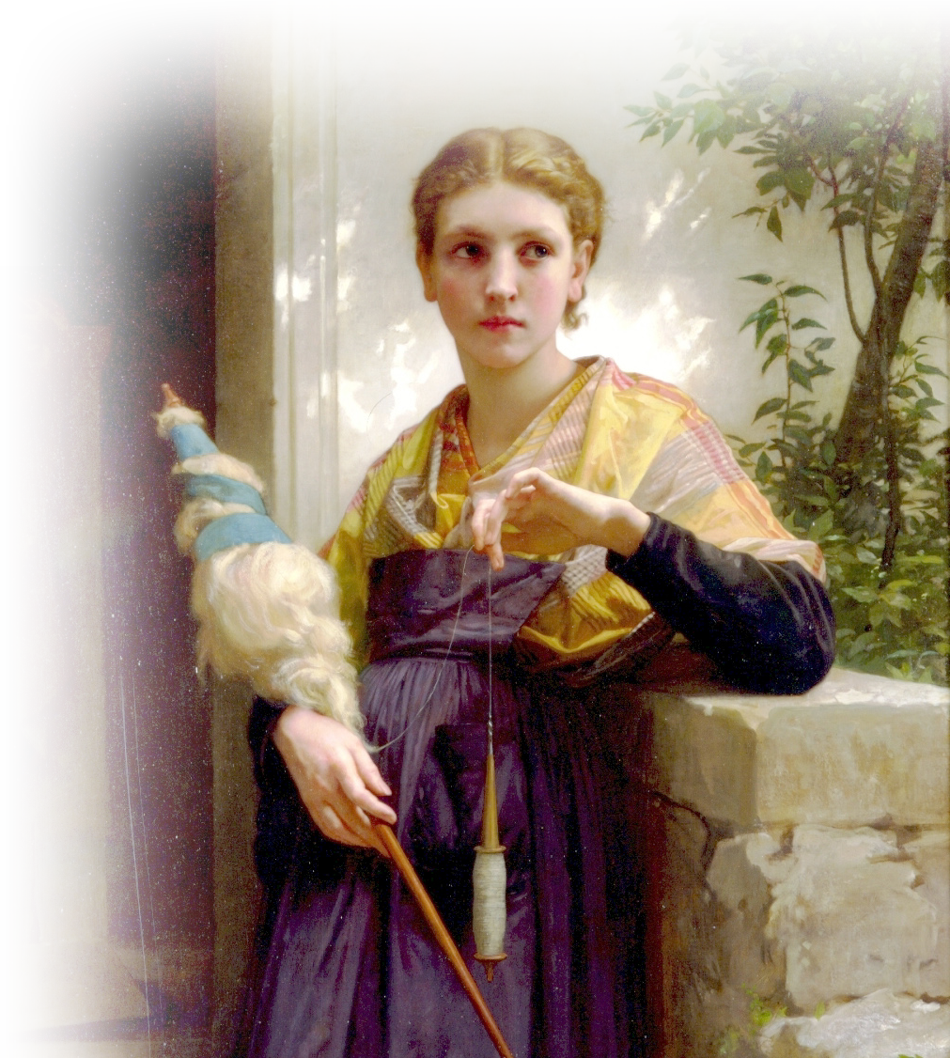
Praise her for being a good:
6. Merchant 18
Manufacturer 19
¹⁹ She puts her hands to the distaff, and her hands hold the spindle.
Notes:
Woman with distaff – FREE --By William-Adolphe Bouguereau - Art Renewal Center Museum, image 68., Public Domain, https://commons.wikimedia.org/w/index.php?curid=3731488

Slide 25

Praise her for being a good:
6. Merchant 18
Manufacturer 19
Neighbor 20
²⁰ She opens her hand to the poor, and reaches out her hands to the needy.
Notes:
Open arms = FREE = from http://www.sxc.hu/photo/1161027

Slide 26

Praise her for being a good:
6. Merchant 18
Manufacturer 19
Neighbor 20
Planner 21
²¹ She is not afraid for her household when it snows, for all her household are clothed in crimson.
Notes:
Open arms = FREE = from http://www.sxc.hu/photo/1161027

Slide 27

Praise her for being a good:
6. Merchant 18
Manufacturer 19
Neighbor 20
Planner 21
Homemaker 22
²² She makes coverings for her bed; she is clothed in fine linen
and purple. (NIV)
Notes:
Bedroom setting = LICENSED and NOT FOR REUSE. To reuse elsewhere, get a license from http://www.dreamstime.com/luxury-bedroom-stock-photo-imagefree3571510

Slide 28

Praise her for being a good:
11. Judge of Character 23
²³ Her husband is respected at the city gate, where he takes his seat among the elders of the land. (NIV)
Notes:
Wedding kiss = FREE = from http://www.sxc.hu/photo/1038218

Slide 29

Praise her for being a good:
11. Judge of Character 23
12. Entrepreneur 24
²⁴ She makes linen garments and sells them; she supplies the merchant with sashes.
Notes:
Ebay logo Owned by Ebay = FREE = from http://upload.wikimedia.org/wikipedia/commons/5/5a/EBay_Logo.svg

Slide 30
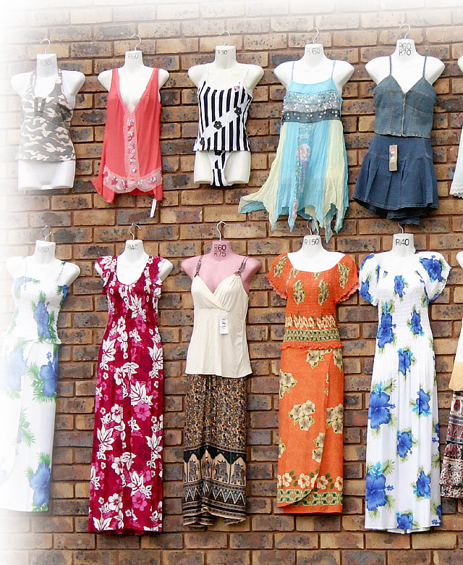
Praise her for being a good:
11. Judge of Character 23
12. Entrepreneur 24
13. Dresser 25
²⁵ Strength and dignity are her clothing, and she laughs at the time to come.
Notes:
Clothing = FREE = from http://www.sxc.hu/browse.phtml?f=download&id=707504

Slide 31

Praise her for being a good:
11. Judge of Character 23
12. Entrepreneur 24
13. Dresser 25
14. Talker 26
²⁶ She opens her mouth with wisdom, and the teaching of kindness is on her tongue.
Notes:
Woman on phone = FREE = from https://pixabay.com/en/woman-girl-lady-young-talk-talkig-791874/

Slide 32

Praise her for being a good:
²⁷ She looks well to the ways of her household, and does not eat the bread of idleness.
11. Judge of Character
12. Entrepreneur 24
13. Dresser 25
14. Talker 26
15. Gate Keeper 27
Notes:
Eyes = FREE = from http://www.sxc.hu/photo/1373700

Slide 33
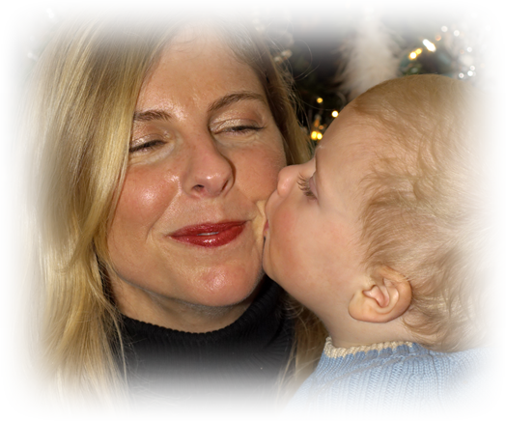
Praise her for being a good:
16. Mother 28
²⁸ Her children arise and call her blessed; (NIV)
Notes:
Mother and child = FREE = from http://www.dreamstime.com/mother-and-child-free-stock-photos-imagefree2671098

Slide 34
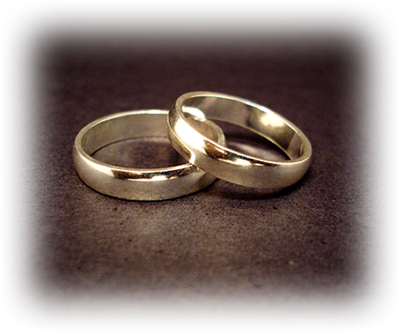
Praise her for being a good:
16. Mother 28
17. Spouse 28
²⁸ her husband too, and he praises her:
Notes:
Wedding rings = FREE = from http://upload.wikimedia.org/wikipedia/commons/3/3d/Wedding_rings.jpg

Slide 35

Praise her for being a good:
16. Mother 28
17. Spouse 28
18. Model 29
²⁹ "Many women have done excellently, but you surpass them all."
Notes:
Model on runway = FREE = from http://upload.wikimedia.org/wikipedia/commons/5/57/Abigail_Keats_Autumn_winter_2010_2.JPG

Slide 36
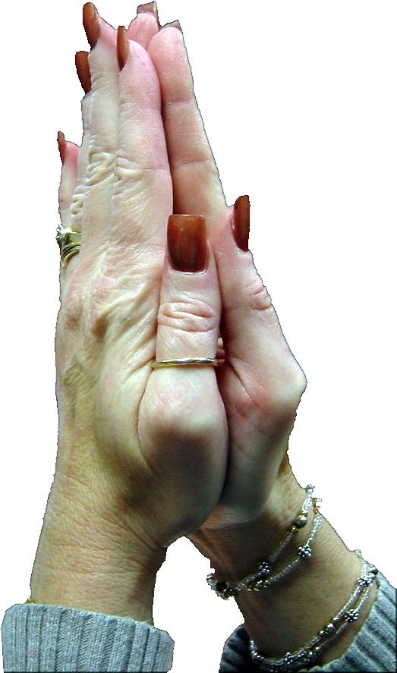
Praise her for being a good:
16. Mother 28
17. Spouse 28
18. Model 29
19. Christian 30
³⁰ Charm is deceitful, and beauty is vain, but a woman who fears the LORD is to be praised.
Notes:
Praying hands = FREE = from BiblePoint photo.

Slide 37

Praise her for being a good:
16. Mother 28
17. Spouse 28
18. Model 29
19. Christian 30
20. Witness 31
³¹ Give her a share in the fruit of her hands, and let her works praise her in the city gates.
Notes:
Modified Trophy = LICENSED and NOT FOR REUSE. To reuse elsewhere, get a license from http://www.istockphoto.com/stock-photo-1406600-trophy.php

Slide 38
Praise Her!
Hallelu-ha
Praise her

Slide 39
Let me sum up:

Slide 40
My First Point was:
Praise Her!

Slide 41
My First Point was:
Praise Her!
Praise Her because...
My Second Point was:

Slide 42
My First Point was:
Praise Her!
Praise Her because...
Praise Her NOW!
My Second Point was:
My Last Point is:

Slide 43
Let’s Pray!

