Slide 1



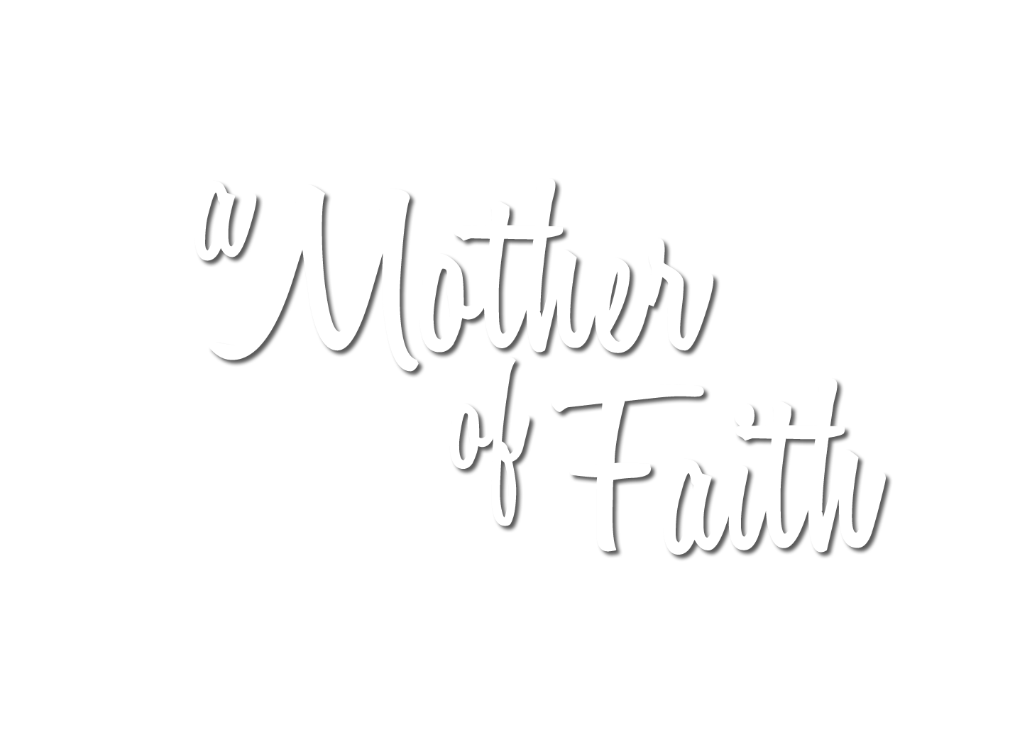
Watch video at
https://youtu.be/DFje8o8gM1s
Notes:
Rose background = FREE = https://images.pexels.com/photos/65619/roses-pink-family-rose-family-65619.jpeg?auto=compress&cs=tinysrgb&dpr=3&h=750&w=1260
Clipart rose = FREE = https://pixabay.com/vectors/rose-graphic-flower-deco-398576/
Copyright © 2006−2021. All rights reserved. Bible Point is a registered trademark of Dennis Henderson. All other trademarks acknowledged.
Bible Point contains graphics from Bible Point artists. These illustrations belong to Bible Point and the respective artists. You may use the designs and illustrations for graphical illustration of lessons free and without special permission, provided they are not used in any way that maligns the Christian faith. Furthermore, republication or production of any illustration by any other graphic service whether it be in book, in a machine-readable form, or in any other design resource is strictly prohibited. Furthermore, they cannot be duplicated or resold as any other form of publishing, clip art, or graphic resource.
So What does it mean? (A simple translations of the legal jargon)
So, if you don’t own the presentation(s), graphic(s), and text(s) how can you legally use them? The purchase of the license allows you to use all the images in the product. However, the actual ownership and copyright of the presentation(s), graphic(s), and text(s) remain the property of Bible Point and its licensors. If you had plans on using this product in your “for sale” work—think again!
License Agreement
Article 1: License Grant
All the graphics and text in Bible Point presentations (excluding quotes from the Bible and stated sources) are the intellectual and real property of Bible Point and its licensors, and is protected by law, including United States copyright laws and international treaties. Bible Point grants to you a license:
1. To use the presentation in a single church, single school, or single office of a Christian organization.
2. To make a single archival back-up copy of the program.
3. To modify the presentation(s) and merge with other presentations in a single church, school, or Christian organization.
4. To transfer to another party if that party agrees to accept the terms and conditions of this agreement, and you do not retain any copies of the presentation, whether printed, machine readable, modified, or merged form.
Article 2: Terms
This license is effective until terminated. You may terminate the license at any time by destroying the presentation(s), graphic(s), or text(s) together with all copies, modifications and merged portions in any form. Bible Point may terminate your license if you fail to comply with this Agreement. You agree, upon such termination, for any reason, to destroy the presentation(s), graphics, and text(s) with all copies, modifications, and merged portions in any form.
Article 3: Disclaimers
1. Bible Point presentations, graphics, and texts are licensed to you As Is. You, the consumer, bear the entire risk relating to the quality and performance of the presentation(s), graphic(s), or text(s). In no event will Bible Point be liable for damages resulting from any defect.
2. Thirty-day limited warrantee on disks. Bible Point warrants the disks to be free of defects in material and workmanship under normal use for 30 days after purchase. During the 30-day period you may return a defective presentation, graphic, or text with proof of purchase and it will be replaced without charge, unless the presentation is damaged by misuse.
Article 4: General
1. You may not sub-license, assign, or transfer the license of the presentation(s), graphic(s), or text(s) except as provided by this Agreement.
2. This Agreement will be governed by the laws of the State of Michigan.
So What does it mean? (A simple translations of the legal jargon)
May I let someone borrow or copy my licensed Bible Point presentation (even after I modified it)? As long as it is within your local church, or single school, or the immediate office of a Christian organization you may. Otherwise, please refer the person interested in borrowing to: http://www.biblepoint.com or E-mail: dennis@DrDH.net with any related questions.

Slide 2
Notes:
Rose background = FREE = https://images.pexels.com/photos/65619/roses-pink-family-rose-family-65619.jpeg?auto=compress&cs=tinysrgb&dpr=3&h=750&w=1260
Clipart rose = FREE = https://pixabay.com/vectors/rose-graphic-flower-deco-398576/
Copyright © 2006−2021. All rights reserved. Bible Point is a registered trademark of Dennis Henderson. All other trademarks acknowledged.
Bible Point contains graphics from Bible Point artists. These illustrations belong to Bible Point and the respective artists. You may use the designs and illustrations for graphical illustration of lessons free and without special permission, provided they are not used in any way that maligns the Christian faith. Furthermore, republication or production of any illustration by any other graphic service whether it be in book, in a machine-readable form, or in any other design resource is strictly prohibited. Furthermore, they cannot be duplicated or resold as any other form of publishing, clip art, or graphic resource.
So What does it mean? (A simple translations of the legal jargon)
So, if you don’t own the presentation(s), graphic(s), and text(s) how can you legally use them? The purchase of the license allows you to use all the images in the product. However, the actual ownership and copyright of the presentation(s), graphic(s), and text(s) remain the property of Bible Point and its licensors. If you had plans on using this product in your “for sale” work—think again!
License Agreement
Article 1: License Grant
All the graphics and text in Bible Point presentations (excluding quotes from the Bible and stated sources) are the intellectual and real property of Bible Point and its licensors, and is protected by law, including United States copyright laws and international treaties. Bible Point grants to you a license:
1. To use the presentation in a single church, single school, or single office of a Christian organization.
2. To make a single archival back-up copy of the program.
3. To modify the presentation(s) and merge with other presentations in a single church, school, or Christian organization.
4. To transfer to another party if that party agrees to accept the terms and conditions of this agreement, and you do not retain any copies of the presentation, whether printed, machine readable, modified, or merged form.
Article 2: Terms
This license is effective until terminated. You may terminate the license at any time by destroying the presentation(s), graphic(s), or text(s) together with all copies, modifications and merged portions in any form. Bible Point may terminate your license if you fail to comply with this Agreement. You agree, upon such termination, for any reason, to destroy the presentation(s), graphics, and text(s) with all copies, modifications, and merged portions in any form.
Article 3: Disclaimers
1. Bible Point presentations, graphics, and texts are licensed to you As Is. You, the consumer, bear the entire risk relating to the quality and performance of the presentation(s), graphic(s), or text(s). In no event will Bible Point be liable for damages resulting from any defect.
2. Thirty-day limited warrantee on disks. Bible Point warrants the disks to be free of defects in material and workmanship under normal use for 30 days after purchase. During the 30-day period you may return a defective presentation, graphic, or text with proof of purchase and it will be replaced without charge, unless the presentation is damaged by misuse.
Article 4: General
1. You may not sub-license, assign, or transfer the license of the presentation(s), graphic(s), or text(s) except as provided by this Agreement.
2. This Agreement will be governed by the laws of the State of Michigan.
So What does it mean? (A simple translations of the legal jargon)
May I let someone borrow or copy my licensed Bible Point presentation (even after I modified it)? As long as it is within your local church, or single school, or the immediate office of a Christian organization you may. Otherwise, please refer the person interested in borrowing to: http://www.biblepoint.com or E-mail: dennis@DrDH.net with any related questions.

Slide 3
You can be a Woman of Faith

Slide 4
You can be a Woman of Faith
How?

Slide 5

Have a Sincere Faith 1:5
⁵ I have been reminded of your sincere faith,
Notes:
https://www.pexels.com/photo/sunset-hands-love-woman-5390/
https://pixabay.com/illustrations/certified-genuine-authentic-1726361/
Sincere” = “no hypocrisy” = a(n) hypocrisy = no mask, pretending, faking it ... We are good fakers. Example... Coming to church a husband and wife can have a heated disagreement in the car. When they step into church, holding hands, politely speaking so no one knows. They are masking the fight. Pretending to be a peace... Likewise people fake the faith. Pretend to be trusting God ...
This implies that faith could be insincere. (See Simon in Acts 8:13) there is a fake or fraudulent faith.

Slide 6

Have a Sincere Faith 1:5
⁵ I have been reminded of your sincere faith,
Notes:
https://www.pexels.com/photo/sunset-hands-love-woman-5390/
https://pixabay.com/illustrations/certified-genuine-authentic-1726361/
Sincere” = “no hypocrisy” = a(n) hypocrisy = no mask, pretending, faking it ... We are good fakers. Example... Coming to church a husband and wife can have a heated disagreement in the car. When they step into church, holding hands, politely speaking so no one knows. They are masking the fight. Pretending to be a peace... Likewise people fake the faith. Pretend to be trusting God ...
This implies that faith could be insincere. (See Simon in Acts 8:13) there is a fake or fraudulent faith.

Slide 7

Have an Alive Faith 1:5
⁵ I have been reminded of your sincere faith, which first lived in
your grandmother
Lois and in your
mother Eunice
and, I am persuaded, now lives in you also.
Notes:
https://www.pexels.com/photo/baby-grandchild-granddaughter-grandmother-460285/
This likewise implies that there is a “Dead faith.” See James, faith without works is dead.
A person who prays for God to take worry and anxiety away, and then pick right up with the worry after prayer has a dead faith. No, you live it. You say I gave this to God. It is now His, not mine. Don’t worry, be happy!
A person who says they trust God for finances, but at the same time cannot tithe, has a dead faith. It does not show up in real life. No, you live it. I will give to God his tenth, and trust that somehow He will provide the blessings to sustain me. You live it.

Slide 8

Have a Flammable Faith 1:6
⁶ For this reason I remind you to fan into flame the gift of God, which is in you through the laying on of my hands.
Notes:
https://www.pexels.com/photo/yellow-flame-1316484/
You might call this contagious faith. Like fire, It spreads to others.
Psalm 40:3 He put a new song in my mouth, a hymn of praise to our God. Many will see and fear and put their trust in the LORD. (Psa 40:3 NIV)
A woman of faith fans the flame of faith in the lives of her children. It only takes a spark to get a fire going.
I was a teenager when the spark ignited me. I saw another teen, Butch Gaynor, share his faith with another teen, Tim Gunning and his friend. His friend accepted Christ. I said, “If he can do it, so can I!” It was a spark that ignited me.
A woman of Faith ignites, sets on fire the gift of God’s eternal life in others.

Slide 9
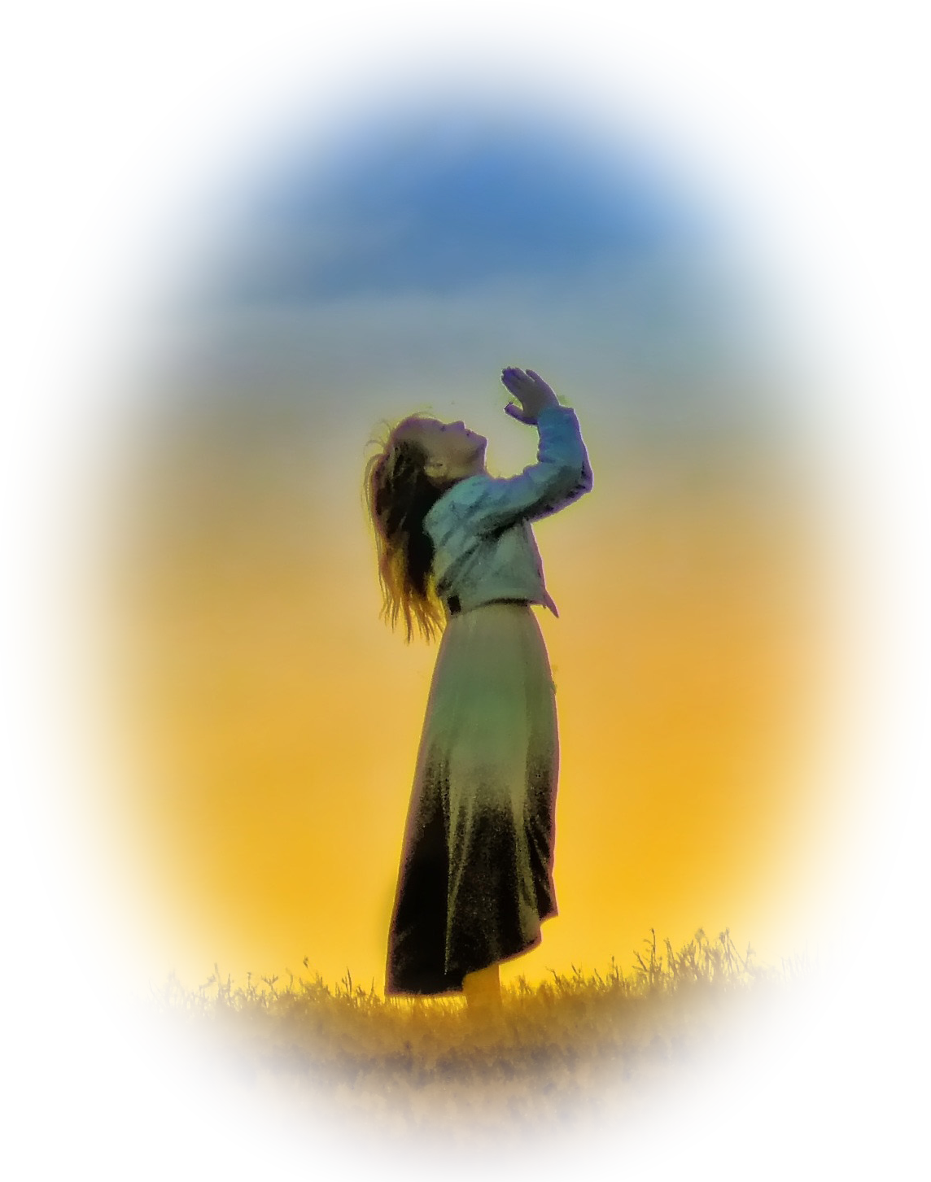
Have a Fearless Faith 1:7
⁷ For God did not give us a spirit of timidity, but a spirit of power, of love and of self-discipline.
Notes:
https://www.goodfreephotos.com/albums/other-photos/girl-praying-up-at-the-heavens.jpg
Some people are very timid about their faith. You don’t even know if they believe. They are afraid to publicly share that they are Christians.
At the heart of this is fear. Fear is a sense of “powerlessness, self-centeredness, and lack of self-control.” (Sound Mind) Some people “lose it!” Lose their minds with fear. Do irrational things.
Those who have a fearless faith experience God’s power, God’s love, and a God-given self-discipline!

Slide 10

Have a Bold Faith 1:8
⁸ So do not be ashamed to testify about our Lord, or ashamed of me his prisoner. But join with me in suffering for the gospel, by the power of God,
Notes:
https://c.pxhere.com/photos/d7/1b/person_mountain_top_achieve_mountain_achievement_successful_goal_freedom-552835.jpg!d
As I said earlier, the first time I shared my faith because I saw someone else do it.
I looked up the verses he used, and went out hunting for a target—of course, a stranger, someone I did not know.
It happened, there he was, hitch-hiking on the side of the road. Etc.
Story of Bill Crane – Are you a Christian? No, but I’m gonna be? Gonna be? When? As soon as you tell me how!

Slide 11

Have a Holy Faith 1:9
⁹ who has saved us and called us to a holy life--not because of anything we have done but because of his own purpose and grace.
Notes:
https://pixabay.com/photos/jesus-god-holy-spirit-bible-gospel-3507364/
Holiness is about PURITY: For God did not call us to be impure, but to live a holy life. (1Th 4:7 NIV)
Holiness is about CLEANSING: ²⁶ to make her holy, cleansing her by the washing with water through the word, (Eph 5:26 NIV)
Holiness is about BEING DIFFERENT
Holiness is about BEING SPECIAL

Slide 12

Have an Accepting Faith 1:9-10
⁹ .... This grace was given us in Christ Jesus before the beginning of time, ¹⁰ but it has now been revealed through the appearing of our Savior, Christ Jesus, who has destroyed death and has brought life and immortality to light through the gospel.
Notes:
https://www.publicdomainpictures.net/en/view-image.php?image=97881&picture=christmas-gift-box

Slide 13
Let’s Pray!

