Slide 1
A Different Spin on
CHRISTMAS!
This lesson uses the Sefer AH font free at www.dafont.com/sefer-ah.font
Notes:
Copyright © 2006−2021. All rights reserved. Bible Point is a registered trademark of Dennis Henderson. All other trademarks acknowledged.
Bible Point contains graphics from Bible Point artists. These illustrations belong to Bible Point and the respective artists. You may use the designs and illustrations for graphical illustration of lessons free and without special permission, provided they are not used in any way that maligns the Christian faith. Furthermore, republication or production of any illustration by any other graphic service whether it be in book, in a machine-readable form, or in any other design resource is strictly prohibited. Furthermore, they cannot be duplicated or resold as any other form of publishing, clip art, or graphic resource.
So What does it mean? (A simple translations of the legal jargon)
So, if you don’t own the presentation(s), graphic(s), and text(s) how can you legally use them? The purchase of the license allows you to use all the images in the product. However, the actual ownership and copyright of the presentation(s), graphic(s), and text(s) remain the property of Bible Point and its licensors. If you had plans on using this product in your “for sale” work—think again!
License Agreement
Article 1: License Grant
All the graphics and text in Bible Point presentations (excluding quotes from the Bible and stated sources) are the intellectual and real property of Bible Point and its licensors, and is protected by law, including United States copyright laws and international treaties. Bible Point grants to you a license:
1. To use the presentation in a single church, single school, or single office of a Christian organization.
2. To make a single archival back-up copy of the program.
3. To modify the presentation(s) and merge with other presentations in a single church, school, or Christian organization.
4. To transfer to another party if that party agrees to accept the terms and conditions of this agreement, and you do not retain any copies of the presentation, whether printed, machine readable, modified, or merged form.
Article 2: Terms
This license is effective until terminated. You may terminate the license at any time by destroying the presentation(s), graphic(s), or text(s) together with all copies, modifications and merged portions in any form. Bible Point may terminate your license if you fail to comply with this Agreement. You agree, upon such termination, for any reason, to destroy the presentation(s), graphics, and text(s) with all copies, modifications, and merged portions in any form.
Article 3: Disclaimers
1. Bible Point presentations, graphics, and texts are licensed to you As Is. You, the consumer, bear the entire risk relating to the quality and performance of the presentation(s), graphic(s), or text(s). In no event will Bible Point be liable for damages resulting from any defect.
2. Thirty-day limited warrantee on disks. Bible Point warrants the disks to be free of defects in material and workmanship under normal use for 30 days after purchase. During the 30-day period you may return a defective presentation, graphic, or text with proof of purchase and it will be replaced without charge, unless the presentation is damaged by misuse.
Article 4: General
1. You may not sub-license, assign, or transfer the license of the presentation(s), graphic(s), or text(s) except as provided by this Agreement.
2. This Agreement will be governed by the laws of the State of Michigan.
So What does it mean? (A simple translations of the legal jargon)
May I let someone borrow or copy my licensed Bible Point presentation (even after I modified it)? As long as it is within your local church, or single school, or the immediate office of a Christian organization you may. Otherwise, please refer the person interested in borrowing to: http://www.biblepoint.com or E-mail: dennis@DrDH.net with any related questions.

Slide 2
A Different Spin on
CHRISTMAS!

Slide 3
A Different Spin on
CHRISTMAS!
^{From a HEBREWS’ perspective}

Slide 4
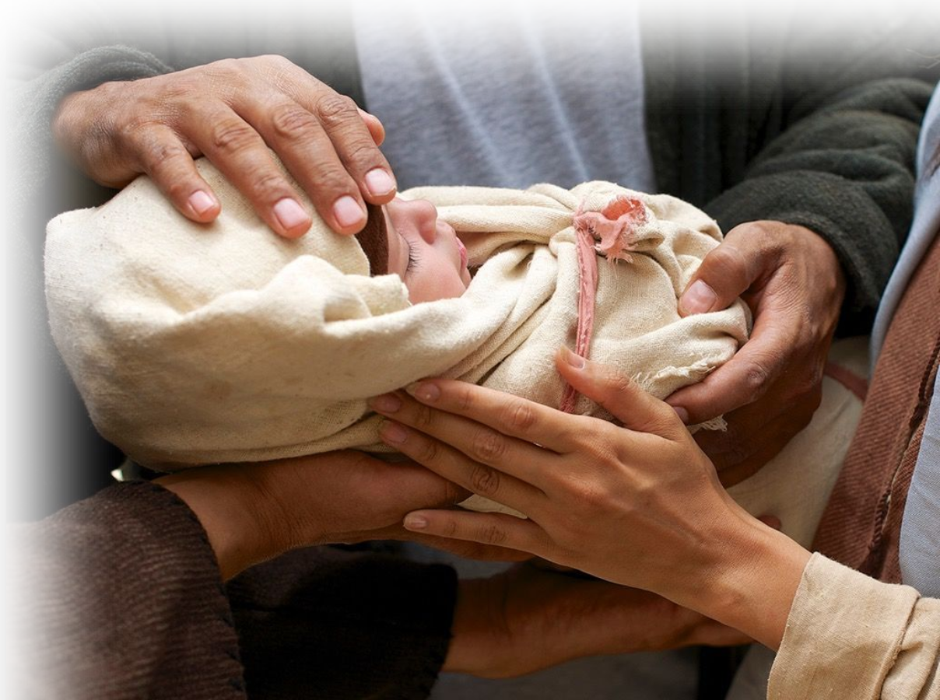
You Know the Story ...
²¹ On the eighth day, when it was time to circumcise him, he was named Jesus, the name the angel had given him before he had been conceived.
Notes:
Two events are recorded here:
Circumcision of Jesus was under the law and fulfilled the law. Gal 6: Part of the law required circumcision of the male on the 8th day.
And Purificationof Mary
Read Leviticus 12:2-4 The rite of purification for a mother, after the birth of a son, could only be performed after three distinct time periods, totaling 41 days: Â Seven days of ritual uncleanness Â Circumcision on the eighth day Â A further thirty-three days of ritual uncleanness And so we see Mary going to the Temple “[w]hen the time of their purification according to the Law of Moses had been completed.” Assuming that Jesus was presented on the day immediately following the completion of Mary’s ritual uncleanness, he was probably 42 days old when he was presented at the Temple. As required by the Torah (the Law of Moses), Mary presented two sacrifices – a burnt offering for her newborn son, and a sin offering for herself, as a sign that her ritual impurity was over. But look at what Luke records their offering to be in 2:24: “[They went] to offer a sacrifice in keeping with what is said in the Law of the Lord: ‘a pair of doves or two young pigeons.’” Now take another look at Leviticus 12:6: “When the days of her purification for a son or daughter are over, she is to bring to the priest at the entrance to the Tent of Meeting a year-old lamb for a burnt offering and a young pigeon or a dove for a sin offering.” Do you notice the Law’s requirements are very specific. What offering is specified by the Torah? “A year-old lamb for a burnt offering and a young pigeon or a dove for a sin offering.” But take a look at what Mary offered as a sacrifice – “a pair of doves or two young pigeons.” Yet Luke says this was “in keeping with what is said in the Law of the Lord.” This is because Leviticus 12:8 tells us: “If she cannot afford a lamb, she is to bring two doves or two young pigeons, one for a burnt offering and the other for a sin offering. In this way the priest will make atonement for her, and she will be clean.” God had made provision in his Law for the poor, and Joseph and Mary obviously fell into this category. They were too poor to buy a lamb for an offering, and so had recourse to the poor man’s substitute – “a pair of doves or two young pigeons.” From this we see clearly that Jesus was not born into a wealthy family. Indeed, he was born into a poor family from an obscure rural village on the outskirts of the Roman empire. But this was all part of Christ’s total identification with humanity

Slide 5
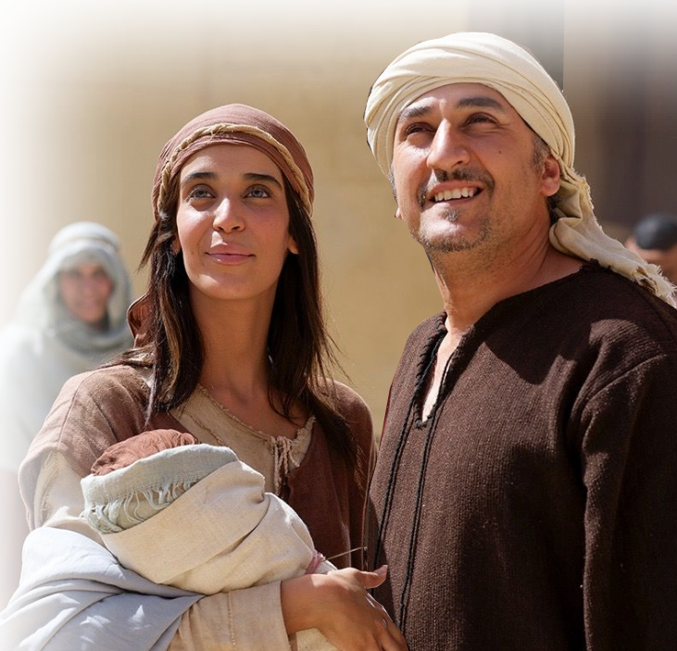
You Know the Story ...
²² When the time of their purification according to the Law of Moses had been completed, Joseph and Mary took him to Jerusalem to present him to the Lord ...
Notes:
Two events are recorded here:
Circumcision of Jesus was under the law and fulfilled the law. Gal 6: Part of the law required circumcision of the male on the 8th day.
And Purificationof Mary
Read Leviticus 12:2-4 The rite of purification for a mother, after the birth of a son, could only be performed after three distinct time periods, totaling 41 days: Â Seven days of ritual uncleanness Â Circumcision on the eighth day Â A further thirty-three days of ritual uncleanness And so we see Mary going to the Temple “[w]hen the time of their purification according to the Law of Moses had been completed.” Assuming that Jesus was presented on the day immediately following the completion of Mary’s ritual uncleanness, he was probably 42 days old when he was presented at the Temple. As required by the Torah (the Law of Moses), Mary presented two sacrifices – a burnt offering for her newborn son, and a sin offering for herself, as a sign that her ritual impurity was over. But look at what Luke records their offering to be in 2:24: “[They went] to offer a sacrifice in keeping with what is said in the Law of the Lord: ‘a pair of doves or two young pigeons.’” Now take another look at Leviticus 12:6: “When the days of her purification for a son or daughter are over, she is to bring to the priest at the entrance to the Tent of Meeting a year-old lamb for a burnt offering and a young pigeon or a dove for a sin offering.” Do you notice the Law’s requirements are very specific. What offering is specified by the Torah? “A year-old lamb for a burnt offering and a young pigeon or a dove for a sin offering.” But take a look at what Mary offered as a sacrifice – “a pair of doves or two young pigeons.” Yet Luke says this was “in keeping with what is said in the Law of the Lord.” This is because Leviticus 12:8 tells us: “If she cannot afford a lamb, she is to bring two doves or two young pigeons, one for a burnt offering and the other for a sin offering. In this way the priest will make atonement for her, and she will be clean.” God had made provision in his Law for the poor, and Joseph and Mary obviously fell into this category. They were too poor to buy a lamb for an offering, and so had recourse to the poor man’s substitute – “a pair of doves or two young pigeons.” From this we see clearly that Jesus was not born into a wealthy family. Indeed, he was born into a poor family from an obscure rural village on the outskirts of the Roman empire. But this was all part of Christ’s total identification with humanity

Slide 6
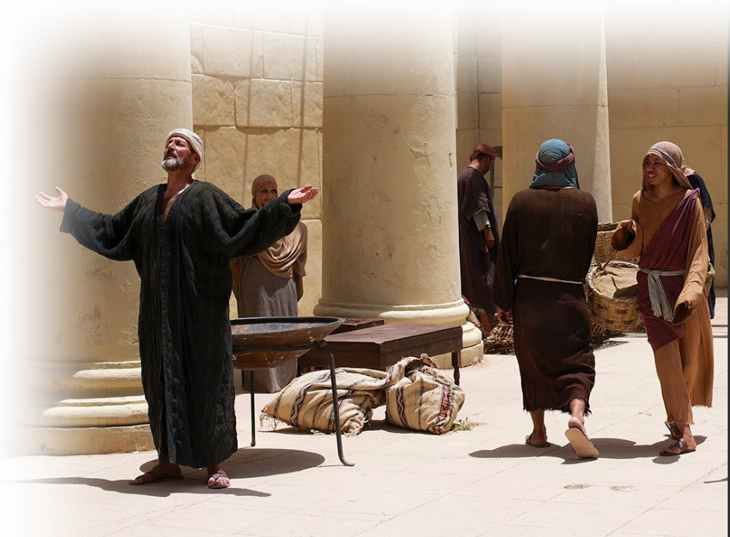
You Know the Story ...
²⁵ Now there was a man in Jerusalem called Simeon, who was righteous and devout. He was waiting for the consolation of Israel, and the Holy Spirit was upon him. ²⁶ It had been revealed to him by the Holy Spirit that he would not die before he had seen the Lord's Christ. ....

Slide 7
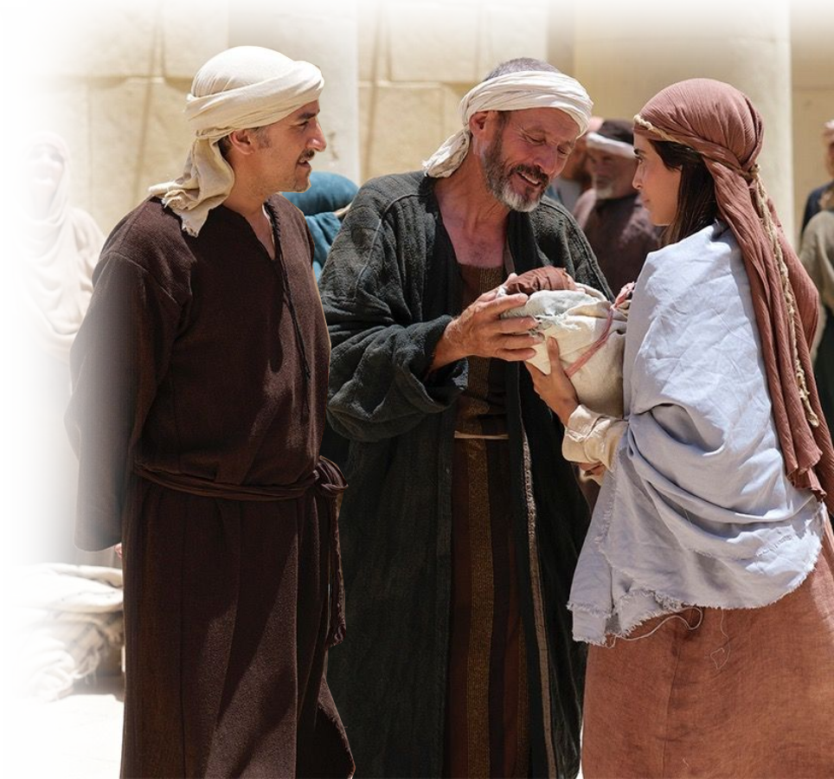
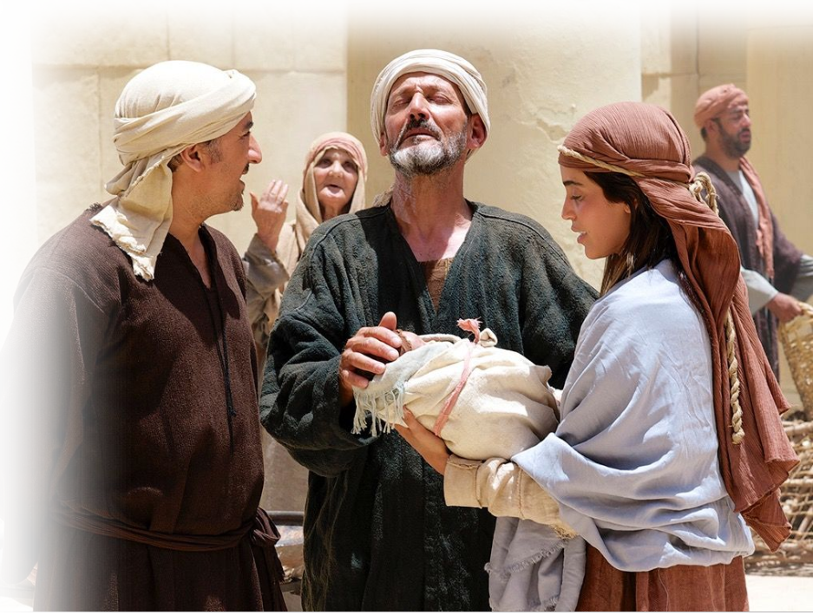
You Know the Story ...
³⁴ Then Simeon blessed them and said to Mary, his mother:
"This child is destined to cause the falling and rising of many in Israel, and to be a sign that will be spoken against, ³⁵ so that the thoughts of many hearts will be revealed. And a sword will pierce your own soul too."

Slide 8
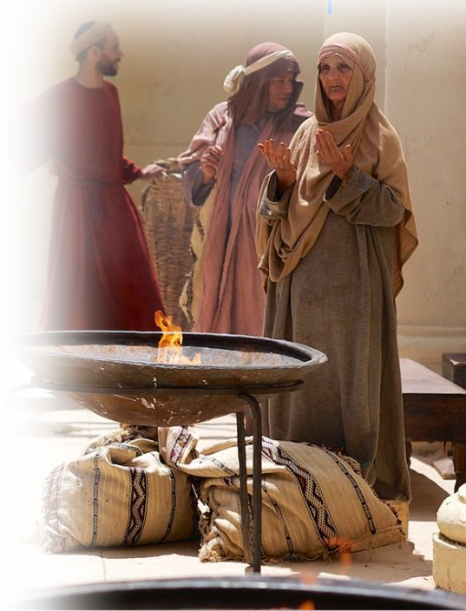
You Know the Story ...
³⁶ There was also a prophetess, Anna, the daughter of Phanuel, of the tribe of Asher. She was very old; she had lived with her husband seven years after her marriage, ³⁷ and then was a widow until she was eighty-four. She never left the temple but worshiped night and day, fasting and praying

Slide 9
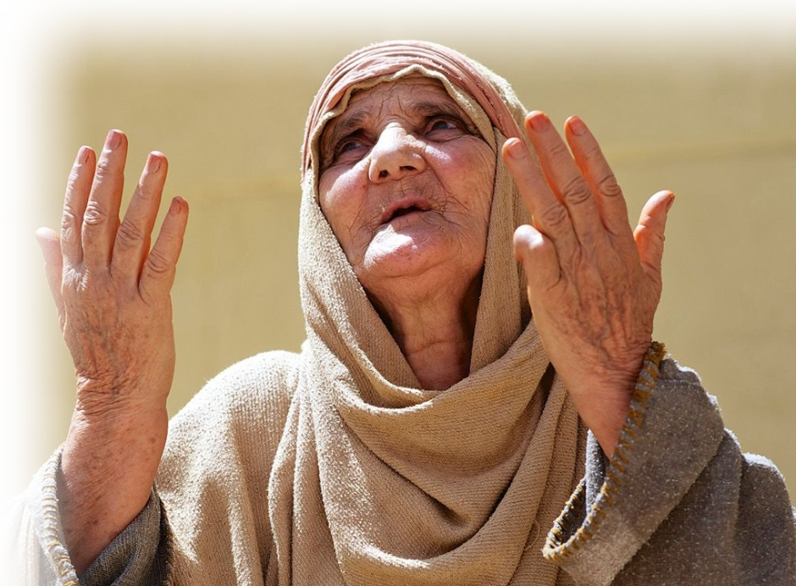
You Know the Story ...
³⁸ Coming up to them at that very moment, she gave thanks to God and spoke about the child to
all who were looking forward to the redemption of Jerusalem.

Slide 10
The Christmas Sacrifice

Slide 11
The Christmas Sacrifice
Looking back …
10:5 ... when Christ came into the world

Slide 12
Jesus came BODILY 10:5-6
Notes:
God is not interested in the stuff you bring—unless it is your body—God wants you!

Slide 13
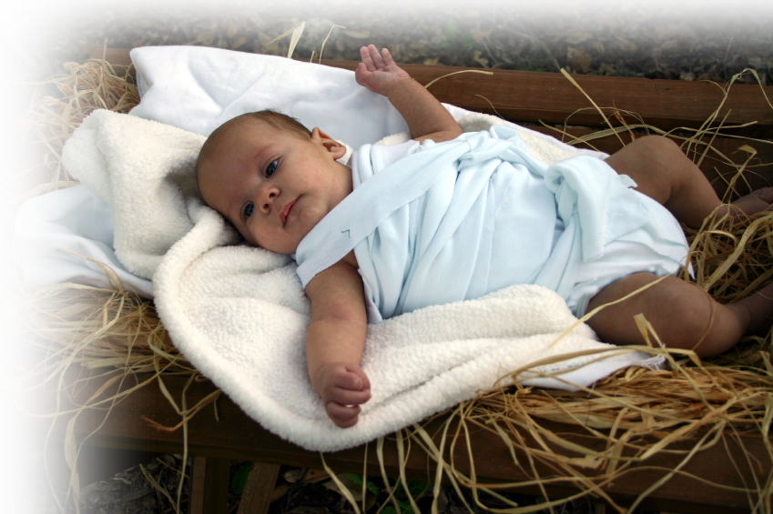
Jesus came BODILY 10:5-6
5 Therefore, when Christ came into the world, he said: "Sacrifice and offering you did not desire, but a body you prepared for me;
Notes:
God is not interested in the stuff you bring—unless it is your body—God wants you!

Slide 14
Jesus came WILLINGLY 10:7-10
Notes:
Scroll = FREE = https://commons.wikimedia.org/wiki/File:Open_Torah_scroll.jpg
God is not after your offering, your money, your time—He doesn’t need any of it. He could just say the word and create anything he desires—so he does not need your stuff. (it’s already His by creation anyway)
What God wants is for you to Want to please Him. He wants your OBEDIENT HEART.
Only when we do His will is the offering validated.

Slide 15

Jesus came WILLINGLY 10:7-10
6 with burnt offerings and sin offerings you were not pleased. 7 Then I said,
'Here I am--it is written
about me in the scroll–
I have come to do
your will, O God.’
8 First he said, "Sacrifices and offerings, burnt offerings and sin offerings you did not desire, nor were you pleased with them" (although the law required them to be made).
9 Then he said, "Here I am, I have come to do your will."
Notes:
Scroll = FREE = https://commons.wikimedia.org/wiki/File:Open_Torah_scroll.jpg
God is not after your offering, your money, your time—He doesn’t need any of it. He could just say the word and create anything he desires—so he does not need your stuff. (it’s already His by creation anyway)
What God wants is for you to Want to please Him. He wants your OBEDIENT HEART.
Only when we do His will is the offering validated.

Slide 16
Jesus came WILLINGLY 10:7-10
8 First he said,
"Sacrifices and offerings,
burnt offerings and sin
offerings you did not desire,
nor were you pleased with
them"
Notes:
God is not after your offering, your money, your time—He doesn’t need any of it. He could just say the word and create anything he desires—so he does not need your stuff. (it’s already His by creation anyway)
What God wants is for you to Want to please Him. He wants your OBEDIENT HEART.
Only when we do His will is the offering validated.

Slide 17
Jesus came WILLINGLY 10:7-10
8 First he said,
"Sacrifices and offerings,
burnt offerings and sin
offerings you did not desire,
nor were you pleased with
them"
(although the law required them to be made).
Notes:
God is not after your offering, your money, your time—He doesn’t need any of it. He could just say the word and create anything he desires—so he does not need your stuff. (it’s already His by creation anyway)
What God wants is for you to Want to please Him. He wants your OBEDIENT HEART.
Only when we do His will is the offering validated.

Slide 18
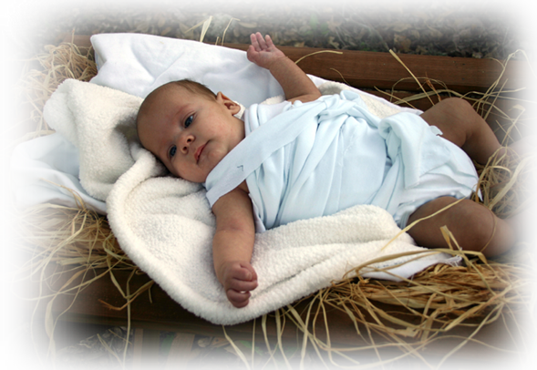
Jesus came WILLINGLY 10:7-10
9 Then he said,
"Here I am,
I have come
to do
your will."
Notes:
God is not after your offering, your money, your time—He doesn’t need any of it. He could just say the word and create anything he desires—so he does not need your stuff. (it’s already His by creation anyway)
What God wants is for you to Want to please Him. He wants your OBEDIENT HEART.
Only when we do His will is the offering validated.

Slide 19
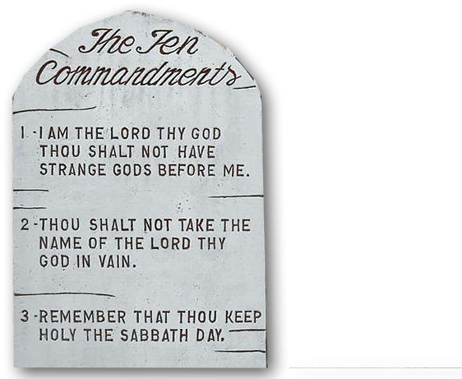
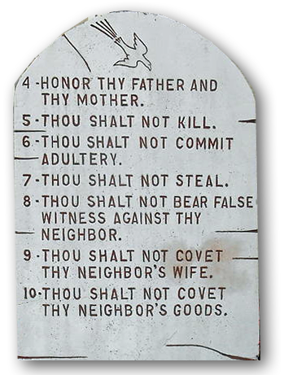
Jesus came WILLINGLY 10:7-10
9 ... He sets aside the first to establish the second.
Old Testament
Notes:
Ten Commandments = FREE =https://commons.wikimedia.org/wiki/File:Saipan_mount_carmel_cathedral_ten_commandments.JPG
Communion = FREE =
God is not after your offering, your money, your time—He doesn’t need any of it. He could just say the word and create anything he desires—so he does not need your stuff. (it’s already His by creation anyway)
What God wants is for you to Want to please Him. He wants your OBEDIENT HEART.
Only when we do His will is the offering validated.

Slide 20
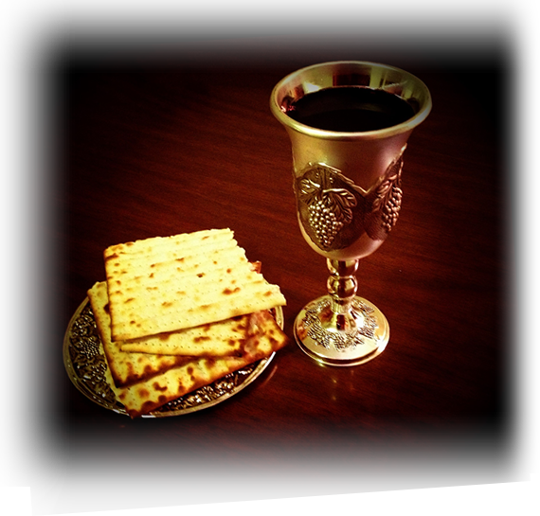
Jesus came WILLINGLY 10:7-10
9 ... He sets aside the first to establish the second.
Old Testament
New Testament
Notes:
Ten Commandments = FREE =https://commons.wikimedia.org/wiki/File:Saipan_mount_carmel_cathedral_ten_commandments.JPG
Communion = FREE =
God is not after your offering, your money, your time—He doesn’t need any of it. He could just say the word and create anything he desires—so he does not need your stuff. (it’s already His by creation anyway)
What God wants is for you to Want to please Him. He wants your OBEDIENT HEART.
Only when we do His will is the offering validated.

Slide 21
Jesus came SACRIFICIALLY 10:11-12
Notes:
By “that will” that He came to do ---we have been made holy through His bodily sacrifice once for all
Willing Sacrifice
Holy Sacrifice
Bodily Sacrifice
Final Sacrifice
In contrast the Old Testament =
Repetitive
Duties
Repetitive
Never Final / Finished – no seat, nor sitting, never done
But --- Jesus finished it all! Seated!

Slide 22
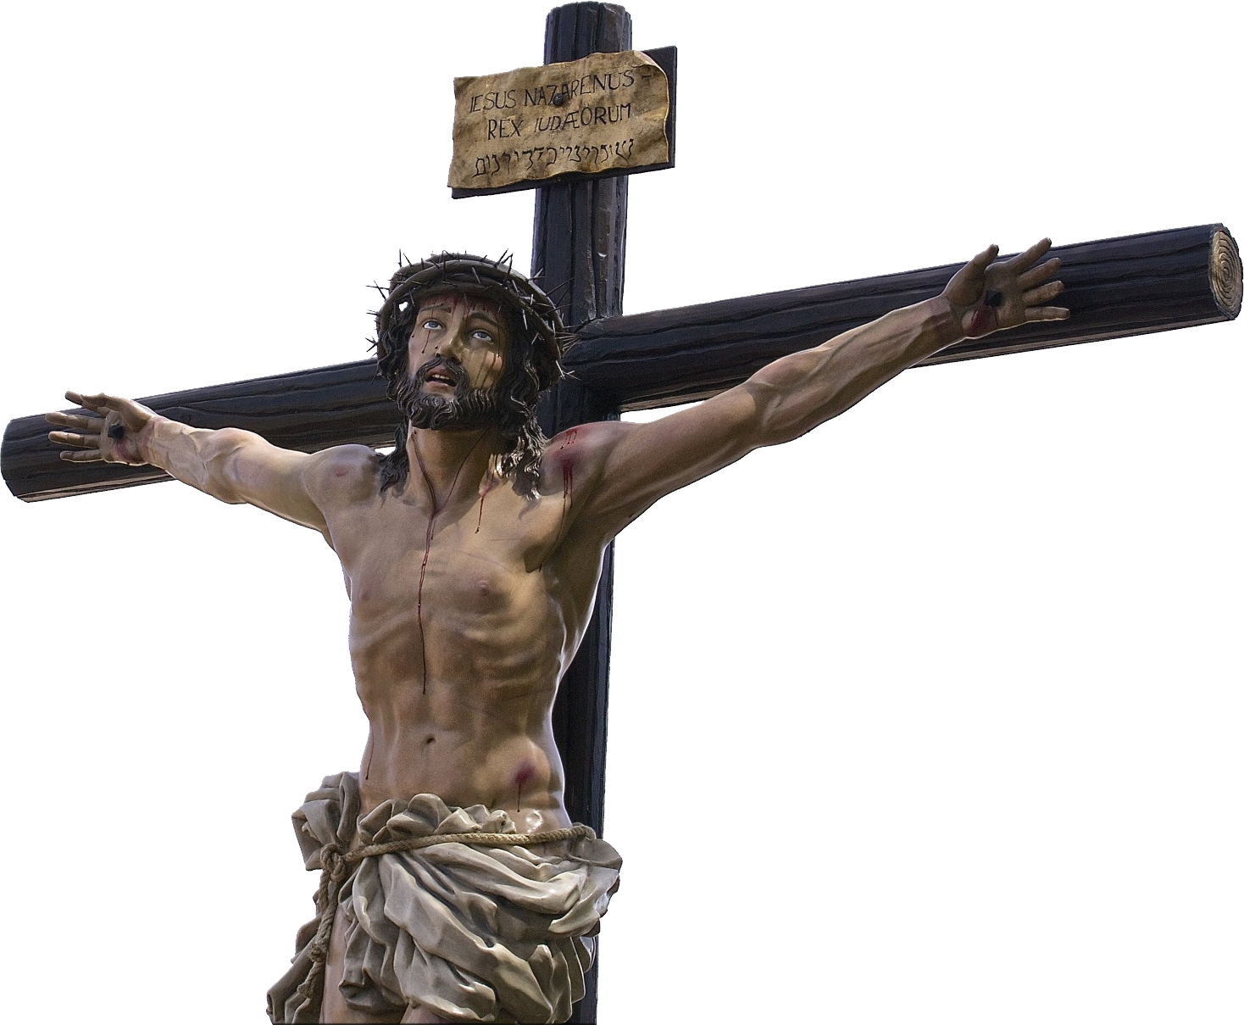
Jesus came SACRIFICIALLY 10:11-12
10 And by that will, we have been made holy through the sacrifice of the body of Jesus Christ once for all.
A Willing Sacrifice
Notes:
By “that will” of the NEW COVENANT He came to make us holy through His bodily sacrifice once for all
Willing Sacrifice
Holy Sacrifice
Bodily Sacrifice
Final Sacrifice
In contrast the Old Testament =
Repetitive
Duties
Repetitive
Never Final / Finished – no seat, nor sitting, never done
But --- Jesus finished it all! Seated!

Slide 23
Jesus came SACRIFICIALLY 10:11-12
10 And by that will, we have been made holy through the sacrifice of the body of Jesus Christ once for all.
A Holy Sacrifice
Notes:
By “that will” that He came to do ---we have been made holy through His bodily sacrifice once for all
Willing Sacrifice
Holy Sacrifice
Bodily Sacrifice
Final Sacrifice
In contrast the Old Testament =
Repetitive
Duties
Repetitive
Never Final / Finished – no seat, nor sitting, never done
But --- Jesus finished it all! Seated!

Slide 24
Jesus came SACRIFICIALLY 10:11-12
10 And by that will, we have been made holy through the sacrifice of the body of Jesus Christ once for all.
A Bodily Sacrifice
Notes:
By “that will” that He came to do ---we have been made holy through His bodily sacrifice once for all
Willing Sacrifice
Holy Sacrifice
Bodily Sacrifice
Final Sacrifice
In contrast the Old Testament =
Repetitive
Duties
Repetitive
Never Final / Finished – no seat, nor sitting, never done
But --- Jesus finished it all! Seated!

Slide 25
Jesus came SACRIFICIALLY 10:11-12
10 And by that will, we have been made holy through the sacrifice of the body of Jesus Christ once for all.
A Substitute Sacrifice
Notes:
By “that will” that He came to do ---we have been made holy through His bodily sacrifice once for all
Willing Sacrifice
Holy Sacrifice
Bodily Sacrifice
Final Sacrifice
In contrast the Old Testament =
Repetitive
Duties
Repetitive
Never Final / Finished – no seat, nor sitting, never done
But --- Jesus finished it all! Seated!

Slide 26

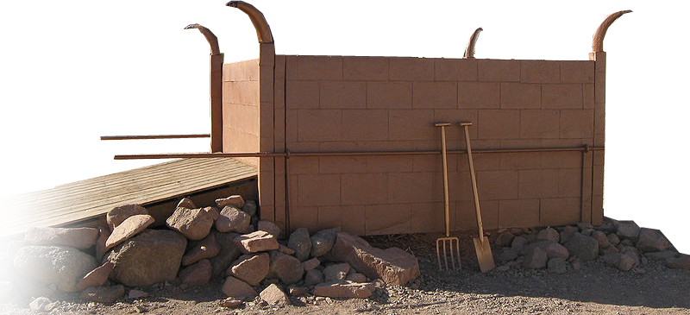
Jesus came SACRIFICIALLY 10:11-12
11 Day after day every priest stands and performs his religious duties; again and again he offers the same sacrifices, which can never take away sins.
A Non-Recurring Sacrifice
Notes:
Alta- FREE - https://commons.wikimedia.org/wiki/File:Timna_Tabernacle_Altar_of_Burnt_Offerings.jpg
By “that will” that He came to do ---we have been made holy through His bodily sacrifice once for all
Willing Sacrifice
Holy Sacrifice
Bodily Sacrifice
Final Sacrifice Recurring
In contrast the Old Testament =
Repetitive
Duties
Repetitive
Never Final / Finished – no seat, nor sitting, never done
But --- Jesus finished it all! Seated!

Slide 27
Jesus came SACRIFICIALLY 10:11-12
12 But when this priest had offered for all time one sacrifice for sins, ...
A Final, Complete Sacrifice
Notes:
By “that will” that He came to do ---we have been made holy through His bodily sacrifice once for all
Willing Sacrifice
Holy Sacrifice
Bodily Sacrifice
Final Sacrifice
In contrast the Old Testament =
Repetitive
Duties
Repetitive
Never Final / Finished – no seat, nor sitting, never done
But --- Jesus finished it all! Seated!

Slide 28
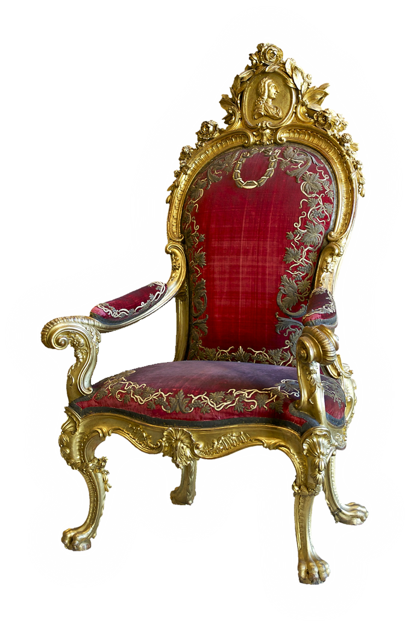
Jesus came SACRIFICIALLY 10:11-12
... he sat down at the right hand of God
A Final, Complete Sacrifice

Slide 29
He came PATIENTLY 10:13-14

Slide 30
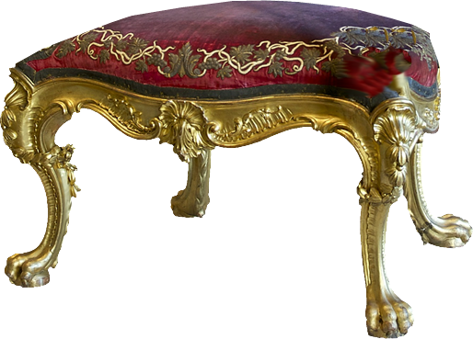
He came PATIENTLY 10:13-14
... he sat down at the right hand of God. 13 Since that time he waits for his enemies to be made his footstool,
Notes:
Jesu is in no hurry. He is not on your time table. He is patiently waiting ...
⁹ The Lord is not slow in keeping his promise, as some understand slowness. He is patient with you, not wanting anyone to perish, but everyone to come to repentance. (2Pe 3:9 NIV)
Here = to make enemies footstool.

Slide 31
He came PERFECTINGLY 10:14

Slide 32
He came PERFECTINGLY 10:14
14 because by one sacrifice he has made perfect forever those
who are being made holy.
Notes:
For Him, it’s all about you!
I sometimes tease saying, “I may not be perfect, but give me a week.” Now we know that is not true. But what is true is ...
“I man not be perfect, but wait till I’m glorified!” I will be “perfect, even in holiness, never to sin again. Because Jesus will absolutely perfect me.
You see you have to be made holy by HIM!!! You will never do it on your own.

Slide 33
Think about ...
Hebrews 10:5 ... when Christ came into the world

Slide 34
Think about ...
Hebrews 10:5 ... when Christ came into the world
John 3:17 For God did not send his Son into the world to condemn the world, but to save the world through him.

Slide 35
Think about ...
Hebrews 10:5 ... when Christ came into the world
John 3:17 For God did not send his Son into the world to condemn the world, but to save the world through him.
1Timothy 1:15 Christ Jesus came into the world to save sinners--of whom I am the worst.

Slide 36

Think about ...
Hebrews 10:5 ... when Christ came into the world
John 3:17 For God did not send his Son into the world to condemn the world, but to save the world through him.
1Timothy 1:15 Christ Jesus came into the world to save sinners--of whom I am the worst.
HE CAME TO SAVE YOU!

Slide 37
Let’s Pray

