Slide 1
A Different Spin on
CHRISTMAS!
Notes:
Copyright © 2006−2021. All rights reserved. Bible Point is a registered trademark of Dennis Henderson. All other trademarks acknowledged.
Bible Point contains graphics from Bible Point artists. These illustrations belong to Bible Point and the respective artists. You may use the designs and illustrations for graphical illustration of lessons free and without special permission, provided they are not used in any way that maligns the Christian faith. Furthermore, republication or production of any illustration by any other graphic service whether it be in book, in a machine-readable form, or in any other design resource is strictly prohibited. Furthermore, they cannot be duplicated or resold as any other form of publishing, clip art, or graphic resource.
So What does it mean? (A simple translations of the legal jargon)
So, if you don’t own the presentation(s), graphic(s), and text(s) how can you legally use them? The purchase of the license allows you to use all the images in the product. However, the actual ownership and copyright of the presentation(s), graphic(s), and text(s) remain the property of Bible Point and its licensors. If you had plans on using this product in your “for sale” work—think again!
License Agreement
Article 1: License Grant
All the graphics and text in Bible Point presentations (excluding quotes from the Bible and stated sources) are the intellectual and real property of Bible Point and its licensors, and is protected by law, including United States copyright laws and international treaties. Bible Point grants to you a license:
1. To use the presentation in a single church, single school, or single office of a Christian organization.
2. To make a single archival back-up copy of the program.
3. To modify the presentation(s) and merge with other presentations in a single church, school, or Christian organization.
4. To transfer to another party if that party agrees to accept the terms and conditions of this agreement, and you do not retain any copies of the presentation, whether printed, machine readable, modified, or merged form.
Article 2: Terms
This license is effective until terminated. You may terminate the license at any time by destroying the presentation(s), graphic(s), or text(s) together with all copies, modifications and merged portions in any form. Bible Point may terminate your license if you fail to comply with this Agreement. You agree, upon such termination, for any reason, to destroy the presentation(s), graphics, and text(s) with all copies, modifications, and merged portions in any form.
Article 3: Disclaimers
1. Bible Point presentations, graphics, and texts are licensed to you As Is. You, the consumer, bear the entire risk relating to the quality and performance of the presentation(s), graphic(s), or text(s). In no event will Bible Point be liable for damages resulting from any defect.
2. Thirty-day limited warrantee on disks. Bible Point warrants the disks to be free of defects in material and workmanship under normal use for 30 days after purchase. During the 30-day period you may return a defective presentation, graphic, or text with proof of purchase and it will be replaced without charge, unless the presentation is damaged by misuse.
Article 4: General
1. You may not sub-license, assign, or transfer the license of the presentation(s), graphic(s), or text(s) except as provided by this Agreement.
2. This Agreement will be governed by the laws of the State of Michigan.
So What does it mean? (A simple translations of the legal jargon)
May I let someone borrow or copy my licensed Bible Point presentation (even after I modified it)? As long as it is within your local church, or single school, or the immediate office of a Christian organization you may. Otherwise, please refer the person interested in borrowing to: http://www.biblepoint.com or E-mail: dennis@DrDH.net with any related questions.

Slide 2
A Different Spin on
CHRISTMAS!

Slide 3
A Different Spin on
CHRISTMAS!
^{From a HEBREWS’ perspective}

Slide 4
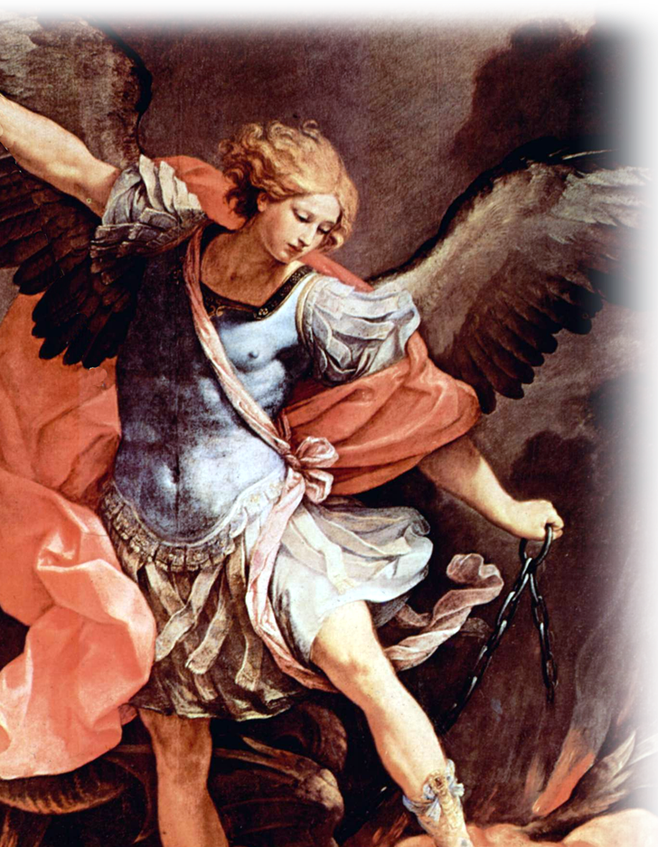
You know the story ...
Luke 1²⁶ In the sixth month, God sent the angel Gabriel to Nazareth, a town in Galilee, ²⁷ to a virgin pledged to be married to a man named Joseph, a descendant of David. The virgin's name was Mary.

Slide 5
You know the story ...
²⁸ The angel went to her and said,
"Greetings, you who are highly favored! The Lord is with you.“
²⁹ Mary was greatly troubled at his words and wondered what kind of greeting this might be.

Slide 6
You know the story ...
³⁰ But the angel said to her,
"Do not be afraid, Mary, you have found favor with God. ³¹ You will be with child and give birth to a son, and you are to give him the name Jesus.

Slide 7
You know the story ...
³² He will be great and will be called the Son of the Most High. The Lord God will give him the throne of his father David, ³³ and he will reign over the house of Jacob forever; his kingdom will never end.“

Slide 8
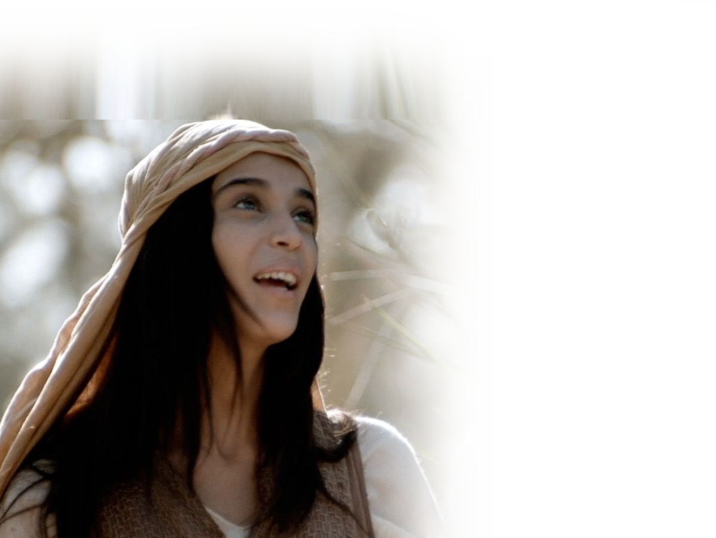
You know the story ...
³⁴ "How will this be,“
Mary asked the angel, "since I am a virgin?"

Slide 9
You know the story ...
³⁵ The angel answered,
"The Holy Spirit will come upon you, and the power of the Most High will overshadow you. So the holy one to be born will be called the Son of God.

Slide 10
The Christmas Incarnation
was necessary ...

Slide 11
To Share our Human Nature 2:14
Notes:
This assumes that you are part of Adams fallen race.
Notice to share in “humanity”-not sinfulness. To err is not human (Jesus was human and never sinned). To err is sinful.
Virgin conception kept Jesus from the pollutions of sin – See angel’s message to Mary.
Share in our humanity – God knows what it is like to be you!
Tired, hungry, sleepy, thirsty, etc. All that is human (except sin).

Slide 12
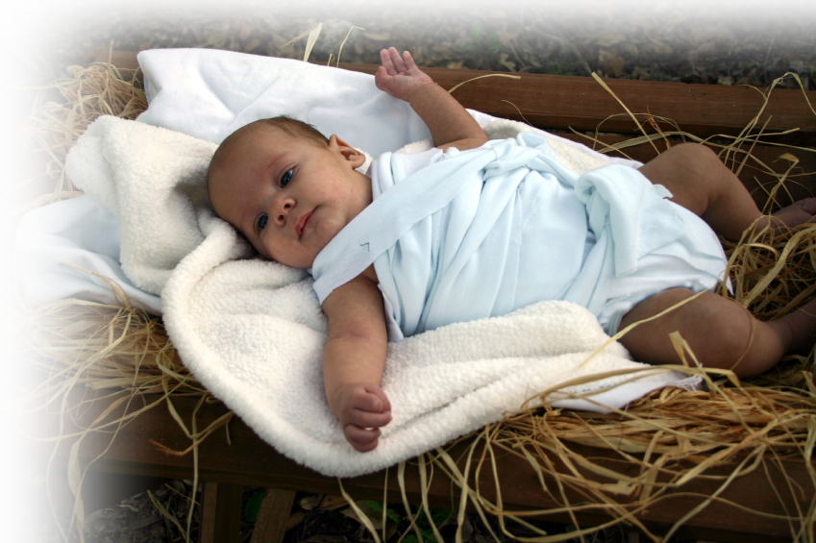
To Share our Human Nature 2:14
14 Since the children have flesh and blood, he too shared in their humanity ...
Notes:
This assumes that you are part of Adams fallen race.
Notice to share in “humanity”-not sinfulness. To err is not human (Jesus was human and never sinned). To err is sinful.
Virgin conception kept Jesus from the pollutions of sin – See angel’s message to Mary.
Share in our humanity – God knows what it is like to be you!
Tired, hungry, sleepy, thirsty, etc. All that is human (except sin).

Slide 13
To Destroy the Power of Death 2:14
Notes:
RIP = FREE = https://pxhere.com/en/photo/545374
Devil = FREE = https://upload.wikimedia.org/wikipedia/commons/b/b4/Devil-goat.jpg
This assumes that you have a mortal arch enemy who seeks out your death, namely Satan, the Devil.
He wants you to be Victorious over the Devil, the world, and the flesh ...

Slide 14
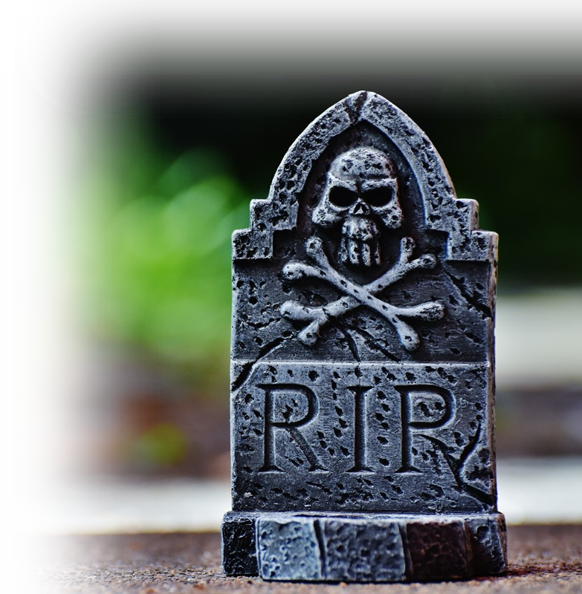
To Destroy the Power of Death 2:14
14 Since the children have flesh and blood, he too shared in their humanity so that by his death he might destroy him who holds the power of death--that is, the devil—
Notes:
RIP = FREE = https://pxhere.com/en/photo/545374
Devil = FREE = https://upload.wikimedia.org/wikipedia/commons/b/b4/Devil-goat.jpg
This assumes that you have a mortal arch enemy who seeks out your death, namely Satan, the Devil.
He wants you to be Victorious over the Devil, the world, and the flesh ...

Slide 15

To Destroy the Power of Death 2:14
14 Since the children have flesh and blood, he too shared in their humanity so that by his death he might destroy him who holds the power of death--that is, the devil—
Notes:
RIP = FREE = https://pxhere.com/en/photo/545374
Devil = FREE = https://upload.wikimedia.org/wikipedia/commons/b/b4/Devil-goat.jpg
This assumes that you have a mortal arch enemy who seeks out your death, namely Satan, the Devil.
He wants you to be Victorious over the Devil, the world, and the flesh ...

Slide 16
To Free from Fear 2:15
Notes:
This assumes that you are afraid of dying.
He wants you to be free from that fear. You see the fear of death paralyzes you from doing or being what you want to be or do.
For example: Afraid to parachute out of a plane, afraid to fly, afraid of drowning, etc. The saying goes, “What’s the worst that could happen? You could die!” That’s what we’re afraid of. But if death is not our end, but just the beginning of our after life—what is there to fear?

Slide 17
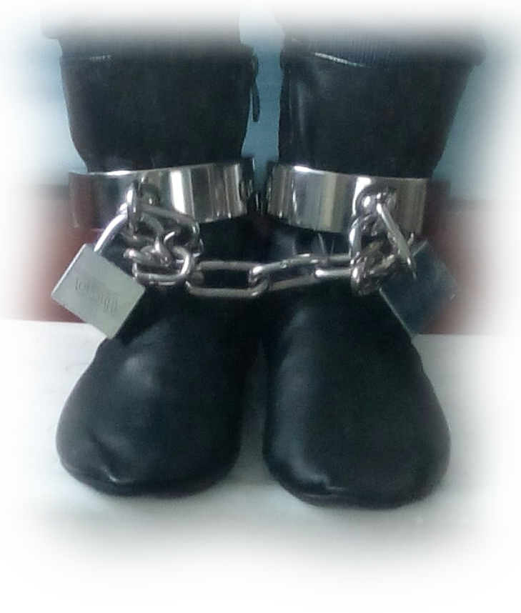
To Free from Fear 2:15
15 and free those who all their lives were held in slavery by their fear of death.
Notes:
This assumes that you are afraid of dying.
He wants you to be free from that fear. You see the fear of death paralyzes you from doing or being what you want to be or do.
For example: Afraid to parachute out of a plane, afraid to fly, afraid of drowning, etc. The saying goes, “What’s the worst that could happen? You could die!” That’s what we’re afraid of. But if death is not our end, but just the beginning of our after life—what is there to fear?

Slide 18
To Help Us 2:16
Notes:
http://www.photo4design.com/stock-photo-pulling-hands-84269#.XBf_bGhKiM8
This assumes you are human. With all the limitation therewith.
He knows what it is like to SUFFER AND SYMPATHIZE. He feels your pain and your joys!

Slide 19
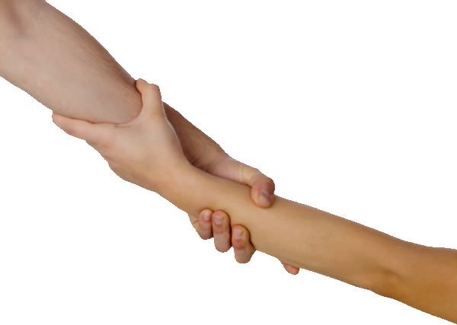
To Help Us 2:16
16 For surely it is not angels he helps, but Abraham's descendants.
Notes:
http://www.photo4design.com/stock-photo-pulling-hands-84269#.XBf_bGhKiM8
This assumes you are human. With all the limitation therewith.
He knows what it is like to SUFFER AND SYMPATHIZE. He feels your pain and your joys!

Slide 20
To Serve as our High Priest 2:17
Notes:
This assumes that you are a believer priest. He is your High Priest.
It is required that a High Priest = Is HUMAN: Every high priest is selected from among men and is appointed to represent them in matters related to God, to offer gifts and sacrifices for sins.
² He is able to deal gently with those who are ignorant and are going astray, since he himself is subject to weakness.
(Heb 5:1-2 NIV)
It is required that a high priest = is HUMAN: He is able to deal gently with those who are ignorant and are going astray, since he himself is subject to weakness (Heb 5:2 NIV)

Slide 21
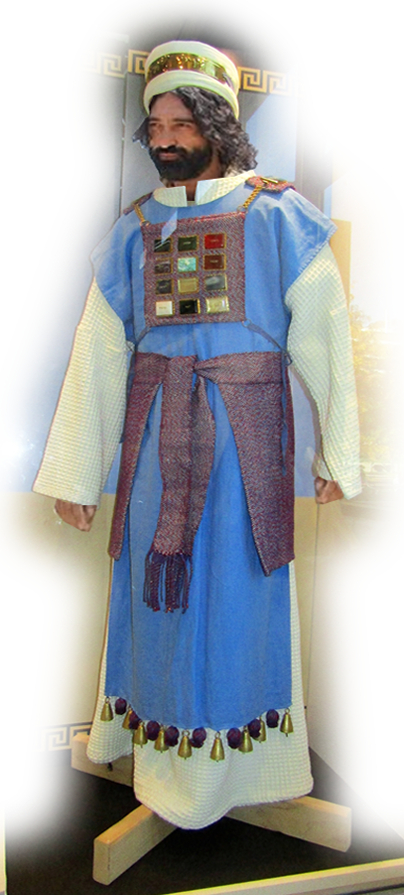
To Serve as our High Priest 2:17
17 For this reason he had to be made like his brothers in every way, in order that he might become a merciful and faithful high priest in service to God,
Notes:
This assumes that you are a believer priest. He is your High Priest.
It is required that a High Priest = Is HUMAN: Every high priest is selected from among men and is appointed to represent them in matters related to God, to offer gifts and sacrifices for sins.
² He is able to deal gently with those who are ignorant and are going astray, since he himself is subject to weakness.
(Heb 5:1-2 NIV)
It is required that a high priest = is HUMAN: He is able to deal gently with those who are ignorant and are going astray, since he himself is subject to weakness (Heb 5:2 NIV)

Slide 22
To Serve as our High Priest 2:17
4 ¹⁴ Therefore, since we have a great high priest who has gone through the heavens, Jesus the Son of God, let us hold firmly to the faith we profess.
Notes:
This assumes that you are a believer priest. He is your High Priest.
It is required that a High Priest = Is HUMAN: Every high priest is selected from among men and is appointed to represent them in matters related to God, to offer gifts and sacrifices for sins.
² He is able to deal gently with those who are ignorant and are going astray, since he himself is subject to weakness.
(Heb 5:1-2 NIV)
It is required that a high priest = is HUMAN: He is able to deal gently with those who are ignorant and are going astray, since he himself is subject to weakness (Heb 5:2 NIV)

Slide 23
To Serve as our High Priest 2:17
¹⁵ For we do not have a high priest who is unable to sympathize with our weaknesses, but we have one who has been tempted in every way, just as we are--yet was without sin
Notes:
This assumes that you are a believer priest. He is your High Priest.
It is required that a High Priest = Is HUMAN: Every high priest is selected from among men and is appointed to represent them in matters related to God, to offer gifts and sacrifices for sins.
² He is able to deal gently with those who are ignorant and are going astray, since he himself is subject to weakness.
(Heb 5:1-2 NIV)
It is required that a high priest = is HUMAN: He is able to deal gently with those who are ignorant and are going astray, since he himself is subject to weakness (Heb 5:2 NIV)

Slide 24

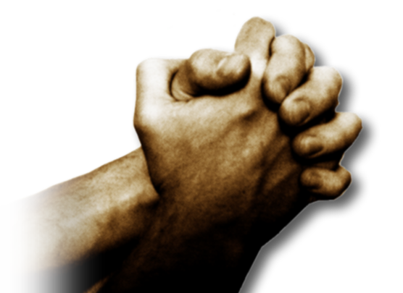

To Serve as our High Priest 2:17
¹⁶ Let us then approach the throne of grace with confidence, so that we may receive mercy and find grace to help us in our time of need.
Notes:
This assumes that you are a believer priest. He is your High Priest.
It is required that a High Priest = Is HUMAN: Every high priest is selected from among men and is appointed to represent them in matters related to God, to offer gifts and sacrifices for sins.
² He is able to deal gently with those who are ignorant and are going astray, since he himself is subject to weakness.
(Heb 5:1-2 NIV)
It is required that a high priest = is HUMAN: He is able to deal gently with those who are ignorant and are going astray, since he himself is subject to weakness (Heb 5:2 NIV)

Slide 25
To Serve as our High Priest 2:17
17 For this reason he had to be made like his brothers in every way, in order that he might become a merciful and faithful high priest in service to God,
Notes:
This assumes that you are a believer priest. He is your High Priest.
It is required that a High Priest = Is HUMAN: Every high priest is selected from among men and is appointed to represent them in matters related to God, to offer gifts and sacrifices for sins.
² He is able to deal gently with those who are ignorant and are going astray, since he himself is subject to weakness.
(Heb 5:1-2 NIV)
It is required that a high priest = is HUMAN: He is able to deal gently with those who are ignorant and are going astray, since he himself is subject to weakness (Heb 5:2 NIV)

Slide 26
To Atone Our Sins 2:17
Notes:
https://upload.wikimedia.org/wikipedia/commons/thumb/c/cb/Ark-of-covenant.jpg/1024px-Ark-of-covenant.jpg
This assumes that your have a sin problem. He is there to save you.
Atonement is Propitiation = place where justice is satisfied.

Slide 27
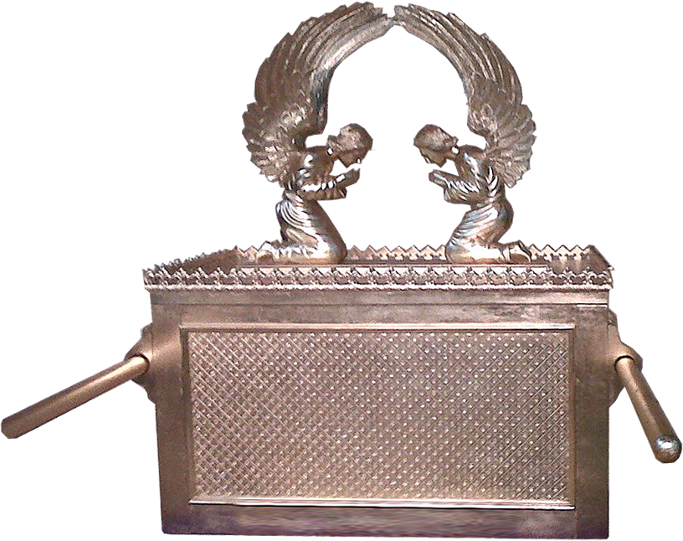
To Atone Our Sins 2:17
17 ... and that he might make atonement for the sins of the people.
Notes:
https://upload.wikimedia.org/wikipedia/commons/thumb/c/cb/Ark-of-covenant.jpg/1024px-Ark-of-covenant.jpg
This assumes that your have a sin problem. He is there to save you.
Atonement is Propitiation = place where justice is satisfied.

Slide 28
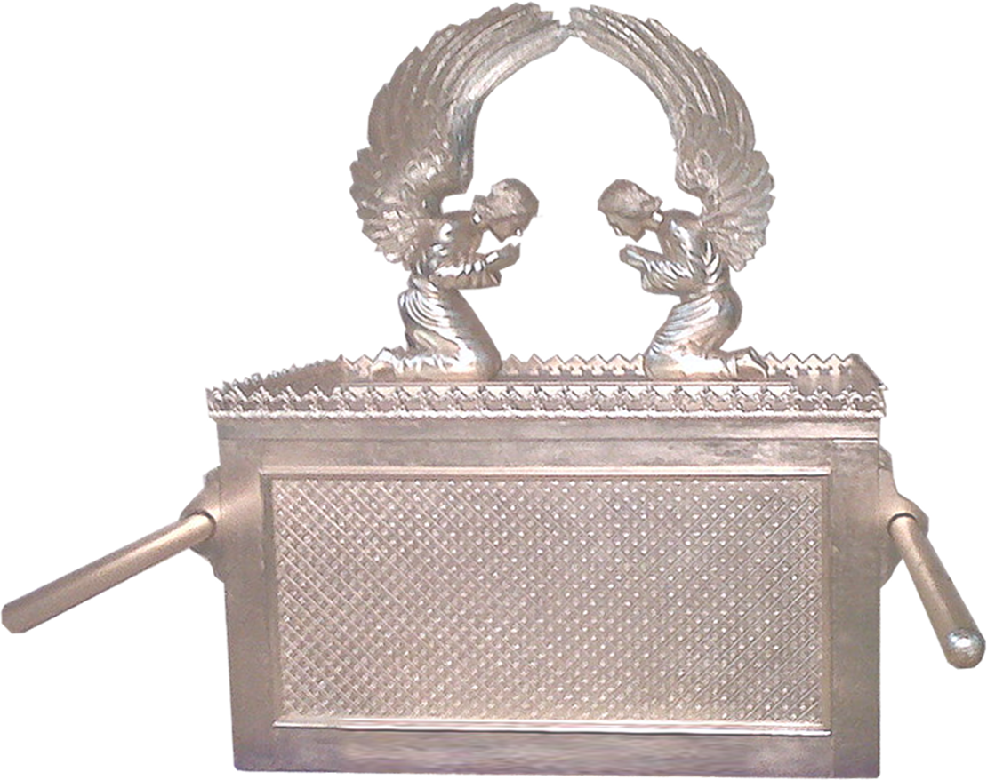
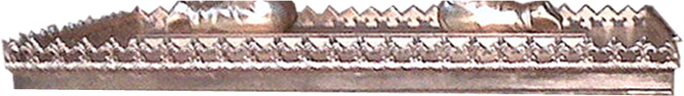
To Atone Our Sins 2:17
17 ... and that he might make atonement for the sins of the people.
Notes:
https://upload.wikimedia.org/wikipedia/commons/thumb/c/cb/Ark-of-covenant.jpg/1024px-Ark-of-covenant.jpgThis assumes that your have a sin problem. He is there to save you.
Atonement is Propitiation = place where justice is satisfied.

Slide 29
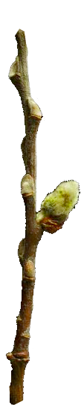
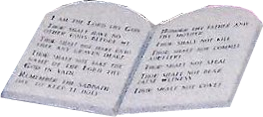
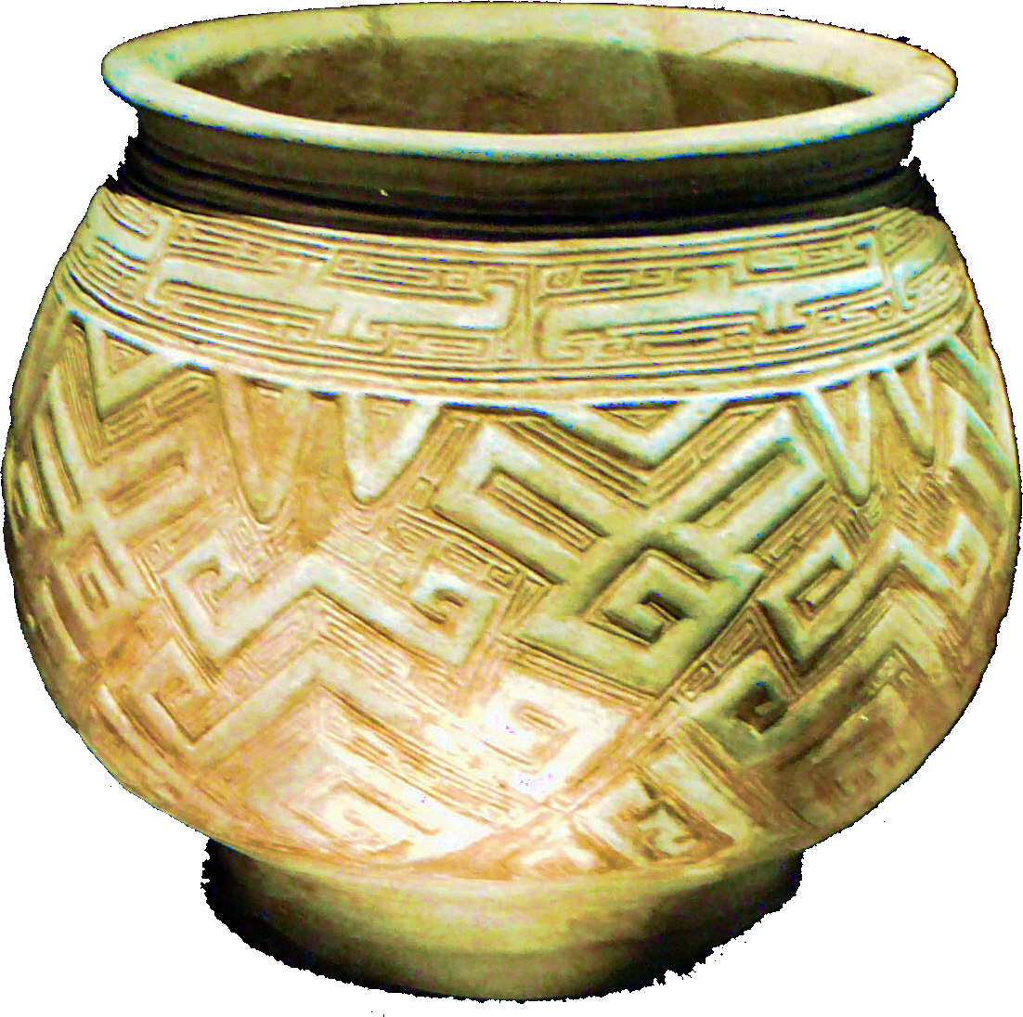
To Atone Our Sins 2:17
17 ... and that he might make atonement for the sins of the people.
Notes:
https://upload.wikimedia.org/wikipedia/commons/thumb/c/cb/Ark-of-covenant.jpg/1024px-Ark-of-covenant.jpg
POT = https://upload.wikimedia.org/wikipedia/commons/e/e5/China_shang_white_pottery_pot.JPG
This assumes that your have a sin problem. He is there to save you.
Atonement is Propitiation = place where justice is satisfied.

Slide 30
To Atone Our Sins 2:17
17 ... and that he might make atonement for the sins of the people.
Notes:
https://upload.wikimedia.org/wikipedia/commons/thumb/c/cb/Ark-of-covenant.jpg/1024px-Ark-of-covenant.jpg
POT = https://upload.wikimedia.org/wikipedia/commons/e/e5/China_shang_white_pottery_pot.JPG
This assumes that your have a sin problem. He is there to save you.
Atonement is Propitiation = place where justice is satisfied.

Slide 31
To Atone Our Sins 2:17
17 ... and that he might make atonement for the sins of the people.
Notes:
https://upload.wikimedia.org/wikipedia/commons/thumb/c/cb/Ark-of-covenant.jpg/1024px-Ark-of-covenant.jpg
POT = https://upload.wikimedia.org/wikipedia/commons/e/e5/China_shang_white_pottery_pot.JPG
This assumes that your have a sin problem. He is there to save you.
Atonement is Propitiation = place where justice is satisfied.

Slide 32
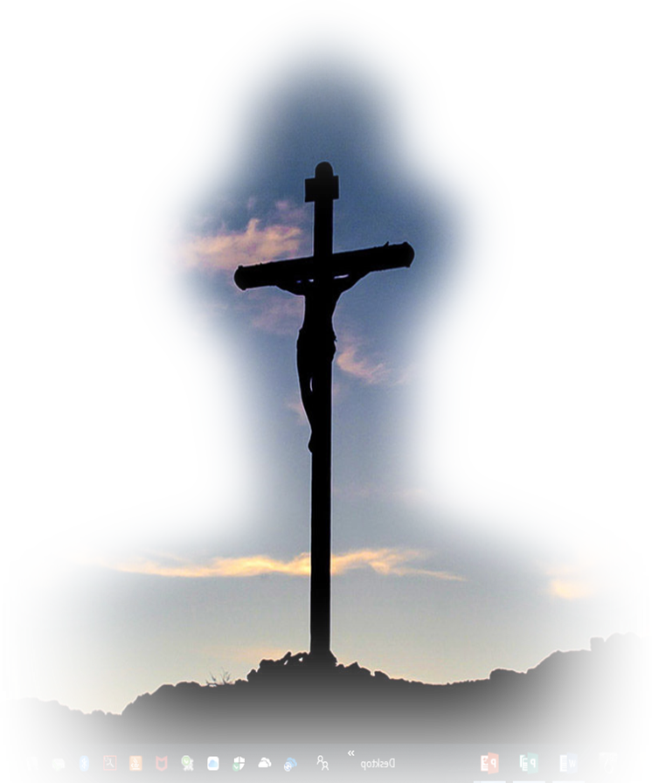
To Atone Our Sins 2:17
17 ... and that he might make atonement for the sins of the people.
Notes:
https://upload.wikimedia.org/wikipedia/commons/thumb/c/cb/Ark-of-covenant.jpg/1024px-Ark-of-covenant.jpgThis assumes that your have a sin problem. He is there to save you.
Atonement is Propitiation = place where justice is satisfied.

Slide 33
To Help Us 2:18
Notes:
https://en.wikipedia.org/wiki/Temptation_of_Christ
This assumes that you need help. He is there to help you.

Slide 34
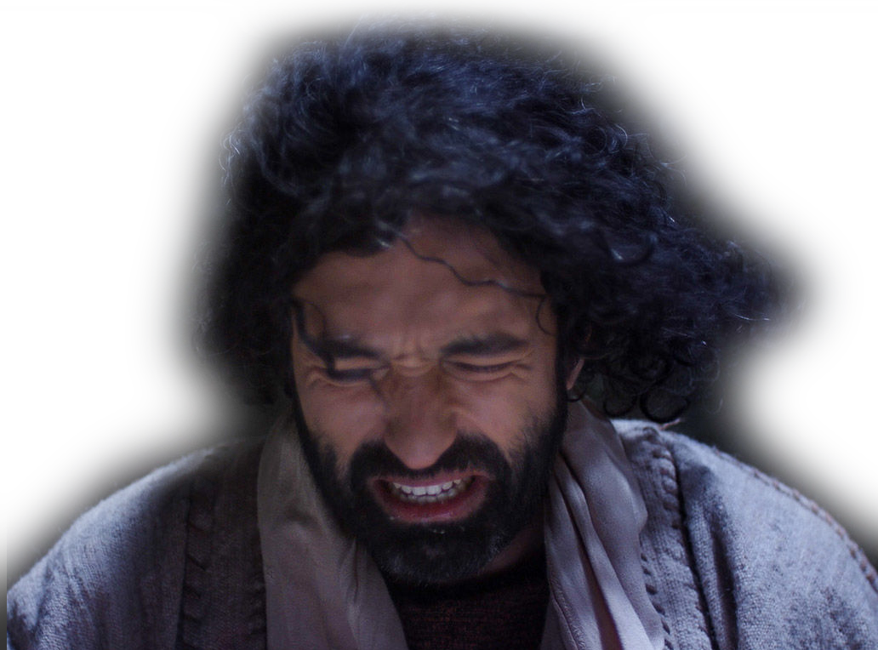
To Help Us 2:18
18 Because he himself suffered when he was tempted, he is able to help those who are being tempted.
Notes:
https://en.wikipedia.org/wiki/Temptation_of_Christ
This assumes that you need help. He is there to help you.

Slide 35
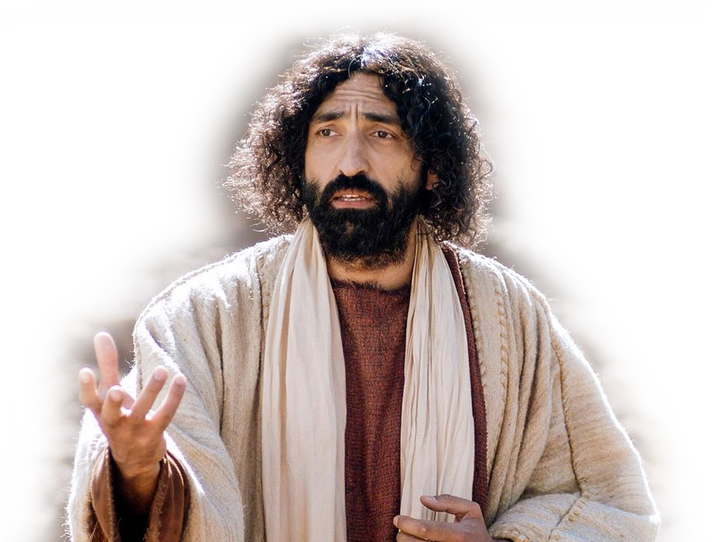
To Help Us 2:18
18 Because he himself suffered when he was tempted, he is able to help those who are being tempted.
Notes:
This assumes that you need help. He is there to help you.

Slide 36
CHRISTMAS is about ...

Slide 37
CHRISTMAS is about ...
Sharing our nature—
He knows what it is
like to be YOU!

Slide 38
CHRISTMAS is about ...
Sharing our nature—
Destroying our arch enemy—
so you can really LIVE!

Slide 39
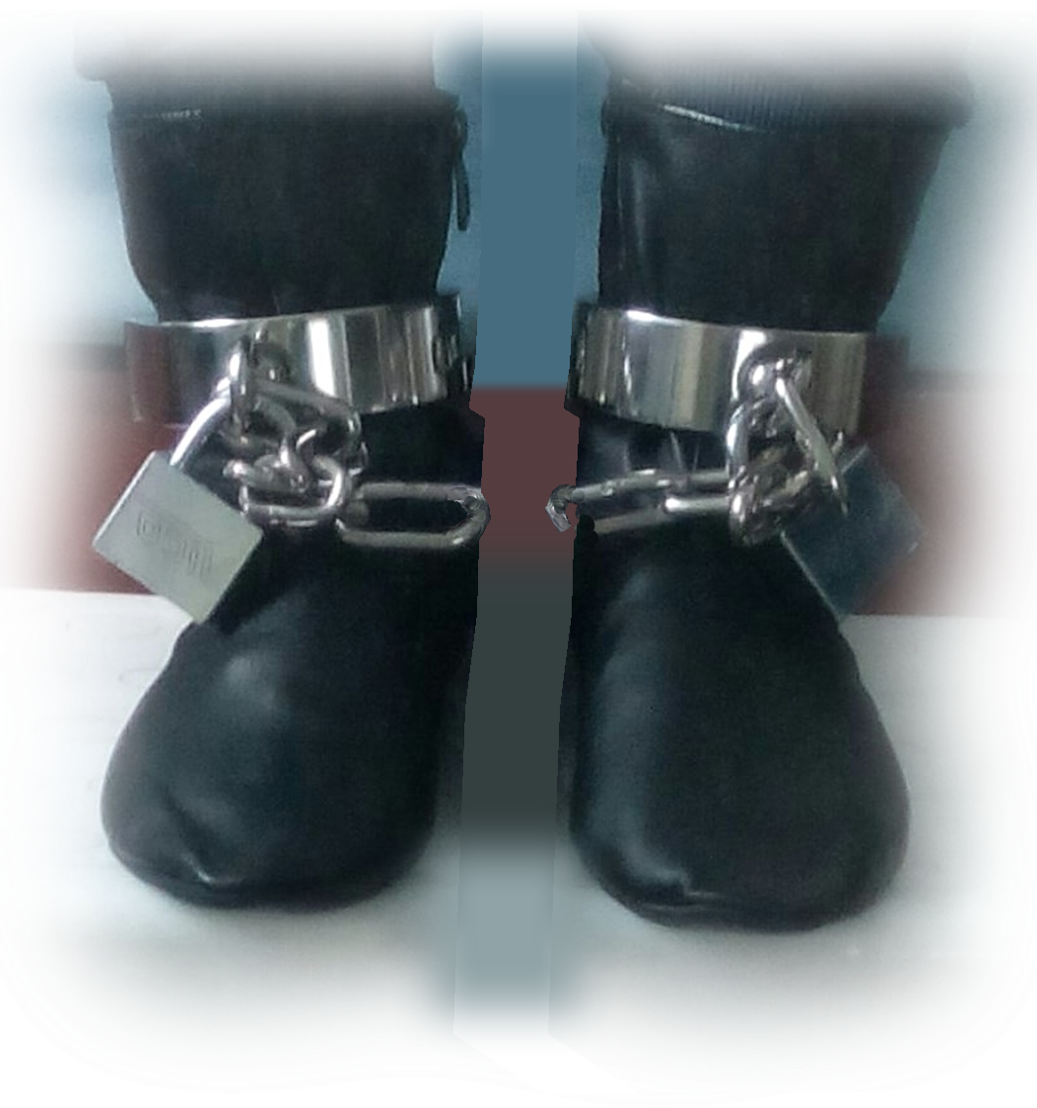
CHRISTMAS is about ...
Sharing our nature—
Destroying our arch enemy—
Freeing you from slavery—
to the Fear of DEATH!

Slide 40

CHRISTMAS is about ...
Sharing our nature—
Destroying our arch enemy—
Freeing you from slavery—
Realizing He qualifies—
to be your SAVIOR!

Slide 41
CHRISTMAS is about ...
Sharing our nature—
Destroying our arch enemy—
Freeing you from slavery—
Realizing He qualifies—
Giving you access—
so you can go to
God YOURSELF

Slide 42
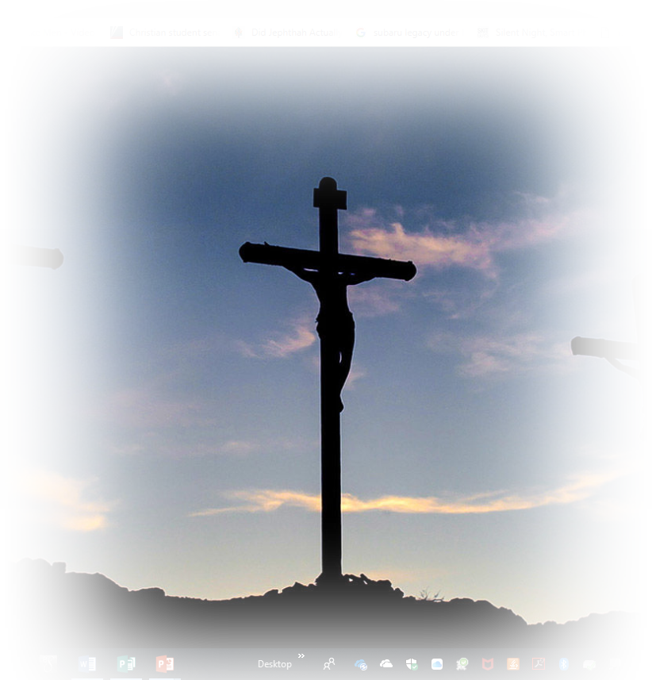
CHRISTMAS is about ...
Sharing our nature—
Destroying our arch enemy—
Freeing you from slavery—
Realizing He qualifies—
Giving you access—
Atoning for your wrongs—
to free you!

Slide 43
CHRISTMAS is about ...
Sharing our nature—
Destroying our arch enemy—
Freeing you from slavery—
Realizing He qualifies—
Giving you access—
Atoning for your wrongs—
Being there for you—
to help when you need it most!

Slide 44
Let’s Pray
Notes:
Perhaps in this Advent season you really do need His help. Today, I’m asking our Prayer Team to come the front and remain behind. So that, if you have any special request, you come to them and they will pray with you.

