Slide 1
A Different Spin on
CHRISTMAS!
Notes:
Copyright © 2006−2021. All rights reserved. Bible Point is a registered trademark of Dennis Henderson. All other trademarks acknowledged.
Bible Point contains graphics from Bible Point artists. These illustrations belong to Bible Point and the respective artists. You may use the designs and illustrations for graphical illustration of lessons free and without special permission, provided they are not used in any way that maligns the Christian faith. Furthermore, republication or production of any illustration by any other graphic service whether it be in book, in a machine-readable form, or in any other design resource is strictly prohibited. Furthermore, they cannot be duplicated or resold as any other form of publishing, clip art, or graphic resource.
So What does it mean? (A simple translations of the legal jargon)
So, if you don’t own the presentation(s), graphic(s), and text(s) how can you legally use them? The purchase of the license allows you to use all the images in the product. However, the actual ownership and copyright of the presentation(s), graphic(s), and text(s) remain the property of Bible Point and its licensors. If you had plans on using this product in your “for sale” work—think again!
License Agreement
Article 1: License Grant
All the graphics and text in Bible Point presentations (excluding quotes from the Bible and stated sources) are the intellectual and real property of Bible Point and its licensors, and is protected by law, including United States copyright laws and international treaties. Bible Point grants to you a license:
1. To use the presentation in a single church, single school, or single office of a Christian organization.
2. To make a single archival back-up copy of the program.
3. To modify the presentation(s) and merge with other presentations in a single church, school, or Christian organization.
4. To transfer to another party if that party agrees to accept the terms and conditions of this agreement, and you do not retain any copies of the presentation, whether printed, machine readable, modified, or merged form.
Article 2: Terms
This license is effective until terminated. You may terminate the license at any time by destroying the presentation(s), graphic(s), or text(s) together with all copies, modifications and merged portions in any form. Bible Point may terminate your license if you fail to comply with this Agreement. You agree, upon such termination, for any reason, to destroy the presentation(s), graphics, and text(s) with all copies, modifications, and merged portions in any form.
Article 3: Disclaimers
1. Bible Point presentations, graphics, and texts are licensed to you As Is. You, the consumer, bear the entire risk relating to the quality and performance of the presentation(s), graphic(s), or text(s). In no event will Bible Point be liable for damages resulting from any defect.
2. Thirty-day limited warrantee on disks. Bible Point warrants the disks to be free of defects in material and workmanship under normal use for 30 days after purchase. During the 30-day period you may return a defective presentation, graphic, or text with proof of purchase and it will be replaced without charge, unless the presentation is damaged by misuse.
Article 4: General
1. You may not sub-license, assign, or transfer the license of the presentation(s), graphic(s), or text(s) except as provided by this Agreement.
2. This Agreement will be governed by the laws of the State of Michigan.
So What does it mean? (A simple translations of the legal jargon)
May I let someone borrow or copy my licensed Bible Point presentation (even after I modified it)? As long as it is within your local church, or single school, or the immediate office of a Christian organization you may. Otherwise, please refer the person interested in borrowing to: http://www.biblepoint.com or E-mail: dennis@DrDH.net with any related questions.

Slide 2
A Different Spin on
CHRISTMAS!
^{From a HEBREWS’ perspective}
Notes:
Just before Easter, 2 ½ years ago, we received a FedEx package from my son, Jonathan. I didn’t think much of it, because he works at FedEx and just assumed, he used it to send us an Easter greeting. When we opened the package, there was another package inside that was wrapped and labeled “Do not open until Easter.” Of course, my wife cannot stand suspense. So impatiently, she proceed to unwarp it. Inside was a stuffed animal, an Easter Rabbit, with a little placard that read: “We’re EGG-Specting.” What an announcement. Several attempts at invitro they were going to have a baby. We had him here last month. But what I want to say is, “Wow, what an announcement.” Now having said that, it did not out do the announcement of our Lord’s birth. First there were the prophecies and then there were the angels.

Slide 3

My Son & His Wife

Slide 4

My Son & His Wife

Slide 5

My Son & His Wife

Slide 6
An Angel made the Announcement
to Mary
Notes:
Gabriel = FREE = https://en.wikipedia.org/wiki/Archangel#/media/File:Guido_Reni_031.jpg

Slide 7
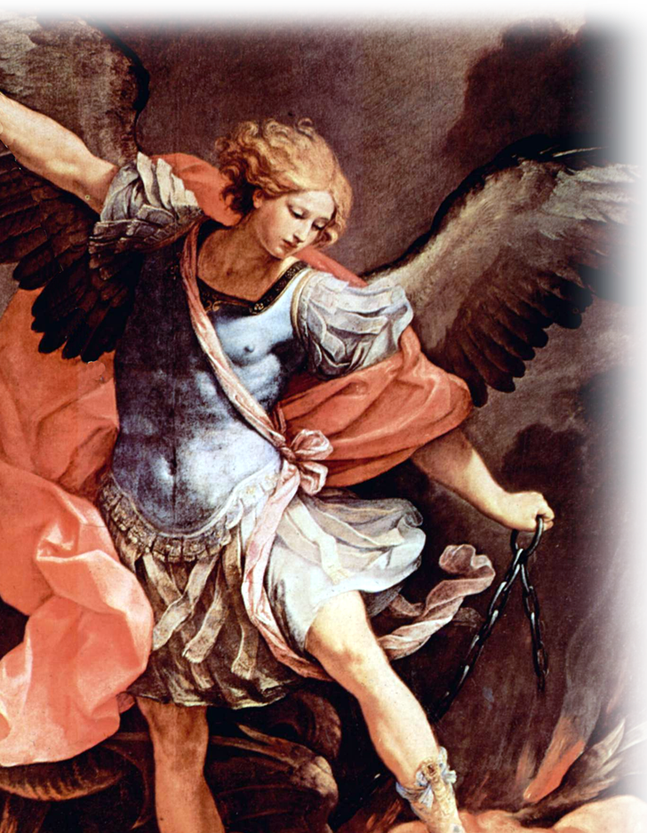
An Angel made the Announcement
Luke 2²⁶ In the sixth month, God sent the angel Gabriel to Nazareth, a town in Galilee, ²⁷ to a virgin pledged to be married to a man named Joseph, a descendant of David. The virgin's name was Mary. ²⁸ The angel went to her and said, "Greetings, you who are highly favored! The Lord is with you."
Notes:
Gabriel = FREE = https://en.wikipedia.org/wiki/Archangel#/media/File:Guido_Reni_031.jpg

Slide 8
An Angel made the Announcement
²⁹ Mary was greatly troubled at his words and wondered what kind of greeting this might be.
³⁰ But the angel said to her, "Do not be afraid, Mary, you have found favor with God. ³¹ You will be with child and give birth to a son, and you are to give him the name Jesus.

Slide 9
Again, an Angel Announced
to Joseph

Slide 10
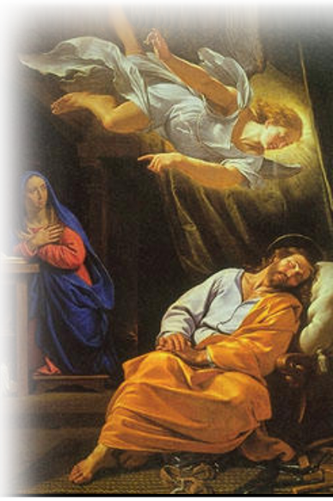
Again, an Angel Announced
^{Mat 1:20} an angel of the Lord appeared to him in a dream and said, "Joseph son of David, do not be afraid to take Mary home as your wife, because what is conceived in her is from the Holy Spirit. ²¹ She will give birth to a son, and you are to give him the name Jesus, because he will save his people from their sins."
Notes:
Joseph Dreaming = FREE + https://en.wikipedia.org/wiki/Saint_Joseph%27s_dreams#/media/File:The_Dream_of_Saint_Joseph.jpg

Slide 11
Again, an Angel Announced
^{1:24} When Joseph woke up, he did what the angel of the Lord had commanded him and took Mary home as his wife.

Slide 12
And again, Angels Announced
to the Shepherds

Slide 13
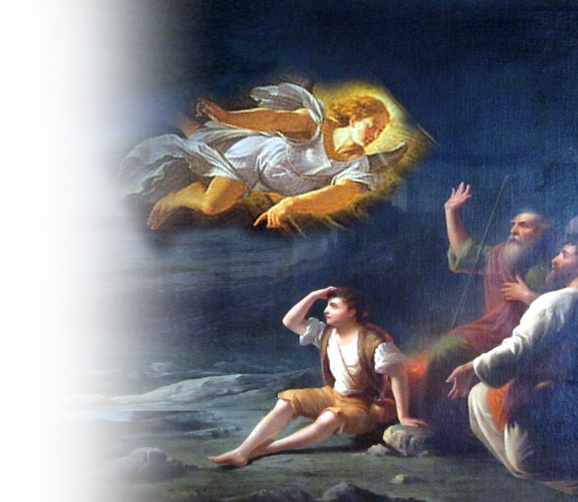
And again, Angels Announced
⁹ An angel of the Lord appeared to them, and the glory of the Lord shone around them, and they were terrified. ¹⁰ But the angel said to them, "Do not be afraid. I bring you good news of great joy that will be for all the people.
Notes:
Angel = FREE = https://en.wikipedia.org/wiki/Saint_Joseph%27s_dreams#/media/File:The_Dream_of_Saint_Joseph.jpg
Shepherds = FREE = https://commons.wikimedia.org/wiki/File:%27The_Angel_Appearing_before_the_Shepherds%27_by_Thomas_Buchanan_Read,_Dayton_Art_Institute.JPG

Slide 14
And again, Angels Announced
¹¹ Today in the town of David a Savior has been born to you; he is Christ the Lord. ¹² This will be a sign to you: You will find a baby wrapped in cloths and lying in a manger."

Slide 15
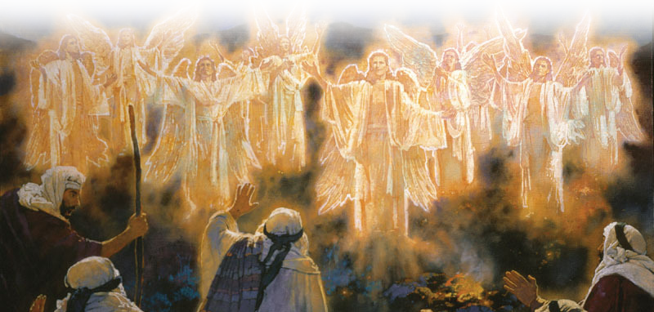
And again, Angels Announced
¹³ Suddenly a great company of the heavenly host appeared with the angel, praising God and saying, ¹⁴ "Glory to God in the highest, and on earth peace to men on whom his favor rests."

Slide 16
Finally, an Angel Warns
about Herod to Joseph

Slide 17
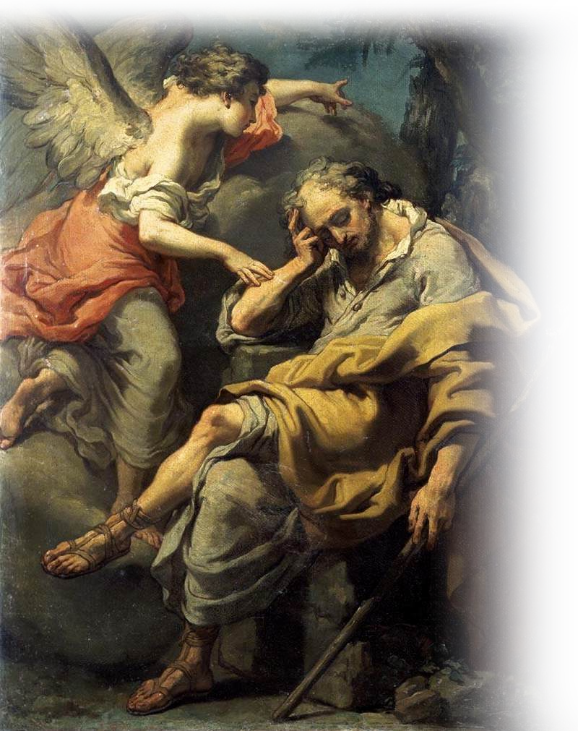
Finally, an Angel Warns
2¹³ When they (the Magi) had gone,
an angel of the Lord appeared to Joseph in a dream. "Get up," he said, "take the child and his mother and escape to Egypt. Stay there until I
tell you, for Herod is going to search for the child to kill him.“ ¹⁹ After
Herod died, an angel of the Lord appeared in a dream to Joseph in Egypt
Notes:
Wiki photo

Slide 18
Angels have a part in Christmas and Amazing as Angels are ...
^{Heb.1:4} ... he became as much superior to the angels as the name he has inherited is superior to theirs.

Slide 19
Angels have a part in Christmas and Amazing as Angels are ...
^{Heb.1:4} ... he became as much superior to the angels as the name he has inherited is superior to theirs.

Slide 20
Angels have a part in Christmas and Amazing as Angels are ...
^{Heb.1:4} ... he became as much superior to the angels as the name he has inherited is superior to theirs.
Jesus is SUPERIOR by far!

Slide 21
Angels have a part in Christmas and Amazing as Angels are ...
^{Heb.1:4} So he became as much superior to the angels as the name he has inherited is superior to theirs.
Jesus is SUPERIOR by far!

Slide 22
Angels have a part in Christmas and Amazing as Angels are ...
^{Heb.1:4} So he became as much superior to the angels as the name he has inherited is superior to theirs.
Jesus is SUPERIOR by far!

Slide 23
Jesus is called “MY SON”Heb 1:6
Notes:
Firstborn = Positional = ranking not origins

Slide 24
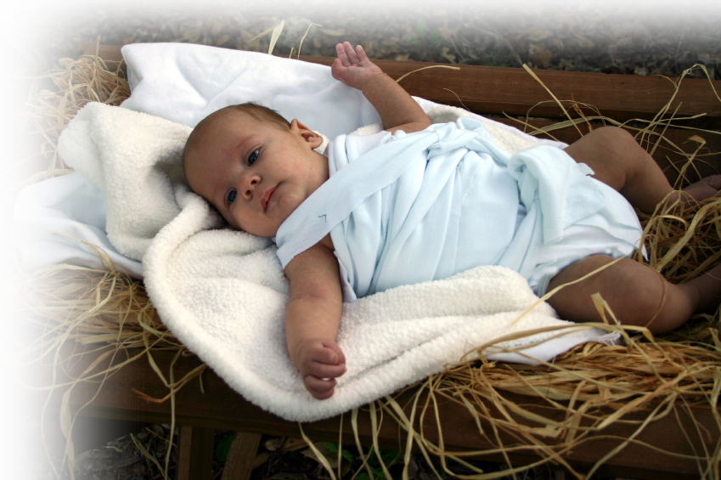
Jesus is called “MY SON”Heb 1:6
⁵ For to which of the angels did God ever say, "You are my Son; today I have become your Father"? Or again, "I will be his Father, and he will be my Son"?
Psalm 2:7
Notes:
Firstborn = Positional = ranking not origins

Slide 25
Jesus is called “FIRSTBORN”Heb 1:6
Notes:
https://commons.wikimedia.org/wiki/File:Grady_Sizemore_Foam_Finger.jpg
Firstborn = Positional = ranking not origins

Slide 26
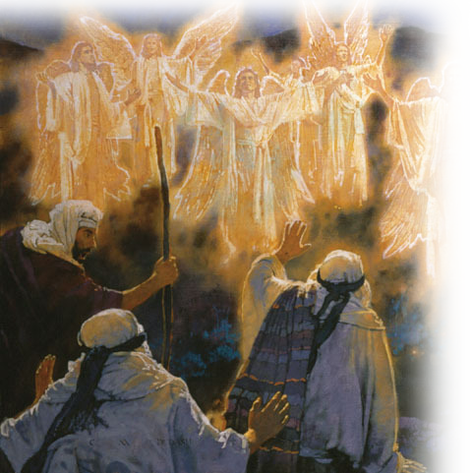

Jesus is called “FIRSTBORN”Heb 1:6
⁶ And again, when God brings his firstborn into the world, he says, "Let all God's angels worship him.“
Psalm 97:7
Notes:
https://commons.wikimedia.org/wiki/File:Grady_Sizemore_Foam_Finger.jpg
Angels = FREE = https://www.flickr.com/photos/eoskins/27477720999
Firstborn = Positional = ranking not origins
Although the word is used predominately for being the first born heir, David is called “appointed firstborn” by God in Psalm 89:27 even though he was the youngest of 8 sons of Jesse. Obviously, it means that David had preeminence over his brothers—he was anointed King, they were not.

Slide 27
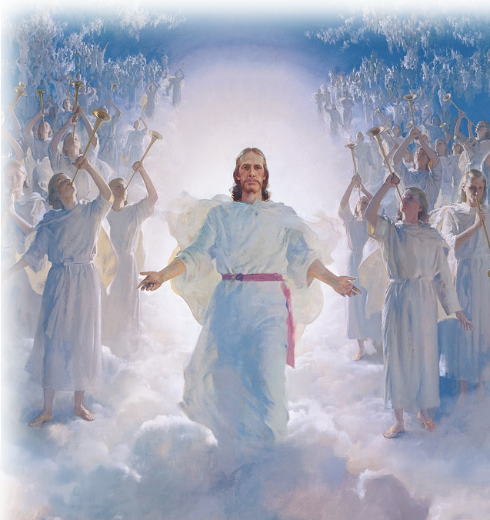
Jesus is called “FIRSTBORN”Heb 1:6
⁶ But when he again brings his firstborn into the world, he says, "Let all the angels of God worship him!" (Heb 1:6 NET)
Psalm 97:7
Notes:
https://commons.wikimedia.org/wiki/File:Grady_Sizemore_Foam_Finger.jpg
Firstborn = Positional = ranking not origins
Second Coming = FREE = https://www.flickr.com/photos/waitingfortheword/5733158786

Slide 28

Regarding Angels ...
Notes:
Modified Servnt = FREE = https://pixabay.com/en/butler-dining-dinner-service-159811/

Slide 29
Regarding Angels ...
⁷ In speaking of the angels he says, "He makes his angels winds, his servants flames of fire.“
Psalm 104:4
Psalm 104:4
Notes:
Modified Servnt = FREE = https://pixabay.com/en/butler-dining-dinner-service-159811/

Slide 30
Regarding Angels ...
⁷ In speaking of the angels he says, "He makes his angels winds, his servants flames of fire.“
¹⁴ Are not all angels ministering spirits sent to serve those who will inherit salvation?
Psalm 104:4
Notes:
Modified Servnt = FREE = https://pixabay.com/en/butler-dining-dinner-service-159811/

Slide 31
As AMAZING as Angels are ...
^{Heb.1:4} ... he became as much superior to the angels as the name he has inherited is superior to theirs.
Jesus is SUPERIOR by far!

Slide 32
Jesus is called “GOD” Heb 1:8-9
Notes:
Theological = Diety

Slide 33

Jesus is called “GOD” Heb 1:8-9
⁸ But about the Son he says, "Your throne, O God, will last for ever and ever, and righteousness will be the scepter of your kingdom.
⁹ You have loved righteousness and hated wickedness; therefore God, your God, has set you above your companions by anointing you with the oil of joy.“
Psalm 45:6,7
Notes:
Theological = Diety
He does not call the Son an angel –instead God calls Jesus, God!

Slide 34
Jesus is called “CREATOR” Heb 1:10
Notes:
https://de.wikipedia.org/wiki/Die_Erschaffung_Adams + https://pixabay.com/en/universe-sky-star-space-cosmos-2742113/
Practical = He is the Creator”

Slide 35
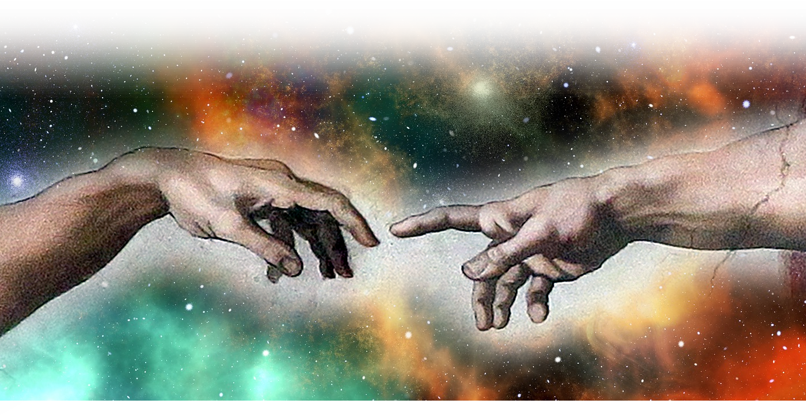
Jesus is called “CREATOR” Heb 1:10
¹⁰ He also says, "In the beginning, O Lord, you laid the foundations of the earth, and the heavens are the work of your hands.
Psalm 102:25
Notes:
https://de.wikipedia.org/wiki/Die_Erschaffung_Adams + https://pixabay.com/en/universe-sky-star-space-cosmos-2742113/
Practical = He is the Creator”
There are 176 references to God creating using a form of the word create alone.
This passage sounds so similar to Genesis 1:1 “in the beginning God created the heavens and earth.” While here both earth and heaven are mentioned but poetically calling it “laying the foundation and the works of Gods/Jesus’ hands.
The picture here is Michael Angelo’s hand of God creating Adam. The original man.
I found this recent article very interesting: FoxNews Website by

Slide 36
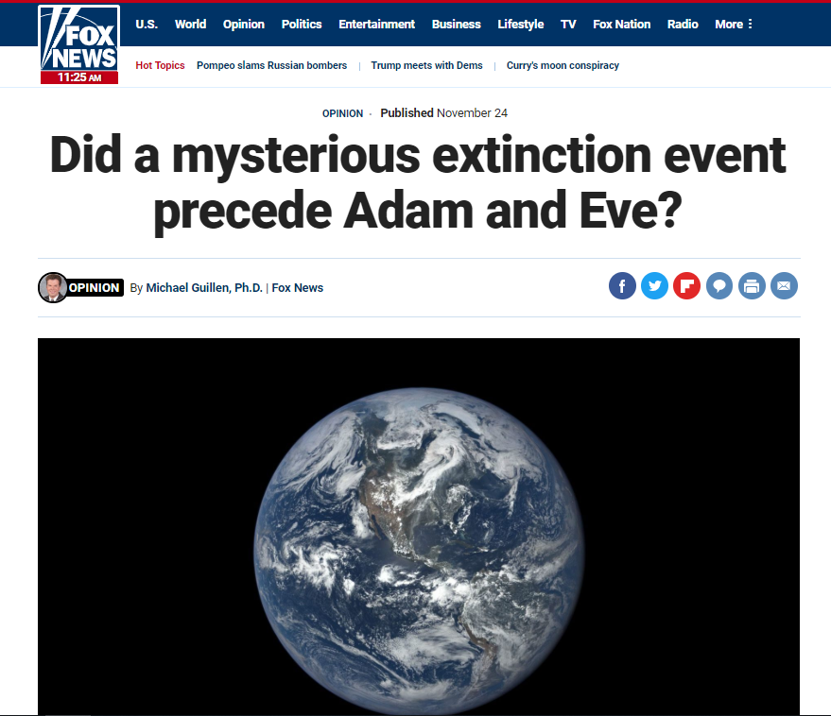
Jesus is called “CREATOR” Heb 1:10
¹⁰ He also says, "In the beginning, O Lord, you laid the foundations of the earth, and the heavens are the work of your hands.
Psalm 102:25
Notes:
https://de.wikipedia.org/wiki/Die_Erschaffung_Adams + https://pixabay.com/en/universe-sky-star-space-cosmos-2742113/
Practical = He is the Creator”
There are 176 references to God creating using a form of the word create alone.
This passage sounds so similar to Genesis 1:1 “in the beginning God created the heavens and earth.” While here both earth and heaven are mentioned but poetically calling it “laying the foundation and the works of Gods/Jesus’ hands.
The picture here is Michael Angelo’s hand of God creating Adam. The original man.
I found this recent article very interesting: FoxNews Published November 24 2018
In one of the most provocative and misunderstood studies of the year, scientists in the U.S. and Switzerland have made an astonishing discovery: All humans alive today are the offspring of a common father and mother – an Adam and Eve – who walked the planet 100,000 to 200,000 years ago, which by evolutionary standards is like yesterday. Moreover, the same is true of nine out of every 10 animal species, meaning that nearly all of Earth’s creatures living today sprang into being recently from some seminal, Big Bang-like event.
Mark Stoeckle at Rockefeller University and David Thaler at the University of Basel reached this striking conclusion after analyzing the DNA “bar codes” of five million animals from 100,000 different species. The bar codes are snippets of DNA that reside outside the nuclei of living cells – so-called mitochondrial DNA, which mothers pass down from generation to generation.
With each reproduction, errors creep into the bar code, as they do when you repeatedly photocopy a document. By measuring the accumulated errors – the blurriness or “diversity” among the bar codes – scientists are able to infer the passage of time.
That’s how Stoeckle and Thaler concluded that ninety percent of all animal species alive today come from parents that all began giving birth at roughly the same time, less than a quarter-million years ago. “This conclusion is very surprising,” Thaler avers, “and I fought against it as hard as I could.”
What caused animal life on Earth to be almost completely renewed such a short time ago? For now, it remains a mystery.
It’s possible something far more powerful than H-bombs decimated life and only a single set of parents for each species survived to live and procreate another day. But the last major extinction event we know about – the one that snuffed out the mighty dinosaurs – happened a full 65 million years ago.
It’s also possible there is something in nature that limits the size of an animal population. Perhaps it’s some built-in evolutionary process that when a population gets too big, it crashes and must restart itself from scratch.
In their report, published in Human Evolution, Stoeckle and Thaler offer other possible explanations, including, Thaler explains, “ice ages and other forms of environmental change, infections, predation, competition from other species and for limited resources, and interactions among these forces.” Whatever the explanation, he adds, the takeaway is this: “all of animal life experiences pulses of growth and stasis or near extinction on similar time scales.”
That is, humans, elephants, birds, you name it – Earth’s creatures tend to stand and fall in unison, like the rising and falling of the tides. And even though we don’t know what Svengali is directing the show, we now have scientific evidence that it wipes the slate clean far more frequently than we ever imagined.
Many religious commentators misunderstand this study to mean that species abruptly came into being only recently. To be clear: according to evolutionary biologists, species developed gradually over many millions of years. Stoeckle and Thaler’s discovery is that something happened roughly 100,000 years ago that created entirely new populations from long-existing species.
That said, Stoeckle and Thaler’s study does line up with the Bible in at least two notable ways. First, it affirms that we and our fellow creatures on Earth arose from a recent and profound creation event, orchestrated by some unknown mechanism. And second, the DNA bar codes reveal that species are quantized. Instead of there being a continuum of animal varieties, as one might expect from millions of years of gradual evolution, creatures fall into very distinct, widely separated populations – what the Bible describes as “kinds,” from the Hebrew word min.
“Darwin struggled to understand the absence of intermediates and his questions remain fruitful [to this day],” says Thaler. What the new study discovered, he explains, is that “If individuals are stars, then species are galaxies. They are compact clusters in the vastness of empty sequence space.”
Above all, Stoeckle and Thaler’s intriguing study serves up hard evidence for the astonishing fragility of life and a humbling lesson for the high-and-mighty among us. It proves we are at the mercy of forces we do not see nor understand; forces that made our existence possible a few hundred thousand years ago and that just as quickly – in the twinkling of an eye – can and will one day take us out.
Michael Guillen Ph.D., former Emmy-winning ABC News Science Editor, taught physics at Harvard and is now president of Spectacular Science Productions. His thriller, "The Null Prophecy," was released in July, 2017. His new book, "The End Of Life As We Know It: Ominous News From The Frontiers Of Science," is available now.
Michael Guillen: Emmy Award Winner and Bestselling Author
A three-time Emmy Award winner, best-selling author, and former Harvard University instructor, Dr. Michael Guillen is known and loved by millions as the ABC News Science Editor, a post he filled for fourteen years (1988-2002). In that capacity, he appeared regularly on Good Morning America, 20/20, Nightline and World News Tonight. He is host of “Where Did It Come From?,” a popular, weekly, one-hour primetime series for The History Channel that debuted in Fall 2006.
In association with Anonymous Content, Dr. Guillen produced LITTLE RED WAGON, an award-winning theatrical motion picture written by Patrick Sheane Duncan (MR. HOLLAND’S OPUS), directed by David Anspaugh (RUDY, HOOSIERS), and inspired by the true story of young Zach Bonner, who in 2010 completed his historic March Across America (Jacksonville, FL to Santa Monica, CA) on behalf of our nation’s estimated 1.3 million homeless children.
Among Dr. Guillen’s past television projects, he served as writer and host of the PBS special “Wit, Grit, and Robot Games,” the ten-part PBS series “Great Minds of Business” and “Great Minds of Medicine,” and the ABC special “SeaWorld Mother Earth Celebration” with co-host Mayim Bialik (“Blossom”). Additionally, he has brought his skills as a consultant and technical advisor to studios such as MGM, Fox and Buena Vista, as well as Walt Disney’s Epcot Center.
At Kennedy Space Center in Cape Canaveral covering John Glenn’s shuttle launch for ABC News, 1998
Over the years, Dr. Guillen has written hundreds of articles for many distinguished publications, from magazines such as Science News and Psychology Today to national newspapers including The New York Timesand The Washington Post. He is the best-selling author of two critically acclaimed books for the general public about mathematics: Bridges to Infinity: the Human Side of Mathematics and Five Equations that Changed the World: the Power and Poetry of Mathematics. He is the author of Can a Smart Person Believe in God?, which tells of his lifelong attempt to reconcile his scientific career with his deeply religious upbringing, and Amazing Truths: How Science and the Bible Agree, which looks at ten great truths affirmed by science and the Bible.
A native of East Los Angeles, Dr. Guillen earned his B.S. from UCLA and his Ph.D. in physics, mathematics and astronomy from Cornell University. For eight years thereafter, he distinguished himself as an award-winning physics instructor at Harvard University. He has received Honorary Doctorates from the University of Maryland and Pepperdine University. A coveted public speaker, he is a member of the National Association of Science Writers and, in 2000, was elected to the renowned Explorers Club, a century-old professional society.
Dr. Michael Guillen is president of Spectacular Science Productions Inc., and Filmanthropy Media Incorporated, as well as chairman and president of Philanthropy Project. He lives in Nashville with his wife, son, horse Jim Dandy, donkeys Violet and Seymour and sheep Sir Barton and Lady Guinevere.

Slide 37
Jesus is called “ETERNAL”
Notes:
Eternal = infinite in duration

Slide 38

Jesus is called “ETERNAL”
¹¹ They will perish, but you remain; .... ¹² ... and your years will never end."
Psalm 102:26-27
Notes:
Eternal = infinite in duration

Slide 39
Jesus is called “UNCHANGING”
Notes:
Sun Dial = FREE = https://c.pxhere.com/photos/d8/70/sundial_clock_sun_ancient_sun_dial_time_old_antique-914546.jpg!d
Immutable = without change You can count on Him

Slide 40
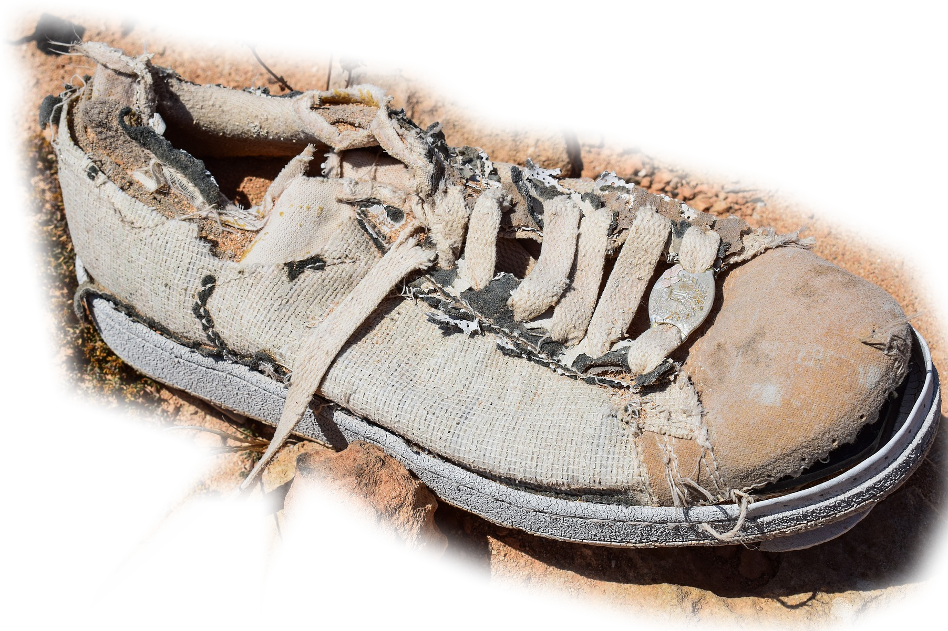

Jesus is called “UNCHANGING”
¹¹ ... they will all wear out like a garment. ¹² You will roll them up like a robe; like a garment they will be changed. But you remain the same, and your years will never end."
Psalm 102:27
Notes:
Shoe = FREE = https://pixabay.com/p-2439003/?no_redirect
Sun Dial = FREE = https://c.pxhere.com/photos/d8/70/sundial_clock_sun_ancient_sun_dial_time_old_antique-914546.jpg!d
They will all wear out = the Second Law of Thermodynamics
The Second Law of Thermodynamics states that the state of entropy of the entire universe, as an isolated system, will always increase over time.
a process of degradation or running down or a trend to disorder
Then I saw a new heaven and a new earth, for the first heaven and the first earth had passed away, (Rev 21:1 NIV)
Time takes no toll on Him.

Slide 41
Jesus is called “UNCHANGING”
¹¹ ... they will all wear out like a garment. ¹² You will roll them up like a robe; like a garment they will be changed. But you remain the same, and your years will never end."
The Second Law of Thermodynamics states that the state of entropy of the entire universe, as an isolated system, will always increase over time.
Psalm 102:27
Notes:
Shoe = FREE = https://pixabay.com/p-2439003/?no_redirect
Sun Dial = FREE = https://c.pxhere.com/photos/d8/70/sundial_clock_sun_ancient_sun_dial_time_old_antique-914546.jpg!d
They will all wear out = the Second Law of Thermodynamics
The Second Law of Thermodynamics states that the state of entropy of the entire universe, as an isolated system, will always increase over time.
a process of degradation or running down or a trend to disorder
Then I saw a new heaven and a new earth, for the first heaven and the first earth had passed away, (Rev 21:1 NIV)
Time takes no toll on Him.

Slide 42
Jesus is called “UNCHANGING”
¹¹ ... they will all wear out like a garment. ¹² You will roll them up like a robe; like a garment they will be changed. But you remain the same, and your years will never end."
Entropy = a process of degradation or running down or a trend to disorder
The Second Law of Thermodynamics states that the state of entropy of the entire universe, as an isolated system, will always increase over time.
Psalm 102:27
Notes:
Shoe = FREE = https://pixabay.com/p-2439003/?no_redirect
Sun Dial = FREE = https://c.pxhere.com/photos/d8/70/sundial_clock_sun_ancient_sun_dial_time_old_antique-914546.jpg!d
They will all wear out = the Second Law of Thermodynamics
The Second Law of Thermodynamics states that the state of entropy of the entire universe, as an isolated system, will always increase over time.
a process of degradation or running down or a trend to disorder
Then I saw a new heaven and a new earth, for the first heaven and the first earth had passed away, (Rev 21:1 NIV)
Time takes no toll on Him.

Slide 43
Jesus is called “UNCHANGING”
¹¹ ... they will all wear out like a garment. ¹² You will roll them up like a robe; like a garment they will be changed. But you remain the same, and your years will never end."
Psalm 102:27
Notes:
Shoe = FREE = https://pixabay.com/p-2439003/?no_redirect
Sun Dial = FREE = https://c.pxhere.com/photos/d8/70/sundial_clock_sun_ancient_sun_dial_time_old_antique-914546.jpg!d
They will all wear out = the Second Law of Thermodynamics
The Second Law of Thermodynamics states that the state of entropy of the entire universe, as an isolated system, will always increase over time.
a process of degradation or running down or a trend to disorder
Then I saw a new heaven and a new earth, for the first heaven and the first earth had passed away, (Rev 21:1 NIV)
Time takes no toll on Him.

Slide 44
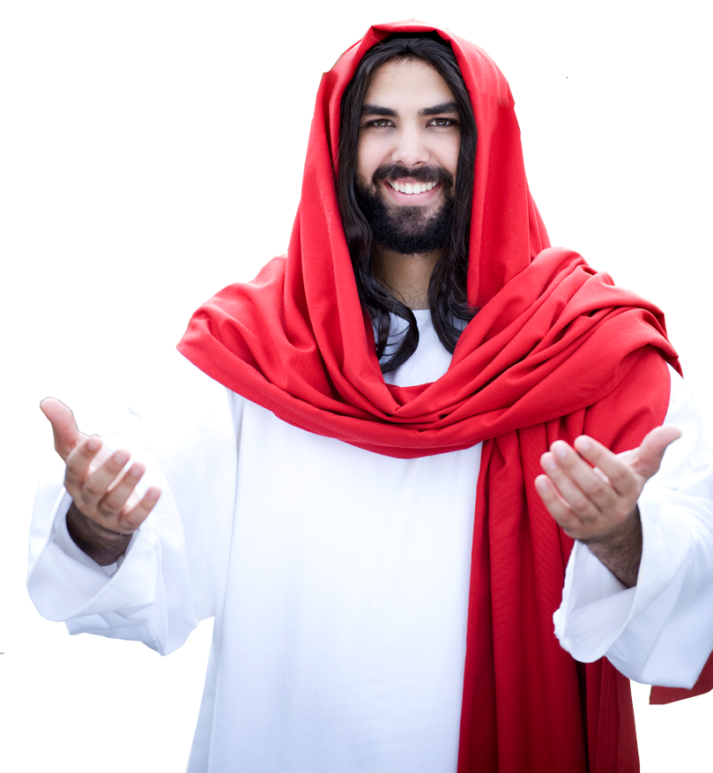
Jesus is called “UNCHANGING”
¹¹ ... they will all wear out like a garment. ¹² You will roll them up like a robe; like a garment they will be changed. But you remain the same, and your years will never end."
⁸ Jesus Christ is the same yesterday and today and forever. (Hebrews 13:8)
Psalm 102:27
Notes:
Shoe = FREE = https://pixabay.com/p-2439003/?no_redirect
Sun Dial = FREE = https://c.pxhere.com/photos/d8/70/sundial_clock_sun_ancient_sun_dial_time_old_antique-914546.jpg!d
They will all wear out = the Second Law of Thermodynamics
The Second Law of Thermodynamics states that the state of entropy of the entire universe, as an isolated system, will always increase over time.
a process of degradation or running down or a trend to disorder
Then I saw a new heaven and a new earth, for the first heaven and the first earth had passed away, (Rev 21:1 NIV)
Time takes no toll on Him.

Slide 45
Jesus is called “VICTOR”

Slide 46
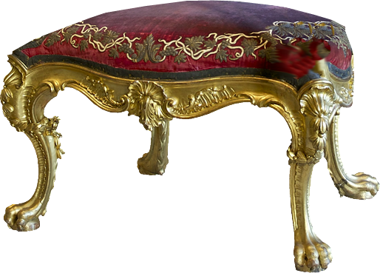
Jesus is called “VICTOR”
¹³ To which of the angels did God ever say, "Sit at my right hand until I make your enemies a footstool for your feet"?
Psalm 110:1 CF. Joshua 10:24
Notes:
I don’t like loosing! I’m so glad I am on the winning side. Jesus will conqueror all. Just read the last three chapters of the Revelation—WE WIN!

Slide 47
Notice that Jesus is called ...
“My Son” 1:4-5

Slide 48
Notice that Jesus is called ...
“My Son” 1:4-5
“Firstborn” 1:6-7

Slide 49
Notice that Jesus is called ...
“My Son” 1:4-5
“Firstborn” 1:6-7
“God” 1:8-9

Slide 50
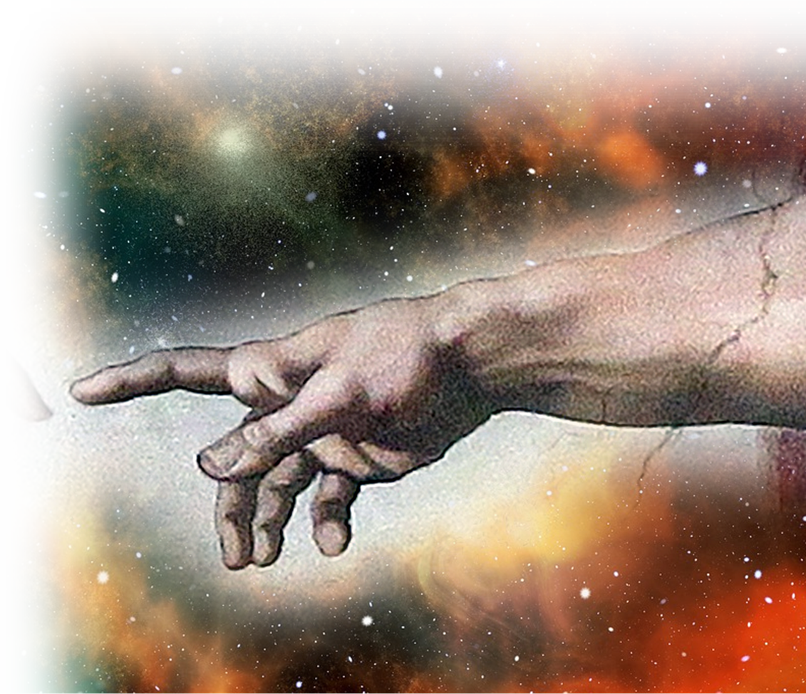
Notice that Jesus is called ...
“My Son” 1:4-5
“Firstborn” 1:6-7
“God” 1:8-9
“Creator” 1:10

Slide 51
Notice that Jesus is called ...
“My Son” 1:4-5
“Firstborn” 1:6-7
“God” 1:8-9
“Creator” 1:10
“Eternal” 1:11-12

Slide 52
Notice that Jesus is called ...
“My Son” 1:4-5
“Firstborn” 1:6-7
“God” 1:8-9
“Creator” 1:10
“Eternal” 1:11-12
“Unchanging” 1: 12

Slide 53
Notice that Jesus is called ...
“My Son” 1:4-5
“Firstborn” 1:6-7
“God” 1:8-9
“Creator” 1:10
“Eternal” 1:11-12
“Unchanging” 1: 12
“Victor” 1:13

Slide 54
While angels are called:

Slide 55
Ministering Spirits
¹⁴ Are not all angels ministering spirits sent to serve those who will inherit salvation?

Slide 56
Ministering Spirits
¹⁴ Are not all angels ministering spirits sent to serve those who will inherit salvation?

Slide 57
Ministering Spirits
¹⁴ Are not all angels ministering spirits sent to serve those who will inherit salvation?
⁷ In speaking of the angels he says, "He makes his angels winds, his servants flames of fire.“

Slide 58
As AMAZING as Angels are ...

Slide 59
As AMAZING as Angels are ...
^{Heb.1:4} ... he became as much superior to the angels as the name he has inherited is superior to theirs.
Jesus is Superior

Slide 60
Angels cannot save you!

Slide 61
Angels cannot save you!
NOT EVEN YOUR GUARDIAN ANGEL!

Slide 62
Jesus is the Savior of the World!
^{Heb.1:4} ... he became as much superior to the angels as the name he has inherited is superior to theirs.

Slide 63
Jesus is the Savior of the World!
^{Luke 2:10} the angel said to them, "Do not be afraid. I bring you good news of great joy that will be for all the people. ¹¹ Today in the town of David a Savior has been born to you; he is Christ the Lord.
^{Heb.1:4} ... he became as much superior to the angels as the name he has inherited is superior to theirs.

Slide 64
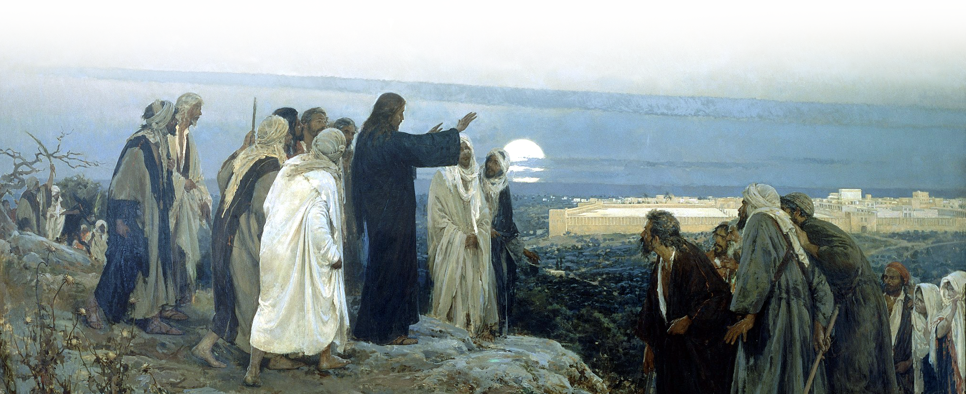
Jesus is the Savior of the World!
^{Heb.1:4} ... he became as much superior to the angels as the
^{John 4:42} "... this man really is the Savior of the world."
Notes:
https://upload.wikimedia.org/wikipedia/commons/thumb/1/1d/Enrique_Simonet_-_Flevit_super_illam_-_1892.jpg/2048px-Enrique_Simonet_-_Flevit_super_illam_-_1892.jpg

Slide 65
Make Him Your Savior Too!

Slide 66
Let’s Pray

