Slide 1
A Different Spin on
CHRISTMAS!
Notes:
Copyright © 2006−2021. All rights reserved. Bible Point is a registered trademark of Dennis Henderson. All other trademarks acknowledged.
Bible Point contains graphics from Bible Point artists. These illustrations belong to Bible Point and the respective artists. You may use the designs and illustrations for graphical illustration of lessons free and without special permission, provided they are not used in any way that maligns the Christian faith. Furthermore, republication or production of any illustration by any other graphic service whether it be in book, in a machine-readable form, or in any other design resource is strictly prohibited. Furthermore, they cannot be duplicated or resold as any other form of publishing, clip art, or graphic resource.
So What does it mean? (A simple translations of the legal jargon)
So, if you don’t own the presentation(s), graphic(s), and text(s) how can you legally use them? The purchase of the license allows you to use all the images in the product. However, the actual ownership and copyright of the presentation(s), graphic(s), and text(s) remain the property of Bible Point and its licensors. If you had plans on using this product in your “for sale” work—think again!
License Agreement
Article 1: License Grant
All the graphics and text in Bible Point presentations (excluding quotes from the Bible and stated sources) are the intellectual and real property of Bible Point and its licensors, and is protected by law, including United States copyright laws and international treaties. Bible Point grants to you a license:
1. To use the presentation in a single church, single school, or single office of a Christian organization.
2. To make a single archival back-up copy of the program.
3. To modify the presentation(s) and merge with other presentations in a single church, school, or Christian organization.
4. To transfer to another party if that party agrees to accept the terms and conditions of this agreement, and you do not retain any copies of the presentation, whether printed, machine readable, modified, or merged form.
Article 2: Terms
This license is effective until terminated. You may terminate the license at any time by destroying the presentation(s), graphic(s), or text(s) together with all copies, modifications and merged portions in any form. Bible Point may terminate your license if you fail to comply with this Agreement. You agree, upon such termination, for any reason, to destroy the presentation(s), graphics, and text(s) with all copies, modifications, and merged portions in any form.
Article 3: Disclaimers
1. Bible Point presentations, graphics, and texts are licensed to you As Is. You, the consumer, bear the entire risk relating to the quality and performance of the presentation(s), graphic(s), or text(s). In no event will Bible Point be liable for damages resulting from any defect.
2. Thirty-day limited warrantee on disks. Bible Point warrants the disks to be free of defects in material and workmanship under normal use for 30 days after purchase. During the 30-day period you may return a defective presentation, graphic, or text with proof of purchase and it will be replaced without charge, unless the presentation is damaged by misuse.
Article 4: General
1. You may not sub-license, assign, or transfer the license of the presentation(s), graphic(s), or text(s) except as provided by this Agreement.
2. This Agreement will be governed by the laws of the State of Michigan.
So What does it mean? (A simple translations of the legal jargon)
May I let someone borrow or copy my licensed Bible Point presentation (even after I modified it)? As long as it is within your local church, or single school, or the immediate office of a Christian organization you may. Otherwise, please refer the person interested in borrowing to: http://www.biblepoint.com or E-mail: dennis@DrDH.net with any related questions.

Slide 2
A Different Spin on
CHRISTMAS!
Notes:
Copyright © 2006−2021. All rights reserved. Bible Point is a registered trademark of Dennis Henderson. All other trademarks acknowledged.
Bible Point contains graphics from Bible Point artists. These illustrations belong to Bible Point and the respective artists. You may use the designs and illustrations for graphical illustration of lessons free and without special permission, provided they are not used in any way that maligns the Christian faith. Furthermore, republication or production of any illustration by any other graphic service whether it be in book, in a machine-readable form, or in any other design resource is strictly prohibited. Furthermore, they cannot be duplicated or resold as any other form of publishing, clip art, or graphic resource.
So What does it mean? (A simple translations of the legal jargon)
So, if you don’t own the presentation(s), graphic(s), and text(s) how can you legally use them? The purchase of the license allows you to use all the images in the product. However, the actual ownership and copyright of the presentation(s), graphic(s), and text(s) remain the property of Bible Point and its licensors. If you had plans on using this product in your “for sale” work—think again!
License Agreement
Article 1: License Grant
All the graphics and text in Bible Point presentations (excluding quotes from the Bible and stated sources) are the intellectual and real property of Bible Point and its licensors, and is protected by law, including United States copyright laws and international treaties. Bible Point grants to you a license:
1. To use the presentation in a single church, single school, or single office of a Christian organization.
2. To make a single archival back-up copy of the program.
3. To modify the presentation(s) and merge with other presentations in a single church, school, or Christian organization.
4. To transfer to another party if that party agrees to accept the terms and conditions of this agreement, and you do not retain any copies of the presentation, whether printed, machine readable, modified, or merged form.
Article 2: Terms
This license is effective until terminated. You may terminate the license at any time by destroying the presentation(s), graphic(s), or text(s) together with all copies, modifications and merged portions in any form. Bible Point may terminate your license if you fail to comply with this Agreement. You agree, upon such termination, for any reason, to destroy the presentation(s), graphics, and text(s) with all copies, modifications, and merged portions in any form.
Article 3: Disclaimers
1. Bible Point presentations, graphics, and texts are licensed to you As Is. You, the consumer, bear the entire risk relating to the quality and performance of the presentation(s), graphic(s), or text(s). In no event will Bible Point be liable for damages resulting from any defect.
2. Thirty-day limited warrantee on disks. Bible Point warrants the disks to be free of defects in material and workmanship under normal use for 30 days after purchase. During the 30-day period you may return a defective presentation, graphic, or text with proof of purchase and it will be replaced without charge, unless the presentation is damaged by misuse.
Article 4: General
1. You may not sub-license, assign, or transfer the license of the presentation(s), graphic(s), or text(s) except as provided by this Agreement.
2. This Agreement will be governed by the laws of the State of Michigan.
So What does it mean? (A simple translations of the legal jargon)
May I let someone borrow or copy my licensed Bible Point presentation (even after I modified it)? As long as it is within your local church, or single school, or the immediate office of a Christian organization you may. Otherwise, please refer the person interested in borrowing to: http://www.biblepoint.com or E-mail: dennis@DrDH.net with any related questions.

Slide 3
You know the story ...
Luke 2:1 In those days Caesar Augustus issued a decree that a census should be taken of the entire Roman world. ² (This was the first census that took place while Quirinius was governor of Syria.)

Slide 4
You know the story ...
³ And everyone went to his own town to register. ⁴ So Joseph also went up from the town of Nazareth in Galilee to Judea, to Bethlehem the town of David, because he belonged to the house and line of David. ⁵ He went there to register with Mary, who was pledged to be married to him and was expecting a child.

Slide 5
You know the story ...
⁶ While they were there, the time came for the baby to be born, ⁷ and she gave birth to her firstborn, a son. She wrapped him in cloths and placed him in a manger, because there was no room for them in the inn.

Slide 6
A Different Spin on
CHRISTMAS!
^{From a HEBREWS’ perspective}

Slide 7
The Christmas Story of Jesus
:
is superior to all others because:

Slide 8
Jesus is the Son Heb.1:1-2
In the past God spoke to our forefathers through the prophets at many times and in various ways, 2 but in these last days he has spoken to us by his Son
Notes:
God will reveal Himself to you when you accept His Son.
He spoke to forefathers: Adam, Noah, Abraham, Isaac, Jacob, Joseph....
He spoke to the prophets: Moses, Joshua, Judges, Samuel .... In those days the word of the LORD was rare; there were not many visions. (1Sa 3:1 NIV)
in the past about a Messiah to come. Everything in the Old Testament points to Jesus.
He has spoken ... You can have a relationship with God.

Slide 9
Jesus is the Son Heb.1:1-2
In the past God spoke to our forefathers through the prophets at many times and in various ways, 2 but in these last days he has spoken to us by his Son
Notes:
God will reveal Himself to you when you accept His Son.
He spoke to forefathers: Adam, Noah, Abraham, Isaac, Jacob, Joseph....
He spoke to the prophets: Moses, Joshua, Judges, Samuel .... In those days the word of the LORD was rare; there were not many visions. (1Sa 3:1 NIV)
in the past about a Messiah to come. Everything in the Old Testament points to Jesus.
He has spoken ... You can have a relationship with God.
His words are in this Book ... BYOB to church ... Ask for a new one for Christmas ....

Slide 10
Jesus is the Son Heb.1:1-2
In the past God spoke to our forefathers through the prophets at many times and in various ways, 2 but in these last days he has spoken to us by his Son
Notes:
This verse is contrasting the messengers who communicate the Word of God.
There were “forefathers:” Adam, Noah, Abraham, Isaac, Jacob, Joseph....
There were “Prophets:” Moses, Joshua, Judges, Samuel .... In those days the word of the LORD was rare; there were not many visions. (1Sa 3:1 NIV)
But the messengers were so inferior to this messenger because he is “Son.” (text does not say “His” or “the” or “a” –just “Son.”
Point is none of the others could claim to be the Son of God.
Remember at the transfiguration of Jesus, the father said, "This is my Son, whom I love; with him I am well pleased. Listen to him!"
(Mat 17:5 NIV)
That’s the Point—Because the messenger is so superior – really listen to him.
God will reveal Himself to you when you accept His Son.
He spoke to forefathers: Adam, Noah, Abraham, Isaac, Jacob, Joseph....
He spoke to the prophets:
in the past about a Messiah to come. Everything in the Old Testament points to Jesus.
He has spoken ... You can have a relationship with God.
His words are in this Book ... BYOB to church ... Ask for a new one for Christmas ....

Slide 11
Jesus is the Son Heb.1:1-2
In the past God spoke to our forefathers through the prophets at many times and in various ways, 2 but in these last days he has spoken to us by his Son
He is superior because ...
Notes:
This verse is contrasting the messengers who communicate the Word of God.
There were “forefathers:” Adam, Noah, Abraham, Isaac, Jacob, Joseph....
There were “Prophets:” Moses, Joshua, Judges, Samuel .... In those days the word of the LORD was rare; there were not many visions. (1Sa 3:1 NIV)
But the messengers were so inferior to this messenger because he is “Son.” (text does not say “His” or “the” or “a” –just “Son.”
Point is none of the others could claim to be the Son of God.
Remember at the transfiguration of Jesus, the father said, "This is my Son, whom I love; with him I am well pleased. Listen to him!"
(Mat 17:5 NIV)
That’s the Point—Because the messenger is so superior – really listen to him.
God will reveal Himself to you when you accept His Son.
He spoke to forefathers: Adam, Noah, Abraham, Isaac, Jacob, Joseph....
He spoke to the prophets:
in the past about a Messiah to come. Everything in the Old Testament points to Jesus.
He has spoken ... You can have a relationship with God.
His words are in this Book ... BYOB to church ... Ask for a new one for Christmas ....

Slide 12
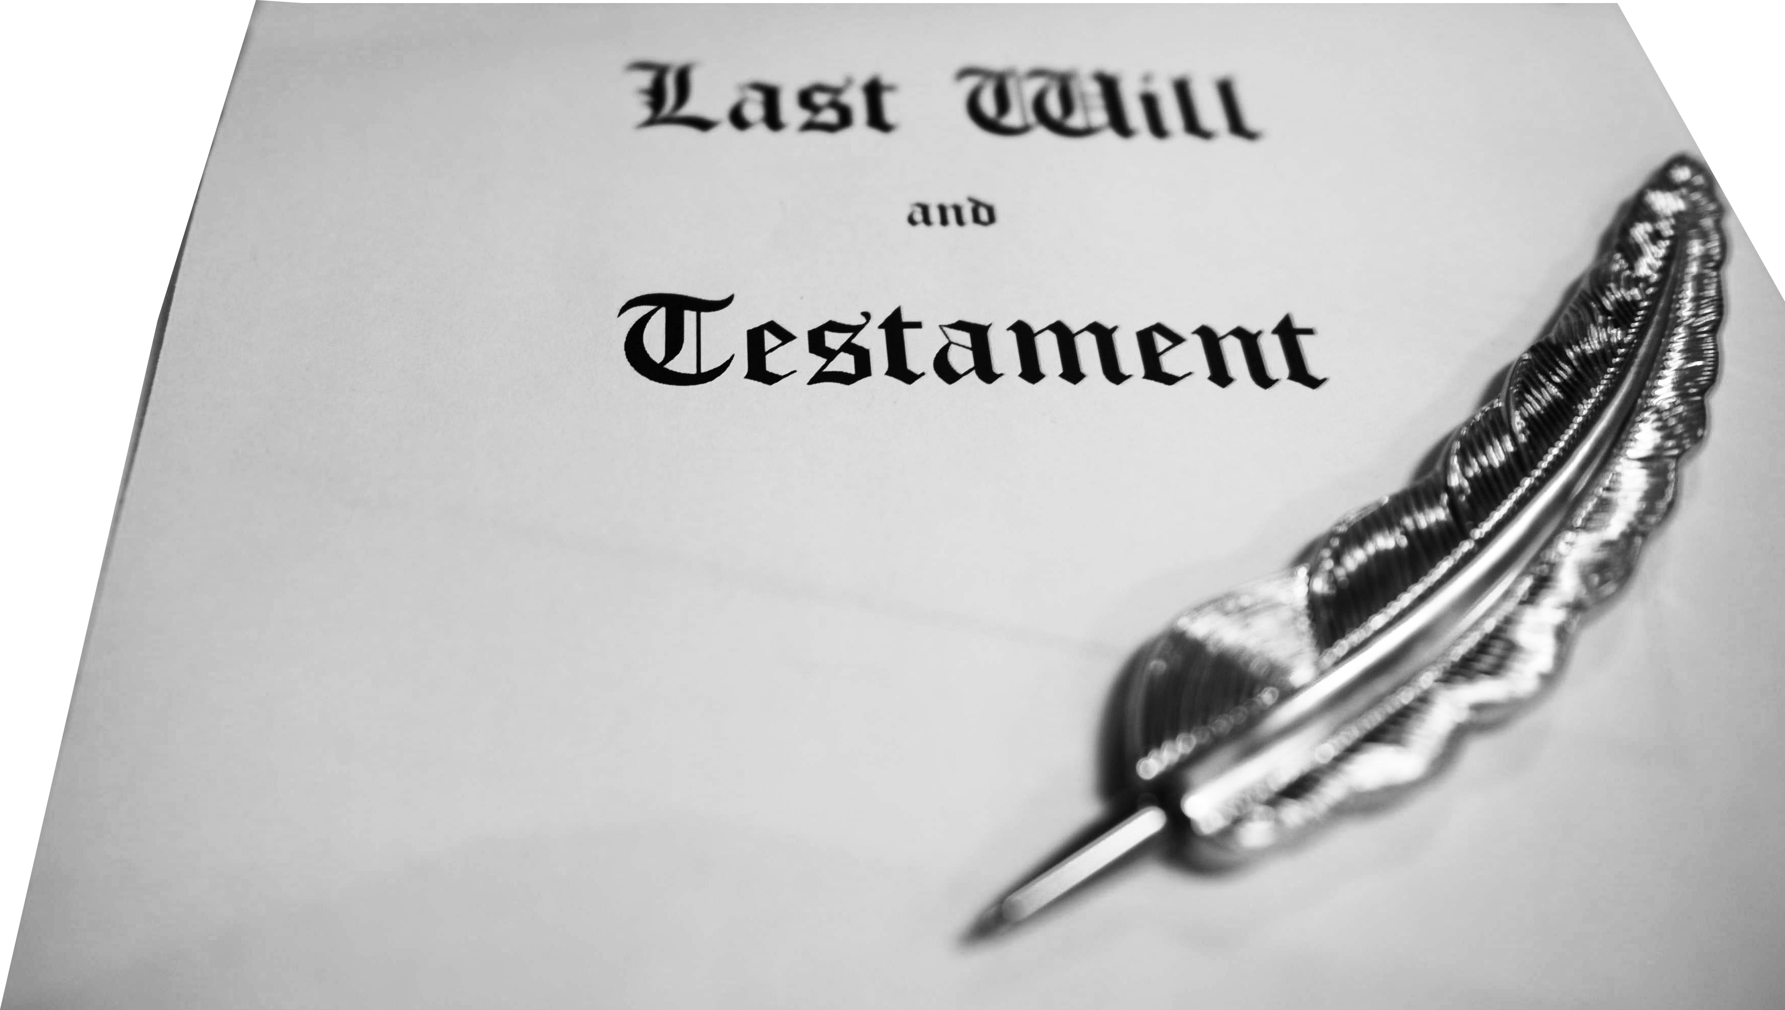
1. Jesus is the Heir 1:2
2 ... whom he appointed heir of all things,
Notes:
Last Will = Free = https://media.defense.gov/2014/Jul/08/2000834387/-1/-1/0/140630-F-MI136-013.JPG
Jesus inherits everything! (Ps 2:2-8) It is all his.
Since everything is rightly His... He owns it all ...
He offers you more than you could ever imagine: an abundant life of forgiveness, purpose, meaning, acceptance. He chose you, saved you, loves you unconditionally, etc.

Slide 13
1. Jesus is the Heir 1:2
2 ... whom he appointed heir of all things,
⁷ I will proclaim the decree of the LORD: He said to me, "You are my Son; today I have become your Father. ⁸ Ask of me, and I will make the nations your inheritance, the ends of the earth your possession. (Psalm 2:7-8)
Notes:
Last Will = Free = https://media.defense.gov/2014/Jul/08/2000834387/-1/-1/0/140630-F-MI136-013.JPG
Jesus inherits everything! (Ps 2:2-8) It is all his.
Since everything is rightly His... He owns it all ...
He offers you more than you could ever imagine: an abundant life of forgiveness, purpose, meaning, acceptance. He chose you, saved you, loves you unconditionally, etc.

Slide 14
1. Jesus is the Heir 1:2
2 ... whom he appointed heir of all things,
I have come that they may have life, and have it to the full. (John 10:10)
Notes:
Last Will = Free = https://media.defense.gov/2014/Jul/08/2000834387/-1/-1/0/140630-F-MI136-013.JPG
Jesus inherits everything! (Ps 2:2-8) It is all his.
Since everything is rightly His... He owns it all ...
He offers you more than you could ever imagine: an abundant life of forgiveness, purpose, meaning, acceptance. He chose you, saved you, loves you unconditionally, etc.

Slide 15
1. Jesus is the Heir 1:2
2 ... whom he appointed heir of all things,
I have come that they may have life, and have it to the full. (John 10:10)
²⁸ I give them eternal life, and they shall never perish; (Joh 10:28 NIV)
Notes:
Last Will = Free = https://media.defense.gov/2014/Jul/08/2000834387/-1/-1/0/140630-F-MI136-013.JPG
Jesus inherits everything! (Ps 2:2-8) It is all his.
Since everything is rightly His... He owns it all ...
He offers you more than you could ever imagine: an abundant life of forgiveness, purpose, meaning, acceptance. He chose you, saved you, loves you unconditionally, etc.

Slide 16
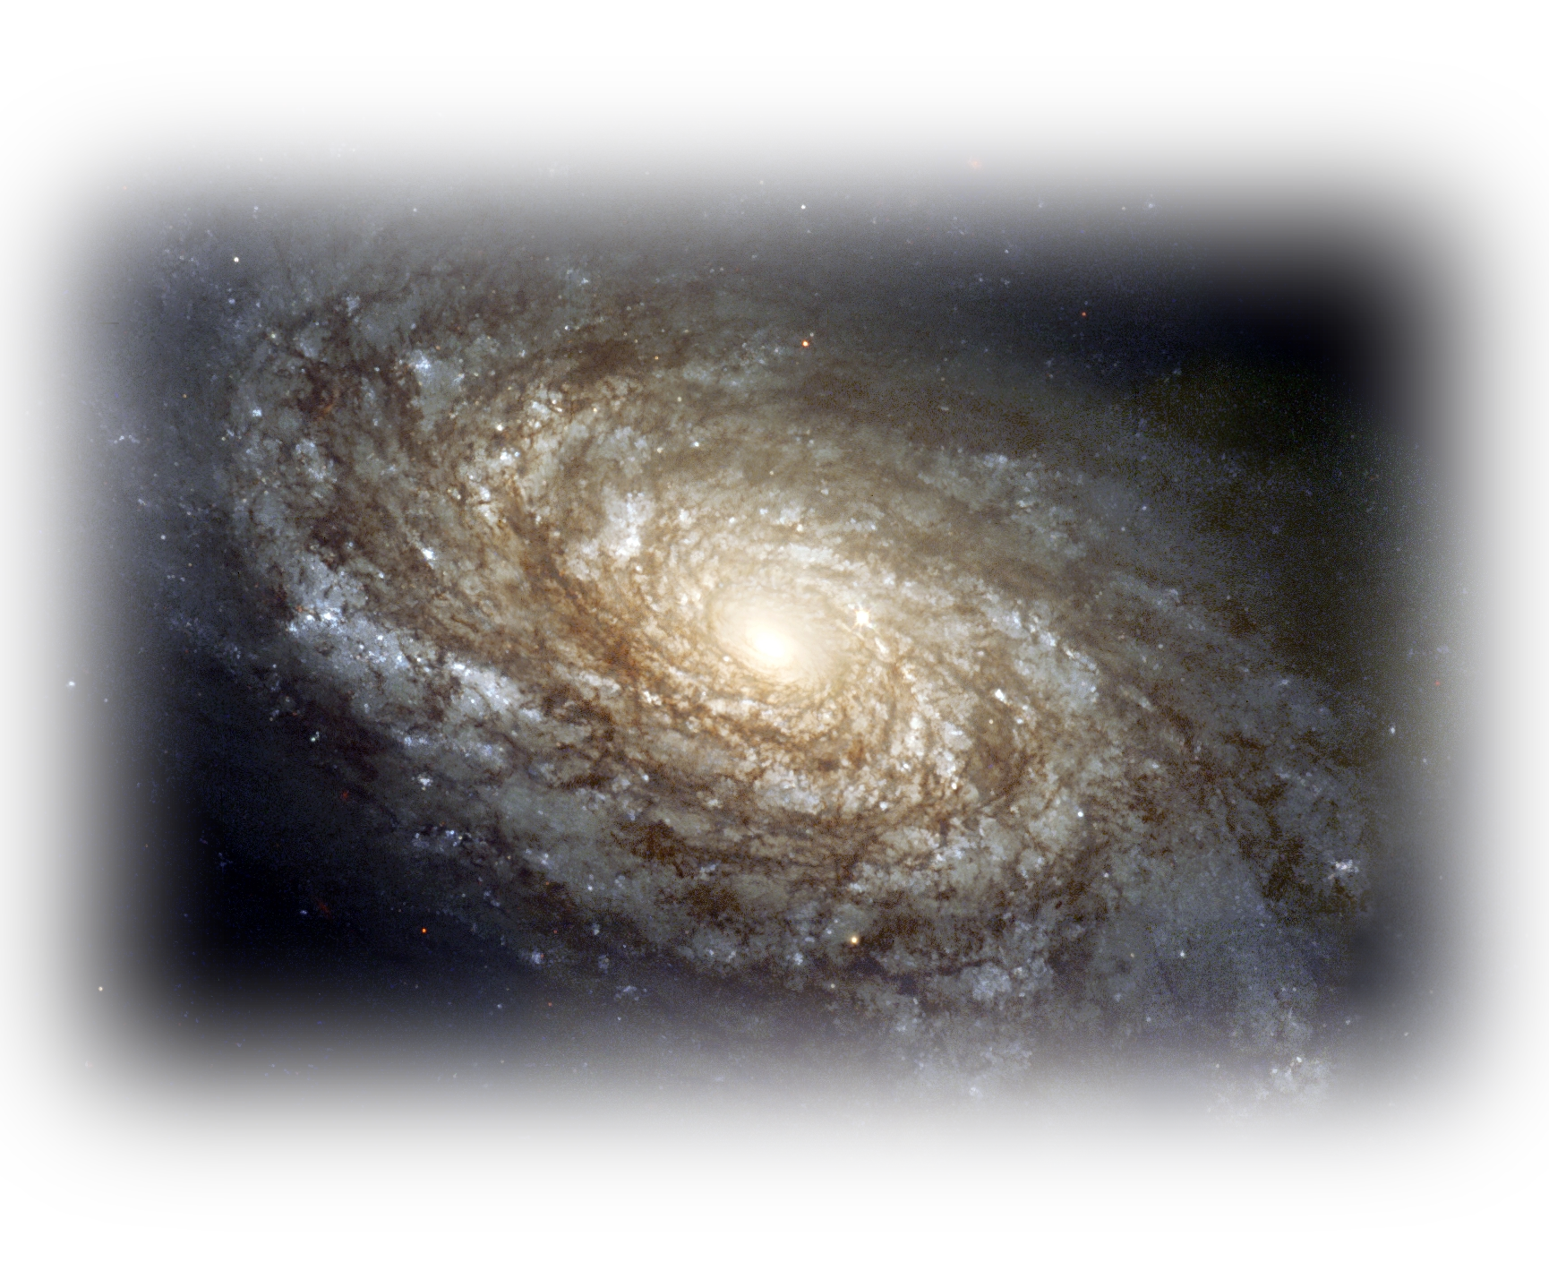
2. Jesus is the Creator 1:2
2 ... and through whom he made the universe.
Notes:
https://en.wikipedia.org/wiki/Galaxy#/media/File:NGC_4414_(NASA-med).jpg
Literally: “He made the ages” or “He made time”
This is huge ... Because even scientists recognize that time is a part of creation. Before creation there was not time. So to say he created the ages is to say he created the universe ... Compare Stephen Hawkings
So what does all that mean to me and you ...
He made you to be uniquely you to accomplish his unique plan for your life. He placed you in this present age – there are not mistakes, you belong here now, not by chance by divine design.
While the evolutionist says you are just a random mistake that happened by accident.
Christmas is about God the Creator invading His own universe that He made with a purpose of meaningful relationships. There are no accident in His world.

Slide 17
2. Jesus is the Creator 1:2
ages.
2 ... and through whom he made the universe.
Notes:
https://en.wikipedia.org/wiki/Galaxy#/media/File:NGC_4414_(NASA-med).jpg
Literally: “He made the ages” or “He made time”
This is huge ... Because even scientists recognize that time is a part of creation. Before creation there was not time. So to say he created the ages is to say he created the universe ... Compare Stephen Hawkings
So what does all that mean to me and you ...
He made you to be uniquely you to accomplish his unique plan for your life. He placed you in this present age – there are not mistakes, you belong here now, not by chance by divine design.
While the evolutionist says you are just a random mistake that happened by accident.
Christmas is about God the Creator invading His own universe that He made with a purpose of meaningful relationships. There are no accident in His world.

Slide 18
2. Jesus is the Creator 1:2
ages.
2 ... and through whom he made the universe.
Jesus placed you in this present age
and made you to be uniquely you
in order to accomplish his unique plan for your life.
Notes:
https://en.wikipedia.org/wiki/Galaxy#/media/File:NGC_4414_(NASA-med).jpg
Literally: “He made the ages” or “He made time”
This is huge ... Because even scientists recognize that time is a part of creation. Before creation there was not time. So to say he created the ages is to say he created the universe ... Compare Stephen Hawkings
So what does all that mean to me and you ...
He made you to be uniquely you to accomplish his unique plan for your life. He placed you in this present age – there are not mistakes, you belong here now, not by chance by divine design.
While the evolutionist says you are just a random mistake that happened by accident.
Christmas is about God the Creator invading His own universe that He made with a purpose of meaningful relationships. There are no accident in His world.

Slide 19

3. Jesus is the Radiator 1:3
3 The Son is the radiance of God's glory
Notes:
https://upload.wikimedia.org/wikipedia/commons/thumb/d/df/Thrissur_Pooram_%28Radiance%29_DSCF8568.JPG/2048px-Thrissur_Pooram_%28Radiance%29_DSCF8568.JPG
Radiance = Effulgence – emitted from a source. Like the sun emits light rays. One does not exist without the other. Jesus is like the Ray, the Father is like the sun.
God the Son and God the Father are inseparable linked .
Now Jesus didn’t walk around with a halo, but he did manifest Deity through his miraculous powers. John 1:14 says we beheld his glory as the one and only Son of God.
Here’s the deal for us...When Jesus invades your life at salvation, the glory of God is also within you. You need to work it out.
1 Cor 10: 31 So whether you eat or drink or whatever you do, do it all for the glory of God. (1Co 10:31 NIV)

Slide 20
3. Jesus is the Radiator 1:3
3 The Son is the radiance of God's glory
When Jesus invades your life ...
“whether you eat or drink or whatever you do, do it all for the glory of God.” (1Cor 10:31)
Notes:
https://upload.wikimedia.org/wikipedia/commons/thumb/d/df/Thrissur_Pooram_%28Radiance%29_DSCF8568.JPG/2048px-Thrissur_Pooram_%28Radiance%29_DSCF8568.JPG
Radiance = Effulgence – emitted from a source. Like the sun emits light rays. One does not exist without the other. Jesus is like the Ray, the Father is like the sun.
God the Son and God the Father are inseparable linked .
Now Jesus didn’t walk around with a halo, but he did manifest Deity through his miraculous powers. John 1:14 says we beheld his glory as the one and only Son of God.
Here’s the deal for us...When Jesus invades your life at salvation, the glory of God is also within you. You need to work it out.
1 Cor 10: 31 So whether you eat or drink or whatever you do, do it all for the glory of God. (1Co 10:31 NIV)

Slide 21
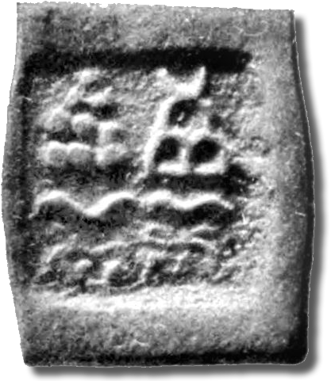
4. Jesus is the Representative 1:3
3 ... and the exact representation of his being,
Notes:
Both the Father Son and Holy Spirit are of the same mold, so to speak. So much so that Jesus says “Anyone who has seen me has seen the Father. (Joh 14:9 NIV)
Isaiah called him, “Emmanuel” = God with us!”
Here’s the point, If you want a personal relationship with God, you must do so through Jesus Christ.

Slide 22
4. Jesus is the Representative 1:3
3 ... and the exact representation of his being,
They will call him Immanuel"--which means, "God with us." (Mat 1:23)
Notes:
Both the Father Son and Holy Spirit are of the same mold, so to speak. So much so that Jesus says “Anyone who has seen me has seen the Father. (Joh 14:9 NIV)
Isaiah called him, “Emmanuel” = God with us!”
Here’s the point, If you want a personal relationship with God, you must do so through Jesus Christ.

Slide 23
4. Jesus is the Representative 1:3
3 ... and the exact representation of his being,
They will call him Immanuel"--which means, "God with us." (Mat 1:23)
Anyone who has seen me has seen the Father. (John 14:9)
Notes:
Both the Father Son and Holy Spirit are of the same mold, so to speak. So much so that Jesus says “Anyone who has seen me has seen the Father. (Joh 14:9 NIV)
Isaiah called him, “Emmanuel” = God with us!”
Here’s the point, If you want a personal relationship with God, you must do so through Jesus Christ.

Slide 24
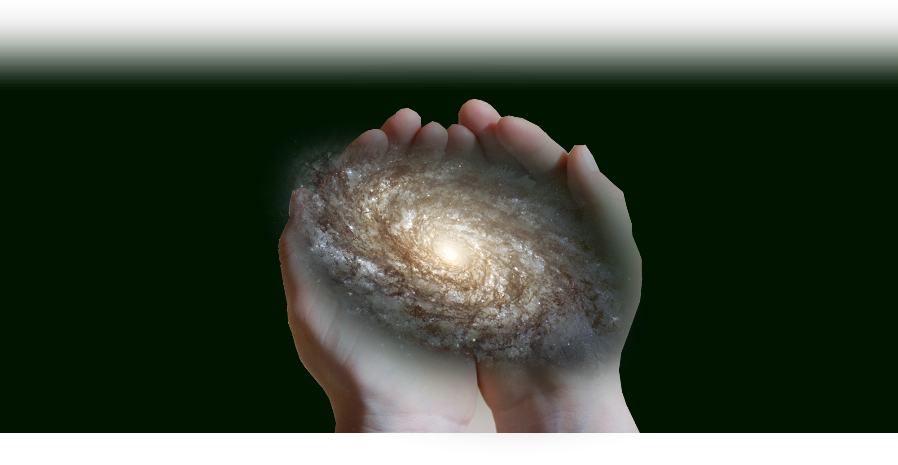
5. Jesus is the Sustainer 1:3
3 ... sustaining all things by his powerful word.
Notes:
Sustain = Greek “phero” = bears, carries, brings, = upholding and moving toward it’s goal
He did not just create the universe as a clock and walk away and say , “Hey, you are on your own, see you later, figure it all out on your own.” NO, he is operating His universe.
He is the “Super Force” scientists speak of that holds everything together. Col 1:16, 17 “By him all things consist!”
By his powerful (spoken rema) word! Jesus spoke the creation into existence and He speaks it to its intended goal. He is taking it somewhere.
He is in control. Storms obeyed his words “Be still,” diseases obeyed, “Take up your mat and walk,” demons obeyed him, “Come out of him.” and death could not hold him. He runs His universe.
This assures me that He has a plan for our lives. But if you never yield to him, though he has Revealed Himself to you, and Represents your path to know God, if you have not surrendered your life to him, you will never discover His plan for your life. You will wander around in the dark Why? When you can find out what He has in store for you—His best!

Slide 25
5. Jesus is the Sustainer 1:3
3 ... sustaining all things by his powerful word.
Notes:
Sustain = Greek “phero” = bears, carries, brings, = upholding and moving toward it’s goal
Stephen Hawkings
He did not just create the universe as a clock and walk away and say , “Hey, you are on your own, see you later, figure it all out on your own.” NO, he is operating His universe.
He is the “Super Force” scientists speak of that holds everything together. Col 1:16, 17 “By him all things consist!”
By his powerful (spoken rema) word! Jesus spoke the creation into existence and He speaks it to its intended goal. He is taking it somewhere.
He is in control. Storms obeyed his words “Be still,” diseases obeyed, “Take up your mat and walk,” demons obeyed him, “Come out of him.” and death could not hold him. He runs His universe.
This assures me that He has a plan for our lives. But if you never yield to him, though he has Revealed Himself to you, and Represents your path to know God, if you have not surrendered your life to him, you will never discover His plan for your life. You will wander around in the dark Why? When you can find out what He has in store for you—His best!

Slide 26
5. Jesus is the Sustainer 1:3
3 ... sustaining all things by his powerful word.
¹⁶ For by him all things were created: things in heaven and on earth, visible and invisible, whether thrones or powers or rulers or authorities; all things were created by him and for him. ¹⁷ He is before all things, and in him all things hold together. (Colossians 1:16-17)
Notes:
Sustain = Greek “phero” = bears, carries, brings, = upholding and moving toward it’s goal
Stephen Hawkings
He did not just create the universe as a clock and walk away and say , “Hey, you are on your own, see you later, figure it all out on your own.” NO, he is operating His universe.
He is the “Strong Force” scientists speak of that holds everything together. Col 1:16, 17 “By him all things consist!”
By his powerful (spoken rema) word! Jesus spoke the creation into existence and He speaks it to its intended goal. He is taking it somewhere.
He is in control. Storms obeyed his words “Be still,” diseases obeyed, “Take up your mat and walk,” demons obeyed him, “Come out of him.” and death could not hold him. He runs His universe.
This assures me that He has a plan for our lives. But if you never yield to him, though he has Revealed Himself to you, and Represents your path to know God, if you have not surrendered your life to him, you will never discover His plan for your life. You will wander around in the dark Why? When you can find out what He has in store for you—His best!

Slide 27
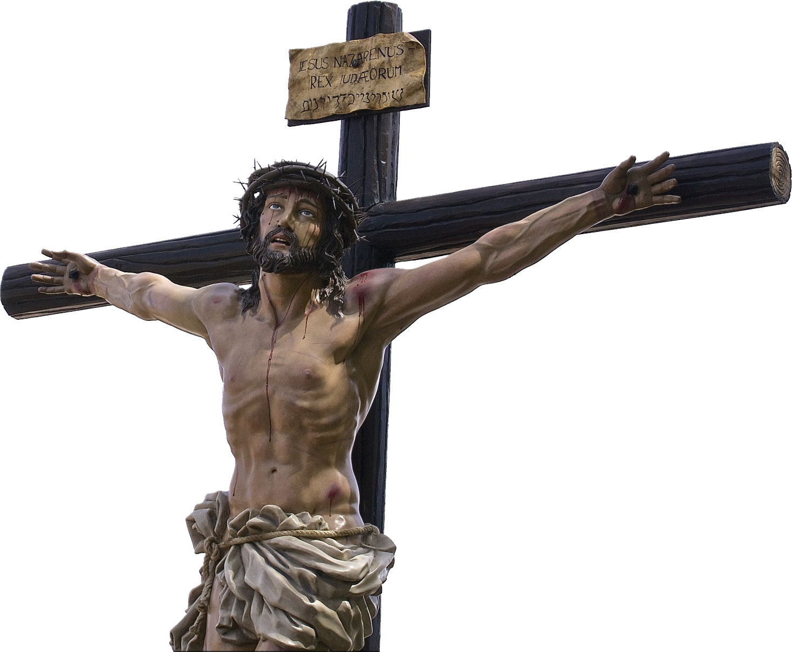
6. Jesus is the Purifier 1:3
3 ... After he had provided purification for sins,
Notes:
https://www.publicdomainpictures.net/en/view-image.php?image=234051&picture=jesus-christ-on-cross
This is what the whole book of Hebrews is about. As our High Priest, He offered Himself as the sacrifice for our sins once for all to take away the stain of our sins.
Isaiah 1:18; 53:6; etc.

Slide 28
6. Jesus is the Purifier 1:3
3 ... After he had provided purification for sins,
the blood of Jesus, his Son,
purifies us from all sin. (1John 1:7)
Notes:
https://www.publicdomainpictures.net/en/view-image.php?image=234051&picture=jesus-christ-on-cross
This is what the whole book of Hebrews is about. As our High Priest, He offered Himself as the sacrifice for our sins once for all to take away the stain of our sins.
Isaiah 1:18; 53:6; etc.
Flowing through the veins of the baby Jesus was the blood the would purify the sins

Slide 29
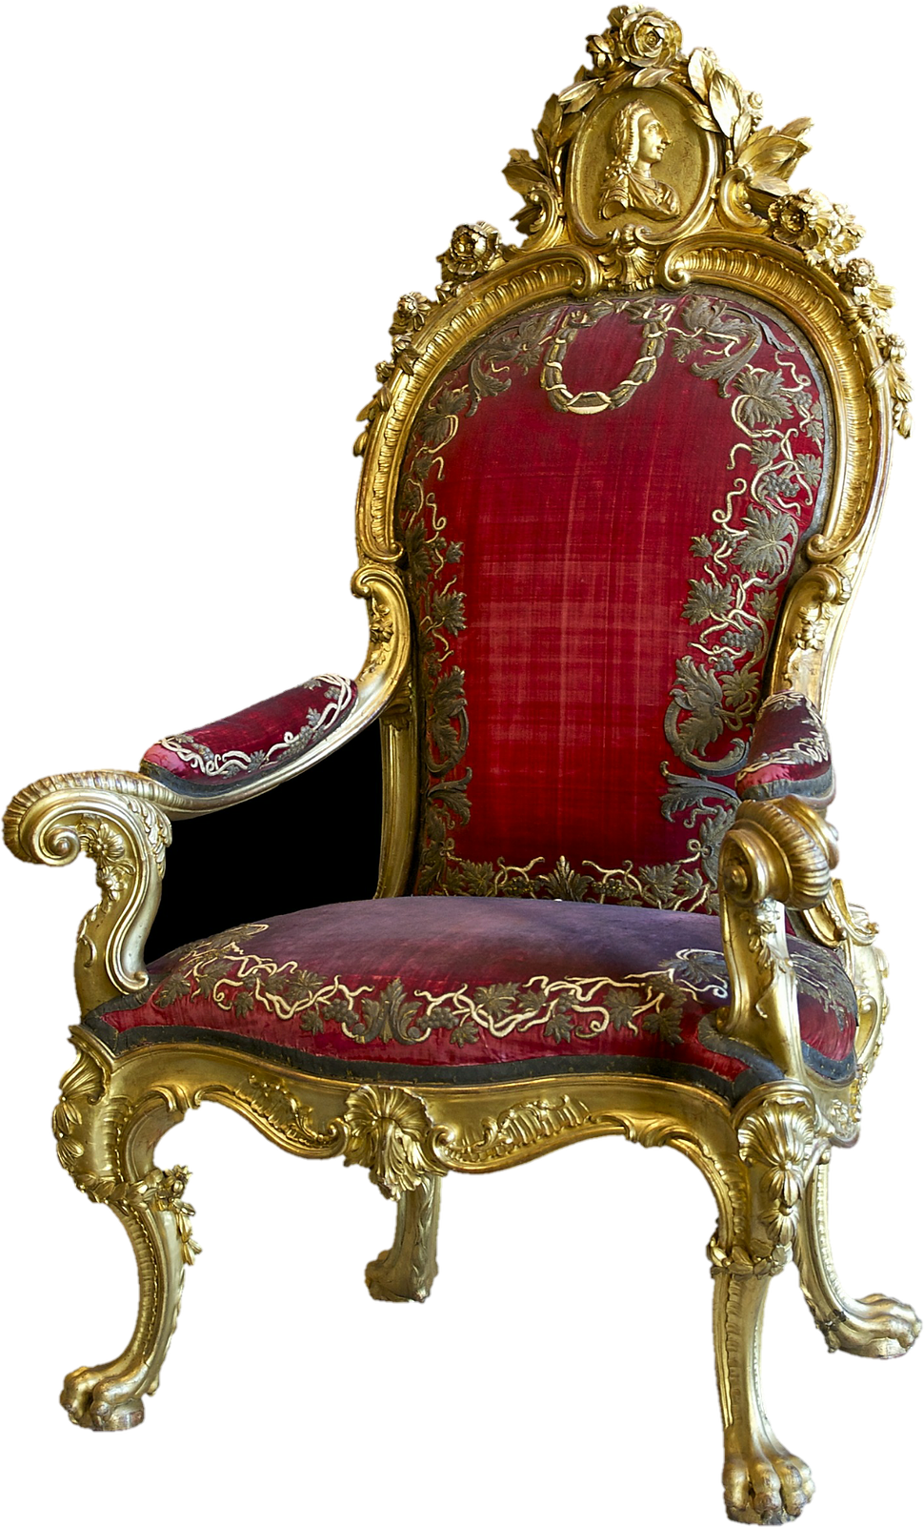
7. Jesus is the Finisher 1:3
3 ... he sat down at the right hand of the Majesty in heaven.
Notes:
https://pixabay.com/en/throne-ruler-chair-chair-seat-2790789/
It is finished! The sixth of the seven sayings on the cross: “Tetelestai” “It is finished” It is paid in full” with sin taken away once for all, he could do what no Levitical pries could ever do—sit down. Why could they not sit? Their work was never done. Another sin required another sacrifice. But not so with Jesus, once for all he put away sin by the sacrifice of himself. (Heb 7:27) He now lives forever to intercede for us (7:25)

Slide 30
7. Jesus is the Finisher 1:3
3 ... he sat down at the right hand of the Majesty in heaven.
Jesus said, "It is finished." With that, he bowed his head and gave up his spirit. (John 19:30)
Notes:
https://pixabay.com/en/throne-ruler-chair-chair-seat-2790789/
It is finished! The sixth of the seven sayings on the cross: “Tetelestai” “It is finished” It is paid in full” with sin taken away once for all, he could do what no Levitical pries could ever do—sit down. Why could they not sit? Their work was never done. Another sin required another sacrifice. But not so with Jesus, once for all he put away sin by the sacrifice of himself. (Heb 7:27) He now lives forever to intercede for us (7:25)

Slide 31
Think about this: CHRISTMAS ...
is about God sending His Son into the world ...
Notes:
Christmas is about God sending His Son into the world as

Slide 32
Think about this: CHRISTMAS ...
is about God sending His Son into the world ...
To SPEAK the love of God into your life
Notes:
Christmas is about God sending His Son into the world as

Slide 33
Think about this: CHRISTMAS ...
is about God sending His Son into the world ...
To SPEAK the love of God into your life
To offer you an INHERITANCE starting now
Notes:
Christmas is about God sending His Son into the world as

Slide 34
Think about this: CHRISTMAS ...
is about God sending His Son into the world ...
To SPEAK the love of God into your life
To offer you an INHERITANCE starting now
To expose you to the RADIANT glory of God
Notes:
Christmas is about God sending His Son into the world as

Slide 35
Think about this: CHRISTMAS ...
is about God sending His Son into the world ...
To SPEAK the love of God into your life
To offer you an INHERITANCE starting now
To expose you to the RADIANT glory of God
To show you Who God REALLY is
Notes:
Christmas is about God sending His Son into the world as

Slide 36
Think about this: CHRISTMAS ...
is about God sending His Son into the world ...
To SPEAK the love of God into your life
To offer you an INHERITANCE starting now
To expose you to the RADIANT glory of God
To show you Who God REALLY is
To UPHOLD you and work all together for good
Notes:
Christmas is about God sending His Son into the world as

Slide 37
Think about this: CHRISTMAS ...
is about God sending His Son into the world ...
To SPEAK the love of God into your life
To offer you an INHERITANCE starting now
To expose you to the RADIANT glory of God
To show you Who God REALLY is
To UPHOLD you and work all together for good
To PURIFY your life from every stain of sin
Notes:
Christmas is about God sending His Son into the world as

Slide 38
Think about this: CHRISTMAS ...
is about God sending His Son into the world ...
To SPEAK the love of God into your life
To offer you an INHERITANCE starting now
To expose you to the RADIANT glory of God
To show you Who God REALLY is
To UPHOLD you and work all together for good
To PURIFY your life of every stain of sin
To FINISH what you started--but messed up!

Slide 39
Think about this: CHRISTMAS ...
is about God sending His Son into the world ...
To SPEAK the love of God into your life
To offer you an INHERITANCE starting now
To expose you to the RADIANT glory of God
To show you Who God REALLY is
To UPHOLD you and work all together for good
To PURIFY your life of all stains of sin
To FINISH what you started--but messed up!
ALL THIS WAS WRAPPED UP IN A MANGER!

Slide 40
Let’s Pray

