Slide 1
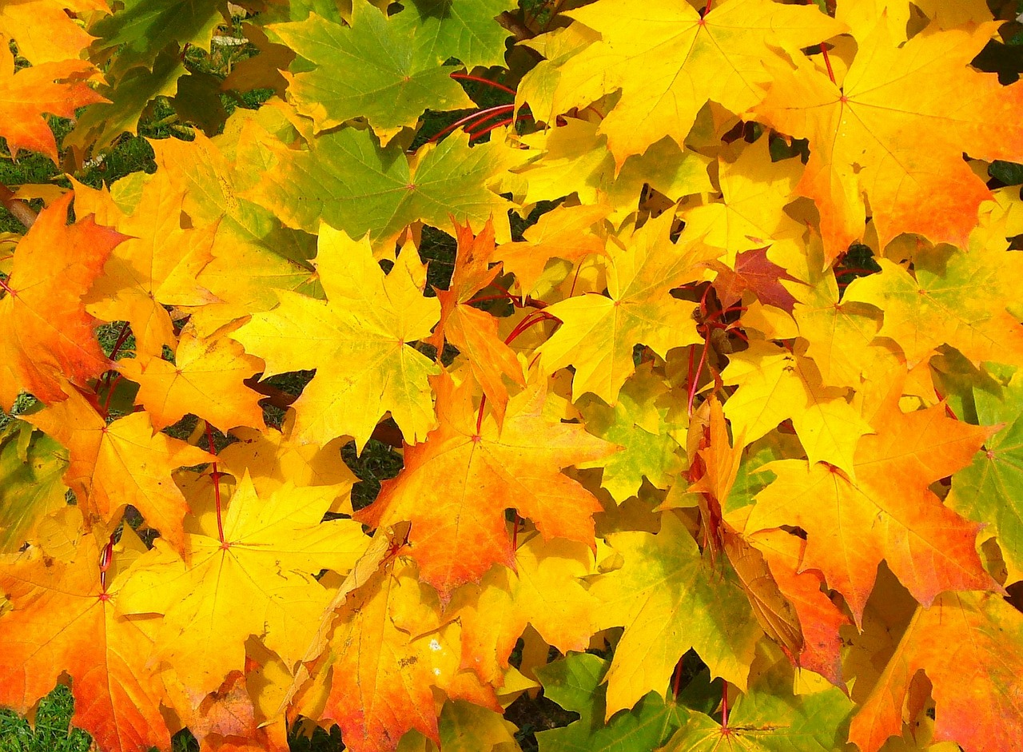
Thanks be to God!
Watch the original presentation at:
https://youtu.be/82HkMayf-YE
Notes:
Background= https://pixabay.com/en/leaves-autumn-fall-colorful-yellow-57427/
Copyright © 2006−2021. All rights reserved. Bible Point is a registered trademark of Dennis Henderson. All other trademarks acknowledged.
Bible Point contains graphics from Bible Point artists. These illustrations belong to Bible Point and the respective artists. You may use the designs and illustrations for graphical illustration of lessons free and without special permission, provided they are not used in any way that maligns the Christian faith. Furthermore, republication or production of any illustration by any other graphic service whether it be in book, in a machine-readable form, or in any other design resource is strictly prohibited. Furthermore, they cannot be duplicated or resold as any other form of publishing, clip art, or graphic resource.
So What does it mean? (A simple translations of the legal jargon)
So, if you don’t own the presentation(s), graphic(s), and text(s) how can you legally use them? The purchase of the license allows you to use all the images in the product. However, the actual ownership and copyright of the presentation(s), graphic(s), and text(s) remain the property of Bible Point and its licensors. If you had plans on using this product in your “for sale” work—think again!
License Agreement
Article 1: License Grant
All the graphics and text in Bible Point presentations (excluding quotes from the Bible and stated sources) are the intellectual and real property of Bible Point and its licensors, and is protected by law, including United States copyright laws and international treaties. Bible Point grants to you a license:
1. To use the presentation in a single church, single school, or single office of a Christian organization.
2. To make a single archival back-up copy of the program.
3. To modify the presentation(s) and merge with other presentations in a single church, school, or Christian organization.
4. To transfer to another party if that party agrees to accept the terms and conditions of this agreement, and you do not retain any copies of the presentation, whether printed, machine readable, modified, or merged form.
Article 2: Terms
This license is effective until terminated. You may terminate the license at any time by destroying the presentation(s), graphic(s), or text(s) together with all copies, modifications and merged portions in any form. Bible Point may terminate your license if you fail to comply with this Agreement. You agree, upon such termination, for any reason, to destroy the presentation(s), graphics, and text(s) with all copies, modifications, and merged portions in any form.
Article 3: Disclaimers
1. Bible Point presentations, graphics, and texts are licensed to you As Is. You, the consumer, bear the entire risk relating to the quality and performance of the presentation(s), graphic(s), or text(s). In no event will Bible Point be liable for damages resulting from any defect.
2. Thirty-day limited warrantee on disks. Bible Point warrants the disks to be free of defects in material and workmanship under normal use for 30 days after purchase. During the 30-day period you may return a defective presentation, graphic, or text with proof of purchase and it will be replaced without charge, unless the presentation is damaged by misuse.
Article 4: General
1. You may not sub-license, assign, or transfer the license of the presentation(s), graphic(s), or text(s) except as provided by this Agreement.
2. This Agreement will be governed by the laws of the State of Michigan.
So What does it mean? (A simple translations of the legal jargon)
May I let someone borrow or copy my licensed Bible Point presentation (even after I modified it)? As long as it is within your local church, or single school, or the immediate office of a Christian organization you may. Otherwise, please refer the person interested in borrowing to: http://www.biblepoint.com or E-mail: dennis@DrDH.net with any related questions.

Slide 2
Thanks be to God!
Notes:
Background= https://pixabay.com/en/leaves-autumn-fall-colorful-yellow-57427/

Slide 3
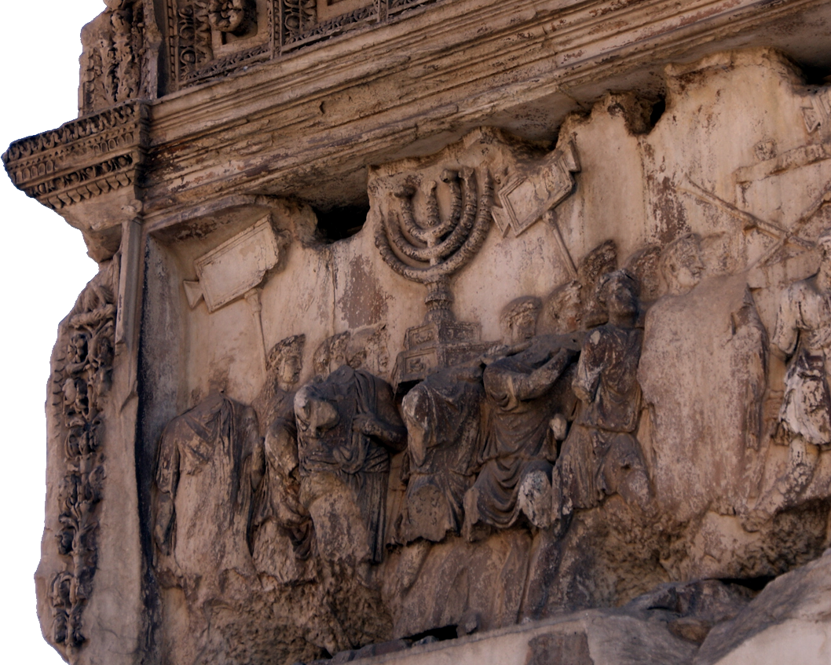
Because we are Triumphant!
^{2 Cor 1:14} But thanks be to God, who always leads us in triumphal procession in Christ ...
Notes:
My own shot – Rome – Arch of Titus
Turn to your neighbor right now and say, “Thank God we are on the winning side!”

Slide 4
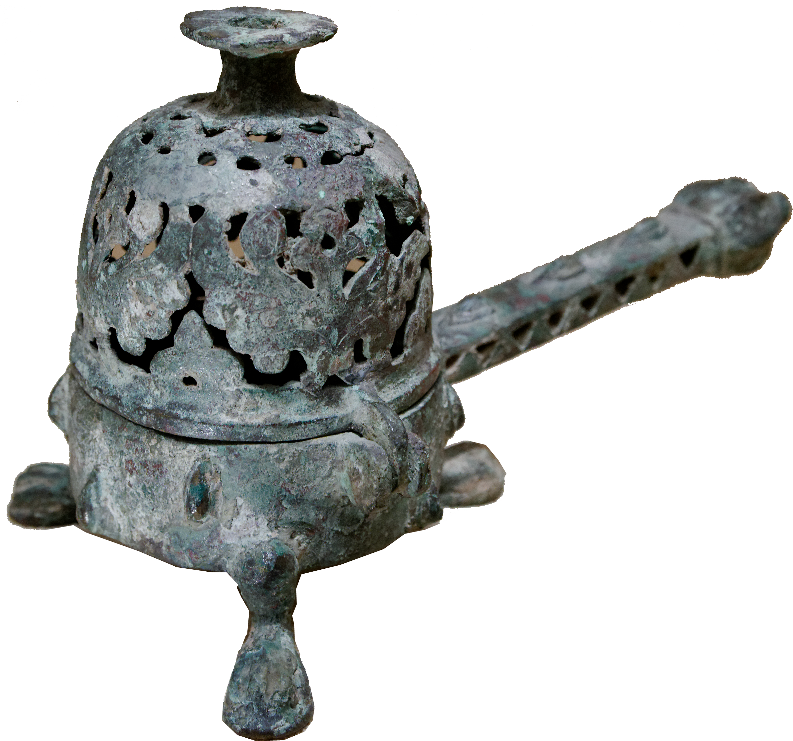
Because we are the Aroma!
¹⁴ ... and through us spreads everywhere the fragrance of the knowledge of him.¹⁵ For we are to God the aroma of Christ among those who are being saved and those who are perishing.
Notes:
https://upload.wikimedia.org/wikipedia/commons/3/32/Incense_burner_Met_1976.102.jpg

Slide 5
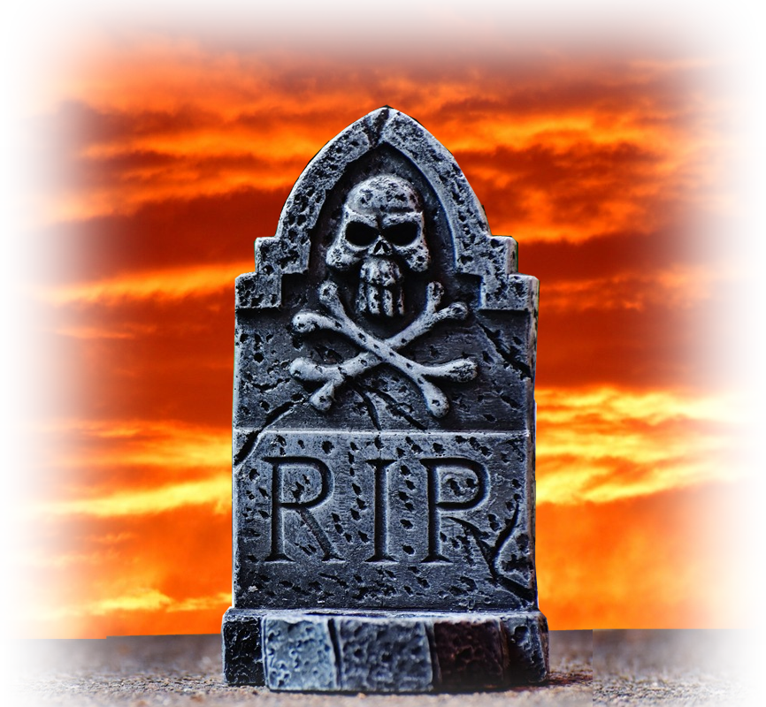
Because we are the Aroma!
¹⁶ To the one we are the smell of death;
Notes:
RIP = FREE = https://pxhere.com/en/photo/545374

Slide 6
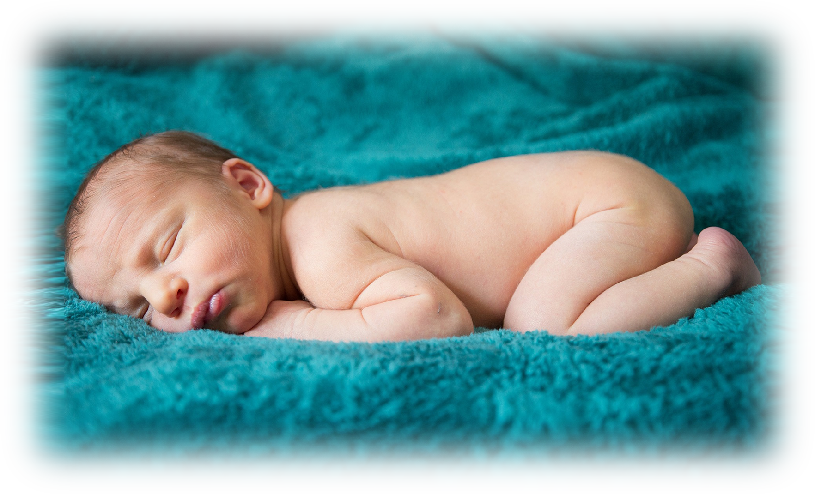
Because we are the Aroma!
¹⁶ To the one we are the smell of death;
to the other, the fragrance of life.
Notes:
https://pixabay.com/en/newborn-baby-infant-sleep-child-2186599/
Thank God our lives matter—our lives are a matter of life and death – we have something to live for!

Slide 7
Because we are the Aroma!
¹⁶ To the one we are the smell of death;
to the other, the fragrance of life.
And who is equal to such a task?
Notes:
This can be a little intimidating.

Slide 8
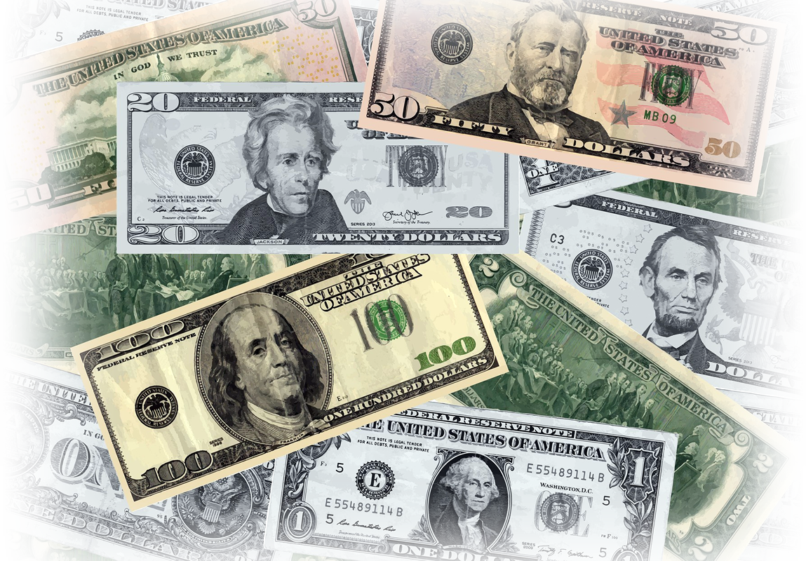
Because we are Sincere!
¹⁷ Unlike so many,
we do not peddle
the word of God for profit.
Notes:
Money = https://pixabay.com/en/background-currency-cash-banknote-2152608/

Slide 9

Because we are Sincere!
¹⁷ Unlike so many,
we do not peddle
the word of God for profit.
On the contrary, in Christ we speak before God with sincerity, like men sent from God.
Notes:
Money = https://pixabay.com/en/background-currency-cash-banknote-2152608/
No Additives = FREE =https://www.flickr.com/photos/fdaphotos/26909593506/sizes/m/
“Sincerely” = “unadulterated motives” Louw & Nida p. 747
Thank God we are a part of a Bible believing Church—we’re the real deal. Jesus is building His church here at Bethany.

Slide 10

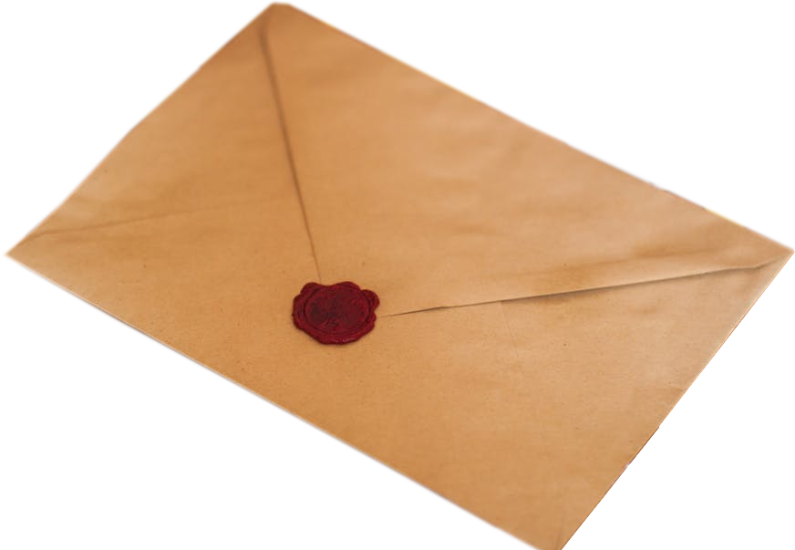
Because we are Living Letters!
^{2Cor 3:1} Are we beginning to commend ourselves again?
Or do we need, like some people, letters of recommend-ation to you or from you? ² You yourselves are our letter, written on our hearts, known and read by everybody.
Notes:
Letter = FREE = https://www.pexels.com/photo/brown-paper-envelope-on-table-211290/
Heart = https://pixabay.com/en/photos/heart/
Thank God His Word changes our lives. Your lives are the living letters that this ministry is legit.

Slide 11
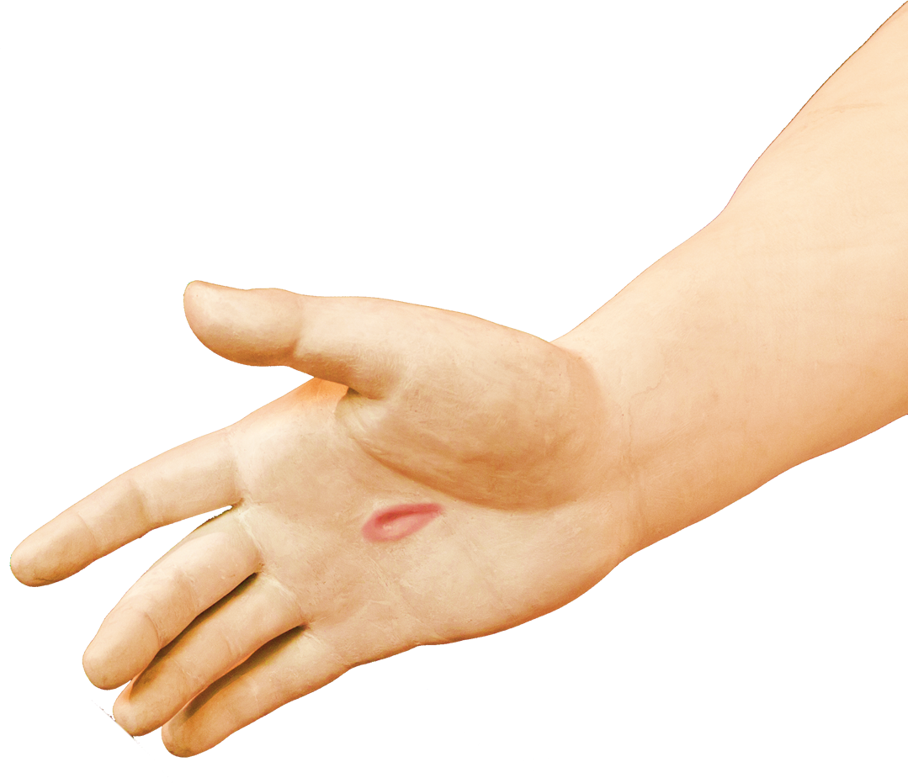
Because we are Living Letters!
³ You show that you are a letter from Christ, the result of our ministry, written not with ink but with the Spirit of the living God, not on tablets of stone
but on tablets of human hearts. ⁴ Such confidence as this is ours through Christ before God.
Notes:
Hand =FREE = https://upload.wikimedia.org/wikipedia/commons/0/06/Christus_hand_detail_temple_square.jpg
People read between the lines of your daily lives and they should read “Jesus.” You are the only Bible some people read!

Slide 12

Because we are Competent!
⁵ Not that we are competent in ourselves to claim anything for ourselves,
Notes:
Thumb = FREE = https://pixabay.com/en/thumbs-up-thumb-hand-positive-1006172/

Slide 13
Because we are Competent!
⁵ Not that we are competent in ourselves to claim anything for ourselves,
but our competence comes from God.
Notes:
The idea here is that we are adequate for what God has assigned us to do.
When He called you, he equipped you. You are and have everything, with His help, to accomplish His mission for your life.
When you do –it is only because of Him!

Slide 14
Because we are Competent!
⁵ Not that we are competent in ourselves to claim anything for ourselves,
but our competence comes from God.
⁶ He has made us competent as ministers of a new covenant--not of the letter but of the Spirit; for the letter kills, but the Spirit gives life.
Notes:
Turn to your neighbor and say, “Thank God He has made us competent.”

Slide 15
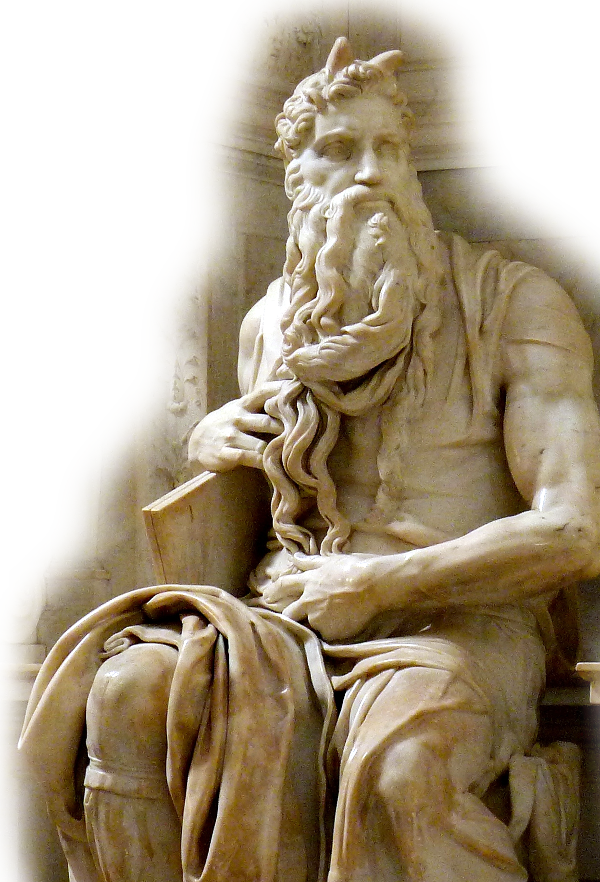
Because we have Surpassing Glory!
The big “If:” ⁷ Now if the ministry that brought death, which was engraved in
letters on stone, came with glory, so that
the Israelites could not look steadily at
the face of Moses because of its glory,
fading though it was,
Notes:
Exodus 34:29ff
²⁹ When Moses came down from Mount Sinai with the two tablets of the Testimony in his hands, he was not aware that his face was radiant because he had spoken with the LORD.
³⁰ When Aaron and all the Israelites saw Moses, his face was radiant, and they were afraid to come near him.
³¹ But Moses called to them; so Aaron and all the leaders of the community came back to him, and he spoke to them.
³² Afterward all the Israelites came near him, and he gave them all the commands the LORD had given him on Mount Sinai.
³³ When Moses finished speaking to them, he put a veil over his face.
³⁴ But whenever he entered the LORD's presence to speak with him, he removed the veil until he came out. And when he came out and told the Israelites what he had been commanded,
³⁵ they saw that his face was radiant. Then Moses would put the veil back over his face until he went in to speak with the LORD. (Exo 34:29-35 NIV)

Slide 16

Because we have Surpassing Glory!
The big “If:” ⁷ Now if the ministry that brought death, which was engraved in
letters on stone, came with glory, so that
the Israelites could not look steadily at
the face of Moses because of its glory,
fading though it was,
The big “Then:” [then] ⁸ will not the ministry of the Spirit be even more glorious?
Notes:
Moses = FREE = https://upload.wikimedia.org/wikipedia/commons/0/0f/%27Moses%27_by_Michelangelo_JBU140.jpg
Dove = FREE = https://pixabay.com/en/white-dove-nature-bird-animals-1712770/
Paul is arguing from the lesser to the greater. If the lesser, the law had glory, then the greater, the Spirit, has more glory!
Thank God we have the surpassing glory of God in the gospel of the Lord Jesus Christ.

Slide 17
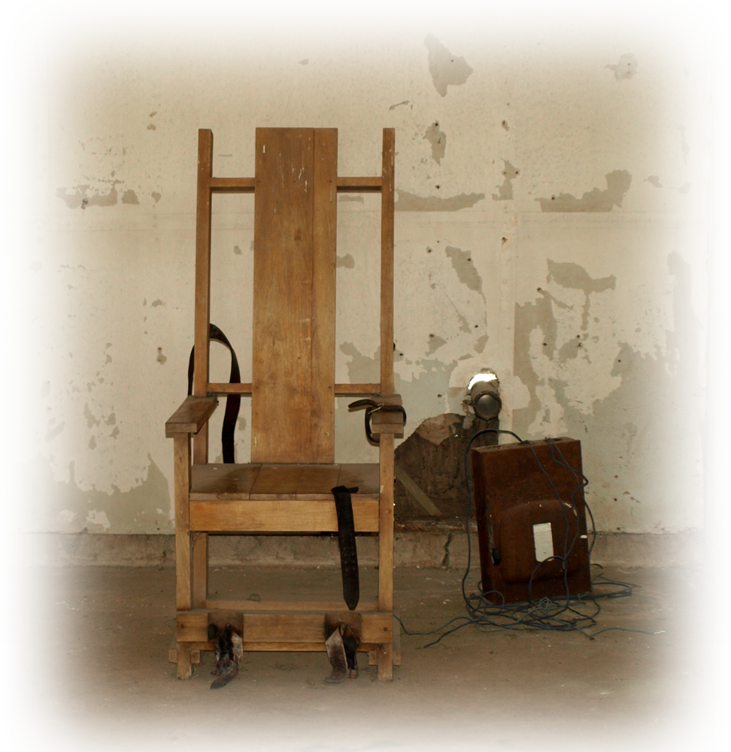
Because we have Surpassing Glory!
Another big “If:”
⁹ If the ministry that condemns men is glorious,
Notes:
Electric chair = FREE = https://upload.wikimedia.org/wikipedia/commons/9/92/RedHatsExecutionChamber.jpg
Still arguing from the lesser to the greater: If that which kills us (the lesser) is glorious—then

Slide 18
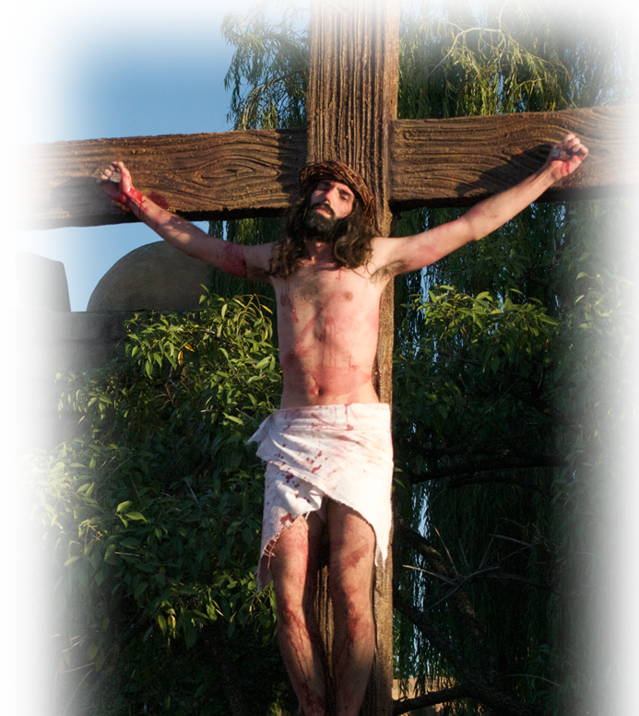
Because we have Surpassing Glory!
Another big “If:”
⁹ If the ministry that condemns men is glorious,
Another big “then:”
[then] how much more glorious is the ministry that brings righteousness!
Notes:
Cross = FREE = https://www.flickr.com/photos/blmurch/3434523441
Still arguing from the lesser to the greater: If that which kills us (the lesser) is glorious—then how much ore glorious is the gospel that brings righteousness and life.

Slide 19
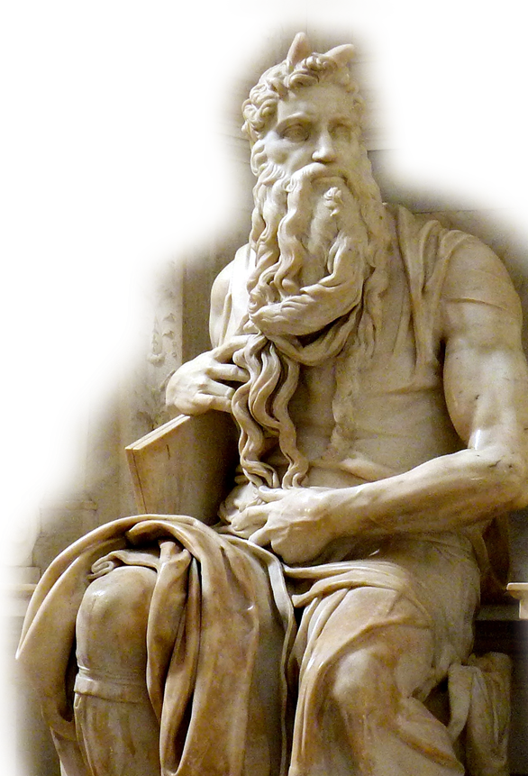
Because we have Surpassing Glory!
The Reason:
¹⁰ For what was glorious
has no glory now in
comparison with the
surpassing glory.
Notes:
Here’s the point: He is arguing from the lesser to the greater—what was glorious in the past – has been surpassed.

Slide 20
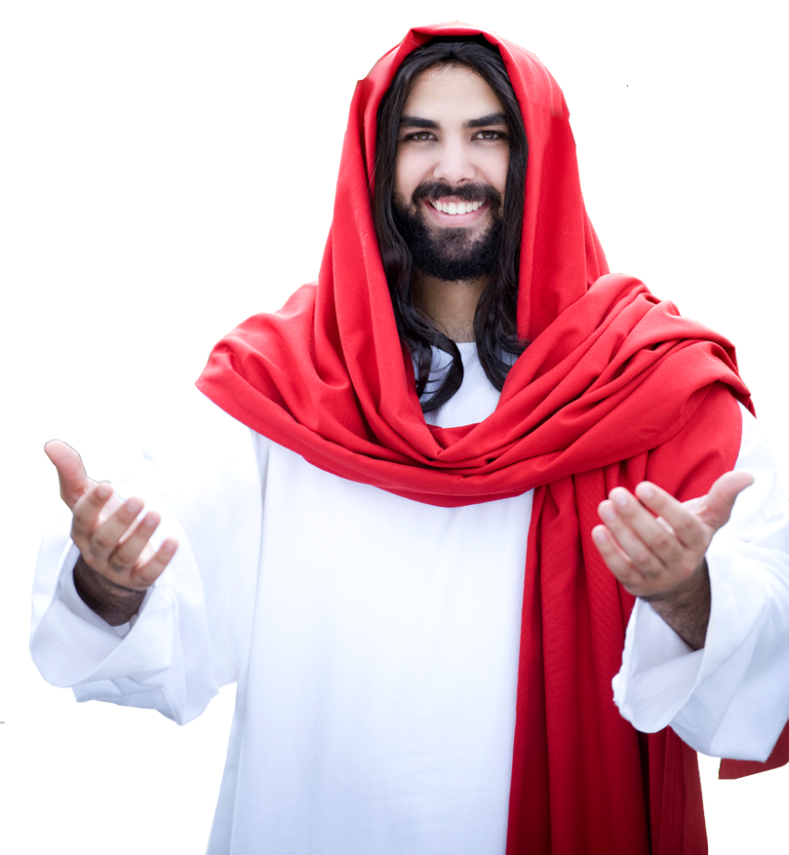
Because we have Surpassing Glory!
The Reason:
¹⁰ For what was glorious
has no glory now in
comparison with the
surpassing glory.

Slide 21
Because we have Surpassing Glory!
Another big “If:”
¹¹ And if what was fading away came with glory,
Notes:
The glory that came with Moses meeting face to face with God to receive the ten commandments was a fading away glory—to be surpassed by Jesus.

Slide 22

Because we have Surpassing Glory!
Another big “If:”
¹¹ And if what was fading away came with glory,
Another big “Then:”
[Then] how much greater is the glory of that which lasts!
Notes:
The glory of the Gospel is Jesus Christ—who lives forever.
Turn to your neighbor and say “Thank God for Jesus!”

Slide 23

Because we have Hope!
¹² Therefore, since we have such a hope, we are very bold.
Notes:
Hope is not “wishful thinking.” ex: I hope to get a Cadillac for Christmas....
Hope is a confident assertion in a reality. Ex: I hope to get to church because I have a Chevy ...

Slide 24
Because we have Hope!
¹³ We are not like Moses, who would put a veil over his face to keep the Israelites from gazing at it while the radiance was fading away.

Slide 25

Because we have Hope!
¹⁴ But their minds were made dull, for to this day the same veil remains when the old covenant is read. It has not been removed

Slide 26
Because we have Hope!
¹⁴ But their minds were made dull, for to this day the same veil remains when the old covenant is read. It has not been removed, because only
in Christ is it taken away. ¹⁵

Slide 27
Because we have Hope!
¹⁴ But their minds were made dull, for to this day the same veil remains when the old covenant is read. It has not been removed, because only
in Christ is it taken away. ¹⁵ Even to this day when Moses is read, a veil covers their hearts.

Slide 28
Because we have Hope!
¹⁶ But whenever anyone turns to the Lord, the veil is taken away.
¹⁷ Now the Lord is the Spirit, and where the Spirit of the Lord is, there is freedom.

Slide 29
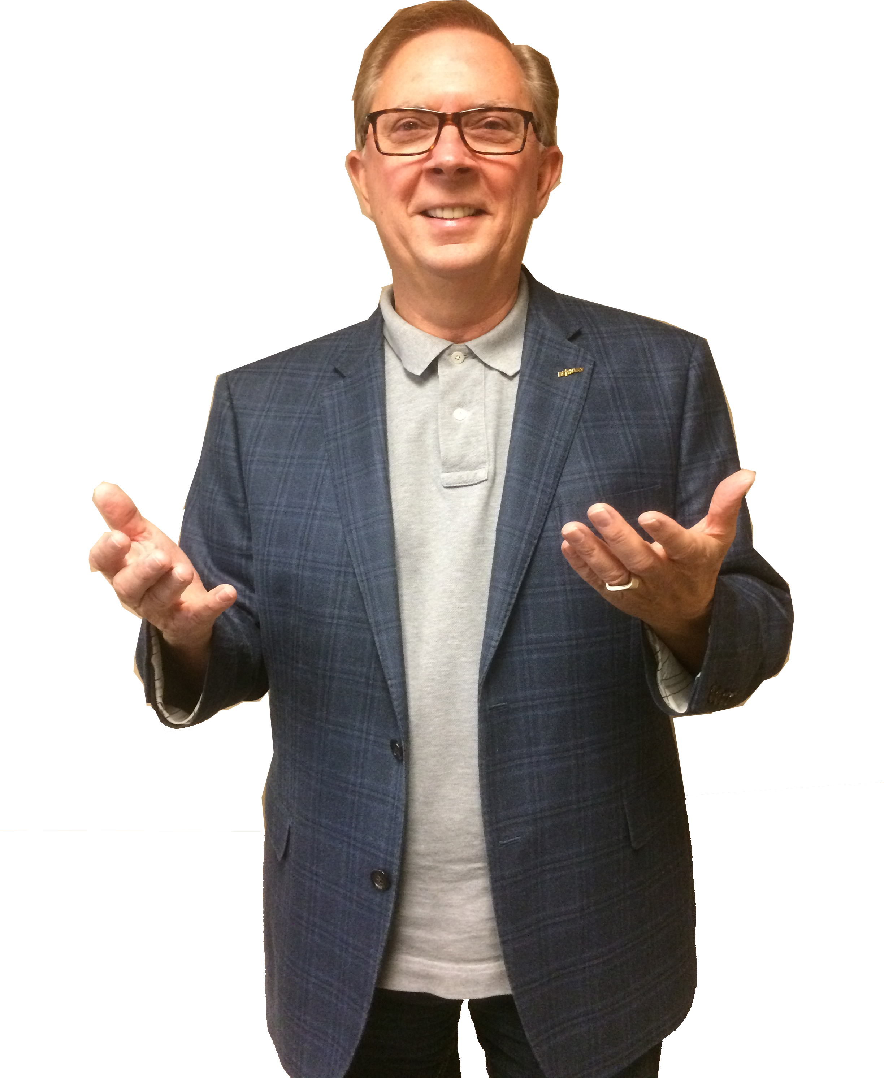
Because we are Transformed!
¹⁸ And we, who with unveiled faces all reflect the Lord's glory, are being transformed into his likeness with ever increasing glory, which comes from the Lord, who is the Spirit.

Slide 30
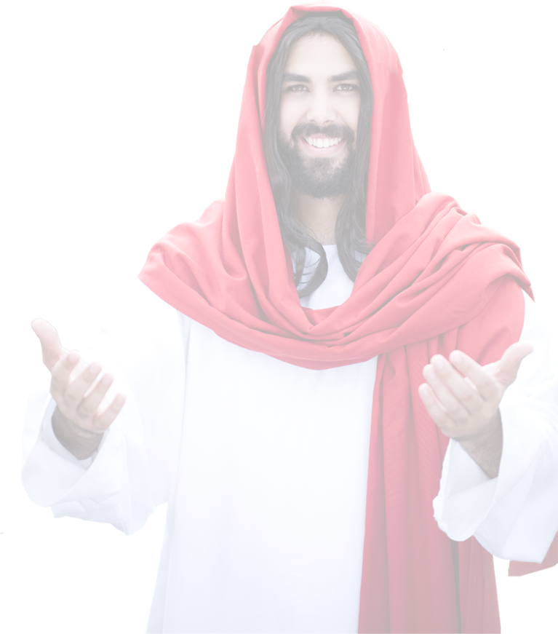
Because we are Transformed!
¹⁸ And we, who with unveiled faces all reflect the Lord's glory, are being transformed into his likeness with ever increasing glory, which comes from the Lord, who is the Spirit.

Slide 31

Because we are Transformed!
¹⁸ And we, who with unveiled faces all reflect the Lord's glory, are being transformed into his likeness with ever increasing glory, which comes from the Lord, who is the Spirit.

Slide 32

Because we are Transformed!
¹⁸ And we, who with unveiled faces all reflect the Lord's glory, are being transformed into his likeness with ever increasing glory, which comes from the Lord, who is the Spirit.

Slide 33

Because we are Transformed!
¹⁸ And we, who with unveiled faces all reflect the Lord's glory, are being transformed into his likeness with ever increasing glory, which comes from the Lord, who is the Spirit.

Slide 34
To Sum Up ...

Slide 35
We give thanks BECAUSE ...
We are Triumphant

Slide 36
We give thanks BECAUSE ...
We are Triumphant
We are an Aroma

Slide 37
We give thanks BECAUSE ...
We are Triumphant
We are an Aroma
We are Sincere

Slide 38
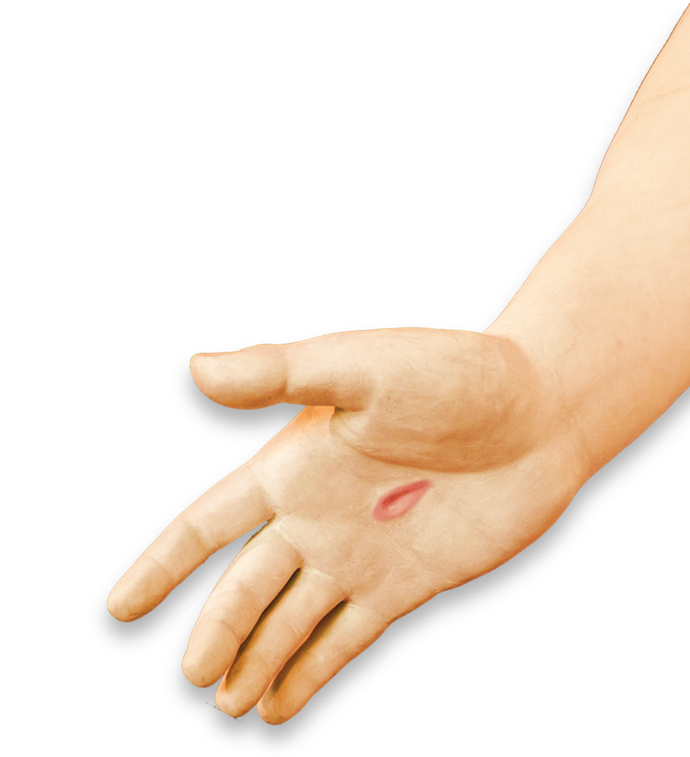
We give thanks BECAUSE ...
We are Triumphant
We are an Aroma
We are Sincere
We are Living Letters

Slide 39
We give thanks BECAUSE ...
We are Triumphant
We are an Aroma
We are Sincere
We are Living Letters
We have Surpassing Glory

Slide 40
We give thanks BECAUSE ...
We are Triumphant
We are an Aroma
We are Sincere
We are Living Letters
We have Surpassing Glory
We have Hope

Slide 41
We give thanks BECAUSE ...
We are Triumphant
We are an Aroma
We are Sincere
We are Living Letters
We have Surpassing Glory
We have Hope
We are Transformed

Slide 42
That’s a lot for which to be
THANKFUL!

Slide 43
Let’s Pray

