Slide 1

Give Thanks
Watch how this lesson was originally presented at:
https://youtu.be/I-J2g_ve3z0
This presentation uses the Euphorigenic font from:
https://www.dafont.com/euphorigenic.font
Notes:
Copyright © 2006−2021. All rights reserved. Bible Point is a registered trademark of Dennis Henderson. All other trademarks acknowledged.
Bible Point contains graphics from Bible Point artists. These illustrations belong to Bible Point and the respective artists. You may use the designs and illustrations for graphical illustration of lessons free and without special permission, provided they are not used in any way that maligns the Christian faith. Furthermore, republication or production of any illustration by any other graphic service whether it be in book, in a machine-readable form, or in any other design resource is strictly prohibited. Furthermore, they cannot be duplicated or resold as any other form of publishing, clip art, or graphic resource.
So What does it mean? (A simple translations of the legal jargon)
So, if you don’t own the presentation(s), graphic(s), and text(s) how can you legally use them? The purchase of the license allows you to use all the images in the product. However, the actual ownership and copyright of the presentation(s), graphic(s), and text(s) remain the property of Bible Point and its licensors. If you had plans on using this product in your “for sale” work—think again!
License Agreement
Article 1: License Grant
All the graphics and text in Bible Point presentations (excluding quotes from the Bible and stated sources) are the intellectual and real property of Bible Point and its licensors, and is protected by law, including United States copyright laws and international treaties. Bible Point grants to you a license:
1. To use the presentation in a single church, single school, or single office of a Christian organization.
2. To make a single archival back-up copy of the program.
3. To modify the presentation(s) and merge with other presentations in a single church, school, or Christian organization.
4. To transfer to another party if that party agrees to accept the terms and conditions of this agreement, and you do not retain any copies of the presentation, whether printed, machine readable, modified, or merged form.
Article 2: Terms
This license is effective until terminated. You may terminate the license at any time by destroying the presentation(s), graphic(s), or text(s) together with all copies, modifications and merged portions in any form. Bible Point may terminate your license if you fail to comply with this Agreement. You agree, upon such termination, for any reason, to destroy the presentation(s), graphics, and text(s) with all copies, modifications, and merged portions in any form.
Article 3: Disclaimers
1. Bible Point presentations, graphics, and texts are licensed to you As Is. You, the consumer, bear the entire risk relating to the quality and performance of the presentation(s), graphic(s), or text(s). In no event will Bible Point be liable for damages resulting from any defect.
2. Thirty-day limited warrantee on disks. Bible Point warrants the disks to be free of defects in material and workmanship under normal use for 30 days after purchase. During the 30-day period you may return a defective presentation, graphic, or text with proof of purchase and it will be replaced without charge, unless the presentation is damaged by misuse.
Article 4: General
1. You may not sub-license, assign, or transfer the license of the presentation(s), graphic(s), or text(s) except as provided by this Agreement.
2. This Agreement will be governed by the laws of the State of Michigan.
So What does it mean? (A simple translations of the legal jargon)
May I let someone borrow or copy my licensed Bible Point presentation (even after I modified it)? As long as it is within your local church, or single school, or the immediate office of a Christian organization you may. Otherwise, please refer the person interested in borrowing to: http://www.biblepoint.com or E-mail: dennis@DrDH.net with any related questions.

Slide 2
Give Thanks

Slide 3
Give Thanks for STRENGTH
1Timothy 1:12 I thank Christ Jesus our Lord, who has given me strength,
that he considered me faithful, appointing me to his service.
Notes:
https://pixabay.com/fr/vectors/point-de-vente-sockets-fiche-303731/
Literally, en in dunamow make able = empower. Paul is thanking Jesus for His empowering him for his task. See Philippians “I can do everything through him who gives me strength.” (Phi 4:13 NIV)
He is likewise thankful for considering him faithful – that makes us all stop and pause for a moment. We must ask ourselves, “Does Jesus consider me faithful?”
He is likewise thankful that he was called to the ministry, as he here says appointing me to His service. That too causes us to pause and ask, “What is the service to which God has called me? Am I thankful or resentful (Jonah was).

Slide 4

Give Thanks for STRENGTH
1Timothy 1:12 I thank Christ Jesus our Lord, who has given me strength,
that he considered me faithful, appointing me to his service.
[empowers me]
Notes:
https://pixabay.com/fr/vectors/point-de-vente-sockets-fiche-303731/
Literally, en in dunamow make able = empower. Paul is thanking Jesus for His empowering him for his task. See Philippians “I can do everything through him who gives me strength.” (Phi 4:13 NIV)
He is likewise thankful for considering him faithful – that makes us all stop and pause for a moment. We must ask ourselves, “Does Jesus consider me faithful?”
He is likewise thankful that he was called to the ministry, as he here says appointing me to His service. That too causes us to pause and ask, “What is the service to which God has called me? Am I thankful or resentful (Jonah was).

Slide 5

Give Thanks for STRENGTH
1Timothy 1:12 I thank Christ Jesus our Lord, who has given me strength,
that he considered me faithful, appointing me to his service.
[empowers me]
Sees me faithfully
plugged in
Notes:
Literally, en in dunamow make able = empower. Paul is thanking Jesus for His empowering him for his task. See Philippians “I can do everything through him who gives me strength.” (Phi 4:13 NIV)
He is likewise thankful for considering him faithful – that makes us all stop and pause for a moment. We must ask ourselves, “Does Jesus consider me faithful?”
He is likewise thankful that he was called to the ministry, as he here says appointing me to His service. That too causes us to pause and ask, “What is the service to which God has called me? Am I thankful or resentful (Jonah was).

Slide 6
Give Thanks for STRENGTH
1Timothy 1:12 I thank Christ Jesus our Lord, who has given me strength,
that he considered me faithful, appointing me to his service.
[empowers me]
Placing me where
He wants me
Notes:
Literally, en in dunamow make able = empower. Paul is thanking Jesus for His empowering him for his task. See Philippians “I can do everything through him who gives me strength.” (Phi 4:13 NIV)
He is likewise thankful for considering him faithful – that makes us all stop and pause for a moment. We must ask ourselves, “Does Jesus consider me faithful?”
He is likewise thankful that he was called to the ministry, as he here says appointing me to His service. That too causes us to pause and ask, “What is the service to which God has called me? Am I thankful or resentful (Jonah was).

Slide 7
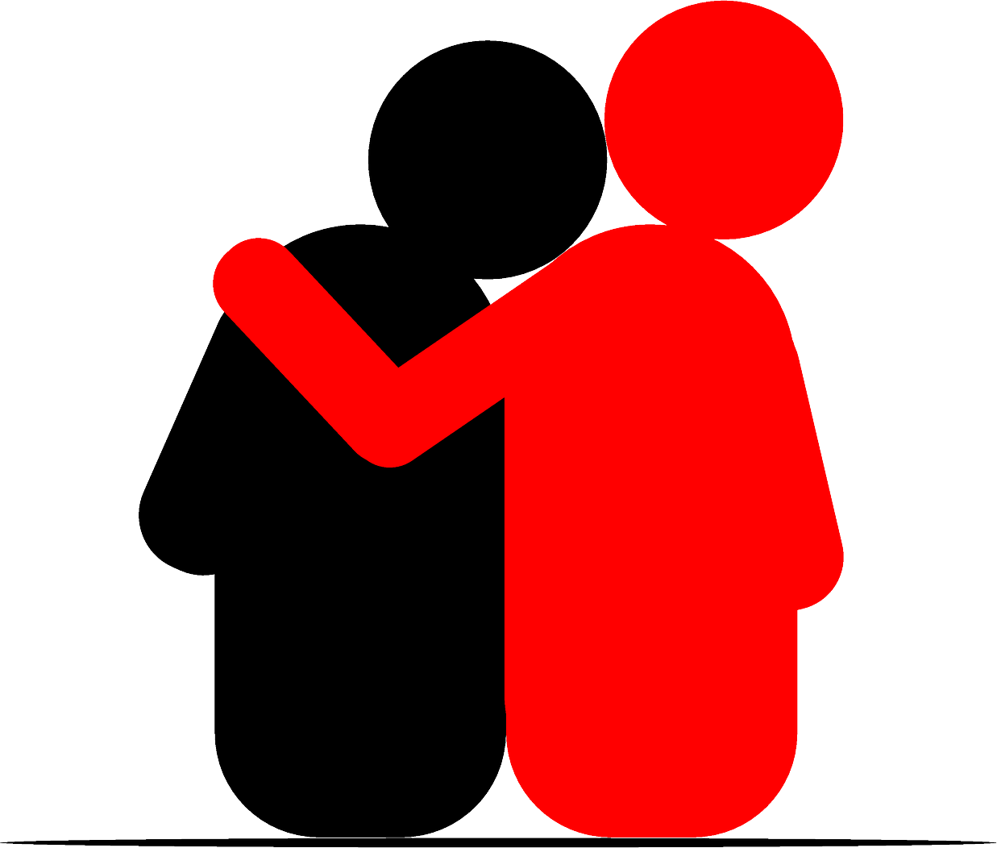
Give Thanks for MERCY
¹³ Even though I was once a blasphemer and a persecutor and a violent man,
I was shown mercy because I acted in ignorance and unbelief.
In spite of ...

Slide 8
Give Thanks for MERCY
¹³ Even though I was once a blasphemer and a persecutor and a violent man,
I was shown mercy because I acted in ignorance and unbelief.
My SPEECH was Dishonoring
You
*&#@^!

Slide 9
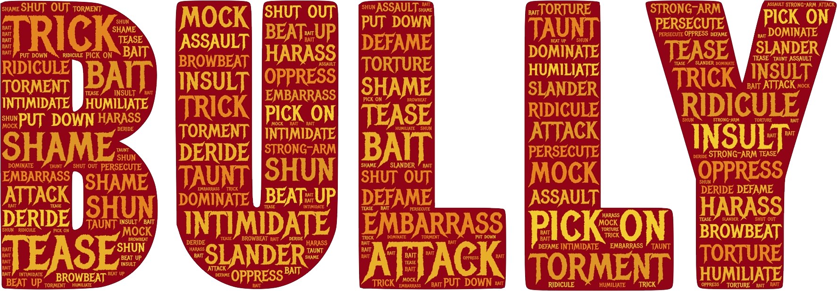
Give Thanks for MERCY
¹³ Even though I was once a blasphemer and a persecutor and a violent man,
I was shown mercy because I acted in ignorance and unbelief.
My ACTIONS were Dishonoring

Slide 10
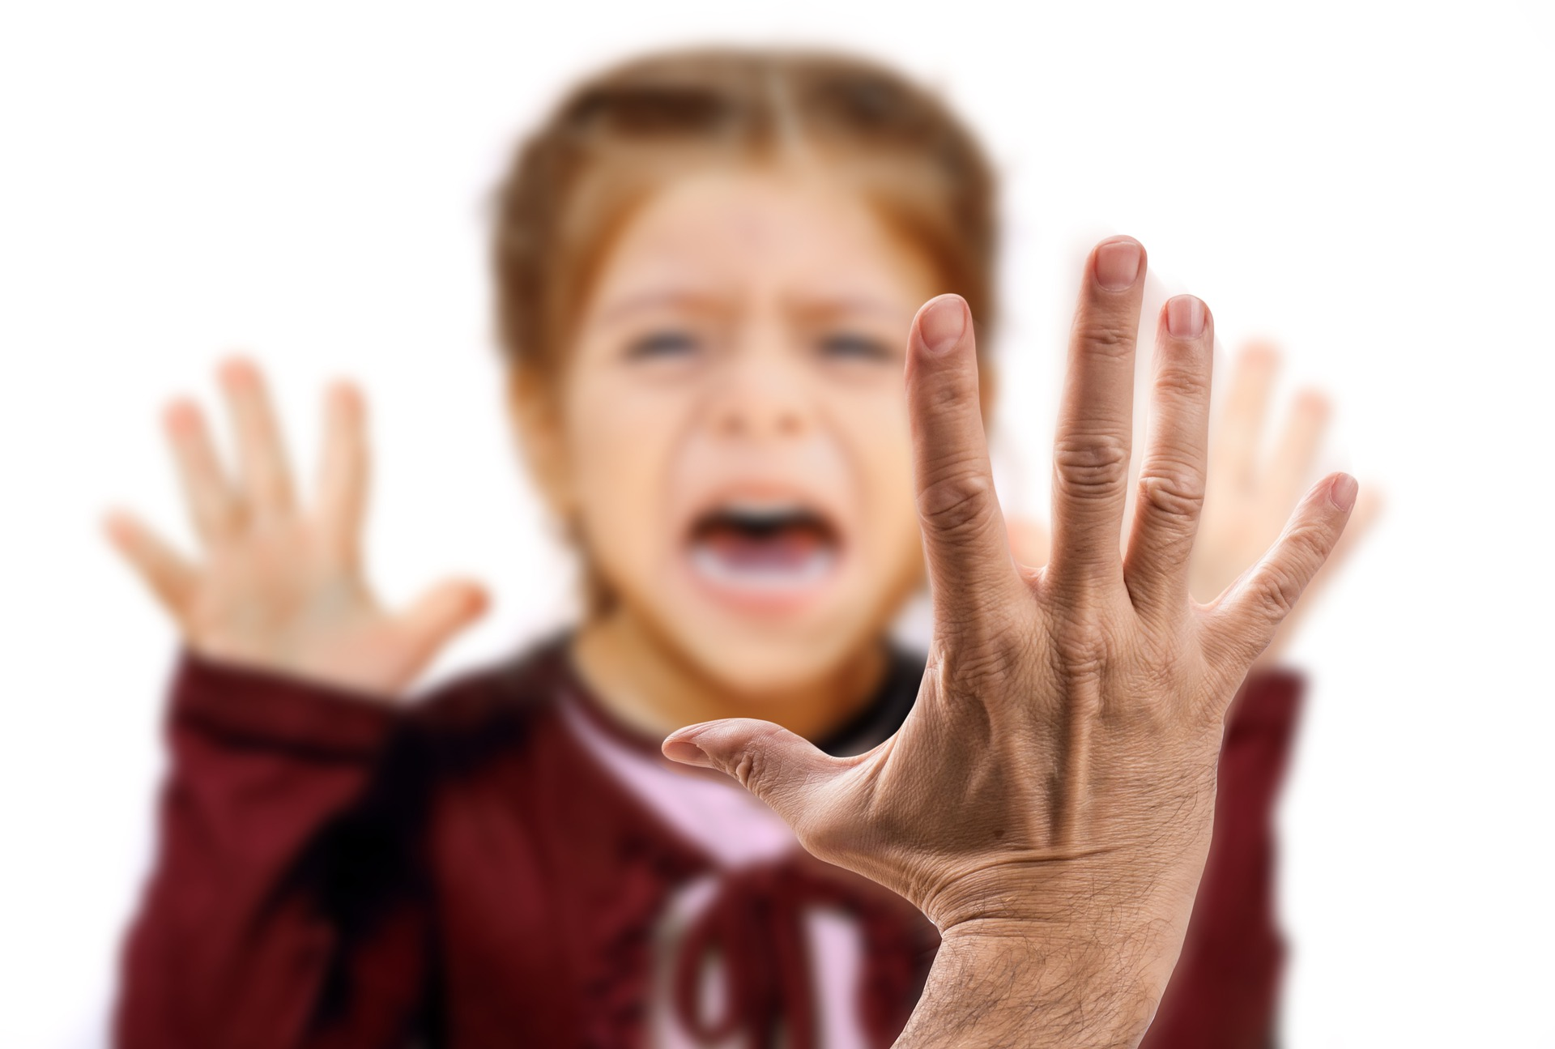
Give Thanks for MERCY
¹³ Even though I was once a blasphemer and a persecutor and a violent man,
I was shown mercy because I acted in ignorance and unbelief.
My PERSONA was Dishonoring

Slide 11
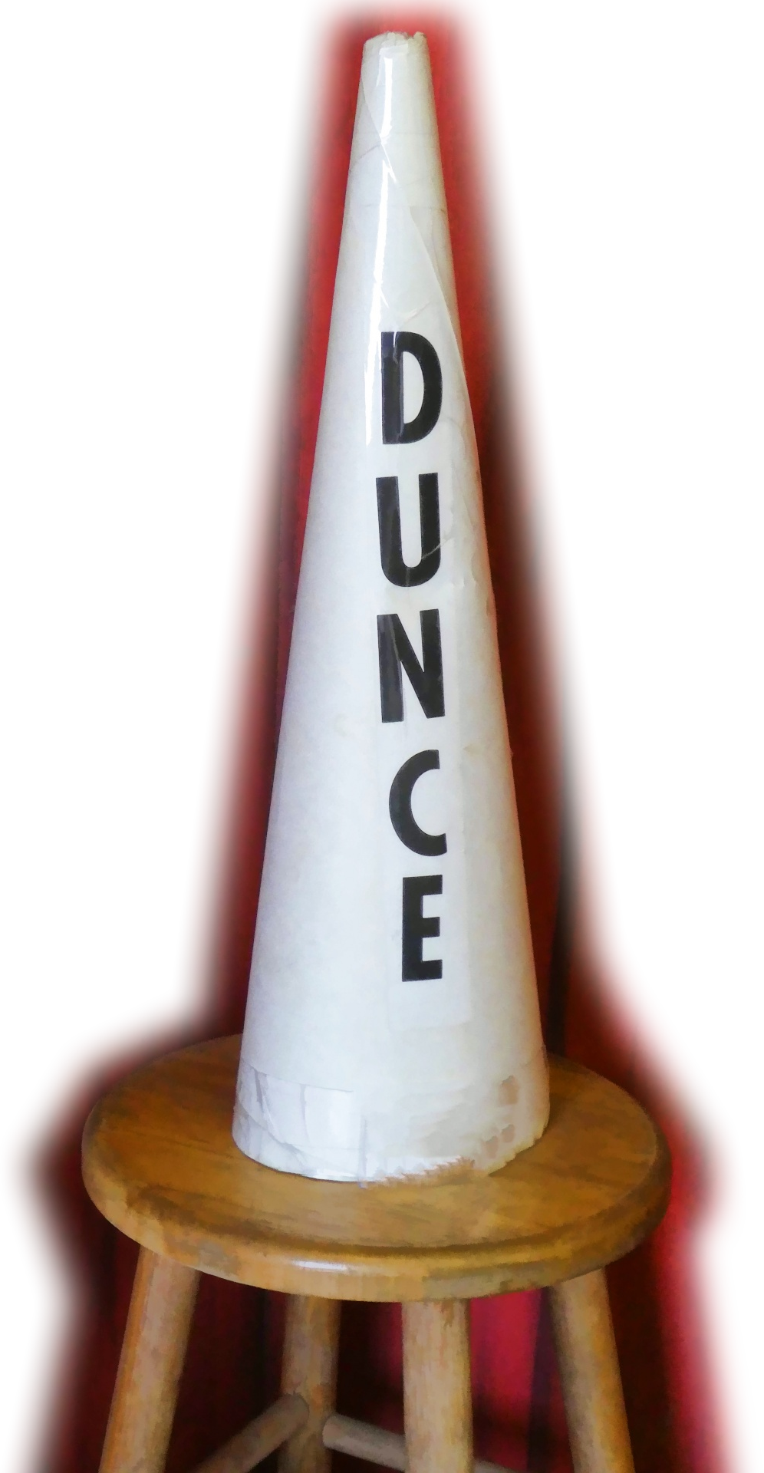
Give Thanks for MERCY
¹³ Even though I was once a blasphemer and a persecutor and a violent man,
I was shown mercy because I acted in ignorance and unbelief.
My MIND was Dishonoring
Notes:
https://www.publicdomainpictures.net/pt/view-image.php?image=269133&picture=chapeu-de-burro
No knowledge

Slide 12
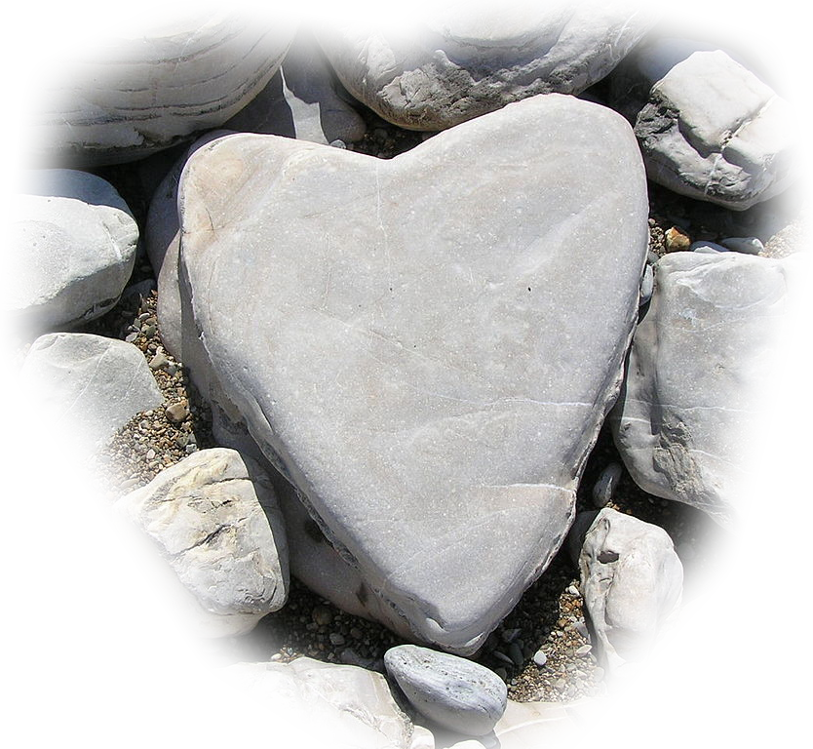
Give Thanks for MERCY
¹³ Even though I was once a blasphemer and a persecutor and a violent man,
I was shown mercy because I acted in ignorance and unbelief.
My HEART was Dishonoring
Notes:
https://upload.wikimedia.org/wikipedia/commons/thumb/e/e9/Heart-shaped_stone.JPG/1024px-Heart-shaped_stone.JPG

Slide 13
Give Thanks for MERCY
¹³ Even though I was once a blasphemer and a persecutor and a violent man,
I was shown mercy because I acted in ignorance and unbelief.
In spite of it all.

Slide 14
Give Thanks for GRACE

Slide 15
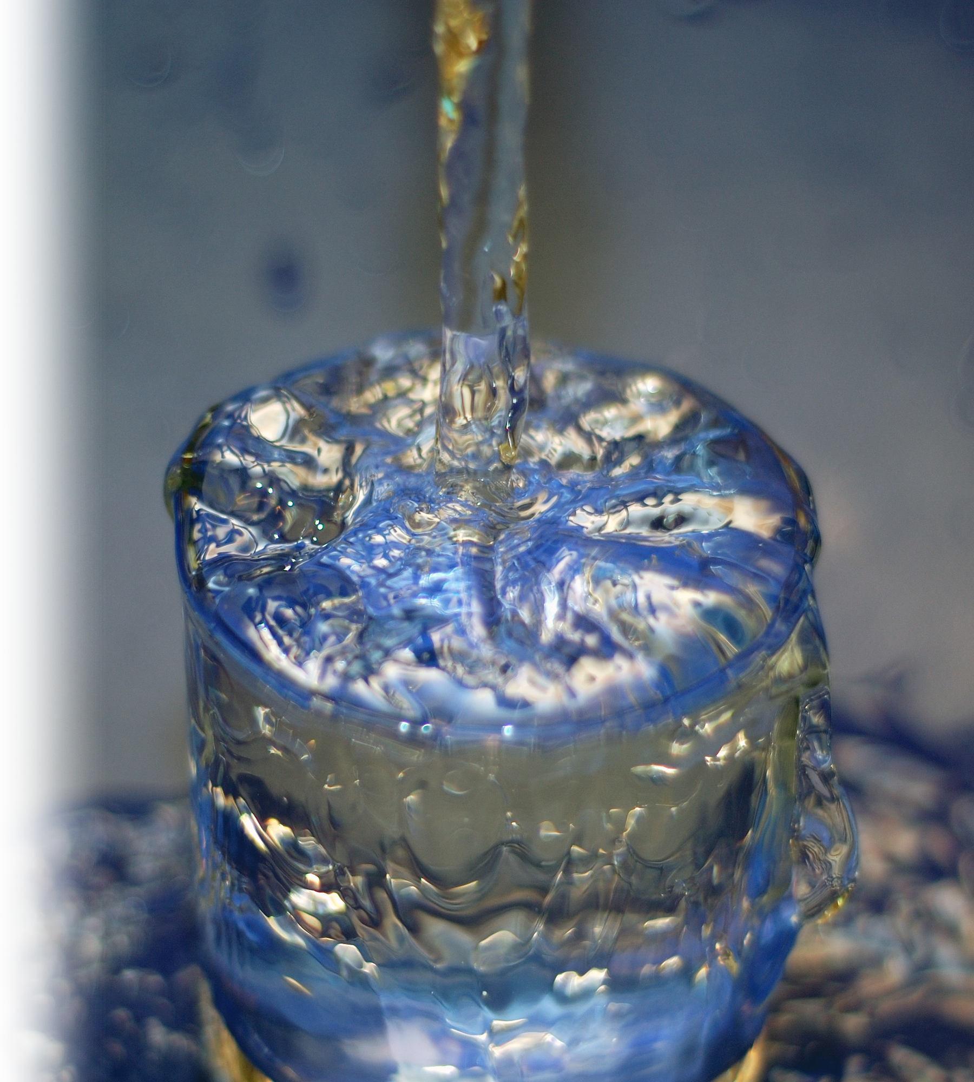
Give Thanks for GRACE
¹⁴ The grace of our Lord was poured out on me abundantly, along with the faith and love that are in Christ Jesus.
Overflowing GRACE

Slide 16
Give Thanks for GRACE
¹⁴ The grace of our Lord was poured out on me abundantly, along with the faith and love that are in Christ Jesus.
Overflowing FAITH

Slide 17
Give Thanks for GRACE
¹⁴ The grace of our Lord was poured out on me abundantly, along with the faith and love that are in Christ Jesus.
Overflowing LOVE

Slide 18
Give Thanks for SALVATION
¹⁵ Here is a trustworthy saying that deserves full acceptance: Christ Jesus came into the world
to save sinners—
of whom I am the worst.

Slide 19
Give Thanks for SALVATION
λογοs
¹⁵ Here is a trustworthy saying that deserves full acceptance: Christ Jesus came into the world
to save sinners—
of whom I am the worst.
Give thanks for His PERSON

Slide 20
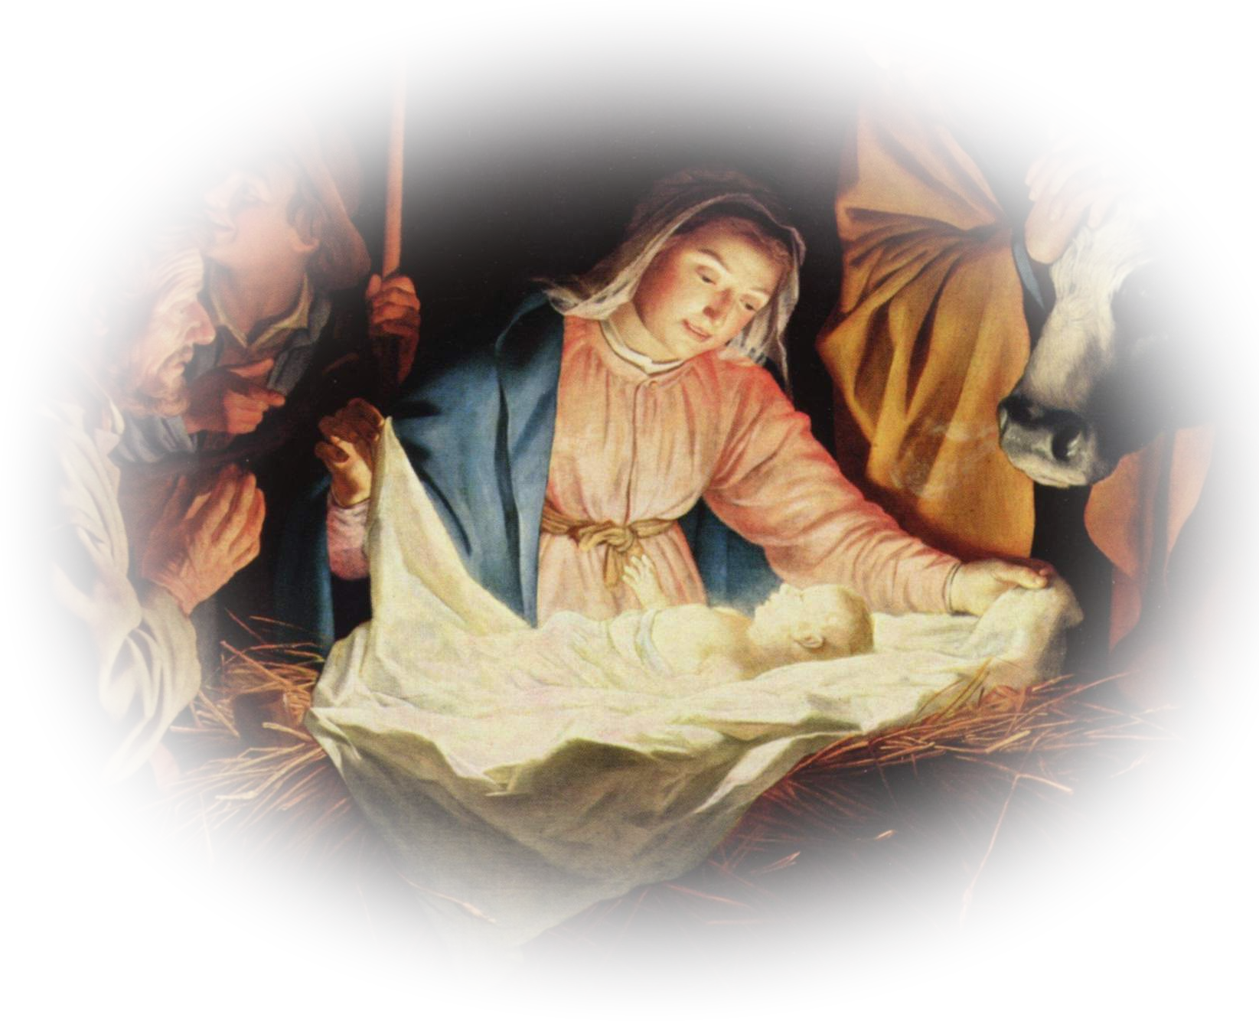
Give Thanks for SALVATION
λογοs
¹⁵ Here is a trustworthy saying that deserves full acceptance: Christ Jesus came into the world
to save sinners—
of whom I am the worst.
Give thanks for His ENTRANCE
Notes:
Thank Jesus for Christmas

Slide 21
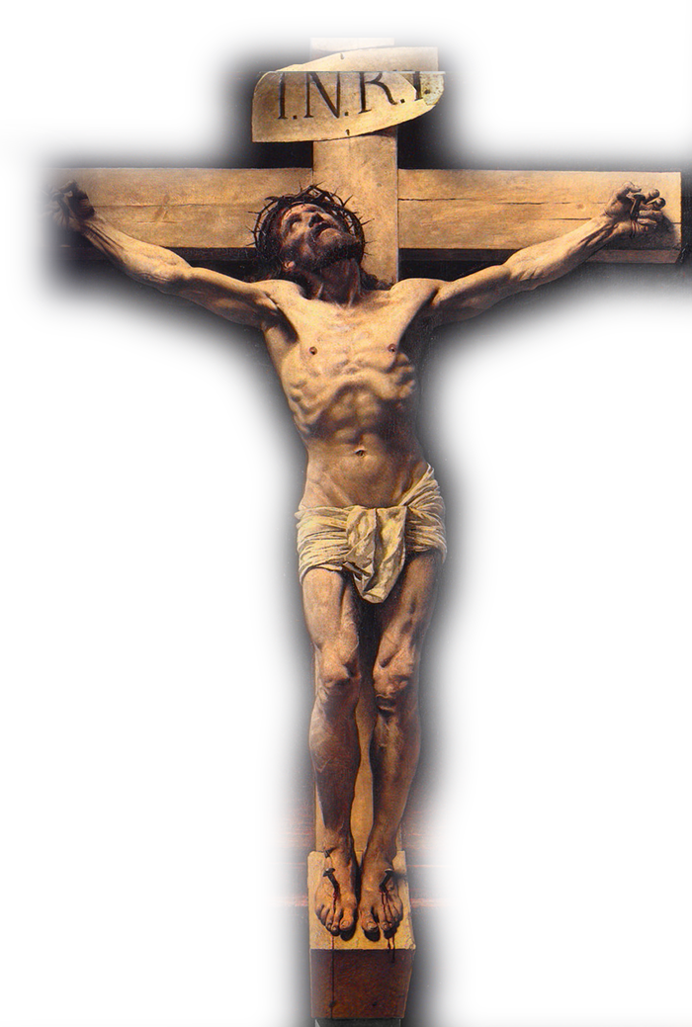
Give Thanks for SALVATION
λογοs
¹⁵ Here is a trustworthy saying that deserves full acceptance: Christ Jesus came into the world
to save sinners—
of whom I am the worst.
Give Thnks for His SOLUTION
Notes:
Thank Jesus for Good friday

Slide 22
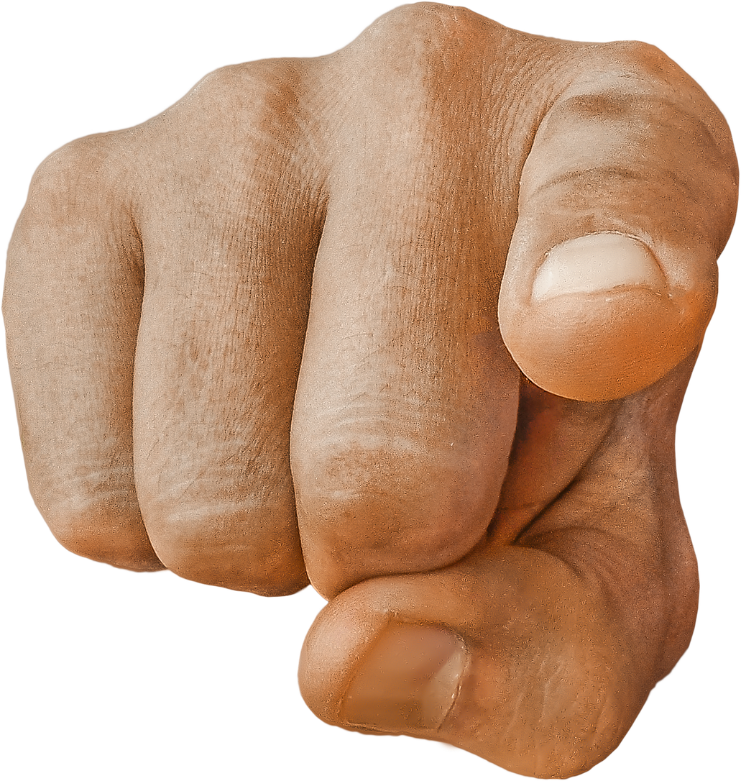
Give Thanks for SALVATION
λογοs
¹⁵ Here is a trustworthy saying that deserves full acceptance: Christ Jesus came into the world
to save sinners—
of whom I am the worst.
Take it PERSONALY!
Notes:
https://pixabay.com/fr/photos/pointer-du-doigt-main-pointage-1922074/
Thank Jesus for Easter Sunday

Slide 23
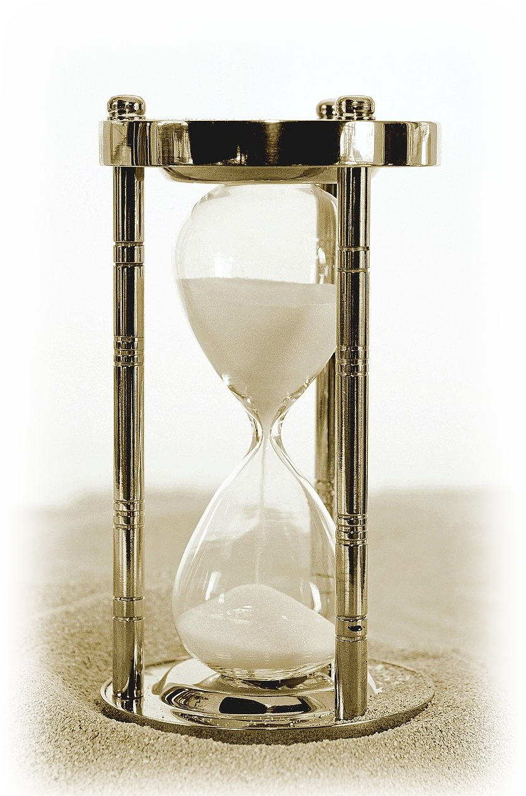
Give Thanks for PATIENCE
¹⁶ But for that very reason
I was shown mercy so that in me, the worst of sinners, Christ Jesus might display his unlimited patience as an example for those who would believe on him and receive eternal life.

Slide 24

Give Thanks for PATIENCE
¹⁶ But for that very reason
I was shown mercy so that in me, the worst of sinners, Christ Jesus might display his unlimited patience as an example for those who would believe on him and receive eternal life.
UNLIMITED Patience
Notes:
https://pixabay.com/fr/vectors/infinity-infini-r%C3%A9p%C3%A9tant-boucle-1837436/

Slide 25
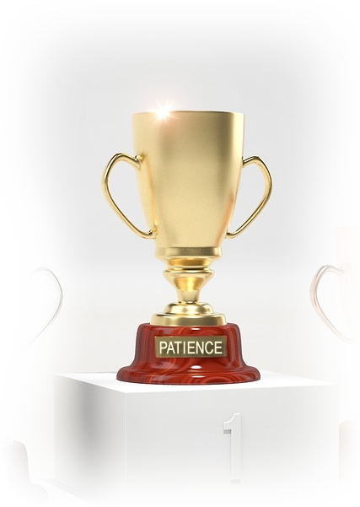
Give Thanks for PATIENCE
¹⁶ But for that very reason
I was shown mercy so that in me, the worst of sinners, Christ Jesus might display his unlimited patience as an example for those who would believe on him and receive eternal life.
DISPLAYED Patience
Notes:
https://pixabay.com/fr/illustrations/coupe-champion-prix-troph%C3%A9e-1613315/

Slide 26

Give Thanks for PATIENCE
¹⁶ But for that very reason
I was shown mercy so that in me, the worst of sinners, Christ Jesus might display his unlimited patience as an example for those who would believe on him and receive eternal life.
EXEMPLARY Patience
Notes:
https://www.flickr.com/photos/76283671@N00/171750803
Prototype – pattern to follow

Slide 27
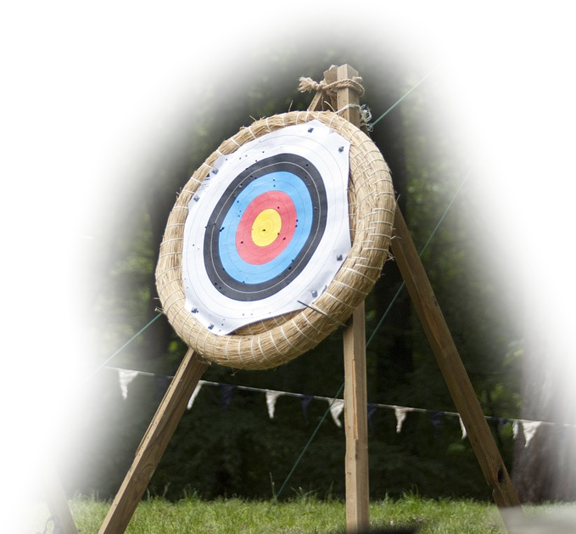
Give Thanks for PATIENCE
¹⁶ But for that very reason
I was shown mercy so that in me, the worst of sinners, Christ Jesus might display his unlimited patience as an example for those who would believe on him and receive eternal life.
PURPOSEFUL Patience
Notes:
https://www.maxpixel.net/Accuracy-Flying-Arrow-Range-Target-Aim-Hit-Sport-4236118

Slide 28

Give Thanks for PATIENCE
¹⁶ But for that very reason
I was shown mercy so that in me, the worst of sinners, Christ Jesus might display his unlimited patience as an example for those who would believe on him and receive eternal life.
PURPOSEFUL Patience

Slide 29
Give Thanks to GOD
¹⁷ Now to the King eternal, immortal, invisible, the only God, be honor and glory for ever and ever. Amen.
Notes:
https://en.wikipedia.org/wiki/File:Crown_jewels_Poland_10.JPG

Slide 30

Give Thanks to GOD
¹⁷ Now to the King eternal, immortal, invisible, the only God, be honor and glory for ever and ever. Amen.
Notes:
https://en.wikipedia.org/wiki/File:Crown_jewels_Poland_10.JPG

Slide 31
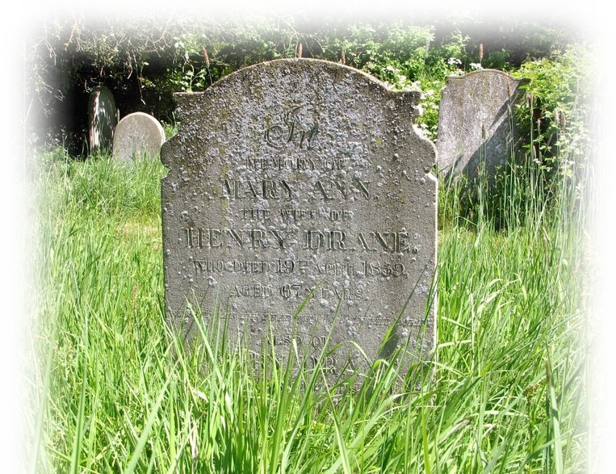
Give Thanks to GOD
¹⁷ Now to the King eternal, immortal, invisible, the only God, be honor and glory for ever and ever. Amen.
Notes:
https://www.geograph.org.uk/photo/6153654

Slide 32
Give Thanks to GOD
¹⁷ Now to the King eternal, immortal, invisible, the only God, be honor and glory for ever and ever. Amen.

Slide 33

Give Thanks to GOD
¹⁷ Now to the King eternal, immortal, invisible, the only God, be honor and glory for ever and ever. Amen.

Slide 34
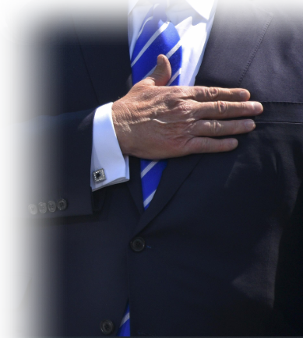
Give Thanks to GOD
¹⁷ Now to the King eternal, immortal, invisible, the only God, be honor and glory for ever and ever. Amen.
Notes:
https://media.defense.gov/2017/Sep/18/2001812231/-1/-1/0/170517-G-ZX620-003C.JPG

Slide 35
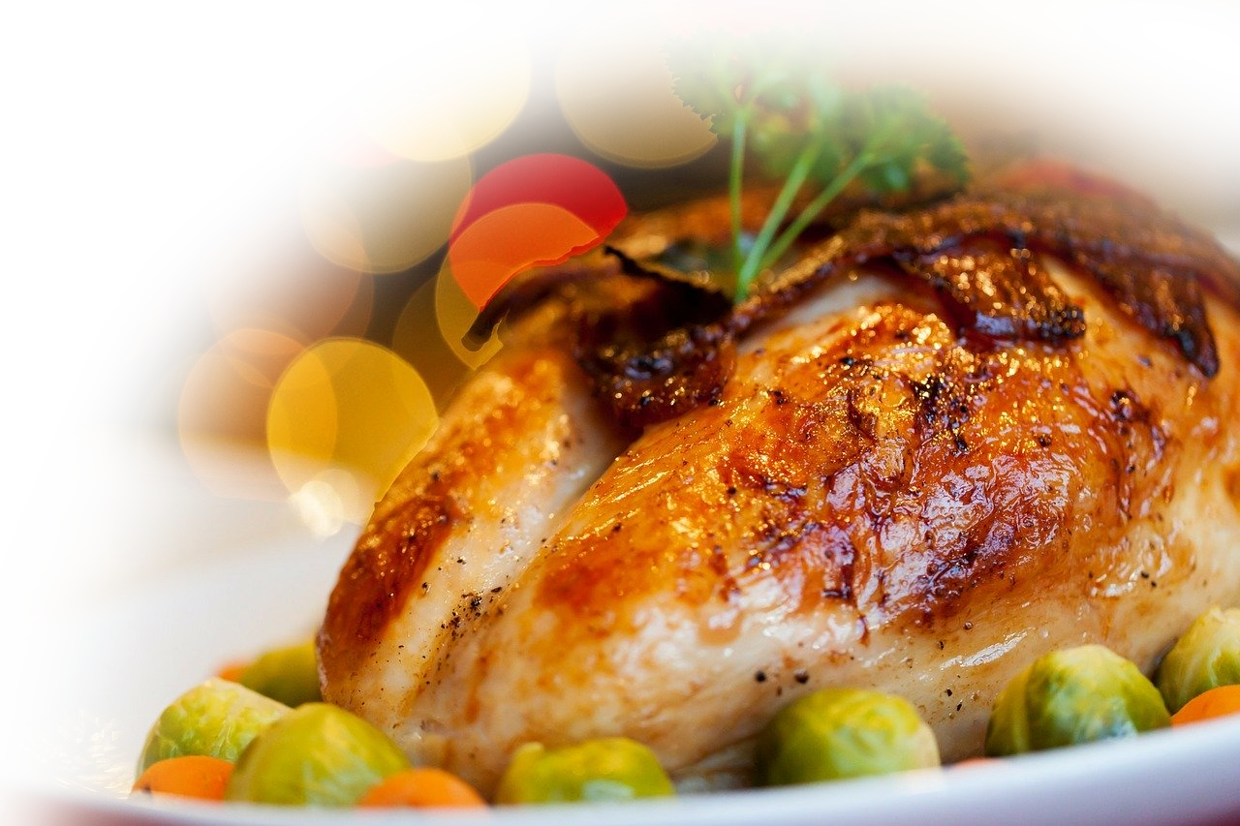
Take this with you ...
This Thursday REMEMBER to give thanks for:
God’s Empowerment
God’s Mercy
God’s Grace
God’s Salvation
God’s Patience
Notes:
https://pixabay.com/fr/photos/c%C3%A9l%C3%A9bration-no%C3%ABl-cuisine-d%C3%A9licieux-315079/

Slide 36

Let’s Pray

