Slide 1
I’m NOT Exactly Sure
What’s Happening Here!
John 12:16
Watch:
https://youtu.be/k5Ke7ImpepU
Notes:
Palm Branches | Random Palm Tree images I got last summer in… | Flickr
Copyright © 2006−2021. All rights reserved. Bible Point is a registered trademark of Dennis Henderson. All other trademarks acknowledged.
Bible Point contains graphics from Bible Point artists. These illustrations belong to Bible Point and the respective artists. You may use the designs and illustrations for graphical illustration of lessons free and without special permission, provided they are not used in any way that maligns the Christian faith. Furthermore, republication or production of any illustration by any other graphic service whether it be in book, in a machine-readable form, or in any other design resource is strictly prohibited. Furthermore, they cannot be duplicated or resold as any other form of publishing, clip art, or graphic resource.
So What does it mean? (A simple translations of the legal jargon)
So, if you don’t own the presentation(s), graphic(s), and text(s) how can you legally use them? The purchase of the license allows you to use all the images in the product. However, the actual ownership and copyright of the presentation(s), graphic(s), and text(s) remain the property of Bible Point and its licensors. If you had plans on using this product in your “for sale” work—think again!
License Agreement
Article 1: License Grant
All the graphics and text in Bible Point presentations (excluding quotes from the Bible and stated sources) are the intellectual and real property of Bible Point and its licensors, and is protected by law, including United States copyright laws and international treaties. Bible Point grants to you a license:
1. To use the presentation in a single church, single school, or single office of a Christian organization.
2. To make a single archival back-up copy of the program.
3. To modify the presentation(s) and merge with other presentations in a single church, school, or Christian organization.
4. To transfer to another party if that party agrees to accept the terms and conditions of this agreement, and you do not retain any copies of the presentation, whether printed, machine readable, modified, or merged form.
Article 2: Terms
This license is effective until terminated. You may terminate the license at any time by destroying the presentation(s), graphic(s), or text(s) together with all copies, modifications and merged portions in any form. Bible Point may terminate your license if you fail to comply with this Agreement. You agree, upon such termination, for any reason, to destroy the presentation(s), graphics, and text(s) with all copies, modifications, and merged portions in any form.
Article 3: Disclaimers
1. Bible Point presentations, graphics, and texts are licensed to you As Is. You, the consumer, bear the entire risk relating to the quality and performance of the presentation(s), graphic(s), or text(s). In no event will Bible Point be liable for damages resulting from any defect.
2. Thirty-day limited warrantee on disks. Bible Point warrants the disks to be free of defects in material and workmanship under normal use for 30 days after purchase. During the 30-day period you may return a defective presentation, graphic, or text with proof of purchase and it will be replaced without charge, unless the presentation is damaged by misuse.
Article 4: General
1. You may not sub-license, assign, or transfer the license of the presentation(s), graphic(s), or text(s) except as provided by this Agreement.
2. This Agreement will be governed by the laws of the State of Michigan.
So What does it mean? (A simple translations of the legal jargon)
May I let someone borrow or copy my licensed Bible Point presentation (even after I modified it)? As long as it is within your local church, or single school, or the immediate office of a Christian organization you may. Otherwise, please refer the person interested in borrowing to: http://www.biblepoint.com or E-mail: dennis@DrDH.net with any related questions.

Slide 2
I’m NOT Exactly Sure
What’s Happening Here!
John 12:16
Notes:
Palm Branches | Random Palm Tree images I got last summer in… | Flickr
It was palm Sunday but because of a sore throat, 5-year-old Johnny styed home from church with a sitter. When the family returned home, they were carrying several palm fronds. Johnny asked them what they were for. “People held them over Jesus’ head as he walked by,” his father told him. Wouldn't you know it,” Johnny fumed, “the one Sunday I don’t go, and he shows up.”
I’m Not Exactly Sure What is Happening Here!
The People: His disciples – followers: then and now
The Confusion: Did not understand – didn’t get it: then and now
The Timing: But when Jesus was glorified – fast forward to after the resurrection: then and now
The Recall: Then they remembered – the lights came on / Monday quarterback: then and now
The Scripture: That these things had been written – the OT prophecies: then and now
The Fulfillment: And had been done to him – fulfillment: then and now

Slide 3
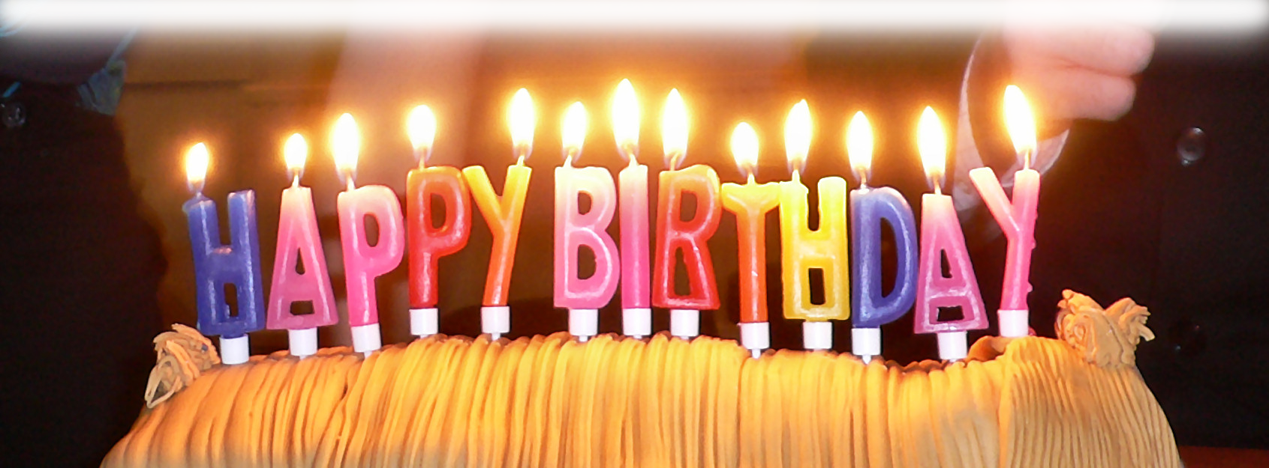
I’m NOT Exactly Sure
What’s Happening Here!
Notes:
Palm Branches | Random Palm Tree images I got last summer in… | Flickr
https://en.wikipedia.org/wiki/Happy_Birthday_to_You#/media/File:Birthday_candles.jpg
I’m Not Exactly Sure What is Happening Here!
The People: His disciples – followers: then and now
The Confusion: Did not understand – didn’t get it: then and now
The Timing: But when Jesus was glorified – fast forward to after the resurrection: then and now
The Recall: Then they remembered – the lights came on / Monday quarterback: then and now
The Scripture: That these things had been written – the OT prophecies: then and now
The Fulfillment: And had been done to him – fulfillment: then and now

Slide 4

I’m NOT Exactly Sure
What’s Happening Here!
Notes:
Palm Branches | Random Palm Tree images I got last summer in… | Flickr
https://3.bp.blogspot.com/-cP9RKo1oT6M/WQTrNjF8lzI/AAAAAAAAmnk/8ZyqRjVwflA_aRsKJGxWeaolcvKSlv20ACLcB/s1600/IMG_5734.jpg
What is Happening Here!
The People: His disciples – followers: then and now
The Confusion: Did not understand – didn’t get it: then and now
The Timing: But when Jesus was glorified – fast forward to after the resurrection: then and now
The Recall: Then they remembered – the lights came on / Monday quarterback: then and now
The Scripture: That these things had been written – the OT prophecies: then and now
The Fulfillment: And had been done to him – fulfillment: then and now

Slide 5
I’m NOT Exactly Sure
What’s Happening Here!
^{John 12:16} At first his disciples did not understand all this. Only after Jesus was glorified did they realize that these things had been written about him and that they had done these things to him.
Notes:
Palm Branches | Random Palm Tree images I got last summer in… | Flickr
https://en.wikipedia.org/wiki/Happy_Birthday_to_You#/media/File:Birthday_candles.jpg
I’m Not Exactly Sure What is Happening Here!
The People: His disciples – followers: then and now
The Confusion: Did not understand – didn’t get it: then and now
The Timing: But when Jesus was glorified – fast forward to after the resurrection: then and now
The Recall: Then they remembered – the lights came on / Monday quarterback: then and now
The Scripture: That these things had been written – the OT prophecies: then and now
The Fulfillment: And had been done to him – fulfillment: then and now

Slide 6
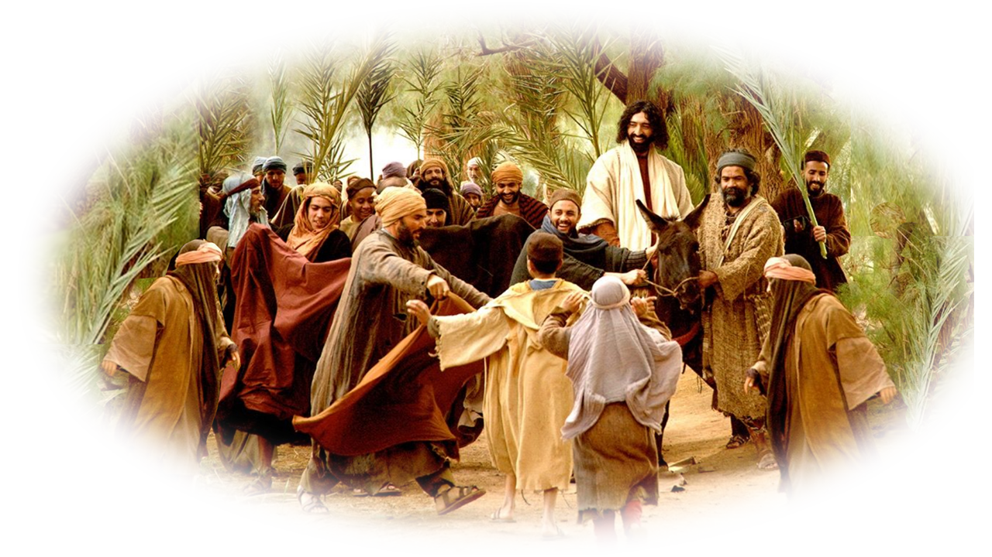
1- “At First:” On Palm Sunday
At first his disciples did not understand all this.

Slide 7
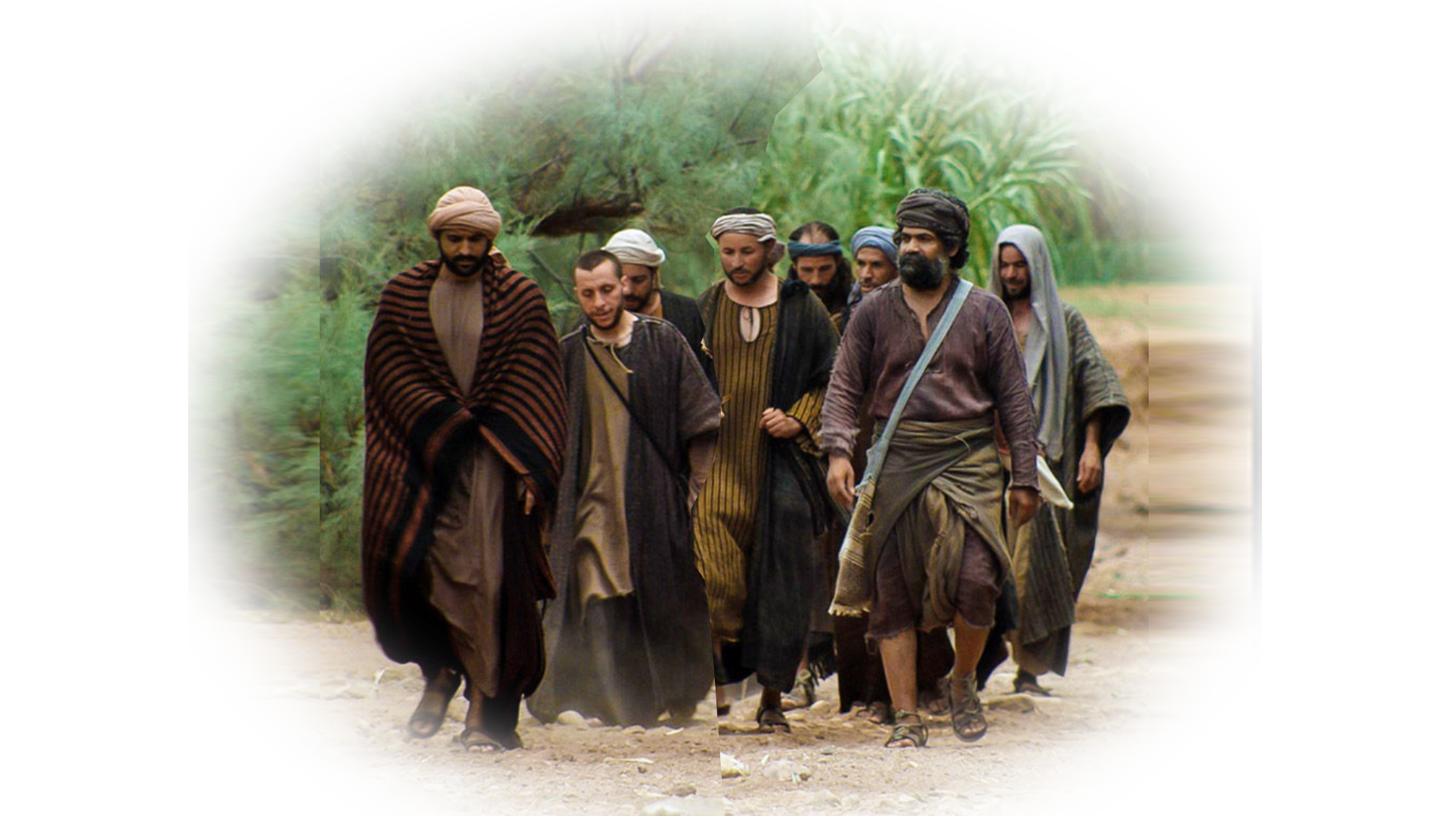
1-The People: “His disciples”
At first his disciples did not understand all this.
Notes:
Let me remind you that these were common ordinary people like you and me … who would change the world … turn it upside down ….
Nearly half (5) were fishermen, (Peter, James, John, Andrew, ?Philip?)
only one (1) may have been of noble birth, (Bartholomew)
one (1) was despised by everyone, (Matthew the Tax Collector)
one (1) was a traitor, (Judas Iscariot)
one (1) was a political Zealot (Simon)
one (1) was a doubter, (Thomas)
Two (2) were “nobodies” –we don’t know much (James the younger and brother Jude)
Peter – a fisherman
James – son of Zebedee – a fisherman
John –son of Zebedee – a fisherman -- The beloved
Andrew – Peter’s brother – a fisherman
Bartholomew – perhaps of nobility (some think)
James (the younger) son of Alpheus
Judas Iscariot – the Traitor
Jude son of Alpheus
Matthew (Levi) – Tax Collector
Philip – likely a fisherman
Simon – the Zealot (political activist)
Thomas – the doubter
I’m Not Exactly Sure What is Happening Here!
The People: His disciples – followers: then and now
The Confusion: Did not understand – didn’t get it: then and now
The Timing: But when Jesus was glorified – fast forward to after the resurrection: then and now
The Recall: Then they remembered – the lights came on / Monday quarterback: then and now
The Scripture: That these things had been written – the OT prophecies: then and now
The Fulfillment: And had been done to him – fulfillment: then and now

Slide 8
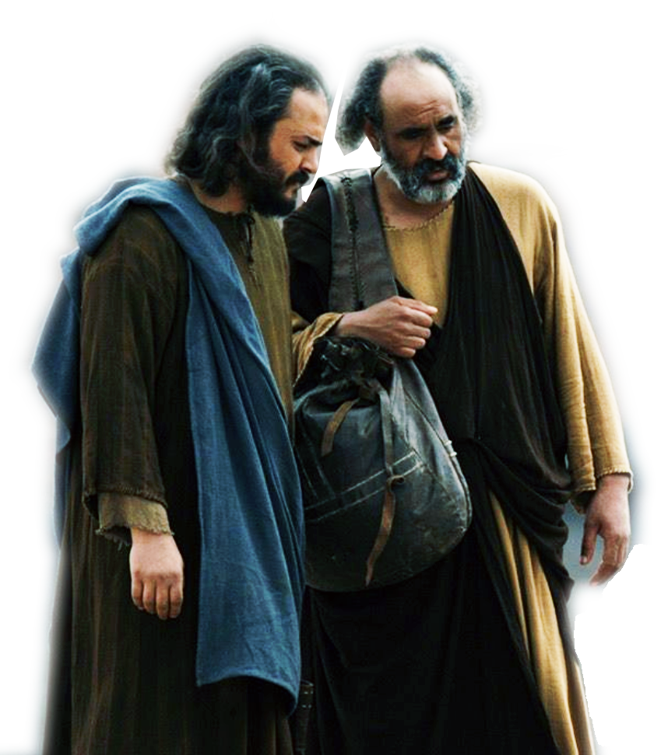
2-The Confusion: Did not understand
At first his disciples did not understand all this.
Notes:
Okay, so I’m a little hard of hearing—even with hearing aids. I tend to confuse some sounds so sometimes I don’t quite understand what people say. Like when you wear a mask, I can’t read your lips to help with my hearing. I’m not deaf—just hard of hearing.
The disciples were not ignorant—just did not connect the dots of what was happening—they were caught up in the moment and oblivious that something important was happening.
Maybe God is doing something BIG in your life right now—and you are missing it. It’s not that you’re dumb—you are just caught up in the details.
You are preoccupied in the problem of the relationship, or the blessing of life that is overwhelming you and you are missing that God is doing something even bigger.
Why you are estranged from your family, why problem upon problem are befalling you, or why everything seems to be going right. Wonder what’s up. What is happening here.
I’m Not Exactly Sure What is Happening Here!
The People: His disciples – followers: then and now
The Confusion: Did not understand – didn’t get it: then and now
The Timing: But when Jesus was glorified – fast forward to after the resurrection: then and now
The Recall: Then they remembered – the lights came on / Monday quarterback: then and now
The Scripture: That these things had been written – the OT prophecies: then and now
The Fulfillment: And had been done to him – fulfillment: then and now

Slide 9
3-The Events: all this
At first his disciples did not understand all this.
Notes:
Securing a donkey
Riding on a donkey
Palms and coats
Hossana
Children singing
Entering Jerusalem
They didn’t get what was going down.
Like our salvation. At eight years old I really didn’t comprehend what happened, until I began to study and learnt what God had done for me. He chose me, he justified me, He pardoned me, He graced me, He mercied me, He sanctified me, he glorified me, he adopted me, etc.
Feast OF Booths (but this is the feast of Passover)
⁴⁰ On the first day you are to take choice fruit from the trees, and palm fronds, leafy branches and poplars, and rejoice before the LORD your God for seven days. (Lev 23:40 NIV)

Slide 10
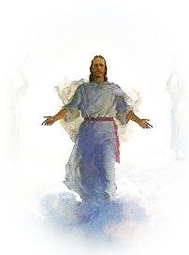
4-The Timing: After he was glorified
Only after Jesus was glorified did they realize …
Notes:
https://c1.staticflickr.com/4/3608/3392966849_f8762e4e36.jpg
Just a few verse further in the text and it says:
²³ Jesus replied, "The hour has come for the Son of Man to be glorified. (Joh 12:23 NIV)
Jesus was glorified at the Resurrection on the first Easter morning. He arose with a glorified body.
Glorification comes after this body dies and is resurrected. To this even Paul agrees:
⁴⁴ it is sown a natural body, it is raised a spiritual body. If there is a natural body, there is also a spiritual body. (1Co 15:44 NIV)
I’m Not Exactly Sure What is Happening Here!
The People: His disciples – followers: then and now
The Confusion: Did not understand – didn’t get it: then and now
The Timing: But when Jesus was glorified – fast forward to after the resurrection: then and now
The Recall: Then they remembered – the lights came on / Monday quarterback: then and now
The Scripture: That these things had been written – the OT prophecies: then and now
The Fulfillment: And had been done to him – fulfillment: then and now

Slide 11
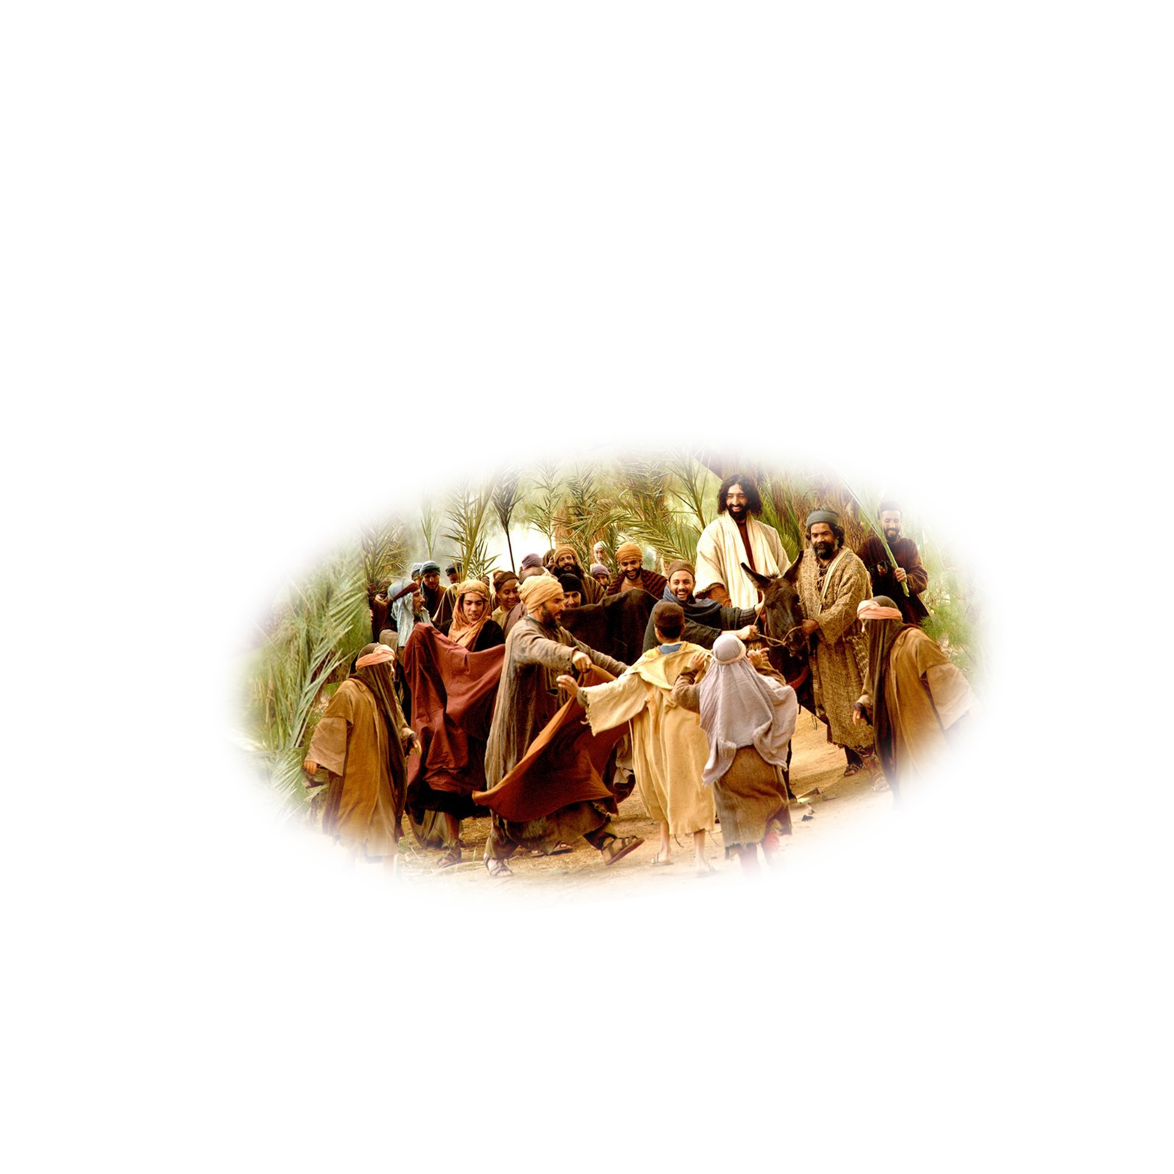

5-The Hindsight: they remembered
Only after Jesus was glorified did they realize …
Notes:
This like Romans 8:28 in the rearview mirror.
God works all things together for good. They did not see God’s hand in the entry to Jerusalem. The had entered the city gates so many times—This was another Passover week with an unusually celebrating– after all Jesus had raised Lazarus from the dead. And people who saw it were in the crowd.
But after the event – they looked back on all that happened and saw God’s fingerprints all over it!
Right now you may be in the midst of your own Palm Sunday event—and don’t know it.
Maybe you will look back and see your last conversation mended a relationship and you didn’t know it.
Maybe you helped a person unknowingly and latter you will learn of it.
Listen, you do not know what a day will bring forth.
Everyone here could probably tell how you can look back on such a situation – remember the past.
Even now some of you here wish you could go back and relive a part or a moment in time. Realizing what you know now you would have acted differently.
Some even say, Wow. If I had only understood then how to be saved and received Christ what a difference it would have made in my life. That’s appears to be what is happening in this passage. They were in a fog, caught in the moment, and didn’t even know what moment it was.
I’m Not Exactly Sure What is Happening Here!
The People: His disciples – followers: then and now
The Confusion: Did not understand – didn’t get it: then and now
The Timing: But when Jesus was glorified – fast forward to after the resurrection: then and now
The Recall: Then they remembered – the lights came on / Monday quarterback: then and now
The Scripture: That these things had been written – the OT prophecies: then and now
The Fulfillment: And had been done to him – fulfillment: then and now

Slide 12
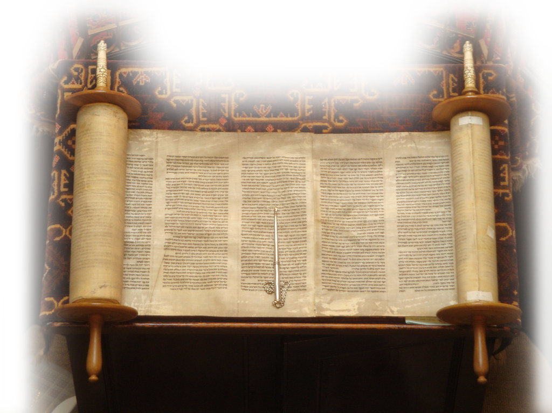
6-The Scripture: had been written
that these things had been written about him
Notes:
https://live.staticflickr.com/3619/3370859327_ca39731af9_b.jpg
But after the Glorification of Jesus. They reflected on the past event of Palm Sunday and they reflected on the Word of God and then began connecting the dots.
Here are just a few they may have connected:
⁹ Rejoice greatly, O Daughter of Zion! Shout, Daughter of Jerusalem! See, your king comes to you, righteous and having salvation, gentle and riding on a donkey, on a colt, the foal of a donkey. (Zec 9:9 NIV)
²⁵ O LORD, save us; O LORD, grant us success.
²⁶ Blessed is he who comes in the name of the LORD. From the house of the LORD we bless you.
(Psa 118:25-26 NIV)
² From the lips of children and infants you have ordained praise because of your enemies, to silence the foe and the avenger. (Psa 8:2 NIV)
Or even more precisely—Daniel’s prophecy of 70 “sevens” predicted right down to the day that Jesus would enter the city presenting Himself King of the Jews. Daniel 9:25-27 In Luke it is called the day of “God’s Visitation.” [you did not recognize the time of your visitation from God. (Luk 19:44 NET)]
I’m Not Exactly Sure What is Happening Here!
The People: His disciples – followers: then and now
The Confusion: Did not understand – didn’t get it: then and now
The Timing: But when Jesus was glorified – fast forward to after the resurrection: then and now
The Recall: Then they remembered – the lights came on / Monday quarterback: then and now
The Scripture: That these things had been written – the OT prophecies: then and now
The Fulfillment: And had been done to him – fulfillment: then and now

Slide 13
7-The Fulfillment: had been done
and that they had done these things to him.
Notes:
the Scripture cannot be broken-- (Joh 10:35 NIV)
¹⁷ "Do not think that I have come to abolish the Law or the Prophets; I have not come to abolish them but to fulfill them.
¹⁸ I tell you the truth, until heaven and earth disappear, not the smallest letter, not the least stroke of a pen, will by any means disappear from the Law until everything is accomplished.
(Mat 5:17-18 NIV)
¹⁶ We did not follow cleverly invented stories when we told you about the power and coming of our Lord Jesus Christ, but we were eyewitnesses of his majesty.
¹⁷ For he received honor and glory from God the Father when the voice came to him from the Majestic Glory, saying, "This is my Son, whom I love; with him I am well pleased."
¹⁸ We ourselves heard this voice that came from heaven when we were with him on the sacred mountain.
¹⁹ And we have the word of the prophets made more certain, and you will do well to pay attention to it, as to a light shining in a dark place, until the day dawns and the morning star rises in your hearts.
²⁰ Above all, you must understand that no prophecy of Scripture came about by the prophet's own interpretation.
²¹ For prophecy never had its origin in the will of man, but men spoke from God as they were carried along by the Holy Spirit.
(2Pe 1:16-21 NIV)
I’m Not Exactly Sure What is Happening Here!
The People: His disciples – followers: then and now
The Confusion: Did not understand – didn’t get it: then and now
The Timing: But when Jesus was glorified – fast forward to after the resurrection: then and now
The Recall: Then they remembered – the lights came on / Monday quarterback: then and now
The Scripture: That these things had been written – the OT prophecies: then and now
The Fulfillment: And had been done to him – fulfillment: then and now

Slide 14

8-The Application: written for YOU!
Notes:
¹¹ He came to that which was his own, but his own did not receive him.
¹² Yet to all who received him, to those who believed in his name, he gave the right to become children of God--
(Joh 1:11-12 NIV)
I’m Not Exactly Sure What is Happening Here!
The People: His disciples – followers: then and now
The Confusion: Did not understand – didn’t get it: then and now
The Timing: But when Jesus was glorified – fast forward to after the resurrection: then and now
The Recall: Then they remembered – the lights came on / Monday quarterback: then and now
The Scripture: That these things had been written – the OT prophecies: then and now
The Fulfillment: And had been done to him – fulfillment: then and now

Slide 15
LET’S PRAY!

