Slide 1
Ten Outtakes from
Palm Sunday!
John 12:1-19
Watch here = https://youtu.be/Kjaj3cU5dHA
Notes:
Palm Background = https://pxhere.com/en/photo/1153558
Copyright © 2006−2021. All rights reserved. Bible Point is a registered trademark of Dennis Henderson. All other trademarks acknowledged.
Bible Point contains graphics from Bible Point artists. These illustrations belong to Bible Point and the respective artists. You may use the designs and illustrations for graphical illustration of lessons free and without special permission, provided they are not used in any way that maligns the Christian faith. Furthermore, republication or production of any illustration by any other graphic service whether it be in book, in a machine-readable form, or in any other design resource is strictly prohibited. Furthermore, they cannot be duplicated or resold as any other form of publishing, clip art, or graphic resource.
So What does it mean? (A simple translations of the legal jargon)
So, if you don’t own the presentation(s), graphic(s), and text(s) how can you legally use them? The purchase of the license allows you to use all the images in the product. However, the actual ownership and copyright of the presentation(s), graphic(s), and text(s) remain the property of Bible Point and its licensors. If you had plans on using this product in your “for sale” work—think again!
License Agreement
Article 1: License Grant
All the graphics and text in Bible Point presentations (excluding quotes from the Bible and stated sources) are the intellectual and real property of Bible Point and its licensors, and is protected by law, including United States copyright laws and international treaties. Bible Point grants to you a license:
1. To use the presentation in a single church, single school, or single office of a Christian organization.
2. To make a single archival back-up copy of the program.
3. To modify the presentation(s) and merge with other presentations in a single church, school, or Christian organization.
4. To transfer to another party if that party agrees to accept the terms and conditions of this agreement, and you do not retain any copies of the presentation, whether printed, machine readable, modified, or merged form.
Article 2: Terms
This license is effective until terminated. You may terminate the license at any time by destroying the presentation(s), graphic(s), or text(s) together with all copies, modifications and merged portions in any form. Bible Point may terminate your license if you fail to comply with this Agreement. You agree, upon such termination, for any reason, to destroy the presentation(s), graphics, and text(s) with all copies, modifications, and merged portions in any form.
Article 3: Disclaimers
1. Bible Point presentations, graphics, and texts are licensed to you As Is. You, the consumer, bear the entire risk relating to the quality and performance of the presentation(s), graphic(s), or text(s). In no event will Bible Point be liable for damages resulting from any defect.
2. Thirty-day limited warrantee on disks. Bible Point warrants the disks to be free of defects in material and workmanship under normal use for 30 days after purchase. During the 30-day period you may return a defective presentation, graphic, or text with proof of purchase and it will be replaced without charge, unless the presentation is damaged by misuse.
Article 4: General
1. You may not sub-license, assign, or transfer the license of the presentation(s), graphic(s), or text(s) except as provided by this Agreement.
2. This Agreement will be governed by the laws of the State of Michigan.
So What does it mean? (A simple translations of the legal jargon)
May I let someone borrow or copy my licensed Bible Point presentation (even after I modified it)? As long as it is within your local church, or single school, or the immediate office of a Christian organization you may. Otherwise, please refer the person interested in borrowing to: http://www.biblepoint.com or E-mail: dennis@DrDH.net with any related questions.

Slide 2
Ten Outtakes from
Palm Sunday!
John 12:1-19
Notes:
Palm Background = https://pxhere.com/en/photo/1153558

Slide 3
What is an “Outtake?”

Slide 4
What is an “Outtake?”
Something that is taken out, such as

Slide 5
What is an “Outtake?”
Something that is taken out, such as
a: in a film it is a take that is not used in the final edited version

Slide 6

What is an “Outtake?”
Something that is taken out, such as
a: in a film it is a take that is not used in the final edited version

Slide 7
What is an “Outtake?”
Something that is taken out, such as
a: in a film it is a take that is not used in the final edited version
b: in a record album it is a musical selection that is not included

Slide 8
For us an “Outtake”
is something that is taken out, such as:

Slide 9

For us an “Outtake”
is something that is taken out, such as:
a: An event taken out of history ...
and is recorded in the Bible!
Notes:
Bible = FREE = https://pxhere.com/en/photo/60703

Slide 10
For us an “Outtake”
is something that is taken out, such as:
a: An event taken out of history ...
and is recorded in the Bible!
b: Each one will have
the word “out” in it.

Slide 11
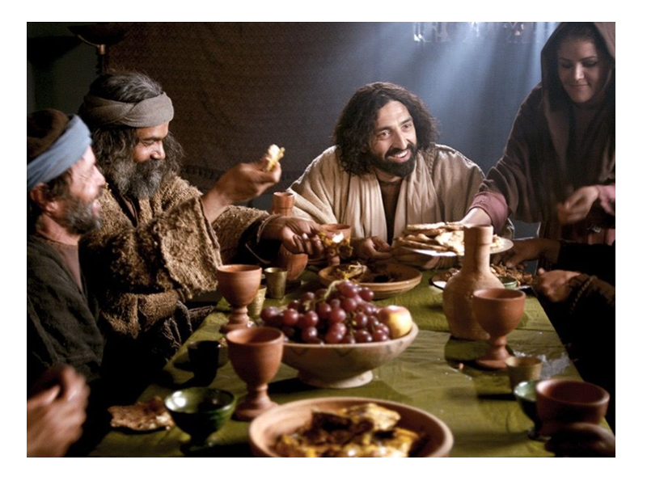
1. Jesus Dined Out
¹ Six days before the Passover, Jesus arrived at Bethany, where Lazarus lived, whom Jesus had raised from the dead. ² Here a dinner was given in Jesus' honor. Martha served, while Lazarus was among those reclining at the table with him.
Notes:
The significance of dining out was not the food (we don’t know what they ate—food as important as it is--is insignificant). It’s who is at the table that is important. Jesus is at the table, the diner is in honor of Him (Lazarus is dining too). Can you imagine the table talk.
“Hey, Jesus how did you bring Lazarus back from the dead?”
“Lazarus, what was it like to be dead for more than four days?”
Jesus wants to dine with you. Rev 3:20 says so, “Behold I stand at the door … dine with him and he with me.” He wants into your life to have intimate conversation and fellowship. Open the door, join the conversation.

Slide 12
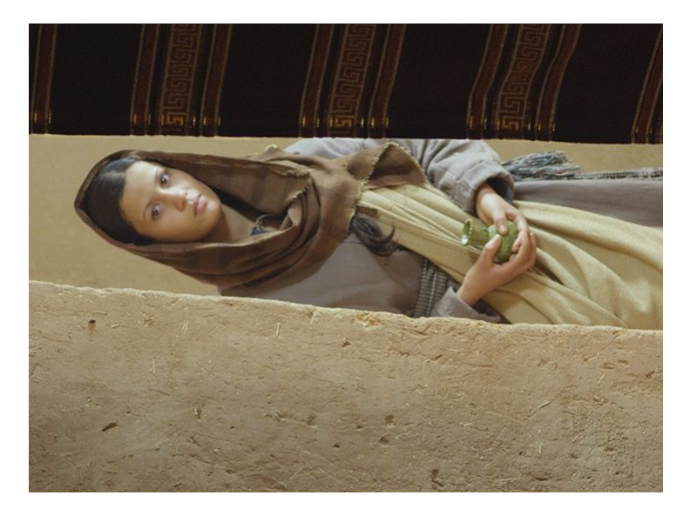
2. Mary Poured Out
³ Then Mary took about a pint of pure nard, an expensive perfume; she poured it on Jesus' feet and wiped his feet with her hair. And the house was filled with the fragrance of the perfume.
Notes:
Mary poured out more than nard—Judas will assess the value as equal to a year’s wages. She is offering to Jesus, not the left overs, but the best she has to offer.

Slide 13
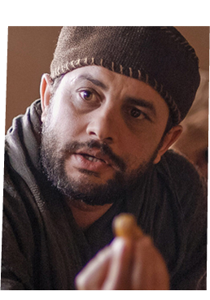
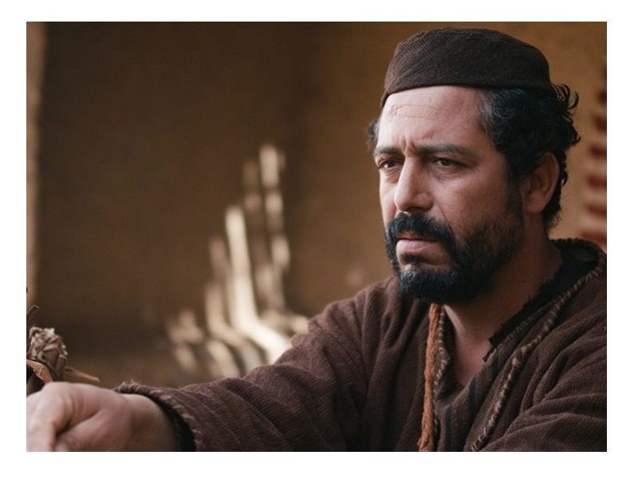
3. Judas Freaked Out
⁴ But one of his disciples, Judas Iscariot, who was later to betray him, objected,
⁵ "Why wasn't this perfume sold and the money given to the poor? It was worth a
year's wages. "
Notes:
You know you get freaked out when things don’t quite go your way. Judas’ “freaking out” is seen in his objection over perceived wastefulness. He doesn’t value her ministry and offering the best—he’s cheap on God and pilfering what he can get. He’s the guy that instead of putting in the offering – is taking out of the offering.
Don’t judge him too critically, especially if you act like him. Recently talked to another minister, about his father, who was a devote Christian man, but had to give up being the financial secretary at church—because it was affecting him. The people who claimed to be most pious and most vocal, gave the least.

Slide 14
3. Judas Freaked Out
⁶ He did not say this because he cared about the poor but because he was a thief; as keeper of the money bag, he used to help himself to what was put into it.

Slide 15
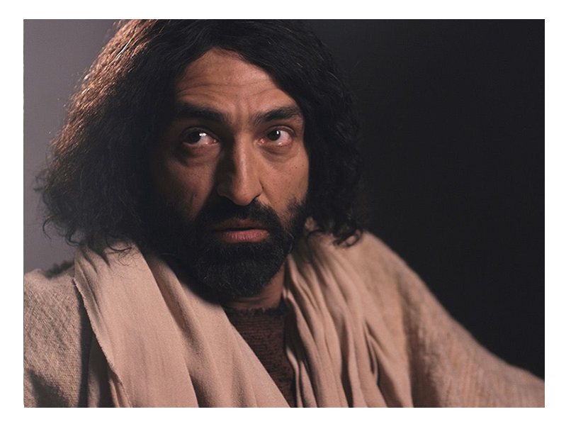
4. Jesus Spoke Out
⁷ "Leave her alone," Jesus replied. " It was intended that she should save this
perfume for the day of my burial. ⁸ You will always
have the poor among you,
but you will not always
have me."
Notes:
1 John 2:2 we have an advocate (lawyer, spokesperson) to handle every accusation.
When Satan accuses Jesus steps in a pleads our case—He very easily settles the matter—he just shows his wounded hands—and says “Paid in full.”

Slide 16
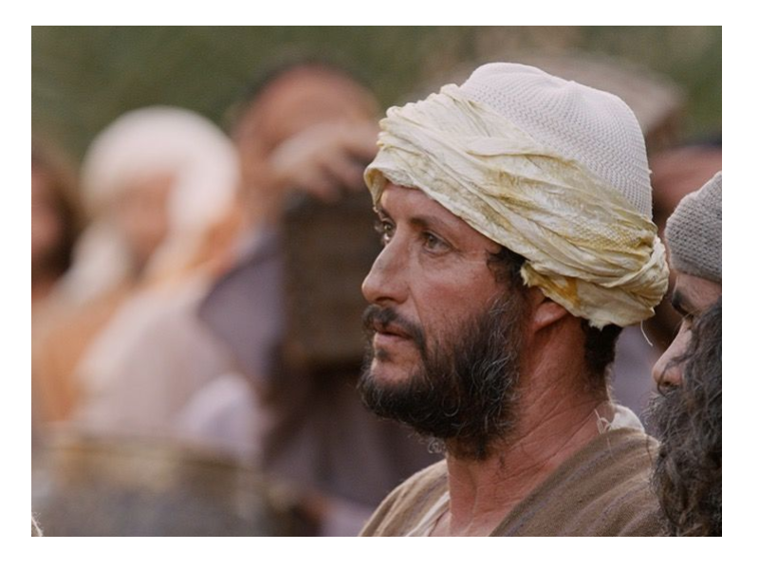
5. People Found Out
⁹ Meanwhile a large crowd of Jews found out that Jesus was there and came, not only because of him but also to
see Lazarus, whom he had raised from the dead.
Notes:
Bethany was buzzing from the rumors of dead Lazarus returning to life—and when they learned Jesus was dining with him—they flocked to see Him. Perhaps with the intention that if he could do the impossible of raising the dead, he could surely solve my problem too.

Slide 17
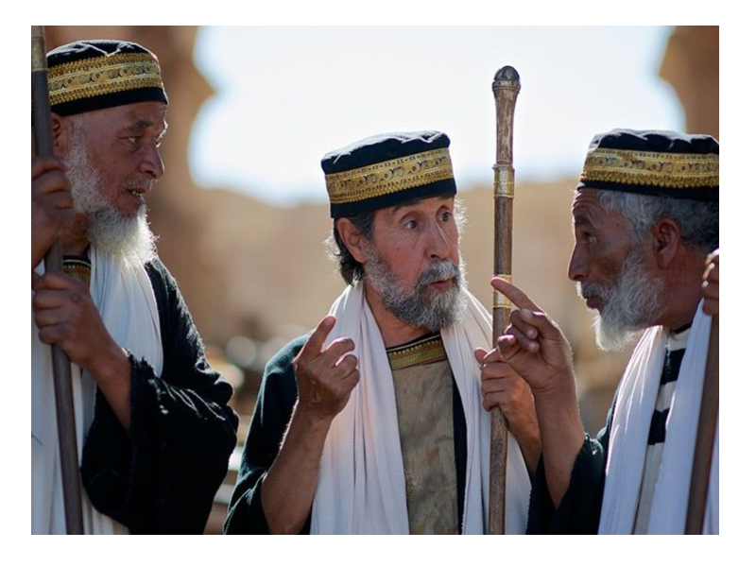
6. Priests Planned Out
¹⁰ So the chief priests made plans to kill Lazarus as well, ¹¹ for on account of him many of the Jews were going over to Jesus and putting their faith in him.
Notes:
Politics have not changed. How could they compete with the results of Jesus’ ministry, crowds followed Jesus’s teaching ministry, blind received sight, dead were raised,
If you can’t compete with your opponents results, ideas (theology) then just assassinate the person instead. Today, if the opponent is succeeding then attack his/her person. Make up some lies—obstruct, oppose, or assassinate the character of the person. It not just the politicians—ordinary, everyday people assassinate co-workers, in-laws, etc.

Slide 18
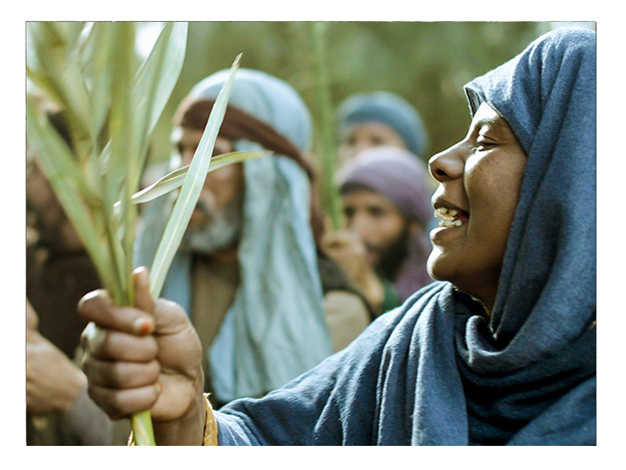
7. Crowds Went Out
¹² The next day the great crowd that had come for
the Feast heard that
Jesus was on his way to
Jerusalem. ¹³ They took
palm branches and went
out to meet him,
Notes:
Who here wouldn’t go. If for no other reason, at least for curiosity sake. Of course you would have gone. You are here today—to learn of Him.

Slide 19
7. Crowds Went Out
¹³ ... shouting, "Hosanna! " "Blessed is he who comes in the name of the Lord!" "Blessed is the King of Israel!"
Notes:
John doesn’t tell us it was children, but Matthew does,
Kids were a
We need kids in church! We need the Millennials who are the parents of kids today. We need to have an attractive church that is accepting of the children.

Slide 20
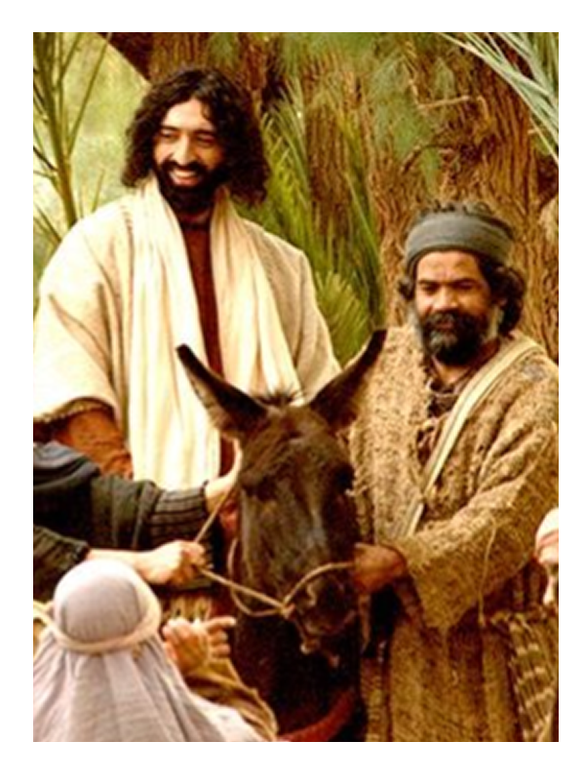
8. Jesus Rode Out
¹⁴ Jesus found a young donkey and sat upon it, as it is written,
¹⁵ "Do not be afraid, O Daughter of Zion; see, your king is coming, seated on a donkey's colt."
Notes:
The Bible had predicted it—it had to come to pass.
He came as King—He still is King—one day he will return—not on a donkey, on a white horse. Not as the Lamb of God –but as the King of kings and Lord of lords to rule over all the earth for 1,000 years as a prelude to the eternal state

Slide 21
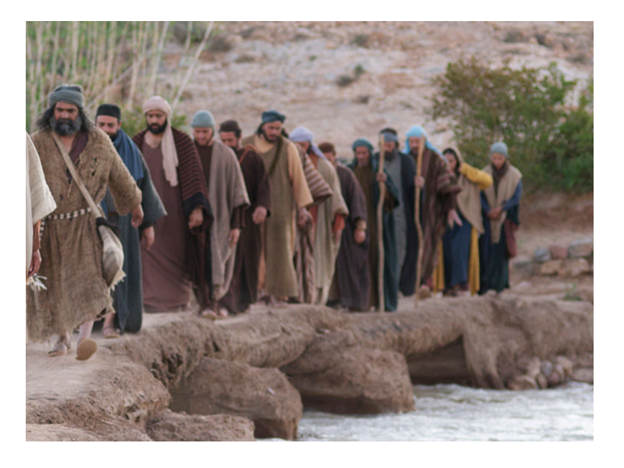
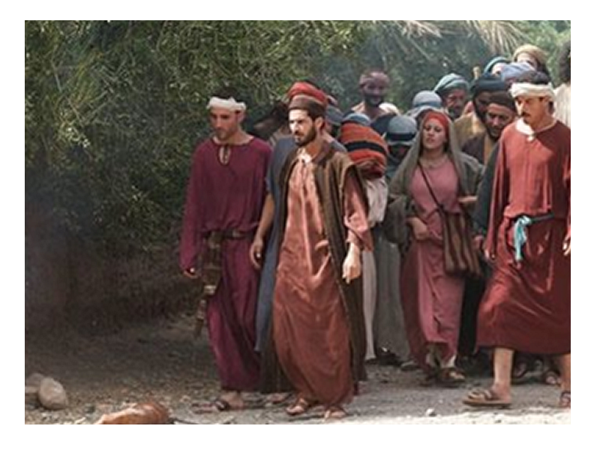
9. Disciples Missed Out
¹⁶ At first his disciples did not understand all this. Only after Jesus was glorified did they realize that these things had been written about him and that they had done these things to him.
Notes:
It was all in the Bible. They either did not know their Bibles very well or they did not really expect it to happen in their life time. The preacher at a board meeting asked if the board members believed that Jesus would return. They all agreed. He then added, “Do you believe he will return today?” They all hesitated, but one by one admitted they doubted it would happen today. The preacher then said, “for in such an hour as ye think not the Son of man cometh.” (Mat 24:44 KJV)
You see they missed out on the significance because they did not know! They did not know because they had not read.

Slide 22
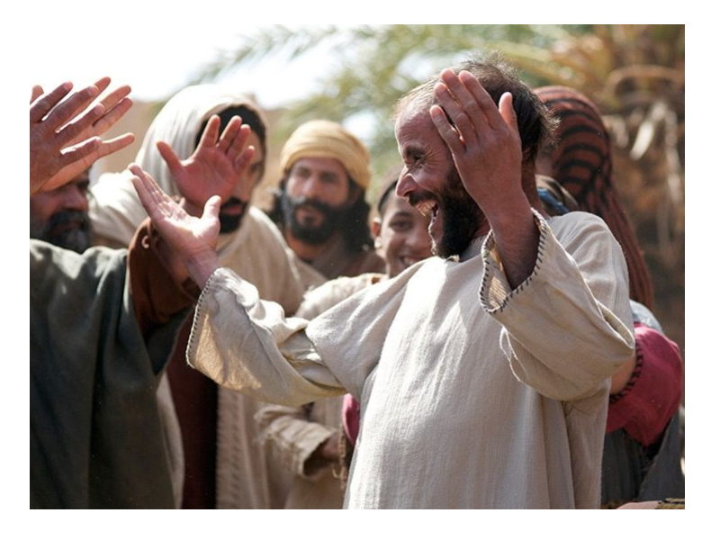
10. Word Spread Out
¹⁷ Now the crowd that was with him when he called Lazarus from the tomb
and raised him from the dead continued to spread the word.
Notes:
This was so big—they had to talk about it. Can you imagine anything bigger? Word spread. People believed and were saved.
Something even bigger happened on Good Friday, and even more spectacular on Easter.
We have to spread the news.
Simple invite people to Good Friday and Easter Sunday services – use the invitation cards.

Slide 23
10. Word Spread Out
¹⁸ Many people, because they had heard that he
had given this miraculous sign, went out to meet him. ¹⁹ So the Pharisees said to one another, "See, this is getting us nowhere. Look how the whole world has gone after him!"

Slide 24

So, which Outtake describes YOU?
Notes:
You’re in the pictures somewhere:
Believing Friend – Lazarus, Mary, the 11
Seeking Crowd – Looking for Him
Betraying Judas – Turned your back on Him
Plotting Priest – Rejecting Him
No one is neutral

Slide 25
Dining with Jesus?
Notes:
You’re in the pictures somewhere:
Believing Friend – Lazarus, Mary, the 11
Seeking Crowd – Looking for Him
Betraying Judas – Turned your back on Him
Plotting Priest – Rejecting Him
No one is neutral

Slide 26
Pouring your life out for Jesus?
Notes:
You’re in the pictures somewhere:
Believing Friend – Lazarus, Mary, the 11
Seeking Crowd – Looking for Him
Betraying Judas – Turned your back on Him
Plotting Priest – Rejecting Him
No one is neutral

Slide 27
Listening to Jesus?
Notes:
Listen to Jesus? My sheep hear my voice ...

Slide 28
Seeking Jesus?
Notes:
Listen to Jesus? My sheep hear my voice ...

Slide 29
Praising Jesus?
Notes:
Listen to Jesus? My sheep hear my voice ...

Slide 30
Sharing Jesus?
Notes:
Listen to Jesus? My sheep hear my voice ...

Slide 31
Pick one or more this Palm Sunday!
Notes:
Listen to Jesus? My sheep hear my voice ...

Slide 32
Let’s Pray!

