Slide 1

Palm Sunday: On the Road to ...
Notes:
Background Calvary crosses = licensed from http://www.bigstockphoto.com/image-12116393/stock-photo-three-cross-on-calvary-hill
Wooden sign = Licensed = from http://www.bigstockphoto.com/image-26716463/stock-photo-road-sign-with-green-grass-isolated-on-a-white-background
Copyright © 2006−2021. All rights reserved. Bible Point is a registered trademark of Dennis Henderson. All other trademarks acknowledged.
Bible Point contains graphics from Bible Point artists. These illustrations belong to Bible Point and the respective artists. You may use the designs and illustrations for graphical illustration of lessons free and without special permission, provided they are not used in any way that maligns the Christian faith. Furthermore, republication or production of any illustration by any other graphic service whether it be in book, in a machine-readable form, or in any other design resource is strictly prohibited. Furthermore, they cannot be duplicated or resold as any other form of publishing, clip art, or graphic resource.
So What does it mean? (A simple translations of the legal jargon)
So, if you don’t own the presentation(s), graphic(s), and text(s) how can you legally use them? The purchase of the license allows you to use all the images in the product. However, the actual ownership and copyright of the presentation(s), graphic(s), and text(s) remain the property of Bible Point and its licensors. If you had plans on using this product in your “for sale” work—think again!
License Agreement
Article 1: License Grant
All the graphics and text in Bible Point presentations (excluding quotes from the Bible and stated sources) are the intellectual and real property of Bible Point and its licensors, and is protected by law, including United States copyright laws and international treaties. Bible Point grants to you a license:
1. To use the presentation in a single church, single school, or single office of a Christian organization.
2. To make a single archival back-up copy of the program.
3. To modify the presentation(s) and merge with other presentations in a single church, school, or Christian organization.
4. To transfer to another party if that party agrees to accept the terms and conditions of this agreement, and you do not retain any copies of the presentation, whether printed, machine readable, modified, or merged form.
Article 2: Terms
This license is effective until terminated. You may terminate the license at any time by destroying the presentation(s), graphic(s), or text(s) together with all copies, modifications and merged portions in any form. Bible Point may terminate your license if you fail to comply with this Agreement. You agree, upon such termination, for any reason, to destroy the presentation(s), graphics, and text(s) with all copies, modifications, and merged portions in any form.
Article 3: Disclaimers
1. Bible Point presentations, graphics, and texts are licensed to you As Is. You, the consumer, bear the entire risk relating to the quality and performance of the presentation(s), graphic(s), or text(s). In no event will Bible Point be liable for damages resulting from any defect.
2. Thirty-day limited warrantee on disks. Bible Point warrants the disks to be free of defects in material and workmanship under normal use for 30 days after purchase. During the 30-day period you may return a defective presentation, graphic, or text with proof of purchase and it will be replaced without charge, unless the presentation is damaged by misuse.
Article 4: General
1. You may not sub-license, assign, or transfer the license of the presentation(s), graphic(s), or text(s) except as provided by this Agreement.
2. This Agreement will be governed by the laws of the State of Michigan.
So What does it mean? (A simple translations of the legal jargon)
May I let someone borrow or copy my licensed Bible Point presentation (even after I modified it)? As long as it is within your local church, or single school, or the immediate office of a Christian organization you may. Otherwise, please refer the person interested in borrowing to: http://www.biblepoint.com or E-mail: dennis@DrDH.net with any related questions.

Slide 2
Along the road to ...

Slide 3
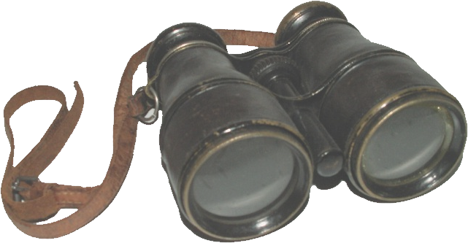
You Pick-Up Curiosity SEEKERS
Notes:
Binoculars = FREE = from http://commons.wikimedia.org/wiki/File:Fernglas%28alt%29.JPG

Slide 4
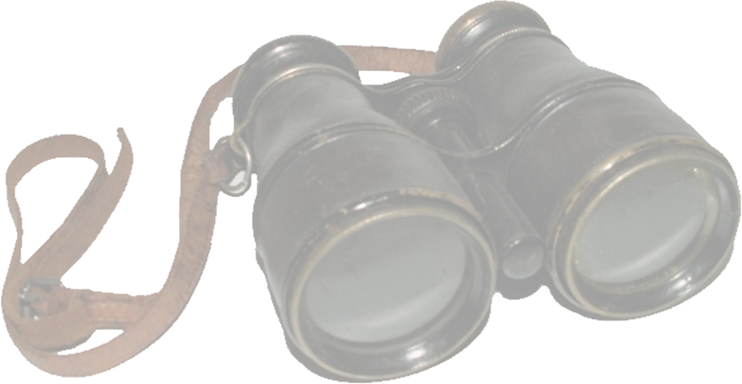
You Pick-Up Curiosity SEEKERS
⁸ A very large crowd spread their cloaks on the road, while others cut branches from the trees and spread them on the road.
⁹ The crowds that went ahead of him and those that followed shouted, ...
(Mat 21:8-9)
Notes:
Binoculars = FREE = from http://commons.wikimedia.org/wiki/File:Fernglas%28alt%29.JPG

Slide 5
You Pick-Up Curiosity SEEKERS
¹⁰ When Jesus entered Jerusalem, the whole city was stirred and asked, "Who is this?" (Mat 21:10)
Notes:
Binoculars = FREE = from http://commons.wikimedia.org/wiki/File:Fernglas%28alt%29.JPG

Slide 6

You Pick-Up the NEEDY
Notes:
Handicap sign = FREE = from http://www.sxc.hu/browse.phtml?f=download&id=806340

Slide 7

You Pick-Up the NEEDY
¹⁴ The blind and the lame came to him at the temple, and he healed them.
(Mat 21:14)

Slide 8

You Pick-Up ADVERSARIES

Slide 9

You Pick-Up ADVERSARIES
¹⁵ But when the chief priests and the teachers of the law saw the wonderful things he did and the children shouting in the temple area, "Hosanna to the Son of David," they were indignant.
(Mat 21:15)

Slide 10


You Pick-Up FOLLOWERS

Slide 11

You Pick-Up FOLLOWERS
¹⁶ At first his disciples did not understand all this. Only after Jesus was glorified did they realize that these things had been written about him and that they had done these things to him. (John 12:16)

Slide 12

You Pick-Up a CROSS
Notes:
Wooden sign = Licensed = from http://www.bigstockphoto.com/image-26716463/stock-photo-road-sign-with-green-grass-isolated-on-a-white-background

Slide 13

You Pick-Up a CROSS
¹⁶ Finally Pilate handed him over to them to be crucified. So the soldiers took charge of Jesus.
¹⁷ Carrying his own cross, he went out to the place of the Skull (which in Aramaic is called Golgotha).
(John 19:16-17)
Notes:
Wooden sign = Licensed = from http://www.bigstockphoto.com/image-26716463/stock-photo-road-sign-with-green-grass-isolated-on-a-white-background

Slide 14
You Pick-Up a CROSS
²⁶ As they led him away, they seized Simon from Cyrene, who was on his way in from the country, and put the cross on him and made him carry it behind Jesus. (Luke 23:26)
Notes:
Wooden sign = Licensed = from http://www.bigstockphoto.com/image-26716463/stock-photo-road-sign-with-green-grass-isolated-on-a-white-background

Slide 15
You Pick-Up a CROSS
"If anyone would come after me, he must deny himself and take up his cross daily and follow me.
²⁴ For whoever wants to save his life will lose it, but whoever loses his life for me will save it. (Luke 9:23-24)
Notes:
Wooden sign = Licensed = from http://www.bigstockphoto.com/image-26716463/stock-photo-road-sign-with-green-grass-isolated-on-a-white-background

Slide 16
You Pick-Up a CROSS
²⁷ And anyone who does not carry his cross and follow me cannot be my disciple. (Luke 14:27)
Notes:
Wooden sign = Licensed = from http://www.bigstockphoto.com/image-26716463/stock-photo-road-sign-with-green-grass-isolated-on-a-white-background

Slide 17
You Pick-Up a CROSS
²⁷ And anyone who does not carry his cross and follow me cannot be my disciple. (Luke 14:27)
Will YOU?
Notes:
Wooden sign = Licensed = from http://www.bigstockphoto.com/image-26716463/stock-photo-road-sign-with-green-grass-isolated-on-a-white-background

Slide 18
Let’s join Him on the road to...

Slide 19
Let’s join Him on the road to...
Let’s Pray!

