Slide 1



Slide 2
Notes:
Copyright © 2006−2021. All rights reserved. Bible Point is a registered trademark of Dennis Henderson. All other trademarks acknowledged.
Bible Point contains graphics from Bible Point artists. These illustrations belong to Bible Point and the respective artists. You may use the designs and illustrations for graphical illustration of lessons free and without special permission, provided they are not used in any way that maligns the Christian faith. Furthermore, republication or production of any illustration by any other graphic service whether it be in book, in a machine-readable form, or in any other design resource is strictly prohibited. Furthermore, they cannot be duplicated or resold as any other form of publishing, clip art, or graphic resource.
So What does it mean? (A simple translations of the legal jargon)
So, if you don’t own the presentation(s), graphic(s), and text(s) how can you legally use them? The purchase of the license allows you to use all the images in the product. However, the actual ownership and copyright of the presentation(s), graphic(s), and text(s) remain the property of Bible Point and its licensors. If you had plans on using this product in your “for sale” work—think again!
License Agreement
Article 1: License Grant
All the graphics and text in Bible Point presentations (excluding quotes from the Bible and stated sources) are the intellectual and real property of Bible Point and its licensors, and is protected by law, including United States copyright laws and international treaties. Bible Point grants to you a license:
1. To use the presentation in a single church, single school, or single office of a Christian organization.
2. To make a single archival back-up copy of the program.
3. To modify the presentation(s) and merge with other presentations in a single church, school, or Christian organization.
4. To transfer to another party if that party agrees to accept the terms and conditions of this agreement, and you do not retain any copies of the presentation, whether printed, machine readable, modified, or merged form.
Article 2: Terms
This license is effective until terminated. You may terminate the license at any time by destroying the presentation(s), graphic(s), or text(s) together with all copies, modifications and merged portions in any form. Bible Point may terminate your license if you fail to comply with this Agreement. You agree, upon such termination, for any reason, to destroy the presentation(s), graphics, and text(s) with all copies, modifications, and merged portions in any form.
Article 3: Disclaimers
1. Bible Point presentations, graphics, and texts are licensed to you As Is. You, the consumer, bear the entire risk relating to the quality and performance of the presentation(s), graphic(s), or text(s). In no event will Bible Point be liable for damages resulting from any defect.
2. Thirty-day limited warrantee on disks. Bible Point warrants the disks to be free of defects in material and workmanship under normal use for 30 days after purchase. During the 30-day period you may return a defective presentation, graphic, or text with proof of purchase and it will be replaced without charge, unless the presentation is damaged by misuse.
Article 4: General
1. You may not sub-license, assign, or transfer the license of the presentation(s), graphic(s), or text(s) except as provided by this Agreement.
2. This Agreement will be governed by the laws of the State of Michigan.
So What does it mean? (A simple translations of the legal jargon)
May I let someone borrow or copy my licensed Bible Point presentation (even after I modified it)? As long as it is within your local church, or single school, or the immediate office of a Christian organization you may. Otherwise, please refer the person interested in borrowing to: http://www.biblepoint.com or E-mail: dennis@DrDH.net with any related questions.

Slide 3

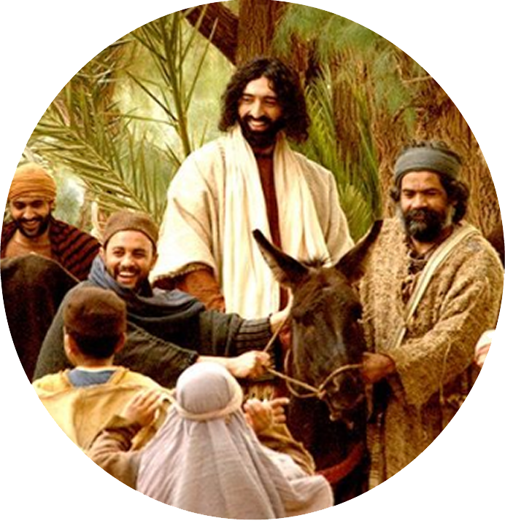
Two FOCUSES:
In Luke 19:41-44
1- On Jesus
Notes:
Triumphal Entry = http://www.freebibleimages.org/photos/triumphant-entry/

Slide 4
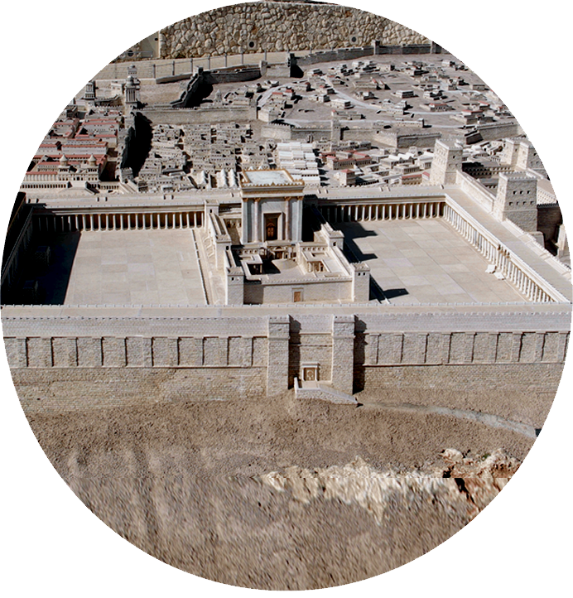
Two FOCUSES:
In Luke 19:41-44
1- On Jesus
2- On Jerusalem

Slide 5
First - Focus on JESUS:

Slide 6
How He APPROACHES ...
⁴¹ As he approached Jerusalem ...
Notes:
Humbly riding on a donkey
Kingly riding on a donkey
Prophetically riding on a donkey
Victoriously riding on a donkey
Etc.

Slide 7
How He APPROACHES ...
⁴¹ As he approached Jerusalem ...
Prophetically!
⁹ Rejoice greatly, ... See,
your king comes to you,
righteous and having salvation, gentle and riding on a donkey, on a colt, the foal of a donkey. (Zechariah 9:9)
Notes:
Prophetically – Zecahriah 9:9

Slide 8
How He APPROACHES ...
⁴¹ As he approached Jerusalem ...
Royally!
⁹ Rejoice greatly, ... See,
your king comes to you,
righteous and having salvation, gentle and riding on a donkey, on a colt, the foal of a donkey. (Zechariah 9:9)
Notes:
Royally – He is presenting Himself as King of the Jews.

Slide 9
How He APPROACHES ...
⁴¹ As he approached Jerusalem ...
Righteously!
⁹ Rejoice greatly, ... See,
your king comes to you,
righteous and having salvation, gentle and riding on a donkey, on a colt, the foal of a donkey. (Zechariah 9:9)
Notes:
Righteously – in the ultimate sense, he is absolutely sinless! He is qualified to be the Savior of the world.

Slide 10
How He APPROACHES ...
⁴¹ As he approached Jerusalem ...
Redemptively
⁹ Rejoice greatly, ... See,
your king comes to you,
righteous and having salvation, gentle and riding on a donkey, on a colt, the foal of a donkey. (Zechariah 9:9)
Notes:
Redemptively -- He is the Savior of the World.
The children had been appropriately yelling, Hosanna = “Save, I pray thee.”
Jesus is the “Savior of the world” John 4:42

Slide 11
How He APPROACHES ...
⁴¹ As he approached Jerusalem ...
Humbly
⁹ Rejoice greatly, ... See,
your king comes to you,
righteous and having salvation, gentle and riding on a donkey, on a colt, the foal of a donkey. (Zechariah 9:9)
Notes:
Gently = humbly. He is not on a white steed, with armies following Him as a king leading his forces into battle . No instead he is lowly, humble , gently leading a rag tag army of children and peasants who are singing praises of ascent from Psalms 120
Humble does not mean weakly because in His second advent He does lead an army on a white steed (Rev 19). Humbly – perfect gentleman! Knows when to get angry and when to keep a lid on it.
He will go into Jerusalem, to the temple to cleans it a second time.

Slide 12
How He SEES ...
⁴¹ As he approached Jerusalem and saw the city,
Notes:
Jerusalem, in particular, the temple mount. The place where Abraham had offered up Isaac. The place where Solomon’s Temple stood with the Shekinah Glory cloud and pillar of fire stood for nearly 700 years. However, destroyed by Nebuchadnezzar in 586 BC and later rebuilt by Zerubbabel in 516 BC. But no glory cloud, although Haggai predicted the later house (Herod’s temple pictured here) would have greater glory than Solomon's. Why, because Jesus, of whom John wrote, we beheld his glory, the glory of the only begotten of the Father, full of grace and truth. Jesus was the glory of this temple. He sees where He as a king and a Priest was predicted to sit on His throne according to Zechariah 6¹³ : he will be clothed with majesty and will sit and rule on his throne. And he will be a priest on his throne. And there will be harmony between the two.‘
He was coming to his own as King and as Priest. He saw them, they were unprepared for Him. So ... (next slide) weeps for them.

Slide 13
How He SEES ...
⁴¹ As he approached Jerusalem and saw the city,
He will be clothed with
majesty and will sit and
rule on his throne. And he
will be a priest on his throne. And there will be harmony between the two. (Zech 6:13)
Notes:
Jerusalem, in particular, the temple mount. The place where Abraham had offered up Isaac. The place where Solomon’s Temple stood with the Shekinah Glory cloud and pillar of fire stood for nearly 700 years. However, destroyed by Nebuchadnezzar in 586 BC and later rebuilt by Zerubbabel in 516 BC. But no glory cloud, although Haggai predicted the later house (Herod’s temple pictured here) would have greater glory than Solomon's. Why, because Jesus, of whom John wrote, we beheld his glory, the glory of the only begotten of the Father, full of grace and truth. Jesus was the glory of this temple. He sees where He as a king and a Priest was predicted to sit on His throne according to Zechariah 6¹³ : he will be clothed with majesty and will sit and rule on his throne. And he will be a priest on his throne. And there will be harmony between the two.‘
He was coming to his own as King and as Priest. He saw them, they were unprepared for Him. So ... (next slide) weeps for them.

Slide 14
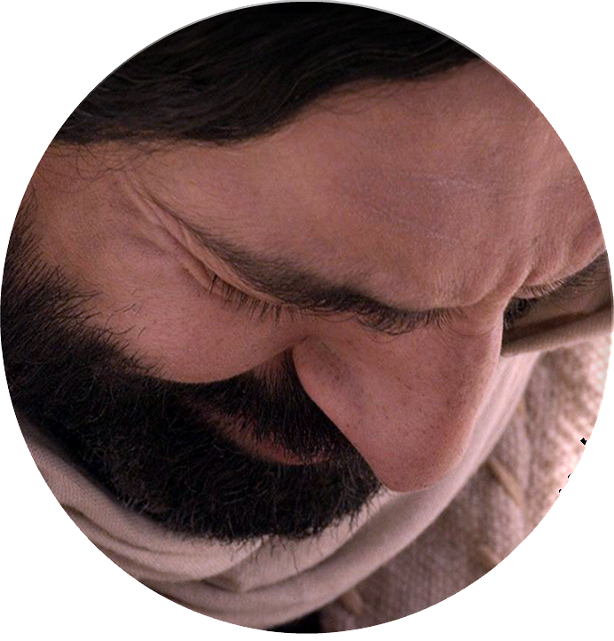
How He WEEPS ...
⁴¹ As he approached Jerusalem and saw the city, he wept over it
Notes:
Jesus = http://www.freebibleimages.org
Just the week before Jesus wept over the death of Lazarus. Now he weeps for Jerusalem because of their rejection of Him in just 5 days. They will crucify the Lord of Glory. He does not weep for Himself—he weeps for their lost condition.
Once before he was moved with compassion on the masses, because they were like lost sheep without a shepherd. Now He is so moved by their lost-ness he weeps over them.

Slide 15
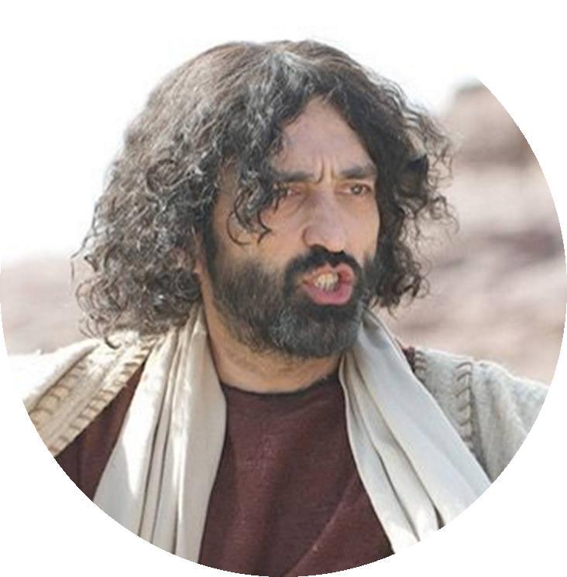
How He TALKS ...
⁴¹ As he approached Jerusalem and saw the city, he wept over it ⁴² and said ....
Notes:
When Jesus talked they needed to listen ... This is still true today .. When Jesus talks we need to listen. He now speaks to Jerusalem ... He speaks to us (like them)
Jesus has said, “My sheep hear my voice, and I know them, and they follow me.”

Slide 16
Second - Focus on JERUSALEM

Slide 17
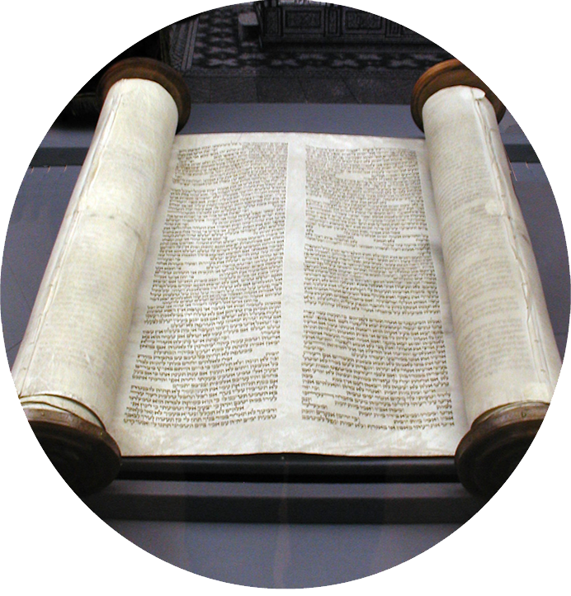
What They Don’t KNOW
"If you, even you, had only known on this day what would bring you peace ...”
Notes:
SCROLL = https://upload.wikimedia.org/wikipedia/commons/5/54/K%C3%B6ln-Tora-und-Innenansicht-Synagoge-Glockengasse-040.JPG
Ignorance is no excuse -- They had the scriptures and so do we.
They should have known because God had revealed it to them in the Word of God.

Slide 18
What They Don’t KNOW
"If you, even you, had only known on this day what would bring you peace ...”
[483 years] will pass from
the time the command is
given to rebuild Jerusalem until a ruler-- the Anointed One-- comes. (Dan 9:25 NLT)
Notes:
“This very day.” There is something about this day. Zechariah had predicted the donkey riding King-Priest who is the Savior of the World entering Jerusalem.
But it was Daniel the Prophet who predicted to the very day that Messiah the Prince would come to Jerusalem. Daniel 9:25.
7 X 7 = 49
62 X 7 = 434
69 X 7 = 483
The starting point of the 483 years was the issuing of the decree to rebuild Jerusalem. That took place on March 14, 445 BC. When you convert the 483 years into 360 day years (prophetic years) it turns out to be 173,880 days. When you move forward the 173,880 days from April 6, 445 BC it ends on April 6, 32 AD. The day of this Palm Sunday – the Triumphal, Royal entry of the King of the Jews. Jesus is officially offering Himself as King of the Jews.

Slide 19
What They Don’t KNOW
"If you, even you, had only known on this day what would bring you peace ...”
After this period ... the Anointed One will be killed ... (Dan 9:26 NLT)
Notes:
The next verse in Daniel 9 says that after the 483 years, 173,880 days, the Anointed One (Messiah) will be killed (lit. cut off violently –as in a crucifixion).
So Jesus knows that as He enters, and all are praising him, that those in Jerusalem, priests, high priest, Pharisees, Sadducees, and people at large will turn the Hosannas into chants to “”crucify, him.”
Just five days later they will violently kill Him.

Slide 20
What They Don’t KNOW
"If you, even you, had only known on this day what would bring you peace ...”
Notes:
It’s strange that while Jesus is approaching Jerusalem on Palm Sunday, they are sing the Psalms of the ascent.
Psalm 122: ⁶ Pray for the peace of Jerusalem: (Psa 122:6 NIV)
Jesus is the “Prince of Peace” of Isiah 9:6.

Slide 21
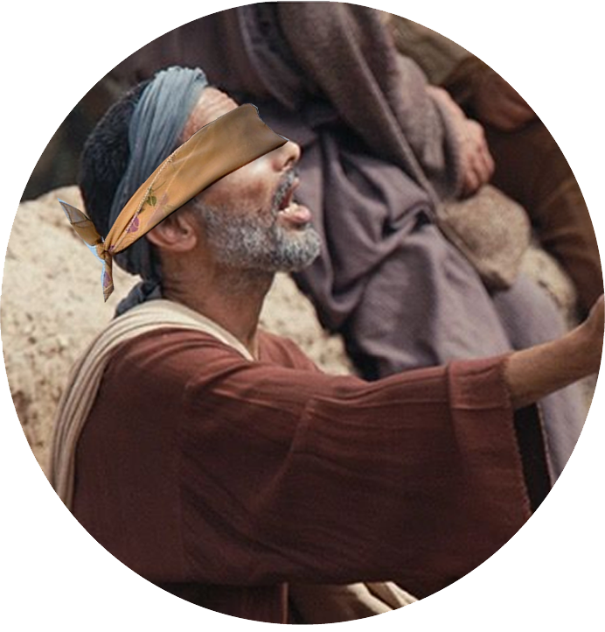
What They Can’t SEE
"If you, even you, had only known on this day what would bring you peace--but now it is hidden from your eyes.
Notes:
Blind = http://www.freebibleimages.org/photos/lumo-blindman-jericho/
Hidden from their eyes because of unbelief. Hidden because the did not take Scripture seriously. Hidden because they put on blinders and refused to accept the Word of God.
³⁹ Jesus said, "For judgment I have come into this world, so that the blind will see and those who see will become blind."
⁴⁰ Some Pharisees who were with him heard him say this and asked, "What? Are we blind too?"
⁴¹ Jesus said, "If you were blind, you would not be guilty of sin; but now that you claim you can see, your guilt remains.
(Joh 9:39-41 NIV)

Slide 22
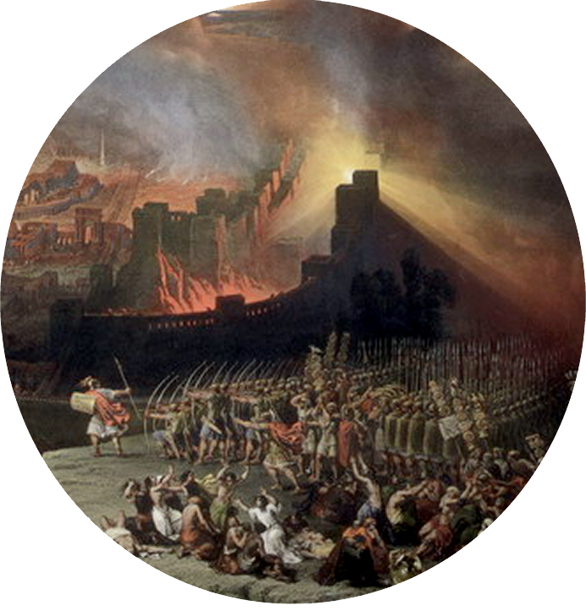
What They Won’t EXPERIENCE
⁴³ The days will come upon you when your enemies will build an embankment against you and encircle you and hem you in on every side. ...
Notes:
In just 38 years, Jerusalem, will be attacked on the Sabbath day by the Roman General Titus, because he knows that the Jews won’t fight on the Sabbath. They will completely fulfill this prophetic word of Jesus.
Just as Daniel predicted “a ruler will arise whose armies will destroy the city and the Temple.” (Dan 9:26 NLT)

Slide 23
What They Won’t EXPERIENCE
⁴⁴ They will dash you to the ground, you and the children within your walls. They will not leave one stone on another, ...”
PEACE
Notes:
Jerusalem destroyed = https://upload.wikimedia.org/wikipedia/commons/b/b2/Ercole_de_Roberti_Destruction_of_Jerusalem_Fighting_Fleeing_Marching_Slaying_Burning_Chemical_reactions_b.jpg
It’s strange that while Jesus is approaching Jerualem on Palm Sunday, they are sing the Psalms of the ascent.
Psalm 122: ⁶ Pray for the peace of Jerusalem: (Psa 122:6 NIV)
They are singing and Jesus is predicting that there is no peace for the wicked, for those who reject the Lord of Glory, who reject Jesus Christ the Savior of the World.

Slide 24

What They Don’t RECOGNIZE
⁴⁴ They will dash you to the ground, you and the children within your walls. They will not leave one stone on another, because you did not recognize the time of God's coming to you."
Notes:
Clock = https://static.pexels.com/photos/21294/pexels-photo.jpg
They did not recognize the time! As Daniel had predicted to the day.

Slide 25
What They Don’t RECOGNIZE
⁴⁴ They will dash you to the ground, you and the children within your walls. They will not leave one stone on another, because you did not recognize the time of God's coming to you."
Notes:
Clock = https://static.pexels.com/photos/21294/pexels-photo.jpg
The time of God’s Coming in the person of Jesus Christ.

Slide 26
Here’s the point ...
They COMPLETELY Missed Him on Palm Sunday...

Slide 27
Here’s the point ...
They COMPLETELY Missed Him on Palm Sunday...
He came to that which was his own, but his own did not receive him. (John 1:11)

Slide 28

Here’s the point ...
Don’t You Miss Him Too!
Notes:
He is here today.
Rev 3:20 “I stand at the door and knock. If anyone hears my voice and opens the door, I will come in and eat with him, and he with me.” (Rev 3:20 NIV)

Slide 29
Here’s the point ...
Don’t You Miss Him Too!
For he says, ... I tell you,
now is the time of God's
favor, now is the day of
salvation. ^{2 Cor 6:2}

Slide 30
Here’s the point ...
Don’t You Miss Him Too!
Behold, I stand at the door and knock. If anyone hears My voice and opens the door, I will come in to him and dine with him, and he with Me. ^{(Rev 3:20 NKJ)}

Slide 31
Here’s the point ...
Don’t You Miss Him Too!
Yet to all who received him, to those who believed in his name, he gave the right to become children of God ... ^{John 1:12}

Slide 32
Let’s
Pray!

