Slide 1

The Palm Sunday
CROWDS
Watch
https://youtu.be/HP5CC1wfMgM
Notes:
https://get.pxhere.com/photo/tree-nature-grass-branch-blur-growth-plant-lawn-leaf-flower-environment-green-tropical-botany-garden-flora-plants-close-up-leaves-outdoors-focus-macro-photography-flowering-plant-grass-family-plant-stem-woody-plant-land-plant-arecales-palm-family-1170181.jpg
Copyright © 2006−2021. All rights reserved. Bible Point is a registered trademark of Dennis Henderson. All other trademarks acknowledged.
Bible Point contains graphics from Bible Point artists. These illustrations belong to Bible Point and the respective artists. You may use the designs and illustrations for graphical illustration of lessons free and without special permission, provided they are not used in any way that maligns the Christian faith. Furthermore, republication or production of any illustration by any other graphic service whether it be in book, in a machine-readable form, or in any other design resource is strictly prohibited. Furthermore, they cannot be duplicated or resold as any other form of publishing, clip art, or graphic resource.
So What does it mean? (A simple translations of the legal jargon)
So, if you don’t own the presentation(s), graphic(s), and text(s) how can you legally use them? The purchase of the license allows you to use all the images in the product. However, the actual ownership and copyright of the presentation(s), graphic(s), and text(s) remain the property of Bible Point and its licensors. If you had plans on using this product in your “for sale” work—think again!
License Agreement
Article 1: License Grant
All the graphics and text in Bible Point presentations (excluding quotes from the Bible and stated sources) are the intellectual and real property of Bible Point and its licensors, and is protected by law, including United States copyright laws and international treaties. Bible Point grants to you a license:
1. To use the presentation in a single church, single school, or single office of a Christian organization.
2. To make a single archival back-up copy of the program.
3. To modify the presentation(s) and merge with other presentations in a single church, school, or Christian organization.
4. To transfer to another party if that party agrees to accept the terms and conditions of this agreement, and you do not retain any copies of the presentation, whether printed, machine readable, modified, or merged form.
Article 2: Terms
This license is effective until terminated. You may terminate the license at any time by destroying the presentation(s), graphic(s), or text(s) together with all copies, modifications and merged portions in any form. Bible Point may terminate your license if you fail to comply with this Agreement. You agree, upon such termination, for any reason, to destroy the presentation(s), graphics, and text(s) with all copies, modifications, and merged portions in any form.
Article 3: Disclaimers
1. Bible Point presentations, graphics, and texts are licensed to you As Is. You, the consumer, bear the entire risk relating to the quality and performance of the presentation(s), graphic(s), or text(s). In no event will Bible Point be liable for damages resulting from any defect.
2. Thirty-day limited warrantee on disks. Bible Point warrants the disks to be free of defects in material and workmanship under normal use for 30 days after purchase. During the 30-day period you may return a defective presentation, graphic, or text with proof of purchase and it will be replaced without charge, unless the presentation is damaged by misuse.
Article 4: General
1. You may not sub-license, assign, or transfer the license of the presentation(s), graphic(s), or text(s) except as provided by this Agreement.
2. This Agreement will be governed by the laws of the State of Michigan.
So What does it mean? (A simple translations of the legal jargon)
May I let someone borrow or copy my licensed Bible Point presentation (even after I modified it)? As long as it is within your local church, or single school, or the immediate office of a Christian organization you may. Otherwise, please refer the person interested in borrowing to: http://www.biblepoint.com or E-mail: dennis@DrDH.net with any related questions.

Slide 2
The Palm Sunday
CROWDS
Notes:
https://get.pxhere.com/photo/tree-nature-grass-branch-blur-growth-plant-lawn-leaf-flower-environment-green-tropical-botany-garden-flora-plants-close-up-leaves-outdoors-focus-macro-photography-flowering-plant-grass-family-plant-stem-woody-plant-land-plant-arecales-palm-family-1170181.jpg
It’s kind of Ironic that on a Palm Sunday where there were crowds thronging to the temple for passover and Jesus in the midst of it all.
That we are all hunkered down and avoiding all crowds.
But these crowds are really groups or classifications of people, too. So, hand in there with this topic today. It may surprise you.
We left off last week with Jesus at Bethany with Martha serving and Mary perfuming

Slide 3
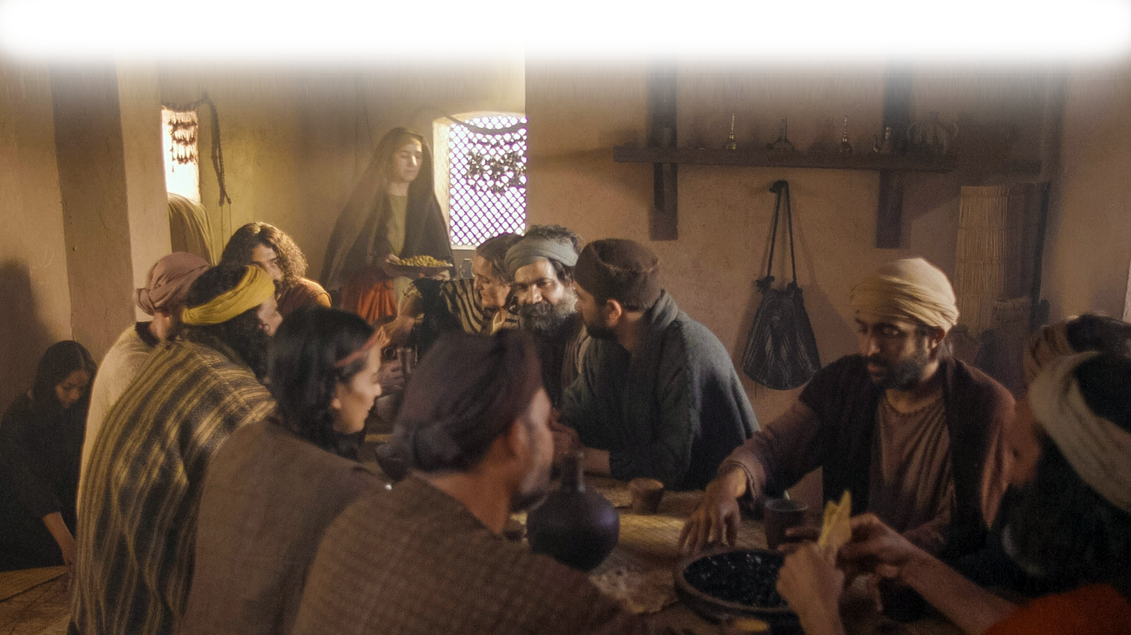
Jesus and Disciples

Slide 4
Jesus and Disciples
^{John12:9} When the large crowd of the Jews learned that Jesus was there, they came, not only on account of him but also to see Lazarus, whom he had raised from the dead. ¹⁰ So the chief priests made plans to put Lazarus to death as well, ¹¹ because on account of him many of the Jews were going away and believing in Jesus.

Slide 5
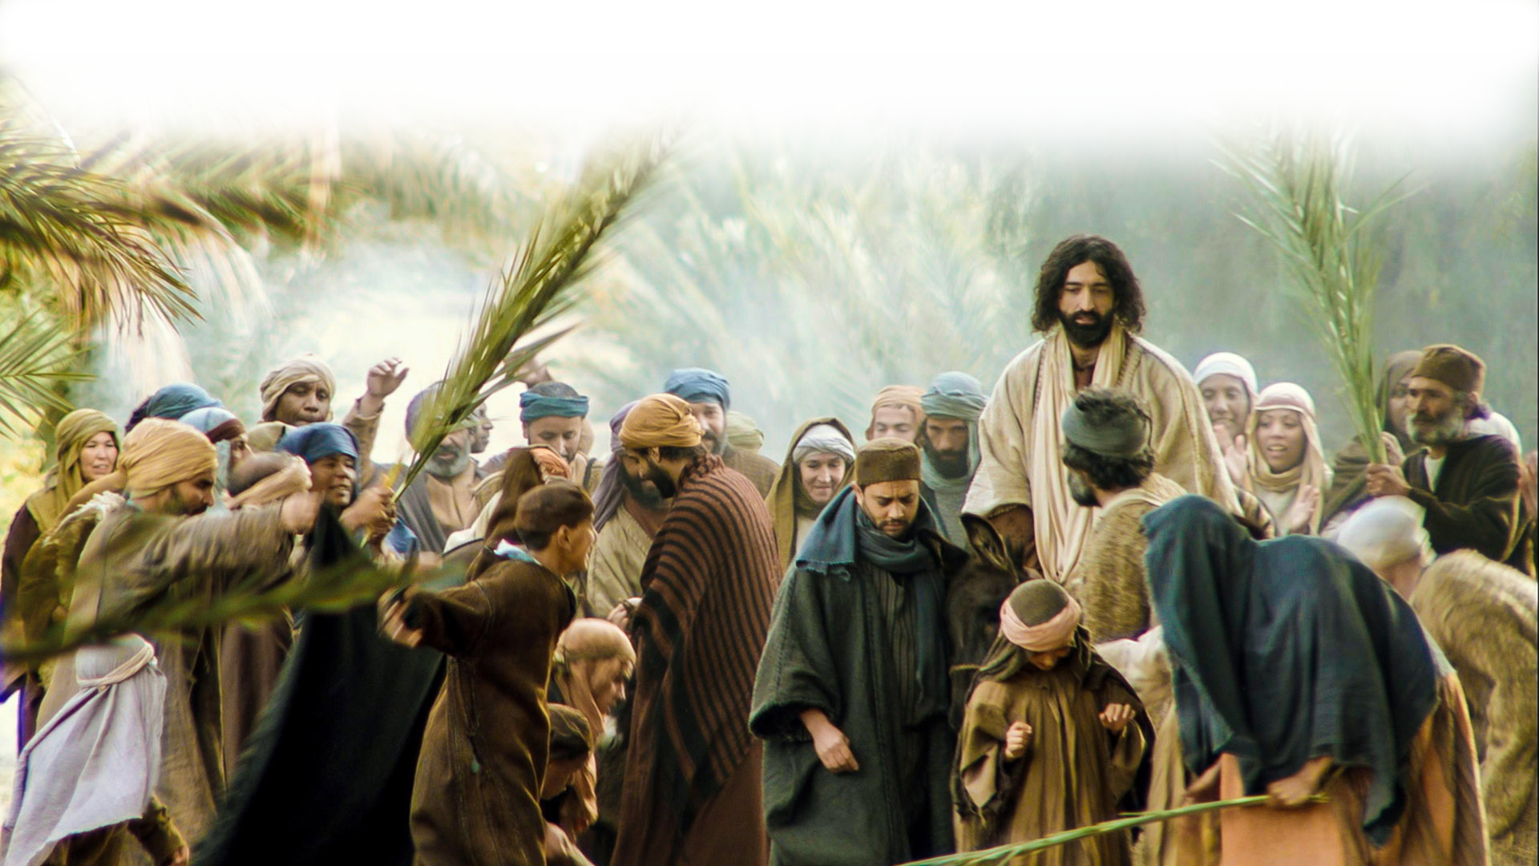
The FESTIVE Crowd John 12:12

Slide 6
The FESTIVE Crowd John 12:12
¹² The next day the large crowd that had come to the feast heard that Jesus was coming to Jerusalem. ¹³ So they took branches of palm trees and went out to meet him, crying out,
Notes:
It was on the “Church” calendar, they are like our “Christmas and Easter” crowd . For them every year, every male had to go up to Jerusalem for Passover.
They are the religious crowd that goes to every service at church, they go through all the motions, they are good people but not necessarily saved people.

Slide 7
The FESTIVE Crowd John 12:12
"Hosanna! Blessed is he who comes in the name of the Lord, even the King of Israel!“
(See Psalm 118:26)
Notes:
They are mouthing the right words, in fact they have them memorized they have done this so much.
Like knowing all the words to the Christmas carols about Christ, but no necessarily knowing Him or meaning them.

Slide 8
The FESTIVE Crowd John 12:12
¹⁴ And Jesus found a young donkey and sat on it, just as it is written,
¹⁵ "Fear not, daughter of Zion; behold, your king is coming, sitting on a donkey's colt!“
See Zechariah 9:9
Notes:
Meanwhile Jesus fulfills scripture Zechariah 9:9 – but this parade to the temple seems oblivious to it.
Sometimes I listen to people reflect on the sermon I’ve shared and it breaks my heart—they have missed the point of it all.
That’s what is happening here. It’s more a parade to a festival, saying all the right things, but not really getting what is being said.

Slide 9
The FESTIVE Crowd John 12:12
¹⁶ His disciples did not understand these things at first, but when Jesus was glorified, then they remembered that these things had been written about him and had been done to him.
Notes:
Here is the capstone of it all, Not even the disciple understood what was going down.
Jesus is officially presenting Himself as King. In less than a week this fickle crowd will turn on him and choose Barabbas over him. Even his disciples will flee leaving him to die alone.

Slide 10
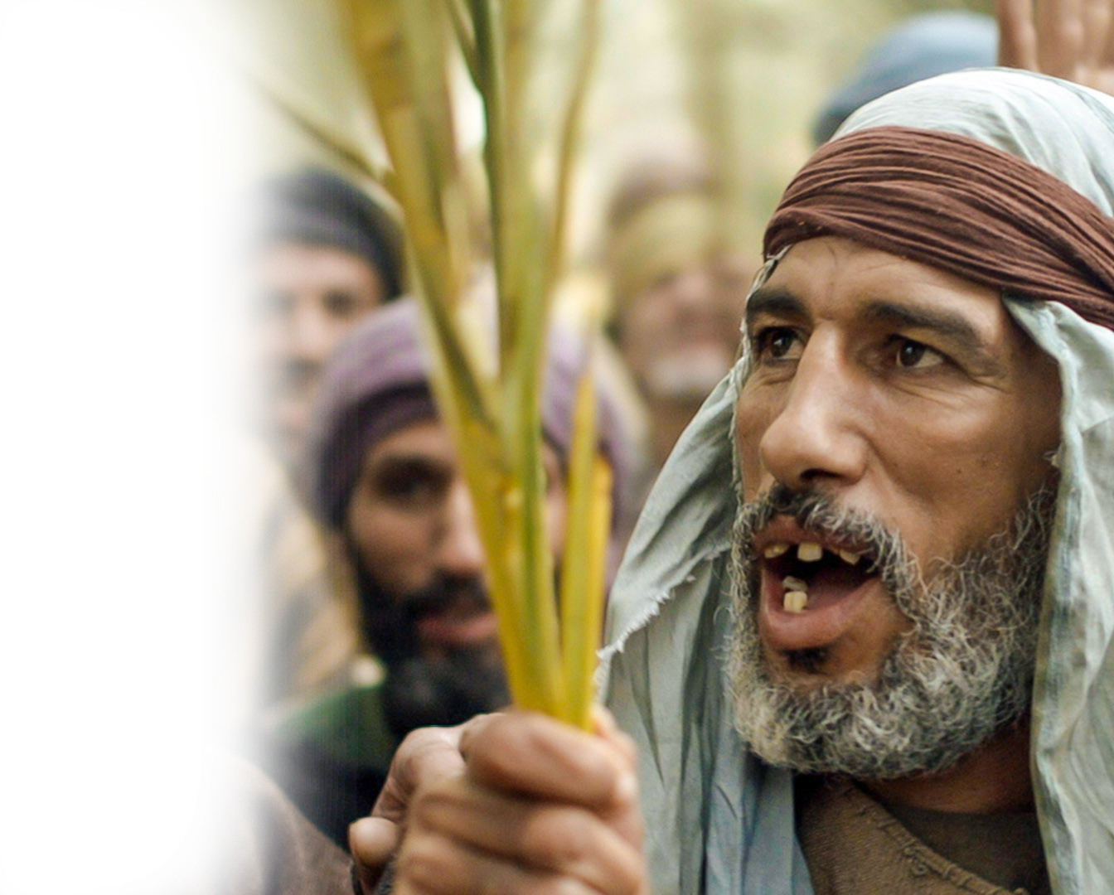
The EYE-WITNESS Crowd 12:17
¹⁷ The crowd that had been with him when he called Lazarus out of the tomb and raised him from the dead continued to bear witness.
Notes:
They saw the miracle. Totally amazed and true believers now.
In fact they are “bearing witness” to the miracle.
That’s what genuine believers do. They share the miracle of salvation.

Slide 11
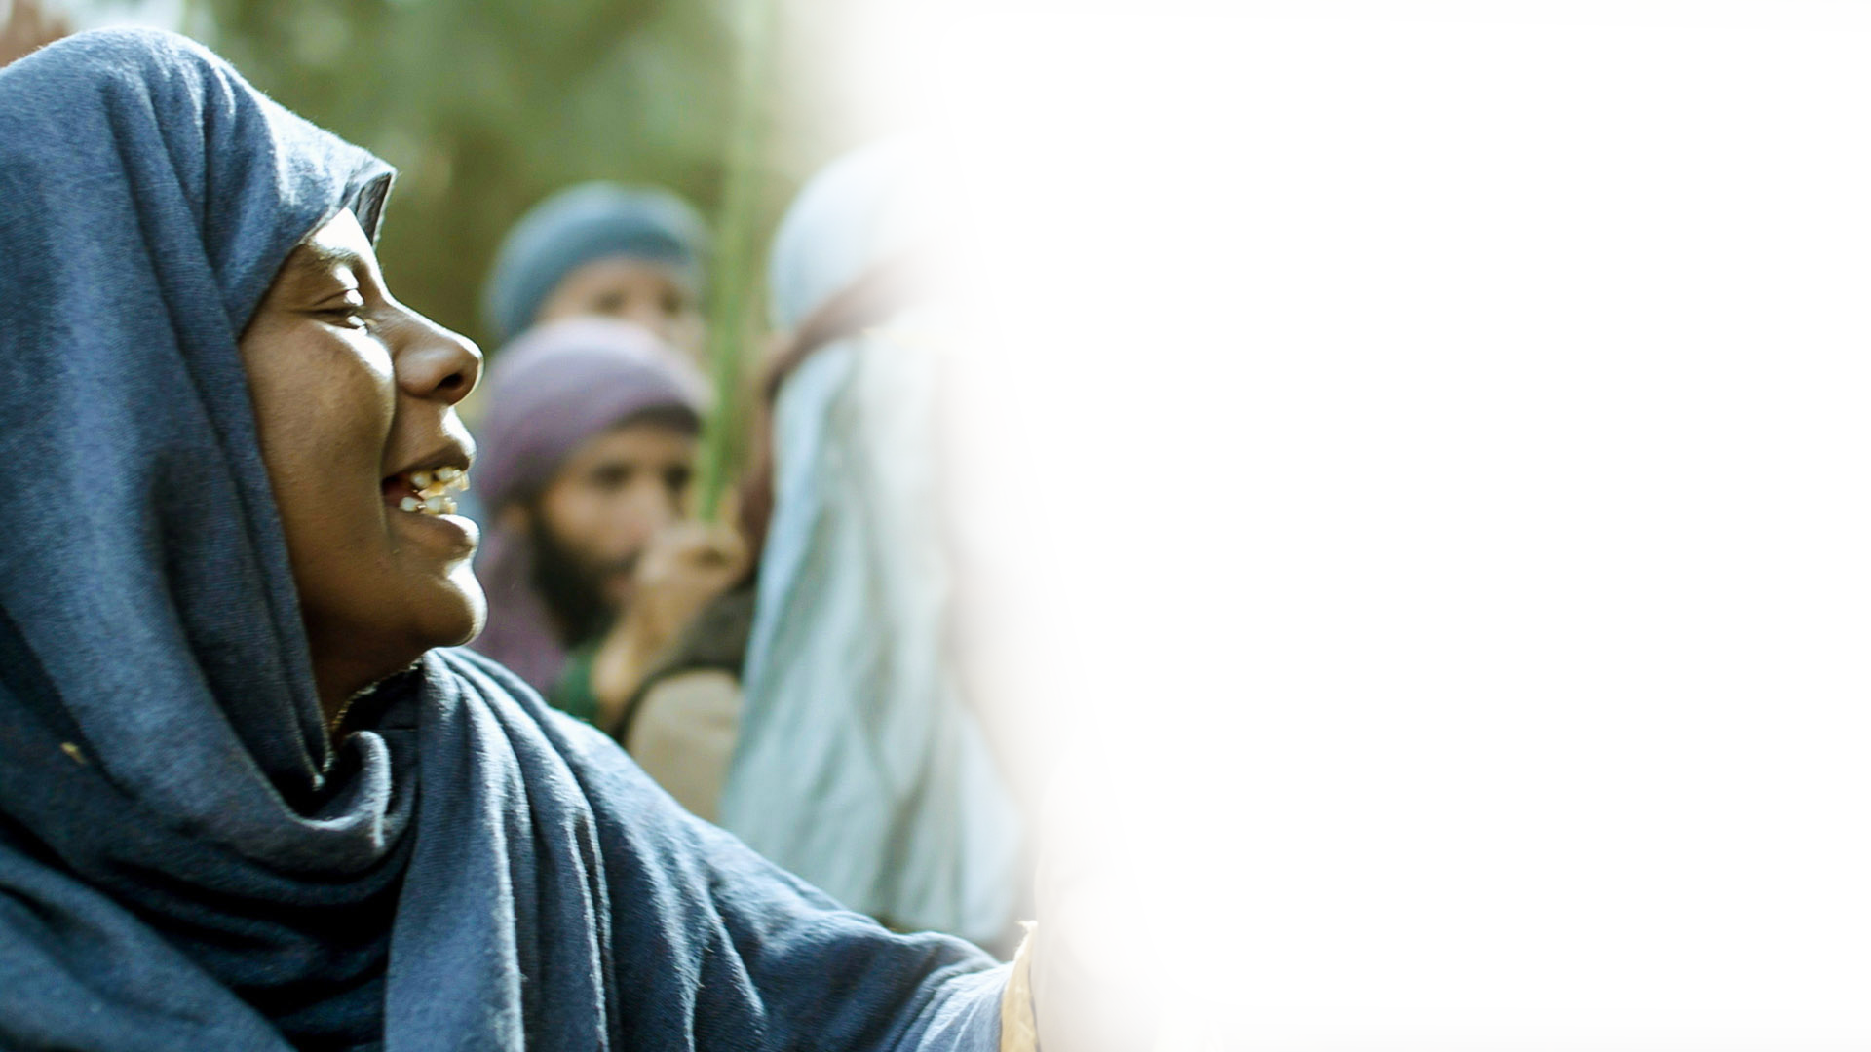
The CURIOUS Crowd 12:18
¹⁸ The reason why the crowd went to meet him was that they heard he had done this sign.
Notes:
They heard the news and curiosity was piqued.

Slide 12
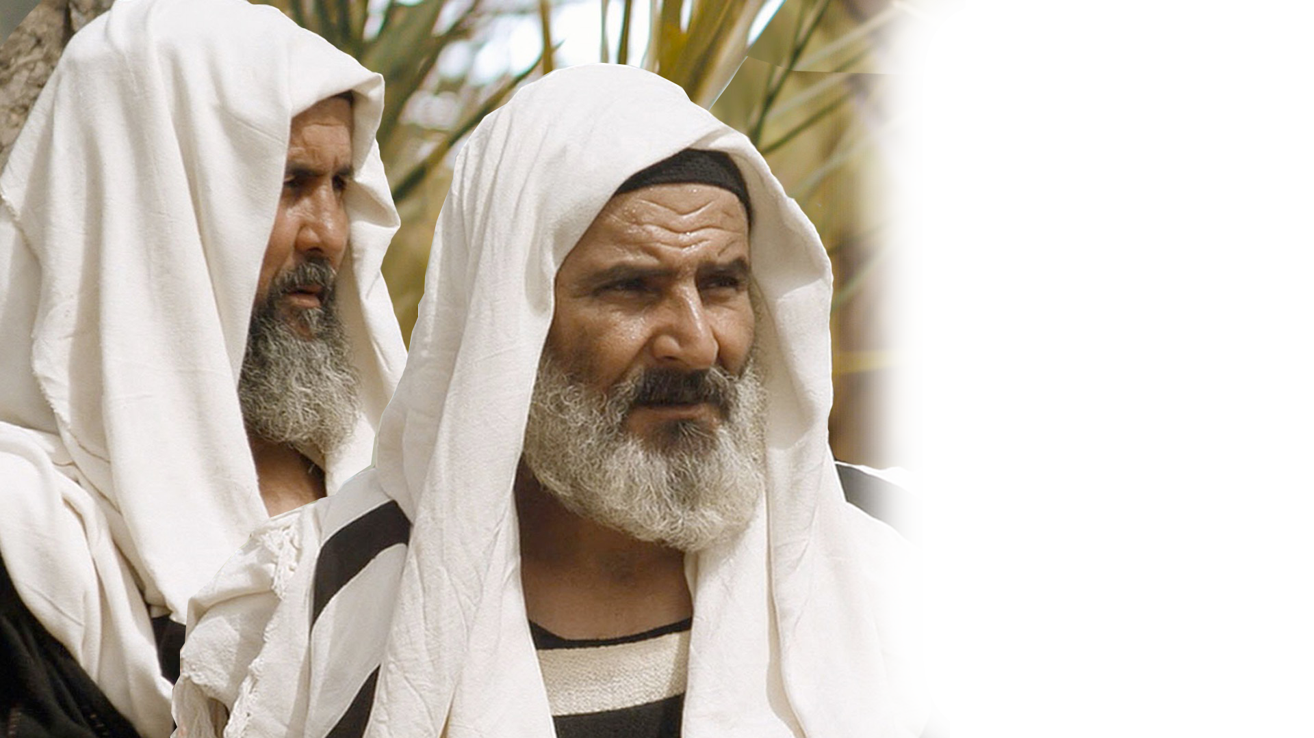
The SELF-RIGHTEOUS Crowd 12:19
¹⁹ So the Pharisees said to one another,
"You see that you are gaining nothing. Look, the world has gone after him."
Notes:
Skeptical crowd. Negative. Oppositional. They don’t need Jesus and His righteousness.
They are self-righteous, arrogant, Never Jesusers (you know like never-Trumpers!)
They are like the media, CNN and MSNBC reporters—not interested in the facts, only interested in destroying Jesus. They have used up all their gotcha questions and are now looking for anything to take Jesus down. Eventually, they will bribe false witnesses (fake news) and use it to sentence Jesus to death.

Slide 13
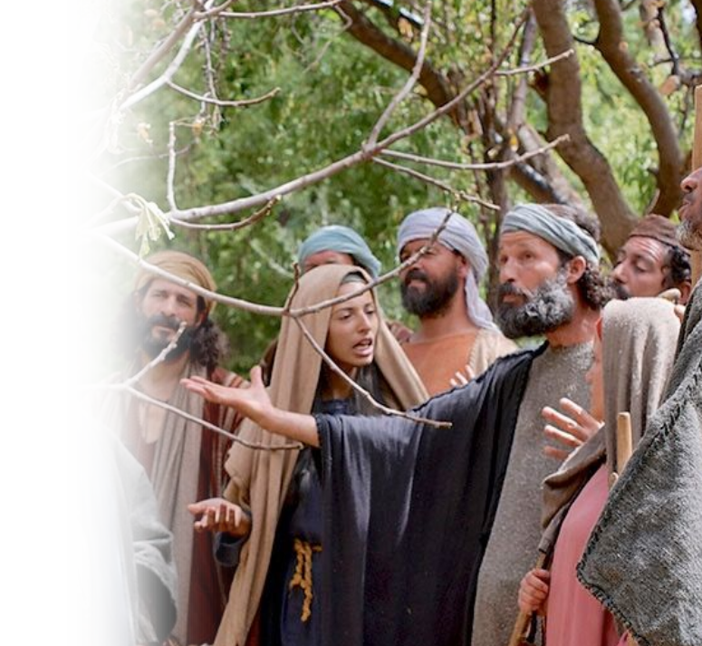
The OUTSIDE Crowd 12:20
²⁰ Now among those who went up to worship at the feast were some Greeks. ²¹ So these came to Philip, who was from Bethsaida in Galilee, and asked him,
"Sir, we wish to see Jesus.“
Notes:
On the outside looking in. Not Jewish. Genuine inquiry crowd.
The Jews wanted to see a sign; these Gentiles just wanted to see (a private interview with) Jesus.

Slide 14
The OUTSIDE Crowd 12:20
²² Philip went and told Andrew; Andrew and Philip went and told Jesus.
²³ And Jesus answered them,
"The hour has come for the Son of Man to be glorified.
Notes:
Not time for talking—time for doing.
He does not say “to be crucified.”Jesus looks beyond the cross to the glory that follows the resurrection!

Slide 15
The OUTSIDE Crowd 12:20
²⁴ Truly, truly, I say to you, unless a grain of wheat falls into the earth and dies, it remains alone; but if it dies, it bears much fruit.
²⁵ Whoever loves his life loses it, and whoever hates his life in this world will keep it for eternal life.
Notes:
Are they willing to pay the price to be a believer.
Salvation is free. Just truly believe. But being a believer may cost you your life.

Slide 16
The OUTSIDE Crowd 12:20
²⁶ If anyone serves me, he must follow me; and where I am, there will my servant be also. If anyone serves me, the Father will honor him.

Slide 17
The OUTSIDE Crowd 12:20
²⁷ "Now is my soul troubled. And what shall I say? 'Father, save me from this hour'? But for this purpose I have come to this hour.
²⁸ Father, glorify your name."
Then a voice came from heaven:
"I have glorified it, and I will glorify it again."

Slide 18
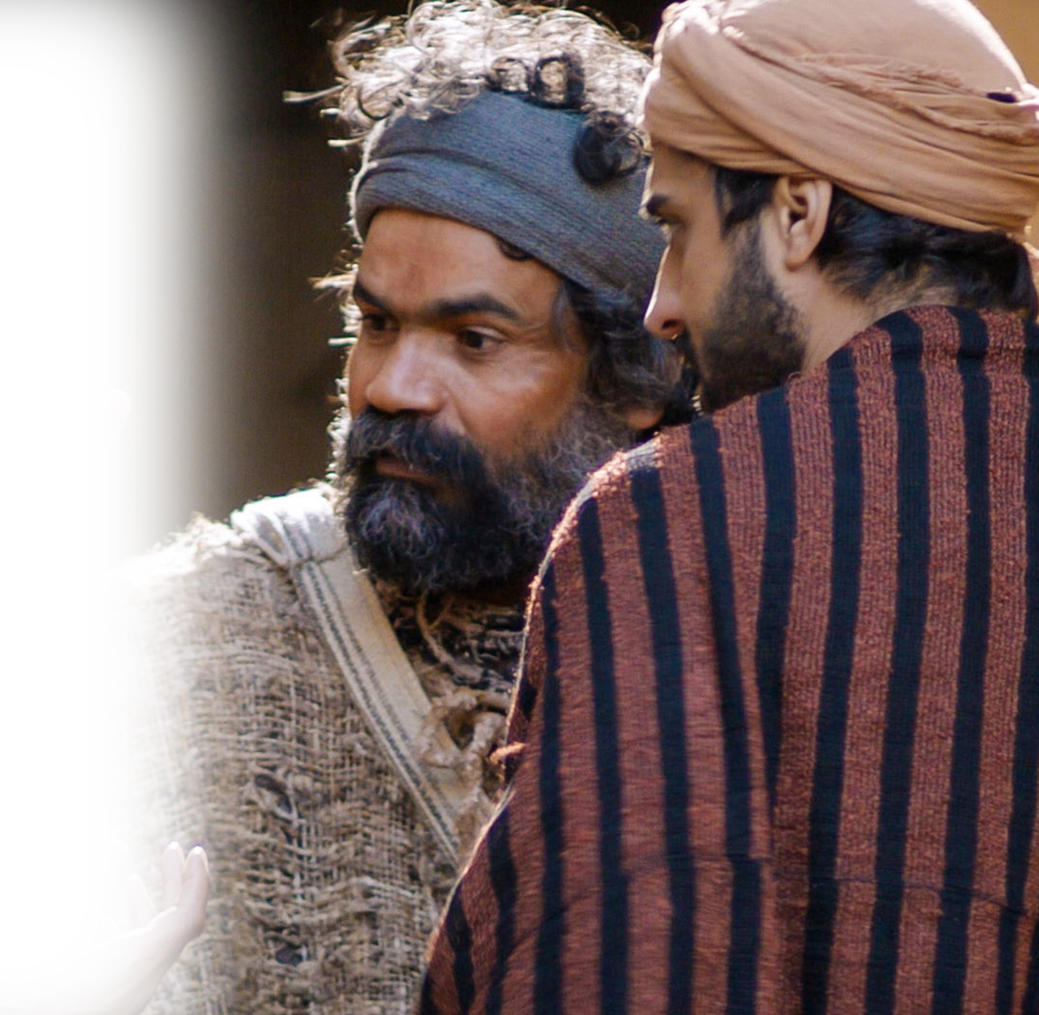
The LISTENING Crowd 12:29
²⁹ The crowd that stood there and heard it said that it had thundered. Others said, "An angel has spoken to him."

Slide 19
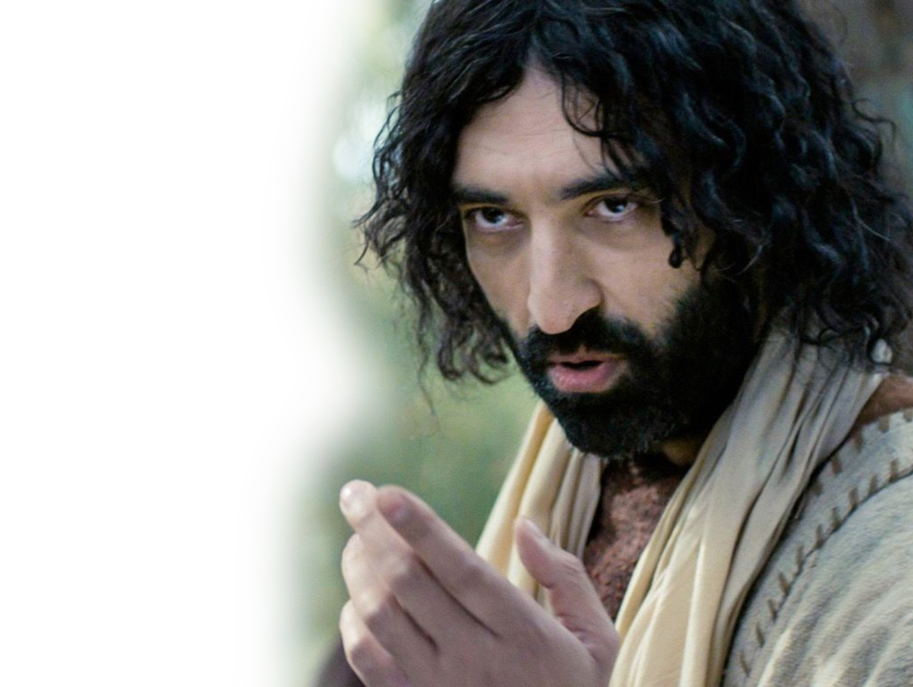
The LISTENING Crowd 12:29
³⁰ Jesus answered,
"This voice has come for your sake, not mine. ³¹ Now is the judgment of this world; now will the ruler of this world be cast out.
³² And I, when I am lifted up from the earth, will draw all people to myself."

Slide 20
The LISTENING Crowd 12:29
³² And I, when I am lifted up from the earth, will draw all people to myself." ³³ He said this to show by what kind of death he was going to die.

Slide 21
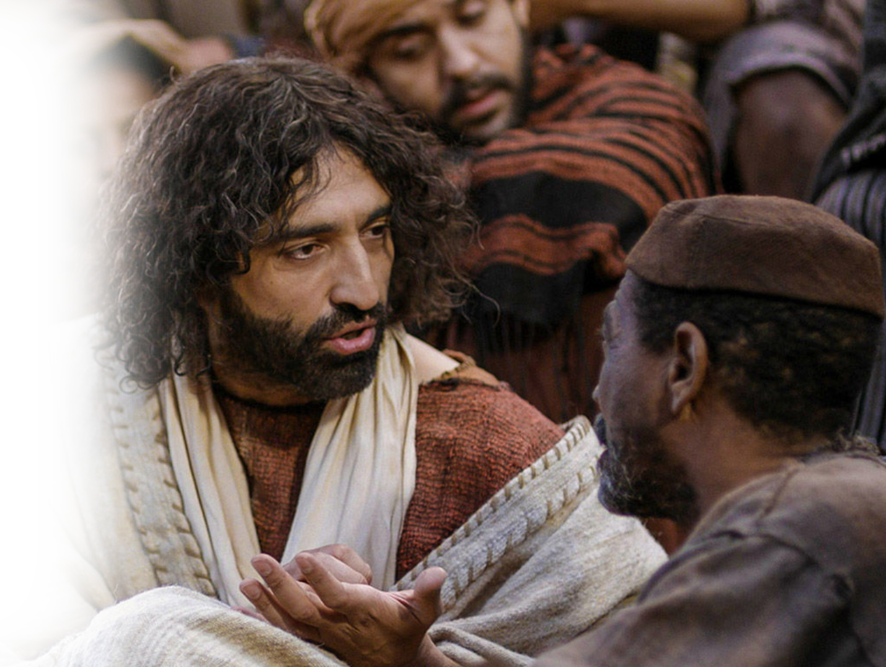
The QUESTIONING Crowd 12:34
³⁴ So the crowd answered him,
"We have heard from the Law that the Christ remains forever. How can you say that the Son of Man must be lifted up?
Who is this Son of Man?"
Notes:
The Answer to their question was staring them in the face!

Slide 22
The QUESTIONING Crowd 12:34
³⁵ So Jesus said to them,
"The light is among you for a little while longer. Walk while you have the light, lest darkness overtake you. The one who walks in the darkness does not know where he is going.

Slide 23
The QUESTIONING Crowd 12:34
³⁶ While you have the light, believe in the light, that you may become sons of light."
When Jesus had said these things, he departed and hid himself from them.

Slide 24
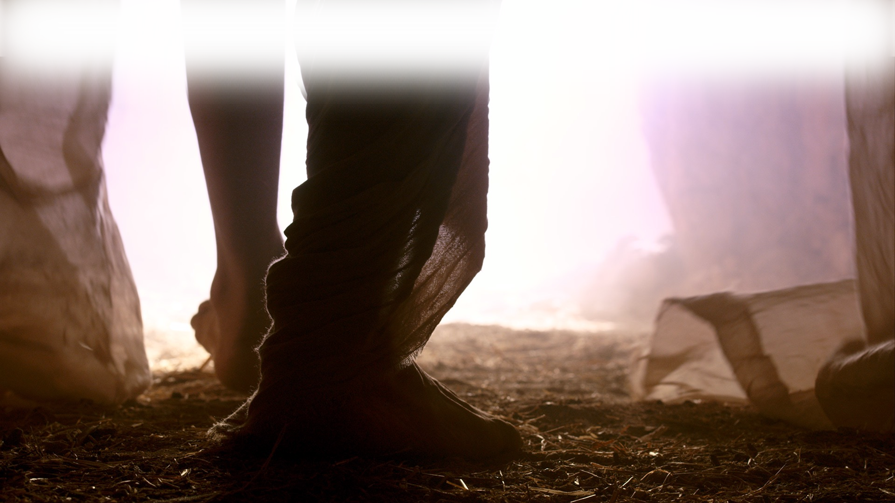
The Triumphal Tragedy
³⁷ Though he had done so many signs before them, they still did not believe in him ….

Slide 25
So Which Crowd Are You In?
Festive Crowd – Celebrating Jesus
Witnessing Crowd – Talking about Jesus
Curious Crowd – Looking for Jesus
Self-Righteous Crowd – Don’t need Jesus
Outsider Crowd – Wanting to see Jesus
Listening Crowd – Revealing Jesus
Questioning Crowd – In the dark about Jesus

Slide 26
Summarized like this …
¹¹ He came to his own, and his own people did not receive him. ¹² But to all who did receive him, who believed in his name, he gave the right to become children of God, ¹³ who were born, not of blood nor of the will of the flesh nor of the will of man, but of God.
(John 1:11-13 )

Slide 27
Let’s Pray!

