Slide 1
Happy Father’s Day
Notes:
pixabay.com/photos/gift-present-wood-package-gift-box-1420830/

Slide 2
A few things that will bring a dad great joy
Notes:
pixabay.com/photos/gift-present-wood-package-gift-box-1420830/
A Few Things that Bring Men Great Joy
1-Great Joy from a Warm Welcome
²⁹ Welcome him in the Lord with great joy, and honor men like him,
³⁰ because he almost died for the work of Christ, risking his life to make up for the help you could not give me. (Phi 2:29-30 NIV)
2-Great Joy from a Genuine Concern
¹⁰ I rejoice greatly in the Lord that at last you have renewed your concern for me. Indeed, you have been concerned, but you had no opportunity to show it. (Phi 4:10 NIV)
3-Great Joy from an Agape Love
⁷ Your love has given me great joy and encouragement, because you, brother, have refreshed the hearts of the saints. (Phm 1:7 NIV)
4-Great Joy from a Good Kid
⁴ I have no greater joy than to hear that my children are walking in the truth. (3Jo 1:4 NIV)
5-Great Joy in God’s Presence
²⁴ To him who is able to keep you from falling and to present you before his glorious presence without fault and with great joy--
²⁵ to the only God our Savior be glory, majesty, power and authority, through Jesus Christ our Lord, before all ages, now and forevermore! Amen.
(Jud 1:24-25 NIV)

Slide 3
A Warm Welcome
²⁹ Welcome him in the Lord with great joy, and honor men like him, ³⁰ because he almost died for the work of Christ, risking his life to make up for the help you could not give me. (Philippians 2:29-30)
Notes:
pixabay.com/photos/gift-present-wood-package-gift-box-1420830/
www.maxpixel.net/static/photo/1x/Shake-Together-Help-Encouragement-Hands-2805248.png

Slide 4
A Respectful Honor
²⁹ Welcome him in the Lord with great joy, and honor men like him, ³⁰ because he almost died for the work of Christ, risking his life to make up for the help you could not give me. (Philippians 2:29-30)
Notes:
pixabay.com/photos/gift-present-wood-package-gift-box-1420830/
www.maxpixel.net/Trophy-White-Enter-Cup-Rare-Winner-Win-Champions-1008963

Slide 5
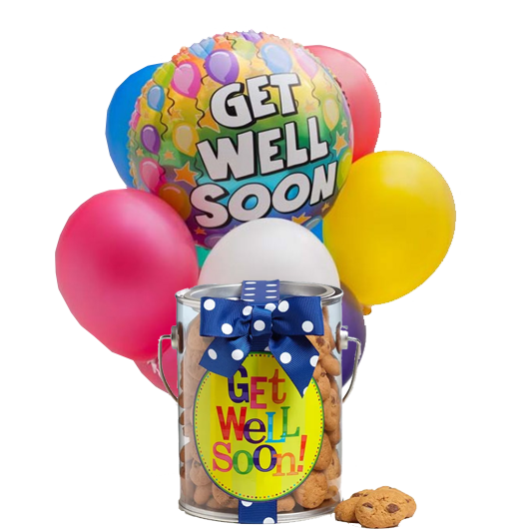
A Genuine Concern
¹⁰ I rejoice greatly in the Lord that at last you have renewed your concern for me. Indeed, you have been concerned, but you had no opportunity to show it. (Philippians 4:10)

Slide 6
An Agape Love
⁷ Your love has given me great joy and encourage-ment, because you, brother, have refreshed the hearts of the saints. (Philemon 1:7)
Notes:
pxhere.com/en/photo/826280

Slide 7
A Truthful Child
⁴ I have no greater joy than to hear that my children are walking in the truth. (3John 1:4)
Notes:
pxhere.com/en/photo/992335

Slide 8
God’s Presence
24 To him who is able to keep you from falling and to present you before his glorious presence without fault and with great joy-- (Jude 1:24)

Slide 9
What do we take away today?
Pick at least one!
It’s not hard to honor Dad:
1- Greet Him–he wants to hear from you!
2- Honor Him–He want your respect
3- Be Concerned–he wants to know that you care!
4- Love Him–like the Lord loves him!
5- Be Real–he wants you to live truthfully!
6- Commend Him–to God’s presence!

Slide 10
LET’S PRAY!

