Slide 1
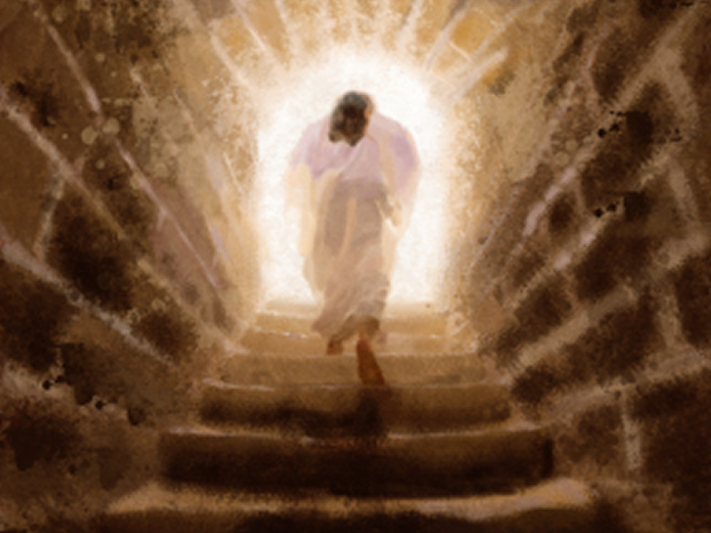
EASTER …
What does it matter?
Notes:
Copyright © 2006−2021. All rights reserved. Bible Point is a registered trademark of Dennis Henderson. All other trademarks acknowledged.
Bible Point contains graphics from Bible Point artists. These illustrations belong to Bible Point and the respective artists. You may use the designs and illustrations for graphical illustration of lessons free and without special permission, provided they are not used in any way that maligns the Christian faith. Furthermore, republication or production of any illustration by any other graphic service whether it be in book, in a machine-readable form, or in any other design resource is strictly prohibited. Furthermore, they cannot be duplicated or resold as any other form of publishing, clip art, or graphic resource.
So What does it mean? (A simple translations of the legal jargon)
So, if you don’t own the presentation(s), graphic(s), and text(s) how can you legally use them? The purchase of the license allows you to use all the images in the product. However, the actual ownership and copyright of the presentation(s), graphic(s), and text(s) remain the property of Bible Point and its licensors. If you had plans on using this product in your “for sale” work—think again!
License Agreement
Article 1: License Grant
All the graphics and text in Bible Point presentations (excluding quotes from the Bible and stated sources) are the intellectual and real property of Bible Point and its licensors, and is protected by law, including United States copyright laws and international treaties. Bible Point grants to you a license:
1. To use the presentation in a single church, single school, or single office of a Christian organization.
2. To make a single archival back-up copy of the program.
3. To modify the presentation(s) and merge with other presentations in a single church, school, or Christian organization.
4. To transfer to another party if that party agrees to accept the terms and conditions of this agreement, and you do not retain any copies of the presentation, whether printed, machine readable, modified, or merged form.
Article 2: Terms
This license is effective until terminated. You may terminate the license at any time by destroying the presentation(s), graphic(s), or text(s) together with all copies, modifications and merged portions in any form. Bible Point may terminate your license if you fail to comply with this Agreement. You agree, upon such termination, for any reason, to destroy the presentation(s), graphics, and text(s) with all copies, modifications, and merged portions in any form.
Article 3: Disclaimers
1. Bible Point presentations, graphics, and texts are licensed to you As Is. You, the consumer, bear the entire risk relating to the quality and performance of the presentation(s), graphic(s), or text(s). In no event will Bible Point be liable for damages resulting from any defect.
2. Thirty-day limited warrantee on disks. Bible Point warrants the disks to be free of defects in material and workmanship under normal use for 30 days after purchase. During the 30-day period you may return a defective presentation, graphic, or text with proof of purchase and it will be replaced without charge, unless the presentation is damaged by misuse.
Article 4: General
1. You may not sub-license, assign, or transfer the license of the presentation(s), graphic(s), or text(s) except as provided by this Agreement.
2. This Agreement will be governed by the laws of the State of Michigan.
So What does it mean? (A simple translations of the legal jargon)
May I let someone borrow or copy my licensed Bible Point presentation (even after I modified it)? As long as it is within your local church, or single school, or the immediate office of a Christian organization you may. Otherwise, please refer the person interested in borrowing to: http://www.biblepoint.com or E-mail: dennis@DrDH.net with any related questions.

Slide 2
EASTER …
What does it matter?

Slide 3
RESURRECTION …
What does it matter?

Slide 4
It’s the Gospel Truth

Slide 5
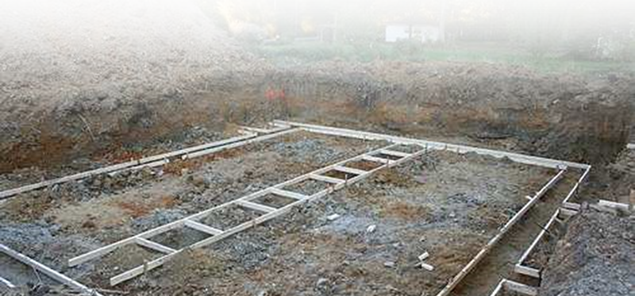
Upon which we take our STAND
¹ Now, brothers, I want to remind you of the gospel I preached to you, which you received and on which you have taken your stand.
The “Bedrock” of the Christian Faith

Slide 6

It’s the Truth that SAVES
² By this gospel you are saved, if you hold firmly to the word I preached to you.

Slide 7
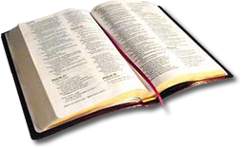
It’s the Truth that SAVES
² By this gospel you are saved, if you hold firmly to the word I preached to you.

Slide 8

It’s the Truth that SAVES
² By this gospel you are saved, if you hold firmly to the word I preached to you. Otherwise, you have believed in vain.
Emptiness

Slide 9
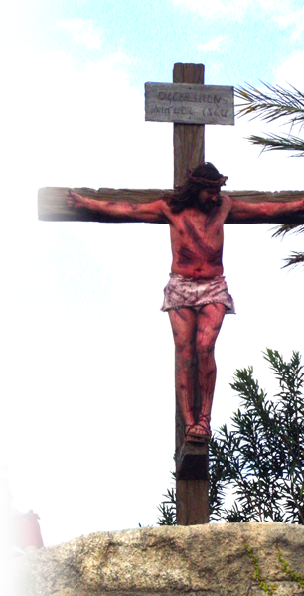
It’s the Truth that SAVES
³ For what I received I passed on to you as of first importance: that Christ died for our sins according to the Scriptures, ⁴ that he was buried, that he was raised on the third day according to the Scriptures,

Slide 10
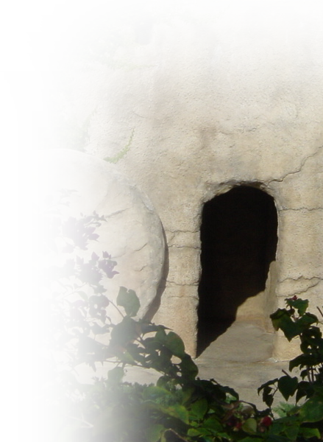
It’s the Truth that SAVES
³ For what I received I passed on to you as of first importance: that Christ died for our sins according to the Scriptures,
⁴ that he was buried, that he
was raised on the third day according to the Scriptures,

Slide 11
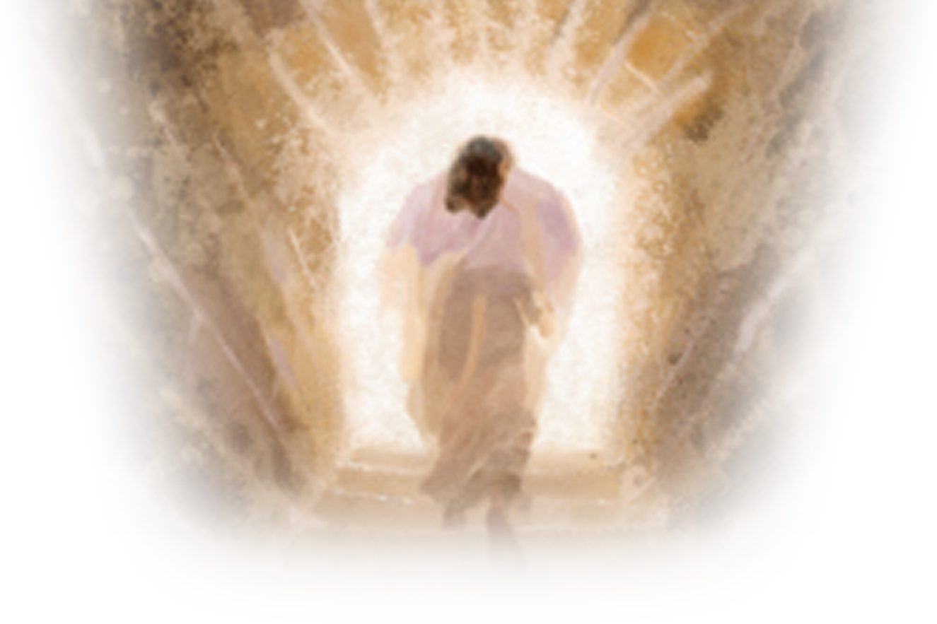
It’s the Truth that SAVES
³ For what I received I passed on to you as of first importance: that Christ died for our sins according to the Scriptures, ⁴ that he was buried, that he
was raised on the third day according to the Scriptures,

Slide 12

It’s the Truth that SAVES
³ For what I received I passed on to you as of first importance: that Christ died for our sins according to the Scriptures, ⁴ that he was buried, that he
was raised on the third day according to the Scriptures,

Slide 13
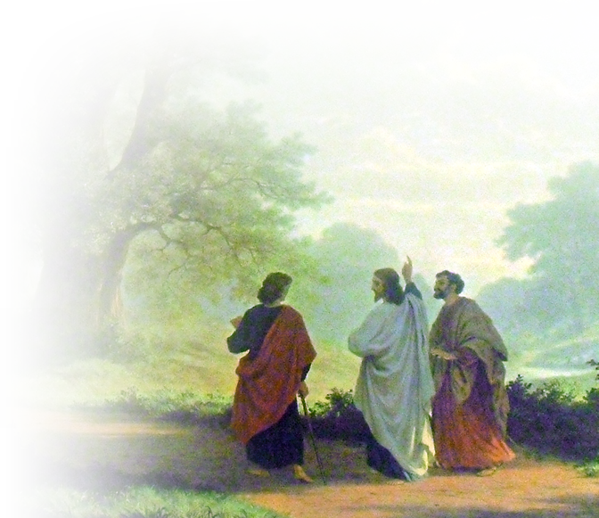
It’s a Historical FACT
⁵ and that he appeared to Peter,
Notes:
Personal photo

Slide 14
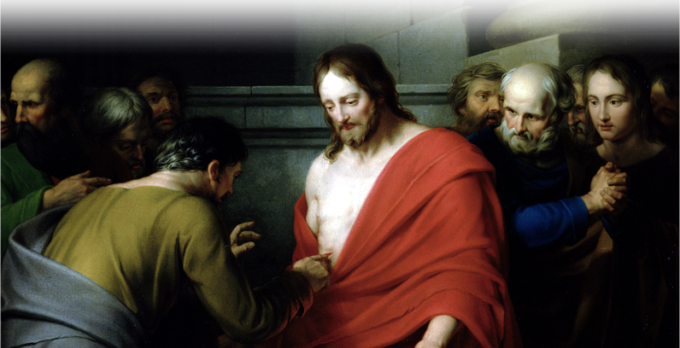
It’s a Historical FACT
⁵ and that he appeared to Peter, and then to the Twelve.

Slide 15
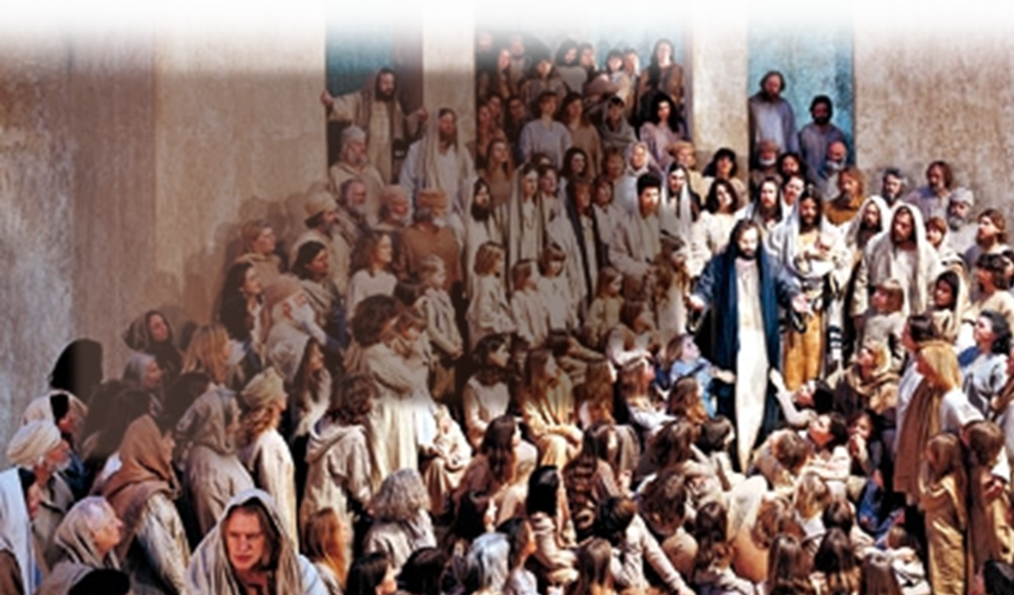
It’s a Historical FACT
⁵ and that he appeared to Peter, and then to the Twelve. ⁶ After that, he appeared to more than five hundred of the brothers at the same time, most of whom are still living, though some have fallen asleep.
Notes:
Crowd taken from http://i3.squidoocdn.com/resize/squidoo_images/590/draft_lens4255192module35512432photo_1243144465Jesus-teaching.jpg

Slide 16
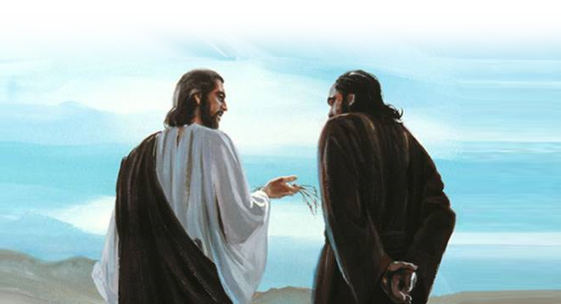
It’s a Historical FACT
⁷ Then he appeared to James,
Notes:
http://sjrm.i.ph/photo/d/736-1/jesus+rebuked+peter.jpg

Slide 17
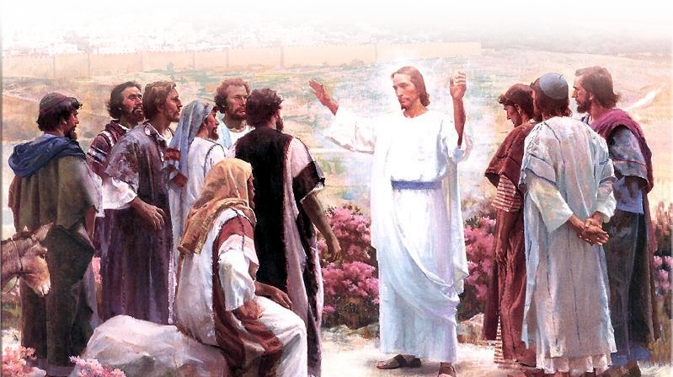
It’s a Historical FACT
⁷ Then he appeared to James, then to all the apostles,
Notes:
Jesus with the 12 = http://www.turnbacktogod.com/jesus-resurrection-pictures/

Slide 18
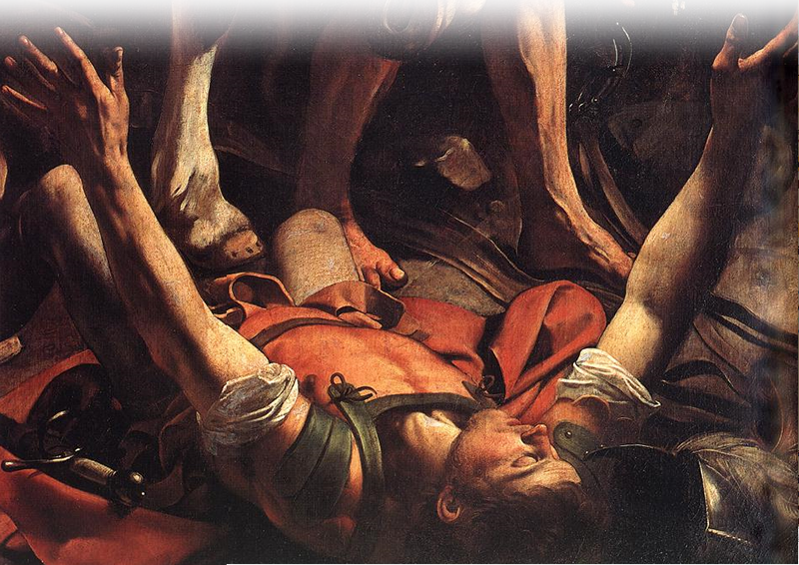
It’s a Historical FACT
⁸ and last of all he appeared to me also, as to one abnormally born.
Notes:
Saul - http://www.lib-art.com/artgallery/8068-the-conversion-on-the-way-to-damasc-caravaggio.html

Slide 19
It’s Life Transforming Truth
⁹ For I am the least of the apostles and do not even deserve to be called an apostle, because I persecuted the church of God.
¹⁰ But by the grace of God I am what I am, and his grace to me was not without effect. No, I worked harder than all of them--yet not I, but the grace of God that was with me.

Slide 20
It’s Absolute TRUTH
¹¹ Whether, then, it was I or they, this is what we preach, and this is what you believed.

Slide 21
It’s a Logically Necessary TRUTH
¹² But if it is preached that Christ has been raised from the dead, [then] how can some of you say that there is no resurrection of the dead?
¹³ If there is no resurrection of the dead, then not even Christ has been raised.
¹⁴ And if Christ has not been raised,
[then] our preaching is useless and so is your faith.

Slide 22
It’s a Logically Necessary TRUTH
¹⁵ More than that, we are then found to be false witnesses about God, for we have testified about God that he raised Christ from the dead. But he did not raise him if in fact the dead are not raised.
¹⁶ For if the dead are not raised, then Christ has not been raised either.

Slide 23
It’s a Logically Necessary TRUTH
¹⁵ More than that, we are then found to be false witnesses about God, for we have testified about God that he raised Christ from the dead. But he did not raise him if in fact the dead are not raised.
¹⁶ For if the dead are not raised, then Christ has not been raised either.

Slide 24
It’s a Logically Necessary TRUTH
¹⁵ More than that, we are then found to be false witnesses about God, for we have testified about God that he raised Christ from the dead. But he did not raise him if in fact the dead are not raised.
¹⁶ For if the dead are not raised, then Christ has not been raised either.

Slide 25
It’s a Logically Necessary TRUTH
¹⁷ And if Christ has not been raised, [then] your faith is futile; you are still in your sins.
¹⁸ Then those also who have fallen asleep in Christ are lost.
¹⁹ If only for this life we have hope in Christ, [then] we are to be pitied more than all men.

Slide 26
It’s a Glorious Triumphant TRUTH
²⁰ But Christ has indeed been raised from the dead, the firstfruits of those who have fallen asleep.

Slide 27
Let’s Sum Up
This is the Gospel Truth
Died – buried – raised from the dead
It’s a Historical Fact
Attested to by hundreds of eye witnesses
It’s logically necessary for eternal hope!
Pity the person who does not believe!
It alone is the Saving truth
To believe in anything less is “vain”

Slide 28
Let’s Sum Up
So what do you believe?

Slide 29
Let’s Pray

