Slide 1
EASTER!
What difference does it make?
Watch
https://youtu.be/lPFE16C_FiE
Notes:
Copyright © 2006−2021. All rights reserved. Bible Point is a registered trademark of Dennis Henderson. All other trademarks acknowledged.
Bible Point contains graphics from Bible Point artists. These illustrations belong to Bible Point and the respective artists. You may use the designs and illustrations for graphical illustration of lessons free and without special permission, provided they are not used in any way that maligns the Christian faith. Furthermore, republication or production of any illustration by any other graphic service whether it be in book, in a machine-readable form, or in any other design resource is strictly prohibited. Furthermore, they cannot be duplicated or resold as any other form of publishing, clip art, or graphic resource.
So What does it mean? (A simple translations of the legal jargon)
So, if you don’t own the presentation(s), graphic(s), and text(s) how can you legally use them? The purchase of the license allows you to use all the images in the product. However, the actual ownership and copyright of the presentation(s), graphic(s), and text(s) remain the property of Bible Point and its licensors. If you had plans on using this product in your “for sale” work—think again!
License Agreement
Article 1: License Grant
All the graphics and text in Bible Point presentations (excluding quotes from the Bible and stated sources) are the intellectual and real property of Bible Point and its licensors, and is protected by law, including United States copyright laws and international treaties. Bible Point grants to you a license:
1. To use the presentation in a single church, single school, or single office of a Christian organization.
2. To make a single archival back-up copy of the program.
3. To modify the presentation(s) and merge with other presentations in a single church, school, or Christian organization.
4. To transfer to another party if that party agrees to accept the terms and conditions of this agreement, and you do not retain any copies of the presentation, whether printed, machine readable, modified, or merged form.
Article 2: Terms
This license is effective until terminated. You may terminate the license at any time by destroying the presentation(s), graphic(s), or text(s) together with all copies, modifications and merged portions in any form. Bible Point may terminate your license if you fail to comply with this Agreement. You agree, upon such termination, for any reason, to destroy the presentation(s), graphics, and text(s) with all copies, modifications, and merged portions in any form.
Article 3: Disclaimers
1. Bible Point presentations, graphics, and texts are licensed to you As Is. You, the consumer, bear the entire risk relating to the quality and performance of the presentation(s), graphic(s), or text(s). In no event will Bible Point be liable for damages resulting from any defect.
2. Thirty-day limited warrantee on disks. Bible Point warrants the disks to be free of defects in material and workmanship under normal use for 30 days after purchase. During the 30-day period you may return a defective presentation, graphic, or text with proof of purchase and it will be replaced without charge, unless the presentation is damaged by misuse.
Article 4: General
1. You may not sub-license, assign, or transfer the license of the presentation(s), graphic(s), or text(s) except as provided by this Agreement.
2. This Agreement will be governed by the laws of the State of Michigan.
So What does it mean? (A simple translations of the legal jargon)
May I let someone borrow or copy my licensed Bible Point presentation (even after I modified it)? As long as it is within your local church, or single school, or the immediate office of a Christian organization you may. Otherwise, please refer the person interested in borrowing to: http://www.biblepoint.com or E-mail: dennis@DrDH.net with any related questions.

Slide 2
EASTER!
What difference does it make?
Notes:
https://upload.wikimedia.org/wikipedia/commons/4/4b/Jesus%27s_Tomb_%282819155661%29.jpg modified – stone added.

Slide 3
EASTER!
What difference does it make?
It makes all the DIIFERENCE in the WORLD!
Notes:
https://upload.wikimedia.org/wikipedia/commons/4/4b/Jesus%27s_Tomb_%282819155661%29.jpg modified – stone added.
The resurrection of Jesus from the dead is a fact. Over 500 witnessed it, among whom the last was the Apostle Paul. Three times in the book of Acts he tells his story of how he was persecuting the church of Jesus Christ and then the Resurrected Jesus appeared to him and it changed everything.
In fact, the apostle Paul made it clear that everything before meeting the resurrected Christ he considered rubbish, dung. That’s the difference it made to him. He writes about it in Philippians 3.

Slide 4
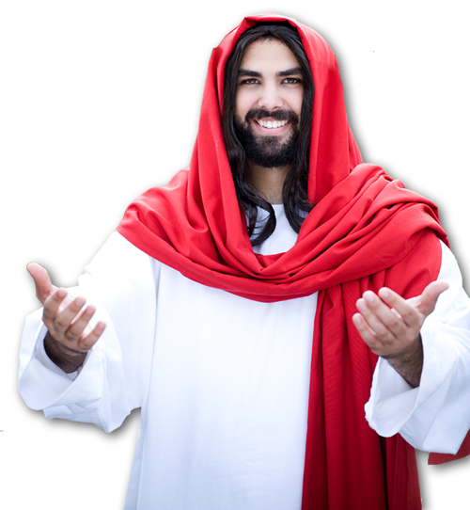
It makes a POWERFUL difference!
^{Phil 3:10} I want to know Christ and the power of his resurrection and the fellowship of sharing in his sufferings, becoming like him in his death, ¹¹ and so, somehow, to attain to the resurrection from the dead.
Notes:
To know Christ (not about Christ; but to know him) is to know the power of his resurrection; to know the power of his resurrection you must know him. Such intimate knowledge is the basis for your own resurrection life. It’s who you know, not what you know. When you know him personally, you share in his suffering—like we saw in baptism, his death became our death, by faith I shared in that. His burial became mine. I shared in that. His resurrection became my resurrection. I shared in that. Somehow that union with Christ will lead to my own resurrection with him. That’s powerful stuff!
Paul put it this way in Galatians 2:20 “²⁰ I have been crucified with Christ and I no longer live, but Christ lives in me. The life I live in the body, I live by faith in the Son of God, who loved me and gave himself for me. (Gal 2:20 NIV)
⁴ We were therefore buried with him through baptism into death in order that, just as Christ was raised from the dead through the glory of the Father, we too may live a new life.
⁵ If we have been united with him like this in his death, we will certainly also be united with him in his resurrection.
(Rom 6:4-5 NIV)
It makes a Powerful difference – it happened, is happening, and will happen (Jesus, eph 2:1, 1 thes 4:17)

Slide 5
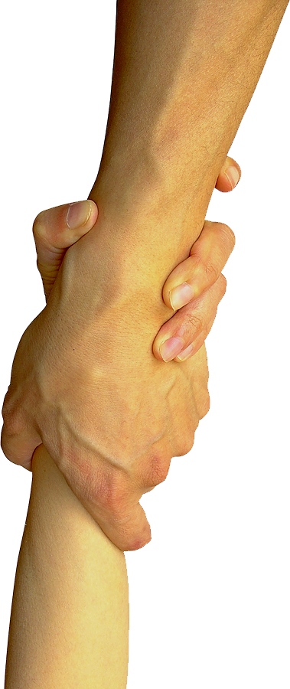
It makes a PURPOSEFUL difference
¹² Not that I have already obtained all this, or have already been made perfect, but I press on to take hold of that for which Christ Jesus took hold of me.
Notes:
It makes a Purposeful difference – He laid hold on you for purpose – your life is meaningful
God has a plan for your life ... You need to find him to find your plan.
Jeremiah “i know the plans I have for you ...” If he knows them, and you want to find out, you better get to know Him>

Slide 6

It makes a PERSPECTIVE difference
¹³ Brothers, I do not consider myself yet to have taken hold of it. But one thing I do: Forgetting what is behind ...
PAST
Notes:
It makes a Perspective difference – puts the past in the past
I have not fulfilled the purpose for which Christ saved my life yet. I haven’t taken hold of all of it yet. So put my past into perspective.
Things farther away get smaller in perspective. The past get smaller and smaller.

Slide 7

It makes a PRESENT difference
¹³ ... and straining toward what is ahead, ...
PAST
AHEAD
Notes:
It makes a Present difference – now have something to live for

Slide 8

It makes a PRESSING difference
¹⁴ I press on toward the goal ...
Notes:
It makes a Pressing difference - focus on the future
Finish line = free = http://confessionsofanadoptiveparent.com/wp-content/uploads/2013/02/iStock_000013906320_Medium.jpg

Slide 9
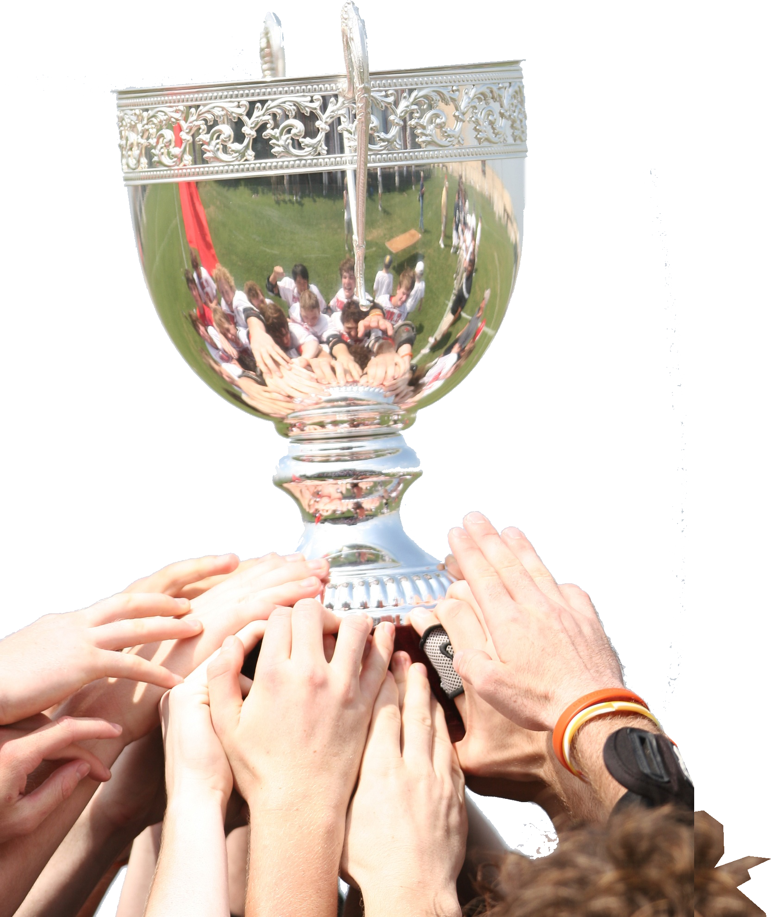
It makes a WINNING difference
¹⁴ ... to win the prize for which God has called me heavenward in Christ Jesus.
Notes:
It makes a Winning difference –the prize
Trophy = free = https://pixabay.com/en/champions-award-trophy-cup-victory-1411861/

Slide 10
Two thoughts on WINNING:
Notes:
At the 2002 Winter Olympic Games speed skater Steven Bradbury won Australia’s first ever winter gold medal.

Slide 11
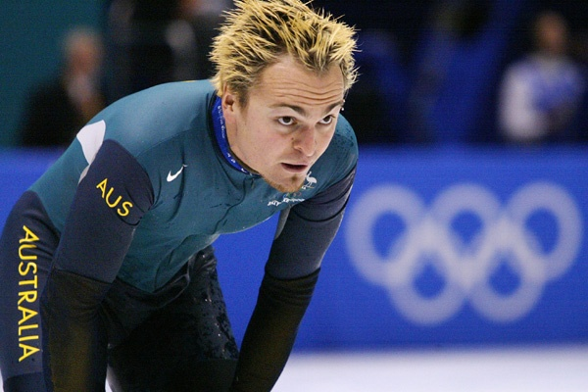
FIRST Thought on WINNING
In 2002 Gold Medal Olympian
speed skater, Steven Bradbury
Notes:
At the 2002 Winter Olympic Games speed skater Steven Bradbury won Australia’s first ever winter gold medal.
Steven John Bradbury OAM (born 14 October 1973) is an Australian former short track speed skater and four-time Olympian. He is best known for winning the 1,000 m event at the 2002 Winter Olympics after all of his opponents were involved in a last corner pile-up. He was the first Australian to win a Winter Olympic gold medal and was also part of the short track relay team that won Australia's first Winter Olympic medal, a bronze in 1994.
In the final, Bradbury was again well off the pace when all four of his competitors (Ohno, Ahn Hyun-Soo, Li and Turcotte) crashed out at the final corner while jostling for the gold medal. This allowed the Australian, who was around 15 m behind with only 50 m to go, to avoid the pile-up and take the victory.^{[15][16][18]} Bradbury raised his arms aloft in complete disbelief and amazement at the unlikely circumstances of his victory. A shocked Bradbury became the first person from any southern hemisphere country to win a Winter Olympic event.

Slide 12
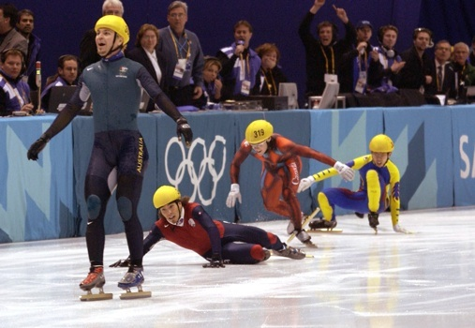
FIRST Thought on WINNING

Slide 13
FIRST Thought on WINNING
To win you must ...

Slide 14
FIRST Thought on WINNING
To win you must ... be in the race!

Slide 15
SECOND thought on WINNING!

Slide 16
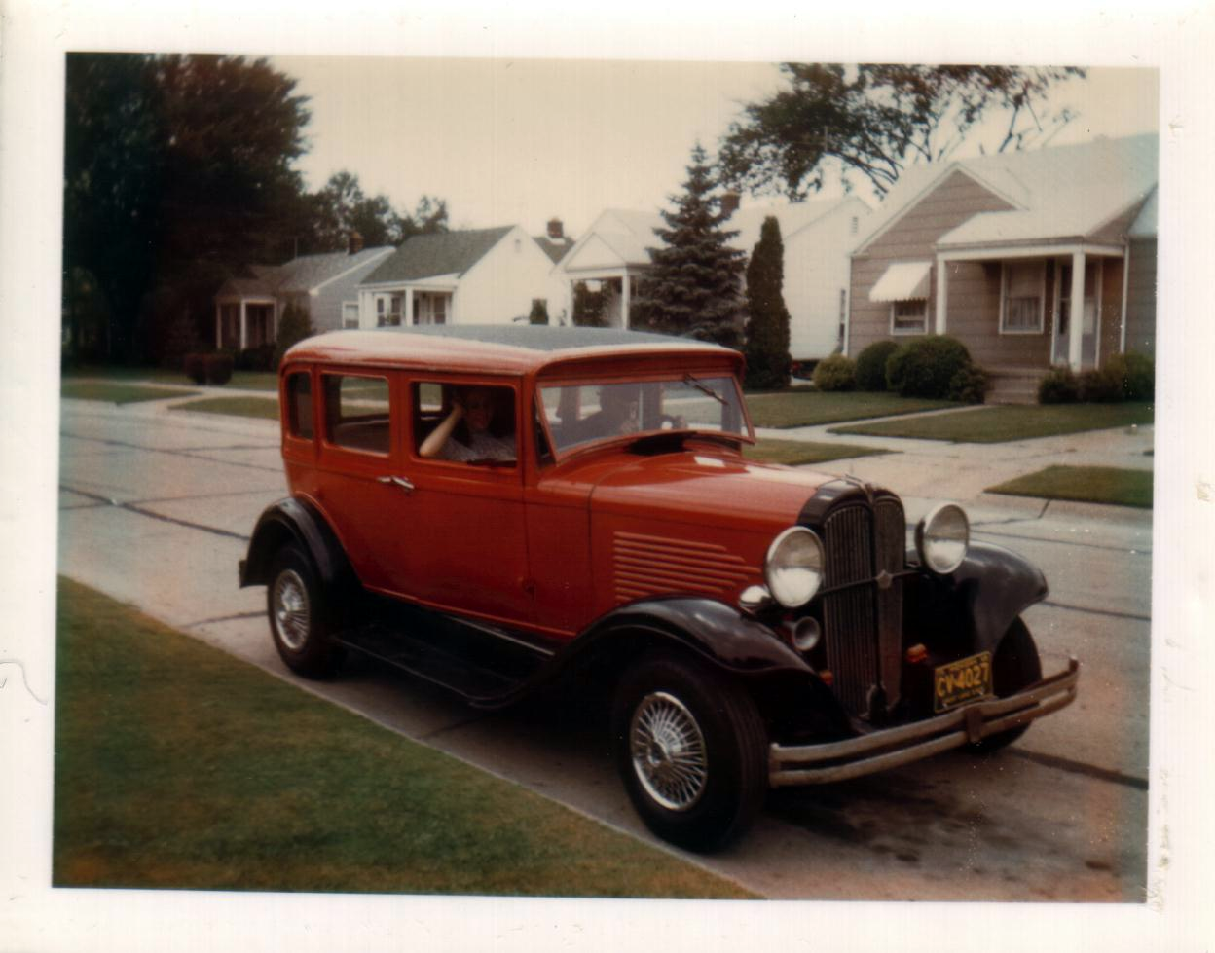
1932 Willys Overland
Notes:
It was stock.
Straight six with a whapping 65 horsepower, in 1932 won the Pike’s Peak international speed race to the top of the mountain.
As you can see it had an air-conditioning system of popping up a vent on the cowl just in front of the windshield and the ability to roll down all the windows, and crank out the windshield.
One drawback, no heater. I carried extra blankets in the winter time and a scrapper to scrape the windshield on the inside (no defroster). I did have on windshield wiper on the drivers side.
It lost all oil pressure after about 10 min after starting.
No turn signals—use your arm.
When the starter quit – I just put a crank through the grill and in one pull it would start (in the summer time that is).

Slide 17
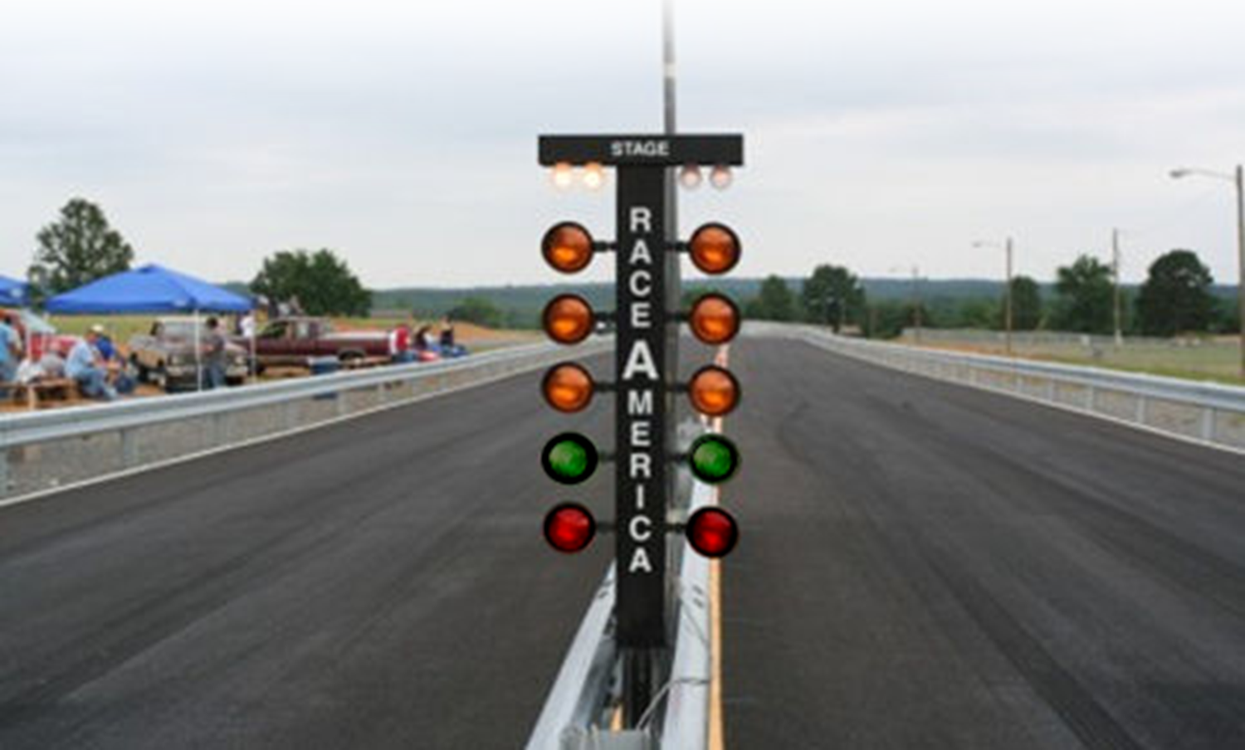

The Race …

Slide 18

The Race …

Slide 19
The Race …

Slide 20
The Race …

Slide 21

The Race …

Slide 22
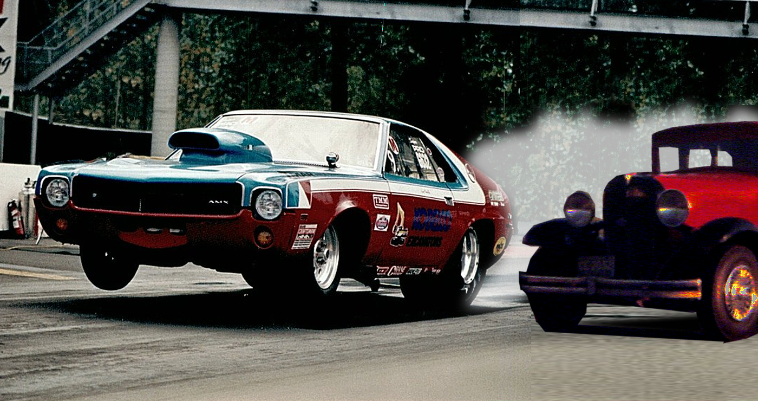
There off …

Slide 23
AMX less than 10 second

Slide 24
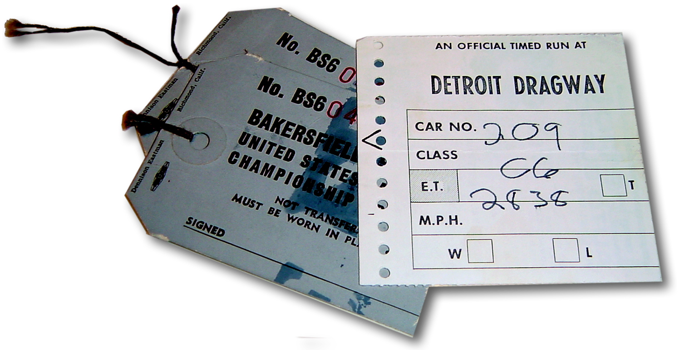
AMX less than 10 second
‘32 Willys ...

Slide 25
AMX less than 10 second
‘32 Willys ... 28.38 seconds

Slide 26
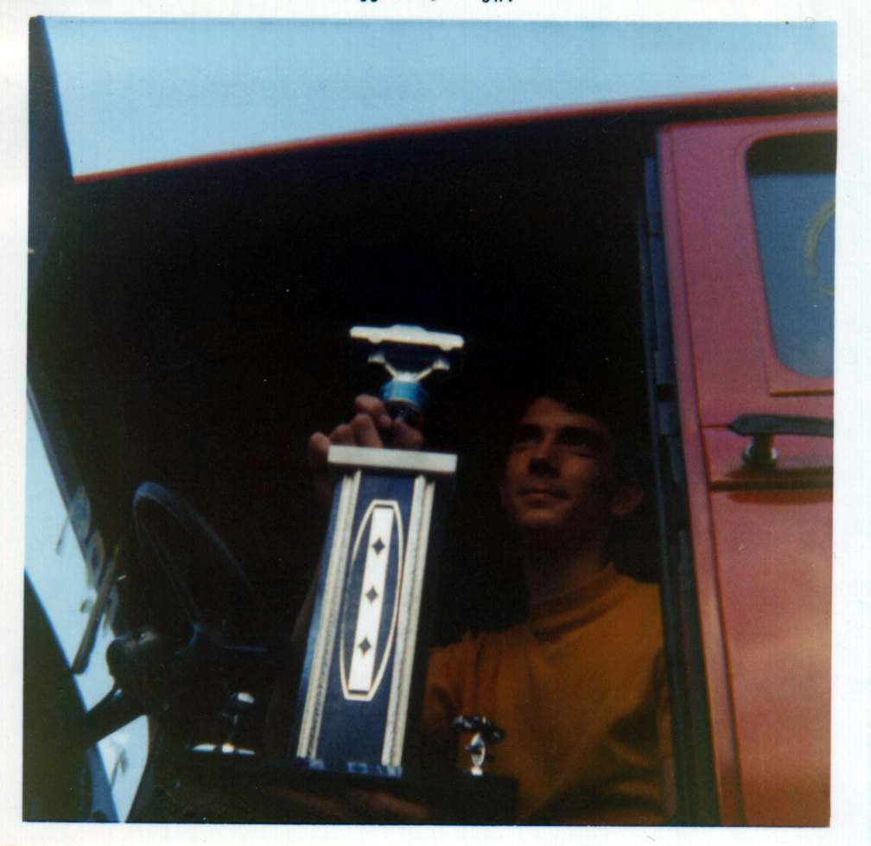
I WON!

Slide 27
SECOND thought ...

Slide 28
God wants YOU to be a WINNER!

Slide 29
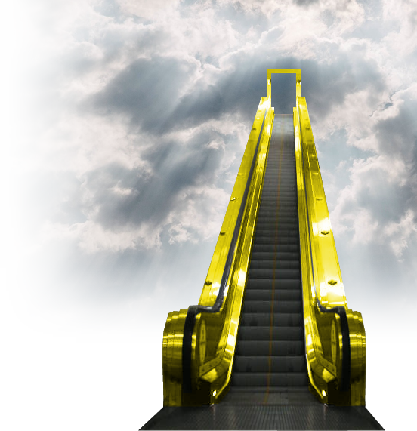
It makes a LASTING difference
²⁰ But our citizenship is in heaven.

Slide 30
It makes a LASTING difference
²⁰ But our citizenship is in heaven. And we eagerly await a Savior from there, the Lord Jesus Christ, ²¹ who, by the power that enables him to bring everything under his control, will transform our lowly bodies so that they will be like his glorious body.
Notes:
We will win over death itself! With a body like His resurrected, glorious body!

Slide 32
EASTER!
What difference does it make?
Notes:
https://upload.wikimedia.org/wikipedia/commons/4/4b/Jesus%27s_Tomb_%282819155661%29.jpg modified – stone added.

Slide 33
EASTER!
What difference does it make?
It makes BELIEVERS
into
WINNERS!
Notes:
https://upload.wikimedia.org/wikipedia/commons/4/4b/Jesus%27s_Tomb_%282819155661%29.jpg modified – stone added.

Slide 34
Become a WINNER
Right Now!

Slide 35
Become a WINNER
Right Now!
BELIEVE TODAY!

Slide 36
Let’s Pray!

Slide 37


Slide 38
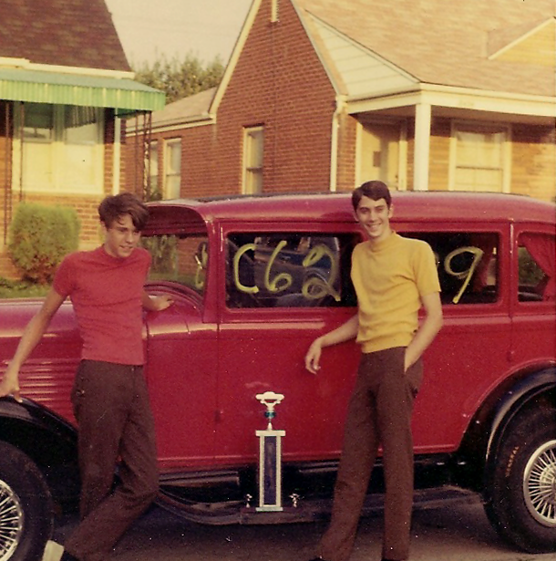
The Race is a Team Effort ...
Join with others in following my example (Phi 3:17)

