Slide 1
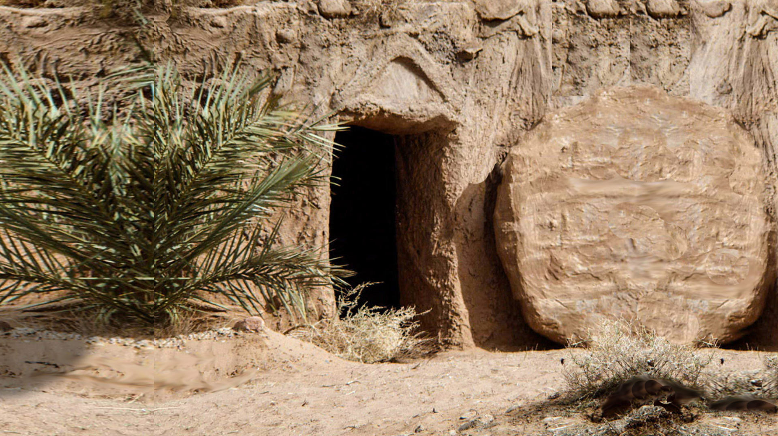

LIFE-LESSONS
from
The Man Who
MISSED
EASTER
Watch:
https://www.facebook.com/watch/live/?v=724073511596264&ref=watch_permalink
Notes:
Copyright © 2006−2021. All rights reserved. Bible Point is a registered trademark of Dennis Henderson. All other trademarks acknowledged.
Bible Point contains graphics from Bible Point artists. These illustrations belong to Bible Point and the respective artists. You may use the designs and illustrations for graphical illustration of lessons free and without special permission, provided they are not used in any way that maligns the Christian faith. Furthermore, republication or production of any illustration by any other graphic service whether it be in book, in a machine-readable form, or in any other design resource is strictly prohibited. Furthermore, they cannot be duplicated or resold as any other form of publishing, clip art, or graphic resource.
So What does it mean? (A simple translations of the legal jargon)
So, if you don’t own the presentation(s), graphic(s), and text(s) how can you legally use them? The purchase of the license allows you to use all the images in the product. However, the actual ownership and copyright of the presentation(s), graphic(s), and text(s) remain the property of Bible Point and its licensors. If you had plans on using this product in your “for sale” work—think again!
License Agreement
Article 1: License Grant
All the graphics and text in Bible Point presentations (excluding quotes from the Bible and stated sources) are the intellectual and real property of Bible Point and its licensors, and is protected by law, including United States copyright laws and international treaties. Bible Point grants to you a license:
1. To use the presentation in a single church, single school, or single office of a Christian organization.
2. To make a single archival back-up copy of the program.
3. To modify the presentation(s) and merge with other presentations in a single church, school, or Christian organization.
4. To transfer to another party if that party agrees to accept the terms and conditions of this agreement, and you do not retain any copies of the presentation, whether printed, machine readable, modified, or merged form.
Article 2: Terms
This license is effective until terminated. You may terminate the license at any time by destroying the presentation(s), graphic(s), or text(s) together with all copies, modifications and merged portions in any form. Bible Point may terminate your license if you fail to comply with this Agreement. You agree, upon such termination, for any reason, to destroy the presentation(s), graphics, and text(s) with all copies, modifications, and merged portions in any form.
Article 3: Disclaimers
1. Bible Point presentations, graphics, and texts are licensed to you As Is. You, the consumer, bear the entire risk relating to the quality and performance of the presentation(s), graphic(s), or text(s). In no event will Bible Point be liable for damages resulting from any defect.
2. Thirty-day limited warrantee on disks. Bible Point warrants the disks to be free of defects in material and workmanship under normal use for 30 days after purchase. During the 30-day period you may return a defective presentation, graphic, or text with proof of purchase and it will be replaced without charge, unless the presentation is damaged by misuse.
Article 4: General
1. You may not sub-license, assign, or transfer the license of the presentation(s), graphic(s), or text(s) except as provided by this Agreement.
2. This Agreement will be governed by the laws of the State of Michigan.
So What does it mean? (A simple translations of the legal jargon)
May I let someone borrow or copy my licensed Bible Point presentation (even after I modified it)? As long as it is within your local church, or single school, or the immediate office of a Christian organization you may. Otherwise, please refer the person interested in borrowing to: http://www.biblepoint.com or E-mail: dennis@DrDH.net with any related questions.
One Easter Sunday morning as the pastor was preaching a children's sermon, he reached into a bag of props and pulled out one egg. He pointed at the egg and asked the children, “What’s in here?”
“I know, I know!” a little boy yelled out, “pantyhose!”
A pastor and a taxi driver both died and went to heaven. St. Peter was at the Pearly gates waiting for them.
‘Come with me,’ said St. Peter to the taxi driver.
The taxi driver did as he was told and followed St Peter to a mansion. It had everything you could imagine from a bowling alley to an Olympic size pool.
‘Oh my word, thank you,’ said the taxi driver.
Next, St. Peter led the pastor to a rough old shack with a bunk bed and a little old television set.
‘Wait, I think you are a little mixed up,’ said the pastor. ‘Shouldn’t I be the one who gets the mansion? After all, I was a pastor, went to church every day, and preached God’s word.’
‘Yes, that’s true.’ St Peter rejoined, ‘But during your Easter sermons people slept. When the taxi driver drove, everyone prayed.’
Young Ernie and his family were invited to have Easter Sunday lunch at his grandmother's house in Monkey's Eyebrow, Arizona. USA. Everyone was seated around the table as the food was being served. When Ernie received his plate he started eating straight away. 'Ernie, wait until we say grace,' demanded his father. 'I don't have to,' the five year old replied. 'Of course you do, Ernest,' his mother insisted rather forcefully. 'We always say a prayer before eating at our house.' 'That's at our house,' Ernie explained, 'but this is Grandma's house, and she knows how to cook.'

Slide 2
LIFE-LESSONS
from
The Man Who
MISSED
EASTER
Notes:
One Easter Sunday morning as the pastor was preaching a children's sermon, he reached into a bag of props and pulled out one egg. He pointed at the egg and asked the children, “What’s in here?”
“I know, I know!” a little boy yelled out, “pantyhose!”
A pastor and a taxi driver both died and went to heaven. St. Peter was at the Pearly gates waiting for them.
‘Come with me,’ said St. Peter to the taxi driver.
The taxi driver did as he was told and followed St Peter to a mansion. It had everything you could imagine from a bowling alley to an Olympic size pool.
‘Oh my word, thank you,’ said the taxi driver.
Next, St. Peter led the pastor to a rough old shack with a bunk bed and a little old television set.
‘Wait, I think you are a little mixed up,’ said the pastor. ‘Shouldn’t I be the one who gets the mansion? After all, I was a pastor, went to church every day, and preached God’s word.’
‘Yes, that’s true.’ St Peter rejoined, ‘But during your Easter sermons people slept. When the taxi driver drove, everyone prayed.’
Young Ernie and his family were invited to have Easter Sunday lunch at his grandmother's house in Monkey's Eyebrow, Arizona. USA. Everyone was seated around the table as the food was being served. When Ernie received his plate he started eating straight away. 'Ernie, wait until we say grace,' demanded his father. 'I don't have to,' the five year old replied. 'Of course you do, Ernest,' his mother insisted rather forcefully. 'We always say a prayer before eating at our house.' 'That's at our house,' Ernie explained, 'but this is Grandma's house, and she knows how to cook.'

Slide 3
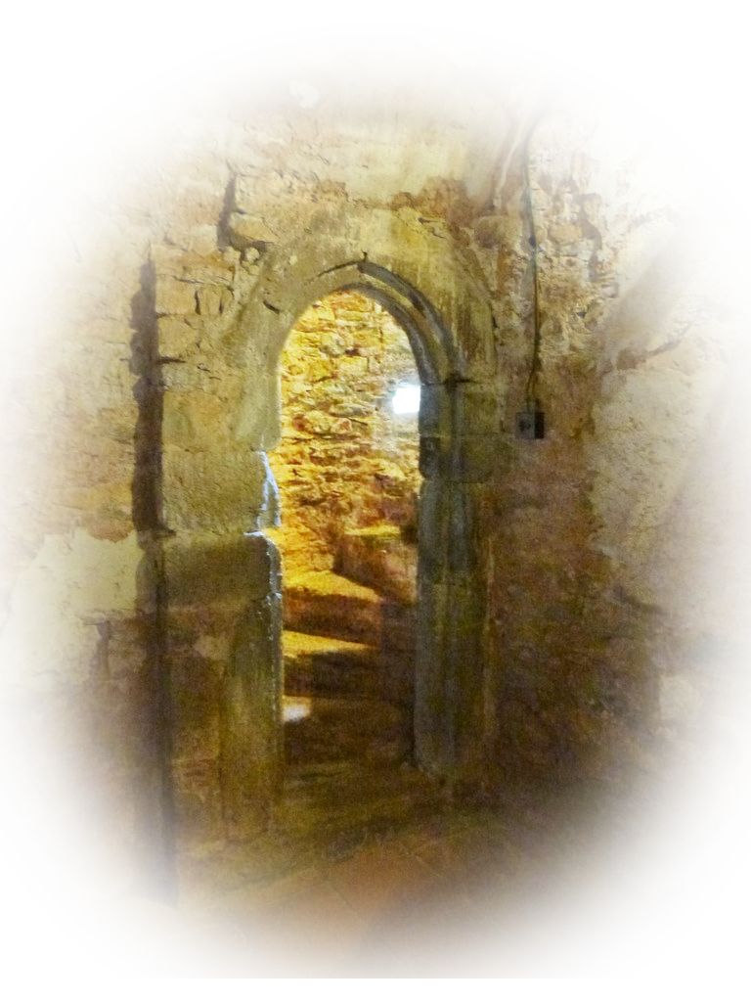
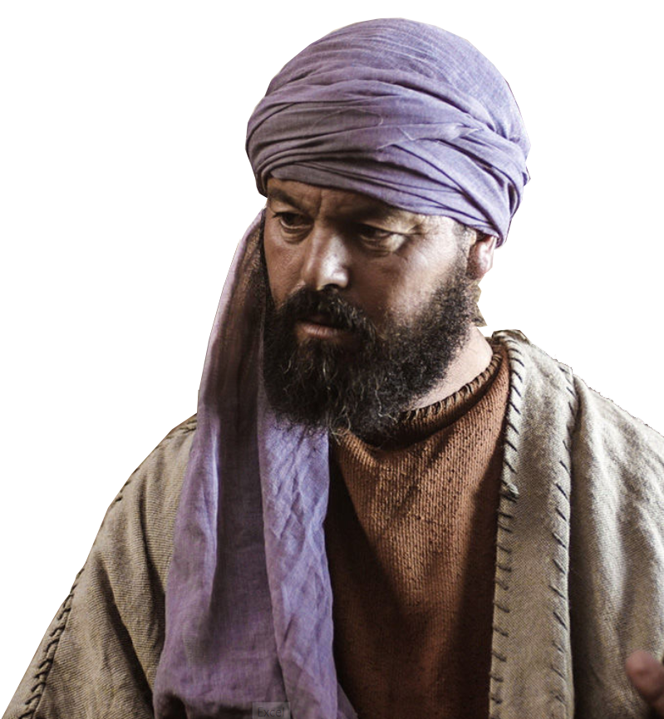
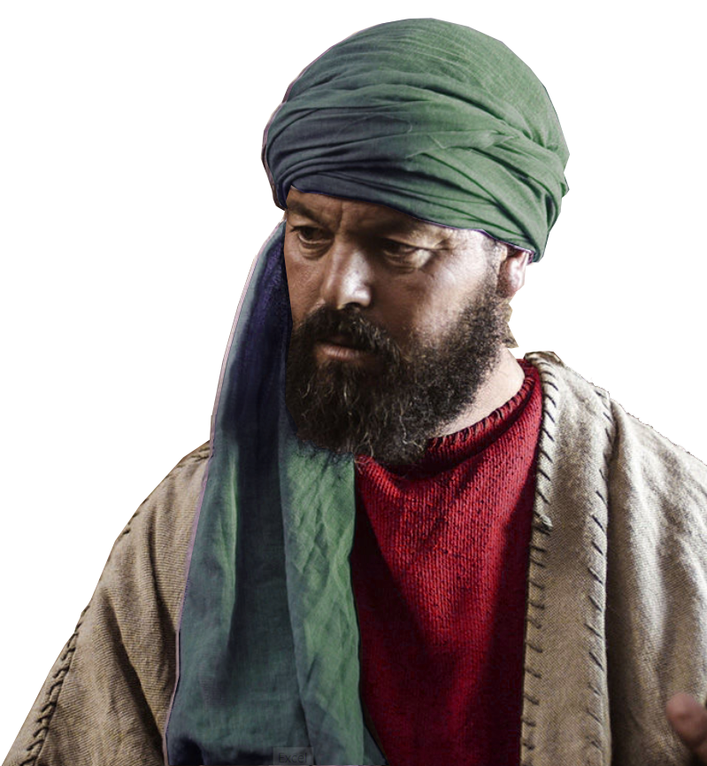
My Text:
^{John 20:24} Now Thomas (called Didymus), one of the Twelve, was not with the disciples when Jesus came.

Slide 4
Lesson 1: You Can Miss Easter
Thomas Did!

Slide 5
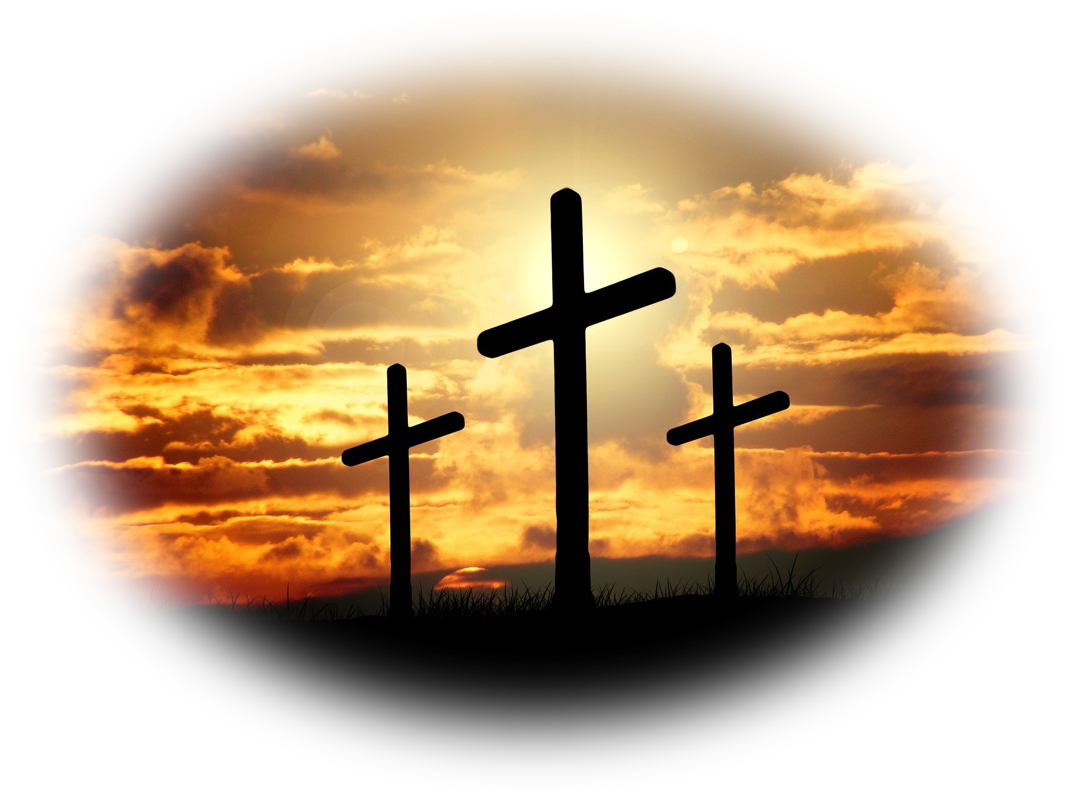
Thomas Missed:
  The cross
Notes:
https://pixabay.com/photos/cross-sunset-sunrise-hill-sky-sun-671379/
The Man Who Missed the Easter Sunday
Who was Thomas? 24a
A Twin
One of the 12
Committed John 11
Sincere John14:5
Where was Thomas? 24b Who knows—
but we do know where he was not!
What did Thomas missed? 19-23
Christ’s Appearance to the ten.
Christ’s Commission
How did Thomas reacted 25
Skeptical—He knew Jesus was crucified, dead, and buried.
Pessimistically--negatively
Perhaps Suspicious—the 12 are playing me to be gullible
Perhaps Sincerely—as in John 14:5
In any case—John records that he needed proof—
Their testimony was not good enough
He did not Believe it—“I will not believe”
The Man Who Attended Easter a Week Late
Why did Thomas attend? 26 Does not say, perhaps curiosity,
obligated, or prove his point, who knows—but we do know
that he did attend. Why are you here? Curious, obligated,
2- What did Thomas Experienced 26
Jesus Showed Up -- The Repeat Appearance to the eleven. 26
Jesus Challenge Him 27
3- How did Thomas Reacted 28
Take this with you -- The lesson for Him and all 29
The lesson for you 30-31

Slide 6
Thomas Missed:
  The empty tomb
  appearance
Notes:
The Man Who Missed the Easter Sunday
Who was Thomas? 24a
A Twin
One of the 12
Committed John 11
Sincere John14:5
Where was Thomas? 24b Who knows—
but we do know where he was not!
What did Thomas missed? 19-23
Christ’s Appearance to the ten.
Christ’s Commission
How did Thomas reacted 25
Skeptical—He knew Jesus was crucified, dead, and buried.
Pessimistically--negatively
Perhaps Suspicious—the 12 are playing me to be gullible
Perhaps Sincerely—as in John 14:5
In any case—John records that he needed proof—
Their testimony was not good enough
He did not Believe it—“I will not believe”
The Man Who Attended Easter a Week Late
Why did Thomas attend? 26 Does not say, perhaps curiosity,
obligated, or prove his point, who knows—but we do know
that he did attend. Why are you here? Curious, obligated,
2- What did Thomas Experienced 26
Jesus Showed Up -- The Repeat Appearance to the eleven. 26
Jesus Challenge Him 27
3- How did Thomas Reacted 28
Take this with you -- The lesson for Him and all 29
The lesson for you 30-31

Slide 7
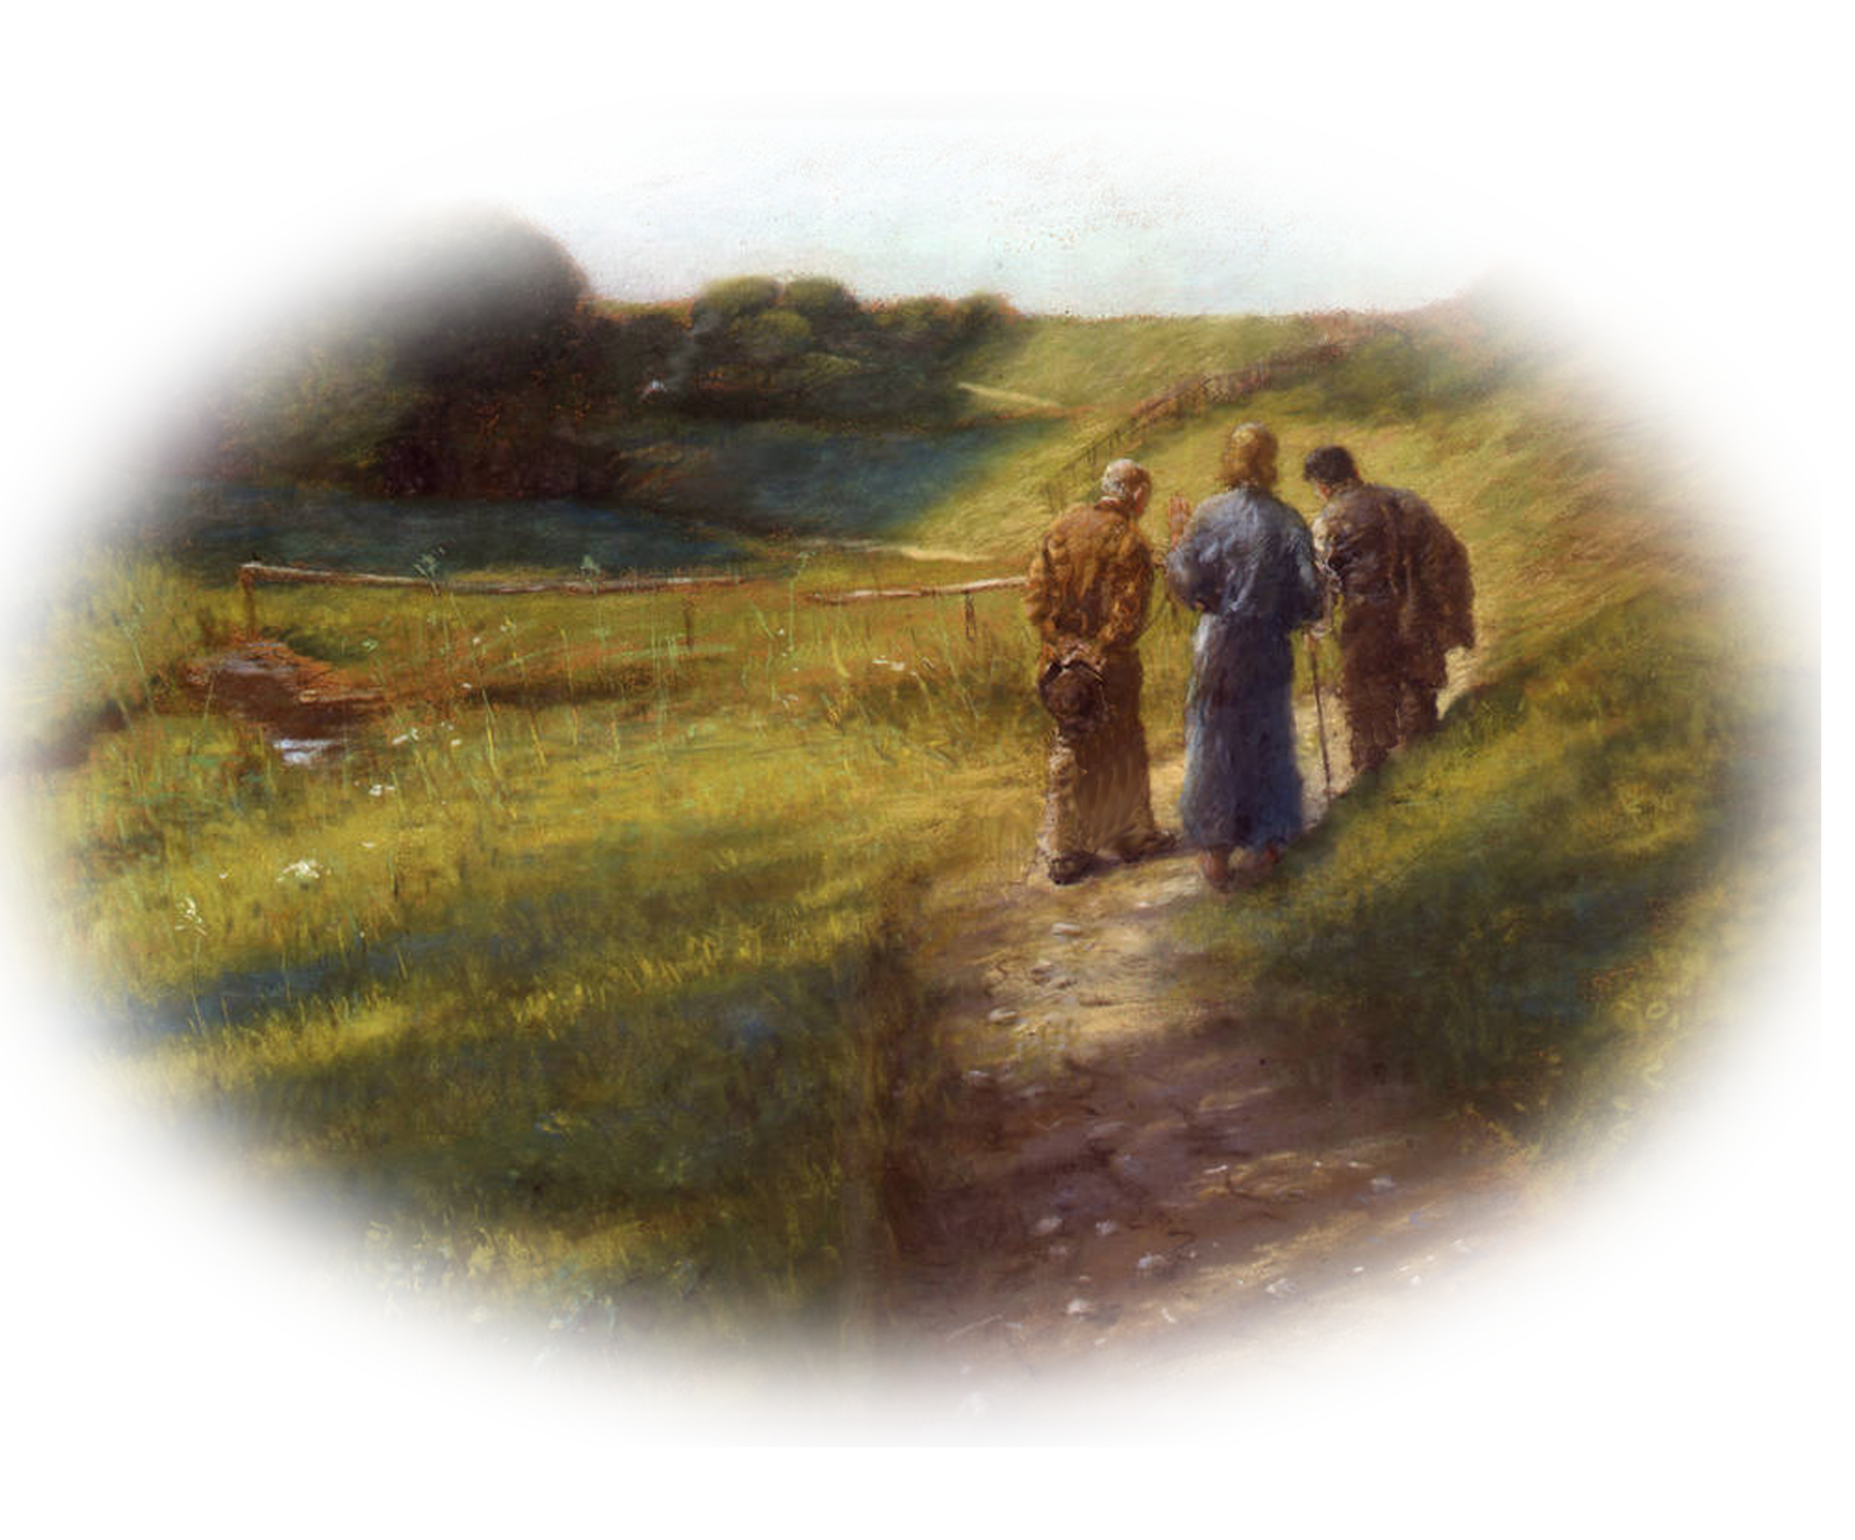
Thomas Missed:
  Emmaus Road
  Appearance
Notes:
Fritz_von_Uhde_-_Der_Gang_nach_Emmaus_(1891).jpg (1000×731) (wikimedia.org)
The Man Who Missed the Easter Sunday
Who was Thomas? 24a
A Twin
One of the 12
Committed John 11
Sincere John14:5
Where was Thomas? 24b Who knows—
but we do know where he was not!
What did Thomas missed? 19-23
Christ’s Appearance to the ten.
Christ’s Commission
How did Thomas reacted 25
Skeptical—He knew Jesus was crucified, dead, and buried.
Pessimistically--negatively
Perhaps Suspicious—the 12 are playing me to be gullible
Perhaps Sincerely—as in John 14:5
In any case—John records that he needed proof—
Their testimony was not good enough
He did not Believe it—“I will not believe”
The Man Who Attended Easter a Week Late
Why did Thomas attend? 26 Does not say, perhaps curiosity,
obligated, or prove his point, who knows—but we do know
that he did attend. Why are you here? Curious, obligated,
2- What did Thomas Experienced 26
Jesus Showed Up -- The Repeat Appearance to the eleven. 26
Jesus Challenge Him 27
3- How did Thomas Reacted 28
Take this with you -- The lesson for Him and all 29
The lesson for you 30-31

Slide 8
Thomas Missed:
  The Upper Room
  Appearance
Notes:
https://www.geograph.org.uk/photo/4698851
The Man Who Missed the Easter Sunday
Who was Thomas? 24a
A Twin
One of the 12
Committed John 11
Sincere John14:5
Where was Thomas? 24b Who knows—
but we do know where he was not!
What did Thomas missed? 19-23
Christ’s Appearance to the ten.
Christ’s Commission
How did Thomas reacted 25
Skeptical—He knew Jesus was crucified, dead, and buried.
Pessimistically--negatively
Perhaps Suspicious—the 12 are playing me to be gullible
Perhaps Sincerely—as in John 14:5
In any case—John records that he needed proof—
Their testimony was not good enough
He did not Believe it—“I will not believe”
The Man Who Attended Easter a Week Late
Why did Thomas attend? 26 Does not say, perhaps curiosity,
obligated, or prove his point, who knows—but we do know
that he did attend. Why are you here? Curious, obligated,
2- What did Thomas Experienced 26
Jesus Showed Up -- The Repeat Appearance to the eleven. 26
Jesus Challenge Him 27
3- How did Thomas Reacted 28
Take this with you -- The lesson for Him and all 29
The lesson for you 30-31

Slide 9
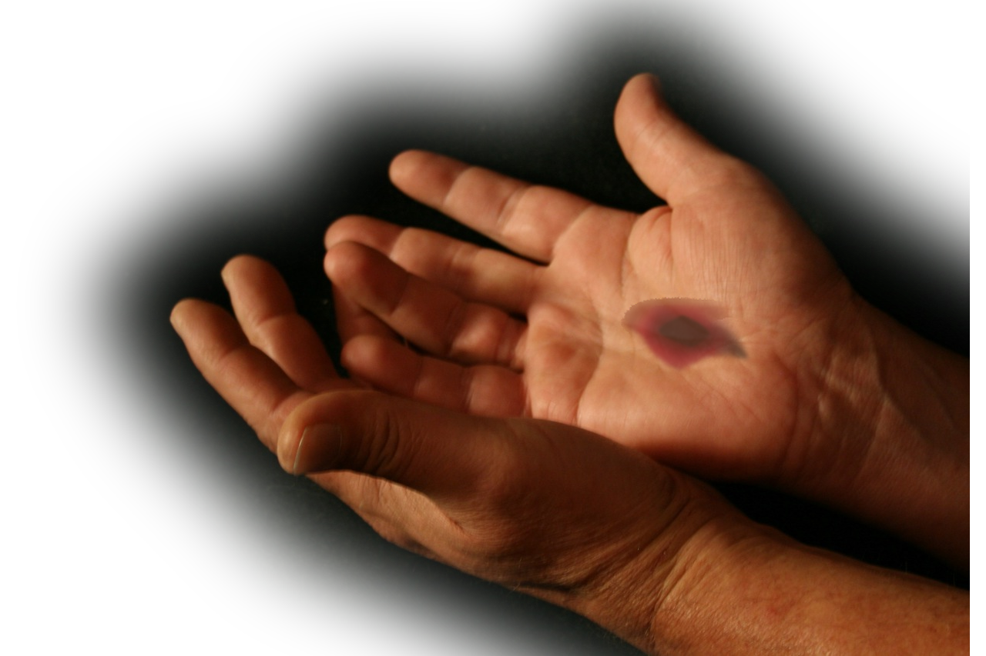
Thomas Missed:
  Jesus showing hands
Notes:
https://upload.wikimedia.org/wikipedia/commons/8/82/Givinghandsandredpushpin.jpg
The Man Who Missed the Easter Sunday
Who was Thomas? 24a
A Twin
One of the 12
Committed John 11
Sincere John14:5
Where was Thomas? 24b Who knows—
but we do know where he was not!
What did Thomas missed? 19-23
Christ’s Appearance to the ten.
Christ’s Commission
How did Thomas reacted 25
Skeptical—He knew Jesus was crucified, dead, and buried.
Pessimistically--negatively
Perhaps Suspicious—the 12 are playing me to be gullible
Perhaps Sincerely—as in John 14:5
In any case—John records that he needed proof—
Their testimony was not good enough
He did not Believe it—“I will not believe”
The Man Who Attended Easter a Week Late
Why did Thomas attend? 26 Does not say, perhaps curiosity,
obligated, or prove his point, who knows—but we do know
that he did attend. Why are you here? Curious, obligated,
2- What did Thomas Experienced 26
Jesus Showed Up -- The Repeat Appearance to the eleven. 26
Jesus Challenge Him 27
3- How did Thomas Reacted 28
Take this with you -- The lesson for Him and all 29
The lesson for you 30-31

Slide 10

We were not there either!
So how was he and how are we to believe?
Notes:
https://upload.wikimedia.org/wikipedia/commons/8/82/Givinghandsandredpushpin.jpg
The Man Who Missed the Easter Sunday
Who was Thomas? 24a
A Twin
One of the 12
Committed John 11
Sincere John14:5
Where was Thomas? 24b Who knows—
but we do know where he was not!
What did Thomas missed? 19-23
Christ’s Appearance to the ten.
Christ’s Commission
How did Thomas reacted 25
Skeptical—He knew Jesus was crucified, dead, and buried.
Pessimistically--negatively
Perhaps Suspicious—the 12 are playing me to be gullible
Perhaps Sincerely—as in John 14:5
In any case—John records that he needed proof—
Their testimony was not good enough
He did not Believe it—“I will not believe”
The Man Who Attended Easter a Week Late
Why did Thomas attend? 26 Does not say, perhaps curiosity,
obligated, or prove his point, who knows—but we do know
that he did attend. Why are you here? Curious, obligated,
2- What did Thomas Experienced 26
Jesus Showed Up -- The Repeat Appearance to the eleven. 26
Jesus Challenge Him 27
3- How did Thomas Reacted 28
Take this with you -- The lesson for Him and all 29
The lesson for you 30-31

Slide 11

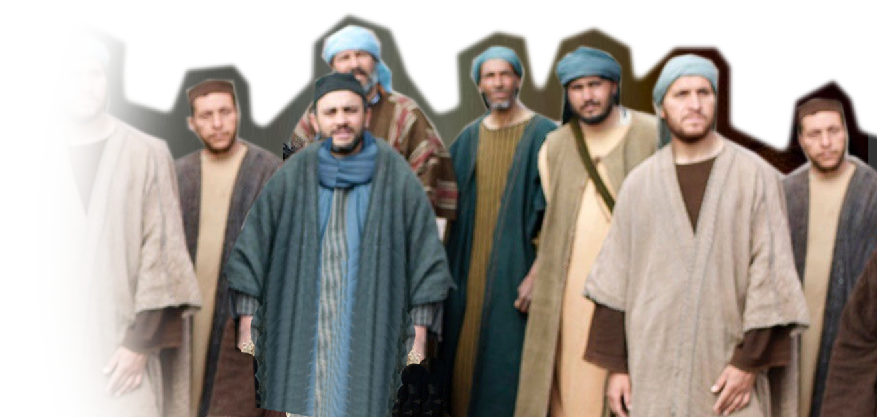
Lesson 2: You Need to Believe Eyewitness Testimony
²⁵ So the other disciples told him, "We have seen the Lord!"

Slide 12
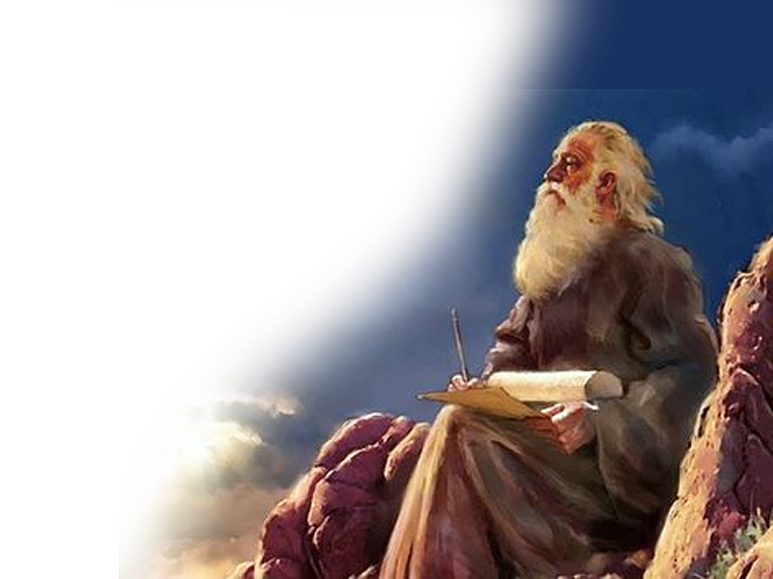
Other Testimony:
1. Prophetic Testimony
Yet it pleased the LORD to bruise Him; He has put Him to grief. When You make His soul an offering for sin, He shall see His seed, He shall prolong His days, And the pleasure of the LORD shall prosper in His hand. (Isaiah 53:10 NKJ)
Notes:
Prophetic Psalms 2:7; 16:8-10; 30:3; 41:10; 118:17
Prophetic Isaiah 53:10
But it was the LORD's good plan to crush him and cause him grief. Yet when his life is made an offering for sin, he will have many descendants. He will enjoy a long life, and the LORD's good plan will prosper in his hands (Isa 53:10 NLT)
¹⁰ For you will not leave my soul among the dead or allow your holy one to rot in the grave. (Psa 16:10 NLT)
The Case for Christ
Evidence that Demands a Verdict

Slide 13
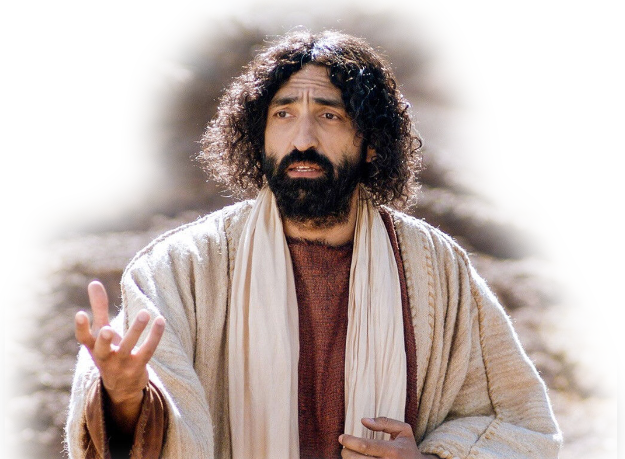
Other Testimony:
2. Jesus’ Testimony
Matthew 16:21 From that time on Jesus began to explain to his disciples that he must go to Jerusalem and suffer many things at the hands of the elders, chief priests and teachers of the law, and that he must be killed and on the third day be raised to life.
See: Mat 17:22; Mark 8:31
Notes:
Prophetic Psalms 2:7; 16:8-10; 30:3; 41:10; 118:17
Prophetic Isaiah 53:10
But it was the LORD's good plan to crush him and cause him grief. Yet when his life is made an offering for sin, he will have many descendants. He will enjoy a long life, and the LORD's good plan will prosper in his hands (Isa 53:10 NLT)
¹⁰ For you will not leave my soul among the dead or allow your holy one to rot in the grave. (Psa 16:10 NLT)
The Case for Christ
Evidence that Demands a Verdict

Slide 14
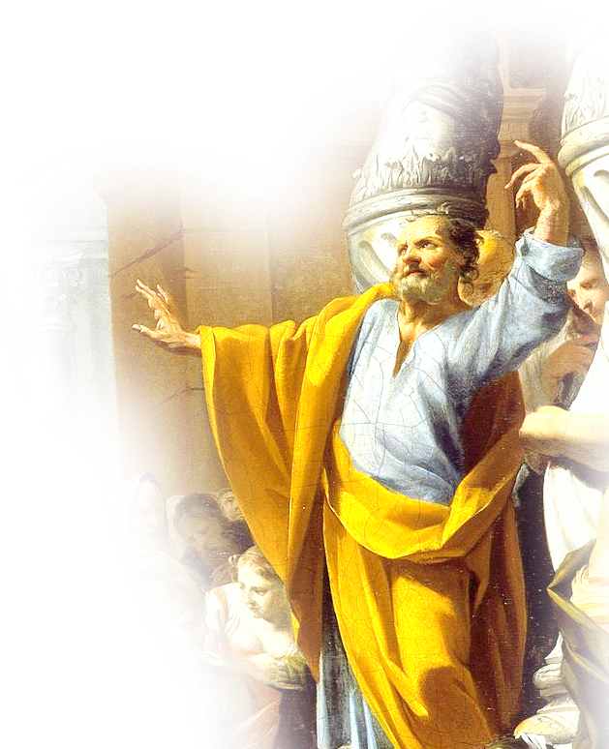
Other Testimony:
3. Disciples’ Testimony
Acts 2:32 God has raised this Jesus to life, and we are all witnesses of the fact.
1Cor. 15:5 … he appeared to Peter, and then to the Twelve. ⁶ After that, he appeared to more than five hundred of the brothers at the same time, most of whom are still living, though some have fallen asleep.
Notes:
Prophetic Psalms 2:7; 16:8-10; 30:3; 41:10; 118:17
Prophetic Isaiah 53:10
But it was the LORD's good plan to crush him and cause him grief. Yet when his life is made an offering for sin, he will have many descendants. He will enjoy a long life, and the LORD's good plan will prosper in his hands (Isa 53:10 NLT)
¹⁰ For you will not leave my soul among the dead or allow your holy one to rot in the grave. (Psa 16:10 NLT)
The Case for Christ
Evidence that Demands a Verdict

Slide 15
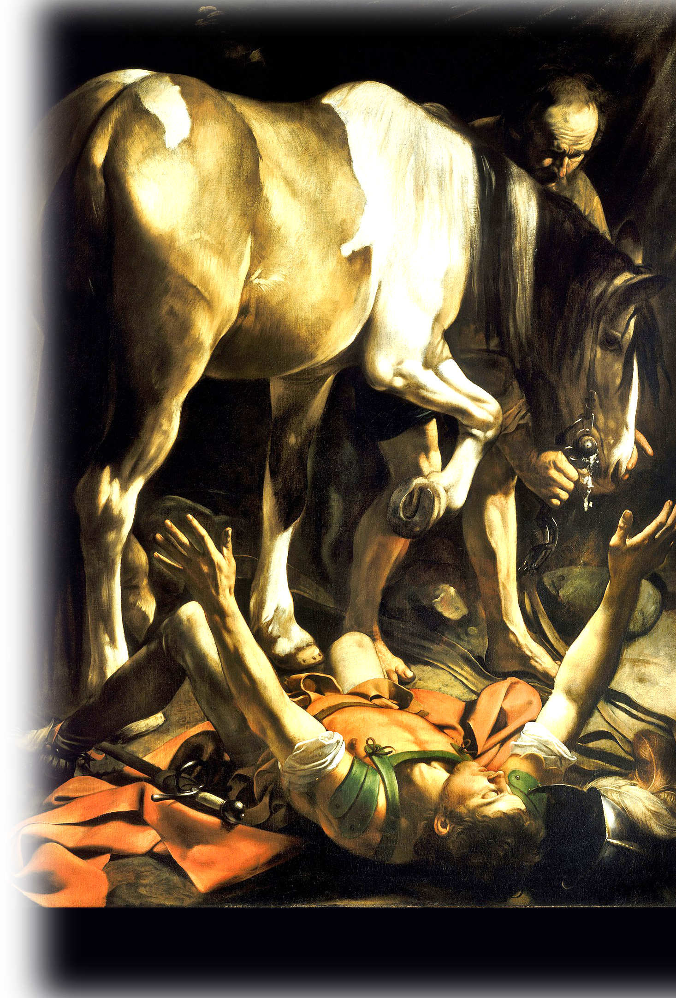
Other Testimony:
4. Changed Lives
Acts 9:3-5 … suddenly a light from heaven flashed around him. 4 He fell to the ground and heard a voice say to him, "Saul, Saul, why do you persecute me?“ ⁵ "Who are you, Lord?" Saul asked. "I am Jesus, whom you are persecuting," he replied.
Notes:
Saul’s Conversion https://en.wikipedia.org/wiki/First_Epistle_to_Timothy

Slide 16


Other Testimony:
4. More Testimony
The Case for Christ
Evidence that
Demands a Verdict
Notes:
Prophetic Psalms 2:7; 16:8-10; 30:3; 41:10; 118:17
Prophetic Isaiah 53:10
But it was the LORD's good plan to crush him and cause him grief. Yet when his life is made an offering for sin, he will have many descendants. He will enjoy a long life, and the LORD's good plan will prosper in his hands (Isa 53:10 NLT)
¹⁰ For you will not leave my soul among the dead or allow your holy one to rot in the grave. (Psa 16:10 NLT)
The Case for Christ
Evidence that Demands a Verdict

Slide 17
They Gave Eyewitness Testimony
²⁵ So the other disciples told him, "We have seen the Lord!"
So how did Thomas respond?

Slide 18
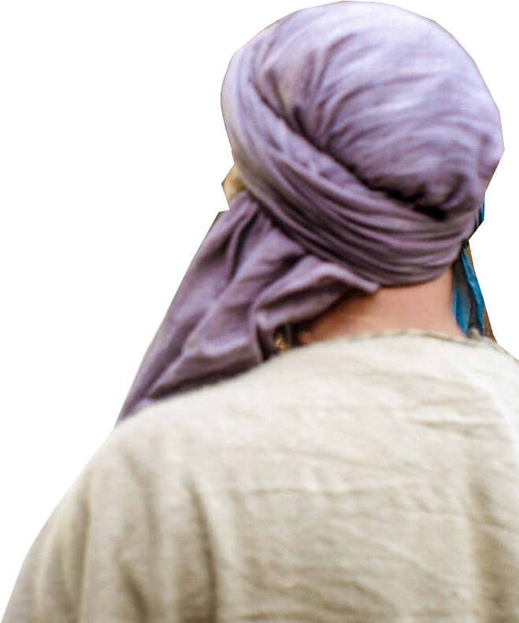
Lesson 3: You Must Overcome Your Doubts 20:25b
Notes:
The Case for Christ

Slide 19
Lesson 3: You Must Overcome Your Doubts 20:25b
²⁵ … But he said to them, "Unless I see the nail marks in his hands and put my finger where the nails were, and put my hand into his side, I will not believe it."
He missed it—and wouldn’t believe it!
Notes:
The Case for Christ

Slide 20
Lesson 4: You Can Still Experience
Easter Blessings
Notes:
No matter how foolish you may have been or how foolish you may have spoken—you can always discover the Easter Blessing. Thomas did.

Slide 21
Lesson 4: You Can Still Experience
Easter Blessings
²⁶ A week later his disciples were in the house again, and Thomas was with them. Though the doors were locked …
Notes:
No matter how foolish you may have been or how foolish you may have spoken—you can always discover the Easter Blessing. Thomas did.

Slide 22
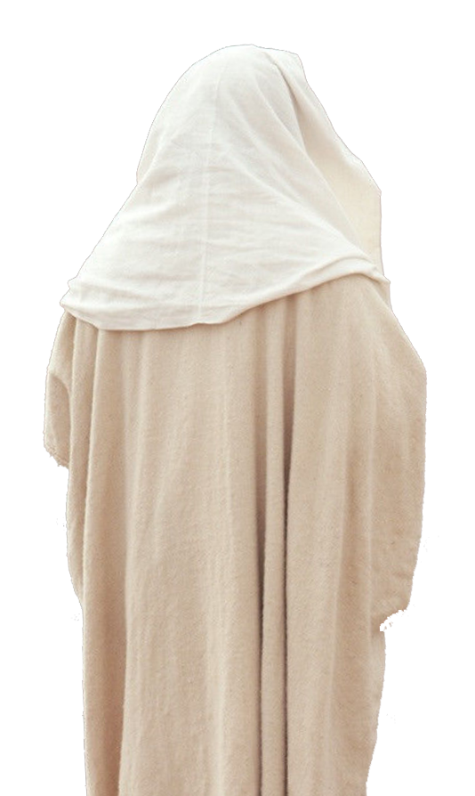
Lesson 4: You Can Still Experience
Easter Blessings
²⁶ …
Jesus came and stood among them and said,
"Peace be with you!"

Slide 23
Lesson 4: You Can Still Experience
Easter Blessings
²⁷ Then he said to Thomas, "Put your finger here; see
my hands. Reach
out your hand and put it into my side. Stop doubting and believe."
Notes:
From time to time, I hear someone say, “Well, if he were to appear before me, I too would believe.”
Be careful what you ask for. You will get an appearance before him: Because you are right. When you He appears to you … You will acknowledge him—but it will be too late.
¹⁰ For we must all appear before the judgment seat of Christ, that each one may receive what is due him for the things done while in the body, whether good or bad. (2Co 5:10 NIV)
¹³ The sea gave up the dead that were in it, and death and Hades gave up the dead that were in them, and each person was judged according to what he had done.
¹⁴ Then death and Hades were thrown into the lake of fire. The lake of fire is the second death.
¹⁵ If anyone's name was not found written in the book of life, he was thrown into the lake of fire.
(Rev 20:13-15 NIV)

Slide 24
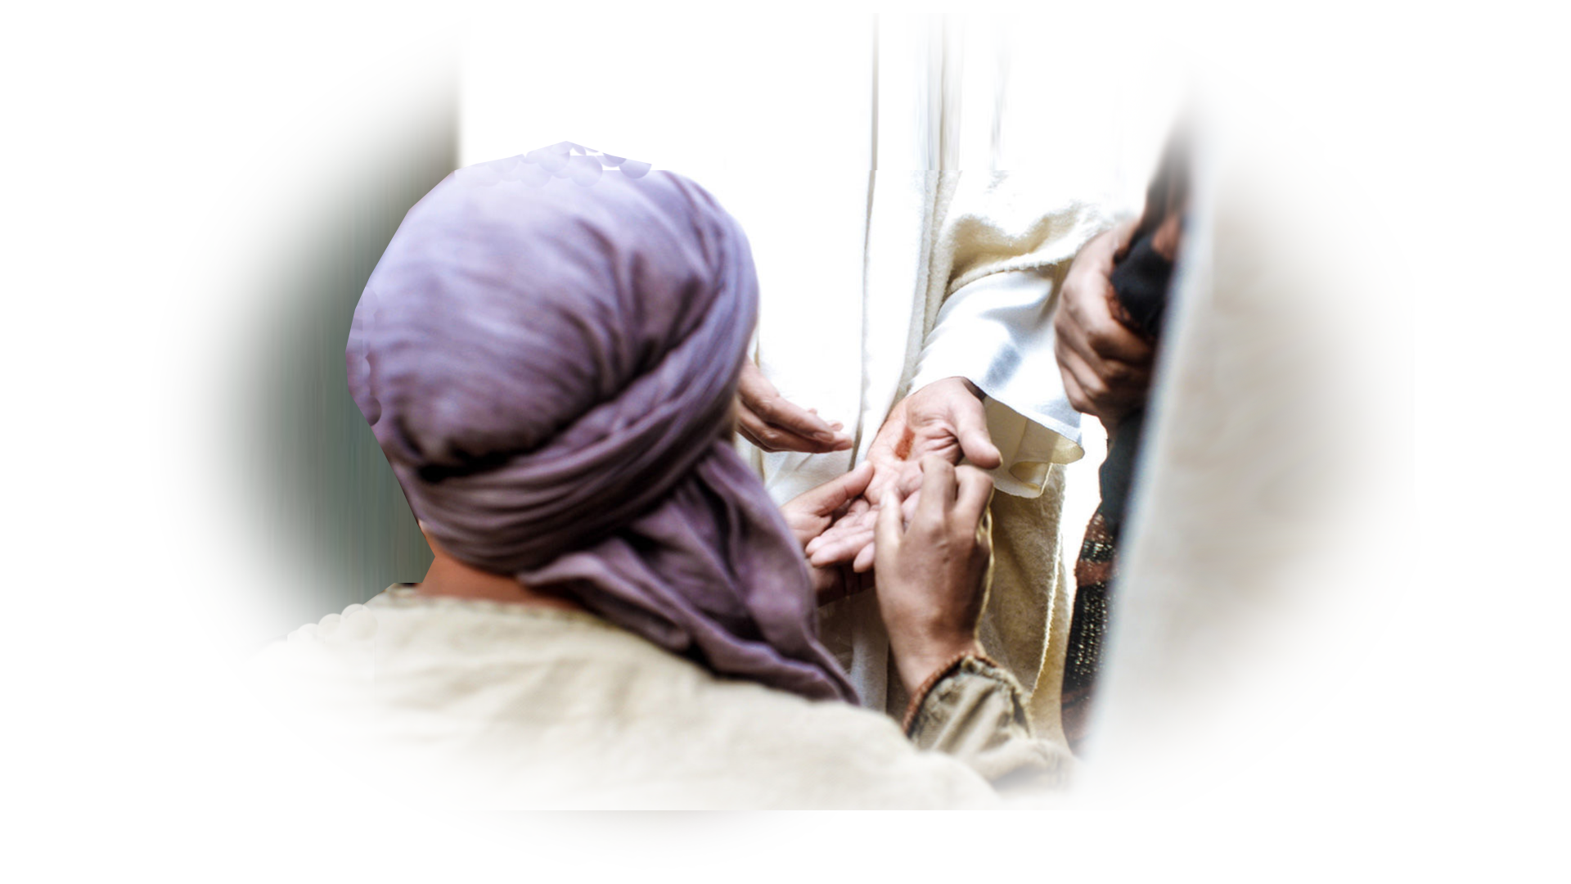
Lesson 4: You Can Still Experience
Easter Blessings
²⁸ Thomas said to him, "My Lord and my God!"
Notes:
⁹ Therefore God exalted him to the highest place and gave him the name that is above every name,
¹⁰ that at the name of Jesus every knee should bow, in heaven and on earth and under the earth,
¹¹ and every tongue confess that Jesus Christ is Lord, to the glory of God the Father.
(Phi 2:9-11 NIV)
¹⁹ Now we know that whatever the law says, it says to those who are under the law, so that every mouth may be silenced and the whole world held accountable to God. (Rom 3:19 NIV)

Slide 25
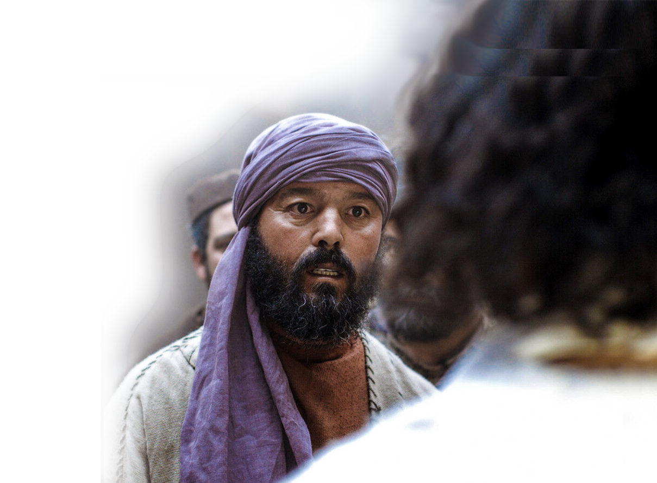
Lesson 4: You Can Still Experience
Easter Blessings
²⁹ Then Jesus told him, "Because you have seen me, you have believed; blessed are those who have not seen and yet have believed."
Notes:
Thomas, you have seen me, examined the evidence of the nail prints. You have believed
But the real blessing is to those who have accepted the Eyewitness reports and believed.

Slide 26
Lesson 5: You Must Believe Eyewitness Testimony to Live
Notes:
¹⁰ All who believe in the Son of God know in their hearts that this testimony is true. Those who don't believe this are actually calling God a liar because they don't believe what God has testified about his Son. (1Jo 5:10 NLT)
This record of this miracle was not written for Thomas—this was written for us. It is the eyewitness testimony inspired by God and inscribed in the Bible. This is Gods testimony to you. This book.
Other miracles/signs =
1- Water to wine
2- Healing the la me man
3-Healing the nobleman's son

Slide 27
Lesson 5: You Must Believe Eyewitness Testimony to Live
³⁰ Jesus did many other miraculous signs in the presence of his disciples, which
are not recorded
in this book.
Notes:
¹⁰ All who believe in the Son of God know in their hearts that this testimony is true. Those who don't believe this are actually calling God a liar because they don't believe what God has testified about his Son. (1Jo 5:10 NLT)
This record of this miracle was not written for Thomas—this was written for us. It is the eyewitness testimony inspired by God and inscribed in the Bible. This is Gods testimony to you. This book.
Other miracles/signs =
1- Water to wine
2- Healing the la me man
3-Healing the nobleman's son

Slide 28

Lesson 5: You Must Believe Eyewitness Testimony to Live
³¹ But these are written that you may believe that Jesus is the Christ, the Son of God, and that by believing you may have life in his name.
Notes:
¹⁰ All who believe in the Son of God know in their hearts that this testimony is true. Those who don't believe this are actually calling God a liar because they don't believe what God has testified about his Son. (1Jo 5:10 NLT)

Slide 29
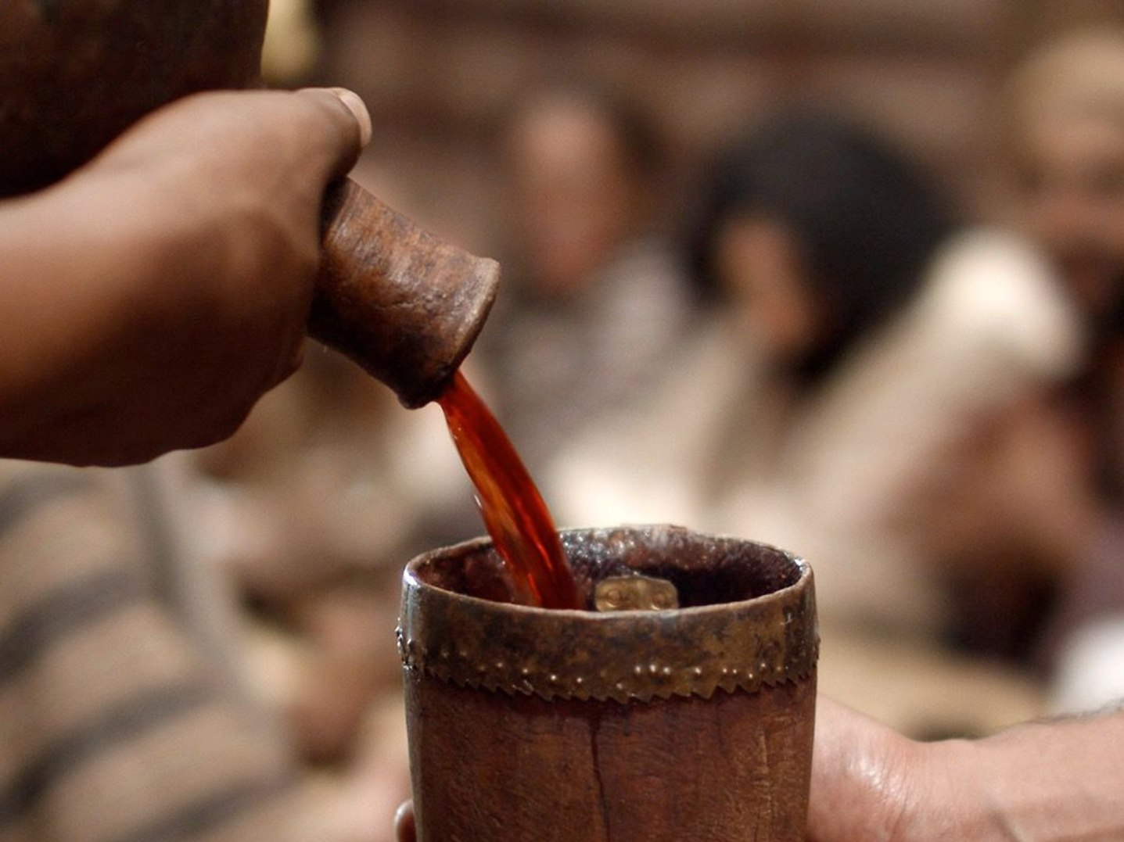
Lesson 5: You Must Believe Eyewitness Testimony to Live
1- Water to Wine 2
³¹ But these are written that you may believe that Jesus is the Christ, the Son of God, and that by believing you may have life in his name.
Notes:
¹⁰ All who believe in the Son of God know in their hearts that this testimony is true. Those who don't believe this are actually calling God a liar because they don't believe what God has testified about his Son. (1Jo 5:10 NLT)

Slide 30
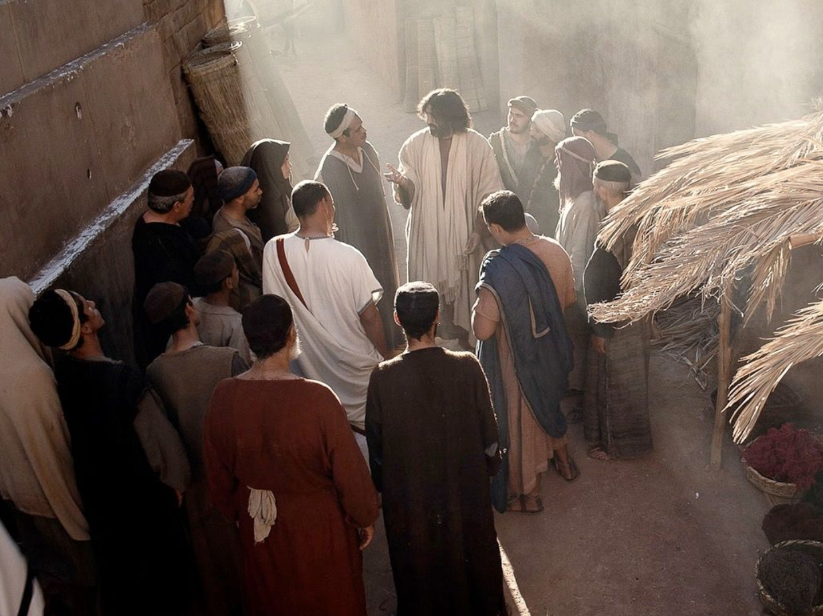
Lesson 5: You Must Believe Eyewitness Testimony to Live
2- Nobleman's Son 4
³¹ But these are written that you may believe that Jesus is the Christ, the Son of God, and that by believing you may have life in his name.
Notes:
¹⁰ All who believe in the Son of God know in their hearts that this testimony is true. Those who don't believe this are actually calling God a liar because they don't believe what God has testified about his Son. (1Jo 5:10 NLT)

Slide 31
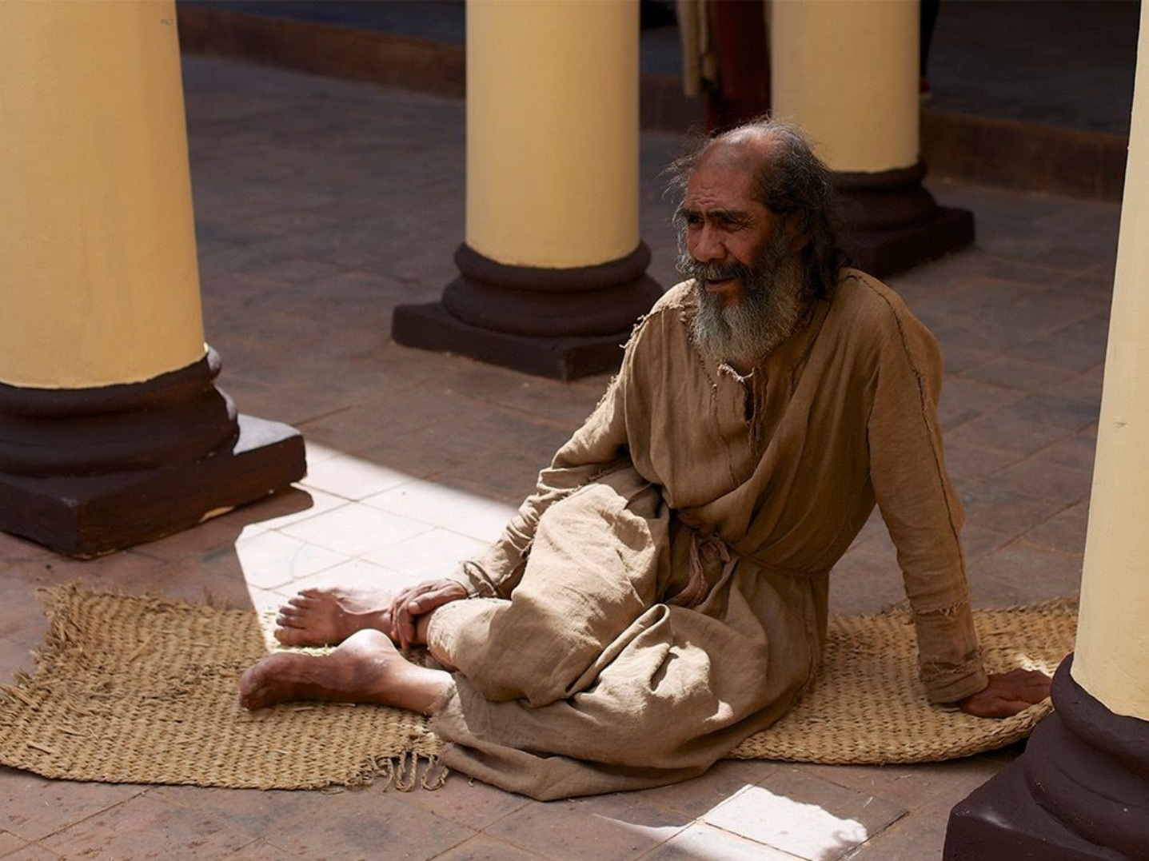
Lesson 5: You Must Believe Eyewitness Testimony to Live
3- Paralytic Healed 5
³¹ But these are written that you may believe that Jesus is the Christ, the Son of God, and that by believing you may have life in his name.
Notes:
¹⁰ All who believe in the Son of God know in their hearts that this testimony is true. Those who don't believe this are actually calling God a liar because they don't believe what God has testified about his Son. (1Jo 5:10 NLT)

Slide 32
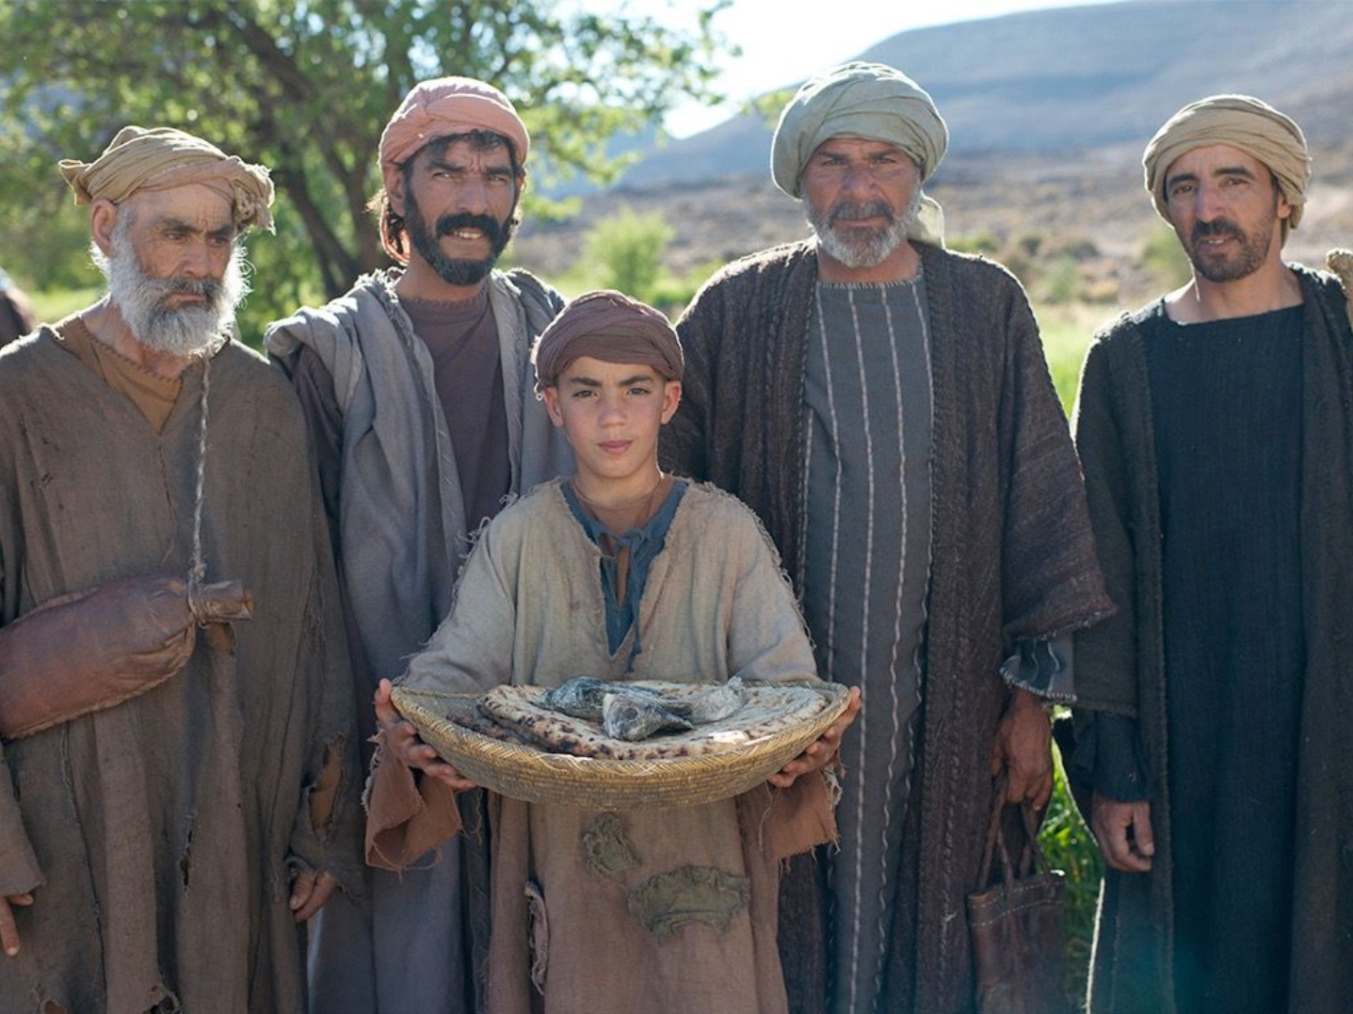
Lesson 5: You Must Believe Eyewitness Testimony to Live
4- Fed 5,000
³¹ But these are written that you may believe that Jesus is the Christ, the Son of God, and that by believing you may have life in his name.
Notes:
¹⁰ All who believe in the Son of God know in their hearts that this testimony is true. Those who don't believe this are actually calling God a liar because they don't believe what God has testified about his Son. (1Jo 5:10 NLT)

Slide 33
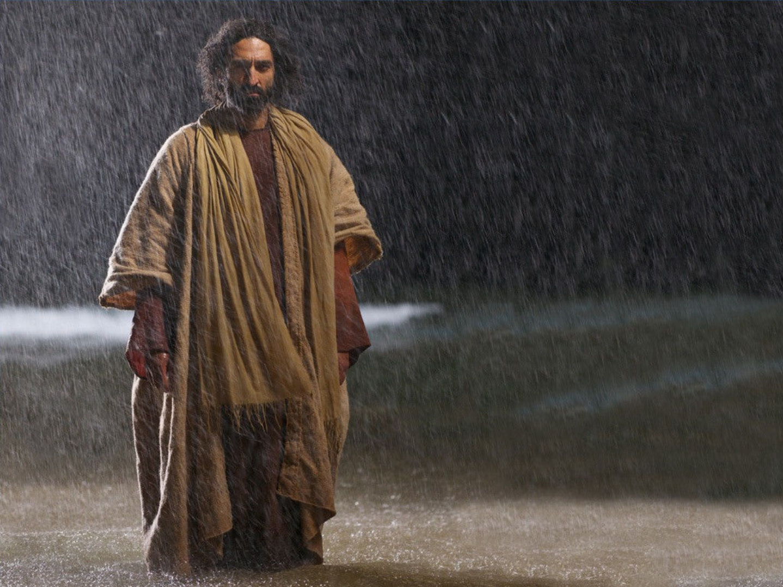
Lesson 5: You Must Believe Eyewitness Testimony to Live
5- Walked on Water
³¹ But these are written that you may believe that Jesus is the Christ, the Son of God, and that by believing you may have life in his name.
Notes:
¹⁰ All who believe in the Son of God know in their hearts that this testimony is true. Those who don't believe this are actually calling God a liar because they don't believe what God has testified about his Son. (1Jo 5:10 NLT)

Slide 34
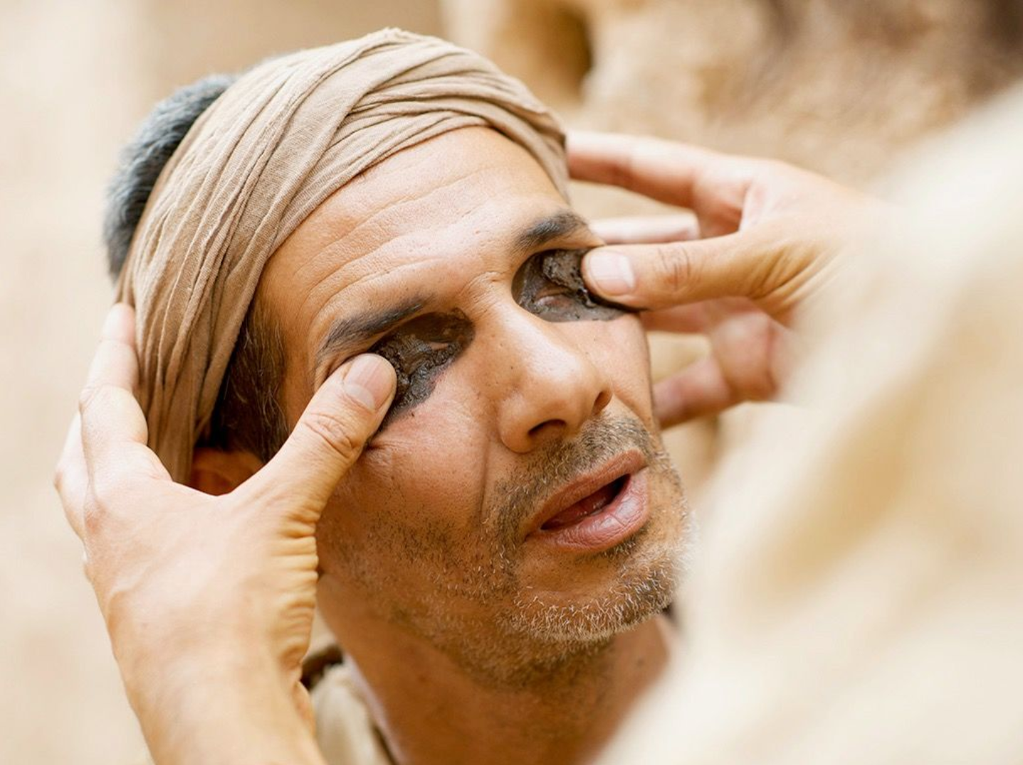
Lesson 5: You Must Believe Eyewitness Testimony to Live
6- Healed Blind Man
³¹ But these are written that you may believe that Jesus is the Christ, the Son of God, and that by believing you may have life in his name.
Notes:
¹⁰ All who believe in the Son of God know in their hearts that this testimony is true. Those who don't believe this are actually calling God a liar because they don't believe what God has testified about his Son. (1Jo 5:10 NLT)

Slide 35
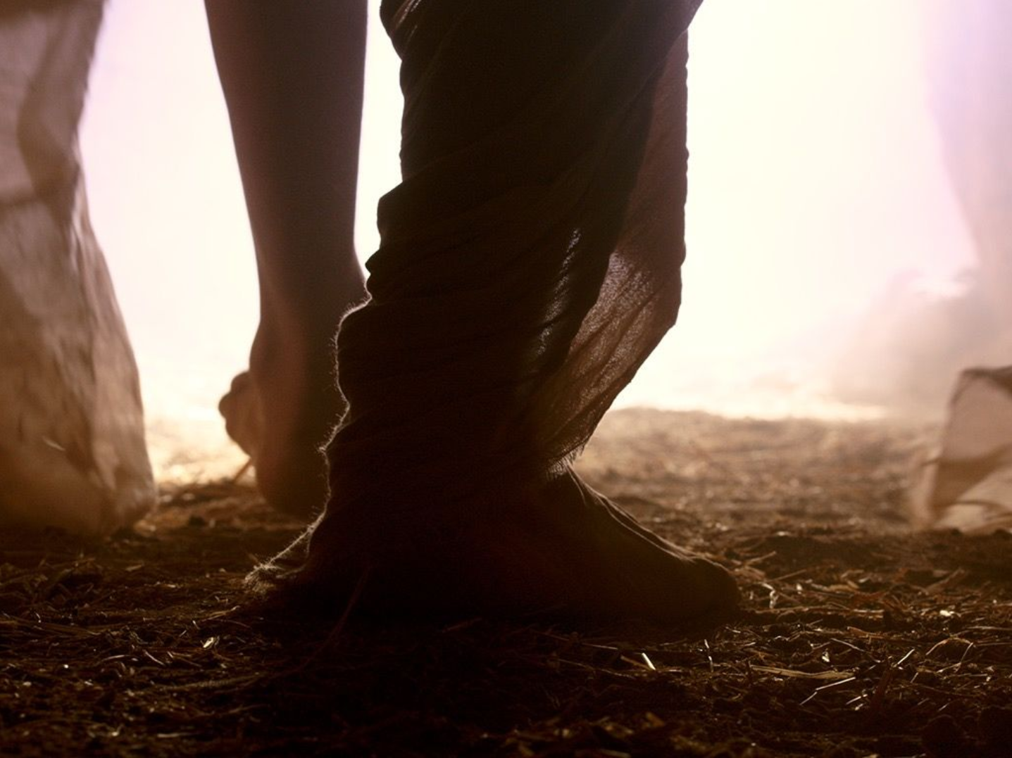
Lesson 5: You Must Believe Eyewitness Testimony to Live
7- Raised Lazarus
³¹ But these are written that you may believe that Jesus is the Christ, the Son of God, and that by believing you may have life in his name.
Notes:
¹⁰ All who believe in the Son of God know in their hearts that this testimony is true. Those who don't believe this are actually calling God a liar because they don't believe what God has testified about his Son. (1Jo 5:10 NLT)

Slide 36
Lesson 5: You Must Believe Eyewitness Testimony to Live
8- Resurrection
³¹ But these are written that you may believe that Jesus is the Christ, the Son of God, and that by believing you may have life in his name.
Notes:
¹⁰ All who believe in the Son of God know in their hearts that this testimony is true. Those who don't believe this are actually calling God a liar because they don't believe what God has testified about his Son. (1Jo 5:10 NLT)

Slide 37
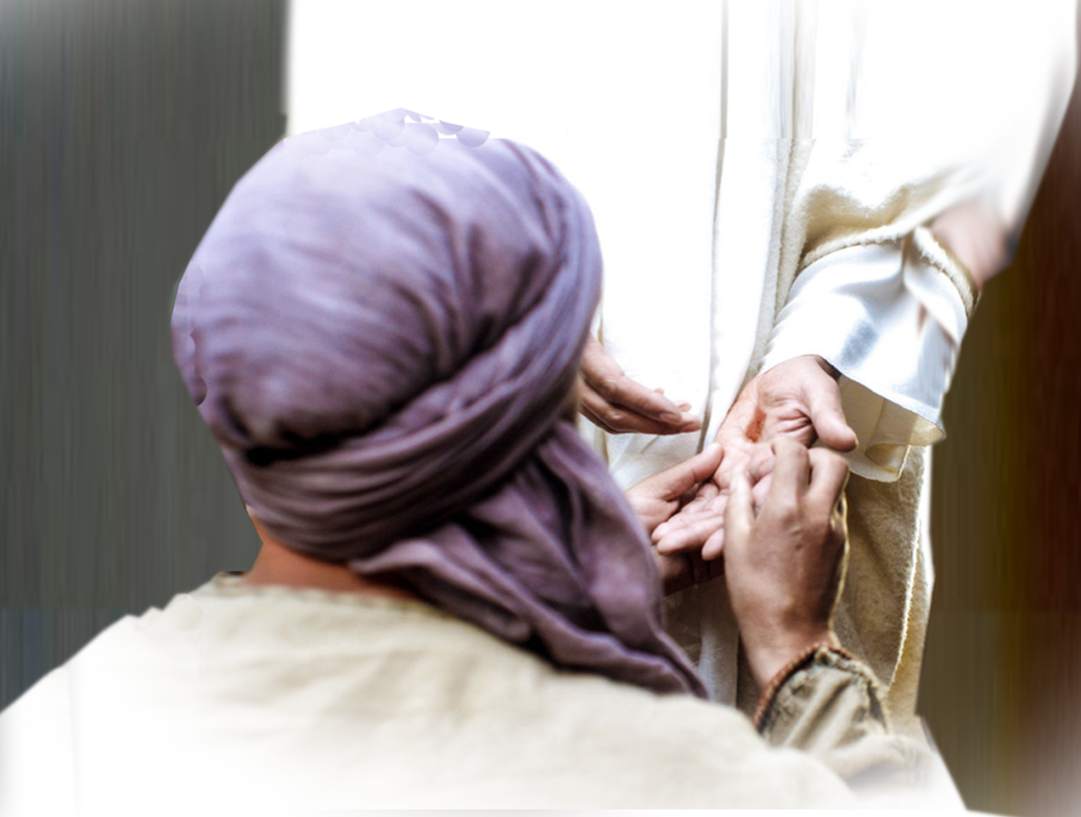
Lesson 5: You Must Believe Eyewitness Testimony to Live
9- Appearance
³¹ But these are written that you may believe that Jesus is the Christ, the Son of God, and that by believing you may have life in his name.
Notes:
¹⁰ All who believe in the Son of God know in their hearts that this testimony is true. Those who don't believe this are actually calling God a liar because they don't believe what God has testified about his Son. (1Jo 5:10 NLT)

Slide 38
Lesson 5: You Must Believe Eyewitness Testimony to Live
³¹ But these are written that you may believe that Jesus is the Christ, the Son of God, and that by believing you may have life in his name.
Notes:
¹⁰ All who believe in the Son of God know in their hearts that this testimony is true. Those who don't believe this are actually calling God a liar because they don't believe what God has testified about his Son. (1Jo 5:10 NLT)

Slide 39
Lesson 5: You Must Believe Eyewitness Testimony to Live
¹⁰ All who believe in the Son of God know in their hearts that this testimony is true. Those who don't believe this are actually calling God a liar because they don't believe what God has testified about his Son. (1John 5:10 NLT)
Notes:
¹⁰ All who believe in the Son of God know in their hearts that this testimony is true. Those who don't believe this are actually calling God a liar because they don't believe what God has testified about his Son. (1Jo 5:10 NLT)

Slide 40
Lesson 5: You Must Believe Eyewitness Testimony to Live
¹⁰ All who believe in the Son of God know in their hearts that this testimony is true. Those who don't believe this are actually calling God a liar because they don't believe what God has testified about his Son. (1John 5:10 NLT)
Notes:
¹⁰ All who believe in the Son of God know in their hearts that this testimony is true. Those who don't believe this are actually calling God a liar because they don't believe what God has testified about his Son. (1Jo 5:10 NLT)

Slide 41
Let’s Recap the lessons:
1- You Can Miss Easter (Thomas did)
2- You Need to Believe Eyewitness Testimony
3- You Have to Overcome Your Doubs
4- You May Still Experience Easter Blessings!
5- You Must Believe Scriptural Testimony!

Slide 42
Here’s the point …
You need to:
Stop doubting
and
Start believing!

Slide 43
Affirm your faith … confess to God:
“I believe that Jesus is the Christ,
the Son of the living God,
Who voluntarily died for my sins …
and raised Himself from the dead
to give me eternal life. Amen.”

Slide 44
Let’s Pray!

