Slide 1
Should Have
Seen This
Coming!
Luke 24:6
Watch:
https://youtu.be/b7eihJrJ7rk
Notes:
Copyright © 2006−2021. All rights reserved. Bible Point is a registered trademark of Dennis Henderson. All other trademarks acknowledged.
Bible Point contains graphics from Bible Point artists. These illustrations belong to Bible Point and the respective artists. You may use the designs and illustrations for graphical illustration of lessons free and without special permission, provided they are not used in any way that maligns the Christian faith. Furthermore, republication or production of any illustration by any other graphic service whether it be in book, in a machine-readable form, or in any other design resource is strictly prohibited. Furthermore, they cannot be duplicated or resold as any other form of publishing, clip art, or graphic resource.
So What does it mean? (A simple translations of the legal jargon)
So, if you don’t own the presentation(s), graphic(s), and text(s) how can you legally use them? The purchase of the license allows you to use all the images in the product. However, the actual ownership and copyright of the presentation(s), graphic(s), and text(s) remain the property of Bible Point and its licensors. If you had plans on using this product in your “for sale” work—think again!
License Agreement
Article 1: License Grant
All the graphics and text in Bible Point presentations (excluding quotes from the Bible and stated sources) are the intellectual and real property of Bible Point and its licensors, and is protected by law, including United States copyright laws and international treaties. Bible Point grants to you a license:
1. To use the presentation in a single church, single school, or single office of a Christian organization.
2. To make a single archival back-up copy of the program.
3. To modify the presentation(s) and merge with other presentations in a single church, school, or Christian organization.
4. To transfer to another party if that party agrees to accept the terms and conditions of this agreement, and you do not retain any copies of the presentation, whether printed, machine readable, modified, or merged form.
Article 2: Terms
This license is effective until terminated. You may terminate the license at any time by destroying the presentation(s), graphic(s), or text(s) together with all copies, modifications and merged portions in any form. Bible Point may terminate your license if you fail to comply with this Agreement. You agree, upon such termination, for any reason, to destroy the presentation(s), graphics, and text(s) with all copies, modifications, and merged portions in any form.
Article 3: Disclaimers
1. Bible Point presentations, graphics, and texts are licensed to you As Is. You, the consumer, bear the entire risk relating to the quality and performance of the presentation(s), graphic(s), or text(s). In no event will Bible Point be liable for damages resulting from any defect.
2. Thirty-day limited warrantee on disks. Bible Point warrants the disks to be free of defects in material and workmanship under normal use for 30 days after purchase. During the 30-day period you may return a defective presentation, graphic, or text with proof of purchase and it will be replaced without charge, unless the presentation is damaged by misuse.
Article 4: General
1. You may not sub-license, assign, or transfer the license of the presentation(s), graphic(s), or text(s) except as provided by this Agreement.
2. This Agreement will be governed by the laws of the State of Michigan.
So What does it mean? (A simple translations of the legal jargon)
May I let someone borrow or copy my licensed Bible Point presentation (even after I modified it)? As long as it is within your local church, or single school, or the immediate office of a Christian organization you may. Otherwise, please refer the person interested in borrowing to: http://www.biblepoint.com or E-mail: dennis@DrDH.net with any related questions.

Slide 2
Should Have
Seen This
Coming!
Luke 24:6
Notes:
Background = BiblePoint photo
Somethings are so obvious that we can see them coming. Like the kids eating all the candy in the Easter eggs on Easter Day … But other things are not so easily seen coming, but we might have if we had paid attention along the way.
An 9.0 earthquake after a series of small tremors. A tornado in a severe summer storm. Or, even a pandemic, if we had been given accurate information from the start. But in most cases we don’t have these forewarnings. Not so with the resurrection of Jesus Christ. They should have seen it coming.
The very first Easter was quiet similar. They should have seen the empty tomb coming—but they missed it. Join us to see why they should have seen it coming and why it matters to you today!
Should Have Seen It Coming!
On the first Easter morning … they found the tomb empty … Luke 24:1-5
The Jews should have seen it coming … John 2:18-21
The Scribes and Pharisees should have seen it coming… (Mat 12:38-46 + 16:4)
The Rock (Peter) should have seen it coming (Mark 8:31-33)
The Disciples should have seen it coming … (Mark 10:33-34 + Matthew 20:17-19)
After the cross …
The Chief Priest saw it coming … (Matthew 27:62-66)
Really, No one saw this coming … (Matthew 28:1-4 + Luke 24:5-8)
Earthquake
Angels
Resurrection
Of course, you and I live after the resurrection, so we couldn’t see it coming. It already happened. We view it now from a different perspective. So, the questions now is, “Do you believe that it has happened?” I mean really believe that Jesus is risen from the dead. He is alive.
It is crucial that you believe Romans 10:9,10
Perhaps you are thinking right now, Wow, I didn’t see that coming! I have to believe in the resurrected Christ to be saved by God. It’s true. You must believe to be save. Why not believe right now. Tell Him that you believe in this prayer …

Slide 3
Like an empty Easter egg …
Notes:
Like a candy filled Easter egg that you know will be emptied by the kids with a sweet tooth.

Slide 4
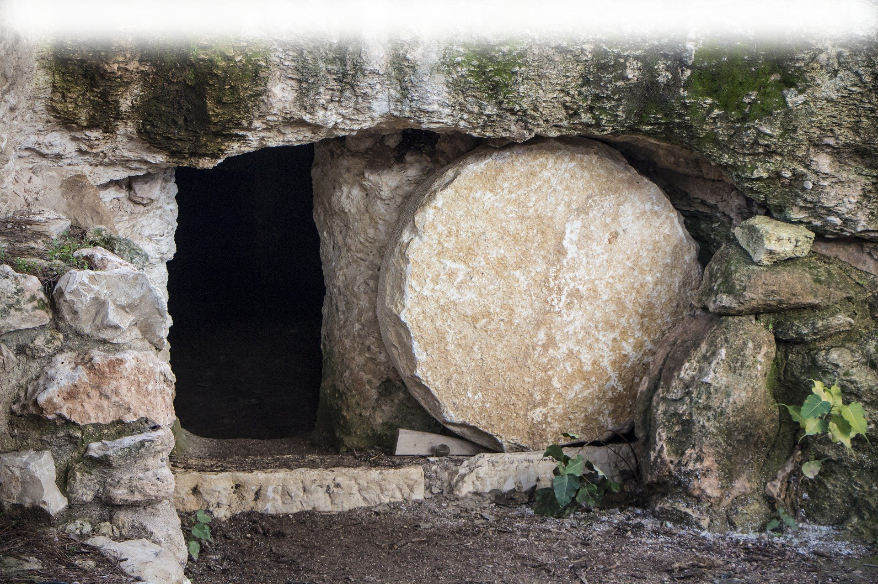
He is not here, He is risen
Notes:
So the words of the angel that He is not here, He is risen just as He said.
They should have seen it coming. Who should have seen Him coming …

Slide 5
The Jews should have …
Notes:
https://upload.wikimedia.org/wikipedia/commons/thumb/e/e9/Model_of_Jerusalem_in_the_Late_Second_Temple_Period_03.jpg/1024px-Model_of_Jerusalem_in_the_Late_Second_Temple_Period_03.jpg

Slide 6
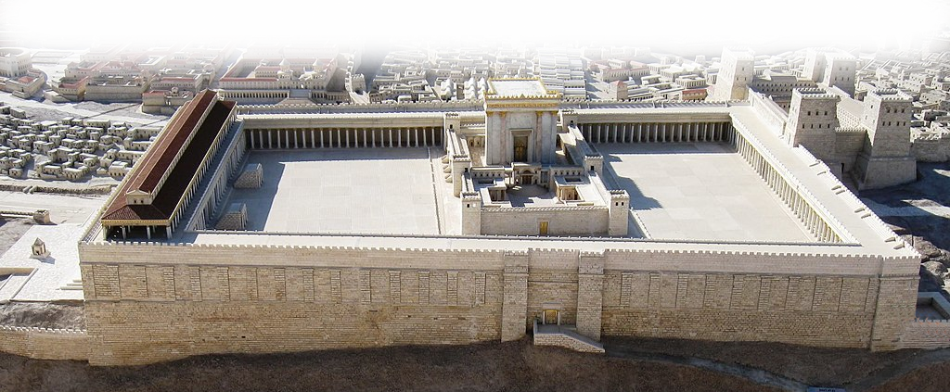
The Jews should have …
Notes:
https://upload.wikimedia.org/wikipedia/commons/thumb/e/e9/Model_of_Jerusalem_in_the_Late_Second_Temple_Period_03.jpg/1024px-Model_of_Jerusalem_in_the_Late_Second_Temple_Period_03.jpg

Slide 7
The Jews should have …
^{John 2:19} Jesus answered them, "Destroy this temple, and in three days I will raise it up.“ ²⁰
Notes:
https://upload.wikimedia.org/wikipedia/commons/thumb/e/e9/Model_of_Jerusalem_in_the_Late_Second_Temple_Period_03.jpg/1024px-Model_of_Jerusalem_in_the_Late_Second_Temple_Period_03.jpg

Slide 8
The Jews should have …
²⁰ The Jews then said, "It has taken forty-six years to build this temple, and will you raise it up in three days?“

Slide 9
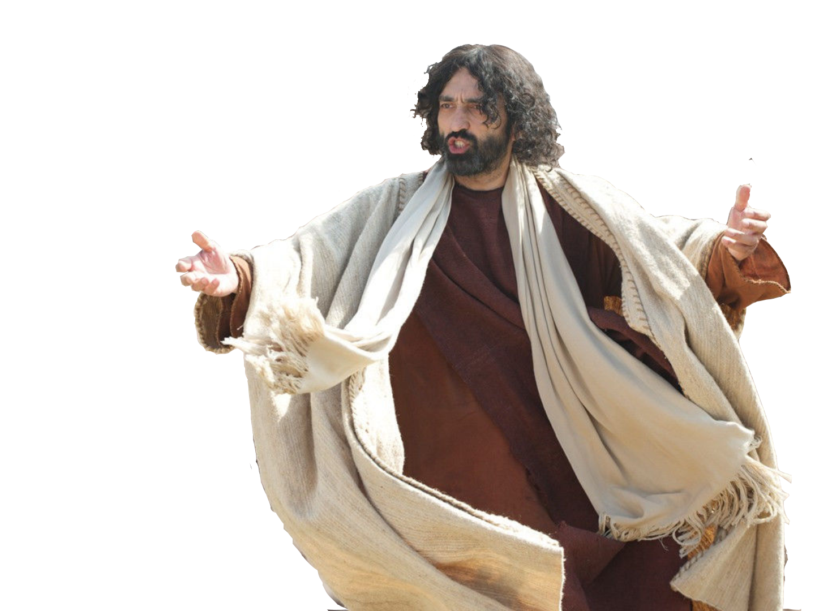
The Jews should have …
²¹ But he was speaking about the temple of his body.
Notes:
https://pixabay.com/photos/empty-tomb-nazareth-israel-3326100/
But instead of seeing it coming … they used this statement as the basis of His execution …. Blaspheme against the temple. Because he called for the tem.les destruction --- Fake News!

Slide 10
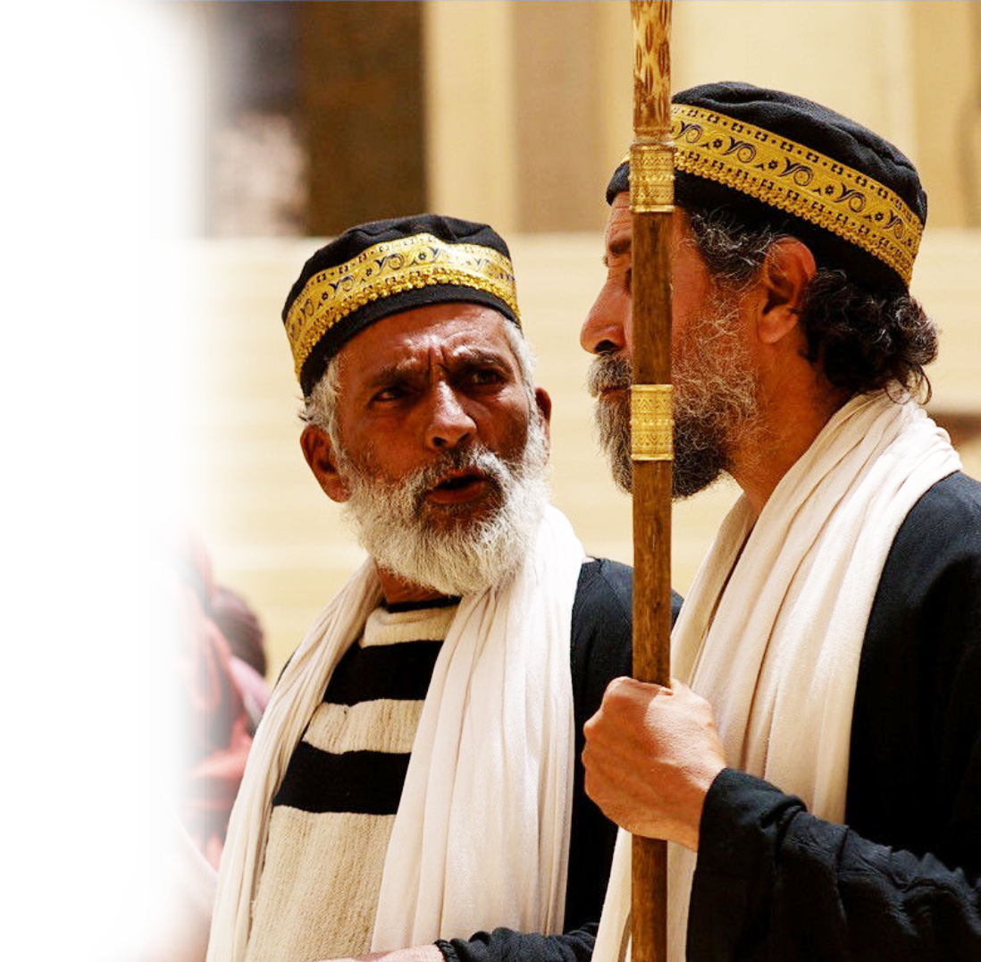
The Pharisees should have …

Slide 11
The Pharisees should have …
^{Matthew 12:38}
"… Teacher, we wish to see a sign from you."
Notes:
When you ask for a sign you show you do not believe—you doubt. Your lack of faith demands a “credible sign.”

Slide 12
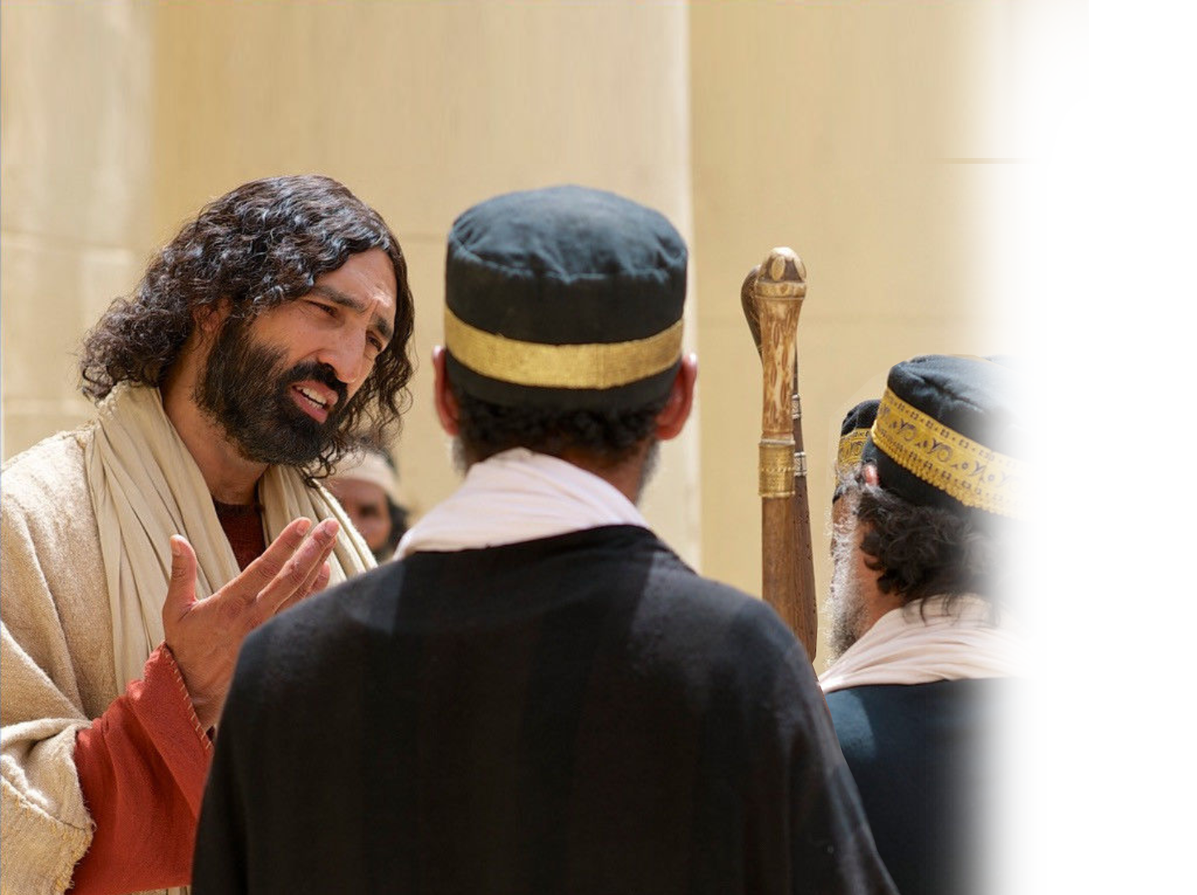
The Pharisees should have …
39 But he answered them, "An evil and adulterous generation seeks for a sign, but no sign will be given to it except the sign of the prophet Jonah.

Slide 13
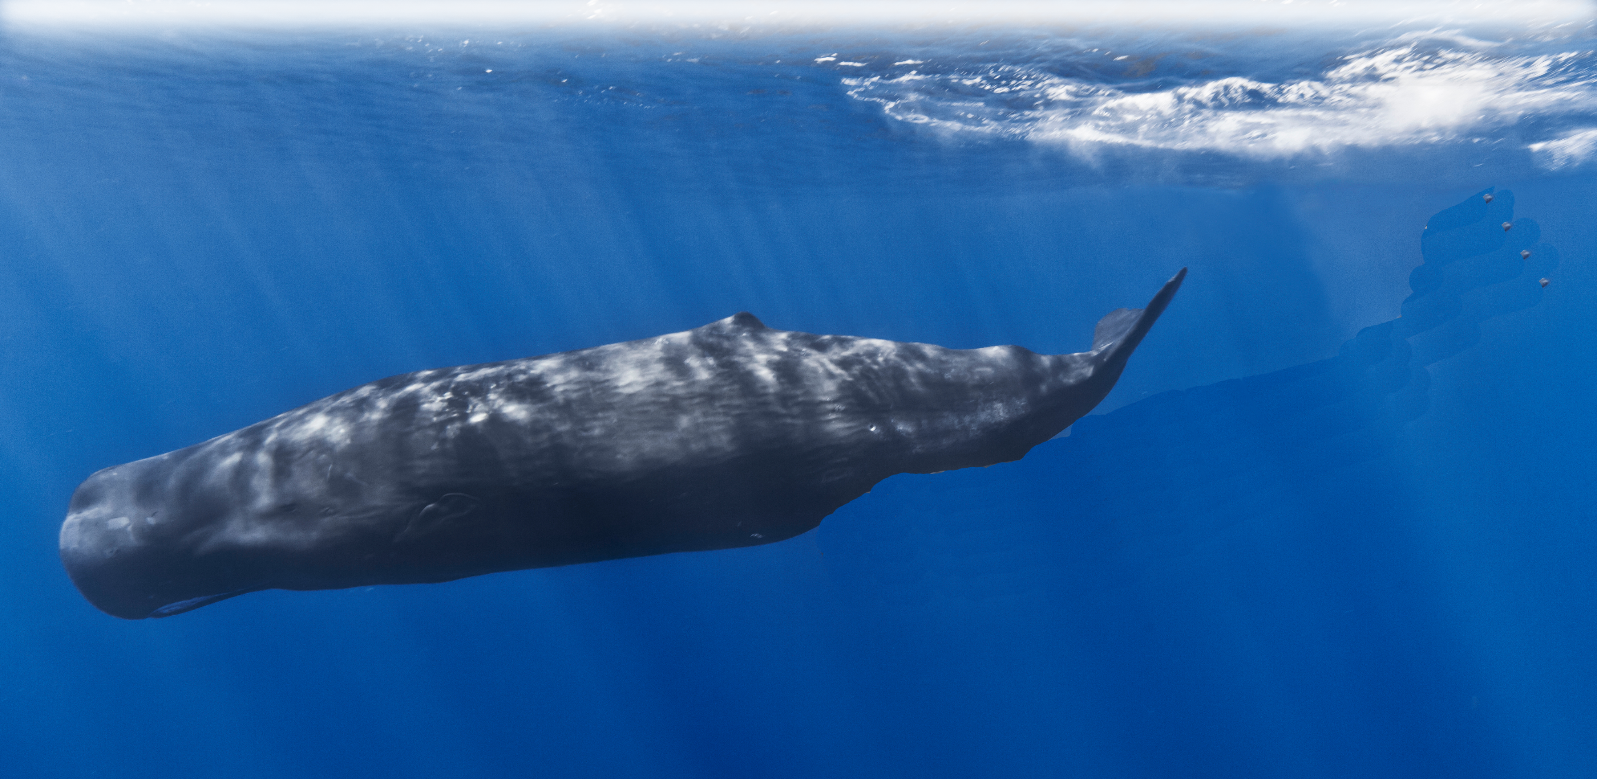
The Pharisees should have …
40 For just as Jonah was three days and three nights in the belly of the great fish,
so will the Son
of Man be three days
and three nights in the heart of the earth.
Notes:
https://upload.wikimedia.org/wikipedia/commons/b/b1/Mother_and_baby_sperm_whale.jpg
The resurrection is the only sign that Jesus will give them

Slide 14
The Pharisees should have …
41 The men of Nineveh will rise up at the judgment with this generation and condemn it, for they repented at the preaching of Jonah, and behold, something greater than Jonah is here.
Notes:
The men of Nineveh had the figuratively resurrected Jonah preaching to them, Jonah who had been in the “prepared fish” 3 days and nights – and they repented at his preaching.
But you will not even repent though I come back from the dead. You bring your own judgment upon your own head.

Slide 15
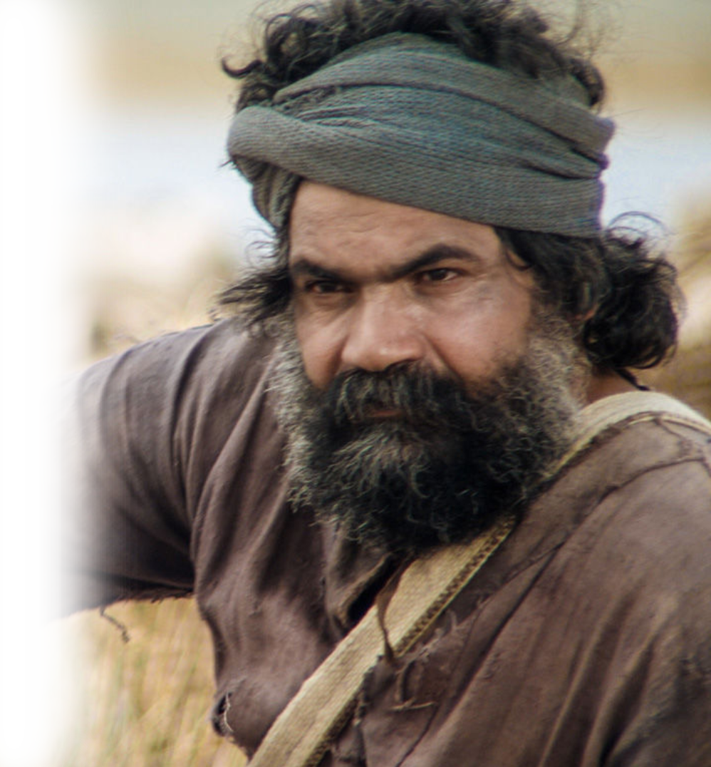
The Rock should have …

Slide 16
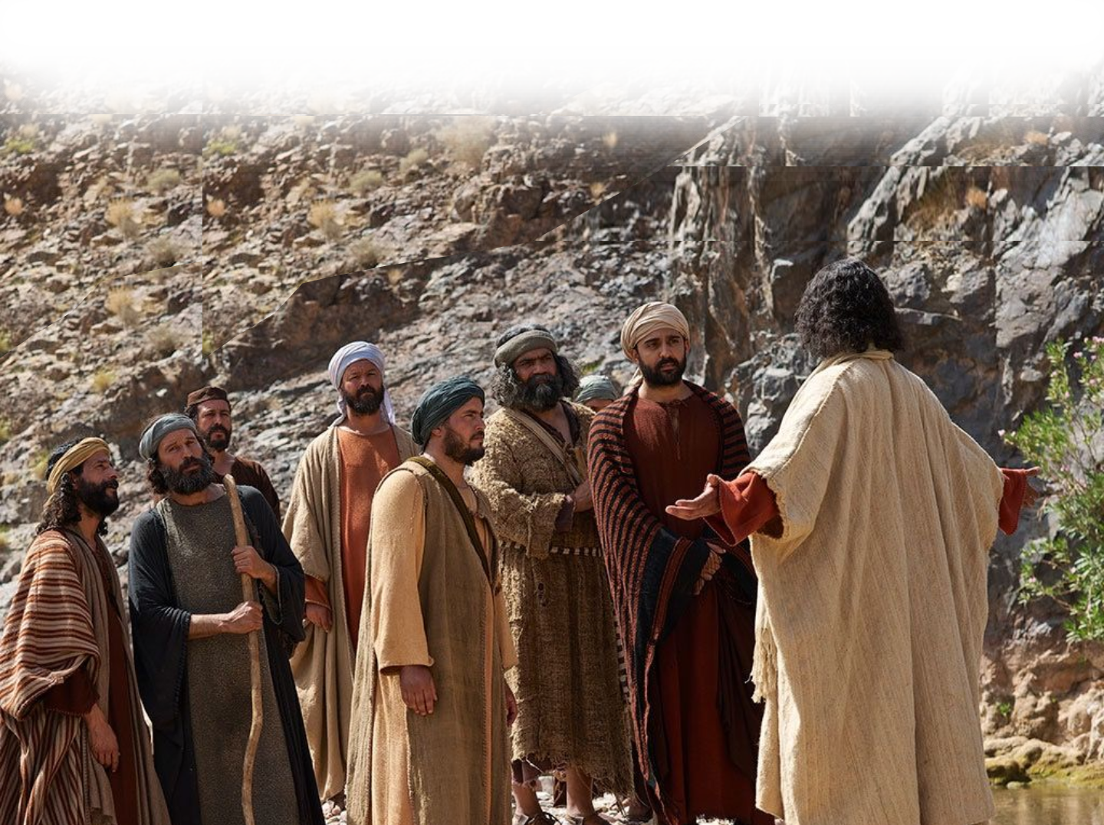
The Rock should have …
^{Mark 8:31} And he [Jesus] began to teach them that the Son of Man must suffer many things and be rejected by the elders and the chief
priests and the scribes
and be killed, and
after three days
rise again.
³² And he said this plainly.

Slide 17
The Rock should have …
And Peter took him aside and began to rebuke him
[saying, "Far be it from you, Lord! This shall never happen to you.“ Mat 16:22]

Slide 18
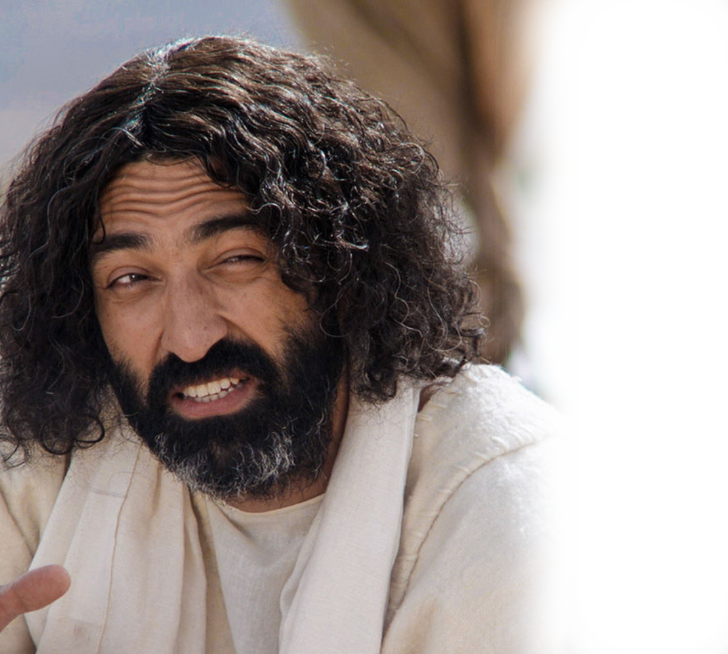
The Rock should have …
33 But turning and seeing his disciples, he rebuked Peter and said,
"Get behind me, Satan! For you are not setting your mind on the things of God, but on the things of man.“

Slide 19
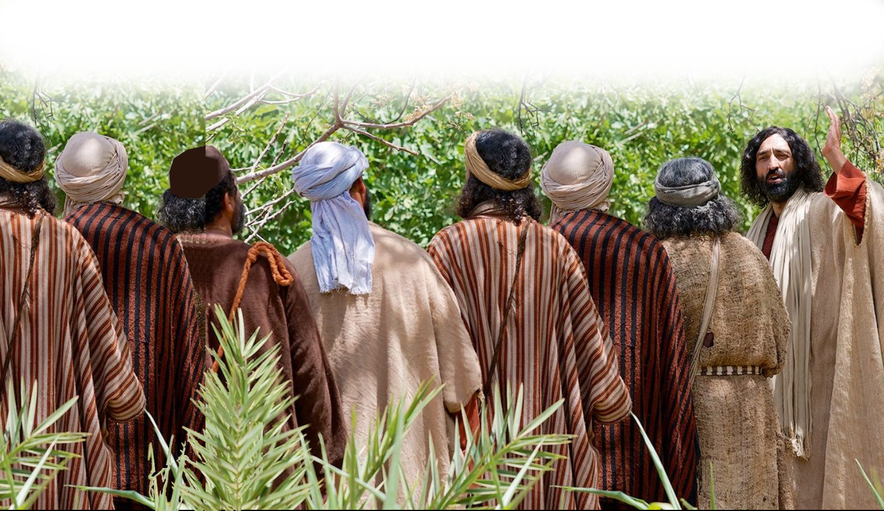
The Disciples should have …
Notes:
https://www.flickr.com/photos/archer10/34882194185

Slide 20
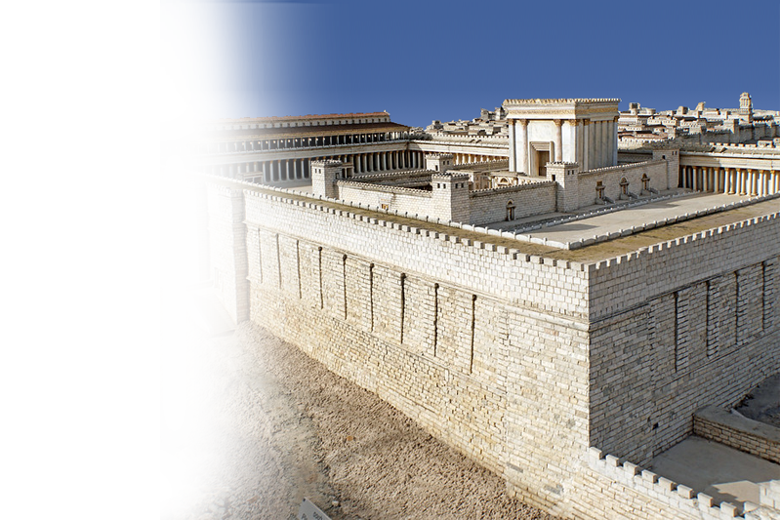
The Disciples should have …
^{Matthew 20:17} And as Jesus was going up to Jerusalem, he took the twelve disciples aside, and on the way he said to them,
Notes:
https://www.flickr.com/photos/archer10/34882194185

Slide 21
The Disciples should have …
¹⁸ "See, we are going up to Jeru-salem. And the Son of Man will be delivered over to the chief priests and scribes, and they will condemn him to death ¹⁹ and deliver him over to the Gentiles to be mocked and flogged and crucified, and he will be raised on the third day.“

Slide 22
They should have seen it coming
It appears that they just did not want to believe it!

Slide 23
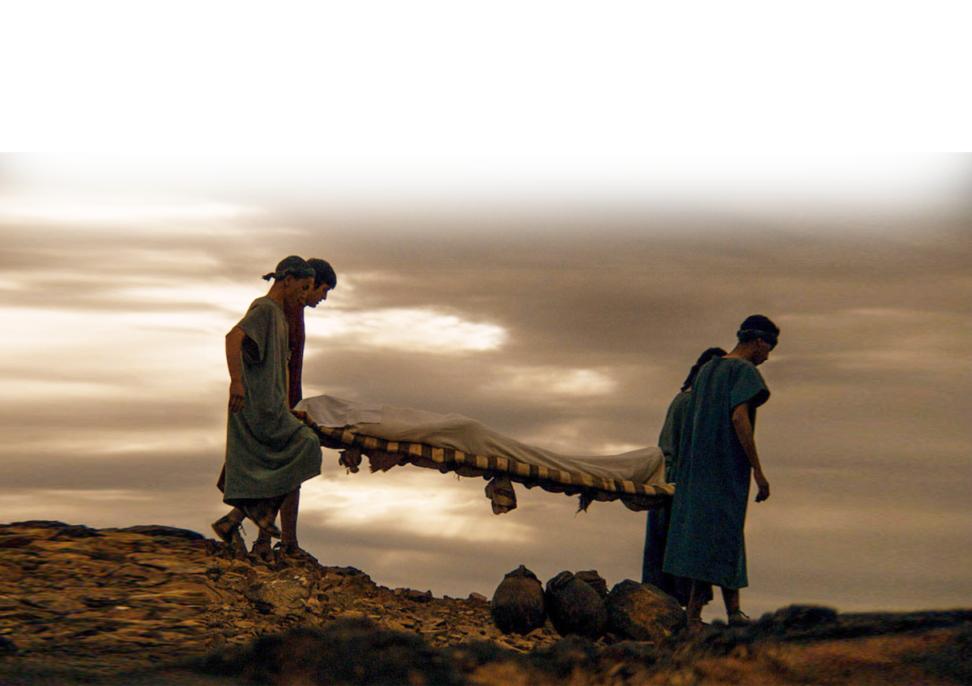
After the Cross …

Slide 24
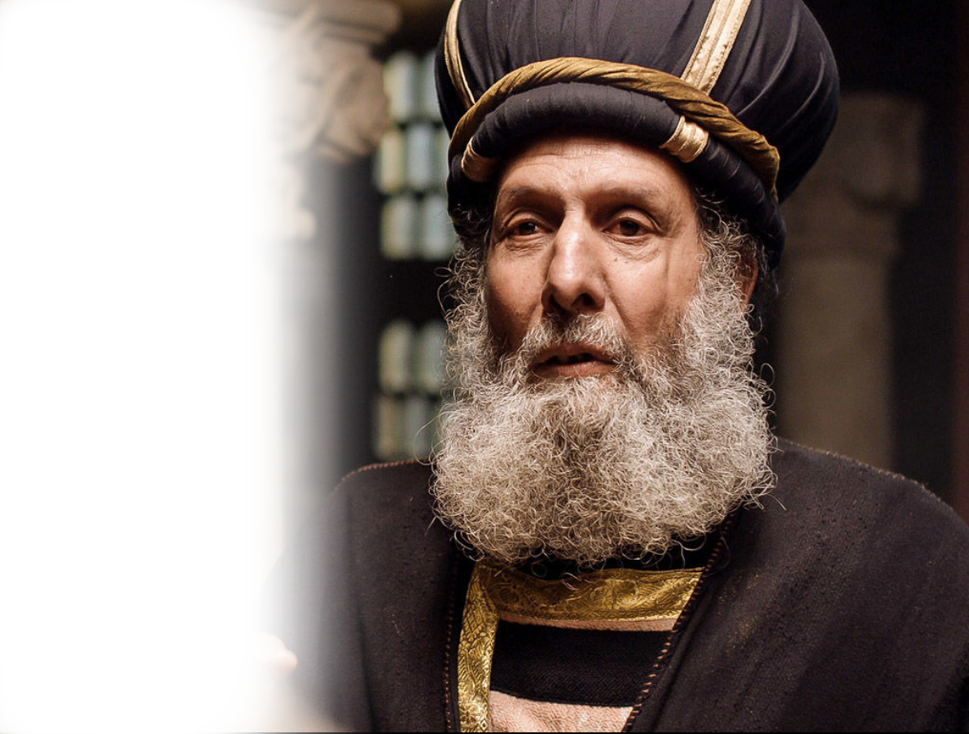
The Chief Priest sort of saw it …
^{Matthew 27:62} … the chief priests and the Pharisees gathered before Pilate ⁶³ and said,
"Sir, we remember how that impostor said, while he was still alive, 'After three days I will rise.’
Notes:
So, they did understand that they spread “Fake News.” They know Jesus referred to his body when he said destroy this temple and in three days I will raise it up again. They saw it coming but did not believe it.

Slide 25
The Chief Priest sort of saw it …
⁶⁴ Therefore order the tomb to be made secure until the third day, lest his disciples go and steal him away and tell the people, 'He has risen from the dead,' and the last fraud will be worse than the first.“

Slide 26
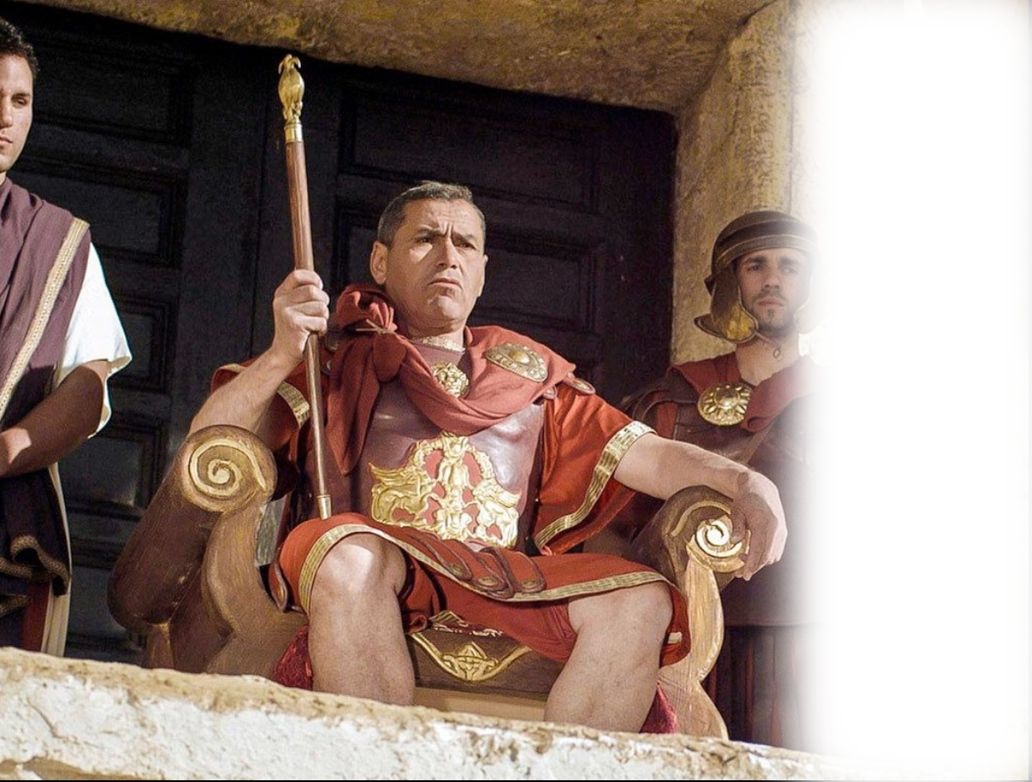
The Chief Priest sort of saw it …
⁶⁵ Pilate said to them, "You have a guard of soldiers. Go, make it as secure as you can.“

Slide 27
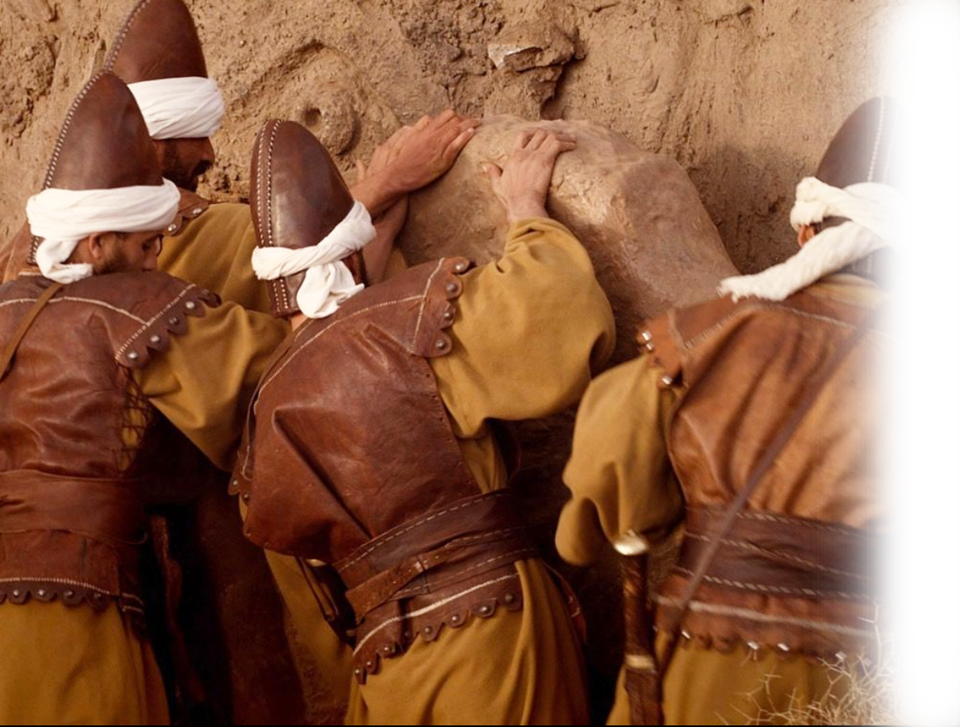
The Chief Priest sort of saw it …
⁶⁶ So they went and made the tomb secure by sealing the stone and setting a guard.

Slide 28
Really, no one saw this coming …

Slide 29
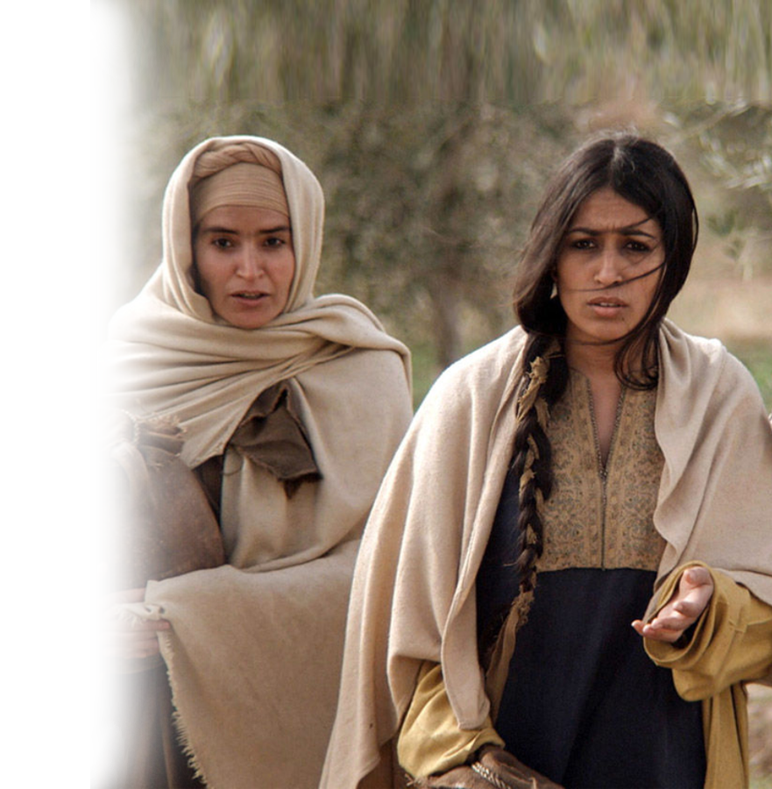
Really, no one saw this coming …
Earthquake: Mat 28:1-2
Now after the Sabbath, toward the dawn of the first day of the week, Mary Magdalene and the other Mary went to see the tomb. ² And behold, there was a great earthquake,

Slide 30
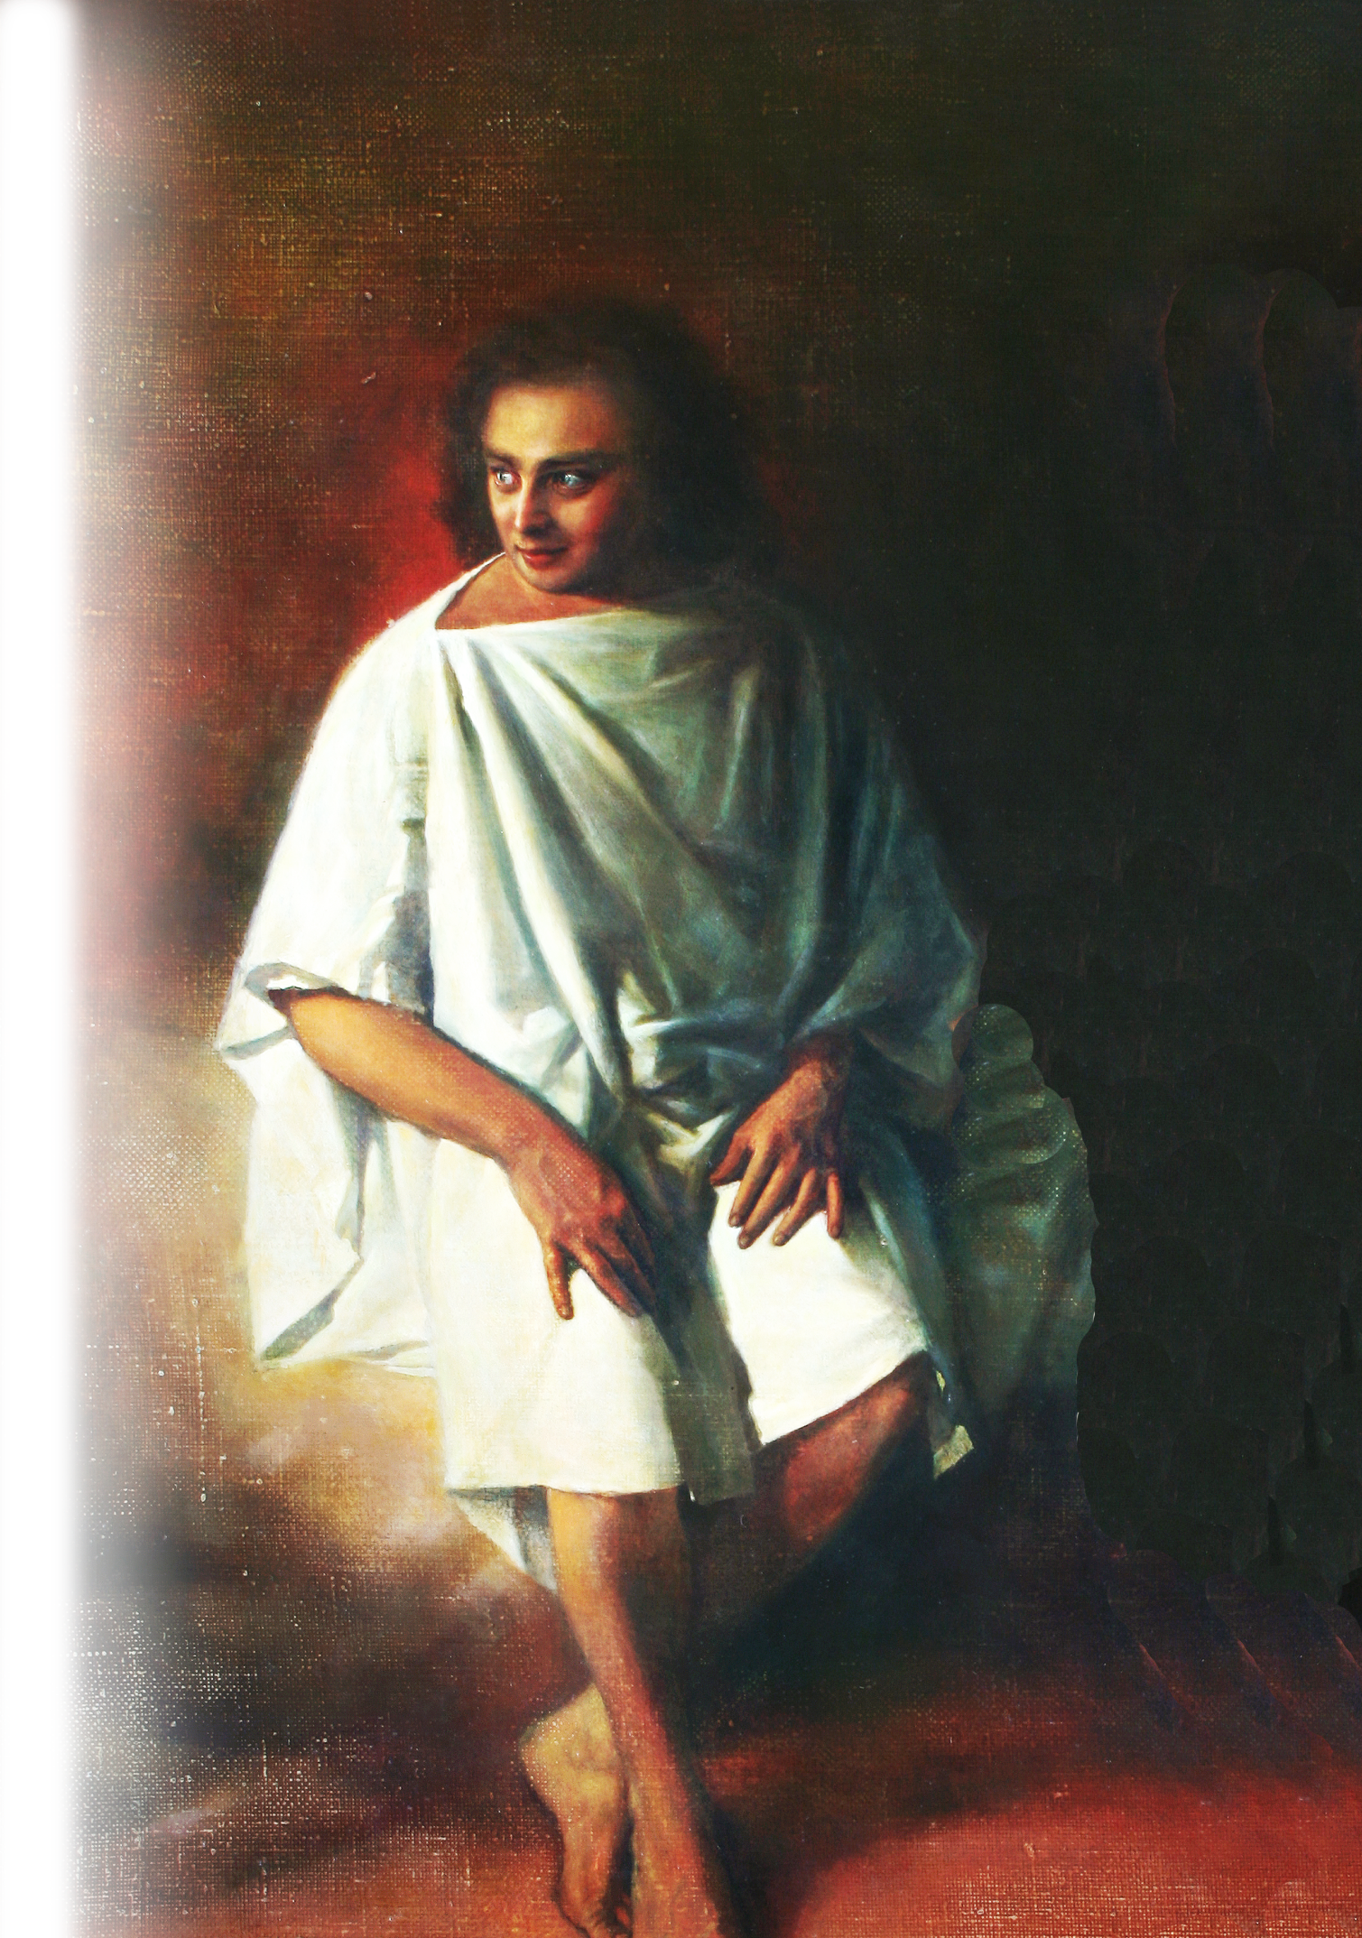
Really, no one saw this coming …
Angels
… for an angel of the Lord descended from heaven and came and rolled back the stone and sat on it. ³ His appearance was like lightning, and his clothing white as snow.
Notes:
https://upload.wikimedia.org/wikipedia/commons/b/b3/Empty_tomb._A.N._Mironov.jpg

Slide 31
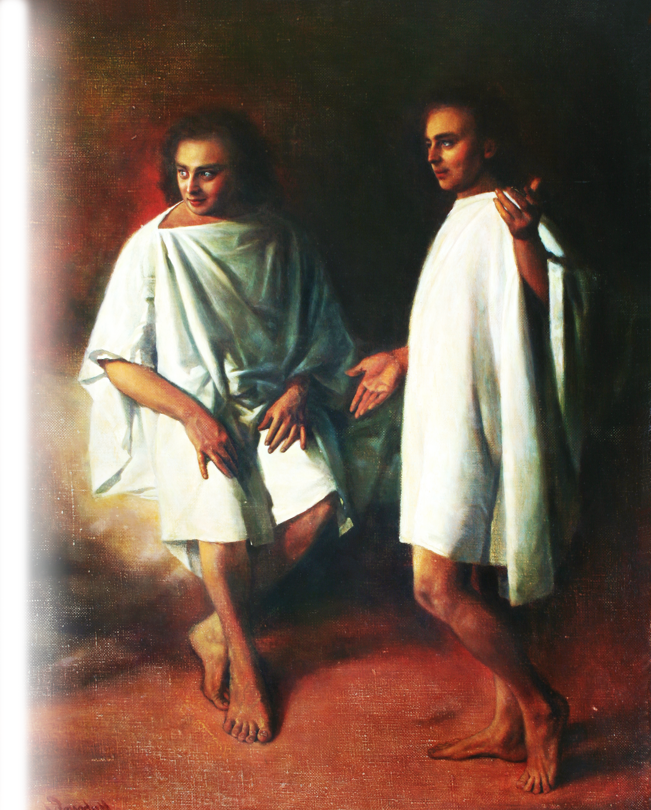
Really, no one saw this coming …
Resurrection
^{Luke} ^{24:5} … the men said to them,
"Why do you seek the living among the dead? ⁶ He is not here, but has risen.
Notes:
https://upload.wikimedia.org/wikipedia/commons/b/b3/Empty_tomb._A.N._Mironov.jpg

Slide 32
Really, no one saw this coming …
Remember how he told you, while he was still in Galilee,
Notes:
https://upload.wikimedia.org/wikipedia/commons/b/b3/Empty_tomb._A.N._Mironov.jpg

Slide 33
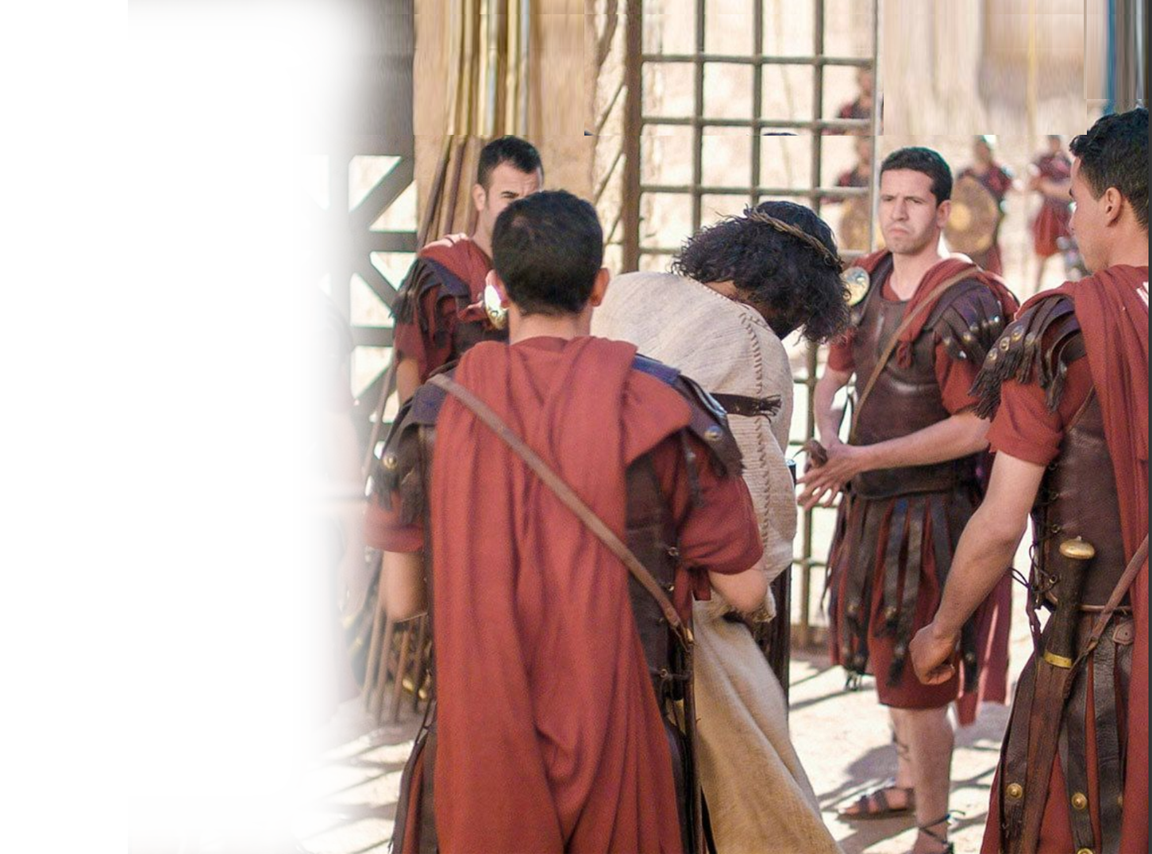
Really, no one saw this coming …
Remember how he told you, while he was still in Galilee, ⁷ that the Son of Man must be delivered into the hands of sinful men
Notes:
https://upload.wikimedia.org/wikipedia/commons/b/b3/Empty_tomb._A.N._Mironov.jpg

Slide 34
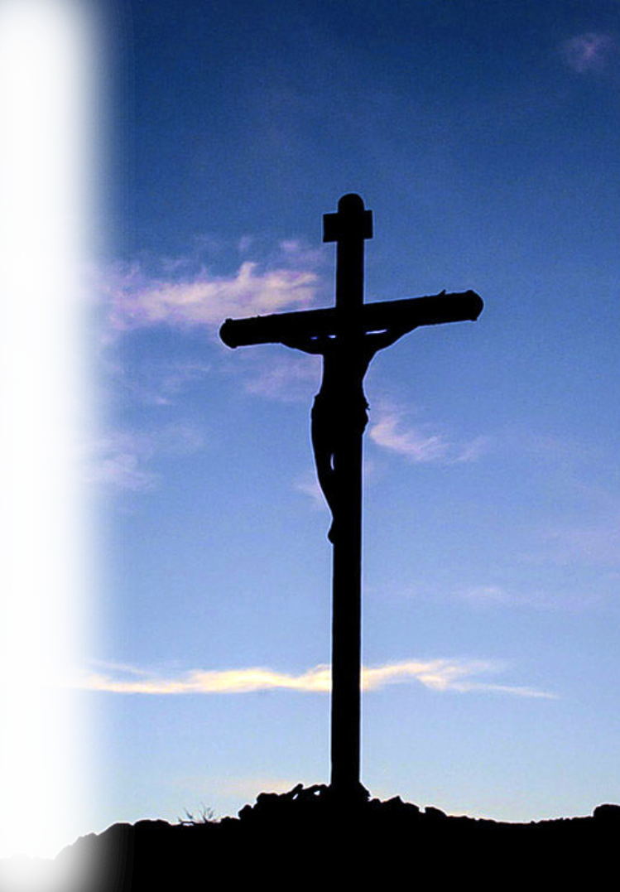
Really, no one saw this coming …
Remember how he told you, while he was still in Galilee, ⁷ that the Son of Man must be delivered into the hands of sinful men and be crucified
Notes:
https://upload.wikimedia.org/wikipedia/commons/b/b3/Empty_tomb._A.N._Mironov.jpg

Slide 35
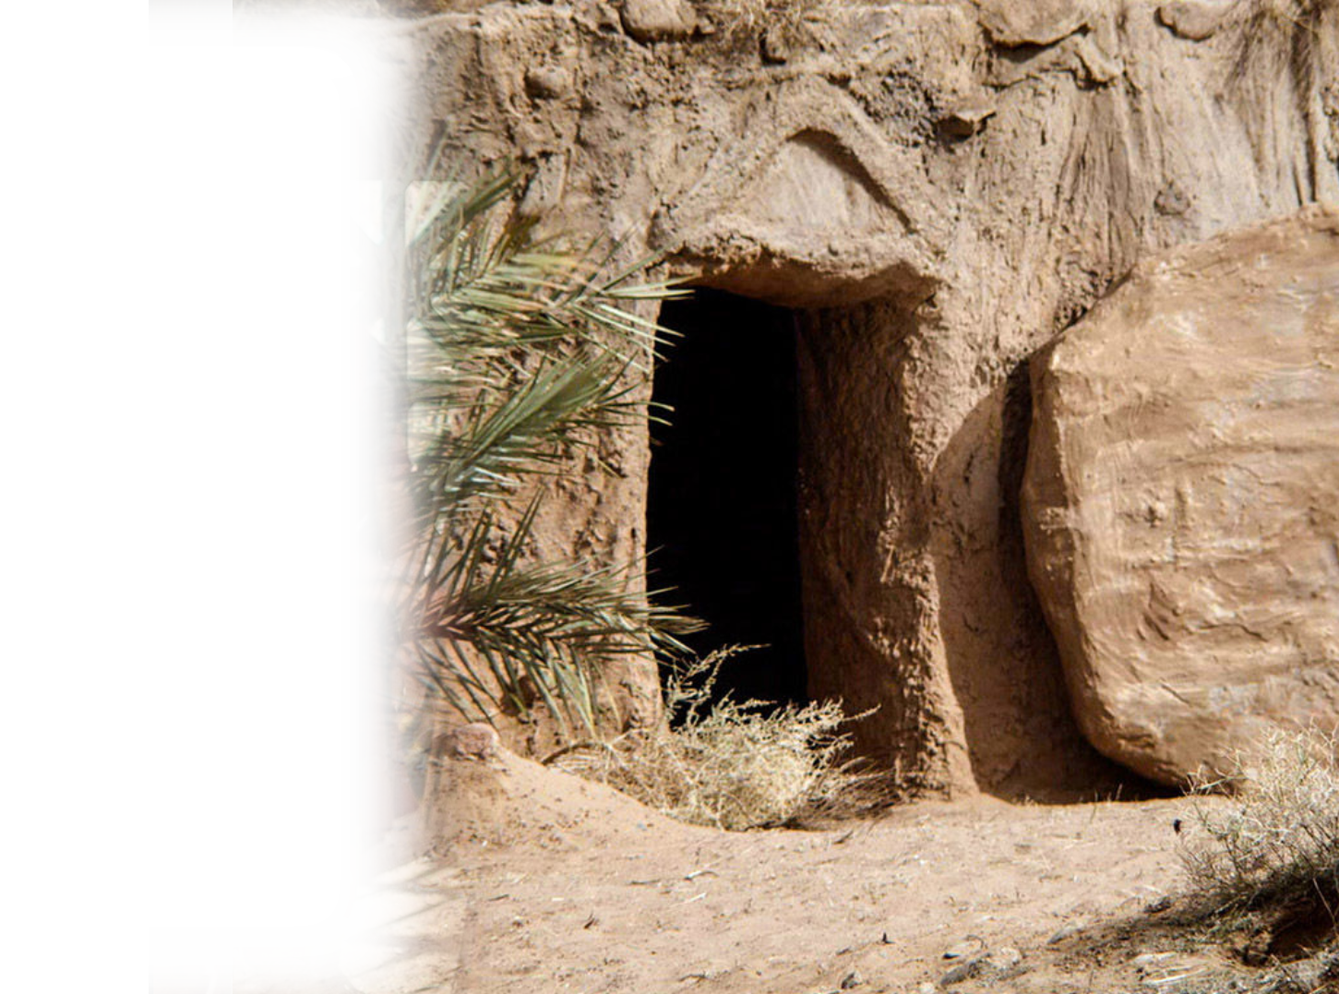
Really, no one saw this coming …
Remember how he told you, while he was still in Galilee, ⁷ that the Son of Man must be delivered into the hands of sinful men and be crucified and on the third day rise.“
Notes:
https://upload.wikimedia.org/wikipedia/commons/b/b3/Empty_tomb._A.N._Mironov.jpg

Slide 36
Really, no one saw this coming …
⁸ And they remembered his words
Notes:
https://upload.wikimedia.org/wikipedia/commons/b/b3/Empty_tomb._A.N._Mironov.jpg

Slide 37
Of course, we didn’t see it …
It happened before us …
We have a different
perspective …

Slide 38
The Question to Us is …
NOT “Did you see this coming?”
BUT “Do you believe it happened?”

Slide 39
So important—life depends on it
¹⁸ Whoever believes in him is not condemned, but whoever does not believe is condemned already, because he has not believed in the name of the only Son of God. (John 3:18)
Notes:
¹⁷ And if Christ has not been raised, your faith is futile and you are still in your sins. (1Co 15:17 ESV)

Slide 40
So important—life depends on it
If you confess with your mouth that Jesus is Lord and believe in your heart that God raised him from the dead, you will be saved. (Romans 10:9)
Notes:
¹⁷ And if Christ has not been raised, your faith is futile and you are still in your sins. (1Co 15:17 ESV)

Slide 41
Perhaps you’re thinking …
WOW, I didn’t see that coming!
I must believe Jesus rose from
the dead and confess Him as
Lord to be save?
YES!
Why not do it now and be eternally secure?

Slide 42
Let’s Pray
Notes:
Should Have Seen It Coming!
On the first Easter morning … they found the tomb empty … Luke 24:1-5
The Jews should have seen it coming … John 2:18-21
The Scribes and Pharisees should have seen it coming… (Mat 12:38-46 + 16:4)
The Rock (Peter) should have seen it coming (Mark 8:31-33)
The Disciples should have seen it coming … (Mark 10:33-34 + Matthew 20:17-19)
After the cross …
The Chief Priest sort of saw it coming … (Matthew 27:62-66)
Really, No one saw this coming … (Matthew 28:1-4 + Luke 24:5-8)
Earthquake
Angels
Resurrection
Of course, you and I live after the resurrection, so we couldn’t see it coming. It already happened. We view it now from a different perspective. So, the questions now is, “Do you believe that it has happened?” I mean really believe that Jesus is risen from the dead. He is alive.
It is crucial that you believe Romans 10:9,10
Perhaps you are thinking right now, Wow, I didn’t see that coming! I have to believe in the resurrected Christ to be saved by God. It’s true. You must believe to be save. Why not believe right now. Tell Him that you believe in this prayer …

Slide 43
Final Thoughts
Today, when the kids empty
the eggs remember the tomb,
like the egg, is empty!
Jesus is alive forevermore …

