Slide 1
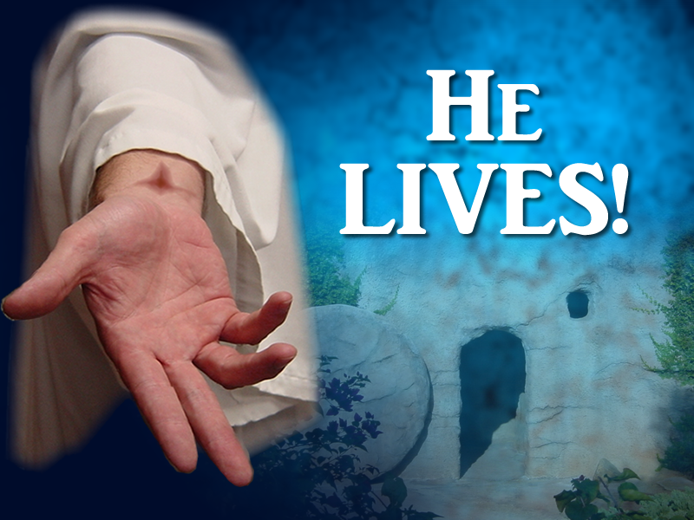
Notes:
Copyright © 2006−2021. All rights reserved. Bible Point is a registered trademark of Dennis Henderson. All other trademarks acknowledged.
Bible Point contains graphics from Bible Point artists. These illustrations belong to Bible Point and the respective artists. You may use the designs and illustrations for graphical illustration of lessons free and without special permission, provided they are not used in any way that maligns the Christian faith. Furthermore, republication or production of any illustration by any other graphic service whether it be in book, in a machine-readable form, or in any other design resource is strictly prohibited. Furthermore, they cannot be duplicated or resold as any other form of publishing, clip art, or graphic resource.
So What does it mean? (A simple translations of the legal jargon)
So, if you don’t own the presentation(s), graphic(s), and text(s) how can you legally use them? The purchase of the license allows you to use all the images in the product. However, the actual ownership and copyright of the presentation(s), graphic(s), and text(s) remain the property of Bible Point and its licensors. If you had plans on using this product in your “for sale” work—think again!
License Agreement
Article 1: License Grant
All the graphics and text in Bible Point presentations (excluding quotes from the Bible and stated sources) are the intellectual and real property of Bible Point and its licensors, and is protected by law, including United States copyright laws and international treaties. Bible Point grants to you a license:
1. To use the presentation in a single church, single school, or single office of a Christian organization.
2. To make a single archival back-up copy of the program.
3. To modify the presentation(s) and merge with other presentations in a single church, school, or Christian organization.
4. To transfer to another party if that party agrees to accept the terms and conditions of this agreement, and you do not retain any copies of the presentation, whether printed, machine readable, modified, or merged form.
Article 2: Terms
This license is effective until terminated. You may terminate the license at any time by destroying the presentation(s), graphic(s), or text(s) together with all copies, modifications and merged portions in any form. Bible Point may terminate your license if you fail to comply with this Agreement. You agree, upon such termination, for any reason, to destroy the presentation(s), graphics, and text(s) with all copies, modifications, and merged portions in any form.
Article 3: Disclaimers
1. Bible Point presentations, graphics, and texts are licensed to you As Is. You, the consumer, bear the entire risk relating to the quality and performance of the presentation(s), graphic(s), or text(s). In no event will Bible Point be liable for damages resulting from any defect.
2. Thirty-day limited warrantee on disks. Bible Point warrants the disks to be free of defects in material and workmanship under normal use for 30 days after purchase. During the 30-day period you may return a defective presentation, graphic, or text with proof of purchase and it will be replaced without charge, unless the presentation is damaged by misuse.
Article 4: General
1. You may not sub-license, assign, or transfer the license of the presentation(s), graphic(s), or text(s) except as provided by this Agreement.
2. This Agreement will be governed by the laws of the State of Michigan.
So What does it mean? (A simple translations of the legal jargon)
May I let someone borrow or copy my licensed Bible Point presentation (even after I modified it)? As long as it is within your local church, or single school, or the immediate office of a Christian organization you may. Otherwise, please refer the person interested in borrowing to: http://www.biblepoint.com or E-mail: dennis@DrDH.net with any related questions.

Slide 3
What the resurrection means to US!

Slide 4
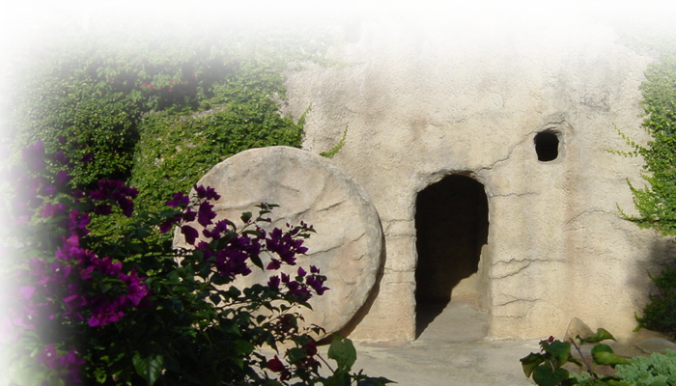
He is ALIVE (Forever)!
But because Jesus lives forever, his priesthood lasts forever. (Heb 7:24 NLT)
He will NEVER DIE again!
Notes:
Empty tomb = FREE = Bible Point photo
Jesus raised at least three from the dead, who all died again: we call this resuscitation
Widow of Nain’s son (Luke 7)
Jairus’ daughter (mark 5 luke 8)
Lazarus John 11
They all died again—not so with Jesus!

Slide 5

He is ASCENDED
So then, since we have a great High Priest who has entered heaven, Jesus the Son of God, let us hold firmly to what we believe. (Heb 4:14 NLT)
He is BODILY
in heaven!
Notes:
Clouds = FREE = from http://www.sxc.hu/browse.phtml?f=download&id=1377961
This is a little hard for some people to believe (without a space ship)!
But were talking about God who came in the flesh—God the Creator, who made everything that is—He runs His universe, He can easily transport Himself to where ever the third heaven is ... As a real placed with a real human body. Those who doubt have too small a concept of God. Obviously they know not the God of the Bible of whom it is said that “nothing is impossible.”
The point: He is alive forever and is in heaven!

Slide 6
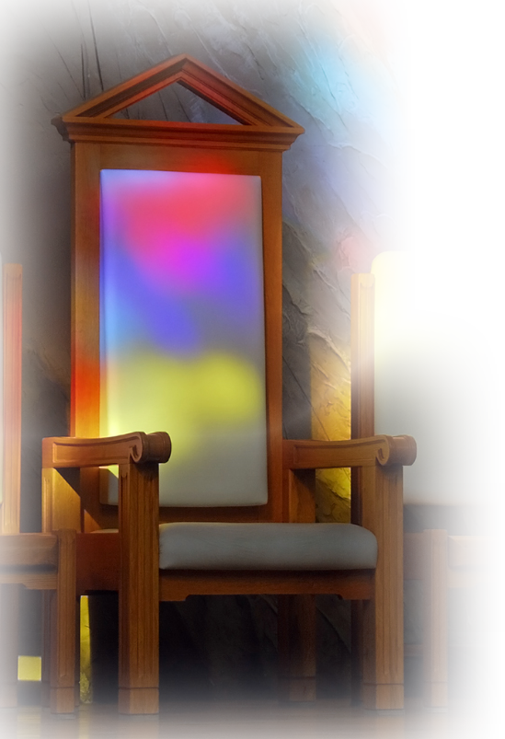
He is SEATED!
When he had cleansed us from our sins, he sat down in the place of honor at the right hand of the majestic God in heaven. (Heb 1:3 ^{NLT})
His work
is DONE!
Notes:
Chair = FREE = from http://www.sxc.hu/browse.phtml?f=download&id=994775
In the OT the tabernacle and temple had no chairs—because a priest’s work was never done.
But Jesus is our High Priest and He offered Himself as the sacrifice—it was on the cross that he yelled out “It is finished”
His work of Redemption is done. So he is resting in the accomplishment of Redemption.

Slide 7
He is the SAVIOR!
Therefore he is able, once and forever, to save those who come to God through him. (Heb 7:25 NLT)
He is the only WAY!
Notes:
We serve a risen Savior!
With eternal salvation. That means once you accept Him as Savior and Lord—you are eternally secure.
I did not say, once recite some formula, get baptized, join a church, make a contribution in the offering plate, etc.
No once you make Him your Savior and Lord—you are saved forever.
Not only is He the way to God, He is the only way
(john 14:6; Acts 4:12; 1 tim 2:5)

Slide 8

He is INTERCEDING!
He lives forever to intercede with God on their behalf.
(Heb 7:25 NLT)
Because we NEED it!
Notes:
Praying hands = FREE = http://www.sxc.hu/browse.phtml?f=download&id=405036i
Intercession is praying for others. That is what Jesus does now.
He makes sense out of our non-sense. We no longer need to go to a priest on earth for access to God as in the OT.
You can go directly to God through the Lord Jesus Christ.

Slide 9
He is COMING (Again)!
Christ died once for all time as a sacrifice to take away the sins of many people. He will come again, not to deal with our sins, but to bring salvation to all who are eagerly waiting for him. (Heb 9:28 NLT)
I’ll be
back!
Because He
PROMISED!
Notes:
If his ascension into heave is hard for some to accept—so is his coming again. But the Scriptures every where tell of him coming to set up a kingdom as the introduction to eternity future.
Jesus promised (quote John 14:1,2 also Acts 1:11)

Slide 10
To sum up:
He is alive forever.
He is in heaven now.
He is seated ... His saving work is done.
He is Savior ... because He is the only way!
He is interceding ...because we need it.
He is coming again ... because He promised.

