Slide 1
Notes:
Super MOM = FREE = from BiblePoint art.

Slide 2
Proverbs 31: 10, 28-31
¹⁰ A wife of noble character who can find? She is worth far more than rubies....
²⁸ Her children arise and call her blessed; her husband also, and he praises her: ²⁹ "Many women do noble things, but you surpass them all." ³⁰ Charm is deceptive, and beauty is fleeting; but a woman who fears the LORD is to be praised. ³¹ Give her the reward she has earned, and let her works bring her praise at the city gate.

Slide 3
Proverbs 31: 10, 28-31
¹⁰ A wife of noble character who can find? She is worth far more than rubies....
²⁸ Her children arise and call her blessed; her husband also, and he praises her: ²⁹ "Many women do noble things, but you surpass them all." ³⁰ Charm is deceptive, and beauty is fleeting; but a woman who fears the LORD is to be praised. ³¹ Give her the reward she has earned, and let her works bring her praise at the city gate.

Slide 4
Proverbs 31: 10, 28-31
¹⁰ A wife of noble character who can find? She is worth far more than rubies....
²⁸ Her children arise and call her blessed; her husband also, and he praises her: ²⁹ "Many women do noble things, but you surpass them all." ³⁰ Charm is deceptive, and beauty is fleeting; but a woman who fears the LORD is to be praised. ³¹ Give her the reward she has earned, and let her works bring her praise at the city gate.

Slide 5
Proverbs 31: 10, 28-31
¹⁰ A wife of noble character who can find? She is worth far more than rubies....
²⁸ Her children arise and call her blessed; her husband also, and he praises her: ²⁹ "Many women do noble things, but you surpass them all." ³⁰ Charm is deceptive, and beauty is fleeting; but a woman who fears the LORD is to be praised. ³¹ Give her the reward she has earned, and let her works bring her praise at the city gate.

Slide 6
Proverbs 31: 10, 28-31
¹⁰ A wife of noble character who can find? She is worth far more than rubies....
²⁸ Her children arise and call her blessed; her husband also, and he praises her: ²⁹ "Many women do noble things, but you surpass them all." ³⁰ Charm is deceptive, and beauty is fleeting; but a woman who fears the LORD is to be praised. ³¹ Give her the reward she has earned, and let her works bring her praise at the city gate.

Slide 7
Hallelu-jah
Praise – Jah (Jehovah)
Notes:
The term “Praise” occurs three times. The third term is “praise her” is halleluha. (Prov 31:31)
Hallel = to shine, to boast (brag), to glory, to praise
When we brag about God it is PRAISE.
When we brag about ourselves it is BOASTING.
But when we brag about others/Mom she “shines!”

Slide 8
Hallelu-jah
Praise – Jah (Jehovah)
Hallelu-ha
Praise her
Notes:
The term “Praise” occurs three times. The third term is “praise her” is halleluha. (Prov 31:31)
Hallel = to shine, to boast (brag), to glory, to praise
When we brag about God it is PRAISE.
When we brag about ourselves it is BOASTING.
But when we brag about others/Mom she “shines!”

Slide 9
That’s My First Point:
1. Praise Her!

Slide 10
My second point:
2. Praise Her FOR ...

Slide 11
My second point:
2. Praise Her FOR ...
BEING and DOING GOOD

Slide 12
My second point:
2. Praise Her FOR ...
BEING and DOING GOOD
¹⁰ A wife of noble character (NIV)
²⁹ "Many women do noble things, but you surpass them all.“ (NIV)

Slide 13
My second point:
strong
2. Praise Her FOR ...
BEING and DOING GOOD
¹⁰ A wife of noble character (NIV)
²⁹ "Many women do noble things, but you surpass them all.“ (NIV)

Slide 14
My second point:
strong
2. Praise Her FOR ...
BEING and DOING GOOD
strong
¹⁰ A wife of noble character (NIV)
²⁹ "Many women do noble things, but you surpass them all.“ (NIV)
Notes:
Hebrew “hil” = strength, strong, power, virtue --

Slide 15
Praise Her for What?

Slide 16
Praise Her for What?
I’m glad you asked ...

Slide 17
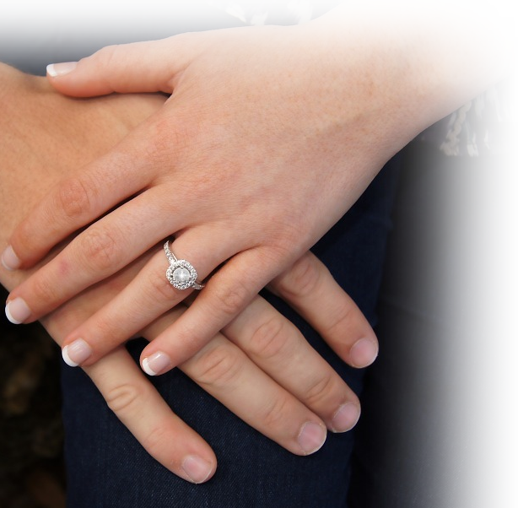
Praise her for being a good:
1. Wife 10-12
¹⁰ A capable wife who can find? She is far more precious than jewels. ¹¹ The heart of her husband trusts in her, and he will have no lack of gain. ¹² She does him good, and not harm, all the days of her life.
Notes:
Hand with wedding ring = FREE =from https://pixabay.com/en/hands-ring-promise-engagement-love-587779/

Slide 18
Praise her for being a good:
Wife 10-12
Shopper 13-14
¹³ She seeks wool and flax, and works with willing hands. ¹⁴ She is like the ships of the merchant, she brings her food from far away.
Notes:
Sale Bag = FREE = BiblePoint

Slide 19
Praise her for being a good:
Wife 10-12
Shopper 13-14
Self-Starter 15
¹⁵ She rises while it is still night and provides food for her household and tasks for her servant-girls.
Notes:
Clock = FREE = from http://www.sxc.hu/photo/72453

Slide 20
Praise her for being a good:
Wife 10-12
Shopper 13-14
Self-Starter 15
Buyer 16
¹⁶ She considers a field and buys it; with the fruit of her hands she plants a vineyard.
Notes:
For Sale Sign = FREE = from http://commons.wikimedia.org/wiki/File:Displaced_sign_-_geograph.org.uk_-_604210.jpg

Slide 21
Praise her for being a good:
Wife 10-12
Shopper 13-14
Self-Starter 15
Buyer 16
Worker 17
¹⁷ She girds herself with strength, and makes her arms strong.
Notes:
We Can Do It – FREE –from http://commons.wikimedia.org/wiki/File:We_Can_Do_It!.jpg

Slide 22
Praise her for being a good:
6. Merchant 18
¹⁸ She perceives that her merchandise is profitable. Her lamp does not go out at night.
Notes:
Sold = FREE = https://www.flickr.com/photos/106574022@N04/10797449516

Slide 23
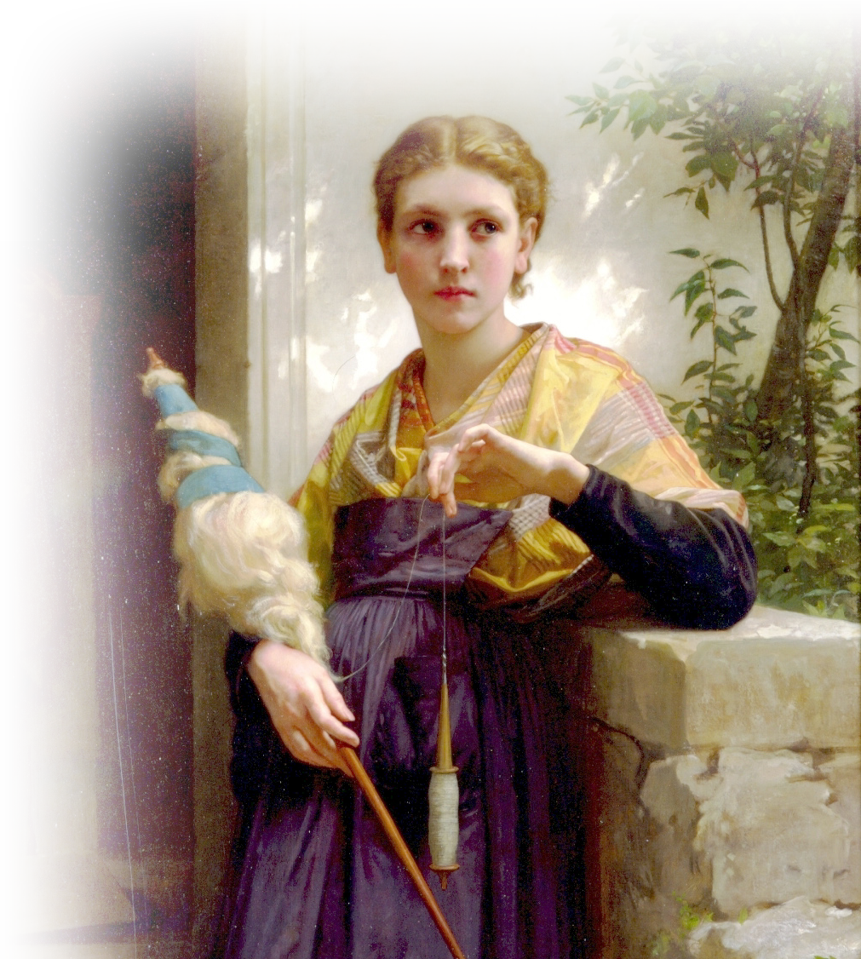
Praise her for being a good:
6. Merchant 18
Manufacturer 19
¹⁹ She puts her hands to the distaff, and her hands hold the spindle.
Notes:
Woman with distaff – FREE --By William-Adolphe Bouguereau - Art Renewal Center Museum, image 68., Public Domain, https://commons.wikimedia.org/w/index.php?curid=3731488

Slide 24
Praise her for being a good:
6. Merchant 18
Manufacturer 19
Neighbor 20
²⁰ She opens her hand to the poor, and reaches out her hands to the needy.
Notes:
Open arms = FREE = from http://www.sxc.hu/photo/1161027

Slide 25
Praise her for being a good:
6. Merchant 18
Manufacturer 19
Neighbor 20
Planner 21
²¹ She is not afraid for her household when it snows, for all her household are clothed in crimson.
Notes:
Open arms = FREE = from http://www.sxc.hu/photo/1161027

Slide 26
Praise her for being a good:
6. Merchant 18
Manufacturer 19
Neighbor 20
Planner 21
Homemaker 22
²² She makes coverings for her bed; she is clothed in fine linen and purple. (NIV)
Notes:
Bedroom setting = LICENSED and NOT FOR REUSE. To reuse elsewhere, get a license from http://www.dreamstime.com/luxury-bedroom-stock-photo-imagefree3571510

Slide 27
Praise her for being a good:
11. Judge of Character 23
²³ Her husband is respected at the city gate, where he takes his seat among the elders of the land. (NIV)
Notes:
Wedding kiss = FREE = from http://www.sxc.hu/photo/1038218

Slide 28
Praise her for being a good:
11. Judge of Character 23
12. Entrepreneur 24
²⁴ She makes linen garments and sells them; she supplies the merchant with sashes.
Notes:
Ebay logo Owned by Ebay = FREE = from http://upload.wikimedia.org/wikipedia/commons/5/5a/EBay_Logo.svg

Slide 29
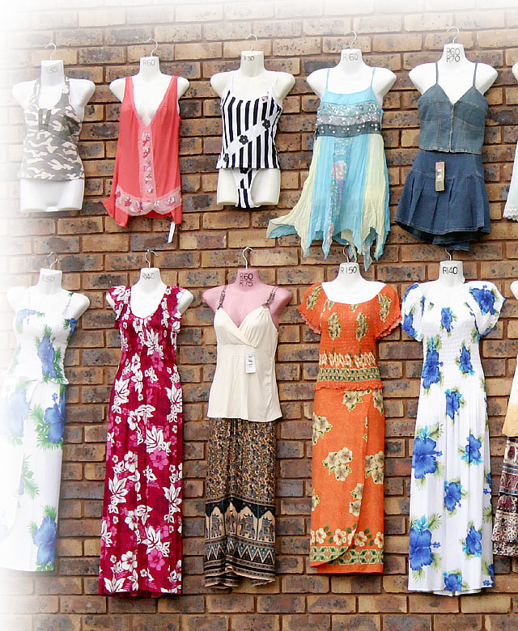
Praise her for being a good:
11. Judge of Character 23
12. Entrepreneur 24
13. Dresser 25
²⁵ Strength and dignity are her clothing, and she laughs at the time to come.
Notes:
Clothing = FREE = from http://www.sxc.hu/browse.phtml?f=download&id=707504

Slide 30
Praise her for being a good:
11. Judge of Character 23
12. Entrepreneur 24
13. Dresser 25
14. Talker 26
²⁶ She opens her mouth with wisdom, and the teaching of kindness is on her tongue.
Notes:
Woman on phone = FREE = from https://pixabay.com/en/woman-girl-lady-young-talk-talkig-791874/

Slide 31
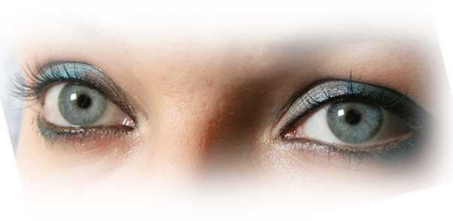
Praise her for being a good:
²⁷ She looks well to the ways of her household, and does not eat the bread of idleness.
11. Judge of Character
12. Entrepreneur 24
13. Dresser 25
14. Talker 26
15. Gate Keeper 27
Notes:
Eyes = FREE = from http://www.sxc.hu/photo/1373700

Slide 32
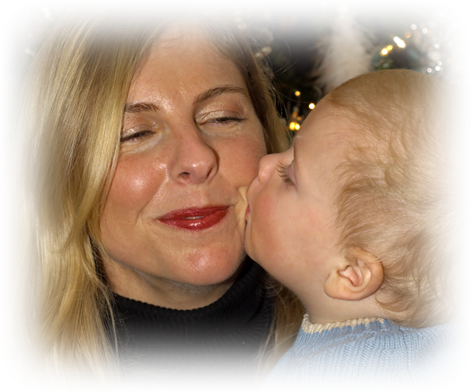
Praise her for being a good:
16. Mother 28
²⁸ Her children arise and call her blessed; (NIV)
Notes:
Mother and child = FREE = from http://www.dreamstime.com/mother-and-child-free-stock-photos-imagefree2671098

Slide 33
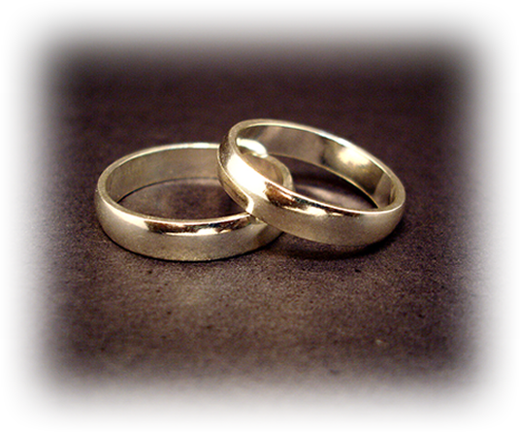
Praise her for being a good:
16. Mother 28
17. Spouse 28
²⁸ her husband too, and he praises her:
Notes:
Wedding rings = FREE = from http://upload.wikimedia.org/wikipedia/commons/3/3d/Wedding_rings.jpg

Slide 34
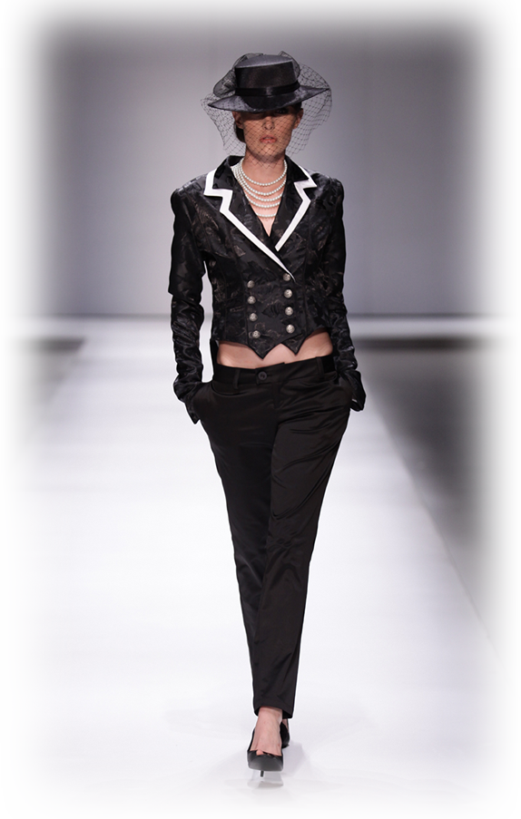
Praise her for being a good:
16. Mother 28
17. Spouse 28
18. Model 29
²⁹ "Many women have done excellently, but you surpass them all."
Notes:
Model on runway = FREE = from http://upload.wikimedia.org/wikipedia/commons/5/57/Abigail_Keats_Autumn_winter_2010_2.JPG

Slide 35
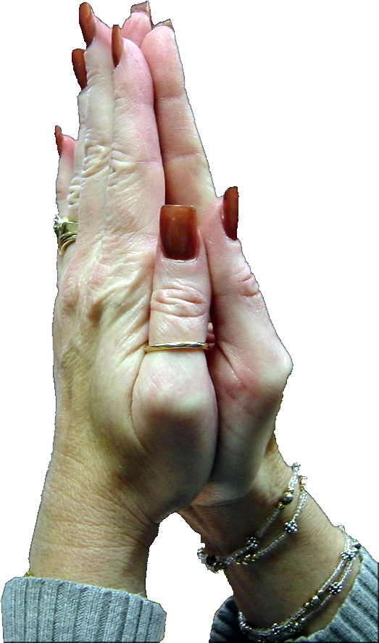
Praise her for being a good:
16. Mother 28
17. Spouse 28
18. Model 29
19. Christian 30
³⁰ Charm is deceitful, and beauty is vain, but a woman who fears the LORD is to be praised.
Notes:
Praying hands = FREE = from BiblePoint photo.

Slide 36
Praise her for being a good:
16. Mother 28
17. Spouse 28
18. Model 29
19. Christian 30
20. Witness 31
³¹ Give her a share in the fruit of her hands, and let her works praise her in the city gates.
Notes:
Modified Trophy = LICENSED and NOT FOR REUSE. To reuse elsewhere, get a license from http://www.istockphoto.com/stock-photo-1406600-trophy.php

Slide 37
Praise Her!
Hallelu-ha Praise her

Slide 38
Let me sum up:

Slide 39
My First Point was:
Praise Her!

Slide 40
My First Point was:
Praise Her!
Praise Her because...
My Second Point was:

Slide 41
My First Point was:
Praise Her!
Praise Her because...
Praise Her NOW!
My Second Point was:
My Last Point is:

Slide 42
Let’s Pray!

