Slide 1
Notes:
Background image = Licensed and NOT for reuse elsewhere = to use elsewhere get a licenses from http://www.bigstockphoto.com/image-12580199/stock-photo-christmas-gifts

Slide 2
An Indescribable Gift
¹⁵ Thanks be to God for his indescribable gift! (2 Corinthians 9:15)

Slide 3
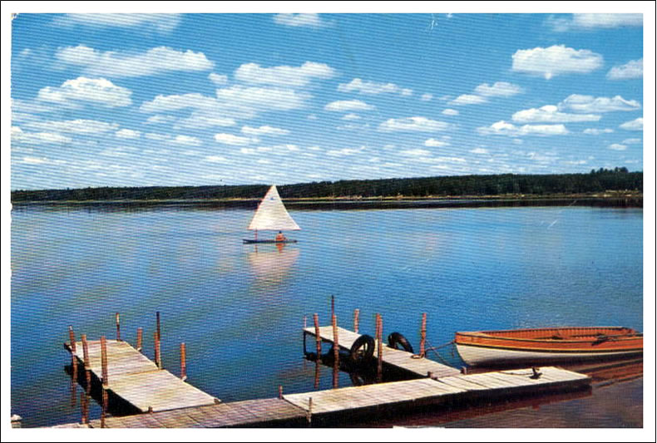
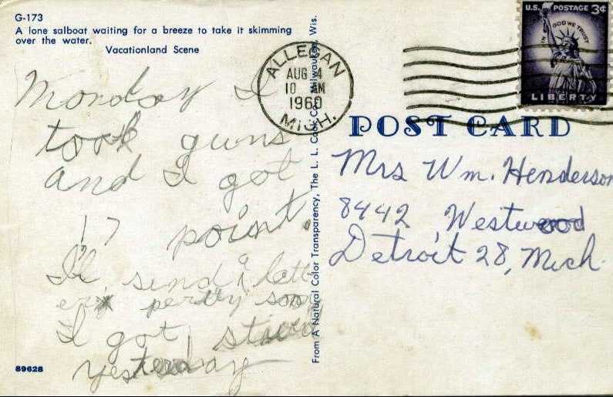
A Love Gift
For God so loved the world that he gave his one and only Son, that whoever believes in him shall not perish but have eternal life. (John 3:16)
Notes:
World heart = FREE = http://commons.wikimedia.org/wiki/File:Werner-projection.jpg

Slide 4
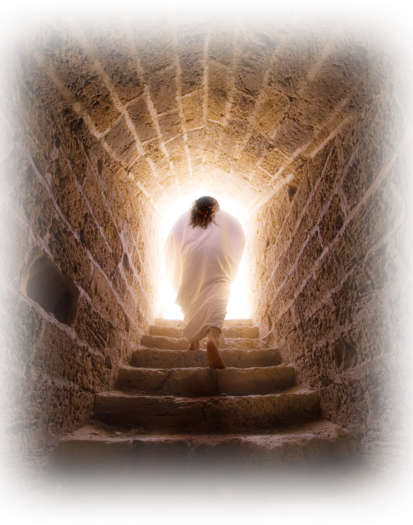
A Lasting Gift
²³ For the wages of sin is death, but the gift of God is eternal life in Christ Jesus our Lord. (Romans 6:23)
Notes:
Istock Image

Slide 5
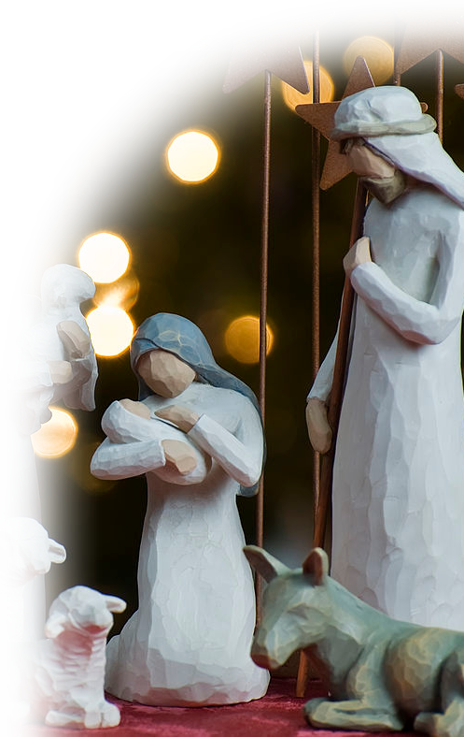
A Wrapped Gift
²³ For the wages of sin is death, but the gift of God is eternal life in Christ Jesus our Lord. (Romans 6:23)
Notes:
Nativity = FREE = from http://commons.wikimedia.org/wiki/File:Nativity_tree2011.jpg

Slide 6
A Free Gift
⁸ For it is by grace you have been saved, through faith— and this not from yourselves, it is the gift of God (Ephesians 2:8)
Notes:
FREE sign = FREE = from http://commons.wikimedia.org/wiki/File:Oh-Yes-its-FREE---iStock.gif

Slide 7
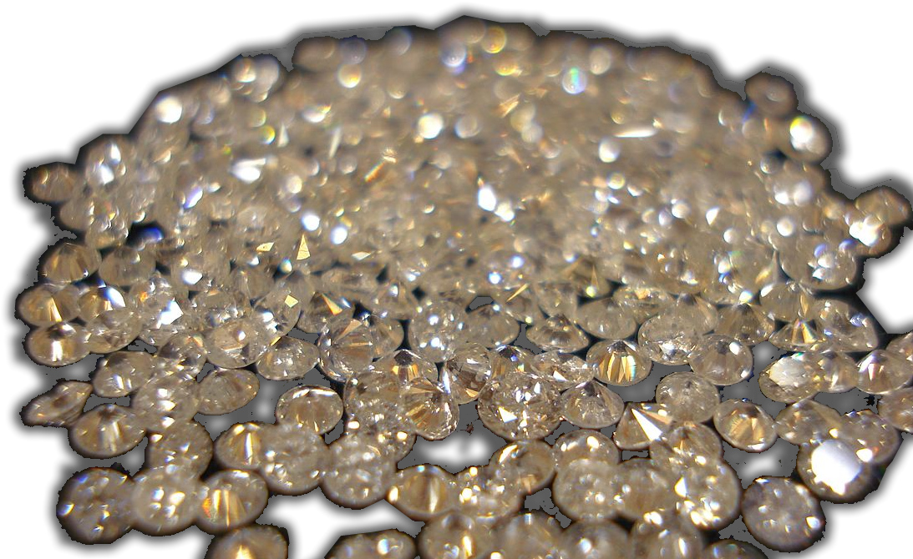
A Valuable Gift
⁴ As you come to him, the living Stone--rejected by men but chosen by God and precious to him-- (1 Peter 2:4)
Notes:
NET = “Priceless”
Diamonds = FREE = from http://commons.wikimedia.org/wiki/File:Diamonds.jpg

Slide 8
A Valuable Gift
⁷ Now to you who believe, this stone is precious. But to those who do not believe, "The stone the builders rejected has become the capstone," (1 Peter 2:7)
Notes:
NET = “Priceless”
Diamonds = FREE = from http://commons.wikimedia.org/wiki/File:Diamonds.jpg

Slide 9
An Unmerited Gift
⁸ For it is by grace you have been saved, through faith--and this not from yourselves, it is the gift of God-- ⁹ not by works, so that no one can boast. (Ephesians 2:8-9)

Slide 10
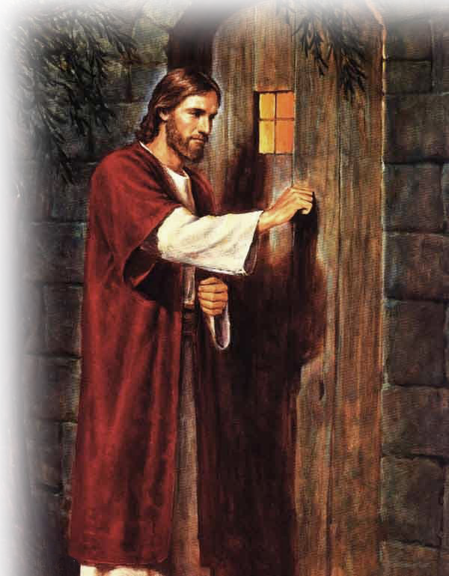
An Offered Gift
²⁰ Here I am! I stand at the door and knock. If anyone hears my voice and opens the door, I will come in and eat with him, and he with me. (Revelation 3:20)
Notes:
Jesus at Door = FREE = from http://www.flickr.com/photos/waitingfortheword/5560611967/sizes/l/in/photostream/

Slide 11
An Offered Gift
¹⁶ “… that whoever believes in him shall not perish but have eternal life. (John 3:16)
Notes:
Jesus at Door = FREE = from http://www.flickr.com/photos/waitingfortheword/5560611967/sizes/l/in/photostream/

Slide 12
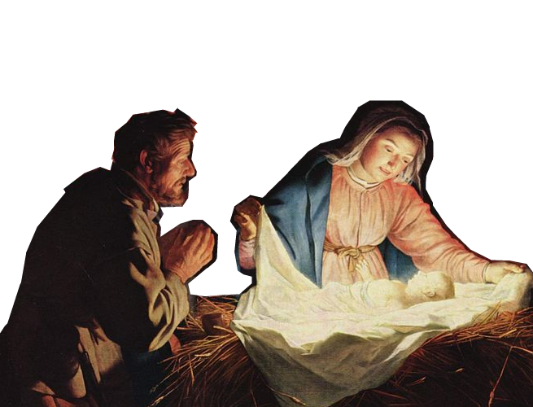
A Received Gift
¹¹ He came to that which was his own, but his own did not receive him. ¹² Yet to all who received him, to those who believed in his name, he gave the right to become children of God … (John 1:11-12)
Notes:
Nativity = FREE =from http://en.wikipedia.org/wiki/File:Gerard_van_Honthorst_001.jpg

Slide 13
An Indescribable Gift
¹⁵ Thanks be to God for his indescribable gift! (2 Corinthians 9:15)

Slide 14
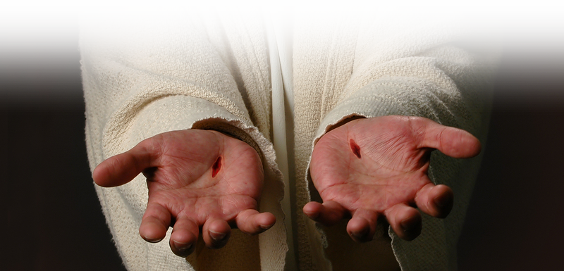
Take the Gift TODAY!
Let’s Pray

