Slide 1
Notes:
Background Image = FREE = from http://123freevectors.deviantart.com/art/Happy-Mothers-Day-Greeting-Card-452980960

Slide 2
A Godly Mother’s Greatest Joy
What Brings Such Joy?

Slide 3
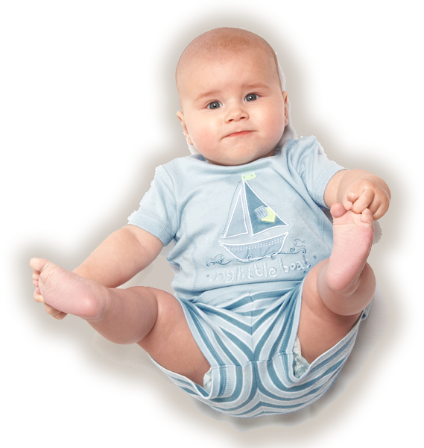
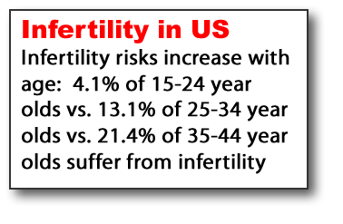
1. Perhaps just having a Child
He settles the barren woman in her home as a happy mother of children. Praise the LORD. (Psalm 113:9)
Notes:
Baby photo free from http://www.dreamstime.com/baby-1-free-stock-image-imagefree1292280

Slide 4
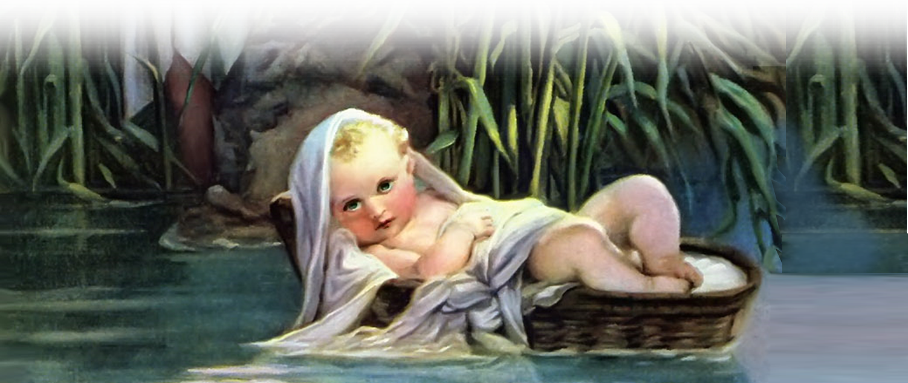
2. Perhaps a Healthy Child
The woman became pregnant and gave birth to a son. When she saw that he was a healthy child, she hid him for three months. (Exodus 2:2 NET)
Notes:
Free picture from http://freechristimages.org/images_Exodus/Discovery_of_Moses_Paul_Delaroche.jpg

Slide 5
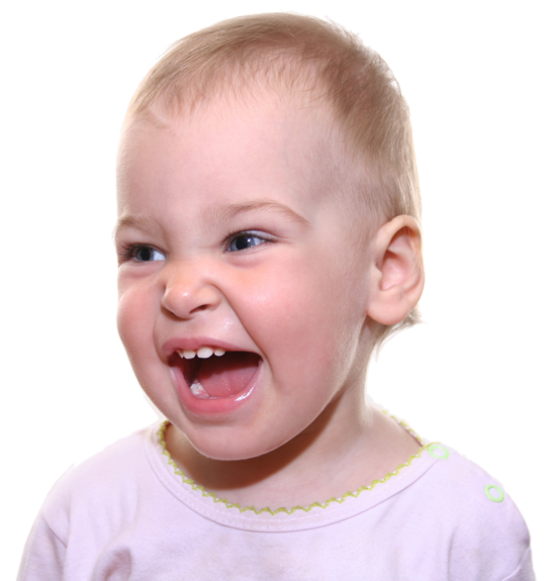
3. Perhaps a Happy Child
A cheerful look brings joy to the heart, and good news gives health to the bones. (Proverbs 15:30)
Good report
Notes:
Happy baby free from http://www.dreamstime.com/happy-baby-free-stock-image-imagefree872728

Slide 6
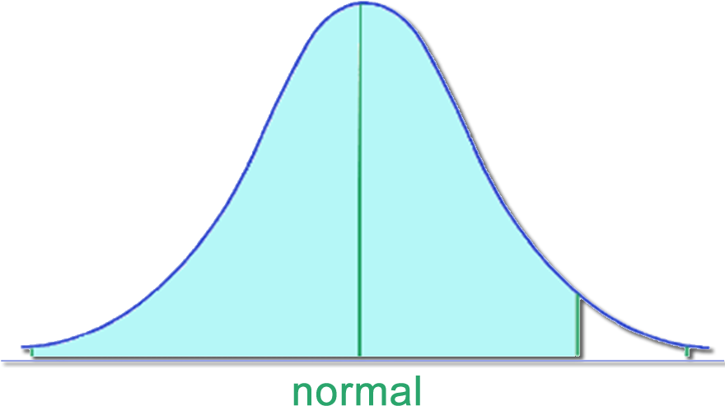
4. Perhaps a Well Adjusted
And Jesus grew in wisdom and stature, and in favor with God and men. (Luke 2:52)

Slide 7
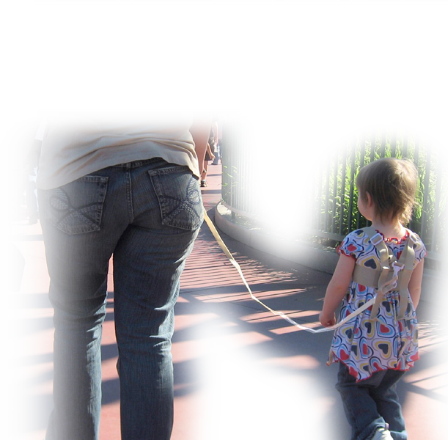
5. Perhaps an Obedient Child
¹ Children, obey your parents in the Lord, for this is right. (Ephesians 6:1)
Notes:
Kid leash = http://www.flickr.com/photos/malingering/2326125904/

Slide 8
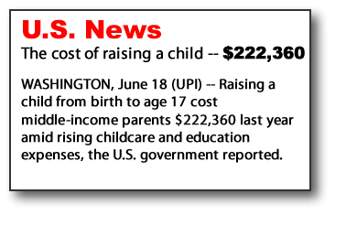
6. Perhaps an Honoring Child
² "Honor your father and mother"--which is the first commandment with a promise (Ephesians 6:2)
Set a price, estimate, value on something
Notes:
Gold free from Dreamstime = http://www.dreamstime.com/ignot-free-stock-image-imagefree1574418

Slide 9
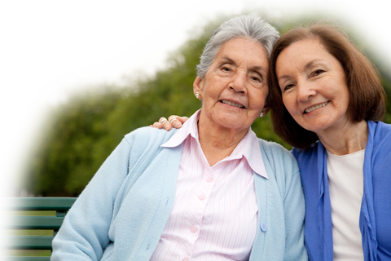
7. Perhaps a Long Life
³ "that it may go well with you and that you may enjoy long life on the earth." (Ephesians 6:2-3)
Notes:
Gold free from Dreamstime = http://www.dreamstime.com/ignot-free-stock-image-imagefree1574418

Slide 10
8. Perhaps a Wise Child
¹⁵ My son, if your heart is wise, then my heart will be glad; (Proverbs 23:15)

Slide 11
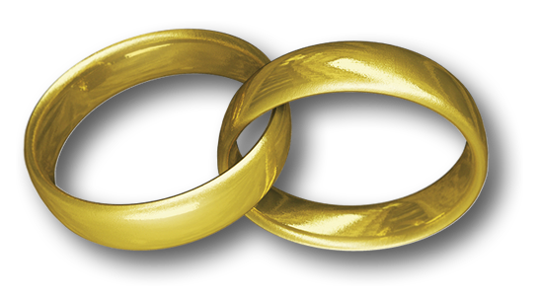
9. Perhaps a Good Marriage
¹⁸ May your fountain be blessed, and may you rejoice in the wife of your youth. (Proverbs 5:18)
Notes:
Rings free from http://www.sxc.hu/browse.phtml?f=download&id=1326034

Slide 12
10. A Child Who BELIEVES
⁵ I have been reminded of your sincere faith, which first lived in your grandmother Lois and in your mother Eunice and, I am persuaded, now lives in you also. (2 Tim 1:5)

Slide 13
Many of these are outside of our control …
But placing faith in Jesus is something everyone here can do…

Slide 14
Make your “Godly Mom” rejoice today …
Place faith in Jesus Now! It’s easy to do …

Slide 16
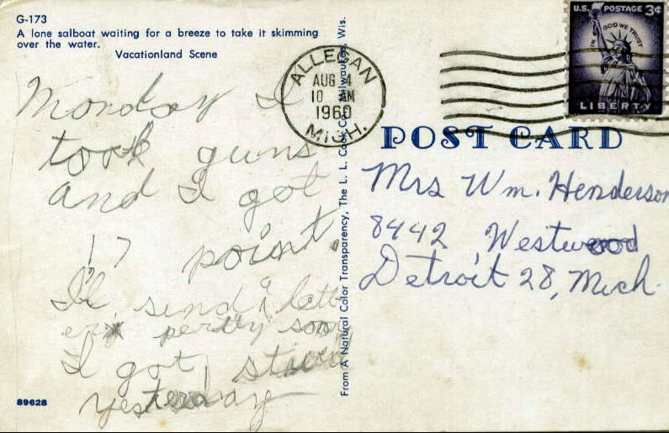

Slide 17
Do it now as we pray!

