Slide 1
How to
Rejoice
in tough times!
A Study of Philippians
Notes:
This series uses the “Good Morning” font. You may download it free at: www.1001fonts.com/good-morning-font.html
and Eras Demi ITC
Copyright © 2000-2021. All rights reserved. Bible Point is a registered trademark of Dennis Henderson. All other trademarks acknowledged.
Bible Point contains graphics from Bible Point artists. These illustrations belong to Bible Point and the respective artists. You may use the designs and illustrations for graphical illustration of lessons free and without special permission, provided they are not used in any way that maligns the Christian faith. Furthermore, republication or production of any illustration by any other graphic service whether it be in book, in a machine-readable form, or in any other design resource is strictly prohibited. Furthermore, they cannot be duplicated or resold as any other form of publishing, clip art, or graphic resource.
So What does it mean? (A simple translations of the legal jargon)
So, if you don’t own the presentation(s), graphic(s), and text(s) how can you legally use them? The purchase of the license allows you to use all the images in the product. However, the actual ownership and copyright of the presentation(s), graphic(s), and text(s) remain the property of Bible Point and its licensors. If you had plans on using this product in your “for sale” work—think again!
License Agreement
Article 1: License Grant
All the graphics and text in Bible Point presentations (excluding quotes from the Bible and stated sources) are the intellectual and real property of Bible Point and its licensors, and is protected by law, including United States copyright laws and international treaties. Bible Point grants to you a license:
1. To use the presentation in a single church, single school, or single office of a Christian organization.
2. To make a single archival back-up copy of the program.
3. To modify the presentation(s) and merge with other presentations in a single church, school, or Christian organization.
4. To transfer to another party if that party agrees to accept the terms and conditions of this agreement, and you do not retain any copies of the presentation, whether printed, machine readable, modified, or merged form.
Article 2: Terms
This license is effective until terminated. You may terminate the license at any time by destroying the presentation(s), graphic(s), or text(s) together with all copies, modifications and merged portions in any form. Bible Point may terminate your license if you fail to comply with this Agreement. You agree, upon such termination, for any reason, to destroy the presentation(s), graphics, and text(s) with all copies, modifications, and merged portions in any form.
Article 3: Disclaimers
1. Bible Point presentations, graphics, and texts are licensed to you As Is. You, the consumer, bear the entire risk relating to the quality and performance of the presentation(s), graphic(s), or text(s). In no event will Bible Point be liable for damages resulting from any defect.
2. Thirty-day limited warrantee on disks. Bible Point warrants the disks to be free of defects in material and workmanship under normal use for 30 days after purchase. During the 30-day period you may return a defective presentation, graphic, or text with proof of purchase and it will be replaced without charge, unless the presentation is damaged by misuse.
Article 4: General
1. You may not sub-license, assign, or transfer the license of the presentation(s), graphic(s), or text(s) except as provided by this Agreement.
2. This Agreement will be governed by the laws of the State of Michigan.
So What does it mean? (A simple translations of the legal jargon)
May I let someone borrow or copy my licensed Bible Point presentation (even after I modified it)? As long as it is within your local church, or single school, or the immediate office of a Christian organization you may. Otherwise, please refer the person interested in borrowing to: http://www.biblepoint.com or E-mail: dh@biblepoint.com with any related questions.
---------------------------------------------------------------------------------------------------------------------------
Scripture taken from the HOLY BIBLE, NEW INTERNATIONAL VERSION®. NIV®. Copyright©1973, 1978, 1984 by International Bible Society. Used by permission of Zondervan. All rights reserved.

Slide 2
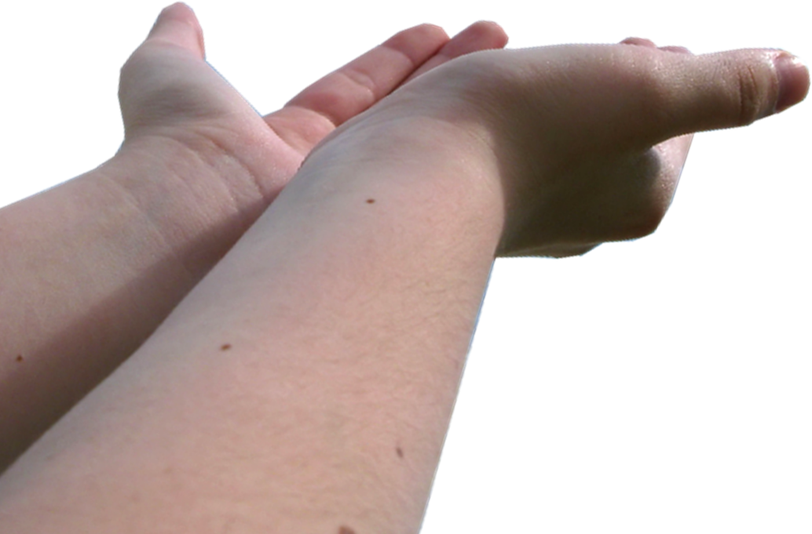
The JOY of “GIVING”
Notes:
Hands offering up = Modified FREE = http://www.rgbstock.com/photo/mhGyknC/giving+hands

Slide 3
Philippians is a Thank You Note
¹⁴ Yet it was kind of you to share my trouble.

Slide 4
There is all kinds of Joy in giving
Notes:
Worry Free Zone Sign = free = from BiblePoint and http://upload.wikimedia.org/wikipedia/commons/b/be/Memphis_highway_sign_IMG_0670.JPG

Slide 5
RECIPROCAL JOY
¹⁵ And you Philippians yourselves know that in the beginning of the gospel, when I left Macedonia, no church entered into partnership with me in giving and receiving, except you only.
Notes:
I know what it is like to be on the end of someone else’s giving. To be the “recipient” as a college student, I would receive from time to time a gift in the mail in the form of a check for my tuition from a family in my home church. Once we were without any significant groceries skimping along—an a knock on the door. We opened it to find a huge box full of groceries. My last year of seminary, moved to Phila -- a man emptied his wallet for groceries. I later became the pastor of that church

Slide 6
HELPFUL JOY
¹⁶ Even in Thessalonica you sent me help for my needs once and again.
Notes:
Life ring with cash = Licensed and NOT FOR REUSE ELSEWHERE. To reuse elsewhere get a license from http://www.bigstockphoto.com/image-7994741/stock-photo-financial-aid-life-preserver

Slide 7
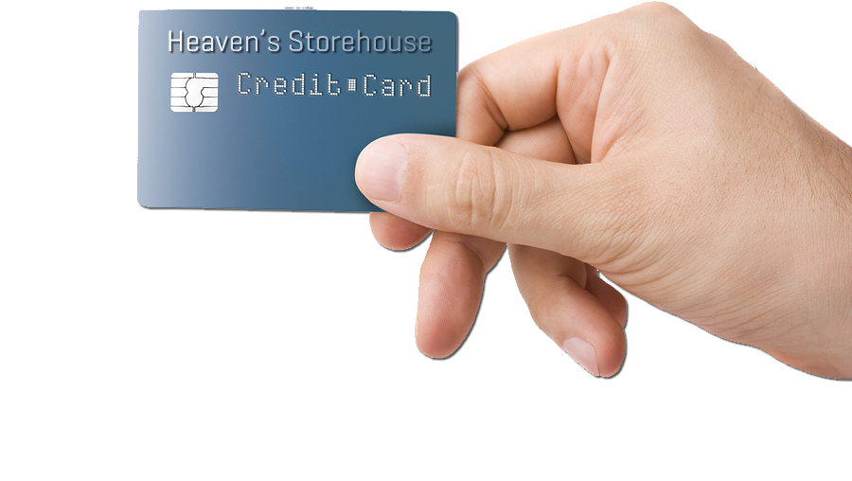
INVESTOR’S JOY
¹⁷ Not that I seek the gift, but I seek the fruit that increases to your credit.
“Store up for yourselves treasures in heaven” (Mat 6:19-21)
Notes:
Credit Card = Licensed and NOT FOR REUSE ELSEWHERE. To reuse elsewhere get a license from http://www.bigstockphoto.com/image-18863135/stock-photo-nameless-credit-card-with-chip-in-a-male-hand-isolated-on-white
¹⁹ "Do not store up for yourselves treasures on earth, where moth and rust consume and where thieves break in and steal;
²⁰ but store up for yourselves treasures in heaven, where neither moth nor rust consumes and where thieves do not break in and steal.
(Mat 6:19-21 NRS)

Slide 8
INVESTOR’S JOY
¹⁷ Not that I seek the gift, but I seek the profit that accumulates to your account.
“Store up for yourselves treasures in heaven” (Mat 6:19-21)
Notes:
Credit Card = Licensed and NOT FOR REUSE ELSEWHERE. To reuse elsewhere get a license from http://www.bigstockphoto.com/image-18863135/stock-photo-nameless-credit-card-with-chip-in-a-male-hand-isolated-on-white
¹⁹ "Do not store up for yourselves treasures on earth, where moth and rust consume and where thieves break in and steal;
²⁰ but store up for yourselves treasures in heaven, where neither moth nor rust consumes and where thieves do not break in and steal.
(Mat 6:19-21 NRS)

Slide 9
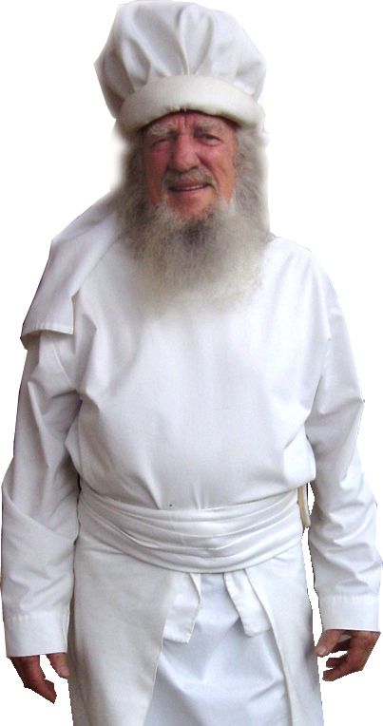
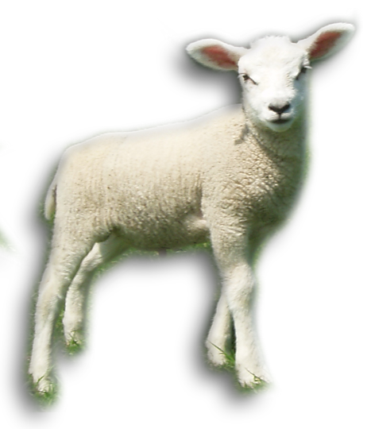
PREISTLY JOY
¹⁸ I have received full payment, and more. I am well supplied, having received from Epaphroditus the gifts you sent, a fragrant offering, a sacrifice acceptable and pleasing to God.
Notes:
Priest = FREE = BiblePoint photo
Lamb FREE = sxc photo

Slide 10
PREISTLY JOY
¹⁸ I have received full payment, and more. I am well supplied, having received from Epaphroditus the gifts you sent, a fragrant offering, a sacrifice acceptable and pleasing to God.
Notes:
Priest = FREE = BiblePoint photo
Lamb FREE = sxc photo

Slide 11
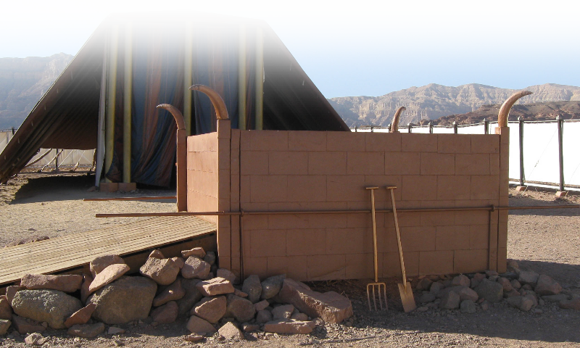
PREISTLY JOY
¹⁸ ... a fragrant offering, a sacrifice …
Notes:
Tabernacle altar = FREE = from http://upload.wikimedia.org/wikipedia/commons/6/60/Timna_Tabernacle_Altar_of_Burnt_Offerings.jpg

Slide 12
PREISTLY JOY
¹⁸ ... a fragrant offering, a sacrifice …
Six Parts (Lev 1:2-9):
Presentation – bring it
Identification – lay hands on it
Execution – slaughter it
Mediation – offer it’s blood
Expiation – flay it & burn it
Satisfaction – pleased with it
Notes:
Tabernacle altar = FREE = from http://upload.wikimedia.org/wikipedia/commons/6/60/Timna_Tabernacle_Altar_of_Burnt_Offerings.jpg

Slide 13
PREISTLY JOY
¹⁸ ... a fragrant offering, a sacrifice …
Jesus is our Hight Priest
¹¹ And every priest stands day after day at his service, offering again and again the same sacrifices that can never take away sins. ¹² But when Christ had offered for all time a single sacrifice for sins, "he sat down at the right hand of God," (Hebrews 10:11-12)
Notes:
Tabernacle altar = FREE = from http://upload.wikimedia.org/wikipedia/commons/6/60/Timna_Tabernacle_Altar_of_Burnt_Offerings.jpg

Slide 14
PREISTLY JOY
¹⁸ ... a fragrant offering, a sacrifice …
Jesus is our Hight Priest
he has appeared once for all at the end of the age to remove sin by the sacrifice of himself. (Hebrews 9:26)
Here is the Lamb of God who takes away the sin of the world! (John 1:29)
Notes:
Tabernacle altar = FREE = from http://upload.wikimedia.org/wikipedia/commons/6/60/Timna_Tabernacle_Altar_of_Burnt_Offerings.jpg

Slide 15
PREISTLY JOY
¹⁸ ... a sacrifice acceptable and pleasing to God.
We are Believer Priests
To him [Jesus] who loves us and freed us from our sins by his blood, ⁶ and made us to be a kingdom, priests serving his God and Father, to him be glory and dominion forever and ever. Amen. (Revelation 1:5-6)
Notes:
Tabernacle altar = FREE = from http://upload.wikimedia.org/wikipedia/commons/6/60/Timna_Tabernacle_Altar_of_Burnt_Offerings.jpg

Slide 16
PREISTLY JOY
¹⁸ ... a sacrifice acceptable and pleasing to God.
We are Believer Priests
⁵ like living stones, let yourselves be built into a spiritual house, to be a holy priesthood, to offer spiritual sacrifices acceptable to God through Jesus Christ. (1Peter 2:5)
Notes:
Tabernacle altar = FREE = from http://upload.wikimedia.org/wikipedia/commons/6/60/Timna_Tabernacle_Altar_of_Burnt_Offerings.jpg

Slide 17
PREISTLY JOY
¹⁸ ... a sacrifice acceptable and pleasing to God.
1ST Offer your SELF
I appeal to you therefore, brothers and sisters, by the mercies of God, to present your bodies as a living sacrifice, holy and acceptable to God, which is your spiritual worship. (Rom 12:1)
Notes:
Tabernacle altar = FREE = from http://upload.wikimedia.org/wikipedia/commons/6/60/Timna_Tabernacle_Altar_of_Burnt_Offerings.jpg

Slide 18
PREISTLY JOY
¹⁸ ... a sacrifice acceptable and pleasing to God.
1ST Offer your SELF
I appeal to you therefore, brothers and sisters, by the mercies of God, to present your bodies as a living sacrifice, holy and acceptable to God, which is your spiritual worship. (Rom 12:1)
Notes:
Tabernacle altar = FREE = from http://upload.wikimedia.org/wikipedia/commons/6/60/Timna_Tabernacle_Altar_of_Burnt_Offerings.jpg

Slide 19
PREISTLY JOY
¹⁸ ... a sacrifice acceptable and pleasing to God.
2nd Offer your SPEECH
¹⁵ Through him, then, let us continually offer a sacrifice of praise to God, that is, the fruit of lips that confess his name. (Hebrews 13:15)
Notes:
Tabernacle altar = FREE = from http://upload.wikimedia.org/wikipedia/commons/6/60/Timna_Tabernacle_Altar_of_Burnt_Offerings.jpg

Slide 20
PREISTLY JOY
¹⁸ ... a sacrifice acceptable and pleasing to God.
3RD Offer your SERVICE
¹⁶ Do not neglect to do good and to share what you have, for such sacrifices are pleasing to God. (Heb 13:16)
Notes:
Tabernacle altar = FREE = from http://upload.wikimedia.org/wikipedia/commons/6/60/Timna_Tabernacle_Altar_of_Burnt_Offerings.jpg

Slide 21
PREISTLY JOY
¹⁸ ... a sacrifice acceptable and pleasing to God.
4TH Offer PEOPLE
because of the grace given me by God ¹⁶ to be a minister of Christ Jesus to the Gentiles in the priestly service of the gospel of God, so that the offering of the Gentiles may be acceptable, sanctified by the Holy Spirit. (Rom 15:15-16)
Notes:
Tabernacle altar = FREE = from http://upload.wikimedia.org/wikipedia/commons/6/60/Timna_Tabernacle_Altar_of_Burnt_Offerings.jpg

Slide 22
PREISTLY JOY
¹⁸ ... a sacrifice acceptable and pleasing to God.
5TH Offer MONEY
I have received from Epaphroditus the gifts you sent, a fragrant offering, a sacrifice acceptable and pleasing to God. (Philippians 4:18)
Notes:
Tabernacle altar = FREE = from http://upload.wikimedia.org/wikipedia/commons/6/60/Timna_Tabernacle_Altar_of_Burnt_Offerings.jpg

Slide 23
PROMISED JOY
¹⁹ And my God will supply every need of yours according to his riches in glory in Christ Jesus.
Notes:
The word “and” connects the fulfillment of this promise to giving which precedes it.

Slide 24
PROMISED JOY
¹⁹ And my God will supply every need of yours according to his riches in glory in Christ Jesus.
Notes:
The word “and” connects the fulfillment of this promise to giving which precedes it.

Slide 25
PROMISED JOY
¹⁹ And my God will supply every need of yours according to his riches in glory in Christ Jesus.
Literally = “fill to the full”
Notes:
The word “and” connects the fulfillment of this promise to giving which precedes it.

Slide 26
PROMISED JOY
¹⁹ And my God will supply every need of yours according to his riches in glory in Christ Jesus.
Not “every want of yours”
Notes:
The word “and” connects the fulfillment of this promise to giving which precedes it.

Slide 27
PROMISED JOY
¹⁹ And my God will supply every need of yours according to his riches in glory in Christ Jesus.
NOT = “out of”
Notes:
The word “and” connects the fulfillment of this promise to giving which precedes it.

Slide 28
PROMISED JOY
¹⁹ And my God will supply every need of yours according to his riches in glory in Christ Jesus.
You are PROMISED this, WHEN YOU GIVE!
Notes:
The word “and” connects the fulfillment of this promise to giving which precedes it.

Slide 29
PROMISED JOY
¹⁹ And my God will supply every need of yours according to his riches in glory in Christ Jesus.
Notes:
The word “and” connects the fulfillment of this promise to giving which precedes it.

Slide 30
PROMISED JOY
¹⁹ And my God will supply every need of yours according to his riches in glory in Christ Jesus.
This Promise is “in Christ Jesus!” You must have Him to have the promise!
Notes:
The word “and” connects the fulfillment of this promise to giving which precedes it.

Slide 31
GLORIOUS JOY
²⁰ To our God and Father be glory forever and ever. Amen.

Slide 32
The CHURCH’S JOY
²¹ Greet every saint in Christ Jesus. The brothers who are with me greet you. ²² All the saints greet you, especially those of Caesar's household.
²³ The grace of the Lord Jesus Christ be with your spirit.

Slide 33
Imagine how much Joy the Lord has for you...
If you would just GIVE IT UP to Him!
Offer Up Your:
Self
Speech
Service
Contacts
Money
Experience His Promise!
Notes:
Contacts = souls for Jesus
Money = Silver

Slide 34
Let’s Pray!

