Slide 1
How to
Rejoice
in tough times!
A Study of Philippians
Notes:
This series uses the “Good Morning” font. You may download it free at: www.1001fonts.com/good-morning-font.html
and Eras Demi ITC
Copyright © 2000-2021. All rights reserved. Bible Point is a registered trademark of Dennis Henderson. All other trademarks acknowledged.
Bible Point contains graphics from Bible Point artists. These illustrations belong to Bible Point and the respective artists. You may use the designs and illustrations for graphical illustration of lessons free and without special permission, provided they are not used in any way that maligns the Christian faith. Furthermore, republication or production of any illustration by any other graphic service whether it be in book, in a machine-readable form, or in any other design resource is strictly prohibited. Furthermore, they cannot be duplicated or resold as any other form of publishing, clip art, or graphic resource.
So What does it mean? (A simple translations of the legal jargon)
So, if you don’t own the presentation(s), graphic(s), and text(s) how can you legally use them? The purchase of the license allows you to use all the images in the product. However, the actual ownership and copyright of the presentation(s), graphic(s), and text(s) remain the property of Bible Point and its licensors. If you had plans on using this product in your “for sale” work—think again!
License Agreement
Article 1: License Grant
All the graphics and text in Bible Point presentations (excluding quotes from the Bible and stated sources) are the intellectual and real property of Bible Point and its licensors, and is protected by law, including United States copyright laws and international treaties. Bible Point grants to you a license:
1. To use the presentation in a single church, single school, or single office of a Christian organization.
2. To make a single archival back-up copy of the program.
3. To modify the presentation(s) and merge with other presentations in a single church, school, or Christian organization.
4. To transfer to another party if that party agrees to accept the terms and conditions of this agreement, and you do not retain any copies of the presentation, whether printed, machine readable, modified, or merged form.
Article 2: Terms
This license is effective until terminated. You may terminate the license at any time by destroying the presentation(s), graphic(s), or text(s) together with all copies, modifications and merged portions in any form. Bible Point may terminate your license if you fail to comply with this Agreement. You agree, upon such termination, for any reason, to destroy the presentation(s), graphics, and text(s) with all copies, modifications, and merged portions in any form.
Article 3: Disclaimers
1. Bible Point presentations, graphics, and texts are licensed to you As Is. You, the consumer, bear the entire risk relating to the quality and performance of the presentation(s), graphic(s), or text(s). In no event will Bible Point be liable for damages resulting from any defect.
2. Thirty-day limited warrantee on disks. Bible Point warrants the disks to be free of defects in material and workmanship under normal use for 30 days after purchase. During the 30-day period you may return a defective presentation, graphic, or text with proof of purchase and it will be replaced without charge, unless the presentation is damaged by misuse.
Article 4: General
1. You may not sub-license, assign, or transfer the license of the presentation(s), graphic(s), or text(s) except as provided by this Agreement.
2. This Agreement will be governed by the laws of the State of Michigan.
So What does it mean? (A simple translations of the legal jargon)
May I let someone borrow or copy my licensed Bible Point presentation (even after I modified it)? As long as it is within your local church, or single school, or the immediate office of a Christian organization you may. Otherwise, please refer the person interested in borrowing to: http://www.biblepoint.com or E-mail: dh@biblepoint.com with any related questions.
---------------------------------------------------------------------------------------------------------------------------
Scripture taken from the HOLY BIBLE, NEW INTERNATIONAL VERSION®. NIV®. Copyright©1973, 1978, 1984 by International Bible Society. Used by permission of Zondervan. All rights reserved.

Slide 2
The JOY of “CONTENTMENT”
Notes:
Thumb Up = Modified FREE = from http://www.rgbstock.com/download/lonewolf/mSB3M4C.jpg
Content = Satisfied = also may mean self-sufficient

Slide 3
There’s a SECRET
I have learned the secret of being content 4:12 (NIV)
The Secret is found in:
Notes:
Worry Free Zone Sign = free = from BiblePoint and http://upload.wikimedia.org/wikipedia/commons/b/be/Memphis_highway_sign_IMG_0670.JPG

Slide 4
The Secret of Perspective
¹⁰ I rejoiced in the Lord greatly that now at length you have revived your concern for me. You were indeed concerned for me, but you had no opportunity.
PESSIMIST = HALF EMPTY
Notes:
Disciples with the problem of feeding 5,000
- Pessimist = can’t be done. “Where are we to buy bread for these people?” -- Six months wages would not be enough?”
- Optimist = There’s a boy with 5 loaves and two fish—but what are they among so many.
- Opportunist = Blessed them and distributed them ....
⁵ When he looked up and saw a large crowd coming toward him, Jesus said to Philip, "Where are we to buy bread for these people to eat?"
⁶ He said this to test him, for he himself knew what he was going to do.
⁷ Philip answered him, "Six months' wages would not buy enough bread for each of them to get a little."
⁸ One of his disciples, Andrew, Simon Peter's brother, said to him,
⁹ "There is a boy here who has five barley loaves and two fish. But what are they among so many people?"
¹⁰ Jesus said, "Make the people sit down." Now there was a great deal of grass in the place; so they sat down, about five thousand in all.
¹¹ Then Jesus took the loaves, and when he had given thanks, he distributed them to those who were seated; so also the fish, as much as they wanted.
¹² When they were satisfied, he told his disciples, "Gather up the fragments left over, so that nothing may be lost." (Joh 6:5-12 NRS)

Slide 5
The Secret of Perspective
¹⁰ I rejoiced in the Lord greatly that now at length you have revived your concern for me. You were indeed concerned for me, but you had no opportunity.
OPTIMIST = HALF FULL
Notes:
Disciples with the problem of feeding 5,000
- Pessimist = can’t be done. “Where are we to buy bread for these people?” -- Six months wages would not be enough?”
- Optimist = There’s a boy with 5 loaves and two fish—but what are they among so many.
- Opportunist = Blessed them and distributed them ....
⁵ When he looked up and saw a large crowd coming toward him, Jesus said to Philip, "Where are we to buy bread for these people to eat?"
⁶ He said this to test him, for he himself knew what he was going to do.
⁷ Philip answered him, "Six months' wages would not buy enough bread for each of them to get a little."
⁸ One of his disciples, Andrew, Simon Peter's brother, said to him,
⁹ "There is a boy here who has five barley loaves and two fish. But what are they among so many people?"
¹⁰ Jesus said, "Make the people sit down." Now there was a great deal of grass in the place; so they sat down, about five thousand in all.
¹¹ Then Jesus took the loaves, and when he had given thanks, he distributed them to those who were seated; so also the fish, as much as they wanted.
¹² When they were satisfied, he told his disciples, "Gather up the fragments left over, so that nothing may be lost." (Joh 6:5-12 NRS)

Slide 6
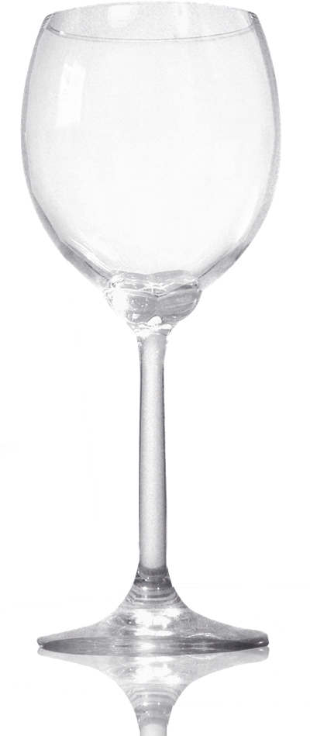
The Secret of Perspective
¹⁰ I rejoiced in the Lord greatly that now at length you have revived your concern for me. You were indeed concerned for me, but you had no opportunity.
OPPORTUNIST = Tastes Great
Notes:
Disciples with the problem of feeding 5,000
- Pessimist = can’t be done. “Where are we to buy bread for these people?” -- Six months wages would not be enough?”
- Optimist = There’s a boy with 5 loaves and two fish—but what are they among so many.
- Opportunist = Blessed them and distributed them ....
⁵ When he looked up and saw a large crowd coming toward him, Jesus said to Philip, "Where are we to buy bread for these people to eat?"
⁶ He said this to test him, for he himself knew what he was going to do.
⁷ Philip answered him, "Six months' wages would not buy enough bread for each of them to get a little."
⁸ One of his disciples, Andrew, Simon Peter's brother, said to him,
⁹ "There is a boy here who has five barley loaves and two fish. But what are they among so many people?"
¹⁰ Jesus said, "Make the people sit down." Now there was a great deal of grass in the place; so they sat down, about five thousand in all.
¹¹ Then Jesus took the loaves, and when he had given thanks, he distributed them to those who were seated; so also the fish, as much as they wanted.
¹² When they were satisfied, he told his disciples, "Gather up the fragments left over, so that nothing may be lost." (Joh 6:5-12 NRS)

Slide 7
The Secret of Progress
¹¹ Not that I am speaking of being in need, for I have learned in whatever situation I am to be content.
OF LIFE
Notes:
School sign = FREE = from http://upload.wikimedia.org/wikipedia/commons/1/16/Yellow_school_sign.JPG

Slide 8
The Secret of Progress
¹¹ Not that I am speaking of being in need, for I have learned in whatever situation I am to be content.
⁵ Trust in the LORD with all your heart, and do not rely on your own insight. ⁶ In all your ways acknowledge him, and he will make straight your paths. (Proverbs 3:5-6).
OF LIFE
Notes:
School sign = FREE = from http://upload.wikimedia.org/wikipedia/commons/1/16/Yellow_school_sign.JPG

Slide 9
The Secret of Providence
the circumstances (NIV)
for I have learned in whatever situation I am to be content.
Notes:
Short Straw = Some Rights reserved = http://www.flickr.com/photos/s3a/522302610/

Slide 10
The Secret of Providence
the circumstances (NIV)
for I have learned in whatever situation I am to be content. ¹² I know how to be brought low, and I know how to abound. In any and every circumstance, I have learned the secret of facing plenty and hunger, abundance and need.
Notes:
Short Straw = Some Rights reserved = http://www.flickr.com/photos/s3a/522302610/

Slide 11
The Secret of Power
¹³ I can do all things through him who strengthens me.

Slide 12
The Secret of Power
¹³ I can do all things through him who strengthens me.
I CAN’T

Slide 13
The Secret of Power
Persevere
Suffer for Jesus
Obey God
Share my faith
Pray for you
Read the Bible
Give a Tithe
¹³ I can do all things through him who strengthens me.
I CAN’T

Slide 14
The Secret of Power
Attend church
Share with others
Disciple others
Sing for Jesus
Teach children
Help the needy
Go thru trials
¹³ I can do all things through him who strengthens me.
I CAN’T

Slide 15
The Secret of Power
Tell the truth
Love others
Get baptized
Join church
Stop lying
Think right
Be a good parent
¹³ I can do all things through him who strengthens me.
I CAN’T

Slide 16
The Secret of Power
Be a good child
Be a good student
Stop cursing
Quit pornography
Stop adultery
Stop prejudice
Control my anger
¹³ I can do all things through him who strengthens me.
I CAN’T

Slide 17
The Secret of Power
Change
Be forgiving
Be pure in spirit
Be blameless
Be holy
Be Christ-like
Be CONTENT
¹³ I can do all things through him who strengthens me.
I CAN’T

Slide 18
The Secret of Power
Change
Be forgiving
Be pure in spirit
Be blameless
Be holy
Be Christ-like
Be CONTENT
¹³ I can do all things through him who strengthens me.
HOW?
I CAN’T

Slide 19
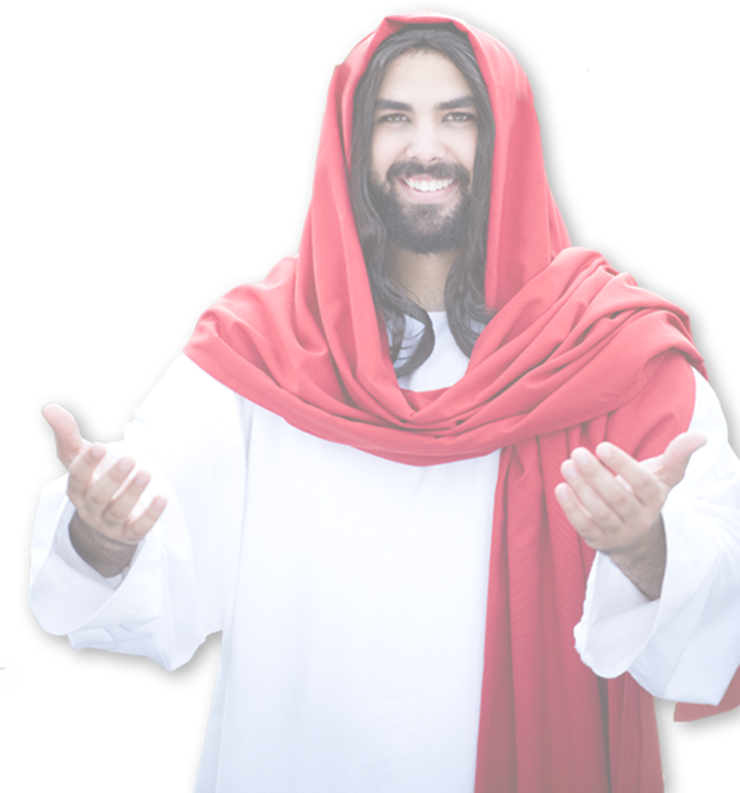
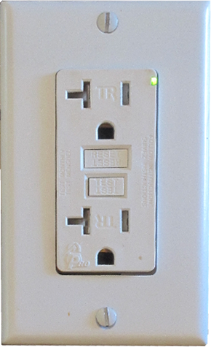
The Secret of Power
¹³ I can do all things through him who strengthens me.
“I am the vine, you are the branches. Those who abide in me and I in them bear much fruit, because apart from me you can do nothing.” John 15:5

Slide 20
The Secret of Power
¹³ I can do all things through him who strengthens me.
⁵ Trust in the LORD with all your heart, and do not rely on your own insight. ⁶ In all your ways acknowledge him, and he will make straight your paths. Prov 3:5-6

Slide 21
Let’s get it right. The secret to contentment involves ...

Slide 22
Perspective—Seeing Opportunities
Progress—Learning from Life’s Lessons
Providence—Recognizing God is in Control
Power—Being connected to the Source

Slide 23
Let’s Pray!

