Slide 1
How to
Rejoice
in tough times!
A Study of Philippians
Notes:
This series uses the “Good Morning” font. You may download it free at: www.1001fonts.com/good-morning-font.html
and Eras Demi ITC
Copyright © 2000-2021. All rights reserved. Bible Point is a registered trademark of Dennis Henderson. All other trademarks acknowledged.
Bible Point contains graphics from Bible Point artists. These illustrations belong to Bible Point and the respective artists. You may use the designs and illustrations for graphical illustration of lessons free and without special permission, provided they are not used in any way that maligns the Christian faith. Furthermore, republication or production of any illustration by any other graphic service whether it be in book, in a machine-readable form, or in any other design resource is strictly prohibited. Furthermore, they cannot be duplicated or resold as any other form of publishing, clip art, or graphic resource.
So What does it mean? (A simple translations of the legal jargon)
So, if you don’t own the presentation(s), graphic(s), and text(s) how can you legally use them? The purchase of the license allows you to use all the images in the product. However, the actual ownership and copyright of the presentation(s), graphic(s), and text(s) remain the property of Bible Point and its licensors. If you had plans on using this product in your “for sale” work—think again!
License Agreement
Article 1: License Grant
All the graphics and text in Bible Point presentations (excluding quotes from the Bible and stated sources) are the intellectual and real property of Bible Point and its licensors, and is protected by law, including United States copyright laws and international treaties. Bible Point grants to you a license:
1. To use the presentation in a single church, single school, or single office of a Christian organization.
2. To make a single archival back-up copy of the program.
3. To modify the presentation(s) and merge with other presentations in a single church, school, or Christian organization.
4. To transfer to another party if that party agrees to accept the terms and conditions of this agreement, and you do not retain any copies of the presentation, whether printed, machine readable, modified, or merged form.
Article 2: Terms
This license is effective until terminated. You may terminate the license at any time by destroying the presentation(s), graphic(s), or text(s) together with all copies, modifications and merged portions in any form. Bible Point may terminate your license if you fail to comply with this Agreement. You agree, upon such termination, for any reason, to destroy the presentation(s), graphics, and text(s) with all copies, modifications, and merged portions in any form.
Article 3: Disclaimers
1. Bible Point presentations, graphics, and texts are licensed to you As Is. You, the consumer, bear the entire risk relating to the quality and performance of the presentation(s), graphic(s), or text(s). In no event will Bible Point be liable for damages resulting from any defect.
2. Thirty-day limited warrantee on disks. Bible Point warrants the disks to be free of defects in material and workmanship under normal use for 30 days after purchase. During the 30-day period you may return a defective presentation, graphic, or text with proof of purchase and it will be replaced without charge, unless the presentation is damaged by misuse.
Article 4: General
1. You may not sub-license, assign, or transfer the license of the presentation(s), graphic(s), or text(s) except as provided by this Agreement.
2. This Agreement will be governed by the laws of the State of Michigan.
So What does it mean? (A simple translations of the legal jargon)
May I let someone borrow or copy my licensed Bible Point presentation (even after I modified it)? As long as it is within your local church, or single school, or the immediate office of a Christian organization you may. Otherwise, please refer the person interested in borrowing to: http://www.biblepoint.com or E-mail: dh@biblepoint.com with any related questions.
---------------------------------------------------------------------------------------------------------------------------
Scripture taken from the HOLY BIBLE, NEW INTERNATIONAL VERSION®. NIV®. Copyright©1973, 1978, 1984 by International Bible Society. Used by permission of Zondervan. All rights reserved.

Slide 2
The JOY of a “Worry Free” Zone

Slide 3
There’s plenty to worry about ...
Notes:
Worry Free Zone Sign = free = from BiblePoint and http://upload.wikimedia.org/wikipedia/commons/b/be/Memphis_highway_sign_IMG_0670.JPG

Slide 4
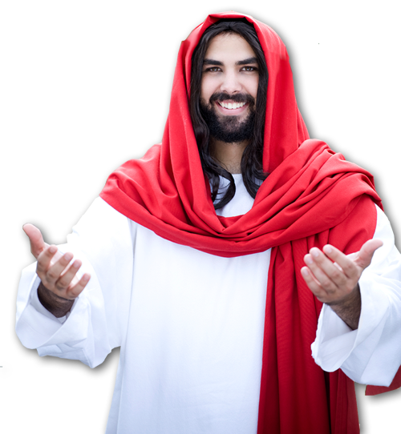
LIFE itself...
²⁵ "Therefore I tell you, do not worry about your life, Mat 6:25

Slide 5
LOVED ONES
¹ Therefore, my brothers, whom I love and long for, my joy and crown, stand firm thus in the Lord, my beloved.
Notes:
Heart cloud = FREE = from http://www.rgbstock.com/download/weirdvis/mBSQ45w.jpg

Slide 6
DISAGREEMENT
² I entreat Euodia and I entreat Syntyche to agree in the Lord.
Notes:
Disagree = FREE = from http://www.sxc.hu/photo/1395767

Slide 7
SPIRITUAL STRUGGLES
³ Yes, and I ask you also, my loyal companion, help these women, for they have struggled beside me in the work of the gospel, together with Clement and the rest of my co-workers, whose names are in the book of life

Slide 8
HOSTILITY
⁵ Let your gentleness be evident to all.
Notes:
Fists = FREE = from http://www.sxc.hu/photo/884897

Slide 9
THE FUTURE
⁵ ... The Lord is near
³³ But seek first his kingdom and his righteousness, and all these things will be given to you as well. ³⁴ Therefore do not worry about tomorrow, for tomorrow will worry about itself. Each day has enough trouble of its own. Mat 6:33-34

Slide 10
It is possible, but to Live in a “Worry-Free” Zone, you must:

Slide 11
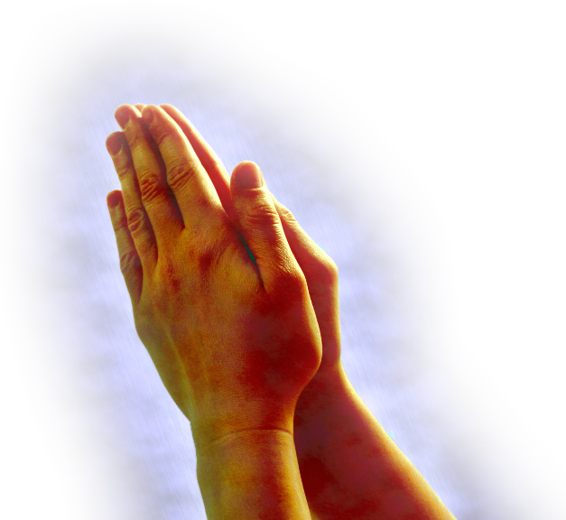
PRAY RIGHT
⁶ do not be anxious about anything, but in everything by prayer and supplication with thanksgiving let your requests be made known to God.
Notes:
Praying hands = FREE = from http://www.sxc.hu/browse.phtml?f=download&id=775521

Slide 12
GENERAL Prayer
⁶ do not be anxious about anything, but in everything by prayer and supplication with thanksgiving let your requests be made known to God.
Notes:
Praying hands = FREE = from http://www.sxc.hu/browse.phtml?f=download&id=775521

Slide 13
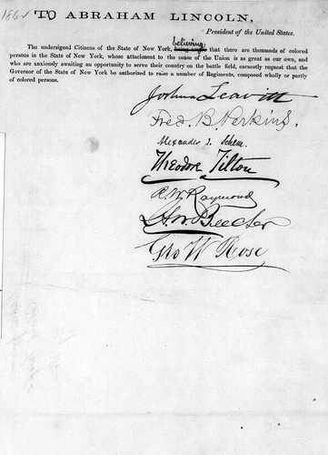
SPECIFIC PRAYER
⁶ do not be anxious about anything, but in everything by prayer and supplication with thanksgiving let your requests be made known to God.
Notes:
Praying hands = FREE = from http://www.sxc.hu/browse.phtml?f=download&id=775521

Slide 14
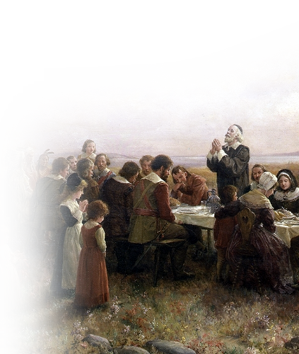
SPECIFIC PRAYER
⁶ do not be anxious about anything, but in everything by prayer and supplication with thanksgiving let your requests be made known to God.
Notes:
Praying hands = FREE = from http://www.sxc.hu/browse.phtml?f=download&id=775521

Slide 15
SPECIFIC PRAYER
⁶ do not be anxious about anything, but in everything by prayer and supplication with thanksgiving let your requests be made known to God.
James 4:2 ... You do not have, because you do not ask God.
Notes:
Praying hands = FREE = from http://www.sxc.hu/browse.phtml?f=download&id=775521

Slide 16
SPECIFIC PRAYER
⁶ do not be anxious about anything, but in everything by prayer and supplication with thanksgiving let your requests be made known to God.
1 Peter 5:7 Cast all your anxiety on him because he cares for you.
Notes:
Praying hands = FREE = from http://www.sxc.hu/browse.phtml?f=download&id=775521

Slide 17
PEACEFUL PRAYER
⁷ And the peace of God, which surpasses all understanding, will guard your hearts and your minds in Christ Jesus.
Notes:
James 4:2 ... You do not have, because you do not ask God. ³ When you ask, you do not receive, because you ask with wrong motives, that you may spend what you get on your pleasures. (Jam 4:2-3 NIV)

Slide 18
PEACEFUL PRAYER
⁷ And the peace of God, which surpasses all understanding, will guard your hearts and your minds in Christ Jesus.
Notes:
James 4:2 ... You do not have, because you do not ask God. ³ When you ask, you do not receive, because you ask with wrong motives, that you may spend what you get on your pleasures. (Jam 4:2-3 NIV)

Slide 19
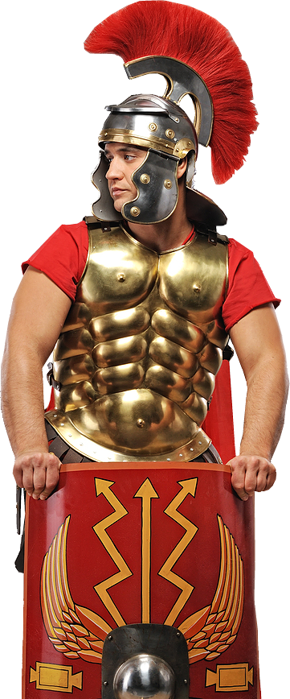
PEACEFUL PRAYER
⁷ And the peace of God, which surpasses all understanding, will guard your hearts and your minds in Christ Jesus.
Notes:
James 4:2 ... You do not have, because you do not ask God. ³ When you ask, you do not receive, because you ask with wrong motives, that you may spend what you get on your pleasures. (Jam 4:2-3 NIV)

Slide 20
I did that, and nothing changed!
Well, then you may need to add this ...

Slide 21
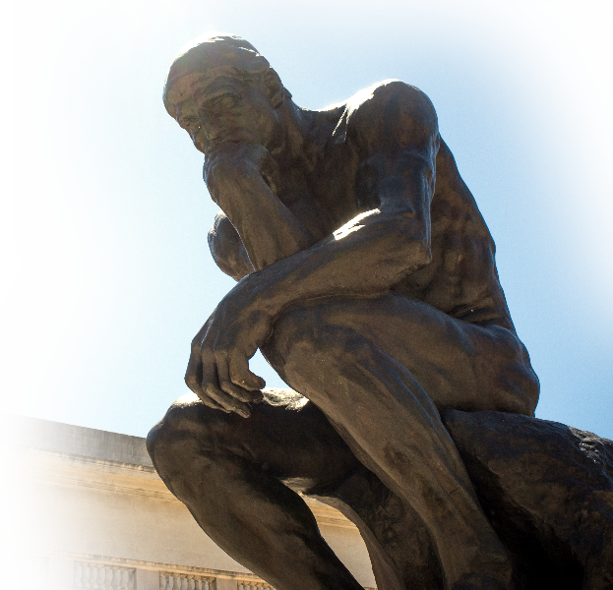
Think Right
⁸ Finally, brothers, whatever is true, whatever is honorable, whatever is just, whatever is pure, whatever is lovely, whatever is commendable, if there is any excellence, if there is anything worthy of praise, think about these things.
For as he thinks within himself, so he is. Pro 23:7
Notes:
The thinker = FREE from http://upload.wikimedia.org/wikipedia/commons/f/fc/Rodin%27s_The_Thinker.jpg

Slide 22
I did that, but still nothing changed!
Well, then you may need to add this ...

Slide 23
LIVE Right
⁹ What you have learned and received and heard and seen in me--practice these things, and the God of peace will be with you.
Notes:
James 4:2 ... You do not have, because you do not ask God. ³ When you ask, you do not receive, because you ask with wrong motives, that you may spend what you get on your pleasures. (Jam 4:2-3 NIV)

Slide 24
Just do it!
⁹ What you have learned and received and heard and seen in me--practice these things, and the God of peace will be with you.
JUST DO IT.
Notes:
James 4:2 ... You do not have, because you do not ask God. ³ When you ask, you do not receive, because you ask with wrong motives, that you may spend what you get on your pleasures. (Jam 4:2-3 NIV)

Slide 25
Experience it!
⁹ What you have learned and received and heard and seen in me--practice these things, and the God of peace will be with you.
Notes:
James 4:2 ... You do not have, because you do not ask God. ³ When you ask, you do not receive, because you ask with wrong motives, that you may spend what you get on your pleasures. (Jam 4:2-3 NIV)

Slide 26
Living in the Worry-Free Zone ...
Is living a life that is “AT peace WITH God”
And
Living a life that is
“ IN the peace OF God”
Notes:
James 4:2 ... You do not have, because you do not ask God. ³ When you ask, you do not receive, because you ask with wrong motives, that you may spend what you get on your pleasures. (Jam 4:2-3 NIV)

Slide 27
Let’s go to the Worry Free Zone now in prayer!

