Slide 1
How to
Rejoice
in tough times!
A Study of Philippians
Notes:
This series uses the “Good Morning” font. You may download it free at: www.1001fonts.com/good-morning-font.html
and Eras Demi ITC
Copyright © 2000-2021. All rights reserved. Bible Point is a registered trademark of Dennis Henderson. All other trademarks acknowledged.
Bible Point contains graphics from Bible Point artists. These illustrations belong to Bible Point and the respective artists. You may use the designs and illustrations for graphical illustration of lessons free and without special permission, provided they are not used in any way that maligns the Christian faith. Furthermore, republication or production of any illustration by any other graphic service whether it be in book, in a machine-readable form, or in any other design resource is strictly prohibited. Furthermore, they cannot be duplicated or resold as any other form of publishing, clip art, or graphic resource.
So What does it mean? (A simple translations of the legal jargon)
So, if you don’t own the presentation(s), graphic(s), and text(s) how can you legally use them? The purchase of the license allows you to use all the images in the product. However, the actual ownership and copyright of the presentation(s), graphic(s), and text(s) remain the property of Bible Point and its licensors. If you had plans on using this product in your “for sale” work—think again!
License Agreement
Article 1: License Grant
All the graphics and text in Bible Point presentations (excluding quotes from the Bible and stated sources) are the intellectual and real property of Bible Point and its licensors, and is protected by law, including United States copyright laws and international treaties. Bible Point grants to you a license:
1. To use the presentation in a single church, single school, or single office of a Christian organization.
2. To make a single archival back-up copy of the program.
3. To modify the presentation(s) and merge with other presentations in a single church, school, or Christian organization.
4. To transfer to another party if that party agrees to accept the terms and conditions of this agreement, and you do not retain any copies of the presentation, whether printed, machine readable, modified, or merged form.
Article 2: Terms
This license is effective until terminated. You may terminate the license at any time by destroying the presentation(s), graphic(s), or text(s) together with all copies, modifications and merged portions in any form. Bible Point may terminate your license if you fail to comply with this Agreement. You agree, upon such termination, for any reason, to destroy the presentation(s), graphics, and text(s) with all copies, modifications, and merged portions in any form.
Article 3: Disclaimers
1. Bible Point presentations, graphics, and texts are licensed to you As Is. You, the consumer, bear the entire risk relating to the quality and performance of the presentation(s), graphic(s), or text(s). In no event will Bible Point be liable for damages resulting from any defect.
2. Thirty-day limited warrantee on disks. Bible Point warrants the disks to be free of defects in material and workmanship under normal use for 30 days after purchase. During the 30-day period you may return a defective presentation, graphic, or text with proof of purchase and it will be replaced without charge, unless the presentation is damaged by misuse.
Article 4: General
1. You may not sub-license, assign, or transfer the license of the presentation(s), graphic(s), or text(s) except as provided by this Agreement.
2. This Agreement will be governed by the laws of the State of Michigan.
So What does it mean? (A simple translations of the legal jargon)
May I let someone borrow or copy my licensed Bible Point presentation (even after I modified it)? As long as it is within your local church, or single school, or the immediate office of a Christian organization you may. Otherwise, please refer the person interested in borrowing to: http://www.biblepoint.com or E-mail: dh@biblepoint.com with any related questions.
---------------------------------------------------------------------------------------------------------------------------
Scripture taken from the HOLY BIBLE, NEW INTERNATIONAL VERSION®. NIV®. Copyright©1973, 1978, 1984 by International Bible Society. Used by permission of Zondervan. All rights reserved.

Slide 2
The JOY of WINNING!

Slide 3
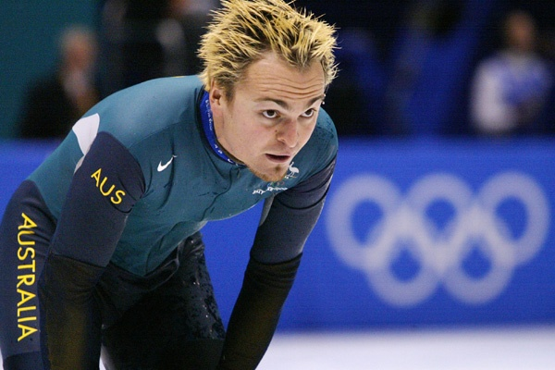
There is joy in winning
Ask 2002 Gold Medal Olympian speed skater, Steven Bradbury
Notes:
At the 2002 Winter Olympic Games speed skater Steven Bradbury won Australia’s first ever winter gold medal.
Held at Salt Lake City in 2002.

Slide 4
There is joy in winning
Ask 2002 Gold Medal Olympian speed skater, Steven Bradbury
Notes:
At the 2002 Winter Olympic Games speed skater Steven Bradbury won Australia’s first ever winter gold medal.

Slide 5
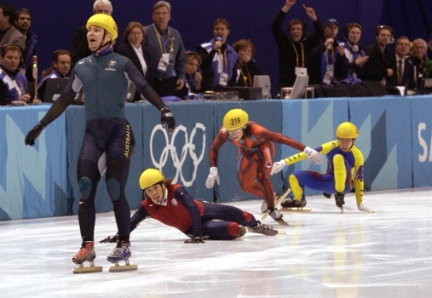
There is joy in winning
The point, to win you must ...

Slide 6
Be In the Race
¹² Not that I have already obtained this or am already perfect, but I press on to make it my own, because Christ Jesus has made me his own.
Notes:
If our Christian life is pictured as a race, then Salvation is the starting blocks and as long as were alive it is not finished.
We need to be in it, not a spectator sitting on the sideline, but an active participant. Praying, Reading His Word, fellowshipping with Christ and His people. sharing our faith with others, serving and ministering to those in need, giving to His church, etc.

Slide 7
You must be Focused
¹³ Brothers, I do not consider that I have made it my own. But one thing I do: forgetting what lies behind and straining forward to what lies ahead,
Notes:
Target = FREE = from http://www.sxc.hu/browse.phtml?f=download&id=978940

Slide 8
You must be Focused
¹³ Brothers, I do not consider that I have made it my own. But one thing I do: forgetting what lies behind and straining forward to what lies ahead,
Notes:
Starting line = FREE = from http://www.rgbstock.com/largephoto/dlritter/mhtAAri.jpg

Slide 9
You must be Focused
¹³ Brothers, I do not consider that I have made it my own. But one thing I do: forgetting what lies behind and straining forward to what lies ahead,
Notes:
Finish line = created from FREE = http://www.sxc.hu/browse.phtml?f=download&id=1068232

Slide 10
You must be Determined
¹⁴ I press on toward the goal for the prize of the upward call of God in Christ Jesus.

Slide 11
You must be Determined
¹⁴ I press on toward the goal for the prize of the upward call of God in Christ Jesus.

Slide 12
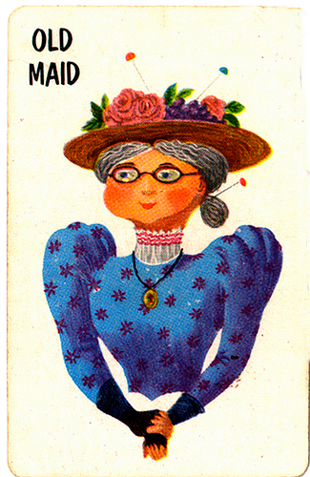
You must Play by the Rules
¹⁵ Let those of us who are mature think this way, and if in anything you think otherwise, God will reveal that also to you. ¹⁶ Only let us hold true to what we have attained.
Notes:
We play Old Maid with the grand kids -- we bend the rules. When they get older its fierce competition—grow up and play by the rules.

Slide 13
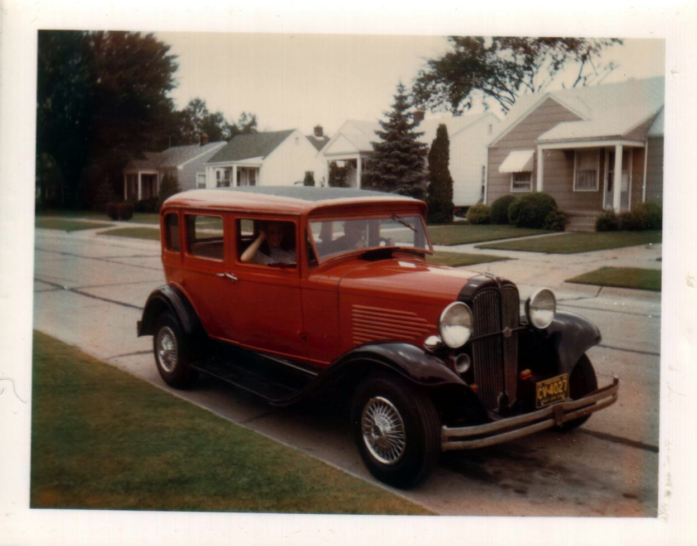
1932 Willys Overland

Slide 14
The Race …

Slide 15
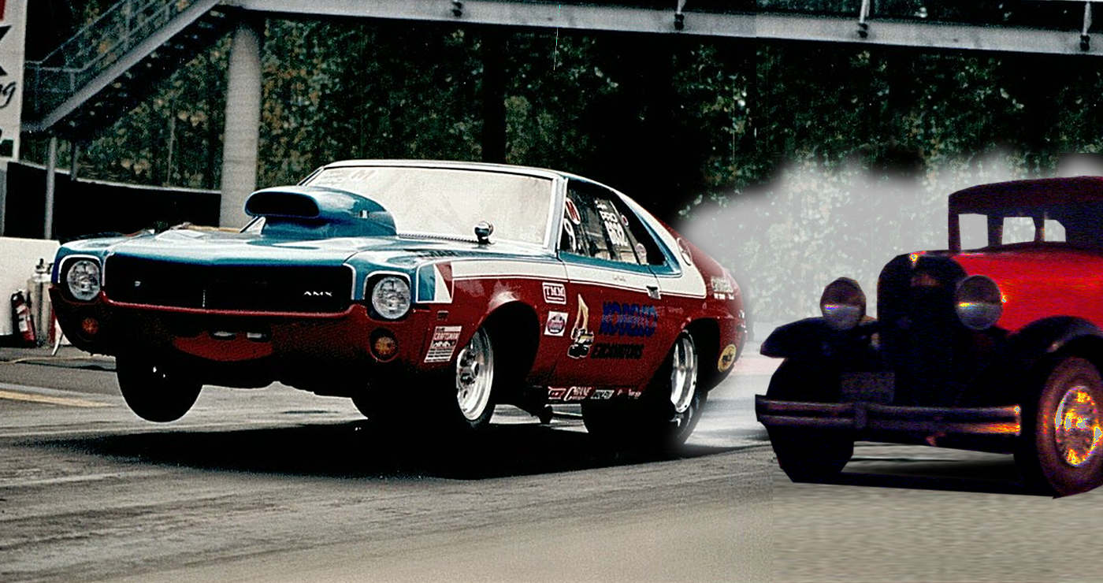
There off …

Slide 16
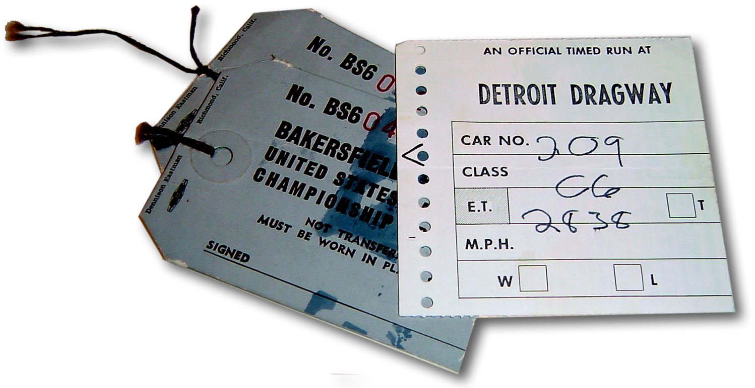
AMX less than 10 second
‘32 Willys

Slide 17
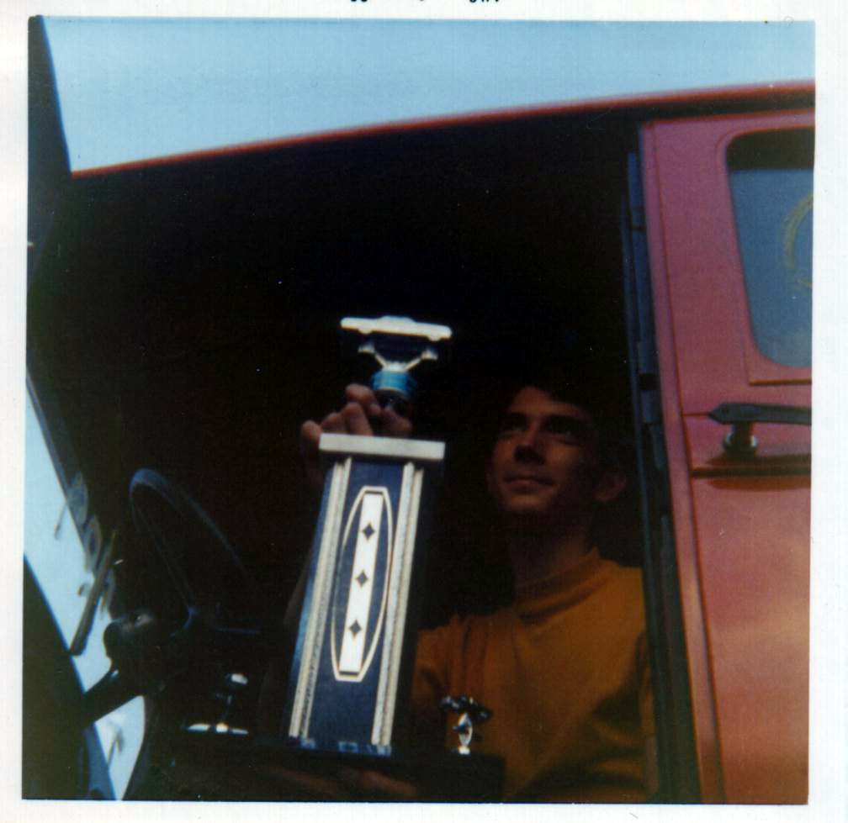
I WON!

Slide 18
God wants all of us to be winners!

Slide 19
But He’s not talking about car racing...
He’s talking about a team sport ...
More like the Olympics
Notes:
Olympic Rings = FREE = from http://commons.wikimedia.org/wiki/File:Olympic_rings_with_white_rims.svg

Slide 20
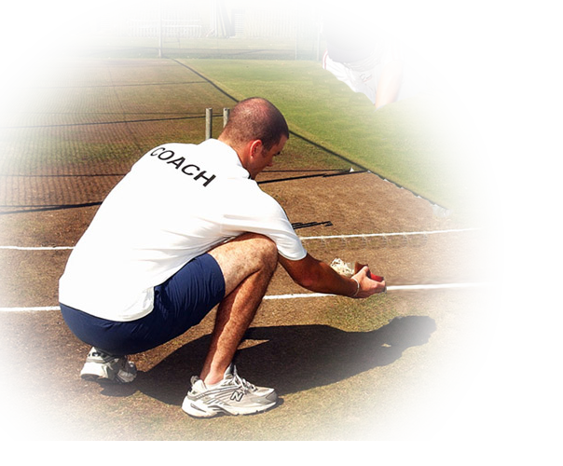
You must have a Good Coach
¹⁷ Brothers, join in imitating me, and keep your eyes on those who walk according to the example you have in us.

Slide 21
You mush have a Worthy Cause
¹⁸ For many, of whom I have often told you and now tell you even with tears, walk as enemies of the cross of Christ.

Slide 22
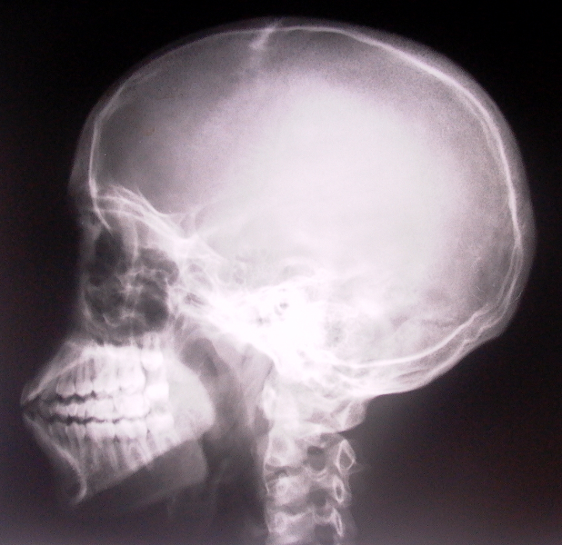
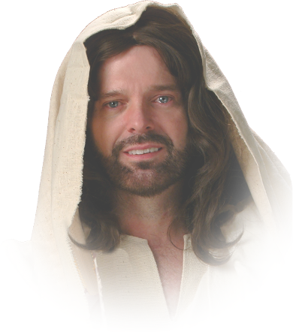
You must have a New Mind-Set
¹⁹ Their end is destruction, their god is their belly, and they glory in their shame, with minds set on earthly things.
Notes:
You need a winners mind-set. You cannot win the joy of the Christian race if you mind is on worldly things!

Slide 23
You must have a Country
²⁰our citizenship is in heaven

Slide 24
Point: When we ...
1- Are in the race
2-Are focused on the goal
3-Are determined to win
4-Play by the rules
5-Have a Good Coach
6-Have a worthy cause
7-Have the right mind-set
8-Represent the right country

Slide 25
Then, we WILL win!
and from it we await a Savior, the Lord Jesus Christ,

Slide 26
Then, we WILL win!
²¹ who will transform our lowly body to be like his glorious body, by the power that enables him even to subject all things to himself.
Notes:
That’s when we attain unto that for which He called us 3:12

Slide 27
Two Final Thoughts--
To Experience the JOY OF WINNING:
You must be in the race
You must finish well

Slide 28
Let’s pray!

