Slide 1
How to
Rejoice
in tough times!
A Study of Philippians
Notes:
This series uses the “Good Morning” font. You may download it free at: www.1001fonts.com/good-morning-font.html
and Eras Demi ITC
Copyright © 2000-2021. All rights reserved. Bible Point is a registered trademark of Dennis Henderson. All other trademarks acknowledged.
Bible Point contains graphics from Bible Point artists. These illustrations belong to Bible Point and the respective artists. You may use the designs and illustrations for graphical illustration of lessons free and without special permission, provided they are not used in any way that maligns the Christian faith. Furthermore, republication or production of any illustration by any other graphic service whether it be in book, in a machine-readable form, or in any other design resource is strictly prohibited. Furthermore, they cannot be duplicated or resold as any other form of publishing, clip art, or graphic resource.
So What does it mean? (A simple translations of the legal jargon)
So, if you don’t own the presentation(s), graphic(s), and text(s) how can you legally use them? The purchase of the license allows you to use all the images in the product. However, the actual ownership and copyright of the presentation(s), graphic(s), and text(s) remain the property of Bible Point and its licensors. If you had plans on using this product in your “for sale” work—think again!
License Agreement
Article 1: License Grant
All the graphics and text in Bible Point presentations (excluding quotes from the Bible and stated sources) are the intellectual and real property of Bible Point and its licensors, and is protected by law, including United States copyright laws and international treaties. Bible Point grants to you a license:
1. To use the presentation in a single church, single school, or single office of a Christian organization.
2. To make a single archival back-up copy of the program.
3. To modify the presentation(s) and merge with other presentations in a single church, school, or Christian organization.
4. To transfer to another party if that party agrees to accept the terms and conditions of this agreement, and you do not retain any copies of the presentation, whether printed, machine readable, modified, or merged form.
Article 2: Terms
This license is effective until terminated. You may terminate the license at any time by destroying the presentation(s), graphic(s), or text(s) together with all copies, modifications and merged portions in any form. Bible Point may terminate your license if you fail to comply with this Agreement. You agree, upon such termination, for any reason, to destroy the presentation(s), graphics, and text(s) with all copies, modifications, and merged portions in any form.
Article 3: Disclaimers
1. Bible Point presentations, graphics, and texts are licensed to you As Is. You, the consumer, bear the entire risk relating to the quality and performance of the presentation(s), graphic(s), or text(s). In no event will Bible Point be liable for damages resulting from any defect.
2. Thirty-day limited warrantee on disks. Bible Point warrants the disks to be free of defects in material and workmanship under normal use for 30 days after purchase. During the 30-day period you may return a defective presentation, graphic, or text with proof of purchase and it will be replaced without charge, unless the presentation is damaged by misuse.
Article 4: General
1. You may not sub-license, assign, or transfer the license of the presentation(s), graphic(s), or text(s) except as provided by this Agreement.
2. This Agreement will be governed by the laws of the State of Michigan.
So What does it mean? (A simple translations of the legal jargon)
May I let someone borrow or copy my licensed Bible Point presentation (even after I modified it)? As long as it is within your local church, or single school, or the immediate office of a Christian organization you may. Otherwise, please refer the person interested in borrowing to: http://www.biblepoint.com or E-mail: dh@biblepoint.com with any related questions.
---------------------------------------------------------------------------------------------------------------------------
Scripture taken from the HOLY BIBLE, NEW INTERNATIONAL VERSION®. NIV®. Copyright©1973, 1978, 1984 by International Bible Society. Used by permission of Zondervan. All rights reserved.

Slide 2
Rejoice
in the Lord!
A Study of Philippians

Slide 3
1. Look UP
That’s where JOY comes from …
Notes:
The Lord is the source of JOY it is vertical …
Happiness is horizontal.

Slide 4
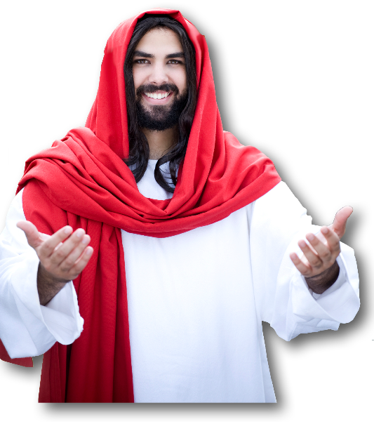
1. Look UP
That’s where JOY comes from …
¹ Finally, my brothers, rejoice in the Lord.
Notes:
Our Lord is in heaven … to look up! This last Thursday was Ascension Day = 40 days after the resurrection when Jesus ascended into heaven. Next Sunday is Pentecost when Jesus sent the Holy Spirit to start the church.
Look up and rejoice. He is risen, He is in Heaven, He sent the Holy Spirit.
This is an imperative—he is commanding this. You …

Slide 5
1. Look UP
That’s where JOY comes from …
¹ Finally, my brothers, rejoice in the Lord.
Notes:
My brothers REJOICE!
Joy is different from happiness, in that, happiness requires favorable circumstances, while joy arises above the circumstances.

Slide 6
1. Look UP
That’s where JOY comes from …
¹ Finally, my brothers, rejoice in the Lord. To write the same things to you is no trouble to me and is safe for you.
Notes:
“The same thing” is that this is the 6th time he mentions rejoice
Already mentioned joy 4 times …
Truth is even though I have told you 10 times already, you need it!

Slide 7
2. Look OUT
There are those who would rob your joy!

Slide 8
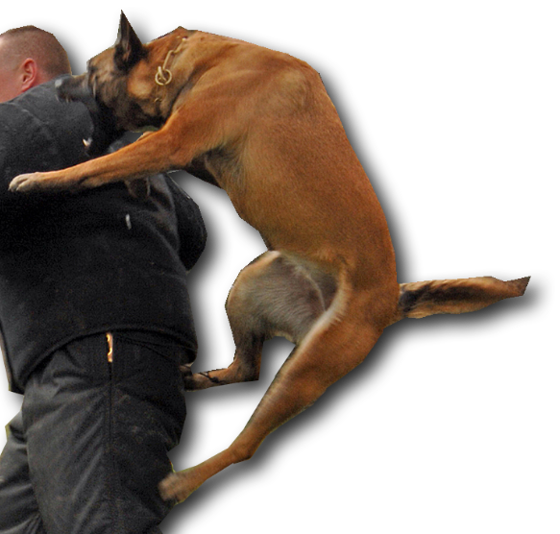
2. Look OUT
There are those who would rob your joy!
² Look out for the dogs, look out for the evildoers, look out for those who mutilate the flesh.
Notes:
The Apostle Paul begins name calling here. (It didn’t start with Donald Trump)
The dogs are Judiasers who have been dogging Paul everywhere he went. They hounded him.
Paul leads a group to faith in Christ by the grace of God and through faith and these Jewish proselytizers come in behind him and tell them Paul only told half of the truth. He withheld from you that you have to get circumcised and follow the laws of Moses. They are legalists who distort the freedom we have in Christ. Paul calls them dogs. ( A ceremonial unclean animal, so this is quite offensive to them).

Slide 9
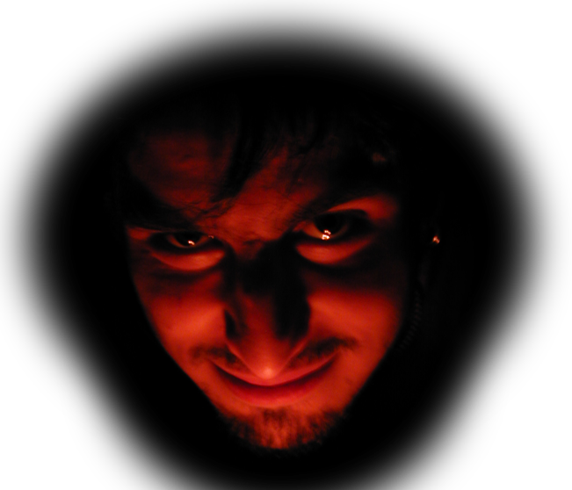
2. Look OUT
There are those who would rob your joy!
² Look out for the dogs, look out for the evildoers, look out for those who mutilate the flesh.
Notes:
They are evil, they are deliberately misguiding you. They are evil.

Slide 10
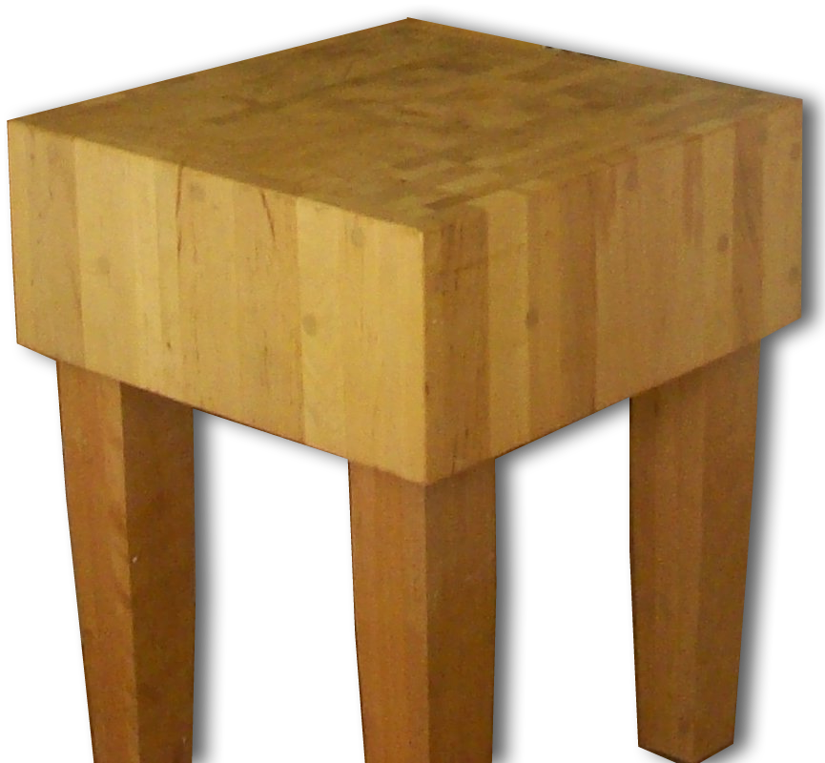
2. Look OUT
There are those who would rob your joy!
² Look out for the dogs, look out for the evildoers, look out for those who mutilate the flesh.
Notes:
They are butchers. The mutilation of the flesh is a reference to “circumcision.” They have made this act, which was to be done because you believe, now as the means of salvation. You have to do it to get saved. So you who accepted the gospel of Paul aren’t saved until you get circumcised.
We have a similar problem today. People teach you are not fully saved until you get baptized. Baptism does not save. Jesus saves! Once saved we get baptized in obedience to Christ command to publicly confess Him before men that we are already saved.

Slide 11
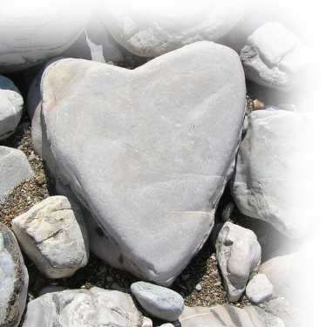
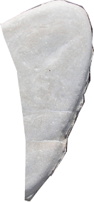
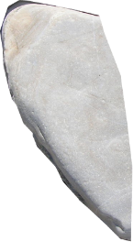
2. Look OUT
There are those who would rob your joy!
³ For we are the circumcision, who worship by the Spirit of God and glory in Christ Jesus and put no confidence in the flesh—
… circumcision is a matter of the heart, by the Spirit, not by the letter. (Romans 2:29)
Notes:
Now Paul explains … the truth is circumcision of the flesh is meaningless without the circumcision of the heart.
Likewise, baptism is totally meaningless if you have not received Jesus first. There in not a single valid case of baptism preceding faith in the Bible. Not one.
You believe and are baptize. You are baptized because you believe and are already saved. Baptism does not save you. Jesus saves you.

Slide 12
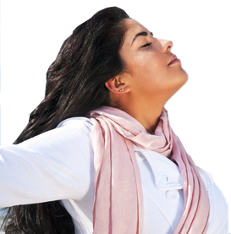
2. Look OUT
There are those who would rob your joy!
³ For we are the circumcision, who worship by the Spirit of God and glory in Christ Jesus and put no confidence in the flesh—
Notes:
The Spirit invaded us at the time of faith in Christ—so we worship by the Spirit’s prompting.

Slide 13
2. Look OUT
There are those who would rob your joy!
³ For we are the circumcision, who worship by the Spirit of God and glory in Christ Jesus and put no confidence in the flesh—
Notes:
The focal point of our worship and lives is that Jesus is glorified. NOT THE FLESH, not the act of circumcision or baptism.

Slide 14
2. Look OUT
There are those who would rob your joy!
³ For we are the circumcision, who worship by the Spirit of God and glory in Christ Jesus and put no confidence in the flesh—
CARNALITY
Notes:
Those who put confidence in the flesh are CARNAL. The derive pleasure from the fleshly desires. We have places where you go to give your flesh a fling—carnivals. Like Cedar point, the dragster.
When you put your confidence in your flesh—what you do—to get salvation it does something for you.. You get proud, arrogant, haughty, self-sufficient. All that is contrary to Christ. Don’t put your confidence in what make you feel good. Your flesh but instead in Christ.

Slide 15
3-Look BACK
At yourself,
Notes:
Look back at yourself … Before you knew christ

Slide 16
3-Look BACK
At yourself, Paul did , here is what he saw …

Slide 17
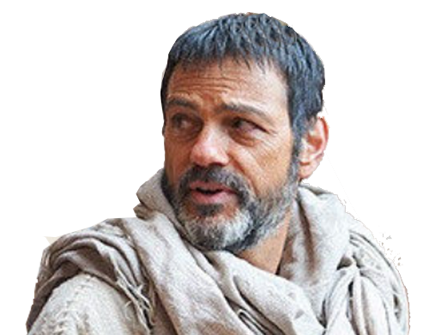
3-Look BACK
At yourself, Paul did , here is what he saw …
⁴ though I myself have reason for confidence in the flesh also. If anyone else thinks he has reason for confidence in the flesh, I have more:
Notes:
I had flung to the flesh “religiously”
No one surpassed me.

Slide 18
3-Look BACK
At yourself, Paul did , here is what he saw …
⁵ circumcised on the eighth day, of the people of Israel, of the tribe of Benjamin, a Hebrew of Hebrews; as to the law, a Pharisee; ⁶ as to zeal, a persecutor of the church; as to righteousness under the law, blameless.
Self-Righteous | — | +
Circumcision |  | X

Slide 19
3-Look BACK
At yourself, Paul did , here is what he saw …
⁵ circumcised on the eighth day, of the people of Israel, of the tribe of Benjamin, a Hebrew of Hebrews; as to the law, a Pharisee; ⁶ as to zeal, a persecutor of the church; as to righteousness under the law, blameless.
Self-Righteous | — | +
Circumcision |  | X
Israelite |  | X

Slide 20
3-Look BACK
At yourself, Paul did , here is what he saw …
⁵ circumcised on the eighth day, of the people of Israel, of the tribe of Benjamin, a Hebrew of Hebrews; as to the law, a Pharisee; ⁶ as to zeal, a persecutor of the church; as to righteousness under the law, blameless.
Self-Righteous | — | +
Circumcision |  | X
Israelite |  | X
Benjaminite |  | X

Slide 21
3-Look BACK
At yourself, Paul did , here is what he saw …
⁵ circumcised on the eighth day, of the people of Israel, of the tribe of Benjamin, a Hebrew of Hebrews; as to the law, a Pharisee; ⁶ as to zeal, a persecutor of the church; as to righteousness under the law, blameless.
Self-Righteous | — | +
Circumcision |  | X
Israelite |  | X
Benjaminite |  | X
Hebrew |  | X

Slide 22
3-Look BACK
At yourself, Paul did , here is what he saw …
⁵ circumcised on the eighth day, of the people of Israel, of the tribe of Benjamin, a Hebrew of Hebrews; as to the law, a Pharisee; ⁶ as to zeal, a persecutor of the church; as to righteousness under the law, blameless.
Self-Righteous | — | +
Circumcision |  | X
Israelite |  | X
Benjaminite |  | X
Hebrew |  | X
Pharisee |  | X

Slide 23
3-Look BACK
At yourself, Paul did , here is what he saw …
⁵ circumcised on the eighth day, of the people of Israel, of the tribe of Benjamin, a Hebrew of Hebrews; as to the law, a Pharisee; ⁶ as to zeal, a persecutor of the church; as to righteousness under the law, blameless.
Self-Righteous | — | +
Circumcision |  | X
Israelite |  | X
Benjaminite |  | X
Hebrew |  | X
Pharisee |  | X
Zeal |  | X

Slide 24
3-Look BACK
At yourself, Paul did , here is what he saw …
⁵ circumcised on the eighth day, of the people of Israel, of the tribe of Benjamin, a Hebrew of Hebrews; as to the law, a Pharisee; ⁶ as to zeal, a persecutor of the church; as to righteousness under the law, blameless.
Self-Righteous | — | +
Circumcision |  | X
Israelite |  | X
Benjaminite |  | X
Hebrew |  | X
Pharisee |  | X
Zeal |  | X
Legalistic |  | X
Notes:
It would be like saying today,
Oh, I got baptized as an infant
Became a member of the church
Tithed, attended
Didn’t smoke, drink, dance, play cards, gamble, go to the movies, do drugs, etc.
Condemned those who did
BUT DID NOT KNOW JESUS

Slide 25
4-Look AHEAD
What will you get from it all?
Self-Righteous | — | +
Circumcision |  | X
Israelite |  | X
Benjaminite |  | X
Hebrew |  | X
Pharisee |  | X
Zeal |  | X
Legalistic |  | X

Slide 26
4-Look AHEAD
What will you get from it all?
⁷ But whatever gain I had, I counted as loss for the sake of Christ.
Self-Righteous | — | +
Circumcision |  | X
Israelite |  | X
Benjaminite |  | X
Hebrew |  | X
Pharisee |  | X
Zeal |  | X
Legalistic |  | X
Notes:
Tally that life all up

Slide 27
4-Look AHEAD
What will you get from it all?
⁷ But whatever gain I had, I counted as loss for the sake of Christ.
Self-Righteous | — | +
Circumcision | X
Israelite | X
Benjaminite | X
Hebrew | X
Pharisee | X
Zeal | X
Legalistic | X
But WHY are they a loss?
Notes:
When I met Jesus, I found it was nothing, zero, useless. I counted it all loss.
Here he is an accountant and the bottom line that previous life was a total loss, waste. WHY?

Slide 28
4-Look AHEAD
What will you get from it all?
⁷ But whatever gain I had, I counted as loss for the sake of Christ.
Self-Righteous | — | +
Circumcision | X
Israelite | X
Benjaminite | X
Hebrew | X
Pharisee | X
Zeal | X
Legalistic | X
Notes:
Those things in and of themselves were not bad—
But they did not bring me to Christ. They never could save me from my sins. They never brought forgiveness, peace, and a real relationship with God and Christ. They were detrimental to that.

Slide 29
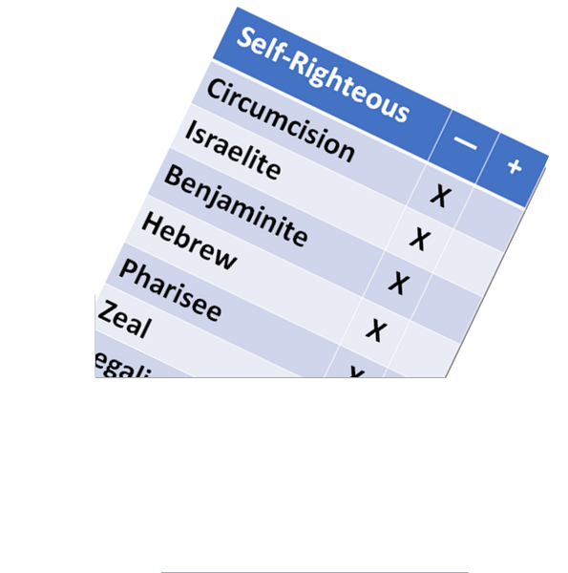
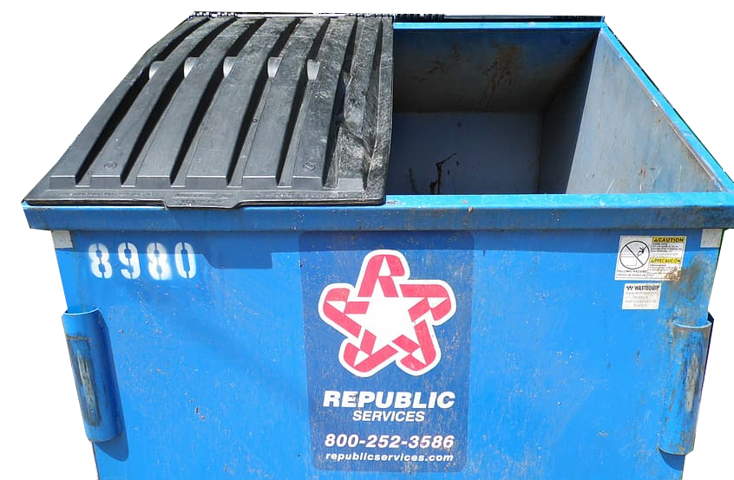
4-Look AHEAD
What will you get from it all?
⁸ Indeed, I count everything as loss because of the surpassing worth of knowing Christ Jesus my Lord. For his sake I have suffered the loss of all things and [I] count them as rubbish, in order that I may gain Christ
WHY?

Slide 30
4-Look AHEAD
What will you get from it all?
⁸ Indeed, I count everything as loss because of the surpassing worth of knowing Christ Jesus my Lord. For his sake I have suffered the loss of all things and [I] count them as rubbish, in order that I may gain Christ
WHY?

Slide 31
4-Look AHEAD
What will you get from it all?
⁸ Indeed, I count everything as loss because of the surpassing worth of knowing Christ Jesus my Lord. For his sake I have suffered the loss of all things and [I] count them as rubbish, in order that I may gain Christ
WHY? and…

Slide 32
4-Look AHEAD
What will you get from it all?
⁸ Indeed, I count everything as loss because of the surpassing worth of knowing Christ Jesus my Lord. For his sake I have suffered the loss of all things and [I] count them as rubbish, in order that I may gain Christ

Slide 33
4-Look AHEAD
What will you get from it all?
⁹ and be found in him, not having a righteousness of my own that comes from the law, but that which comes through faith in Christ, the righteous-ness from God that depends on faith--

Slide 34
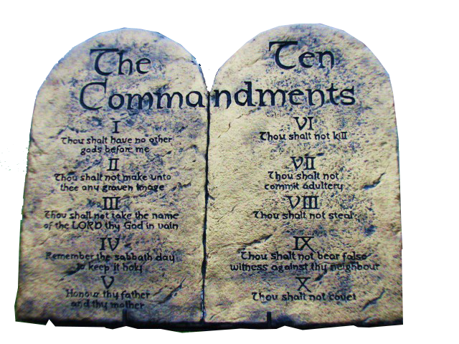
4-Look AHEAD
What will you get from it all?
⁹ and be found in him, not having a righteousness of my own that comes from the law, but that which comes through faith in Christ, the righteous-ness from God that depends on faith--

Slide 35
4-Look AHEAD
What will you get from it all?
⁹ and be found in him, not having a righteousness of my own that comes from the law, but that which comes through faith in Christ, the righteous-ness from God that depends on faith--

Slide 36
4-Look AHEAD
What will you get from it all?
⁹ and be found in him, not having a righteousness of my own that comes from the law, but that which comes through faith in Christ, the righteous-ness from God that depends on faith--

Slide 37
5-Look FOR
Connection with Christ

Slide 38
5-Look FOR
Connection with Christ HIMSELF
¹⁰ that I may know him
Notes:
NOT ABOUT HIM, BUT KNOW HIM!

Slide 39
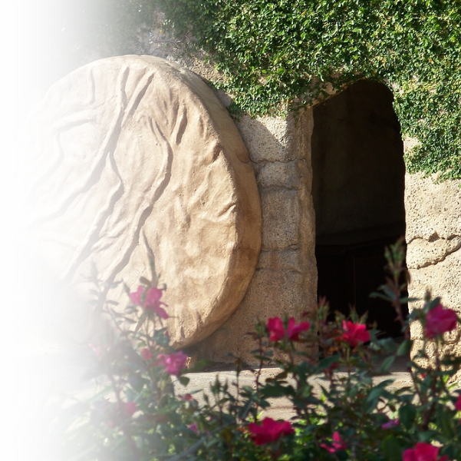
5-Look FOR
Connection with Christ’s POWER
¹⁰ that I may know him and the power of his resurrection,

Slide 40
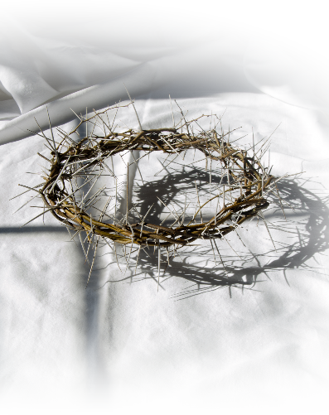
5-Look FOR
Connection with Christ’s SUFFERINGS
¹⁰ that I may know him and the power of his resurrection, and may share his sufferings, becoming like him in his death,
Notes:
He suffered for me…I will suffer for Him.

Slide 41
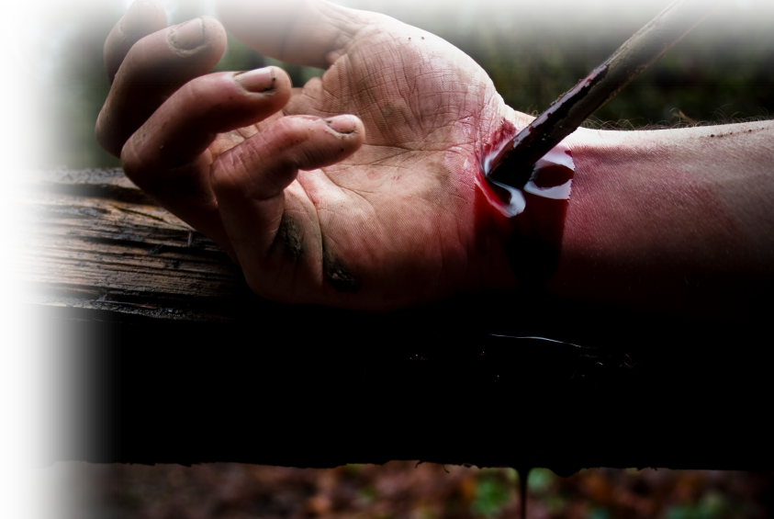
5-Look FOR
Connection with Christ’s DEATH
¹⁰ that I may know him and the power of his resurrection, and may share his sufferings, becoming like him in his death,

Slide 42
5-Look FOR
Connection with Christ’s RESURRECTION
¹⁰ that I may know him and the power of his resurrection, and may share his sufferings, becoming like him in his death, ¹¹ if somehow I may attain the resurrection from the dead.

Slide 43
5-Look FOR
Connection with Christ’s RESURRECTION
¹⁰ that I may know him and the power of his resurrection, and may share his sufferings, becoming like him in his death, ¹¹ if somehow I may attain the resurrection from the dead.
¹¹ so that one way or another I will experience the resurrection from the dead! (NLT)

Slide 44
To sum up: Joy comes from …
Looking UP!
Looking Out!
Looking Back!
Looking Ahead!
Looking For!

Slide 46
Let’s pray!

