Slide 1
How to
Rejoice
in tough times!
A Study of Philippians
Notes:
This series uses the “Good Morning” font. You may download it free at: www.1001fonts.com/good-morning-font.html
and Eras Demi ITC
Copyright © 2000-2021. All rights reserved. Bible Point is a registered trademark of Dennis Henderson. All other trademarks acknowledged.
Bible Point contains graphics from Bible Point artists. These illustrations belong to Bible Point and the respective artists. You may use the designs and illustrations for graphical illustration of lessons free and without special permission, provided they are not used in any way that maligns the Christian faith. Furthermore, republication or production of any illustration by any other graphic service whether it be in book, in a machine-readable form, or in any other design resource is strictly prohibited. Furthermore, they cannot be duplicated or resold as any other form of publishing, clip art, or graphic resource.
So What does it mean? (A simple translations of the legal jargon)
So, if you don’t own the presentation(s), graphic(s), and text(s) how can you legally use them? The purchase of the license allows you to use all the images in the product. However, the actual ownership and copyright of the presentation(s), graphic(s), and text(s) remain the property of Bible Point and its licensors. If you had plans on using this product in your “for sale” work—think again!
License Agreement
Article 1: License Grant
All the graphics and text in Bible Point presentations (excluding quotes from the Bible and stated sources) are the intellectual and real property of Bible Point and its licensors, and is protected by law, including United States copyright laws and international treaties. Bible Point grants to you a license:
1. To use the presentation in a single church, single school, or single office of a Christian organization.
2. To make a single archival back-up copy of the program.
3. To modify the presentation(s) and merge with other presentations in a single church, school, or Christian organization.
4. To transfer to another party if that party agrees to accept the terms and conditions of this agreement, and you do not retain any copies of the presentation, whether printed, machine readable, modified, or merged form.
Article 2: Terms
This license is effective until terminated. You may terminate the license at any time by destroying the presentation(s), graphic(s), or text(s) together with all copies, modifications and merged portions in any form. Bible Point may terminate your license if you fail to comply with this Agreement. You agree, upon such termination, for any reason, to destroy the presentation(s), graphics, and text(s) with all copies, modifications, and merged portions in any form.
Article 3: Disclaimers
1. Bible Point presentations, graphics, and texts are licensed to you As Is. You, the consumer, bear the entire risk relating to the quality and performance of the presentation(s), graphic(s), or text(s). In no event will Bible Point be liable for damages resulting from any defect.
2. Thirty-day limited warrantee on disks. Bible Point warrants the disks to be free of defects in material and workmanship under normal use for 30 days after purchase. During the 30-day period you may return a defective presentation, graphic, or text with proof of purchase and it will be replaced without charge, unless the presentation is damaged by misuse.
Article 4: General
1. You may not sub-license, assign, or transfer the license of the presentation(s), graphic(s), or text(s) except as provided by this Agreement.
2. This Agreement will be governed by the laws of the State of Michigan.
So What does it mean? (A simple translations of the legal jargon)
May I let someone borrow or copy my licensed Bible Point presentation (even after I modified it)? As long as it is within your local church, or single school, or the immediate office of a Christian organization you may. Otherwise, please refer the person interested in borrowing to: http://www.biblepoint.com or E-mail: dh@biblepoint.com with any related questions.
---------------------------------------------------------------------------------------------------------------------------
Scripture taken from the HOLY BIBLE, NEW INTERNATIONAL VERSION®. NIV®. Copyright©1973, 1978, 1984 by International Bible Society. Used by permission of Zondervan. All rights reserved.

Slide 2
Rejoice
over your
friends
Philippians 2:19-30
Notes:
‘full accord” = same soul

Slide 3
Life is Risky Business ...
³⁰ … he nearly died … risking his life …
647,000 Heart Disease Deaths
606,880 Cancer Disease Deaths
88,000 Alcohol Related Deaths
36,750 Auto Accident Deaths
6,227 Pedestrian Deaths
3,655 Fire Related Deaths
Notes:
Heart statics = cdc.gov
Cancer statistics = cancer.org
Alcohol-related statistics = niaa.nih.gov
Auto Accident deaths = usatoday.com
Pedestrian deaths = cnbc.com
Fire Related deaths = nfpa.org
Lost at sea = 2,000 = theguardian.com
Firearm = 39,773 = Wikipedia.org of which 23,854 were suicide (2017)

Slide 4
Life is Risky Business ...
Some things are worth risking your life for?
One of them is your friends...

Slide 5
“There is a friend …
who sticks closer than a brother.” (Proverbs 18:24)

Slide 6
We all need such a friend ...
who, like Timothy, is ...
Notes:
Hands = Licensed and NOT for REUSE elsewhere. To reuse elsewhere get a license from http://www.bigstockphoto.com/download/bid-1635043/

Slide 7
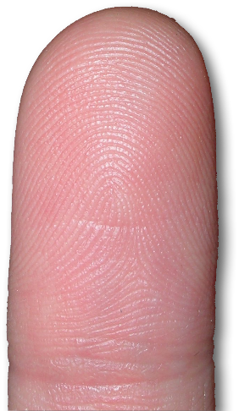
UNIQUELY our friend.
¹⁹ I hope in the Lord Jesus to send Timothy to you soon, so that I too may be cheered by news of you. ²⁰ For I have no one like him …
Notes:
Finger = FREE = from http://www.sxc.hu/browse.phtml?f=download&id=519652
Unique – like David and Jonathan

Slide 8
GENUINELY our friend.
who will be genuinely concerned for your welfare. ²¹ For they all seek their own interests, not those of Jesus Christ.
Notes:
Finger pointing = FREE = BiblePoint photo.
In an age of fake news, fake science, fake fruit, fake everything, and fake friends, you need a genuine friend. The fake are in it for their own agenda. Like fake politics tells you anything to advance themselves and their cause, truth or lie. Seeing their own interests. Fake friends do the same.
You need a genuine friend like Jesus

Slide 9
GENUINELY our friend.
who will be genuinely concerned for your welfare. ²¹ For they all seek their own interests, not those of Jesus Christ.
Notes:
Finger pointing = FREE = BiblePoint photo.
Like Jesus

Slide 10
GENUINELY our friend.
who will be genuinely concerned for your welfare. ²¹ For they all seek their own interests, not those of Jesus Christ.
Notes:
Finger pointing = FREE = BiblePoint photo.
Like Jesus

Slide 11
GENUINELY our friend.
who will be genuinely concerned for your welfare. ²¹ For they all seek their own interests, not those of Jesus Christ.
Notes:
Finger pointing = FREE = BiblePoint photo.
Like Jesus

Slide 12
GENUINELY our friend.
who will be genuinely concerned for your welfare. ²¹ For they all seek their own interests, not those of Jesus Christ.
2
3
1
Notes:
Finger pointing = FREE = BiblePoint photo.
My Aunt Rita played table games – didn’t like them—but my Mom did.

Slide 13
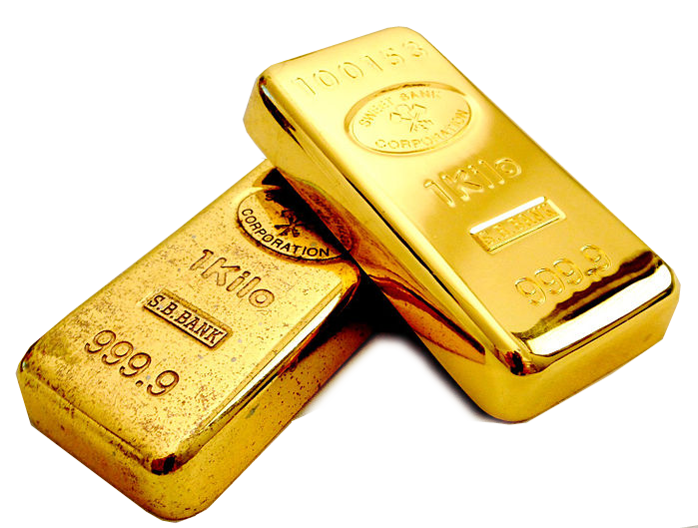
PROVEN to be our friend.
²² But you know Timothy's proven worth,
Notes:
Approved = FREE = from http://www.rgbstock.com/download/sundesigns/meT35hq.jpg
Like Job’s friends
Gold = FREE = https://commons.wikimedia.org/wiki/File:Gold_bullion_ap_001.JPG

Slide 14
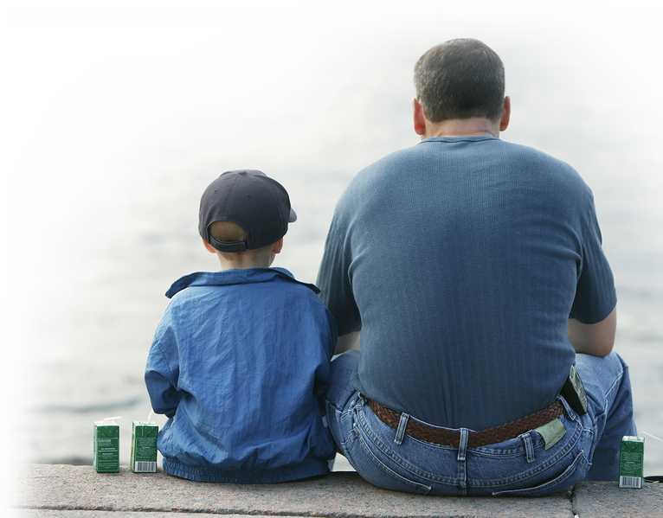
INTIMATELY our friend.
²² ... how as a son with a father he has served with me in the gospel.
² To Timothy, my true child in the faith: 1Tim 1:2) ² To Timothy, my beloved child: (2Tim 1:2)
Notes:
Father & Son = LICENSED AND NOT FOR REUSE ELSEWHERE. To reuse elsewhere get a license from http://www.bigstockphoto.com/download/bid-1636294/
Flip side is true – as a daughter to a mother Naomi & Ruth

Slide 15
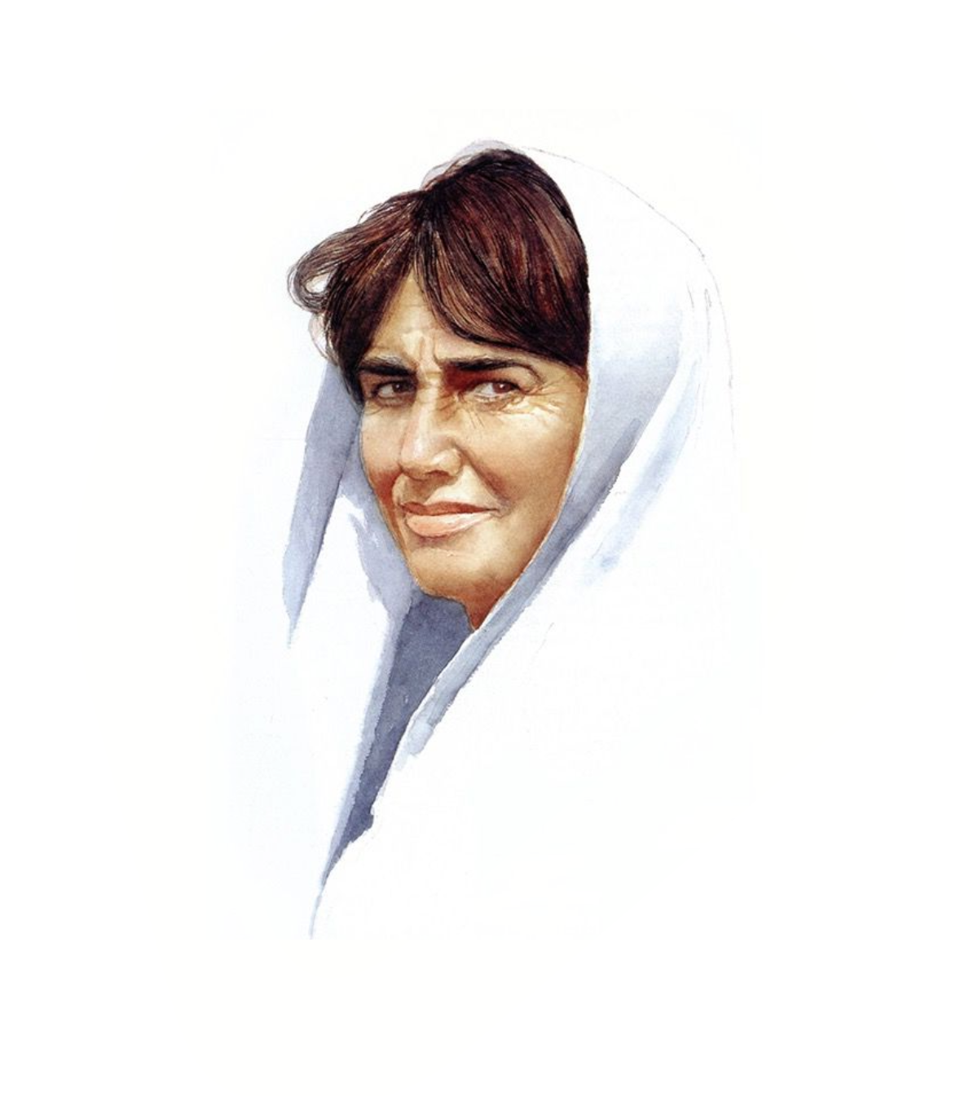
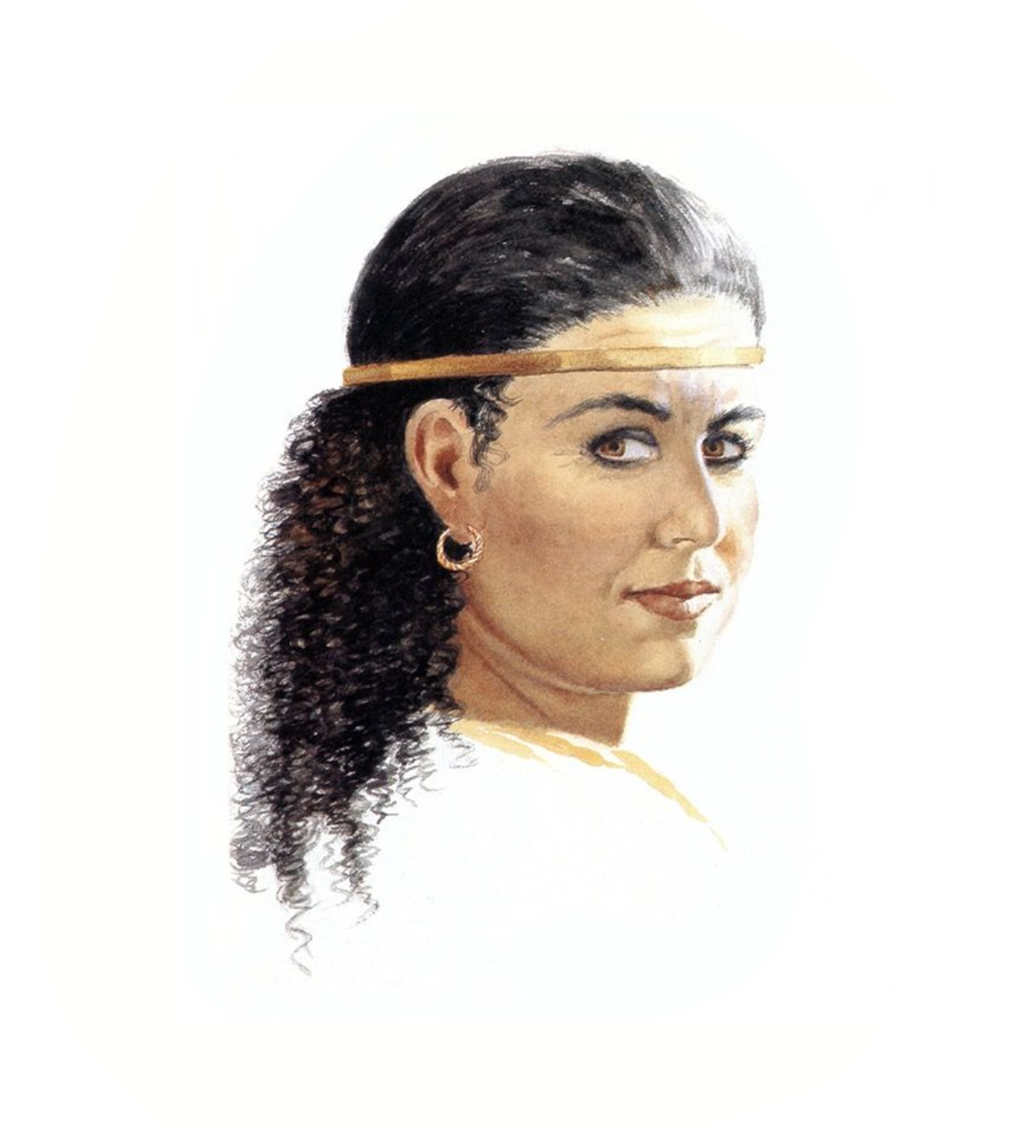
INTIMATELY our friend.
¹⁶ “… I will go, and where you lodge I will lodge. Your people shall be my people, and your God my God. ¹⁷ Where you die I will die, and there will I be buried. May the LORD do so to me and more also if anything but death parts me from you.“ (Ruth 1:16-17)
²² ... how as a son with a father he has served with me in the gospel.
² To Timothy, my true child in the faith: 1Tim 1:2) ² To Timothy, my beloved child: (2Tim 1:2)
Ruth & Naomi
Notes:
Father & Son = LICENSED AND NOT FOR REUSE ELSEWHERE. To reuse elsewhere get a license from http://www.bigstockphoto.com/download/bid-1636294/
Flip side is true – as a daughter to a mother Naomi & Ruth

Slide 16
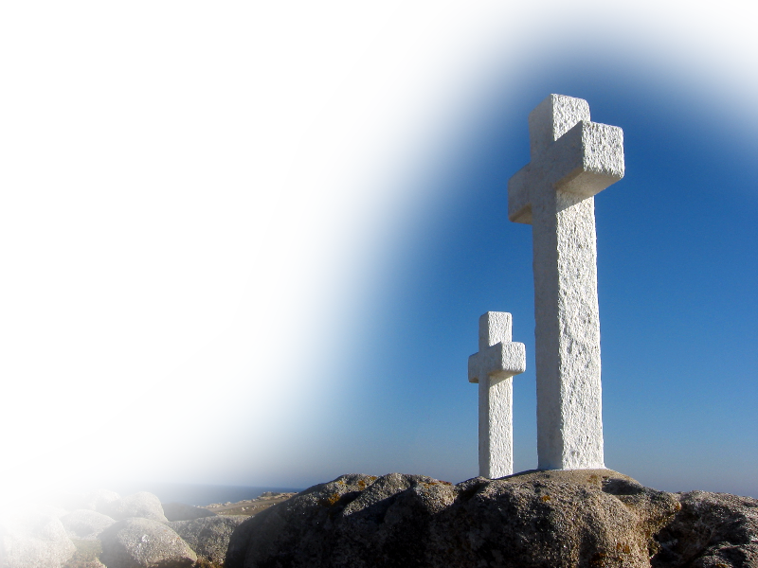
SPIRITUALLY our friend.
²² ... how as a son with a father he has served with me in the gospel.
Notes:
Crosses = FREE = from http://www.rgbstock.com/download/saavem/dJV8ZL.jpg

Slide 17
²³ I hope therefore to send him just as soon as I see how it will go with me, ²⁴ and I trust in the Lord that shortly I myself will come also.

Slide 18
Like Apostle Paul, we all need a friend who, like Epaphroditus, is ...

Slide 19
A CLOSE friend.
²⁵ I have thought it necessary to send to you Epaphroditus my brother …
there is a friend who sticks closer than a brother. (Proverbs 18:24)
Notes:
Cf. 1 John 3:16 We know love by this, that he laid down his life for us-- and we ought to lay down our lives for one another. (1Jo 3:16 NRS)
David & Jonathan https://www.flickr.com/photos/32495192@N07/10807390825/in/photostream/

Slide 20
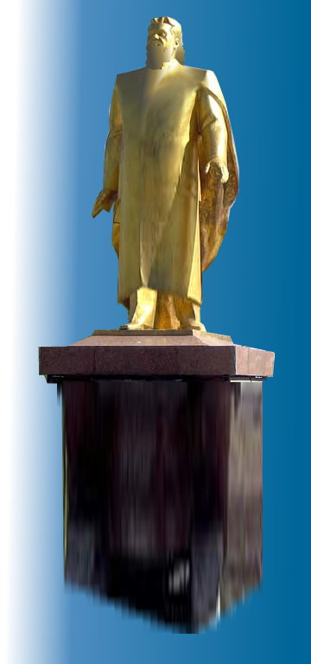
A LOYAL friend.
²⁵ ... and fellow worker and fellow soldier, and your messenger and minister to my need,
King Nebuchadnezzar made an image of gold
Shadrach, Meshach, and Abednego. These men, O king, pay no attention to you … (Daniel 3:1 & 12)
Notes:
Like Shadrack Meshack and Abegnego = Public domain painting = https://www.flickr.com/photos/32495192@N07/10807698745

Slide 21
A LOYAL friend.
²⁵ ... and fellow worker and fellow soldier, and your messenger and minister to my need,
¹⁷ If this be so, our God whom we serve is able to deliver us from the burning fiery furnace, and he will deliver us out of your hand, O king.
Notes:
Like Shadrack Meshack and Abegnego = Public domain painting = https://www.flickr.com/photos/32495192@N07/10807698745

Slide 22
A LOYAL friend.
²⁵ ... and fellow worker and fellow soldier, and your messenger and minister to my need,
¹⁸ But if not, be it known to you, O king, that we will not serve your gods or worship the golden image that you have set up."
(Dan 3:17-18)
Notes:
Like Shadrack Meshack and Abegnego = Public domain painting = https://www.flickr.com/photos/32495192@N07/10807698745

Slide 23
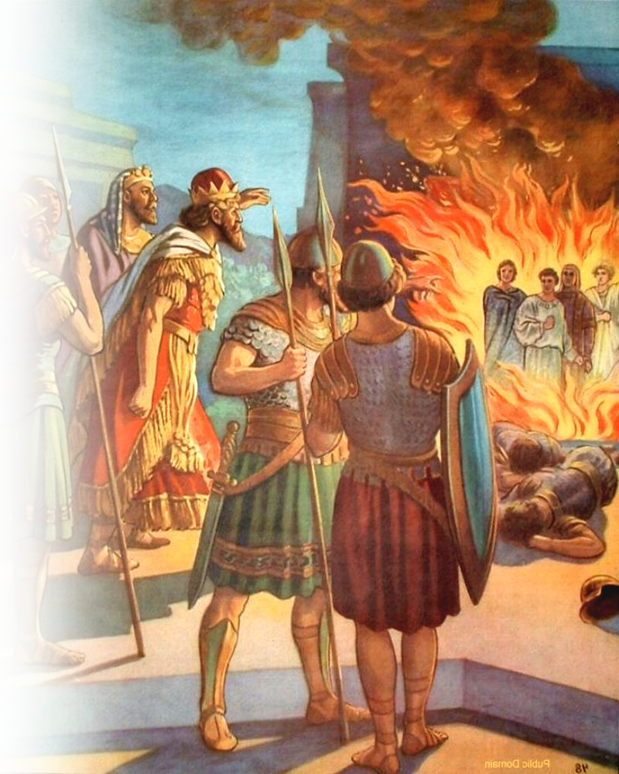
A LOYAL friend.
²⁸ Nebuchadnezzar answered .… ²⁹ "there is no other god who is able to rescue in this way." ³⁰ Then the king promoted Shadrach, Meshach, and Abednego in the province of Babylon. (Dan 3:28-30)
²⁵ ... and fellow worker and fellow soldier, and your messenger and minister to my need,
Notes:
Like Shadrack Meshack and Abegnego = Public domain painting = https://www.flickr.com/photos/32495192@N07/10807698745

Slide 24
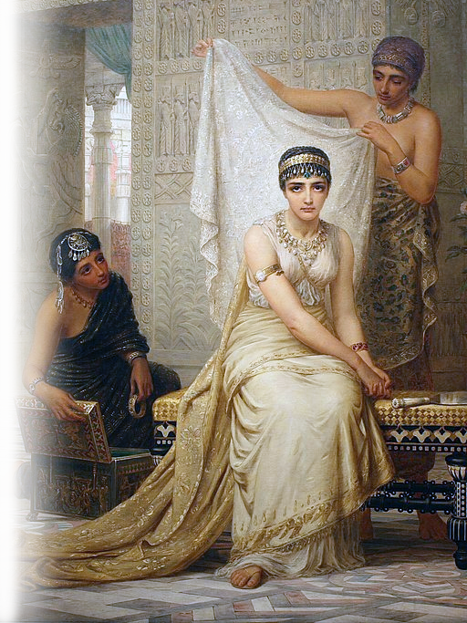
A SENSITIVE friend.
²⁶ for he has been longing for all of you, and has been distressed because you heard that he was ill. ²⁷ He was indeed so ill that he nearly died. But God had mercy on him, and not only on him but on me also, so that I would not have one sorrow after another.
⁴ When Esther's young women … told her, the queen was deeply distressed. … She sent garments to clothe Mordecai, so that he might take off his sackcloth, but he would not accept them. (Esther 4:4)
“Cares that you care!”
Notes:
Like Esther and Mordecai
Esther = Public Domain = https://upload.wikimedia.org/wikipedia/commons/thumb/1/15/Esther_haram.jpg/512px-Esther_haram.jpg

Slide 25
A SENSITIVE friend.
²⁶ for he has been longing for all of you, and has been distressed because you heard that he was ill. ²⁷ He was indeed so ill that he nearly died. But God had mercy on him, and not only on him but on me also, so that I would not have one sorrow after another.
And who knows whether you have not come to the kingdom for such a time as this?" (Esther 4:14)
“Cares that you care!”
Notes:
Like Esther and Mordecai
Esther = Public Domain = https://upload.wikimedia.org/wikipedia/commons/thumb/1/15/Esther_haram.jpg/512px-Esther_haram.jpg

Slide 26
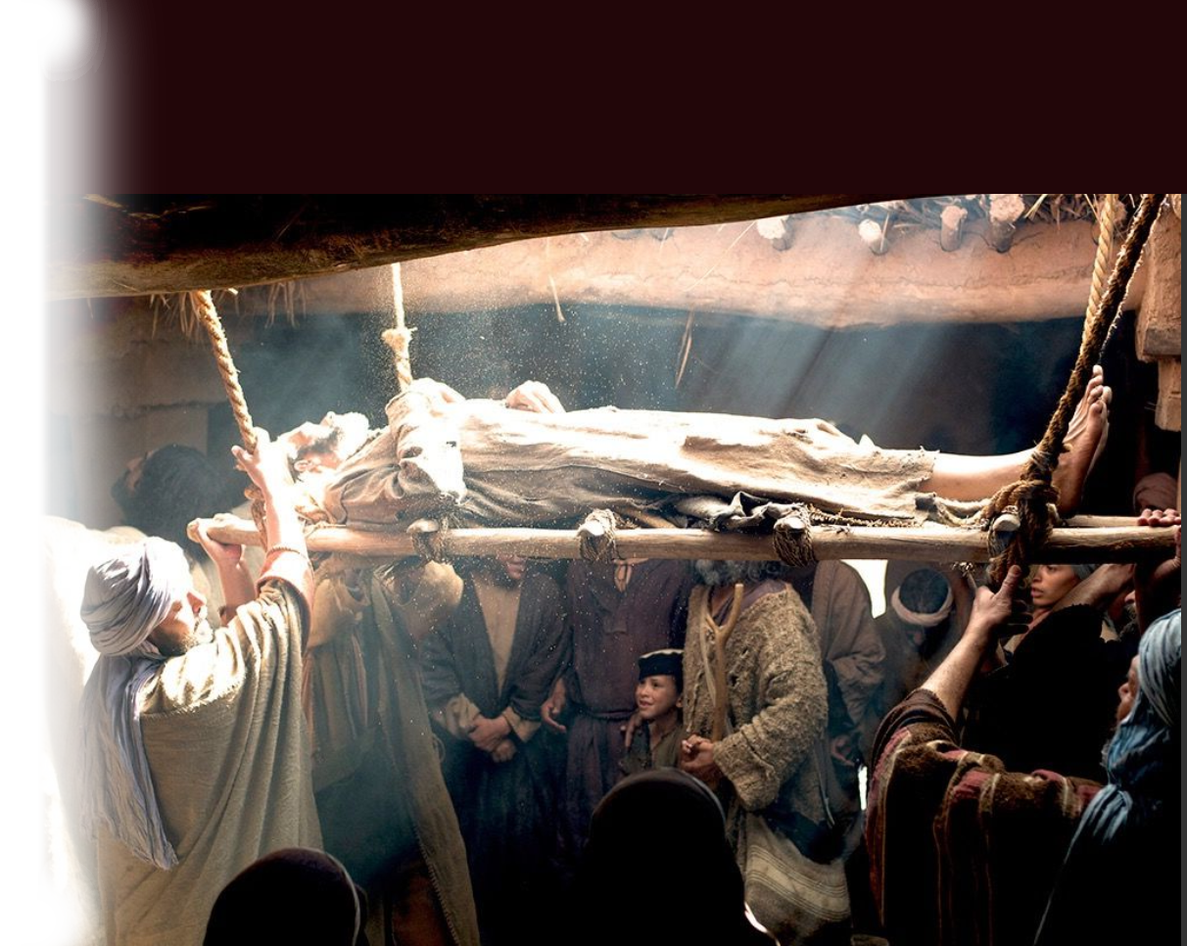
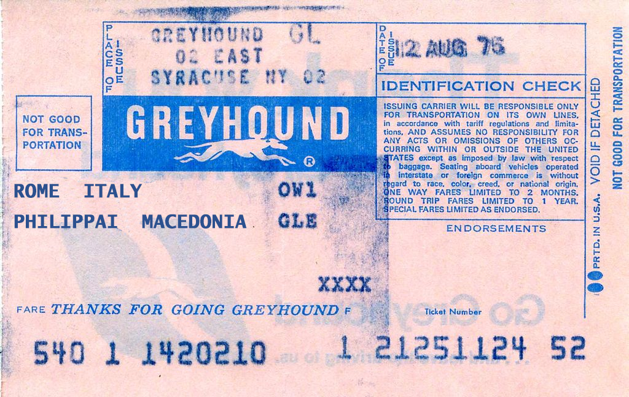
A SHARED friend.
²⁵ I have thought it necessary to send to you Epaphroditus …. ²⁸ I am the more eager to send him, therefore, that you may rejoice at seeing him again, and that I may be less anxious. (Phil. 2:25-28)
… a paralytic carried by four men. ⁴ And when they could not get near him because of the crowd, they removed the roof above him,
Notes:
Like four friends of the paralytic in Mark 2

Slide 27
A SHARED friend.
and when they had made an opening, they let down the bed on which the paralytic lay.
⁵ And when Jesus saw their faith, he said to the paralytic, "Son, your sins are forgiven.“ (Mark 2:3-5)
²⁵ I have thought it necessary to send to you Epaphroditus …. ²⁸ I am the more eager to send him, therefore, that you may rejoice at seeing him again, and that I may be less anxious. (Phil. 2:25-28)
Notes:
Like four friends of the paralytic in Mark 2

Slide 28
Bottom line: We need to...

Slide 29
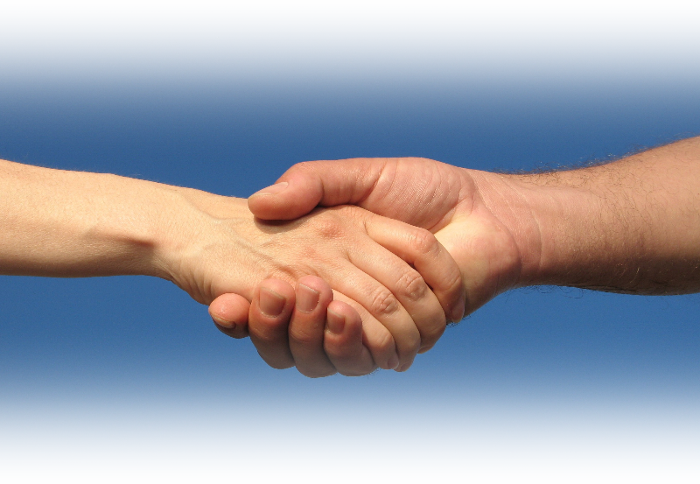
RECEIVE friends like that.
²⁹ So receive him in the Lord with all joy, and honor such men,
Notes:
Handshake = FREE = from http://www.rgbstock.com/download/lusi/mhAUFjc.jpg

Slide 30
HONOR friends like that.
²⁹ So receive him in the Lord with all joy, and honor such men,
WHY?

Slide 31
Such a friend will RISK it all for CHRIST.
³⁰ for he nearly died for the work of Christ, risking his life to complete what was lacking in your service to me.
Notes:
Cross in the clouds = LICENSED AND NOT FOR REUSE ELSEWHERE. To reuse elsewhere get a license from http://www
.bigstockphoto.com/image-5017121/stock-photo-christian-cross
Story of John VanSavage at Whitehall – giving all his money to me ... Didn’t even know me.

Slide 32
Such a friend will RISK it all for YOU.
³⁰ for he nearly died for the work of Christ, risking his life to complete what was lacking in your service to me.
Notes:
Cross in the clouds = LICENSED AND NOT FOR REUSE ELSEWHERE. To reuse elsewhere get a license from http://www
.bigstockphoto.com/image-5017121/stock-photo-christian-cross
Story of John VanSavage at Whitehall – giving all his money to me ... Didn’t even know me.

Slide 33
To have such a friend ...

Slide 34
BE A FRIEND like that.
There are "friends" who destroy each other, but a real friend sticks closer than a brother. (Proverbs 18:24 NLT)
Notes:
There is a group of men who meet for Breakfast every wed 8 am who want to be your friend, There is a ladies Bible study once a month tues –they want to be your friend.

Slide 35
Let’s pray!
No one has greater love than this, to lay down one's life for one's friends. (John 15:13)

