Slide 1
How to
Rejoice
in tough times!
A Study of Philippians
Notes:
This series uses the “Good Morning” font. You may download it free at: www.1001fonts.com/good-morning-font.html
and Eras Demi ITC
Copyright © 2000-2021. All rights reserved. Bible Point is a registered trademark of Dennis Henderson. All other trademarks acknowledged.
Bible Point contains graphics from Bible Point artists. These illustrations belong to Bible Point and the respective artists. You may use the designs and illustrations for graphical illustration of lessons free and without special permission, provided they are not used in any way that maligns the Christian faith. Furthermore, republication or production of any illustration by any other graphic service whether it be in book, in a machine-readable form, or in any other design resource is strictly prohibited. Furthermore, they cannot be duplicated or resold as any other form of publishing, clip art, or graphic resource.
So What does it mean? (A simple translations of the legal jargon)
So, if you don’t own the presentation(s), graphic(s), and text(s) how can you legally use them? The purchase of the license allows you to use all the images in the product. However, the actual ownership and copyright of the presentation(s), graphic(s), and text(s) remain the property of Bible Point and its licensors. If you had plans on using this product in your “for sale” work—think again!
License Agreement
Article 1: License Grant
All the graphics and text in Bible Point presentations (excluding quotes from the Bible and stated sources) are the intellectual and real property of Bible Point and its licensors, and is protected by law, including United States copyright laws and international treaties. Bible Point grants to you a license:
1. To use the presentation in a single church, single school, or single office of a Christian organization.
2. To make a single archival back-up copy of the program.
3. To modify the presentation(s) and merge with other presentations in a single church, school, or Christian organization.
4. To transfer to another party if that party agrees to accept the terms and conditions of this agreement, and you do not retain any copies of the presentation, whether printed, machine readable, modified, or merged form.
Article 2: Terms
This license is effective until terminated. You may terminate the license at any time by destroying the presentation(s), graphic(s), or text(s) together with all copies, modifications and merged portions in any form. Bible Point may terminate your license if you fail to comply with this Agreement. You agree, upon such termination, for any reason, to destroy the presentation(s), graphics, and text(s) with all copies, modifications, and merged portions in any form.
Article 3: Disclaimers
1. Bible Point presentations, graphics, and texts are licensed to you As Is. You, the consumer, bear the entire risk relating to the quality and performance of the presentation(s), graphic(s), or text(s). In no event will Bible Point be liable for damages resulting from any defect.
2. Thirty-day limited warrantee on disks. Bible Point warrants the disks to be free of defects in material and workmanship under normal use for 30 days after purchase. During the 30-day period you may return a defective presentation, graphic, or text with proof of purchase and it will be replaced without charge, unless the presentation is damaged by misuse.
Article 4: General
1. You may not sub-license, assign, or transfer the license of the presentation(s), graphic(s), or text(s) except as provided by this Agreement.
2. This Agreement will be governed by the laws of the State of Michigan.
So What does it mean? (A simple translations of the legal jargon)
May I let someone borrow or copy my licensed Bible Point presentation (even after I modified it)? As long as it is within your local church, or single school, or the immediate office of a Christian organization you may. Otherwise, please refer the person interested in borrowing to: http://www.biblepoint.com or E-mail: dh@biblepoint.com with any related questions.
---------------------------------------------------------------------------------------------------------------------------
Scripture taken from the HOLY BIBLE, NEW INTERNATIONAL VERSION®. NIV®. Copyright©1973, 1978, 1984 by International Bible Society. Used by permission of Zondervan. All rights reserved.

Slide 2
Let Your
Joy Shine
in tough times!
Philippians 2:1-18

Slide 3
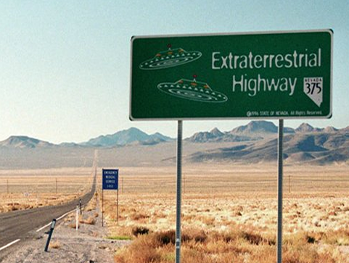
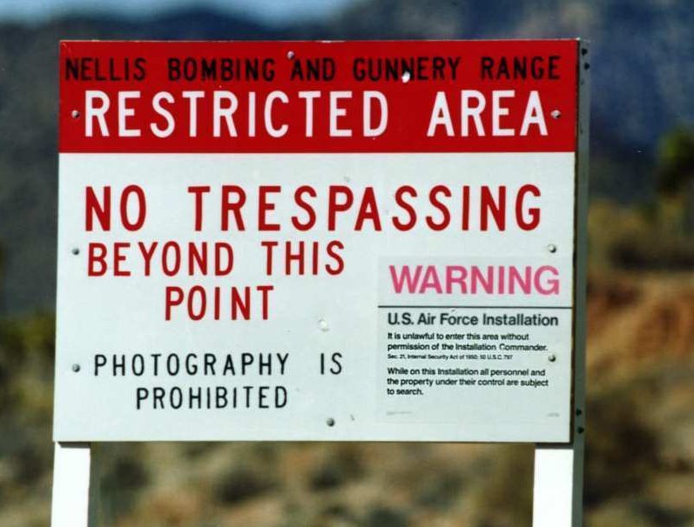
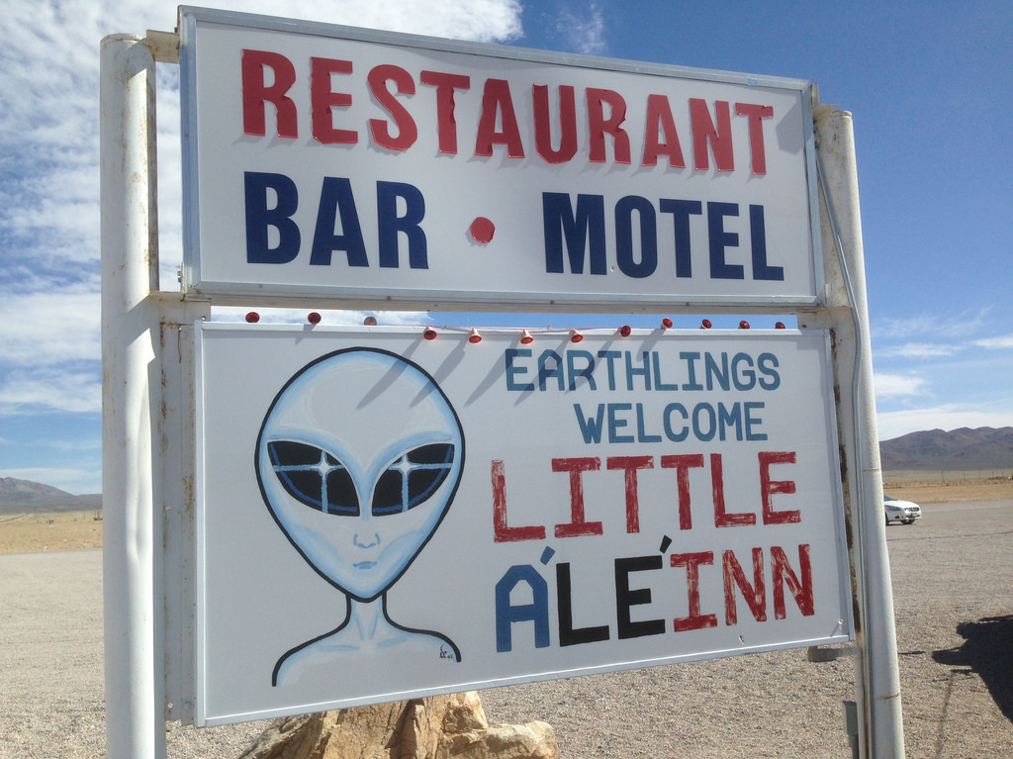
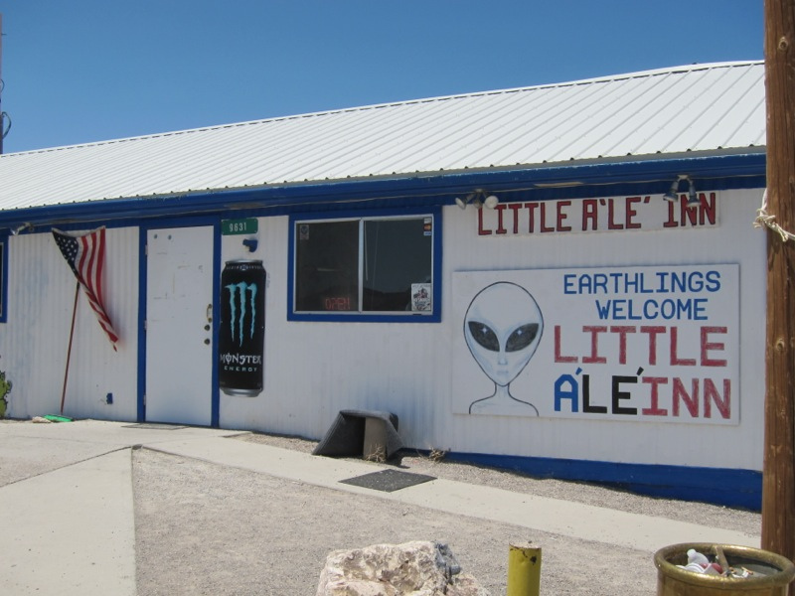
Let Your Joy Shine Bright!
Notes:
Starry night Sky = FREE = from http://www.rgbstock.com/download/ba1969/mrpKXYy.jpg
Alieinn = FREE = https://www.flickr.com/photos/cogdog/16997222765
Extrater. Hwy Sign = FREE = wiki

Slide 4
The darker the night, the brighter the light!
Notes:
https://en.wikipedia.org/wiki/Milky_Way

Slide 5
Your JOY can shine like the STARS!
¹⁵ that you may be blameless and innocent, children of God without blemish in the midst of a crooked and twisted generation, among whom you shine as lights in the world …
Notes:
God wants us to be like the stars “shining like bright lights” in a dark world.

Slide 6
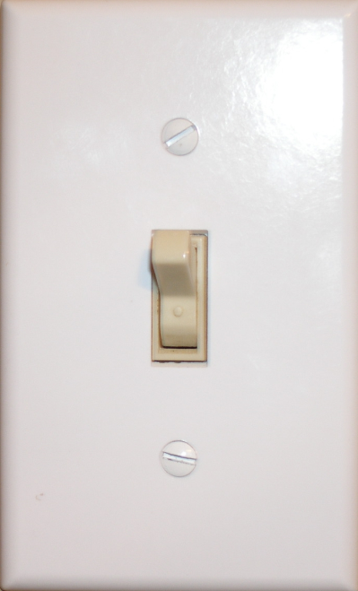
Two switches that turn off the light of Joy!
CIRCUMSTANCES
PEOPLE

Slide 7
Two Secrets to turning the Joy back on!
ATTITUDE

Slide 8
ATTITUDE
^{2:5} Have this mind among yourselves, which is yours in Christ Jesus,

Slide 9
WHOSE ATTITUDE? YOURS!
^{2:5} Have this mind among yourselves, which is yours in Christ Jesus,

Slide 10
YOU WHO ...
¹ If there is any encouragement in Christ, any consolation from love, any sharing in the Spirit, any compassion and sympathy,
1st Class Condition:
“If there is (and in fact there is)”
Then ...
Notes:
Discuss encouragement comfort fellowship tenderness compassion –
1st class condition = If you have any (and you most certainly do) .... So if we have it, but not experiencing it, then where is the problem? He’ll get to that in a few verses down.

Slide 11
YOU WHO ...
¹ SINCE there is any encouragement in Christ, any consolation from love, any sharing in the Spirit, any compassion and sympathy,
1st Class Condition:
“If there is (and in fact there is)”
Then ...
Notes:
Discuss encouragement comfort fellowship tenderness compassion –
1st class condition = If you have any (and you most certainly do) .... So if we have it, but not experiencing it, then where is the problem? He’ll get to that in a few verses down.

Slide 12
THEN ... ² complete my joy
HOW?
by being of the same mind,
having the same love,
being in full accord
and of one mind.
UNITY
UNIFORMITY
Notes:
Unity from being united to the Body of Christ – we are diverse as the body is hands elbows feet etc. We need the diversity but need to live and act in harmony. Love and appreciate others Denny for music, Barb Fore for cooking, etc.
Unity is not UNIFORMITY like we are all out of the same cookie cutter. We are diverse, like a body, hands, feet, mouth etc. All working harmoniously because Jesus is the brain.
Love, Spirit, and purpose. We are all on the same team.

Slide 13
WHAT ATTITUDE?

Slide 14
WHAT ATTITUDE? HUMILITY
³ Do nothing from rivalry or conceit, but in humility count others more significant than yourselves. ⁴ Let each of you look not only to his own interests, but also to the interests of others.
Notes:
Not from rivalry and conceit = HIGH MINDEDNESS; but rather, in humility = LOW MINDEDNESS. WE are not competing—no need for jealousy, rivalry, arrogant conceit. Instead, humility. Here defined as counting others as more important than yourself and looking out for their interests..

Slide 15
WHAT ATTITUDE? HUMILITY
³ Do nothing from rivalry or conceit, but in humility count others more significant than yourselves. ⁴ Let each of you look not only to his own interests, but also to the interests of others.
Notes:
Not from rivalry and conceit = HIGH MINDEDNESS; but rather, in humility = LOW MINDEDNESS. WE are not competing—no need for jealousy, rivalry, arrogant conceit. Instead, humility. Here defined as counting others as more important than yourself and looking out for their interests..

Slide 16
WHAT ATTITUDE? HUMILITY
³ Do nothing from rivalry or conceit, but in humility count others more significant than yourselves. ⁴ Let each of you look not only to his own interests, but also to the interests of others.
Notes:
Not from rivalry and conceit = HIGH MINDEDNESS; but rather, in humility = LOW MINDEDNESS. WE are not competing—no need for jealousy, rivalry, arrogant conceit. Instead, humility. Here defined as counting others as more important than yourself and looking out for their interests..

Slide 17
HOW HUMBLE?
Notes:
How humble should we be?

Slide 18
HOW HUMBLE? LIKE JESUS
⁵ Have this mind among yourselves, which is yours in Christ Jesus,

Slide 19
Like Jesus Who was Equal with GOD!
⁶ who, though he was in the form of God, did not count equality with God a thing to be grasped,
Notes:
Sun burst + Licensed from Bigstock . Not for reuse elsewhere.

Slide 20
Like Jesus Who was Equal with GOD!
⁶ who, though he was in the form of God, did not count equality with God a thing to be grasped,
Notes:
Sun burst + Licensed from Bigstock . Not for reuse elsewhere.

Slide 21
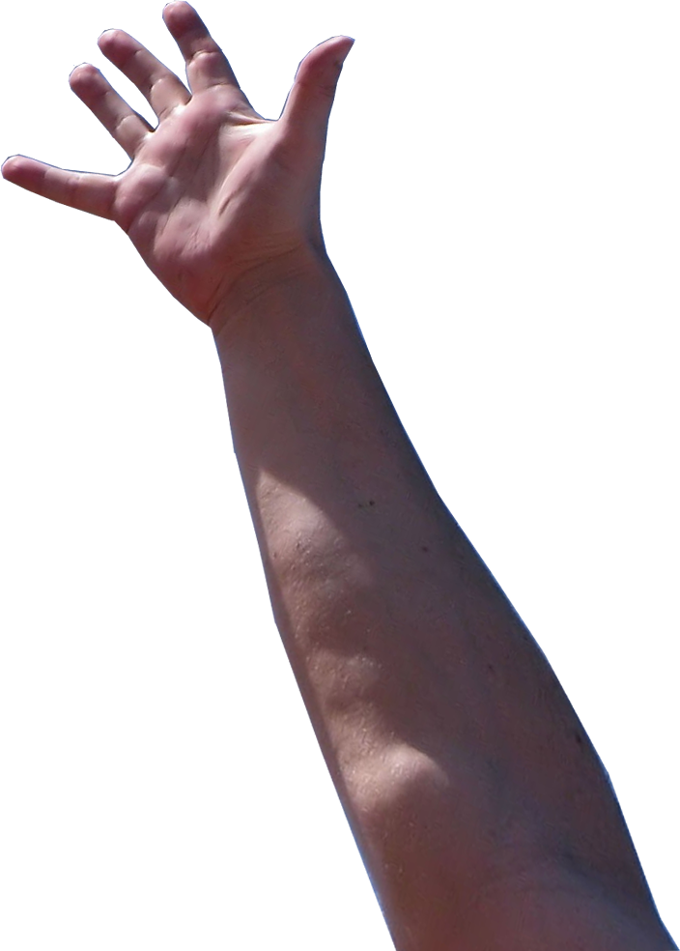
Like Jesus Who was Equal with GOD!
⁶ who, though he was in the form of God, did not count equality with God a thing to be grasped,
Notes:
Sun burst + Licensed from Bigstock . Not for reuse elsewhere.

Slide 22
Like Jesus Who HUMBLED HIMSELF!
⁷ but made himself nothing, taking the form of a servant, being born in the likeness of men. ⁸ And being found in human form, he humbled himself

Slide 23
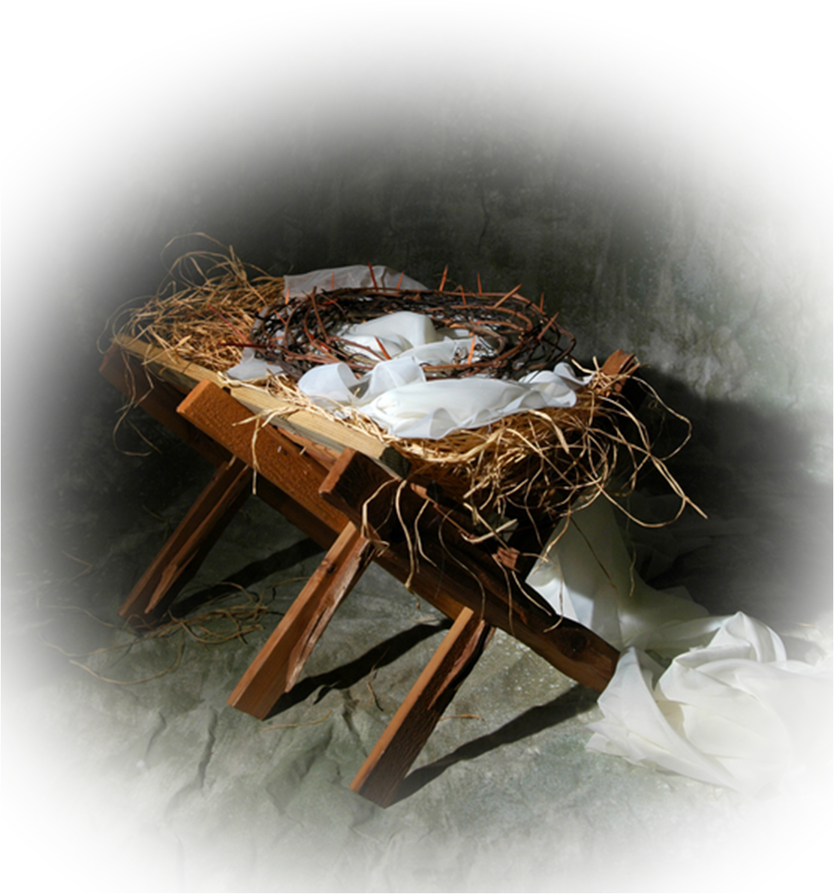
Like Jesus Who HUMBLED HIMSELF!
⁷ but made himself nothing, taking the form of a servant, being born in the likeness of men. ⁸ And being found in human form, he humbled himself

Slide 24
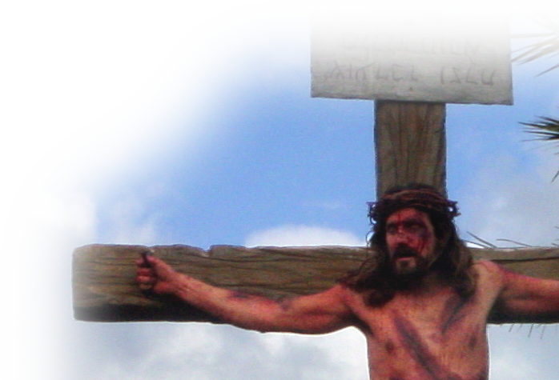
Like Jesus Who HUMBLED HIMSELF!
⁷ but made himself nothing, taking the form of a servant, being born in the likeness of men. ⁸ And being found in human form, he humbled himself by becoming obedient to the point of death, even death on a cross.

Slide 25
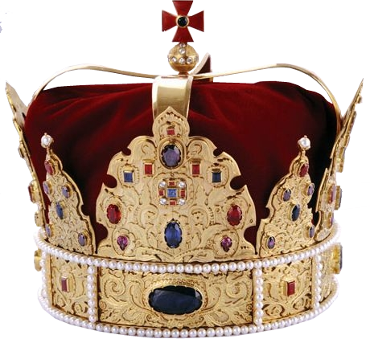
Like Jesus Who HUMBLED HIMSELF!
⁹ Therefore God has highly exalted him and bestowed on him the name that is above every name, ¹⁰ so that at the name of Jesus every knee should bow, in heaven and on earth and under the earth, ¹¹ and every tongue confess that Jesus Christ is Lord, to the glory of God the Father.

Slide 26
The 2nd Secret that will turn on the light of Joy!
ATTITUDE ACTIONS
Notes:
Light switch = FREE = from http://www.rgbstock.com/download/jdeboer/mfe7cfo.jpg

Slide 27
ACTIONS
¹² Therefore, my beloved, as you have always obeyed, so now, not only as in my presence but much more in my absence,
Attitude
Actions

Slide 28
ACTIONS
¹² Therefore, my beloved, as you have always obeyed, so now, not only as in my presence but much more in my absence,
Attitude
Actions

Slide 29
HOW? WORK OUT YOUR SALVATION!

Slide 30
HOW? WORK OUT YOUR OWN SALVATION!

Slide 31
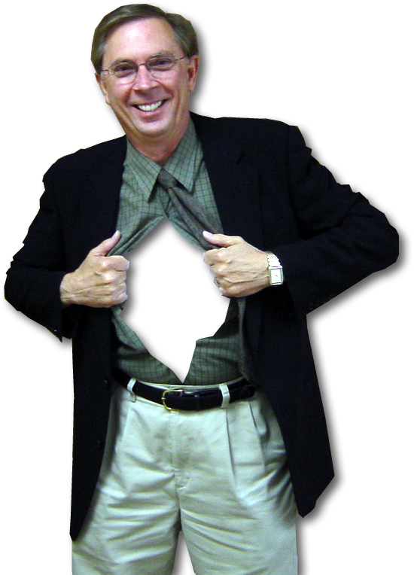
HOW? WORK OUT YOUR OWN SALVATION!
¹² ... work out your own salvation with fear and trembling

Slide 32
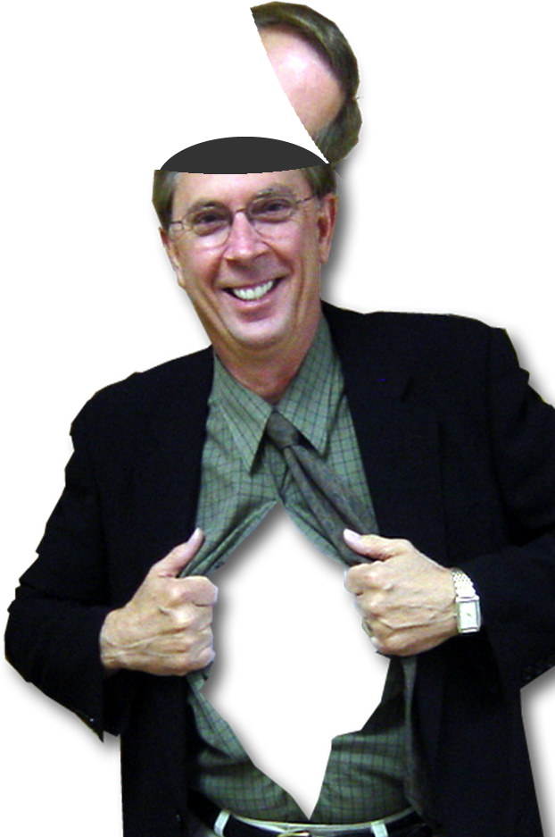
HOW? WORK OUT YOUR OWN SALVATION!
¹³ for it is God who is at work in you, enabling you both to will and to work for his good pleasure.
HOW?

Slide 33
HOW? WORK OUT YOUR OWN SALVATION!
¹³ for it is God who is at work in you, enabling you both to will and to work for his good pleasure.
HOW?

Slide 34
HOW? WORK OUT YOUR OWN SALVATION!
¹³ for it is God who is at work in you, enabling you both to will and to work for his good pleasure.
HOW?

Slide 35
HOW? WORK OUT YOUR OWN SALVATION!
¹³ for it is God who is at work in you, enabling you both to will and to work for his good pleasure.
HOW?

Slide 36
HOW? WORK OUT YOUR OWN SALVATION!
¹⁴ Do all things without grumbling or questioning,

Slide 37
HOW? WORK OUT YOUR OWN SALVATION!
¹⁴ Do all things without grumbling or questioning,
1

Slide 38
WHY? To become SHINING LIGHTS

Slide 39
WHY? To become SHINING LIGHTS
¹⁵ that you may be blameless and innocent, children of God without blemish in the midst of a crooked and twisted generation, among whom you shine as lights in the world,
Let your joy
SHINE!
The darker the night, the brighter the light!
The darker the night, the brighter the light!

Slide 40
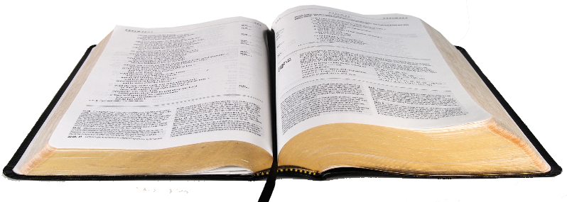
WHY? To become SHINING LIGHTS
¹⁶ holding fast to the word of life, so that in the day of Christ I may be proud that I did not run in vain or labor in vain.
Notes:
God never asks you to do what He has not equipped you to do!
You can do it! You can obey God. You can overcome anything He has summoned you to do!

Slide 41
WHY? To become SHINING LIGHTS
¹⁷ Even if I am to be poured out as a drink offering upon the sacrificial offering of your faith, I am glad and rejoice with you all. ¹⁸ Likewise you also should be glad and rejoice with me.

Slide 42
Final Thoughts
We will shine brightest on the darkest of nights when we adopt a “Me 3rd” attitude and then act on it!
What’s “Me 3rd ?
Jesus 1st
Others 2nd
Me 3rd
ME 3^{RD!}

Slide 43
Final Thoughts
We will shine brightest on the darkest of nights when we adopt a “Me 3rd” attitude and then act on it!
What’s “Me 3rd ?
Jesus 1st
Others 2nd
Me 3rd
ME 3^{RD!}
Then comes the joy!

Slide 44
Let’s pray!

