Slide 1
How to
Rejoice
in tough times!
A Study in Philippians
Notes:
This series uses the “Good Morning” font. You may download it free at: www.1001fonts.com/good-morning-font.html
and Eras Demi ITC
Copyright © 2000-2021. All rights reserved. Bible Point is a registered trademark of Dennis Henderson. All other trademarks acknowledged.
Bible Point contains graphics from Bible Point artists. These illustrations belong to Bible Point and the respective artists. You may use the designs and illustrations for graphical illustration of lessons free and without special permission, provided they are not used in any way that maligns the Christian faith. Furthermore, republication or production of any illustration by any other graphic service whether it be in book, in a machine-readable form, or in any other design resource is strictly prohibited. Furthermore, they cannot be duplicated or resold as any other form of publishing, clip art, or graphic resource.
So What does it mean? (A simple translations of the legal jargon)
So, if you don’t own the presentation(s), graphic(s), and text(s) how can you legally use them? The purchase of the license allows you to use all the images in the product. However, the actual ownership and copyright of the presentation(s), graphic(s), and text(s) remain the property of Bible Point and its licensors. If you had plans on using this product in your “for sale” work—think again!
License Agreement
Article 1: License Grant
All the graphics and text in Bible Point presentations (excluding quotes from the Bible and stated sources) are the intellectual and real property of Bible Point and its licensors, and is protected by law, including United States copyright laws and international treaties. Bible Point grants to you a license:
1. To use the presentation in a single church, single school, or single office of a Christian organization.
2. To make a single archival back-up copy of the program.
3. To modify the presentation(s) and merge with other presentations in a single church, school, or Christian organization.
4. To transfer to another party if that party agrees to accept the terms and conditions of this agreement, and you do not retain any copies of the presentation, whether printed, machine readable, modified, or merged form.
Article 2: Terms
This license is effective until terminated. You may terminate the license at any time by destroying the presentation(s), graphic(s), or text(s) together with all copies, modifications and merged portions in any form. Bible Point may terminate your license if you fail to comply with this Agreement. You agree, upon such termination, for any reason, to destroy the presentation(s), graphics, and text(s) with all copies, modifications, and merged portions in any form.
Article 3: Disclaimers
1. Bible Point presentations, graphics, and texts are licensed to you As Is. You, the consumer, bear the entire risk relating to the quality and performance of the presentation(s), graphic(s), or text(s). In no event will Bible Point be liable for damages resulting from any defect.
2. Thirty-day limited warrantee on disks. Bible Point warrants the disks to be free of defects in material and workmanship under normal use for 30 days after purchase. During the 30-day period you may return a defective presentation, graphic, or text with proof of purchase and it will be replaced without charge, unless the presentation is damaged by misuse.
Article 4: General
1. You may not sub-license, assign, or transfer the license of the presentation(s), graphic(s), or text(s) except as provided by this Agreement.
2. This Agreement will be governed by the laws of the State of Michigan.
So What does it mean? (A simple translations of the legal jargon)
May I let someone borrow or copy my licensed Bible Point presentation (even after I modified it)? As long as it is within your local church, or single school, or the immediate office of a Christian organization you may. Otherwise, please refer the person interested in borrowing to: http://www.biblepoint.com or E-mail: dh@biblepoint.com with any related questions.
---------------------------------------------------------------------------------------------------------------------------
Scripture taken from the HOLY BIBLE, NEW INTERNATIONAL VERSION®. NIV®. Copyright©1973, 1978, 1984 by International Bible Society. Used by permission of Zondervan. All rights reserved.

Slide 2
How to Find Joy in the Social Distancing!
Philippians 1:20-30

Slide 3
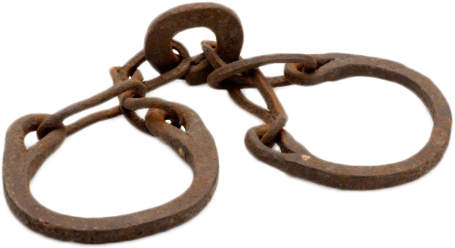
Paul writes from a HOUSE ARREST
¹⁶ And when we came into Rome, Paul was allowed to stay by himself, with the soldier that guarded him. (Act 28:16)
Notes:
Shackels = https://commons.wikimedia.org/wiki/File:IJzeren_voetring_voor_gevangenen_transparent_background.png

Slide 4
Paul writes from a HOUSE ARREST
“Rejoice” occurs 9 times
“Joy” occurs 5 times
QUESTION:
How do YOU do that?

Slide 5
Answer: Focus on the ULTIMATE

Slide 6
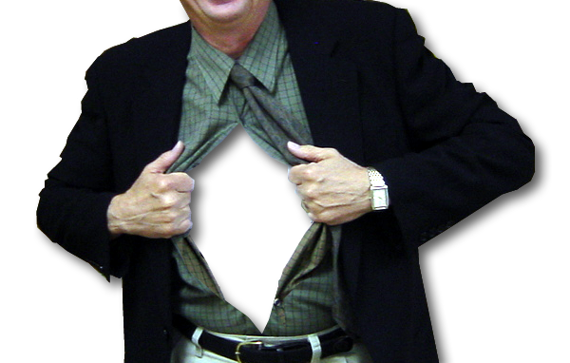
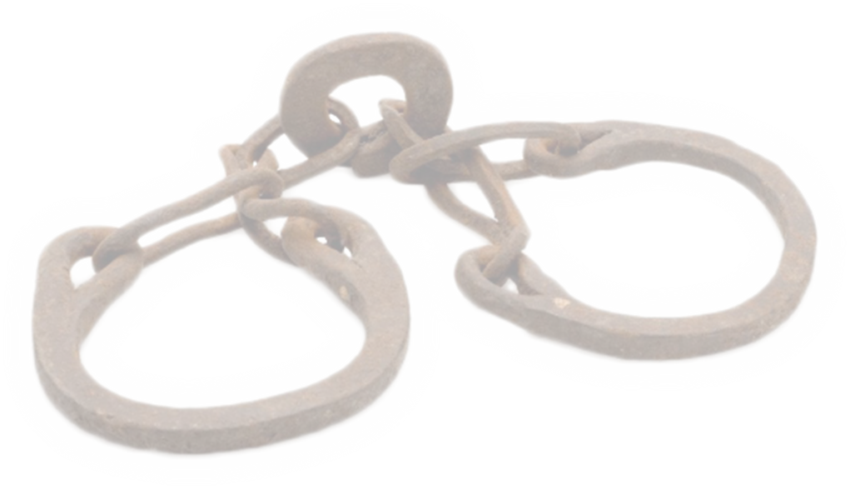
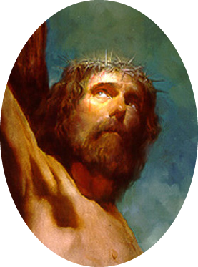
The Ultimate HOPE 1:20
1:20 it is my … hope that … Christ will be honored in my body, whether by life or by death
Notes:
. (Phi 1:20 ESV)
Point here: Life is not about you—it’s about Christ.
WE pickup where we left off last week.

Slide 7
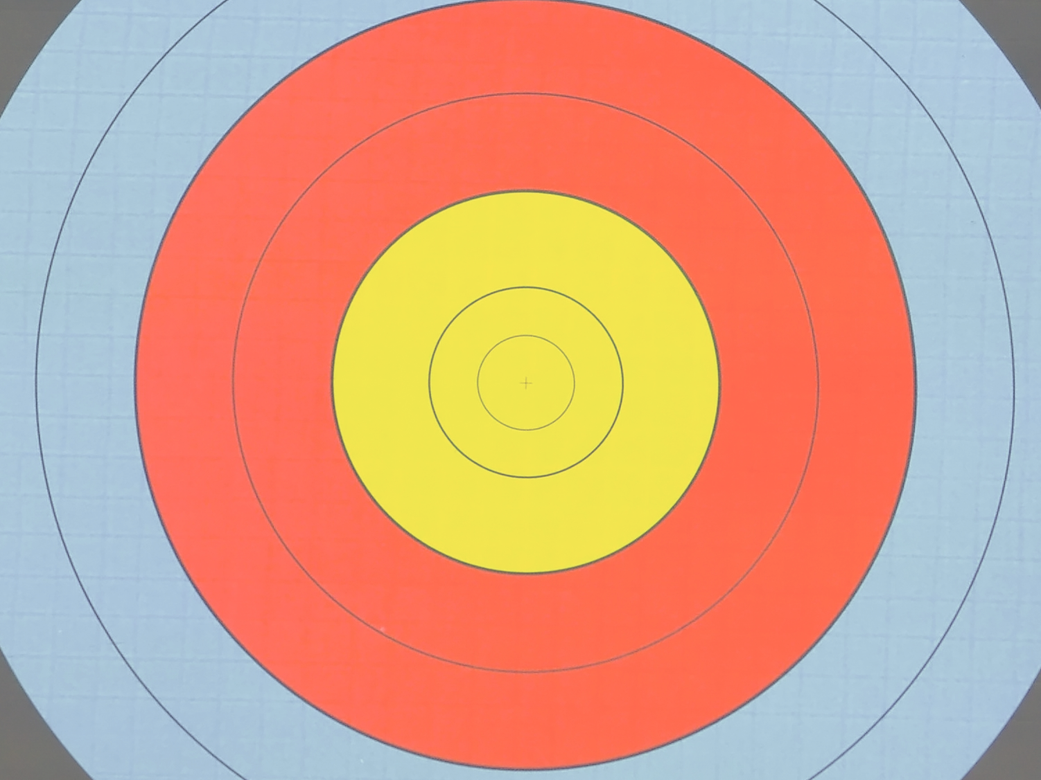
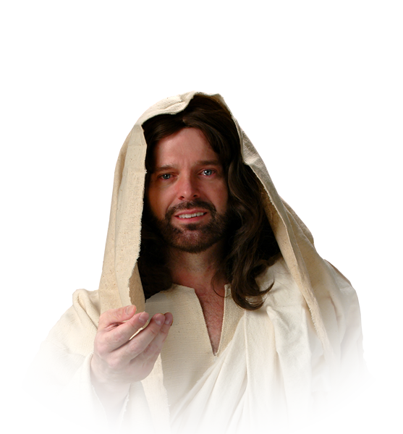
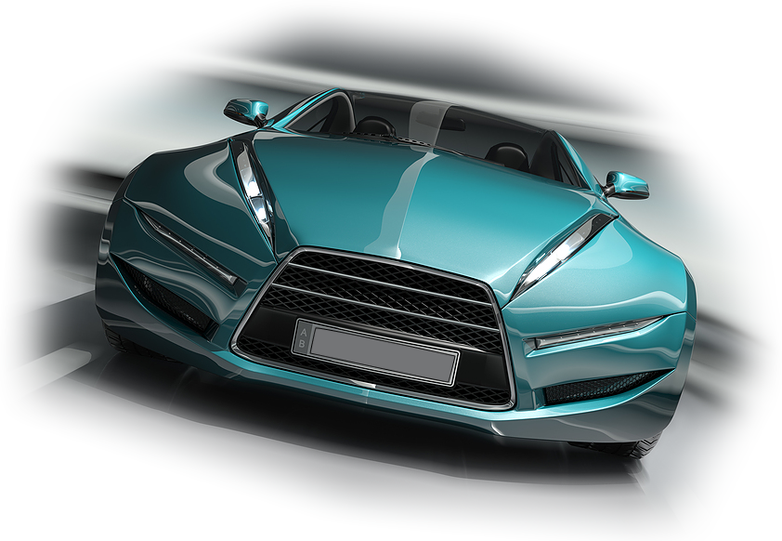
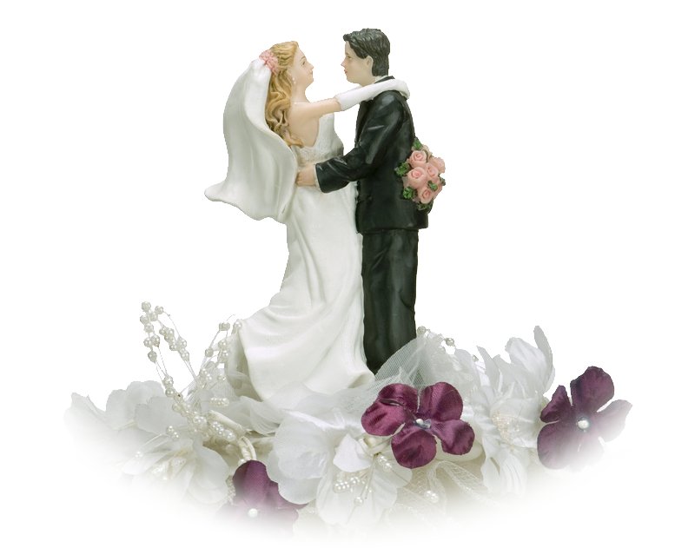
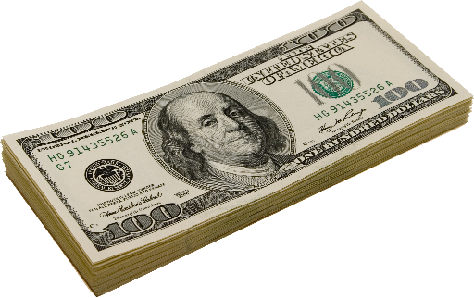
The Ultimate PURPOSE 1:21
²¹ For to me, to live is Christ...

Slide 8
The Ultimate PURPOSE 1:21
²¹ For to me, to live is Christ...

Slide 9
The Ultimate REALITY 1:21
What You Believe = WHERE you spend the line
Above or Below
What You Do = HOW you spend the line
Reward or Retribution
²¹ For to me, to live is Christ...
and to die is gain.

Slide 10
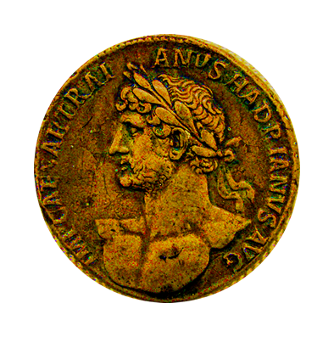
The Ultimate REALITY 1:21
The FOREVER
CROWN
1 Cor 9:24
²¹ For to me, to live is Christ...
and to die is gain.
Notes:
Our gain is portrayed in the Bible with a metaphor of crowns:
Two kinds of crowns: Diadema crown = Reigning, kingly crown – Jem studded golden crown of a king.
Stephonos crown = Victors crown – laurel wreath given to the victors of Olympic event.
We will receive the Victors crown winning a race ===1 Cor 9:24.

Slide 11
The Ultimate REALITY 1:21
The FOREVER
CROWN
1 Cor 9:25
²⁵ Every athlete exercises self-control in all things. They do it to receive a perishable wreath, but we an imperishable. (1Corinthians 9:25)
Notes:
Our gain is portrayed in the Bible with a metaphor of crowns:
Two kinds of crowns: Diadema crown = Reigning, kingly crown – Jem studded golden crown of a king.
Stephonos crown = Victors crown – laurel wreath given to the victors of Olympic event.
We will receive the Victors crown winning a race ===1 Cor 9:24.

Slide 12
The Ultimate REALITY 1:21
The JOYFUL
CROWN
Phil 4:1
... my brothers, whom I love and long for, my joy and crown, (Philippians 4:1)

Slide 13
The Ultimate REALITY 1:21
The RIGHTEOUS
CROWN
2 Tim 4:8
⁸ Henceforth there is laid up for me the crown of righteousness, which the Lord … will award to … all who have loved his appearing. (2Timothy 4:8)

Slide 14
The Ultimate REALITY 1:21
The CROWN OF LIFE
James 1:12
¹² Blessed is the man who remains steadfast under trial, for when he has stood the test …

Slide 15
The Ultimate REALITY 1:21
The CROWN OF LIFE
James 1:12
he will receive the crown of life, which God has promised to those who love him. (James 1:12)

Slide 16
The Ultimate REALITY 1:21
The CROWN OF GLORY
1 PET 5:4
⁴ And when the chief Shepherd appears, you will receive the unfading crown of glory. (1Peter 5:4)

Slide 17
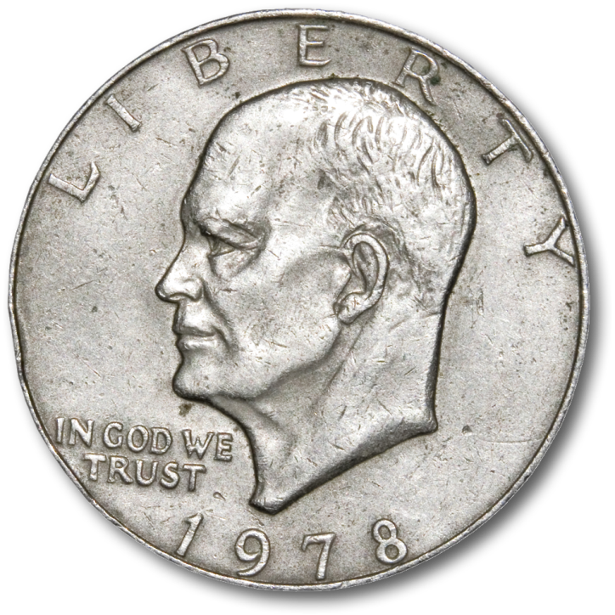
The Ultimate CHOICE 1:22-24
I do not know which I prefer.
This is a Win-Win proposition
Notes:
I like to tease kids with a coin flip trick. It is so simple. I take a coin that flip in the air, wile they are watching the coin , I say, “Heads I win, tails you lose.” If it lands as heads, I say, “Okay, Heads I win.” If it lands tails, I say, “Tails, you lose.”
That’s exactly what we have here. I life is heads – I win. If death is tail – you lose (but I win).
The ultimate choice is not “Heads nor tails”—it is choosing to follow Jesus.
Because when you are a believer, either way –life or death—you win!

Slide 18
The Ultimate CHOICE 1:22-24
Yet which I shall choose I cannot tell.
²³ I am hard pressed between the two. My desire is to depart and be with Christ, for that is far better.
Notes:
I like to tease kids with a coin flip trick. It is so simple. I take a coin that flip in the air, wile they are watching the coin , I say, “Heads I win, tails you lose.” If it lands as heads, I say, “Okay, Heads I win.” If it lands tails, I say, “Tails, you lose.”
That’s exactly what we have here. I life is heads – I win. If death is tail – you lose (but I win).
The ultimate choice is not “Heads nor tails”—it is choosing to follow Jesus.
Because when you are a believer, either way –life or death—you win!

Slide 19
The Ultimate CHOICE 1:22-24
Yet which I shall choose I cannot tell.
²³ I am hard pressed between the two. My desire is to depart and be with Christ, for that is far better.
²⁴ But to remain in the flesh is more necessary on your account.
Notes:
I like to tease kids with a coin flip trick. It is so simple. I take a coin that flip in the air, wile they are watching the coin , I say, “Heads I win, tails you lose.” If it lands as heads, I say, “Okay, Heads I win.” If it lands tails, I say, “Tails, you lose.”
That’s exactly what we have here. I life is heads – I win. If death is tail – you lose (but I win).
The ultimate choice is not “Heads nor tails”—it is choosing to follow Jesus.
Because when you are a believer, either way –life or death—you win!

Slide 20
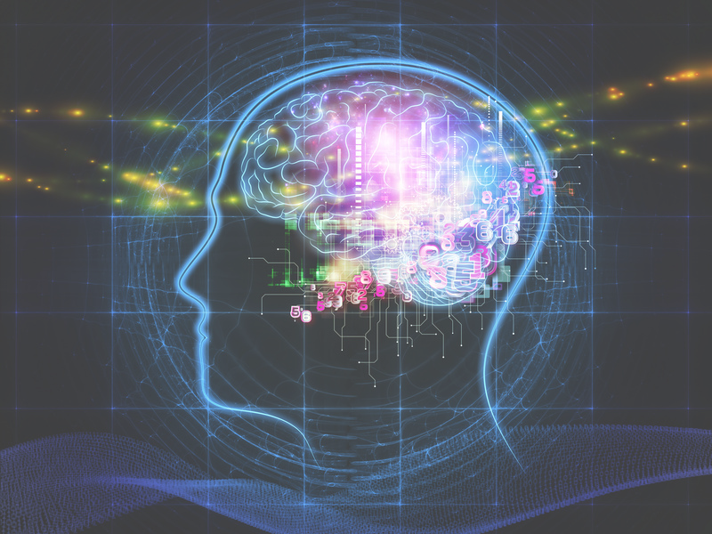
The Ultimate CONVICTION 25-26
²⁵ Convinced of this, I know that I will remain and continue with you all, for your progress and joy in the faith
Notes:
Brain image = FREE = https://www.flickr.com/photos/healthblog/8384110298
Convinced of this = that I must be with you until my work is done. Has been paraphrased down through the ages as simply: “I am immortal until my work for Jesus is done!”
George Whitfield and others have said, "I am immortal till my work is accomplished,"

Slide 21
The Ultimate CONVICTION 25-26
²⁶ so that in me you may have ample cause to glory in Christ Jesus, because of my coming to you again.

Slide 22
The Ultimate CONDUCT 27-28
²⁷ Only let your manner of life be worthy of the gospel of Christ,
Notes:
Text Illustration: The soldier walks 21 steps. On the 21st step he turns and faces the tomb he is guarding. He does this for 21 seconds. The soldier then turns to head back the other direction. He moves his rifle to his outside shoulder away from the tomb. After 21 seconds he walks 21 steps and repeats the process again and again.
Since July 1, 1937 a relatively small number of hand picked soldiers have stood guard at the Tomb of the Unknown Soldier. The tough duty is not for everyone. Over 80% of the soldiers who tryout for guard duty at the Tomb do not make it. Each soldier must have strong military bearing, discipline, stamina, and present an outstanding soldierly appearance. Each Sentinel must be able to flawlessly perform seven different types of walks, honors, and ceremonies. They must retain vast amounts of knowledge concerning the Tomb, Arlington National Cemetery, the United States Army, and their unit. They can have no military or civilian convictions for violating the law. They must score a minimum of 250 on the Army Physical Fitness Test. Their height must be within 5’11” – 6’4.” They need a 30-inch waist and be able to present a soldierly appearance in the Army Blue Uniform.
The Tomb Guards make personal sacrifices to have the honor of serving in their special role. They work on a team rotation similar to firemen at a firehouse. Those soldiers who serve well for at least nine months are rewarded with a special badge to wear on their uniforms that acknowledges their service at the Tomb of the Unknowns. If they ever bring shame on the tomb that they guard or otherwise fail in their duty they are stripped of the badge and the honor that goes with it.

Slide 23
The Ultimate CONDUCT 27-28
²⁷ Only let your manner of life be worthy of the gospel of Christ, so that whether I come and see you or am absent, I may hear of you that you are standing firm in one spirit, with one mind striving side by side for the faith of the gospel, ²⁸ and not frightened in anything by your opponents. This is a clear sign to them of their destruction, but of your salvation, and that from God.
Notes:
Text Illustration: The soldier walks 21 steps. On the 21st step he turns and faces the tomb he is guarding. He does this for 21 seconds. The soldier then turns to head back the other direction. He moves his rifle to his outside shoulder away from the tomb. After 21 seconds he walks 21 steps and repeats the process again and again.
Since July 1, 1937 a relatively small number of hand picked soldiers have stood guard at the Tomb of the Unknown Soldier. The tough duty is not for everyone. Over 80% of the soldiers who tryout for guard duty at the Tomb do not make it. Each soldier must have strong military bearing, discipline, stamina, and present an outstanding soldierly appearance. Each Sentinel must be able to flawlessly perform seven different types of walks, honors, and ceremonies. They must retain vast amounts of knowledge concerning the Tomb, Arlington National Cemetery, the United States Army, and their unit. They can have no military or civilian convictions for violating the law. They must score a minimum of 250 on the Army Physical Fitness Test. Their height must be within 5’11” – 6’4.” They need a 30-inch waist and be able to present a soldierly appearance in the Army Blue Uniform.
The Tomb Guards make personal sacrifices to have the honor of serving in their special role. They work on a team rotation similar to firemen at a firehouse. Those soldiers who serve well for at least nine months are rewarded with a special badge to wear on their uniforms that acknowledges their service at the Tomb of the Unknowns. If they ever bring shame on the tomb that they guard or otherwise fail in their duty they are stripped of the badge and the honor that goes with it.

Slide 24
The Ultimate GIFT 1:29-30
²⁹ For it has been granted to you that for the sake of Christ you should not only believe in him but also suffer for his sake,
Notes:
⁴⁰ and when they had called in the apostles, they had them flogged. Then they ordered them not to speak in the name of Jesus, and let them go.
⁴¹ As they left the council, they rejoiced that they were considered worthy to suffer dishonor for the sake of the name.
⁴² And every day in the temple and at home they did not cease to teach and proclaim Jesus as the Messiah.
(Act 5:40-42 NRS)

Slide 25
The Ultimate GIFT 1:29-30
²⁹ For it has been granted to you that for the sake of Christ you should not only believe in him but also suffer for his sake,
Notes:
⁴⁰ and when they had called in the apostles, they had them flogged. Then they ordered them not to speak in the name of Jesus, and let them go.
⁴¹ As they left the council, they rejoiced that they were considered worthy to suffer dishonor for the sake of the name.
⁴² And every day in the temple and at home they did not cease to teach and proclaim Jesus as the Messiah.
(Act 5:40-42 NRS)

Slide 26
The Ultimate GIFT 1:29-30
²⁹ For it has been granted to you that for the sake of Christ you should not only believe in him but also suffer for his sake,
Notes:
⁴⁰ and when they had called in the apostles, they had them flogged. Then they ordered them not to speak in the name of Jesus, and let them go.
⁴¹ As they left the council, they rejoiced that they were considered worthy to suffer dishonor for the sake of the name.
⁴² And every day in the temple and at home they did not cease to teach and proclaim Jesus as the Messiah.
(Act 5:40-42 NRS)

Slide 27
How do you REJOICE in the CELL BLOCK of life?
Focus on: 1-The Ultimate HOPE 20
2-The Ultimate PURPOSE 21
3-The Ultimate REALITY 21
4-The Ultimate CHOICE 22-24
5-The Ultimate CONVICTION 25-26
6-The Ultimate CONDUCT 27-28
7-The Ultimate GIFT 29-30
Notes:
While you are living in the dot of life, focus on the line of eternity.

Slide 28
So, Find the Joy in Your Social Distancing!

Slide 29
Let’s Pray

