Slide 1
How to
Rejoice
in tough times!
Sundays at 10 AM
Notes:
This series uses the “Good Morning” font. You may download it free at: www.1001fonts.com/good-morning-font.html
and Eras Demi ITC
Copyright © 2000-2021. All rights reserved. Bible Point is a registered trademark of Dennis Henderson. All other trademarks acknowledged.
Bible Point contains graphics from Bible Point artists. These illustrations belong to Bible Point and the respective artists. You may use the designs and illustrations for graphical illustration of lessons free and without special permission, provided they are not used in any way that maligns the Christian faith. Furthermore, republication or production of any illustration by any other graphic service whether it be in book, in a machine-readable form, or in any other design resource is strictly prohibited. Furthermore, they cannot be duplicated or resold as any other form of publishing, clip art, or graphic resource.
So What does it mean? (A simple translations of the legal jargon)
So, if you don’t own the presentation(s), graphic(s), and text(s) how can you legally use them? The purchase of the license allows you to use all the images in the product. However, the actual ownership and copyright of the presentation(s), graphic(s), and text(s) remain the property of Bible Point and its licensors. If you had plans on using this product in your “for sale” work—think again!
License Agreement
Article 1: License Grant
All the graphics and text in Bible Point presentations (excluding quotes from the Bible and stated sources) are the intellectual and real property of Bible Point and its licensors, and is protected by law, including United States copyright laws and international treaties. Bible Point grants to you a license:
1. To use the presentation in a single church, single school, or single office of a Christian organization.
2. To make a single archival back-up copy of the program.
3. To modify the presentation(s) and merge with other presentations in a single church, school, or Christian organization.
4. To transfer to another party if that party agrees to accept the terms and conditions of this agreement, and you do not retain any copies of the presentation, whether printed, machine readable, modified, or merged form.
Article 2: Terms
This license is effective until terminated. You may terminate the license at any time by destroying the presentation(s), graphic(s), or text(s) together with all copies, modifications and merged portions in any form. Bible Point may terminate your license if you fail to comply with this Agreement. You agree, upon such termination, for any reason, to destroy the presentation(s), graphics, and text(s) with all copies, modifications, and merged portions in any form.
Article 3: Disclaimers
1. Bible Point presentations, graphics, and texts are licensed to you As Is. You, the consumer, bear the entire risk relating to the quality and performance of the presentation(s), graphic(s), or text(s). In no event will Bible Point be liable for damages resulting from any defect.
2. Thirty-day limited warrantee on disks. Bible Point warrants the disks to be free of defects in material and workmanship under normal use for 30 days after purchase. During the 30-day period you may return a defective presentation, graphic, or text with proof of purchase and it will be replaced without charge, unless the presentation is damaged by misuse.
Article 4: General
1. You may not sub-license, assign, or transfer the license of the presentation(s), graphic(s), or text(s) except as provided by this Agreement.
2. This Agreement will be governed by the laws of the State of Michigan.
So What does it mean? (A simple translations of the legal jargon)
May I let someone borrow or copy my licensed Bible Point presentation (even after I modified it)? As long as it is within your local church, or single school, or the immediate office of a Christian organization you may. Otherwise, please refer the person interested in borrowing to: http://www.biblepoint.com or E-mail: dh@biblepoint.com with any related questions.
---------------------------------------------------------------------------------------------------------------------------
Scripture taken from the HOLY BIBLE, NEW INTERNATIONAL VERSION®. NIV®. Copyright©1973, 1978, 1984 by International Bible Society. Used by permission of Zondervan. All rights reserved.

Slide 2
This series uses the “Good Morning” font. You may download it free at:
www.1001fonts.com/good-morning-font.html

Slide 3
How make lemonade out of the lemons of life!

Slide 4
A Little Background
¹ Paul and Timothy, servants of Christ Jesus, To all the saints in Christ Jesus who are in Philippi, with the bishops and deacons: ² Grace to you and peace from God our Father and the Lord Jesus Christ.

Slide 5
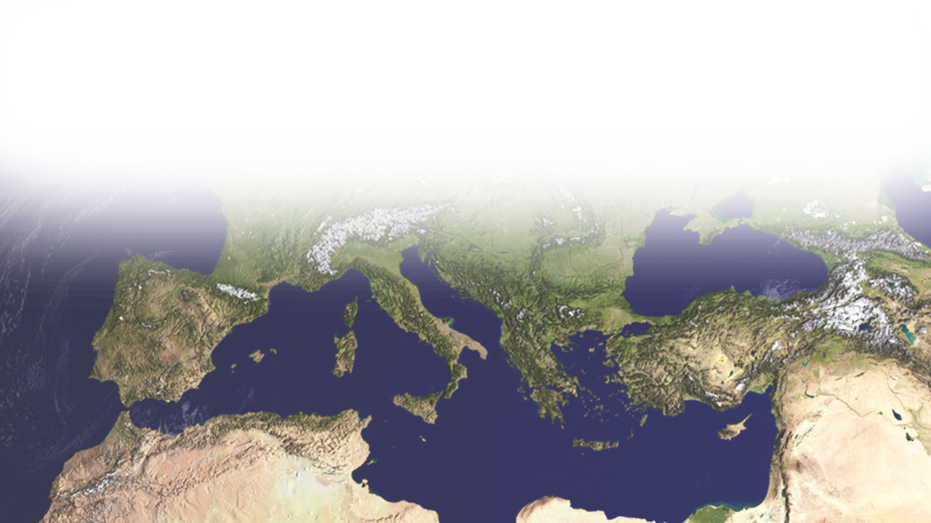
A Little Background
Paul and Timothy, servants of Christ Jesus, To all the saints in Christ Jesus who are at Philippi, with the overseers and deacons: ² Grace to you and peace from God our Father and the Lord Jesus Christ.

Slide 6
A Little Background
^{Act 16:14} One who heard us was a woman named Lydia, … who was a worshiper of God. The Lord opened her heart to pay attention to what was said by Paul. ¹⁵ And after she was baptized, and her household ….
Notes:
(Act 16:14-15 ESV)

Slide 7
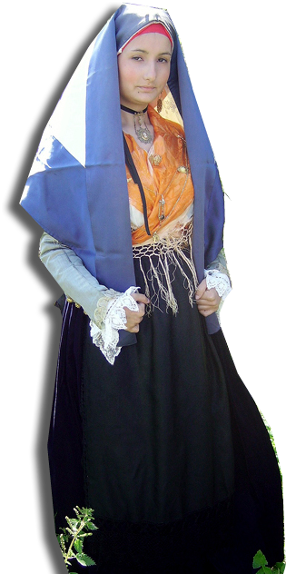
A Little Background
^{Act 16:16-17 16} … we were met by a slave girl who had a spirit of divination and brought her owners much gain by fortune-telling. ¹⁷ She followed Paul and us, crying out, "These men are servants of the Most High God, who proclaim to you the way of salvation."
Notes:
¹⁶ … we were met by a slave girl who had a spirit of divination and brought her owners much gain by fortune-telling.
¹⁷ She followed Paul and us, crying out, "These men are servants of the Most High God, who proclaim to you the way of salvation."
(Act 16:16-17 ESV)

Slide 8
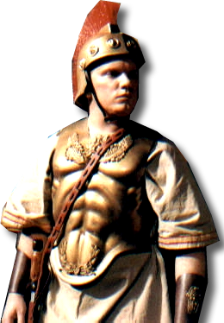
A Little Background
^{Act 16:25-31} About midnight .... ²⁶ Suddenly there was an earthquake .... The jailer ... said, "Sirs, what must I do to be saved?"
³¹ They answered, "Believe in the Lord Jesus, and you will be saved, you and your household."

Slide 9
A Little Background
The Philippian Church is Born

Slide 10
Paul knows the lemons of life
He also shares how to make lemonade out of them ...

Slide 11
Appeal to a HIGHER POWER

Slide 12
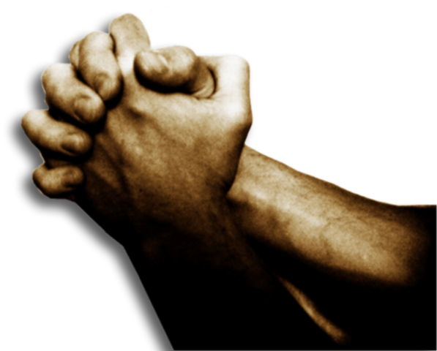
Appeal to a HIGHER POWER
³ I thank my God in all my remembrance of you, ⁴ always in every prayer of mine for you all making my prayer with joy,

Slide 13
Appeal to a HIGHER POWER
Thankful Prayer
³ I thank my God in all my remembrance of you, ⁴ always in every prayer of mine for you all making my prayer with joy,

Slide 14
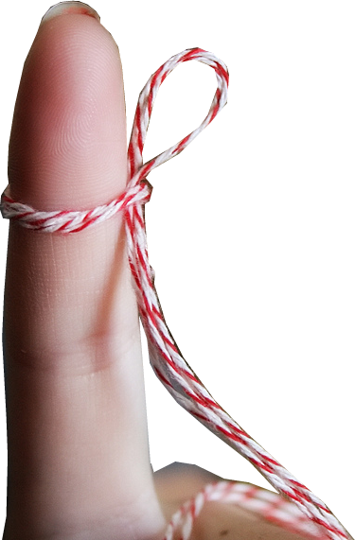
Appeal to a HIGHER POWER
Thoughtful Prayer
³ I thank my God in all my remembrance of you, ⁴ always in every prayer of mine for you all making my prayer with joy,

Slide 15
Appeal to a HIGHER POWER
Joyful Prayer
³ I thank my God in all my remembrance of you, ⁴ always in every prayer of mine for you all making my prayer with joy,

Slide 16
Appeal to a HIGHER POWER
Confident Prayer
⁵ because of your partnership in the gospel from the first day until now. ⁶ And I am sure of this, that he who began a good work in you will bring it to completion at the day of Jesus Christ.
Notes:
Thumbs up = https://pixabay.com/en/as-ok-so-yes-facebook-i-like-it-343456/

Slide 17
Appeal to a HIGHER POWER
Confident Prayer
⁵ because of your partnership in the gospel from the first day until now. ⁶ And I am sure of this, that he who began a good work in you will bring it to completion at the day of Jesus Christ.
Notes:
Thumbs up = https://pixabay.com/en/as-ok-so-yes-facebook-i-like-it-343456/

Slide 18
Appeal to a HIGHER POWER
Confident Prayer
⁵ because of your partnership in the gospel from the first day until now. ⁶ And I am sure of this, that he who began a good work in you will bring it to completion at the day of Jesus Christ.
Notes:
Thumbs up = https://pixabay.com/en/as-ok-so-yes-facebook-i-like-it-343456/

Slide 19
Appeal to a HIGHER POWER
Heartfelt Prayer
⁷ It is right for me to feel this way about you all, because I hold you in my heart, for you are all partakers with me of grace, both in my imprisonment and in the defense and confirmation of the gospel.
Notes:
Heart = https://pixabay.com/en/heart-love-red-valentine-romantic-157895/

Slide 20
Appeal to a HIGHER POWER
Heartfelt Prayer
⁸ For God is my witness, how I yearn for you all with the affection of Christ Jesus.

Slide 21
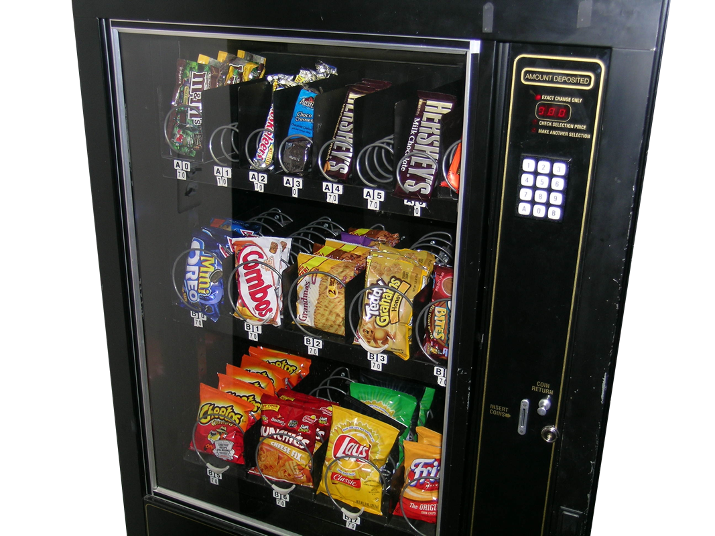
Appeal to a HIGHER POWER
Specific Prayer
⁹ And this is my prayer

Slide 22
Appeal to a HIGHER POWER
Specific Prayer
Connect heart ...
⁹ And it is my prayer that your love may abound more and more, with knowledge and all discernment,
Notes:
He is not praying for another earthquake, the doors to spring open and release him. NO instead he is praying for the Philippians hearts to be filled witht he love of God to overflow.

Slide 23
Appeal to a HIGHER POWER
Specific Prayer
Connect heart ...
⁹ And it is my prayer that your love may abound more and more, with knowledge and all discernment,
Notes:
He is not praying for another earthquake, the doors to spring open and release him. NO instead he is praying for the Philippians hearts to be filled witht he love of God to overflow.

Slide 24
Appeal to a HIGHER POWER
Specific Prayer
Connect heart & God
¹⁰ so that you may approve what is excellent, and so be pure and blameless for the day of Christ, ¹¹ filled with the fruit of righteousness that comes through Jesus Christ, to the glory and praise of God.
Notes:
All for the glory of God. Prayer is not some vending machine in the sky. You put your coin of prayer in, push the button B6, and out pops your answer of what you wanted. NO! Prayer that gets answered is a prayer for God’s Glory and the answer is not always for your convenience!
Genuine prayer is what Jesus did in the garden of Gethsemane, “Not my will, but Your will be done!”

Slide 25
Appeal to a HIGHER PURPOSE
Notes:
"When a cowboy applied for health insurance, the agent routinely asked if he had had any accidents during the previous year. The cowboy replied, ’No, but I was bitten by a rattlesnake, and a horse kicked me in the ribs. That laid me up for a while.’ The agent said, ’Weren’t those accidents?’ ’No,’ replied the cowboy, ’they did it on purpose.’
Likewise, the Apostle Paul does not believe in accidents. Everything happens for a HIGHER PURPOSE.

Slide 26
Appeal to a HIGHER PURPOSE
¹² I want you to know, brothers, that what has happened to me has really served to advance the gospel,
Notes:
Target = https://pixabay.com/en/target-dart-arch-sports-arrow-bow-36797/

Slide 27
Appeal to a HIGHER PURPOSE
The “Higher” Purpose
^{Isaiah 55:9} ⁹ For as the heavens are higher than the earth, so are my ways higher than your ways and my thoughts than your thoughts.
Notes:
Target = https://pixabay.com/en/target-dart-arch-sports-arrow-bow-36797/

Slide 28
Appeal to a HIGHER PURPOSE
The “50:20” Purpose
^{Gen 50:20} As for you, you meant evil against me, but God meant it for good, to bring it about that many people should be kept alive, as they are today.
Notes:
Target = https://pixabay.com/en/target-dart-arch-sports-arrow-bow-36797/

Slide 29
Appeal to a HIGHER PURPOSE
The “8:28” Purpose
^{Rom 8:28} And we know that for those who love God all things work together for good, for those who are called according to his purpose.
Notes:
Target = https://pixabay.com/en/target-dart-arch-sports-arrow-bow-36797/

Slide 30
Appeal to a HIGHER PURPOSE
The “Secret” Purpose
^{Deut 29:29} The secret things belong to the LORD our God, but the things that are revealed belong to us and to our children forever ….
Notes:
Target = https://pixabay.com/en/target-dart-arch-sports-arrow-bow-36797/

Slide 31
Appeal to a HIGHER PURPOSE
The “Mysterious” Purpose
¹² I want you to know, brothers, that what has happened to me has really served to advance the gospel,
Notes:
Target = https://pixabay.com/en/target-dart-arch-sports-arrow-bow-36797/

Slide 32
Appeal to a HIGHER PURPOSE
The “GOSPEL” Purpose
¹² I want you to know, brothers, that what has happened to me has really served to advance the gospel,
GOSPEL
Notes:
Target = https://pixabay.com/en/target-dart-arch-sports-arrow-bow-36797/

Slide 33
Appeal to a HIGHER PURPOSE
The “GOSPEL” Purpose
¹³ so that it has become known throughout the whole imperial guard and to all the rest that my imprisonment is for Christ.
GOSPEL
Notes:
Target = https://pixabay.com/en/target-dart-arch-sports-arrow-bow-36797/

Slide 34
Appeal to a HIGHER PURPOSE
The “GOSPEL” Purpose
¹⁴ And most of the brothers, having become confident in the Lord by my imprison-ment, are much more bold to speak the word without fear.
GOSPEL
Notes:
Target = https://pixabay.com/en/target-dart-arch-sports-arrow-bow-36797/

Slide 35
Appeal to a HIGHER PURPOSE
The “GOSPEL” Purpose
¹⁵ Some indeed preach Christ from envy and rivalry, but others from good will. ¹⁶ The latter do it out of love, knowing that I am put here for the defense of the gospel.
GOSPEL
Notes:
Target = https://pixabay.com/en/target-dart-arch-sports-arrow-bow-36797/

Slide 36
Appeal to a HIGHER PURPOSE
The “GOSPEL” Purpose
¹⁷ The former proclaim Christ out of rivalry, not sincerely but thinking to afflict me in my imprisonment.
GOSPEL
Notes:
Target = https://pixabay.com/en/target-dart-arch-sports-arrow-bow-36797/

Slide 37
Appeal to a HIGHER PURPOSE
The “GOSPEL” Purpose
¹⁸ What then? Only that in every way, whether in pretense or in truth, Christ is proclaimed,
GOSPEL
Notes:
Target = https://pixabay.com/en/target-dart-arch-sports-arrow-bow-36797/

Slide 38
CONCLUSION:
and in that I rejoice. Yes, and I will rejoice,
Notes:
Target = https://pixabay.com/en/target-dart-arch-sports-arrow-bow-36797/

Slide 39
CONCLUSION:
¹⁹ for I know that through your prayers and the help of the Spirit of Jesus Christ this will turn out for my deliverance,
APPEAL TO THE HIGHER POWER
Notes:
Target = https://pixabay.com/en/target-dart-arch-sports-arrow-bow-36797/

Slide 40
CONCLUSION:
¹⁹ for I know that through your prayers and the help of the Spirit of Jesus Christ this will turn out for my deliverance,
APPEAL TO THE HIGHER PURPOSE
Notes:
Target = https://pixabay.com/en/target-dart-arch-sports-arrow-bow-36797/

Slide 41
CONCLUSION:
¹⁹ for I know that through your prayers and the help of the Spirit of Jesus Christ this will turn out for my deliverance,
APPEAL TO THE HIGHER PURPOSE
“What has happened to me” (NIV)
Notes:
Target = https://pixabay.com/en/target-dart-arch-sports-arrow-bow-36797/

Slide 42
So how do you make lemonade from the lemons of life?
1- Appeal to a Higher Power
2- Appeal to a Higher Purpose
So you can rejoice!

Slide 43
Let’s pray!

