Slide 1
Conflict Resolution
A Study of Philemon
Notes:
Copyright © 2006−2020. All rights reserved. Bible Point is a registered trademark of Dennis Henderson. All other trademarks acknowledged.
Bible Point contains graphics from Bible Point artists. These illustrations belong to Bible Point and the respective artists. You may use the designs and illustrations for graphical illustration of lessons free and without special permission, provided they are not used in any way that maligns the Christian faith. Furthermore, republication or production of any illustration by any other graphic service whether it be in book, in a machine-readable form, or in any other design resource is strictly prohibited. Furthermore, they cannot be duplicated or resold as any other form of publishing, clip art, or graphic resource.
So What does it mean? (A simple translations of the legal jargon)
So, if you don’t own the presentation(s), graphic(s), and text(s) how can you legally use them? The purchase of the license allows you to use all the images in the product. However, the actual ownership and copyright of the presentation(s), graphic(s), and text(s) remain the property of Bible Point and its licensors. If you had plans on using this product in your “for sale” work—think again!
License Agreement
Article 1: License Grant
All the graphics and text in Bible Point presentations (excluding quotes from the Bible and stated sources) are the intellectual and real property of Bible Point and its licensors, and is protected by law, including United States copyright laws and international treaties. Bible Point grants to you a license:
1. To use the presentation in a single church, single school, or single office of a Christian organization.
2. To make a single archival back-up copy of the program.
3. To modify the presentation(s) and merge with other presentations in a single church, school, or Christian organization.
4. To transfer to another party if that party agrees to accept the terms and conditions of this agreement, and you do not retain any copies of the presentation, whether printed, machine readable, modified, or merged form.
Article 2: Terms
This license is effective until terminated. You may terminate the license at any time by destroying the presentation(s), graphic(s), or text(s) together with all copies, modifications and merged portions in any form. Bible Point may terminate your license if you fail to comply with this Agreement. You agree, upon such termination, for any reason, to destroy the presentation(s), graphics, and text(s) with all copies, modifications, and merged portions in any form.
Article 3: Disclaimers
1. Bible Point presentations, graphics, and texts are licensed to you As Is. You, the consumer, bear the entire risk relating to the quality and performance of the presentation(s), graphic(s), or text(s). In no event will Bible Point be liable for damages resulting from any defect.
2. Thirty-day limited warrantee on disks. Bible Point warrants the disks to be free of defects in material and workmanship under normal use for 30 days after purchase. During the 30-day period you may return a defective presentation, graphic, or text with proof of purchase and it will be replaced without charge, unless the presentation is damaged by misuse.
Article 4: General
1. You may not sub-license, assign, or transfer the license of the presentation(s), graphic(s), or text(s) except as provided by this Agreement.
2. This Agreement will be governed by the laws of the State of Michigan.
So What does it mean? (A simple translations of the legal jargon)
May I let someone borrow or copy my licensed Bible Point presentation (even after I modified it)? As long as it is within your local church, or single school, or the immediate office of a Christian organization you may. Otherwise, please refer the person interested in borrowing to: http://www.biblepoint.com or E-mail: dennis@drdh.net with any related questions.

Slide 2
My Premise Today:
You can learn to do
“Conflict Resolution”
(Become a Peace Maker)

Slide 3
Why would I say that?
Because
the Apostle Paul
learned to
be one!

Slide 4
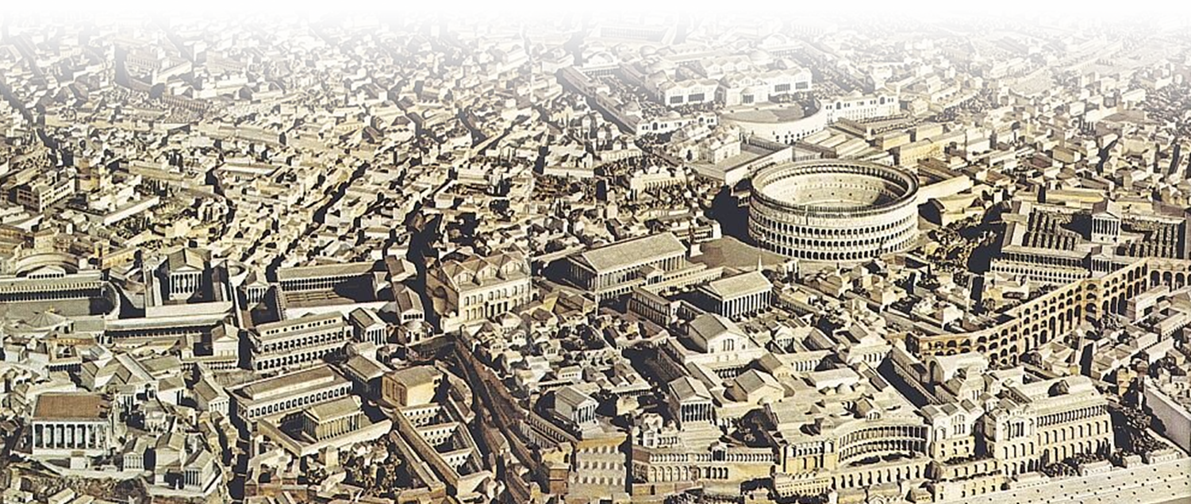
Bear with me ...
Paul wrote Philemon from Rome around 60 AD

Slide 5
In the previous 14 years ...
Three missionary journeys
Jerusalem imprisonments
3 Trials
Sailed to Rome –
imprisonment

Slide 6
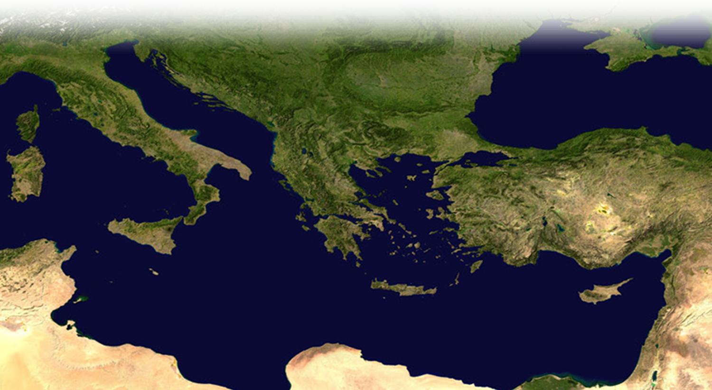
So back up 14 years – 46 AD
Notes:
So back up with me 14 years—it is not 60 AD but 46AD. Paul is not in Rome—he is still back in Antioch.

Slide 7
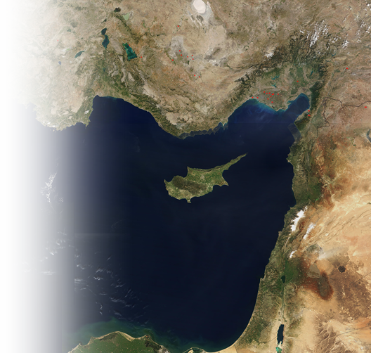
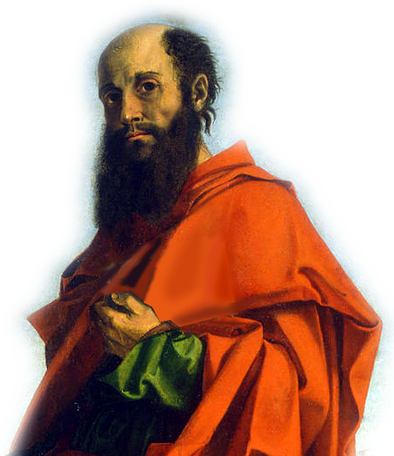
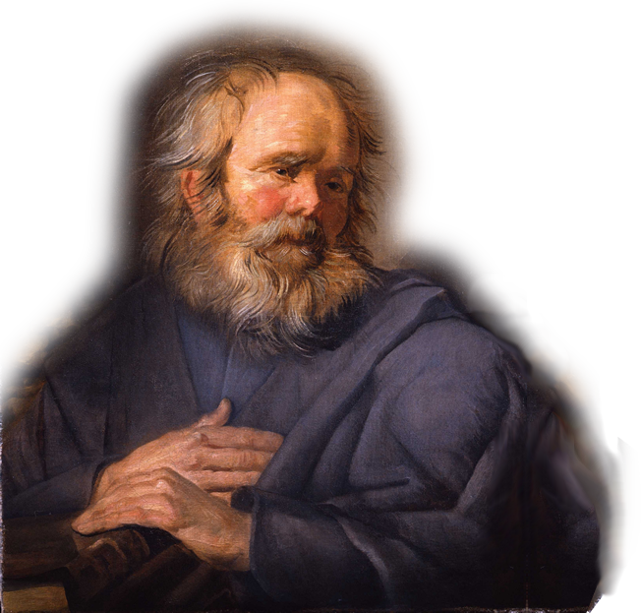
Paul and Barnabas Set Out
Salamis
Notes:
Man used here as Barnabas was originally painted to be John Mark = FREE = from http://en.wikipedia.org/wiki/John_Mark
² While they were worshiping the Lord and fasting, the Holy Spirit said, "Set apart for me Barnabas and Saul for the work to which I have called them."
³ So after they had fasted and prayed, they placed their hands on them and sent them off.
⁴ The two of them, sent on their way by the Holy Spirit, went down to Seleucia and sailed from there to Cyprus.
(Act 13:2-4 NIV)

Slide 8
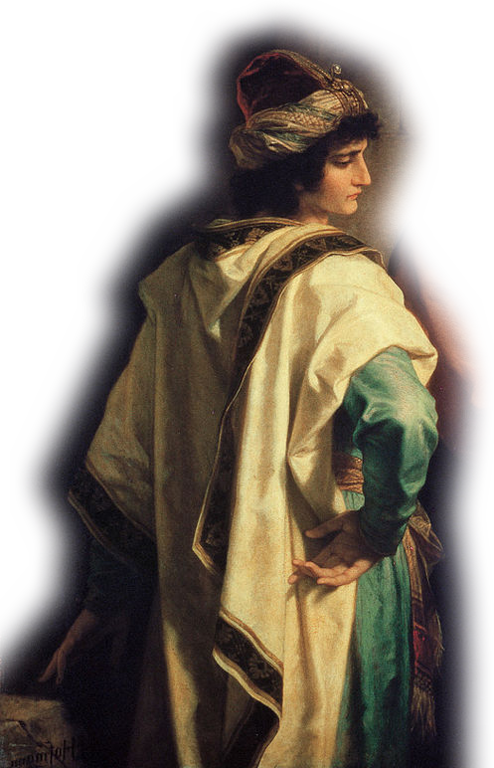
Pick-Up John Mark - Cousin
Perga of
Pamphylia
Paphos
Notes:
² While they were worshiping the Lord and fasting, the Holy Spirit said, "Set apart for me Barnabas and Saul for the work to which I have called them."
³ So after they had fasted and prayed, they placed their hands on them and sent them off.
⁴ The two of them, sent on their way by the Holy Spirit, went down to Seleucia and sailed from there to Cyprus.
(Act 13:2-4 NIV)

Slide 9
John Mark Bailed On Them
Perga of
Pamphylia
Notes:
Character of John Mark is from painting of the Rich Young Ruler = FREE = from http://en.wikipedia.org/wiki/Jesus_and_the_rich_young_man#/media/File:Hoffman-ChristAndTheRichYoungRuler.jpg
² While they were worshiping the Lord and fasting, the Holy Spirit said, "Set apart for me Barnabas and Saul for the work to which I have called them."
³ So after they had fasted and prayed, they placed their hands on them and sent them off.
⁴ The two of them, sent on their way by the Holy Spirit, went down to Seleucia and sailed from there to Cyprus.
(Act 13:2-4 NIV)

Slide 10
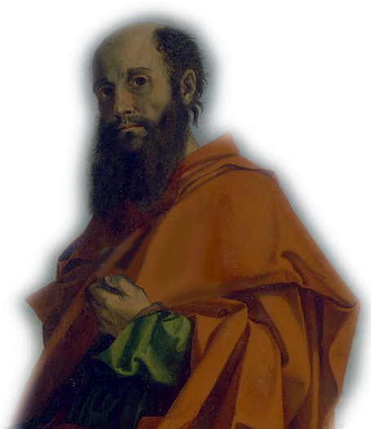
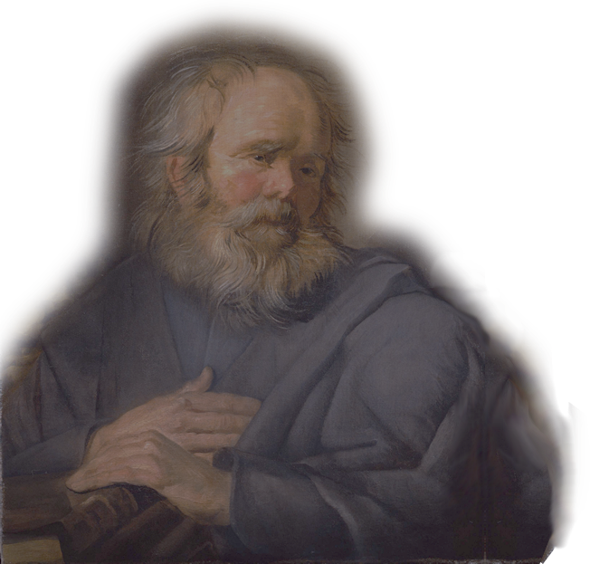
Why?
Perhaps it was ...
The Itinerary ...
Homesickness ...
Frightened ...
Malaria ...
Paul’s Leadership ...
Paul’s Preaching ...
Notes:
Why? Perhaps ... (as suggested in the article below from: http://markmoore.org/resources/essays/acts/johnmark.pdf)
Why Did John Mark Leave? (Acts 13:13) By Mark Scott & Mark Moore
1.John objected to Paul's itinerary. Obviously Cypress was Barnabas' home territory. Because John was related to Barnabas, we might assume that he too had roots in this island or at least friendly family connections. When the trip went beyond this familiar territory John might have balked.
2. John got homesick. He did follow Paul and Barnabas from Jerusalem to Antioch and now returns to Jerusalem. This may be a clue that he longed for home.
3. John was frightened. The area they were headed was known to be riddled with bandits. John may have been frightened by the prospect of getting beat up. Moreover, given Paul's track record, even in Paphos, conflict with political entities was inevitable.
4. Paul may have contracted malaria. Some have suggested that the reason Paul and Barnabas bypassed Ephesus for Psidian Antioch was for the higher altitude and a more agreeable climate for recovering from malaria. Indeed Paul says in Gal. 4:13 that he came to them the first time because of a bodily illness. Perhaps John was trying to avoid this devastating disease.
5. John may have objected to Paul's leadership. Up to the conversion of Sergius Paulus, Barnabas was clearly the leader. He introduced Paul to the Apostles in Jerusalem. He verified the work in Antioch. He recruited Paul to help with the work. He gets top billing both on their mission of mercy in Jerusalem (chp 11) and their evangelistic tour on Cyprus (chp 13). Suddenly (and from here on out), Paul not only changes his name but takes the lead over Barnabas. John Mark may have been jealous for his kinsman when he took a back seat to Paul.
6. John may have objected to Paul's preaching. As Paul's message of grace turns toward Gentile audiences, it becomes clear that he will not require them to be circumcised. This has profound implications that will fester into a serious confrontation in chapter 15. John may object to Paul's "libertine" views just as other conservatives from Jerusalem did.

Slide 11
Fast-Forward
Iconium
Lystra
Pisidian Antioch
Derbe
Completed 1st Journey

Slide 12
Fast-Forward
Completed 1st Journey

Slide 13
Fast-Forward
Completed 1st Journey
The Jerusalem Council
Jerusalem

Slide 14
Ready for 2nd Journey
³⁵ But Paul and Barnabas remained in Antioch, where they and many others taught and preached the word of the Lord.

Slide 15
Ready for 2nd Journey
³⁶ Some time later
Paul said to Barnabas,

Slide 16
Ready for 2nd Journey
"Let us go back and visit the brothers in all the towns where we preached the word of the Lord and see how they are doing.“

Slide 17
Ready for 2nd Journey
³⁷ Barnabas wanted
to take John, also called Mark, with them,

Slide 18
Ready for 2nd Journey
³⁸ but Paul did not think it wise to take him, because he had deserted them in Pamphylia and had not continued with them in the work.

Slide 19
Ready for 2nd Journey
³⁹ They had such a sharp disagreement ...

Slide 20
Ready for 2nd Journey
Heated exchange:
Paul did not “think it wise” = John/Mark was literally
“not worthy of honor.”
John/Mark “deserted!”
(ἀποστάντα)
³⁹ They had such a sharp disagreement ...

Slide 21
Ready for 2nd Journey
Barnabas’ Defense:
³⁹ They had such a sharp disagreement ...
1. Polite
2. Thanks
3. Compli.
4. Prayer
5. Joyful
6. Gentle
7. Loving
8. Respect
9. Mediate
10. Useful
11. Affection
12. Helpful
13. Voluntary
14. Big Picture
15. Spiritual
16. Partner
17. Credit Card
18. Substitute
19. Refresh
20. Confident
21. Follow-Up

Slide 22
Ready for 2nd Journey
³⁹ They had such a sharp disagreement that they parted company.

Slide 23
Ready for 2nd Journey
Sometimes you have to:
“Agree to Disagree”
and just keep on
serving Jesus!
³⁹ They had such a sharp disagreement that they parted company.

Slide 24
Ready for 2nd Journey
Barnabas took Mark and sailed for Cyprus

Slide 25
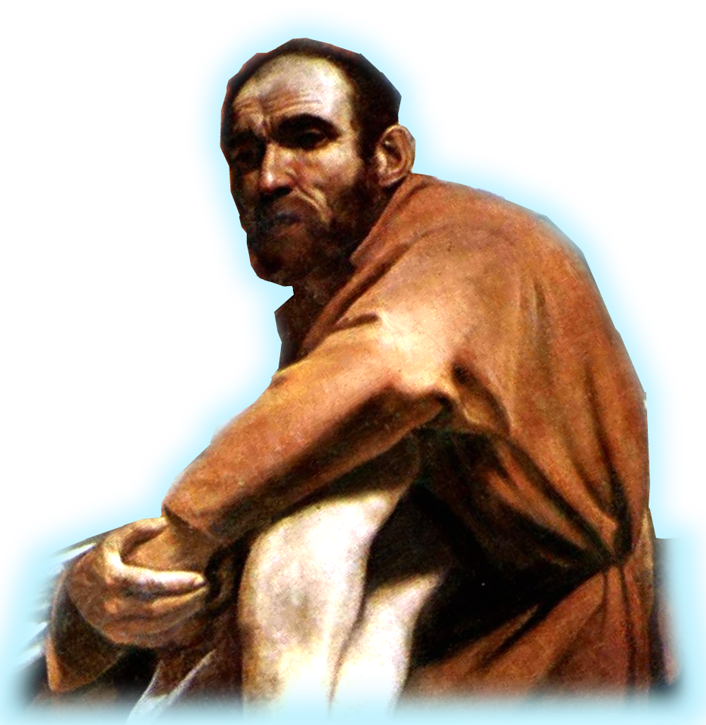
Ready for 2nd Journey
⁴⁰ but Paul chose Silas and left, commended by the brothers to the grace of the Lord.

Slide 26
Ready for 2nd Journey
⁴¹ He went through Syria and Cilicia, strengthening the churches.

Slide 27
Important Point:
The Lord even uses our
conflicts for His glory!
Two missionary teams!

Slide 28
However, at some point, some way ...
The conflict between
Paul and Mark was
RESOLVED!

Slide 29
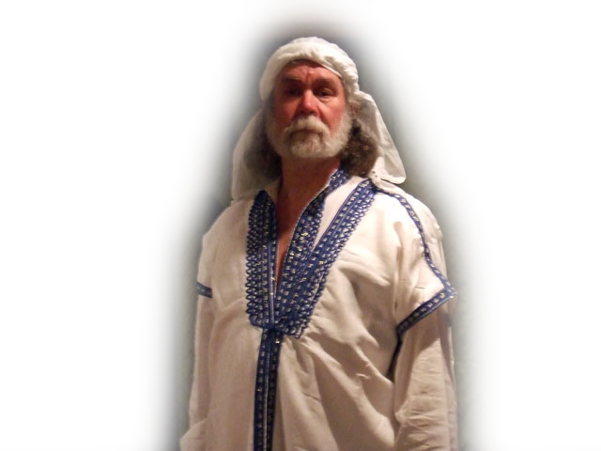
By 60 AD – letter to Philemon

Slide 30
The People with Paul ...
²³ Epaphras, my fellow prisoner in Christ Jesus, sends you greetings. ²⁴ And so do Mark, Aristarchus, Demas and Luke, my fellow workers.
HI!

Slide 31
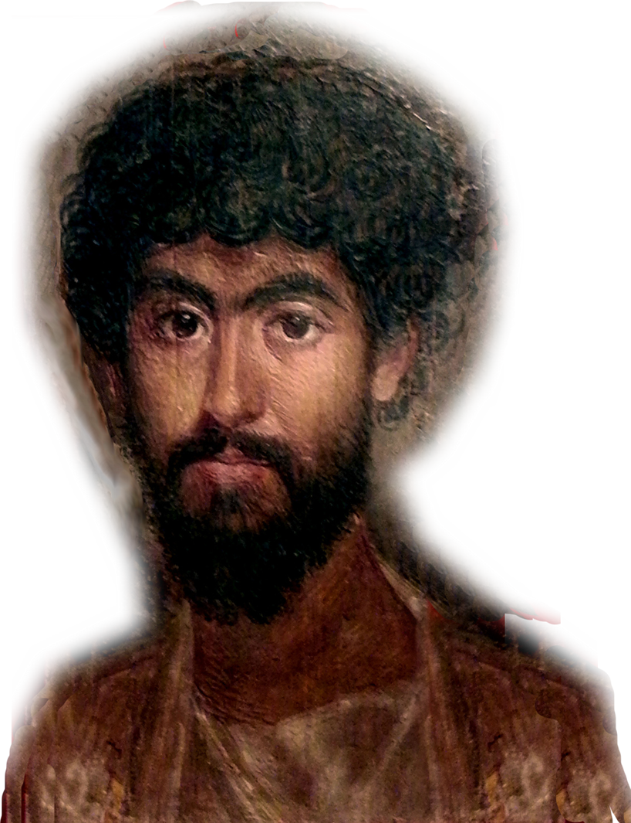
By 64 AD – letter to Timothy
Get Mark and bring him with you, because he is helpful to me in my ministry. (2Tim 4:11)
Like Onesimus (who’s
name means “useful)—
Mark is “useful” to me!”

Slide 32

A good point: We Need You!
²⁰ As it is, there are many parts, but one body. ²¹ The eye cannot say to the hand, "I don't need you!" And the head cannot say to the feet, "I don't need you!“ ²² On the contrary, those parts of the body that seem to be weaker are indispensable (1Co 12)

Slide 33
Here’s my final point...
You might as well resolve any conflict now ... because you will be spending all eternity with your brothers and sister in Christ.

Slide 34
Let’s Pray!

