Slide 1

Conflict Resolution
A Study of Philemon
Notes:
Copyright © 2006−2020. All rights reserved. Bible Point is a registered trademark of Dennis Henderson. All other trademarks acknowledged.
Bible Point contains graphics from Bible Point artists. These illustrations belong to Bible Point and the respective artists. You may use the designs and illustrations for graphical illustration of lessons free and without special permission, provided they are not used in any way that maligns the Christian faith. Furthermore, republication or production of any illustration by any other graphic service whether it be in book, in a machine-readable form, or in any other design resource is strictly prohibited. Furthermore, they cannot be duplicated or resold as any other form of publishing, clip art, or graphic resource.
So What does it mean? (A simple translations of the legal jargon)
So, if you don’t own the presentation(s), graphic(s), and text(s) how can you legally use them? The purchase of the license allows you to use all the images in the product. However, the actual ownership and copyright of the presentation(s), graphic(s), and text(s) remain the property of Bible Point and its licensors. If you had plans on using this product in your “for sale” work—think again!
License Agreement
Article 1: License Grant
All the graphics and text in Bible Point presentations (excluding quotes from the Bible and stated sources) are the intellectual and real property of Bible Point and its licensors, and is protected by law, including United States copyright laws and international treaties. Bible Point grants to you a license:
1. To use the presentation in a single church, single school, or single office of a Christian organization.
2. To make a single archival back-up copy of the program.
3. To modify the presentation(s) and merge with other presentations in a single church, school, or Christian organization.
4. To transfer to another party if that party agrees to accept the terms and conditions of this agreement, and you do not retain any copies of the presentation, whether printed, machine readable, modified, or merged form.
Article 2: Terms
This license is effective until terminated. You may terminate the license at any time by destroying the presentation(s), graphic(s), or text(s) together with all copies, modifications and merged portions in any form. Bible Point may terminate your license if you fail to comply with this Agreement. You agree, upon such termination, for any reason, to destroy the presentation(s), graphics, and text(s) with all copies, modifications, and merged portions in any form.
Article 3: Disclaimers
1. Bible Point presentations, graphics, and texts are licensed to you As Is. You, the consumer, bear the entire risk relating to the quality and performance of the presentation(s), graphic(s), or text(s). In no event will Bible Point be liable for damages resulting from any defect.
2. Thirty-day limited warrantee on disks. Bible Point warrants the disks to be free of defects in material and workmanship under normal use for 30 days after purchase. During the 30-day period you may return a defective presentation, graphic, or text with proof of purchase and it will be replaced without charge, unless the presentation is damaged by misuse.
Article 4: General
1. You may not sub-license, assign, or transfer the license of the presentation(s), graphic(s), or text(s) except as provided by this Agreement.
2. This Agreement will be governed by the laws of the State of Michigan.
So What does it mean? (A simple translations of the legal jargon)
May I let someone borrow or copy my licensed Bible Point presentation (even after I modified it)? As long as it is within your local church, or single school, or the immediate office of a Christian organization you may. Otherwise, please refer the person interested in borrowing to: http://www.biblepoint.com or E-mail: dennis@drdh.net with any related questions.

Slide 2
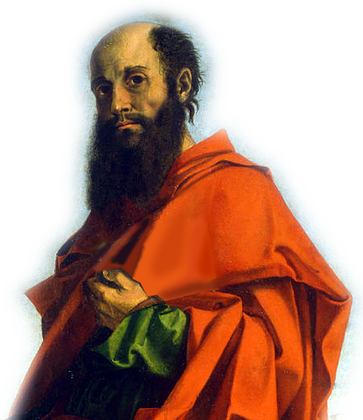
The People: The Author
¹ Paul, a prisoner of Christ Jesus, and Timothy our
brother,

Slide 3
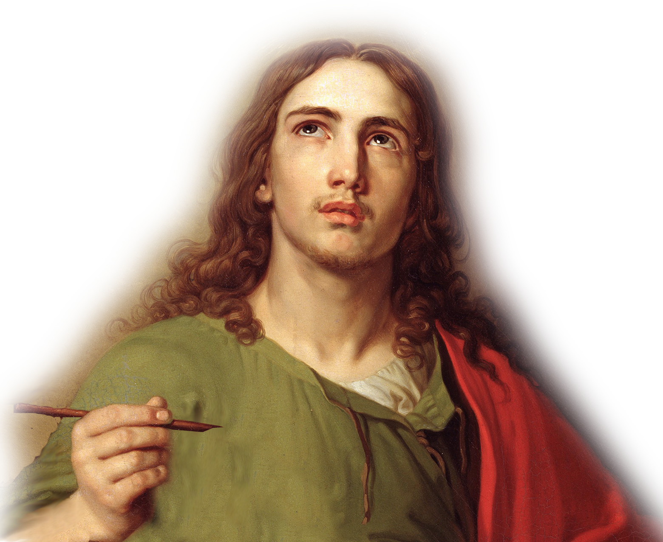
The People: The Author
¹ Paul, a prisoner of Christ Jesus, and Timothy our
brother,
Notes:
Apostle Paul = FREE = from http://en.wikipedia.org/wiki/Paul_the_Apostle#mediaviewer/File:Bartolomeo_Montagna_-_Saint_Paul_-_Google_Art_Project.jpg
Timothy = (John) = FREE = from http://en.wikipedia.org/wiki/John_the_Evangelist#mediaviewer/File:GRM_Inv._J-3182.jpg

Slide 4
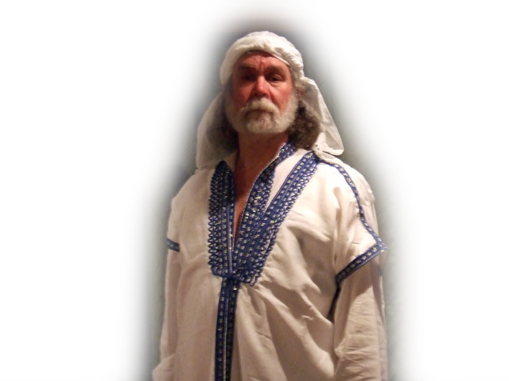
The People: The Recipients
To Philemon our dear friend
and fellow worker, ²
Notes:
Philemon = Listed Free = on Google search

Slide 5

The People: The Recipients
To Philemon our dear friend
and fellow worker, ²
to Apphia our sister,
Notes:
Apphia = FREE = http://upload.wikimedia.org/wikipedia/commons/d/d4/Godward-Nerissa-1906.jpg

Slide 6
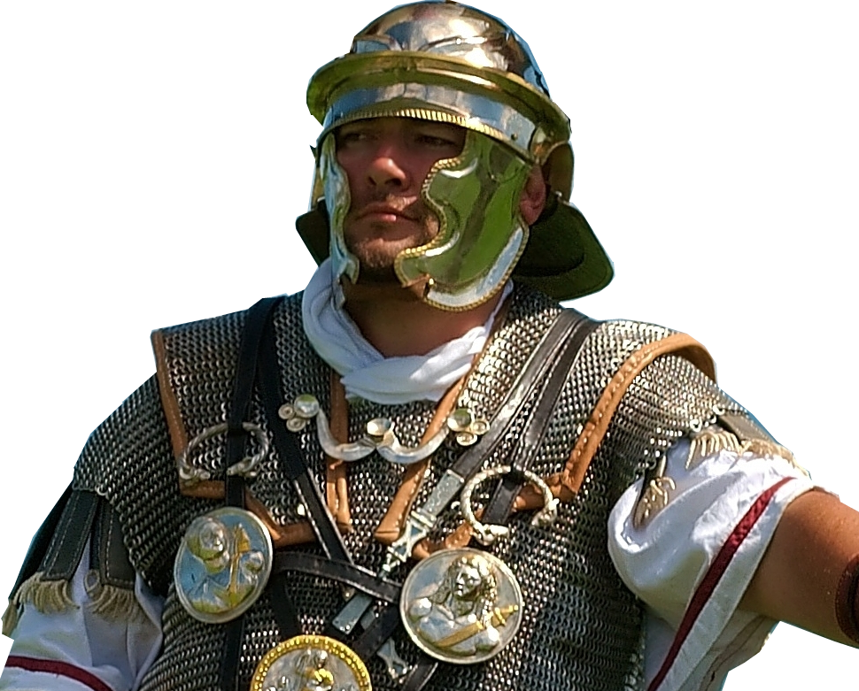
The People: The Recipients
To Philemon our dear friend
and fellow worker, ²
to Apphia our sister,
to Archippus our fellow soldier
Notes:
Archippus = FREE = http://en.wikipedia.org/wiki/Roman_legion#mediaviewer/File:Centurion_2_Boulogne_Luc_Viatour.jpg

Slide 7
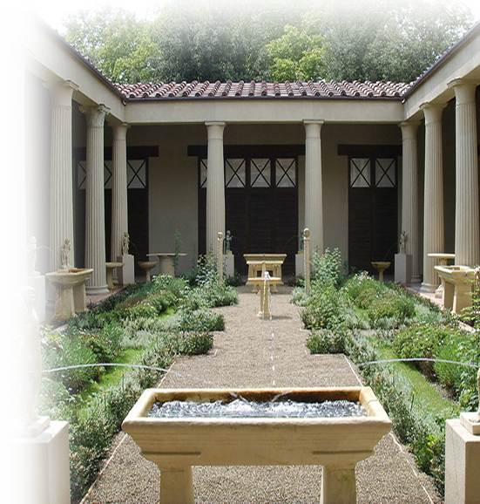
The People: The Recipients
To Philemon our dear friend
and fellow worker, ²
to Apphia our sister,
to Archippus our fellow soldier
and
to the church that meets
in your home:
Notes:
Roman House Pompeii = FREE = http://en.wikipedia.org/wiki/Roman_gardens#mediaviewer/File:Ricostruzione_del_giardino_della_casa_dei_vetii_di_pompei_(mostra_al_giardino_di_boboli,_2007)_01.JPG

Slide 8
The People: The Greeters
HI!
²³ Epaphras, my fellow
prisoner in Christ Jesus, sends you greetings.

Slide 9
The People: The Greeters
HI!
²³ Epaphras, my fellow prisoner in Christ Jesus, sends you greetings. ²⁴ And so do Mark
HI!

Slide 10
The People: The Greeters
HI!
²³ Epaphras, my fellow prisoner in Christ Jesus, sends you greetings. ²⁴ And so do Mark, Aristarchus,
HI!
HI!

Slide 11
The People: The Greeters
HI!
²³ Epaphras, my fellow prisoner in Christ Jesus, sends you greetings. ²⁴ And so do Mark, Aristarchus, Demas
HI!
HI!
HI!

Slide 12
The People: The Greeters
HI!
²³ Epaphras, my fellow prisoner in Christ Jesus, sends you greetings. ²⁴ And so do Mark, Aristarchus, Demas and Luke, my fellow workers.
HI!
HI!
HI!
HI!

Slide 13
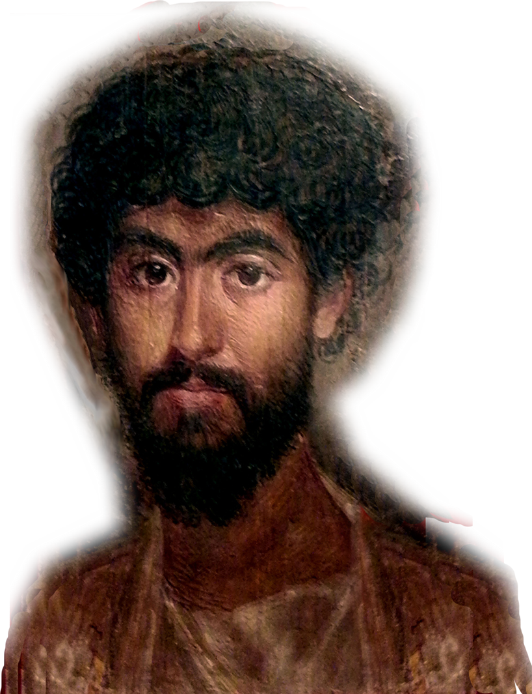
The People: The PROBLEM
Onesimus
Run-away slave
Theft
Conversion
Need to Reconcile
Notes:
Onesemus = FREE = https://www.flickr.com/photos/italintheheart/9522592715/

Slide 14
The SOLUTION: Send Him Back!

Slide 15
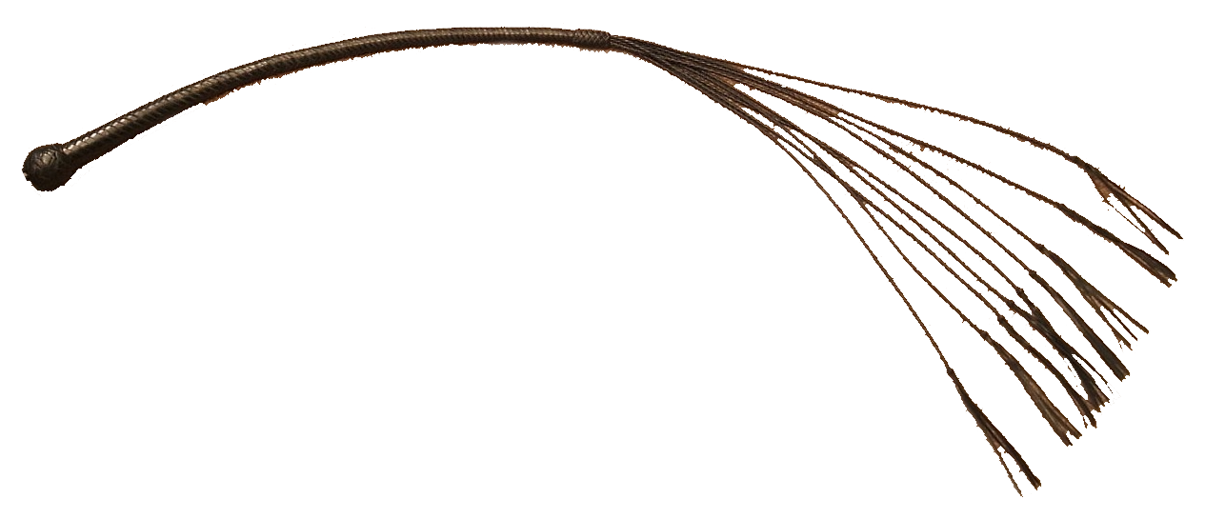
What Might Happen ...
Whip him
Notes:
Whip = FREE = http://en.wikipedia.org/wiki/Whip#mediaviewer/File:Cat_o%27_nine.JPG

Slide 16

What Might Happen ...
Whip him
Brand him a slave
Notes:
Whip = FREE = http://en.wikipedia.org/wiki/Whip#mediaviewer/File:Cat_o%27_nine.JPG
Brandng iron = FREE = from http://upload.wikimedia.org/wikipedia/commons/3/3e/Branding_irons-Dutch_K%2C_c%2C_and_k.jpeg

Slide 17
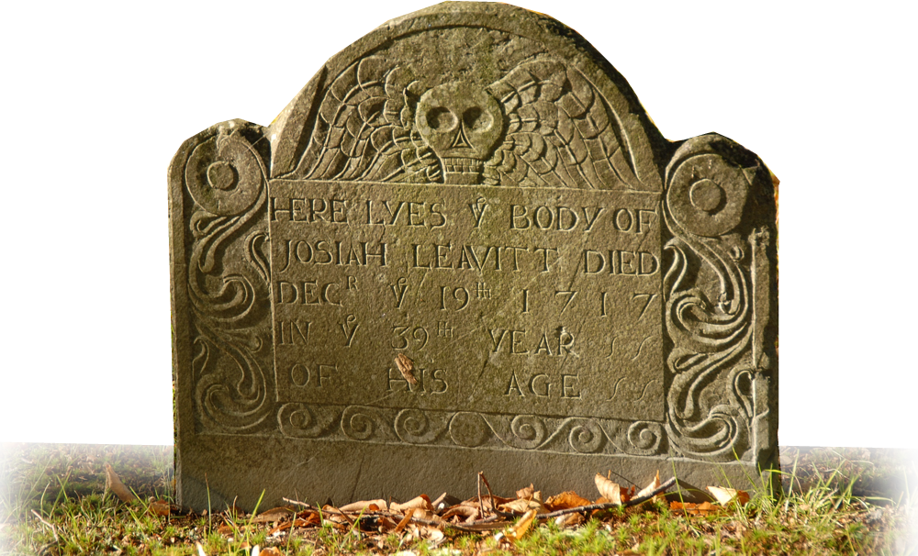
What Might Happen ...
Whip him
Brand him a slave
Execute him
Notes:
Whip = FREE = http://en.wikipedia.org/wiki/Whip#mediaviewer/File:Cat_o%27_nine.JPG
Brandng iron = FREE = from http://upload.wikimedia.org/wikipedia/commons/3/3e/Branding_irons-Dutch_K%2C_c%2C_and_k.jpeg
Grave Stone = FREE = http://en.wikipedia.org/wiki/Headstone#mediaviewer/File:008-Josiah_Leavitt_(d._Dec_19th,_1717)_grave,_Hingham_Center_Cemetery,_Hingham,_Plymouth_Co.,_MA.jpg

Slide 18
What could be done?

Slide 19
What could be done?

Slide 20
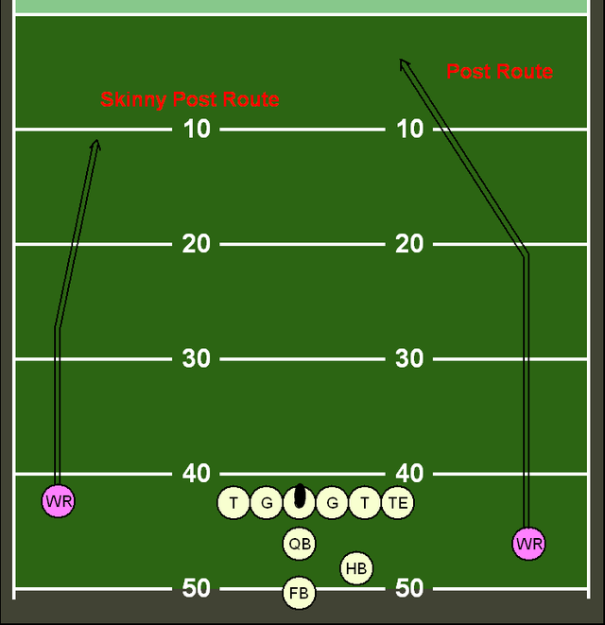
The Strategy or techniques
21 Tactful Ways
5 Positive
8 Gentle
8 Powerful
Notes:
Strategy = FREE = from http://en.wikipedia.org/wiki/Post_(route)#mediaviewer/File:Post_route.png

Slide 21
1. Polite Approach
vs. RUDE Approach v.3
PLEASE?
³ Grace to you and peace from God our Father and the Lord Jesus Christ.
Season
speech with grace!

Slide 22

2. Thankful Approach
vs. Ungrateful Approach v.4
⁴ I always thank my God as I remember you in my prayers,
Preface remarks with thanks

Slide 23

3. Compliment Approach
vs. Critical Approach v.5
Faith
Love
⁵ because
I hear about your faith in the Lord Jesus and your love for all the saints.
Find
something
to compliment
Notes:
Thumbs Up = FREE = from http://pdpics.deviantart.com/art/Thumbs-up-346424636

Slide 24
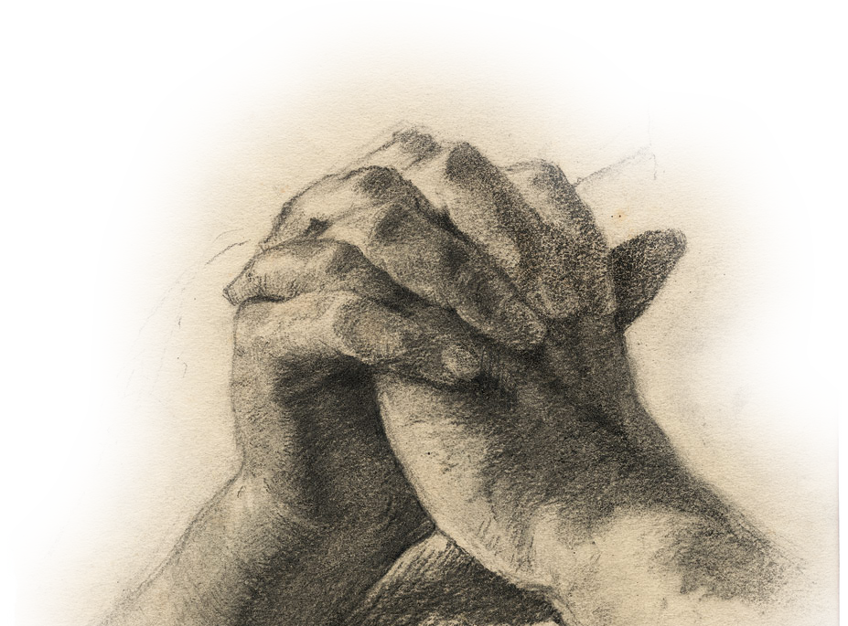
4. Prayerful Approach
vs. Prayer-less Approach v.6
Actively share your faith
⁶ I pray that you may be active in sharing your faith, so that you will have a full understanding of every good thing we have in Christ.
Pray first
… then
address it!
Notes:
Praying hands = FREE = http://commons.wikimedia.org/wiki/File:Otto_Greiner_Betende_H%C3%A4nde.jpg

Slide 25

5. Joyful Approach
⁷ Your love has given me great joy and encourage-ment, because you, brother, have refreshed the hearts of the saints.
Vs. Moping Approach v.7
Love
Joy
Encouragement
Really delight
in it!

Slide 26
Notice:
These first five approaches are “buttering up” Philemon for the next 16 approaches.

Slide 27
Talk about this …
When you experience conflict, which of these “positive” approaches comes easiest to you?
Being Polite
Being Thankful
Being Complimentary
Being Prayerful
Being Joyful
Which is the hardest?

Slide 28
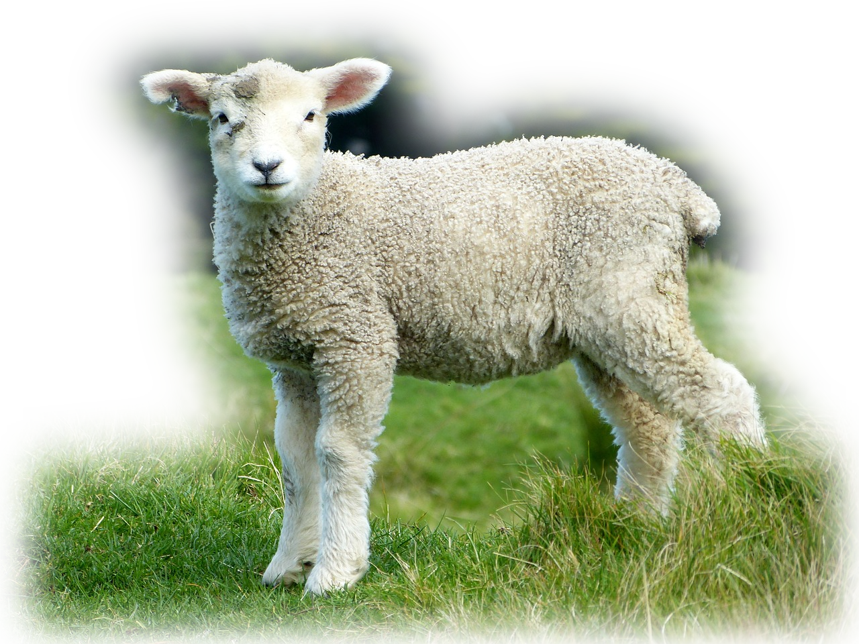
>> 8 Gentle Approaches
to Resolving
Conflict

Slide 29
6. Gentle Approach
vs. Harsh (Bold) Approach v.8
Therefore, although in Christ I could be bold and order you to do what you ought to do,
Uses the “Kid Gloves” with Others

Slide 30

7. Loving Approach
vs. Self-Centered v.9
Based
in Love
... yet I appeal to you on the basis of love. I then, as Paul--
Love covers sin
Notes:
Love Sculpture NY – FREE - http://en.wikipedia.org/wiki/Love_(sculpture)#mediaviewer/File:LOVE_sculpture_NY.JPG
yet I appeal to you on the basis of love. I then, as Paul--an old man and now also a prisoner of Christ Jesus-- (Phm 1:9 NIV)

Slide 31

8. Respectful Approach
vs. Disrespectful v.9
Respect your elders
as Paul--an old man and now also a prisoner of Christ Jesus
Notes:
FREE – Salute - http://en.wikipedia.org/wiki/Salute#mediaviewer/File:Female_officer_saluting.jpg

Slide 32
9. Mediator Approach
vs. On-Your-Own v.10
“I appeal”
“for my son”
I appeal to you for my son Onesimus, who became my son while I was in chains.
Stand in the gap for another!

Slide 33

10. Useful Approach
¹¹ Formerly he was useless to you, but now he has become useful both to you and to me.
vs. Disposable v.11
Useful
to you
Useful
to me
Find God’s Giftedness in Others!
Notes:
I Need You – FREE - http://commons.wikimedia.org/wiki/File:I_Need_You_on_the_Job_Every_Day_-_NARA_-_534704.jpg
The name Onesimus means “Useful”

Slide 34

11. Affectionate Approach
Vs. Hostile Approach v.12
“My very heart”
σπλανγξνα
I am sending him--who is my very heart--back to you.
Take the risk to share your heart!
Notes:
Heart – FREE – From Deviant Art.com

Slide 35

12. Helpful Approach
I would have liked to keep him with me so that he could take your place in helping me while I am in chains for the gospel.
Vs. Harmful v.13
“Helping me”
in “your place”
It will be
to your
credit!
Notes:
Helper hand = FREE = https://www.flickr.com/photos/51764518@N02/9259030856/

Slide 36

13. Voluntary Approach
Vs. Pressured v.14
Consensual
Spontaneous
Not Forced
But I did not want to do anything without your consent, so that any favor you do will be spontaneous and not forced.
Expect other’s
best behavior!

Slide 37
Talk about this …
When you experience conflict, which of these “positive” approaches comes easiest to you?
Being Gentle
Being Loving
Being Respectful
Being a Mediator
Point to Usefulness
Being Affectionate
Pointing out Help
Seeking voluntary fixes
Which is the hardest?

Slide 38
NOTICE: THESE GENTLE
approaches prepare Philemon for the last
eight “POWERFUL”
approaches ...

Slide 39
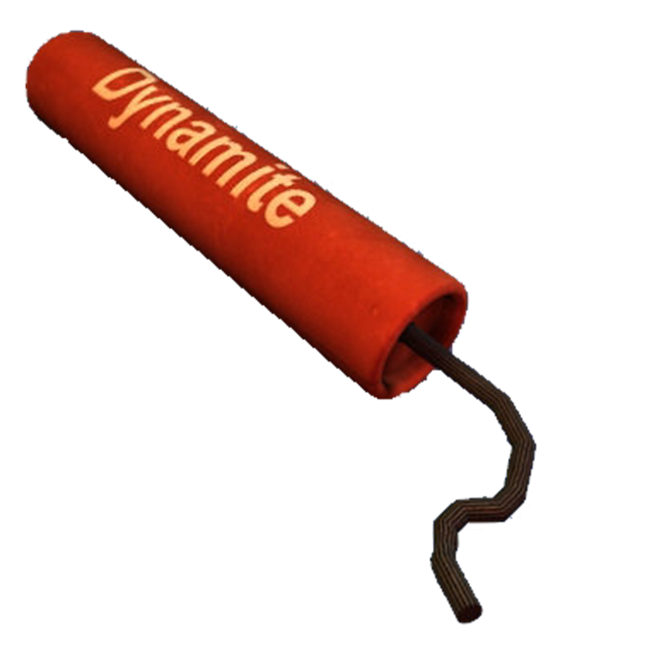
>> 8 POWERFUL Approaches
to Resolving
Conflict

Slide 40

14. Big Picture Approach
vs. Short-Sighted v.15
Positive Hypothetical
Perhaps the reason he was separated from you for a little while was that you might have him back for good--
Give the benefit of the doubt!
Notes:
Picture Frame = FREE = http://commons.wikimedia.org/wiki/File:Empty-frame.png

Slide 41

15. Spiritual Approach
vs. Non-Christian v.16
Brother in the Lord
no longer as a slave, but better than a slave, as a dear brother.
Use spiritual leverage!
Notes:
Band of Bros = FREE = from BiblePoint

Slide 42
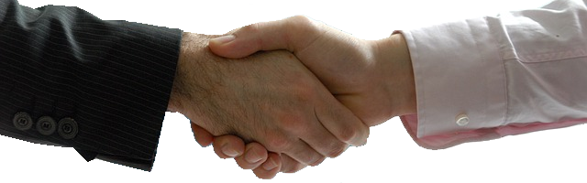
16. Partnership Approach
vs. Disassociation v.17
Consider me
Welcome him as me
So if you consider me a partner, welcome him as you would welcome me.
Reason through your feelings!
Notes:
Handshake = FREE = http://pixabay.com/en/handshake-business-professional-440959/

Slide 43
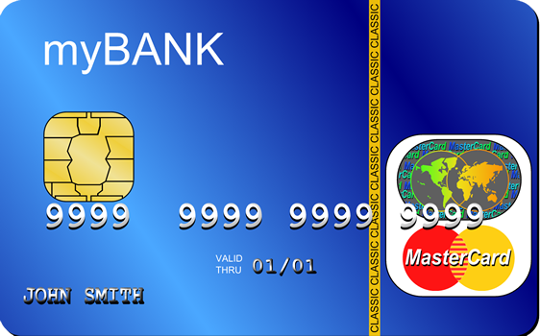
17. Credit Card Approach
vs. I’ll make you pay v.18
Charge it to me
If he has done you any wrong or owes you anything, charge it to me.
Bear
one another’s burdens!

Slide 44

18. Substitution Approach
vs. Make ‘em pay v.19
I will pay
You owe me
I, Paul, am writing this with my own hand. I will pay it back--not to mention that you owe me your very self.
Follow in Christ’s steps
Notes:
Money = FREE = https://www.flickr.com/photos/101332430@N03/

Slide 45

19. Refreshing Approach
Vs. Fatigued v.20
Let me reap benefit
Refresh me
I do wish, brother, that I may have some benefit from you in the Lord; refresh my heart in Christ.
Tactfully assert expectations!
Notes:
Glass of water = FREE = https://www.flickr.com/photos/cobaltfish/8581477307/

Slide 46

20. Confident Approach
Vs. Doubtful v.21
In obedience
To do more
²¹ Confident
of your obedience, I write to you, knowing that you will do even more than I ask.
Be optimistic
of relationships
Notes:
Chalk board = FREE = http://pixabay.com/en/field-barley-sky-clouds-think-328962/

Slide 47

21. Follow-Up Approach
Vs. “Let it go” v.22
Guest Room
Restored
²² And one thing more: Prepare a guest room for me, because I hope to be restored to you in answer to your prayers.
Learn to follow-up
on people

Slide 48
Talk about this …
The last time you used one of these approaches and how it went for you:
Big Picture
Spiritual
Partnership
Credit Card
Substitution
Refreshing me
Confident
Follow-up

Slide 49
Can you think of how any
of these approaches could change the hostility in a political discussion?
Which approach might
be a place to start?

Slide 50
Conclusion:
This set of eight approaches are “POWERFUL”
when added to the previous 13!

Slide 51
Conclusion:
So ...
Learn to use them, as Paul did, on a SINGLE situation!

Slide 52
Next Time:
How Paul learned to use these approaches and how you can too!

Slide 53
Let’s Pray!

