Slide 1
Conflict Resolution
A Study of Philemon
Notes:
Copyright © 2006−2020. All rights reserved. Bible Point is a registered trademark of Dennis Henderson. All other trademarks acknowledged.
Bible Point contains graphics from Bible Point artists. These illustrations belong to Bible Point and the respective artists. You may use the designs and illustrations for graphical illustration of lessons free and without special permission, provided they are not used in any way that maligns the Christian faith. Furthermore, republication or production of any illustration by any other graphic service whether it be in book, in a machine-readable form, or in any other design resource is strictly prohibited. Furthermore, they cannot be duplicated or resold as any other form of publishing, clip art, or graphic resource.
So What does it mean? (A simple translations of the legal jargon)
So, if you don’t own the presentation(s), graphic(s), and text(s) how can you legally use them? The purchase of the license allows you to use all the images in the product. However, the actual ownership and copyright of the presentation(s), graphic(s), and text(s) remain the property of Bible Point and its licensors. If you had plans on using this product in your “for sale” work—think again!
License Agreement
Article 1: License Grant
All the graphics and text in Bible Point presentations (excluding quotes from the Bible and stated sources) are the intellectual and real property of Bible Point and its licensors, and is protected by law, including United States copyright laws and international treaties. Bible Point grants to you a license:
1. To use the presentation in a single church, single school, or single office of a Christian organization.
2. To make a single archival back-up copy of the program.
3. To modify the presentation(s) and merge with other presentations in a single church, school, or Christian organization.
4. To transfer to another party if that party agrees to accept the terms and conditions of this agreement, and you do not retain any copies of the presentation, whether printed, machine readable, modified, or merged form.
Article 2: Terms
This license is effective until terminated. You may terminate the license at any time by destroying the presentation(s), graphic(s), or text(s) together with all copies, modifications and merged portions in any form. Bible Point may terminate your license if you fail to comply with this Agreement. You agree, upon such termination, for any reason, to destroy the presentation(s), graphics, and text(s) with all copies, modifications, and merged portions in any form.
Article 3: Disclaimers
1. Bible Point presentations, graphics, and texts are licensed to you As Is. You, the consumer, bear the entire risk relating to the quality and performance of the presentation(s), graphic(s), or text(s). In no event will Bible Point be liable for damages resulting from any defect.
2. Thirty-day limited warrantee on disks. Bible Point warrants the disks to be free of defects in material and workmanship under normal use for 30 days after purchase. During the 30-day period you may return a defective presentation, graphic, or text with proof of purchase and it will be replaced without charge, unless the presentation is damaged by misuse.
Article 4: General
1. You may not sub-license, assign, or transfer the license of the presentation(s), graphic(s), or text(s) except as provided by this Agreement.
2. This Agreement will be governed by the laws of the State of Michigan.
So What does it mean? (A simple translations of the legal jargon)
May I let someone borrow or copy my licensed Bible Point presentation (even after I modified it)? As long as it is within your local church, or single school, or the immediate office of a Christian organization you may. Otherwise, please refer the person interested in borrowing to: http://www.biblepoint.com or E-mail: dennis@drdh.net with any related questions.

Slide 2
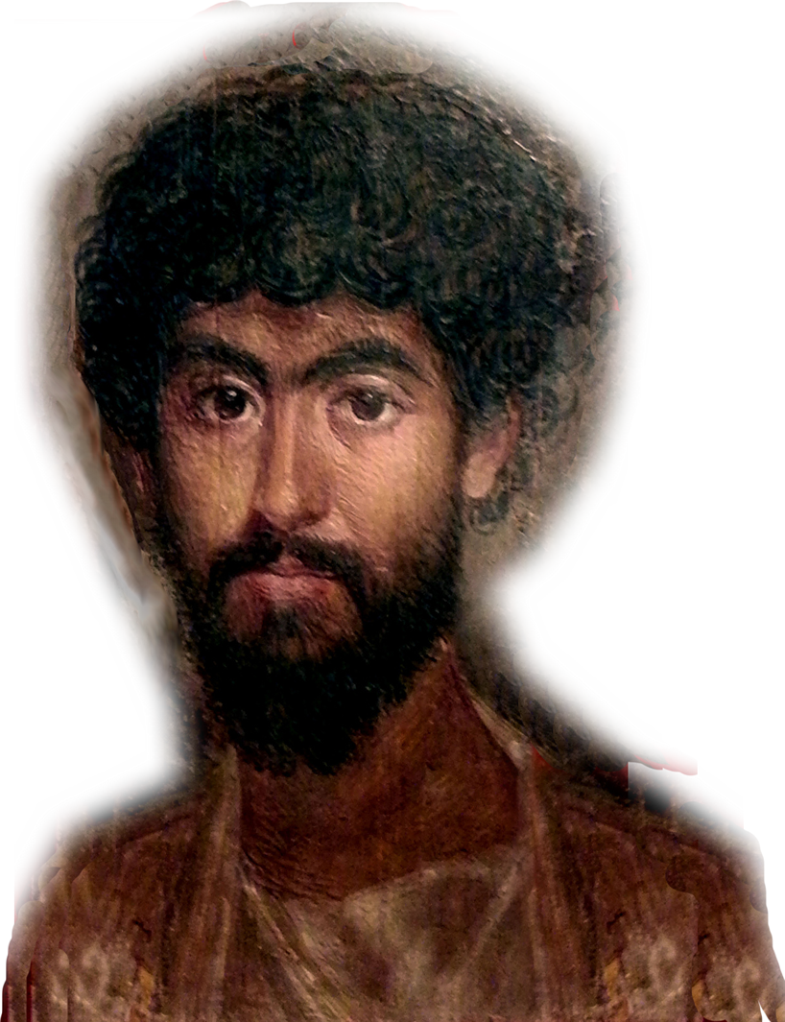

Today I want you to imagine...
the year is 60 A.D.
That YOU are
Onesimus ...
a slave ...
a thief ...
on the run ...

Slide 3
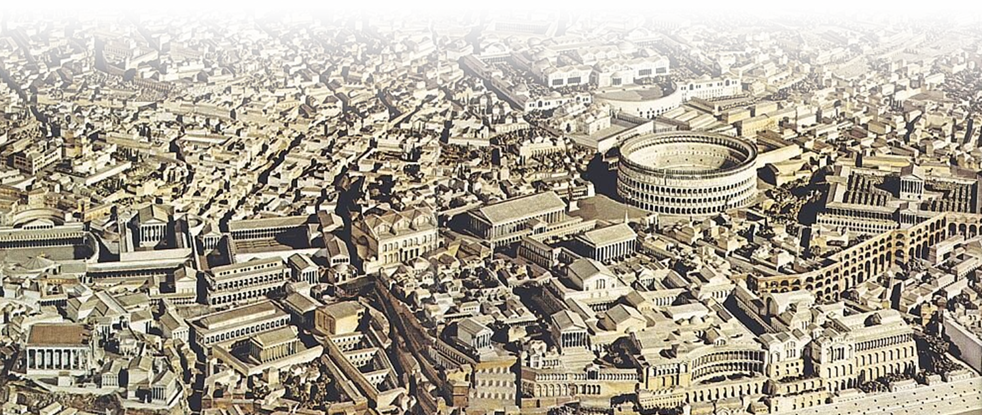
Imagine... you fled to Rome

Slide 4
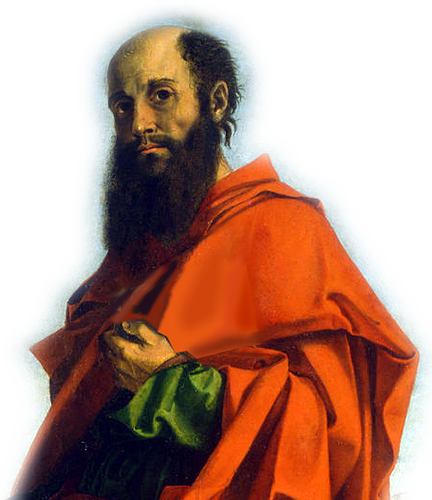
Imagine... you fled to Rome
That you met Paul ...

Slide 5
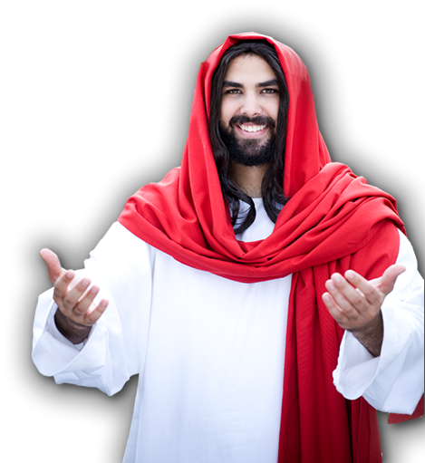
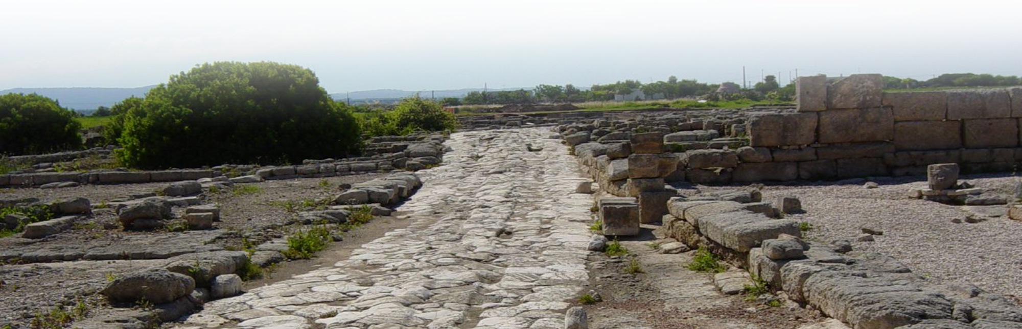
Imagine... you fled to Rome
That you met Paul ...
He led you to faith in Christ ...
Perhaps using the
Romans Road
Notes:
Leads you to Christ ... Perhaps using the Romans Road (shortened argument of the Book of Romans) that he penned.

Slide 6


1- You are a Guilty Sinner
²³ for all have sinned and fall short of the glory of God, (Romans 3:23)
Matthew 5:48
Notes:
Leads you to Christ ... Perhaps using the Romans Road (shortened argument of the Book of Romans) that he penned.

Slide 7

2- You CANNOT Save Yourself
¹⁰ As it is written: "There is no one righteous, not even one;
¹¹ there is no one who understands, no one who seeks God. ¹² All have turned away, they have together become worthless; there is no one who does good, not even one."
Notes:
Leads you to Christ ... Perhaps using the Romans Road (shortened argument of the Book of Romans) that he penned.

Slide 8
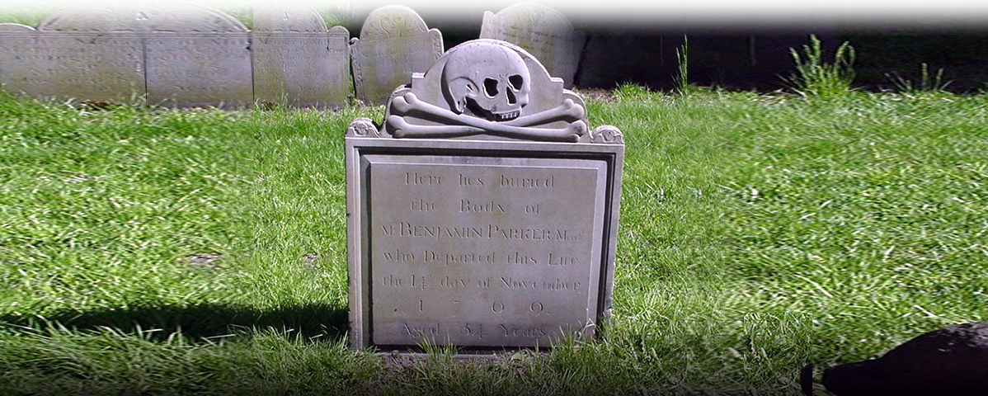
3- You Deserve Death
²³ For the wages of sin is
death... (Rom 6:23)
Notes:
Leads you to Christ ... Perhaps using the Romans Road (shortened argument of the Book of Romans) that he penned.

Slide 9

4- You Need God’s Gift
²³ For the wages of sin is death, but the gift of God is eternal life
Notes:
Leads you to Christ ... Perhaps using the Romans Road (shortened argument of the Book of Romans) that he penned.

Slide 10
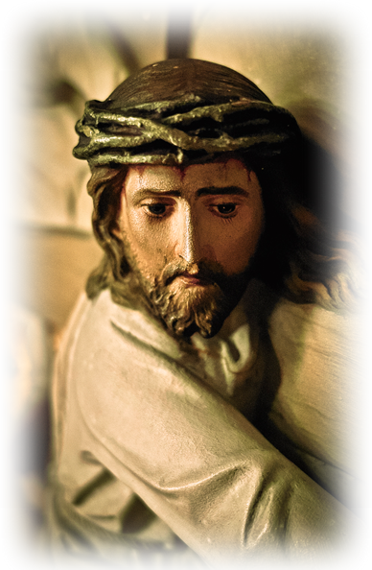
5- Jesus Has the Gift
²³ For the wages of sin is death, but the gift of God is eternal life in Christ Jesus our Lord. (Rom 6:23)

Slide 11
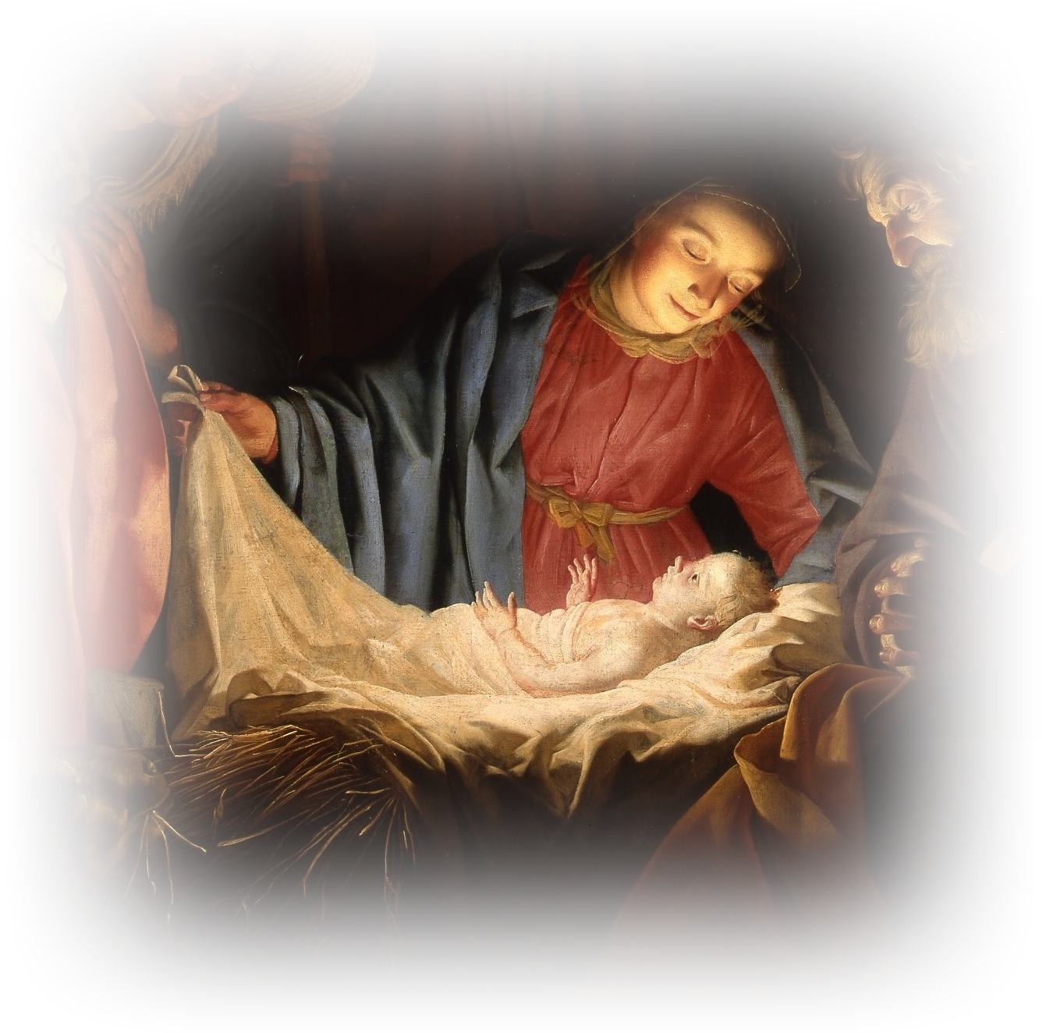
6- Jesus is God! (in flesh)
⁵ Theirs are the patriarchs, and from them is traced the human ancestry
of Christ, who is God over all,
forever praised! Amen.
(Romans 9:5)
Notes:
Leads you to Christ ... Perhaps using the Romans Road (shortened argument of the Book of Romans) that he penned.

Slide 12
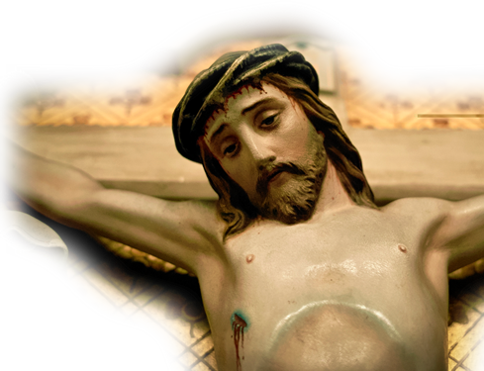
7- Jesus Paid Your Debt
⁸ But God demonstrates his own love for us in this: While we were still
sinners, Christ died
for us. (Rom 5:8)
Notes:
Leads you to Christ ... Perhaps using the Romans Road (shortened argument of the Book of Romans) that he penned.

Slide 13
8- You Need Jesus as Your Lord
²³ For the wages of sin is death,
but the gift of God is eternal life
in Christ Jesus our Lord.
(Romans 6:23)
Notes:
Leads you to Christ ... Perhaps using the Romans Road (shortened argument of the Book of Romans) that he penned.

Slide 14


9- You Must Call on Him
"Everyone who calls
on the name of the
Lord will be saved."
(Rom 10:13)
Notes:
Leads you to Christ ... Perhaps using the Romans Road (shortened argument of the Book of Romans) that he penned.

Slide 15

10- Call Confessing
⁹ That if you confess with your mouth, "Jesus is Lord," and believe in your heart that God raised him from the dead, you will be saved.
LORD
Notes:
Leads you to Christ ... Perhaps using the Romans Road (shortened argument of the Book of Romans) that he penned.

Slide 16

11- Call Believing
¹⁰ For it is with your heart that you believe and are justified, and it is with your mouth that you confess and are
saved. (Rom 10:9-10)
Notes:
Leads you to Christ ... Perhaps using the Romans Road (shortened argument of the Book of Romans) that he penned.

Slide 17
Time to Share:
Have any of you accepted Christ by someone sharing the Roman’s Road with you?
Take a couple of minutes to share how you came to faith in Christ with those at your table.

Slide 18
Imagine...that you did just that
You Prayed to Receive Him
You then were Baptized
You began Sharing Your Faith
You began Serving with Apostle Paul
You began Serving the Needy

Slide 19
Now, Imagine that ...
Your past is uncovered ...
You are a runaway slave ...
You are a thief ...

Slide 20
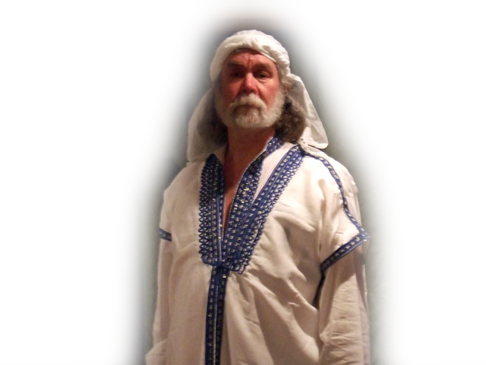
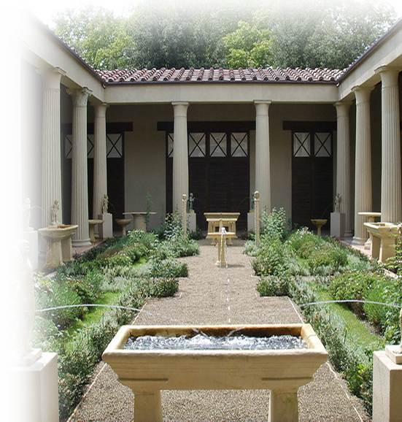

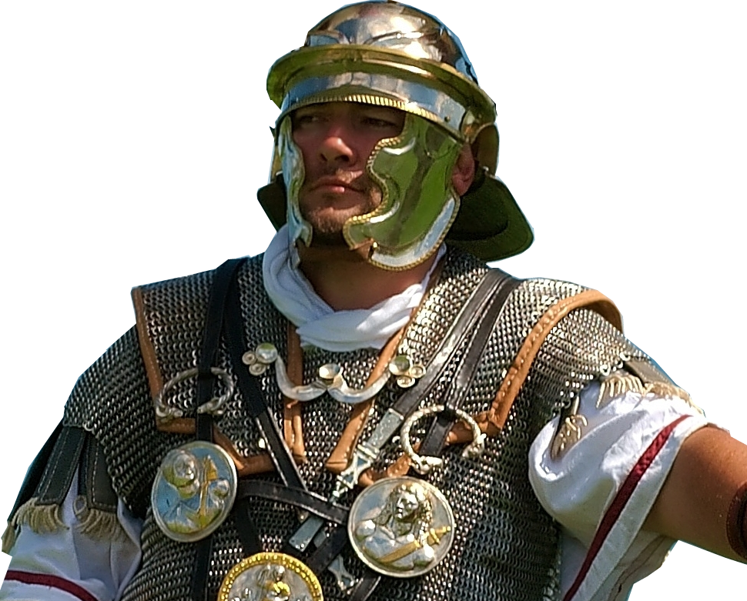
Paul knows your ...
Master, Philemon ...
Master’s wife Apphia ...
Master’s son Archippus ...
Your “house-church”

Slide 21
You have Paul in a pickle ....
--To keep you
--To send you back
Son in the faith! Philemon 1:10
Slave of Philemon 1:16

Slide 22

Consequence of going back
Whip you

Slide 23

Consequence of going back
Whip you
Brand you a slave

Slide 24
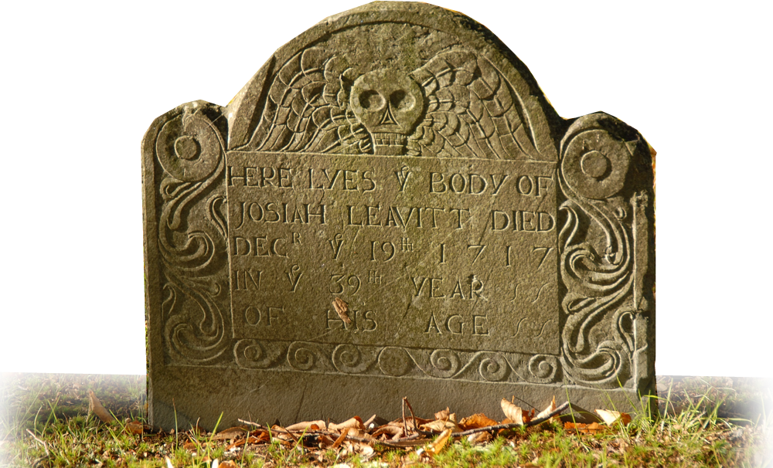
Consequence of going back
Whip you
Brand you a slave
Execute you

Slide 25
Consequence of going back
Whip you
Brand you a slave
Execute you
(Possibly forgive you???)

Slide 26
The solution:
Conflict Resolution
MEDIATOR

Slide 27
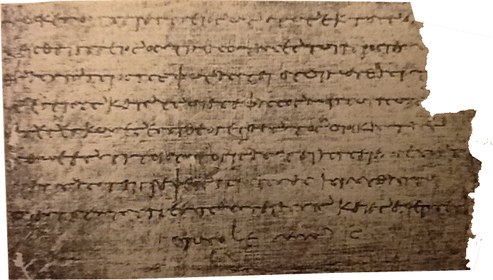
Done in a “Personal Letter”
Three movements:
Prayer of reflection 1-7
Appeal for reconciliation 8-17
Vicarious resolution 18-25
21 Strategies

Slide 28
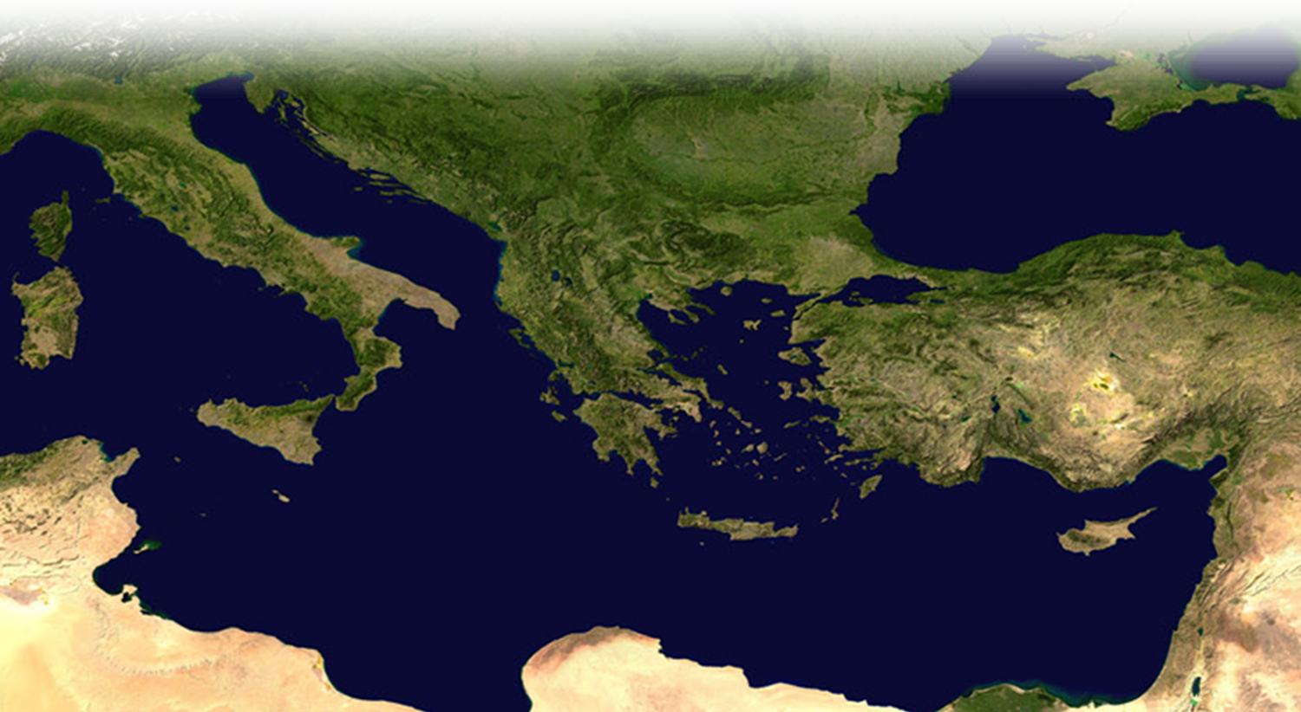
Imagine going back ...

Slide 29
You’re carrying the letter ...

Slide 30
What happened next?
We don’t know...
It’s safe to assume...
They reconciled.
Was Onesimus freed?
Did he join Paul?

Slide 31

Fast Forward ...
Ignatius (@110AD)
refers an Onesimus as the Bishop of Ephesus!

Slide 32

Fast Forward ...
Ignatius (@110AD)
refers an Onesimus as the Bishop of Ephesus!
Could it be ...

Slide 33
Think of a current conflict …
Identify who it’s with …
Think how you can resolve it …
Imagine if they came to Christ …
Could that person be your Onesimus?
How does the great commandment fit in to all this?

Slide 34
Conclusion:
Today we discovered the setting for our study of 21 strategies to resolve a conflict that we will exam next time!

Slide 35
Let’s Pray.

