Slide 1
Conflict Resolution
A Study of Philemon
Conflict Resolution:
A Little Background on Conflict
Twenty-One Ways to Resolve Conflict
You Can Learn to be a Conflict Resolver
By Pastor Dennis Hendrson, D.Min.
©2020 Dennis Henderson, all rights reserved.

Slide 3
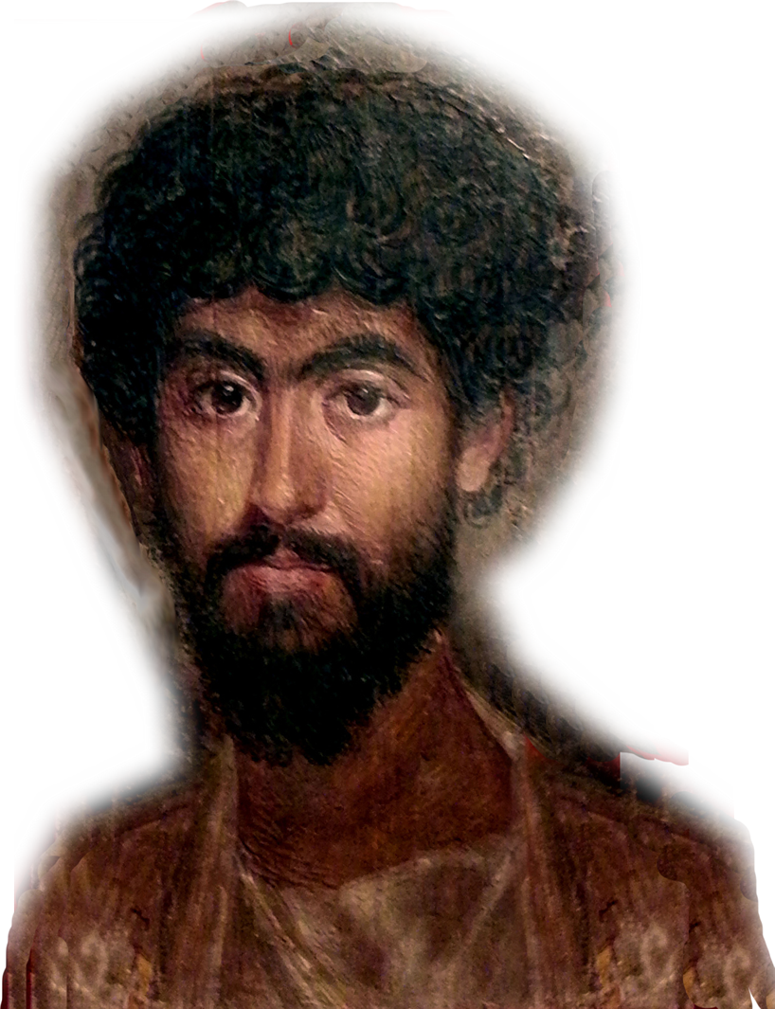
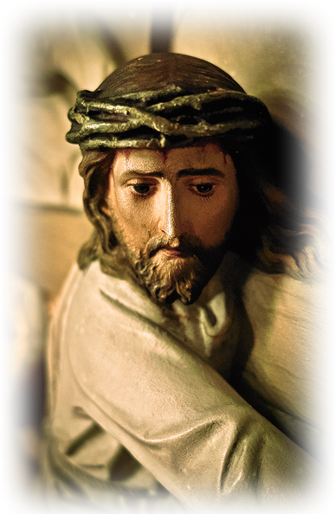
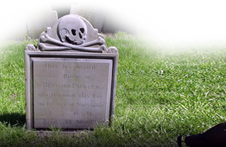
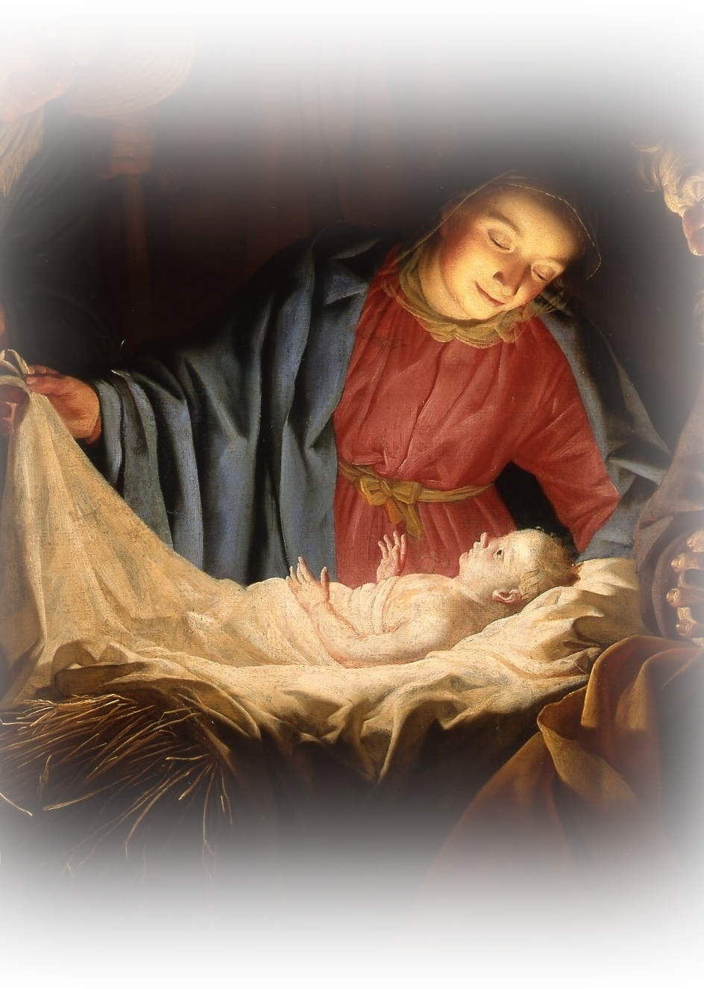
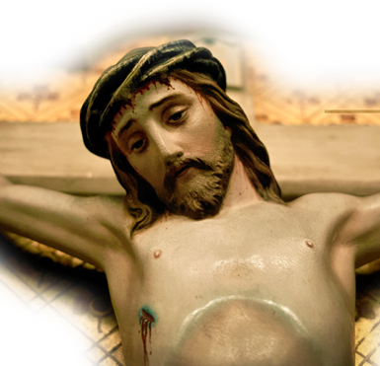
Conflict Resolution A Study of Philemon
Today I want you to imagine...
Time = _______ AD ...
That YOU are:
Onesimus ...
a S___________ ...
a T____________ ...
on the R________ ...
Imagine... you fled to R______
That you met P_______ ...
He leads you to C__________ ...
Perhaps Using the Romans Road ...
1- You are a G___________ sinner ...
²³ for all have sinned and fall short of the glory of God, (Romans 3:23)
2- You C________________ save yourself ...
¹¹ "There is no one righteous, not even one; ¹² All have turned away, they have together become worthless; there is no one who does good, not even one." (3:10-12)
3- You D________________ Death ...
²³ For the wages of sin is death... (Rom 6:23)
4- You Need God’s G______________ ...
²³ For the wages of sin is death, but the gift of God is eternal life in Christ Jesus our Lord. (Rom 6:23)
5- J__________ Has the Gift ...
²³ For the wages of sin is death, but the gift of God is eternal life in Christ Jesus our Lord. (Rom 6:23)
6- Jesus is G__________ ... Come in the flesh
⁵ Theirs are the patriarchs, and from them is traced the human ancestry of Christ, who is God over all, forever praised! Amen. (Rom 9:5)
7- Jesus P__________ your debt ...
⁸ But God demonstrates his own love for us in this: While we were still sinners, Christ died for us. (Rom 5:8)
1

Slide 4
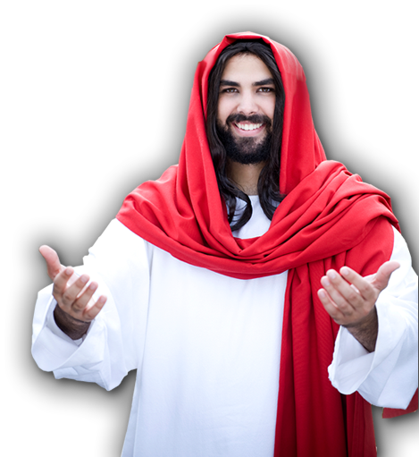
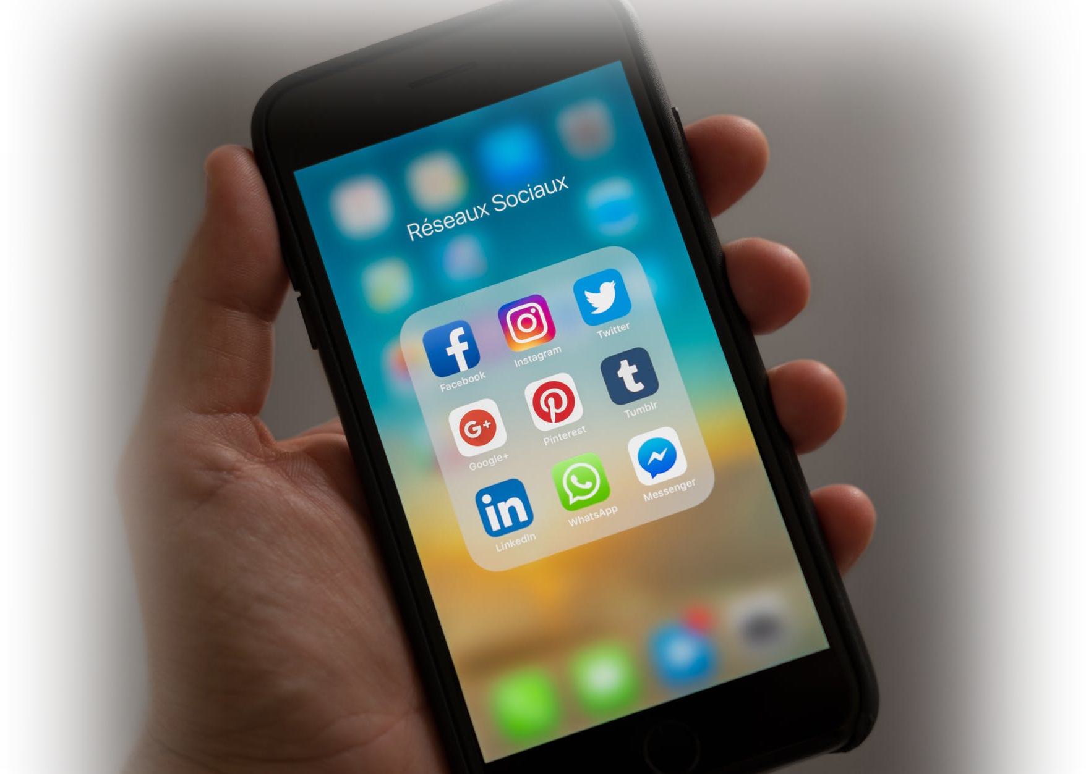
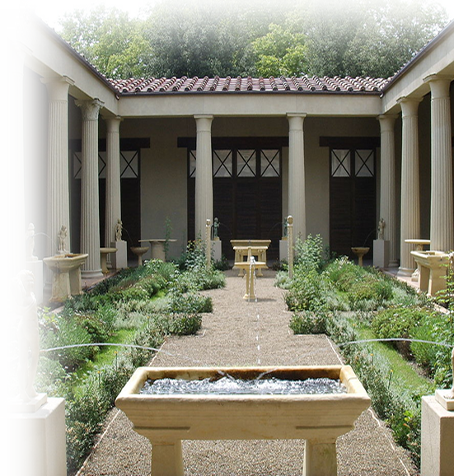
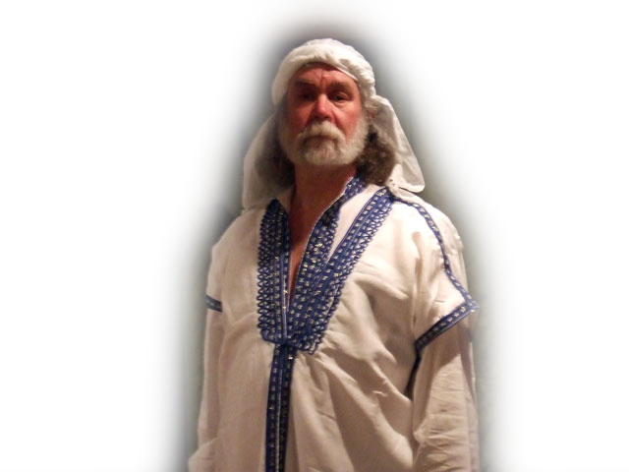
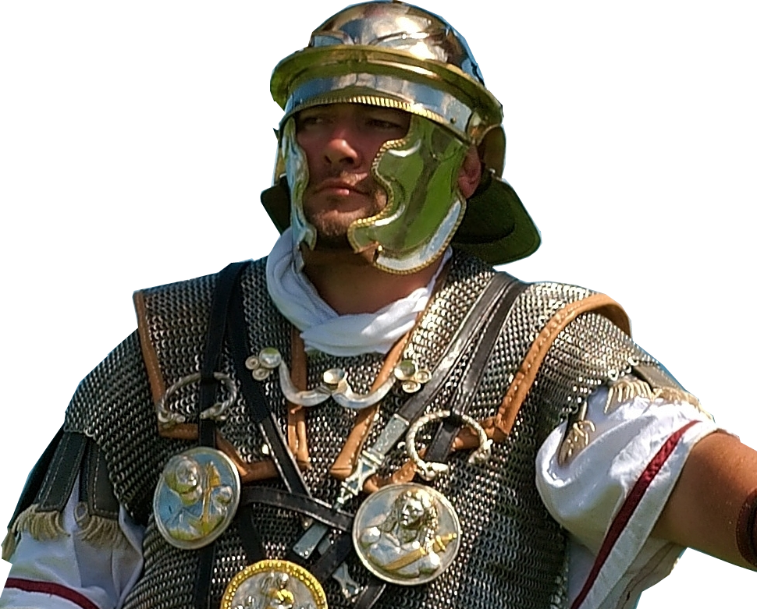
8- You Need Jesus as Your L_________ ...
²³ ... but the gift of God is eternal life in Christ Jesus our Lord. (Rom 6:23)
9- You Must C_________ on Him ...
"Everyone who calls on the name of the Lord will be saved." (Rom 10:13)
10- You take the gift by C__________________
⁹ That if you confess with your mouth, "Jesus is Lord," and believe in your heart that God raised him from the dead, you will be saved.
11- You take the gift by B____________________
¹⁰ For it is with your heart that you believe and are justified, and it is with your mouth that you confess and are saved. (Rom 10:9-10)
Now Imagine... That you did just that ...
Prayed to Receive Him
Got Baptized
Began Sharing Your Faith
Serving with Apostle Paul
Serving the needy
Now, Imagine that ...
Your past is U_______________ ...
you are a R____________ S_________...
you are a T____________ ...
Paul K_____________ your ...
Master, Philemon ...
Master’s wife Apphia ...
Master’s son Archippus ...
Your “house-church”
LORD
2

Slide 5
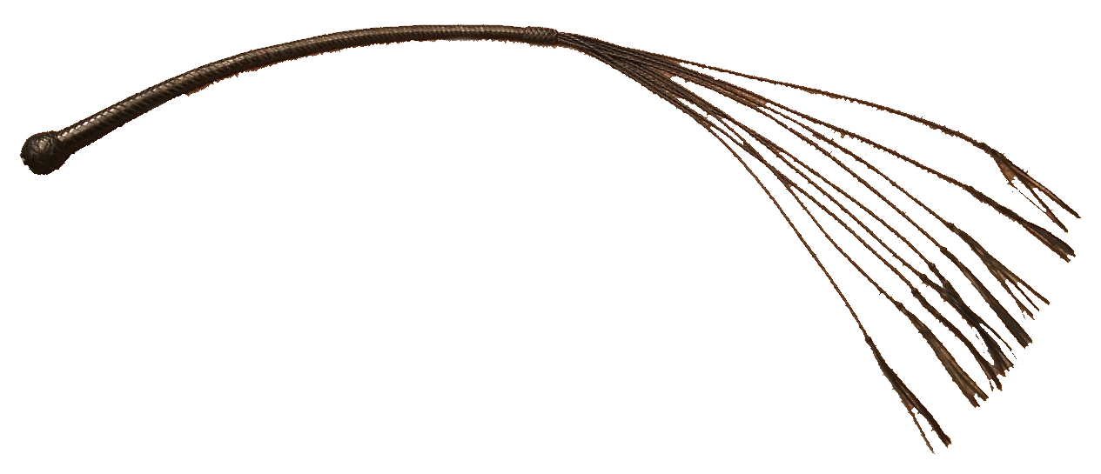
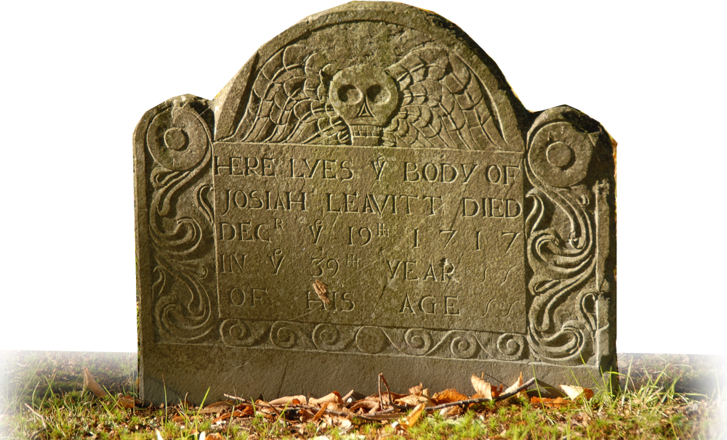
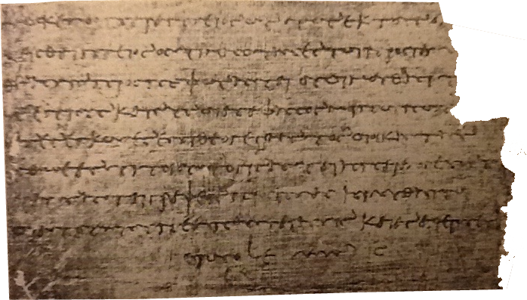
You have Paul in a pickle ....
--To K___________ you
--To send you B____________
Consequence with going back
W__________ you
B___________ you a slave
E______________ you
(Possibly F______________ you???)
The solution Conflict Resolution
Done in a “Personal Letter”
Three movements:
P____________ of reflection 1-7
A____________ for reconciliation 8-17
V_________________ resolution 18-25
21 Strategies
Son in the faith! Philemon 1:10
Slave of Philemon 1:16
M___________
3

Slide 6
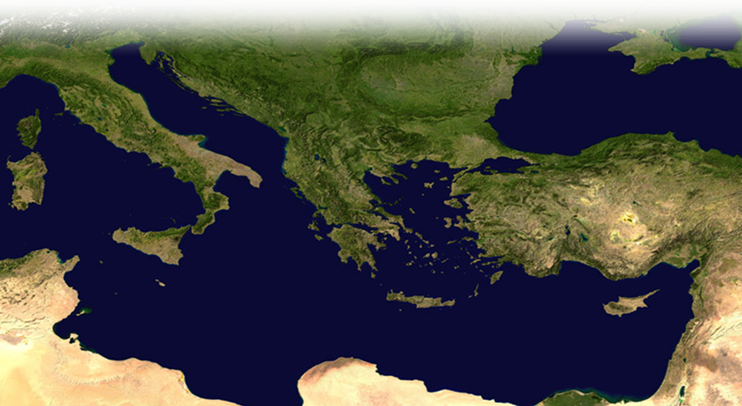
Imagine going back ...
You’re carrying the letter ...
What happened next?
We don’t know...
It’s safe to assume...
They R___________________.
Was Onesimus freed?
Did he join Paul?
Fast Forward ...
Ignatius (@_________AD)
refers an Onesimus as the B_____________ of Ephesus!
Could it be ...
Conclusion:
Today we discovered the setting for our study of 21 strategies to resolve a conflict that we will exam next time!
Let’s Pray.
4

Slide 7
Conflict Resolution
A Study of Philemon
Conflict Resolution:
A Little Background on Conflict
Twenty-One Ways to Resolve Conflict
You Can Learn to be a Conflict Resolver
By Pastor Dennis Hendrson, D.Min.
©2020 Dennis Henderson, all rights reserved.
5

Slide 8
6

Slide 9
Conflict Resolution A Study of Philemon
Today I want begin with ...
1. The People:
The A__________
¹ Paul, a prisoner of Christ Jesus, and Timothy our brother,
The R_______________
To Philemon our dear friend and fellow worker, ² to Apphia our sister, to Archippus our fellow soldier and to the church that meets in your home:
The G_____________
²³ Epaphras, my fellow prisoner in Christ Jesus, sends you greetings. ²⁴ And so do Mark, Aristarchus, Demas and Luke, my fellow workers.
2. The P__________________
Onesimus
Run-away slave
Theft
Conversion
Needs to reconcile
3. The SOLUTION: Send Him Back!
What Might Happen ...
Whip him
Brand him a slave
Execute him
What could be done?
The Strategy or techniques
21 Tactful Ways
5 Positive
8 Gentle
8 Powerful
HI!
7

Slide 10
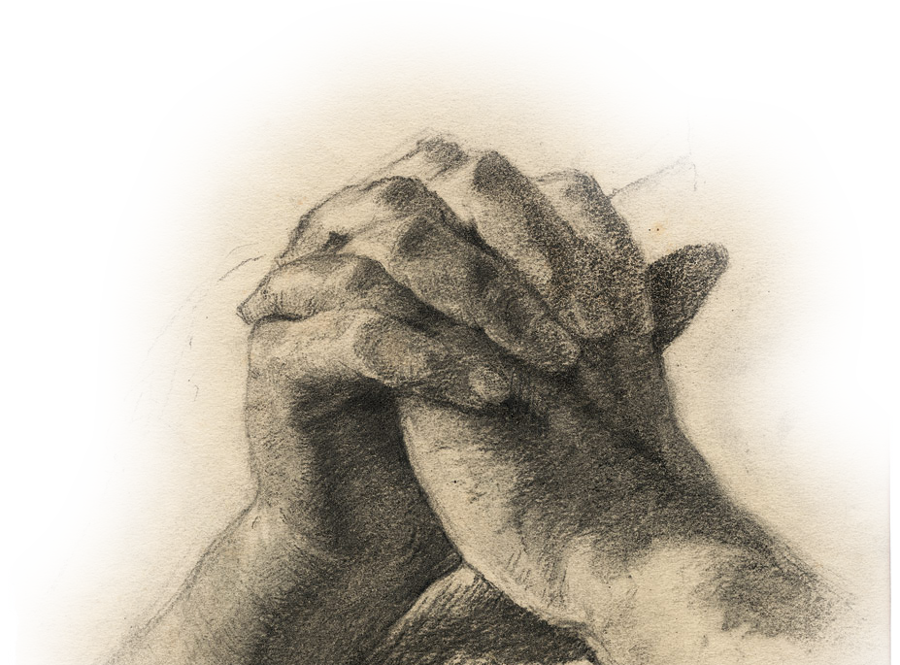
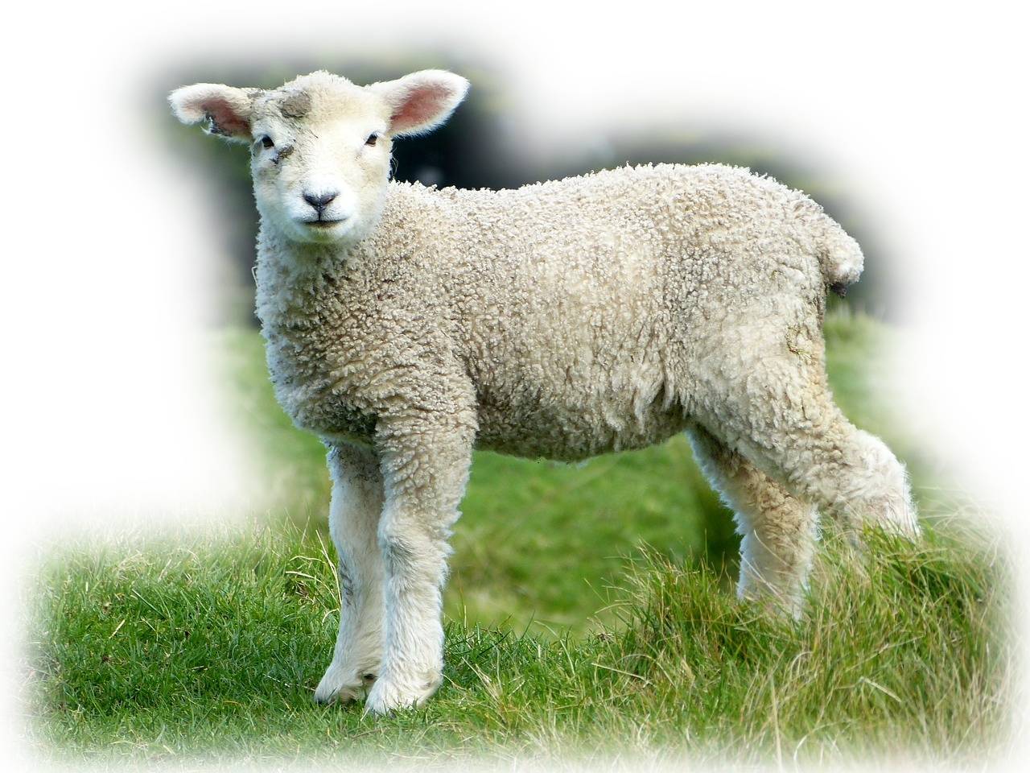
THE FIVE POSTIVE APPROACHES
1. P_____________ Approach vs. RUDE Approach v.3
³ Grace to you and peace from God our Father and the Lord Jesus Christ.
S____________ your speech with grace!
2. T__________________ Approach vs. Ungrateful Approach v.4
⁴ I always thank my God as I remember you in my prayers,
Preface remarks with T___________
3. C_____________________ Approach vs. Critical Approach v.5
⁵ because I hear about your faith in the Lord Jesus and your love for all the saints.
Faith Love
Find something to C__________________
4. P_________________ Approach vs. Prayer-less Approach v.6
⁶ I pray that you may be active in sharing your faith,
Actively share your faith
P_________ first—Then address it!
5. J_______________ Approach Vs. Moping Approach v.7
⁷ Your love has given me great joy and encouragement ...
Love
Joy
Encouragement
Really D___________________ in it!
Notice:
These first five approaches are “B_______________ up” Philemon for the next 16 approaches.
THE EIGHT GENTLE APPROACHES to Resolving Conflict
PLEASE?
8

Slide 11
THE EIGHT GENTLE APPROACHES to Resolving Conflict
6. G__________________ Approach vs. Harsh Approach v.8
So, although I have quite a lot of confidence in Christ and could command you to do what is proper,
Uses the “K__________ Gloves” with Others
7. L_______________ Approach vs. Self-Centered v.9
... yet I appeal to you on the basis of love. I then, as Paul--
Based in Love
L______________ covers sin
8. R____________________ Approach vs. Disrespectful v.9
as Paul--an old man and now also a prisoner of Christ Jesus
R________________ your elders
9. M___________________ Approach vs. On-Your-Own v.10
I appeal to you for my son Onesimus, who became my son while I was in chains.
“I appeal”
“for my son”
Stand in the G________ for another!
10. U____________________ Approach vs. Disposable v.11
Formerly he was useless to you, but now he has become useful both to you and to me.
Useful to you -- Useful to me
Find God’s G_____________________ in Others!
11. A_________________ Approach Vs. Hostile Approach v.12
I am sending him--who is my very heart--back to you.
“My very heart” = σπλανγξνα
Take the R________ to share your heart!
9

Slide 12
12. H________________ Approach Vs. Harmful v.13
I would have liked to keep him with me so that he could take your place in helping me while I am in chains for the gospel.
“Helping me” -- In “your place”
It will be to your C___________!
13. V________________ Approach Vs. Pressured v.14
But I did not want to do anything without your consent, so that any favor you do will be spontaneous and not forced.
Consensual
Spontaneous
Not Forced
Expect other’s best ______________!
NOTICE: THESE GENTLE
approaches prepare Philemon for the last eight “POWERFUL” approaches ...
THE EIGHT POWERFUL APPROACHES to Resolving Conflict
14. Big P_____________ Approach vs. Short-Sighted v.15
Perhaps the reason he was separated from you for a little while was that you might have him back for good-
Positive Hypothetical
Give the B_____________ of the doubt!
15. S_______________ Approach vs. Non-Christian v.16
no longer as a slave, but better than a slave, as a dear brother.
Brother in the Lord
Use spiritual L_______________!
10

Slide 13
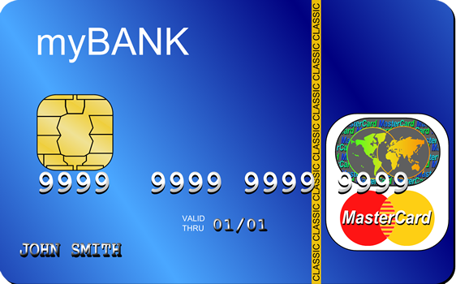
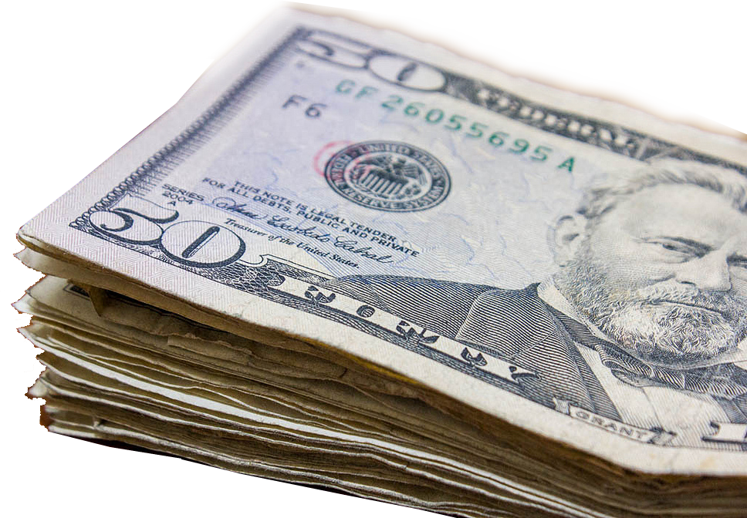
16. P____________________ Approach vs. Disassociation v.17
So if you consider me a partner, welcome him as you would welcome me.
Consider me -- Welcome him as me
Reason through your F____________!
17. C____________ Card Approach vs. I’ll make you pay v.18
If he has done you any wrong or owes you anything, charge it to me me.
Charge it to me
B_________ one another’s burdens!
18. S____________________ Approach vs. Make ‘em pay v.19
... I will pay it back--not to mention that you owe me your very self.
I will pay -- You owe me
Follow in Christ’s S________
19. R______________________ Approach Vs. Fatigued v.20
I do wish, brother, that I may have some benefit from you in the Lord; refresh my heart in Christ.
Let me reap benefit
Refresh me
Tactfully assert E_________________!
20. C____________________ Approach Vs. Doubtful v.21
Confident of your obedience, I write to you, knowing that you will do even more than I ask.
-In obedience -To do more
Be O____________________ of relationships
21. F__________-U_____ Approach Vs. “Let it go” v.22
And one thing more: Prepare a guest room for me, because I hope to be restored to you in answer to your prayers.
-Guest Room -Restored
Conclusion:
This set of eight approaches are “POWERFUL” when added to the previous 13! So ...Learn to use them, as Paul did, on a SINGLE situation! Let’s Pray!
11

Slide 14
12

Slide 15
Conflict Resolution
A Study of Philemon
Conflict Resolution:
A Little Background on Conflict
Twenty-One Ways to Resolve Conflict
You Can Learn to be a Conflict Resolver
By Pastor Dennis Hendrson, D.Min.
©2020 Dennis Henderson, all rights reserved.
13

Slide 16
14

Slide 17
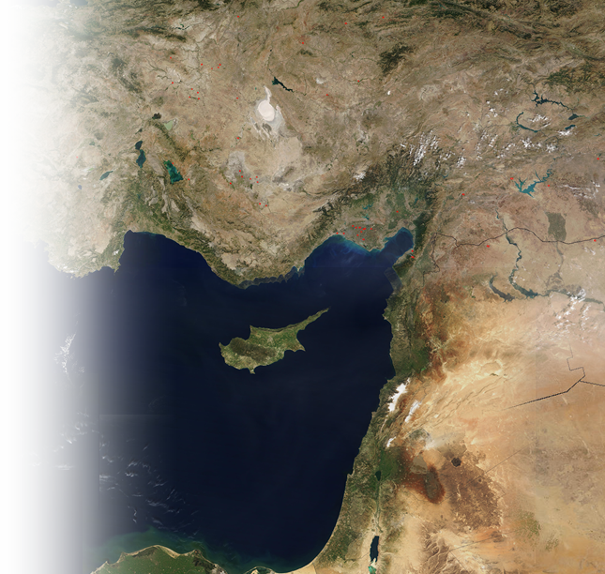
Conflict Resolution A Study of Philemon
My Premise Today: You can L_________ to do “Conflict Resolution” (Become a Peace Maker)
Why would I say that?
Because the Apostle Paul L__________ to be one!
Bear with me ... Paul wrote Philemon from Rome around _____ AD
In the previous 14 years ...
Three missionary journeys
Jerusalem imprisonments
3 Trials
Sailed to Rome – imprisonment
So back up 14 years – ______ AD
Paul and Barnabas S____ O_____
P______-U____ John Mark - Cousin
John Mark B__________ On Them
Why?
The Itinerary ...
Homesickness ...
Frightened ...
Malaria …
Paul’s Leadership …
Paul’s Preaching …
Completed 1st Missionary Journey
+ Antioch Pisidian + Iconium + Lystra + Derbe
Then return
- Lystra - Iconium - Antioch Pisidian - Perga of Pamphilia - Antioch
Perga of Pamphylia
Antioch
Salamis
Paphos
Iconium
Pisidian Antioch
Lystra
Derbe
Antioch
15

Slide 18
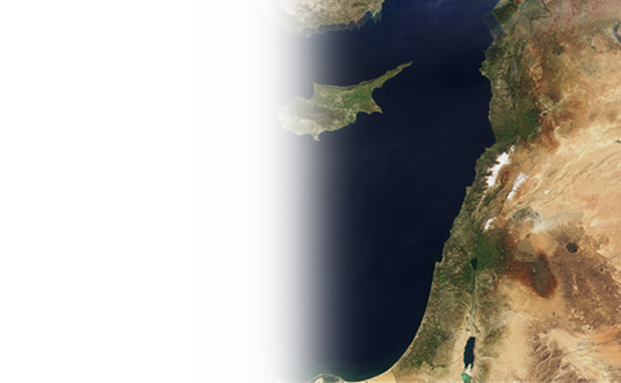
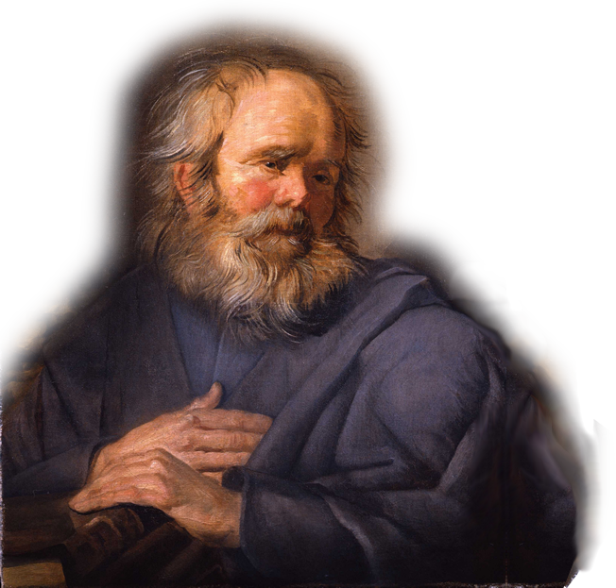
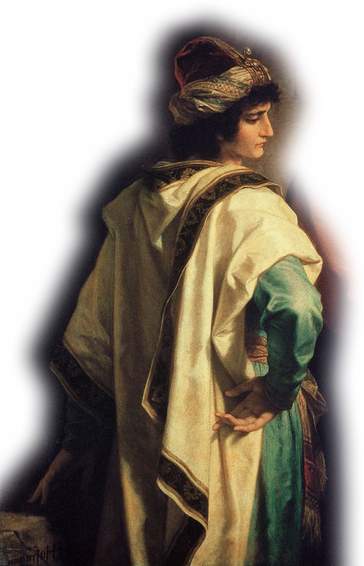
The Jerusalem Council
Return to Antioch
³⁵ But Paul and Barnabas remained in Antioch, where they and many others taught and preached the word of the Lord.
³⁶ Some time later Paul said to Barnabas,
"Let us go back and visit the brothers in all the towns where we preached the word of the Lord and see how they are doing.“
Antioch
Ready for 2nd Journey
³⁷ Barnabas wanted to take John, also called Mark, with them,
³⁸ but Paul did not think it wise to take him, because he had deserted them in Pamphylia and had not continued with them in the work.
³⁹ They had such a S____________ D_________________ ...
Heated exchange:
Paul did not “think it wise” = John/Mark was literally “not worthy of honor” John/Mark “deserted!”
(ἀποστάντα)
Barnabas’ D________________:
1. Polite
2. Thanks
3. Complimentary 4. Prayer 5. Joyful 6. Gentle
7. Loving
³⁹ They had such a sharp disagreement that they P_____________ company.
Sometimes you have to: “A_________ to D_____________” and just keep on serving Jesus!
8.Respectful 9. Mediate
10. Useful 11. Affection
12. Helpful
13. Voluntary
14. Big Picture
15. Spiritual
16. Partner
17. Credit Card
18. Substitute
19. Refresh
20. Confident
21. Follow-Up
16

Slide 19
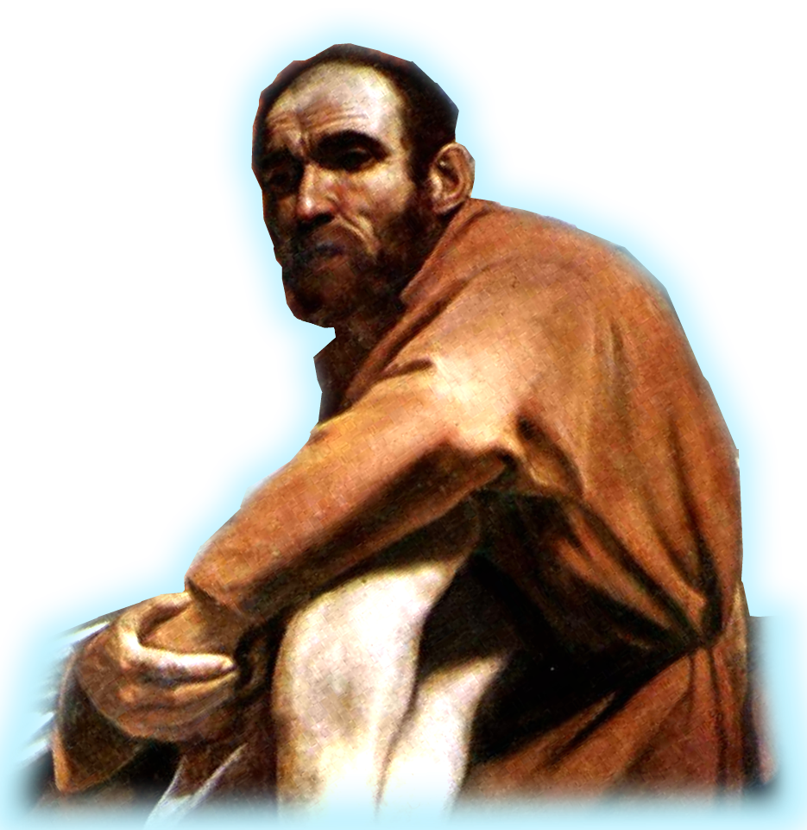
The Results ³⁹ … Barnabas took Mark and sailed for Cyprus
⁴⁰ but Paul chose Silas and left, commended by the brothers to the grace of the Lord.
⁴¹ He went through Syria and Cilicia, strengthening the churches.
Important Point:
The Lord even uses our C____________ for His glory!
T__________ missionary teams!
However, at some point, some way ...
The conflict between Paul and Mark was R______________!
By 60 AD – letter to Philemon
The People with Paul ...
^{Philemon 1:23} Epaphras, my fellow prisoner in Christ Jesus, sends you greetings. ²⁴ And so do Mark, Aristarchus, Demas and Luke, my fellow workers.
By 64 AD – letter to Timothy
^{2Timothy 4:11} Get Mark and bring him with you, because he is helpful to me in my ministry.
Mark, like Onesimus (name means “useful), is “U_____________” to me!”
A good point: W_____ N_______ Y______!
²⁰ As it is, there are many parts, but one body. ²¹ The eye cannot say to the hand, "I don't need you!" And the head cannot say to the feet, "I don't need you!“ ²² On the contrary, those parts of the body that seem to be weaker are indispensable (1Co 12)
Here’s my final point...
You might as well resolve any conflict N______ ... because you will be spending all E______________ with your brothers and sister in Christ.
17

