Slide 1
Picking up the
Pieces
Through
INSPECTIONS
A Study of Nehemiah
Notes:
https://upload.wikimedia.org/wikipedia/commons/7/74/Wikipedia-logo-v2-pieces.svg
https://www.freepik.com/free-photo/jigsaw-puzzle-with-missing-piece-missing-puzzle-pieces_5469650.htm
Copyright © 2006−2021. All rights reserved. Bible Point is a registered trademark of Dennis Henderson. All other trademarks acknowledged.
Bible Point contains graphics from Bible Point artists. These illustrations belong to Bible Point and the respective artists. You may use the designs and illustrations for graphical illustration of lessons free and without special permission, provided they are not used in any way that maligns the Christian faith. Furthermore, republication or production of any illustration by any other graphic service whether it be in book, in a machine-readable form, or in any other design resource is strictly prohibited. Furthermore, they cannot be duplicated or resold as any other form of publishing, clip art, or graphic resource.
So What does it mean? (A simple translations of the legal jargon)
So, if you don’t own the presentation(s), graphic(s), and text(s) how can you legally use them? The purchase of the license allows you to use all the images in the product. However, the actual ownership and copyright of the presentation(s), graphic(s), and text(s) remain the property of Bible Point and its licensors. If you had plans on using this product in your “for sale” work—think again!
License Agreement
Article 1: License Grant
All the graphics and text in Bible Point presentations (excluding quotes from the Bible and stated sources) are the intellectual and real property of Bible Point and its licensors, and is protected by law, including United States copyright laws and international treaties. Bible Point grants to you a license:
1. To use the presentation in a single church, single school, or single office of a Christian organization.
2. To make a single archival back-up copy of the program.
3. To modify the presentation(s) and merge with other presentations in a single church, school, or Christian organization.
4. To transfer to another party if that party agrees to accept the terms and conditions of this agreement, and you do not retain any copies of the presentation, whether printed, machine readable, modified, or merged form.
Article 2: Terms
This license is effective until terminated. You may terminate the license at any time by destroying the presentation(s), graphic(s), or text(s) together with all copies, modifications and merged portions in any form. Bible Point may terminate your license if you fail to comply with this Agreement. You agree, upon such termination, for any reason, to destroy the presentation(s), graphics, and text(s) with all copies, modifications, and merged portions in any form.
Article 3: Disclaimers
1. Bible Point presentations, graphics, and texts are licensed to you As Is. You, the consumer, bear the entire risk relating to the quality and performance of the presentation(s), graphic(s), or text(s). In no event will Bible Point be liable for damages resulting from any defect.
2. Thirty-day limited warrantee on disks. Bible Point warrants the disks to be free of defects in material and workmanship under normal use for 30 days after purchase. During the 30-day period you may return a defective presentation, graphic, or text with proof of purchase and it will be replaced without charge, unless the presentation is damaged by misuse.
Article 4: General
1. You may not sub-license, assign, or transfer the license of the presentation(s), graphic(s), or text(s) except as provided by this Agreement.
2. This Agreement will be governed by the laws of the State of Michigan.
So What does it mean? (A simple translations of the legal jargon)
May I let someone borrow or copy my licensed Bible Point presentation (even after I modified it)? As long as it is within your local church, or single school, or the immediate office of a Christian organization you may. Otherwise, please refer the person interested in borrowing to: http://www.biblepoint.com or E-mail: dennis@DrDH.net with any related questions.

Slide 2
Picking up the
Pieces
Through
COMPLETION
A Study of Nehemiah
Notes:
https://upload.wikimedia.org/wikipedia/commons/7/74/Wikipedia-logo-v2-pieces.svg
https://www.freepik.com/free-photo/jigsaw-puzzle-with-missing-piece-missing-puzzle-pieces_5469650.htm

Slide 3
CAUTION:
Today’s message is politically charged!
Notes:
Today’s message has “Political” Overtones
I do this to show how politics have not changed. What I mean is that the political scene today illustrates what Nehemiah was going through!

Slide 4
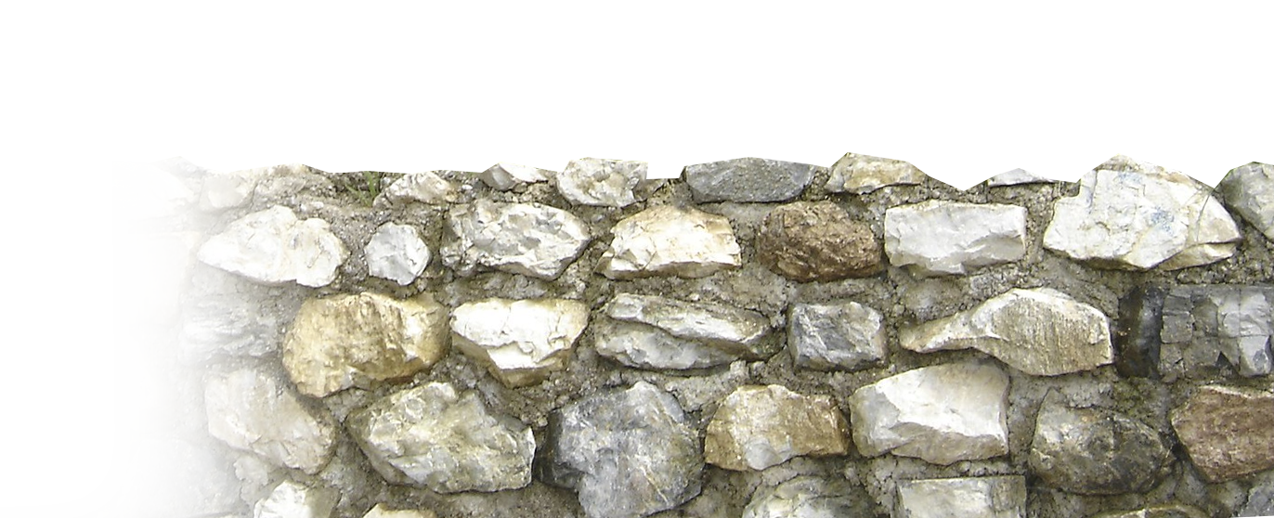
Nehemiah wanted to
“Build that Wall!”
To protect the Jews in Jerusalem
To protect the temple in Jerusalem
To establish boundaries
His adversaries made it as difficult as possible …

Slide 5

The Struggle to COMPLETION 6:1-14
The struggle comes from …
Notes:
https://pixabay.com/illustrations/one-hundred-percent-complete-stamp-459227/

Slide 6
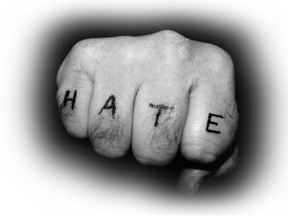
Haters
Notes:
https://upload.wikimedia.org/wikipedia/commons/0/08/Haters.jpg

Slide 7
Haters … Never Nehemiah-ers 1-6
They will do whatever it takes to remove the leader from his office …
Notes:
Haters identified 1
Haters goal = Whatever it takes to take him out – remove from power 2
Haters rejected 3
Haters persistence 4

Slide 8
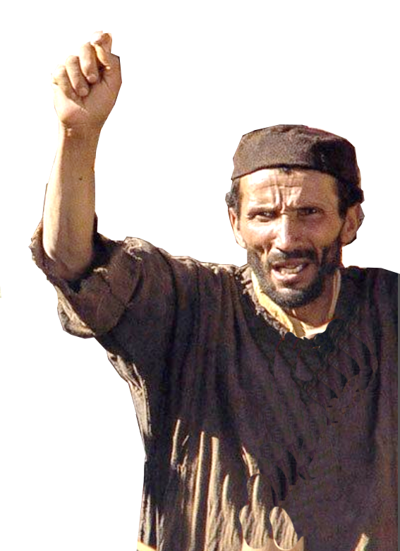
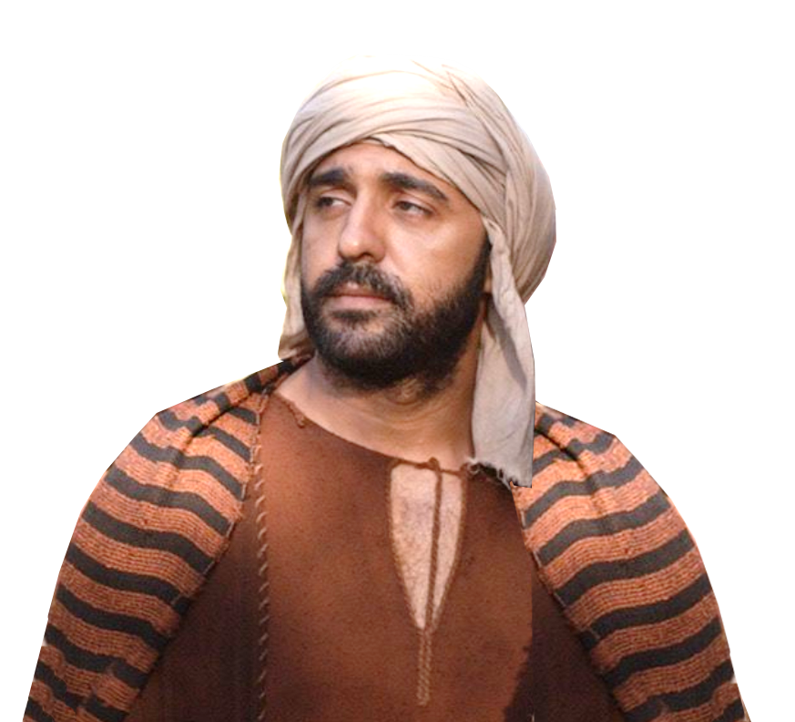
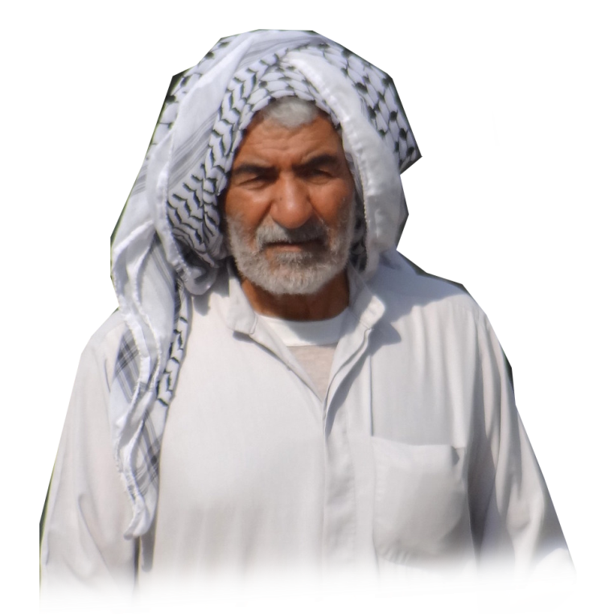
Haters’ IDENTIFIED 6:1
¹ Now when Sanballat and Tobiah and Geshem the Arab and the rest of our
enemies heard that I had
built the wall and that
there was no breach left
in it (although up to that
time I had not set up the
doors in the gates),
Notes:
So let’s identify the haters … they are the Never Nehemiah-ers --

Slide 9

Haters’ GOAL 6:2
² Sanballat and Geshem sent to me, saying,
"Come and let us meet together at Hakkephirim in the plain of Ono."
But they intended
to do me harm.
Notes:
Displeased (greatly evil-ed) with Nehemiah from the beginning (2:10)
--Despised Nehemiah (2:19)
--Greatly enraged at Nehemiah (4:1, 7)
--Harm Nehemiah (6:2)

Slide 10
Haters’ GOAL 6:2
² Sanballat and Geshem sent to me, saying,
"Come and let us meet together at Hakkephirim in the plain of Ono."
But they intended
to do me harm.

Slide 11
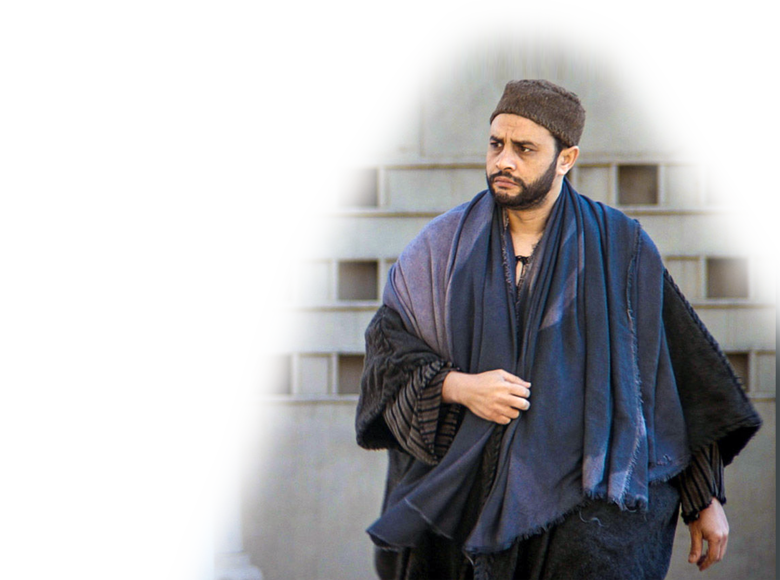
Haters REJECTED 6:3
³ And I sent messengers to them, saying,
"I am doing a great work and I cannot come down. Why should the work stop while I leave it and come down to you?“
TOO BUSY… !
Notes:
I don’t have time for you!
I’m too busy building the wall!

Slide 12
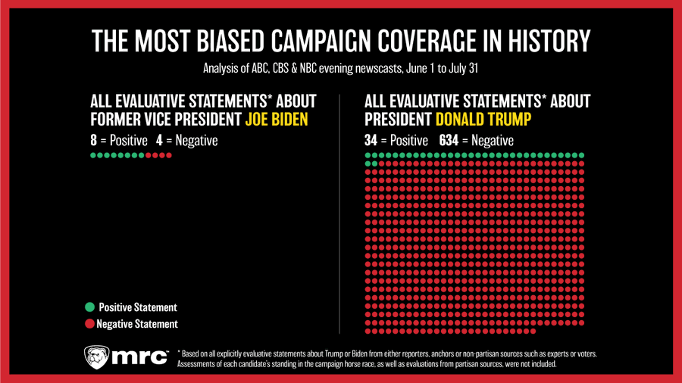
Haters’ PERSISTENCE 6:4
AGAIN
AGAIN
AGAIN
AGAIN
⁴ And they sent to me four times in this way, and I answered them in the same manner.
Notes:
https://www.foxnews.com/media/evening-newscasts-150-times-more-negative-trump
Median Research Center --
If you say it long enough, they will believe it …
If we say fake news enough times it must be true.

Slide 13
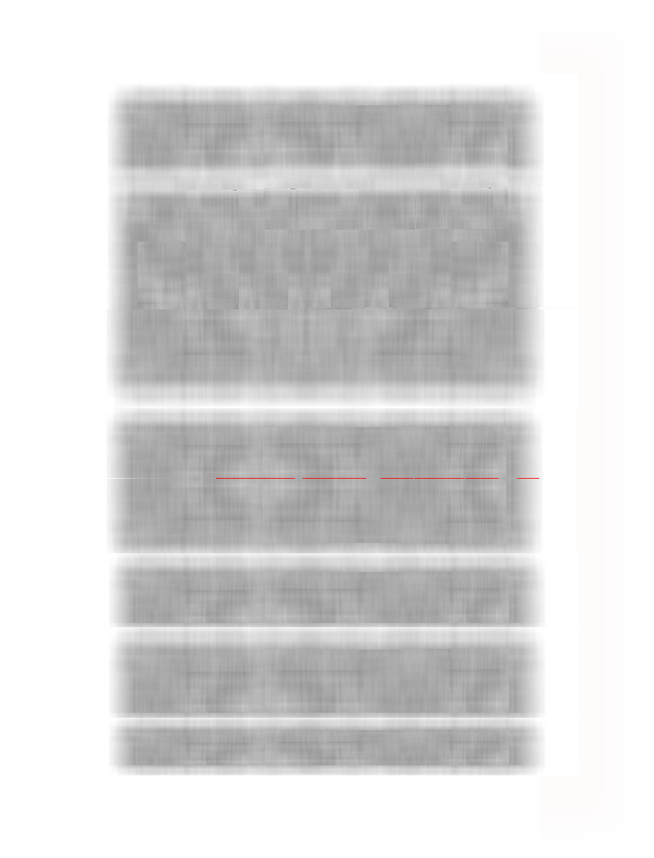
Haters’ PERSISTENCE 6:4
AGAIN
AGAIN
AGAIN
AGAIN
AGAIN
⁴ And they sent to me four times in this way, and I answered them in the same manner. ⁵ In the same way Sanballat for the fifth time sent his servant to me with an open letter in his hand.
Notes:
https://www.foxnews.com/media/evening-newscasts-150-times-more-negative-trump
Median Research Center --
Reading an “Open” letter then was like putting on CNN, MSNBC, CBS, FOX, Facebook and Twitter today!

Slide 14
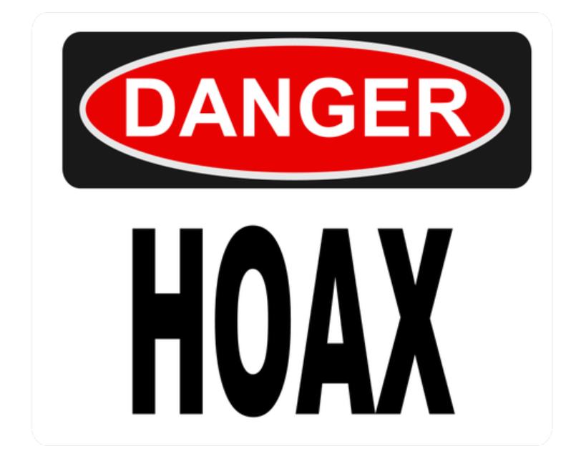
Hoax-sters like… FAKE NEWS 6-9
Notes:
https://publicdomainvectors.org/photos/Danger-Hoax.png

Slide 15

Hoax-sters … like FAKE NEWS 6-9
Notes:
https://pixabay.com/illustrations/hoax-news-false-concept-2097359/
Like CNN, MSNBC, ABC, CBS, etc. All 24/7 repeating false news
The Collusion with the Russian hoax for over two years!
Ukraine Obstruction
Now it is Postal Service Election interference
Fake News

Slide 16

The Hoax’ Sources 6
⁵ … an open letter in his hand.
⁶ In it was written, "It is reported among the nations, and Geshem also says it, that you and the Jews intend to rebel; that is why you are building the wall. And according to these reports you wish to become their king.
Notes:
// Adam Shift fake phone call.
// Fake news
It is “anonymously” by unnamed but “reliable sources” (like false Steele dossier) and Geshem (like congressman Adam Shift of that day).

Slide 17

The Hoax’ Sources 6
⁵ … an open letter in his hand.
⁶ In it was written, "It is reported among the nations, and Geshem also says it, that you and the Jews intend to rebel; that is why you are building the wall. And according to these reports you wish to become their king.
Notes:
// Adam Shift fake phone call.
// Fake news
It is “anonymously” by unnamed but “reliable sources” (like false Steele dossier) and Geshem (like congressman Adam Shift of that day).

Slide 18

The Hoax’ Charge 6
⁵ … an open letter in his hand.
⁶ In it was written, "It is reported among the nations, and Geshem also says it, that you and the Jews intend to rebel; that is why you are building the wall. And according to these reports you wish to become their king.
Notes:
// Adam Shift fake phone call.
// Fake news
It is “anonymously” by unnamed but “reliable sources” (like false Steele dossier) and Geshem (like congressman Adam Shift of that day).

Slide 19

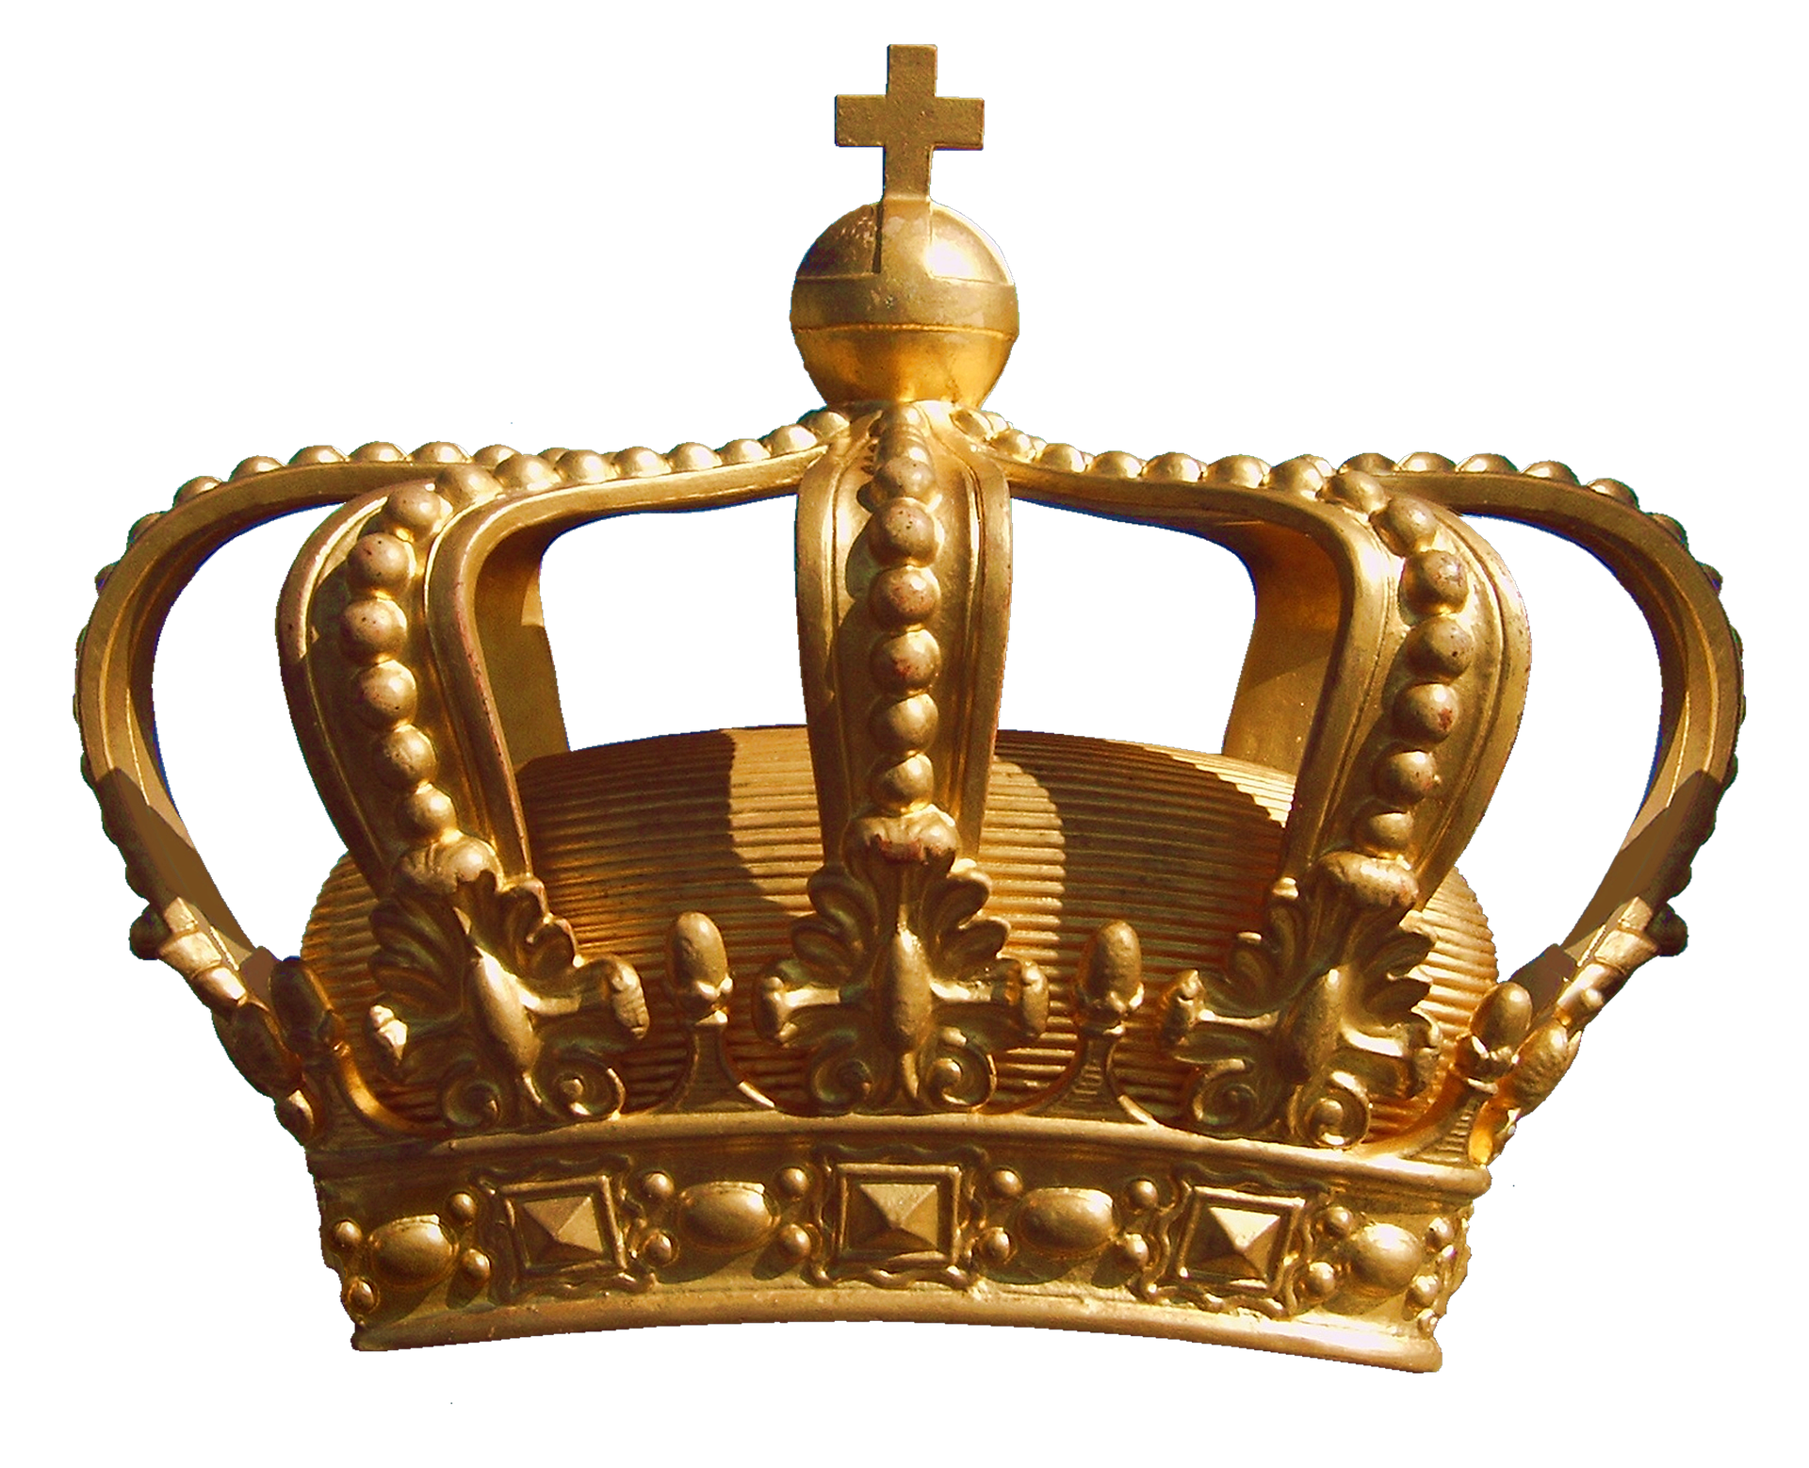
The Hoax’ Charge 6
⁵ … an open letter in his hand.
⁶ In it was written, "It is reported among the nations, and Geshem also says it, that you and the Jews intend to rebel; that is why you are building the wall. And according to these reports you wish to become their king.
Notes:
// Adam Shift fake phone call.
// Fake news
It is “anonymously” by unnamed but “reliable sources” (like false Steele dossier) and Geshem (like congressman Adam Shift of that day).

Slide 20
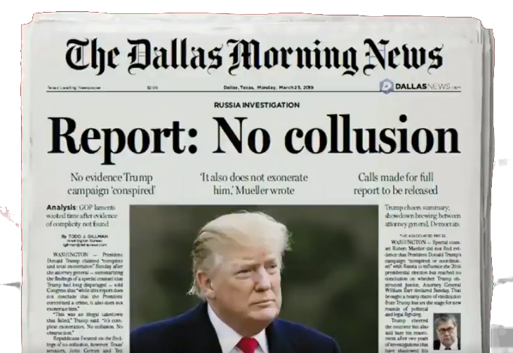
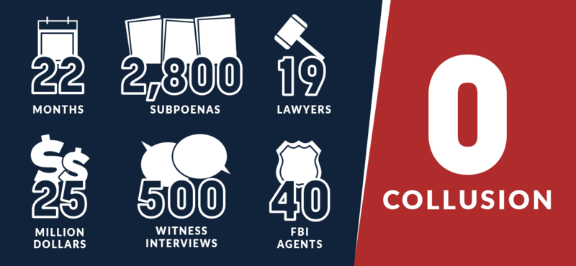
The Hoax’ Collusion 7
⁷ And you have also set up prophets to proclaim concerning you in Jerusalem, 'There is a king in Judah.'
Notes:
https://twitter.com/toddgillman/status/1118928139814617088
https://webster.house.gov/2019/3/webster-mueller-finds-no-collusion
You have colluded with the prophets to convince the people in Jerusalem to make you king. (kind of like colluding with the Russians to influence the election)

Slide 21
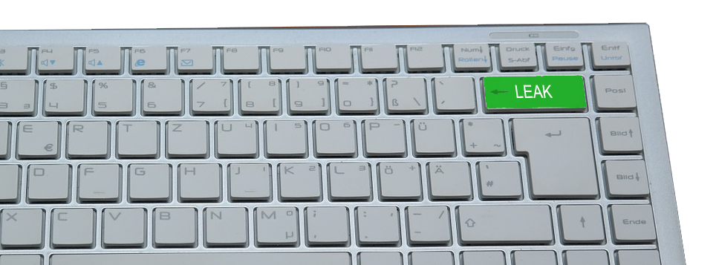
The Hoax’ Threat 7
⁷ … And now the king will hear of these reports. So now come and let us take counsel together."
Leak to thepress
Notes:
https://www.needpix.com/photo/download/85275/keyboard-computer-input-keys-hardware-letters-pc-calculator-tap
This part is like the Jim Comey setting up General Flynn to entrap him or get him to perjure himself.
The true king of Persia will hear of your obstruction of justice. We will see to it that you are impeached from Jerusalem and Judah.
I’m not saying Trump is a Nehemiah, I’m just saying, politics have not changed much. Nehemiah has been set up
Or …
Like the leaked quid pro quo that Trump was threatening holding up funds unless Ukraine jumped through his hoops.

Slide 22
The Hoax’ Threat 7
⁷ … And now the king will hear of these reports. So now come and let us take counsel together."
Notes:
https://www.needpix.com/photo/download/85275/keyboard-computer-input-keys-hardware-letters-pc-calculator-tap
This part is like the Jim Comey setting up General Flynn to entrap him or get him to perjure himself.
The true king of Persia will hear of your obstruction of justice. We will see to it that you are impeached from Jerusalem and Judah.
I’m not saying Trump is a Nehemiah, I’m just saying, politics have not changed much. Nehemiah has been set up
Or …
Like the leaked quid pro quo that Trump was threatening holding up funds unless Ukraine jumped through his hoops.

Slide 23
The Hoax Rejected 8
⁸ Then I sent to him, saying, "No such things as you say have been done, for you are inventing them out of your own mind."
Notes:
Just like Trump who denied it all along and called it all a hoax—because it was all orchestrated by the Democrats.
Kind of like the Ukraine phone call—they never thought he would release it.

Slide 24

The Hoax’ Purpose 9
⁹ For they all wanted to frighten us, thinking,
"Their hands will drop from the work, and it will not be done."
Notes:
https://pixabay.com/vectors/fear-anxiety-silhouette-shadow-4750252/
Frighten = intimidate
All because they could not accept that the Persian King sent me to do the job // All because they could not accept the will of the people who elected him.

Slide 25
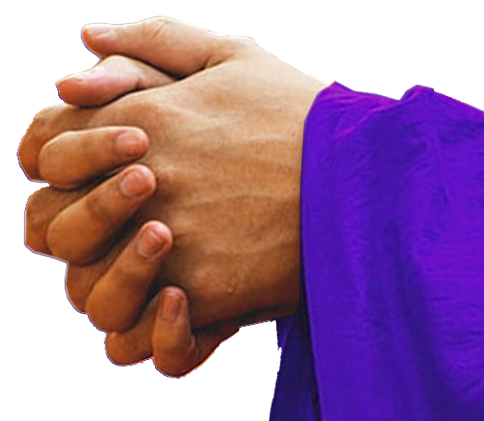
The Hoax’ Demise 9
⁹ For they all wanted to frighten us, thinking,
"Their hands will drop from the work, and it will not be done."
But now, O God, strengthen my hands.
Notes:
https://pixabay.com/vectors/fear-anxiety-silhouette-shadow-4750252/
Frighten = intimidate
All because they could not accept that the Persian King sent me to do the job // All because they could not accept the will of the people who elected him.

Slide 26
Spies like… FBI, CIA, FOIA

Slide 27

Spies … like FBI, CIA, FISA
Notes:
https://commons.wikimedia.org/wiki/File:The_Spy_FM_Logo.png

Slide 28
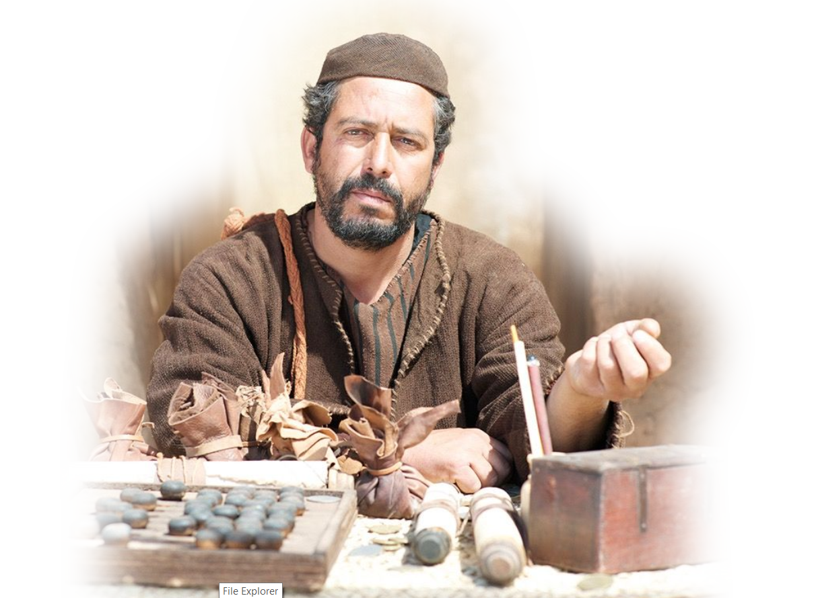
The Spy Identified 10
¹⁰ Now when I went into the house of Shemaiah the son of Delaiah, son of Mehetabel, who was confined to his home, he said,

Slide 29
The Spy’s Deception 10
"Let us meet together in the house of God, within the temple. Let us close the doors of the temple, for they are coming to kill you. They are coming to kill you by night."

Slide 30
The Spy Rejected 11
¹¹ But I said,
"Should such a man as I run away? And what man such as I could go into the temple and live?
I will not go in."
Notes:
Should I hide in the basement?
That is a great question that needs to be asked today.

Slide 31
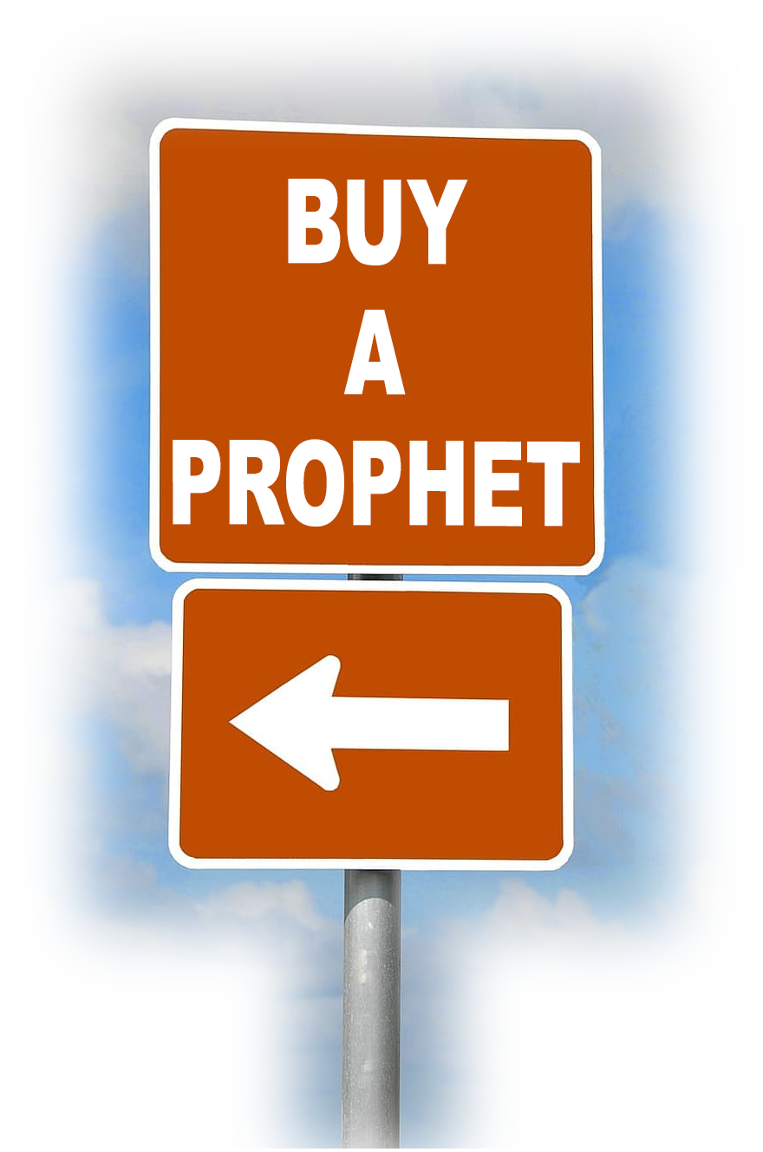
The Spy Exposed 12
¹² And I understood and saw that God had not sent him, but he had pronounced the prophecy against me because Tobiah and Sanballat had hired him.
Notes:
The prophet was doing a hit job. He was Hired to take Nehemiah out of the picture …

Slide 32

The Spy Funded 13
¹³ For this purpose he was hired, that I should be afraid and act in this way and sin, and so they could give me a bad name in order to taunt me.
Notes:
https://www.vox.com/2018/1/5/16845704/steele-dossier-russia-trump
By now you are aware that the Democrat party, specifically, Hillary Clinton’s campaign, hired Fusion GPS to do opposition research and funded the fake Steel dossier that was used to approved FISA warrant to spy on the President. That’s exactly what was going down with Nehemiah. This was a inside job trying to destroy the leader.

Slide 33
The Spy Funded 13
¹³ For this purpose he was hired, that I should be afraid and act in this way and sin, and so they could give me a bad name in order to taunt me.
Notes:
https://www.vox.com/2018/1/5/16845704/steele-dossier-russia-trump
By now you are aware that the Democrat party, specifically, Hillary Clinton’s campaign, hired Fusion GPS to do opposition research and funded the fake Steel dossier that was used to approved FISA warrant to spy on the President. That’s exactly what was going down with Nehemiah. This was a inside job trying to destroy the leader.

Slide 34
The Spy Funded 13
¹³ For this purpose he was hired, that I should be afraid and act in this way and sin, and so they could give me a bad name in order to taunt me.
Notes:
https://www.vox.com/2018/1/5/16845704/steele-dossier-russia-trump
By now you are aware that the Democrat party, specifically, Hillary Clinton’s campaign, hired Fusion GPS to do opposition research and funded the fake Steel dossier that was used to approved FISA warrant to spy on the President. That’s exactly what was going down with Nehemiah. This was a inside job trying to destroy the leader.

Slide 35
The Spy’s Accountability 14
¹⁴ Remember Tobiah and Sanballat, O my God, according to these things that they did, and also the prophetess Noadiah and the rest of the prophets who wanted to make me afraid.
Notes:
Nehemiah prayed that the Lord would Remember what the hitmen did.
They had conspired to take him down.

Slide 36
With Politics out of the way …

Slide 37
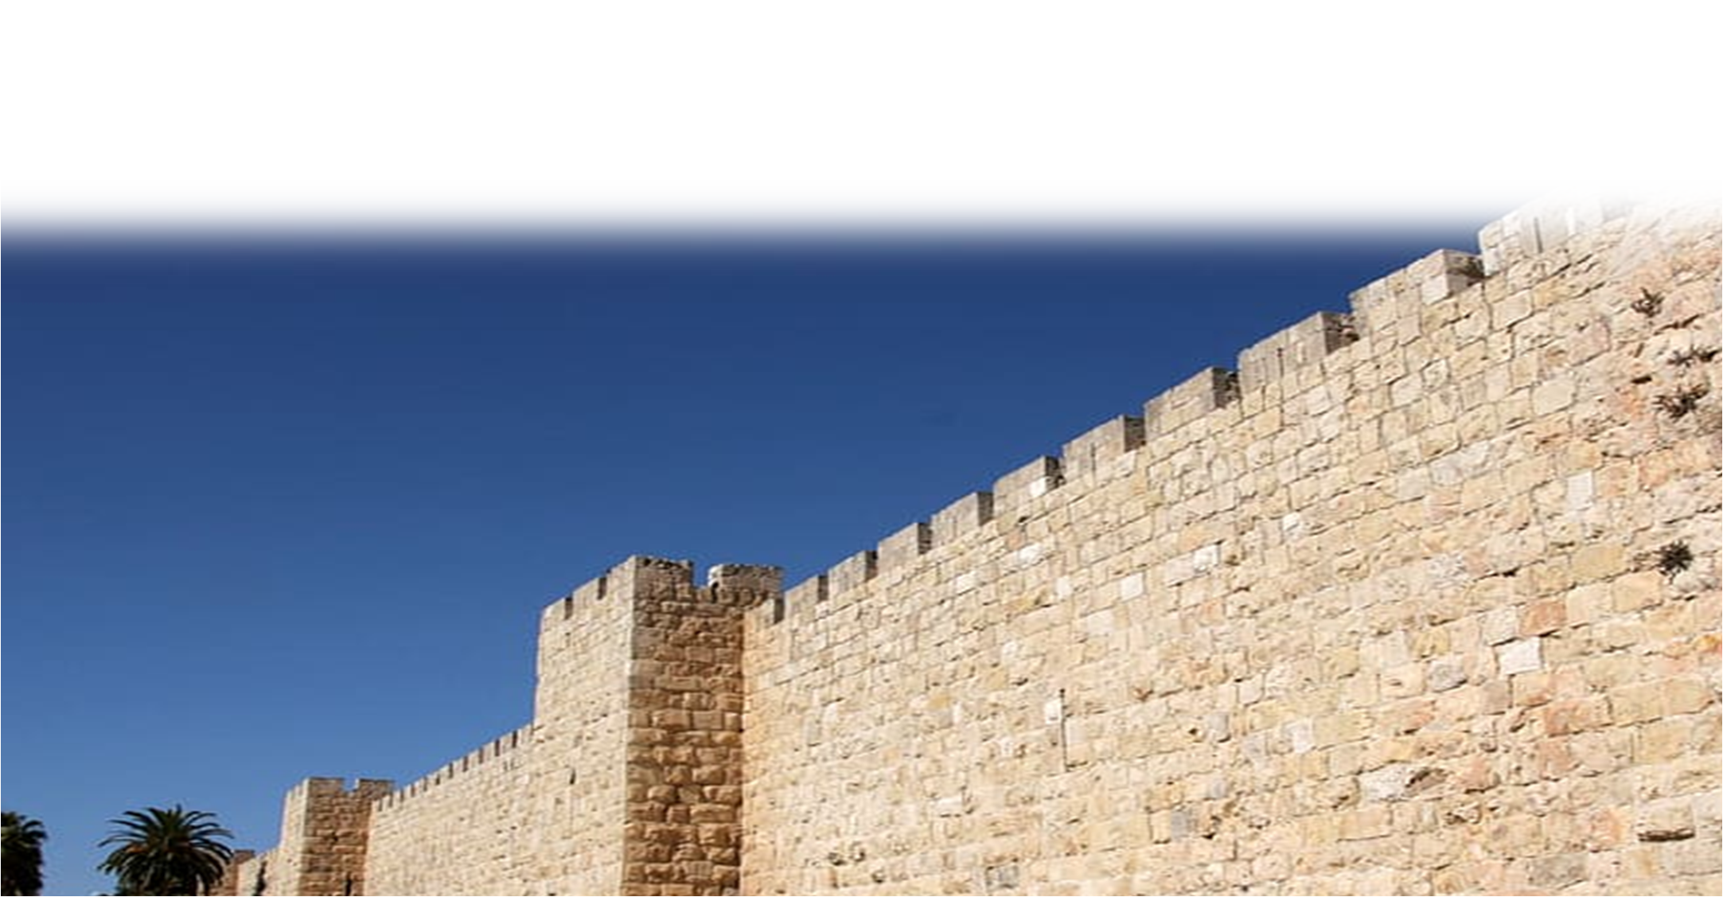
The Speed of Completion 15
¹⁵ So the wall was finished on the twenty-fifth day of the month
Elul, in fifty-two days.
Notes:
https://www.pxfuel.com/en/free-photo-jgjnf

Slide 38
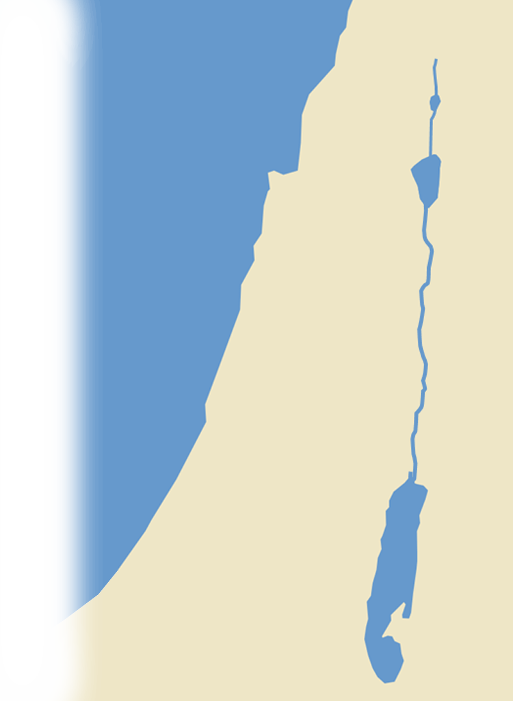
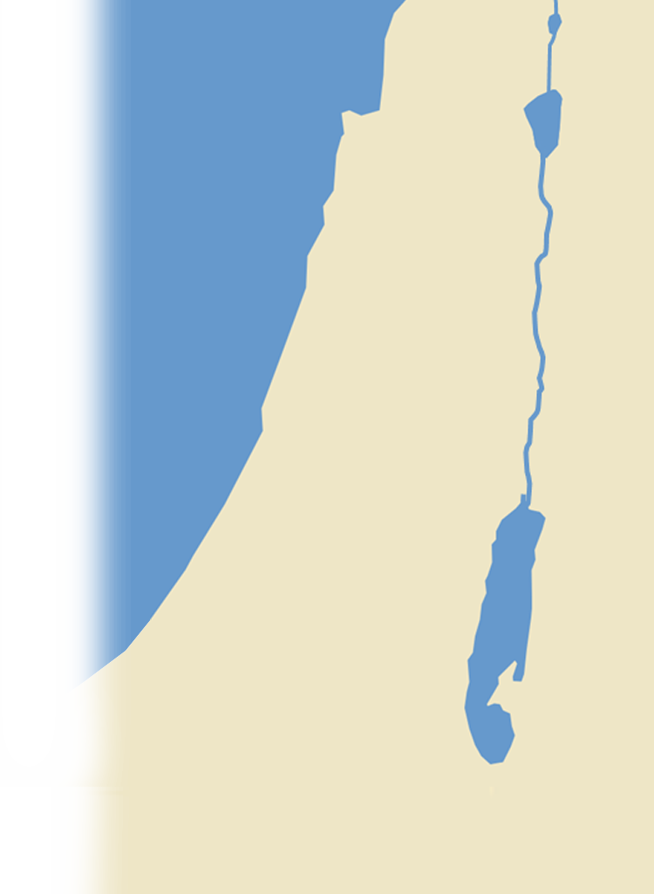



The Legacy of Completion 16
¹⁶ And when all our enemies heard of it, all the nations around us were afraid and fell greatly in their own esteem, for they perceived that this work had been accomplished with the help of our God.
SAMARIA
HORAN
AMMON
ASHDOD
JUDAH
ARABS
Notes:
Enemies:
Afraid
Took a heavy blow – wind was taken out of there sails
Perceived God was with the Jews

Slide 39
The Legacy of Completion 16
RESPECT
¹⁶ And when all our enemies heard of it, all the nations around us were afraid and fell greatly in their own esteem, for they perceived that this work had been accomplished with the help of our God.
SAMARIA
HORAN
AMMON
ASHDOD
JUDAH
ARABS
Notes:
Enemies:
Afraid
Took a heavy blow – wind was taken out of there sails
Perceived God was with the Jews

Slide 40
The Legacy of Completion 16
ESTEEM
¹⁶ And when all our enemies heard of it, all the nations around us were afraid and fell greatly in their own esteem, for they perceived that this work had been accomplished with the help of our God.
SAMARIA
HORAN
AMMON
ASHDOD
JUDAH
ARABS
Notes:
Enemies:
Afraid
Took a heavy blow – wind was taken out of there sails
Perceived God was with the Jews

Slide 41
The Legacy of Completion 16
ACCOMPLISHMENT
¹⁶ And when all our enemies heard of it, all the nations around us were afraid and fell greatly in their own esteem, for they perceived that this work had been accomplished with the help of our God.
SAMARIA
HORAN
AMMON
ASHDOD
JUDAH
ARABS
Notes:
Enemies:
Afraid
Took a heavy blow – wind was taken out of there sails
Perceived God was with the Jews

Slide 42

The Aftermath of Completion 17
JUDAH
Notes:
Nobles went to the enemy – They had deep ties with the enemy and had some good reason to have Nehemiah removed.
Nehemiah was a problem to there political aspirations.
17 Moreover, in those days the nobles of Judah sent many letters to Tobiah, and Tobiah's letters came to them.
18 For many in Judah were bound by oath to him, because he was the son-in-law of Shecaniah the son of Arah: and his son Jehohanan had taken the daughter of Meshullam the son of Berechiah as his wife.
(Neh 6:17-18 ESV)

Slide 43
Dealing with the Deep State
¹⁷ Moreover, in those days the nobles of Judah sent many letters to Tobiah, and Tobiah's letters came to them. ¹⁸ For many in Judah were bound by oath
to him, because he was the
son-in-law of Shecaniah the son
of Arah: and his son Jehohanan had taken the daughter of Meshullam
the son of Berechiah as his wife.
AMMON
JUDAH
Notes:
Nobles went to the enemy – They had deep ties with the enemy and had some good reason to have Nehemiah removed.
Nehemiah was a problem to there political aspirations. Nehemiah was a disrupter in the political status quo.

Slide 44
Dealing with the Deep State
¹⁷ Moreover, in those days the nobles of Judah sent many letters to Tobiah, and Tobiah's letters came to them. ¹⁸ For many in Judah were bound by oath
to him, because he was the
son-in-law of Shecaniah the son
of Arah: and his son Jehohanan had taken the daughter of Meshullam
the son of Berechiah as his wife.
AMMON
JUDAH
Notes:
This is the deep state – politically connected people who preceded Nehemiah who had made terrible treaties.
Bound to the treaties.

Slide 45
Dealing with the Deep State
¹⁷ Moreover, in those days the nobles of Judah sent many letters to Tobiah, and Tobiah's letters came to them. ¹⁸ For many in Judah were bound by oath
to him, because he was the
son-in-law of Shecaniah the son
of Arah: and his son Jehohanan had taken the daughter of Meshullam
the son of Berechiah as his wife.
AMMON
JUDAH
Notes:
There were family ties as well. Intermarrying with the unbelievers leads to compromise of values.

Slide 46
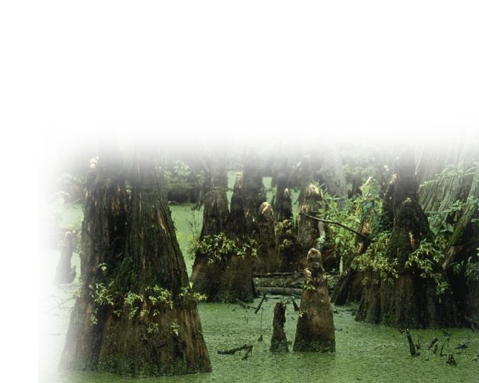


Dealing with the Deep State
¹⁹ Also they spoke of his good deeds in my presence and reported my words to him. And Tobiah sent letters to make me afraid.
Notes:
https://pixnio.com/free-images/nature-landscapes/wetlands-and-swamps/swamp-water-landscape-680x544.jpg
These are those who are career bureaucrats. Not elected, appointed,--corruptly making calls against Nehemiah.
This deep state swamp does not go away. We will run into this deep state problem in the last chapter where Tobiah, when Nehemiah returns to Persia, moves into the temple (desecrating it), and Nehemiah upon his returns (like Jesus who overturned the money changers and drives them out of the temple) Nehemiah has to throw Tobiah out for desecrating the temple. Neh 13:1-7

Slide 47
So What Do We Take Away?
It’s not about our President.
It’s not even really about Nehemiah.
It’s really about US …
⁴ For whatever was written in former days was written for our instruction, that through endurance and through the encouragement of the Scriptures we might have hope. (Romans 15:4)
Notes:
Listen, this is not about Trump, though he contemporarily illustrates Nehemiah. Likewise, this is not about Nehemiah—he didn’t write this for himself. No this is about us, you and me.

Slide 48
So What Do We Take Away?
It’s not about our President
It’s not about Nehemiah
It’s really about US …
¹¹ Now these things happened to them as an example, but they were written down for our instruction, on whom the end of the ages has come. (1Corinthians 10:11)
Notes:
Listen, this is not about Trump, though he contemporarily illustrates Nehemiah. Likewise, this is not about Nehemiah—he didn’t write this for himself. No this is about us, you and me.

Slide 49
So What Do We Take Away?
When you follow the Lord like Nehemiah …
Notes:
Being a Christian is not for sissies.

Slide 50
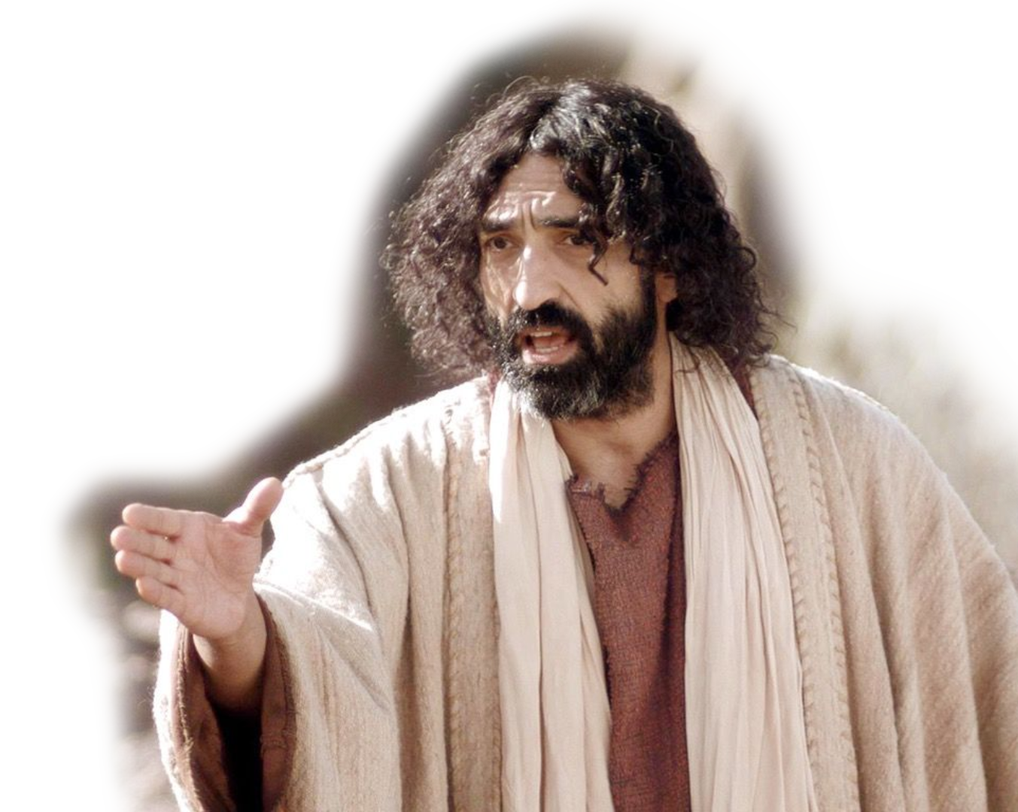
So What Do We Take Away?
When you follow the Lord like Nehemiah …
1. You will be hated.
If the world hates you,
know that it has hated
me before it hated you.
(John 15:18)
Notes:
Being a Christian is not for sissies.
2 Timothy 3:12 Indeed, all who desire to live a godly life in Christ Jesus will be persecuted, (2Ti 3:12 ESV)
¹¹ "Blessed are you when others revile you and persecute you and utter all kinds of evil against you falsely on my account. (Mat 5:11 ESV)

Slide 51
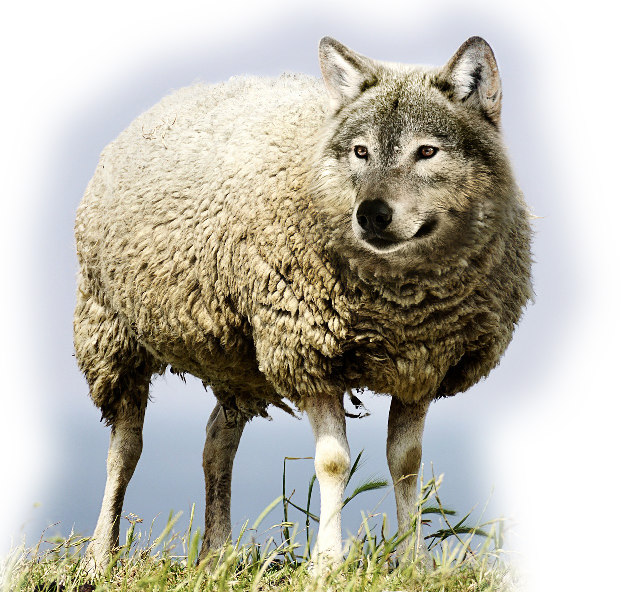
So What Do We Take Away?
When you follow the Lord like Nehemiah …
1. You will be hated.
2. Don’t be deceived.
"Beware of false prophets,
who come to you in sheep’s
clothing but inwardly are
ravenous wolves.” (Mat 7:15)
Notes:
https://pixabay.com/photos/wolf-in-sheep-s-clothing-wolf-sheep-2577813/
You had better know what that candidate believes before you vote for him or her—or you may find that the one you voted for will eat you alive.
MT 24:5 false Christs “deceive many”
MT 24:11 false prophets will “deceive many”
MT 24:24 false miracles will “deceive many”

Slide 52
So What Do We Take Away?
When you follow the Lord like Nehemiah …
1. You will be hated.
2. Don’t be deceived.
3. You will be spied upon.
Yet because of false brothers secretly brought in--who slipped in to spy out our freedom that we have in Christ Jesus, so that they might bring us into slavery-- (Galatians 2:4)
Notes:
The Galatians were falling for a fake Gospel, which was not the Gospel at all—Don’t be so foolish to think that everyone who claims to be a Christians is one. There are those who do really good things to whom Jesus will say, “Depart from me, I never knew you!”
False Gospel = prosperity gospel
False Gospel = social justice gospel
False Gospel = whatever does not conform to the Biblical gospel.

Slide 53
So What Do We Take Away?
When you follow the Lord like Nehemiah …
1. You will be hated.
2. Don’t be deceived.
3. You will be spied upon.
4. Finish what you start.
¹⁵ So the wall was
finished … in
fifty-two days.
I will build
my church, and
the gates of hell shall not prevail against it. (Mathewt 16:18)
Notes:
WE are Bethany, a Jesus Built church. Let’s stay true to Him so that which he has begun he will complete in the day of Jesus Christ’s coming.

Slide 54
Let’s Pray!

