Slide 1
Picking up the
Pieces
Through
INSPECTIONS
A Study of Nehemiah
Notes:
https://upload.wikimedia.org/wikipedia/commons/7/74/Wikipedia-logo-v2-pieces.svg
https://www.freepik.com/free-photo/jigsaw-puzzle-with-missing-piece-missing-puzzle-pieces_5469650.htm
Copyright © 2006−2021. All rights reserved. Bible Point is a registered trademark of Dennis Henderson. All other trademarks acknowledged.
Bible Point contains graphics from Bible Point artists. These illustrations belong to Bible Point and the respective artists. You may use the designs and illustrations for graphical illustration of lessons free and without special permission, provided they are not used in any way that maligns the Christian faith. Furthermore, republication or production of any illustration by any other graphic service whether it be in book, in a machine-readable form, or in any other design resource is strictly prohibited. Furthermore, they cannot be duplicated or resold as any other form of publishing, clip art, or graphic resource.
So What does it mean? (A simple translations of the legal jargon)
So, if you don’t own the presentation(s), graphic(s), and text(s) how can you legally use them? The purchase of the license allows you to use all the images in the product. However, the actual ownership and copyright of the presentation(s), graphic(s), and text(s) remain the property of Bible Point and its licensors. If you had plans on using this product in your “for sale” work—think again!
License Agreement
Article 1: License Grant
All the graphics and text in Bible Point presentations (excluding quotes from the Bible and stated sources) are the intellectual and real property of Bible Point and its licensors, and is protected by law, including United States copyright laws and international treaties. Bible Point grants to you a license:
1. To use the presentation in a single church, single school, or single office of a Christian organization.
2. To make a single archival back-up copy of the program.
3. To modify the presentation(s) and merge with other presentations in a single church, school, or Christian organization.
4. To transfer to another party if that party agrees to accept the terms and conditions of this agreement, and you do not retain any copies of the presentation, whether printed, machine readable, modified, or merged form.
Article 2: Terms
This license is effective until terminated. You may terminate the license at any time by destroying the presentation(s), graphic(s), or text(s) together with all copies, modifications and merged portions in any form. Bible Point may terminate your license if you fail to comply with this Agreement. You agree, upon such termination, for any reason, to destroy the presentation(s), graphics, and text(s) with all copies, modifications, and merged portions in any form.
Article 3: Disclaimers
1. Bible Point presentations, graphics, and texts are licensed to you As Is. You, the consumer, bear the entire risk relating to the quality and performance of the presentation(s), graphic(s), or text(s). In no event will Bible Point be liable for damages resulting from any defect.
2. Thirty-day limited warrantee on disks. Bible Point warrants the disks to be free of defects in material and workmanship under normal use for 30 days after purchase. During the 30-day period you may return a defective presentation, graphic, or text with proof of purchase and it will be replaced without charge, unless the presentation is damaged by misuse.
Article 4: General
1. You may not sub-license, assign, or transfer the license of the presentation(s), graphic(s), or text(s) except as provided by this Agreement.
2. This Agreement will be governed by the laws of the State of Michigan.
So What does it mean? (A simple translations of the legal jargon)
May I let someone borrow or copy my licensed Bible Point presentation (even after I modified it)? As long as it is within your local church, or single school, or the immediate office of a Christian organization you may. Otherwise, please refer the person interested in borrowing to: http://www.biblepoint.com or E-mail: dennis@DrDH.net with any related questions.

Slide 2
Picking up the
Pieces
Through
RESOLUTION
A Study of Nehemiah
Notes:
https://upload.wikimedia.org/wikipedia/commons/7/74/Wikipedia-logo-v2-pieces.svg
https://www.freepik.com/free-photo/jigsaw-puzzle-with-missing-piece-missing-puzzle-pieces_5469650.htm

Slide 3
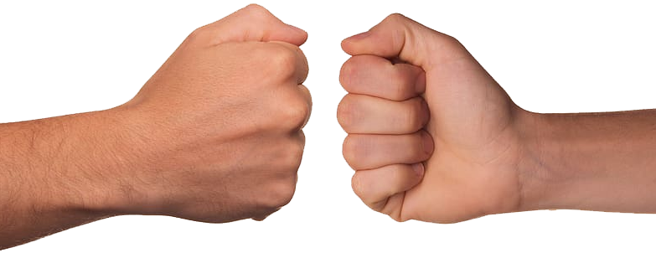
Through CONFLICT RESOLUTION
Notes:
Through CONFLICT RESOLUTION 5:1-19

Slide 4
We are living in a world of Conflict
COVID 19
Lockdown vs No Lockdown
Closed Schools vs Open Schools
Closed Churches vs Open Churches
Mask vs Unmask
Vaccine vs No Vaccine
Notes:
COVID 19
Lockdown vs No Lockdown – no sharper debate than in CA – “NO CHURCH” but Cassinos, Walmart, etc open
-- Likewise s

Slide 5
We are living in a world of Conflict
Political Conflict
Democrat vs Republican
Defund Police vs Defend Police
Socialism vs Democracy
Marxism vs Capitalism
Notes:
Some think that “social justice” is the answer.
I have searched the Bible and no where does the Bible separate “Social Justice” from regular “Justice.”
All justice has social impact. So there is no need to qualify it as “social justice.”
So what is “justice?” Justice is getting what you deserve.
Now charity is giving to need – and is not justice.

Slide 6
We are living in a world of Conflict
Social Conflict
Abortion vs Life .
Black Lives Matter vs All Lives Matter .
Violent Protest vs Peaceful Protests
Censorship vs Free Speech
Fear vs Courage
Notes:
Some think that “social justice” is the answer.
I have searched the Bible and no where does the Bible separate “Social Justice” from regular “Justice.”
All justice has social impact. So there is no need to qualify it as “social justice.”
So what is “justice?” Justice is getting what you deserve.
Now charity is giving to need – and is not justice.

Slide 7
We are living in a world of Conflict
Spiritual Conflict
Evil vs Good
Satan vs Christ
World vs Church
Bible Burning vs Bible Reading
On and On …
Notes:
on and on … censorship vs free speech; love vs hate,

Slide 8
We are living in a world of Conflict
Proverbs 28:5
Evil men do not understand justice, but those who seek the LORD understand it completely.
Micah 6:8
He has told you, O man, what is good; and what does the LORD require of you but to do justice, and to love kindness, and to walk humbly with your God?

Slide 9
We are living in a world of Conflict
Proverbs 28:5
Evil men do not understand justice, but those who seek the LORD understand it completely.
Micah 6:8
He has told you, O man, what is good; and what does the LORD require of you but to do justice, and to love kindness, and to walk humbly with your God?

Slide 10
We are living in a world of Conflict
Proverbs 28:5
Evil men do not understand justice, but those who seek the LORD understand it completely.
Micah 6:8
He has told you, O man, what is good; and what does the LORD require of you but to do justice, and to love kindness, and to walk humbly with your God?

Slide 11
We are living in a world of Conflict
Proverbs 28:5
Evil men do not understand justice, but those who seek the LORD understand it completely.
Micah 6:8
He has told you, O man, what is good; and what does the LORD require of you but to do justice, and to love kindness, and to walk humbly with your God?

Slide 12

Identify the Conflict 5:1-5
Notes:
https://www.needpix.com/photo/download/244133/magnifying-glass-calligraphy-larger-view-see-better-greater-sharper-readable-reading-aid-focus

Slide 13
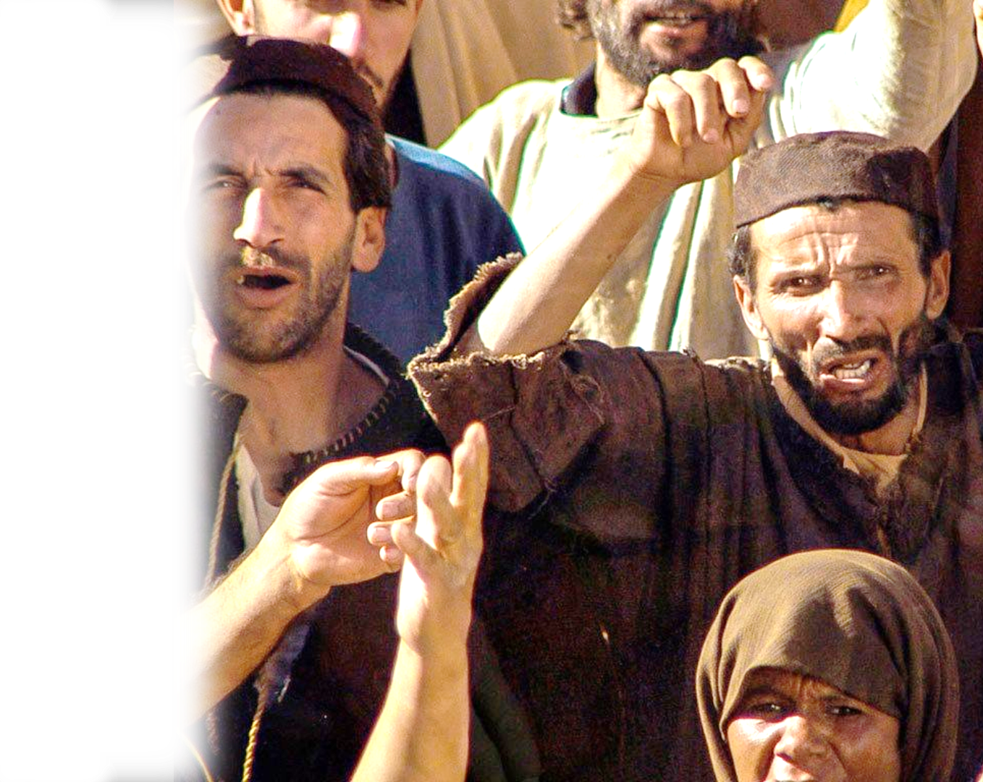
Vocal Conflict 5:1
¹ Now there arose a great outcry of the people and of their wives against their Jewish brothers.
Notes:
http://www.freebibleimages.org/photos/jesus-pilate/

Slide 14

Serious Conflict 5:2
² For there were those who said,
"With our sons and our daughters, we are many.
So let us get grain, that we may eat and keep alive."
Notes:
https://commons.wikimedia.org/wiki/File:Stop_Hunger_Now_Logo.png
Starvation … lives are at stake

Slide 15

Financial Conflict 5:3-4
³ There were also those who said, "We are mortgaging our fields, our vineyards, and our houses to get grain because of the famine." ⁴ And there were those who said, "We have borrowed money for the king's tax on our fields and our vineyards.
Notes:
https://newtheory.com/wp-content/uploads/2018/02/debt-collection.html
Second mortgages to buy a meal
Second mortgages to pay taxes …

Slide 16
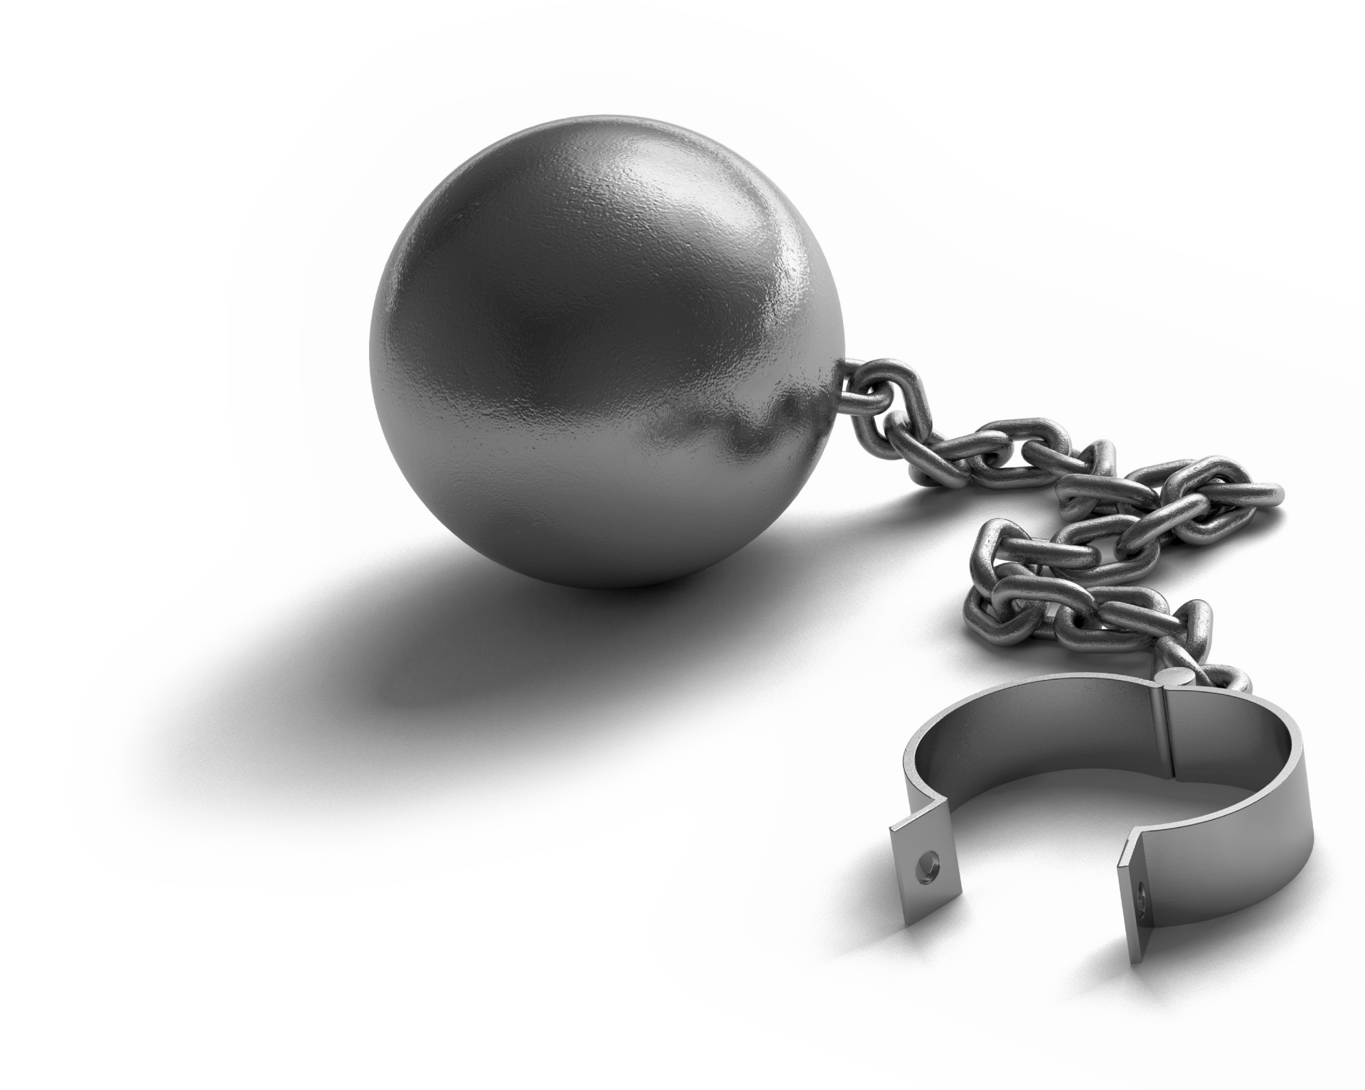
Immoral Conflict 5:2
⁵ Now our flesh is as the flesh of our brothers, our children are as their children. Yet we are forcing our sons and our daughters to be slaves, and some of our daughters have already been enslaved, but it is not in our power to help it, for other men have our fields and our vineyards."
Notes:
https://www.publicdomainpictures.net/en/view-image.php?image=231518&picture=ball-and-chain
Selling children into slavery because they have already lost their fields, crops, incomes …
Let’s face it, the biggest conflict right now is
Black lives matters and Antifa with the Police.
It started with Killing of George Floyd.
It has escalated in all out riots across the country.
So where do you stand on this?
Of course, everyone thought is was an outrage of JUSTICE—EVERYONE DID.
So how should you as a Christian respond? Just like Nehemiah …

Slide 17

Silence the Conflict 5:6-8
Notes:
https://www.goodfreephotos.com/vector-images/signal-of-silence-sign-vector-clipart.png.php
This is not censorship, or coercion, or force/violence … No this is through …

Slide 18
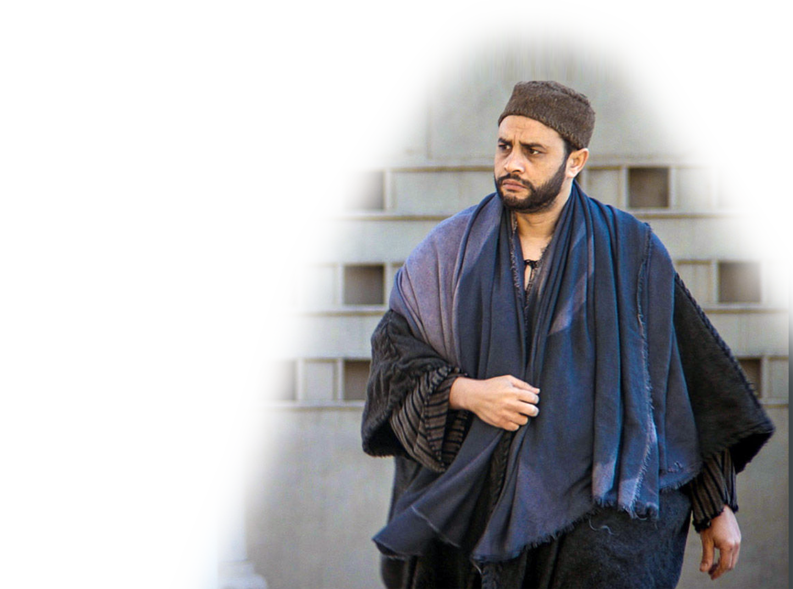
Silence with Anger 5:6
⁶ I was very angry when I heard their outcry and these words.
Notes:
I was angry … and I thought …
I need to protest, no I need to start a riot, then everyone will know I am mad.
If break into the market and loot of all the goods—then I can call it reparations.
If I tear down what we have repaired and burn the newly constructed gates then I will show Sanballot and Tobiah the Arabs and the Philistines just how angry I am.
If I defund the gate keepers—everyone will know not to mess with me.
That’s the way the evil thinks. Proverbs 28:5
Evil men do not understand justice, but those who seek the LORD understand it completely.
Not Nehemiah. He was angry and sinned not. Like Jesus …

Slide 19
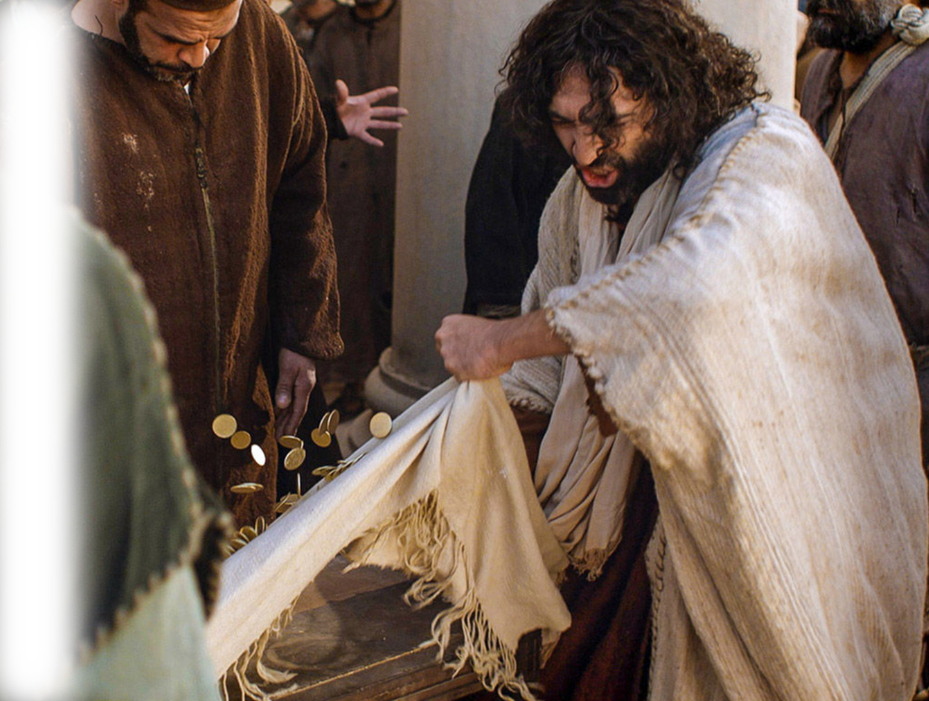
Silenced by Anger 5:6
"Take these things away;
do not make my Father's house a house of trade."
"Zeal for your house
will consume me."
(John 2:16, ,17 )
Notes:
Just as Jesus did … John 2
Zeal of the Lord has eaten me up …
Jesus took action – He threw out the money changers … drove out the animals.
This a focus on the problem—not an attack on people. He solved the problem. The Problem was they make the temple a store, a merchant money making machine, not a temple—a place of prayer. Solution, stop the selling.
That is a far cry from protestors destroying other people's property, burning down the temple, or killing those who you oppose and despise.
In fact, Jesus was angry internally, angry externally and took action, but is was Just, Merciful (as God in flesh he could have sent them to hell right then and there), and humbly.
This leads me to the next text– the apostle Paul. Said …
Ephesians
²⁶ Be angry and do not sin; do not let the sun go down on your anger,
²⁷ and give no opportunity to the devil.
(Eph 4:26-27 ESV)

Slide 20
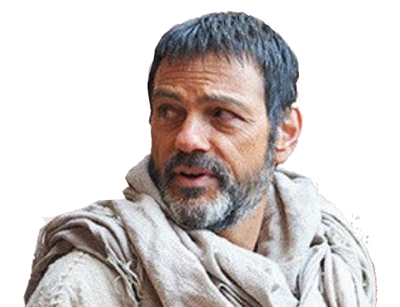
Silenced by Anger 5:6
Eph 4:26-27
²⁶ Be angry and do not sin; do not let the sun go down on your anger, ²⁷ and give no opportunity to the devil.
Notes:
Through CONFLICT RESOLUTION 5:1-19
Ephesians
²⁶ Be angry and do not sin; do not let the sun go down on your anger,
²⁷ and give no opportunity to the devil.
(Eph 4:26-27 ESV)
Jesus and Nehemiah were angry with righteous indignation—AND DID NOT SIN!
In fact, Jesus was sinless. That’s what the Apostle requires of us too!
Let’s return to angry Nehemiah, and how he handled this conflict.

Slide 21
Silence within Himself 5:7
⁷ I took counsel with myself,
Notes:
https://pixabay.com/photos/guilty-finger-suggest-3096217/
He did not act impulsively out of a fit of rage. He cooled down so he could focus on the problem.

Slide 22


Silence with Charges 5:7
⁷ I took counsel with myself, and I brought charges against the nobles and the officials.
Notes:
https://pixabay.com/photos/guilty-finger-suggest-3096217/
He did the just thing, he brought charges against them. This is taking legal action. Making a logical verbal case regarding what was wrong before a judge (those who he was accusing—so they could see the error of their way).
This was a great injustice.
"If you lend money to any of my people with you who is poor, you shall not be like a moneylender to him, and you shall not exact interest from him. (Exo 22:25 ESV)
³⁵ "If your brother becomes poor and cannot maintain himself with you, you shall support him as though he were a stranger and a sojourner, and he shall live with you.
³⁶ Take no interest from him or profit, but fear your God, that your brother may live beside you.
³⁷ You shall not lend him your money at interest, nor give him your food for profit.
(Lev 25:35-37 ESV)

Slide 23
Silence with Charges 5:7
I said to them, "You are exacting interest, each from his brother.“
"If you lend money to any of my people with you who is poor, you shall not be like a moneylender to him, and you shall not exact interest from him. Exodus 22:25
Notes:
https://pixabay.com/photos/guilty-finger-suggest-3096217/
This was a great injustice.
"If you lend money to any of my people with you who is poor, you shall not be like a moneylender to him, and you shall not exact interest from him. (Exo 22:25 ESV)
³⁵ "If your brother becomes poor and cannot maintain himself with you, you shall support him as though he were a stranger and a sojourner, and he shall live with you.
³⁶ Take no interest from him or profit, but fear your God, that your brother may live beside you.
³⁷ You shall not lend him your money at interest, nor give him your food for profit.
(Lev 25:35-37 ESV)

Slide 24
Silence with Charges 5:7
I said to them, "You are exacting interest, each from his brother.“
³⁶ Take no interest from him or profit, but fear your God, that your brother may live beside you. ³⁷ You shall not lend him your money at interest, nor give him your food for profit. Lev 25:35-37
Notes:
https://pixabay.com/photos/guilty-finger-suggest-3096217/
This was a great injustice.
"If you lend money to any of my people with you who is poor, you shall not be like a moneylender to him, and you shall not exact interest from him. (Exo 22:25 ESV)
³⁵ "If your brother becomes poor and cannot maintain himself with you, you shall support him as though he were a stranger and a sojourner, and he shall live with you.
³⁶ Take no interest from him or profit, but fear your God, that your brother may live beside you.
³⁷ You shall not lend him your money at interest, nor give him your food for profit.
(Lev 25:35-37 ESV)

Slide 25
Silence with Charges 5:7
And I held a great assembly
against them ⁸ and said to them, …
Notes:
https://pixabay.com/photos/guilty-finger-suggest-3096217/
This was a great injustice.
"If you lend money to any of my people with you who is poor, you shall not be like a moneylender to him, and you shall not exact interest from him. (Exo 22:25 ESV)
³⁵ "If your brother becomes poor and cannot maintain himself with you, you shall support him as though he were a stranger and a sojourner, and he shall live with you.
³⁶ Take no interest from him or profit, but fear your God, that your brother may live beside you.
³⁷ You shall not lend him your money at interest, nor give him your food for profit.
(Lev 25:35-37 ESV)
¹⁹ "You shall not charge interest on loans to your brother, interest on money, interest on food, interest on anything that is lent for interest.
²⁰ You may charge a foreigner interest, but you may not charge your brother interest, that the LORD your God may bless you in all that you undertake in the land that you are entering to take possession of it.
(Deu 23:19-20 ESV)
Why is this wrong? Because God says it is wrong.

Slide 26
Silence with Shame 5:8
"We, as far as we are able,
have bought back our Jew-
ish brothers who have
been sold to the nations,
but you even sell your
brothers that they may
be sold to us!" They were
silent and could not find a word to say.
Notes:
Here’s the point: Stop the violence so you can fix the problem.

Slide 27

Correct the Conflict 5:9-13
Notes:
Through CONFLICT RESOLUTION 5:1-19

Slide 28
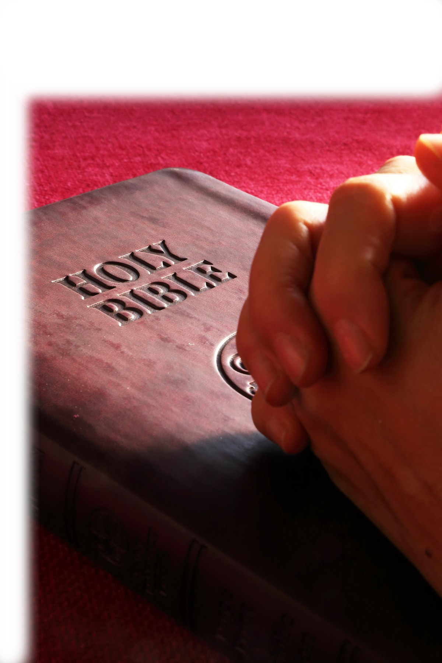
Correct by Godly Fear 5:9
⁹ So I said, "The thing that you are doing is not good. Ought you not to walk in the fear of our God to prevent the taunts of the nations our enemies?
Notes:
Through CONFLICT RESOLUTION 5:1-19
^{ESV} Proverbs 28:5 Evil men do not understand justice, but those who seek the LORD understand it completely. (Pro 28:5 ESV)
So they protest, riot, and call their violence ‘Justice.” They don know even know what justice is!
Our duty is to do good “and … to do justice, and to love kindness, and to walk humbly with your God? (Mic 6:8 ESV)

Slide 29

Correct by Stopping 5:10
¹⁰ Moreover, I and my brothers and my servants are lending them money and grain. Let us abandon this exacting of interest.
Notes:
Through CONFLICT RESOLUTION 5:1-19
He did what was kind in solving the problem.
Our duty is to do good “and … to do justice, and to love kindness, and to walk humbly with your God? (Mic 6:8 ESV)

Slide 30
Correct by Stopping 5:10
¹⁰ Moreover, I and my brothers and my servants are lending them money and grain. Let us abandon this exacting of interest.
Notes:
Through CONFLICT RESOLUTION 5:1-19
He called for the end of the evil practiced.
Our duty is to do good “and … to do justice, and to love kindness, and to walk humbly with your God? (Mic 6:8 ESV)

Slide 31
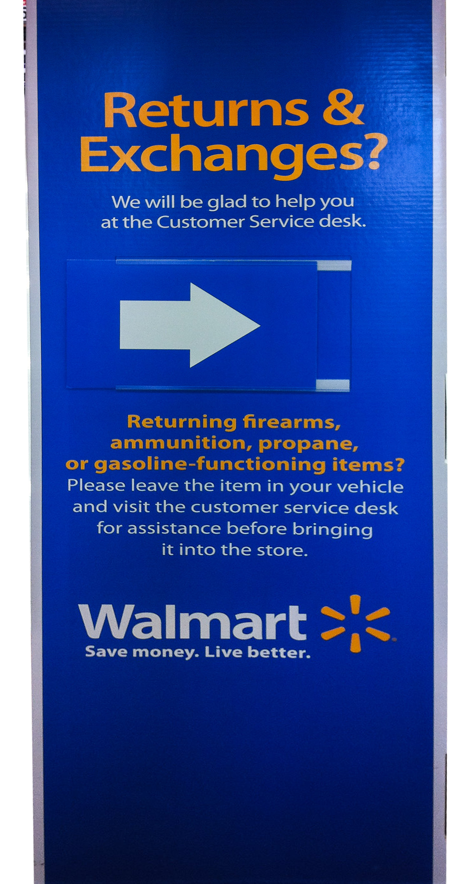
Correct by Returning 5:9
¹¹ Return to them this very day their fields, their vineyards, their olive orchards, and their houses, and the percentage of money, grain, wine, and oil that you have been exacting from them."
Notes:
https://www.flickr.com/photos/vauvau/11855382986
Reparations – imposed on the guilty not their children – but those who did it.
Reparations are same generation:
(Deuteronomy 24:16) - "Fathers shall not be put to death for their sons, nor shall sons be put to death for their fathers; everyone shall be put to death for his own sin."
(Ezekiel 18:20)--"The person who sins will die. The son will not bear the punishment for the father’s iniquity, nor will the father bear the punishment for the son’s iniquity; the righteousness of the righteous will be upon himself, and the wickedness of the wicked will be upon himself."

Slide 32
Correct by Returning 5:9
¹¹ Return to them this very day their fields, their vineyards, their olive orchards, and their houses, and the percentage of money, grain, wine, and oil that you have been exacting from them."
"Fathers shall not be put to death for their sons, nor shall sons be put to death for their fathers; everyone shall be put to death for his own sin.“ Dt 24:16
Notes:
https://www.flickr.com/photos/vauvau/11855382986
Reparations – imposed on the guilty not their children – but those who did it.
Reparations are same generation:
(Deuteronomy 24:16) - "Fathers shall not be put to death for their sons, nor shall sons be put to death for their fathers; everyone shall be put to death for his own sin."
(Ezekiel 18:20)--"The person who sins will die. The son will not bear the punishment for the father’s iniquity, nor will the father bear the punishment for the son’s iniquity; the righteousness of the righteous will be upon himself, and the wickedness of the wicked will be upon himself."

Slide 33
Correct by Returning 5:9
¹¹ Return to them this very day their fields, their vineyards, their olive orchards, and their houses, and the percentage of money, grain, wine, and oil that you have been exacting from them."
"The person who sins will die. The son will not bear the punishment for the father’s iniquity, nor will the father bear the punishment for the son’s iniquity;
Ezekiel 18:20
Notes:
https://www.flickr.com/photos/vauvau/11855382986
Reparations – imposed on the guilty not their children – but those who did it.
Reparations are same generation:
(Deuteronomy 24:16) - "Fathers shall not be put to death for their sons, nor shall sons be put to death for their fathers; everyone shall be put to death for his own sin."
(Ezekiel 18:20)--"The person who sins will die. The son will not bear the punishment for the father’s iniquity, nor will the father bear the punishment for the son’s iniquity; the righteousness of the righteous will be upon himself, and the wickedness of the wicked will be upon himself."

Slide 34
Correct by Returning 5:9
¹² Then they said,
"We will restore these and require nothing from them. We will do as you say."
And I called the priests and made them swear to do as they had promised.
Notes:
Restoration!
They voluntarily pledged to restore what they had taken.
This is a spiritual victory, this is the beginning of a spiritual revival in the land.

Slide 35
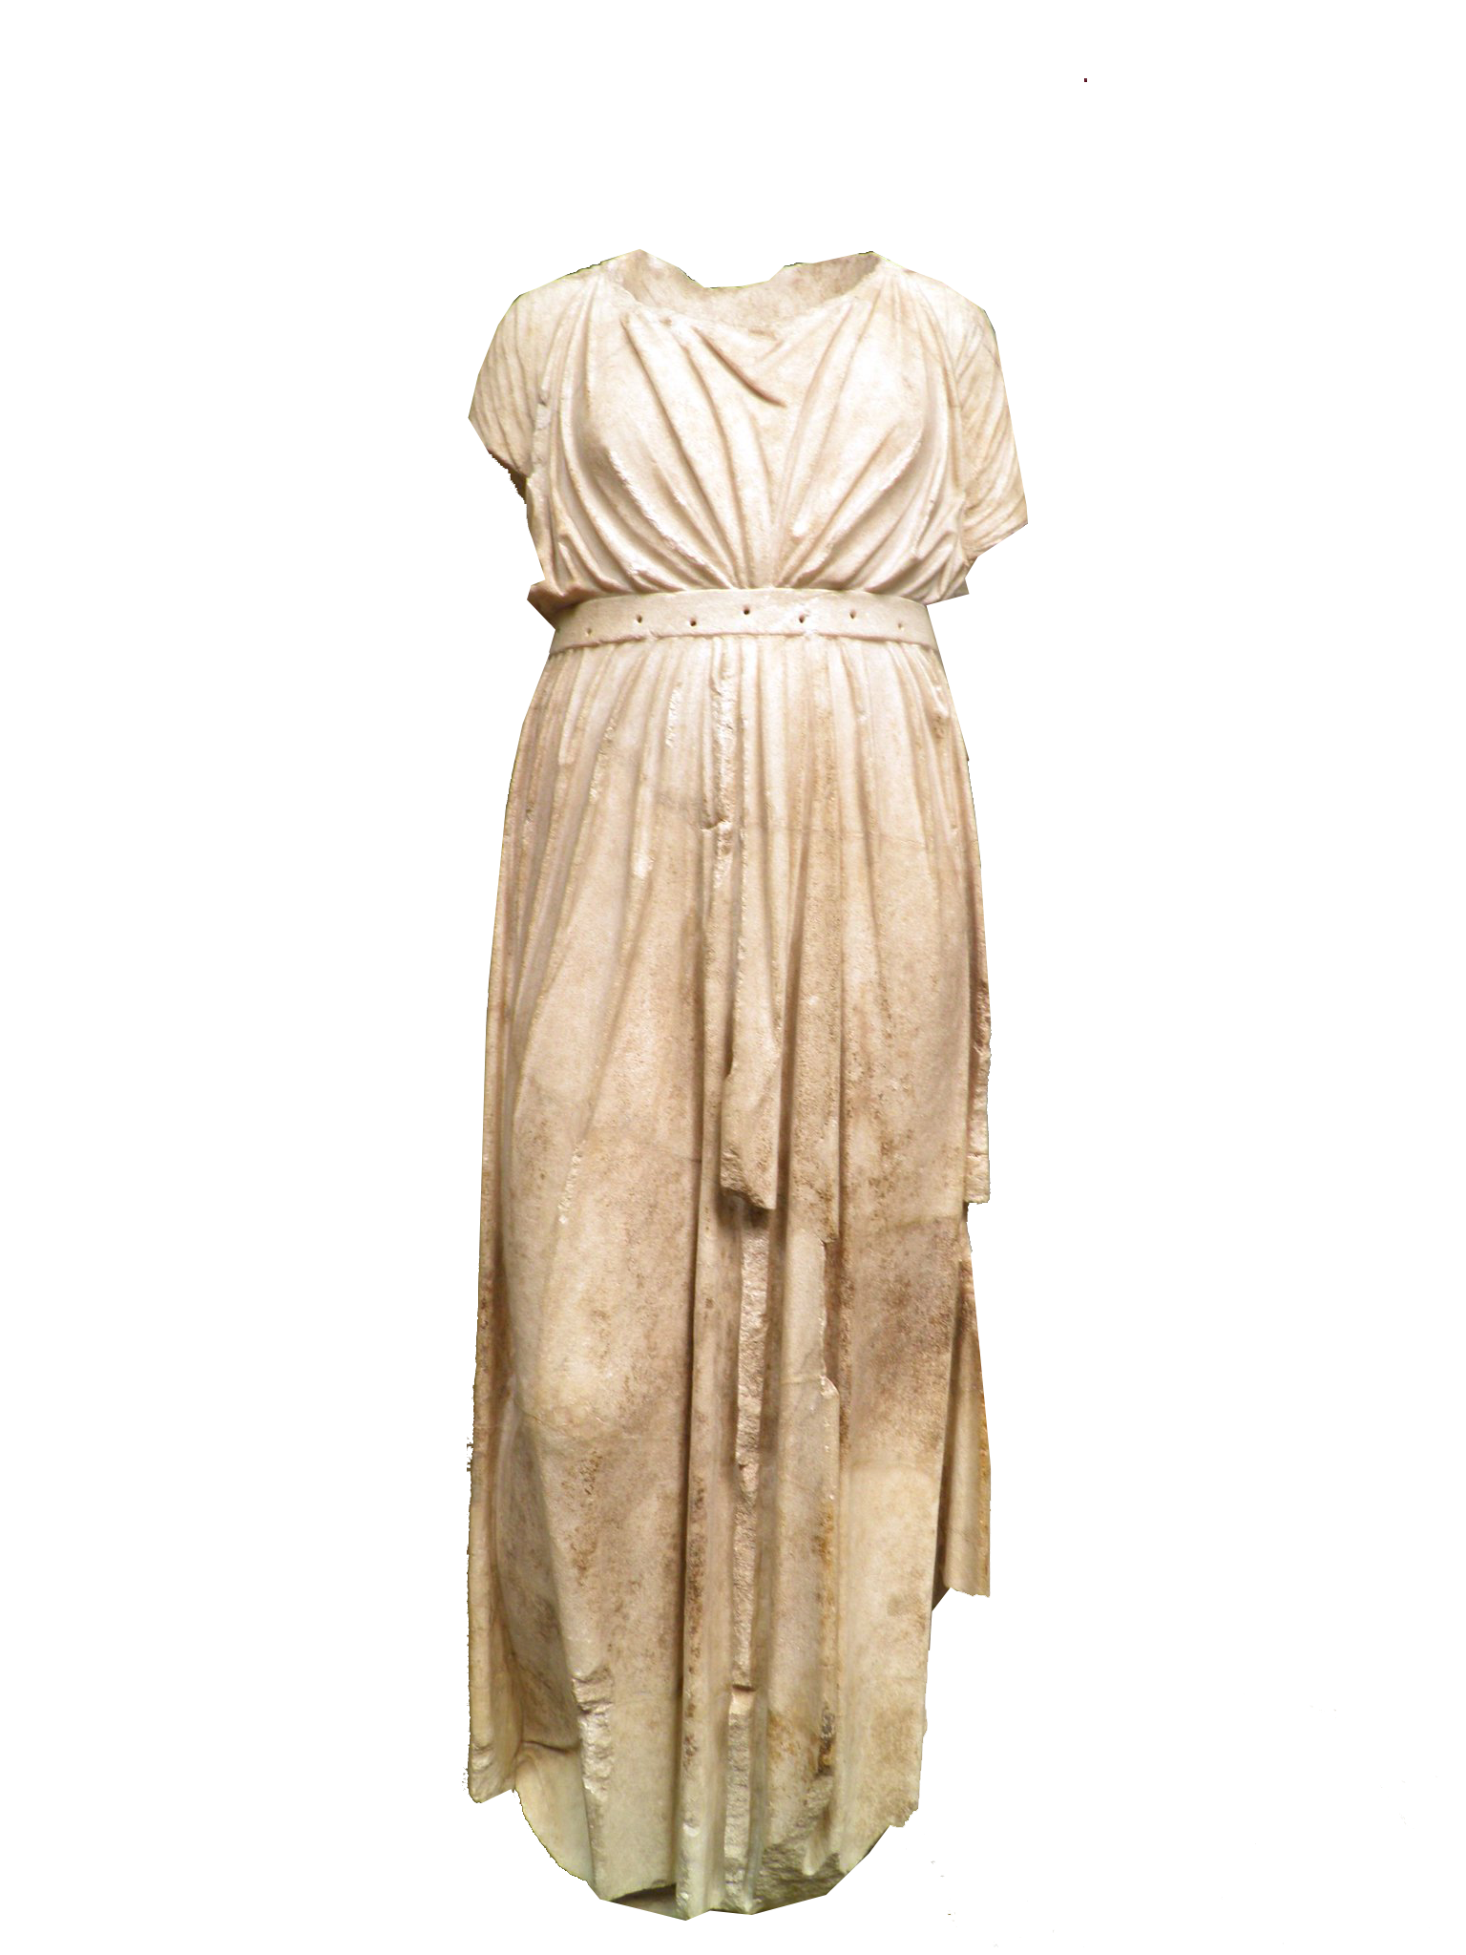
Correct by Threatening 5:9
¹³ I also shook out the fold of my garment and said,
"So may God shake out every man from his house and from his labor who does not keep this promise. So may he be shaken out and emptied."
Notes:
https://www.flickr.com/photos/carolemage/5796740338
He knows it is easy to say “We’ll return it” but not do it.
So he invokes a curse on those who lie about restoration.

Slide 36
All the People Said “Amen” 5:13
¹³ .… And all the assembly
said "Amen" and praised
the LORD.
AMEN
Notes:
Through CONFLICT RESOLUTION 5:1-19
They DID IT!

Slide 37
All the People Said “Amen” 5:13
¹³ .… And all the assembly
said "Amen" and praised
the LORD.
And the people did as they had promised.
AMEN
Notes:
Through CONFLICT RESOLUTION 5:1-19
They DID IT!

Slide 38

Solve the Conflict 5:14-19
Notes:
https://p0.pxfuel.com/preview/908/586/494/metaphor-tug-rope-competition.jpg

Slide 39
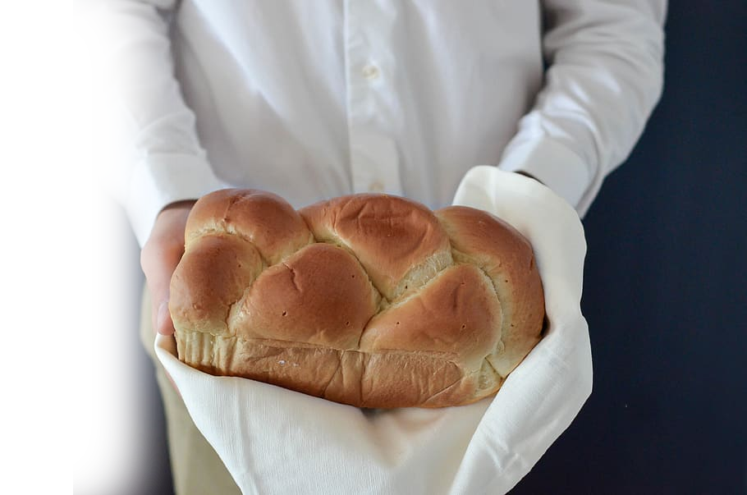
Solve Conflict by Example 5:14
¹⁴ Moreover, from the time that
I was appointed to be their governor in the land of Judah, from the twentieth year to the thirty-second year of Artaxerxes the king, twelve years, neither I nor my brothers ate the food allowance of the governor.
Notes:
https://www.pxfuel.com/en/free-photo-xnuzs
He set the example
Oh that those who want to spend our tax dollars on frivolous things would do so out of their own resources first.
The Leader is to be an example—Why are our leaders not in Social Security and ponzi scheme ours?

Slide 40
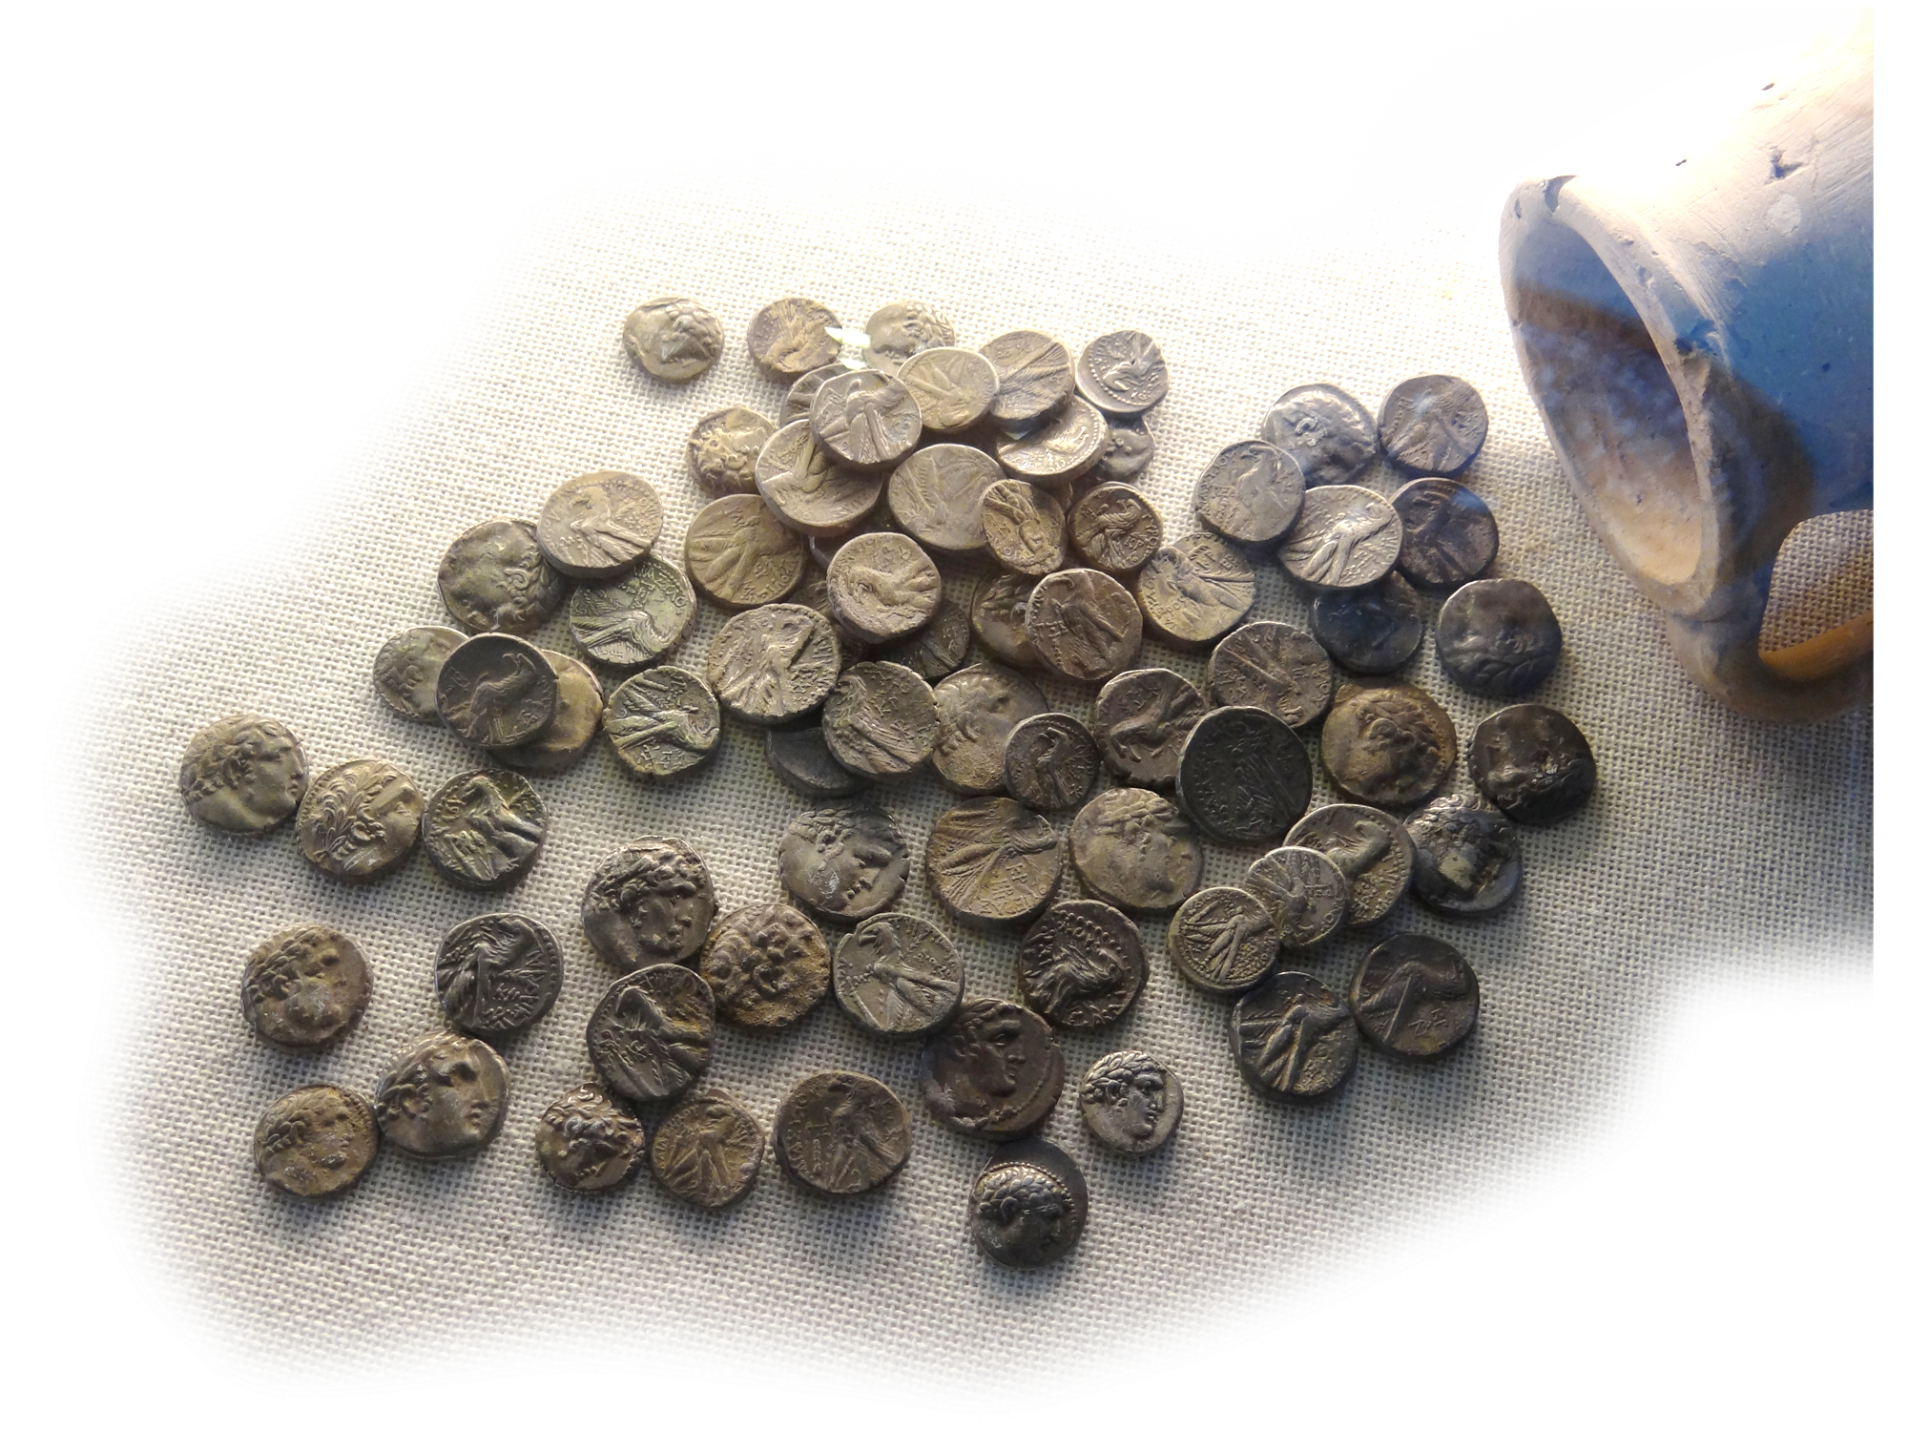
Solve Conflict by Example 5:15
¹⁵ The former governors who were before me laid heavy burdens on the people and took from them for their daily
ration forty shekels of silver.
Even their servants lorded
it over the people. But
I did not do so, because
of the fear of God.
Notes:
This is the problem of governments. Those who govern give themselves fat checks by taking from the people.

Slide 41
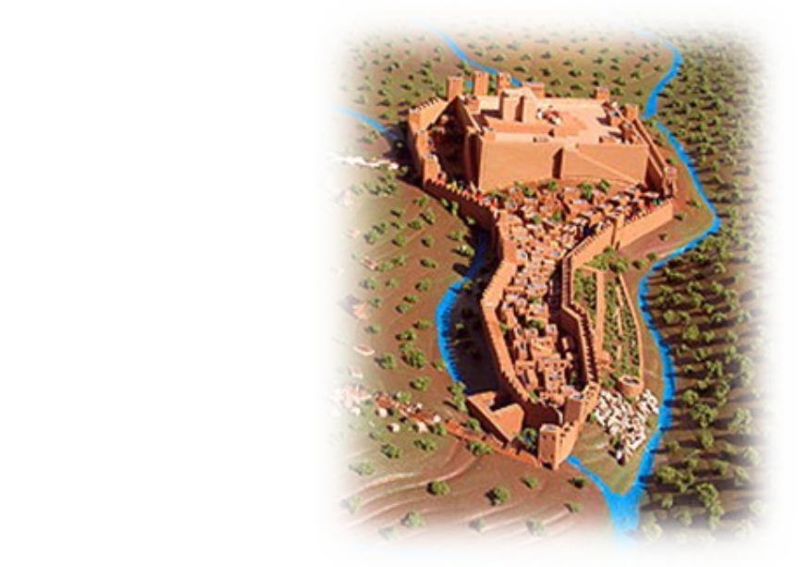
Solve Conflict by Doing 5:16
¹⁶ I also persevered in the work on this wall, and we acquired no land, and all my servants were gathered there for the work.
Notes:
Nehemiah did not get rich off of his position. Very unlike our politicians today.
WE need Godly leaders.

Slide 42
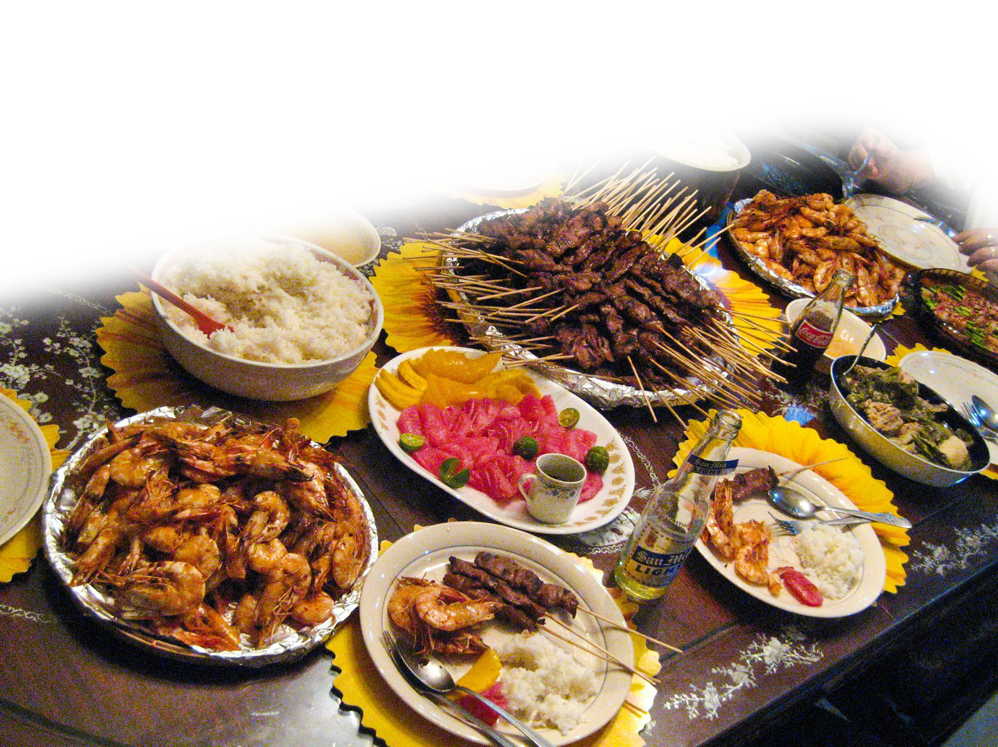
Solve Conflict by Generosity 5:17
¹⁷ Moreover, there were at my table 150 men, Jews and officials, besides those who came to us from the nations that were around us.
Notes:
Through CONFLICT RESOLUTION 5:1-19
Even

Slide 43
Solve Conflict by Generosity 5:18
¹⁸ Now what was prepared at my expense for each day was one ox and six choice sheep and birds, and every ten days all kinds of wine in abundance. Yet for all this I did not demand the food allowance of the governor, because the service was too heavy on this people.
Notes:
Through CONFLICT RESOLUTION 5:1-19
He did not demand an expense account

Slide 44

Solve Conflict by Praying 5:19
¹⁹ Remember for my good,
O my God, all that I have
done for this people.
He has told you, O man, what is good; and what does the LORD require of you but to do justice, and to love kindness, and to walk humbly with your God? (Micah 6:8)
Notes:
How much humbler could he get.
Nehemiah lived it and solved it.
It is a good thing our salvation is not based on our good works.
Our salvation is based on God’s grace. Undeserved favor.
However, our rewards are based on our good works.
Pity the man who will stand before God and has only evil works to his credit.
Pity even more the man who has no salvation nor good works.

Slide 45
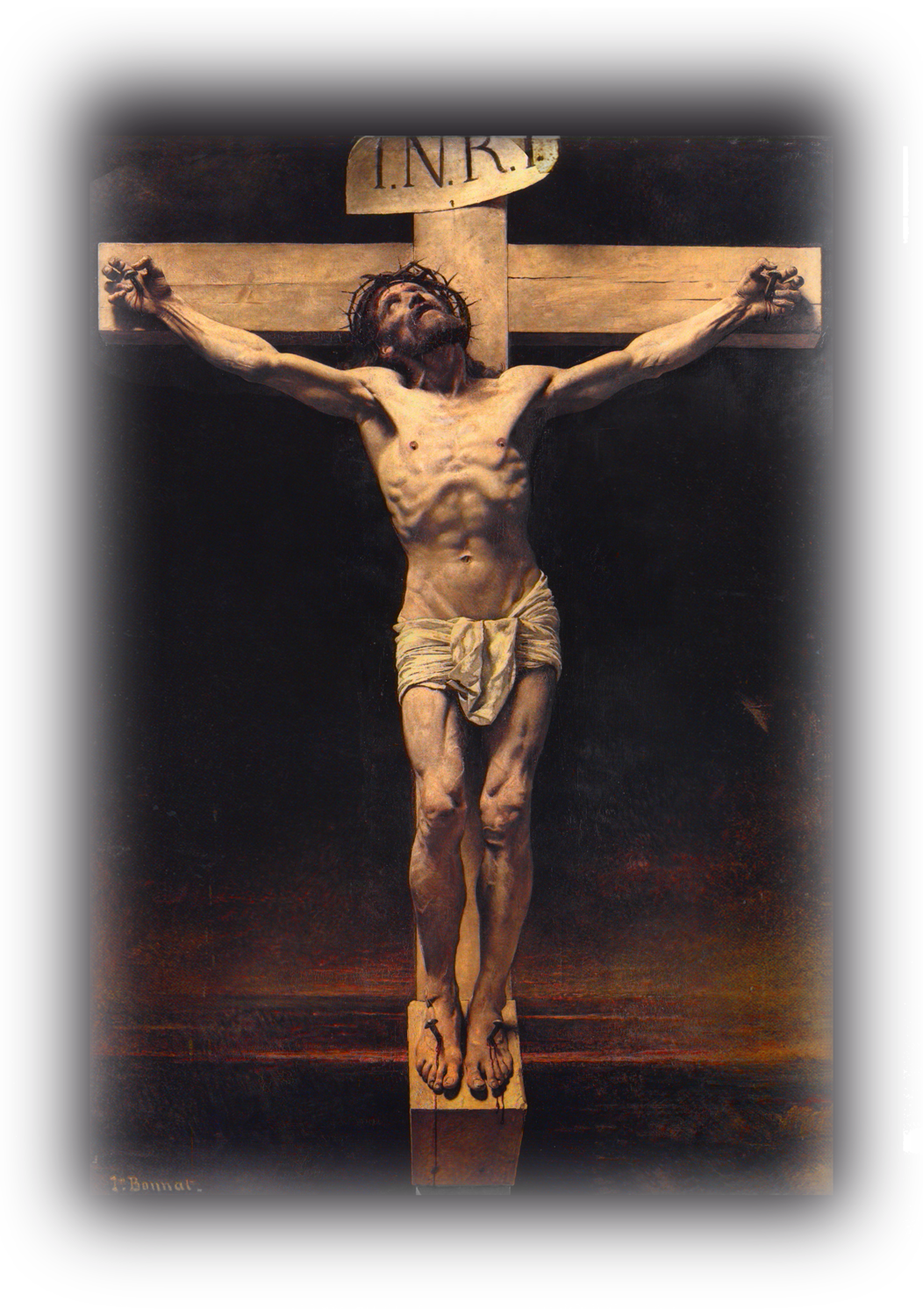
The Greatest Conflict Resolver:
2 Cor 5: 18 All this is from God, who through Christ
reconciled us to himself
and gave us the ministry
of reconciliation;

Slide 46
The Greatest Conflict Resolver:
Identified the Conflict = Sin
Silenced the Conflict = By taking it from us
Corrected the Conflict = Changed us “in Him”
Solved the Conflict = Righteousness of God
²¹ For our sake he made him to be sin who knew no sin, so that in him we might become the righteousness of God. (2Co 5:21)

Slide 47
The Greatest Conflict Resolver:
Identified the Conflict = Sin
Silenced the Conflict = By making Christ to be sin
Corrected the Conflict = Changed us “in Him”
Solved the Conflict = Righteousness of God
²¹ For our sake he made him to be sin who knew no sin, so that in him we might become the righteousness of God. (2Co 5:21)

Slide 48
The Greatest Conflict Resolver:
Identified the Conflict = Sin
Silenced the Conflict = By taking it from us
Corrected the Conflict = Placed us “in Him”
Solved the Conflict = Righteousness of God
²¹ For our sake he made him to be sin who knew no sin, so that in him we might become the righteousness of God. (2Co 5:21)

Slide 49
The Greatest Conflict Resolver:
Identified the Conflict = Sin
Silenced the Conflict = By taking it from us
Corrected the Conflict = Placed us “in Him”
Solved the Conflict = Righteousness of God
²¹ For our sake he made him to be sin who knew no sin, so that in him we might become the righteousness of God. (2Co 5:21)

Slide 50
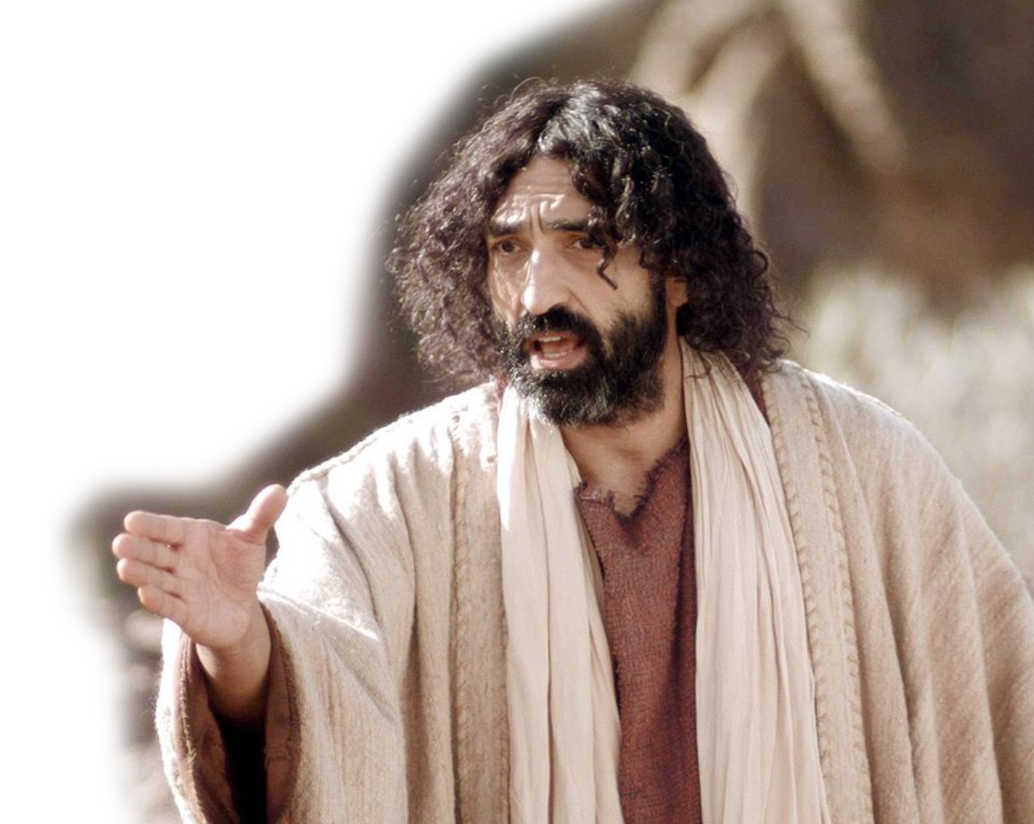
WE must do as He has done!
Blessed are the
peacemakers, for
they will be called
sons of God. Mat 5:9

Slide 51
How?
Proverbs 28:5
Evil men do not understand justice, but those who seek the LORD understand it completely.
Micah 6:8
He has told you, O man, what is good; and what does the LORD require of you but to do justice, and to love kindness, and to walk humbly with your God?

Slide 52
Let’s Pray!

