Slide 1
Picking up the
Pieces in a broken
WORLD
A Study of Nehemiah
Notes:
https://upload.wikimedia.org/wikipedia/commons/7/74/Wikipedia-logo-v2-pieces.svg
https://www.freepik.com/free-photo/jigsaw-puzzle-with-missing-piece-missing-puzzle-pieces_5469650.htm
Copyright © 2006−2021. All rights reserved. Bible Point is a registered trademark of Dennis Henderson. All other trademarks acknowledged.
Bible Point contains graphics from Bible Point artists. These illustrations belong to Bible Point and the respective artists. You may use the designs and illustrations for graphical illustration of lessons free and without special permission, provided they are not used in any way that maligns the Christian faith. Furthermore, republication or production of any illustration by any other graphic service whether it be in book, in a machine-readable form, or in any other design resource is strictly prohibited. Furthermore, they cannot be duplicated or resold as any other form of publishing, clip art, or graphic resource.
So What does it mean? (A simple translations of the legal jargon)
So, if you don’t own the presentation(s), graphic(s), and text(s) how can you legally use them? The purchase of the license allows you to use all the images in the product. However, the actual ownership and copyright of the presentation(s), graphic(s), and text(s) remain the property of Bible Point and its licensors. If you had plans on using this product in your “for sale” work—think again!
License Agreement
Article 1: License Grant
All the graphics and text in Bible Point presentations (excluding quotes from the Bible and stated sources) are the intellectual and real property of Bible Point and its licensors, and is protected by law, including United States copyright laws and international treaties. Bible Point grants to you a license:
1. To use the presentation in a single church, single school, or single office of a Christian organization.
2. To make a single archival back-up copy of the program.
3. To modify the presentation(s) and merge with other presentations in a single church, school, or Christian organization.
4. To transfer to another party if that party agrees to accept the terms and conditions of this agreement, and you do not retain any copies of the presentation, whether printed, machine readable, modified, or merged form.
Article 2: Terms
This license is effective until terminated. You may terminate the license at any time by destroying the presentation(s), graphic(s), or text(s) together with all copies, modifications and merged portions in any form. Bible Point may terminate your license if you fail to comply with this Agreement. You agree, upon such termination, for any reason, to destroy the presentation(s), graphics, and text(s) with all copies, modifications, and merged portions in any form.
Article 3: Disclaimers
1. Bible Point presentations, graphics, and texts are licensed to you As Is. You, the consumer, bear the entire risk relating to the quality and performance of the presentation(s), graphic(s), or text(s). In no event will Bible Point be liable for damages resulting from any defect.
2. Thirty-day limited warrantee on disks. Bible Point warrants the disks to be free of defects in material and workmanship under normal use for 30 days after purchase. During the 30-day period you may return a defective presentation, graphic, or text with proof of purchase and it will be replaced without charge, unless the presentation is damaged by misuse.
Article 4: General
1. You may not sub-license, assign, or transfer the license of the presentation(s), graphic(s), or text(s) except as provided by this Agreement.
2. This Agreement will be governed by the laws of the State of Michigan.
So What does it mean? (A simple translations of the legal jargon)
May I let someone borrow or copy my licensed Bible Point presentation (even after I modified it)? As long as it is within your local church, or single school, or the immediate office of a Christian organization you may. Otherwise, please refer the person interested in borrowing to: http://www.biblepoint.com or E-mail: dennis@DrDH.net with any related questions.

Slide 2
Picking up the
Pieces
Through
OPPOSTITION
Chapter 4
Notes:
https://upload.wikimedia.org/wikipedia/commons/7/74/Wikipedia-logo-v2-pieces.svg
https://www.freepik.com/free-photo/jigsaw-puzzle-with-missing-piece-missing-puzzle-pieces_5469650.htm
He wasn’t a politician, He just wanted to make his nation great again.
His first attempt at politics landed him as the leader of his nation.
With that came unbelievable opposition from those of the opposite party and within his own party too.
There was plenty of fake news about him, conspiracy theories, and outright threats against him.
You probably think I’m talking about President Trump—I’m not. I’m talking about Nehemiah.
My topic today is Picking-up the pieces in a broken world—that will mean opposition.
Lets review for a moment to catch our guests up in the situation Nehemiah finds himself.
Chap 1 – Nehemiah gets the news of the terrible condition of Jerusalem and he petition God for help
Chap 2a – Nehemiah sad condition is noticed by the king, but he is prepared to respond and the king grants his request
Chap 2b – Nehemiah arrives in Jerusalem and before announcing his plan does an inspection to see if conditions are really as bad as he was told—they were
Chap 3 – Nehemiah began construction with a plan and a people
Chap 4 – Nehemiah now faces opposition to the work he is endeavoring.
Like our president, before his first day on the job there were adversaries who opposed him and were conspiring for his downfall.

Slide 3

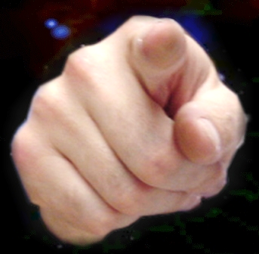
Whenever you begin to
“Pick Up the Pieces”
Someone will OPPOSE you!

Slide 4
OPPOSITION Comes in Many Ways
RIDICULING
PLOTING
DISCOURAGING
ENEMIES
and more …
Notes:
Imagine you are the leader of a great nation that has been through a terrible national debilitating crisis occurred and
You every decisions you make people of the opposing party do not like so they ridicule you and declare you are responsible for the mess you are now in.
Suppose they are plotting to take you down by making up fake news and are unrelenting in attacking you
Now lets suppose it continues for days on end, so most people get discouraged,
Let’s face it, by definition an enemy makes it their full-time occupation to make your life miserable – they are your enemies …
No I am not talking about our president—I’m talking about Nehemiah. There are many parallels … but today I want to learn some principles form Nehemiah on how to pick up the pieces in the midst of opposition.

Slide 5
How to handle RIDICULE 4:1-6
Notes:
Let's begin with how to handle RIDICULE…
Because this is one of the tools of your opponents to hinder you.

Slide 6
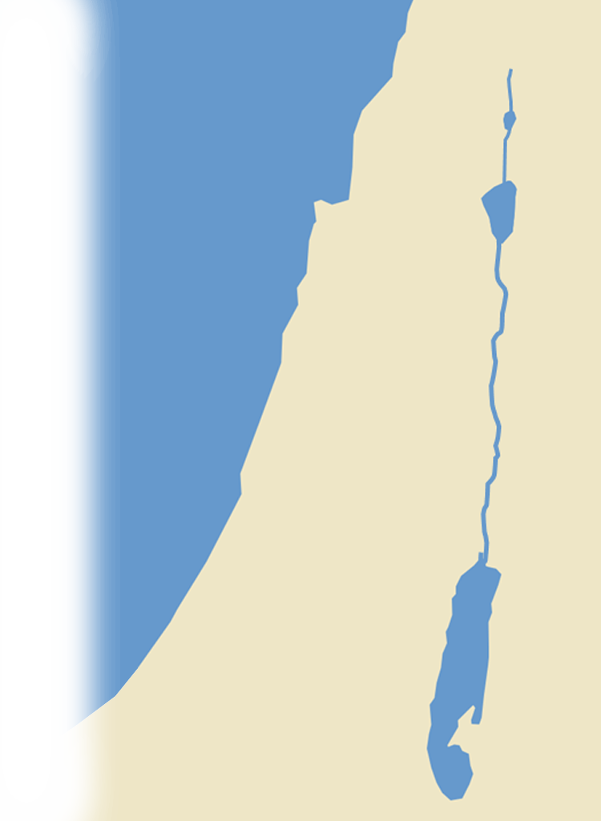
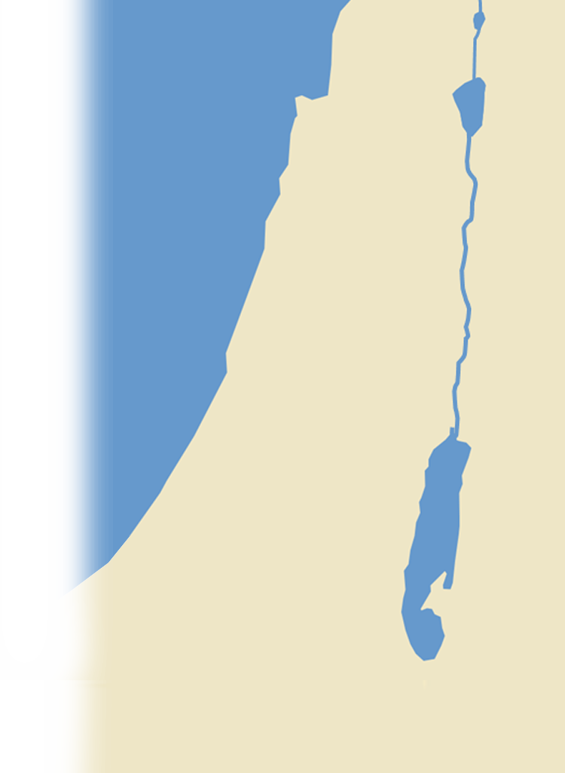




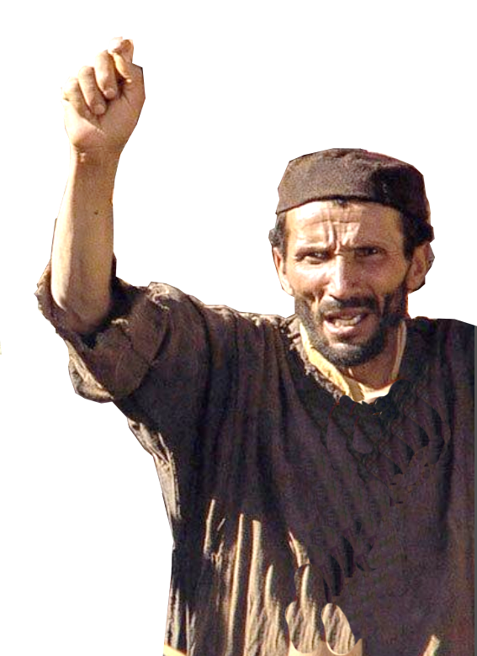
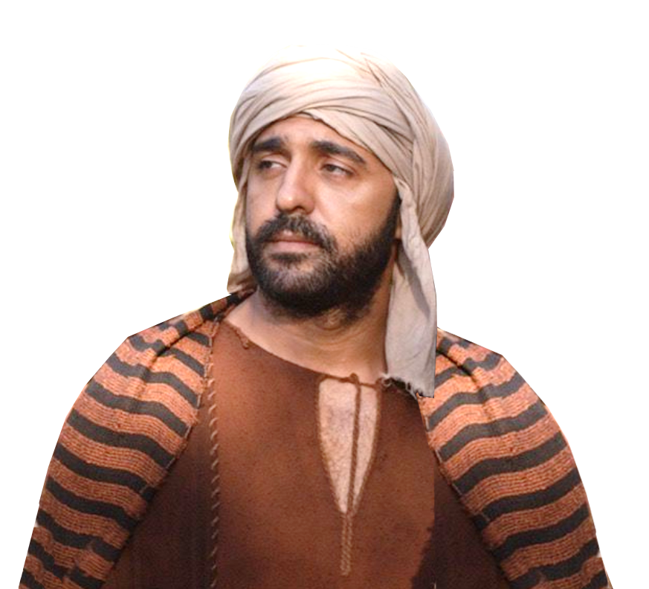
The Ridiculers 4:1-3
¹ Now when Sanballat heard that we were building the wall, he was angry and greatly enraged, and he jeered at the Jews. ² And he said in the presence of his brothers and of the army of Samaria, ….
³ Tobiah the Ammonite was
beside him, ….
SAMARIA
HORAN
AMMON
JUDAH
Notes:
So let’s identify the ridiculers in Nehemiah’s day …

Slide 7
The Ridiculing 4:2-3
¹ Now when Sanballat heard that we were building the wall, he was angry and greatly enraged, and he jeered at the Jews.
Notes:
In 2:10 it displeased him (literally “eviled” him) here Sanballat gets extremely angry and enraged.

Slide 8


The Ridiculing 4:2-3
Their
Character
² And he said in the presence of his brothers and of the army of Samaria, "What are these feeble Jews doing? Will they restore it for themselves? Will they sacrifice? Will they finish up in a day? Will they revive the stones out of the heaps of rubbish, and burned ones at that?"
Notes:
https://upload.wikimedia.org/wikipedia/commons/1/18/Auschwitz_outerwear_distinguish_yellow_Star_of_David.jpg
Feeble? Oh really, they appear very industrious. All of them uniting together to rebuild the walls of Jerusalem.
Students – Someone may say, “Who do you think you are to be a college student? You don’t have what it takes!

Slide 9
The Ridiculing 4:2-3
Their
Ability
² And he said in the presence of his brothers and of the army of Samaria, "What are these feeble Jews doing? Will they restore it for themselves? Will they sacrifice? Will they finish up in a day? Will they revive the stones out of the heaps of rubbish, and burned ones at that?"
YOU
CAN’T!
Notes:
Come on … they are not mason and carpenters …
NO they are
Priests,
goldsmiths,
perfumers,
Rulers,
daughters,
Levites,
Servants,
Gate keepers,
Merchants

Slide 10

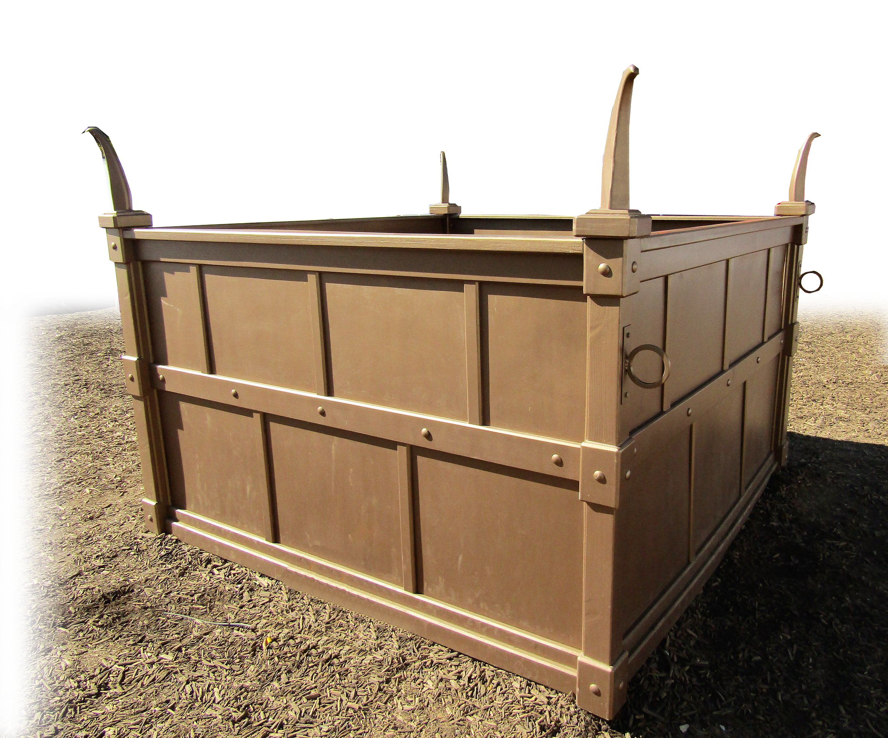
The Ridiculing 4:2-3
Their
Faith
² And he said in the presence of his brothers and of the army of Samaria, "What are these feeble Jews doing? Will they restore it for themselves? Will they sacrifice? Will they finish up in a day? Will they revive the stones out of the heaps of rubbish, and burned ones at that?"
Notes:
Ridiculing their worship, like how did your worship deliver you from the Babylonians who destroyed you. It didn’t work then, How will it work now?
Students, believe me they will ridicule your faith. It is nothing new. It happened in Nehemiah’s day in the 5th century before Christ, it happened in Jesus’s day (if you are the Christ come down from the cross), it happened to our president for holding a Bible upside-down, and it will happen to you too.

Slide 11
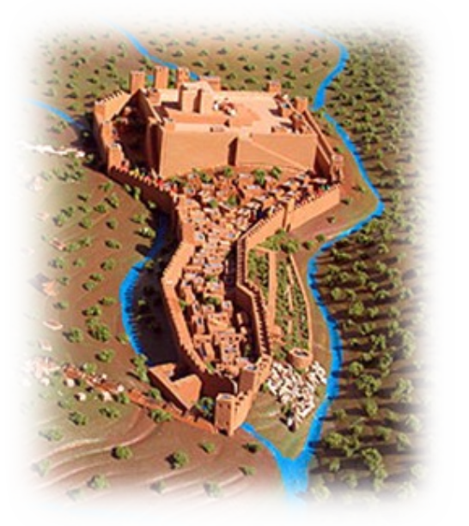
The Ridiculing 4:2-3
Their
Goal
² And he said in the presence of his brothers and of the army of Samaria, "What are these feeble Jews doing? Will they restore it for themselves? Will they sacrifice? Will they finish up in a day? Will they revive the stones out of the heaps of rubbish, and burned ones at that?"
Notes:
You won’t finish. You will quit. Your goal is unreasonable.

Slide 12
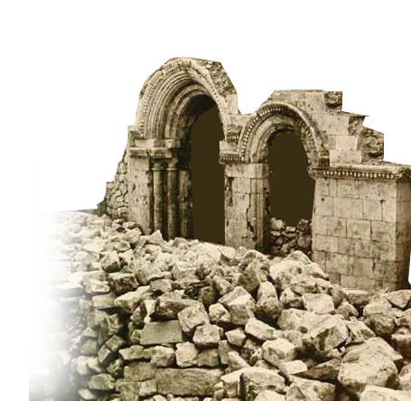
The Ridiculing 4:2-3
Their
Supplies
² And he said in the presence of his brothers and of the army of Samaria, "What are these feeble Jews doing? Will they restore it for themselves? Will they sacrifice? Will they finish up in a day? Will they revive the stones out of the heaps of rubbish, and burned ones at that?"
Notes:
Sticks and stone may break my bones but words will never hurt me. FALSE!

Slide 13
The Solution to Ridicule 4:4-6

Slide 14
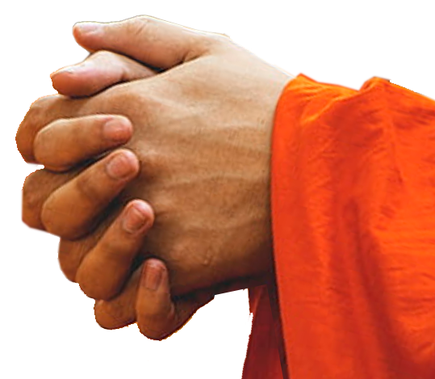
The Solution to Ridicule 4:4-6
UPWARD = PRAY
⁴ Hear, O our God, for we are despised. Turn back their taunt on their own heads and give them up to be plundered in a land where they are captives.
Notes:
https://www.uihere.com/free-photos/selective-focus-photography-of-person-holding-hand-329857
He is praying for “Justice!” Justice means giving someone what they deserve.
Ot = eye for eye = justice
Give them a taste of their own medicine.
Let them go through what we went through.

Slide 15
The Solution to Ridicule 4:4-6
UPWARD = PRAY
⁴ Hear, O our God, for we are despised. Turn back their taunt on their own heads and give them up to be plundered in a land where they are captives.
Notes:
https://www.uihere.com/free-photos/selective-focus-photography-of-person-holding-hand-329857
He is praying for “Justice!” Justice means giving someone what they deserve.
Ot = eye for eye = justice
Give them a taste of their own medicine.
Let them go through what we went through.

Slide 16
The Solution to Ridicule 4:4-6
UPWARD = PRAY
⁵ Do not cover their guilt, and let not their sin be blotted out from your sight, for they have provoked you to anger in the presence of the builders.
Notes:
This is a prayer for Justice.
Lord, this is an attack on you.
“What is done to the least of these my brothers is done unto me” Mt 25:40,45
I’ve been asking this congregation to have justice or righteousness be restored to our nation. That’s what Nehemiah is praying.
Justice means getting what you deserve.

Slide 17
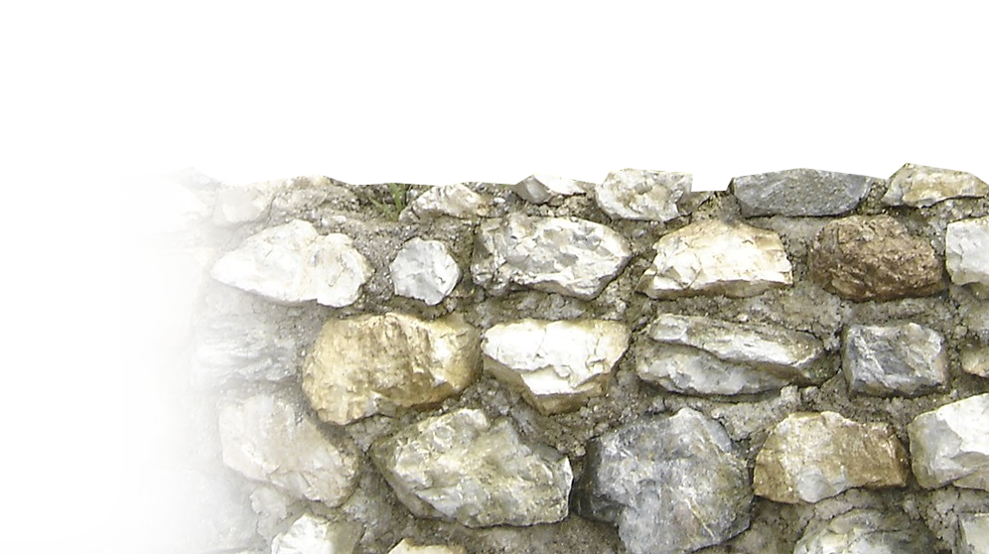
The Solution to Ridicule 4:4-6
OUTWARD = BUILD
⁶ So we built the wall.
And all the wall was
joined together to half
its height,
Notes:
https://commons.wikimedia.org/wiki/File:Stierschwazersilberbergwerk.JPG
Threw off all the ridicule and got back to work. Keep on your task. Persevere.
They made incredible progress—half the wall is built. The easy part. The lower half.
Now comes the hard part, lifting those blocks to the top half.
Listen life does not always get easier—it may in fact get much harder before you attain your goal.

Slide 18

The Solution to Ridicule 4:4-6
INWARD = MIND TO WORK
⁶ So we built the wall.
And all the wall was
joined together to half
its height, for the people
had a mind to work.
Notes:
Mind to work = https://pixabay.com/illustrations/brain-mind-obsession-work-activity-954823/
Prov 23:7 For as he thinketh in his heart, so is he: (Pro 23:7 KJV)

Slide 19
How to handle CONSPIRACY 4:7-9

Slide 20
The Plotters 4:7
⁷ But when Sanballat and Tobiah and the Arabs and the Ammonites and the Ashdodites heard that the repairing of the walls of Jerusalem was going forward and that the breaches were beginning to be closed, they were very angry.
SAMARIA
HORAN
AMMON
ASHDOD
JUDAH
ARABS
Notes:
The plot thickens. The opposition increases both in number of opposers and strategy to take Nehemiah down.

Slide 21
The Plotters 4:7
⁷ But when Sanballat and Tobiah and the Arabs and the Ammonites and the Ashdodites heard that the repairing of the walls of Jerusalem was going forward and that the breaches were beginning to be closed, they were very angry.
SAMARIA
HORAN
AMMON
ASHDOD
JUDAH
ARABS
Notes:
The plot thickens. The opposition increases both in number of opposers and strategy to take Nehemiah down.

Slide 22

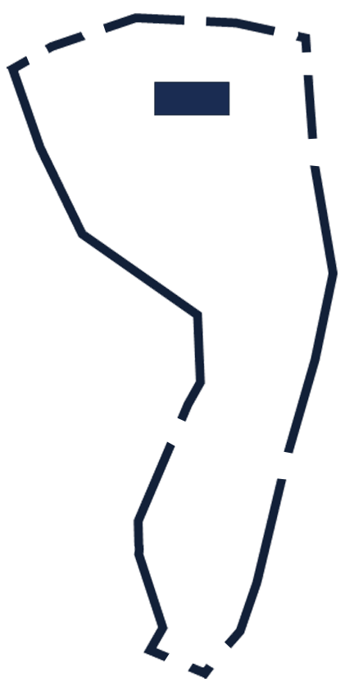
The Plot 4:8
⁸ And they all plotted together to come and fight against Jerusalem and to cause confusion in it.
TEMPLE
Notes:
Plotted = conspired to take down Nehemiah and the work on the wall.
Sound like anything familiar today? Democrat campaigners to stop the wall and take it down.

Slide 23
The Solution 4:9
UPWARD = PRAY
⁹ And we prayed to our God

Slide 24
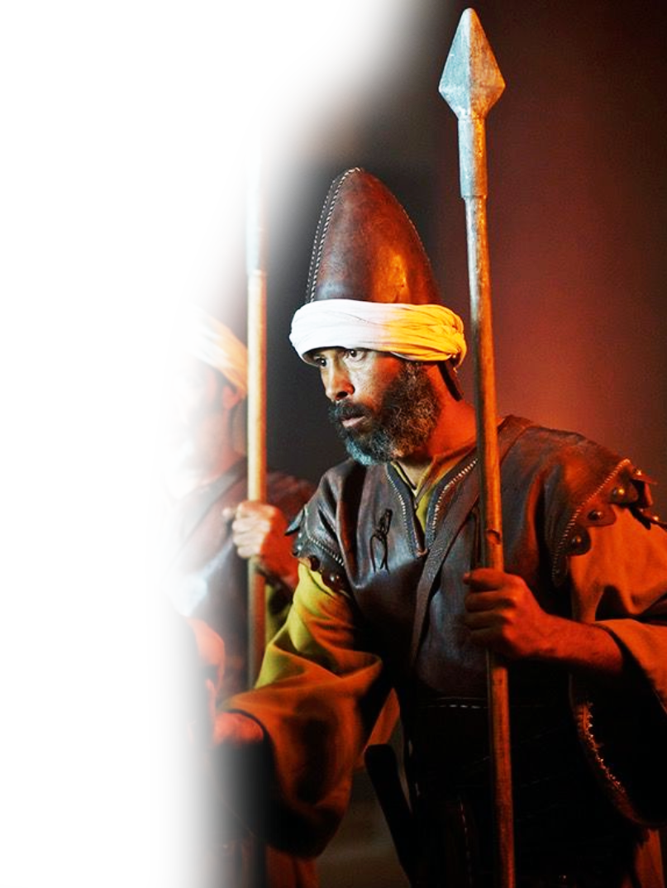
The Solution 4:9
OUTWARD = GUARD
⁹ And we prayed to our God and set a guard as a protection against them
Notes:
Jesus told the disciples to “watch and pray” here Nehemiah “prays and watches.”
Pray and the defend.

Slide 25

The Solution 4:9
INWARD = PERSIST
⁹ And we prayed to our God and set a guard as a protection against them
day and night.
24 HOURS
A DAY!
Notes:
I can remember as a college student pulling an all nighter to get my papers done for class.

Slide 26
How to handle DISCOURAGEMENT

Slide 27
The Discouragers 4:10-12
SAMARIA
¹⁰ In Judah it was said,
¹¹ And our enemies said,
¹² the Jews … said,
HORAN
AMMON
ASHDOD
JUDAH
ARABS
Notes:
Everyone is saying. This is both external and internal challenges to what He is doing for God.

Slide 28
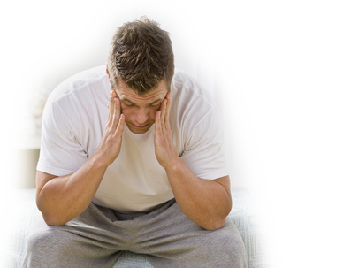
The Discouragement 4:10-12
We’re TIRED!
¹⁰ In Judah it was said,
"The strength of those who bear the burdens is failing. There is too much rubble. By ourselves we will not be able to rebuild the wall."
Notes:
https://www.flickr.com/photos/74285857@N05/6697132255
WE’re tired! We’re weary! Maybe we are not cut out for this?

Slide 29
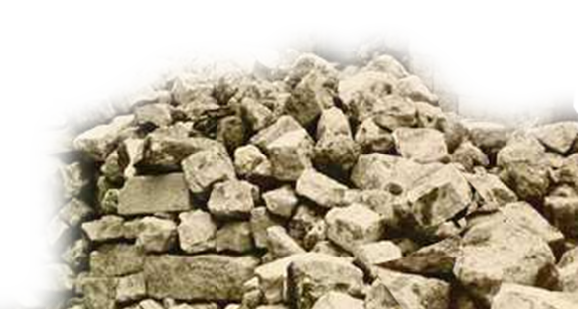
The Discouragement 4:10-12
It’s TOO MUCH!
¹⁰ In Judah it was said,
"The strength of those who bear the burdens is failing. There is too much rubble. By ourselves we will not be able to rebuild the wall."
Notes:
It’s just too hard.

Slide 30
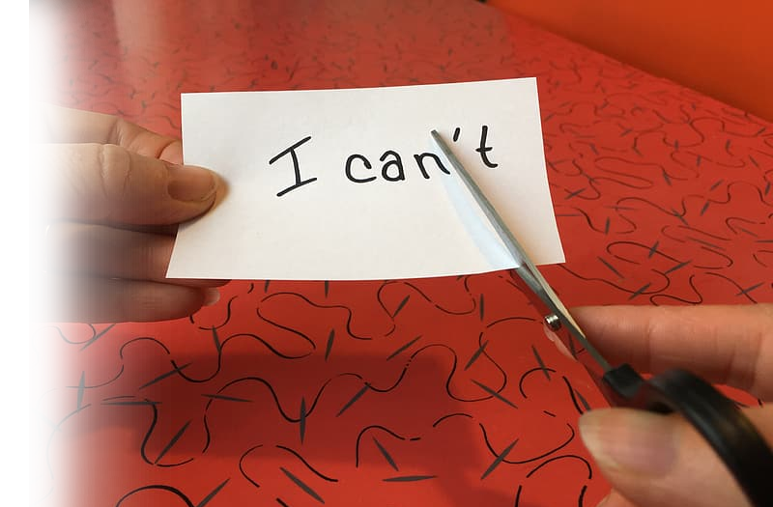
The Discouragement 4:10-12
We CAN’T!
¹⁰ In Judah it was said,
"The strength of those who bear the burdens is failing. There is too much rubble. By ourselves we will not be able to rebuild the wall."
we cannot rebuild the wall (Neh 4:10 NIV)
Notes:
Https://www.pikrepo.com/fymvm/i-can-t-written-on-paper
NIV translates as “cannot” because the same Hebrew word can be translated either way.
They were able – in fact the did rebuild. They ware say, I quit, I don’t want to, I can not.

Slide 31
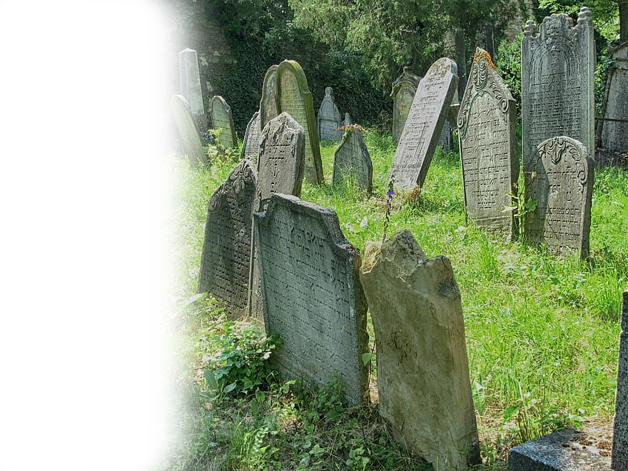
The Discouragement 4:10-12
We’ll ALL DIE!
¹¹ And our enemies said, "They will not know or see till we come among them and kill them and stop the work."
Notes:
https://www.pikist.com/free-photo-vytrm

Slide 32

The Discouragement 4:10-12
Let’s QUIT now!
¹² At that time the Jews who lived near them came from all directions and said to us ten times, "You must return to us."

Slide 33
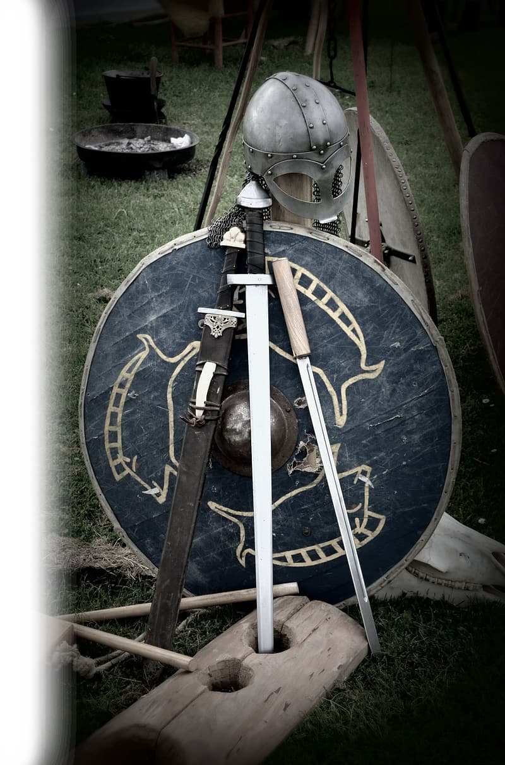
The SOLUTION 4:13-14
¹³ So in the lowest parts of the space behind the wall, in open places, I stationed the people by their clans, with their swords, their spears, and their bows.
Notes:
https://www.pikrepo.com/fqysd/black-handled-sword-with-blue-shield-behind
At the lowest point (of the wall – of your life) you must take your stand and go on the defense.

Slide 34

The SOLUTION 4:13-14
¹⁴ And I looked and arose and said to the nobles and to the officials and to the rest of the people,
"Do not be afraid of them.
Notes:
https://pixabay.com/illustrations/fear-fearless-without-fear-617132/

Slide 35
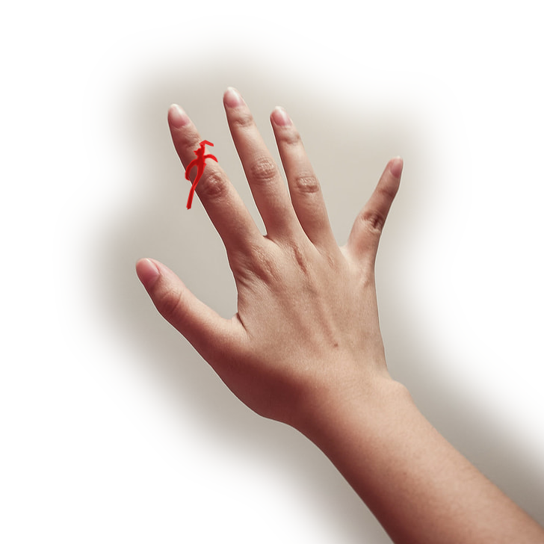
The SOLUTION 4:13-14
Remember the Lord, who is great and awesome,
Notes:
https://www.pickpik.com/human-hand-hand-photography-palm-finger-human-body-part-87317
Remember, and do not forget the Lord is great and awesome and He will fight for you.

Slide 36
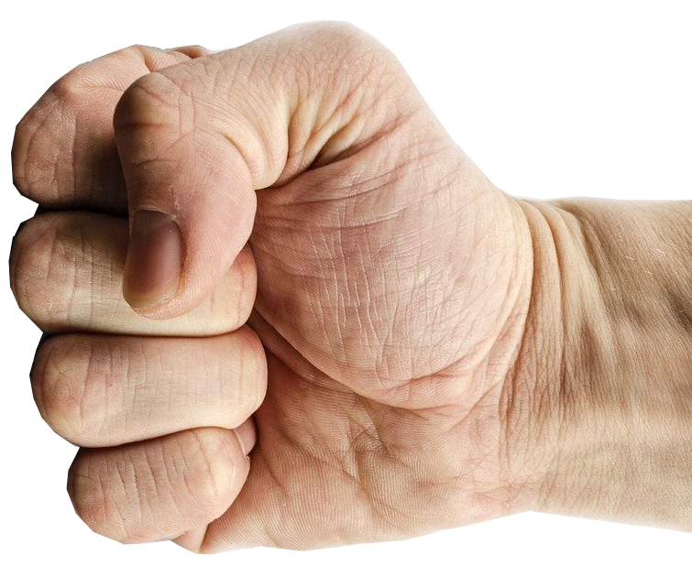
The SOLUTION 4:13-14
and fight for your brothers, your sons, your daughters, your wives, and your homes."
Notes:
https://pixabay.com/photos/punch-fist-hand-strength-isolated-316605/
Don’t take the threats lying down. Stand up for righteousness.

Slide 37
How to handle ENEMIES 4:15-23

Slide 38
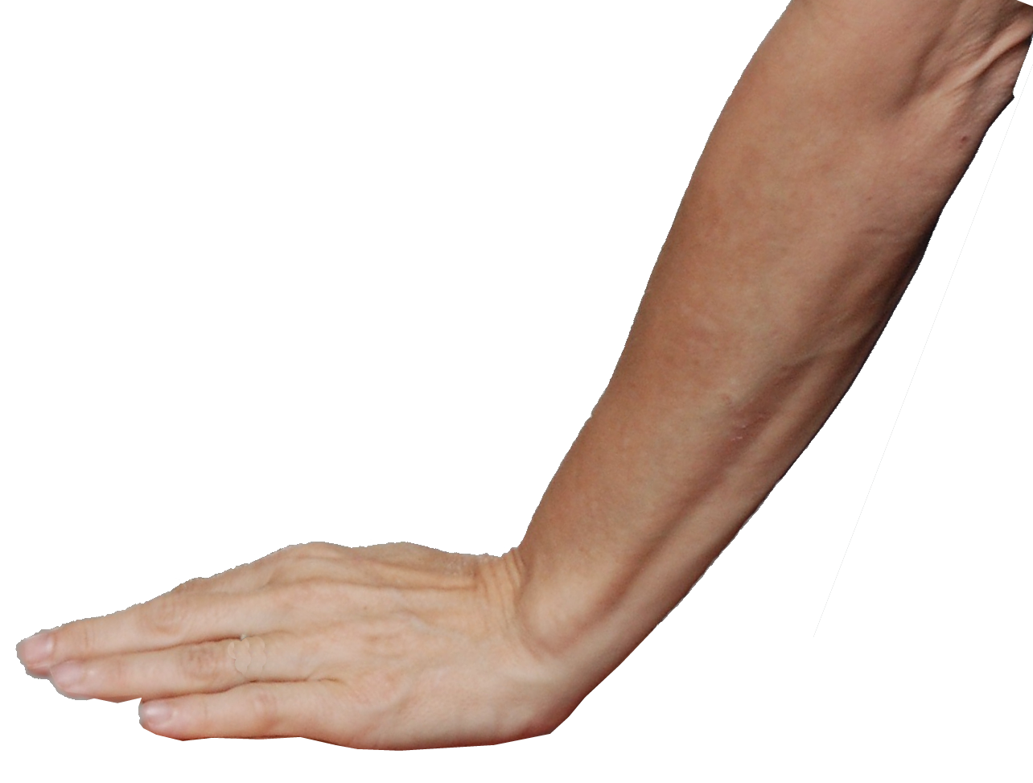
Let God FRUSTRATE Them 4:15
¹⁵ When our enemies heard that it was known to us and that God had frustrated their plan,
we all returned to the wall, each to his work.

Slide 39
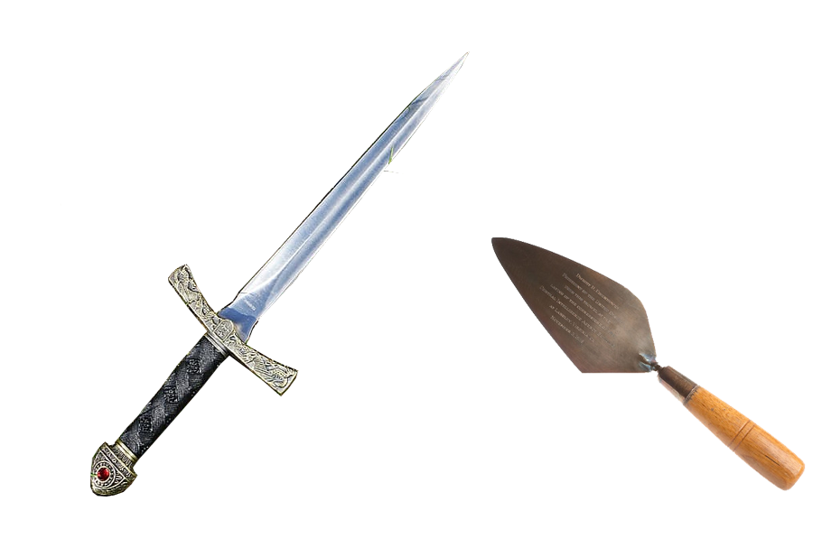
Use Your Tools 4:16-18
¹⁶ From that day on, half of my servants worked on construction, and half held the spears, shields, bows, and coats of mail. And the leaders stood behind the whole house of Judah,
Notes:
https://www.wallpaperflare.com/weapon-knife-blade-metal-dagger-sharp-metallic-middle-ages-wallpaper-wfabb
https://www.flickr.com/photos/ciagov/5416802658

Slide 40

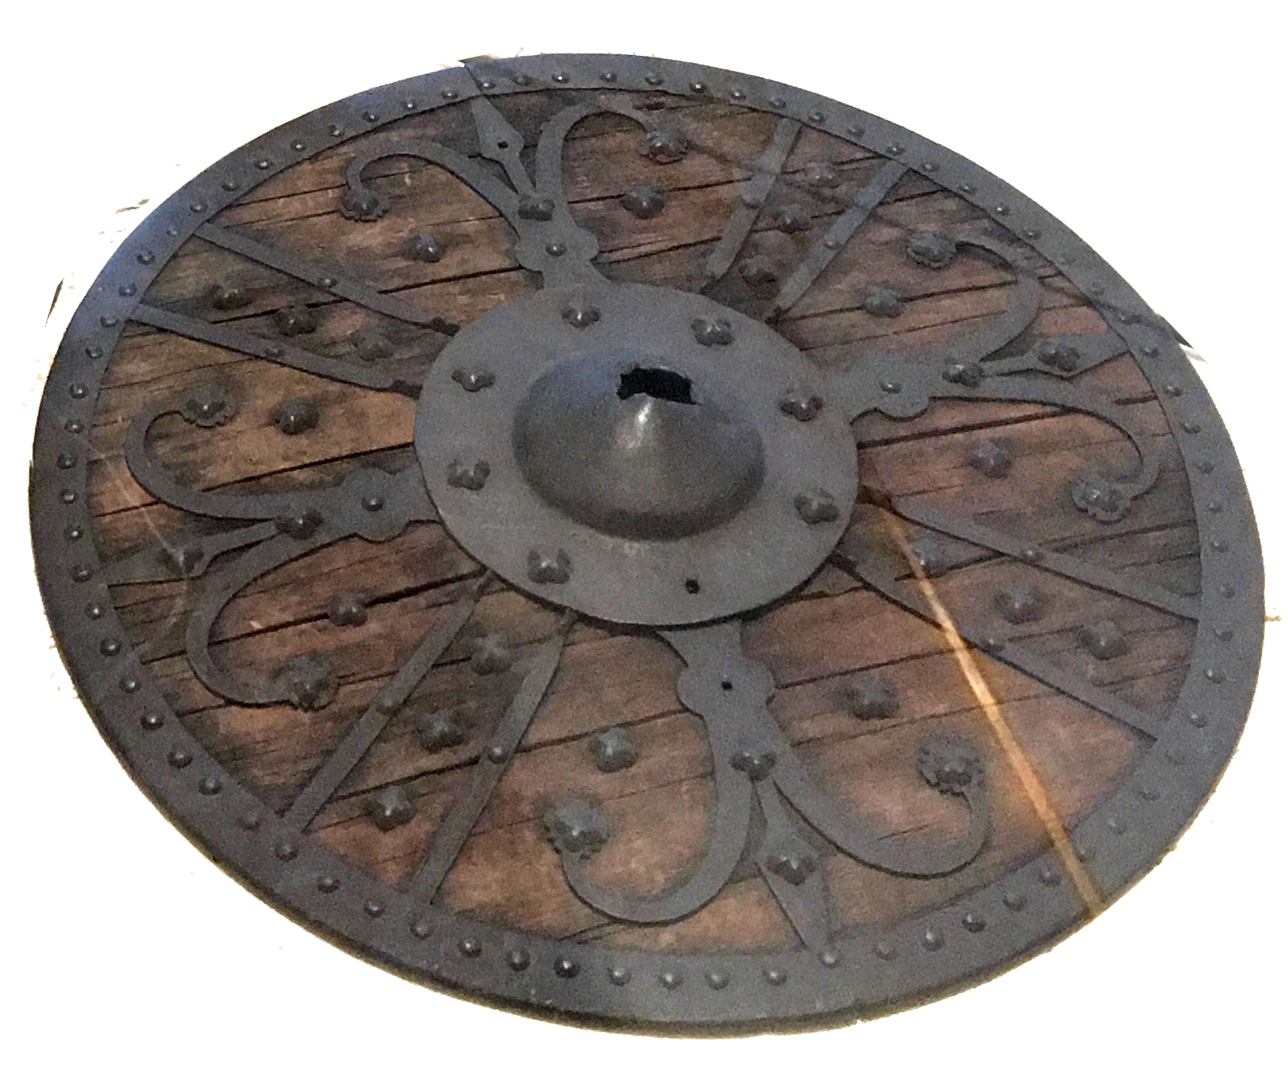
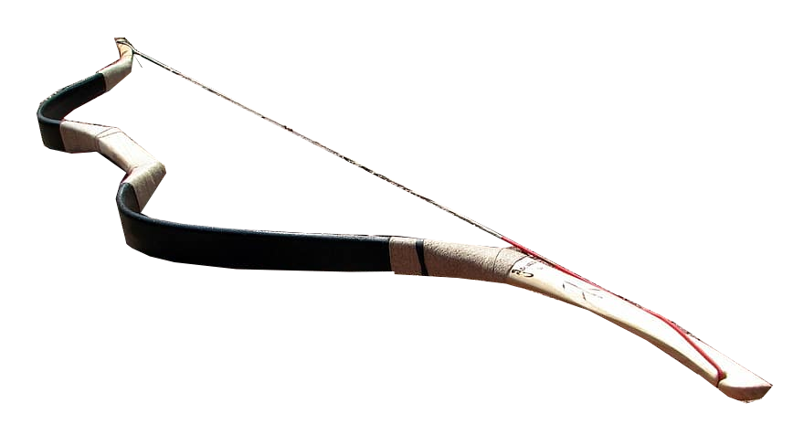
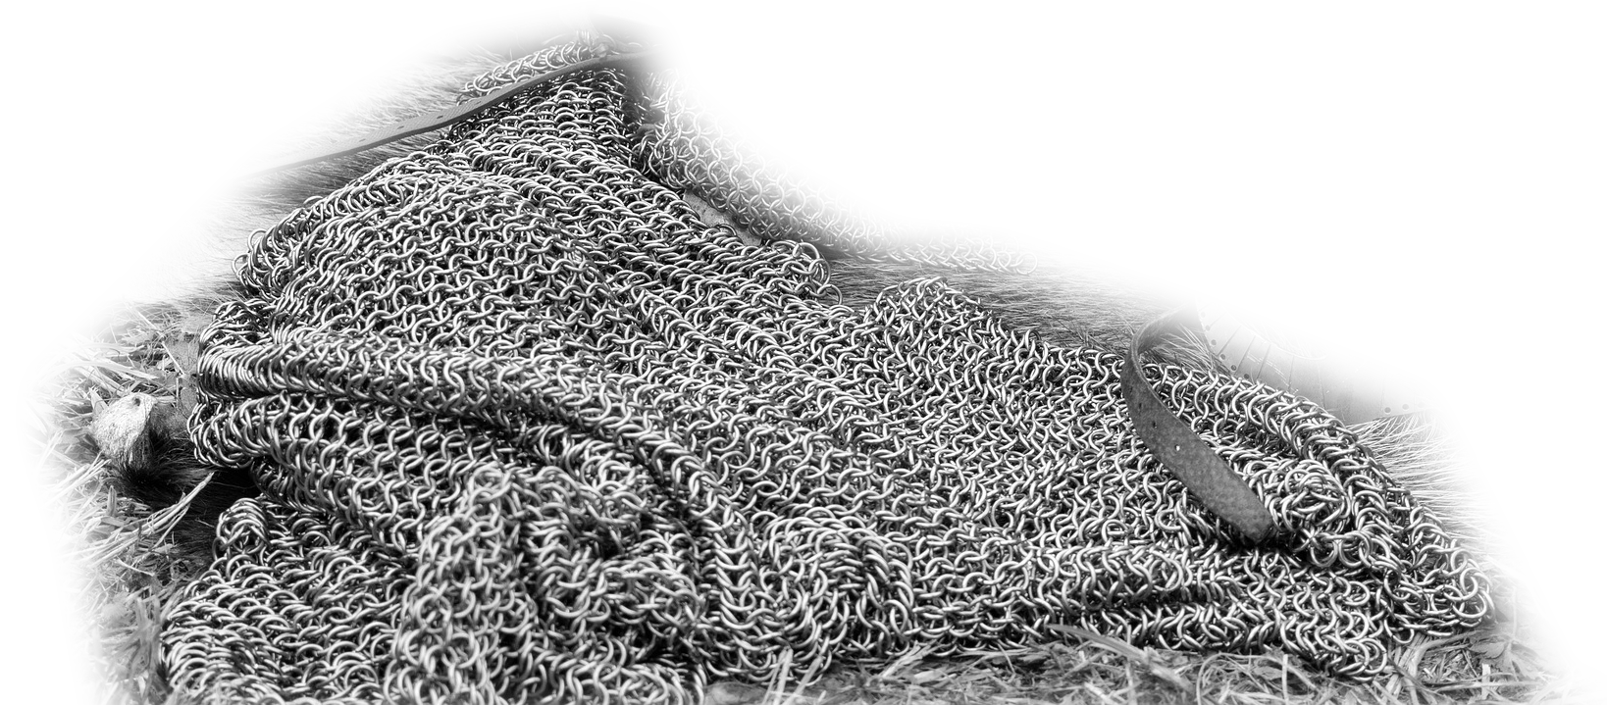
Use Your Weapons 4:16-18
¹⁶ From that day on, half of my servants worked on construction, and half held the spears, shields, bows, and coats of mail. And the leaders stood behind the whole house of Judah,
Notes:
https://commons.wikimedia.org/wiki/File:Kulturhistorisk_Museum,_Oslo,_Norway._Medieval_weapons_(skull,12c._sword,_battle_axe,_13c._helmet,_14c._shield,_15c._dagger,_spear_point,_quiver,_crossbow_arrow,_arrowheads,_chain_mail)_2017-12-14_b.jpg
https://www.flickr.com/photos/ciagov/5416802658
https://pixabay.com/photos/armor-coat-of-mail-the-middle-ages-1709127/
https://www.pikist.com/free-photo-xexiz

Slide 41
Use God’s Provisions 4:16-18
¹⁷ who were building on the wall. Those who carried burdens were loaded in such a way that each labored on the work with one hand and held his weapon with the other.

Slide 42
Use God’s Provisions 4:16-18
¹⁸ And each of the builders had his sword strapped at his side while he built. The man who sounded the trumpet was beside me.

Slide 43
Work the Plan 4:19-23
Sheep
Fish
Muster
Old
¹⁹ And I said to the nobles and to the officials and to the rest of the people,
"The work is great and widely spread, and we are separated on the wall, far from one another.
East
TEMPLE
Horse
Valley
Water
Dung
Fountain

Slide 44
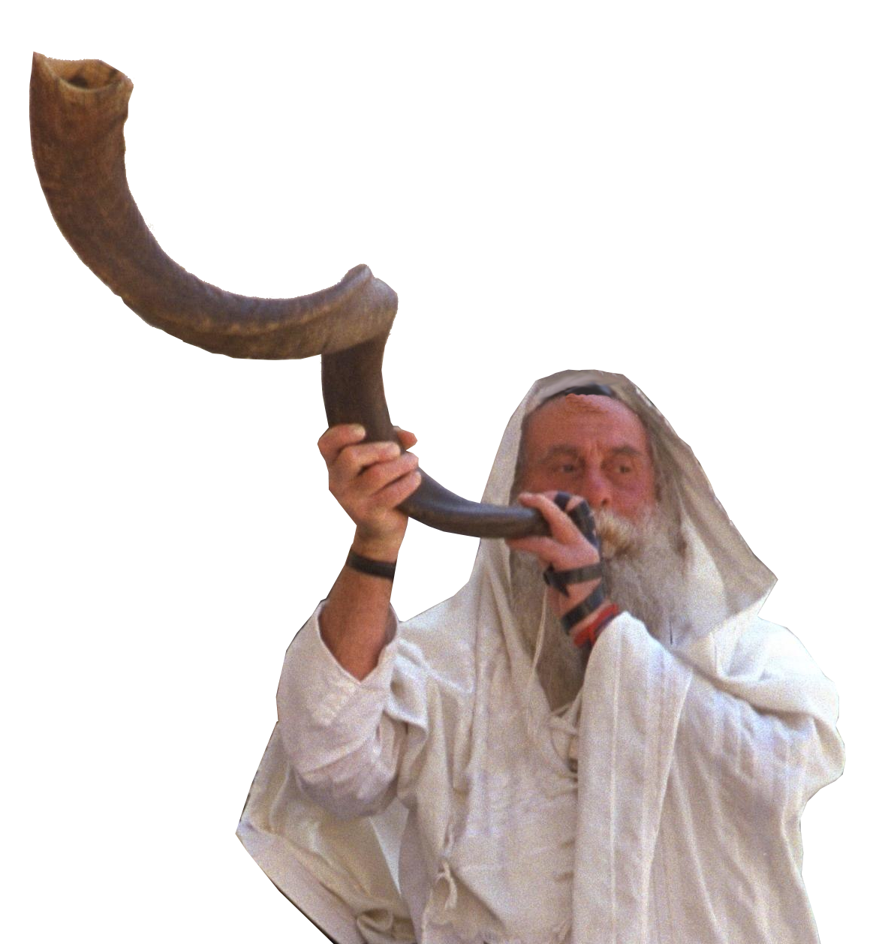
Work the Plan 4:19-23
Sheep
Fish
Muster
Old
²⁰ In the place where you hear the sound of the trumpet, rally to us there. Our God will fight for us."
East
TEMPLE
Horse
Valley
Water
Dung
Fountain
Notes:
https://commons.wikimedia.org/wiki/File:Flickr_-_Government_Press_Office_(GPO)_-_The_Wailing_Wall.jpg

Slide 45


Work the Plan 4:19-23
Sheep
Fish
Muster
Old
²¹ So we labored at the work, and half of them held the spears from the break of dawn until the stars came out.
East
TEMPLE
Horse
Valley
Water
Dung
Fountain

Slide 46
Work the Plan 4:19-23
Sheep
Fish
Muster
Old
²² I also said to the people at that time,
"Let every man and his servant pass the night within Jerusalem, that they may be a guard for us by night and may labor by day."
East
TEMPLE
Horse
Valley
Water
Dung
Fountain

Slide 47
Work the Plan 4:19-23
Sheep
Fish
Muster
Old
²³ So neither I nor my brothers nor my servants nor the men of the guard who followed me, none of us took off our clothes; each kept his weapon at his right hand.
East
TEMPLE
Horse
Valley
Water
Dung
Fountain

Slide 48
Here’s the Takeaway …
You will experience opposition.
When you do …
1) Look Upward (Pray to the Lord)
2) Look Outward (Focus on the task)
3) Look Inward (Guard your mind & heart)
4) Stay strong (Don’t get discouraged)
5) Stand firm (Just do it for the glory of God!)

Slide 49
Let’s Pray!

