Slide 1
Picking up the
Pieces
Through
CONSTRUCTION
A Study of Nehemiah
Notes:
https://upload.wikimedia.org/wikipedia/commons/7/74/Wikipedia-logo-v2-pieces.svg
https://www.freepik.com/free-photo/jigsaw-puzzle-with-missing-piece-missing-puzzle-pieces_5469650.htm
Copyright © 2006−2021. All rights reserved. Bible Point is a registered trademark of Dennis Henderson. All other trademarks acknowledged.
Bible Point contains graphics from Bible Point artists. These illustrations belong to Bible Point and the respective artists. You may use the designs and illustrations for graphical illustration of lessons free and without special permission, provided they are not used in any way that maligns the Christian faith. Furthermore, republication or production of any illustration by any other graphic service whether it be in book, in a machine-readable form, or in any other design resource is strictly prohibited. Furthermore, they cannot be duplicated or resold as any other form of publishing, clip art, or graphic resource.
So What does it mean? (A simple translations of the legal jargon)
So, if you don’t own the presentation(s), graphic(s), and text(s) how can you legally use them? The purchase of the license allows you to use all the images in the product. However, the actual ownership and copyright of the presentation(s), graphic(s), and text(s) remain the property of Bible Point and its licensors. If you had plans on using this product in your “for sale” work—think again!
License Agreement
Article 1: License Grant
All the graphics and text in Bible Point presentations (excluding quotes from the Bible and stated sources) are the intellectual and real property of Bible Point and its licensors, and is protected by law, including United States copyright laws and international treaties. Bible Point grants to you a license:
1. To use the presentation in a single church, single school, or single office of a Christian organization.
2. To make a single archival back-up copy of the program.
3. To modify the presentation(s) and merge with other presentations in a single church, school, or Christian organization.
4. To transfer to another party if that party agrees to accept the terms and conditions of this agreement, and you do not retain any copies of the presentation, whether printed, machine readable, modified, or merged form.
Article 2: Terms
This license is effective until terminated. You may terminate the license at any time by destroying the presentation(s), graphic(s), or text(s) together with all copies, modifications and merged portions in any form. Bible Point may terminate your license if you fail to comply with this Agreement. You agree, upon such termination, for any reason, to destroy the presentation(s), graphics, and text(s) with all copies, modifications, and merged portions in any form.
Article 3: Disclaimers
1. Bible Point presentations, graphics, and texts are licensed to you As Is. You, the consumer, bear the entire risk relating to the quality and performance of the presentation(s), graphic(s), or text(s). In no event will Bible Point be liable for damages resulting from any defect.
2. Thirty-day limited warrantee on disks. Bible Point warrants the disks to be free of defects in material and workmanship under normal use for 30 days after purchase. During the 30-day period you may return a defective presentation, graphic, or text with proof of purchase and it will be replaced without charge, unless the presentation is damaged by misuse.
Article 4: General
1. You may not sub-license, assign, or transfer the license of the presentation(s), graphic(s), or text(s) except as provided by this Agreement.
2. This Agreement will be governed by the laws of the State of Michigan.
So What does it mean? (A simple translations of the legal jargon)
May I let someone borrow or copy my licensed Bible Point presentation (even after I modified it)? As long as it is within your local church, or single school, or the immediate office of a Christian organization you may. Otherwise, please refer the person interested in borrowing to: http://www.biblepoint.com or E-mail: dennis@DrDH.net with any related questions.

Slide 2
Picking up the
Pieces
Through
INSPECTION
The word “REPAIR” occurs
38 times in this chapter.
Notes:
https://upload.wikimedia.org/wikipedia/commons/7/74/Wikipedia-logo-v2-pieces.svg
https://www.freepik.com/free-photo/jigsaw-puzzle-with-missing-piece-missing-puzzle-pieces_5469650.htm

Slide 3
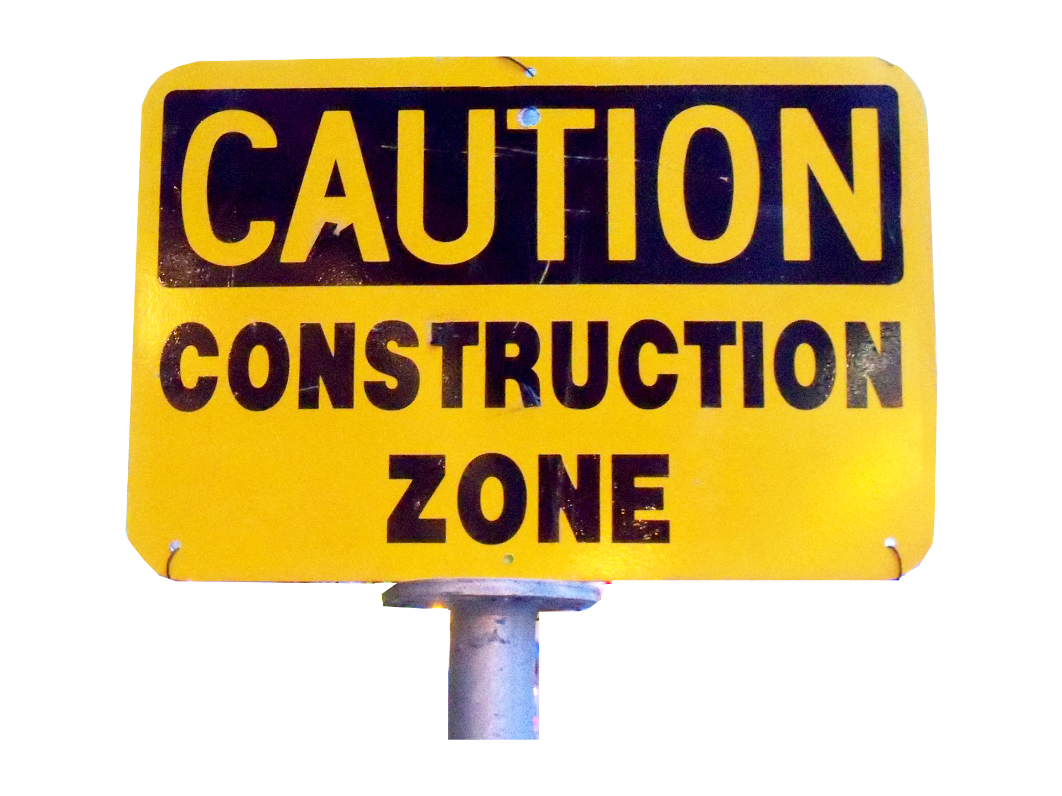
Every Construction Project Needs:
1- Plan for Construction (Prints)

Slide 4

Every Construction Project Needs:
1- Plan for Construction (Prints)
2- People for Construction
(Workers)

Slide 5

Every Construction Project Needs:
1- Plan for Construction (Prints)
2- People for Construction
(Workers)
3- Purpose for Construction
(Significance)

Slide 6
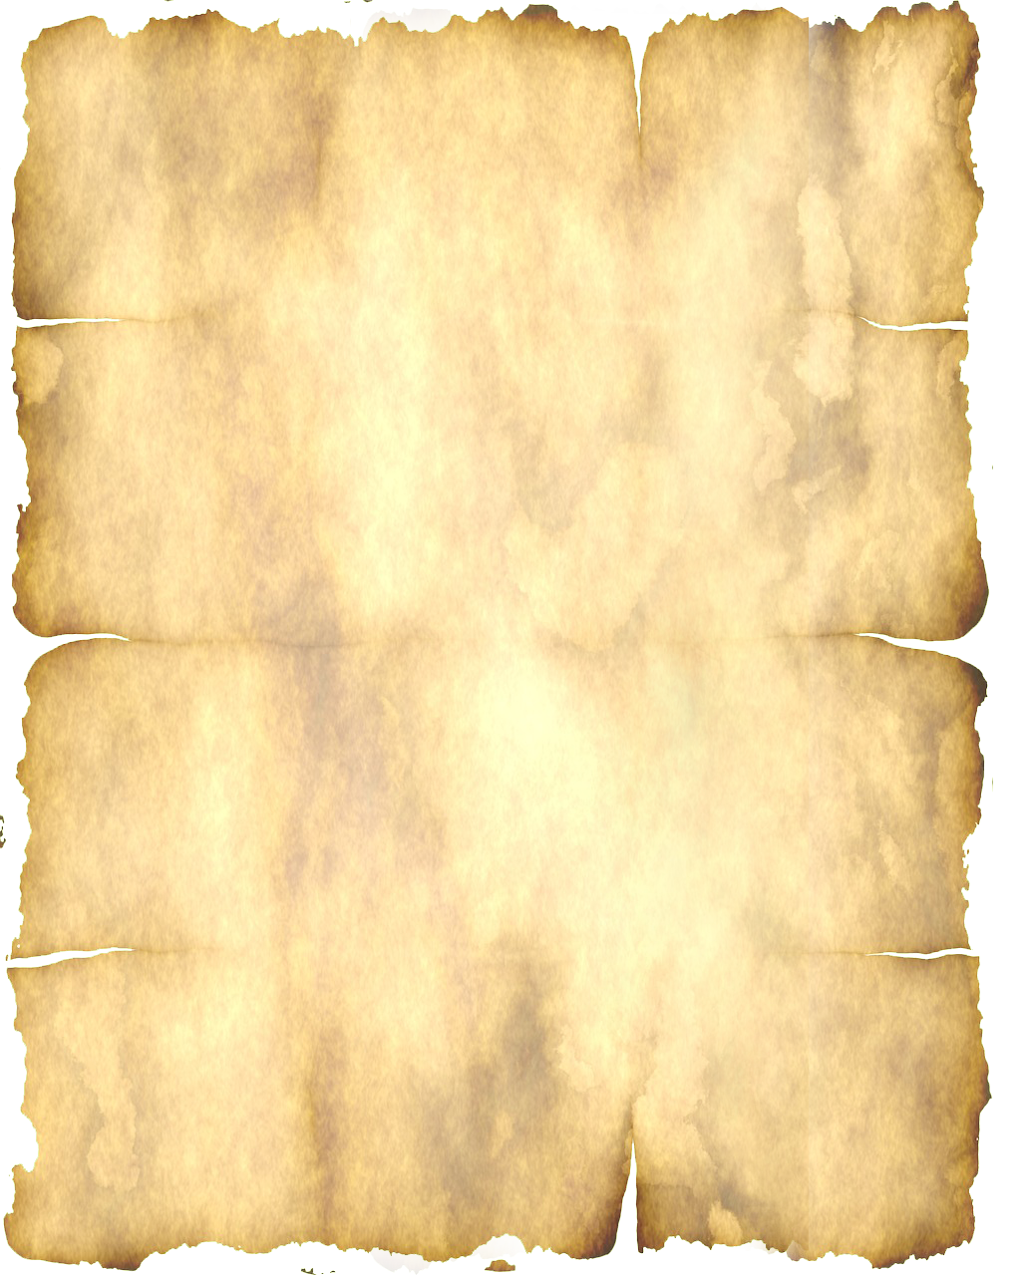
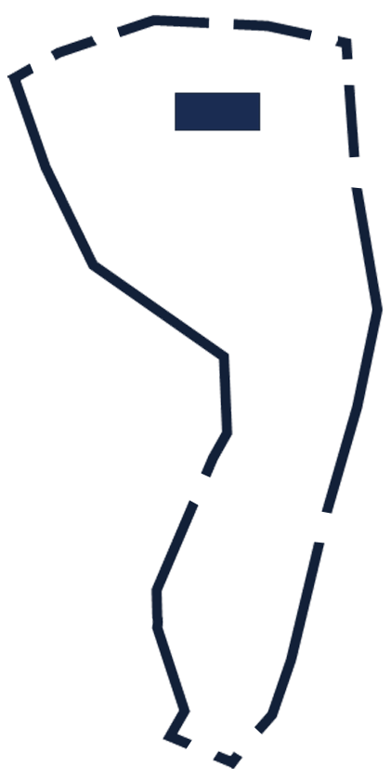
1- Plan for Construction (Prints)
TEMPLE
Notes:
https://www.needpix.com/photo/download/1515326/construction-constructionzone-sign-signs-workarea-constructionarea-worksite-constructionsite-construction-zone
The Construction Project focuses on WHAT NEEDS TO BE DONE!
The Construction Workers focuses on WHO NEEDS TO DO IT!

Slide 7
The SHEEP Gate 1-2
Sheep
¹ Then Eliashib the high priest rose up with his brothers the priests, and they built the Sheep Gate ….
TEMPLE

Slide 8
The FISH Gate 3-5
Sheep
Fish
³ The sons of Hassenaah built the Fish Gate. They laid its beams and set its doors, its bolts, and its bars. ….
TEMPLE

Slide 9
The OLD Gate 6-12
Sheep
Fish
Old
⁶ Joiada the son of Paseah and Meshullam the son of Besodeiah repaired the Gate of Yeshanah .…
“The Old City Gate was repaired” (NLT)
TEMPLE

Slide 10
The VALLEY Gate 13
Sheep
Fish
Old
¹³ Hanun and the inhabitants of Zanoah repaired the Valley Gate. They rebuilt it and set its doors, its bolts, and its bars, and repaired a thousand cubits of the wall, ….
TEMPLE
Valley

Slide 11
The DUNG Gate 14
Sheep
Fish
Old
¹⁴ Malchijah the son of Rechab, ruler of the district of Beth-haccherem, repaired the Dung Gate. He rebuilt it and set its doors, its bolts, and its bars.
TEMPLE
Valley
Dung

Slide 12
The FOUNTAIN Gate 15-20
Sheep
Fish
Old
¹⁵ And Shallum the son of Col-hozeh, ruler of the district of Mizpah, repaired the Fountain Gate. He rebuilt it and covered it and set its doors, its bolts, and its bars.
TEMPLE
Valley
Dung
Fountain

Slide 13
The WATER Gate 21-27
Sheep
Fish
Old
After him Pedaiah the son of Parosh ²⁶ and the temple servants living on Ophel repaired to a point opposite the Water Gate on the east and the projecting tower.
TEMPLE
Valley
Water
Dung
Fountain

Slide 14
The HORSE Gate 28
Sheep
Fish
Old
²⁸ Above the Horse Gate the priests repaired, each one opposite his own house.
TEMPLE
Horse
Valley
Water
Dung
Fountain

Slide 15
The EAST Gate 29
Sheep
Fish
Old
²⁹ After them Zadok the son of Immer repaired opposite his own house. After him Shemaiah the son of Shecaniah, the keeper of the East Gate, repaired.
East
TEMPLE
Horse
Valley
Water
Dung
Fountain

Slide 16
The MUSTER Gate 6-12
Sheep
Fish
Muster
Old
³¹ After him Malchijah, one of the goldsmiths, repaired as far as the house of the temple servants and of the merchants, opposite the Muster Gate, and to the upper chamber of the corner.
East
TEMPLE
Horse
Valley
Water
Dung
Fountain

Slide 17
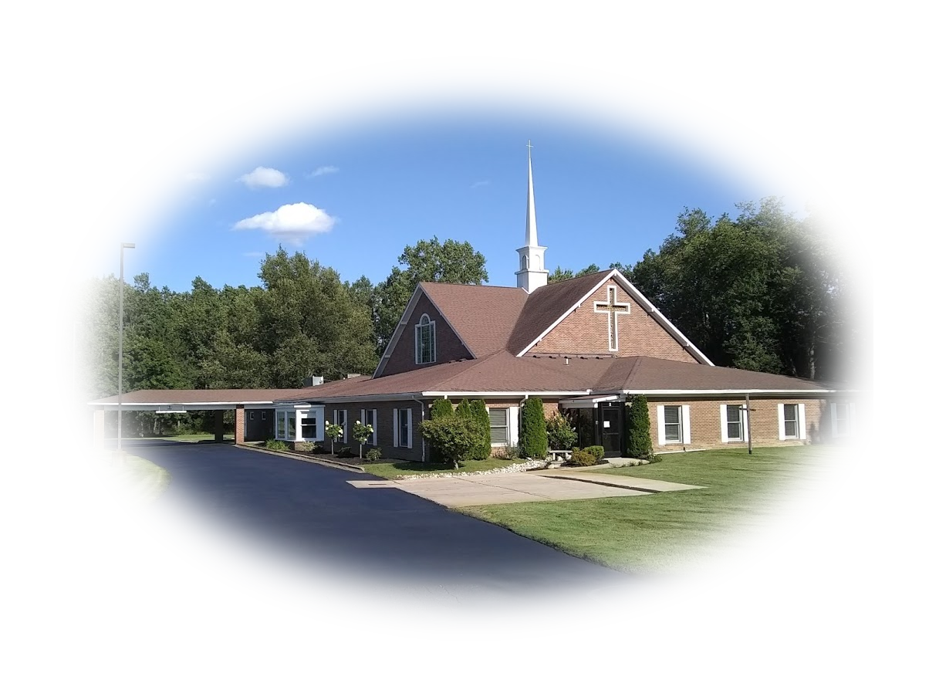
What do we learn?
No one did/does it all …
Bite-size pieces …
Like them, Bethany needs
EVERYONE doing their
part to complete our task.
There is something here for everyone to do!
WHAT?

Slide 18
What do we learn?
Attend Regularly
Give Faithfully
Share Faith Generously
Serve Wholeheartedly
- Nursery
- KidzLife
- AREA 51
WHO?
- Team Member
- Bible Study Member
- Outreach
Notes:
¹¹ And he gave the apostles, the prophets, the evangelists, the shepherds and teachers,
¹² to equip the saints for the work of ministry, for building up the body of Christ,
(Eph 4:11-12 ESV)

Slide 19

PEOPLE: The Construction WORKERS
Notes:
https://upload.wikimedia.org/wikipedia/commons/thumb/f/f8/MUTCD_CW20-7.svg/1024px-MUTCD_CW20-7.svg.png
The Who Does IT.

Slide 20
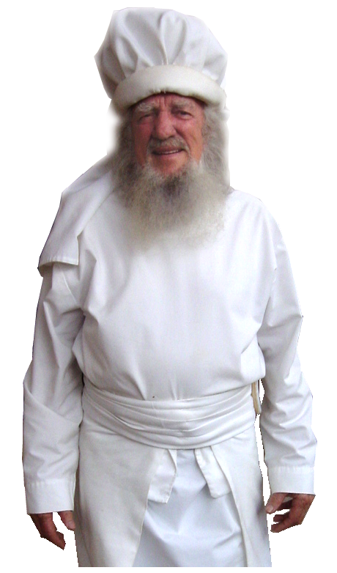
1- The PRIESTS
¹ Then Eliashib the high priest rose up with his brothers the priests, and they built the Sheep Gate.

Slide 21
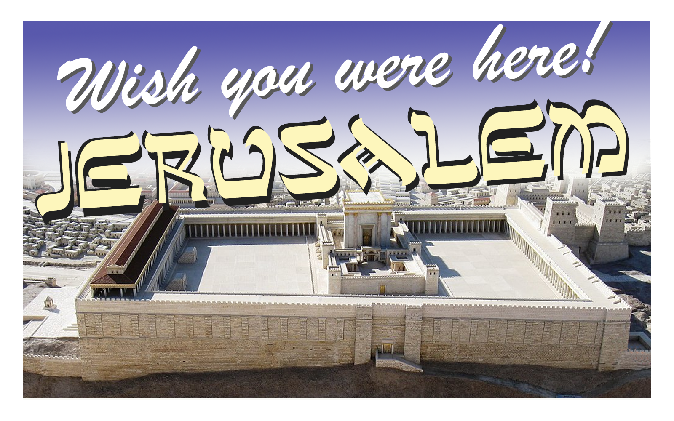
2- The OUT-OF-TOWNERS
… the men of Jericho built. (3:2)
… the Tekoites repaired (5)
… the ment of Gibeon and
of Mizpah (7)
… inhabitants of Zanoah (13)
… of Beth-haccherem (14)
Notes:
Perfumer is literally an “ointment maker” who not only would make ointments but medicines too. More like a pharmacist.

Slide 22
2- The OUT-OF-TOWNERS
… district of Beth-zur (16)
… the district of Keilah (17)
… the Tekoites repaired
another section (3:27)

Slide 23
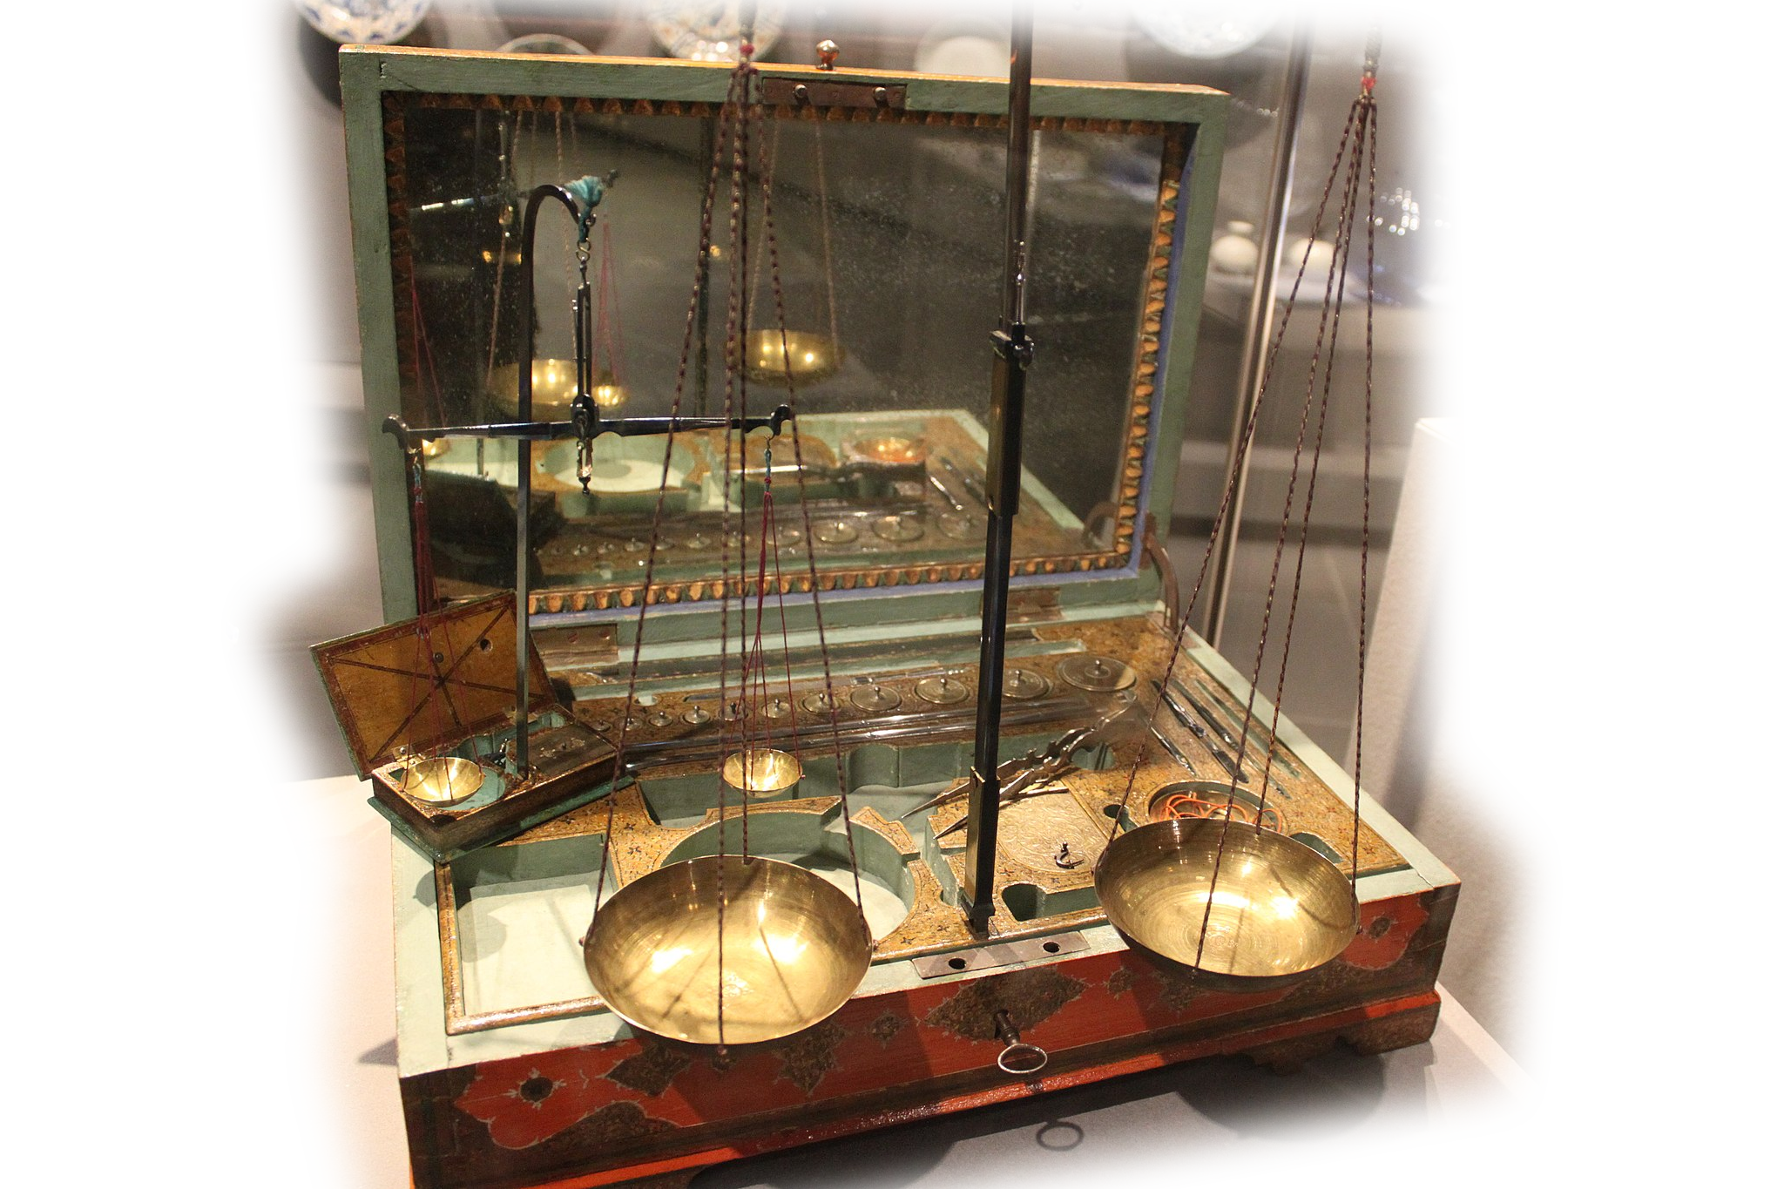
3- The GOLDSMITHS
… Uzziel the son of
Harhaiah, goldsmiths,
repaired. (3:8)
Notes:
https://upload.wikimedia.org/wikipedia/commons/thumb/6/65/Goldsmith%27s_workbox_-_Iran_-_1709_-_Louvre_-_MAO_685.jpg/2048px-Goldsmith%27s_workbox_-_Iran_-_1709_-_Louvre_-_MAO_685.jpg

Slide 24
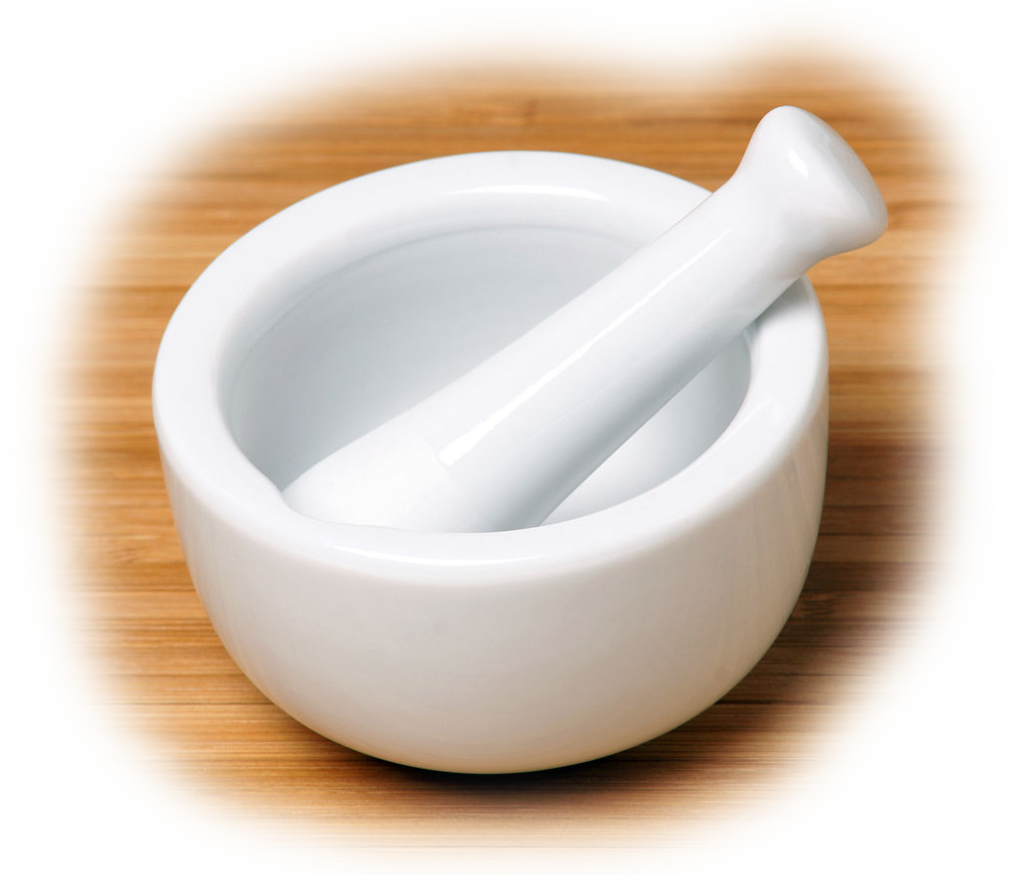
4- The PERFUMERS
Next to him Hananiah,
one of the perfumers,
repaired (3:8)
Notes:
https://en.wikipedia.org/wiki/Mortar_and_pestle#/media/File:White-Mortar-and-Pestle.jpg

Slide 25

5- The RULERS
“Ruler of _______”
Eight times:
3:9, 12, 14, 15, 16, 17, 18, 19,
Notes:
https://pixabay.com/illustrations/crown-royal-royalty-king-queen-4926512/

Slide 26

6- The DAUGHTERS
Shallum the son of Hallohesh, ruler of half the district of Jerusalem, repaired, he and his daughters. (3:12)
Notes:
https://www.publicdomainpictures.net/en/view-image.php?image=188182&picture=labor-day-worker

Slide 27
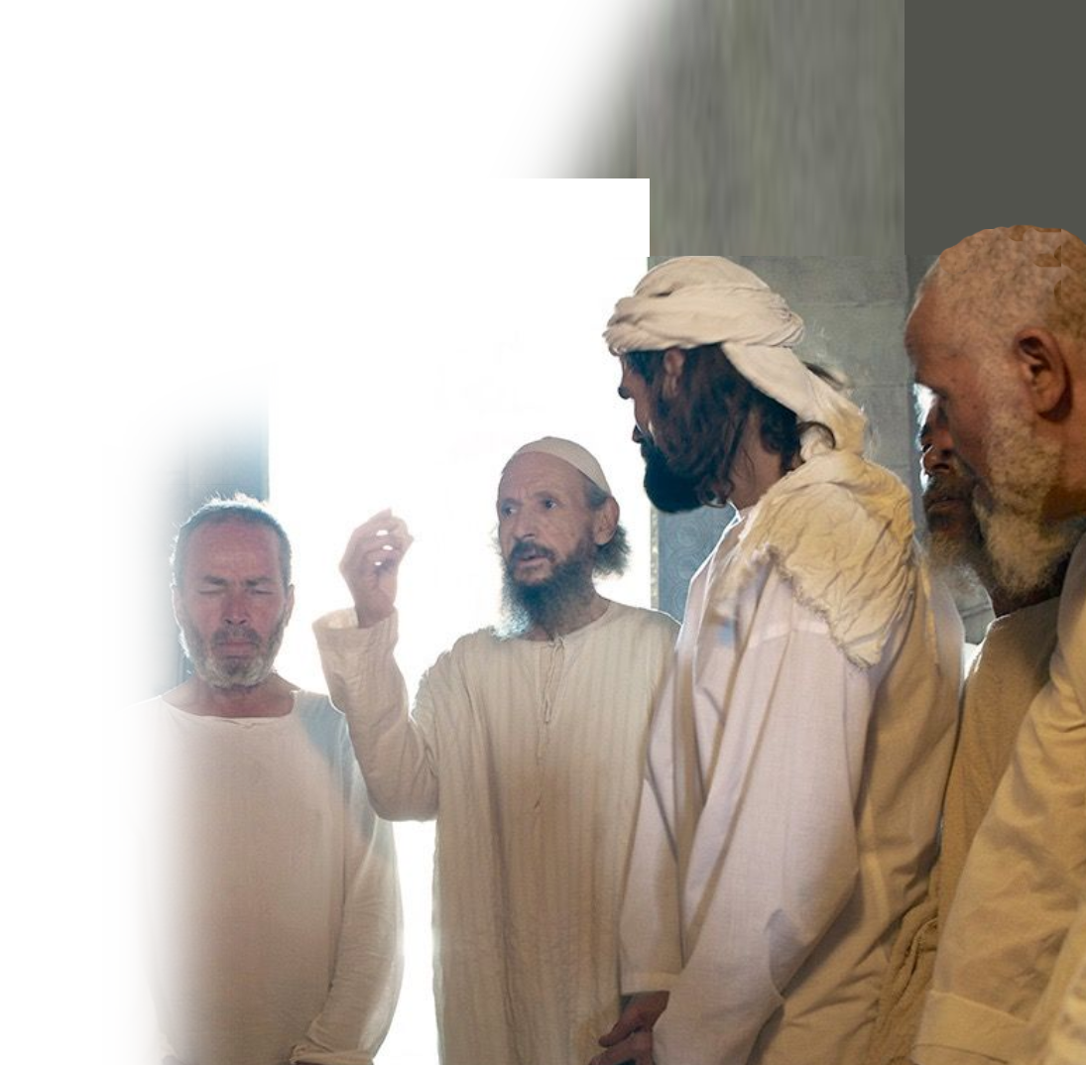
7- The LEVITES
… the Levites repaired. (3:17)

Slide 28
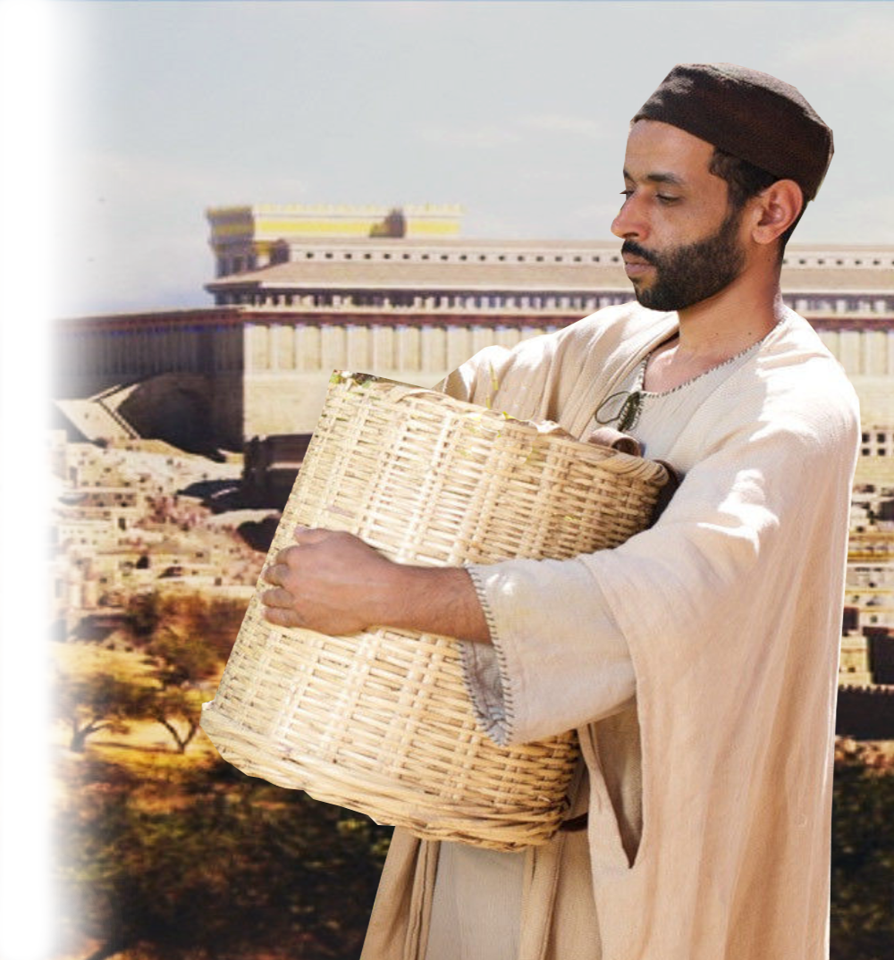
8- The TEMPLE SERVANTS
… the temple servants living on Ophel repaired (3:26)

Slide 29
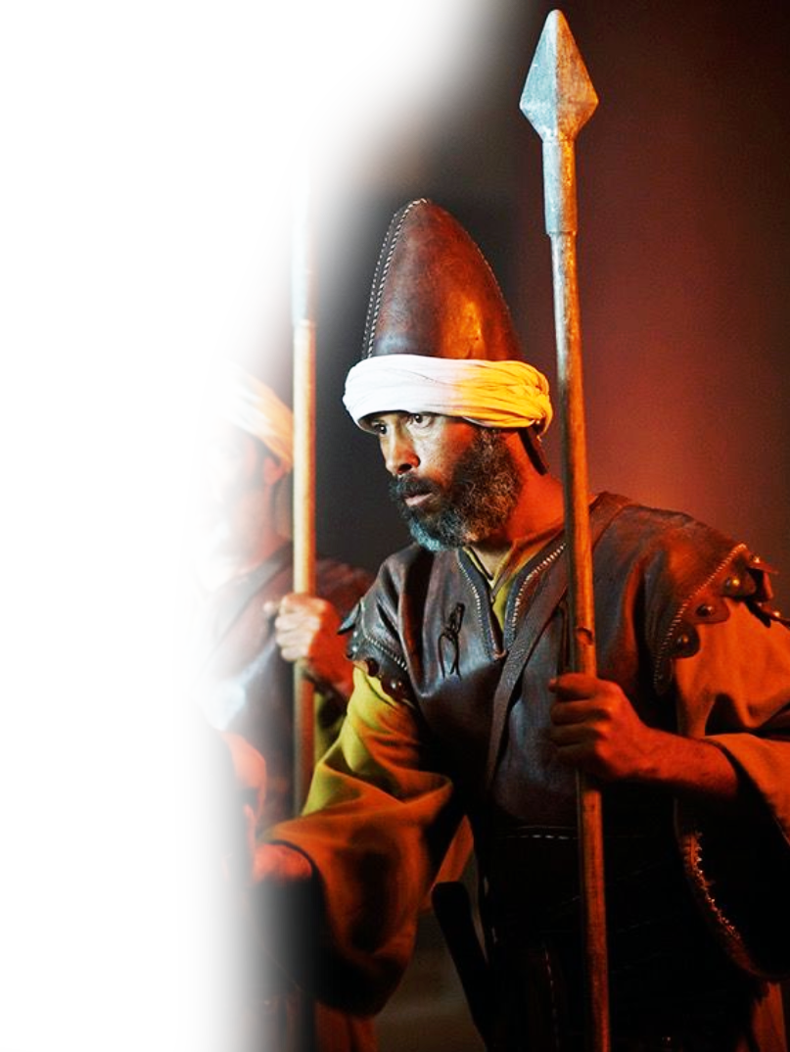
9- The GATE KEEPERS
Shemaiah the son of Shecaniah, the keeper of the East Gate, repaired. (3:29)

Slide 30
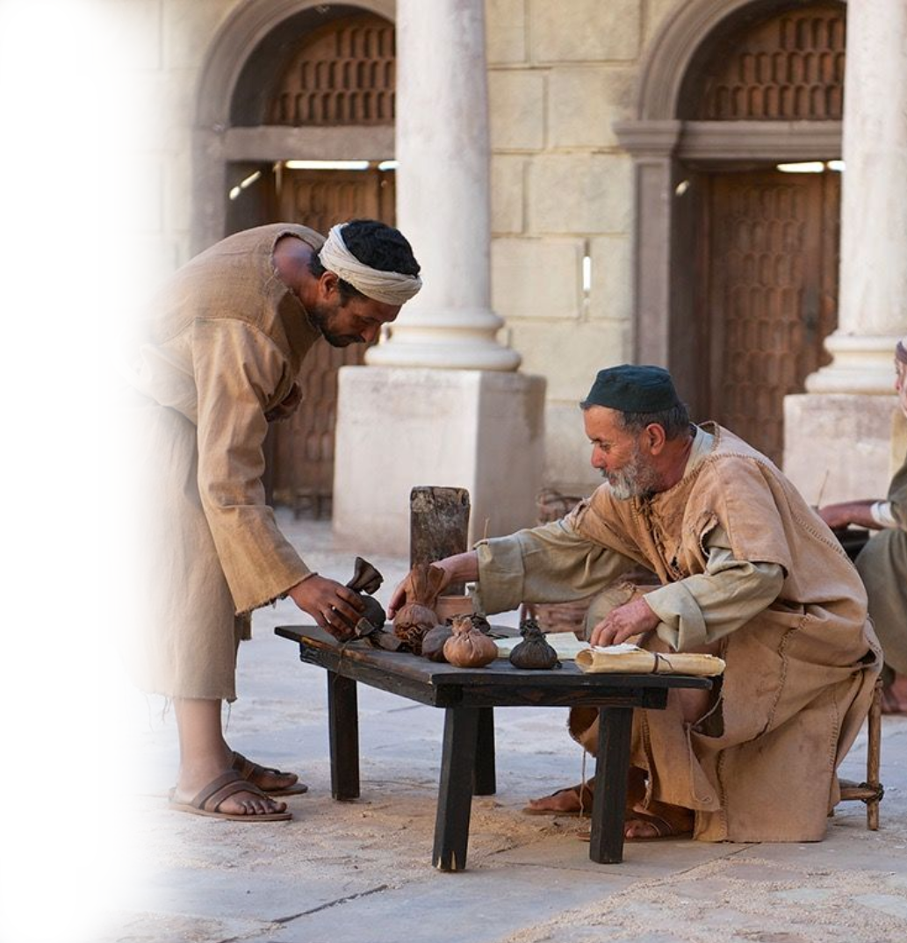
10- The MERCHANTS
³² And between the upper chamber of the corner and the Sheep Gate the gold-smiths and the merchants repaired. (3:32)
Notes:
Among these groupings are list of unpronounceable names. But God knew them each by name and credits them for what they done. And next notes who did nothing.

Slide 31
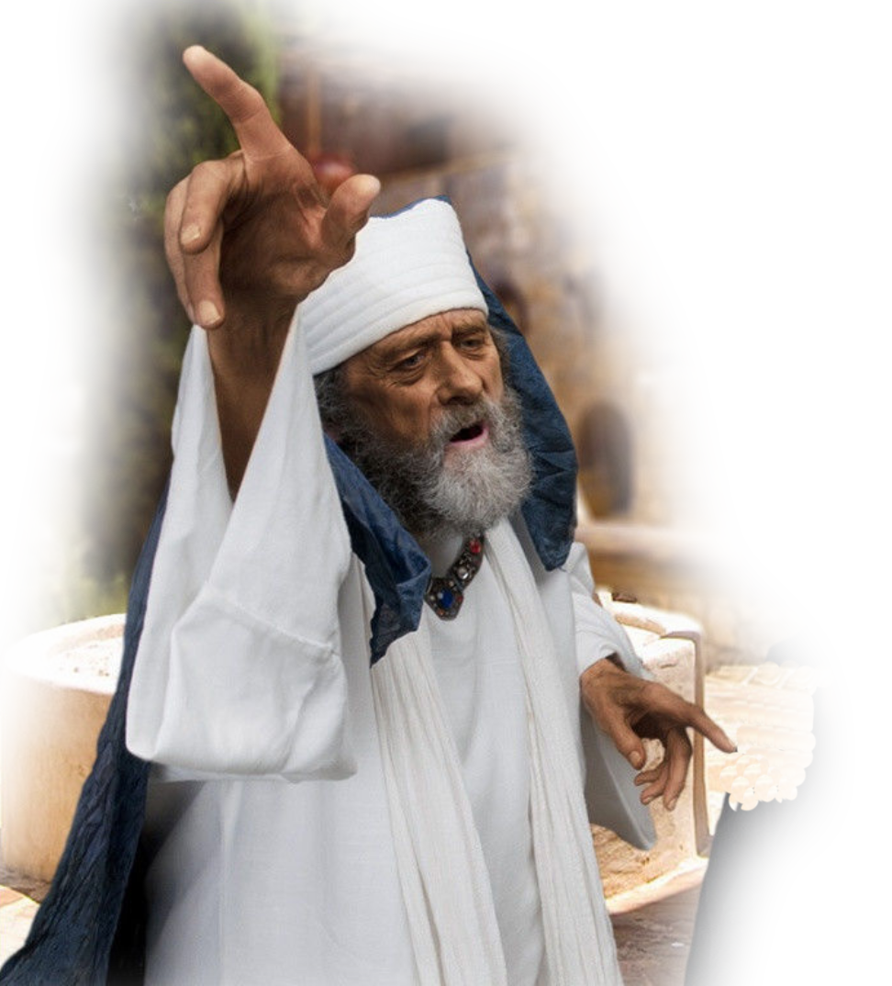
WHO DIDN’T?
… the Tekoites repaired, but their nobles would not stoop to serve their Lord. (3:5)

Slide 32
What Does God Want Us to Learn?

Slide 33
What Does God Want Us to Learn?
There is a job for everyone of us to do …

Slide 34

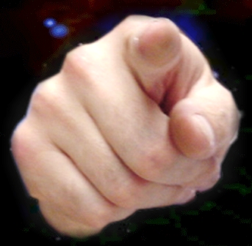
What Does God Want Us to Learn?
There is a job for everyone of us to do …
That means YOU!

Slide 35
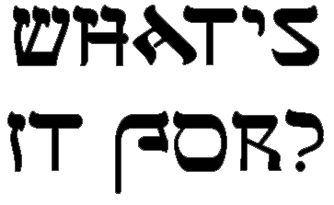
3- Purpose for Construction
Notes:
https://www.needpix.com/photo/download/1515326/construction-constructionzone-sign-signs-workarea-constructionarea-worksite-constructionsite-construction-zone
The Construction Project focuses on WHAT NEEDS TO BE DONE!
The Construction Workers focuses on WHO NEEDS TO DO IT!

Slide 36
3- Purpose for Construction
"You search the Scriptures because you think they give you eternal life. But the Scriptures point to me! (John 5:39 NLT)
Notes:
https://www.needpix.com/photo/download/1515326/construction-constructionzone-sign-signs-workarea-constructionarea-worksite-constructionsite-construction-zone
The Construction Project focuses on WHAT NEEDS TO BE DONE!
The Construction Workers focuses on WHO NEEDS TO DO IT!

Slide 37
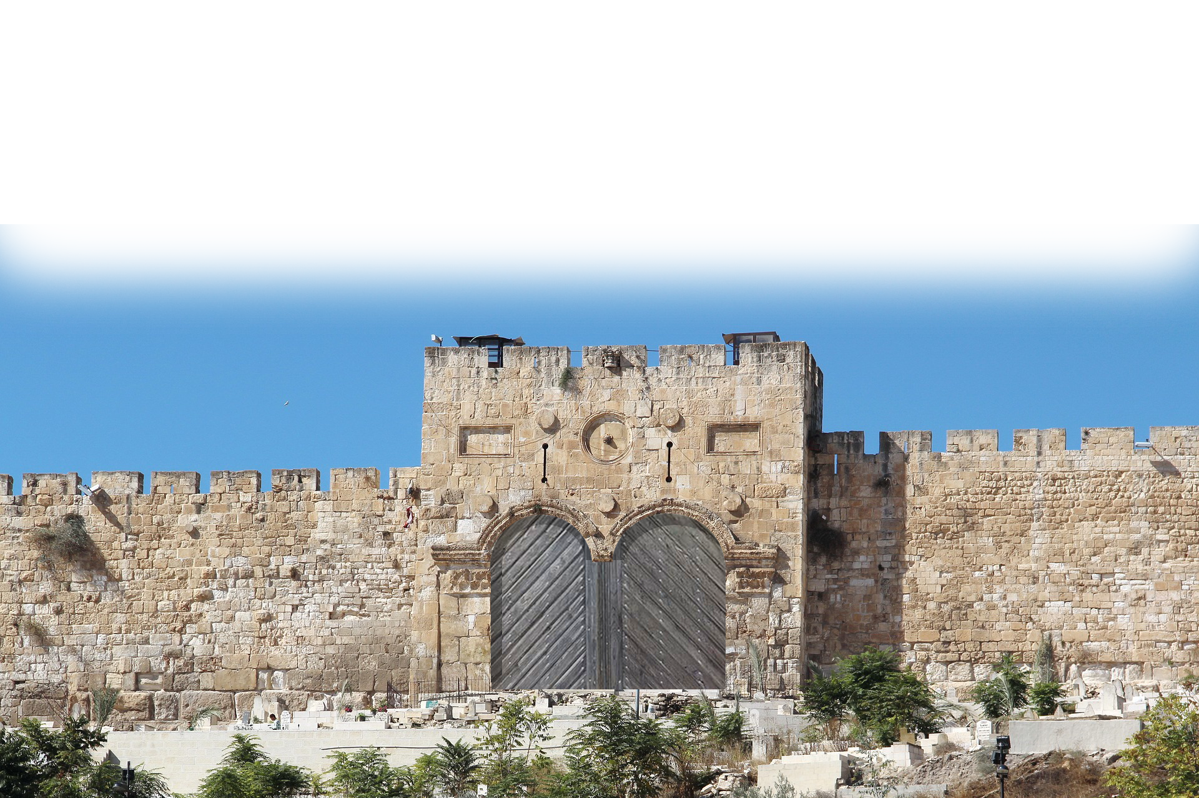
Gates relate to an aspect of Christ and the Christian Life
Building your life on Christ is like the …
Notes:
Some of the Older Preachers, Ray Stedman, J. Vernon McGee, Warren Weirsbe, and others, related each.
Building your life on Christ is like the …

Slide 38
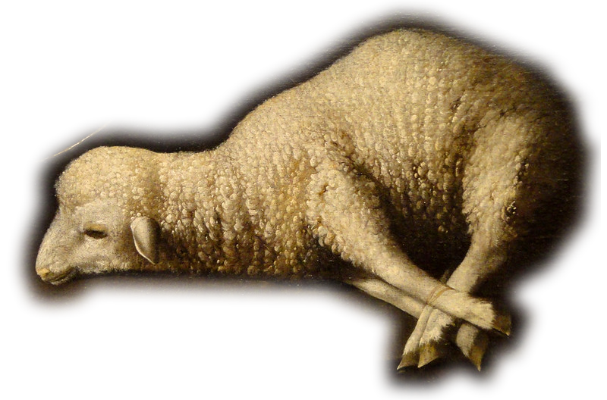
The SHEEP Gate 1-2
Sheep
^{Isa 53:6} All we like sheep have gone astray; we have turned--every one--to his own way; and the LORD has laid on him the iniquity of us all.
TEMPLE
Notes:
https://www.flickr.com/photos/eoskins/13926843934

Slide 39
The SHEEP Gate 1-2
Sheep
^{Isa 53:6} All we like sheep have gone astray; we have turned--every one--to his own way; and the LORD has laid on him the iniquity of us all.
TEMPLE
Notes:
https://www.flickr.com/photos/eoskins/13926843934

Slide 40
The SHEEP Gate 1-2
Sheep
^{Isa 53:6} All we like sheep have gone astray; we have turned--every one--to his own way; and the LORD has laid on him the iniquity of us all.
^{John 1:29} Behold, the Lamb of God, who takes away the sin of the world!
TEMPLE
Notes:
https://www.flickr.com/photos/eoskins/13926843934

Slide 41
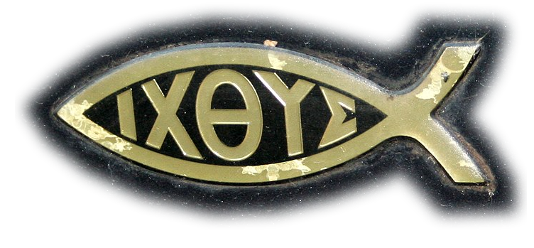
The FISH Gate 3-5
Sheep
Fish
^{Mark 4:19} And he said to them, "Follow me, and I will make you fishers of men."
TEMPLE
Notes:
https://upload.wikimedia.org/wikipedia/commons/thumb/1/1b/Ichthys_C-Class.jpg/2048px-Ichthys_C-Class.jpg

Slide 42

The OLD Gate 6-12
Sheep
Fish
^{Rev 21:5} "Behold, I am making all things new."
^{2Cor 5:17} Therefore, if anyone is in Christ, he is a new creation. The old has passed away; behold, the new has come.
Old
TEMPLE
Notes:
https://upload.wikimedia.org/wikipedia/commons/3/3a/%C3%89glise_Saint-Jacques-Saint-Christophe_de_la_Villette%2C_Paris_-_Alpha_and_Omega_on_Front_Side.jpg
https://pixabay.com/photos/glass-wine-water-mix-color-3535446/
Jesus first miracle = Miracle of changing water to wine = He can change you too.

Slide 43
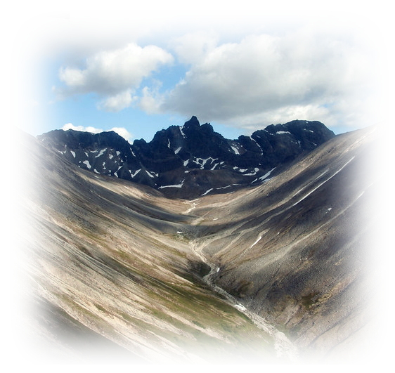
The VALLEY Gate 13
Sheep
Fish
Old
^{Phil 2:5} Have this mind among yourselves, which is yours in Christ Jesus… ⁶ Who … ⁷ …made himself nothing, taking the form of a servant, … he humbled himself … to the point of death, even death on a cross.
TEMPLE
Valley
Notes:
https://www.flickr.com/photos/lakeclarknps/26104437328

Slide 44
The VALLEY Gate 13
Sheep
Fish
Old
^{Phil 2:5} ⁹ Therefore God has highly exalted him and bestowed on him the name that is above every name,
TEMPLE
Valley
Notes:
https://www.flickr.com/photos/lakeclarknps/26104437328

Slide 45

The DUNG Gate 14
Sheep
Fish
Old
^{1John 1:7} But if we walk in the light, as he is in the light, we have fellowship with one another, and the blood of Jesus his Son cleanses us from all sin.
TEMPLE
Valley
Dung
Notes:
https://commons.wikimedia.org/wiki/File:Poop_Emoji_Icon.png
https://www.pxfuel.com/en/free-photo-xdzbe

Slide 46
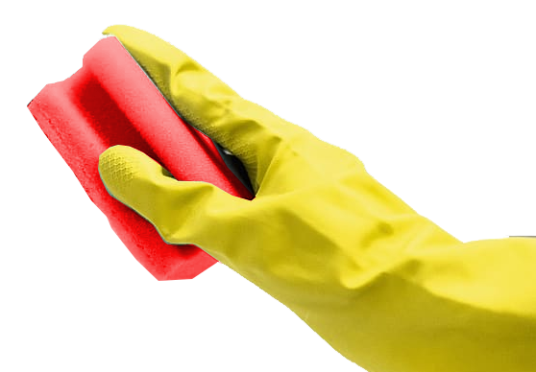
The DUNG Gate 14
Sheep
Fish
Old
^{1John 1:7} But if we walk in the light, as he is in the light, we have fellowship with one another, and the blood of Jesus his Son cleanses us from all sin.
TEMPLE
Valley
Dung
Notes:
https://commons.wikimedia.org/wiki/File:Poop_Emoji_Icon.png
https://www.pxfuel.com/en/free-photo-xdzbe

Slide 47
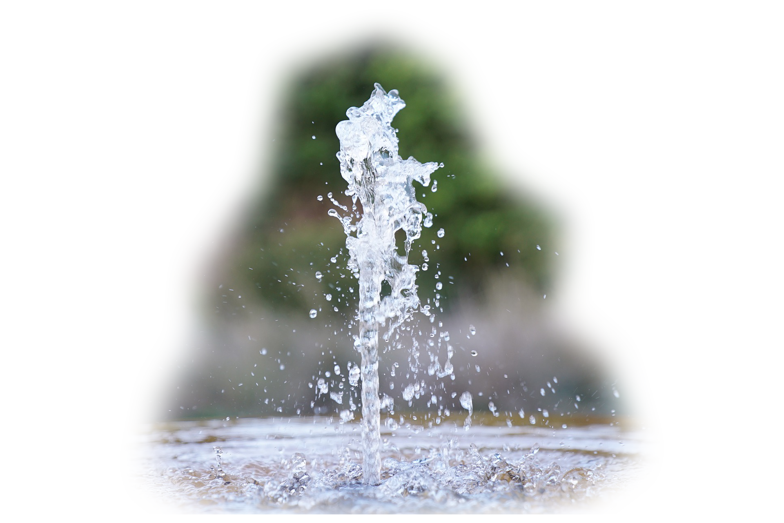
The FOUNTAIN Gate 15-20
Sheep
Fish
Old
^{John 4:14} but whoever drinks of the water that I will give him will never be thirsty again. The water that I will give him will become in him a spring of water welling up to eternal life."
TEMPLE
Valley
Dung
Fountain
Notes:
https://pixabay.com/photos/water-fountain-water-spurt-garden-4400160/

Slide 48

The WATER Gate 21-27
Sheep
Fish
Old
^{Eph 5:25} Christ loved the church and gave himself up for her, ²⁶ that he might sanctify her, having cleansed her by the washing of water with the word….
TEMPLE
Valley
Water
Dung
Fountain

Slide 49
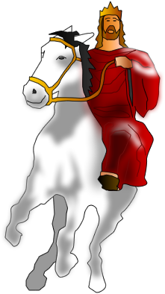
The HORSE Gate 28
Sheep
Fish
Old
^{Rev 19:11} Then I saw heaven opened, and behold, a white horse! The one sitting on it is called Faithful and True, and in righteousness he judges and makes war.
TEMPLE
Horse
Valley
Water
Dung
Fountain
Notes:
He entered Jerusalem the first time on a Donkey to fulfill Biblical prophecy on Palm Sunday.
He enters the next time on a horse to fulfill prophecy of Revelation 19.

Slide 50
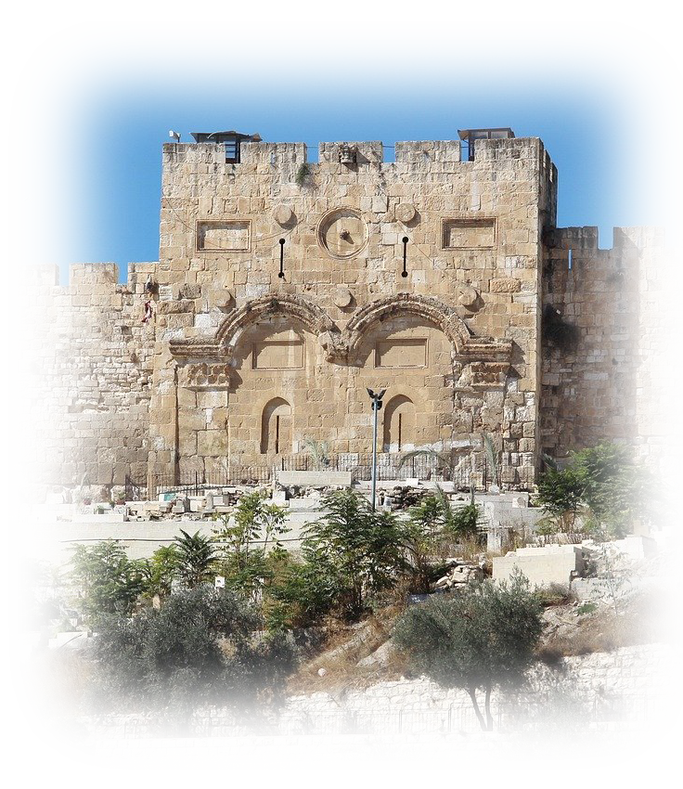
The EAST Gate 29
Sheep
Fish
^{Ez 44:2} …"This gate shall remain shut; it shall not be opened, and no one shall enter by it, for the LORD, the God of Israel, has entered by it. Therefore it shall remain shut. ³ Only the prince …. shall enter by way of the … the gate, and shall go out by the same way."
Old
East
TEMPLE
Horse
Valley
Water
Dung
Fountain
Notes:
Then he brought me back to the outer gate of the sanctuary, which faces east. And it was shut.
² And the LORD said to me, "This gate shall remain shut; it shall not be opened, and no one shall enter by it, for the LORD, the God of Israel, has entered by it. Therefore it shall remain shut.
³ Only the prince may sit in it to eat bread before the LORD. He shall enter by way of the vestibule of the gate, and shall go out by the same way."
(Eze 44:1-3 ESV)

Slide 51
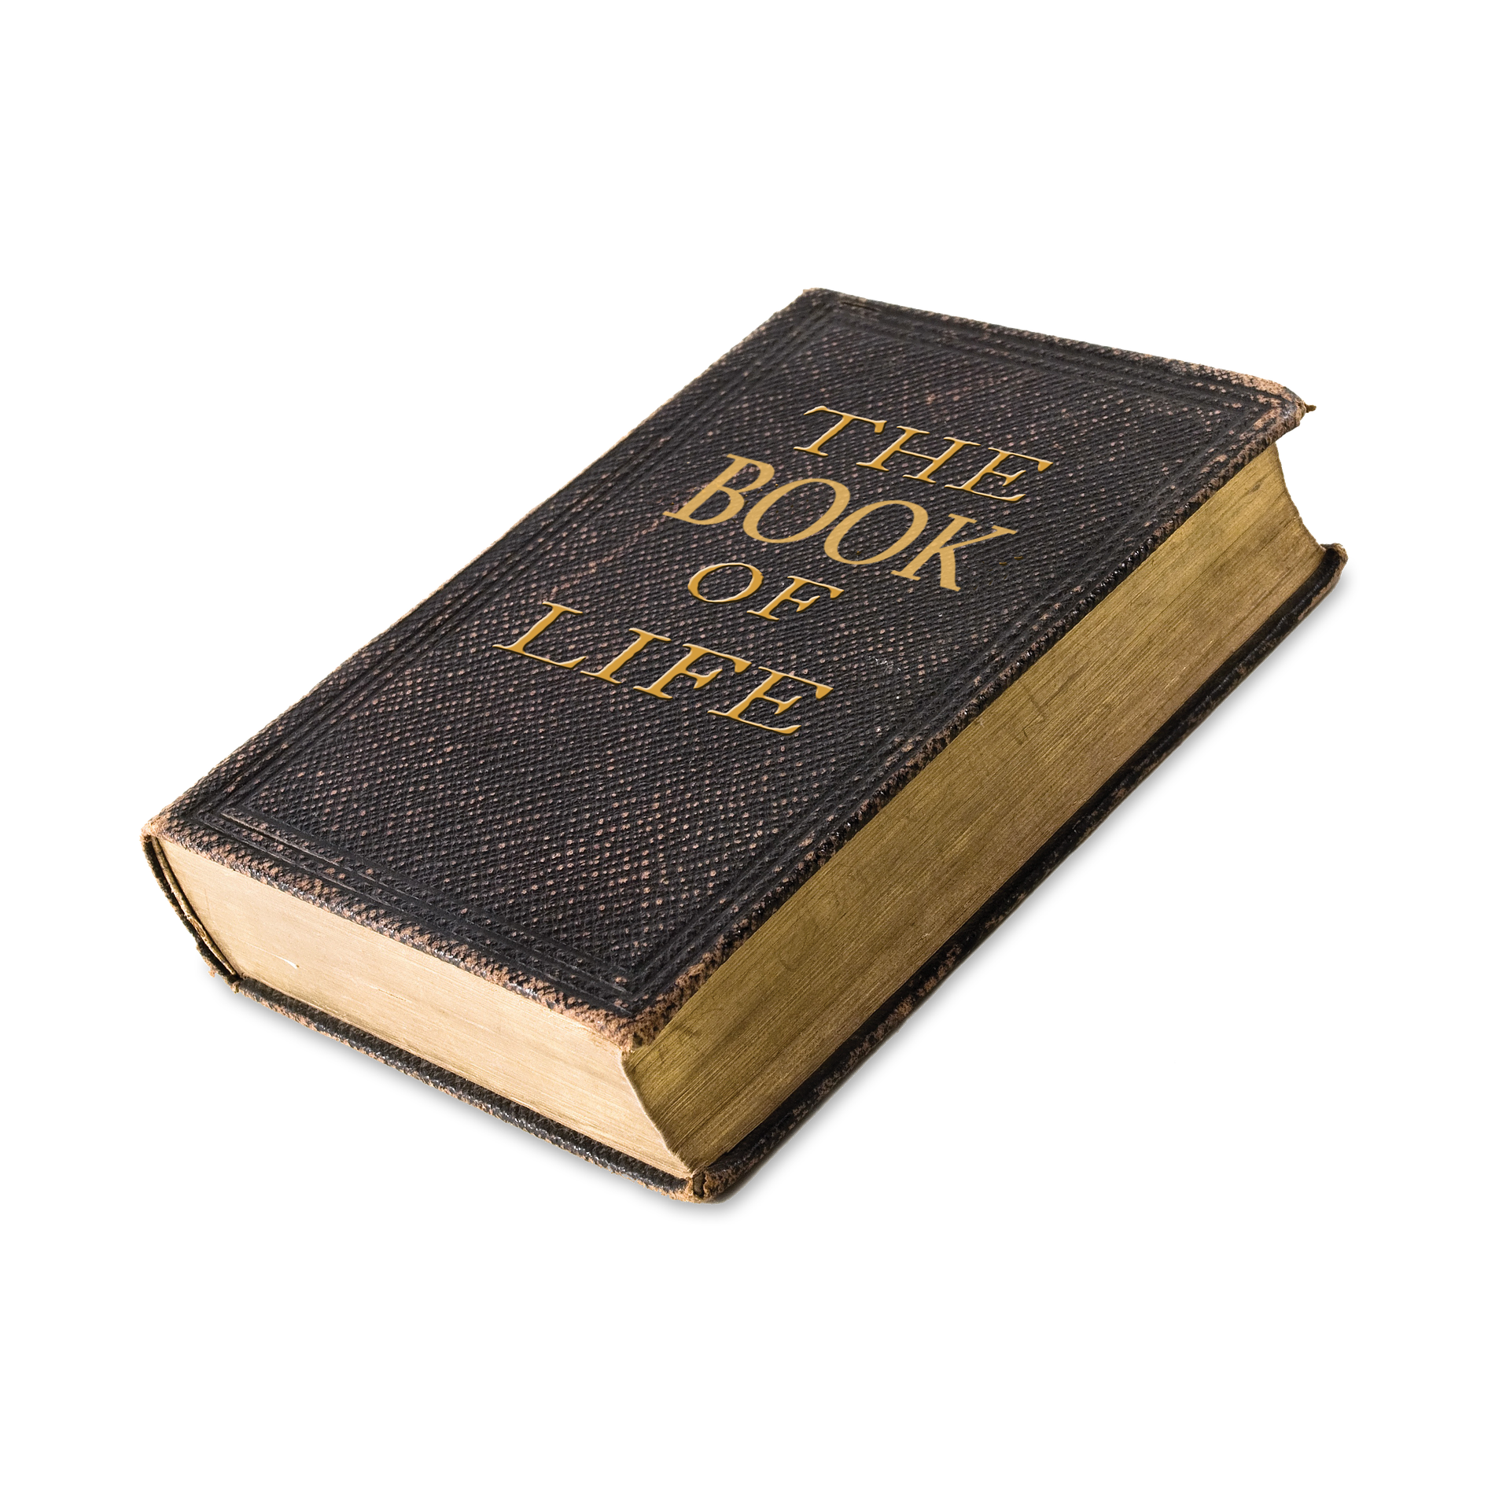
The MUSTER Gate 6-12
Sheep
Fish
Muster
Old
^{Rev 21:27} But nothing unclean will ever enter it, nor anyone who does what is detestable or false, but only those who are written in the Lamb's book of life.
East
TEMPLE
Horse
Valley
Water
Dung
Fountain
Notes:
https://pixabay.com/photos/life-rules-book-rules-of-life-2643192/
Book of Life

Slide 52
What are you saying?

Slide 53
What are you saying?
God has a providential purpose
in every building project!

Slide 54
What are you saying?
God has a providential purpose
in every building project!
And you NEED to be a part of it!

Slide 55
What are you saying?
You know that your labor in the Lord is not in vain. (1Co 15:58 NIV)
God has a providential purpose
in every building project!
And you NEED to be a part of it!

Slide 56
Let’s Pray!

