Slide 1
Picking up the
Pieces
Through
INSPECTIONS
A Study of Nehemiah
Notes:
https://upload.wikimedia.org/wikipedia/commons/7/74/Wikipedia-logo-v2-pieces.svg
https://www.freepik.com/free-photo/jigsaw-puzzle-with-missing-piece-missing-puzzle-pieces_5469650.htm
Copyright © 2006−2021. All rights reserved. Bible Point is a registered trademark of Dennis Henderson. All other trademarks acknowledged.
Bible Point contains graphics from Bible Point artists. These illustrations belong to Bible Point and the respective artists. You may use the designs and illustrations for graphical illustration of lessons free and without special permission, provided they are not used in any way that maligns the Christian faith. Furthermore, republication or production of any illustration by any other graphic service whether it be in book, in a machine-readable form, or in any other design resource is strictly prohibited. Furthermore, they cannot be duplicated or resold as any other form of publishing, clip art, or graphic resource.
So What does it mean? (A simple translations of the legal jargon)
So, if you don’t own the presentation(s), graphic(s), and text(s) how can you legally use them? The purchase of the license allows you to use all the images in the product. However, the actual ownership and copyright of the presentation(s), graphic(s), and text(s) remain the property of Bible Point and its licensors. If you had plans on using this product in your “for sale” work—think again!
License Agreement
Article 1: License Grant
All the graphics and text in Bible Point presentations (excluding quotes from the Bible and stated sources) are the intellectual and real property of Bible Point and its licensors, and is protected by law, including United States copyright laws and international treaties. Bible Point grants to you a license:
1. To use the presentation in a single church, single school, or single office of a Christian organization.
2. To make a single archival back-up copy of the program.
3. To modify the presentation(s) and merge with other presentations in a single church, school, or Christian organization.
4. To transfer to another party if that party agrees to accept the terms and conditions of this agreement, and you do not retain any copies of the presentation, whether printed, machine readable, modified, or merged form.
Article 2: Terms
This license is effective until terminated. You may terminate the license at any time by destroying the presentation(s), graphic(s), or text(s) together with all copies, modifications and merged portions in any form. Bible Point may terminate your license if you fail to comply with this Agreement. You agree, upon such termination, for any reason, to destroy the presentation(s), graphics, and text(s) with all copies, modifications, and merged portions in any form.
Article 3: Disclaimers
1. Bible Point presentations, graphics, and texts are licensed to you As Is. You, the consumer, bear the entire risk relating to the quality and performance of the presentation(s), graphic(s), or text(s). In no event will Bible Point be liable for damages resulting from any defect.
2. Thirty-day limited warrantee on disks. Bible Point warrants the disks to be free of defects in material and workmanship under normal use for 30 days after purchase. During the 30-day period you may return a defective presentation, graphic, or text with proof of purchase and it will be replaced without charge, unless the presentation is damaged by misuse.
Article 4: General
1. You may not sub-license, assign, or transfer the license of the presentation(s), graphic(s), or text(s) except as provided by this Agreement.
2. This Agreement will be governed by the laws of the State of Michigan.
So What does it mean? (A simple translations of the legal jargon)
May I let someone borrow or copy my licensed Bible Point presentation (even after I modified it)? As long as it is within your local church, or single school, or the immediate office of a Christian organization you may. Otherwise, please refer the person interested in borrowing to: http://www.biblepoint.com or E-mail: dennis@DrDH.net with any related questions.

Slide 2
Picking up the
Pieces
Through
INSPECTION
Notes:
https://upload.wikimedia.org/wikipedia/commons/7/74/Wikipedia-logo-v2-pieces.svg
https://www.freepik.com/free-photo/jigsaw-puzzle-with-missing-piece-missing-puzzle-pieces_5469650.htm
Like our world Nehemiah’s world was broken.
His nation was toppled by a foreign power and was in total ruins.
His city was destroyed with no defense.
His people were in utter poverty and injustices prevailed.
He learned of this condition while he lived in luxury in a suburban nation called Persia. In its lush capitol of Susa. It was through his brother who visited him from Jerusalem that he learned this.
He was utterly grieved over the ruin of his nation and people.
For four months he prayed.
It altered who he was. He was spiritually depressed by the news.
That was noticed by king, Artaxerxes who demand the reason for his sad countenance.
It was risky to speak up and not at all politically correct to say what he need to say as it opposed the king’s previous position on Jerusalem that its walls should not be rebuilt
But after a brief “emoji” prayer, he took the politically incorrect view and convinced the King to allow him to rebuild Jerusalem—him a cupbearer, waiter on the king to build the walls of Jerusalem.
The King granted his request and …
We pickup today with his arrival in Jerusalem.
Our topic today is …

Slide 3
Picking up the
Pieces
Through
INSPECTION
¹¹ So I went to Jerusalem and was there three days.
Notes:
https://upload.wikimedia.org/wikipedia/commons/7/74/Wikipedia-logo-v2-pieces.svg
https://www.freepik.com/free-photo/jigsaw-puzzle-with-missing-piece-missing-puzzle-pieces_5469650.htm

Slide 4
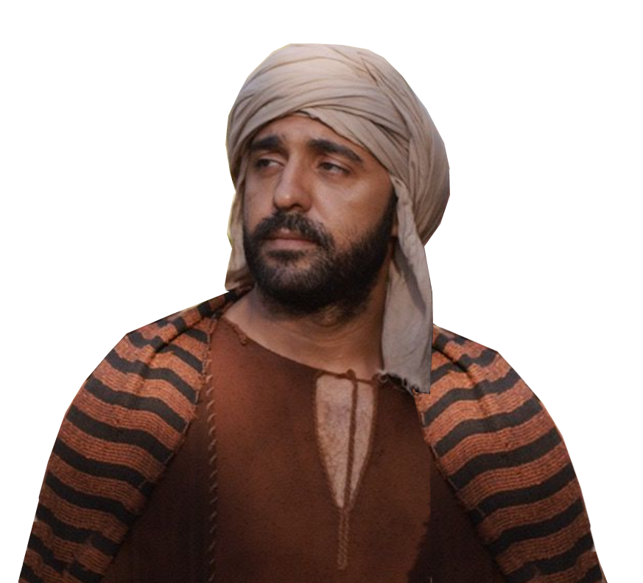
There is tension in the air 2:10
¹⁰ But when Sanballat the Horonite and Tobiah the Ammonite servant heard this, it displeased them greatly that someone had come to seek the welfare of the people of Israel.
Notes:
Tension upon arrival.
He is DISRUPTER.
Displeased is rooted in the word “Evil”
Welfare is rooted in the word “Good”
We have the tension of “Good and evil” in a political dispute.
The good guy wants the wall and the bad guys don’t want the wall.
The wall is for protection from the evil. The evil don’t want the people protected.

Slide 5
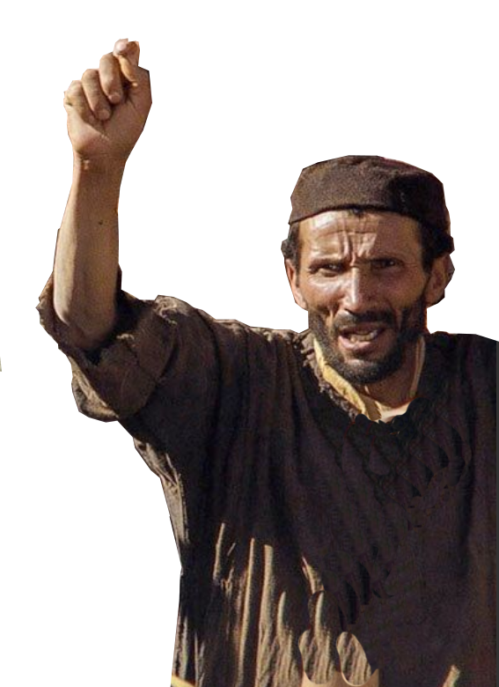
There is tension in the air 2:10
¹⁰ But when Sanballat the Horonite and Tobiah the Ammonite servant heard this, it displeased them greatly that someone had come to seek the welfare of the people of Israel.
Notes:
Tension upon arrival
Displeased is rooted in the word “Evil”
Welfare is rooted in the word “Good”
We have the tension of “Good and evil” in a political dispute.
The good guy wants the wall and the bad guys don’t want the wall.
The wall is for protection from the evil. The evil don’t want the people protected.

Slide 6
There is tension in the air 2:10
¹⁰ But when Sanballat the Horonite and Tobiah the Ammonite servant heard this, it displeased them greatly that someone had come to seek the welfare of the people of Israel.
Notes:
Tension upon arrival
Displeased is rooted in the word “Evil”
Welfare is rooted in the word “Good”
We have the tension of “Good and evil” in a political dispute.
The good guy wants the wall and the bad guys don’t want the wall.
The wall is for protection from the evil. The evil don’t want the people protected.

Slide 7

There is tension in the air 2:10
¹⁰ But when Sanballat the Horonite and Tobiah the Ammonite servant heard this, it displeased them greatly that someone had come to seek the welfare of the people of Israel.
Notes:
Tension upon arrival
Displeased is rooted in the word “Evil”
Welfare is rooted in the word “Good”
We have the tension of “Good and evil” in a political dispute.
The good guy wants the wall and the bad guys don’t want the wall.
The wall is for protection from the evil. The evil don’t want the people protected.

Slide 8
There is tension in the air 2:10
¹⁰ But when Sanballat the Horonite and Tobiah the Ammonite servant heard this, it displeased them greatly that someone had come to seek the welfare of the people of Israel.
Notes:
Tension upon arrival
Displeased is rooted in the word “Evil”
Welfare is rooted in the word “Good”
We have the tension of “Good and evil” in a political dispute.
The good guy wants the wall and the bad guys don’t want the wall.
The wall is for protection from the evil. The evil don’t want the people protected.

Slide 9

There is tension in the air 2:10
¹⁰ But when Sanballat the Horonite and Tobiah the Ammonite servant heard this, it displeased them greatly that someone had come to seek the welfare of the people of Israel.
Notes:
Tension upon arrival
Displeased is rooted in the word “Evil”
Welfare is rooted in the word “Good”
We have the tension of “Good and evil” in a political dispute.
The good guy wants the wall and the bad guys don’t want the wall.
The wall is for protection from the evil. The evil don’t want the people protected.

Slide 10
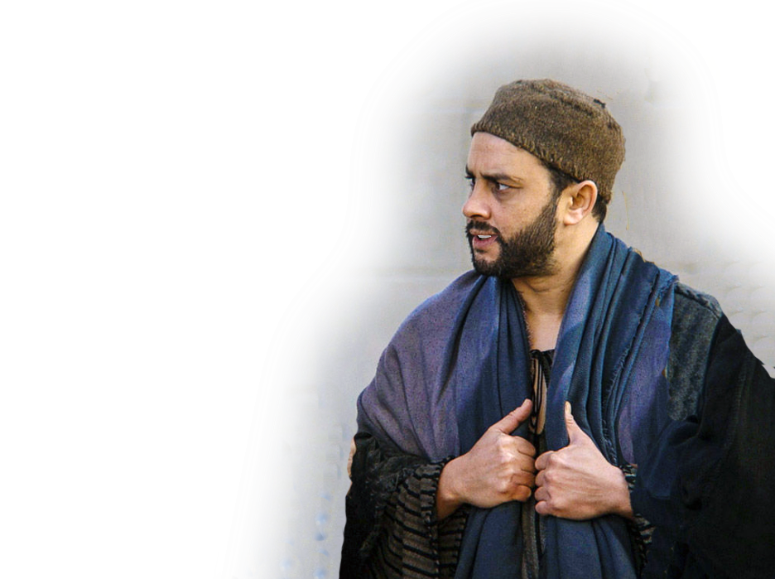

Keep your Silence
¹² Then I arose in the night, I and a few men with me. And I told no one what my God had put into my heart to do for Jerusalem. There was no animal with me but the one on which I rode.
Notes:
When there is tension in the air “Silence is golden.” I think most Christians find that to be the case today.
I do believe that there is a silent majority right now. They don’t denounce the violence, rioting, protests, cancel culture, defund the police, gay marriage, transgender identity crisis, abortion, freeing and giving the vote to prisoners, non-citizens, etc.
You have to know when to keep a tight lip and when to speak.
“a time to keep silence, and a time to speak;” (Ecc 3:7 ESV)
Nehemiah knew this. It was a time to keep silent about what God had put in his heart.
Some people talk too much and do too little.
Others, like Nehemiah, have few words and let his actions speak louder than words.

Slide 11
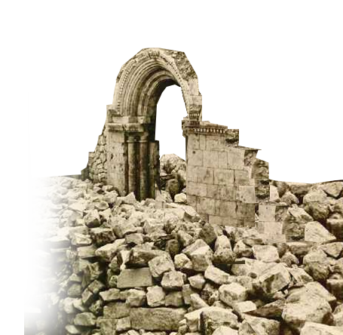
Inspect your Damages
¹³ I went out by night by the Valley Gate to the Dragon Spring and to the Dung Gate, and I inspected the walls of Jerusalem that were broken down and its gates that had been destroyed by fire.

Slide 12

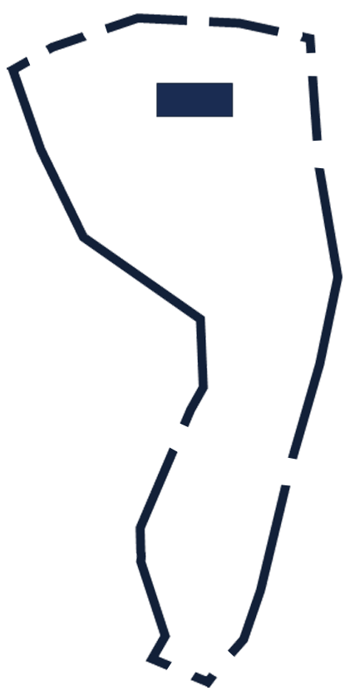
Inspect your Damages
¹³ I went out by night by the Valley Gate to the Dragon Spring and to the Dung Gate, and I inspected the walls of Jerusalem that were broken down and its gates that had been destroyed by fire.
TEMPLE
Valley Gate
Dung Gate
Notes:
Parchament = Pixabay

Slide 13
Inspect your Damages
¹⁴ Then I went on to the Fountain Gate and to the King's Pool, but there was no room for the animal that was under me to pass.
TEMPLE
Valley Gate
Dung Gate
Fountain Gate
Notes:
Listen, you do not have to leave the convenience of your homes to see the damages of
COVID 19
Black Lives Matter (Antifa)
Cancel Culture
Defund the Police
Etc.
It is brought to you in living color on cable tv 24/7.
America is damaged goods. It can either get better or worse.

Slide 14
Inspect your Damages
¹⁴ Then I went on to the Fountain Gate and to the King's Pool, but there was no room for the animal that was under me to pass.
TEMPLE
Valley Gate
Dung Gate
Fountain Gate

Slide 15
Inspect your Damages
¹⁴ Then I went on to the Fountain Gate and to the King's Pool, but there was no room for the animal that was under me to pass.
TEMPLE
Valley Gate
Dung Gate
Fountain Gate

Slide 16
Inspect your Damages
¹⁵ Then I went up in the night by the valley and inspected the wall, and I turned back and entered by the Valley Gate, and so returned.
TEMPLE
Valley Gate
Dung Gate
Fountain Gate
Notes:
He did his homework before he took a position.
He didn’t just listen to the news—he verified what his brother had told him.
Yes, Jerusalem was in ruins, totally defenseless and vulnerable to any enemy, gangs, thugs, warlords who wished to plunder or raid the small band of settlers could easily do so.
You and I should learn from him to verify the news. Be sure it is reputable. Just because a lot of source say the same daily bullet points does not make a single one of them true. You need to inspect the nation. Inspect, see for yourself what the real situation is behind.
The COVID 19 accounting, the anarchist in our streets. Black Lives Matter. The green new deal. Etc. That means you will have to listen to both sides of the story—not biased to one side or the other before your inspection.
What is it that really ails America? Answer: Spiritual failure.

Slide 17
Inspect your Damages
¹⁵ Then I went up in the night by the valley and inspected the wall, and I turned back and entered by the Valley Gate, and so returned.
TEMPLE
Valley Gate
Valley Gate
Fountain Gate
Notes:
He did his homework before he took a position.
He didn’t just listen to the news—he verified what his brother had told him.
Yes, Jerusalem was in ruins, totally defenseless and vulnerable to any enemy, gangs, thugs, warlords who wished to plunder or raid the small band of settlers could easily do so.
You and I should learn from him to verify the news. Be sure it is reputable. Just because a lot of source say the same daily bullet points does not make a single one of them true. You need to inspect the nation. Inspect, see for yourself what the real situation is behind.
The COVID 19 accounting, the anarchist in our streets. Black Lives Matter. The green new deal. Etc. That means you will have to listen to both sides of the story—not biased to one side or the other before your inspection.
What is it that really ails America? Answer: Spiritual failure.

Slide 18
Conceal your Mission
¹⁶ And the officials did not know where I had gone or what I was doing, and I had not yet told the Jews, the priests, the nobles, the officials, and the rest who were to do the work.
Notes:
This was a covert operation of data collecting to make a decision on how to act.
Stealth was the mode of operation.

Slide 19
Conceal your Mission
¹⁶ And the officials did not know where I had gone or what I was doing, and I had not yet told the Jews, the priests, the nobles, the officials, and the rest who were to do the work.
Notes:
He did not plan to be silent forever.
“a time to keep silence, and a time to speak;” (Ecc 3:7 ESV)
According to that now famous hymn writer, Kenny Rogers:
You've got to know when to hold 'em
Know when to fold 'em
Know when to walk away
And know when to run
You never count your money
When you're sittin' at the table
There'll be time enough for countin'
When the dealin's done

Slide 20
Conceal your Mission
¹⁶ And the officials did not know where I had gone or what I was doing, and I had not yet told the Jews, the priests, the nobles, the officials, and the rest who were to do the work.
Notes:
Notice he planned to show his hand at the appropriate time to the following:
Jews –People who descended from Abraham, through Isaac and Jacob
Priests – Descended from Levi
Nobles – Descended from David
Officials – Political figures
Laborers – Working class

Slide 21
Assess your Situation
¹⁷ Then I said to them,
"You see the trouble we are in, how Jerusalem lies in ruins with its gates burned.
Notes:
“Trouble” is the very same word that his brother used to describe the situation in 1:3.
The root word is Rah = evil. He is saying this is an “evil “ situation. To be wall-less is to be defenseless and is an evil situation.
The city is in ruins. Where there is no protection (wall or police) there is chaos and evil.

Slide 22
Assess your Situation
¹⁷ Then I said to them,
"You see the trouble we are in, how Jerusalem lies in ruins with its gates burned.
Notes:
“Trouble” is the very same word that his brother used to describe the situation in 1:3.
The root word is Rah = evil. He is saying this is an “evil “ situation. To be wall-less is to be defenseless and is an evil situation.
The city is in ruins. Where there is no protection (wall or police) there is chaos and evil.

Slide 23
Sell your Vision
¹⁷ Then I said to them,
Come, let us build the wall of Jerusalem, that we may no longer suffer derision."
Notes:
Come, is an imperative to walk along side with Nehemiah.

Slide 24
Sell your Vision
¹⁷ Then I said to them,
Come, let us build the wall of Jerusalem, that we may no longer suffer derision."
Notes:
Come, is an imperative to walk along side with Nehemiah.
build that wall!

Slide 25
Sell your Vision
¹⁷ Then I said to them,
Come, let us build the wall of Jerusalem, that we may no longer suffer derision."
Notes:
Come, is an imperative to walk along side with Nehemiah.
build that wall!
No longer suffer derision = reproach of 1:3 which his brother had reported. Literally, a disgrace.

Slide 26
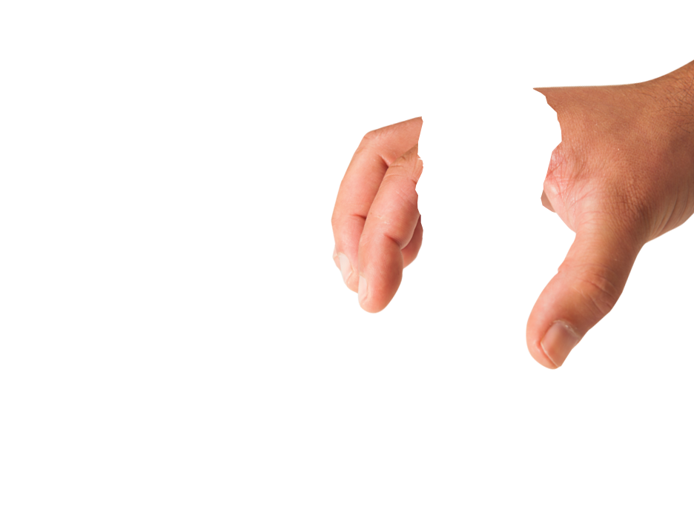
Sell your Vision
¹⁸ And I told them of the hand of my God that had been upon me for good, and also of the words that the king had spoken to me. And they said, "Let us rise up and build."
So they strengthened their hands for the good
work.
Notes:
Now he sells his vision
He told the story of
He learned of this condition while he lived in luxury in a suburban nation called Persia. In its lush capitol of Susa. It was through his brother who visited him from Jerusalem that he learned this.
He was utterly grieved over the ruin of his nation and people.
For four months he prayed.
It altered who he was. He was spiritually depressed.
That was noticed by king, Artaxerxes who demand the reason for his sad countenance.
It was risky to speak up and not at all politically correct to say what he said as it opposed the king’s previous position on Jerusalem.
But after a brief “emoji” prayer, he took the politically incorrect view and convinced the King to allow him to rebuild Jerusalem—him a cupbearer, waiter on the king.
We pickup today with his arrival in Jerusalem.
With the permission of the King and resourced to do the task. In fact he had a vision, plan, and needed them as the workers to execute the plan.

Slide 27
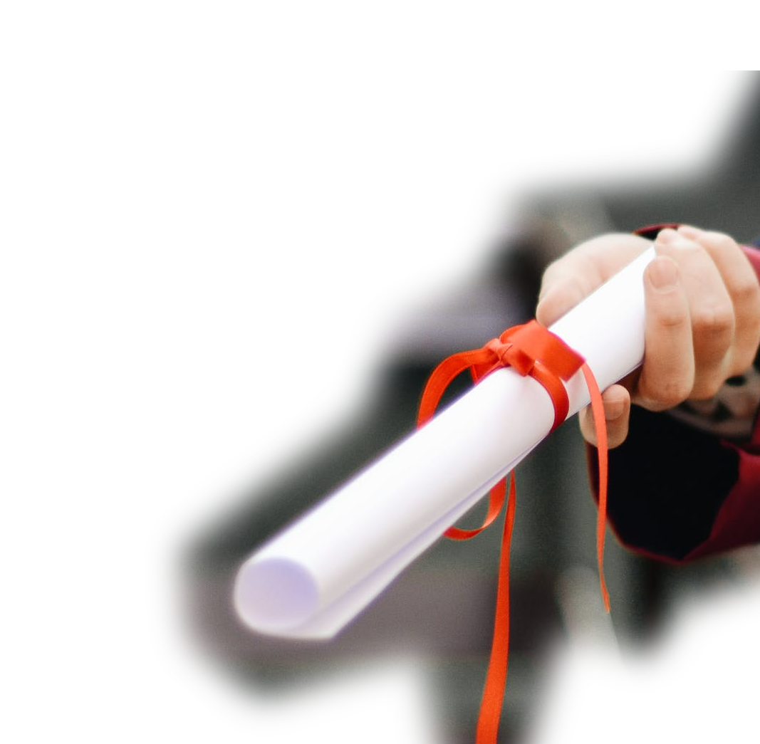
Sell your Vision
¹⁸ And I told them of the hand of my God that had been upon me for good, and also of the words that the king had spoken to me. And they said, "Let us rise up and build."
So they strengthened their hands for the good work.
Notes:
2:2-8

Slide 28
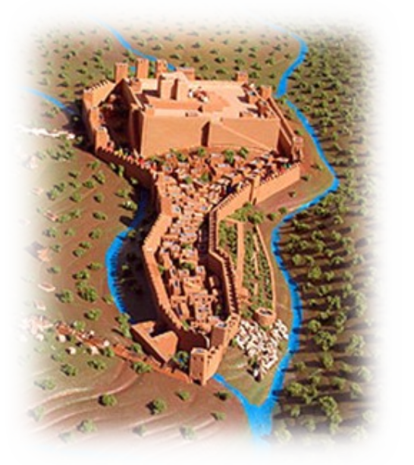
Sell your Vision
¹⁸ And I told them of the hand of my God that had been upon me for good, and also of the words that the king had spoken to me. And they said, "Let us rise up and build."
So they strengthened their hands for the good work.
Notes:
Vision is sold! They bought into the idea

Slide 29
Sell your Vision
¹⁸ And I told them of the hand of my God that had been upon me for good, and also of the words that the king had spoken to me. And they said, "Let us rise up and build."
So they strengthened their hands for the good work.
Notes:
Vision is sold! They bought into the idea

Slide 30

Deflect your Criticism
¹⁹ But when Sanballat the Horonite and Tobiah the Ammonite servant and Geshem the Arab heard of it, they jeered at us and despised us and said, "What is this thing that you are doing? Are you rebelling against the king?"
Notes:
https://www.flickr.com/photos/30478819@N08/48440130557/

Slide 31
Deflect your Criticism
¹⁹ But when Sanballat the Horonite and Tobiah the Ammonite servant and Geshem the Arab heard of it, they jeered at us and despised us and said, "What is this thing that you are doing? Are you rebelling against the king?"
Notes:
https://www.flickr.com/photos/30478819@N08/48440130557/

Slide 32
Deflect your Criticism
¹⁹ But when Sanballat the Horonite and Tobiah the Ammonite servant and Geshem the Arab heard of it, they jeered at us and despised us and said, "What is this thing that you are doing? Are you rebelling against the king?"
Notes:
https://www.flickr.com/photos/30478819@N08/48440130557/

Slide 33
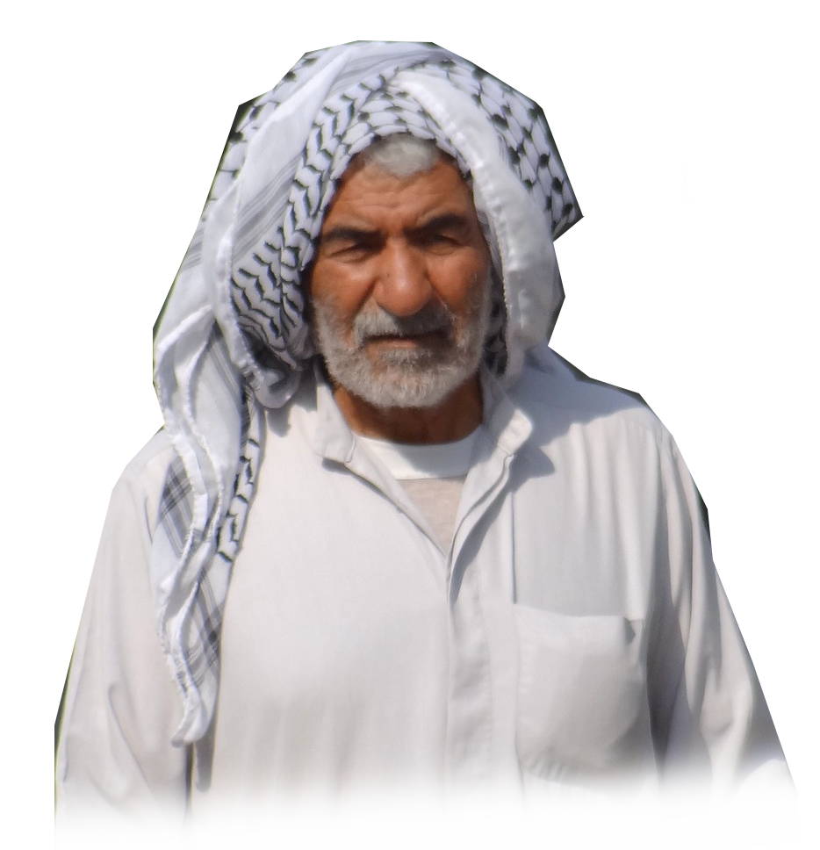
Deflect your Criticism
¹⁹ But when Sanballat the Horonite and Tobiah the Ammonite servant and Geshem the Arab heard of it, they jeered at us and despised us and said, "What is this thing that you are doing? Are you rebelling against the king?"
Notes:
https://www.flickr.com/photos/30478819@N08/48440130557/

Slide 34
Deflect your Criticism
¹⁹ But when Sanballat the Horonite and Tobiah the Ammonite servant and Geshem the Arab heard of it, they jeered at us and despised us and said, "What is this thing that you are doing? Are you rebelling against the king?"
Notes:
https://www.flickr.com/photos/30478819@N08/48440130557/

Slide 35
Deflect your Criticism
¹⁹ But when Sanballat the Horonite and Tobiah the Ammonite servant and Geshem the Arab heard of it, they jeered at us and despised us and said, "What is this thing that you are doing? Are you rebelling against the king?"
Notes:
https://www.flickr.com/photos/30478819@N08/48440130557/

Slide 36
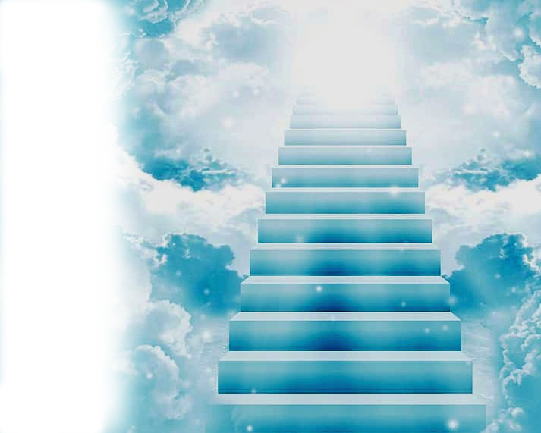
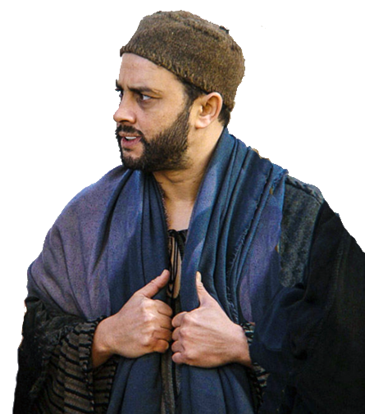
Deflect your Criticism
²⁰ Then I replied to them,
"The God of heaven will make us prosper, and we his servants will arise and build, but you have no portion or right or claim in Jerusalem."
Notes:
He does not respond in the usual manner = Look, here is the papers from King Artaxerxes. Here is the letter for wood supply.
Instead, he testifies that God is the one who commissioned Him, not Artaxerxes.
God will prosper this venture—not a political hack or even a king.

Slide 37
Deflect your Criticism
²⁰ Then I replied to them,
"The God of heaven will make us prosper, and we his servants will arise and build, but you have no portion or right or claim in Jerusalem."
Notes:
I want to remind you that Jesus has promised “I will build My church and the gates of hell will not prevail against it.”
Jesus will build Bethany as we are servants of the Lord Jesus Christ.

Slide 38

Deflect your Criticism
²⁰ Then I replied to them,
"The God of heaven will make us prosper, and we his servants will arise and build, but you have no portion or right or claim in Jerusalem."
Notes:
Those who do not share the faith really have no part with us in the kingdom of God.
John 3:16-18 + 36
¹⁶ "For God so loved the world, that he gave his only Son, that whoever believes in him should not perish but have eternal life.
¹⁷ For God did not send his Son into the world to condemn the world, but in order that the world might be saved through him.
¹⁸ Whoever believes in him is not condemned, but whoever does not believe is condemned already, because he has not believed in the name of the only Son of God.
³⁶ Whoever believes in the Son has eternal life; whoever does not obey the Son shall not see life, but the wrath of God remains on him.

Slide 39
Deflect your Criticism
¹⁶ "For God so loved the
world, that he gave his only
Son, that whoever believes in
him should not perish but have
eternal life. ¹⁷ For God did not send his Son into the world to condemn the world, but in order that the world might be saved through him.
Notes:
Those who do not share the faith really have no part with us in the kingdom of God.
John 3:16-18 + 36
¹⁶ "For God so loved the world, that he gave his only Son, that whoever believes in him should not perish but have eternal life.
¹⁷ For God did not send his Son into the world to condemn the world, but in order that the world might be saved through him.
¹⁸ Whoever believes in him is not condemned, but whoever does not believe is condemned already, because he has not believed in the name of the only Son of God.
³⁶ Whoever believes in the Son has eternal life; whoever does not obey the Son shall not see life, but the wrath of God remains on him.

Slide 40
Deflect your Criticism
¹⁸ Whoever believes in him
is not condemned, but who-
ever does not believe is
condemned already, because
he has not believed in the name of the only Son of God. … ³⁶ Whoever believes in the Son has eternal life; whoever does not obey the Son shall not see life, but the wrath of God remains on him.
Notes:
Those who do not share the faith really have no part with us in the kingdom of God.
John 3:16-18 + 36
¹⁶ "For God so loved the world, that he gave his only Son, that whoever believes in him should not perish but have eternal life.
¹⁷ For God did not send his Son into the world to condemn the world, but in order that the world might be saved through him.
¹⁸ Whoever believes in him is not condemned, but whoever does not believe is condemned already, because he has not believed in the name of the only Son of God.
³⁶ Whoever believes in the Son has eternal life; whoever does not obey the Son shall not see life, but the wrath of God remains on him.

Slide 41
Our Takeaways Today:
There is a Tension between Good and Evil …
Inspect your damages – what are your damages?
Assess your situation – what is your situation?
Buy into God’s vision – what does God want?
Deflect your critics – who oppose the Gospel?
Check your heart – are you in or are you out?

Slide 42
Let’s Pray!

