Slide 1
Picking up the
Pieces
Last Week
A Study of Nehemiah
Notes:
https://upload.wikimedia.org/wikipedia/commons/7/74/Wikipedia-logo-v2-pieces.svg
https://www.freepik.com/free-photo/jigsaw-puzzle-with-missing-piece-missing-puzzle-pieces_5469650.htm
Copyright © 2006−2021. All rights reserved. Bible Point is a registered trademark of Dennis Henderson. All other trademarks acknowledged.
Bible Point contains graphics from Bible Point artists. These illustrations belong to Bible Point and the respective artists. You may use the designs and illustrations for graphical illustration of lessons free and without special permission, provided they are not used in any way that maligns the Christian faith. Furthermore, republication or production of any illustration by any other graphic service whether it be in book, in a machine-readable form, or in any other design resource is strictly prohibited. Furthermore, they cannot be duplicated or resold as any other form of publishing, clip art, or graphic resource.
So What does it mean? (A simple translations of the legal jargon)
So, if you don’t own the presentation(s), graphic(s), and text(s) how can you legally use them? The purchase of the license allows you to use all the images in the product. However, the actual ownership and copyright of the presentation(s), graphic(s), and text(s) remain the property of Bible Point and its licensors. If you had plans on using this product in your “for sale” work—think again!
License Agreement
Article 1: License Grant
All the graphics and text in Bible Point presentations (excluding quotes from the Bible and stated sources) are the intellectual and real property of Bible Point and its licensors, and is protected by law, including United States copyright laws and international treaties. Bible Point grants to you a license:
1. To use the presentation in a single church, single school, or single office of a Christian organization.
2. To make a single archival back-up copy of the program.
3. To modify the presentation(s) and merge with other presentations in a single church, school, or Christian organization.
4. To transfer to another party if that party agrees to accept the terms and conditions of this agreement, and you do not retain any copies of the presentation, whether printed, machine readable, modified, or merged form.
Article 2: Terms
This license is effective until terminated. You may terminate the license at any time by destroying the presentation(s), graphic(s), or text(s) together with all copies, modifications and merged portions in any form. Bible Point may terminate your license if you fail to comply with this Agreement. You agree, upon such termination, for any reason, to destroy the presentation(s), graphics, and text(s) with all copies, modifications, and merged portions in any form.
Article 3: Disclaimers
1. Bible Point presentations, graphics, and texts are licensed to you As Is. You, the consumer, bear the entire risk relating to the quality and performance of the presentation(s), graphic(s), or text(s). In no event will Bible Point be liable for damages resulting from any defect.
2. Thirty-day limited warrantee on disks. Bible Point warrants the disks to be free of defects in material and workmanship under normal use for 30 days after purchase. During the 30-day period you may return a defective presentation, graphic, or text with proof of purchase and it will be replaced without charge, unless the presentation is damaged by misuse.
Article 4: General
1. You may not sub-license, assign, or transfer the license of the presentation(s), graphic(s), or text(s) except as provided by this Agreement.
2. This Agreement will be governed by the laws of the State of Michigan.
So What does it mean? (A simple translations of the legal jargon)
May I let someone borrow or copy my licensed Bible Point presentation (even after I modified it)? As long as it is within your local church, or single school, or the immediate office of a Christian organization you may. Otherwise, please refer the person interested in borrowing to: http://www.biblepoint.com or E-mail: dennis@DrDH.net with any related questions.

Slide 2
BROKEN
Our World is still
Notes:
https://upload.wikimedia.org/wikipedia/commons/7/74/Wikipedia-logo-v2-pieces.svg
https://www.freepik.com/free-photo/jigsaw-puzzle-with-missing-piece-missing-puzzle-pieces_5469650.htm

Slide 3

BROKEN
Health has been
COVID-19
Notes:
https://upload.wikimedia.org/wikipedia/commons/7/74/Wikipedia-logo-v2-pieces.svg
https://www.freepik.com/free-photo/jigsaw-puzzle-with-missing-piece-missing-puzzle-pieces_5469650.htm
https://pixabay.com/illustrations/connection-covid-19-coronavirus-4884862/
This has broken our church. We are splintered in two: those here and those at home online.
Some are not involved in either – totally out of the habit of attending church.
Science is broken too. Scientific models were 2.4 million off in deaths. Either science is off or Trump saved 2 million 400,000 lives.
Science need for ventilators wrong!

Slide 4
BROKEN
The Economy is
UNEMPLOYMENT
LOST
20.6 million jobs
Notes:
https://upload.wikimedia.org/wikipedia/commons/7/74/Wikipedia-logo-v2-pieces.svg
https://www.freepik.com/free-photo/jigsaw-puzzle-with-missing-piece-missing-puzzle-pieces_5469650.htm
The US jobs report for April brings sobering, if not unexpected news: The country has lost 20.6 million jobs since mid-March, resulting in an unemployment rate of 14.7%, a level not seen since the Great Depression in the 1930s. https://www.cidrap.umn.edu/news-perspective/2020/05/us-job-losses-due-covid-19-highest-great-depression
Good news in the new Trump Economy unemployment is going down. Only at 11%.
4 million new jobs created in June.

Slide 5
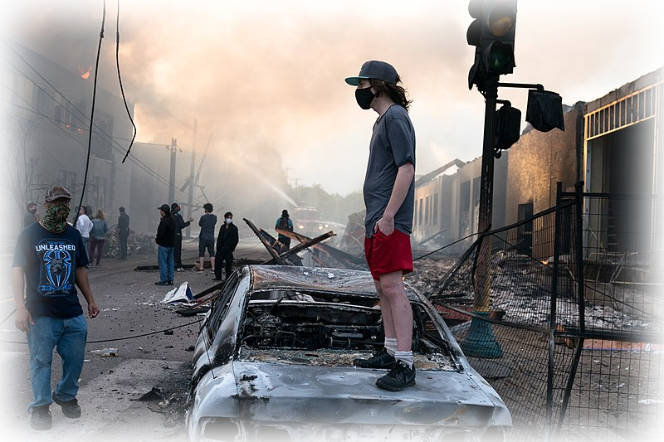
BROKEN
Law & Order is
RIOTS
Notes:
https://upload.wikimedia.org/wikipedia/commons/7/74/Wikipedia-logo-v2-pieces.svg
https://www.freepik.com/free-photo/jigsaw-puzzle-with-missing-piece-missing-puzzle-pieces_5469650.htm
Law & Order verses Riots and Defund the Police

Slide 6
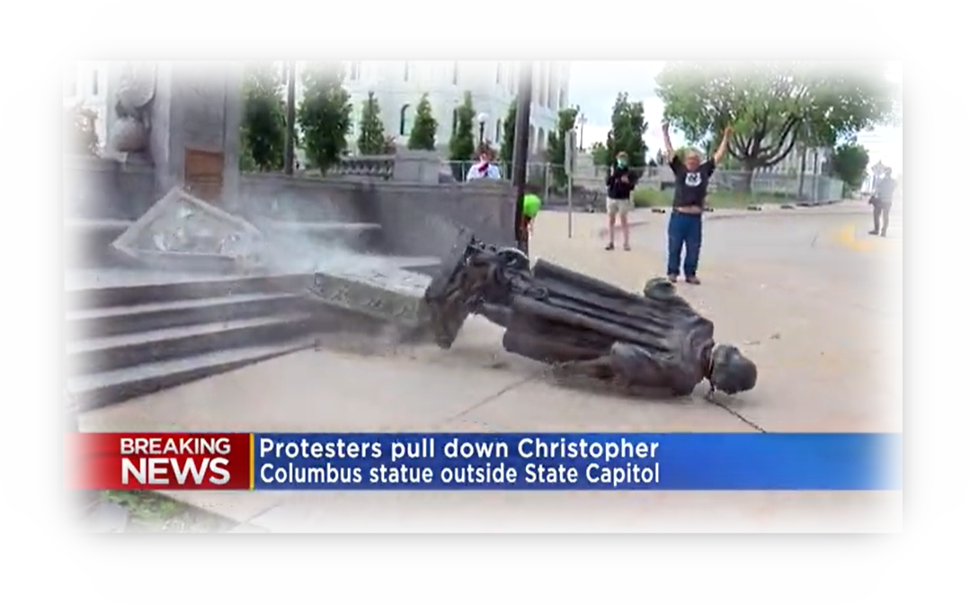
BROKEN
Culture is
CANCEL CULTURE
Notes:
https://upload.wikimedia.org/wikipedia/commons/7/74/Wikipedia-logo-v2-pieces.svg
https://www.freepik.com/free-photo/jigsaw-puzzle-with-missing-piece-missing-puzzle-pieces_5469650.htm
Cancel Culture movement
Rewrite History
Topple Christopher Columbus
https://minnesota.cbslocal.com/video/4585537-protesters-pull-down-christopher-columbus-statue-outside-state-capitol/

Slide 7


BROKEN
Politics is
Marxist vs Capitalist
Notes:
https://upload.wikimedia.org/wikipedia/commons/7/74/Wikipedia-logo-v2-pieces.svg
https://www.freepik.com/free-photo/jigsaw-puzzle-with-missing-piece-missing-puzzle-pieces_5469650.htm
Marxist = Communist Fist https://www.needpix.com/photo/99335/communism-fight-finger-fist-hand-socialism-worker
Statue of Liberty https://www.pikist.com/free-photo-xnlyx

Slide 8

BROKEN
Media is
Fake vs Truth
Notes:
https://upload.wikimedia.org/wikipedia/commons/7/74/Wikipedia-logo-v2-pieces.svg
https://www.freepik.com/free-photo/jigsaw-puzzle-with-missing-piece-missing-puzzle-pieces_5469650.htm
Fake News = Russia, Russia, Russia = totally false, and the false narrative is back in the news.
You cannot trust CNN MSNBC ABC Fox – You have to dig for the facts yourself. They are all politically bias.

Slide 9

BROKEN
Relationships are
FAMILY DIVISIONS
Notes:
https://upload.wikimedia.org/wikipedia/commons/7/74/Wikipedia-logo-v2-pieces.svg
https://www.freepik.com/free-photo/jigsaw-puzzle-with-missing-piece-missing-puzzle-pieces_5469650.htm
This is the real culprit to our broken world:
The family is the basic building block on
Divorce
Fatherless families = 70% among blacks
40% among whites

Slide 10
BROKEN
True Spirituality is
Nation of NONES
“Nones” = 23.5%
Evangelicals = 22.5%
Catholics = 23%
Notes:
https://upload.wikimedia.org/wikipedia/commons/7/74/Wikipedia-logo-v2-pieces.svg
https://www.freepik.com/free-photo/jigsaw-puzzle-with-missing-piece-missing-puzzle-pieces_5469650.htm
This is the real culprit to our broken world:
According to newly released General Social Survey data analyzed by Ryan P. Burge of Eastern Illinois University, Americans claiming "no religion” — sometimes referred to as “nones” because of how they answer the question “what is your religious tradition?” — now represent about 23.1 percent of the population, up from 21.6 percent in 2016. People claiming evangelicalism, by contrast, now represent 22.5 percent of Americans, a slight dip from 23.9 percent in 2016.
That makes the two groups statistically tied with Catholics (23 percent) as the largest religious — or nonreligious — groupings in the country.

Slide 11

His World was 1:1-3
BROKEN
³ And they said to me,
"The remnant there in the province who had survived the exile is in great trouble and shame. The wall of Jerusalem is broken down, and its gates are destroyed by fire."
Notes:
https://pixabay.com/illustrations/road-sign-usa-trouble-problem-1274311/

Slide 12
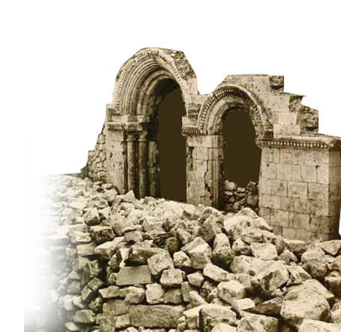
His World was 1:1-3
BROKEN
³ And they said to me,
"The remnant there in the province who had survived the exile is in great trouble and shame. The wall of Jerusalem is broken down, and its gates are destroyed by fire."
Notes:
There are no boundaries, there is great trouble, it is downright shameful?
Sound a it like America?
As we will learn, there is corruption and exploitation (of the poor).

Slide 13
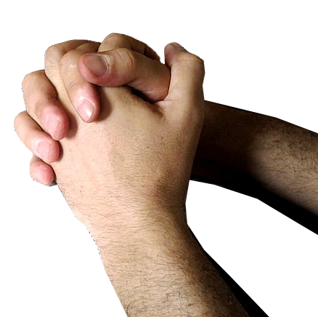
Picking up the
Pieces
He Started
Through
PETITION
Notes:
https://upload.wikimedia.org/wikipedia/commons/7/74/Wikipedia-logo-v2-pieces.svg
https://www.freepik.com/free-photo/jigsaw-puzzle-with-missing-piece-missing-puzzle-pieces_5469650.htm
https://i1.pickpik.com/photos/962/611/587/interlocking-hands-prayer-bible-preview.jpg

Slide 14
Picking up the
Pieces
Through
PREPARATION
Notes:
https://upload.wikimedia.org/wikipedia/commons/7/74/Wikipedia-logo-v2-pieces.svg
https://www.freepik.com/free-photo/jigsaw-puzzle-with-missing-piece-missing-puzzle-pieces_5469650.htm
After praying Nehemiah continue Picking up the Pieces through adequate PREPARATON.

Slide 15
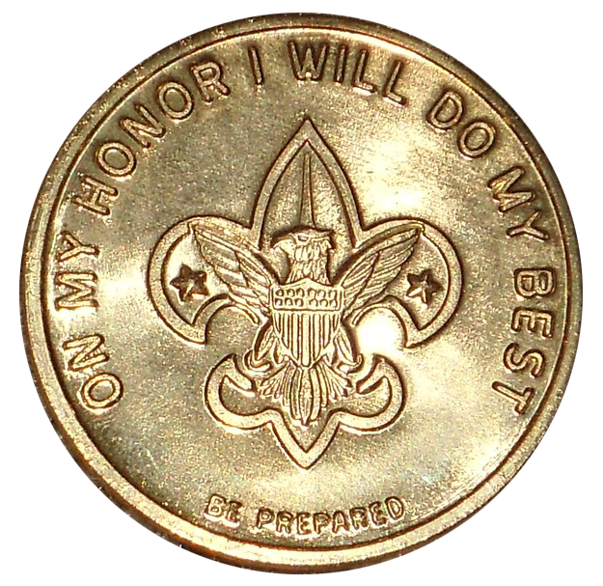
Preparation is not OPTIONAL
"Therefore thus I will do to
you, O Israel; because I
will do this to you,
prepare to meet your
God, O Israel!" (Amo 4:12)
Notes:
https://www.needpix.com/photo/download/817399/boy-scout-coin-be-prepared-do-my-best-flower-of-the-lily-gold-free-pictures-free-photos-free-images

Slide 16
Preparation is not OPTIONAL
But in your hearts set apart
Christ as Lord. Always
be prepared to give an
answer to everyone who
asks you to give the reason
for the hope that you have. But do this with gentleness and respect, (1Peter 3:15 NIV)
Notes:
https://www.needpix.com/photo/download/817399/boy-scout-coin-be-prepared-do-my-best-flower-of-the-lily-gold-free-pictures-free-photos-free-images

Slide 17

Preparation is not OPTIONAL
But in your hearts set apart
Christ as Lord. Always
be prepared to give an
answer to everyone who
asks you to give the reason
for the hope that you have. But do this with gentleness and respect, (1Peter 3:15 NIV)

Slide 18
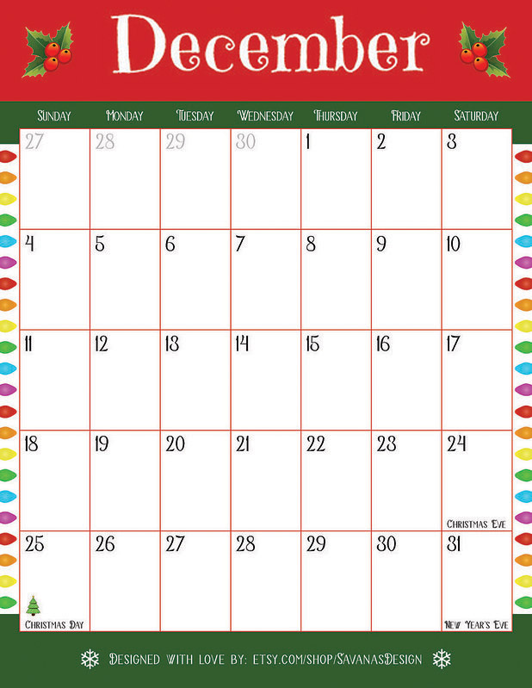
Preparation takes Time
^{1:1} Now it happened in
the month of Chislev,
in the twentieth year
Notes:
https://www.flickr.com/photos/savanasdesign/30479445624/
https://www.flickr.com/photos/119903731@N02/13047964665
1:1 It is 445BC (Twentieth Year) month of Chislev would be like our December (5-January 3)
2:1 It is also 445 BC (Twentieth Year) by month of Nisa which would be like our April.
Solution: The Persian calendar ran Spring to Spring-like the Hebrew Nisan calendar (religious); while the Hebrew Tishri calendar (civil) ran Fall to Fall.
Using the fall to fall calendar both Dec followed by Nisan are in the same year.
Like three months apart.
Grab on to that for a moment. Nehemiah has been praying and fast for four months before he does anything! He has marinated this thing in prayer.

Slide 19

Preparation takes Time
^{1:1} Now it happened in
the month of Chislev,
in the twentieth year
^{2:1} In the month of Nisan,
in the twentieth year
of King Artaxerxes,
Notes:
https://www.flickr.com/photos/savanasdesign/30479445624/
https://www.flickr.com/photos/119903731@N02/13047964665
1:1 It is 445BC (Twentieth Year) month of Chislev would be like our December (5-January 3)
2:1 It is also 445 BC (Twentieth Year) by month of Nisa which would be like our April.
Solution: The Persian calendar ran Spring to Spring-like the Hebrew Nisan calendar; while the Hebrew Tishri calendar ran Fall to Fall.
Using the fall to fall calendar both Dec followed by Nisan are in the same year.
Like three months apart.
Grab on to that for a moment. Nehemiah has been praying and fasting for four months before he does anything! He has marinated this thing in prayer.

Slide 20
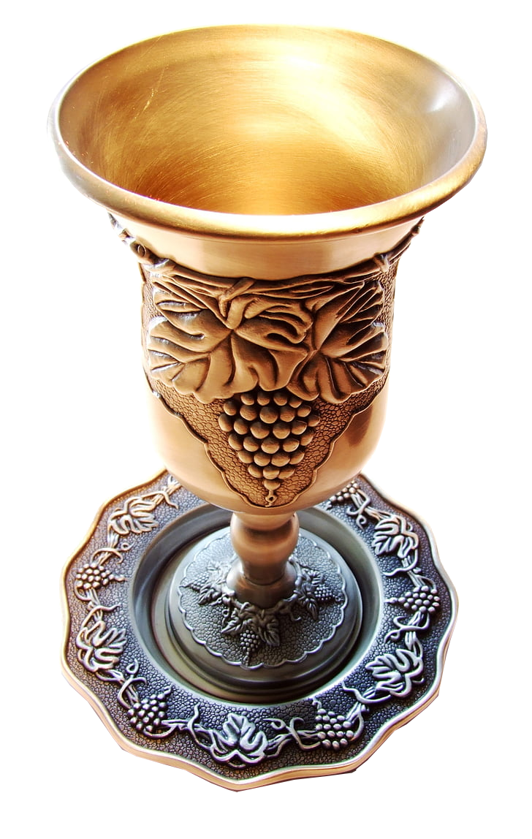
Preparation takes Heart
when wine was before him, I took up the wine and gave it to the king. Now I had not been sad in his presence.
Notes:
https://sobump.com/products/UUZdz6QxaX-Comme-Des-Garcons-Play-Upside-Down-Heart
When wine was before him = I was on the job to be serving wine
Down in heart = depressed. Spiritually depressed.

Slide 21

Preparation takes Heart
when wine was before him, I took up the wine and gave it to the king. Now I had not been sad in his presence. ² And the king said to me, "Why is your face sad, seeing you are not sick?
Notes:
https://sobump.com/products/UUZdz6QxaX-Comme-Des-Garcons-Play-Upside-Down-Heart
Why is your face so sad? = literally why is your face so BAD!? = Why are you depressed

Slide 22
Preparation takes Heart
when wine was before him, I took up the wine and gave it to the king. Now I had not been sad in his presence. ² And the king said to me, "Why is your face sad, seeing you are not sick? This is nothing but sadness of the heart."
Notes:
https://sobump.com/products/UUZdz6QxaX-Comme-Des-Garcons-Play-Upside-Down-Heart
When wine was before him = I was on the job to be serving wine
Down in heart = depressed. Spiritually depressed.
Reminds me of Psalm 42 & 43 where 3 times the Psalmist asks himself; “Why are you cast down, O my soul, and why are you in turmoil within me?” and then he answers himself: “Hope in God;” (Psa 42:5 ESV)
The cure to depression is “Hoping in God.”
Nehemiah has been praying and hoping in God to do something, but for four months nothing is happening – He is spiritually depressed!
And on top of that the king has noticed—Nehemiah is putting a damper on the party!

Slide 23
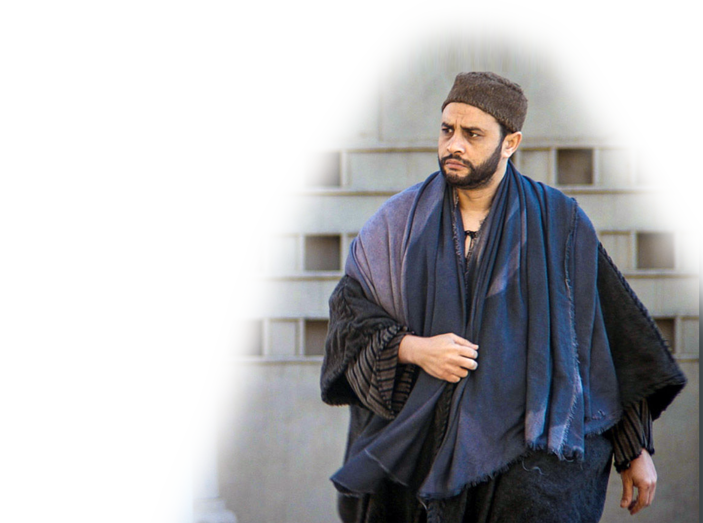
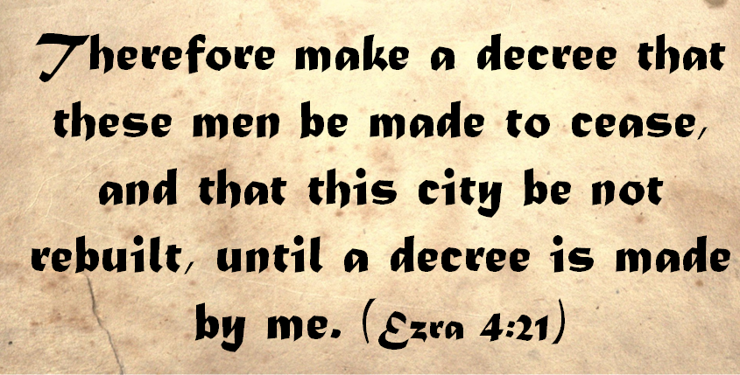
Preparation takes Fortitude
Then I was very much afraid.
Notes:
Why the fear? Why the delay?
Because in the past Artaxerxes shot down the rebuilding of the wall (in Ezra 4:6-23)
Where it appears that after the rebuilding of the temple there was an effort to rebuild the walls of Jerusalem, but adversaries wrote to King Artaxerxes that it was a rebellious attempt (fake news) and Artaxerxes issued a decree to stop.
So now Nehemiah is risking a challenge to the king's previous decision. Of course he is afraid.
Ever been shot down for a raise—and feared asking again?
Ever been shot down for a date—and feared rejection again?
Ever been publicly humiliated in front of friends—and feared that happening again?
Ever tried to share your faith with someone who then ridiculed your faith—and then feared broaching the subject again?
Ever been mocked for your prayer request—and then feared bringing it up again?
So you see what might have been the root of the fear, much fear, VERY MUCH FEAR!

Slide 24
Preparation takes Fortitude
Then I was very much afraid.
³ I said to the king,
"Let the king live forever! Why should not my face be sad, when the city, the place of my fathers' graves, lies in ruins, and its gates have been destroyed by fire?“
Notes:
Answers the question with a question. He puts the shoe on the king’s foot would you be if it was your homeland in a defenseless situation.
He is shrewd in his answer to the king as he describes the situation. He does not mention the name “Jerusalem.” lest the king remember he decreed against the rebellious city.
I described for you how church and America are broken too. Why should we not be depressed?

Slide 25
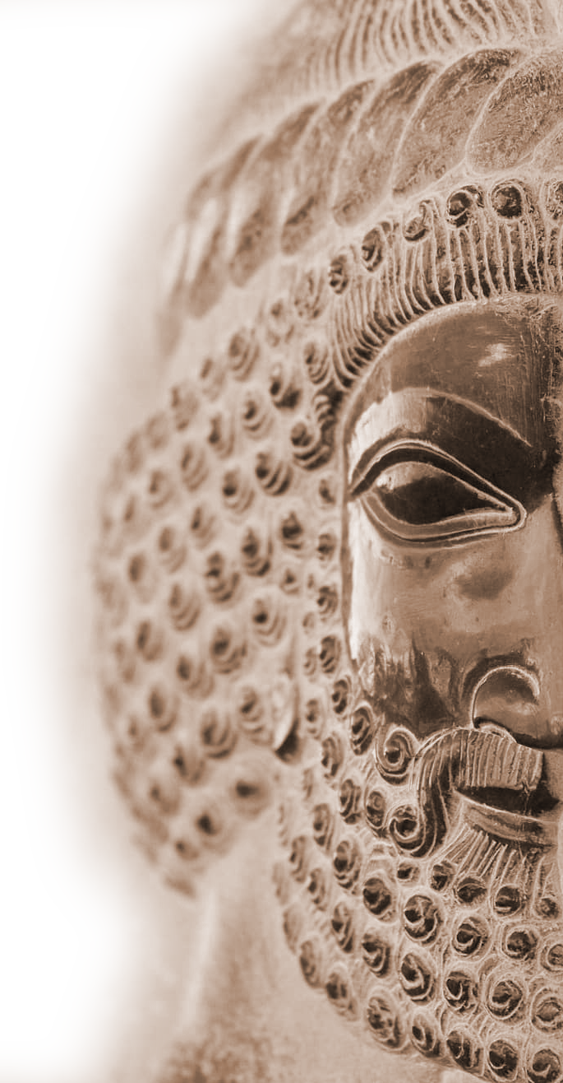
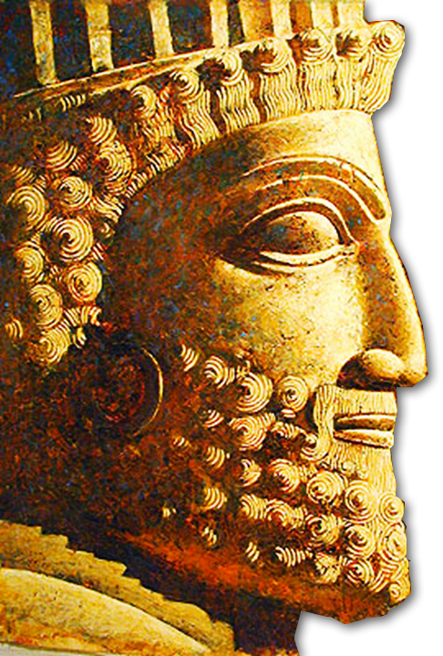
Preparation takes Fortitude
⁴ Then the king said to me,
"What are you requesting?"
Notes:
https://upload.wikimedia.org/wikipedia/commons/6/6b/Artaxerxes_II_relief_portrait_detail.jpg https://www.pikist.com/free-photo-xlkfj
King is a get it done guy – What are you requesting? Let’s get it done!

Slide 26
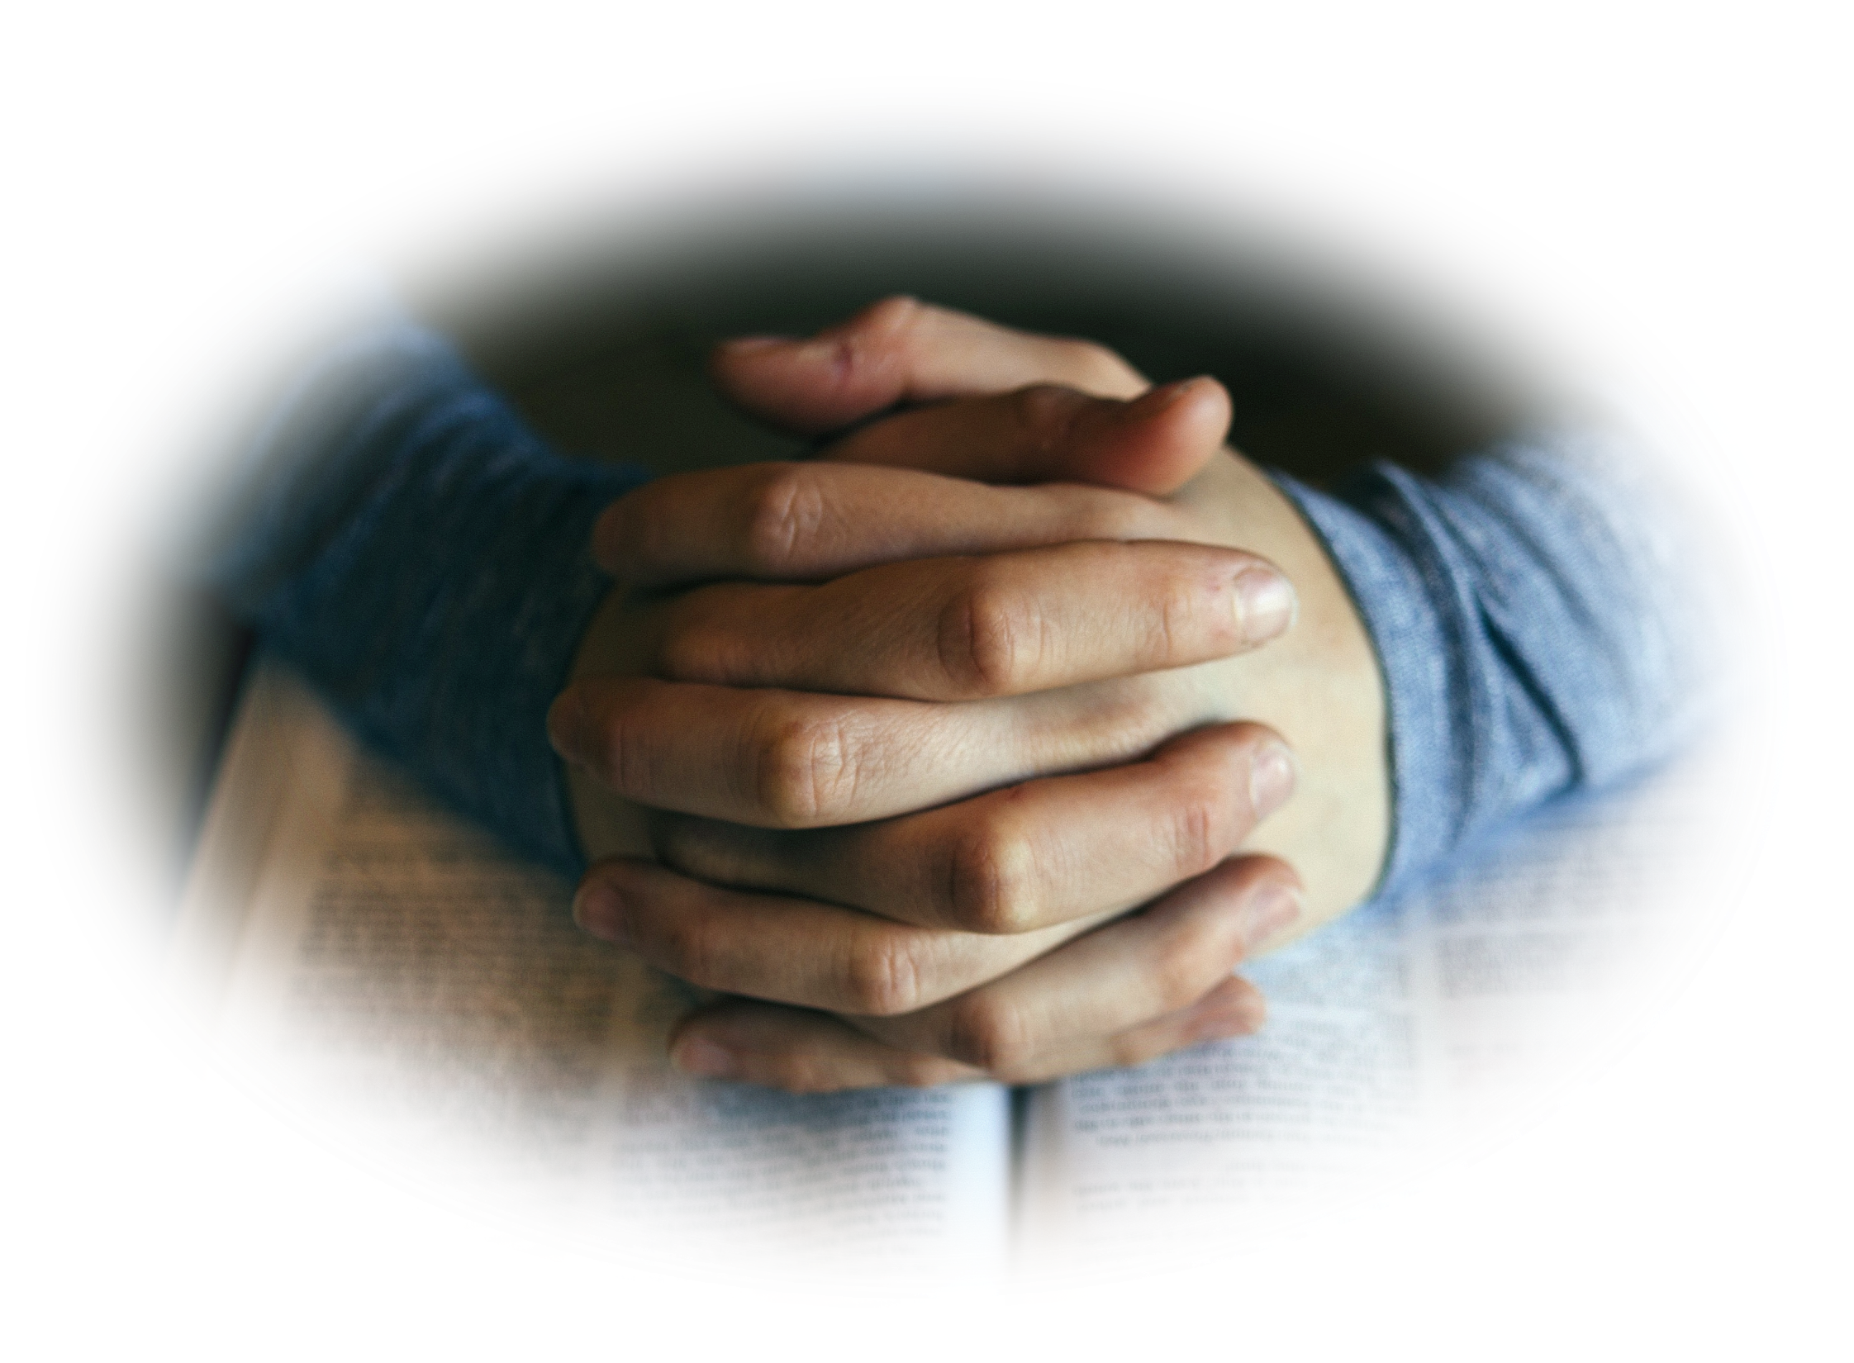

Preparation takes Prayer
So I prayed to the God of heaven.
Notes:
https://commons.wikimedia.org/wiki/File:Twemoji2_1f64f.svg
https://get.pxhere.com/photo/writing-hand-book-person-wood-finger-bible-prayer-organ-document-sense-human-action-107876.jpg
This was a short prayer—no time to fold hands and get on knees. Like Peter walking on the water with Jesus, when he took his eyes off Jesus, he immediately began to sink. Then he prayed the shortest prayer in the Bible: “Lord, save me.” Just three words,
Dianne in hospital, stroke, prayed ___________________________________.
You can do this all day long,
God of Heaven you have to help me here.
Imagine a situation with an angry person … God of heaven you have to help me here.
Or imagine a situation with terrible health news … God of heaven you have to help me here.
Imagine being put on the spot to share your faith … God of heaven your servant needs help here.
After four months of praying, on the spot Nehemiah prayed again.
Like praying for four months for America, and then with your election ballot you pray once more, God you have to help your servant here.

Slide 27
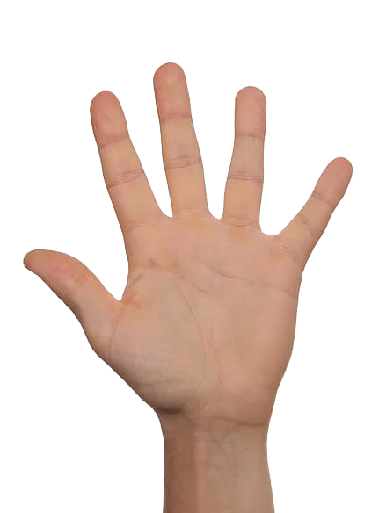
Preparation takes Volunteers
⁵ And I said to the king,
"If it pleases the king, and if your servant has found favor in your sight, that you send me to Judah, to the city of my fathers' graves, that I may rebuild it."
Notes:
https://www.pikist.com/free-photo-sqfua
But do this with gentleness and respect, (1Peter 3:15 NIV)

Slide 28
Preparation takes Volunteers
⁵ And I said to the king,
"If it pleases the king, and if your servant has found favor in your sight, that you send me to Judah, to the city of my fathers' graves, that I may rebuild it."
Notes:
https://www.pikist.com/free-photo-sqfua
God use me!
He is so different from Moses, who wanted God to use someone else. Five times tried to weasel his way out of God’s call.
1) Who am I
2) Who are you
3) What if it doesn’t work
4) I can’t
5) Send someone else
Not Nehemiah. He says, send me! Even today some people say to God’s call …
God send the pastor …. Missionary … But it is those who day, “God use me” that He blesses!
Here at church our most valuable asset is the volunteer. You are the most important part of this church. We need you to step up and volunteer.
That’s what Nehemiah did. In his heart he was saying, “Lord, here am I send me.” But with his body he was raising his hand and saying “Artaxerxes send me!
Notice again he does not mention the name “Jerusalem” but the region of “Judah.”

Slide 29
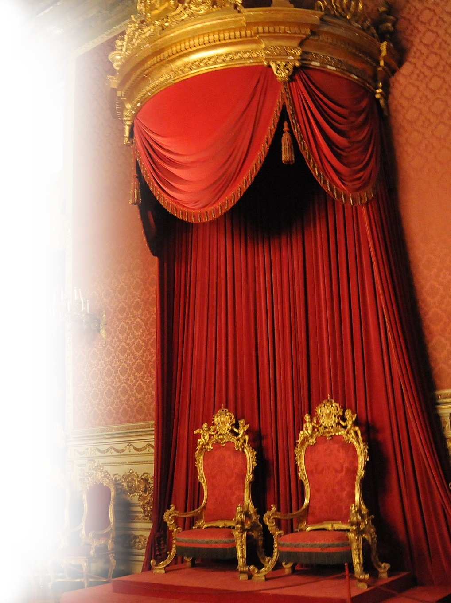
Preparation takes Planning
⁶ And the king said to me (the queen sitting beside him),
"How long will you be gone,
and when will you return?"
So it pleased the king to send me when I had given him a time.
Notes:
https://upload.wikimedia.org/wikipedia/commons/thumb/4/4b/Throne_room_of_the_Pal%C3%A1cio_Nacional_da_Ajuda.JPG/2048px-Throne_room_of_the_Pal%C3%A1cio_Nacional_da_Ajuda.JPG
The king’s question of how long implies that he is approving his return to rebuild.
Planning is crucial to have answers to the questions that maybe asked.
How long does it take to ready for a bible lesson? How long will your prayer time last? How long before you share your faith?
How long can you live on your retirement savings? Etc.
Although this passage does not say how long—from 5:14 we know it was at least 12 years.
The queen's presence is probably included to note a witness was present to this transaction.

Slide 30
Preparation takes Planning
⁷ And I said to the king,
"If it pleases the king, let letters be given me to the governors of the province Beyond the River, that they may let me pass through until I come to Judah, …
Notes:
Nehemiah had a plan … it included
1- Letters for passage through the territories to get to his destination
Next slide
2- letters for supplies to undertake the rebuilding the wall.

Slide 31
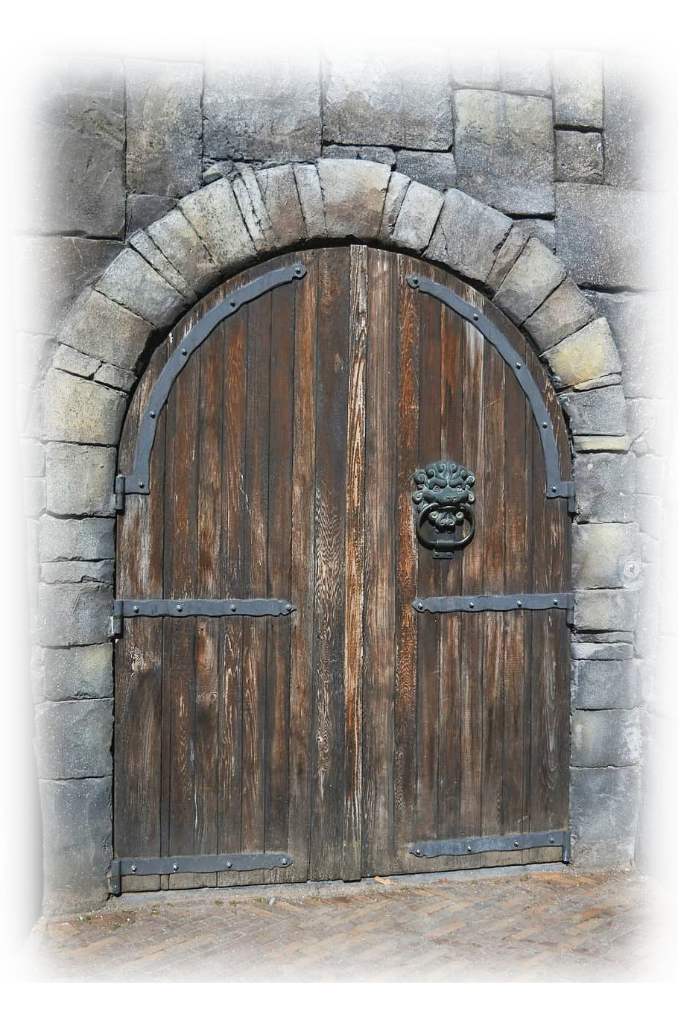
Preparation takes Planning
⁷ And I said to the king,
⁸ and a letter to Asaph, the keeper of the king's forest, that he may give me timber to make beams for the gates of the fortress of the temple, and for the wall of the city, and for the house that I shall occupy."
Notes:
https://www.pxfuel.com/en/free-photo-exbeh
Obviously, he has blueprints in mind and needs the resources to rebuild.
He needed timber for 1) gates –made of wood
Gates were entry points to the city. They opened to let in, and they closed to keep out.
Without gates anyone can access the city at anytime. Gates are security measures.

Slide 32
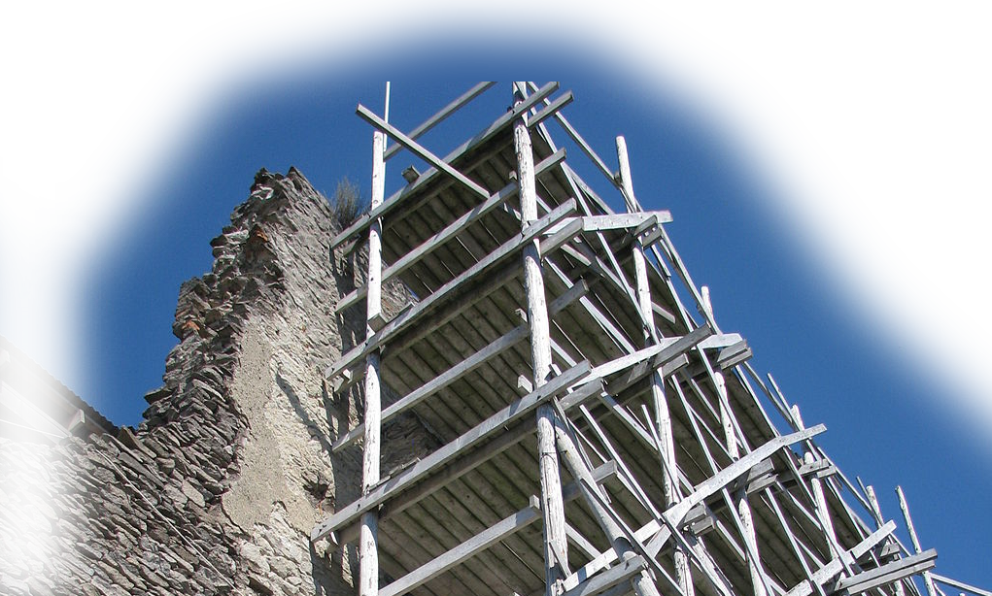
Preparation takes Planning
⁷ And I said to the king,
⁸ and a letter to Asaph, the keeper of the king's forest, that he may give me timber to make beams for the gates of the fortress of the temple, and for the wall of the city, and for the house that I shall occupy."
Notes:
https://upload.wikimedia.org/wikipedia/commons/thumb/7/7e/Deva_Citadel_2011_-_Wall_Section_Under_Restoration-1.jpg/1024px-Deva_Citadel_2011_-_Wall_Section_Under_Restoration-1.jpg
Obviously, he has blueprints in mind and needs the resources to rebuild.
He needed timber for
1) gates –made of wood
2) Walls – possibly scaffolding
The purpose of a wall is to separate. It is protective barrier. It keeps danger out. The city that dwells without wall is defenseless, vulnerable, and foolish.
People need boundaries too. You cannot let people abuse you, physically, sexually, violently, emotionally, verbally. Recently, I had to hang up on a person who lost all control of their tongue and was cursing me out up and down. To set my boundary, I hung up. Walls are to protect. Nehemiah knew that and so did the king.
Combined a wall with gates allows you to have boundaries and let people into your life and keep people out of your life in a good Christian balanced way.

Slide 33
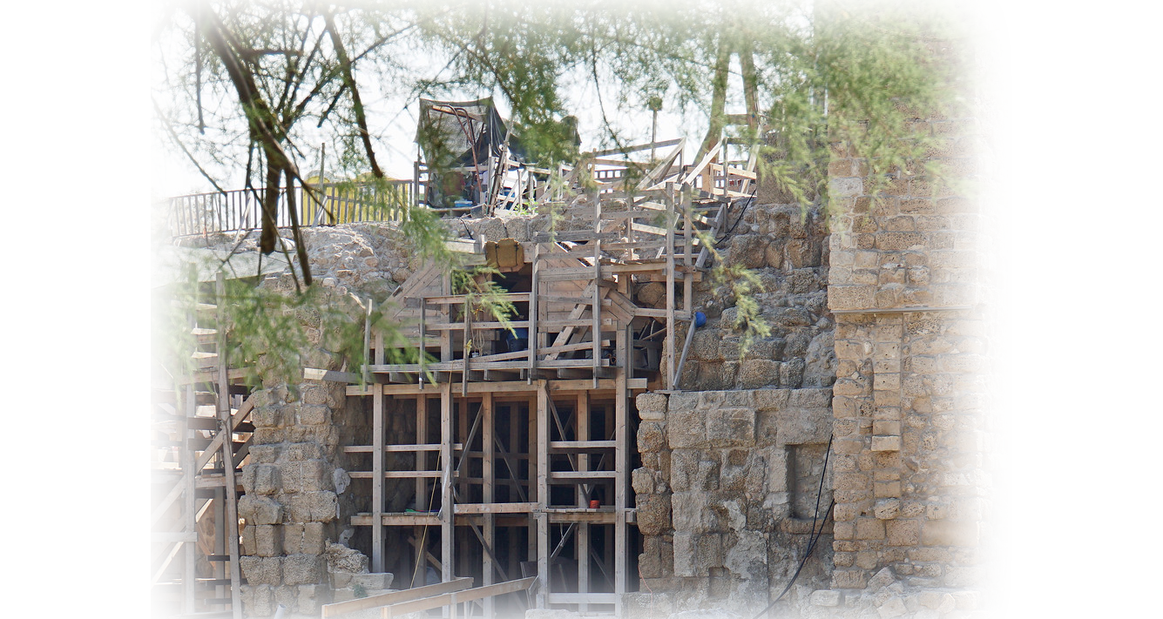
Preparation takes Planning
⁷ And I said to the king,
⁸ and a letter to Asaph, the keeper of the king's forest, that he may give me timber to make beams for the gates of the fortress of the temple, and for the wall of the city, and for the house that I shall occupy."
Notes:
https://www.flickr.com/photos/archer10/34093517226/
Obviously, he has blueprints in mind and needs the resources to rebuild.
He needed timber for 1) gates –made of wood
2) Walls – possibly scaffolding
3) And house – at least for roof
The house is a shelter with walls and windows and doors. We all lock our doors at night to keep predators out. Nehemiah had this wall, gates, boundary thing down.
He had a plan and knew what was needed to pull off the plan.

Slide 34
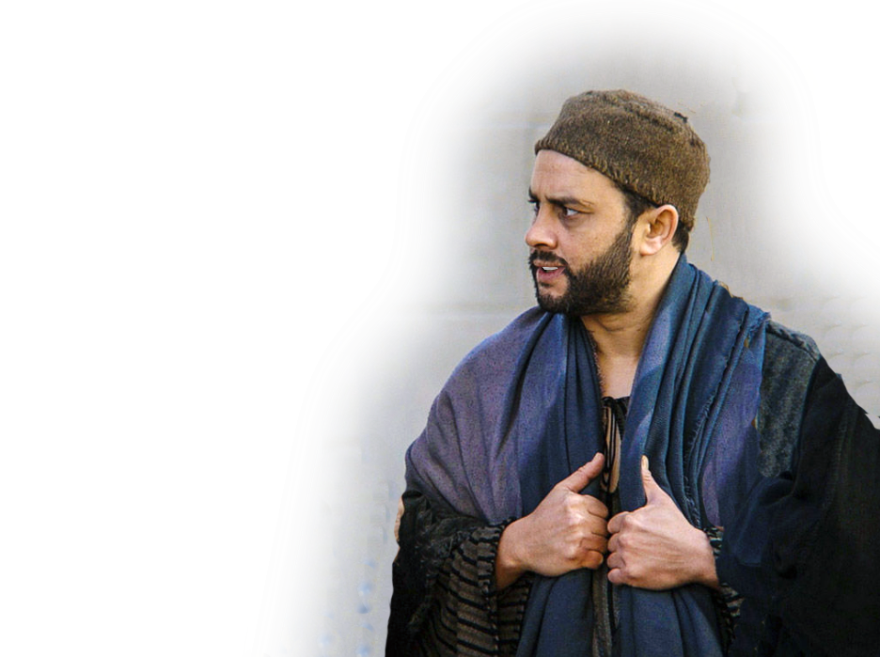
Preparation takes Action
And the king granted me what I asked, for the good hand of my God was upon me. ⁹ Then I came to the governors of the province Beyond the River and gave them the king's letters. Now the king had sent with me officers of the army and horsemen.
HE GOT IT!
Notes:
You have not because you ask not. (James 4:2)
For four months he had been planning, with fear and trepidation—and now the King of Persia granted his request.

Slide 35
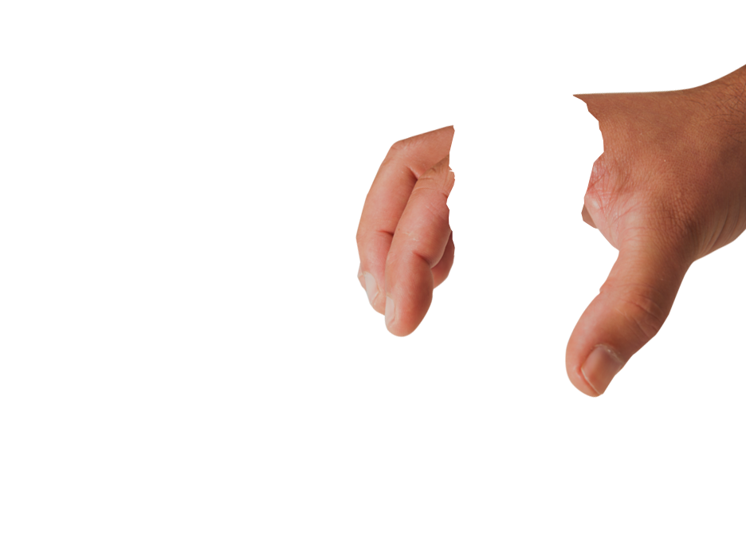
Preparation takes Action
And the king granted me what I asked, for the good hand of my God was upon me. ⁹ Then I came to the governors of the province Beyond the River and gave them the king's letters. Now the king had sent with me officers of the army and horsemen.
WHY?
Notes:
https://pnghunter.com/png/hands-43/
Why? God’s good hand was upon him. God sovereignly had His hand on Nehemiah.
For four months he had been seeking God to do something…and now he got the answer from the King of Kings, the Lord God.

Slide 36

Preparation takes Action
And the king granted me what I asked, for the good hand of my God was upon me. ⁹ Then I came to the governors of the province Beyond the River and gave them the king's letters. Now the king had sent with me officers of the army and horsemen.
HE HAD IT!
Notes:
https://www.pexels.com/photo/person-holding-white-scroll-2292837/

Slide 37
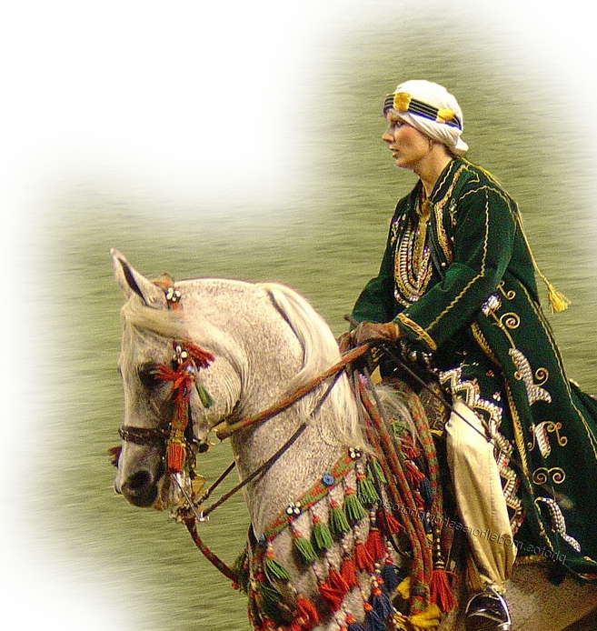
Preparation takes Action
And the king granted me what I asked, for the good hand of my God was upon me. ⁹ Then I came to the governors of the province Beyond the River and gave them the king's letters. Now the king had sent with me officers of the army and horsemen.
HE HAD IT!
Notes:
https://upload.wikimedia.org/wikipedia/commons/b/b9/A_beautiful_Horse_and_Rider_at_the_2006_Arabian_Horse_Nationals_%282536434720%29.jpg
With plans in hand he is on his way because he planned.

Slide 38
So … How about your preparation
Isn’t it time?
Where is your heart?
Do you have the fortitude?
Are you praying and volunteering?
What are your plans?
How are you preparing?
When will you take action?
Notes:
Is it time --- for salvation, baptism, church membership, tithing, sharing
Where is your heart? --- Do have a heart for God? Does it sadden you that you are not at church? Etc.
Do you have fortitude? --- Will you stand up for what is right?
Are you praying and then allowing God to use you as the answer? Volunteering? Here I am Lord!
What are your plans? Please make some.
Then prepare
Finally take action! Execute the plan.

Slide 39
Let’s Pray!

