Slide 1

REGRETFUL
Get Out of Your
RUT
Notes:
Earth = FREE = https://www.pexels.com/photo/earth-space-universe-globe-41953/
You will need the font: “Soul Mission” for this presentation. You may get it free at www.dafont.com/soulmission.font Or www.1001fonts.com/soulmission-font.html
Copyright © 2006−2020. All rights reserved. Bible Point is a registered trademark of Dennis Henderson. All other trademarks acknowledged.
Bible Point contains graphics from Bible Point artists. These illustrations belong to Bible Point and the respective artists. You may use the designs and illustrations for graphical illustration of lessons free and without special permission, provided they are not used in any way that maligns the Christian faith. Furthermore, republication or production of any illustration by any other graphic service whether it be in book, in a machine-readable form, or in any other design resource is strictly prohibited. Furthermore, they cannot be duplicated or resold as any other form of publishing, clip art, or graphic resource.
So What does it mean? (A simple translations of the legal jargon)
So, if you don’t own the presentation(s), graphic(s), and text(s) how can you legally use them? The purchase of the license allows you to use all the images in the product. However, the actual ownership and copyright of the presentation(s), graphic(s), and text(s) remain the property of Bible Point and its licensors. If you had plans on using this product in your “for sale” work—think again!
License Agreement
Article 1: License Grant
All the graphics and text in Bible Point presentations (excluding quotes from the Bible and stated sources) are the intellectual and real property of Bible Point and its licensors, and is protected by law, including United States copyright laws and international treaties. Bible Point grants to you a license:
1. To use the presentation in a single church, single school, or single office of a Christian organization.
2. To make a single archival back-up copy of the program.
3. To modify the presentation(s) and merge with other presentations in a single church, school, or Christian organization.
4. To transfer to another party if that party agrees to accept the terms and conditions of this agreement, and you do not retain any copies of the presentation, whether printed, machine readable, modified, or merged form.
Article 2: Terms
This license is effective until terminated. You may terminate the license at any time by destroying the presentation(s), graphic(s), or text(s) together with all copies, modifications and merged portions in any form. Bible Point may terminate your license if you fail to comply with this Agreement. You agree, upon such termination, for any reason, to destroy the presentation(s), graphics, and text(s) with all copies, modifications, and merged portions in any form.
Article 3: Disclaimers
1. Bible Point presentations, graphics, and texts are licensed to you As Is. You, the consumer, bear the entire risk relating to the quality and performance of the presentation(s), graphic(s), or text(s). In no event will Bible Point be liable for damages resulting from any defect.
2. Thirty-day limited warrantee on disks. Bible Point warrants the disks to be free of defects in material and workmanship under normal use for 30 days after purchase. During the 30-day period you may return a defective presentation, graphic, or text with proof of purchase and it will be replaced without charge, unless the presentation is damaged by misuse.
Article 4: General
1. You may not sub-license, assign, or transfer the license of the presentation(s), graphic(s), or text(s) except as provided by this Agreement.
2. This Agreement will be governed by the laws of the State of Michigan.
So What does it mean? (A simple translations of the legal jargon)
May I let someone borrow or copy my licensed Bible Point presentation (even after I modified it)? As long as it is within your local church, or single school, or the immediate office of a Christian organization you may. Otherwise, please refer the person interested in borrowing to: http://www.biblepoint.com or E-mail: dennis@drdh.net with any related questions.

Slide 2
This is a tough RUT to get out of!

Slide 3
Today we will FOCUS on 3 kinds.

Slide 4
1-PERSONAL Regrets

Slide 5
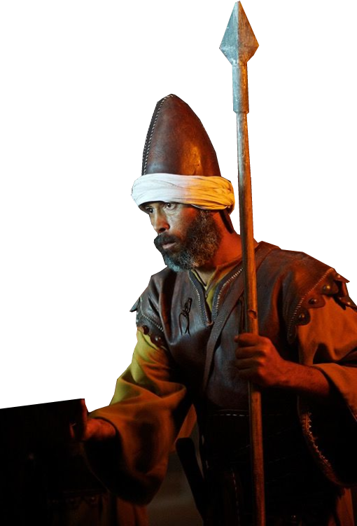
1-PERSONAL Regrets
PEOPLE INVOLVED in Regrets
Judges 11:1 Jephthah the Gileadite was a mighty warrior. His father was Gilead; his mother was a prostitute. ² Gilead's wife also bore him sons ...
Notes:
Family issues // Dad’s Remarriage

Slide 6
1-PERSONAL Regrets
ACTIONS INVOLVED in Regrets
² ... they drove Jephthah away.
"You are not going to get any inheritance in our family," they said, "because you are the son of another woman."

Slide 7
1-PERSONAL Regrets
ACTIONS INVOLVED in Regrets
³ So Jephthah fled from his brothers and settled in the land of Tob, where a group of adventurers gathered around him and followed him.

Slide 8

1-PERSONAL Regrets
ACTIONS INVOLVED in Regrets
⁴ Some time later, when the Ammonites made war on Israel, ⁵ the elders of Gilead went to get Jephthah from the land of Tob.

Slide 9
1-PERSONAL Regrets
EATING CROW from Regrets
⁶ "Come," they said, "be our commander, so we can fight the Ammonites."
⁷ Jephthah said to them,
"Didn’t you hate me and drive
me from my father’s house?
Why do you come to me now,
when you’re in trouble?“

Slide 10
1-PERSONAL Regrets
EATING CROW from Regrets
⁸ The elders of Gilead said to him, "Nevertheless, we are turning to
you now; come with us to fight the Ammonites, and you will be our
head over all who live in Gilead."

Slide 11
1-PERSONAL Regrets
EATING CROW from Regrets
⁹ Jephthah answered,
"Suppose you take me back
to fight the Ammonites and the LORD gives them to me--will I really be your head?“

Slide 12
1-PERSONAL Regrets
EATING CROW from Regrets
¹⁰ The elders of Gilead replied,
"The LORD is our witness; we will certainly do as you say.“

Slide 13
1-PERSONAL Regrets
EATING CROW from Regrets
¹¹ So Jephthah went with the elders of Gilead, and the people made him head and commander over them. And he repeated all his words before the LORD in Mizpah.

Slide 14
Eating Crow can be Nasty
But not when it is SEASONED WITH GRACE
⁶ Let your conversation be always full of grace, seasoned with salt, so that you may know how to answer everyone. (Col 4:6 NIV)

Slide 15
The Second Regretful Rut ...

Slide 16
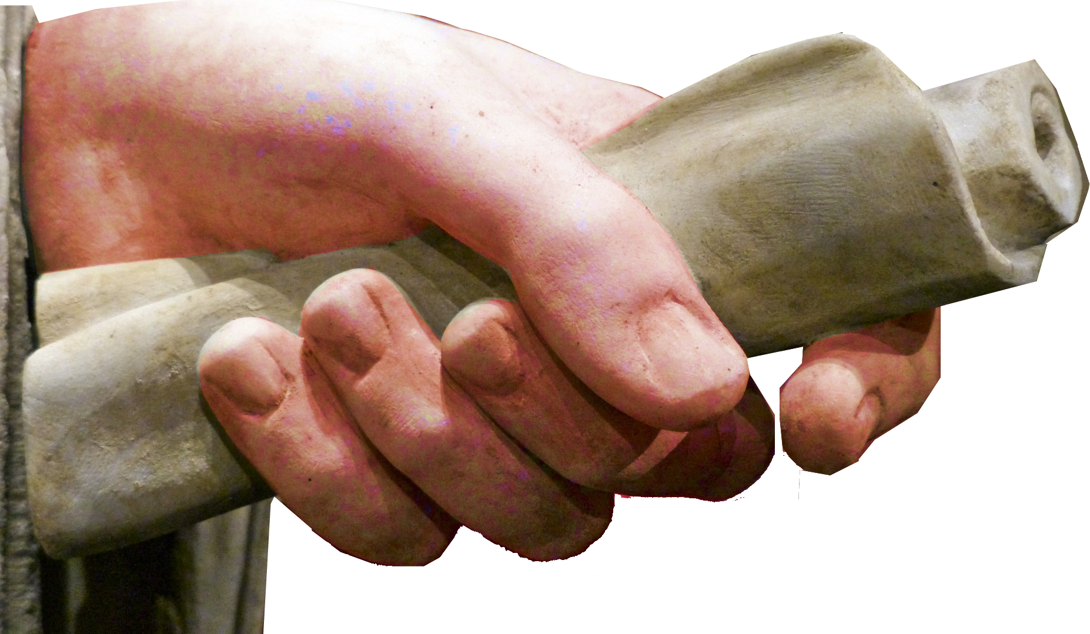
2-RATIONAL Regrets
¹² Then Jephthah sent messengers to the Ammonite king with the question:
"What do you
have against
us that you
have attacked
our country?“
Notes:
Hand with scroll = Free = https://www.publicdomainpictures.net/en/view-image.php?image=248662&picture=hand-with-scroll-statue

Slide 17
2-RATIONAL Regrets
¹³ The king of the Ammonites answered Jephthah's messengers,
        "When Israel came up out of Egypt, they took away my land from the Arnon to the Jabbok, all The way to the Jordan. Now
        give it back peaceably.“

Slide 18
2-RATIONAL Regrets
¹⁴ Jephthah sent back messengers to the Ammonite king,
¹⁵ saying:
"This is what Jephthah says: Israel did not take the land of
Moab or the land of
the Ammonites.....

Slide 19
2-RATIONAL Regrets
^{... 19} “[Back] Then Israel sent messengers to Sihon king of the Amorites, who ruled in Heshbon, and said to him, 'Let us pass through your country to our own place.’ ²⁰ Sihon,
however, did not trust
Israel to pass through
his territory.

Slide 20
2-RATIONAL Regrets
He mustered all his men and encamped at Jahaz and fought with Israel.
²¹ "Then the LORD ... defeated them. Israel took over all the land of
the Amorites who lived
in that country, ... ²³
Now since the LORD, ...
has driven the Amorites
out before his people Israel,

Slide 21
2-RATIONAL Regrets
out before his people Israel,
what right have you to take it over?
²⁴ Will you not take what your god Chemosh gives you?
Likewise, whatever
the LORD our God
has given us, we will
possess. ....

Slide 22
2-RATIONAL Regrets
²⁶ For three hundred years Israel occupied Heshbon, Aroer, the surrounding settlements and all the towns along the Arnon.
Why didn’t you retake
them during that time?

Slide 23
2-RATIONAL Regrets
²⁷ I have not wronged you, but you are doing me wrong by waging war against me. Let the LORD, the Judge, decide the dispute this day between the
Israelites and the
Ammonites."

Slide 24
2-RATIONAL Regrets
²⁸ The king of Ammon, however, paid no attention to the message Jephthah sent him.
He will Regret this decision

Slide 25

2-RATIONAL Regrets
²⁹ Then the Spirit of the LORD came upon Jephthah. He crossed Gilead and Manasseh, passed through Mizpah of Gilead, and from there he advanced against the Ammonites.

Slide 26
3-SPIRITUAL Regrets

Slide 27
3-SPIRITUAL Regrets
³⁰ And Jephthah made a vow to the LORD:
"If you give the Ammonites into my hands, ³¹ whatever comes out of the door of my house to meet me when I return in triumph from the Ammonites will be the LORD's, and I will sacrifice it as a burnt offering."

Slide 28
3-SPIRITUAL Regrets
³² Then Jephthah went over to fight the Ammonites, and the LORD gave them into his hands. ³³ He devastated twenty towns from Aroer to the vicinity of Minnith, as far as Abel Keramim. Thus Israel subdued Ammon.
³⁴ When Jephthah returned to his home in Mizpah, who should come out to meet him but his daughter, dancing to the sound of tambourines! She was an only child. Except for her he had neither son nor daughter.
³⁵ When he saw her, he tore his clothes and cried, "Oh! My daughter! You have made me miserable and wretched, because I have made a vow to the LORD that I cannot break."
³⁶ "My father," she replied, "you have given your word to the LORD. Do to me just as you promised, now that the LORD has avenged you of your enemies, the Ammonites.
³⁷ But grant me this one request," she said. "Give me two months to roam the hills and weep with my friends, because I will never marry."
³⁸ "You may go," he said. And he let her go for two months. She and the girls went into the hills and wept because she would never marry.
³⁹ After the two months, she returned to her father and he did to her as he had vowed. And she was a virgin. From this comes the Israelite custom
⁴⁰ that each year the young women of Israel go out for four days to commemorate the daughter of Jephthah the Gileadite. (Jdg 11:29-40 NIV)

Slide 29
3-SPIRITUAL Regrets
³⁸ "You may go," he said. And he let her go for two months. She and the girls went into the hills and wept because she would never marry.
³⁹ After the two months, she returned to her father and he did to her as he had vowed. And she was a virgin. From this comes the Israelite custom
⁴⁰ that each year the young women of Israel go out for four days to commemorate the daughter of Jephthah the Gileadite. (Jdg 11:29-40 NIV)

Slide 30
Identifying Your:
1-Personal Regrets (a result of being RASH/Impulsive with PEOPLE)
2-Rational Regrets (a result of being RASH with REASON)
3-Spiritual Regrets (a result of being RASH with GOD)
Get UNSTUCK:

Slide 31

LET S PRAY

Slide 32
UNSTUCK
Get Out of Your Ruts

Slide 33
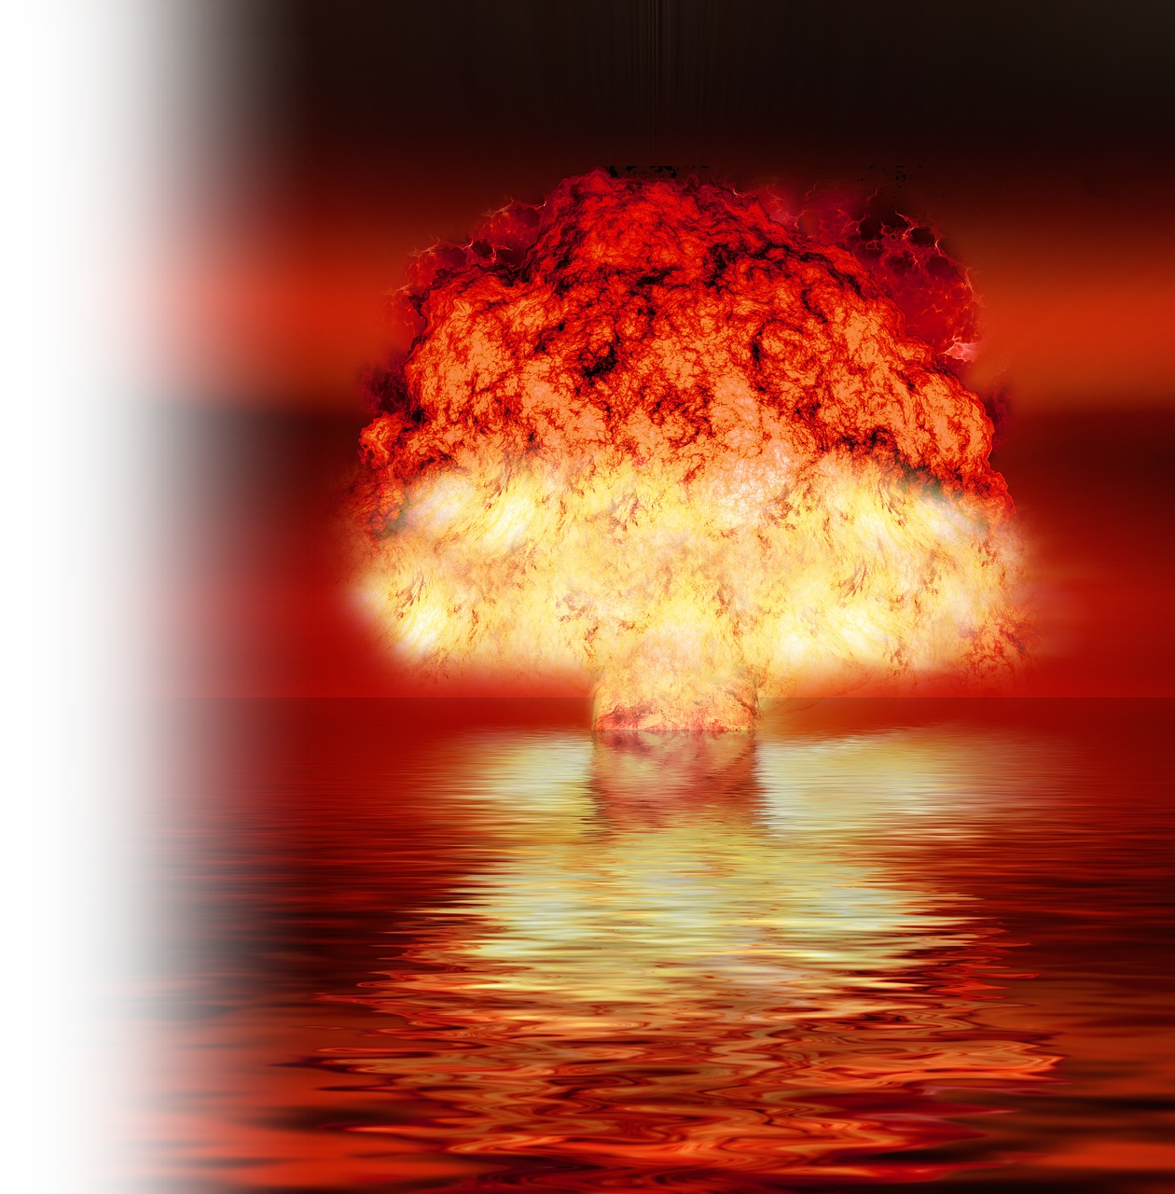

Self-Destructive
Get Out of Your
RUT
Notes:
Earth = FREE = https://www.pexels.com/photo/earth-space-universe-globe-41953/

Slide 34
Get Out of the Self-Destructive Rut 13ff
(being your own worst enemy) Samson was a man stuck in the rut of self-destruction---Against His Calling 13:1-25
With a Women Problem 14:1-2 -- A besetting sin
1- Philistine wife 2-A Harlot 3-Delilah
With a Commitment Problem 14-15 – Nazarite vow 13:5-7
1-touched dead 14:9; (2-no wine); 3-cut hair 16:17
With a Spiritual Problem 16:16-20 -- Spirit of the Lord
  He experienced the Power of the Spirit 13:25
  He utilized the Power of the Spirit (in emergencies) 14:6, 19; 15:14
  He took for granted the Power of the Spirit 16:20
Notes:
Samson was his own worst enemy with respect to ...
1. A Specific Problem
A Vow Problem
3. A Spiritual Problem

Slide 35
LET S PRAY

Slide 36
UNSTUCK
Get Out of Your Ruts

Slide 37

SELF
CENTERED
Get Out of Your
RUT
Notes:
Target = free = https://pixabay.com/en/darts-dart-game-bull-s-eye-target-155726/

Slide 38
Get Out of the
SELF-CENTEREDNESS Rut 17-24

Slide 39
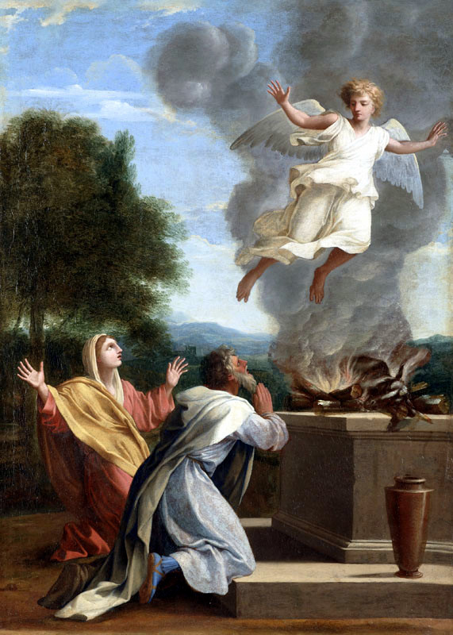
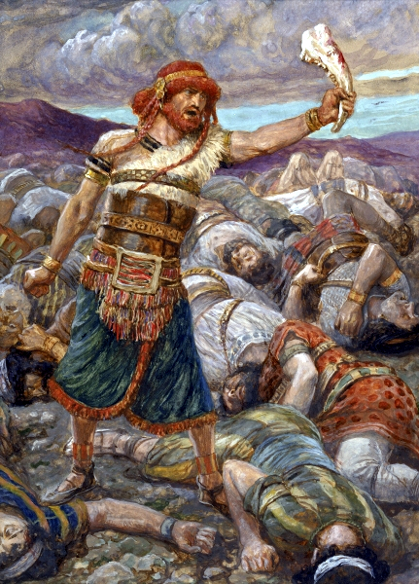
Notes:
https://en.wikipedia.org/wiki/Samson#/media/File:Eustache_Le_Sueur_-_The_Sacrifice_of_Manoah,_1640-1650.jpg
https://en.wikipedia.org/wiki/Samson#/media/File:Tissot_Samson_Slays_a_Thousand_Men.jpg

Slide 40
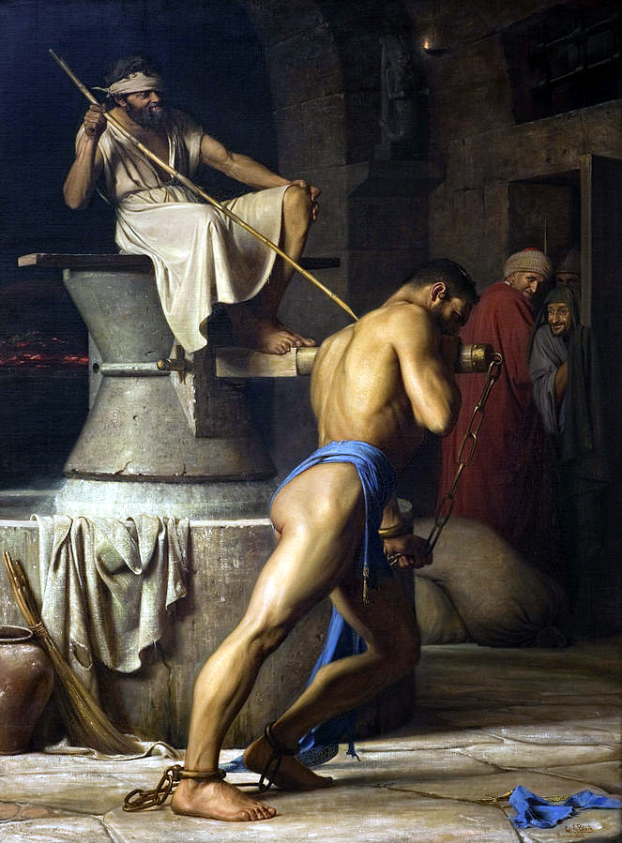
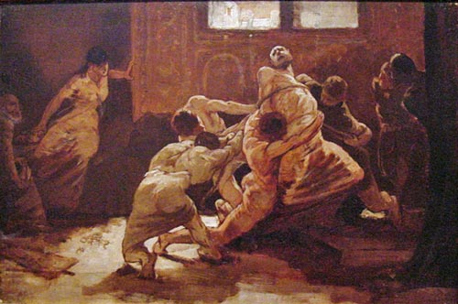
Notes:
https://en.wikipedia.org/wiki/Samson#/media/File:Samson_hos_filistrene.jpg
https://upload.wikimedia.org/wikipedia/commons/0/09/Vedder-samson.jpg

Slide 41
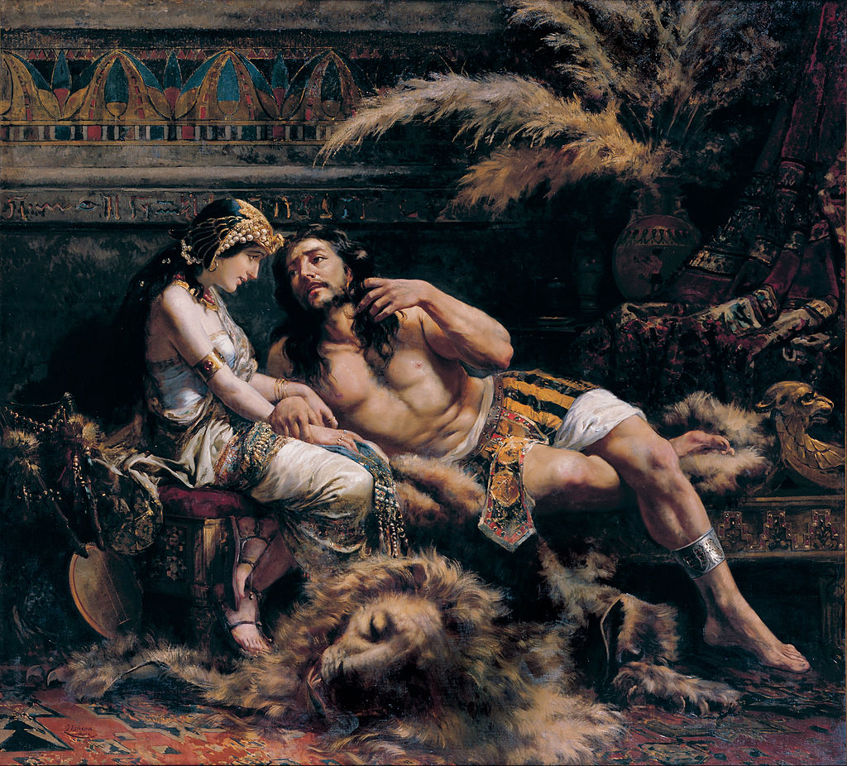
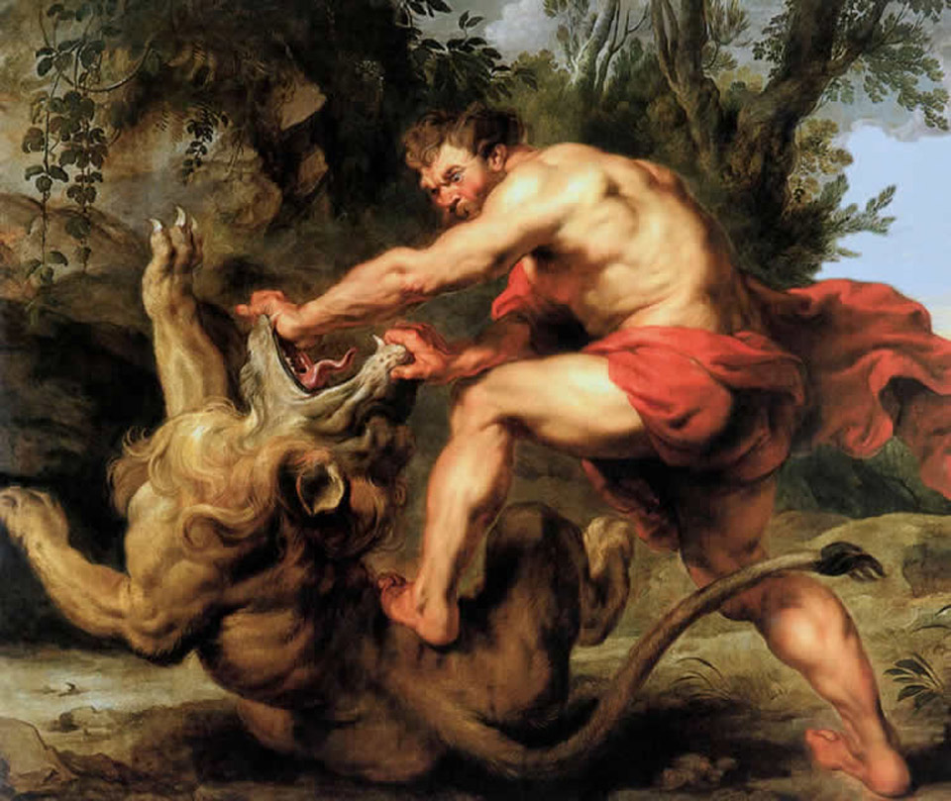
Notes:
https://upload.wikimedia.org/wikipedia/commons/thumb/e/e0/Jos%C3%A9_Echenagus%C3%ADa_-_Samson_and_Delilah_-_Google_Art_Project.jpg/1024px-Jos%C3%A9_Echenagus%C3%ADa_-_Samson_and_Delilah_-_Google_Art_Project.jpg
https://upload.wikimedia.org/wikipedia/commons/f/f6/Sans%C3%B3n_matando_al_le%C3%B3n_-_Pedro_Pablo_Rubens.jpg

Slide 42
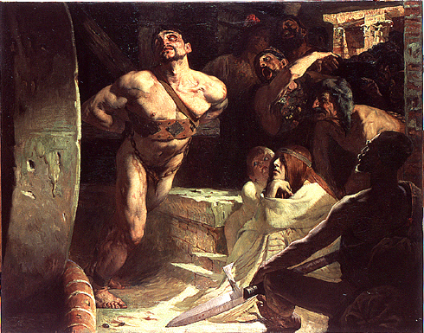
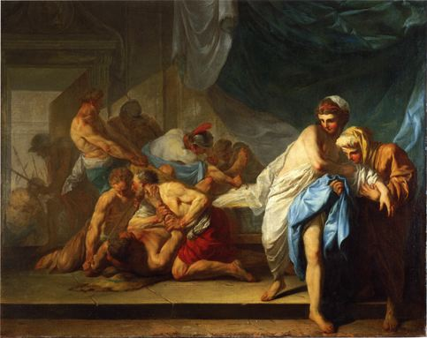
Notes:
https://upload.wikimedia.org/wikipedia/commons/a/a7/Mitrecey_Samson_tournant_la_meule.JPG
https://upload.wikimedia.org/wikipedia/commons/f/f8/Amand_Samson_livr%C3%A9_aux_philistins.jpg

Slide 43
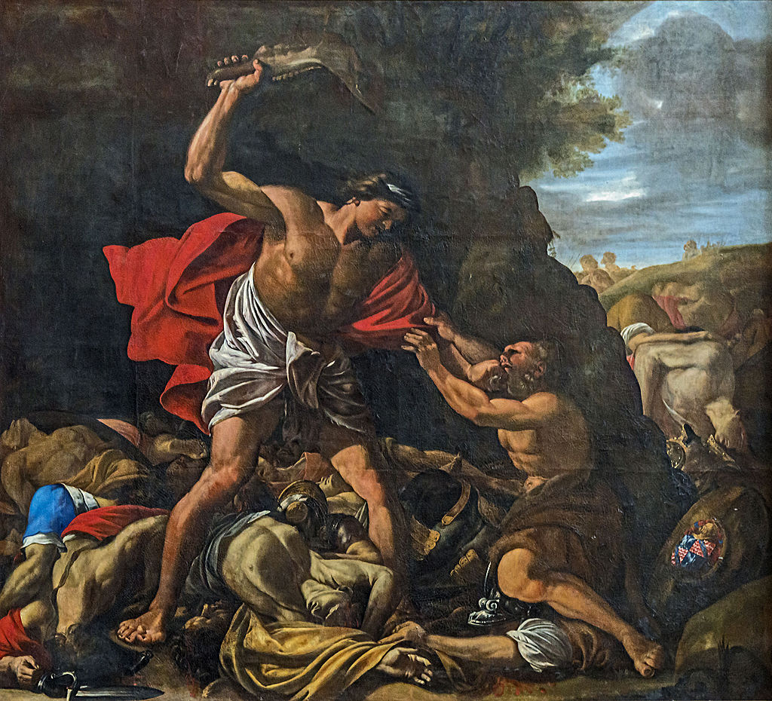
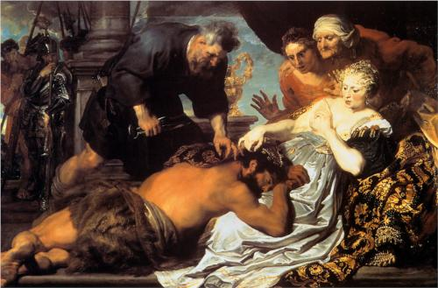
Notes:
https://upload.wikimedia.org/wikipedia/commons/thumb/4/48/Cath%C3%A9drale_Saint-%C3%89tienne_de_Toulouse_-_Samson_massacrant_les_Philistins_PM31000755.jpg/1024px-Cath%C3%A9drale_Saint-%C3%89tienne_de_Toulouse_-_Samson_massacrant_les_Philistins_PM31000755.jpg
https://upload.wikimedia.org/wikipedia/commons/a/a0/Samson-and-delilah-1620.jpg

Slide 44
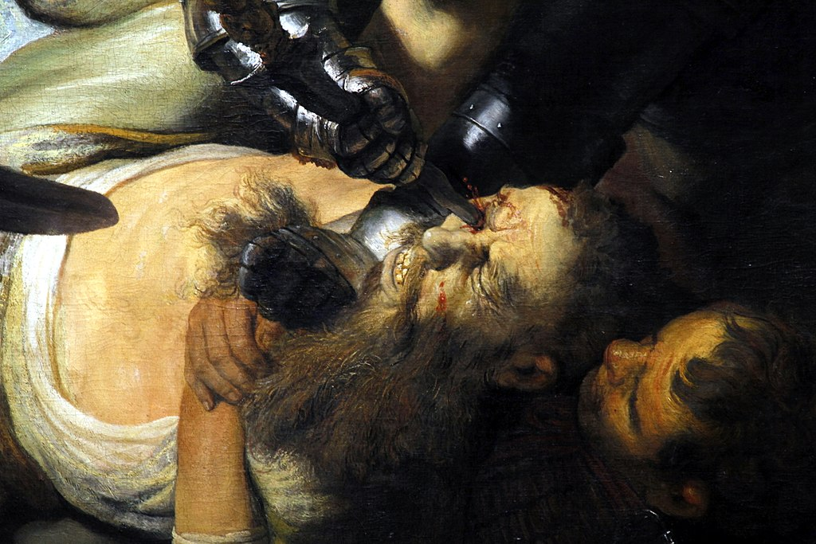
Notes:
https://upload.wikimedia.org/wikipedia/commons/thumb/4/49/Blinding_of_Samson_by_Rembrandt_%28detail%29_-_St%C3%A4del_-_Frankfurt_am_Main_-_Germany_2017.jpg/1024px-Blinding_of_Samson_by_Rembrandt_%28detail%29_-_St%C3%A4del_-_Frankfurt_am_Main_-_Germany_2017.jpg

Slide 45
LET S PRAY

Slide 46
Recycled DIFFICULTIES ...
Failure ch 1
Compromise 2
Cyclical 2-3 Othniel / Ehud
Timidity 4-5 Deborah
Defeat 6-8 Gideon
Evil 9 Abimelech
Foolishness 10-11 Jephthah
Worldliness 13-16 Samson
Self-Centeredness 17-24

