Slide 1
UNSTUCK
Get Out of Your Ruts
Notes:
You will need the font: “Soul Mission” for this presentation. You may get it free at www.dafont.com/soulmission.font Or www.1001fonts.com/soulmission-font.html
Copyright © 2006−2020. All rights reserved. Bible Point is a registered trademark of Dennis Henderson. All other trademarks acknowledged.
Bible Point contains graphics from Bible Point artists. These illustrations belong to Bible Point and the respective artists. You may use the designs and illustrations for graphical illustration of lessons free and without special permission, provided they are not used in any way that maligns the Christian faith. Furthermore, republication or production of any illustration by any other graphic service whether it be in book, in a machine-readable form, or in any other design resource is strictly prohibited. Furthermore, they cannot be duplicated or resold as any other form of publishing, clip art, or graphic resource.
So What does it mean? (A simple translations of the legal jargon)
So, if you don’t own the presentation(s), graphic(s), and text(s) how can you legally use them? The purchase of the license allows you to use all the images in the product. However, the actual ownership and copyright of the presentation(s), graphic(s), and text(s) remain the property of Bible Point and its licensors. If you had plans on using this product in your “for sale” work—think again!
License Agreement
Article 1: License Grant
All the graphics and text in Bible Point presentations (excluding quotes from the Bible and stated sources) are the intellectual and real property of Bible Point and its licensors, and is protected by law, including United States copyright laws and international treaties. Bible Point grants to you a license:
1. To use the presentation in a single church, single school, or single office of a Christian organization.
2. To make a single archival back-up copy of the program.
3. To modify the presentation(s) and merge with other presentations in a single church, school, or Christian organization.
4. To transfer to another party if that party agrees to accept the terms and conditions of this agreement, and you do not retain any copies of the presentation, whether printed, machine readable, modified, or merged form.
Article 2: Terms
This license is effective until terminated. You may terminate the license at any time by destroying the presentation(s), graphic(s), or text(s) together with all copies, modifications and merged portions in any form. Bible Point may terminate your license if you fail to comply with this Agreement. You agree, upon such termination, for any reason, to destroy the presentation(s), graphics, and text(s) with all copies, modifications, and merged portions in any form.
Article 3: Disclaimers
1. Bible Point presentations, graphics, and texts are licensed to you As Is. You, the consumer, bear the entire risk relating to the quality and performance of the presentation(s), graphic(s), or text(s). In no event will Bible Point be liable for damages resulting from any defect.
2. Thirty-day limited warrantee on disks. Bible Point warrants the disks to be free of defects in material and workmanship under normal use for 30 days after purchase. During the 30-day period you may return a defective presentation, graphic, or text with proof of purchase and it will be replaced without charge, unless the presentation is damaged by misuse.
Article 4: General
1. You may not sub-license, assign, or transfer the license of the presentation(s), graphic(s), or text(s) except as provided by this Agreement.
2. This Agreement will be governed by the laws of the State of Michigan.
So What does it mean? (A simple translations of the legal jargon)
May I let someone borrow or copy my licensed Bible Point presentation (even after I modified it)? As long as it is within your local church, or single school, or the immediate office of a Christian organization you may. Otherwise, please refer the person interested in borrowing to: http://www.biblepoint.com or E-mail: dennis@drdh.net with any related questions.

Slide 2

FORGETFUL
Get Out of Your
RUT
Notes:
http://www.easyfreeclipart.com/spiritual-memory-loss-laced-with-grace-christian-devotions-clipart-1258715.html

Slide 3

1.The INITIAL Forgetfulness 3:5-11
Serving
God
The Israelites
^{3:5} The Israelites

Slide 4
1.The INITIAL Forgetfulness 3:5-11
Serving
God
The Israelites SIN
lived among them
Downfall
into Sin
^{3:5} The Israelites lived among the Canaanites, Hittites, Amorites, Perizzites, Hivites and Jebusites.

Slide 5
1.The INITIAL Forgetfulness 3:5-11
Serving
God
The Israelites SIN
lived among them
intermarried
^{3:6} They took
their daughters in marriage and gave their own daughters to their sons, and
Downfall
into Sin
Notes:
³ Do not intermarry with them. Do not give your daughters to their sons or take their daughters for your sons, (Deu 7:3 NIV)

Slide 6
1.The INITIAL Forgetfulness 3:5-11
Serving
God
The Israelites SIN
lived among them
intermarried
served their gods
^{3:6} They took
their daughters in marriage and gave their own daughters to their sons, and served their
gods
Downfall
into Sin

Slide 7
1.The INITIAL Forgetfulness 3:5-11
Serving
God
The Israelites SIN
lived among them
intermarried
served their gods.
did evil
^{3: 7} The Israelites
did evil in the eyes
of the LORD; they forgot the LORD their God and served the Baals and the Asherahs.
Downfall
into Sin

Slide 8
1.The INITIAL Forgetfulness 3:5-11
Serving
God
The Israelites SIN
lived among them
intermarried
served their gods.
did evil
forgot the LORD
^{3: 7} The Israelites
did evil in the eyes
of the LORD; they forgot the LORD their God and served the Baals and the Asherahs.
Downfall
into Sin

Slide 9
1.The INITIAL Forgetfulness 3:5-11
Serving
God
The Israelites SIN
lived among them
intermarried
served their gods.
did evil
forgot the LORD
served Baals & Asherahs.
^{3: 7} The Israelites
did evil in the eyes
of the LORD; they forgot the LORD their God and served the Baals and the Asherahs.
Downfall
into Sin

Slide 10
1.The INITIAL Forgetfulness 3:5-11
Serving
God
The Israelites ENSLAVED
^{3:8} The
anger of the LORD burned against Israel so that he sold them into the hands of ... [the] king of Aram Naharaim, ... for
eight years.
Downfall
into Sin
Enslaved
by Enemy

Slide 11
1.The INITIAL Forgetfulness 3:5-11
Serving
God
The Israelites ENSLAVED
out of anger
^{3:8} The
anger of the LORD burned against Israel so that he sold them into the hands of ... [the] king of Aram Naharaim, ... for
eight years.
Downfall
into Sin
Enslaved
by Enemy

Slide 12
1.The INITIAL Forgetfulness 3:5-11
Serving
God
The Israelites ENSLAVED
out of anger
sold to enemy
^{3:8} The
anger of the LORD burned against Israel so that he sold them into the hands of ... [the] king of Aram Naharaim, ... for
eight years.
Downfall
into Sin
Enslaved
by Enemy

Slide 13
1.The INITIAL Forgetfulness 3:5-11
Serving
God
The Israelites ENSLAVED
out of anger
sold to enemy
eight years
^{3:8} The
anger of the LORD burned against Israel so that he sold them into the hands of ... [the] king of Aram Naharaim, ... for
eight years.
Downfall
into Sin
Enslaved
by Enemy

Slide 14
1.The INITIAL Forgetfulness 3:5-11
Serving
God
The Israelites
⁹ But when
they cried out to
the LORD, he raised up for them a deliverer, Othniel son of Kenaz, Caleb's younger brother,
who saved
them.
Downfall
into Sin
CRIED OUT
Enslaved
by Enemy
Cry out
to God

Slide 15
1.The INITIAL Forgetfulness 3:5-11
Serving
God
The Israelites
⁹ But when
they cried out to
the LORD, he raised up for them a deliverer, Othniel son of Kenaz, Caleb's younger brother,
who saved
them.
Downfall
into Sin
DELIVERER/JUDGE
God Sends
Judge
Enslaved
by Enemy
Cry out
to God

Slide 16
1.The INITIAL Forgetfulness 3:5-11
Serving
God
The Israelites RESCUED
⁹ But when
they cried out to
the LORD, he raised up for them a deliverer, Othniel son of Kenaz, Caleb's younger brother,
who saved
them.
God Rescues
Downfall
into Sin
SAVED
God Sends
Judge
Enslaved
by Enemy
Cry out
to God

Slide 17
1.The INITIAL Forgetfulness 3:5-11
Serving
God
The Israelites RESCUED
God Rescues
Downfall
into Sin
SAVED
SPIRITUAL BATTLE
¹⁰ The Spirit
of the LORD came upon him, so that
he became Israel's judge and went to war.
God Sends
Judge
Enslaved
by Enemy
Cry out
to God

Slide 18
1.The INITIAL Forgetfulness 3:5-11
Serving
God
The Israelites RESCUED
God Rescues
¹⁰ ...
The LORD gave Cushan-Rishathaim king of Aram into the hands of Othniel, who overpowered him.
Downfall
into Sin
SAVED
SPIRITUAL BATTLE
SPIRITUAL VICTORY
God Sends
Judge
Enslaved
by Enemy
Cry out
to God

Slide 19

1.The INITIAL Forgetfulness 3:5-11
Serving
God
PEACE
The Israelites RESCUED
God Rescues
Downfall
into Sin
SAVED
SPIRITUAL BATTLE
SPIRITUAL VICTORY
SPIRITUAL PEACE
¹¹ So the
land had peace for forty years, until Othniel son of Kenaz died.
God Sends
Judge
Enslaved
by Enemy
Cry out
to God

Slide 20
2. The REPEATED Forgetfulness
Serving
God
Serving
God
PEACE
¹² Once again
the Israelites did
evil in the eyes of the LORD, and because they did this evil the LORD gave Eglon king of Moab power over Israel
Downfall
into Sin
God Rescues
Downfall
into Sin
¹¹ So the
land had peace for forty years, until Othniel son of Kenaz died.
God Sends
Judge
Enslaved
by Enemy
Cry out
to God

Slide 21

2. The REPEATED Forgetfulness
Serving
God
¹² Once again
the Israelites did
evil in the eyes of the LORD, and because they did this evil the LORD gave Eglon king of Moab power over Israel
Downfall
into Sin

Slide 22
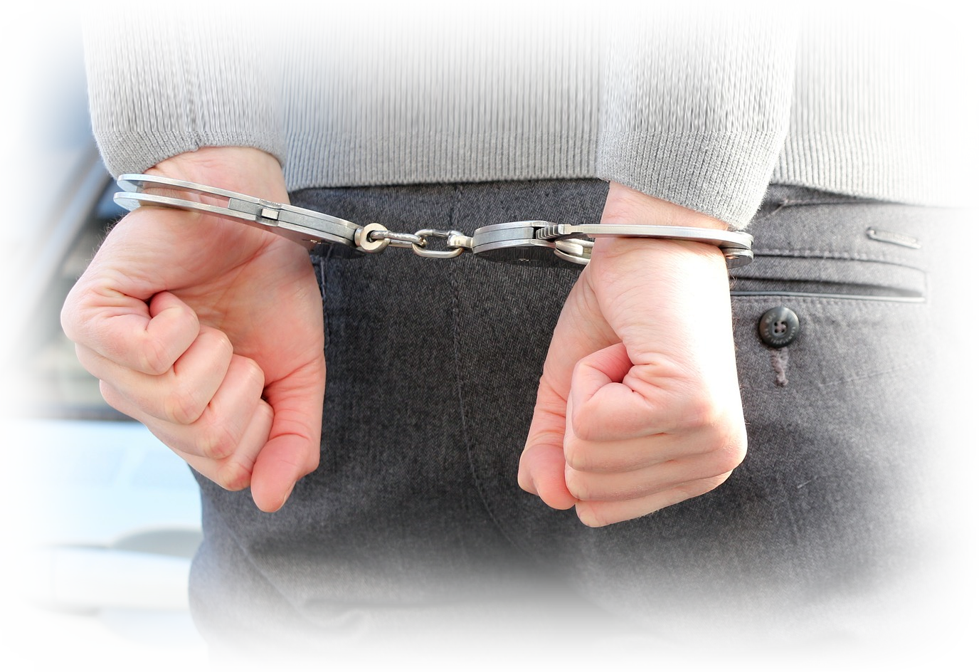
2. The REPEATED Forgetfulness
Serving
God
¹² Once again
the Israelites did
evil in the eyes of the LORD, and because they did this evil the LORD gave Eglon king of Moab power over Israel
Downfall
into Sin
Enslaved
by Enemy

Slide 23
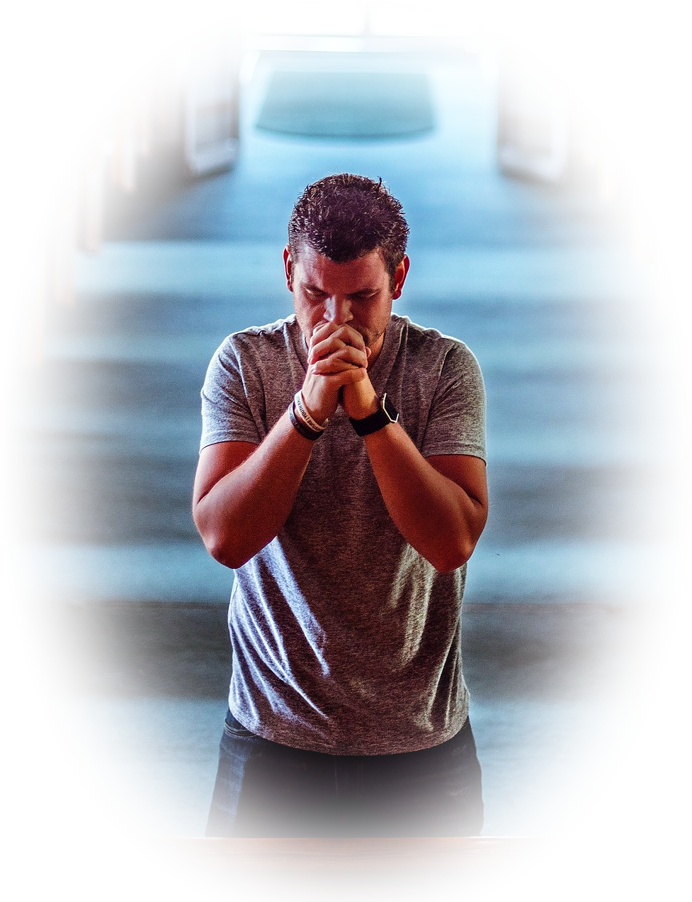
2. The REPEATED Forgetfulness
Serving
God
¹⁵ Again the
Israelites cried out
to the LORD, and he gave them a deliverer--Ehud, a left-handed man, the son of Gera the Benjamite.
Downfall
into Sin
Enslaved
by Enemy
Cry out
to God

Slide 24
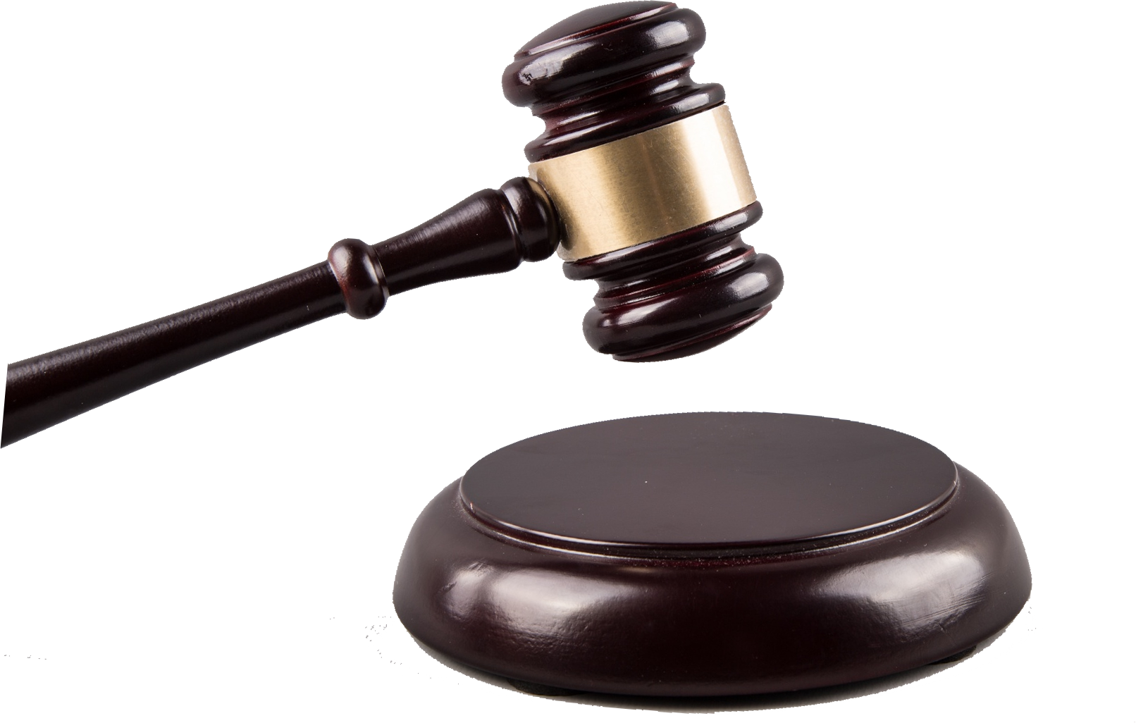
2. The REPEATED Forgetfulness
Serving
God
¹⁵ Again the
Israelites cried out
to the LORD, and he gave them a deliverer--Ehud, a left-handed man, the son of Gera the Benjamite.
Downfall
into Sin
God Sends
Judge
Enslaved
by Enemy
Cry out
to God

Slide 25
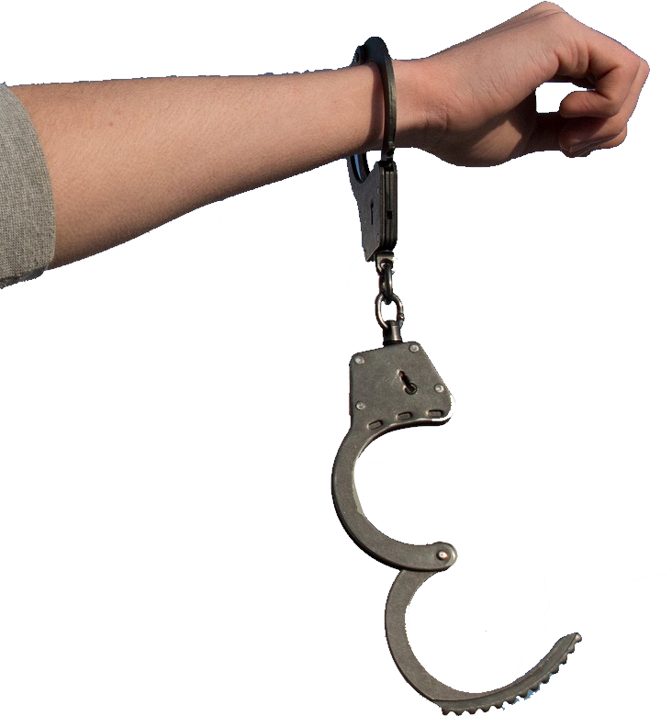
2. The REPEATED Forgetfulness
Serving
God
God Rescues
¹⁶ Now Ehud
had made a double-edged sword ....
Moab was made subject to Israel, and the land had peace
for eighty years.
Downfall
into Sin
God Sends
Judge
Enslaved
by Enemy
Cry out
to God

Slide 26

2. The REPEATED Forgetfulness
Serving
God
God Rescues
¹⁶ Now Ehud
had made a double-edged sword ....
Moab was made subject to Israel, and the land had peace
for eighty years.
Downfall
into Sin
God Sends
Judge
Enslaved
by Enemy
Cry out
to God

Slide 27
3. The Forgetful RUT 3:31; 4:1; 6:1; etc.
Serving
God
AGAIN
God Rescues
3:31 After Ehud
came Shamgar son
of Anath, who struck down six hundred Philistines with an oxgoad. He too
saved Israel.
Downfall
into Sin
God Sends
Judge
Enslaved
by Enemy
Cry out
to God

Slide 28
3. The Forgetful RUT 3:31; 4:1; 6:1; etc.
Serving
God
AGAIN
and
AGAIN
God Rescues
4:1 After Ehud
died, the Israelites
once again did evil in the eyes of the LORD. ² So the LORD sold them into the hands of Jabin, a king of Canaan,
Downfall
into Sin
God Sends
Judge
Enslaved
by Enemy
Cry out
to God

Slide 29
3. The Forgetful RUT 3:31; 4:1; 6:1; etc.
Serving
God
AGAIN
and
AGAIN
and
AGAIN
God Rescues
Downfall
into Sin
6:1 Again the Israelites did evil in the eyes of the LORD,
God Sends
Judge
Enslaved
by Enemy
Cry out
to God

Slide 30
3. The Forgetful RUT 3:31; 4:1; 6:1; etc.
Serving
God
WHY?
God Rescues
Downfall
into Sin
6:1 Again the Israelites did evil in the eyes of the LORD,
God Sends
Judge
Enslaved
by Enemy
Cry out
to God

Slide 31
3. The Forgetful RUT 3:31; 4:1; 6:1; etc.
Serving
God
WHY?
Because they
FORGOT...
God Rescues
Downfall
into Sin
^{3: 7} The Israelites
did evil in the eyes
of the LORD; they forgot the LORD
their God
God Sends
Judge
Enslaved
by Enemy
Cry out
to God

Slide 32

Get UNSTUCK: REMEMBER TO:
Serving
God
God Rescues
.
Fall
into Sin
God Sends
Judge
Enslaved
by It
Cry out
to God

Slide 33
Get UNSTUCK: REMEMBER TO:
Serving
God
HOW?
God Rescues
.
Fall
into Sin
God Sends
Judge
Enslaved
by It
Cry out
to God

Slide 34


Get UNSTUCK: REMEMBER TO:
Serve the LORD
HOW?
God Rescues
as for me and my household, we will serve the LORD."
(Joshua 24:15)
God Sends
Judge
Cry out
to God

Slide 35
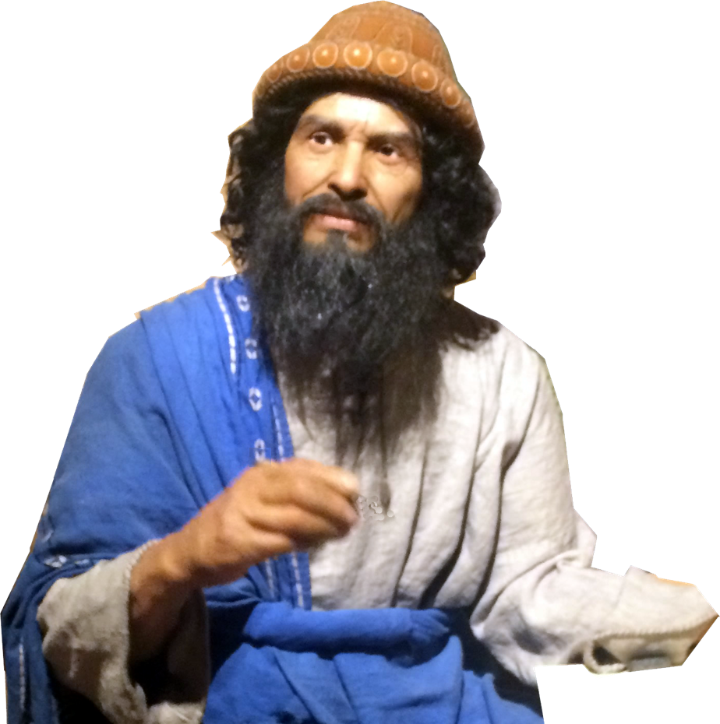
Get UNSTUCK: REMEMBER TO:
Serve the LORD
BE COMMITTED
like Joshua
God Rescues
as for me and my household, we will serve the LORD."
(Joshua 24:15)
God Sends
Judge
Cry out
to God

Slide 36
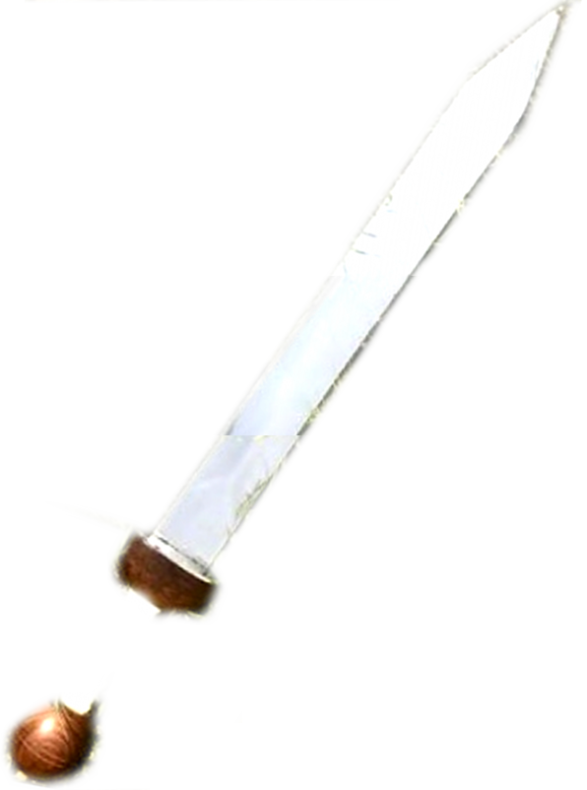
Get UNSTUCK: REMEMBER TO:
Serve the LORD
START FIGHTING
like Joshua
God Rescues
¹⁰ So Joshua fought the Amalekites as Moses had ordered, (Exodus 17:10)
God Sends
Judge
Cry out
to God

Slide 37
Get UNSTUCK: REMEMBER TO:
Serve the LORD
START FIGHTING
like Joshua
God Rescues
the LORD, the God
of Israel, fought for Israel. (Jos 10:42)
God Sends
Judge
Cry out
to God

Slide 38
Get UNSTUCK: REMEMBER TO:
Serve the LORD
START FIGHTING
like Joshua
HOW?
God Rescues
the LORD, the God
of Israel, fought for Israel. (Jos 10:42)
God Sends
Judge
Cry out
to God

Slide 39
Get UNSTUCK: REMEMBER TO:
Serve the LORD
DON’T FORGET (Remember)
God Rescues
God Sends
Judge
Cry out
to God

Slide 40
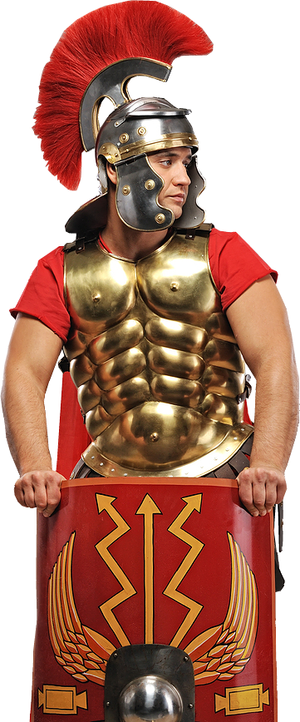
Get UNSTUCK: REMEMBER TO:
Serve the LORD
1-ARM YOURSELF – Eph 6
¹³ Therefore put on the full armor of God,
God Rescues
God Sends
Judge
Cry out
to God
Notes:
You have to put it on. God gives it to you, but you must put it on.

Slide 41
Get UNSTUCK: REMEMBER TO:
Serve the LORD
2-STAND YOUR GROUND
¹³ Therefore put on the full armor of God, so that when the day of evil comes, you may be able to stand your ground, and after you have done everything, to stand.
God Rescues
God Sends
Judge
Cry out
to God
Notes:
Don’t run, flee, but stand your ground – If you are armed.
Too many foolishly think that they can win the battle without spiritual armaments.

Slide 42
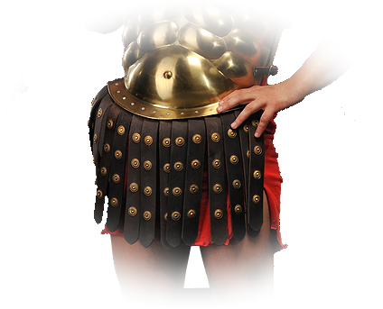
Get UNSTUCK: REMEMBER TO:
Serve the LORD
3-TIGHTEN YOUR BELT
¹⁴ Stand firm then, with the belt of truth buckled around your waist, with the breast-plate of righteousness in place,
God Rescues
God Sends
Judge
Cry out
to God
Notes:
The word of God is the truth. You need to tighten up your life with the truth of God’s Word.
So when you start your day, start with a truth from God—out of the Bible!
When you neglect the word—you set yourself up for defeat. God wants you to be a winner. That’s why He gave you the word.
When you daily tighten up the belt, you will stand as Joshua did and the enemies walls will come down.

Slide 43
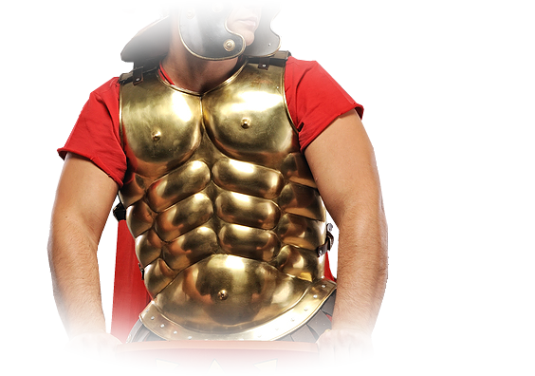
Get UNSTUCK: REMEMBER TO:
Serve the LORD
4-GUARD YOUR HEART
¹⁴ Stand firm then, with the belt of truth buckled around your waist, with the breast-plate of righteousness in place,
God Rescues
God Sends
Judge
Cry out
to God
Notes:
Your heart is vulnerable. So you must protect it.
With the Righteousness of Christ imputed to you = Justification = Once for all fitting/clothed in righteousness. = SAVED
With the Righteousness of Christ implemented by you = Sanctification = Daily taking up the righteouseness of Christ and living it out. = Living Like I’m SAVED

Slide 44
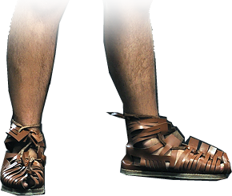
Get UNSTUCK: REMEMBER TO:
Serve the LORD
5-SANDLE YOUR FEET
¹⁵ and with your feet fitted with the readiness that comes from the gospel of peace.
God Rescues
God Sends
Judge
Cry out
to God
Notes:
Stand on your feet – not sit on your butt in a pew. This is not a spectator sport, not a recreation room—this is a battlefield.
You take the battle to the enemy. . Share the gospel.

Slide 45
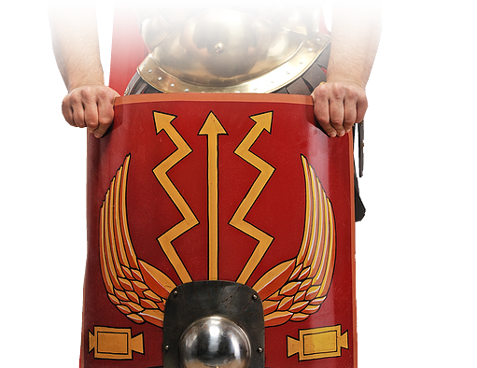
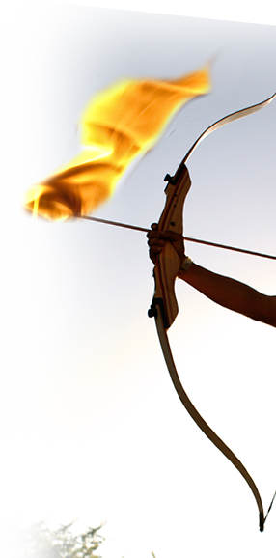
Get UNSTUCK: REMEMBER TO:
Serve the LORD
6-PUT UP YOUR SHIELD
¹⁶ In addition to all this, take
up the shield of faith, with which you can extinguish all
the flaming arrows of the evil one.
God Rescues
God Sends
Judge
Cry out
to God
Notes:
Your faith is your protection from incoming attacks. The missiles launched against you are DOUBT, QUESTIONS, WORRIES, FEARS, ETC.
When doubt, worry, fear, sense of powerlessness overwhelms you – you are at the end of your rope, TIE A KNOT, HANG ON, TRUST GOD!
You do that by lifting up your faith as a shield. I beleive! I beleive!

Slide 46
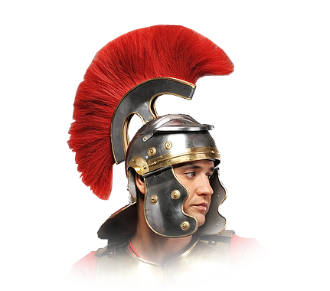
Get UNSTUCK: REMEMBER TO:
Serve the LORD
7-PROTECT YOUR THOUGHTS
¹⁷ Take the helmet of
salvation and the sword
of the Spirit, which is the
word of God.
God Rescues
God Sends
Judge
Cry out
to God
Notes:
Some battles are lost in your head and not on the battle field. You need the assurance of salvation to protect your thoughts.
If you doubt yourself and God, you will stumble and fall. So protect your thoughts.
⁶ Do not be anxious about anything, but in everything, by prayer and petition, with thanksgiving, present your requests to God.
⁷ And the peace of God, which transcends all understanding, will guard your hearts and your minds in Christ Jesus.
⁸ Finally, brothers, whatever is true, whatever is noble, whatever is right, whatever is pure, whatever is lovely, whatever is admirable--if anything is excellent or praiseworthy--think about such things.
⁹ Whatever you have learned or received or heard from me, or seen in me--put it into practice. And the God of peace will be with you.
(Phi 4:6-9 NIV)

Slide 47
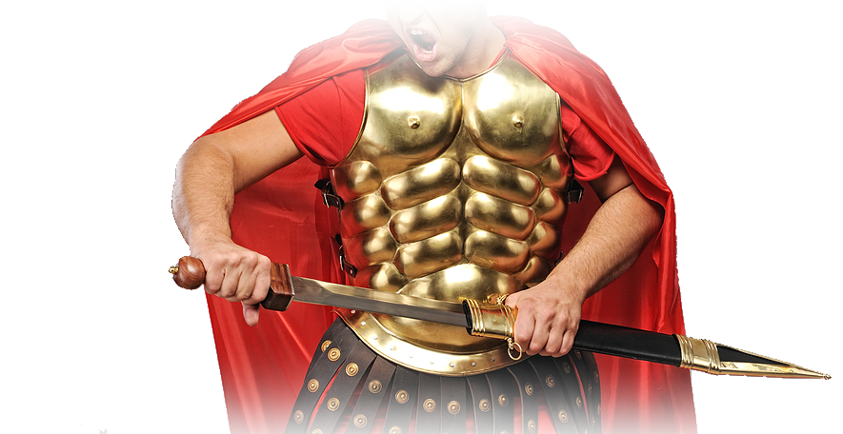
Get UNSTUCK: REMEMBER TO:
Serve the LORD
8-USE YOUR SWORD
¹⁷ Take the helmet of salvation and the sword
of the Spirit, which is the word of God.
God Rescues
God Sends
Judge
Cry out
to God
Notes:
Everything so far is defensive—now for you offensive weapons: The Word of God.

Slide 48
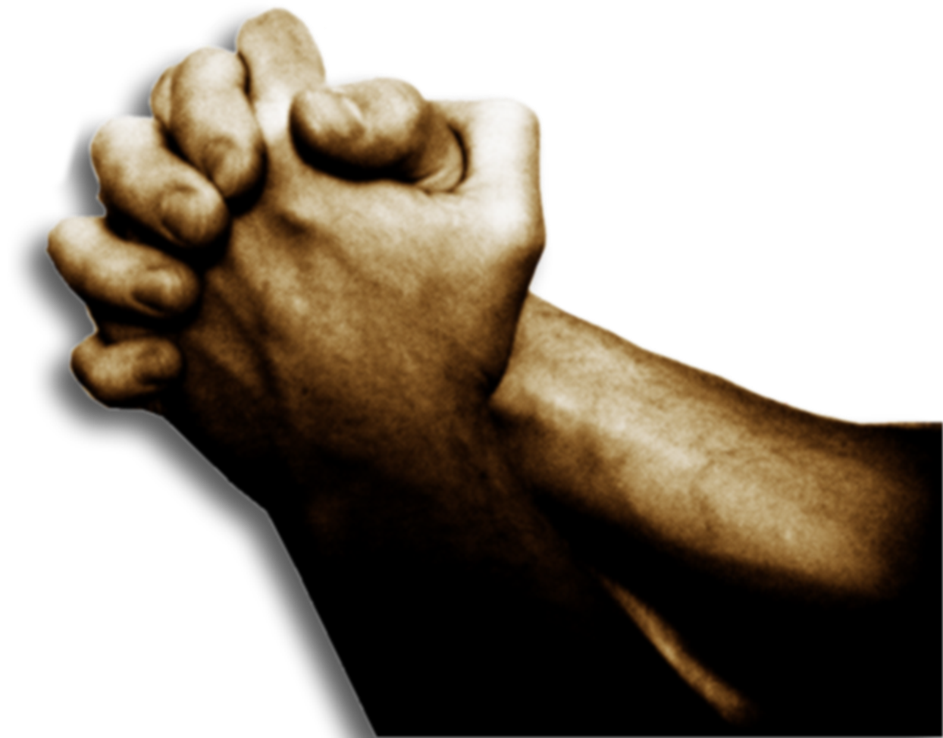
Get UNSTUCK: REMEMBER TO:
Serve the LORD
9-TAP YOUR REAL POWER
¹⁸ And pray in the Spirit on all occasions with all kinds of prayers and requests. With this in mind, be alert and always keep on praying for all the saints.
God Rescues
God Sends
Judge
Cry out
to God
Notes:
Everything so far is defensive—now for you offensive weapons: The Word of God AND PRAYER

Slide 49
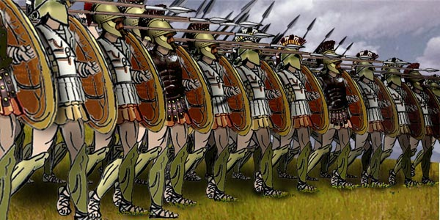
I HAD A BATTLE ...

Slide 50
I HAD A BATTLE ...

Slide 51
I HAD A BATTLE ...

Slide 52
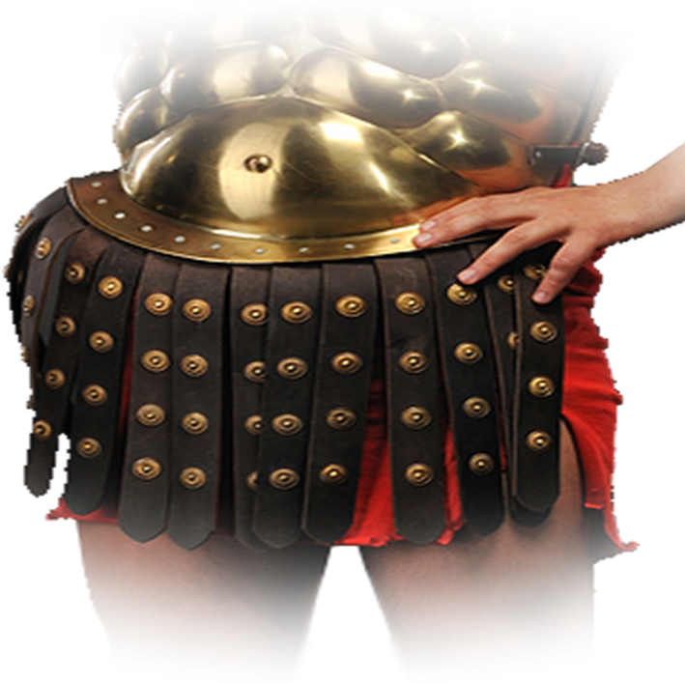
I HAD A BATTLE ...

Slide 53
I HAD A BATTLE ...

Slide 54
I HAD A BATTLE ...

Slide 55
I HAD A BATTLE ...

Slide 56
I HAD A BATTLE ...

Slide 57
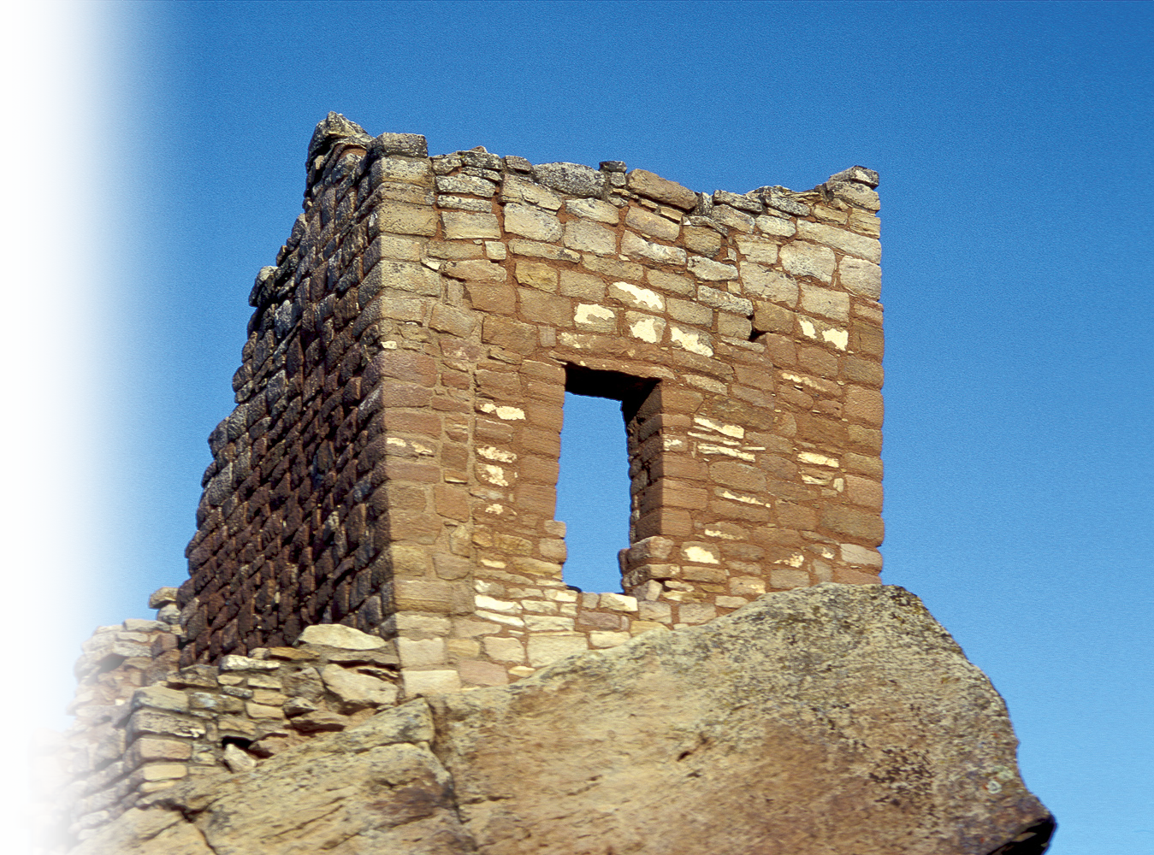
REMEMBER THIS ...
⁴ The weapons we fight with are not the weapons of the world. On the contrary, they have divine power to demolish strongholds. (2Corinthians 10:4)

Slide 58
REMEMBER THIS ...
... the LORD, the God of Israel, fought for Israel. (Jos 10:42)

Slide 59
REMEMBER THIS ...
He will fight for YOU TOO!
Notes:
I don’t know what battle you are fighting today. Fear, depression, anxiety, worry, relational, financial, physical or spiritual.
The Lord has given you the armor—so pick it up and use it. He will empower you when you put it on and stand.

Slide 60

LET S PRAY
,

