Slide 1

Notes:
You will need the font: “Soul Mission” for this presentation. You may get it free at www.dafont.com/soulmission.font Or www.1001fonts.com/soulmission-font.html
Copyright © 2006−2020. All rights reserved. Bible Point is a registered trademark of Dennis Henderson. All other trademarks acknowledged.
Bible Point contains graphics from Bible Point artists. These illustrations belong to Bible Point and the respective artists. You may use the designs and illustrations for graphical illustration of lessons free and without special permission, provided they are not used in any way that maligns the Christian faith. Furthermore, republication or production of any illustration by any other graphic service whether it be in book, in a machine-readable form, or in any other design resource is strictly prohibited. Furthermore, they cannot be duplicated or resold as any other form of publishing, clip art, or graphic resource.
So What does it mean? (A simple translations of the legal jargon)
So, if you don’t own the presentation(s), graphic(s), and text(s) how can you legally use them? The purchase of the license allows you to use all the images in the product. However, the actual ownership and copyright of the presentation(s), graphic(s), and text(s) remain the property of Bible Point and its licensors. If you had plans on using this product in your “for sale” work—think again!
License Agreement
Article 1: License Grant
All the graphics and text in Bible Point presentations (excluding quotes from the Bible and stated sources) are the intellectual and real property of Bible Point and its licensors, and is protected by law, including United States copyright laws and international treaties. Bible Point grants to you a license:
1. To use the presentation in a single church, single school, or single office of a Christian organization.
2. To make a single archival back-up copy of the program.
3. To modify the presentation(s) and merge with other presentations in a single church, school, or Christian organization.
4. To transfer to another party if that party agrees to accept the terms and conditions of this agreement, and you do not retain any copies of the presentation, whether printed, machine readable, modified, or merged form.
Article 2: Terms
This license is effective until terminated. You may terminate the license at any time by destroying the presentation(s), graphic(s), or text(s) together with all copies, modifications and merged portions in any form. Bible Point may terminate your license if you fail to comply with this Agreement. You agree, upon such termination, for any reason, to destroy the presentation(s), graphics, and text(s) with all copies, modifications, and merged portions in any form.
Article 3: Disclaimers
1. Bible Point presentations, graphics, and texts are licensed to you As Is. You, the consumer, bear the entire risk relating to the quality and performance of the presentation(s), graphic(s), or text(s). In no event will Bible Point be liable for damages resulting from any defect.
2. Thirty-day limited warrantee on disks. Bible Point warrants the disks to be free of defects in material and workmanship under normal use for 30 days after purchase. During the 30-day period you may return a defective presentation, graphic, or text with proof of purchase and it will be replaced without charge, unless the presentation is damaged by misuse.
Article 4: General
1. You may not sub-license, assign, or transfer the license of the presentation(s), graphic(s), or text(s) except as provided by this Agreement.
2. This Agreement will be governed by the laws of the State of Michigan.
So What does it mean? (A simple translations of the legal jargon)
May I let someone borrow or copy my licensed Bible Point presentation (even after I modified it)? As long as it is within your local church, or single school, or the immediate office of a Christian organization you may. Otherwise, please refer the person interested in borrowing to: http://www.biblepoint.com or E-mail: dennis@drdh.net with any related questions.

Slide 2
Notes:
You will need the font: “Soul Mission” for this presentation. You may get it free at www.dafont.com/soulmission.font Or www.1001fonts.com/soulmission-font.html
Copyright © 2006−2020. All rights reserved. Bible Point is a registered trademark of Dennis Henderson. All other trademarks acknowledged.
Bible Point contains graphics from Bible Point artists. These illustrations belong to Bible Point and the respective artists. You may use the designs and illustrations for graphical illustration of lessons free and without special permission, provided they are not used in any way that maligns the Christian faith. Furthermore, republication or production of any illustration by any other graphic service whether it be in book, in a machine-readable form, or in any other design resource is strictly prohibited. Furthermore, they cannot be duplicated or resold as any other form of publishing, clip art, or graphic resource.
So What does it mean? (A simple translations of the legal jargon)
So, if you don’t own the presentation(s), graphic(s), and text(s) how can you legally use them? The purchase of the license allows you to use all the images in the product. However, the actual ownership and copyright of the presentation(s), graphic(s), and text(s) remain the property of Bible Point and its licensors. If you had plans on using this product in your “for sale” work—think again!
License Agreement
Article 1: License Grant
All the graphics and text in Bible Point presentations (excluding quotes from the Bible and stated sources) are the intellectual and real property of Bible Point and its licensors, and is protected by law, including United States copyright laws and international treaties. Bible Point grants to you a license:
1. To use the presentation in a single church, single school, or single office of a Christian organization.
2. To make a single archival back-up copy of the program.
3. To modify the presentation(s) and merge with other presentations in a single church, school, or Christian organization.
4. To transfer to another party if that party agrees to accept the terms and conditions of this agreement, and you do not retain any copies of the presentation, whether printed, machine readable, modified, or merged form.
Article 2: Terms
This license is effective until terminated. You may terminate the license at any time by destroying the presentation(s), graphic(s), or text(s) together with all copies, modifications and merged portions in any form. Bible Point may terminate your license if you fail to comply with this Agreement. You agree, upon such termination, for any reason, to destroy the presentation(s), graphics, and text(s) with all copies, modifications, and merged portions in any form.
Article 3: Disclaimers
1. Bible Point presentations, graphics, and texts are licensed to you As Is. You, the consumer, bear the entire risk relating to the quality and performance of the presentation(s), graphic(s), or text(s). In no event will Bible Point be liable for damages resulting from any defect.
2. Thirty-day limited warrantee on disks. Bible Point warrants the disks to be free of defects in material and workmanship under normal use for 30 days after purchase. During the 30-day period you may return a defective presentation, graphic, or text with proof of purchase and it will be replaced without charge, unless the presentation is damaged by misuse.
Article 4: General
1. You may not sub-license, assign, or transfer the license of the presentation(s), graphic(s), or text(s) except as provided by this Agreement.
2. This Agreement will be governed by the laws of the State of Michigan.
So What does it mean? (A simple translations of the legal jargon)
May I let someone borrow or copy my licensed Bible Point presentation (even after I modified it)? As long as it is within your local church, or single school, or the immediate office of a Christian organization you may. Otherwise, please refer the person interested in borrowing to: http://www.biblepoint.com or E-mail: dennis@drdh.net with any related questions.

Slide 3


Slide 4


Slide 5


Slide 6


Slide 7
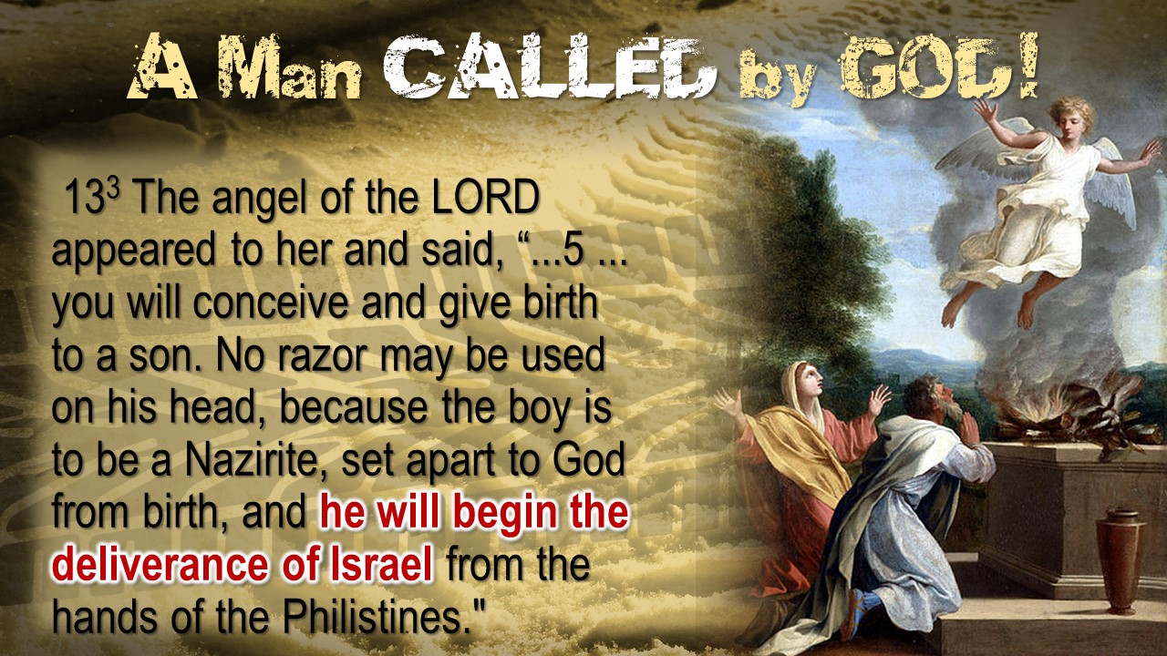

Slide 8
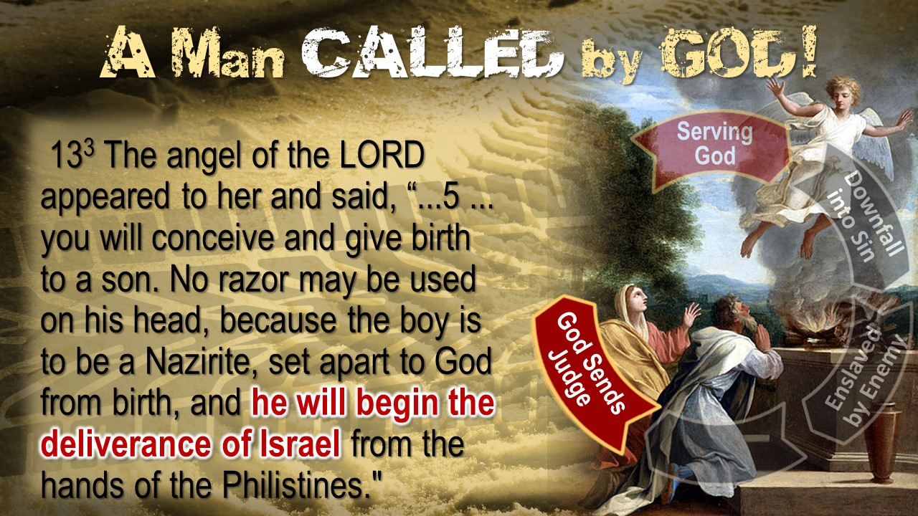

Slide 9
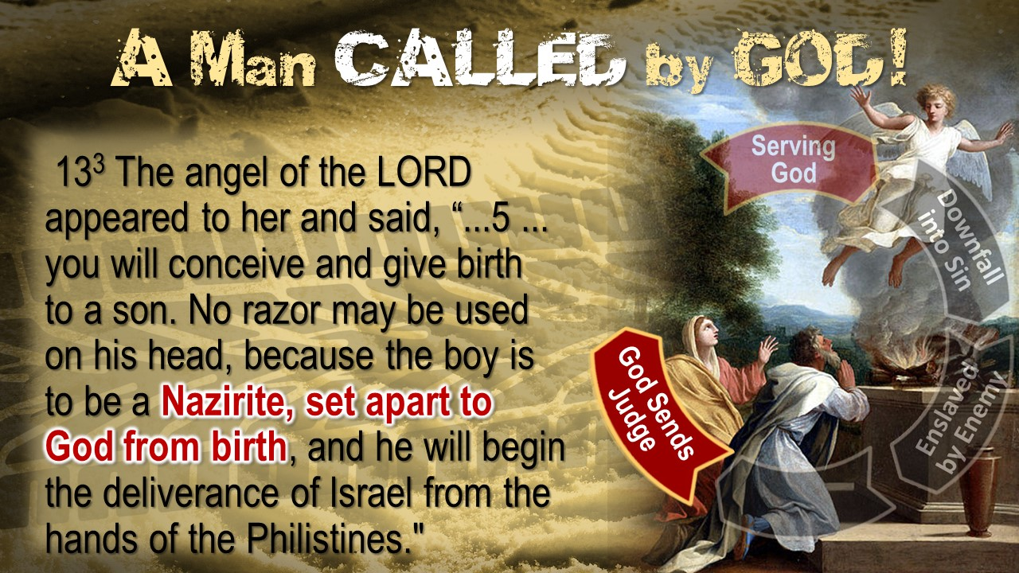

Slide 10
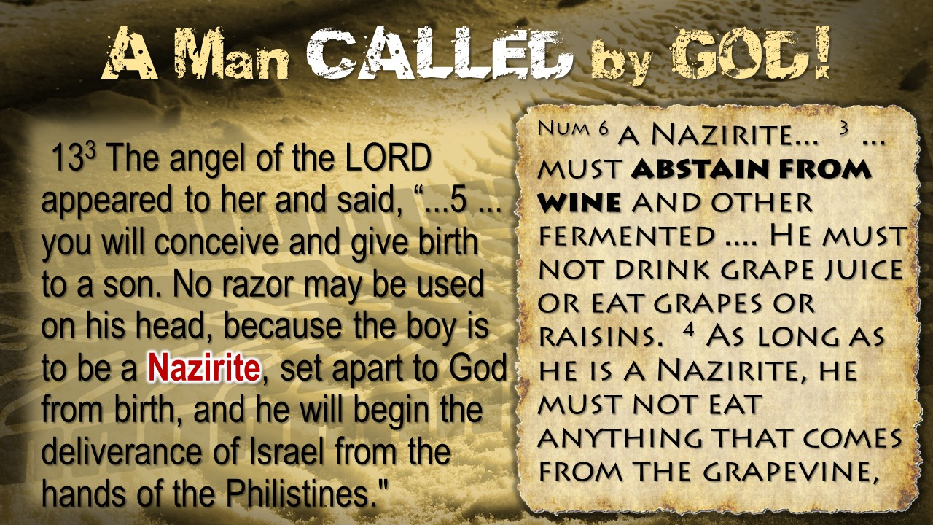

Slide 11
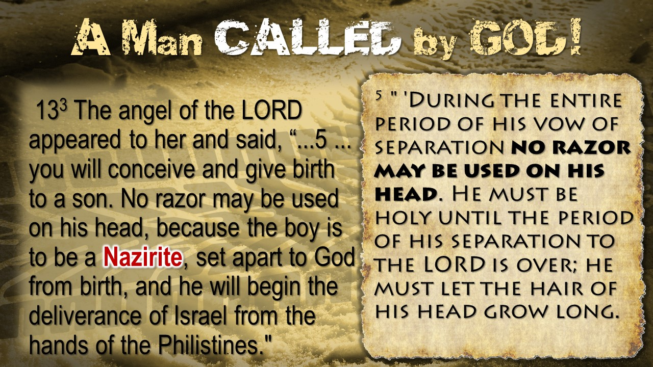

Slide 12
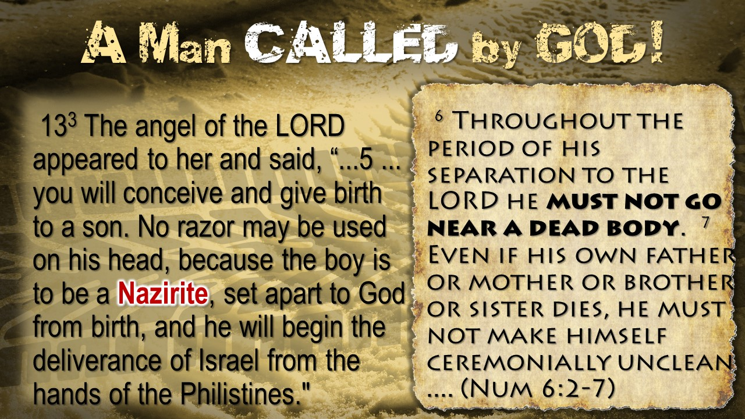

Slide 13


Slide 14


Slide 15


Slide 16


Slide 17
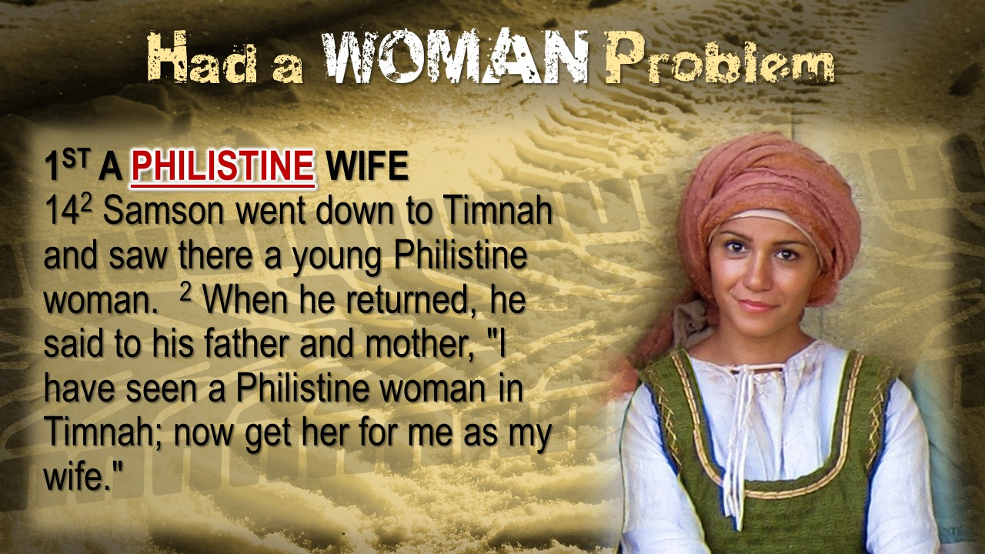

Slide 18
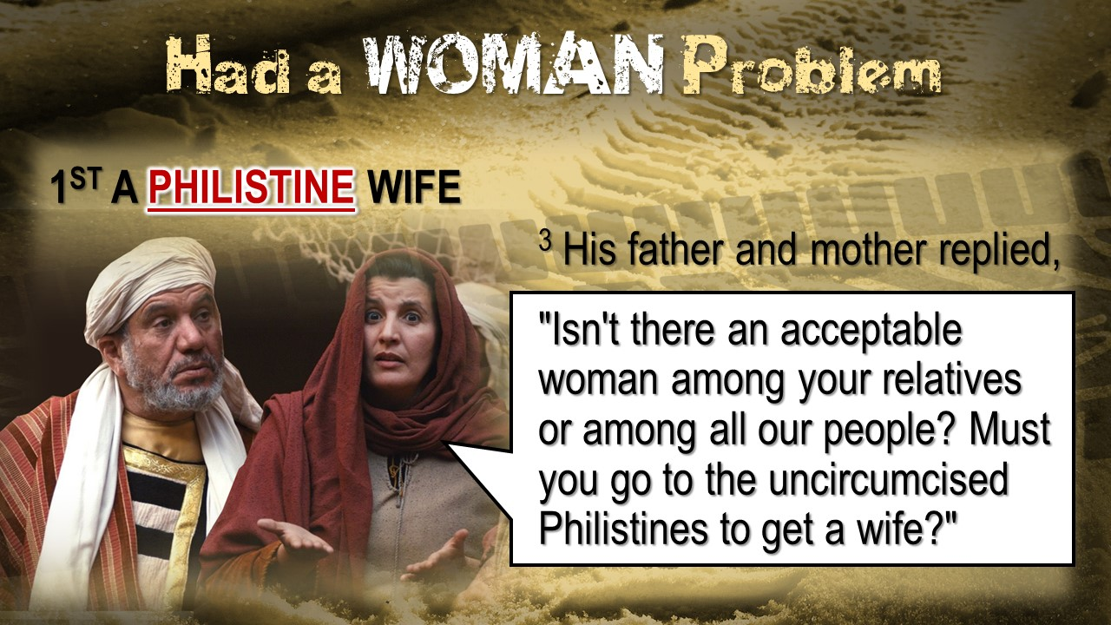

Slide 19
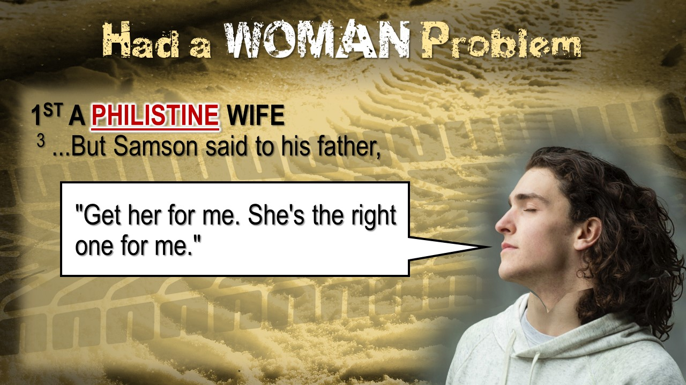

Slide 20


Slide 21
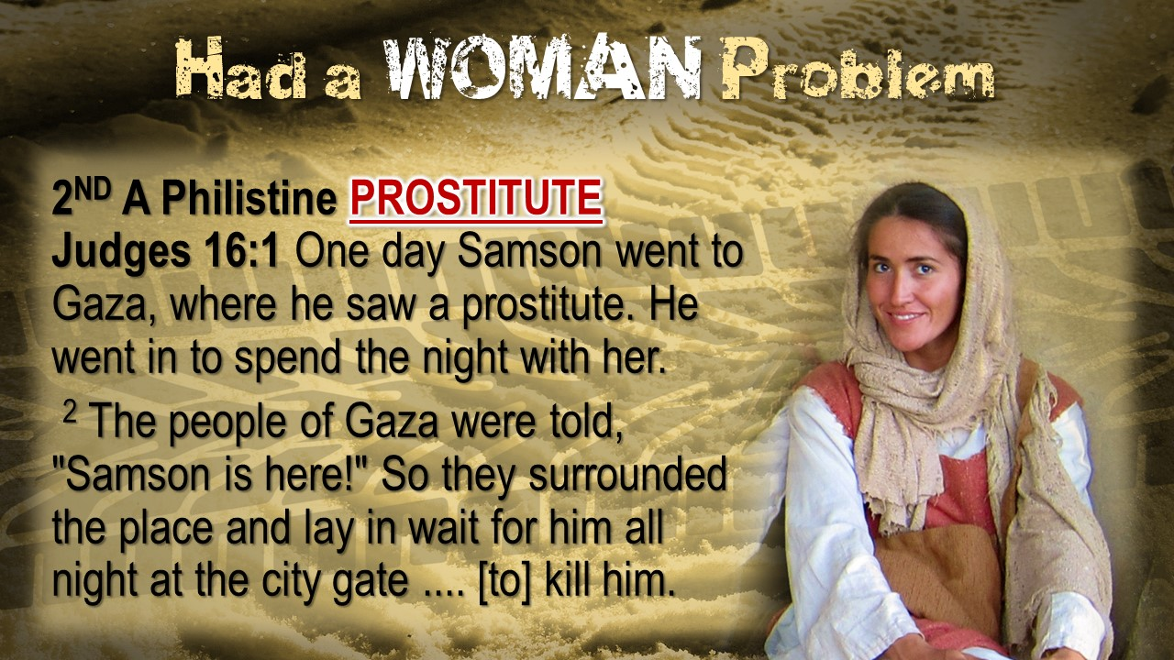

Slide 22
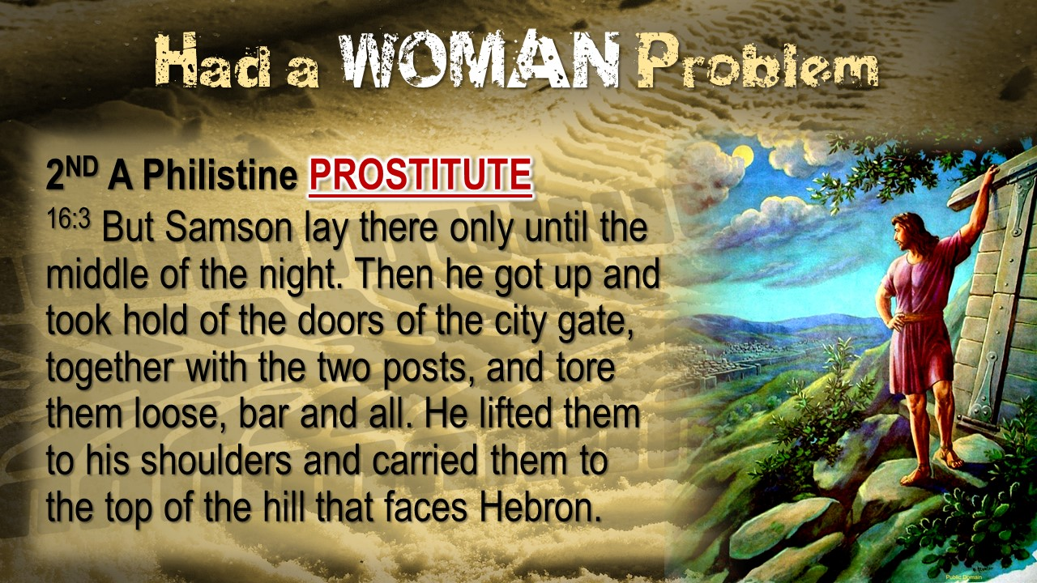

Slide 23


Slide 24
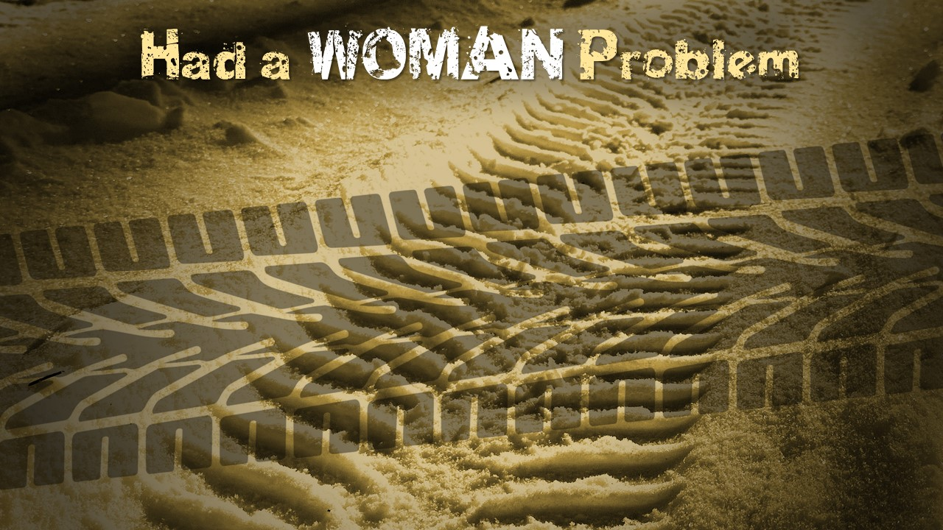

Slide 25


Slide 26
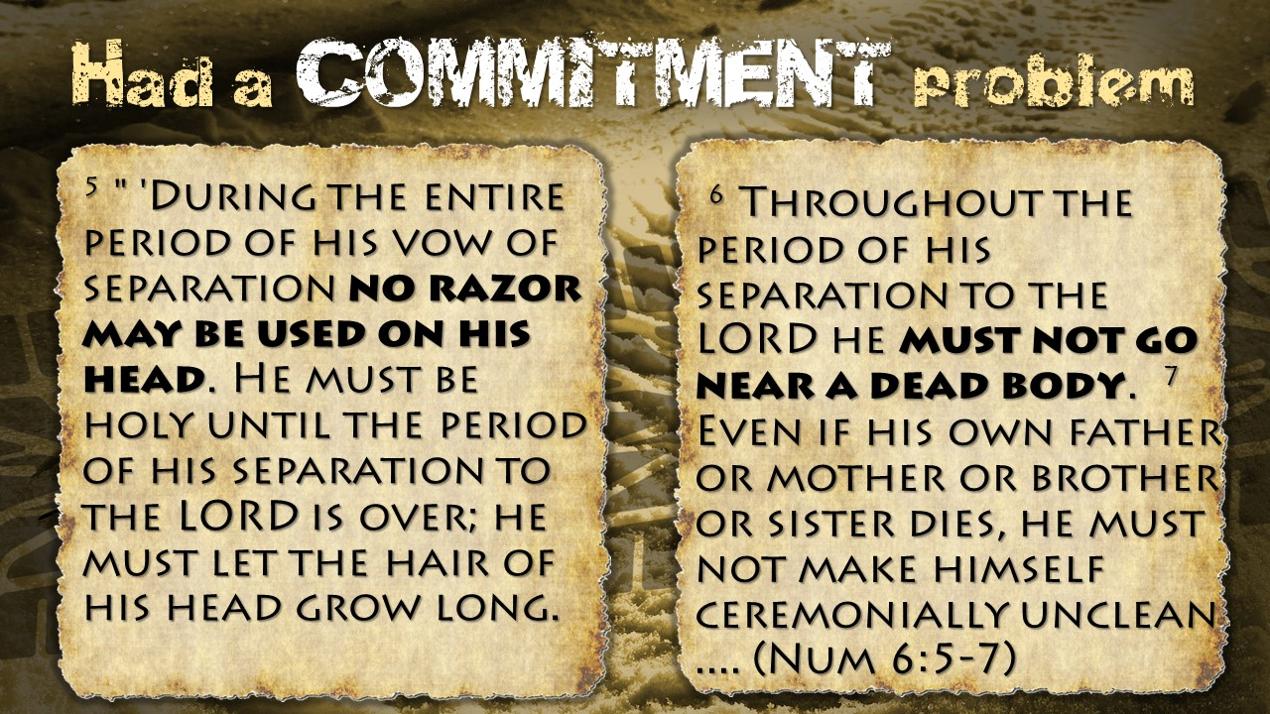

Slide 27
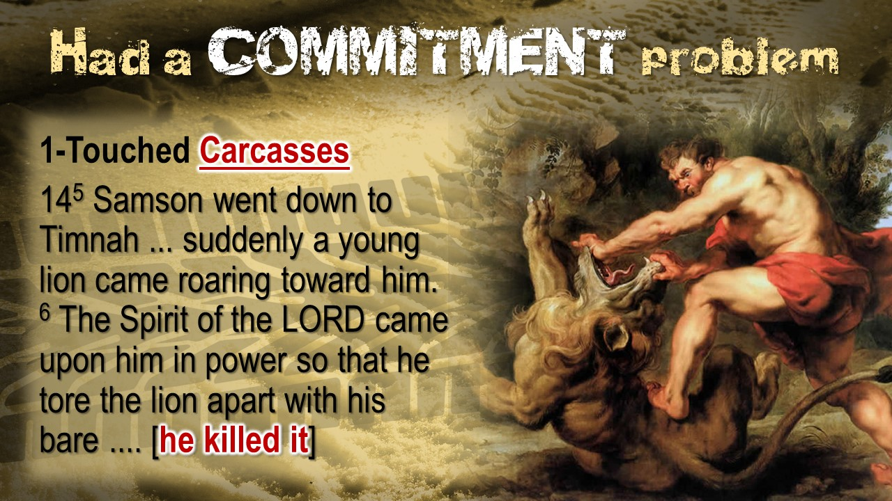

Slide 28
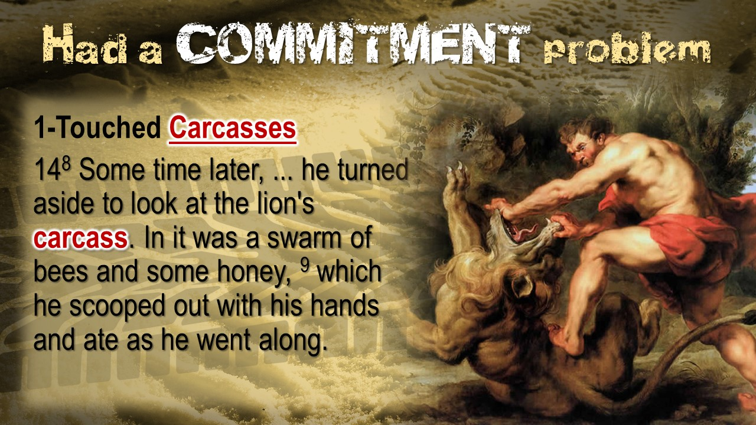

Slide 29
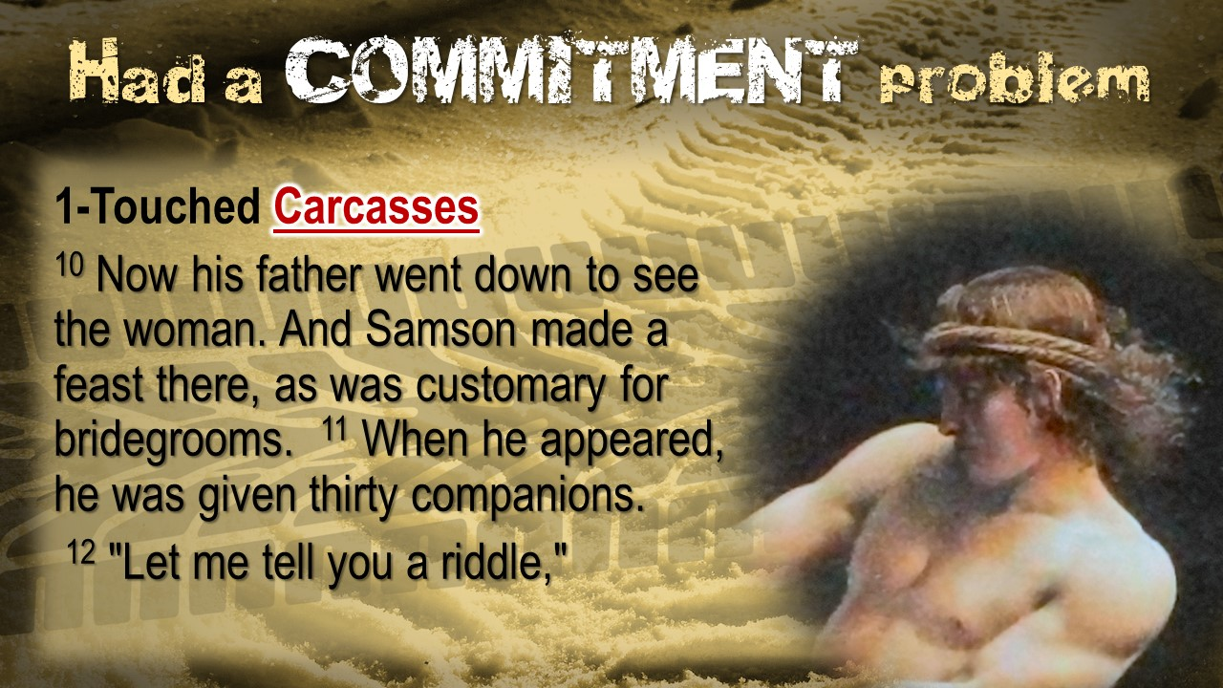

Slide 30
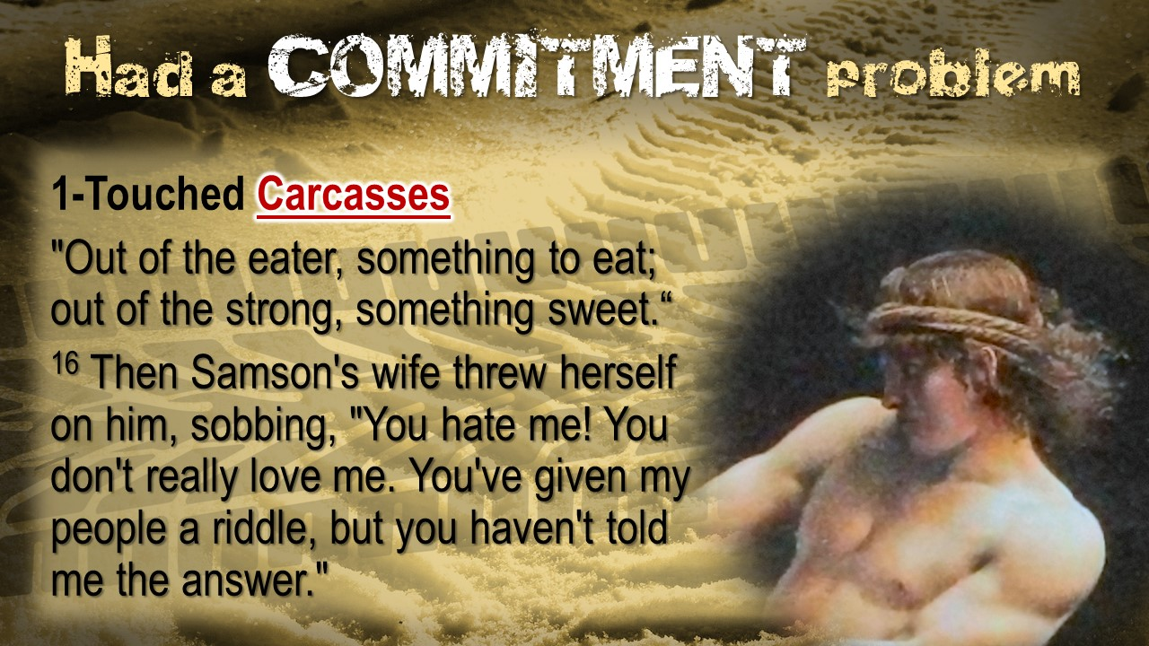

Slide 31
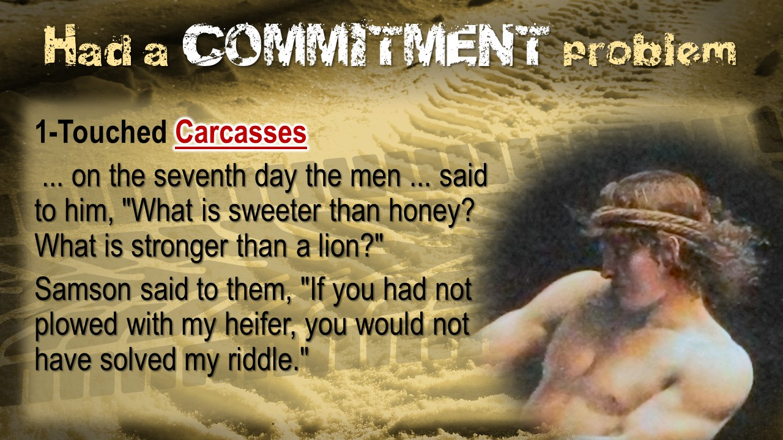

Slide 32
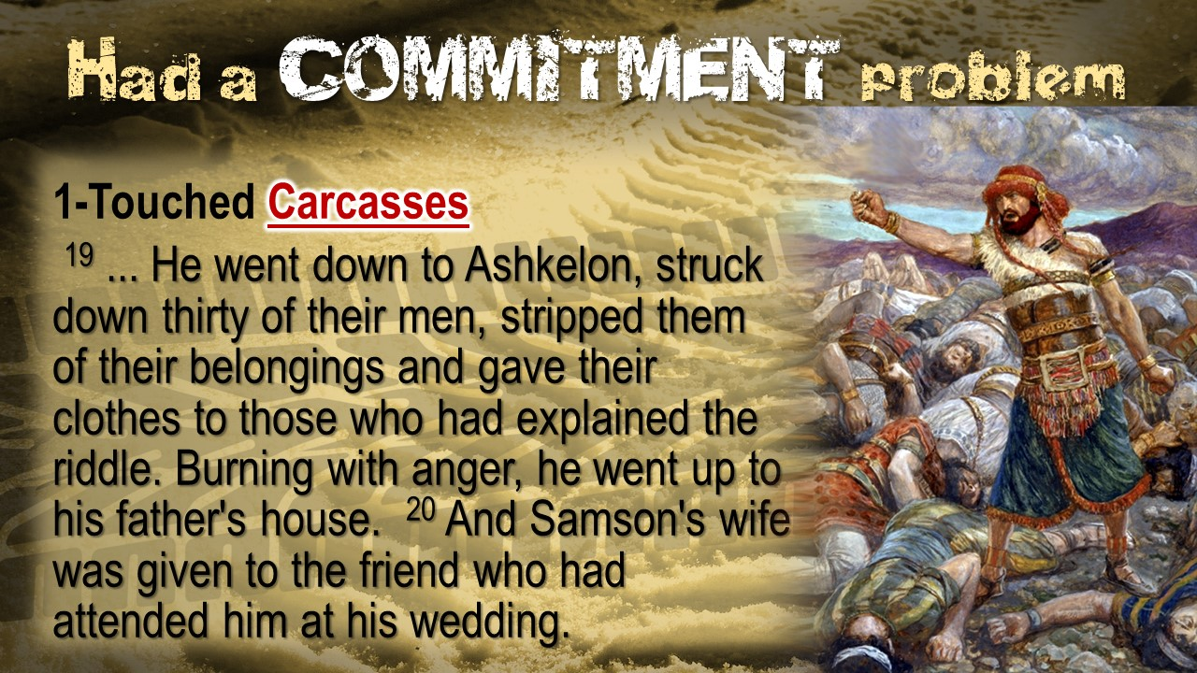

Slide 33
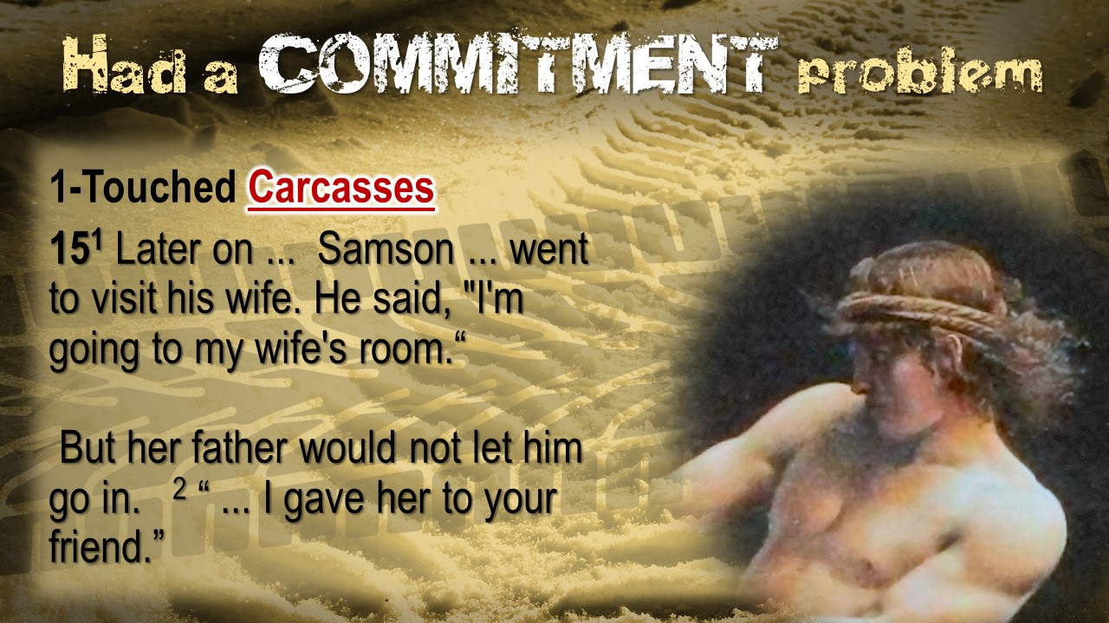

Slide 34
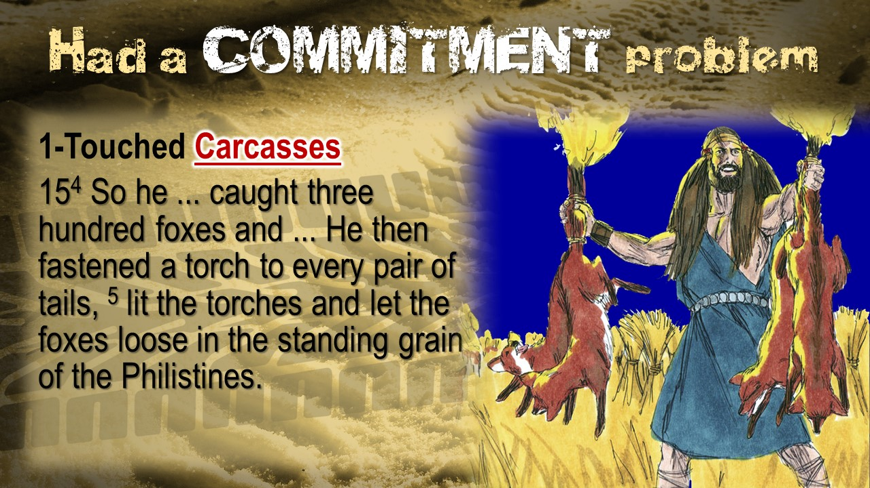

Slide 35
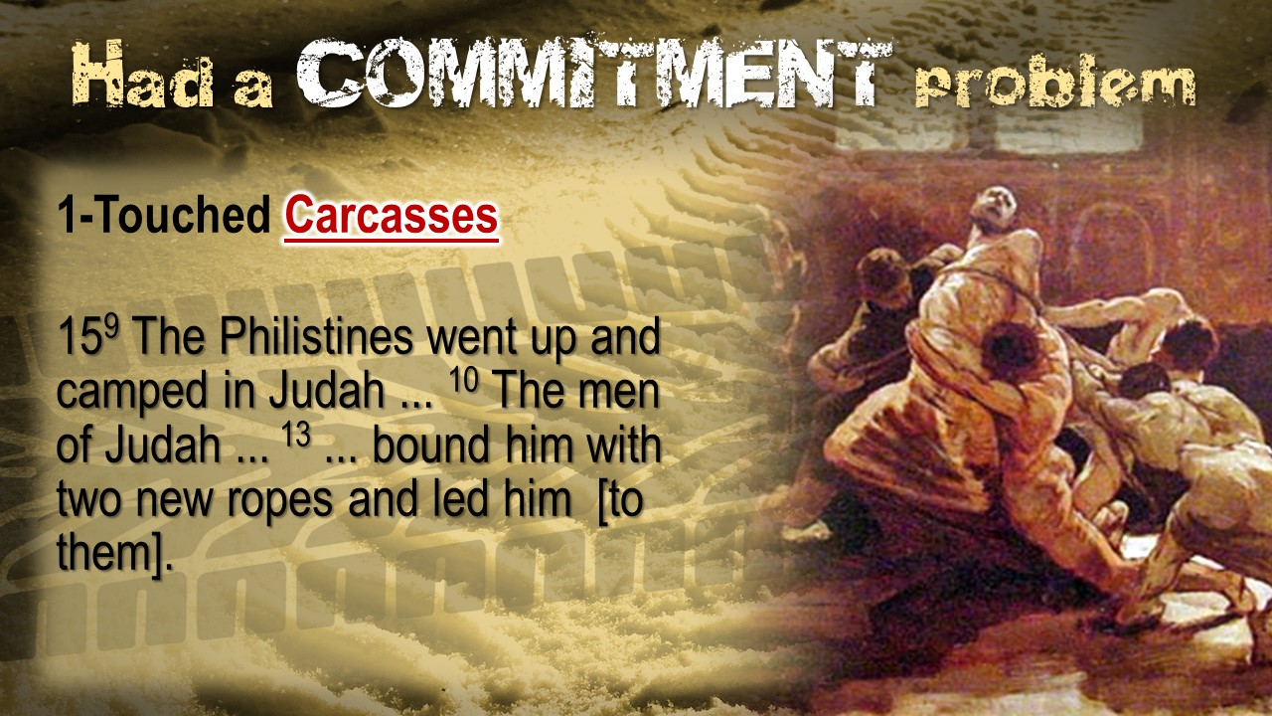

Slide 36
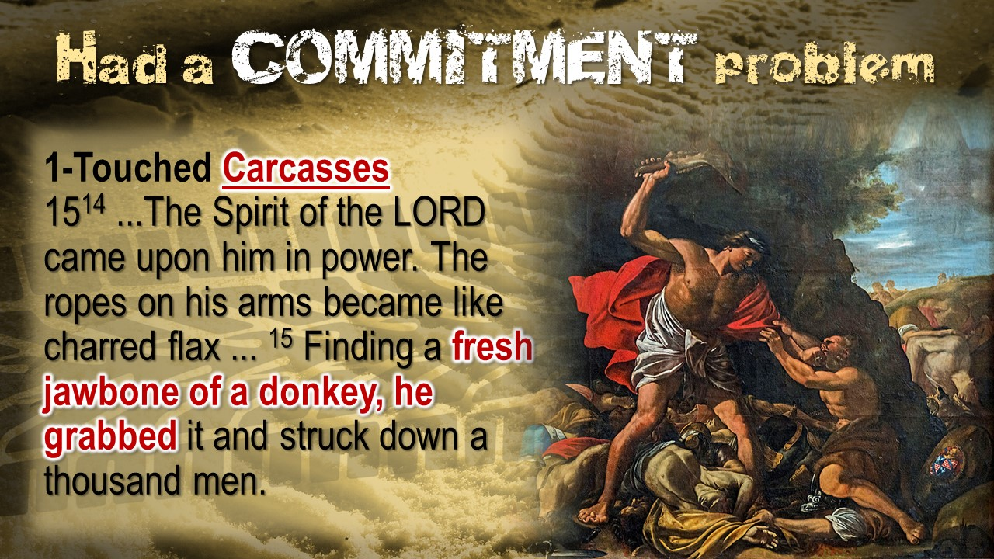

Slide 37
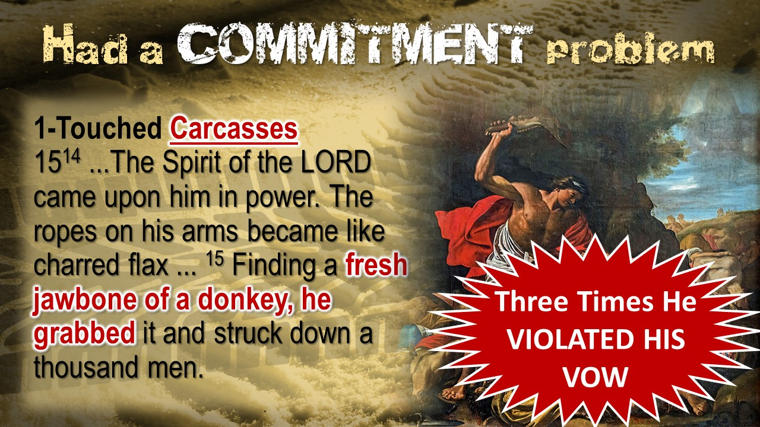

Slide 38


Slide 39


Slide 41
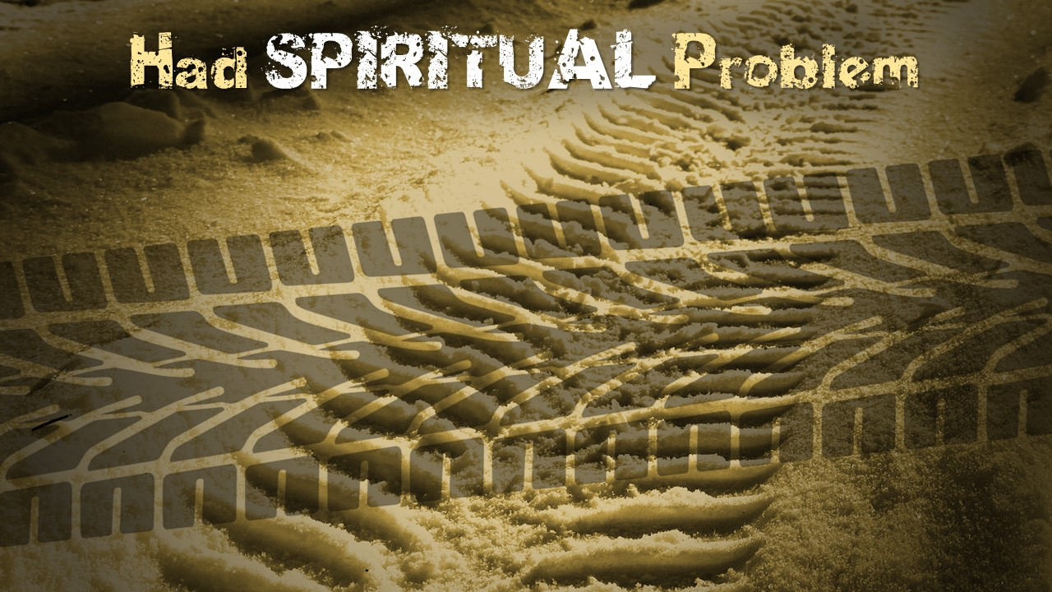

Slide 42
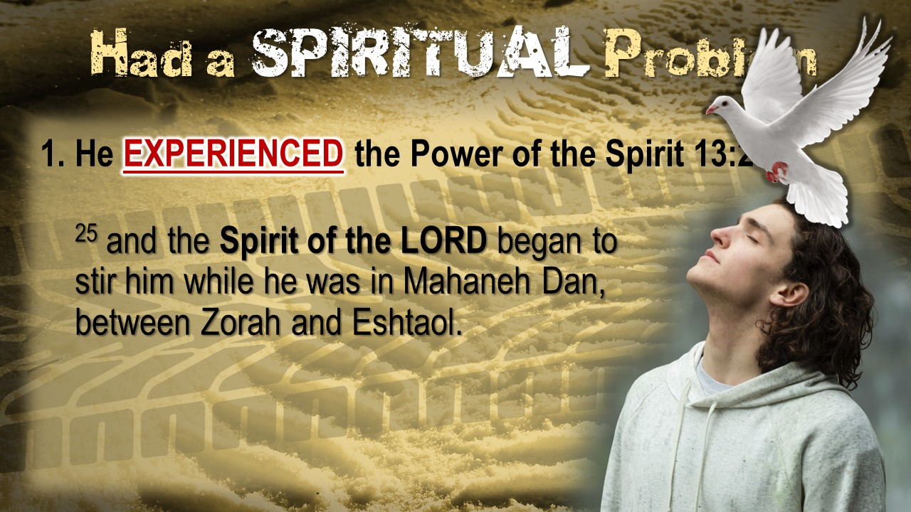

Slide 43
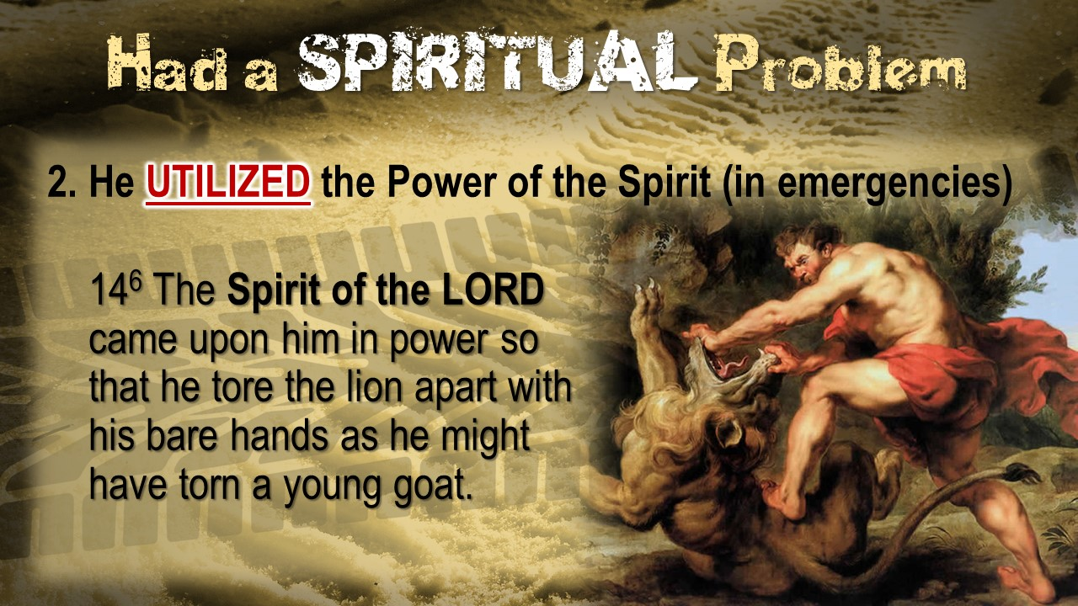

Slide 44
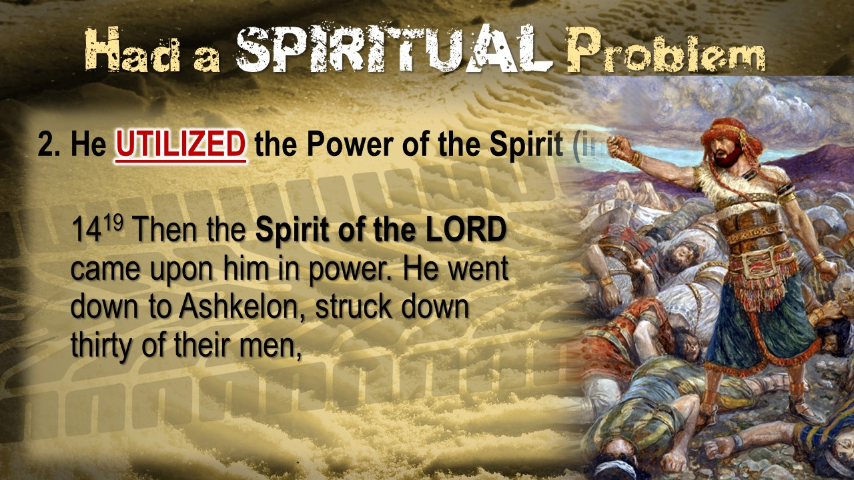

Slide 45
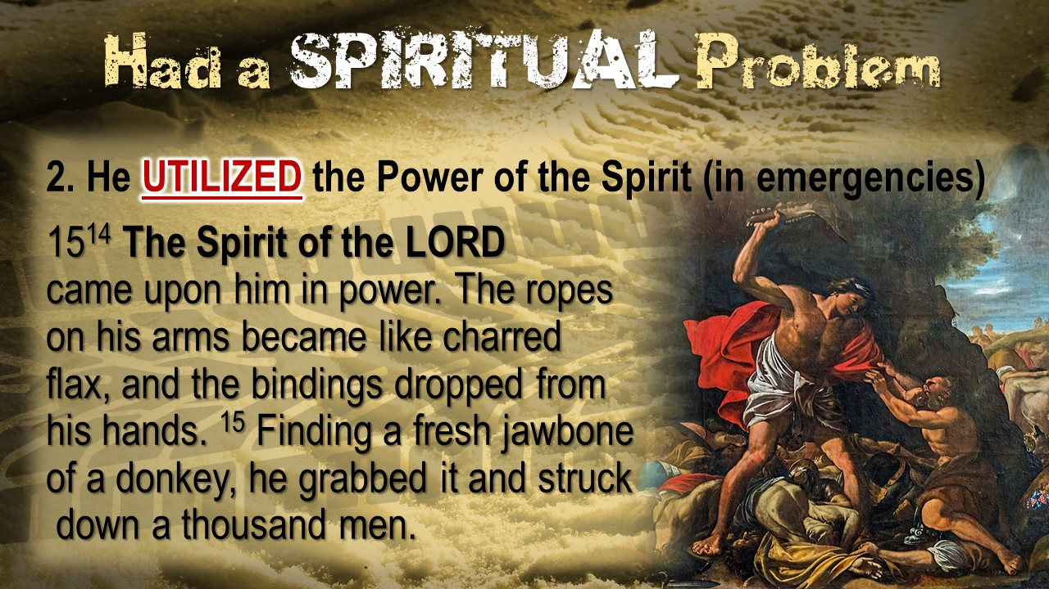

Slide 46
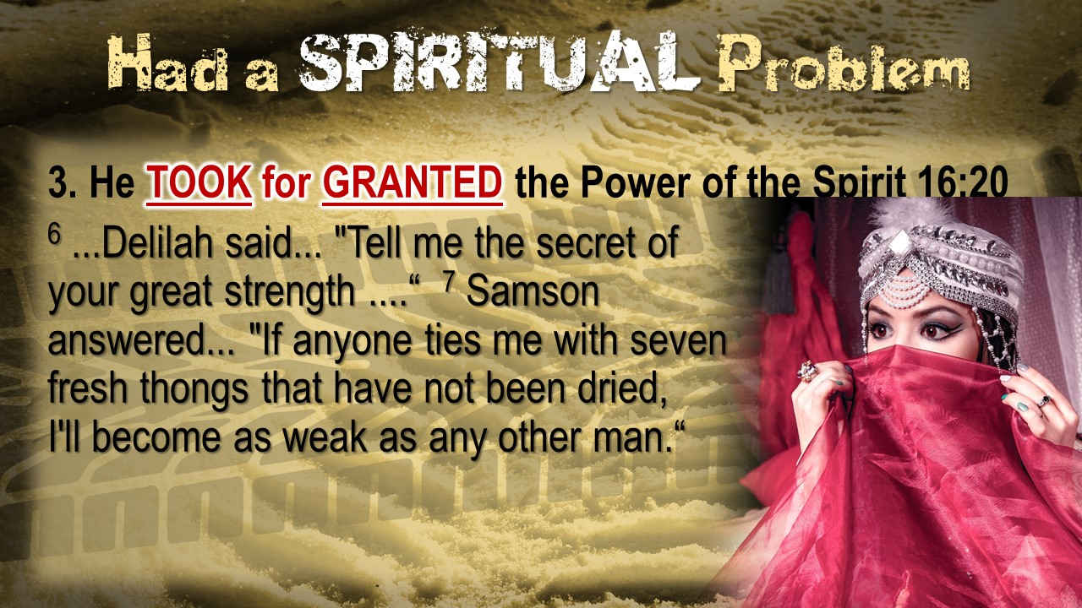

Slide 47
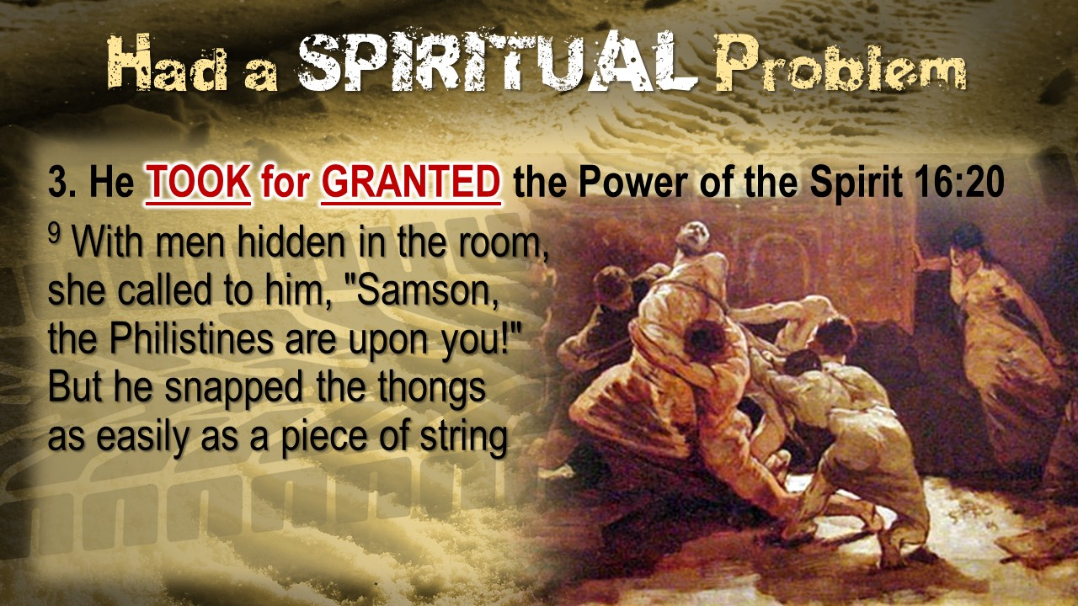

Slide 48
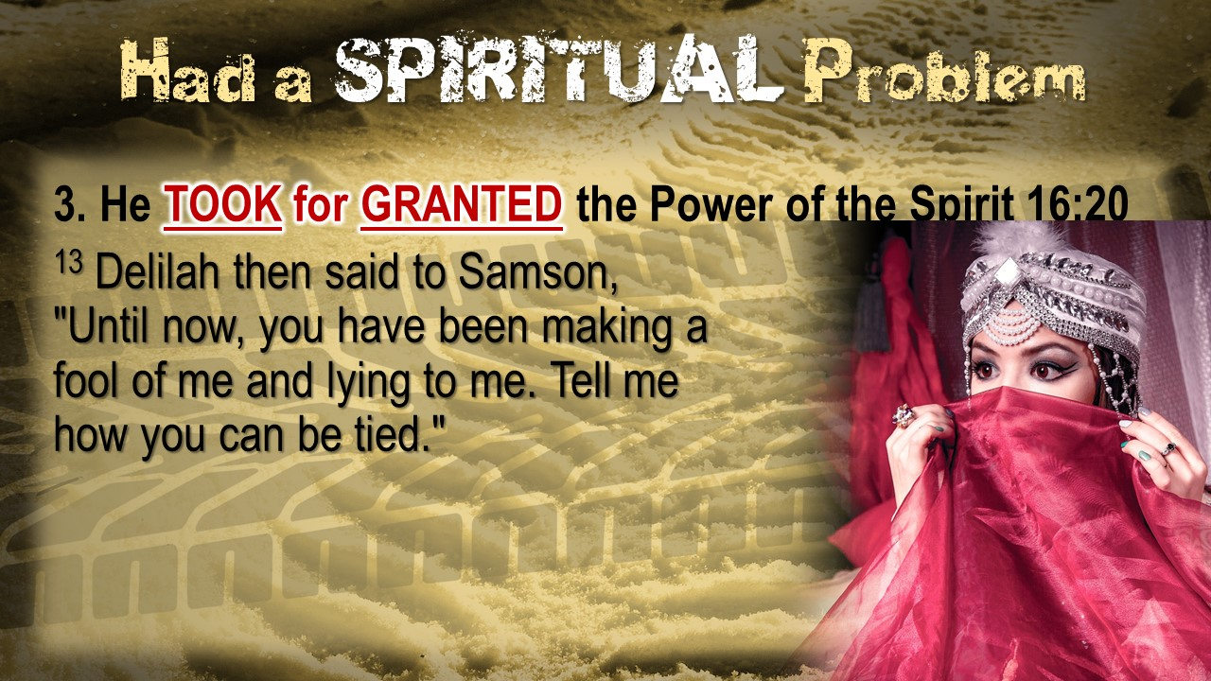

Slide 49
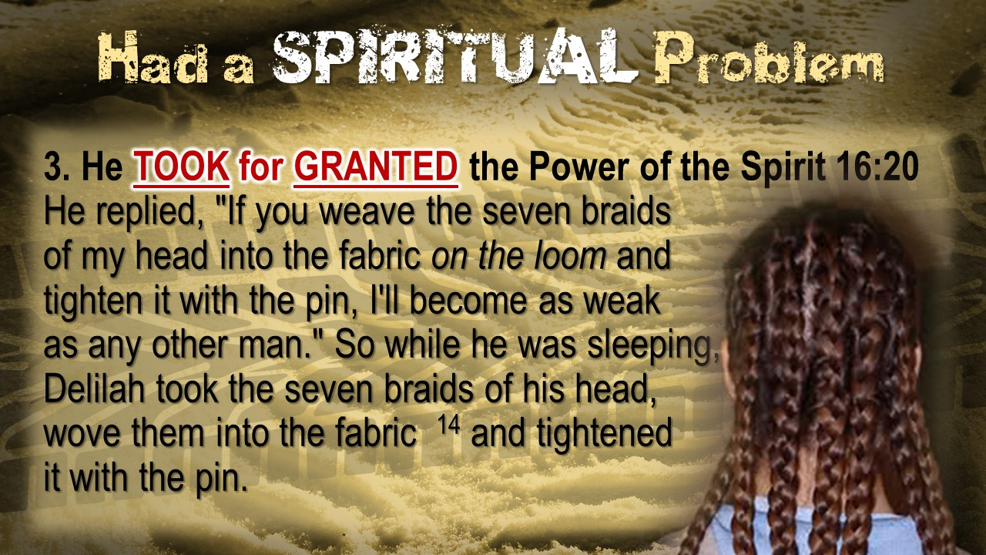

Slide 50
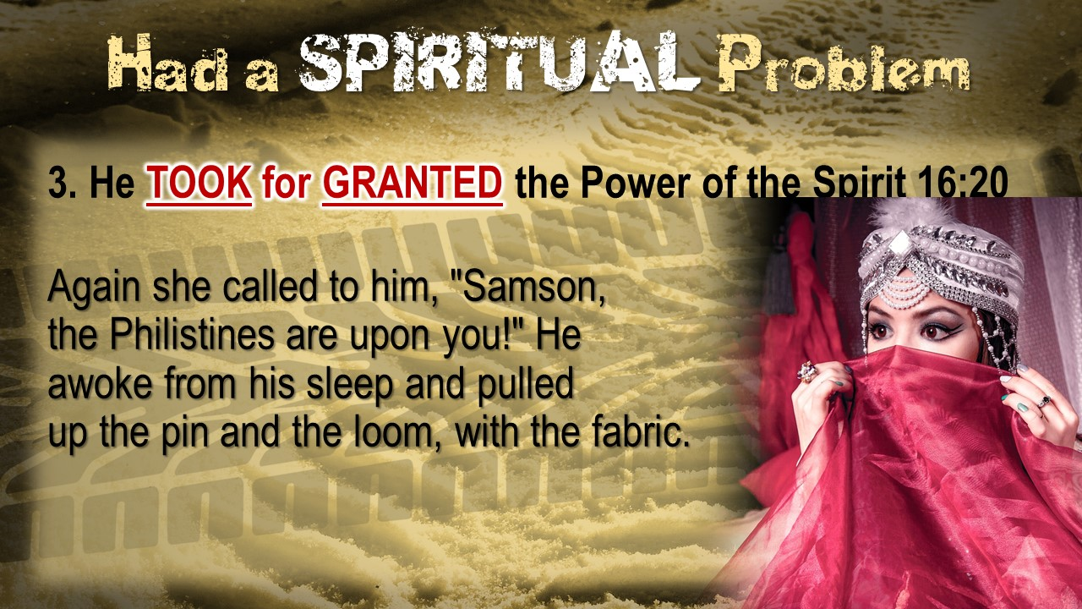

Slide 51
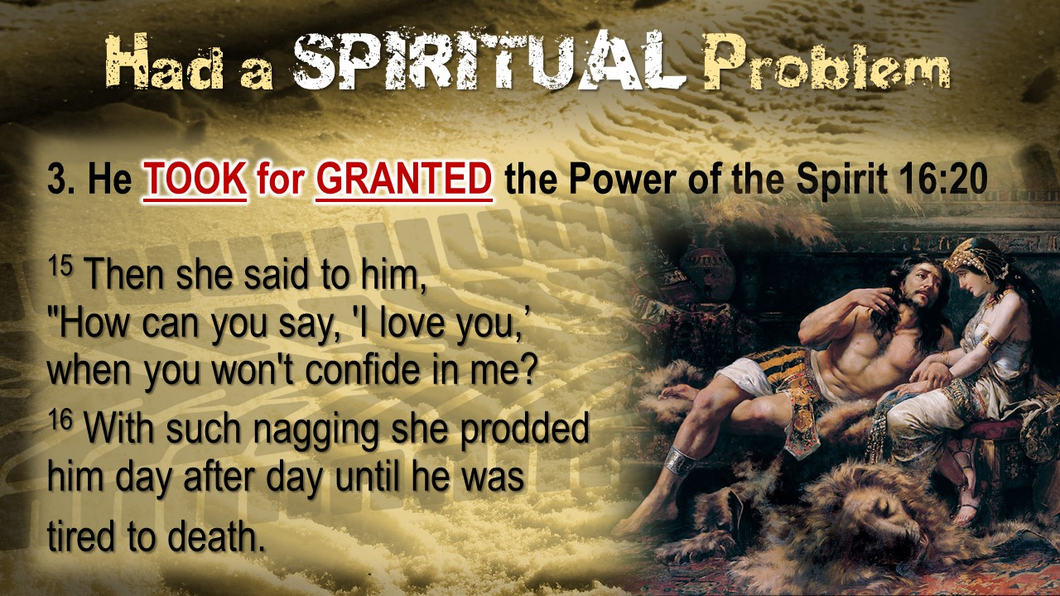

Slide 52
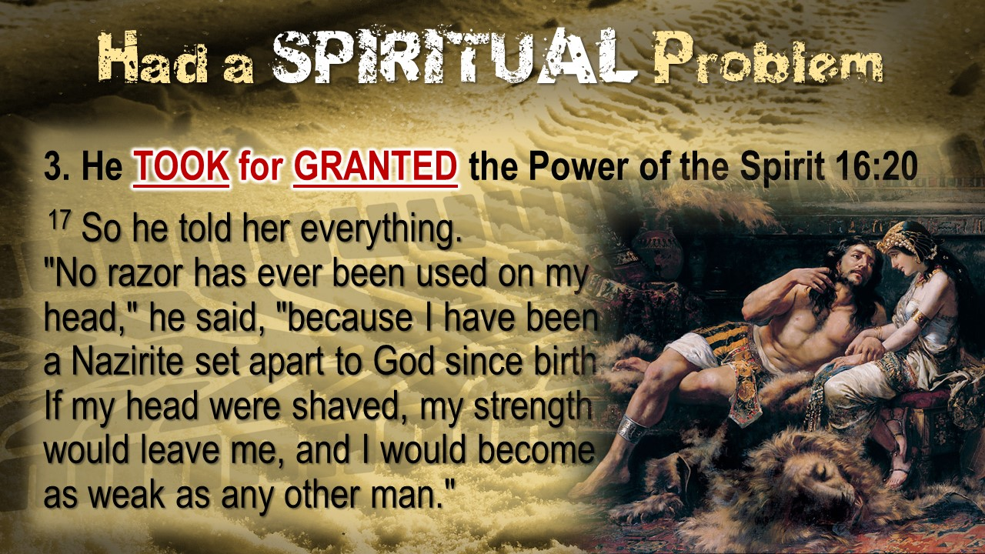

Slide 53
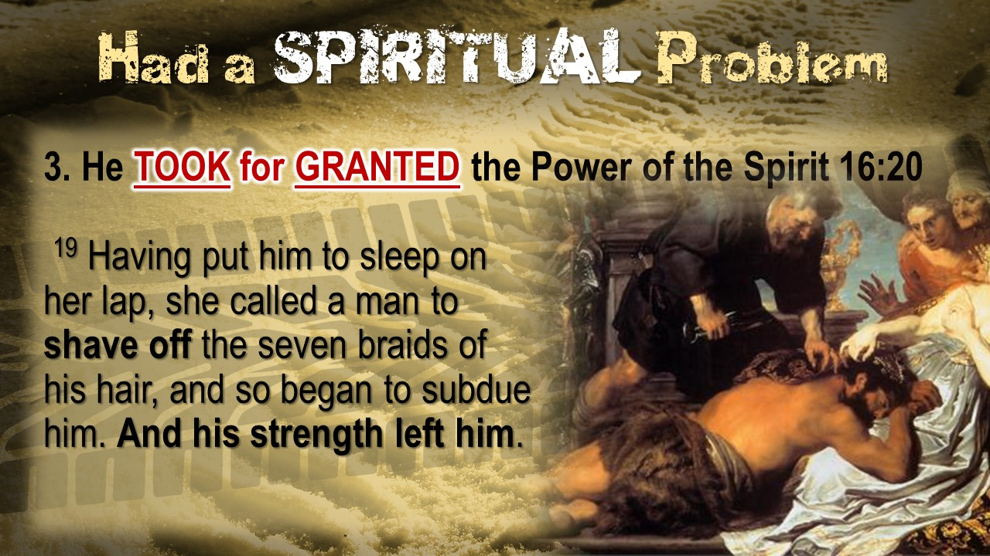

Slide 54
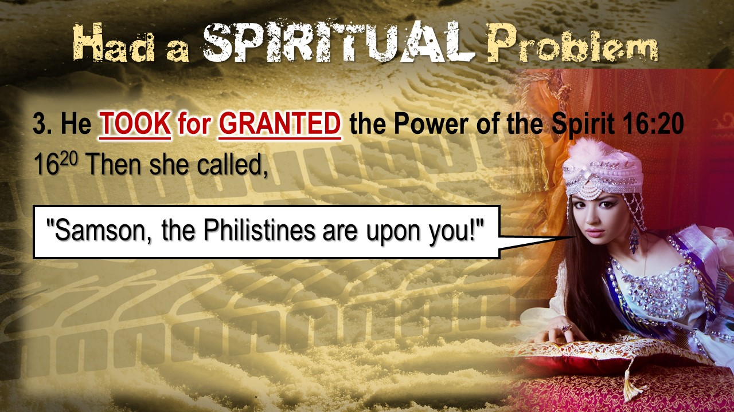

Slide 55
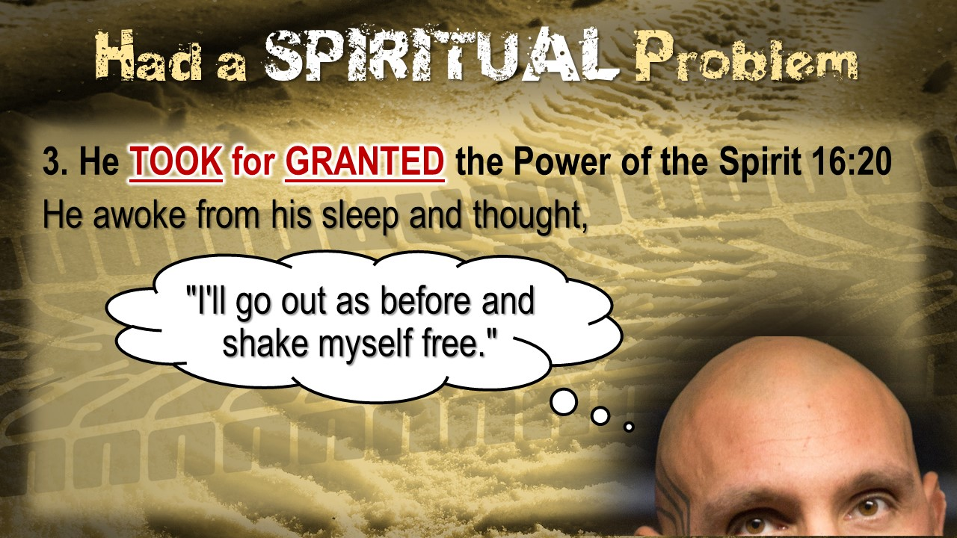

Slide 56
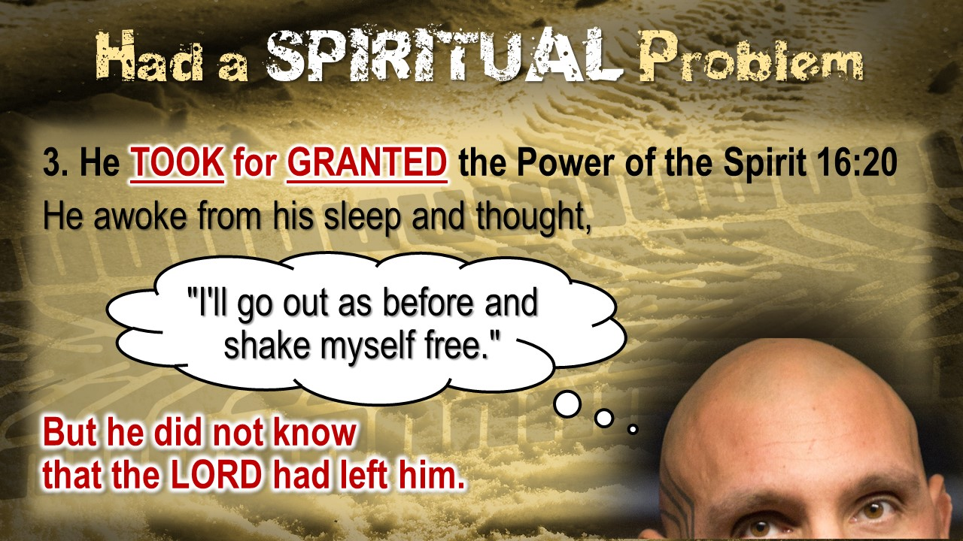

Slide 57
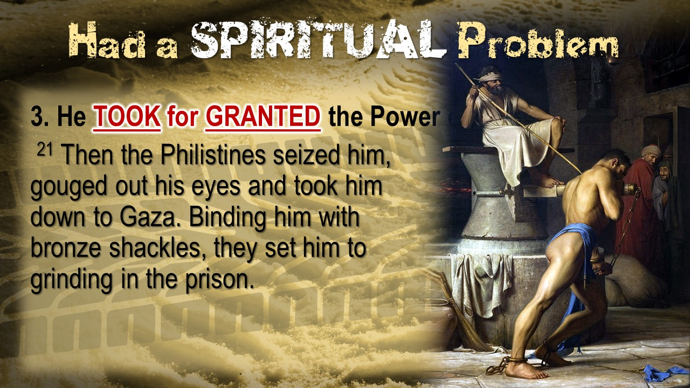

Slide 58
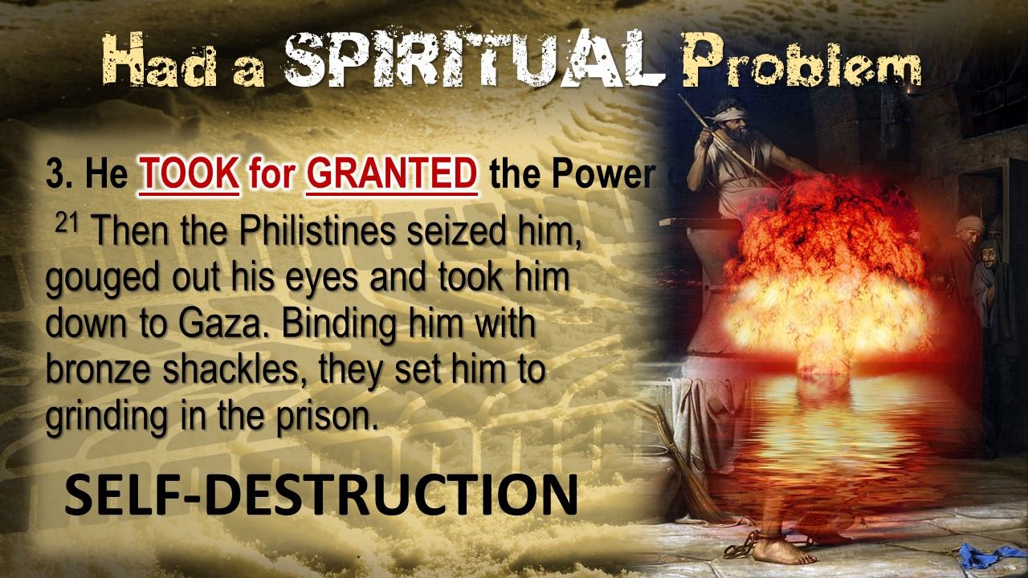

Slide 59


Slide 60
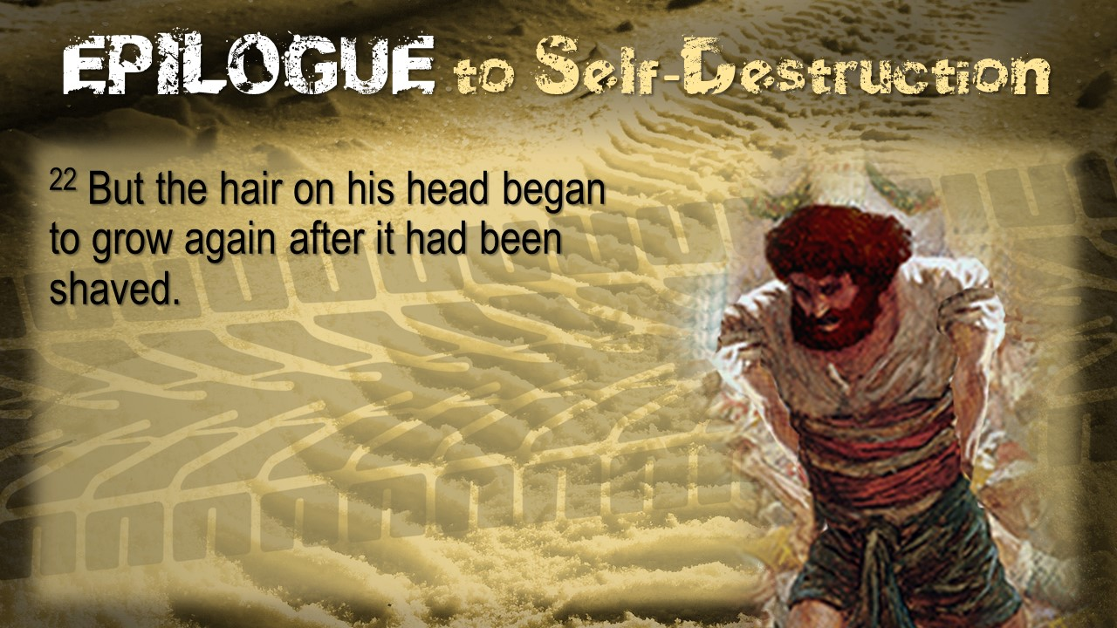

Slide 61
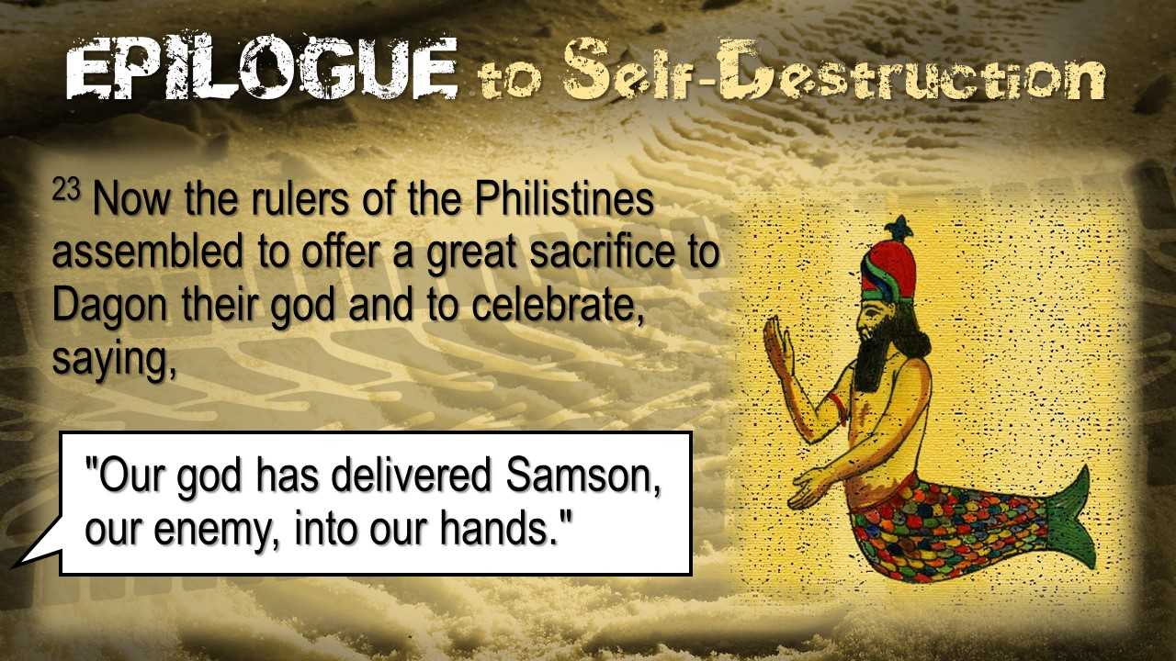

Slide 62
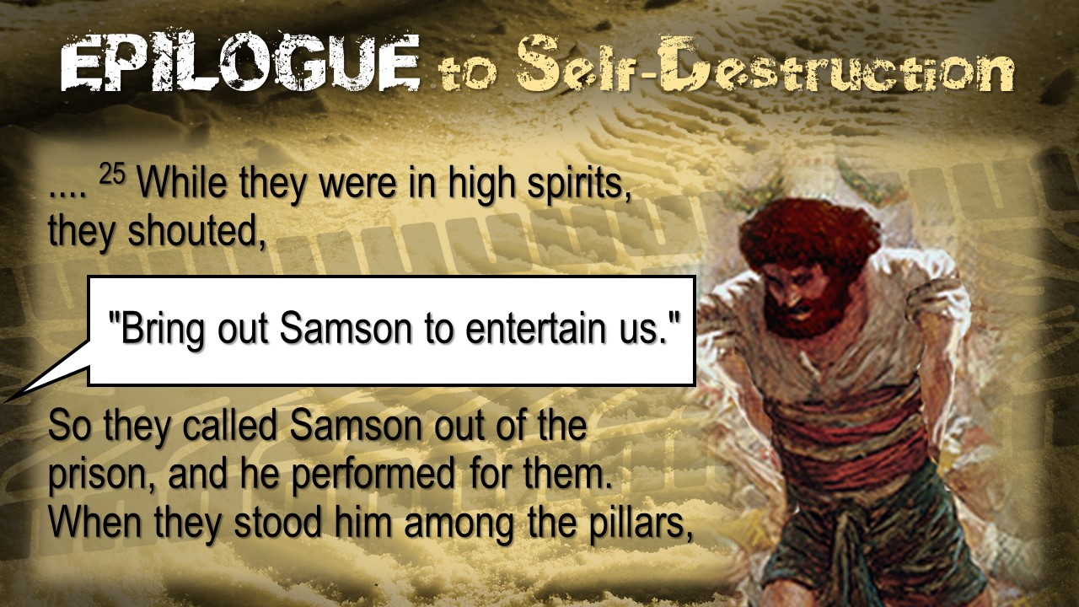

Slide 63
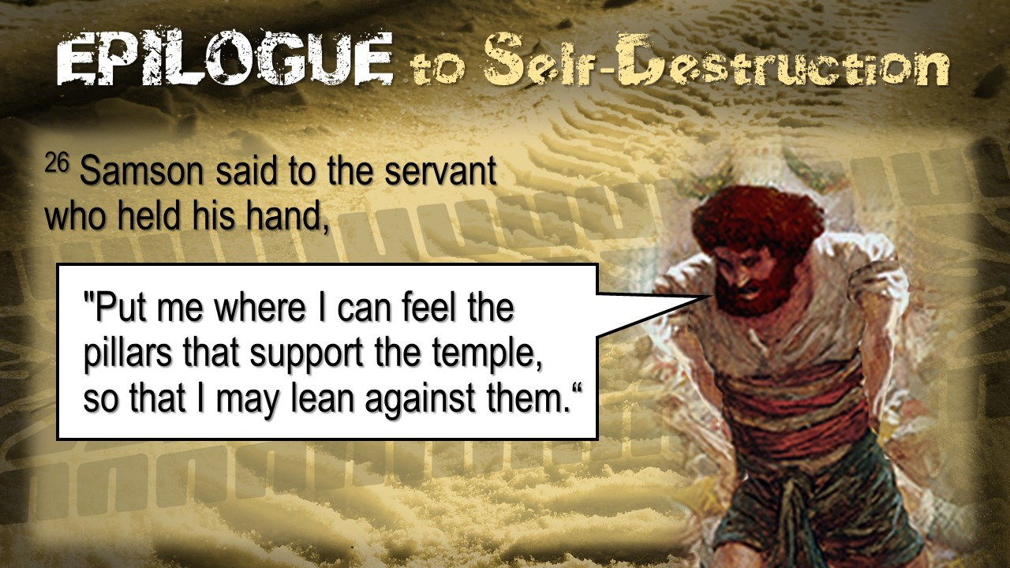

Slide 64


Slide 65
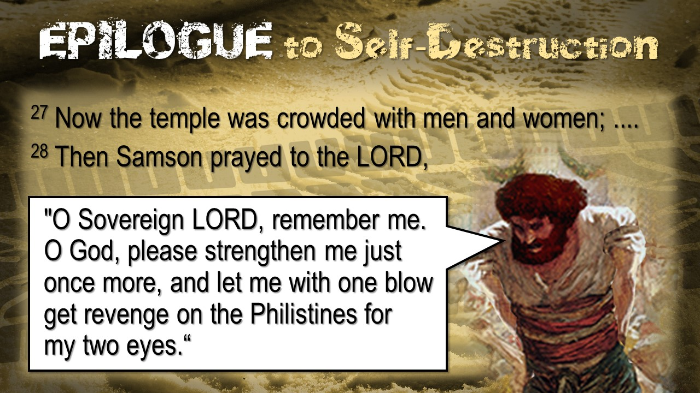

Slide 66
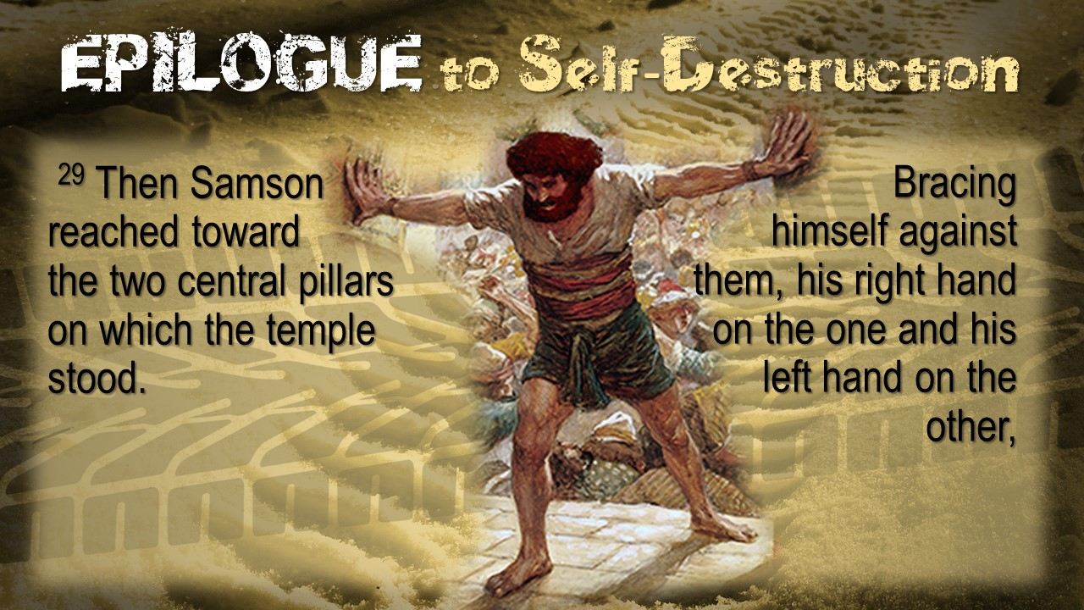

Slide 67
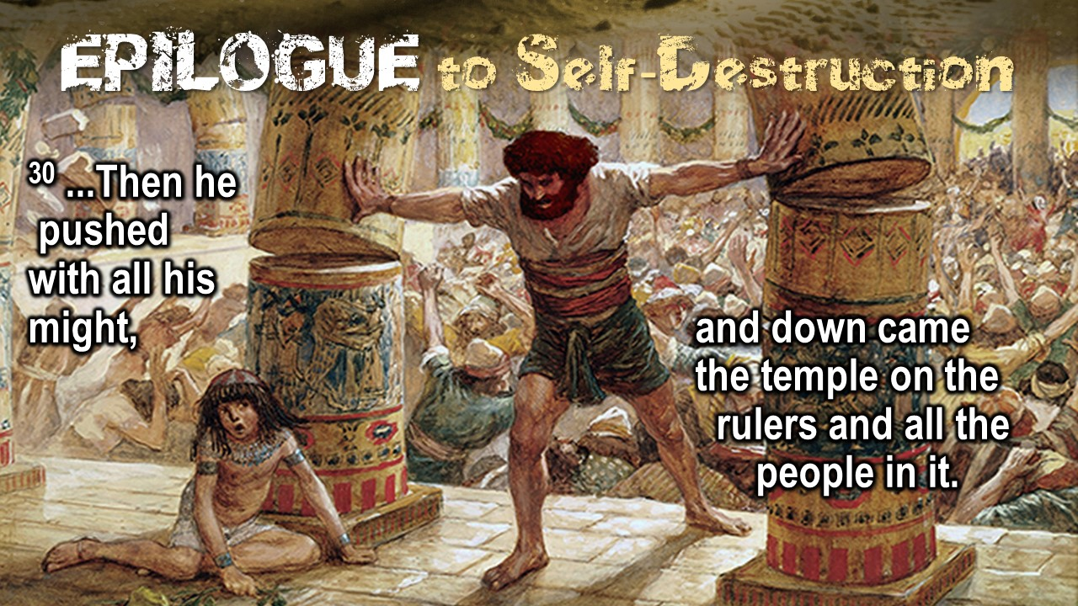

Slide 68
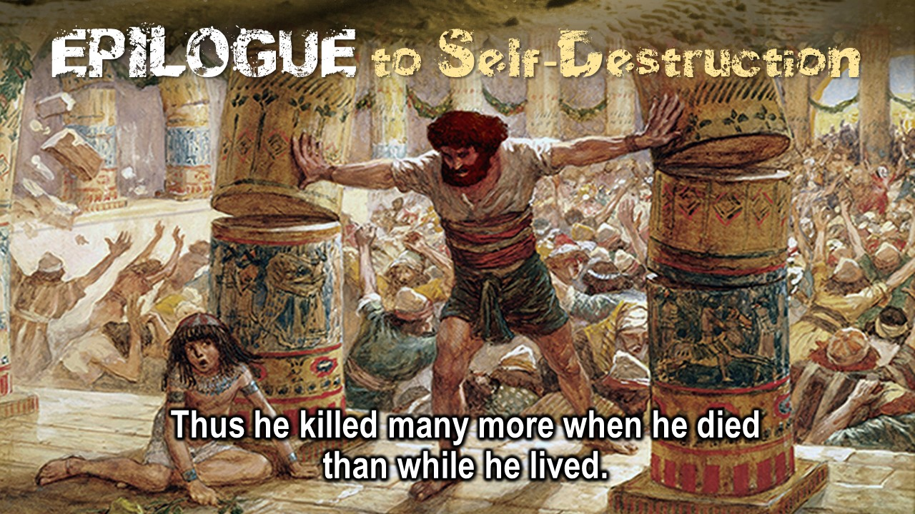

Slide 69


Slide 70


Slide 71


Slide 72


Slide 73


Slide 74


Slide 75


Slide 76


Slide 77


