Slide 1
God’s Road to
God’s Road to
SUCCESS
may Need a “Reset”
and How to Find It
Notes:
Https://pixabay.com/en/career-road-away-way-of-life-479578/
Copyright © 2006−2020. All rights reserved. Bible Point is a registered trademark of Dennis Henderson. All other trademarks acknowledged.
Bible Point contains graphics from Bible Point artists. These illustrations belong to Bible Point and the respective artists. You may use the designs and illustrations for graphical illustration of lessons free and without special permission, provided they are not used in any way that maligns the Christian faith. Furthermore, republication or production of any illustration by any other graphic service whether it be in book, in a machine-readable form, or in any other design resource is strictly prohibited. Furthermore, they cannot be duplicated or resold as any other form of publishing, clip art, or graphic resource.
So What does it mean? (A simple translations of the legal jargon)
So, if you don’t own the presentation(s), graphic(s), and text(s) how can you legally use them? The purchase of the license allows you to use all the images in the product. However, the actual ownership and copyright of the presentation(s), graphic(s), and text(s) remain the property of Bible Point and its licensors. If you had plans on using this product in your “for sale” work—think again!
License Agreement
Article 1: License Grant
All the graphics and text in Bible Point presentations (excluding quotes from the Bible and stated sources) are the intellectual and real property of Bible Point and its licensors, and is protected by law, including United States copyright laws and international treaties. Bible Point grants to you a license:
1. To use the presentation in a single church, single school, or single office of a Christian organization.
2. To make a single archival back-up copy of the program.
3. To modify the presentation(s) and merge with other presentations in a single church, school, or Christian organization.
4. To transfer to another party if that party agrees to accept the terms and conditions of this agreement, and you do not retain any copies of the presentation, whether printed, machine readable, modified, or merged form.
Article 2: Terms
This license is effective until terminated. You may terminate the license at any time by destroying the presentation(s), graphic(s), or text(s) together with all copies, modifications and merged portions in any form. Bible Point may terminate your license if you fail to comply with this Agreement. You agree, upon such termination, for any reason, to destroy the presentation(s), graphics, and text(s) with all copies, modifications, and merged portions in any form.
Article 3: Disclaimers
1. Bible Point presentations, graphics, and texts are licensed to you As Is. You, the consumer, bear the entire risk relating to the quality and performance of the presentation(s), graphic(s), or text(s). In no event will Bible Point be liable for damages resulting from any defect.
2. Thirty-day limited warrantee on disks. Bible Point warrants the disks to be free of defects in material and workmanship under normal use for 30 days after purchase. During the 30-day period you may return a defective presentation, graphic, or text with proof of purchase and it will be replaced without charge, unless the presentation is damaged by misuse.
Article 4: General
1. You may not sub-license, assign, or transfer the license of the presentation(s), graphic(s), or text(s) except as provided by this Agreement.
2. This Agreement will be governed by the laws of the State of Michigan.
So What does it mean? (A simple translations of the legal jargon)
May I let someone borrow or copy my licensed Bible Point presentation (even after I modified it)? As long as it is within your local church, or single school, or the immediate office of a Christian organization you may. Otherwise, please refer the person interested in borrowing to: http://www.biblepoint.com or E-mail: biblepoint@comcast.net with any related questions.

Slide 2
The Most Overused Cliché
is the Definition of Insanity:

Slide 3
The Most Overused Cliché
is the Definition of Insanity:
“doing the same thing over and over and expecting a different result.”

Slide 4
The Most Overused Cliché
is the Definition of Insanity:
“doing the same thing over and over and expecting a different result.”
What Israel did at Ai did not work— it was time for a new strategy!

Slide 5
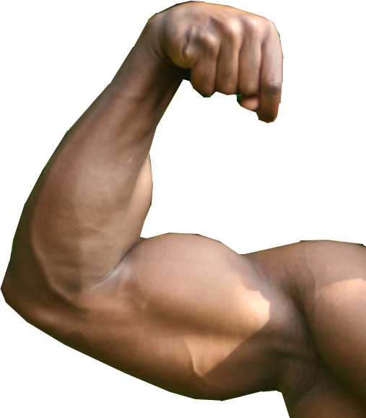
Reset the Mandate
The Original Mandate:
Notes:
Not Afraid = https://www.flickr.com/photos/tomascaspers/30658721
Be strong and courageous. Do not be terrified; do not be discouraged, for the LORD your God will be with you wherever you go." (Jos 1:9 NIV)

Slide 6
Reset the Mandate
The Original Mandate:
^{1:6} Be strong and courageous,
Notes:
Not Afraid = https://www.flickr.com/photos/tomascaspers/30658721
Be strong and courageous. Do not be terrified; do not be discouraged, for the LORD your God will be with you wherever you go." (Jos 1:9 NIV)

Slide 7
Reset the Mandate
The Original Mandate:
^{1:6} Be strong and courageous,
^{1:7} Be strong and very courageous.
Notes:
Not Afraid = https://www.flickr.com/photos/tomascaspers/30658721
Be strong and courageous. Do not be terrified; do not be discouraged, for the LORD your God will be with you wherever you go." (Jos 1:9 NIV)

Slide 8
Reset the Mandate
The Original Mandate:
^{1:6} Be strong and courageous,
^{1:7} Be strong and very courageous.
^{1:9} Be strong and courageous. Do not be terrified;
Notes:
Not Afraid = https://www.flickr.com/photos/tomascaspers/30658721
Be strong and courageous. Do not be terrified; do not be discouraged, for the LORD your God will be with you wherever you go." (Jos 1:9 NIV)

Slide 9
Reset the Mandate
The Original Mandate:
^{1:6} Be strong and courageous,
^{1:7} Be strong and very courageous.
^{1:9} Be strong and courageous. Do not be terrified; do not be discouraged
Notes:
Not Afraid = https://www.flickr.com/photos/tomascaspers/30658721
Be strong and courageous. Do not be terrified; do not be discouraged, for the LORD your God will be with you wherever you go." (Jos 1:9 NIV)

Slide 10
Reset the Mandate
The Original Mandate:
^{1:6} Be strong and courageous,
^{1:7} Be strong and very courageous.
^{1:9} Be strong and courageous. Do not be terrified; do not be discouraged for the LORD your God will be with you wherever you go.
Notes:
Not Afraid = https://www.flickr.com/photos/tomascaspers/30658721
Be strong and courageous. Do not be terrified; do not be discouraged, for the LORD your God will be with you wherever you go." (Jos 1:9 NIV)

Slide 11
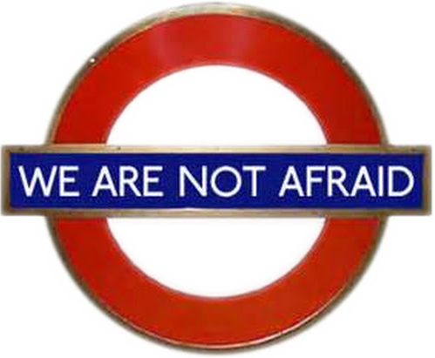
Reset the Mandate
The Reset Mandate:
Notes:
Not Afraid = https://www.flickr.com/photos/tomascaspers/30658721
Israel had blown it and need a reset.
Like in a video game or on your pc – just hit reset and start over – that’s what Israel needed and perhaps some here need—a reset!

Slide 12
Reset the Mandate
The Reset Mandate:
^{Josh 8:1} Then the LORD said to Joshua, "Do not be afraid; do not be discouraged. Take the whole army with you, and go up and attack Ai. For I have delivered into your hands the king of Ai, his people, his city and his land.
Notes:
Not Afraid = https://www.flickr.com/photos/tomascaspers/30658721
Be strong and courageous. Do not be terrified; do not be discouraged, for the LORD your God will be with you wherever you go." (Jos 1:9 NIV)

Slide 13
Reset the Mandate
The Reset Mandate:
^{Josh 8:1} Then the LORD said to Joshua, "Do not be afraid; do not be discouraged. Take the whole army with you, and go up and attack Ai. For I have delivered into your hands the king of Ai, his people, his city and his land.
Notes:
Not Afraid = https://www.flickr.com/photos/tomascaspers/30658721
Be strong and courageous. Do not be terrified; do not be discouraged, for the LORD your God will be with you wherever you go." (Jos 1:9 NIV)

Slide 14
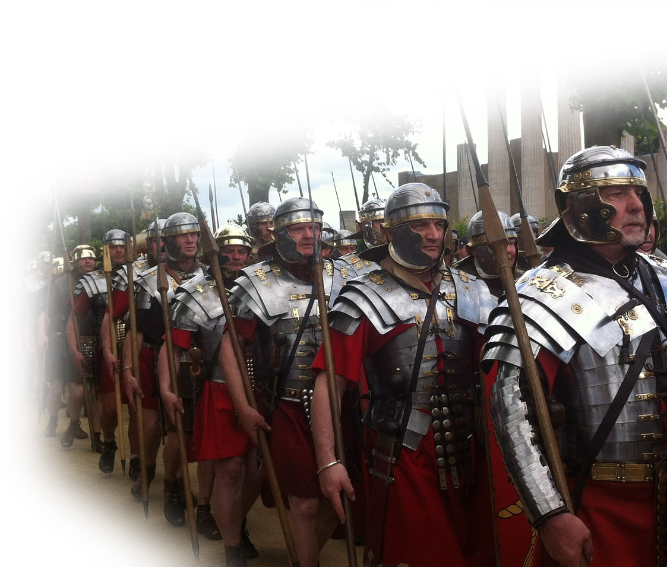
Reset the Mandate
The Reset Mandate:
^{Josh 8:1} Then the LORD said to Joshua, "Do not be afraid; do not be discouraged. Take the whole army with you, and go up and attack Ai. For I have delivered into your hands the king of Ai, his people, his city and his land.
Notes:
Not Afraid = https://www.flickr.com/photos/tomascaspers/30658721
Be strong and courageous. Do not be terrified; do not be discouraged, for the LORD your God will be with you wherever you go." (Jos 1:9 NIV)

Slide 15
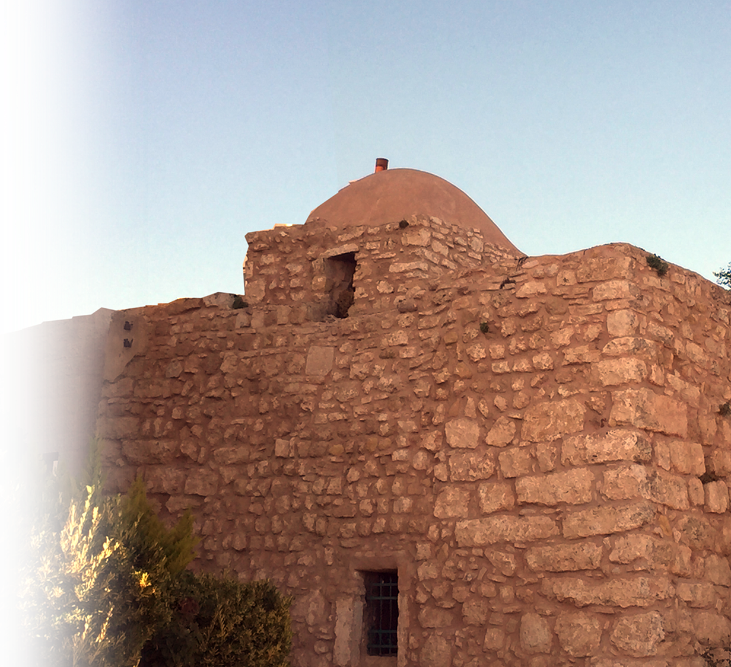
Reset the Mandate
The Reset Mandate:
^{Josh 8:1} Then the LORD said to Joshua, "Do not be afraid; do not be discouraged. Take the whole army with you, and go up and attack Ai. For I have delivered into your hands the king of Ai, his people, his city and his land.
Notes:
Not Afraid = https://www.flickr.com/photos/tomascaspers/30658721
Be strong and courageous. Do not be terrified; do not be discouraged, for the LORD your God will be with you wherever you go." (Jos 1:9 NIV)

Slide 16
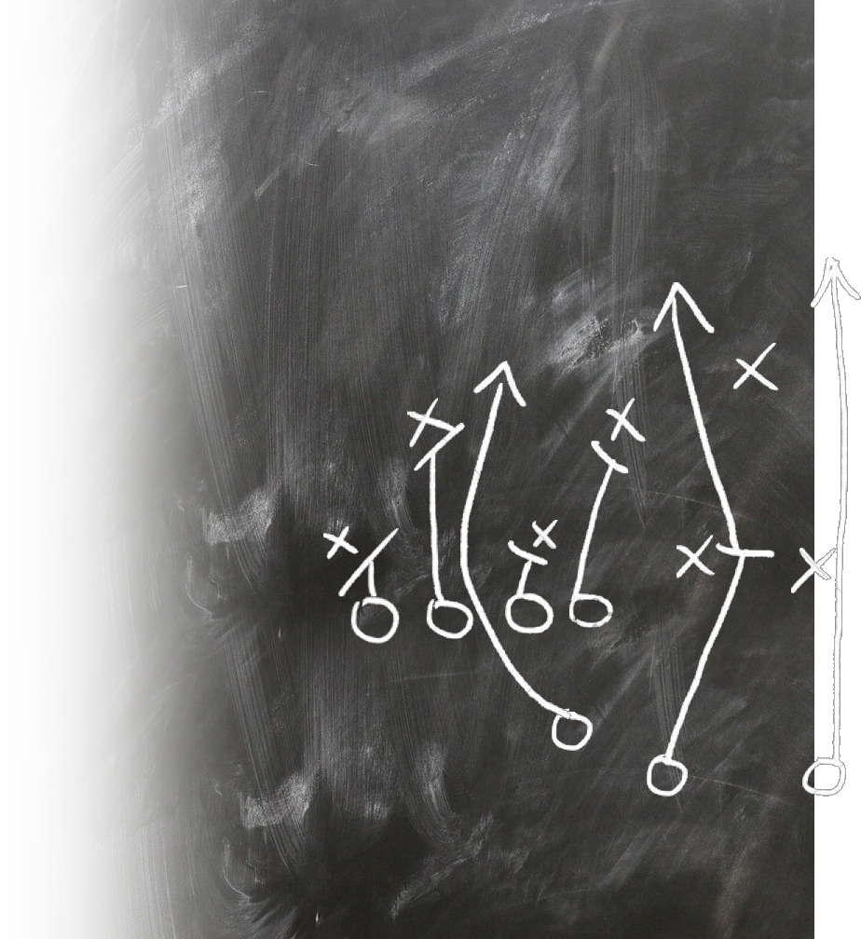
Reset the Strategy
Notes:
https://upload.wikimedia.org/wikipedia/commons/6/6f/ChessSet.jpg

Slide 17
Reset the Strategy
Old Strategy:
Notes:
https://upload.wikimedia.org/wikipedia/commons/6/6f/ChessSet.jpg
If Achan had only waited—he would have gotten all he wanted.

Slide 18
Reset the Strategy
Old Strategy:
Unfaithful to the Lord
Notes:
https://upload.wikimedia.org/wikipedia/commons/6/6f/ChessSet.jpg
If Achan had only waited—he would have gotten all he wanted.

Slide 19
Reset the Strategy
Old Strategy:
Unfaithful to the Lord
Trusted own might
Notes:
https://upload.wikimedia.org/wikipedia/commons/6/6f/ChessSet.jpg
If Achan had only waited—he would have gotten all he wanted.

Slide 20
Reset the Strategy
Old Strategy:
Unfaithful to the Lord
Trusted own might
Defiled by hidden sin
Notes:
https://upload.wikimedia.org/wikipedia/commons/6/6f/ChessSet.jpg
If Achan had only waited—he would have gotten all he wanted.

Slide 21
Reset the Strategy
Old Strategy:
Unfaithful to the Lord
Trusted own might
Defiled by hidden sin
Lord was not with them
Notes:
https://upload.wikimedia.org/wikipedia/commons/6/6f/ChessSet.jpg
If Achan had only waited—he would have gotten all he wanted.

Slide 22
Reset the Strategy
Old Strategy:
Unfaithful to the Lord
Trusted own might
Defiled by hidden sin
Lord was not with them
Defeat: 36 died
Notes:
https://upload.wikimedia.org/wikipedia/commons/6/6f/ChessSet.jpg
If Achan had only waited—he would have gotten all he wanted.

Slide 23
Reset the Strategy
New Strategy Reset:
Notes:
https://upload.wikimedia.org/wikipedia/commons/6/6f/ChessSet.jpg
What Israel did at Ai did not work. So don’t reset to that –go back to what does work.
For years I ministered in Divorce Recovery groups – time to time an individual would be a repeater—because they kept doing what didn’t work only harder.
What they needed was a new strategy ... I produced a video series called “living Single Again” to suggest that instead of doing the same old thing over again how about doing relationships God’s way.
That area of your life that is not working may need a reset of a new strategy. Israel did.

Slide 24
Reset the Strategy
New Strategy Reset:
² You shall do to Ai and its king as you did to Jericho and its king, except that you may carry off their plunder and livestock for yourselves. Set an ambush behind the city."
Notes:
https://upload.wikimedia.org/wikipedia/commons/6/6f/ChessSet.jpg
If Achan had only waited—he would have gotten all he wanted.

Slide 25
Reset the Strategy
New Strategy Reset:
² You shall do to Ai and its king as you did to Jericho and its king, except that you may carry off their plunder and livestock for yourselves. Set an ambush behind the city."
⁵ Trust in the LORD with all your heart and lean not on your own understanding;
⁶ in all your ways acknowledge him, and he will make your paths straight.
Notes:
https://upload.wikimedia.org/wikipedia/commons/6/6f/ChessSet.jpg
If Achan had only waited—he would have gotten all he wanted.

Slide 26
Reset the Strategy
New Strategy Reset:
² You shall do to Ai and its king as you did to Jericho and its king, except that you may carry off their plunder and livestock for yourselves. Set an ambush behind the city."
Notes:
https://upload.wikimedia.org/wikipedia/commons/6/6f/ChessSet.jpg
If Achan had only waited—he would have gotten all he wanted.

Slide 27
Reset the Strategy
New Strategy Reset:
² You shall do to Ai and its king as you did to Jericho and its king, except that you may carry off their plunder and livestock for yourselves. Set an ambush behind the city."
⁴ Delight yourself in the LORD, and he will give you the desires of your heart.
⁵ Commit your way to the LORD; trust in him, and he will act.
(Psalm 37:4-5 ESV)
Notes:
https://upload.wikimedia.org/wikipedia/commons/6/6f/ChessSet.jpg
If Achan had only waited—he would have gotten all he wanted.

Slide 28
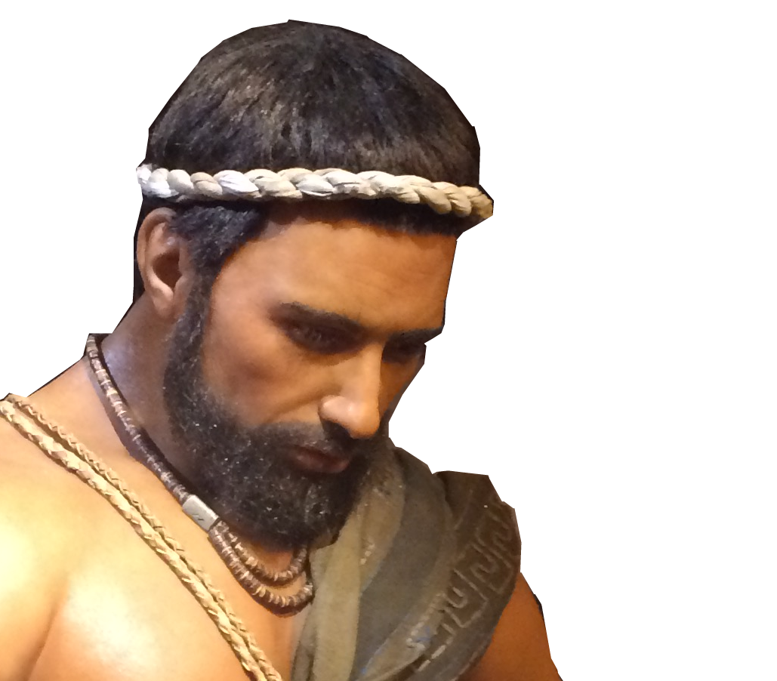
Reset the Strategy
New Strategy Reset:
² You shall do to Ai and its king as you did to Jericho and its king, except that you may carry off their plunder and livestock for yourselves. Set an ambush behind the city."
But those who wait on the LORD Shall renew their strength; They shall mount up with wings like eagles, They shall run and not be weary, They shall walk and not faint. (Isa 40:31 NKJ)
Notes:
https://upload.wikimedia.org/wikipedia/commons/6/6f/ChessSet.jpg
If Achan had only waited—he would have gotten all he wanted.

Slide 29
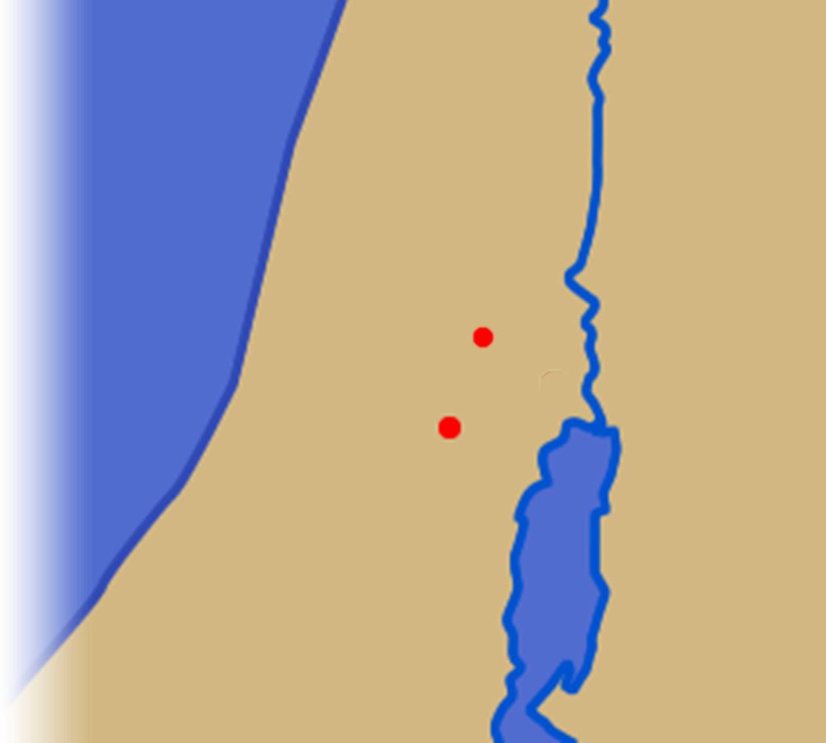
Reset the Strategy
New Strategy Reset:
² You shall do to Ai and its king as you did to Jericho and its king, except that you may carry off their plunder and livestock for yourselves. Set an ambush behind the city."
Ai
Jericho
Notes:
https://upload.wikimedia.org/wikipedia/commons/6/6f/ChessSet.jpg
The Battle was the same as before ... Israel against the Canaanites—so they needed to “Trust in the Lord...”
But the approach was new ... Not circle for seven days—but ambush! “Lean not on own understanding ... “

Slide 30
Reset the Strategy
1. A Planned Ambush
³ So Joshua and the whole army moved out to attack Ai. He chose thirty thousand of his best fighting men and sent them .... to set an ambush behind the city. ....
Ai
Jericho

Slide 31
Reset the Strategy
1. A Planned Ambush
³ So Joshua and the whole army moved out to attack Ai. He chose thirty thousand of his best fighting men and sent them .... to set an ambush behind the city. ....
Ai
Jericho

Slide 32
Reset the Strategy
1. A Planned Ambush
³ So Joshua and the whole army moved out to attack Ai. He chose thirty thousand of his best fighting men and sent them .... to set an ambush behind the city. ....
Ai
Ambush
Jericho

Slide 33
Reset the Strategy
2. Planned Execution
¹³ ... That night Joshua went into the valley. ¹⁴ When the king of Ai saw this, he and all the men of the city hurried out early in the morning to meet Israel in battle ....
Ai
Ambush
Jericho

Slide 34
Reset the Strategy
2. Planned Execution
¹³ ... That night Joshua went into the valley. ¹⁴ When the king of Ai saw this, he and all the men of the city hurried out early in the morning to meet Israel in battle ....
Ai
Ambush
Jericho

Slide 35
Reset the Strategy
2. Planned Execution
¹³ ... That night Joshua went into the valley. ¹⁴ When the king of Ai saw this, he and all the men of the city hurried out early in the morning to meet Israel in battle ....
Ai
Ambush
Jericho

Slide 36
Reset the Strategy
3. A Planned Retreat
¹⁵ Joshua and all Israel let themselves be driven back before them, and they fled toward the desert. ¹⁶ All the men of Ai .... pursued Joshua and were lured away from the city.
Ambush

Slide 37
Reset the Strategy
4. The Planned Attack
¹⁷ ... They left the city open and went in pursuit of Israel. ¹⁸ Then .... the men in the ambush rose quickly from their position and rushed forward. They entered the city and captured it and quickly set it on fire.
Ambush

Slide 38
Reset the Strategy
5. The Planned Surprise
²⁰ The men of Ai looked back and saw the smoke of the city rising ... ²¹ ... when Joshua ... saw that the ambush had taken the city ..., they turned around and attacked the men of Ai.
Ambush

Slide 39
Reset the Strategy
6. The Planned Trap
²² The men of the ambush also came out ..., so that they were caught in the middle, with Israelites on both sides.
Israel cut them down, leaving them neither survivors nor fugitives. ....
Ambush

Slide 40
Reset the Strategy
7. The Planned Victory
²⁶ For Joshua did not draw back the hand that held out his javelin until he had destroyed all who lived in Ai.
Ambush

Slide 41
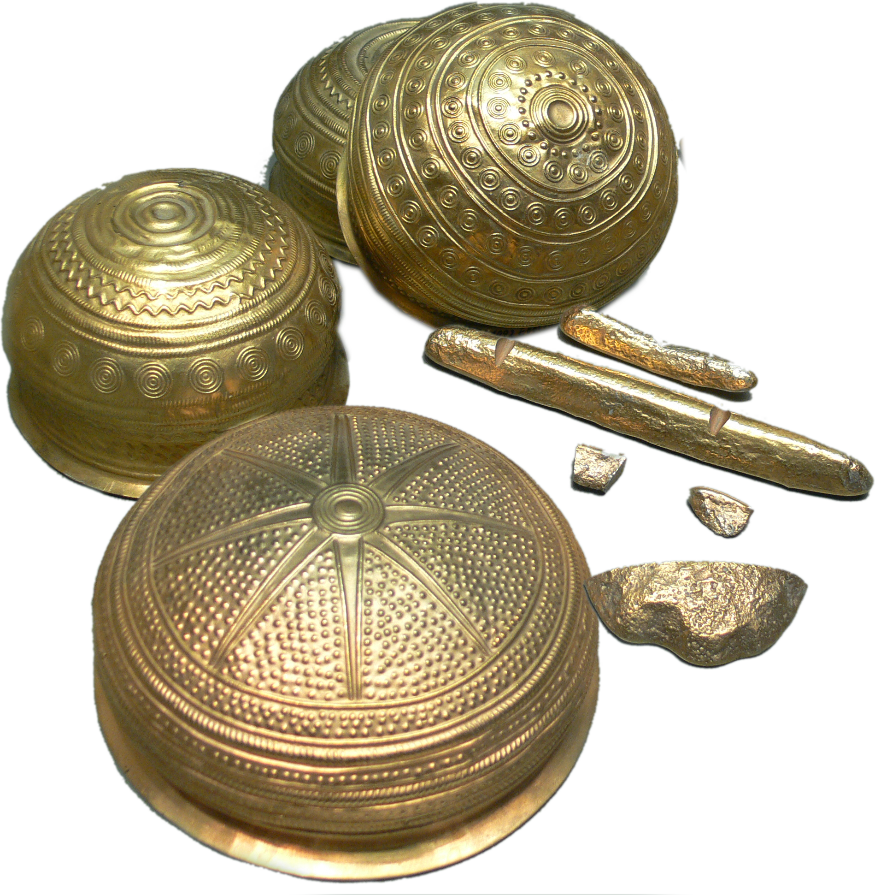
Reset the Strategy
8. The Planned Spoils
²⁷ But Israel did carry off for themselves the livestock and plunder of this city, as the LORD had instructed Joshua. ²⁸ So Joshua burned Ai and made it a permanent heap of ruins, a desolate place to this day.
Notes:
Gold plunder = https://upload.wikimedia.org/wikipedia/commons/b/b6/Goldfund_von_Eberswalde.jpg
The Battle was the same as Ai but the strategy was the same ...
Methods may change but the goal is the same. Paul said “I become all things to all men ...” To the Jew a Jew etc.
Same is true today ... What worked with the great generation, or the boomers may not work with the GenX or Gen z.
We must wait upon the Lord....

Slide 42
Reset the Commitment

Slide 43
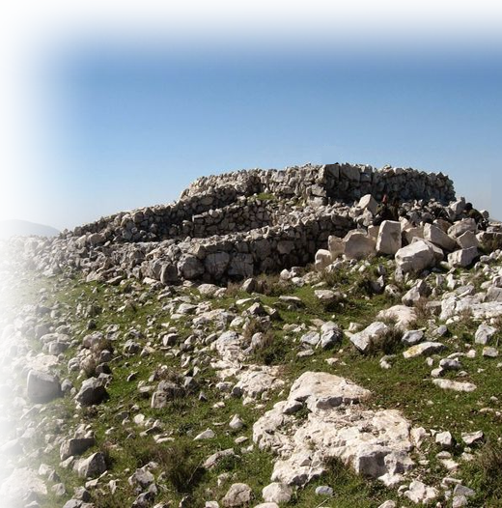
Reset the Commitment
1. Reset God’s Will
³⁰ Then Joshua built on Mount Ebal an altar to the LORD, the God of Israel, ³¹ as Moses the servant of the LORD had commanded the Israelites.
Notes:
Mount Ebal = from pinterest photo = https://i.pinimg.com/736x/54/44/8c/54448c700168e7238456186d7d8d2cae--altars-archaeology.jpg

Slide 44
Reset the Commitment
1. Reset God’s Will
³⁰ Then Joshua built on Mount Ebal an altar to the LORD, the God of Israel, ³¹ as Moses the servant of the LORD had commanded the Israelites. (Deu 27:4-8)
⁴ And when you have crossed the Jordan set up these stones on Mount Ebal, as I command you today, and coat them with plaster. ⁵ Build there an altar to the LORD your God, an altar of stones. Do not use any iron tool upon them. ⁶ ... offer burnt offerings on it to the LORD your God. ⁷ Sacrifice fellowship offerings there, ... ⁸ And you shall write very clearly all the words of this law on these stones. ....
Notes:
Mount Ebal = from pinterest photo = https://i.pinimg.com/736x/54/44/8c/54448c700168e7238456186d7d8d2cae--altars-archaeology.jpg

Slide 45
Reset the Commitment
1. Reset True Worship
He built it according to what is written in the Book of the Law of Moses--an altar of uncut stones, on which no iron tool had been used.

Slide 46
Reset the Commitment
2. Reset True Worship
He built it according to what is written in the Book of the Law of Moses--an altar of uncut stones, on which no iron tool had been used. On it they offered to the LORD burnt offerings and sacrificed fellowship offerings.

Slide 47
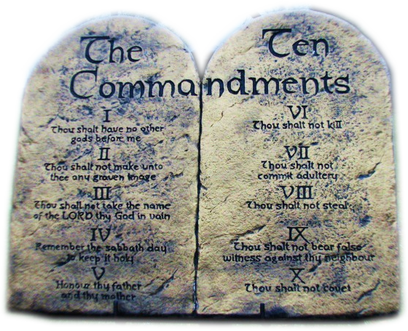
Reset the Commitment
3. Reset God’s Law
³² There, in the presence of the Israelites, Joshua copied on stones the law of Moses, which he had written.
Notes:
It was characteristic to erect a stone stela with the record of the victory of the king in the palace along with that kings laws.
Here, God is King. The Law of the king is the Word of God—written originally on stone by the finger of God.
Joshua is acknowledging God as king!

Slide 48
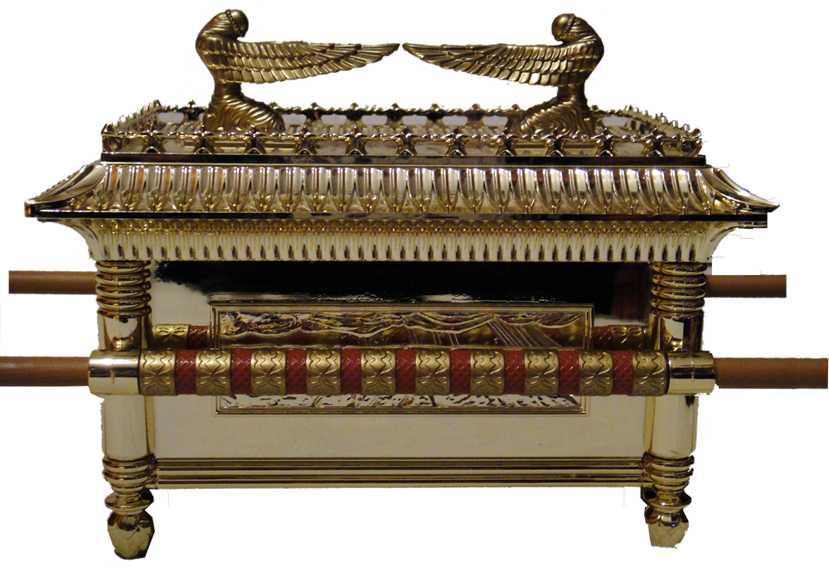
Reset the Commitment
4. Reset God’s Place
³³ All Israel, aliens and citizens alike, with their elders, officials and judges, were standing on both sides of the ark of the covenant of the LORD, facing those who carried it--the priests, who were Levites.
Notes:
Ark = https://upload.wikimedia.org/wikipedia/commons/f/f3/R%C3%A9plica_del_Arca_de_la_Alianza--6.JPG

Slide 49
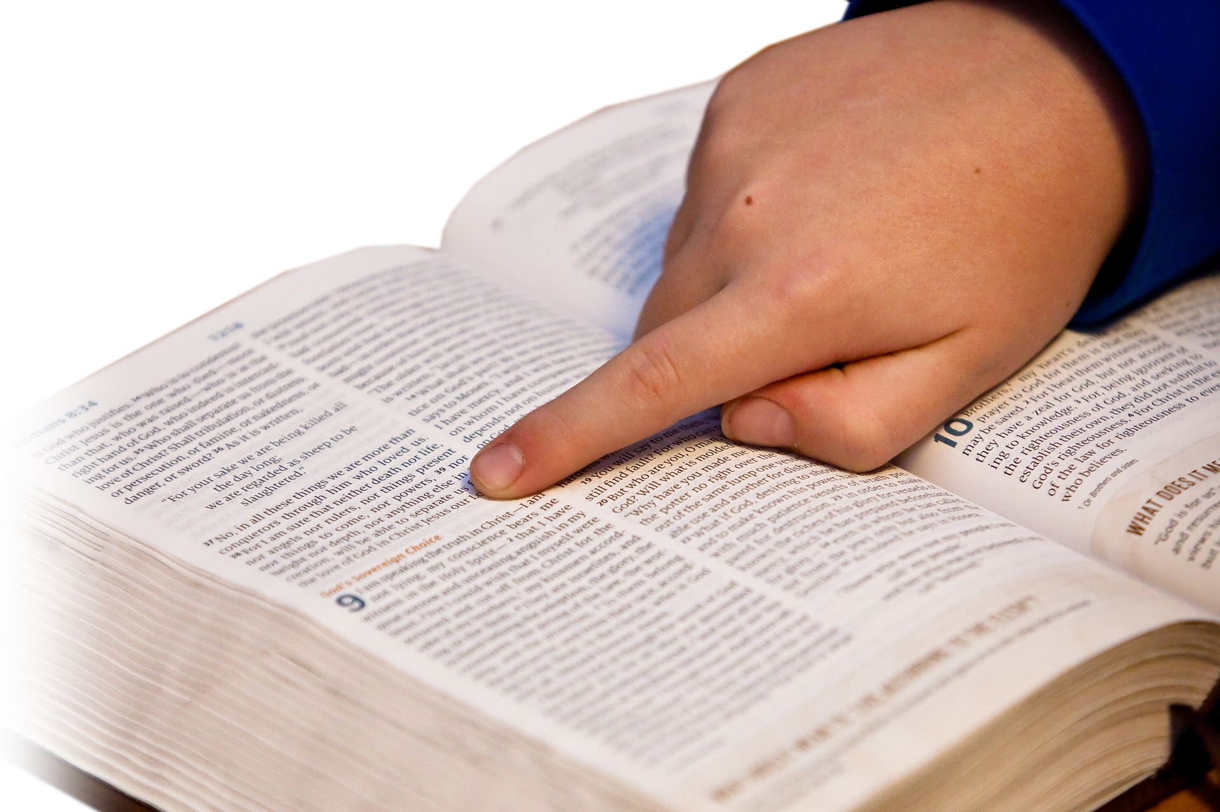
Reset the Commitment
5. Reset Bible Instruction
Half of the people stood in front of Mount Gerizim and half of them in front of Mount Ebal, as Moses the servant of the LORD had formerly commanded when he gave instructions to bless the people of Israel.
Notes:
https://pixabay.com/en/bible-study-bible-hand-child-1634647/

Slide 50
Reset the Commitment
5. Reset Bible Instruction
³⁴ Afterward, Joshua read all the words of the law--the blessings and the curses--just as it is written in the Book of the Law.
Notes:
Deut 27-28 Curses an Blessings
⁹ Carefully follow the terms of this covenant, so that you may prosper in everything you do. (Deu 29:9 NIV)
²⁶ See, I am setting before you today a blessing and a curse--
²⁷ the blessing if you obey the commands of the LORD your God that I am giving you today;
²⁸ the curse if you disobey the commands of the LORD your God and turn from the way that I command you today by following other gods, which you have not known.
²⁹ When the LORD your God has brought you into the land you are entering to possess, you are to proclaim on Mount Gerizim the blessings, and on Mount Ebal the curses.
(Deu 11:26-29 NIV)

Slide 51
Reset the Commitment
5. Reset Bible Instruction
³⁵ There was not a word of all that Moses had commanded that Joshua did not read to the whole assembly of Israel, including the women and children, and the aliens who lived among them.

Slide 52
Reset the Commitment
5. Reset Bible Instruction
³⁵ There was not a word of all that Moses had commanded that Joshua did not read to the whole assembly of Israel, including the women and children, and the aliens who lived among them.
WHY?
Notes:
They had a great spiritual victory at Jericho – the walls came down as they trusted in the Lord for the victory.
At Ai they leaned on their own understanding – they dropped their guard and it resulted in failure.
Now they recommitted themselves to the Lord – and success is in reach. If they don’t drop their guard again.
The same is true for you

Slide 53
Reset the Commitment
BECAUSE ...
Joshua 1:8 Do not let this Book of the Law depart from your mouth; meditate on it day and night, so that you may be careful to do everything written in it. Then you will be prosperous and successful.

Slide 54
Final Thought:
“Commit to the LORD whatever you do, and your plans will succeed.” Proverbs 16:3
Notes:
Put your plans .... Put your life ... In His hands, and you will succeed.

Slide 55
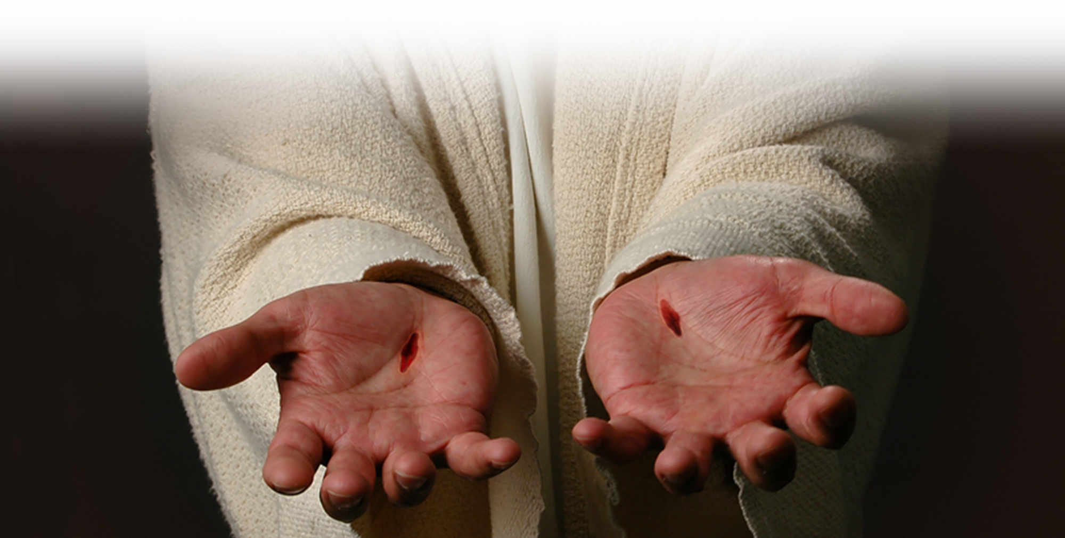
Final Thought:
“Commit to the LORD whatever you do, and your plans will succeed.” Proverbs 16:3
Notes:
Put your plans .... Put your life ... In His hands, and you will succeed.
How about you? Do you need a reset?
Like a video game or a computer—you can do a reset and start over—Maybe you need to reset you mandate/confession, your strategy, and your commitment.

Slide 56
God’s Road to
Let’s PRAY

