Slide 1
God’s Road to
God’s Road to
SUCCESS
may have a “Set-Back”
and How to Find It
Notes:
Https://pixabay.com/en/career-road-away-way-of-life-479578/
Copyright © 2006−2020. All rights reserved. Bible Point is a registered trademark of Dennis Henderson. All other trademarks acknowledged.
Bible Point contains graphics from Bible Point artists. These illustrations belong to Bible Point and the respective artists. You may use the designs and illustrations for graphical illustration of lessons free and without special permission, provided they are not used in any way that maligns the Christian faith. Furthermore, republication or production of any illustration by any other graphic service whether it be in book, in a machine-readable form, or in any other design resource is strictly prohibited. Furthermore, they cannot be duplicated or resold as any other form of publishing, clip art, or graphic resource.
So What does it mean? (A simple translations of the legal jargon)
So, if you don’t own the presentation(s), graphic(s), and text(s) how can you legally use them? The purchase of the license allows you to use all the images in the product. However, the actual ownership and copyright of the presentation(s), graphic(s), and text(s) remain the property of Bible Point and its licensors. If you had plans on using this product in your “for sale” work—think again!
License Agreement
Article 1: License Grant
All the graphics and text in Bible Point presentations (excluding quotes from the Bible and stated sources) are the intellectual and real property of Bible Point and its licensors, and is protected by law, including United States copyright laws and international treaties. Bible Point grants to you a license:
1. To use the presentation in a single church, single school, or single office of a Christian organization.
2. To make a single archival back-up copy of the program.
3. To modify the presentation(s) and merge with other presentations in a single church, school, or Christian organization.
4. To transfer to another party if that party agrees to accept the terms and conditions of this agreement, and you do not retain any copies of the presentation, whether printed, machine readable, modified, or merged form.
Article 2: Terms
This license is effective until terminated. You may terminate the license at any time by destroying the presentation(s), graphic(s), or text(s) together with all copies, modifications and merged portions in any form. Bible Point may terminate your license if you fail to comply with this Agreement. You agree, upon such termination, for any reason, to destroy the presentation(s), graphics, and text(s) with all copies, modifications, and merged portions in any form.
Article 3: Disclaimers
1. Bible Point presentations, graphics, and texts are licensed to you As Is. You, the consumer, bear the entire risk relating to the quality and performance of the presentation(s), graphic(s), or text(s). In no event will Bible Point be liable for damages resulting from any defect.
2. Thirty-day limited warrantee on disks. Bible Point warrants the disks to be free of defects in material and workmanship under normal use for 30 days after purchase. During the 30-day period you may return a defective presentation, graphic, or text with proof of purchase and it will be replaced without charge, unless the presentation is damaged by misuse.
Article 4: General
1. You may not sub-license, assign, or transfer the license of the presentation(s), graphic(s), or text(s) except as provided by this Agreement.
2. This Agreement will be governed by the laws of the State of Michigan.
So What does it mean? (A simple translations of the legal jargon)
May I let someone borrow or copy my licensed Bible Point presentation (even after I modified it)? As long as it is within your local church, or single school, or the immediate office of a Christian organization you may. Otherwise, please refer the person interested in borrowing to: http://www.biblepoint.com or E-mail: biblepoint@comcast.net with any related questions.

Slide 2
The SOURCE of the Setback
Notes:
https://pixabay.com/en/infidelity-love-affair-cheating-379565/
Notice all Israel is included in the one act of sin by Achan – // Romans 5:12 all for one and one for all.
The source of a Spiritual Set-Back can be just about anything like: Lack of your own good judgment, circumstances out of your control, short-sightedness, jealousy, resentment, bitterness, excessive anger, etc.
Here is is UNFAITHFULNESS
Marriage is about faithfulness to one person the rest of your life.
So is trusting in the Lord. You make a commitment of trust in Him as your Lord and God.
Israel had entered into a covenant relationship of faith and trust in God as their God. They were His people and He was their God. It is required that in a faith relationship with God that you are faithful to Him—obedient to him.

Slide 3
The SOURCE of the Setback
7:1 But the Israelites acted unfaithfully in regard to the devoted things; Achan son of Carmi, the son of Zimri, the son of Zerah, of the tribe of Judah, took some of them. So the LORD's anger burned against Israel.
Notes:
https://pixabay.com/en/infidelity-love-affair-cheating-379565/
Notice all Israel is included in the one act of sin by Achan – // Romans 5:12 all for one and one for all. Sin has consequences!
The source of a Spiritual Set-Back can be just about anything like: Lack of your own good judgment, circumstances out of your control, short-sightedness, jealousy, resentment, bitterness, excessive anger, etc.
Here is is UNFAITHFULNESS
Marriage is about faithfulness to one person the rest of your life.
So is trusting in the Lord. You make a commitment of trust in Him as your Lord and God.
Israel had entered into a covenant relationship of faith and trust in God as their God. They were His people and He was their God. It is required that in a faith relationship with God that you are faithful to Him—obedient to him.

Slide 4
The SOURCE of the Setback
7:1 But the Israelites acted unfaithfully in regard to the devoted things; Achan son of Carmi, the son of Zimri, the son of Zerah, of the tribe of Judah, took some of them. So the LORD's anger burned against Israel.
Notes:
https://pixabay.com/en/infidelity-love-affair-cheating-379565/
Notice all Israel is included in the one act of sin by Achan – // Romans 5:12 all for one and one for all.
Devoted = like a marriage— it is called “HOLY matrimony – why? Because it is sacred. It involves a personal devotion of one person to the other.

Slide 5
The SOURCE of the Setback
7:1 But the Israelites acted unfaithfully in regard to the devoted things; Achan son of Carmi, the son of Zimri, the son of Zerah, of the tribe of Judah, took some of them. So the LORD's anger burned against Israel.
Notes:
https://pixabay.com/en/infidelity-love-affair-cheating-379565/
Notice all Israel is included in the one act of sin by Achan – // Romans 5:12 all for one and one for all.
Even the Adulterer “takes something” that does not belong to him or her. But belongs to another.

Slide 6
The SOURCE of the Setback
7:1 But the Israelites acted unfaithfully in regard to the devoted things; Achan son of Carmi, the son of Zimri, the son of Zerah, of the tribe of Judah, took some of them. So the LORD's anger burned against Israel.
Notes:
https://pixabay.com/en/infidelity-love-affair-cheating-379565/
Notice: Faithfulness is serious business! God desires to bless you. The source of provoking the Lord is UNFAITHFULNESS!

Slide 7
The SURPRISE of the Setback
Notes:
https://en.wikipedia.org/wiki/Joshua#/media/File:Joshua%27s_Tomb_in_Jordan_01.jpg
No one starts a day saying, “How can I fail today?” Joshua did not expect it.
He spies and then acts on the recommendation to only have an amazing surprise.
Jericho had 12,000 in habitants—so army was less than half.
Spies recommendation is not unreasonable – especially after the Jericho victory.

Slide 8
The SURPRISE of the Setback
² Now Joshua sent men from Jericho to Ai, ... spy out ... ³ “... Send two or three thousand men to take it ... for only a few men are there.“ ⁴ So about three thousand men went up; but they were routed by the men of Ai, ⁵ who killed about thirty-six of them.
Notes:
https://en.wikipedia.org/wiki/Joshua#/media/File:Joshua%27s_Tomb_in_Jordan_01.jpg
No one starts a day saying, “How can I fail today?” Joshua did not expect it.
He spies and then acts on the recommendation to only have an amazing surprise.
Jericho had 12,000 in habitants—so army was less than half.
Spies recommendation is not unreasonable – especially after the Jericho victory.

Slide 9
The SURPRISE of the Setback
² Now Joshua sent men from Jericho to Ai, ... spy out ... ³ “... Send two or three thousand men to take it ... for only a few men are there.“ ⁴ So about three thousand men went up; but they were routed by the men of Ai, ⁵ who killed about thirty-six of them.
Notes:
https://en.wikipedia.org/wiki/Joshua#/media/File:Joshua%27s_Tomb_in_Jordan_01.jpg
No one starts a day saying, “How can I fail today?” Joshua did not expect it.
He spies and then acts on the recommendation to only have an amazing surprise.

Slide 10
The SURPRISE of the Setback
² Now Joshua sent men from Jericho to Ai, ... spy out ... ³ “... Send two or three thousand men to take it ... for only a few men are there.“ ⁴ So about three thousand men went up; but they were routed by the men of Ai, ⁵ who killed about thirty-six of them.
Notes:
https://en.wikipedia.org/wiki/Joshua#/media/File:Joshua%27s_Tomb_in_Jordan_01.jpg
No one starts a day saying, “How can I fail today?” Joshua did not expect it.
He spies and then acts on the recommendation to only have an amazing surprise.

Slide 11
The IMPACT of the Setback
Notes:
https://upload.wikimedia.org/wikipedia/commons/c/c8/Tissot_Moses_and_Joshua_in_the_Tabernacle.jpg
Anguish

Slide 12
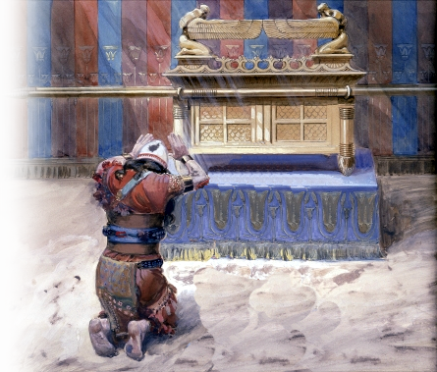
The IMPACT of the Setback
Emotional Anguish
⁶ Then Joshua tore his clothes and fell facedown to the ground before the ark of the LORD, remaining there till evening. The elders of Israel did the same, and sprinkled dust on their heads.
Notes:
https://upload.wikimedia.org/wikipedia/commons/c/c8/Tissot_Moses_and_Joshua_in_the_Tabernacle.jpg
Anguish

Slide 13
The IMPACT of the Setback
Emotional Blame Shifting
⁷ And Joshua said, "Ah, Sovereign LORD, why did you ever bring this people across the Jordan to deliver us into the hands of the Amorites to destroy us? ...
Notes:
https://upload.wikimedia.org/wikipedia/commons/c/c8/Tissot_Moses_and_Joshua_in_the_Tabernacle.jpg
Loss of Confidence –blaming -- “WHy did you?

Slide 14
The IMPACT of the Setback
Emotional “Second Guessing”
⁷ ... If only we had been content to stay on the other side of the Jordan!
Notes:
https://upload.wikimedia.org/wikipedia/commons/c/c8/Tissot_Moses_and_Joshua_in_the_Tabernacle.jpg
Loss of Confidence –blaming -- “WHy did you?

Slide 15
The IMPACT of the Setback
Emotional Failure
⁸ O Lord, what can I say, now that Israel has been routed by its enemies?
Notes:
https://upload.wikimedia.org/wikipedia/commons/c/c8/Tissot_Moses_and_Joshua_in_the_Tabernacle.jpg

Slide 16
The IMPACT of the Setback
Emotional Doom
⁹ The Canaanites and the other people of the country will hear about this and they will surround us and wipe out our name from the earth. What then will you do for your own great name?"
Notes:
https://upload.wikimedia.org/wikipedia/commons/c/c8/Tissot_Moses_and_Joshua_in_the_Tabernacle.jpg
They are no longer Strong and Courageous and Unafraid. They are emotional wimps! Doomed by unfaithfulness.

Slide 17
The REASONS for the Setback
WHY?
Notes:
https://en.wikipedia.org/wiki/Joshua#/media/File:Joshua%27s_Tomb_in_Jordan_01.jpg
Put = years ago, I was about 6—I saw the communion cups and thought they were really cute. So I stole one, took it home an d placed it in the kitchen junk drawer. My mom discovered it and asked who stole the cup—I admitted it. I stole from God.

Slide 18
The REASONS for the Setback
¹⁰ The LORD said to Joshua, "Stand up! .... ¹¹ Israel has sinned; they have violated my covenant, which I commanded them to keep. They have taken some of the devoted things; they have stolen, they have lied, they have put them with their own possessions.
1
WHY?
Because!
Notes:
https://en.wikipedia.org/wiki/Joshua#/media/File:Joshua%27s_Tomb_in_Jordan_01.jpg

Slide 19
The REASONS for the Setback
¹⁰ The LORD said to Joshua, "Stand up! .... ¹¹ Israel has sinned; they have violated my covenant, which I commanded them to keep. They have taken some of the devoted things; they have stolen, they have lied, they have put them with their own possessions.
1
2
WHY?
Because!
Notes:
https://en.wikipedia.org/wiki/Joshua#/media/File:Joshua%27s_Tomb_in_Jordan_01.jpg

Slide 20
The REASONS for the Setback
¹⁰ The LORD said to Joshua, "Stand up! .... ¹¹ Israel has sinned; they have violated my covenant, which I commanded them to keep. They have taken some of the devoted things; they have stolen, they have lied, they have put them with their own possessions.
1
2
WHY?
Because!
3
Notes:
https://en.wikipedia.org/wiki/Joshua#/media/File:Joshua%27s_Tomb_in_Jordan_01.jpg

Slide 21
The REASONS for the Setback
¹⁰ The LORD said to Joshua, "Stand up! .... ¹¹ Israel has sinned; they have violated my covenant, which I commanded them to keep. They have taken some of the devoted things; they have stolen, they have lied, they have put them with their own possessions.
1
2
WHY?
Because!
3
4
Notes:
https://en.wikipedia.org/wiki/Joshua#/media/File:Joshua%27s_Tomb_in_Jordan_01.jpg

Slide 22
The REASONS for the Setback
¹⁰ The LORD said to Joshua, "Stand up! .... ¹¹ Israel has sinned; they have violated my covenant, which I commanded them to keep. They have taken some of the devoted things; they have stolen, they have lied, they have put them with their own possessions.
1
2
WHY?
Because!
3
4
5
Notes:
https://en.wikipedia.org/wiki/Joshua#/media/File:Joshua%27s_Tomb_in_Jordan_01.jpg
Put = years ago, I was about 7—I saw the communion cups and thought they were really cute. So I stole one, took it home an d placed it in the kitchen junk drawer. My mom discovered it and asked who stole the cup—I admitted it. I stole from God.

Slide 23
The REASONS for the Setback
¹² That is why the Israelites cannot stand against their enemies; they turn their backs and run because they have been made liable to destruction. I will not be with you anymore unless you destroy whatever among you is devoted to destruction.
6
WHY?
Because!
Notes:
https://en.wikipedia.org/wiki/Joshua#/media/File:Joshua%27s_Tomb_in_Jordan_01.jpg
¹⁸ But keep away from the devoted things, so that you will not bring about your own destruction by taking any of them. Otherwise you will make the camp of Israel liable to destruction and bring trouble on it.
¹⁹ All the silver and gold and the articles of bronze and iron are sacred to the LORD and must go into his treasury."
(Jos 6:18-19 NIV)
See Deut 7:1-11 (esp v. 2, 4)
See Joshua 6:18

Slide 24
The REASONS for the Setback
¹³ "Go, consecrate the people. Tell them, 'Consecrate yourselves in preparation for tomorrow; for this is what the LORD, the God of Israel, says: That which is devoted is among you, O Israel. You cannot stand against your enemies until you remove it.
WHY?
Because!
7
Notes:
https://en.wikipedia.org/wiki/Joshua#/media/File:Joshua%27s_Tomb_in_Jordan_01.jpg
Because it was among them – they could not stand in the face of the enemies. It need to be removed.
Removing the wicked, vile, sinful practices from our live is the first step to victory even to this day!

Slide 25
The REASONS for the Setback
... ¹⁵ He who is caught with the devoted things ... has violated the covenant of the LORD and has done a disgraceful thing in Israel!' "
8
WHY?
Because!
Notes:
https://en.wikipedia.org/wiki/Joshua#/media/File:Joshua%27s_Tomb_in_Jordan_01.jpg

Slide 26
The REASONS for the Setback
... ¹⁵ He who is caught with the devoted things ... has violated the covenant of the LORD and has done a disgraceful thing in Israel!' “
7:1 But the Israelites acted unfaithfully
8
WHY?
Because!
Notes:
https://en.wikipedia.org/wiki/Joshua#/media/File:Joshua%27s_Tomb_in_Jordan_01.jpg

Slide 27
The EXPOSURE of the Setback
Notes:
²³ "But if you fail to do this, you will be sinning against the LORD; and you may be sure that your sin will find you out. (Num 32:23 NIV)

Slide 28
The EXPOSURE of the Setback
¹⁶ Early the next morning Joshua had Israel come forward by tribes, and Judah was taken. ¹⁷ The clans of Judah came forward, and he took the Zerahites. He had the clan of the Zerahites come forward by families, and Zimri was taken.
TRIBE
Notes:
²³ "But if you fail to do this, you will be sinning against the LORD; and you may be sure that your sin will find you out. (Num 32:23 NIV)

Slide 29
The EXPOSURE of the Setback
¹⁶ Early the next morning Joshua had Israel come forward by tribes, and Judah was taken. ¹⁷ The clans of Judah came forward, and he took the Zerahites. He had the clan of the Zerahites come forward by families, and Zimri was taken.
TRIBE
CLAN
Notes:
²³ "But if you fail to do this, you will be sinning against the LORD; and you may be sure that your sin will find you out. (Num 32:23 NIV)

Slide 30
The EXPOSURE of the Setback
¹⁶ Early the next morning Joshua had Israel come forward by tribes, and Judah was taken. ¹⁷ The clans of Judah came forward, and he took the Zerahites. He had the clan of the Zerahites come forward by families, and Zimri was taken.
TRIBE
CLAN
FAMILY
Notes:
²³ "But if you fail to do this, you will be sinning against the LORD; and you may be sure that your sin will find you out. (Num 32:23 NIV)

Slide 31
The EXPOSURE of the Setback
¹⁸ Joshua had his family come forward man by man, and Achan son of Carmi, the son of Zimri, the son of Zerah, of the tribe of Judah, was taken.
TRIBE
CLAN
FAMILY
MAN
Notes:
²³ "But if you fail to do this, you will be sinning against the LORD; and you may be sure that your sin will find you out. (Num 32:23 NIV)

Slide 32
The EXPOSURE of the Setback
Numbers 32:23 and you may be sure that your sin will find you out.
TRIBE
CLAN
FAMILY
MAN
Notes:
²³ "But if you fail to do this, you will be sinning against the LORD; and you may be sure that your sin will find you out. (Num 32:23 NIV)
Just this past week a very affluent, powerful, Hollywood sexual predator was exposed. He had done it for years—be sure your sin will find you out!”

Slide 33
The EXPOSURE of the Setback
¹³ Nothing in all creation is hidden from God's sight. Everything is uncovered and laid bare before the eyes of him to whom we must give account. (Hebrews 4:13)
TRIBE
CLAN
FAMILY
MAN
Notes:
Ultimately ¹⁰ For we must all appear before the judgment seat of Christ, that each one may receive what is due him for the things done while in the body, whether good or bad. (2Co 5:10 NIV)

Slide 34
The SLIPPERY SLOPE of the Setback

Slide 35
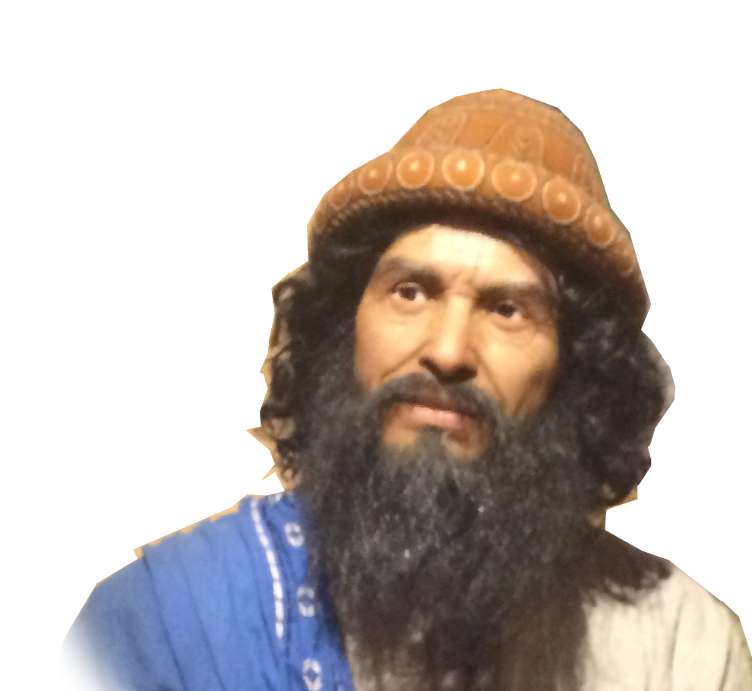
The SLIPPERY SLOPE of the Setback
¹⁹ Then Joshua said to Achan, "My son, give glory to the LORD, the God of Israel, and give him the praise. Tell me what you have done; do not hide it from me."

Slide 36
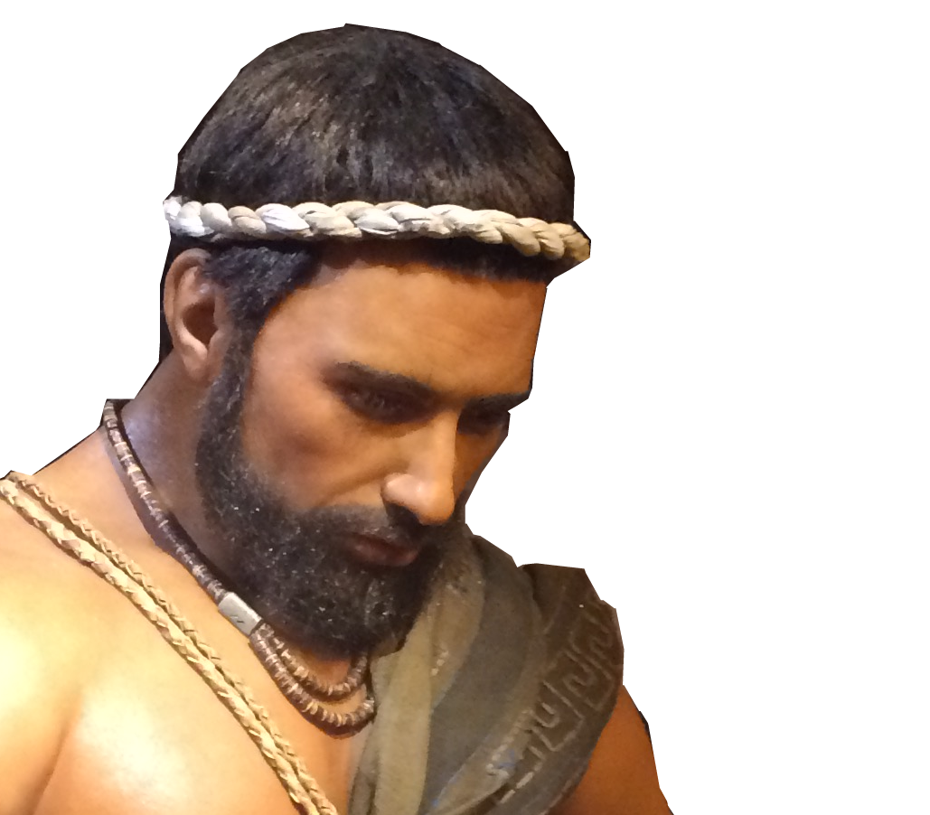
The SLIPPERY SLOPE of the Setback
²⁰ Achan replied,
"It is true! I have sinned against the LORD, the God of Israel. This is what I have done:

Slide 37
The SLIPPERY SLOPE of the Setback
²⁰ Achan replied,
²¹ When I saw in the plunder a beautiful robe from Babylonia, two hundred shekels of silver and a wedge of gold weighing fifty shekels,
1

Slide 38
The SLIPPERY SLOPE of the Setback
²⁰ Achan replied,
I coveted them and took them. They are hidden in the ground inside my tent, with the silver underneath."
2

Slide 39
The SLIPPERY SLOPE of the Setback
²⁰ Achan replied,
I coveted them and took them. They are hidden in the ground inside my tent, with the silver underneath."
2
3

Slide 40
The SLIPPERY SLOPE of the Setback
²⁰ Achan replied,
I coveted them and took them. They are hidden in the ground inside my tent, with the silver underneath."
2
3
4
Notes:
My story at thirteen years old steeling $10

Slide 41
The CONSEQUENCES of the Setback
Notes:
https://en.wikipedia.org/wiki/Joshua#/media/File:Joshua%27s_Tomb_in_Jordan_01.jpg

Slide 42
The CONSEQUENCES of the Setback
7:1 .... So the LORD's anger burned against Israel.
Notes:
https://en.wikipedia.org/wiki/Joshua#/media/File:Joshua%27s_Tomb_in_Jordan_01.jpg

Slide 43
The CONSEQUENCES of the Setback
7:1 .... So the LORD's anger burned against Israel.
7:4 .... they were routed ... killed about thirty-six of them
Notes:
https://en.wikipedia.org/wiki/Joshua#/media/File:Joshua%27s_Tomb_in_Jordan_01.jpg

Slide 44
The CONSEQUENCES of the Setback
7:1 .... So the LORD's anger burned against Israel.
7:4 .... they were routed ... killed about thirty-six of them
7:12 .... I will not be with you anymore
Notes:
https://en.wikipedia.org/wiki/Joshua#/media/File:Joshua%27s_Tomb_in_Jordan_01.jpg

Slide 45
The CONSEQUENCES of the Setback
FAILURE
7:1 .... So the LORD's anger burned against Israel.
7:4 .... they were routed ... killed about thirty-six of them
7:12 .... I will not be with you anymore
7:13 .... You cannot stand against your enemies until you remove it.
Notes:
https://en.wikipedia.org/wiki/Joshua#/media/File:Joshua%27s_Tomb_in_Jordan_01.jpg

Slide 46
The CONSEQUENCES of the Setback
²⁴ ... all Israel, took Achan ..., the silver, the robe, the gold wedge, his sons and daughters, his cattle, donkeys and sheep, his tent and all that he had, to the Valley of Achor.
Notes:
https://en.wikipedia.org/wiki/Joshua#/media/File:Joshua%27s_Tomb_in_Jordan_01.jpg

Slide 47
The CONSEQUENCES of the Setback
²⁵ Joshua said,
"Why have you brought this trouble on us? The LORD will bring trouble on you today."
Notes:
https://en.wikipedia.org/wiki/Joshua#/media/File:Joshua%27s_Tomb_in_Jordan_01.jpg

Slide 48
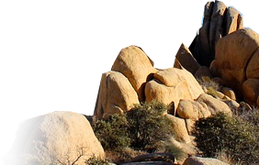
The CONSEQUENCES of the Setback
Then all Israel stoned him, ....²⁶ Over Achan they heaped up a large pile of rocks, which remains to this day. Then the LORD turned from his fierce anger. Therefore that place has been called the Valley of Achor ever since.
Notes:
https://pixabay.com/en/joshua-tree-national-park-rocks-74401/

Slide 49
This is NOT so unusual:
Notes:
Nadab and abihu https://upload.wikimedia.org/wikipedia/commons/9/92/The_Bible_and_its_story.._%281908%29_%2814586362088%29.jpg
Heb 12 ²⁹ for our "God is a consuming fire." (Heb 12:29 NIV)

Slide 50
This is NOT so unusual:
Nadab and Abihu (Lev 10:1-2)
Aaron's sons Nadab and Abihu ... offered unauthorized fire before the LORD, contrary to his command. ² So fire came out from the presence of the LORD and consumed them, and they died before the LORD.
Notes:
Nadab and abihu https://upload.wikimedia.org/wikipedia/commons/9/92/The_Bible_and_its_story.._%281908%29_%2814586362088%29.jpg
Heb 12 ²⁹ for our "God is a consuming fire." (Heb 12:29 NIV)

Slide 51
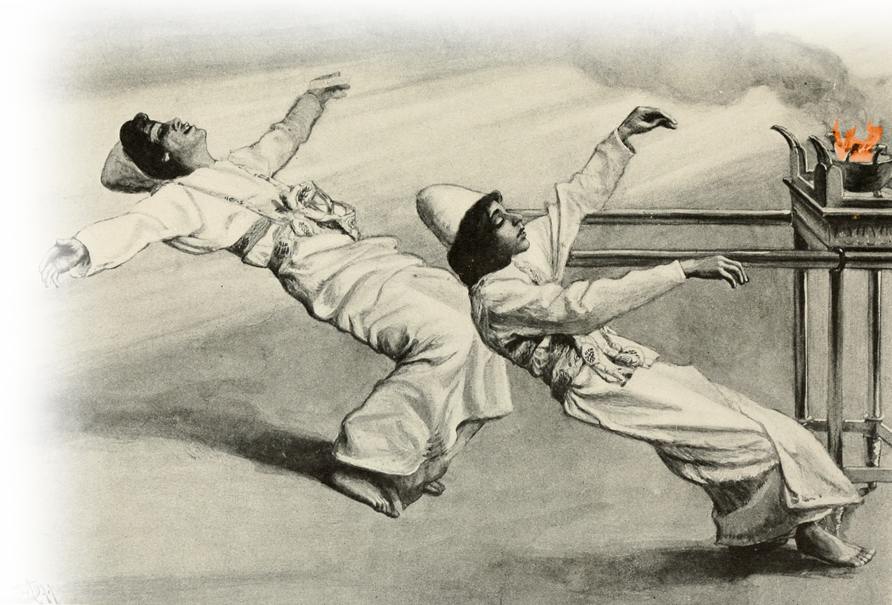
This is NOT so unusual:
Nadab and Abihu (Lev 10:1-2)
Aaron's sons Nadab and Abihu ... offered unauthorized fire before the LORD, contrary to his command. ² So fire came out from the presence of the LORD and consumed them, and they died before the LORD.
Notes:
Nadab and abihu https://upload.wikimedia.org/wikipedia/commons/9/92/The_Bible_and_its_story.._%281908%29_%2814586362088%29.jpg
Heb 12 ²⁹ for our "God is a consuming fire." (Heb 12:29 NIV)

Slide 52
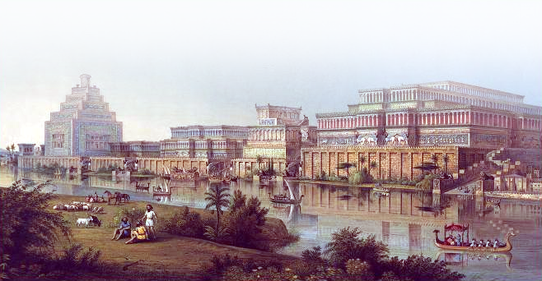
This is NOT so unusual:
Jonah (Jonah 1:1-3) The word of the LORD came to Jonah ... ² "Go to the great city of Nineveh and preach against it, because its wickedness has come up before me.“
Notes:
https://upload.wikimedia.org/wikipedia/commons/3/3a/Archaeologist_Henry_Layard%27s_image_of_Nineveh.jpg

Slide 53
This is NOT so unusual:
Jonah (Jonah 1:1-3) The word of the LORD came to Jonah ... ² "Go to the great city of Nineveh and preach against it, because its wickedness has come up before me.“ ³ But Jonah ran away from the LORD and headed for Tarshish.
Notes:
https://upload.wikimedia.org/wikipedia/commons/3/3a/Archaeologist_Henry_Layard%27s_image_of_Nineveh.jpg

Slide 54
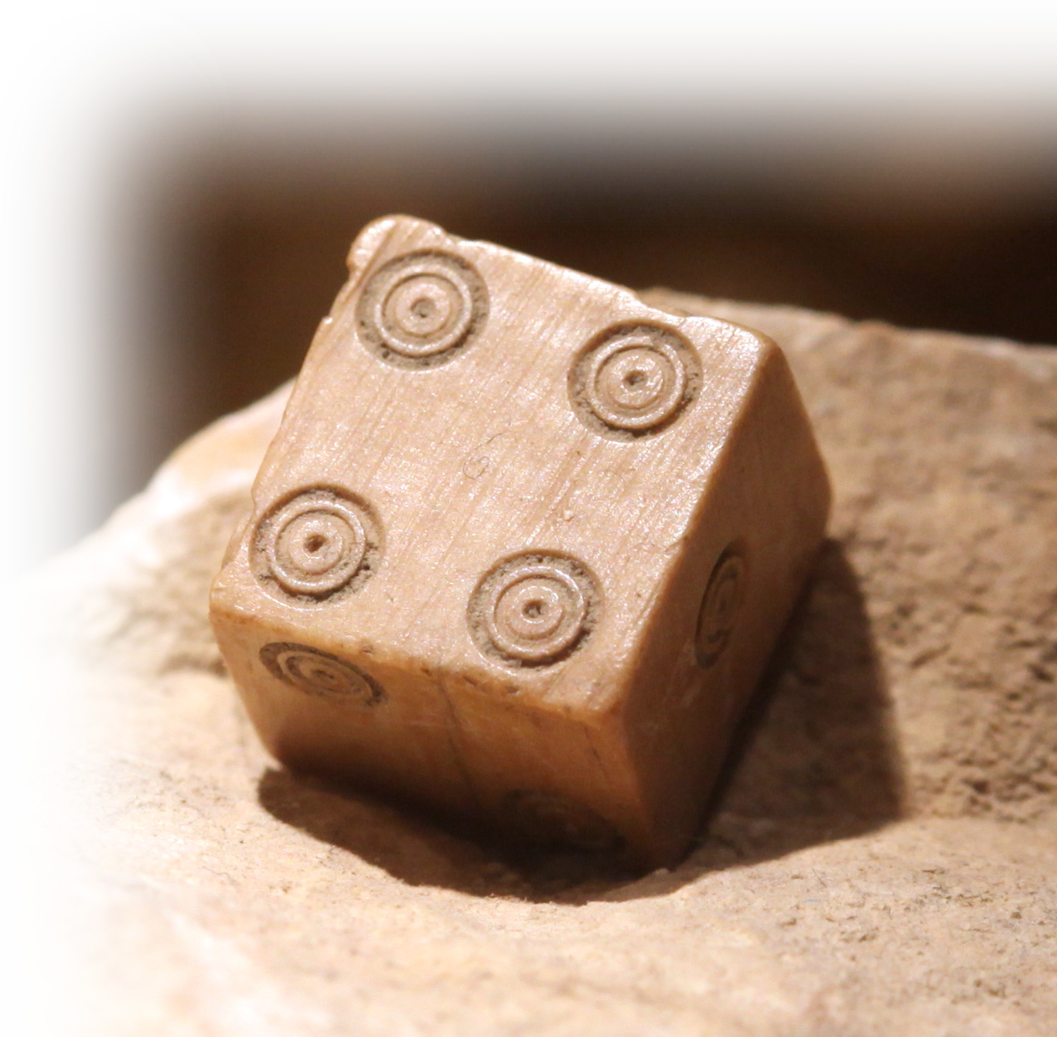
This is NOT so unusual:
Jonah (Jonah 1:7, 15, 17)
They cast lots and the lot fell on Jonah.
¹⁵ Then they took Jonah and threw him overboard ....
Notes:
⁷ Where can I go from your Spirit? Where can I flee from your presence?
⁸ If I go up to the heavens, you are there; if I make my bed in the depths, you are there.
(Psa 139:7-8 NIV)
From the depths of the grave I called for help, and you listened to my cry. (Jon 2:2 NIV)
https://upload.wikimedia.org/wikipedia/commons/2/26/Roman_dice_IMG_4367.JPG

Slide 55
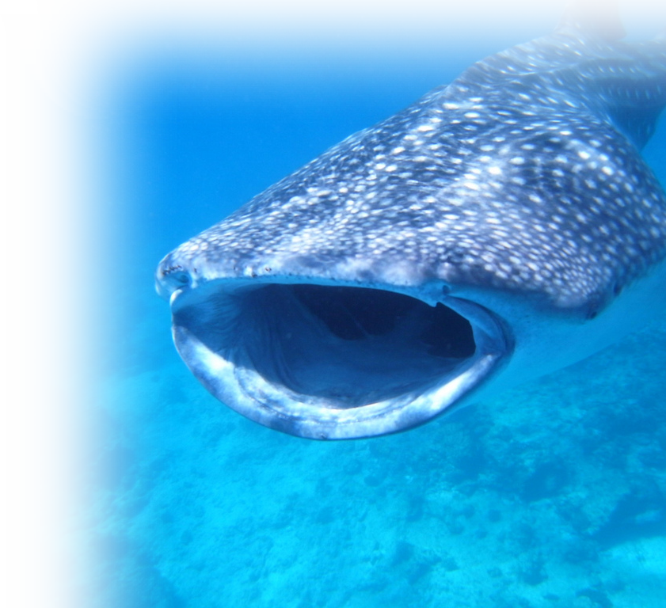
This is NOT so unusual:
Jonah (Jonah 1:7, 15, 17)
¹⁷ But the LORD provided a great fish to swallow Jonah.
Notes:
⁷ Where can I go from your Spirit? Where can I flee from your presence?
⁸ If I go up to the heavens, you are there; if I make my bed in the depths, you are there.
(Psa 139:7-8 NIV)
From the depths of the grave I called for help, and you listened to my cry. (Jon 2:2 NIV)
Whale Shark = FREE =https://www.flickr.com/photos/kaz20/3788030592

Slide 56
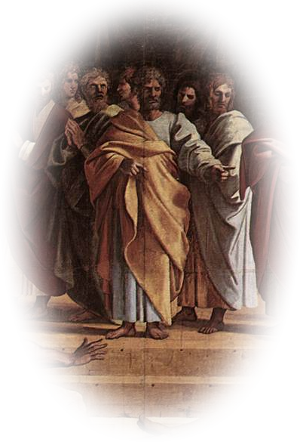
This is NOT so unusual:
Ananias and Sapphira (Act 5:3-5)
³ Then Peter said, "Ananias, how is it that Satan has so filled your heart that you have lied to the Holy Spirit and have kept for yourself some of the money you received for the land? .... You have not lied to men but to God."
Notes:
https://upload.wikimedia.org/wikipedia/commons/2/2c/V%26A_-_Raphael%2C_The_Death_of_Ananias_%281515%29.jpg

Slide 57
This is NOT so unusual:
Ananias and Sapphira (Act 5:3-5)
⁵ When Ananias heard this, he fell down and died.
Notes:
https://upload.wikimedia.org/wikipedia/commons/2/2c/V%26A_-_Raphael%2C_The_Death_of_Ananias_%281515%29.jpg

Slide 58
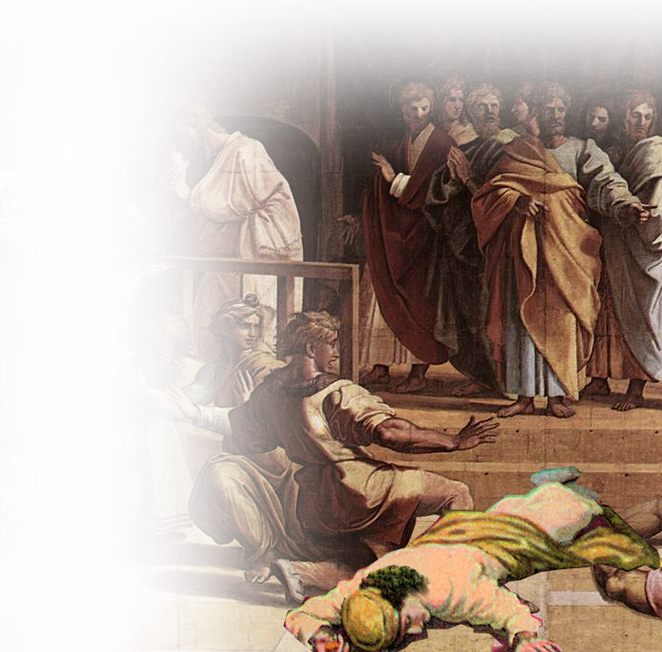
This is NOT so unusual:
Ananias and Sapphira (Act 5:7-9)
⁷ About three hours later his wife came in, not knowing what had happened. .... ⁹ Peter said to her, "How could you agree to test the Spirit of the Lord? ....“ ¹⁰ At that moment she fell down at his feet and died.
Notes:
https://upload.wikimedia.org/wikipedia/commons/2/2c/V%26A_-_Raphael%2C_The_Death_of_Ananias_%281515%29.jpg

Slide 59
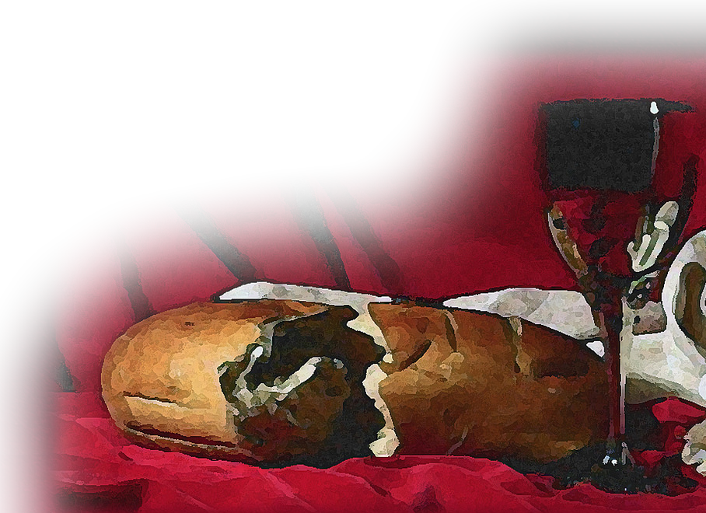
This is NOT so unusual:
The Lord’s Supper Warning (1Co 11:27-32)
²⁷ Therefore, whoever eats the bread or drinks the cup of the Lord in an unworthy manner will be guilty of sinning against the body and blood of the Lord.
Notes:
³¹ It is a dreadful thing to fall into the hands of the living God. (Heb 10:31 NIV)
https://www.flickr.com/photos/waitingfortheword/8615802772

Slide 60
This is NOT so unusual:
The Lord’s Supper Warning (1Co 11:27-32)
²⁸ A man ought to examine himself before he eats of the bread and drinks of the cup. ²⁹ For anyone who eats and drinks without recognizing the body of the Lord eats and drinks judgment on himself.

Slide 61
This is NOT so unusual:
The Lord’s Supper Warning (1Co 11:27-32)
³⁰ That is why many among you are weak and sick, and a number of you have fallen asleep.

Slide 62
This is NOT so unusual:
The Lord’s Supper Warning (1Co 11:27-32)
³¹ But if we judged ourselves, we would not come under judgment. ³² When we are judged by the Lord, we are being disciplined so that we will not be condemned with the world.

Slide 63
Final Thoughts:
Being a Christian is serious stuff.

Slide 64
Final Thoughts:
Being a Christian is serious stuff.
We need to take it more seriously.

Slide 65
Final Thoughts:
Being a Christian is serious stuff.
We need to take it more seriously.
One last thought ...

Slide 66
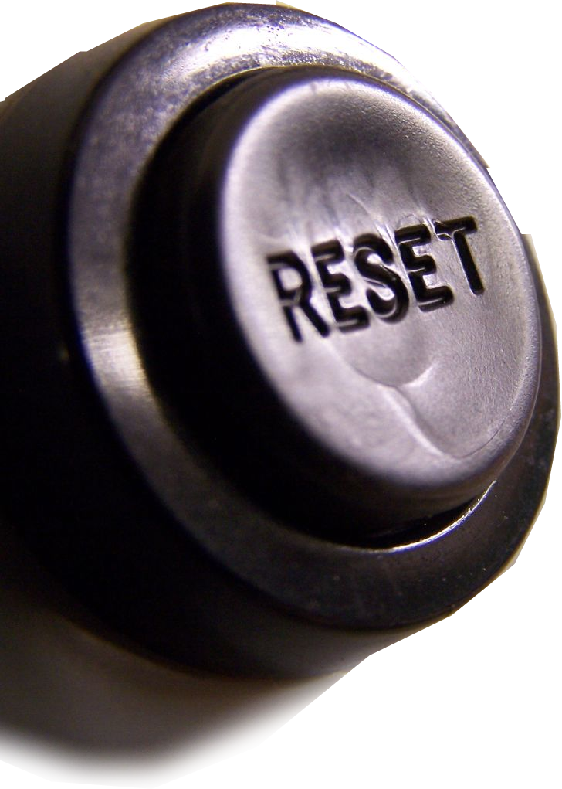
The ANTIDOTE for the Setback:
It’s called RESET!
Notes:
https://www.flickr.com/photos/flattop341/224175619

Slide 67
God’s Road to
Let’s PRAY

